Slide 1
New idea of Crystal fan(晶扇) Ecal for CEPC
张华桥(IHEP, Beijing)
With usefull discussion with Yong Liu, Gang Li, Qian Liu, Manqi, Shengsun, Jianbei, Jianchun etc…

Slide 2
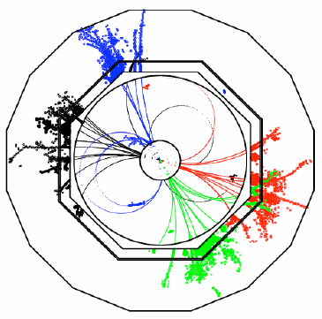
Requirement of a PFA calorimeter
Good Shower separation
Small Moliere radius (Dense detector)
High lateral granularity (~Moliere radius)
High Granularity is crucial
Dense lower power consume electronics
Energy resolution
Could use sampling calorimeter
Critical in some special process
Cost is key issue…
Overlap removal

Slide 3
Exsiting options
2018 JINST 13 P03010
Full silicon + Tunstan
Very popular in ILC/CEPC
Good position resolution
Good logitudinal segmentation
Expensive
No good energy resolution at low E
Crystal
Good Energy resolution
Relative cheaper compared to Si. option
Not good at granularity (3D postioning difficult)
Develeping: crystal bar, dual readout…

Slide 4
Outline
New Idea of crystal fan (barrel only for the moment)
Pure crystal option
2D readout, 3D position information
Improved Hybrid crystal fan with silicon layers option
Improve near-by shower seperation/phi seperation

Slide 5
Basical idea (1)
Crystal module
Crystal not pointing back to IP(Z axis)
Angle with inner det. radius is 𝛼
𝛼 = 0; point to IP(Z axis)
𝛼 <= 90 degrees
Transverse Segmentation
Ex: N_l = 10 layers
Uniform along Z
Ex: 1 cm each seg.
Total crystal volumme
pi*(r2^2-r1^2) * Z
Use BGO as baseline
~20.5 radiation length
𝛼
D
r2
ȹ
r1
𝛼=0
r1 = 1.8 m, r2 = 2.03 m

Slide 6
Some calculations
3 degree of freedom determined the full barrel design
𝛼: [0,90]
N_l: [1,2,3….]
Z: for the moment choose 1 cm segmentation, uniformly
Crystal length D = sqrt(r2^2 – r1^2*sin(𝛼)^2) – r1*cos𝛼
Crystal bar open phi angle ȹ = acos(r2^2 + r1^2 -D^2)/(2*r1*r2)
Ambiguity with Z
Phi segmentation = ȹ/N_l
Total number of crystal bars per Z segmentation: 2*pi*N_l/ȹ
Shower thickness(depth along r) Sn at inner layer starting point:
Fn= r1* ( sin𝛼 /sin(𝛼 –n*ȹ/N_l) – 1 )
Sn = Fn+1 - Fn
Crystal thickness xn:
xn=Sn*sin(𝛼 –n*ȹ/N_l)

Slide 7
Example configuration 1
Crystal module
Take 𝛼 = 0 degrees, transverse 1 layers
D=0.230 m
ȹ=0.0056 (0.32degree）
Assume 1cm * 1cm
ȹ/N_l = 0.0056
Each z segmentation
1130 crystals
𝛼
D
r2
ȹ
r1
Pure crystal

Slide 8
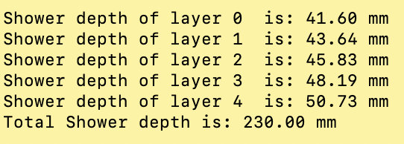
Example configuration 2
Crystal module
Take 𝛼 = 15 degrees, transverse 5 layers
D=0.237 m
ȹ=0.03 (1.7degree）
ȹ/N_l = 0.006
Each z segmentation
1038 crystals
𝛼
D
r2
ȹ
r1
Pure crystal
Similar readouts, similar phi segmentation, 5 times more layers along r
Issue: possible confusion on phi/r

Slide 9
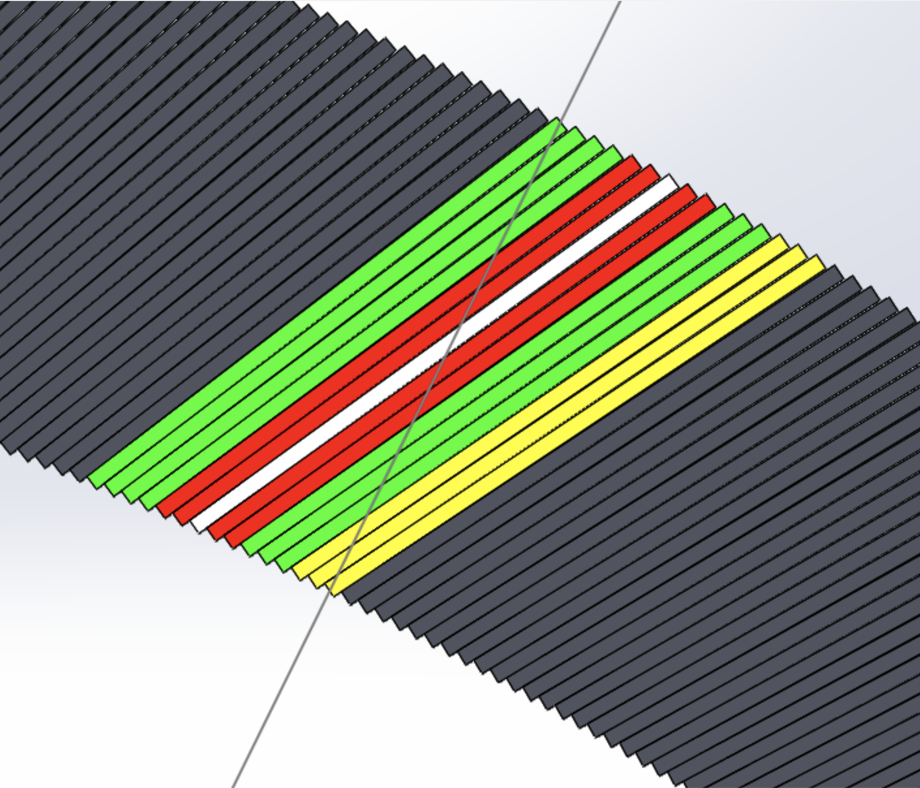
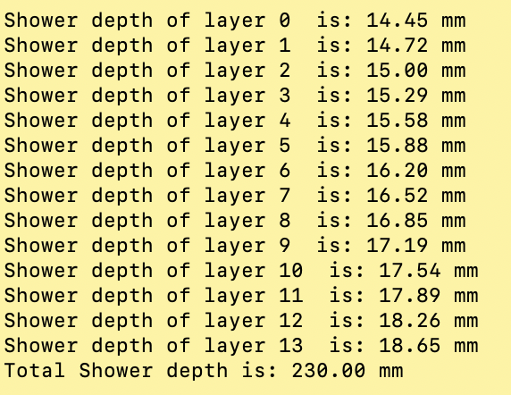
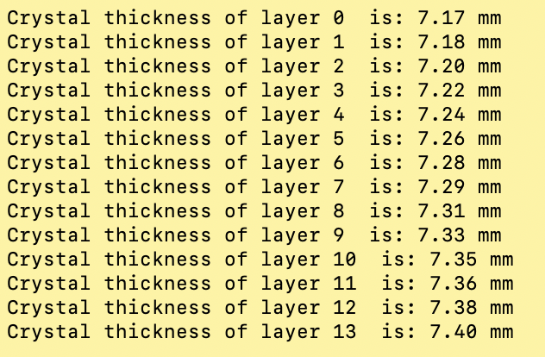
A typical design
Take 𝛼 = 30 degrees, transverse 14 layers
D=0.260 m
ȹ=0.064 (3.7degree）
ȹ/N_l=0.0046
Each z segmentation
1368 crystals
CAD Credit: Xiao Zhao
Crystal bar：261*7.4*10 mm³

Slide 10
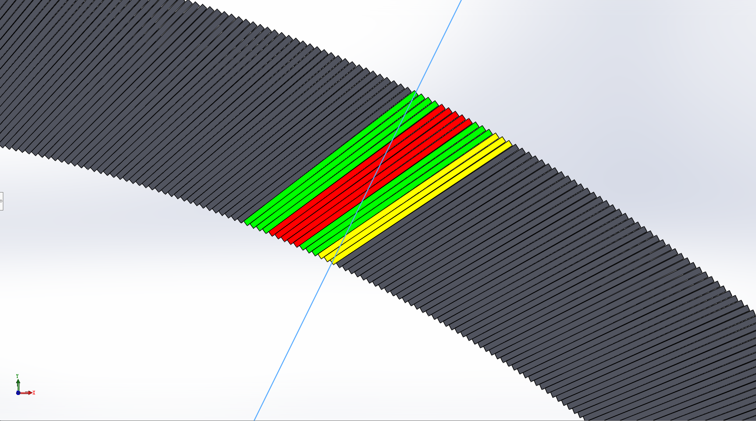
4D Reconstruction
Very preliminary idea
1: Find the shower cluster in Z-phi plane
2: Use shower edge of phi define shower phi at inner circle (ȹ0, r1)
3: Use phi distance to step 2 edg to calculate r = r1 + Sn; (ȹ0, r )
4: Z from Z axis index, energy from readout
0 | 0 | 0 | 0 | 0 | 0 | 0 | 0 | 0 | 0
0 | 0 | 0 | 0 | 1 | 0 | 0 | 0 | 0 | 0
0 | 0 | 0 | 0 | 3 | 1 | 0 | 0 | 0 | 0
0 | 0 | 1 | 5 | 9 | 7 | 4 | 1 | 0 | 0
0 | 0 | 0 | 2 | 5 | 3 | 1 | 0 | 0 | 0
0 | 0 | 0 | 0 | 1 | 0 | 0 | 0 | 0 | 0
0 | 0 | 0 | 0 | 0 | 0 | 0 | 0 | 0 | 0
0 | 0 | 0 | 0 | 0 | 0 | 0 | 0 | 0 | 0
Z
CAD Credit: Xiao Zhao
Still confusion with near by cluster yet to be check
ȹ

Slide 11
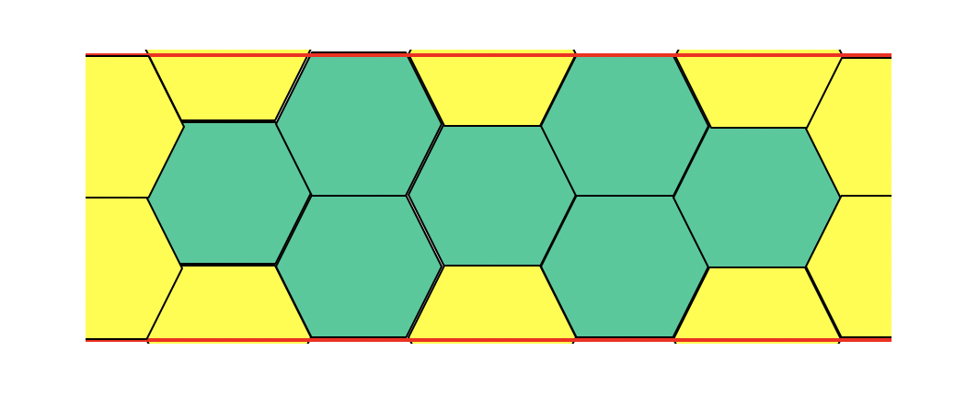
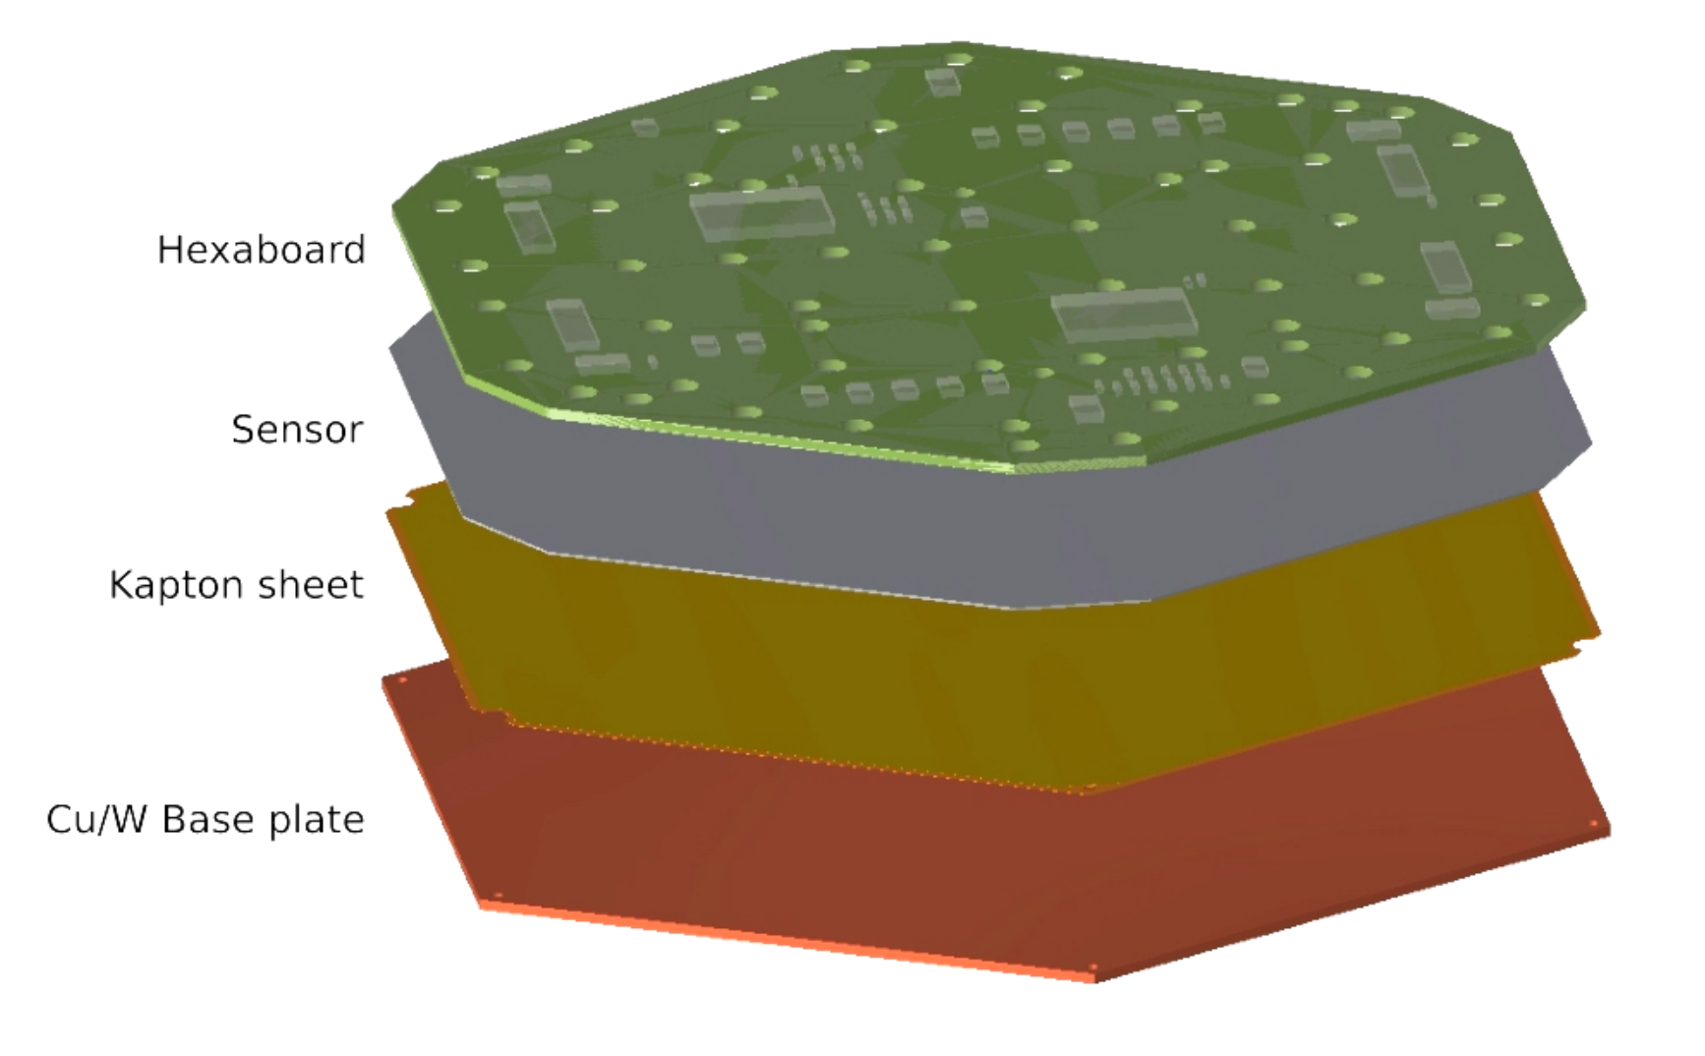
Design of silicion super layer
Silicon layers: plate tiled by hexagon silicon module
Insert along Z axis, replace crystal bars with same starting phi
Provide r, phi information to reduce crystal r-phi amibigurity
Slicon layer
CAD Credit: Xiao Zhao
L= N*83mm, N=2,3,4…
CMS HGCal layers, 6.4mm thick, could fit alpha=30, 14 layer senario(7.17-7.4mm thick)
CMS HGCal like Module

Slide 12
Current status
Still at proposal stage, many details need to pin down:
Implement a baseline crystal fan “geo” (Chengdong)
Generate benchmark objects for performance study
Step 1: 3D segmentation (very preliminary shown here)
Step 2: shower seperation
Step 3: BMR
Further Optimization
Supporting, mounting, calibration, service….
Prototying… (if feasible/worth to do… )

Slide 13
Summary
Noval CEPC Crystal fan proposal
Very uniform along Z and phi (Z-phi symetry)
Fine segmentation of Z, Phi, r
2D readout in Z, Phi plane, reduced readout electronics channels
Readout SiPM+electronics can safely hiden after Ecal
Pro.: Phi-r confusion, near by shower confusion…
Hybrid Crystal fan proposal by insert silicon layers
imporve 3D segmentation
Help to reduce Phi-r confusion and near-by shower confusion
Inputs/discussion are very welcome

Slide 14
Typical crystals (From Ren-yuan Zhu’s slides)

Slide 15
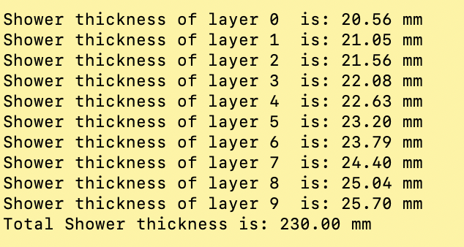
Example configure 3
Crystal module
Take 𝛼 = 15 degrees, transverse 10 layers
D=0.237 m
ȹ=0.03 (1.7degree）
ȹ/N_l = 0.003
Each z segmentation
2077 crystals
𝛼
D
r2
ȹ
r1
Pure crystal

Slide 16
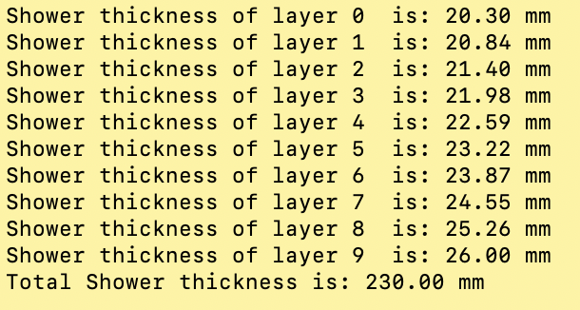
Example configure 4
Crystal module
Take 𝛼 = 30 degrees, transverse 10 layers
D=0.261 m
ȹ=0.064 (3.7degree）
ȹ/N_l=0.0064
Each z segmentation
977 crystals
𝛼
D
r2
ȹ
r1
Pure crystal

Slide 17
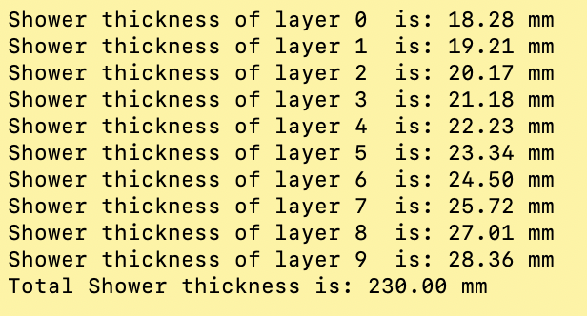
Example configure 5
Crystal module
Take 𝛼 = 60 degrees, transverse 10 layers
D=0.400 m
ȹ=0.17 (9.8degree）
ȹ/N_l = 0.017
Each z segmentation
366 crystals
𝛼
D
r2
ȹ
r1
Pure crystal

