Slide 1
Introduction of spin dynamics in circular accelerators
Zhe Duan
2021. 10. 26

Slide 2
Some comments of this routine meeting
What to be presented here?
  Summary of recent research work
  Detailed explanation of a published research paper by others
  Status review of a specified subject
Flexible, relaxed, learn by reasoning & asking questions

Slide 3
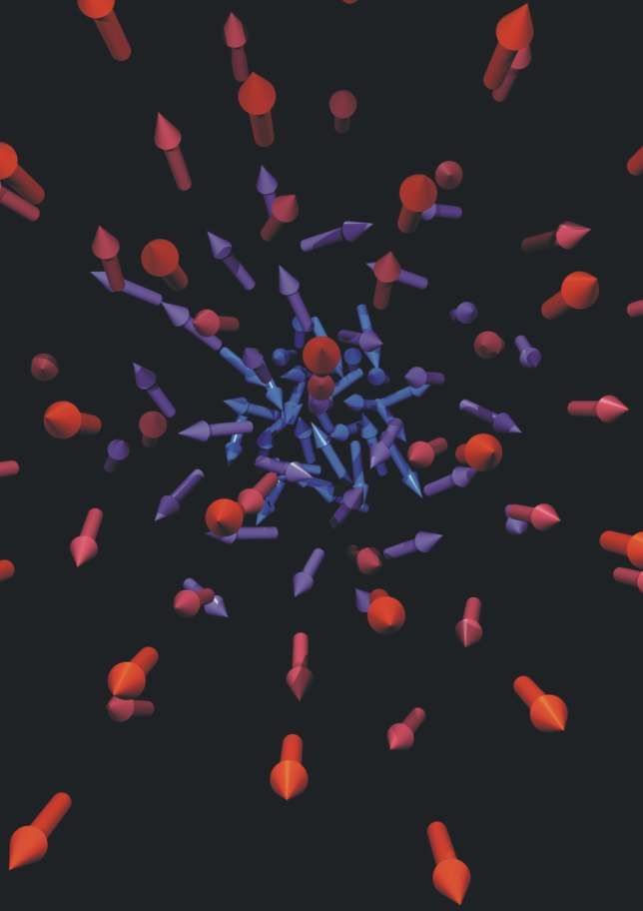
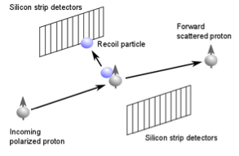
Polarization of spin-1/2 particles
Beam polarization is the ensemble average of a beam of spin-1/2 particles, e+, e-, p+, p-, etc.
Beam polarization is an observable
Analyzing power
Asymmetry
CNI Polarimeter @ RHIC

Slide 4
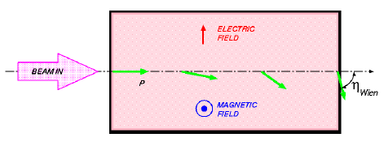









Equation of spin motion: Thomas-BMT equation
Wien filter
$$\overset{⃑}{S}$$
$$\overset{⃑}{S}$$
$$\overset{⃑}{S}$$
Solenoid
$$\overset{⃑}{v}$$
$$\overset{⃑}{v}$$
Bending magnet components
$$\overset{⃑}{S}$$

Slide 5
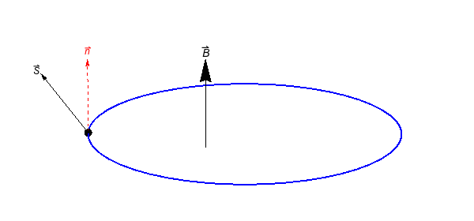
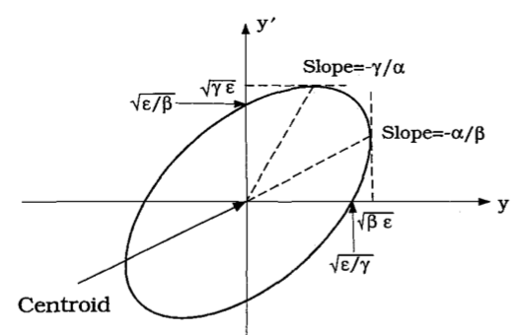

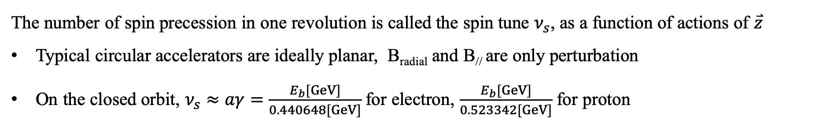
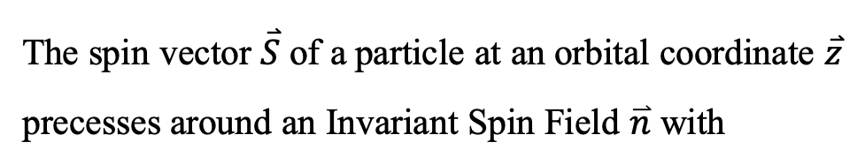

Spin motion in a circular accelerator
The spin vector $\overset{⃑}{S}$ of a particle at an orbital coordinate $\overset{⃑}{z}$ precesses around an Invariant Spin Field $\overset{⃑}{n}$ with
$$θ$$
The number of spin precession in one revolution is called the spin tune $ν_{s}$, as a function of actions of $\overset{⃑}{z}$
Typical circular accelerators are ideally planar, B_{radial} and B// are only perturbation
On the closed orbit, $ν_{s}≈aγ=\frac{E_{b}[GeV]}{0.440648[GeV]}$ for electron, $\frac{E_{b}[GeV]}{0.523342[GeV]}$ for proton
Invariant of orbital motion
Invariant of spin motion

Slide 6
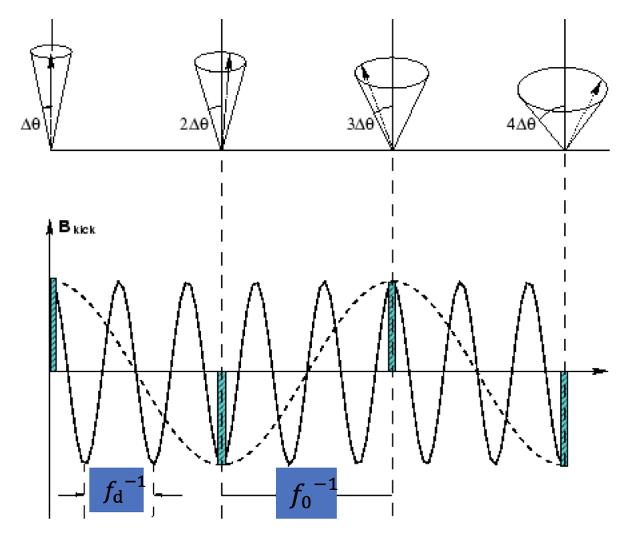
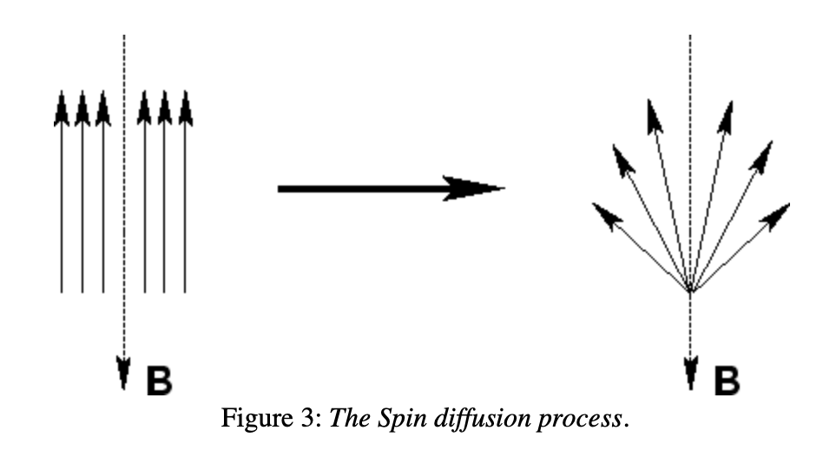


Spin resonances and crossing
The particle spin-orbital motion in a circular accelerator is like oscillators with 4 degrees of freedom.
Spin-orbit coupling resonances occur when
Depolarization occurs when the spin tune crosses spin resonances, for example during resonant depolarization measurement or acceleration[1].
Frequency domain
S_{y}
Time domain
$$ν_{s}$$
[1] M. Froissart and R. Stora, Nucl. Instrum. Meth., vol. 7, p. 297, 1960.
$$ν_{s}=0.5=υ_{d}−2$$

Slide 7
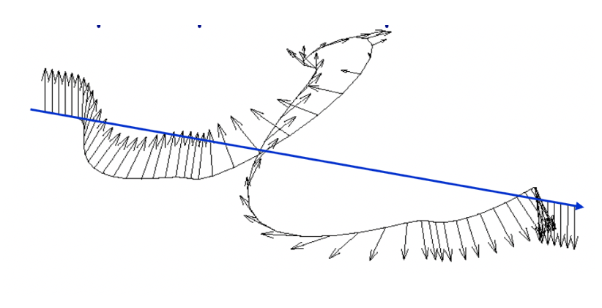
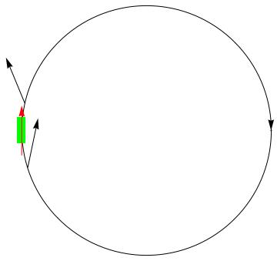
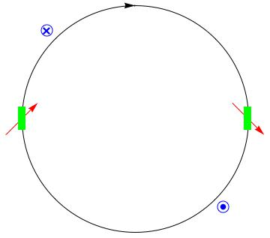
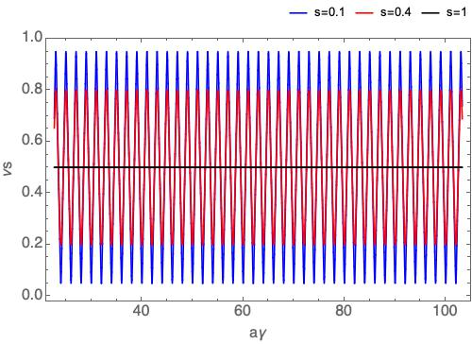
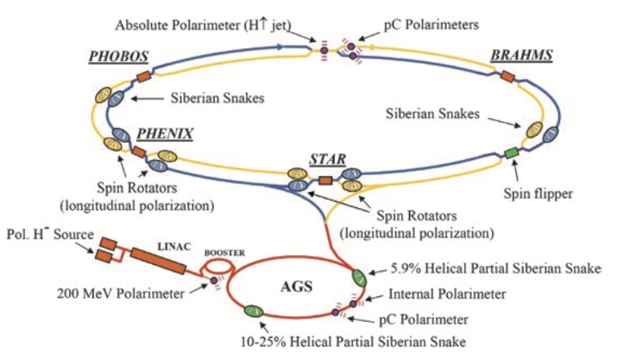
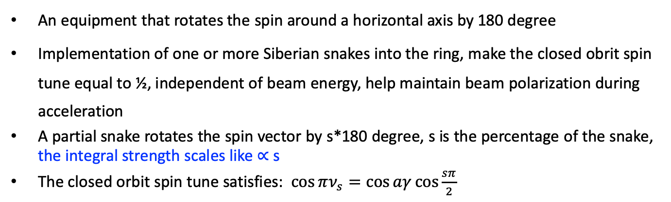
Siberian snakes[1]
An equipment that rotates the spin around a horizontal axis by 180 degree
Implementation of one or more Siberian snakes into the ring, make the closed obrit spin tune equal to ½, independent of beam energy, help maintain beam polarization during acceleration
A partial snake rotates the spin vector by s*180 degree, s is the percentage of the snake, the integral strength scales like $∝$s
The closed orbit spin tune satisfies: $\cos{πν_{s}=\cos{aγ}\cos{\frac{sπ}{2}}}$
Closed orbit spin tune for partial snake with different s
A pair of full snakes
A single full snake
[1] Y. S. Derbenev and A. M. Kondratenko, Sov. Phys. Dokl., vol. 20, p. 562, 1976.

Slide 8
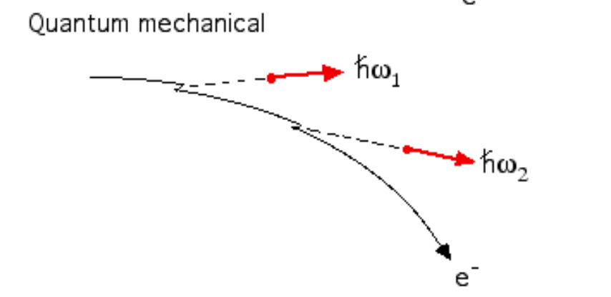
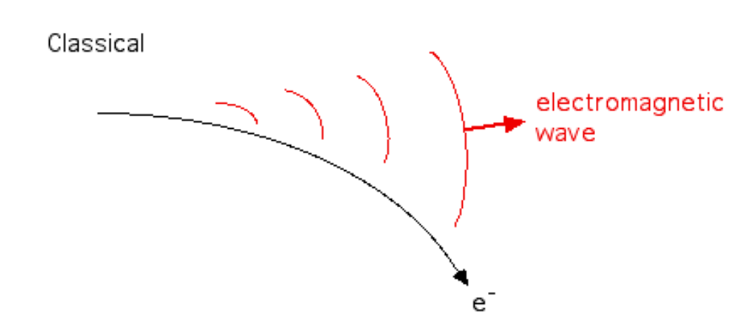
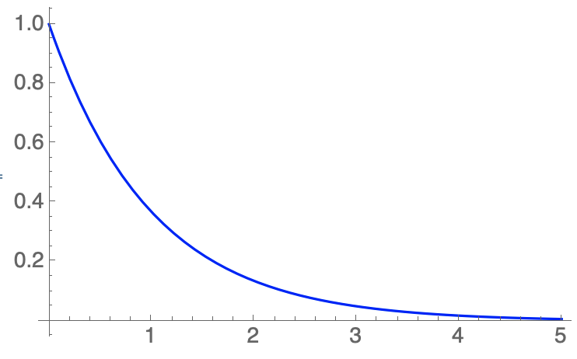
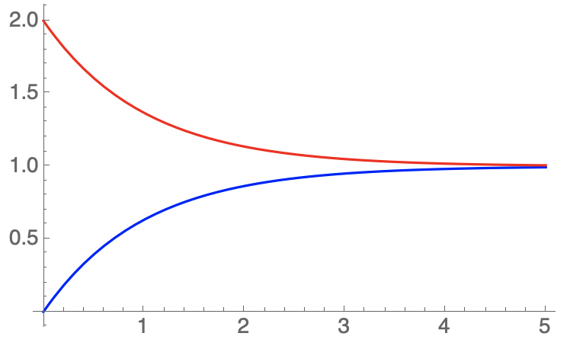
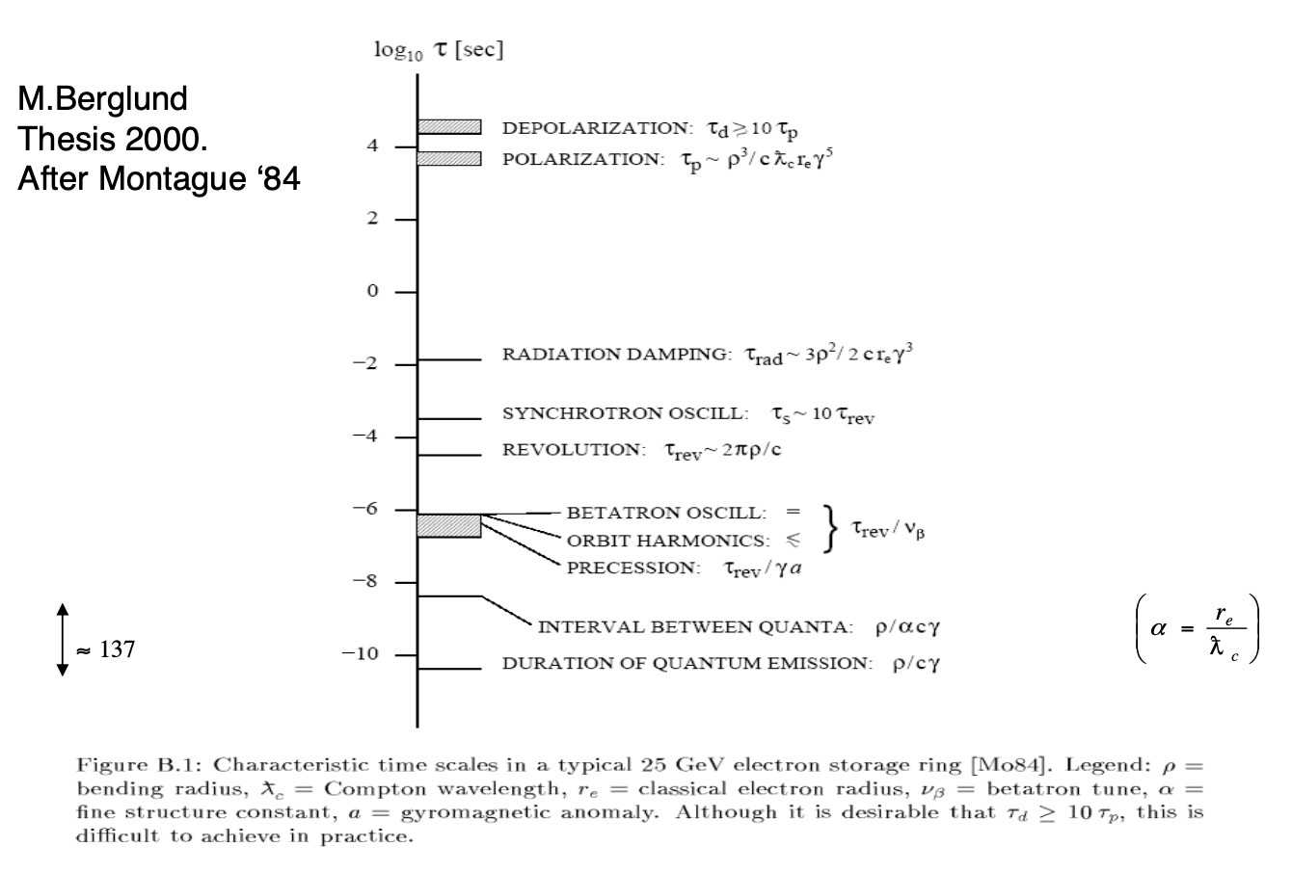
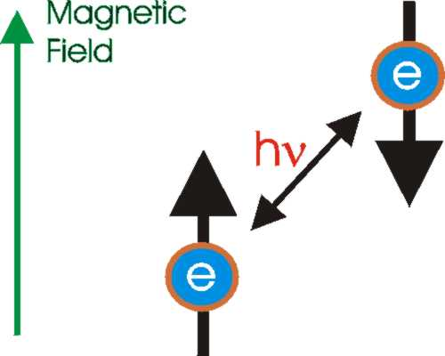
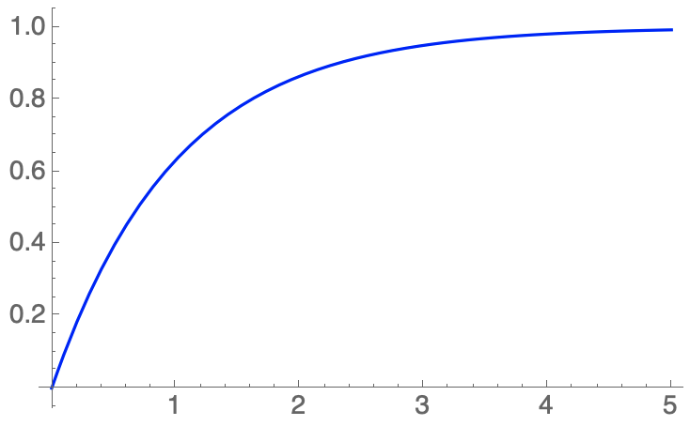



Synchrotron radiation effects in an electron storage ring
Synchrotron radiation dictates the beam orbital and spin motion in an electron storage ring.
Quantum excitation
(Orbital diffusion)
ε(t) / ε_{equ}
emittance
Radiation damping
ε(t) / ε₀
t / $τ_{rad}$
t / $τ_{rad}$
Radiative polarization
(Sokolov-Ternov effect[1])
Radiative depolarization
(Spin diffusion)
Characteristic time scales
P(t) / (-92.38%)
t / $τ_{BKS}$
[1] A. Sokolov and I. Ternov, Sov. Phys. Dokl. 8, 1203 (1964).

Slide 9
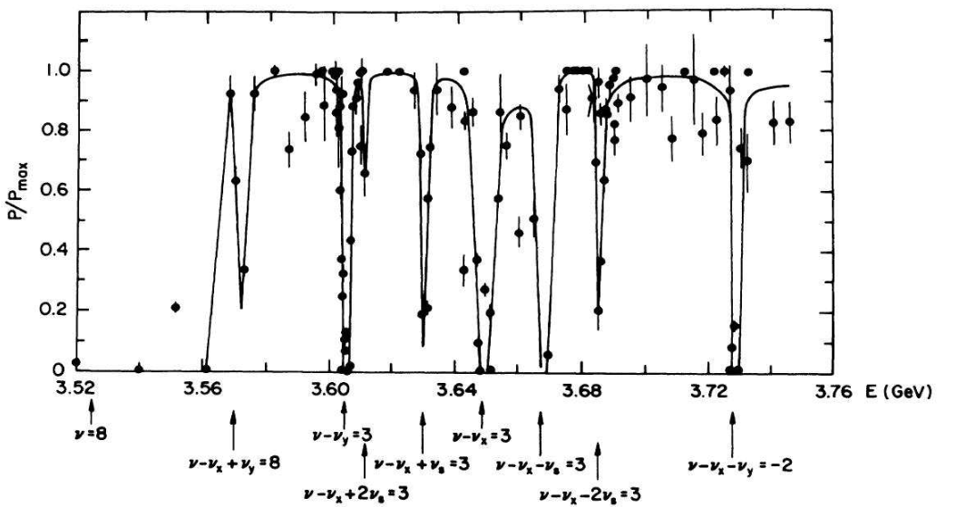
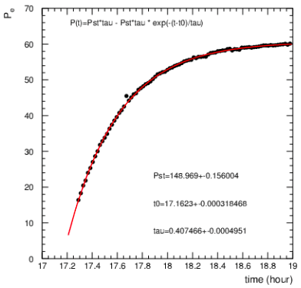
Equilibrium beam polarization in an electron storage ring
The SPEAR electron polarization for different beam energies
[1]
Courtesy of Johnson
HERA electron polarization
(courtesy of D. Barber)
[1] Y. S. Derbenev and A. M. Kondratenko, Sov. Phys. JETP 37, 968 (1973).

Slide 10
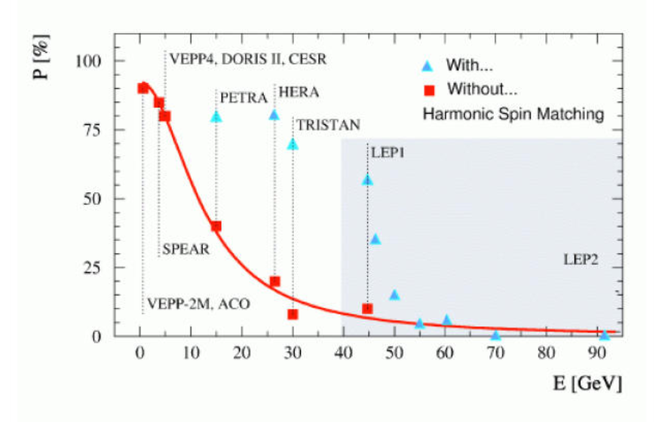
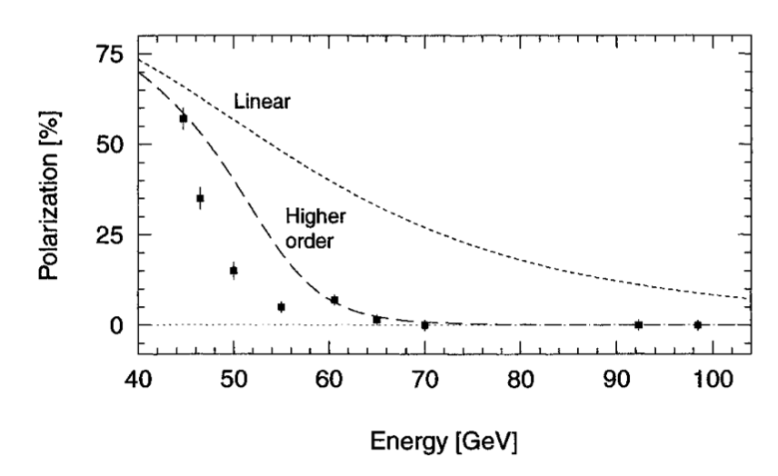


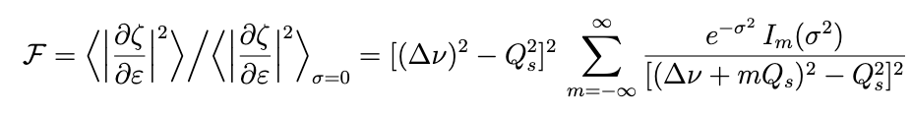

Scaling with beam energy
LEP measured beam polarization
R. Assmann, et al, AIP Conference Proceeding, 570, 169 (2001).
$σ=aγσ_{ε}/Q_{s}$ becomes remarkable at higher beam energy
$$aγ$$
[1] Derbenev, Kondratenko, Skrinsky, PA 9 247, 1979. [2]S. R. Mane, arXiv:1406.0561.

