Slide 1
Simulation of beam polarization in CEPC Booster ChenTao

Slide 2
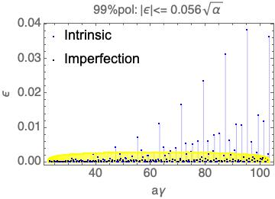
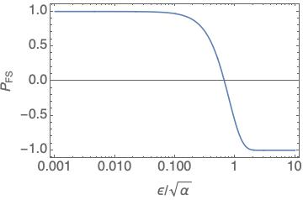
Maintenance of beam polarization in CEPC Booster
In the booster , beam energy from 10GeV -> 45GeV
There are many spin resonances during the acceleration
The beam polarization after crossing a single-isolated spin resonance can be calculated with Froissart-Stora formula:

Slide 3
Depolarization effect in the booster
In a planar ring, the closed orbit spin tune $υ_{s}≈aγ$, two families of important spin resonances:
Imperfection resonance $aγ=K$ , K is integer
Intrinsic resonance $aγ=K±ν_{y}$ , K is integer
The strength of intrinsic resonance is proportional to the amplitude of betatron oscillation of the particle , thus the spin flip method only work well for imperfection resonance , for intrinsic resonance:

Slide 4
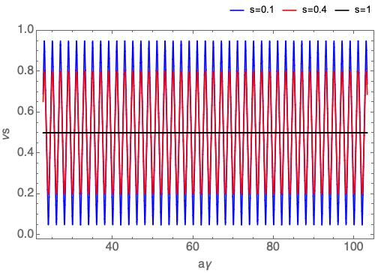
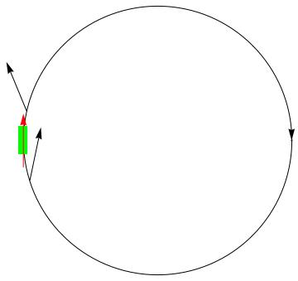
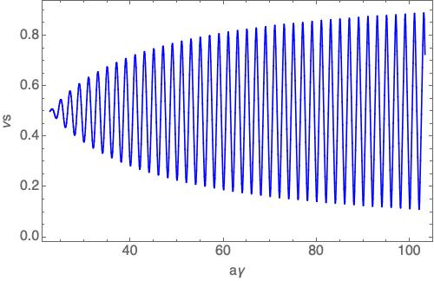
Effect of Siberian snake(s)
The closed orbit spin tune satisfies: $\cos{πν_{s}=\cos{aγ}\cos{\frac{sπ}{2}}}$ for a synchrotron implemented with a partial snake whose spin rotation angle is s*π. To avoid depolarization due to the intrinsic resonances, the betatron tunes should be close to integer.
superconducting solenoid-based Siberian snake:
$\int{B_{SOL}dl}≃\frac{10.479}{1+a}p \left(\frac{GeV}{c}\right) : 105 T∙m @ 10GeV \sim 476T∙m@ 45.5GeV$
fixed in strength, i.e., full snake at injection, partial snake at higher energy
Closed orbit spin tune for partial snake with different s
Siberian snake
10 GeV
4
45.5 GeV

Slide 5
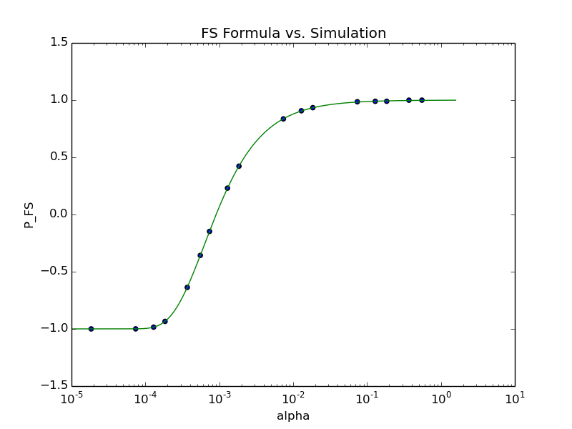
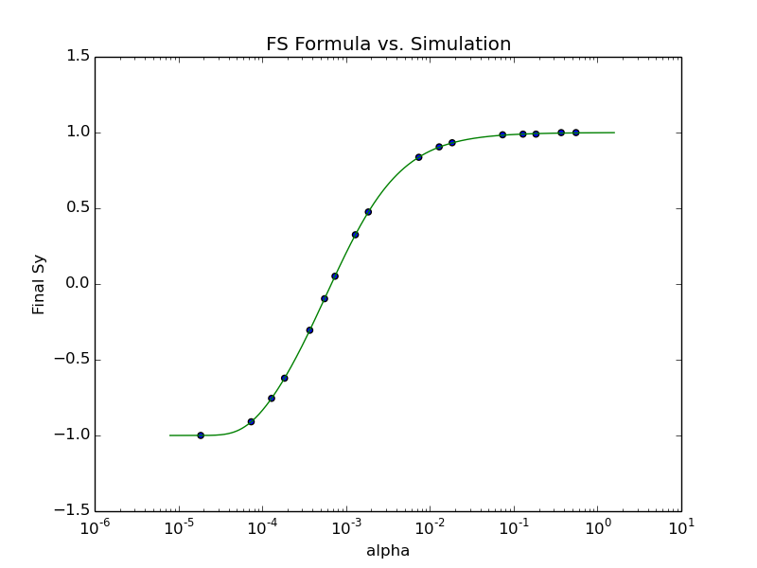
Lattice independent simulations
Diagram of the simulation algorithm
Launch a beam of 32 particles to account for amplitude dependence of intrinsic resonance strength
Benchmark: single spin resonance: $\left|ε\right|=0.02 ,K=30.$ scan ramping rate $α$
Imperfection resonance resonance
Intrinsic resonance
$\left\langle S_{3}\right\rangle =2e^{−π\frac{{\left|ε\right|}^{2}}{2α}}−1$
M.Bai, PhD thesis, 1998

Slide 6
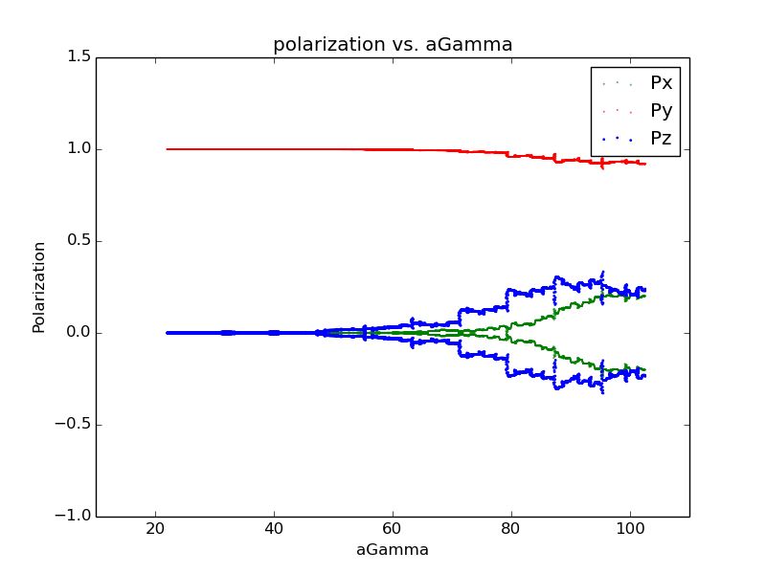
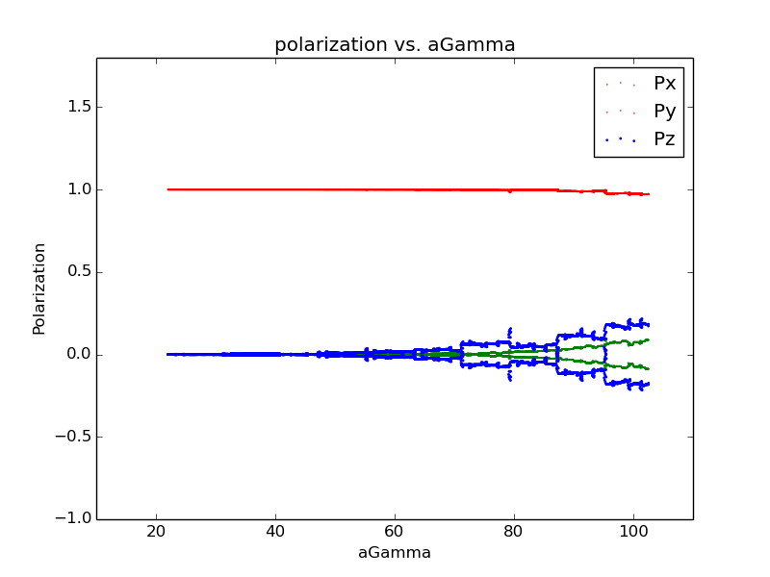
Simulation results
10GeV -> 45GeV acceleration simulation
One constant full snake, constant ramping speed (delta_gamma/turn = 8 )
Assume the injected beam particles are matched to the \vec{n} of the booster
betatron tune $ν_{y}=0.21$
Shift betatron tune $ν_{y}=0.21→0.20$ to avoid snake resonance
Final polarization degree:0.92
Final polarization degree:0.97

Slide 7
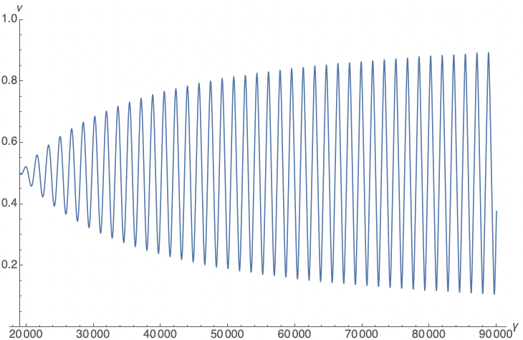
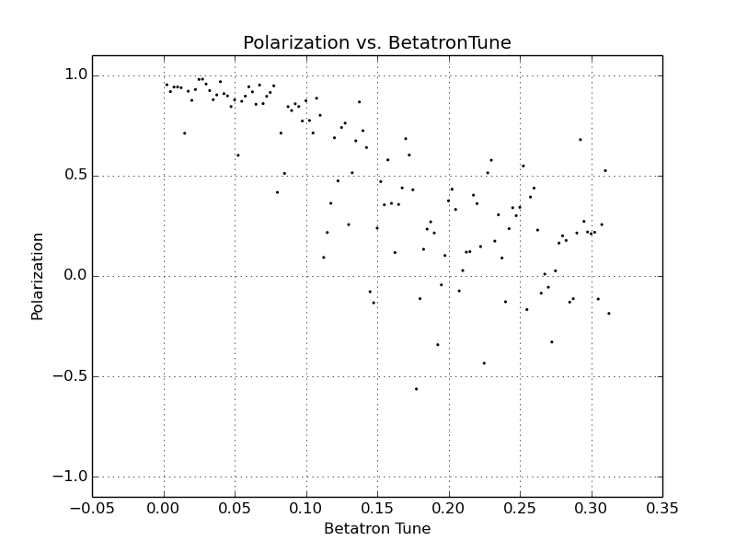
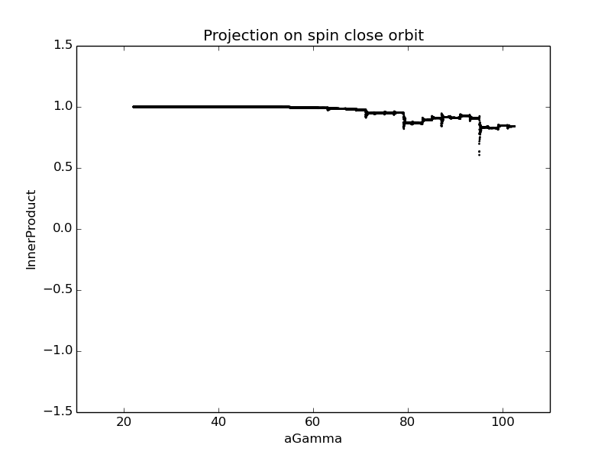
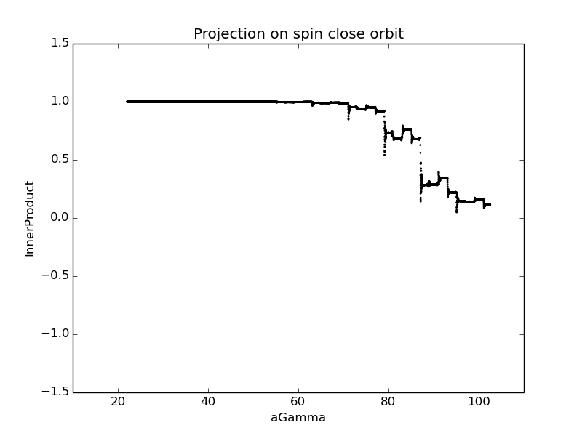
Simulation results
10GeV -> 45GeV acceleration simulation
Fixed strength solenoid snake , initial snake strength =pi
Constant ramping speed (delta_gamma/turn = 8 )
Assume the injected beam particles are matched to the \vec{n} of the booster
0.13
0.10
0.08
~0.84
0.11
$$ν=0.08$$
$$ν=0.13$$

Slide 8
Summary and to-do
The polarization can be preserved during the acceleration in CEPC by using one full snake
Using Solenoid-based partial snakes looks promising in preserving polarization
Need more detailed understanding of the mechanism of the spin resonance
Improve the code to take into account of realistic ramping speed
Implement the snake into the lattice, and conduct more realistic lattice-dependent simulations

