Slide 1
HCAL with Scintillating Glass:
first Geant4 simulation studies
Dejing Du, Yong Liu, Baohua Qi
November 3, 2021

Slide 2
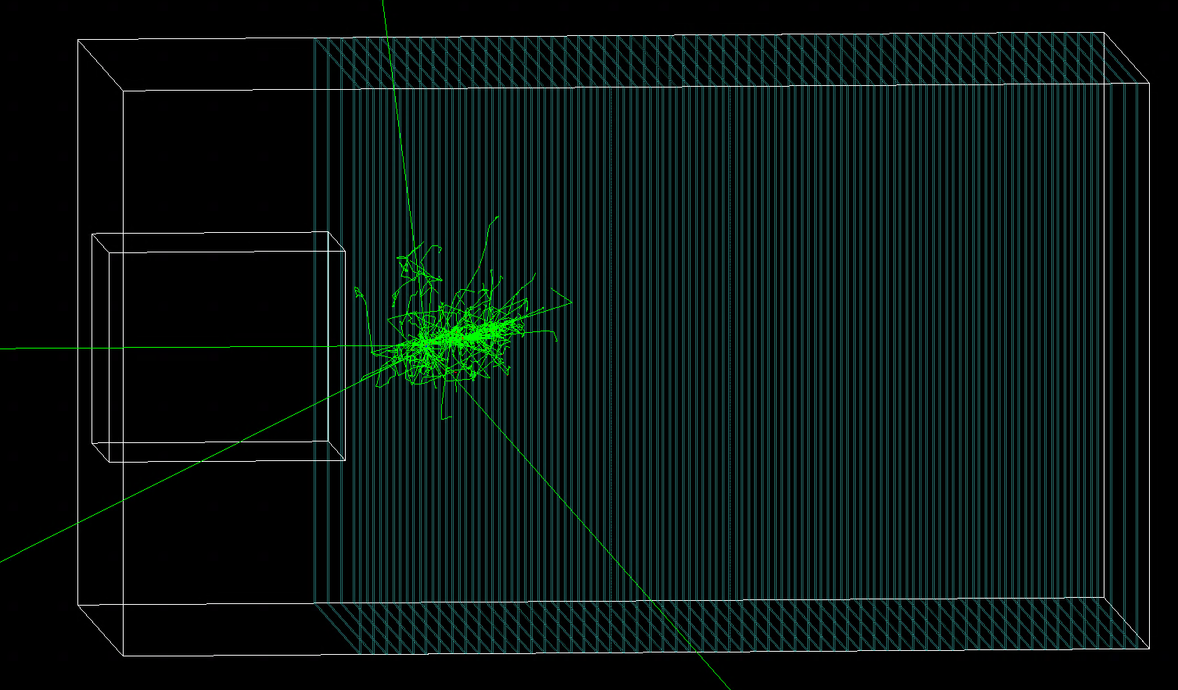
Scintillator HCAL: setup in Geant4 simulation
HCAL geometry
Transverse plane: $108×108{cm}^{2}$
60 longitudinal layers, each with
Scintillator: 3mm
PCB: 2.1mm
Absorber (steel): 20mm
1 GeV kaon0L
Scintillator materials
Plastic scintillator (polystyrene) as baseline reference
Scintillating glass: $42{SiO}_{2}$-$5{Al}_{2}O_{3}$-$22{BaF}_{2}$-$9NaF$-$3{CaF}_{2}$-$3{Gd}_{2}O_{3}$-$9{GdF}_{3}$-$7{TbF}_{3}$
References: https://doi.org/10.1016/j.jeurceramsoc.2021.05.064
Note: HCAL with 40 layers in CEPC CDR as baseline.
Hereby use 60 layers to evaluate leakage effects

Slide 3
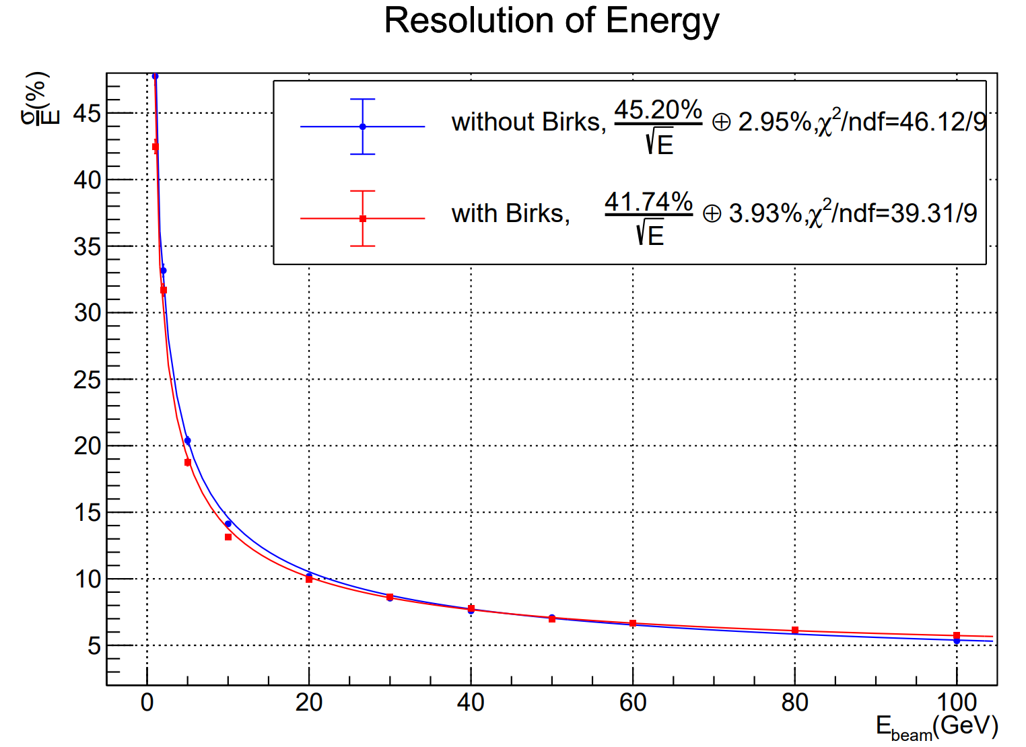
HCAL with plastic scintillator tiles
Impact of Birks’ constant for energy resolution
Birks’ law included, with the Birks’ constant kB=0.126mm/MeV
Incident particle: kaon0L (1-100GeV)
Threshold: 0MIP
Note: Birks’ law generally describes
quenching effects in the scintillating
materials: lower light emission due to
higher density of energy deposition.

Slide 4
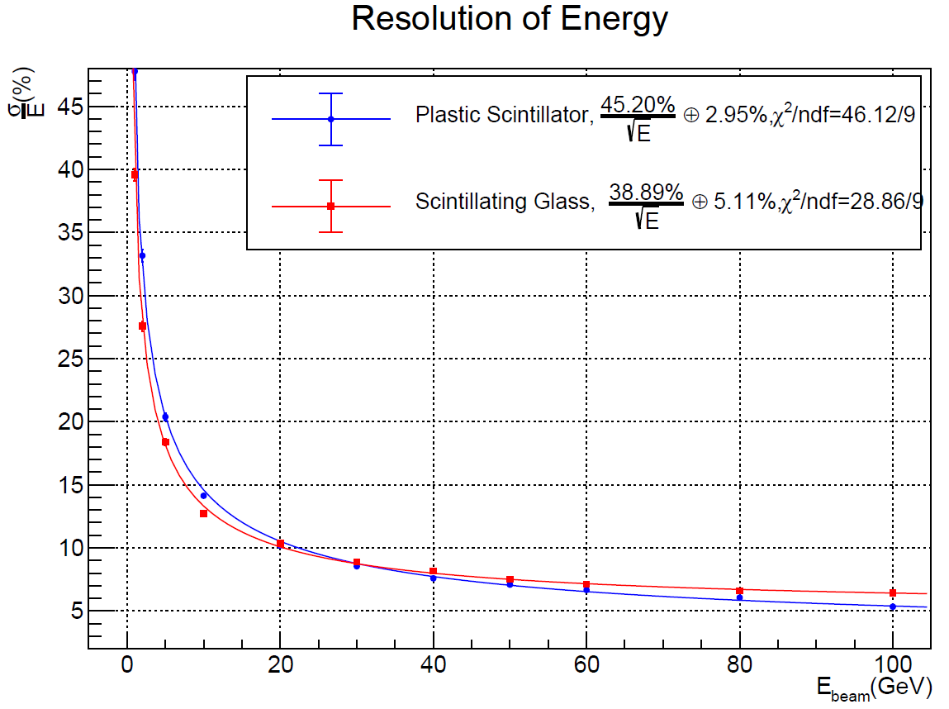
HCAL: plastic scintillator vs scintillating glass
Preliminary performance comparison
Scintillating glass: better hadronic energy resolution in low energy region (<20GeV)
Note that majority of hadrons in jets at CEPC are with low energy
Further issue: constant term
To be further understood
Could be due to the “non-compensation” effects
“Software compensation” technique is ready to be applied

Slide 5
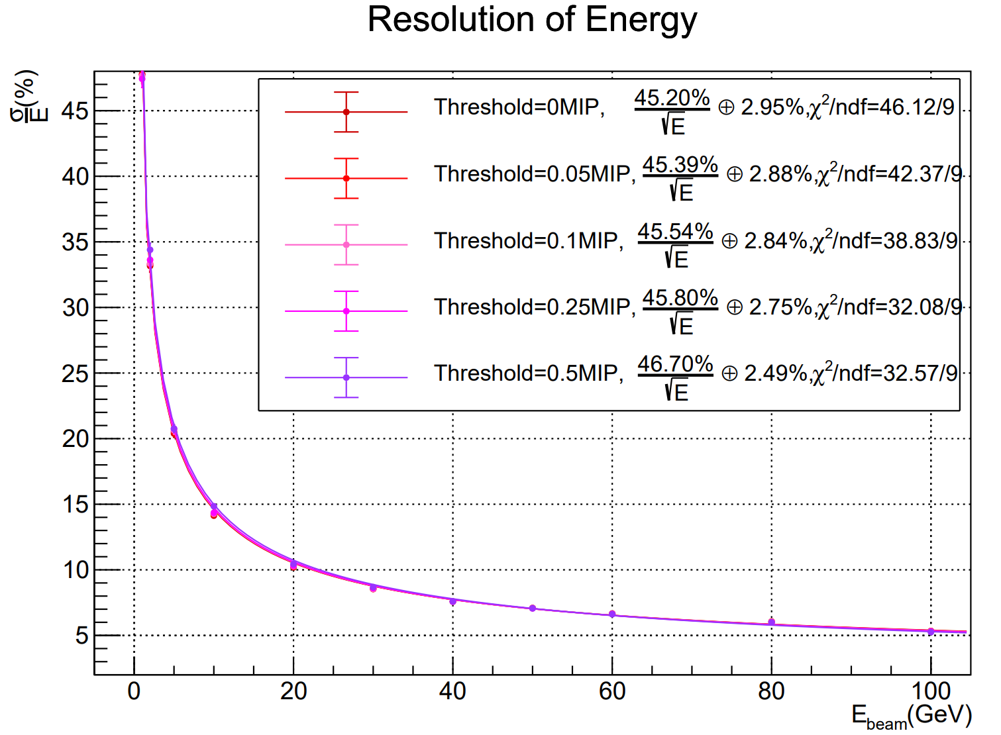
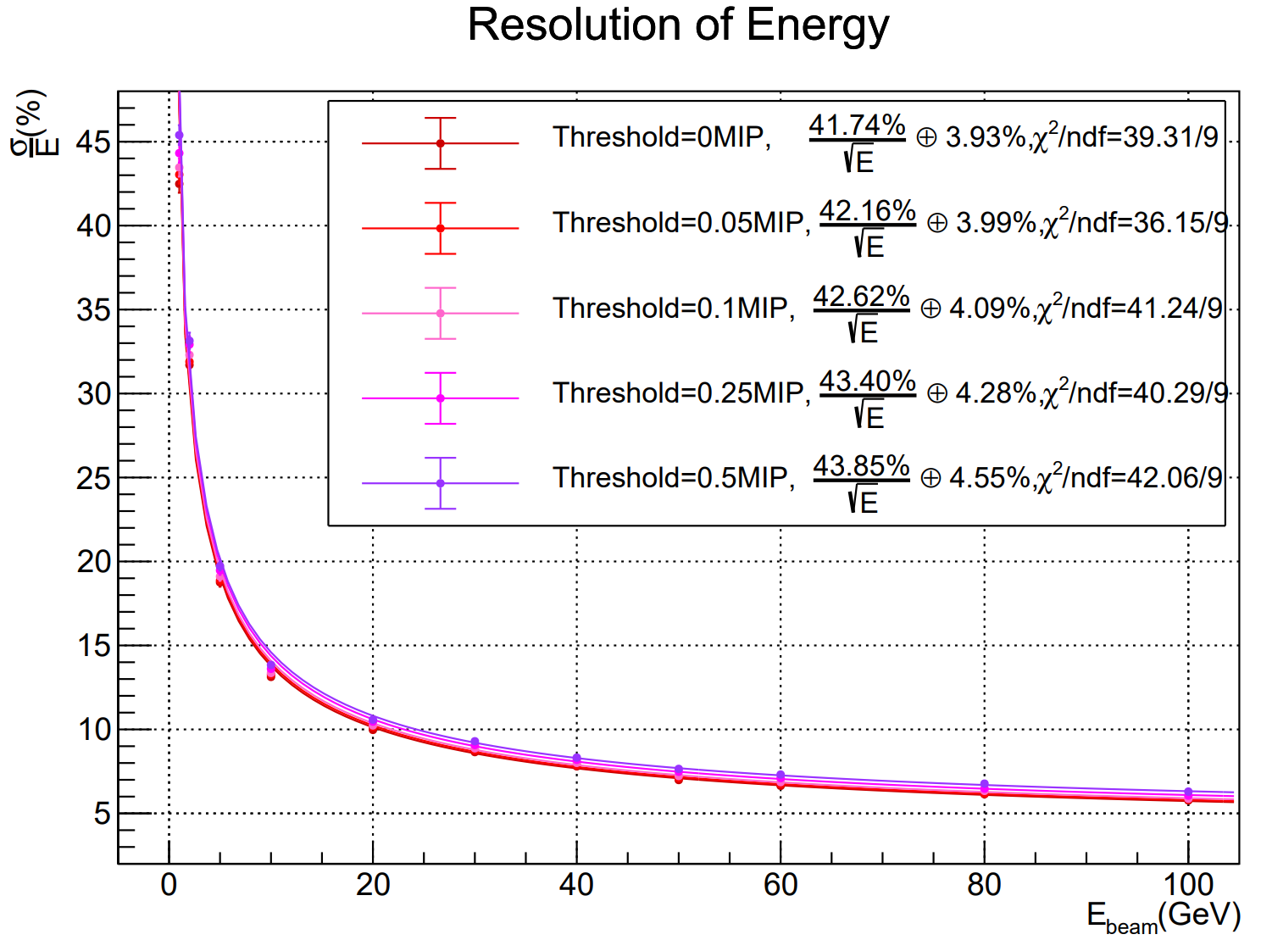
Plastic Scintillator
Impact of energy threshold to hadronic energy resolution
Energy threshold: 0MIP, 0.05MIP, 0.1MIP, 0.25MIP, 0.5MIP
Incident particle: kaon0L (1-100 GeV)
Without birks’ constant
With birks’ constant

Slide 6
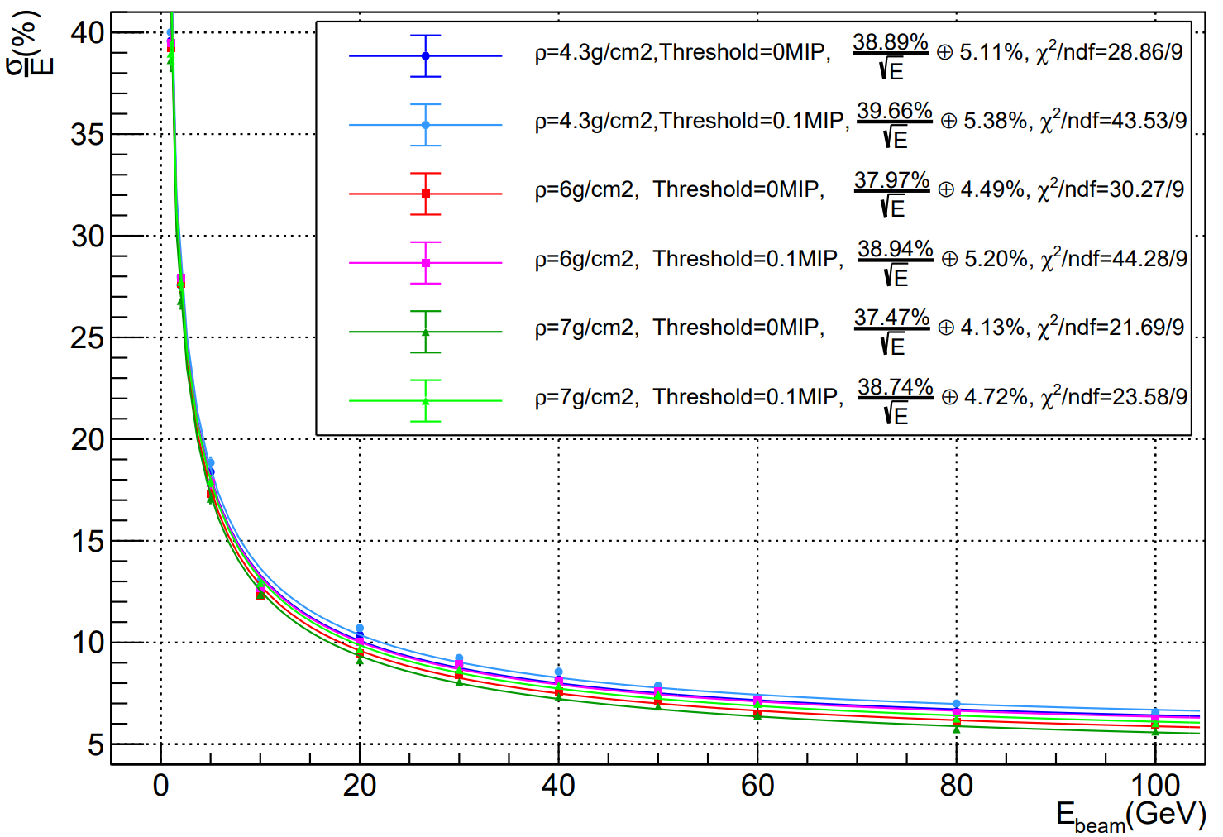
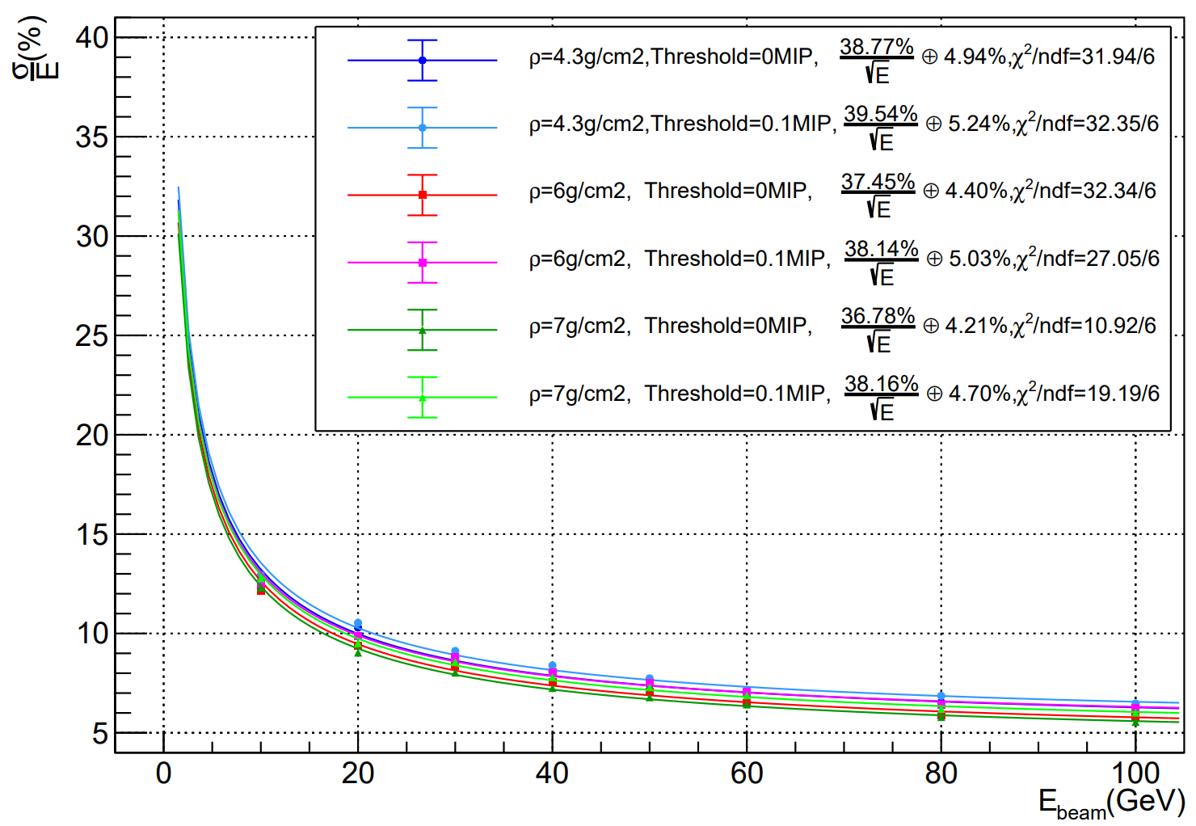
Scintillating Glass
Impact of glass density to hadronic energy resolution
Density varying: $4.3g/{cm}^{3}、6g/{cm}^{3}、7g/{cm}^{3}$
Incident particle : kaon0L
Birks’ constant not included
Fitting range: 1-100GeV
Fitting range: 10-100GeV

Slide 7
Summary and prospects
A novel concept of PFA HCAL with heavy scintillating glass tiles
Major motivations
Better hadronic energy resolution, especially in low energy regions
Higher density provides higher energy sampling fraction
Certain doping to enhance neutron capture: improve hadronic response
More compact HCAL layout (given 4~5 nuclear interaction lengths in depth)
Geant4 full simulation established
First studies show improvement of hadronic energy resolution with scintillating glass
Essential to guide R&D activities of heavy scintillating glass
Key properties: components (doping), intrinsic light yield, transmission, density, emission, decay time, etc.

Slide 8
Simulation of Single Scintillating Glass Tile

Slide 9
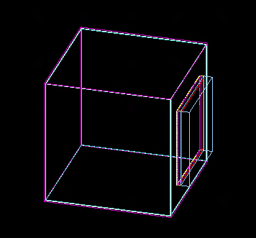
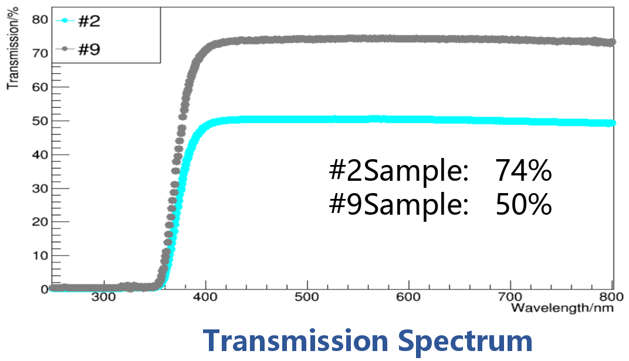
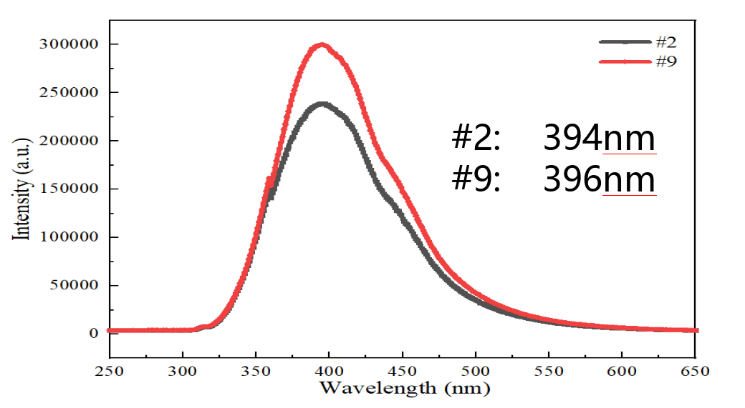
Setup in Geant4 simulation
SiPM
Physical volume
Scintillating glass, Air gap, ESR wrapping,
Coupling agent: BC631
SiPM
mu-
Scintillating glass
1*1*1${cm}^{3}$
6mm
Properties of scintillating glass
BC631
Component: $25SiO_{2}−30B_{2}O_{3}−15{Al}_{2}O_{3}−29{Gd}_{2}O_{3}$:1${Ce}^{3+}$
Density: 4.532 g/cm3
Refractive index: 1.65
Transmission: 74%
Emission peak: 394 nm
Light yield: 1000 ph/MeV

Slide 10
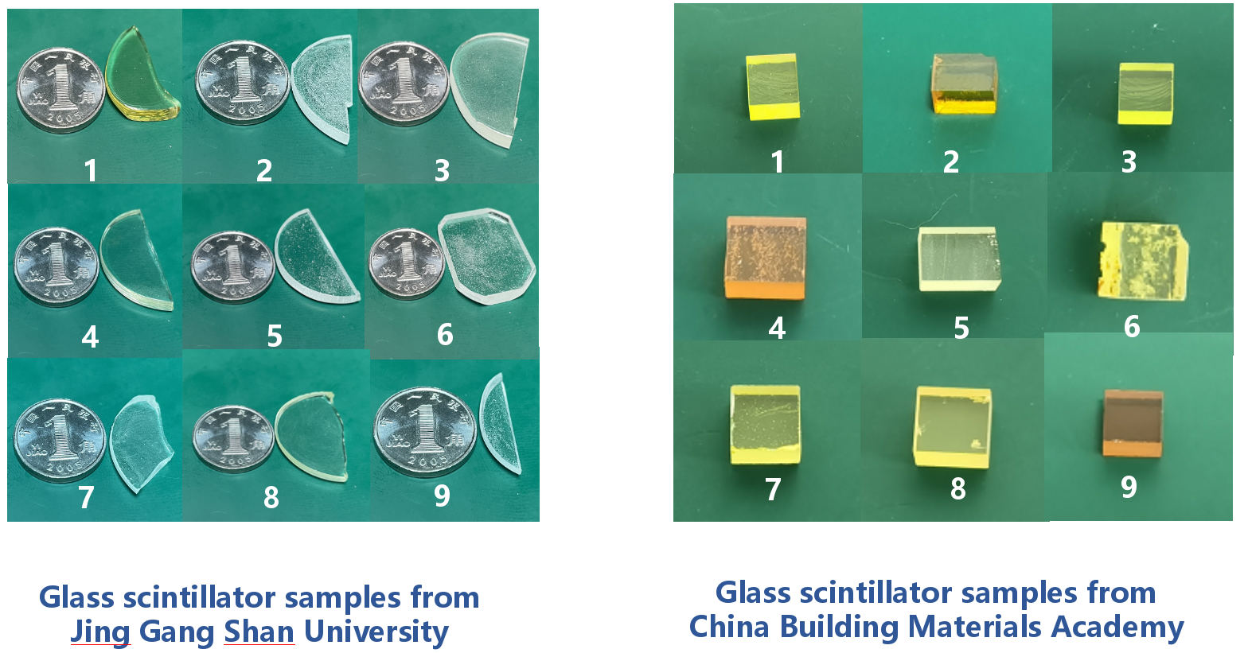
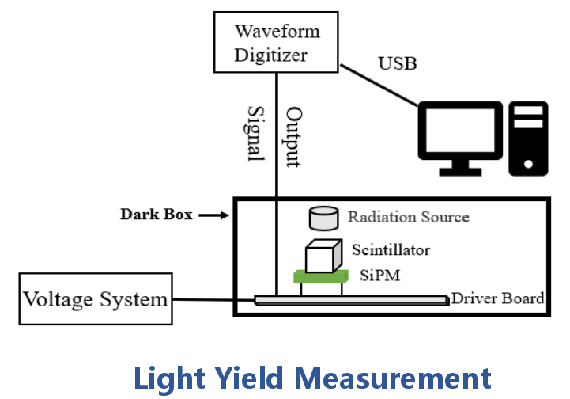
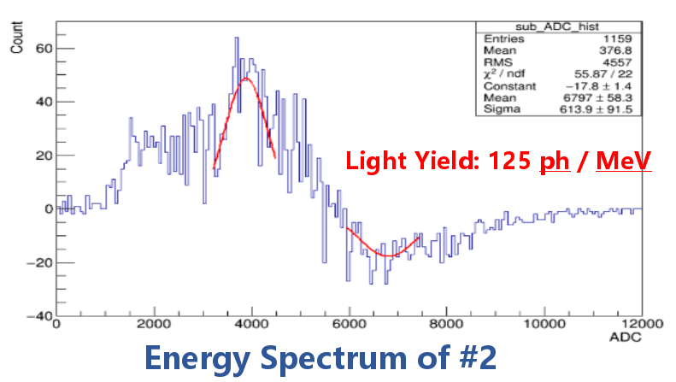
Experimental results
Sen Qian

Slide 11
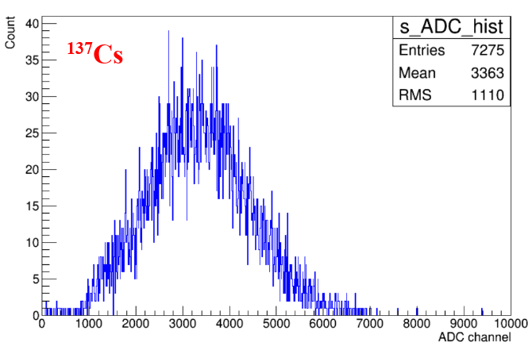
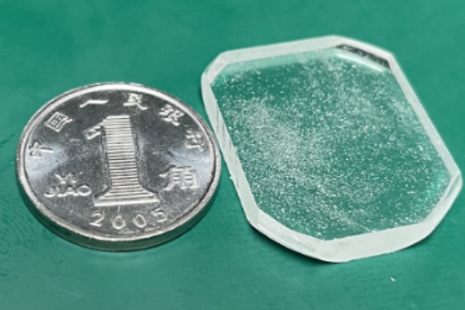
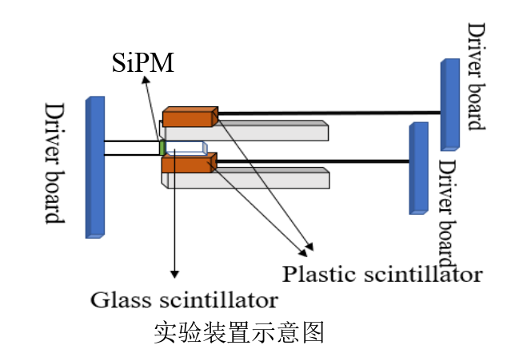
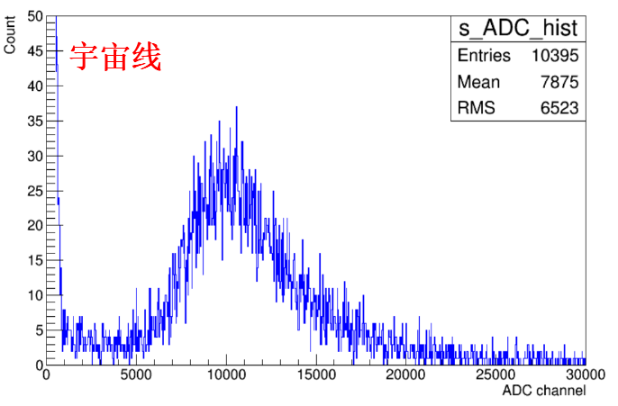
Experimental results
Zhehao Hua

Slide 12
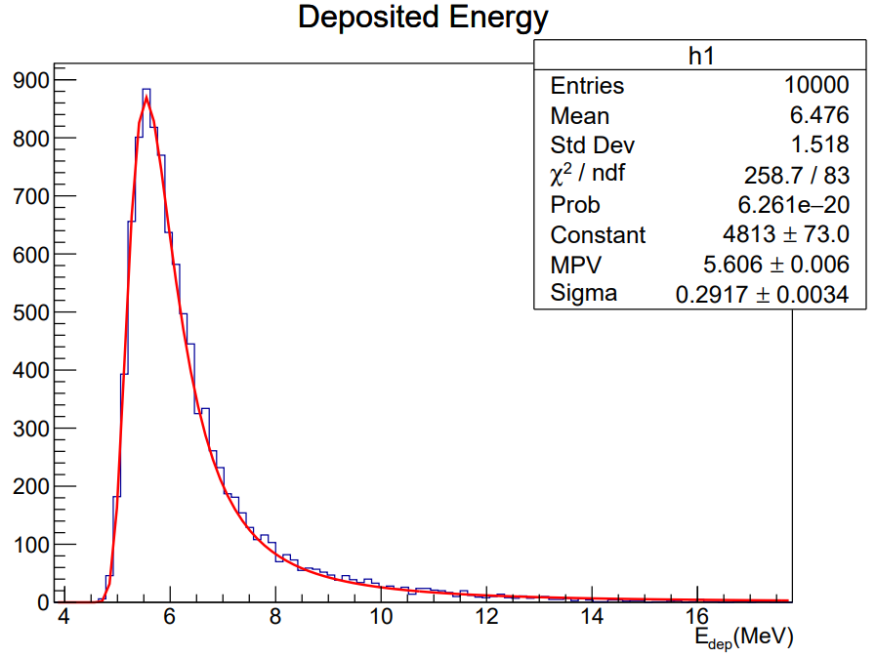
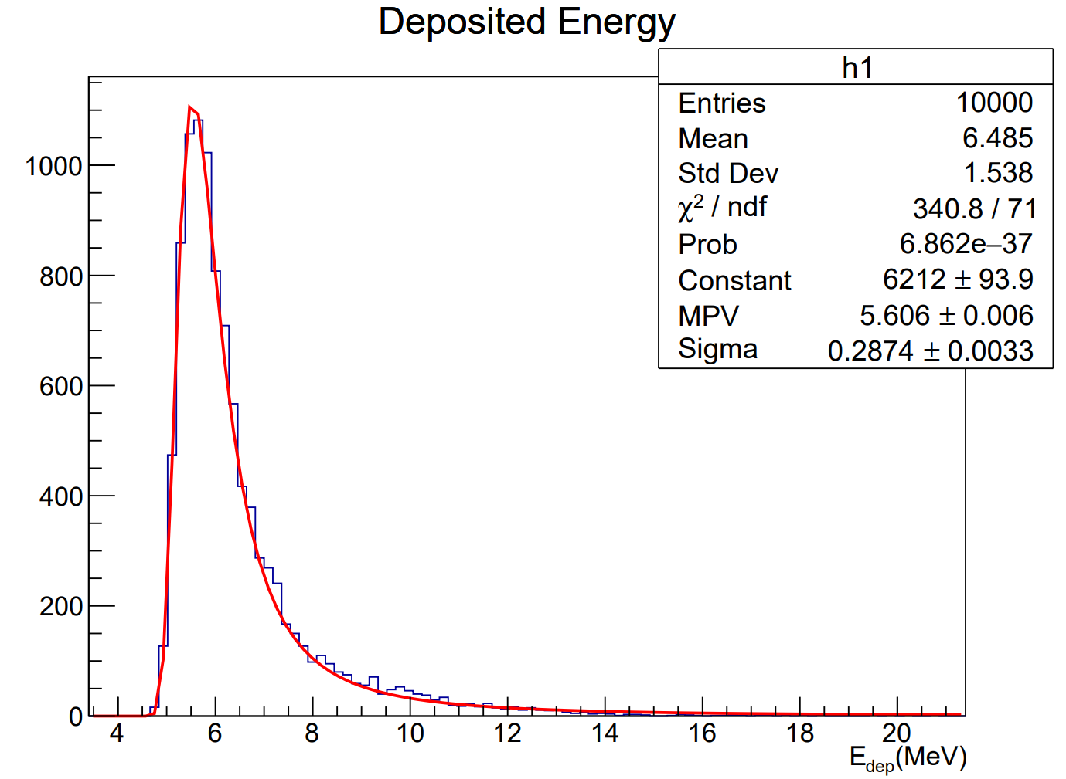
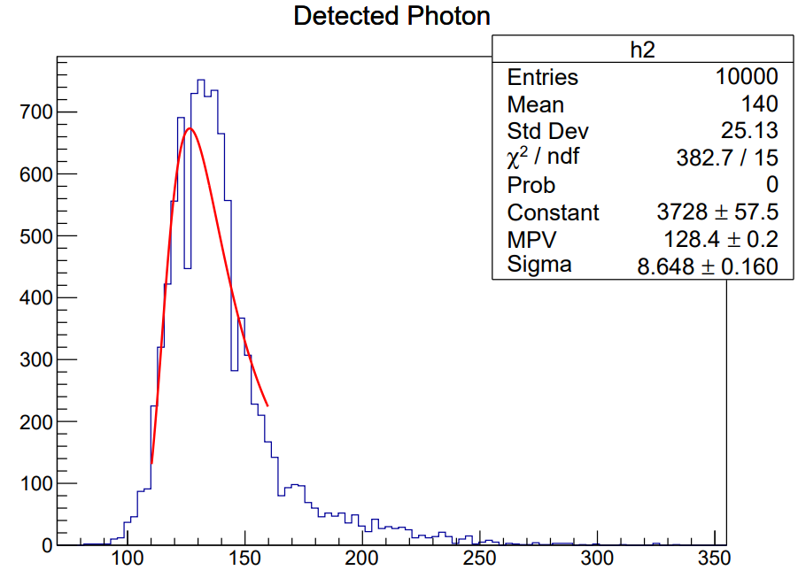
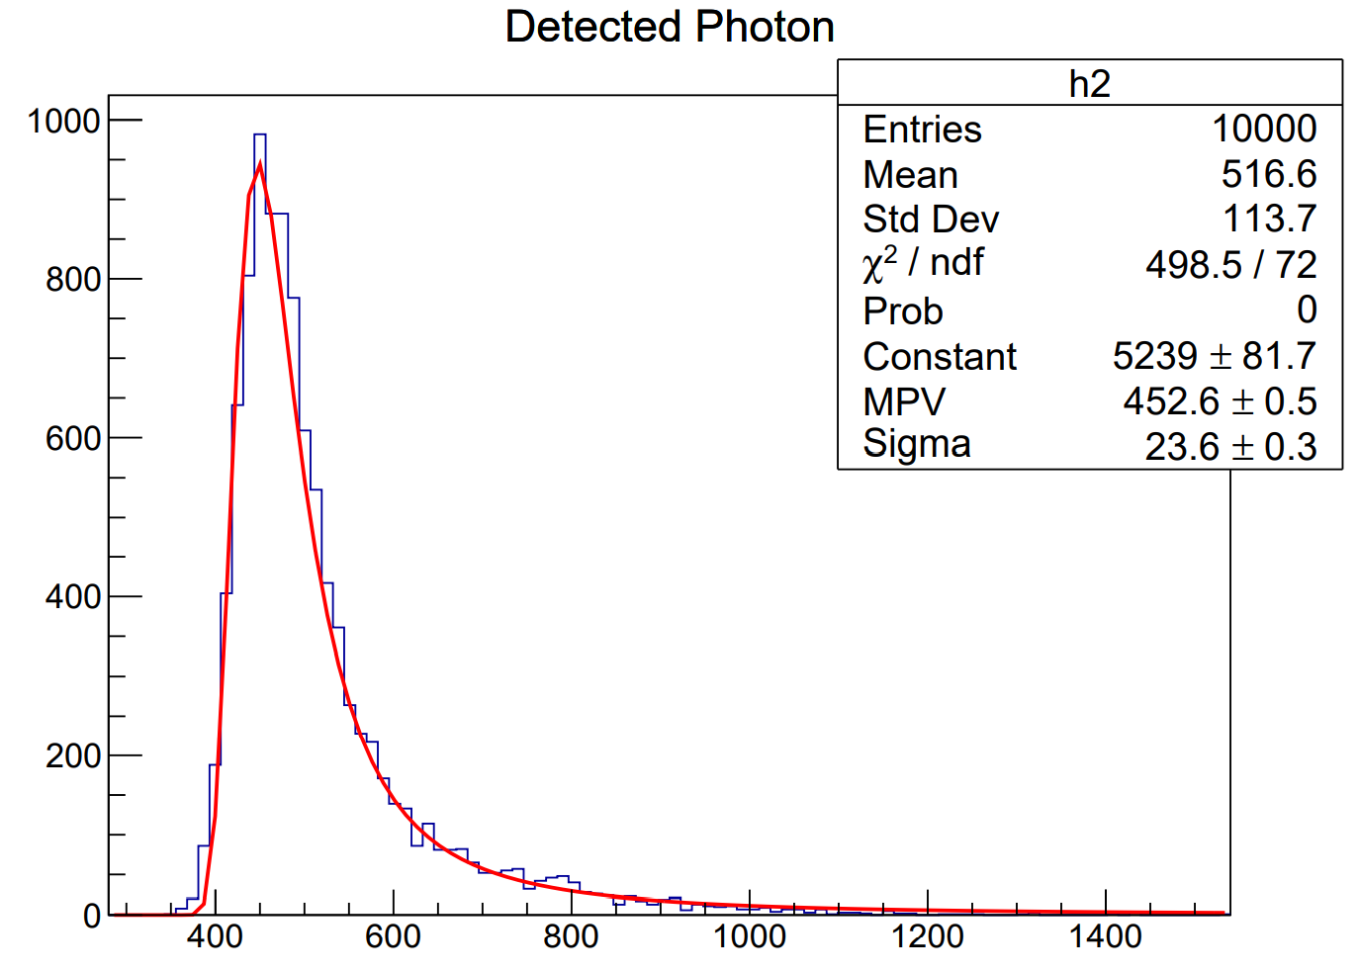
Simulation results
Primary particle: 1GeV muon
Light yield: 125 ph/MeV
Light yield: 1000 ph/MeV
Light yield: 125 ph/MeV
Light yield: 1000 ph/MeV

Slide 13
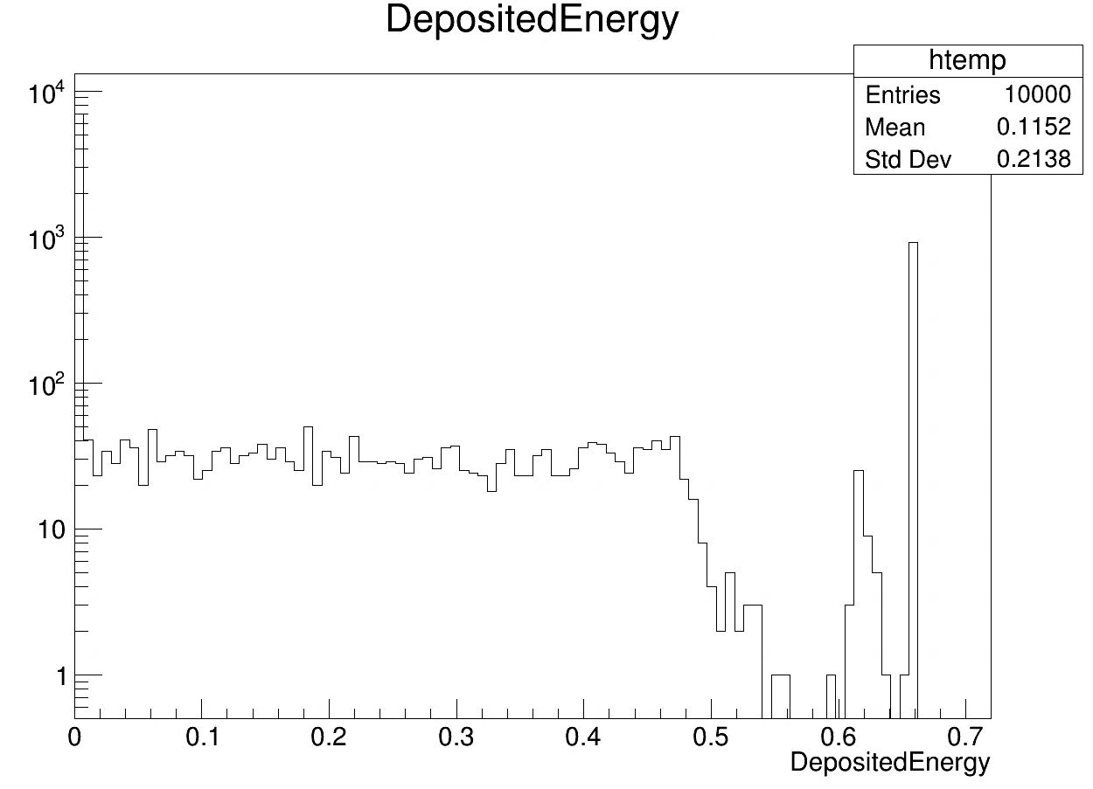
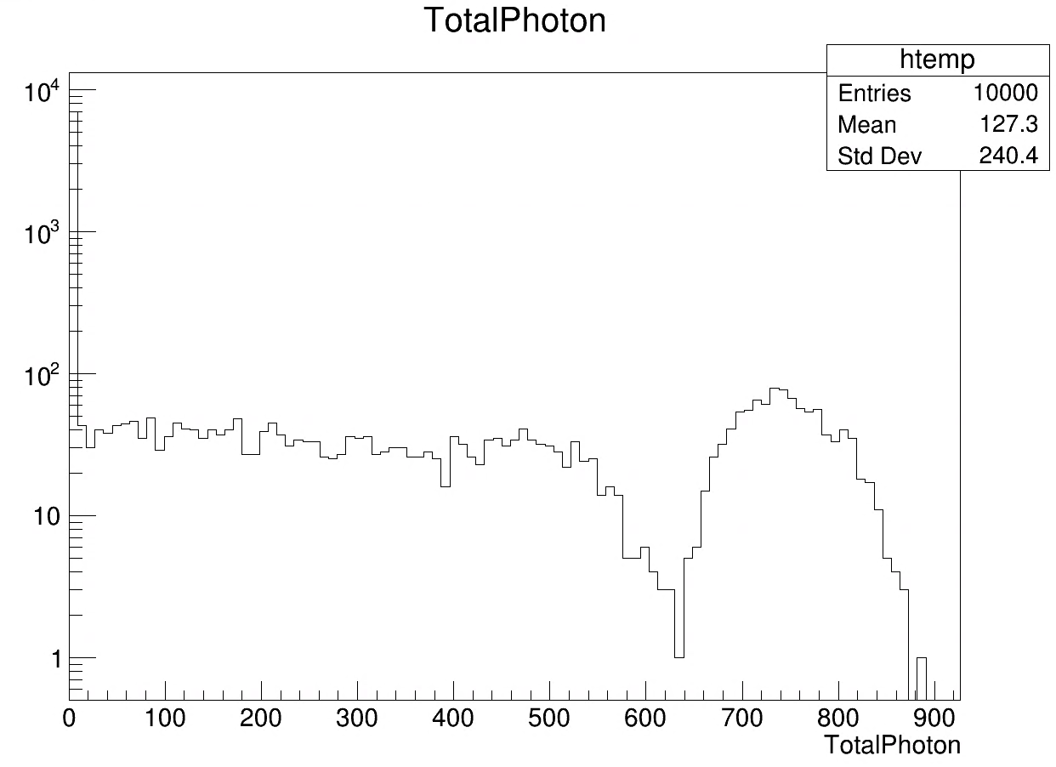
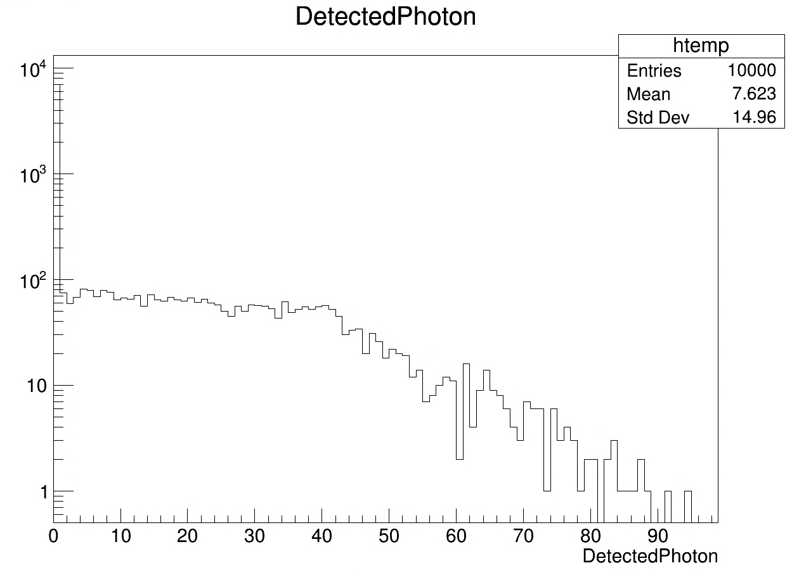
Simulation results
Primary particle: 662keV gamma
Light yield: 1000 ph/MeV

