Slide 1
Summary of Lattice Independent Simulation
Chen Tao
21-11-9

Slide 2
Lattice Independent Simulation
Lattice dependent simulation: tracking particles component-by-component
  Time-consuming
  Inefficient
Lattice independent simulation:
  Planner ring model + resonance strength file
  Resonance strength file contains lattice information can be calculated by DEPOL
  Efficient and getting some preliminary information can help narrow the range of parameters

Slide 3
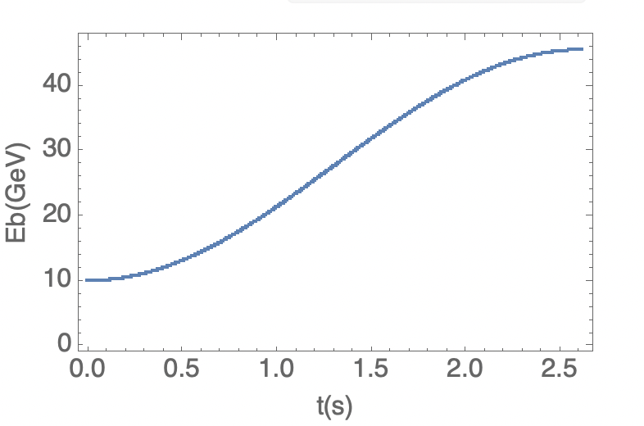

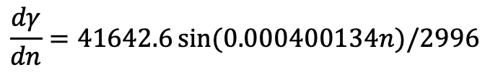
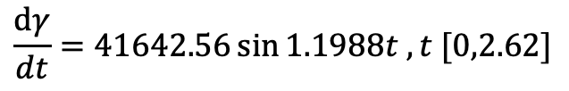

Realistic ramping rate
$$\frac{dγ}{dt}=41642.56\sin{1.1988t , t [0,2.62]}$$
$$γ\left(0\right)=19569.511$$
$$γ\left(t\right)=54306.4−34746.9\cos{1.1988t}$$
$$γ\left(2.62\right)=89043.3$$
Circumference=100044m
1s =2996 circles
$$\frac{dγ}{dn}=41642.6\sin{(0.000400134n})/2996$$

Slide 4
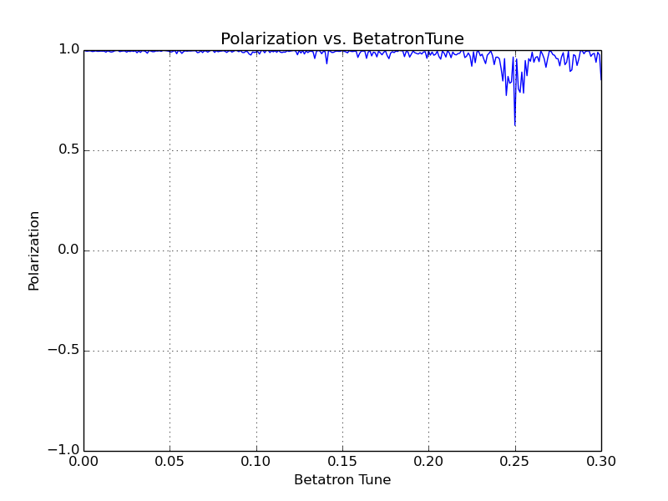
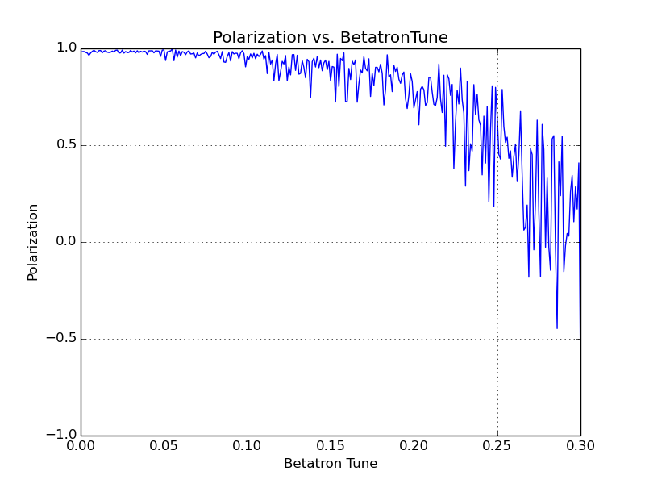
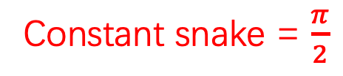
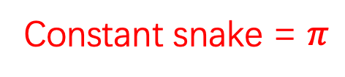
Simulation results
With constant snake
Constant snake = $π$
Constant snake = $\frac{π}{2}$

Slide 5
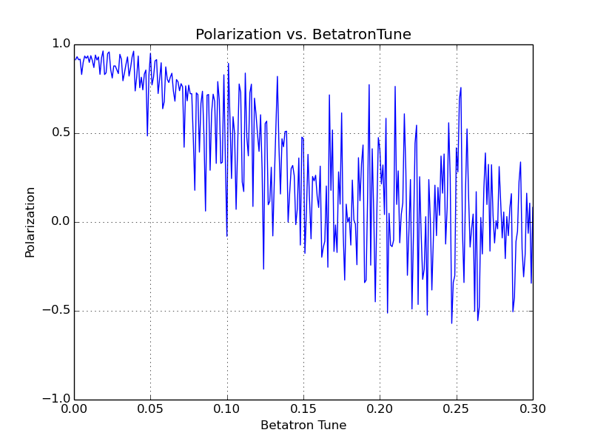
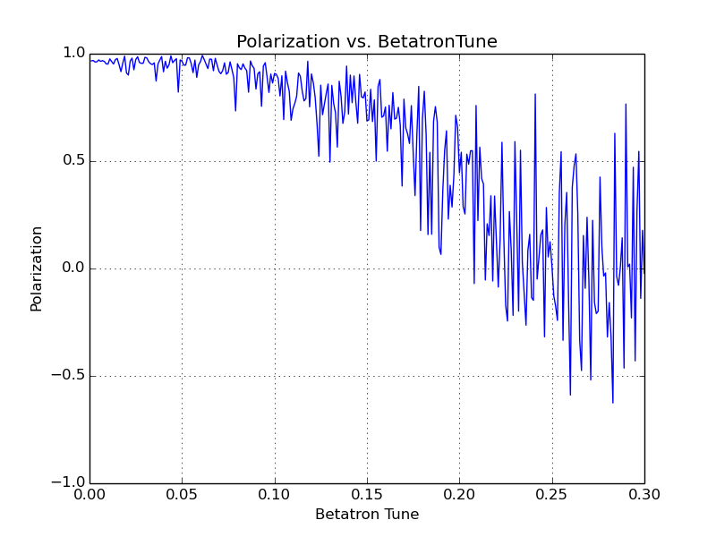

Simulation results
superconducting solenoid-based Siberian snake
Snake strength at injection energy=$π$
Snake strength at injection energy=5

Slide 6
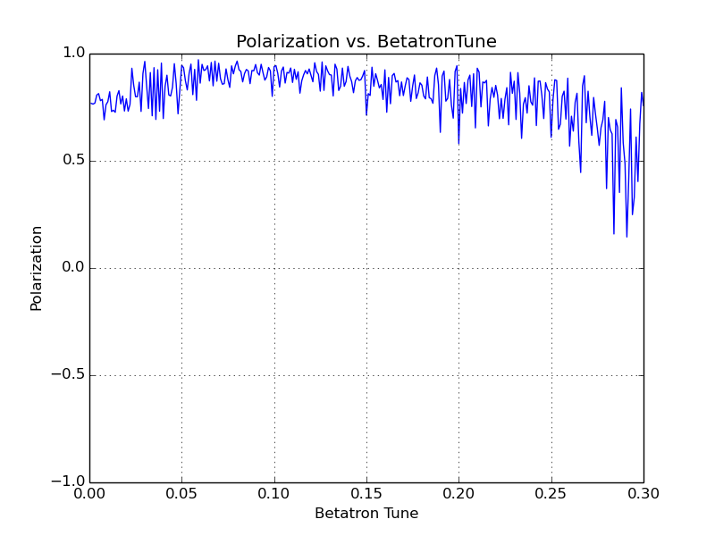
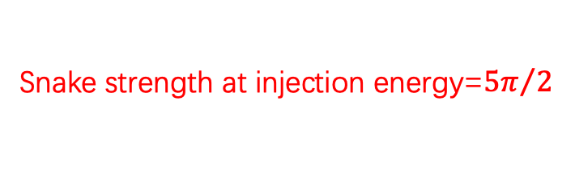
Simulation results
superconducting solenoid-based Siberian snake
Conclusion：
With constant snake , the polarization can be well preserved during the acceleration.
With solenoid-based Siberian snake , the final polarization degree is extremely sensitive to betatron tune in most work space .
The magnetic field needed to maintain polarization is very strong
Snake strength at injection energy=${5π}/2$

Slide 7
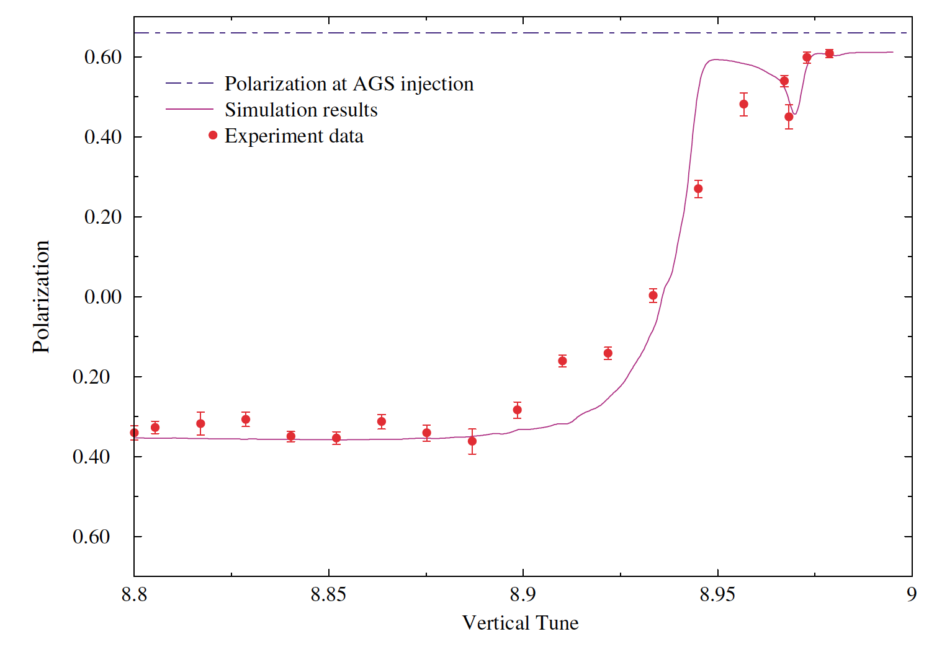

Benchmark of the code
In the paper PhysRevSTAB.7.071001:
  Using a 11.4% constant snake to overcome intrinsic resonance（proton）
The curve is smooth
The anomalous g factor:
  $G_{electron}=0.001159$
  $G_{proton}=1.7928474$

Slide 8
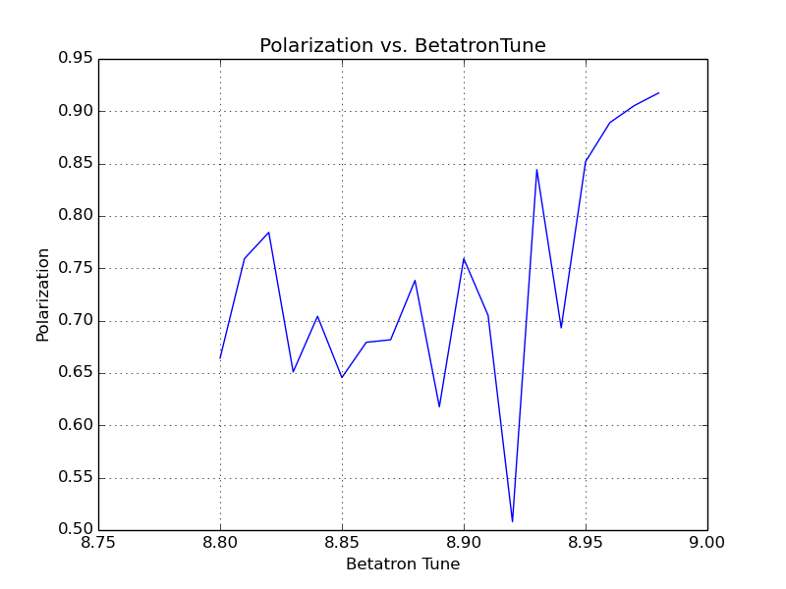
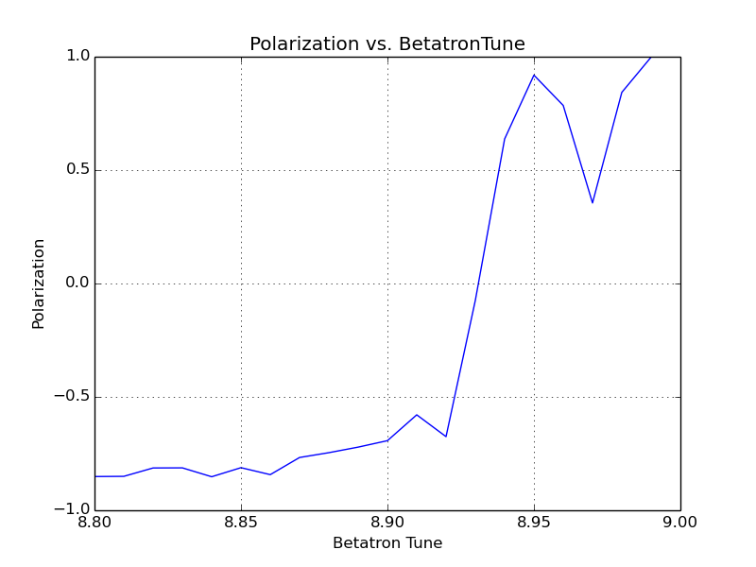
Benchmark of the code
Electron:
Proton:
Some parameters in the paper’s simulation is unknown so that I can not fully reproduce the result
The proton curve is much smoother than electron curve

Slide 9
Summary
Using a constant snake is effective
Using a solenoid-based Siberian snake may preserve the polarization but the parameters need to be carefully selected.
Next to do:
  Using BMAD/tao to do lattice dependent simulation
    Moving betatron tune , resonance strength may vary.
  Design the lattice for spin match at injection and extraction point
    In the present situation , the spin closed orbit at injection and extraction point are not on vertical direction.

