Slide 1
Spin Polarization Simulation on CEPC Booster
ChenTao
2021-11-23

Slide 2
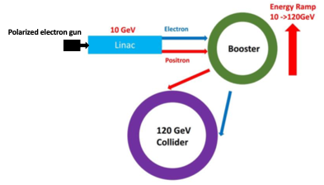
Generate Polarization Beam in CEPC and Transmit to collider
Longitudinal polarization in source & linac
Spin rotators
Partial Siberian snake(s)
Polarized electron gun can generate 80%~90% polarization beam
The polarized beam needs to be accelerated in the booster(10GeV -> 45 GeV for Z-pole operation)
Motivation : To maintain beam polarization in the booster.
Spin rotators
Vertical polarization in booster & collider arc region

Slide 3
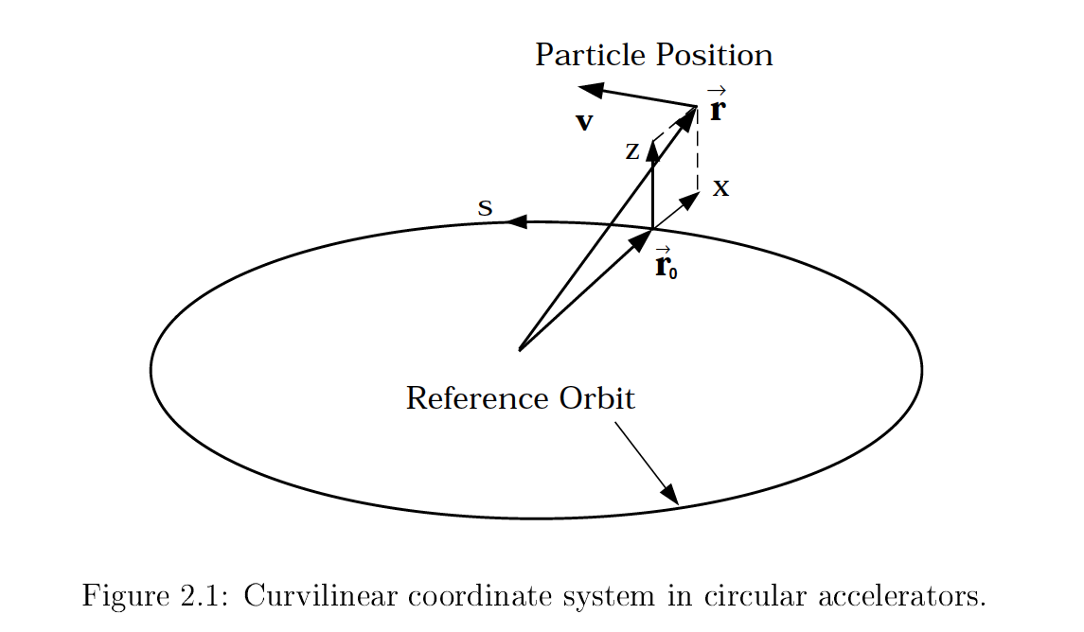
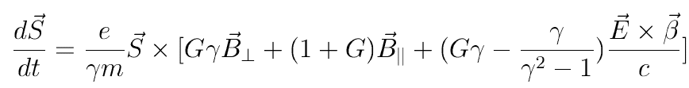
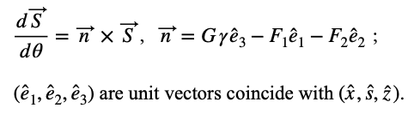



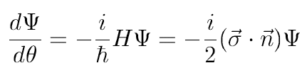


Spin motion in Synchrotron
Tomas-BMT equation:
Use the motion parameter to replace the magnetic field
Use wave function to express the equation in which
Solve for one revolution around the accelerator

Slide 4

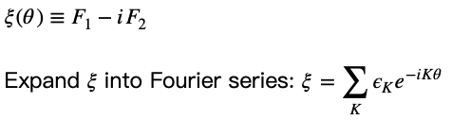

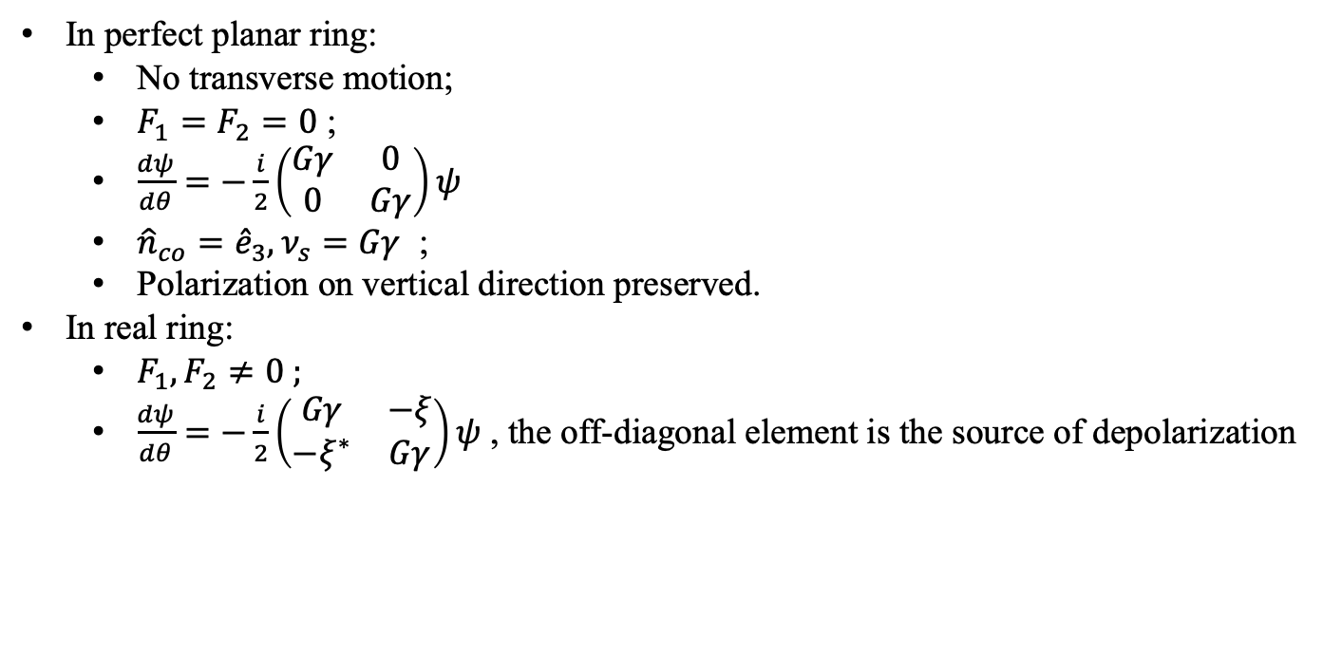
Spin motion in Synchrotron
In perfect planar ring:
  No transverse motion;
  $F_{1}=F_{2}=0$ ;
  $\frac{dψ}{dθ}=−\frac{i}{2}\left(\begin{matrix}Gγ & 0 \\ 0 & Gγ\end{matrix}\right)ψ$
  ${\hat{n}}_{co}={\hat{e}}_{3}, ν_{s}=Gγ$ ;
  Polarization on vertical direction preserved.
In real ring:
  $F_{1},F_{2}≠0 ;$
  $\frac{dψ}{dθ}=−\frac{i}{2}\left(\begin{matrix}Gγ & −ξ \\ −ξ^{∗} & Gγ\end{matrix}\right)ψ$ , the off-diagonal element is the source of depolarization
Choose a certain K , the equation can be solved :
Compare the 2 terms we can get
We can conclude: only when K close to $Gγ$, the spin closed orbit obviously deviate from vertical direction,
Thus the depolarization terms with different K can be treat separately .They are so-called spin resonances ,
K is the location of spin resonance.

Slide 5
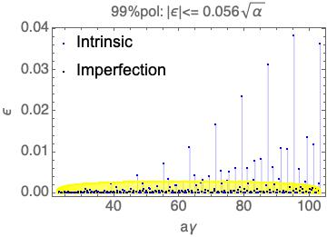
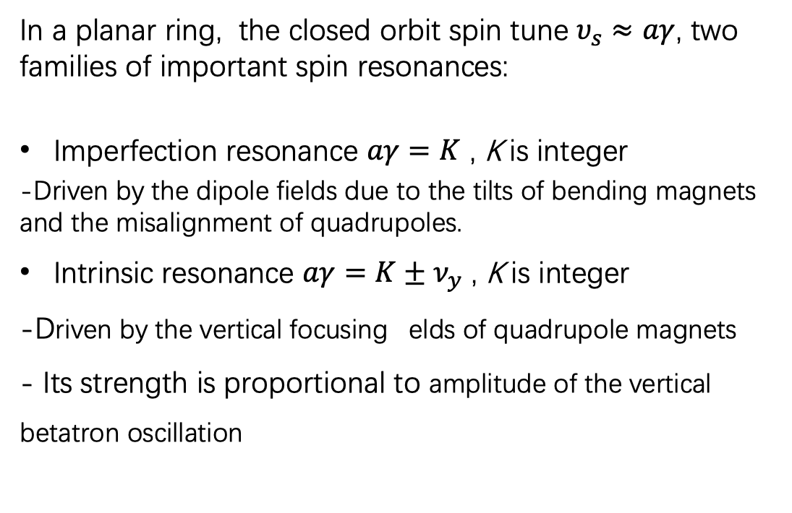
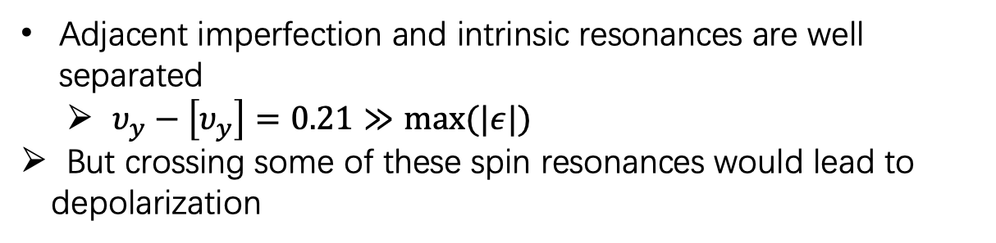
Spin resonance
In a planar ring, the closed orbit spin tune $υ_{s}≈aγ$, two families of important spin resonances:
Imperfection resonance $aγ=K$ , K is integer
-Driven by the dipole fields due to the tilts of bending magnets and the misalignment of quadrupoles.
Intrinsic resonance $aγ=K±ν_{y}$ , K is integer
-Driven by the vertical focusing elds of quadrupole magnets
- Its strength is proportional to amplitude of the vertical betatron oscillation
Adjacent imperfection and intrinsic resonances are well separated
  $υ_{y}−\left[υ_{y}\right]=0.21≫max⁡(|ε|)$
But crossing some of these spin resonances would lead to depolarization

Slide 6

Depolarization Effect
Crossing a single resonance:
Spin closed orbit
Far from the resonance
Closed to the resonance
After the resonance
Crossing speed
Fast cross : polarization not changed;
Slow cross: adiabatic , the spin follows the closed orbit flipping;
Depolarization : non- adiabatic and the spin partially follows the spin closed orbit

Slide 7
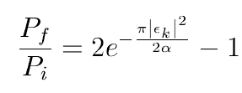
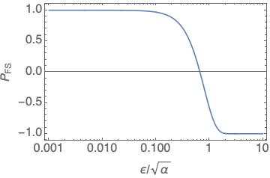
FS formula:
The beam polarization after crossing a single-isolated spin resonance can be calculated w/ Froissart-Stora formula, trade-off between spin resonance strength ε and crossing speed α= dGγ/dθ
  For 0.1 < ε/sqrt{α} < 2 , loss of polarization (depolarization)
  P_{FS} =-1 means flipping of spin direction, but keeping the same polarization

Slide 8
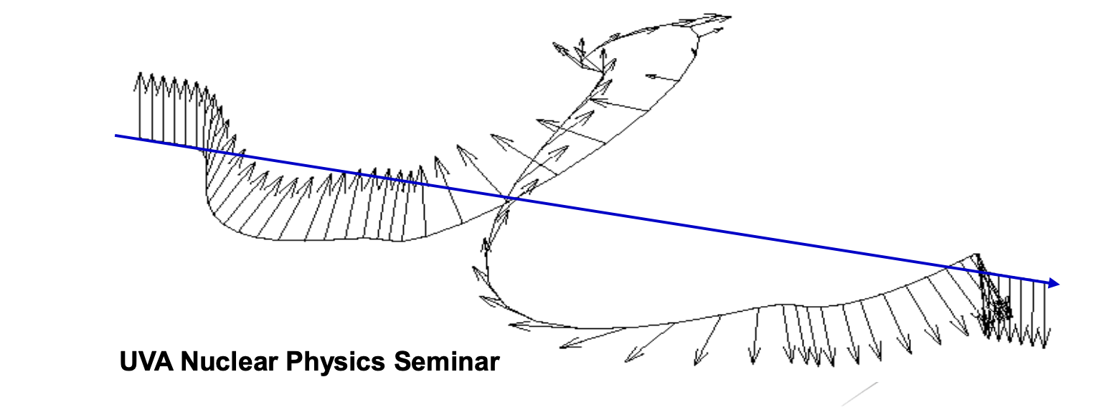
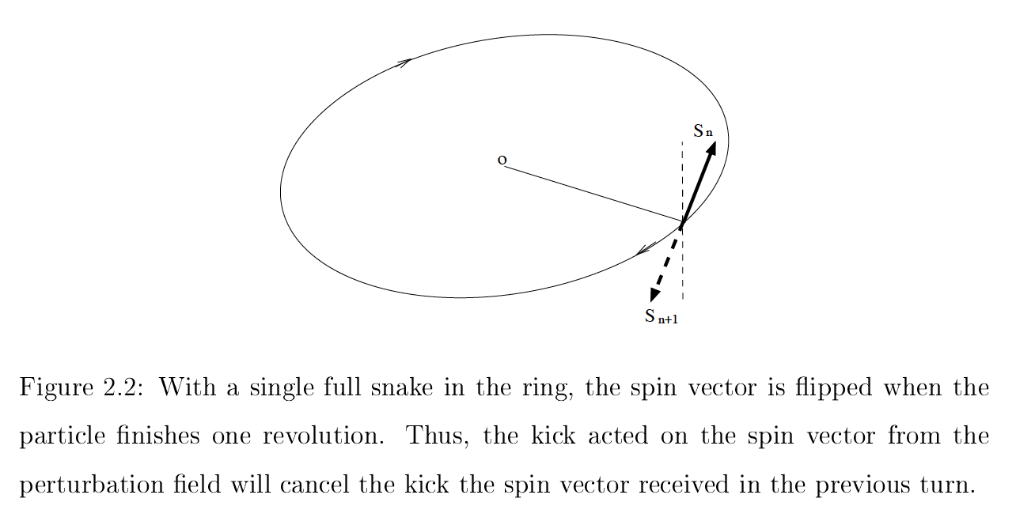
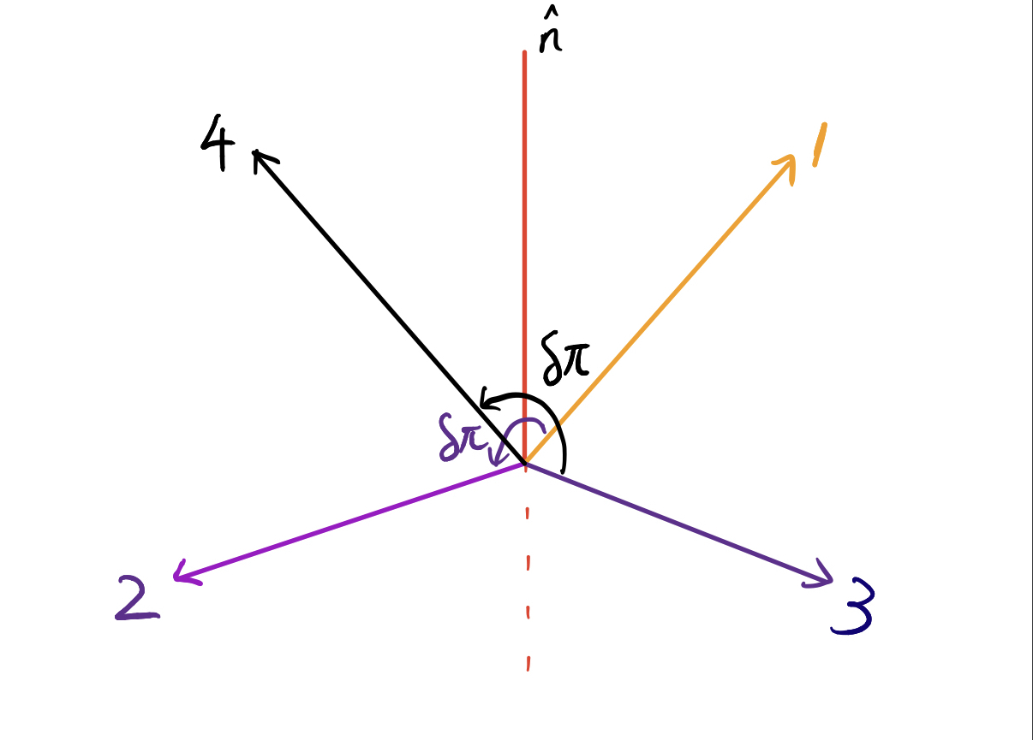
Siberian Snake
rotates spin vector by 180 degree and do not affect orbital motion
The perturbation on the spin from the accelerator lattice is canceled in successive turns
Partial snake : rotate degree less than 180 .

Slide 9
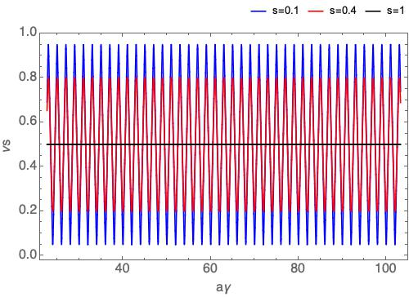
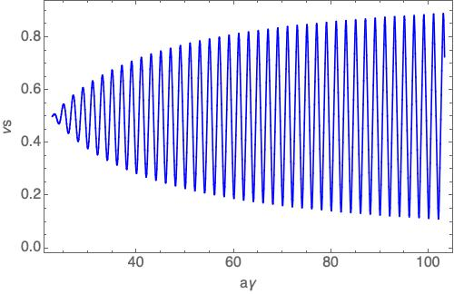
A synchrotron with a partial snake
The closed orbit spin tune satisfies: $\cos{πν_{s}=\cos{aγ}\cos{\frac{sπ}{2}}}$ for a synchrotron implemented with a partial snake whose spin rotation angle is s*π. To avoid depolarization due to the intrinsic resonances, the betatron tunes should be close to integer.
Closed orbit spin tune for partial snake with different s
Closed orbit spin tune for a no-ramping solenoid snake with decreasing s over the beam energy

Slide 10
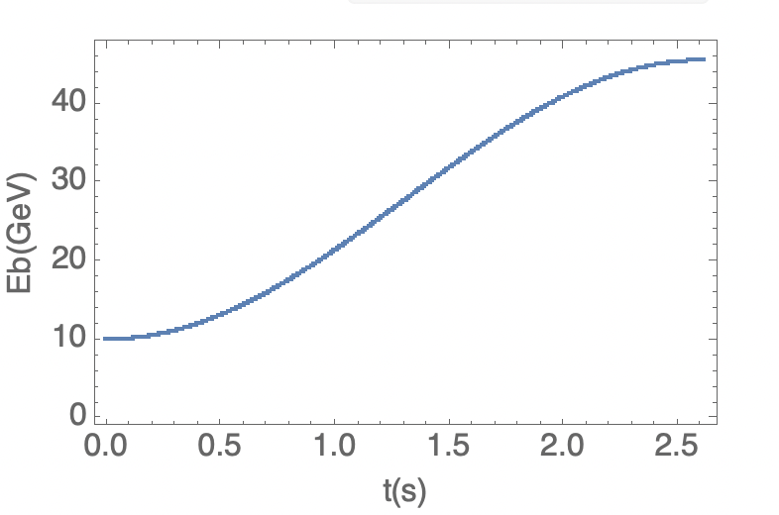
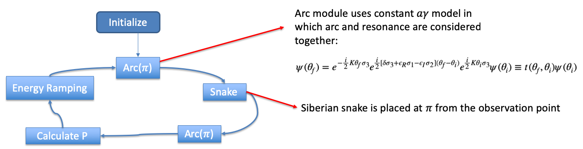
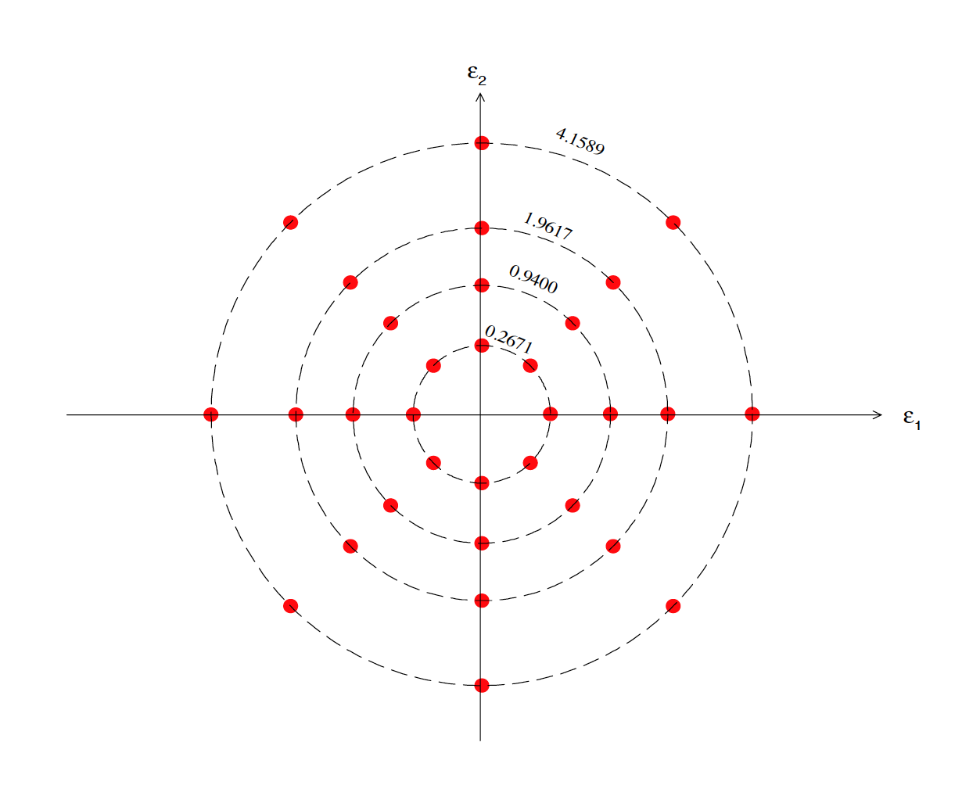
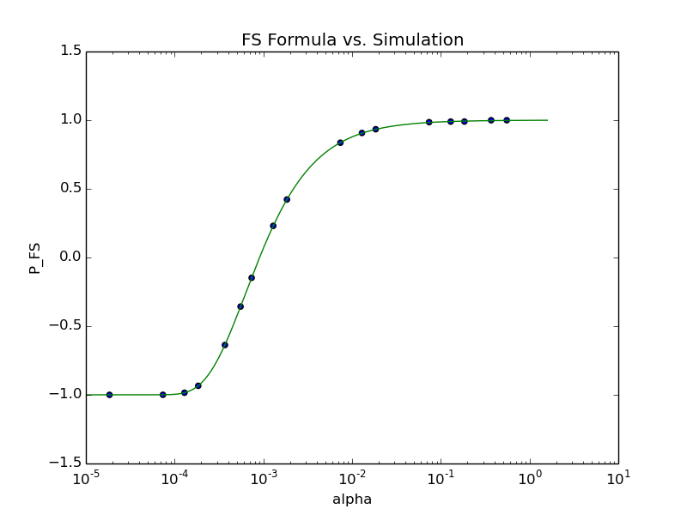
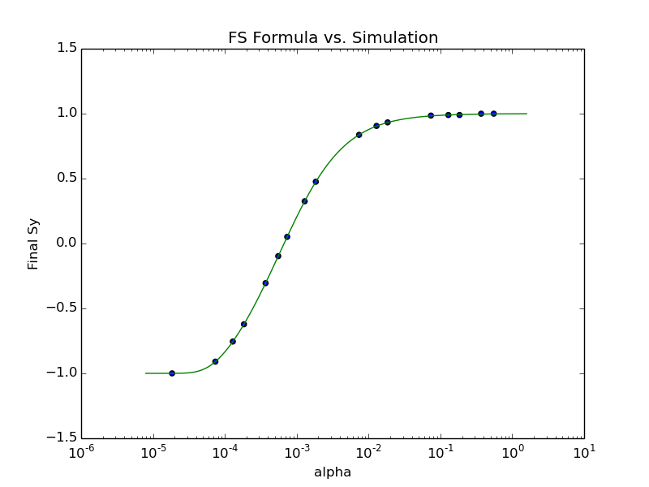
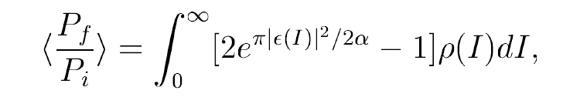

Lattice independent simulations
Diagram of the simulation algorithm
Launch a beam of 32 particles to account for amplitude dependence of intrinsic resonance strength
  Benchmark: single spin resonance: $\left|ε\right|=0.02 ,K=30.$ scan ramping rate $α$
Imperfection resonance resonance
Intrinsic resonance
$\left\langle S_{3}\right\rangle =2e^{−π\frac{{\left|ε\right|}^{2}}{2α}}−1$
M.Bai, PhD thesis, 1998

Slide 11
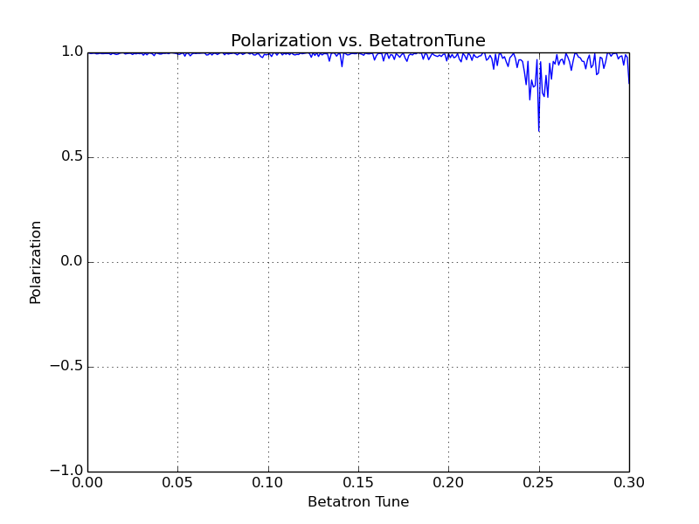
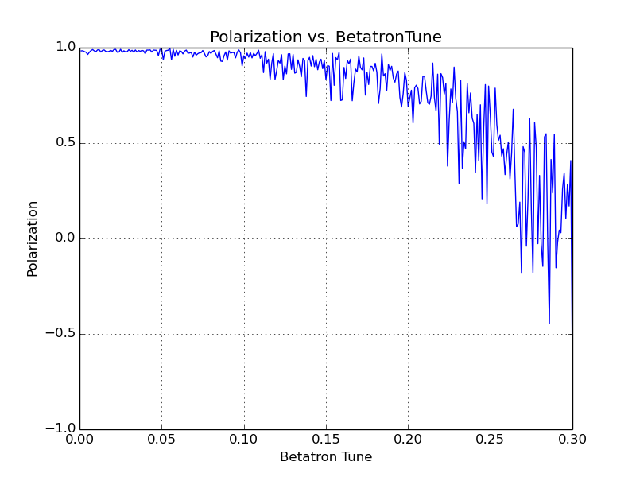
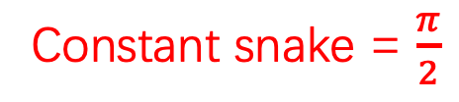
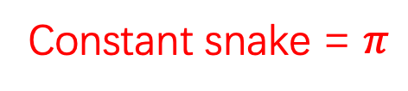
Simulation results
With constant snake , betatron tune=0.21
Constant snake = $π$
Constant snake = $\frac{π}{2}$

Slide 12
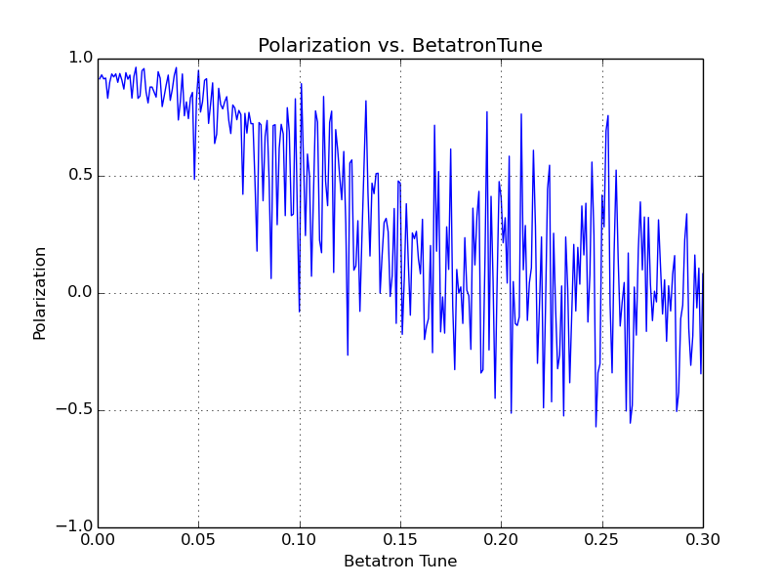
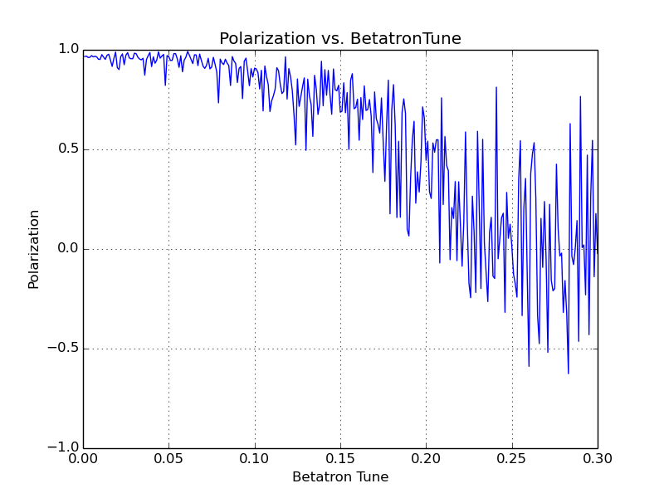

Simulation results
superconducting solenoid-based Siberian snake
Snake strength at injection energy=$π$
Snake strength at injection energy=5

Slide 13
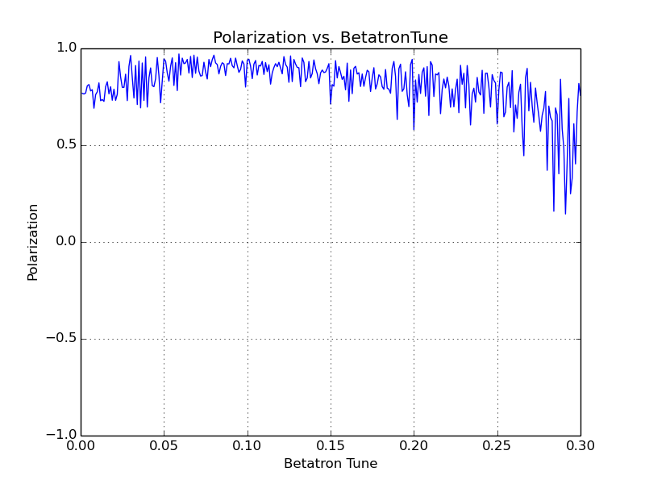

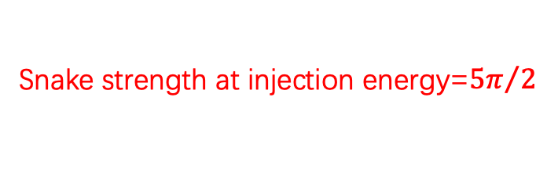
Simulation results
superconducting solenoid-based Siberian snake
Conclusion：
With constant snake , the polarization can be well preserved during the acceleration.
With solenoid-based Siberian snake , the final polarization degree is extremely sensitive to betatron tune in most work space .
The magnetic field needed to maintain polarization is very strong
Snake strength at injection energy=${5π}/2$

