Slide 1
Preliminary Considerations on the beam test
F. Grancagnolo
Nov. 25, 2021

Slide 2
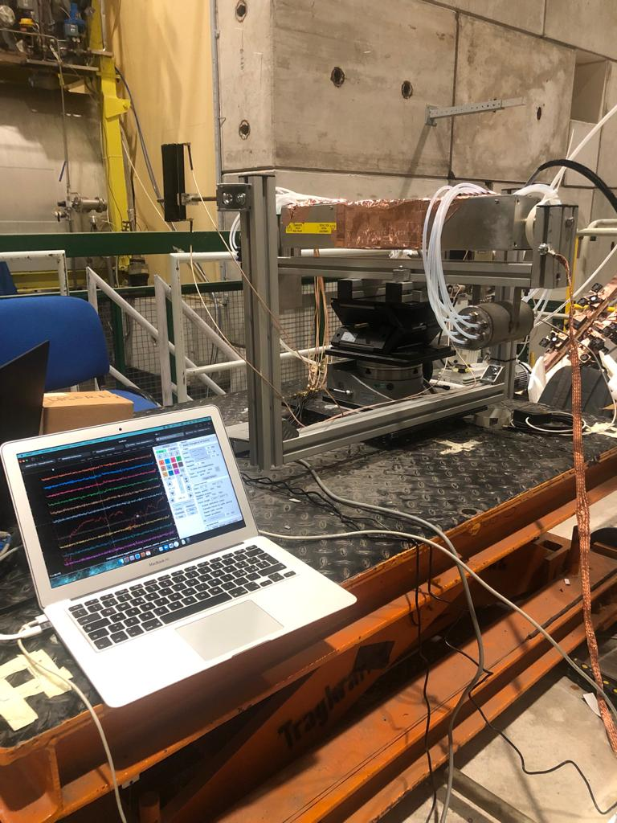
The test
Purpose
Demonstrate the ability to count clusters at a fixed βγ (e.g. muons at a fixed momentum – 165 GeV/c) by changing: - the cell size (1 – 3 cm) - the track angle (0° to 60°) - the gas mixture (90/10: 12 cl/cm, 80/20: 20 cl/cm, for m.i.p.)
Establish the limiting parameters for an efficient cluster counting: - cluster density as a function of impact parameter - space charge (by changing gas gain, sense wire diameter, track angle) - gas gain stability
Train different cluster counting algorithms
Claudio CAPUTO UC Louvain
Federica CUNA INFN Lecce
Nicola DE FILIPPIS INFN Bari
Francesco GRANCAGNOLO INFN Lecce
Matteo GRECO INFN Lecce
Sergey GRIBANOV BINP Novosibirsk
Kurtis JOHNSON U of Florida
Sasha POPOV BINP Novosibirsk
Angela TALIERCIO UC Louvain
Shuiting XIN IHEP Beijing
SHIFTERS

Slide 3
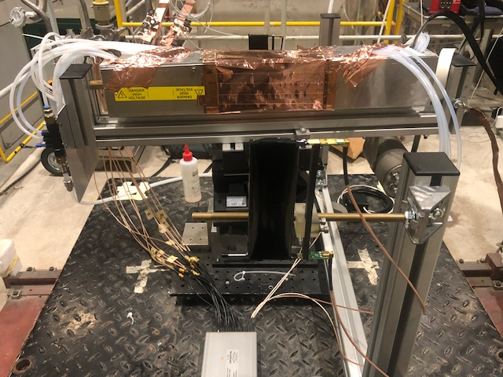
The setup
signal
box
downstream
trigger tile
HV distr.
box
outlet gas
manifold
HV cable
inlet gas
manifold
signal cables
(40 cm)
upstream
trigger tile
DRS

Slide 4
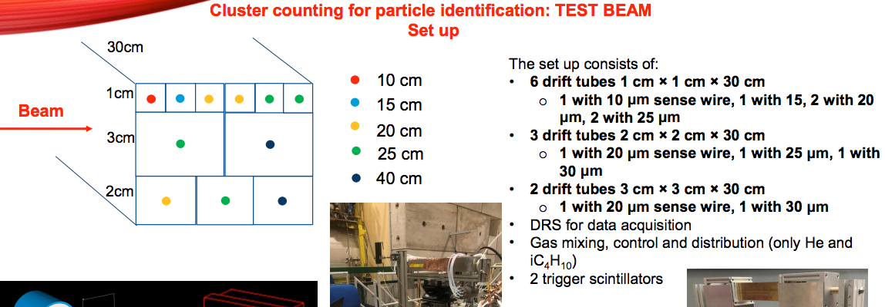

Slide 5
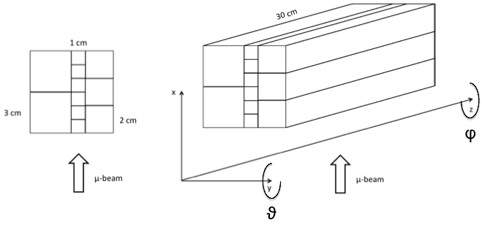
Drift tubes schematics
red 10 μm wire (Mo)
blue 15 μm wire (Mo)
green 20 μm wire (W)
orange 25 μm wire (W)
violet 40 μm wire (Al)
Tube positioning reshuffled during the test
Also, 1 cm tubes are 40 cm long

Slide 6
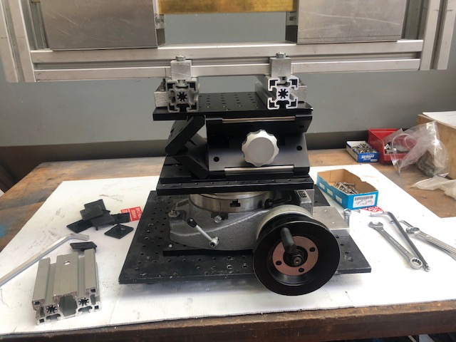
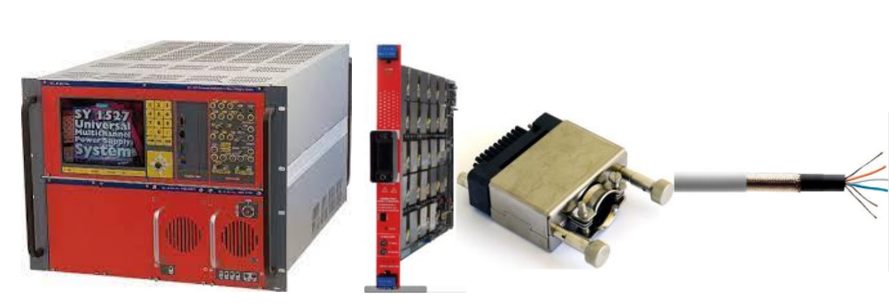
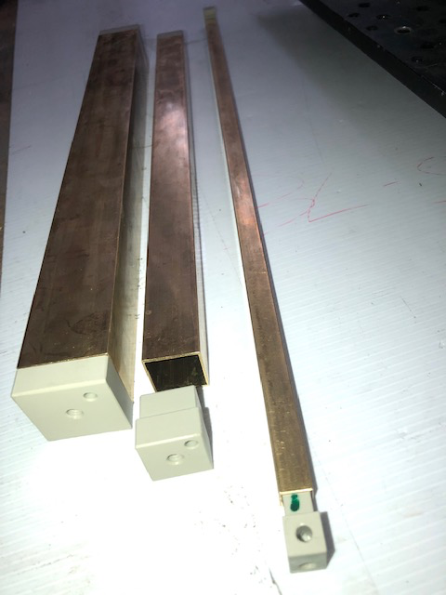
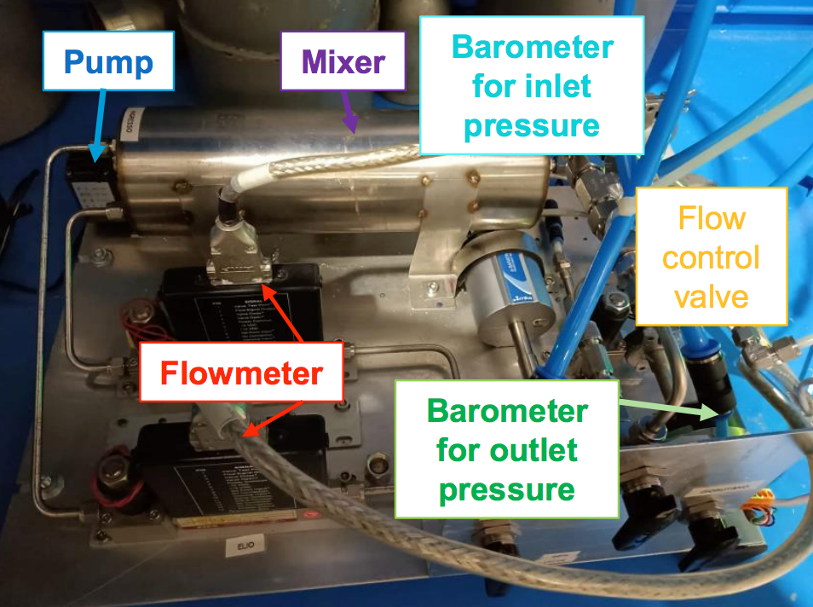
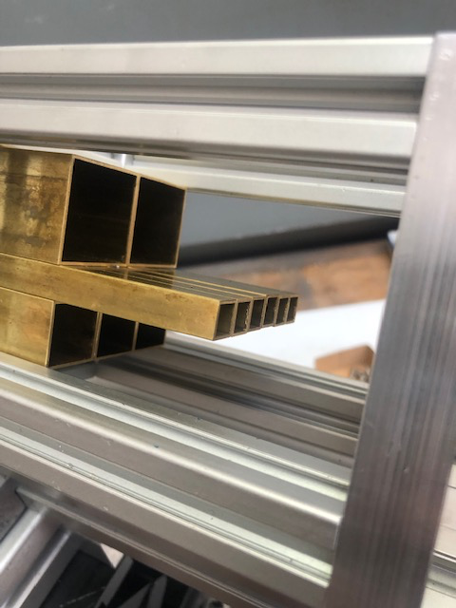
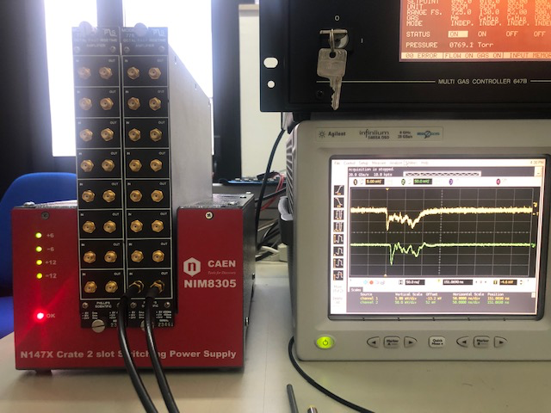
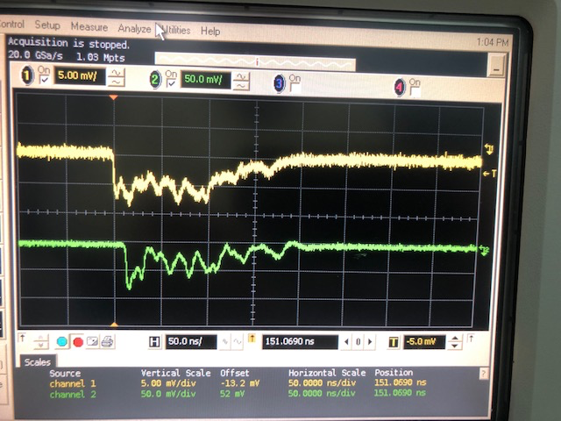
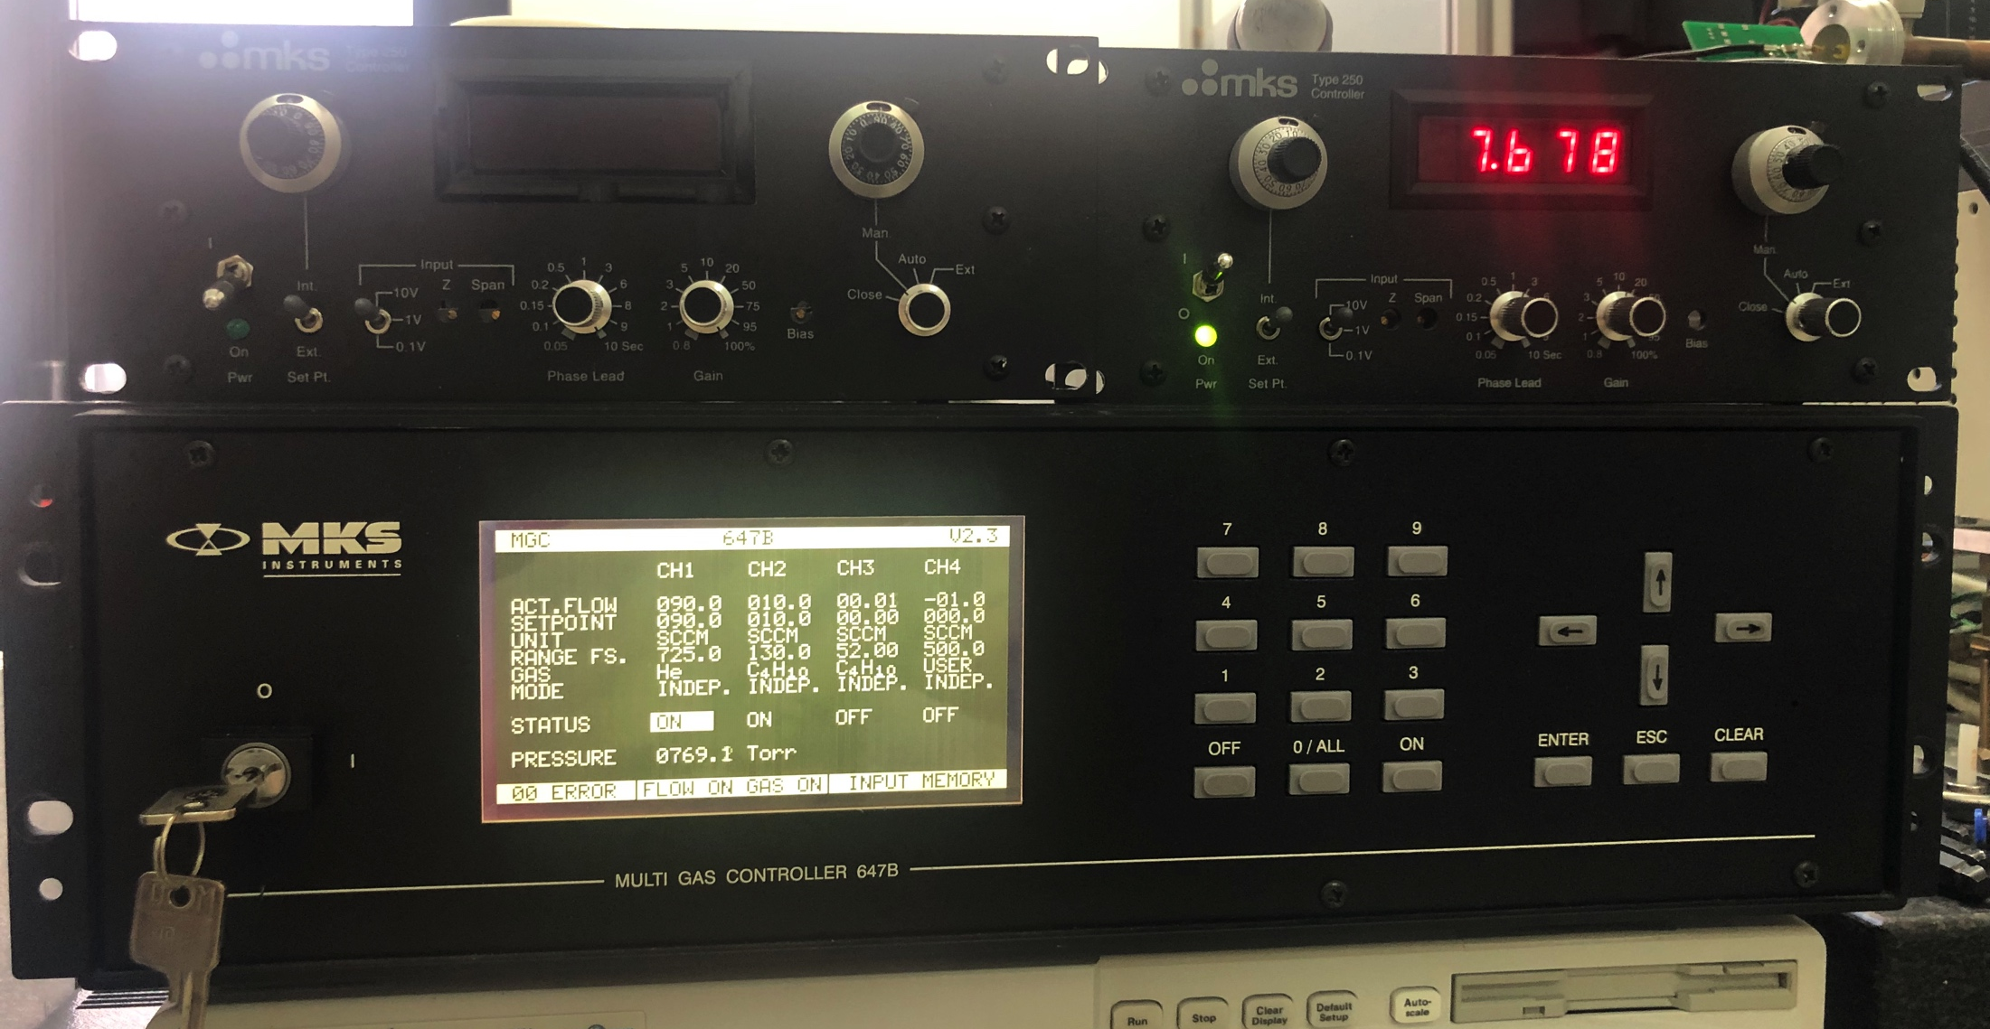
The Hardware
The drift tubes
The rotating table
The HV system
The portable gas system
The gain 10 - 1.7 GHz amplifier (Phillips 775)
The gas controllers

Slide 7
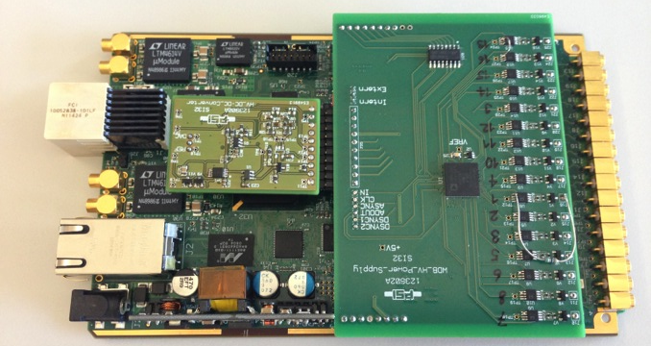
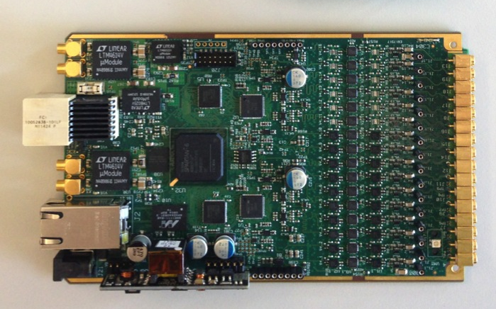
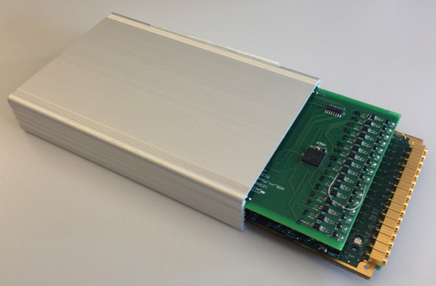
The DAQ board: DRS4
16 channels data acquisition board
designed and used by the
MEG2 experiment at PSI
(μ → e + γ)
see next presentation by G. Chiarello

Slide 8
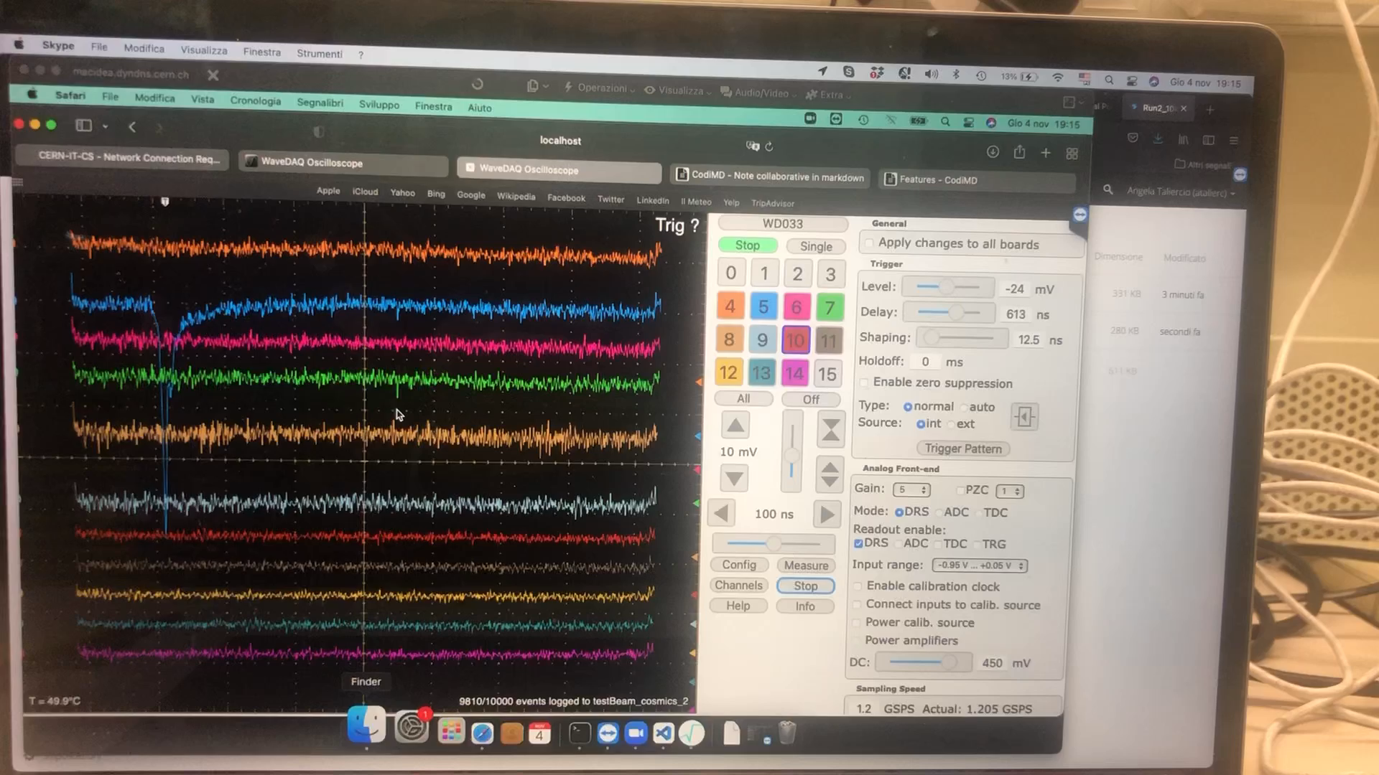
Cosmic rays display

Slide 9
Analysis plan
Determine gas gain for the different (9) configurations and for different gas mixtures
Study the space charge limitations for an efficient cluster collection
Train different cluster counting algorithms by comparing to a well known method (PeakFit)
Check Poisson nature of cluster counting (tube size, track angle, gas mixture)

Slide 10
Some considerations on gas gain
Capacitance per unit length (cylinder approximation):
C_{L} = 2πε₀/ln(R/r_{w}) C_{tube} = C_{L} × L
Inductance per unit length (cylinder approximation):
L_{L} = 2×10⁻⁷ ln(R/r_{w}) μH/m
our drift tubes: L = 30, 40 cm R = 0.4, 0.9, 1.4 cm
  r_{w} = 5.0, 7.5, 10.0, 12.5, 20.0 μm
Characteristic Impedance: Z = √L/C
at gas gain = 10⁵, one single electron deposits a charge
Q₀ = 1.6×10⁻¹⁹×10⁵ Coul = 16 fCoul
and the pulse height generated by a single electron is:
  ΔV = Q₀ /C_{tube}

Slide 11
Charge distribution
equivalent circuit
1 MΩ
10 MΩ
Z
1 nF
HV
+
1 nF
330 Ω
50 Ω
Impedance mismatch: ΔV_{reflect} = (Z−330)/(330+Z) × ΔV ΔV_{transmit} = 660/(330+Z) × ΔV
Current divider: ΔV' = 330/(330+50) × ΔV_{transmit} = 0.87 × ΔV_{transmit}
combined result: ΔV' = 330/(330+50) × 660/(330+Z) × Q₀/C_{tube}

Slide 12
A few numbers
configuration number | R | 2×r_{w} | L | C_{L} | L_{L} | C_{tube} | Z | ΔV (10⁵ gain) | ΔV' (10⁵ gain)
1 | 0.4 cm | 10 μm | 0.4 m | 8.37 pF/m | 1.34 μH/m | 3.35pF | 400 Ω | 4.78 mV | 3.75 mV
3 | 0.4 cm | 15 μm | 0.4 m | 8.91 pF/m | 1.26 μH/m | 3.56 pF | 376 Ω | 4.49 mV | 3.65 mV
5 - 7 | 0.4 cm | 20 μm | 0.4 m | 9.33 pF/m | 1.20 μH/m | 3.73 pF | 359 Ω | 4.29 mV | 3.57 mV
9 - 11 | 0.4 cm | 25 μm | 0.4 m | 9.69 pF/m | 1.15 μH/m | 3.88 pF | 344 Ω | 4.12 mV | 3.50 mV
13 | 0.9 cm | 20 μm | 0.3 m | 8.22 pF/m | 1.36 μH/m | 2.47 pF | 407 Ω | 6.48 mV | 5.04 mV
15 | 0.9 cm | 25 μm | 0.3 m | 8.50 pF/m | 1.32 μH/m | 2.55 pF | 394 Ω | 6.27 mV | 4.96 mV
17 | 0.9 cm | 40 μm | 0.3 m | 9.15 pF/m | 1.22 μH/m | 2.75 pF | 365 Ω | 5.82 mV | 4.80 mV
19 | 1.4 cm | 25 μm | 0.3 m | 7.96 pF/m | 0.94 μH/m | 2.39 pF | 344 Ω | 6.69 mV | 5.02 mV
21 | 1.4 cm | 40 μm | 0.3 m | 8.54 pF/m | 0.85 μH/m | 2.56 pF | 315 Ω | 6.25 mV | 5.30 mV
ΔV (10⁵ gain) = single electron pulse height for an HV producing a
reduced electric field: E/P, corresponding to a gas gain of 10⁵

Slide 13
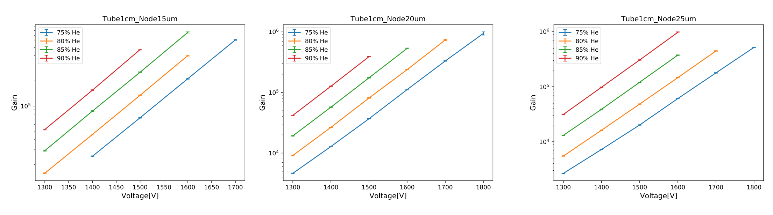
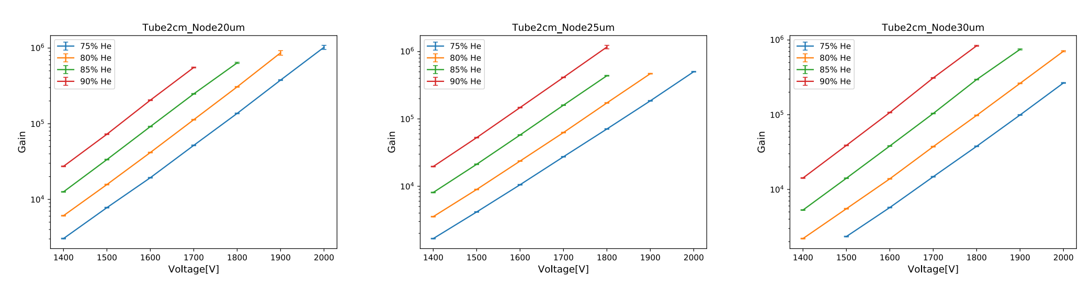
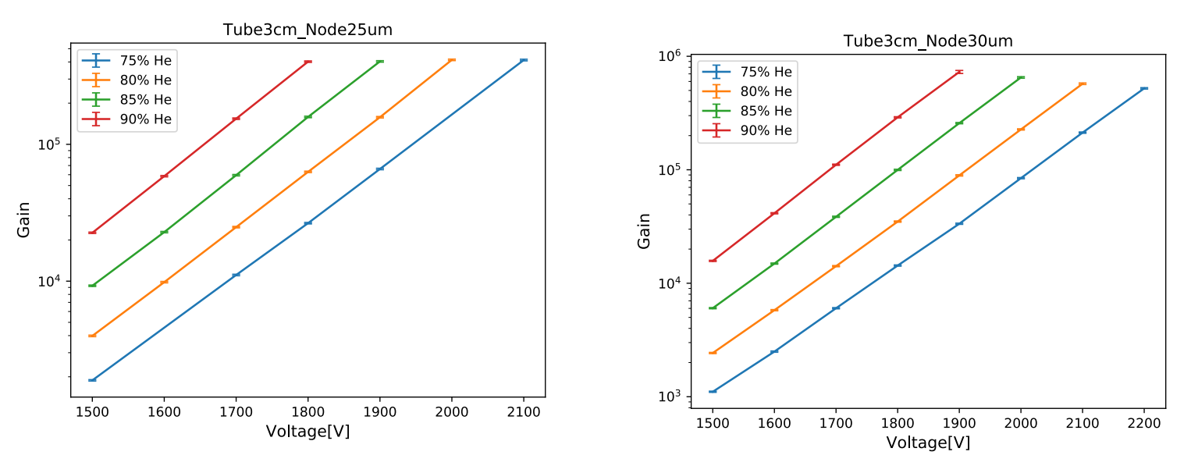
Determining HV (10⁵ gain)
Garfield run on different
configurations by Shuiting
for P = 760 torr, T = 20°C
|
renormalized for
P = 725 torr and extrapolated for
10 and 40 μm wires
|
and readjusted by
observing average
maximum pulse height

Slide 14
HV table (He/iC₄H₁₀ = 90/10, P = 725 torr)
1st attempt (from Garfield)
configuration number | HV | relative gas gain (ΔV)
1 | 1230 V | 2.6
3 | 1255 V | 1.4
5 - 7 | 1305 V | 1.3
9 - 11 | 1330 V | 0. ...
13 | 1470 V | 0.6
15 | 1545 V | 0.9
17 | 1670 V | 0. ...
19 | 1620 V | 0. ...
21 | 1765 V | 0. ...

Slide 15
HV table (He/iC₄H₁₀ = 90/10, P = 725 torr)
1st attempt (from Garfield)
2nd attempt (corrections to Garfield)
configuration number | HV | relative gas gain (ΔV)
1 | 1230 V | 2.6
3 | 1255 V | 1.4
5 - 7 | 1305 V | 1.3
9 - 11 | 1330 V | 0. ...
13 | 1470 V | 0.6
15 | 1545 V | 0.9
17 | 1670 V | 0. ...
19 | 1620 V | 0. ...
21 | 1765 V | 0. ...
HV | relative gas gain (ΔV) | actual gas gain (ΔV')
1230 V – 30 V | 1.2 | 1.47
1255 V – 10 V | 1.1 | 1.29
1305 V – 5 V | 1.1 | 1.31
1330 V + 10 V | 1.1 | 1.27
1470 V + 25 V | 1.1 | 1.57
1545 V + 5 V | 1.0 | 1.49
1670 V + 50 V | 1.2 | 1.92
1620 V + 50 V | 1.1 | 2.00
1765 V + 45 V | 1.0 | 1.73

Slide 16
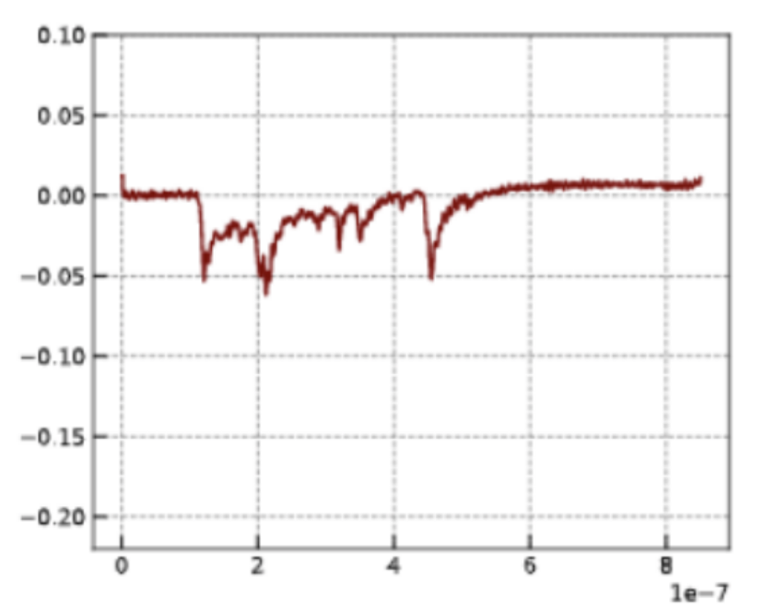
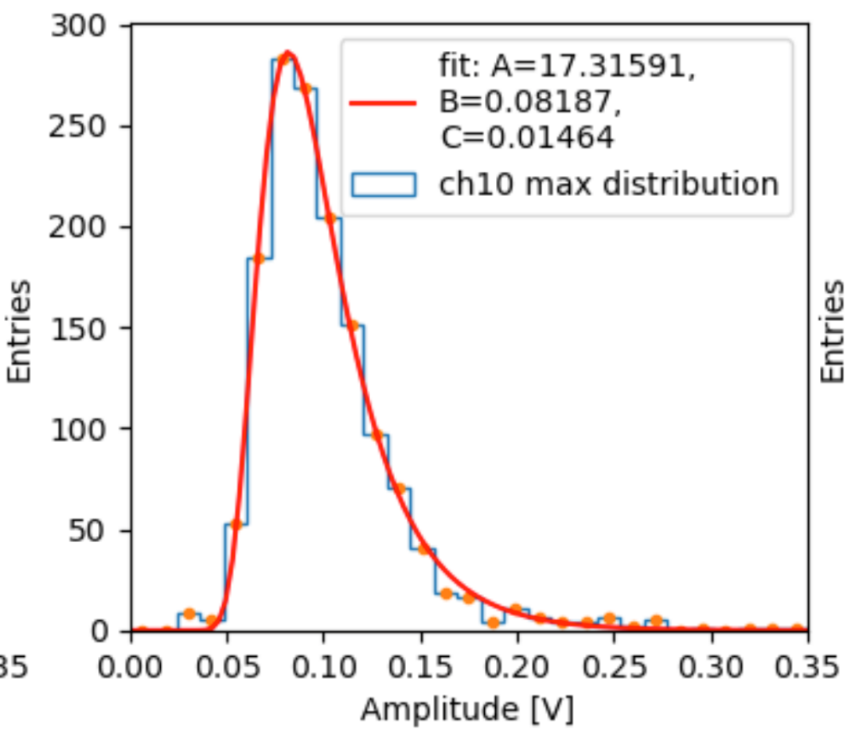
Average maximum pulse height
Assume that the average maximum pulse height ≅
single electron pulse height
and fit to a Landau distribution by taking into account the amplifier gain (see C. Caputo talk)
maximum pulse height
amplifier gain =10

Slide 17
5
red 10 μm wire (Mo)
1 cm tube blue 15 μm wire (Mo)
2 cm tube green 20 μm wire (W)
3 cm tube orange 25 μm wire (W)
violet 40 μm wire (Al)
He/iC₄H₁₀ = 90/10
4
P = 725±5 Torr
3
2

