Slide 1
WaveDream Board by Gianluigi Chiarello
Credit to S. Ritt, Paul Sherrer Institute, Zurich, Switzerland

Slide 2
DRS4 chip
0.2-2 ns
Inverter “Domino” ring chain
IN
Storage
capacitors
Out
FADC
33 MHz
Clock
Shift Register
Analog switched capacitor array: analog memory with a depth of 1024 sampling cells developed at PSI, perform a “sliding window” sampling.
500MSPS ↔ 5GSPS sampling speed with 11.5 bit signal-noise ratio
8 analog channels + 1 clock-dedicated channel for sub 50ps time alignment
Pile-up rejection O(~10 ns)
Time measurement O(10 ps)
Charge measurement O(0.1%)

Slide 3
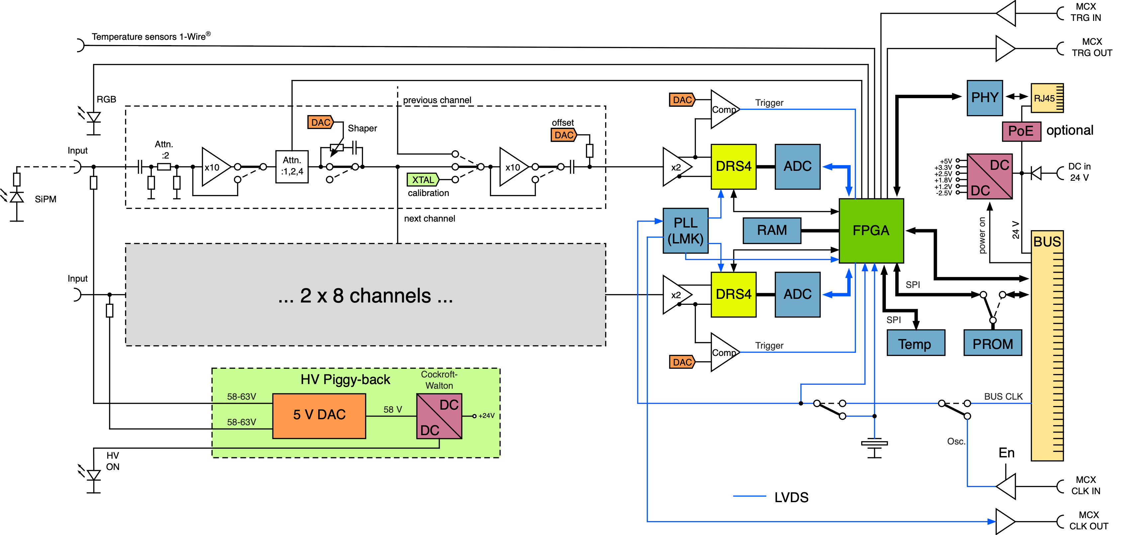
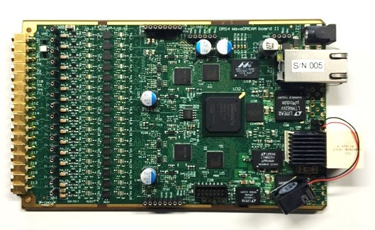
WaveDREAM Board (WDB)
Preamp channel
HV Board for SiPM

Slide 4
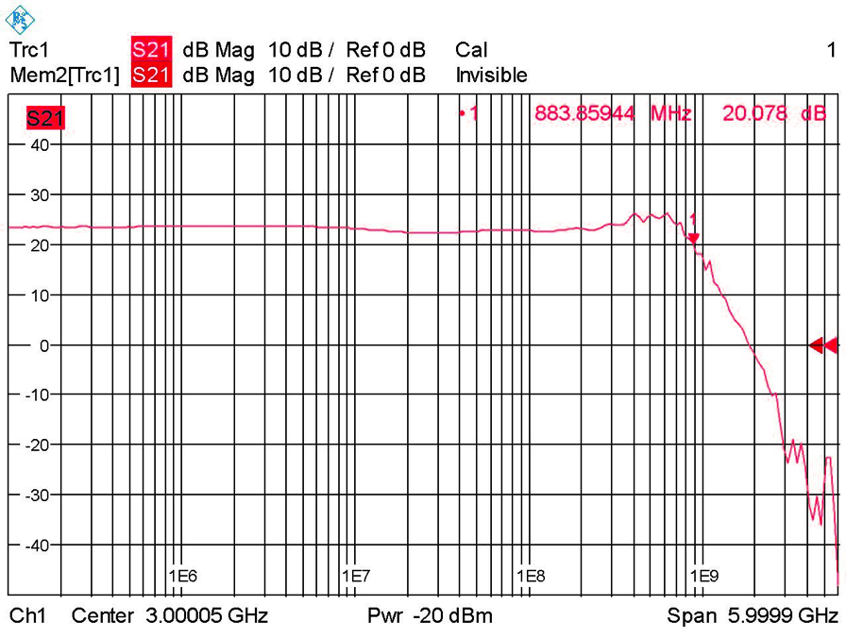
Preamp channel
Gain | BW_{3db} (MHz) | Noise (mV)
1 | 940 | 0.37
10 | 880 | 0.40
100 | 300 | 1.2
100 | 500 | 1.7
100 | 800 | 3.3
Different compensations
LMH6629
LMH6629
LTC6409
PE4215
ADC904
PE4215

Slide 5
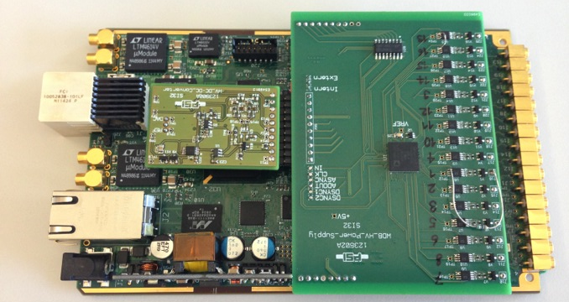
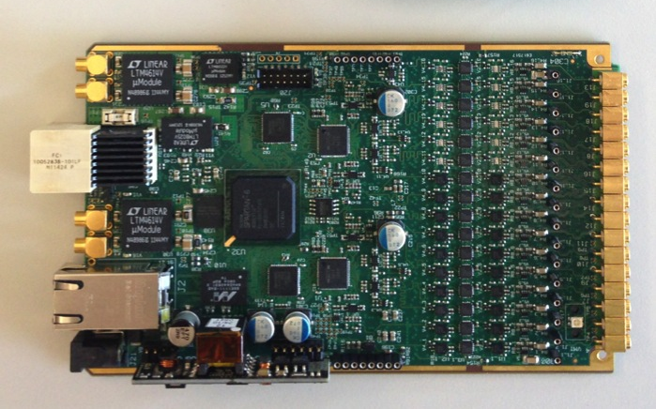
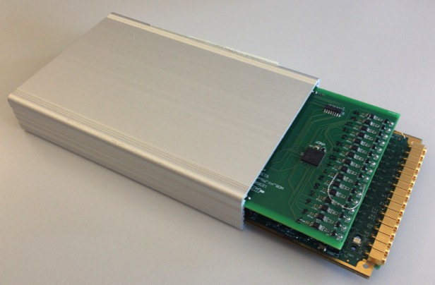
WDB
HV Boards

Slide 6
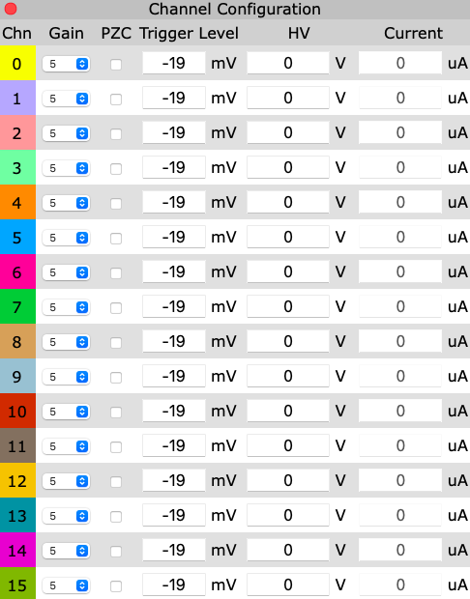
WDS
Set different trigger patterns
Server software using Mongoose C/C++ Framework
Easy low level calls for fast DAQ operations
Single executable with no need of dedicated http server
WDB interface is similar to the interface of an oscilloscope with 16 channels.
For each channel can:
Select the gain
Set a PZC
HV for SIPM

Slide 7
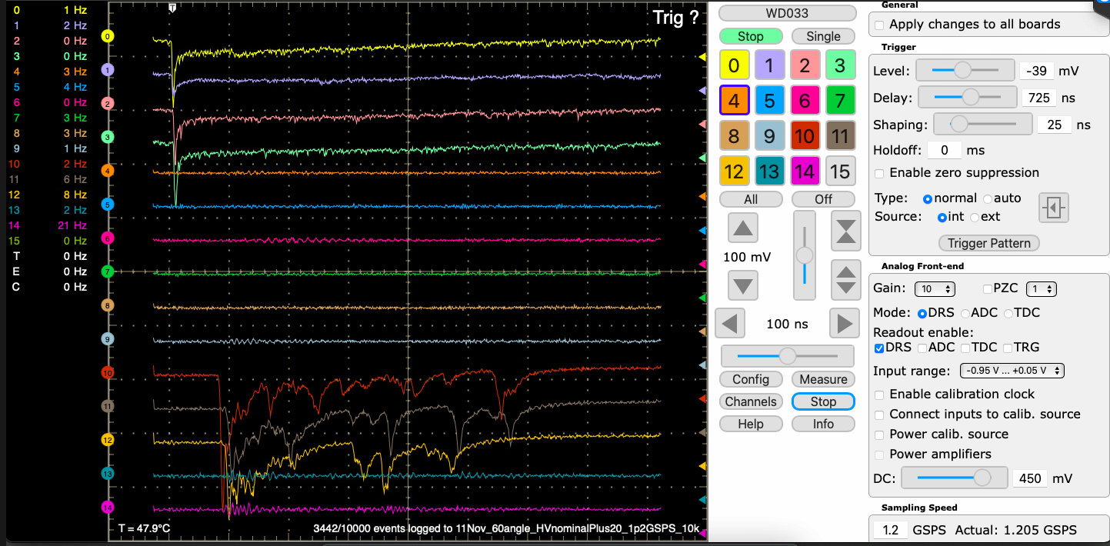
WDS: Examples event screen
4 trigger channels
Channel selection panel
6 tubes 1 cm cell size with typical event
Trigger selection pattern
3 tubes 2 cm cell size
Gain selection
2 tubes 3 cm cell size
typical event
Each data file has been saved in binary format and then converted in root files

Slide 8
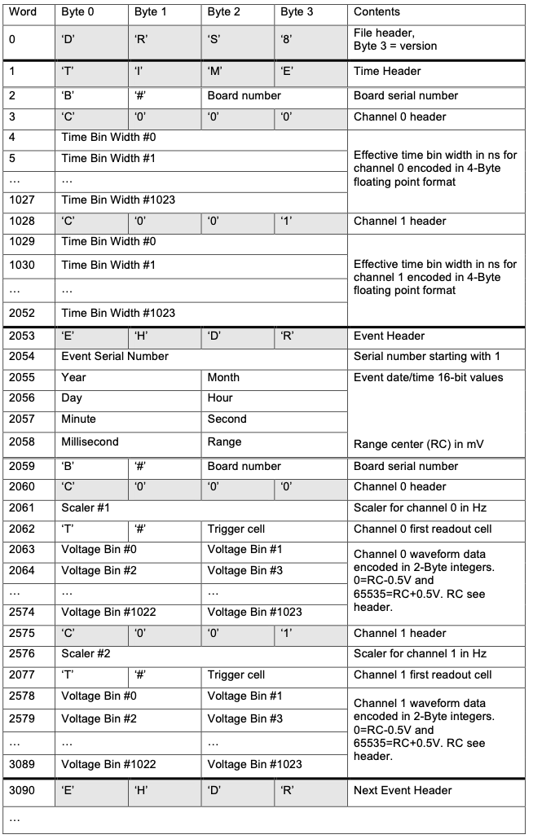
WDS: Binary format
Header relating to the board consisting of the words:
DRS8
TIME
B#XXX (XXX represents the card number and changes according to the WDB, in this case 033)
Calibration information
Header EVENT
Serial. Number
Time information
Channel Information
The macro for converting binary files to root files is ready.

Slide 9
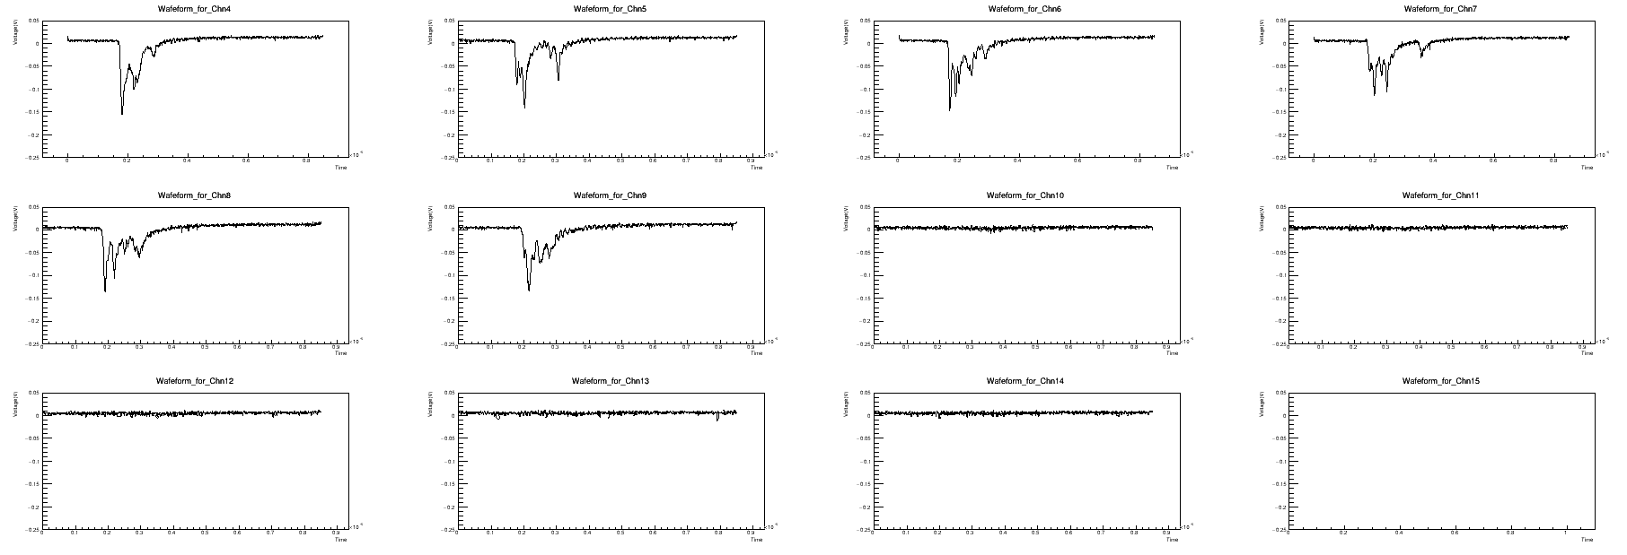
WDS: Root signal

Slide 10
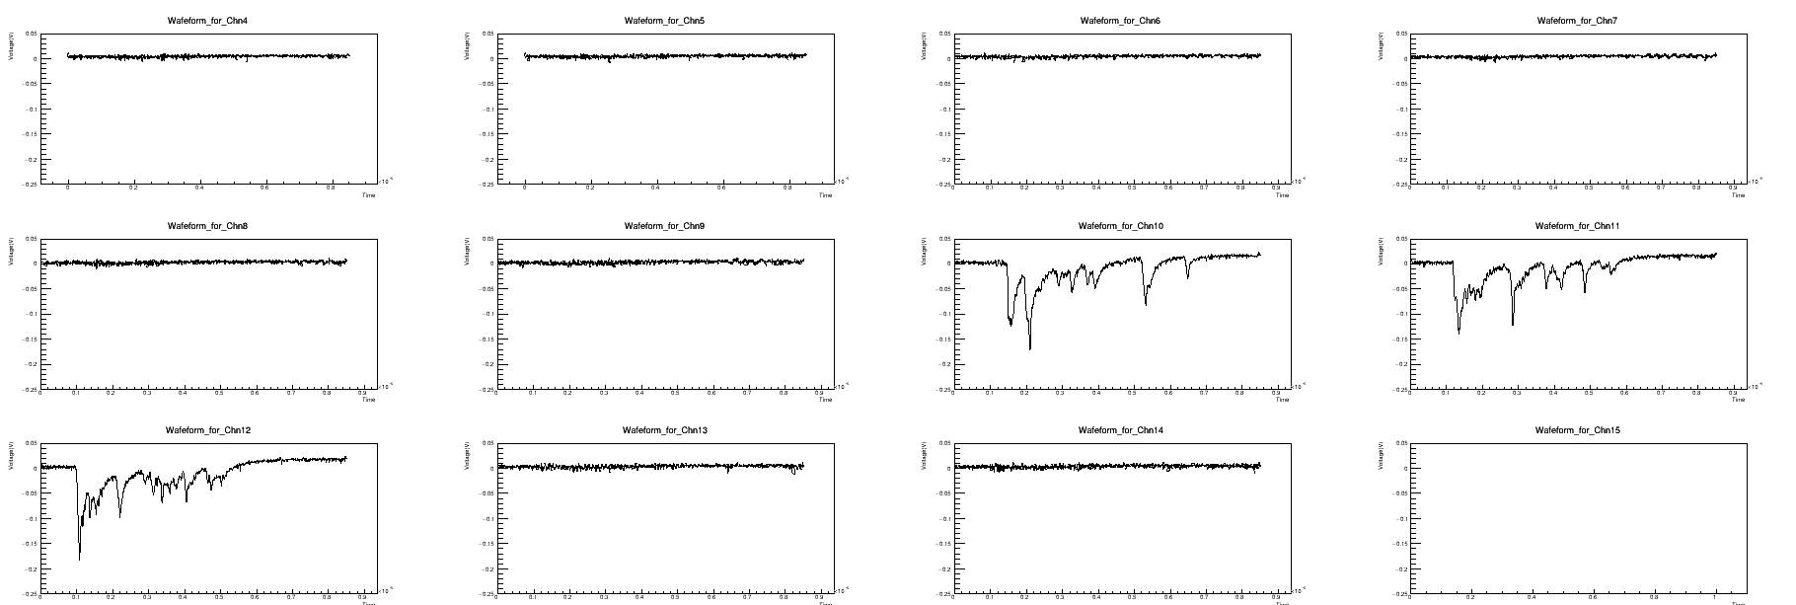
WDS: Root signal

