Slide 1
A Peak finder algorithm
Gianfranco Tassielli & Federica Cuna

Slide 2
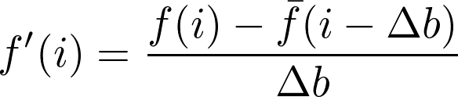

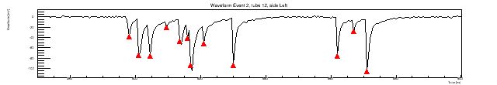
Cluster finder approach
A simple peak finder algorithm has been implemented based on the first and second derivative of the digitized signal function f.
For each bin i is defined:
Δb being the number of bins (signal rise time) over which the average value of f is calculated
A peak (assumed to be an ionization electron) is found when Δf, f' and f" are above a threshold level, defined according to the r.m.s. noise of the signal function f, and when the time difference with a contiguous peak is larger than the time bin resolution.
Simulated waveform
Cylindrical cell geometry
He-iC₄H₁₀
Gas gain 4x10⁵
FE gain 10

Slide 3
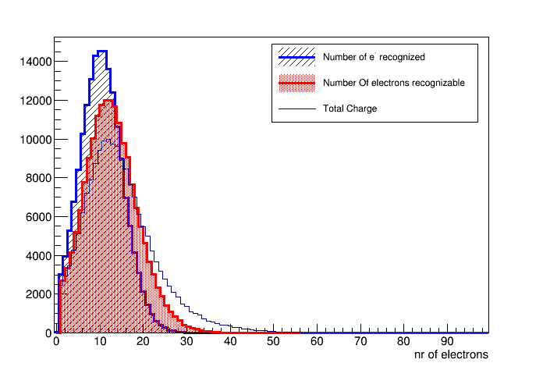


Peak finder performances
Simulation studies
<peaks> = 10.5 ± 4.8
The j-th e⁻ is recognizable when :
t_{j+1} - t_{j} > tcut with tcut 0.6 ps (1.2bin)
Peak amplitude > threshold
Using these conditions, the nr of skipped electron is 2.5
< e- reco> = 12.4 ± 6.0
$$ε= \frac{e^{−} found}{e^{−} recogn}=86.7\%$$
< e- gen> = 14.9 ± 8.4
$$ε= \frac{e^{−} found}{e^{−} gen}=70.5\%$$

Slide 4
Convert peaks in cluster clusterization
How to convert found peaks in clusters?
Look to the time difference between electrons belonging to different clusters and those to the same cluster
Event by event plot the difference
t_{i} - t_{i+1} Vs t_{i}

Slide 5


Cut into slices along x – axis and fit with a double exponential function
$f\left(t\right)=Ae^{−t/τ1}$ + B $e^{−t/τ2}$
τ1 described time distance for different clusters
τ2 described time distance for same cluster
In each slice calculate the right timing cut as the time value that allow to have:
$$\frac{NCls counted}{NCls MC }=1$$
t_{cut}

Slide 6
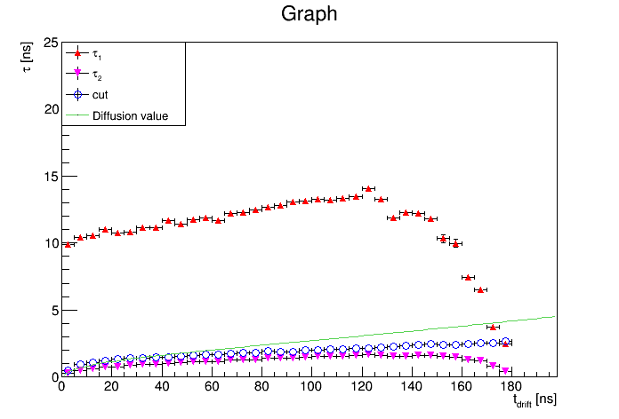
The association of electrons in clusters is based on the time difference between consecutive electrons.
Electrons belonging to same cluster are separated by time differences which are compatible with single electron diffusion.
e- belonging to
different
clusters
Longitudinal Diffusion
values used for the
smearing
MC simulation
Best fit value is the time value that
allow to have Cls_{MC} = Cls_{reco}
e- belonging to the
same cluster

Slide 7
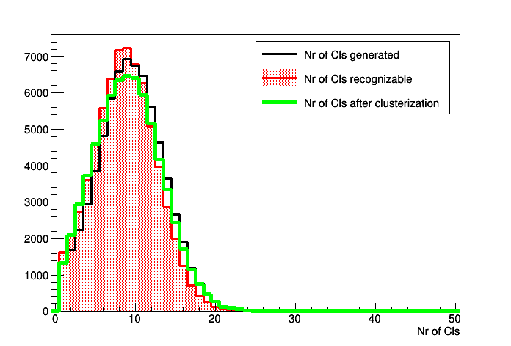


Performances
Time difference between MC generated cluster and reconstructed cluster
mean
RMS
Cls gen
9.66
4.04
Cls recogn
8.77
3.83
Cls found
9.11
4.13
ns
$$ε= \frac{Cls found}{Cls recogn}=103.9\%$$
$$ε= \frac{Cls found}{Cls gen}=94.3\%$$

Slide 8
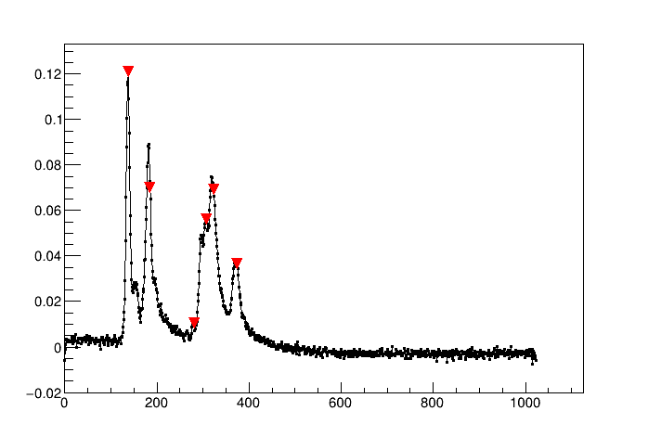
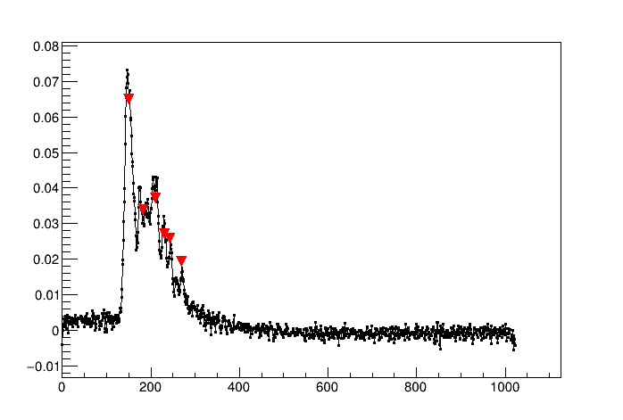
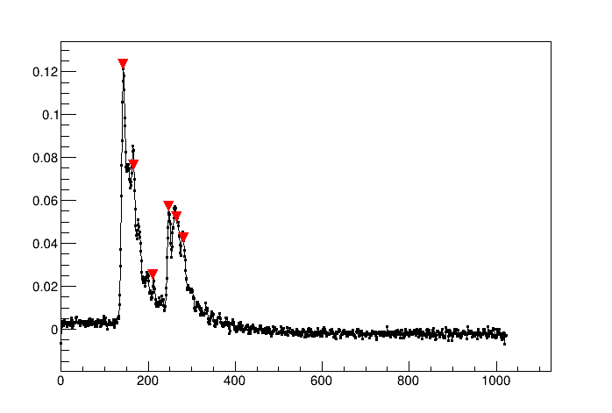
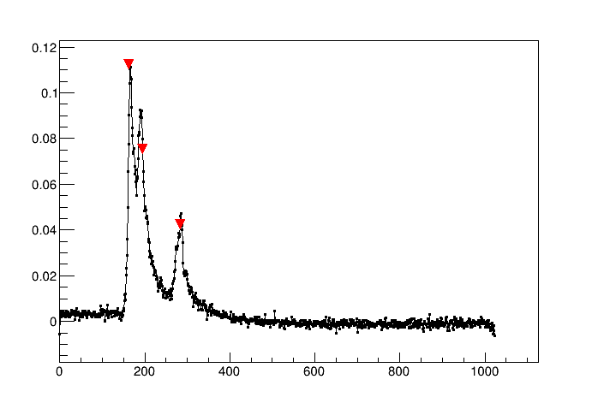
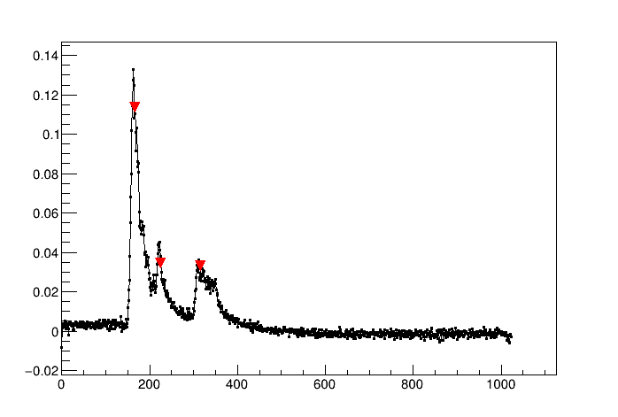
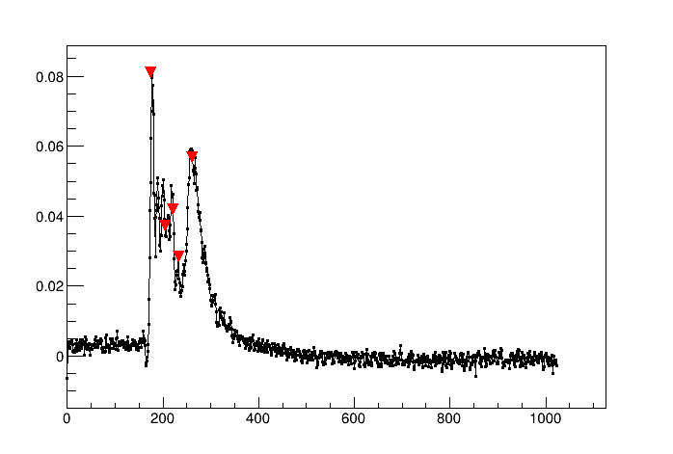
Test beam data
The goal is to implement the peak finder algorithm on the waveforms acquired with the test beam.
ch4
ch5
ch6
45°
Nominal HV +20
1cm drift tubes
All the parameters need to be tuned
ch7
ch8
ch9

Slide 9
Conclusions
A complete code analysis has been implemented to perform several studies on drift tube waveforms (integral, rms, max and min distribution….). The peak finder algorithm had been implemented in this code.
What to do?
Convert the binary file in a root file whose structure need to be suitable for the analysis code (almost done).
Check the analysis code and set up some parameters and features to be feasible for the drift tube waveforms.

Slide 10
The identification of every single structure produced in the signal by the drifting electrons is not a simple task.
we have to elaborated a peak finding algorithm based on the following statements:
the rise and falling time of an elementary pulse are constant and depend only from the experimental set up. They need to be measured;
the variance of the Gaussian noise,σ_{noise}, again function of the experimental set up can be measured in absence of signal, i.e. by using the digitized bins of the signal just before the trigger;
a set of bins is a candidate peak if, over an interval equivalent to the rise time, it presents a rising pulse height larger than 6σ_{noise} with respect to the previous set of bins;
a candidate peak is promoted if, over an interval equivalent to the falling time, it presents a falling pulse height larger than 6 σ_{noise} with respect to the following set of bins
a set of peaks is grouped into a cluster if their relative delays are consistent with the spread in the electron diffusion for their average drift distance;
sets of peaks are separated in different clusters if their average distance is consistent with the mean cluster separation for that particular impact parameter and their average drift distance

