Slide 1
Latest Progress in Geant4 Simulation of HCAL
Dejing Du, Yong Liu, Baohua Qi
December 8, 2021

Slide 2
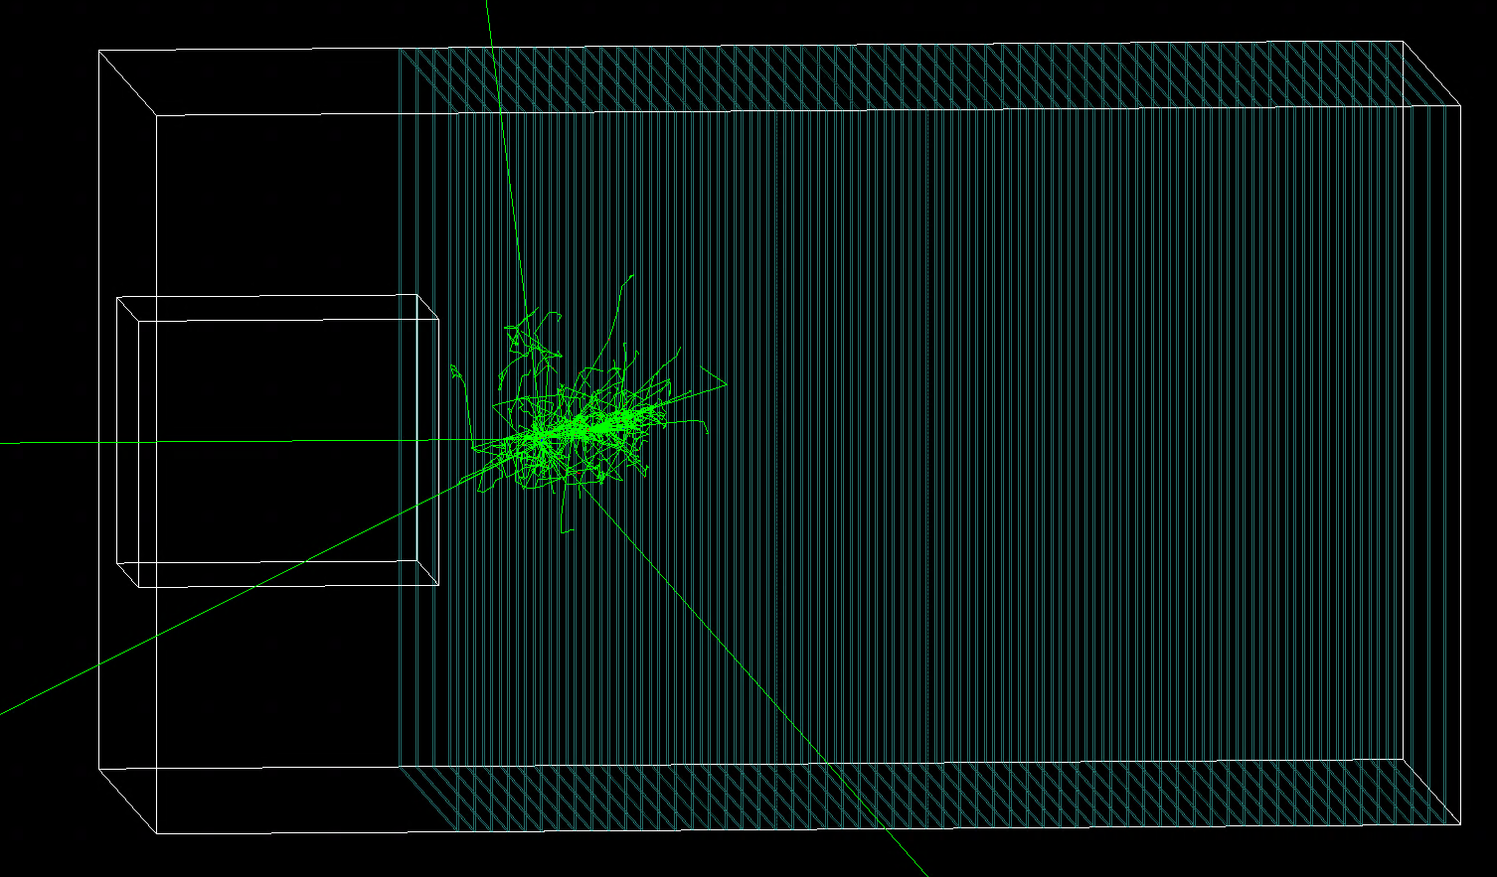
Scintillator HCAL: setup in Geant4 simulation
HCAL geometry
Transverse plane: $108×108{cm}^{2}$
60 longitudinal layers, each with
Scintillator: 3mm
PCB: 2.1mm
Absorber (steel): 20mm
1 GeV kaon0L
Scintillator materials
Plastic scintillator (polystyrene) as baseline reference
Scintillating glass: $25{SiO}_{2}−30B_{2}O_{3}−10{Al}_{2}O_{3}−34{Gd}_{2}O_{3}:1{Ce}^{+}$
density = 4.94 g/cm3
Note: HCAL with 40 layers in CEPC CDR as baseline.
Hereby use 60 layers to evaluate leakage effects

Slide 3
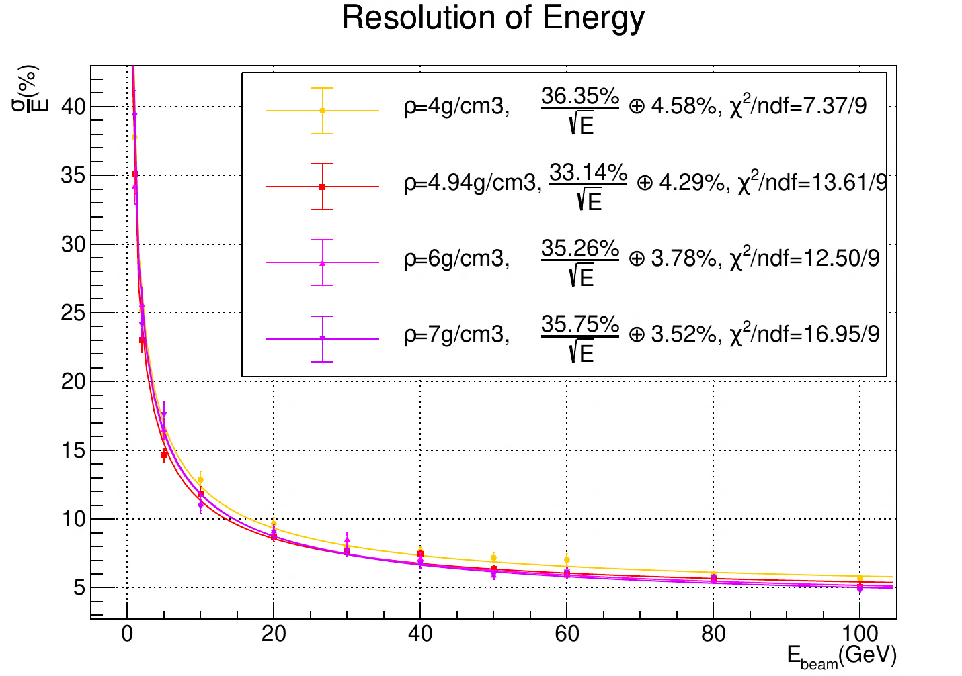
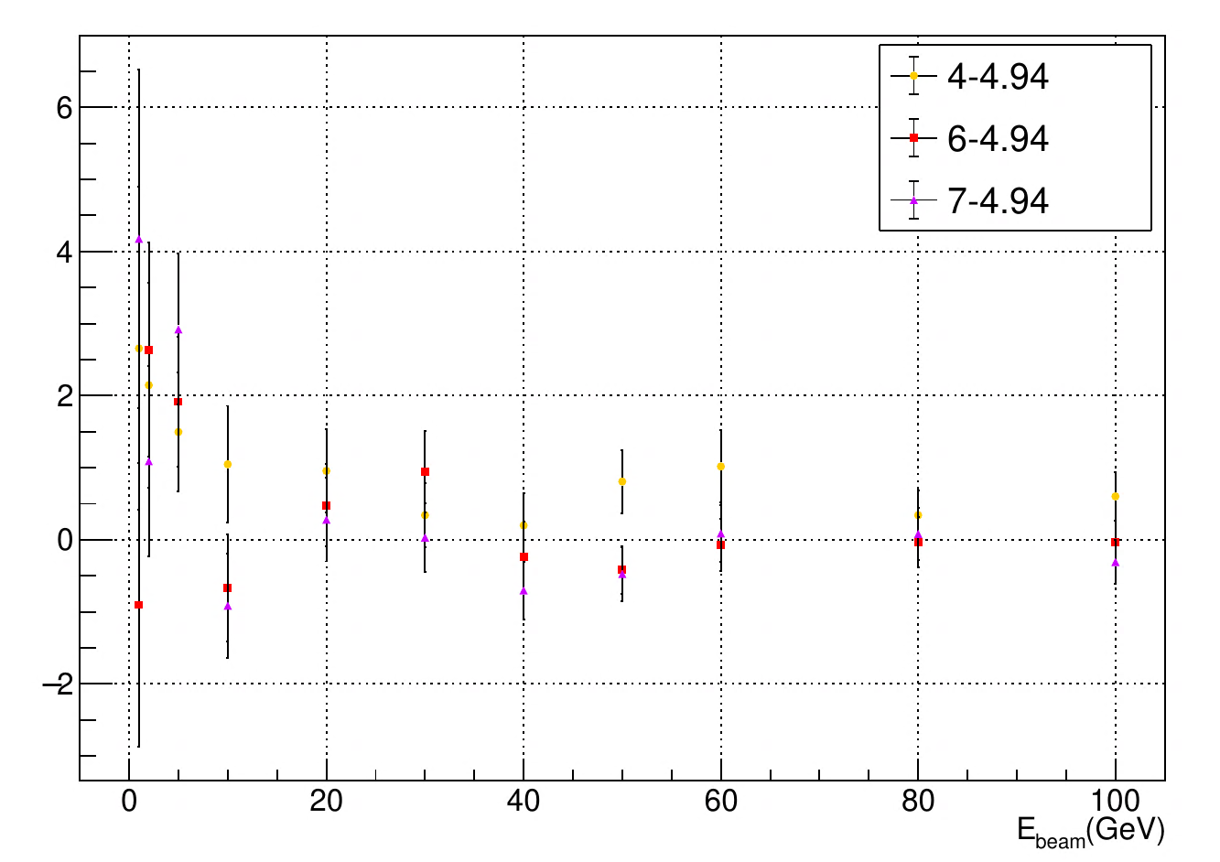
HCAL with scintillating glass
Impact of density for energy resolution
Birks’ constant, energy threshold and timing cut not included
Incident particle: kaon0L (1-100GeV)

Slide 4
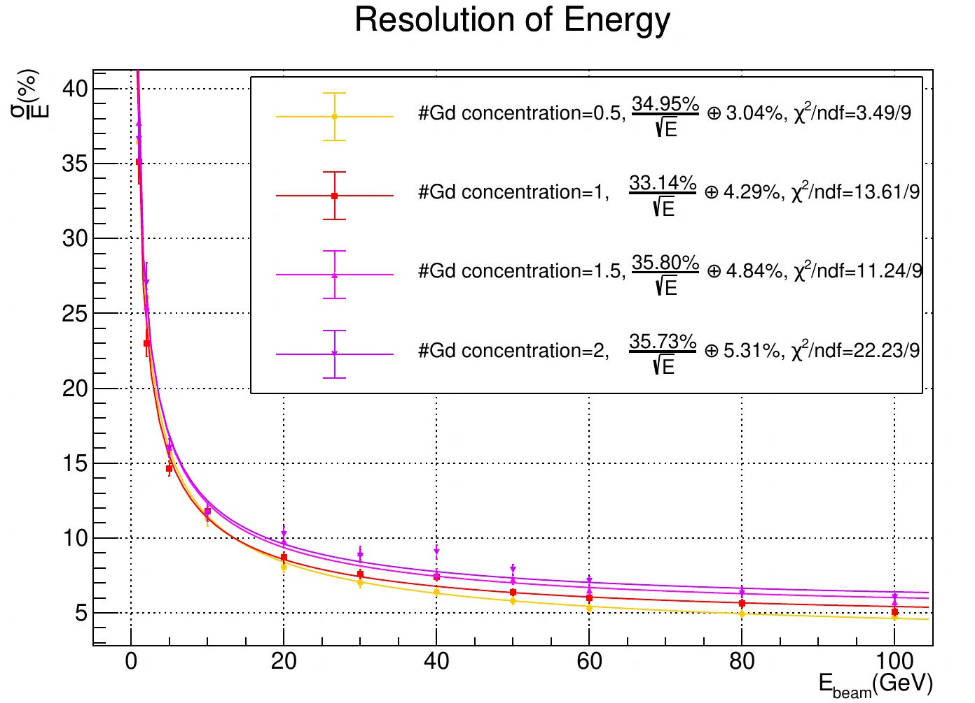
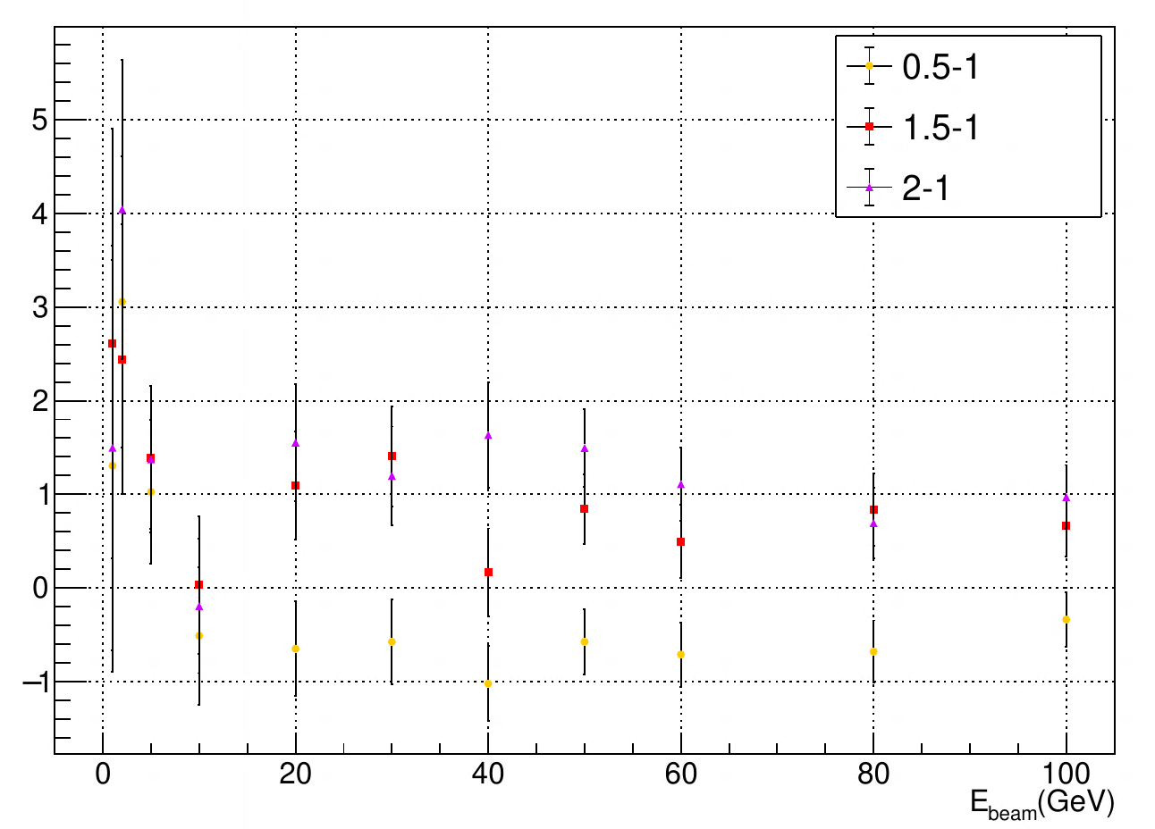
HCAL with scintillating glass
Impact of Gd concentration for energy resolution
Birks’ constant, energy threshold and timing cut not included
Incident particle: kaon0L (1-100GeV)
$$25{SiO}_{2}−30B_{2}O_{3}−10{Al}_{2}O_{3}−34{Gd}_{2}O_{3}:1{Ce}^{+}$$

Slide 5
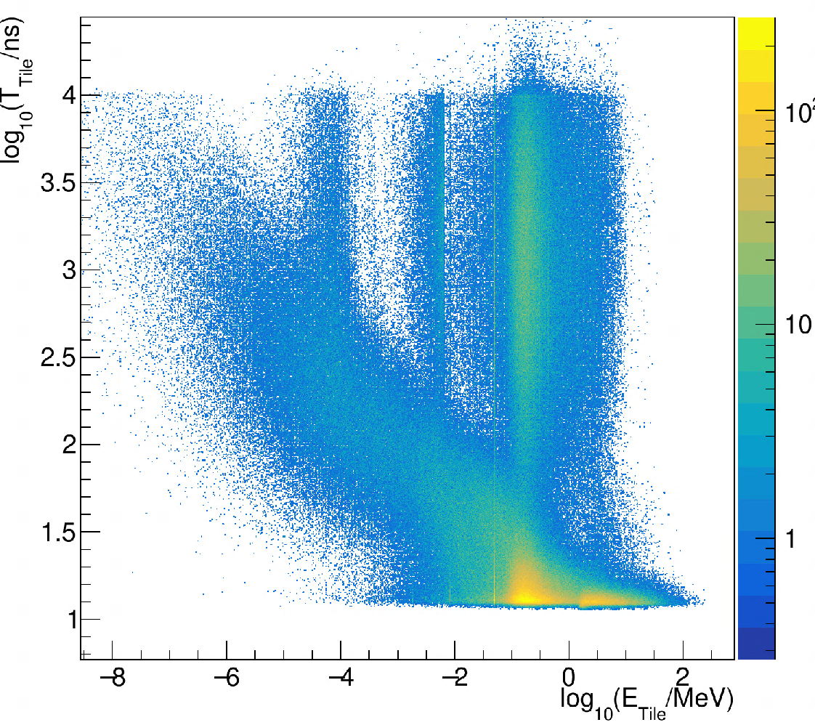
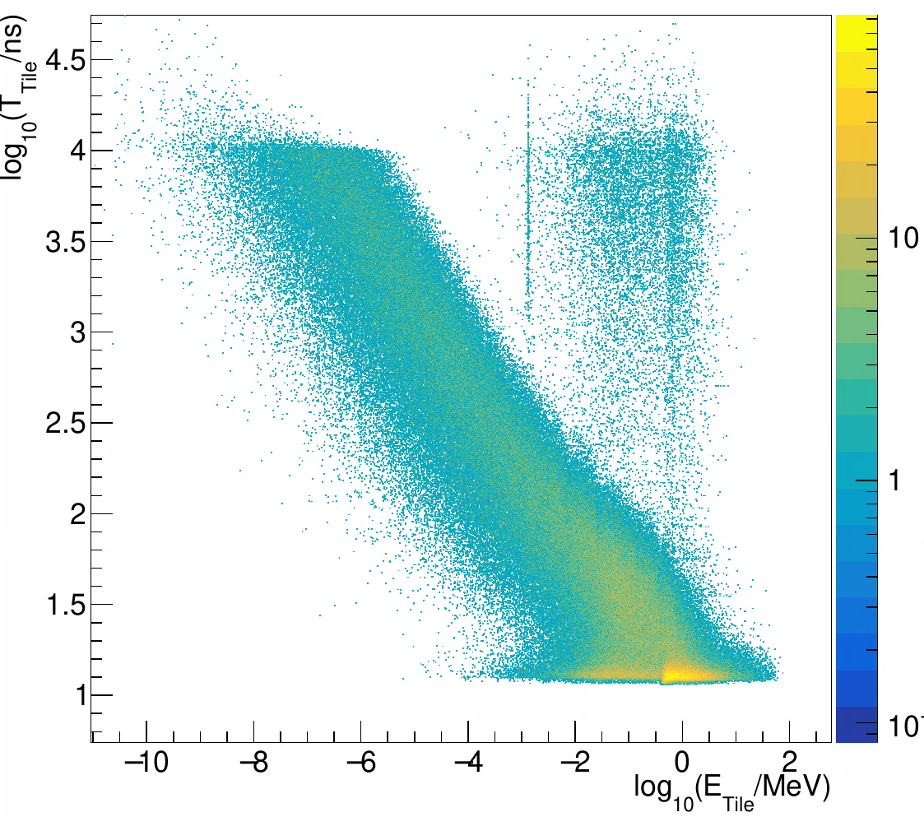
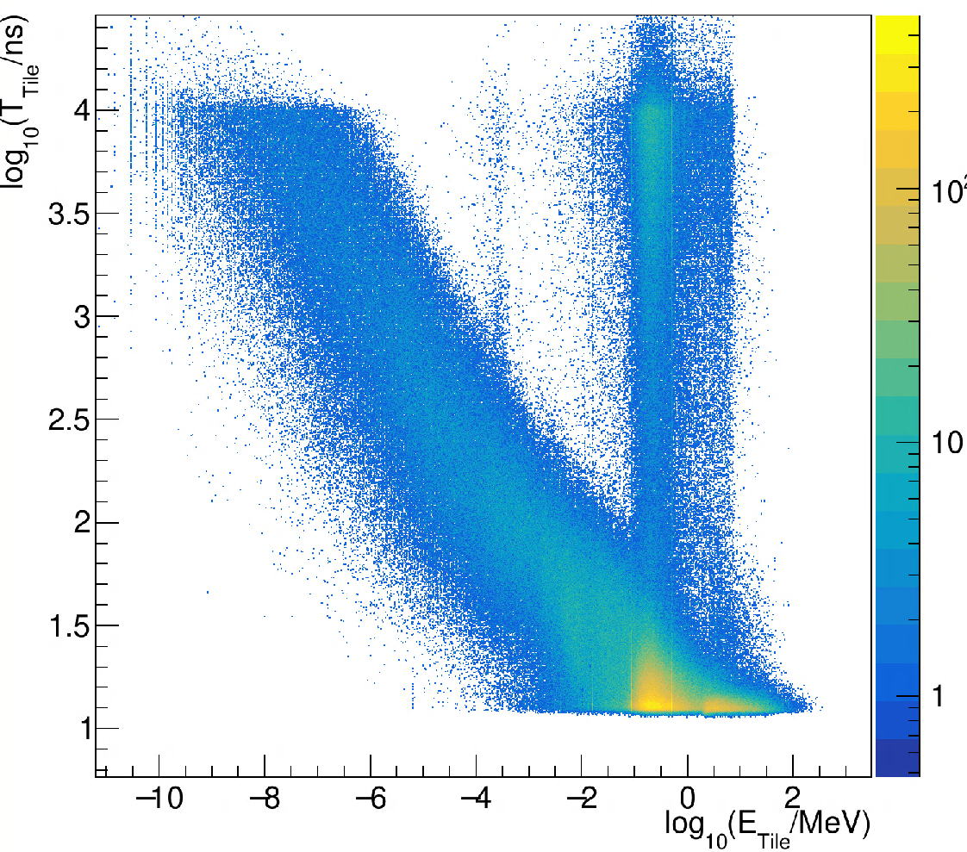
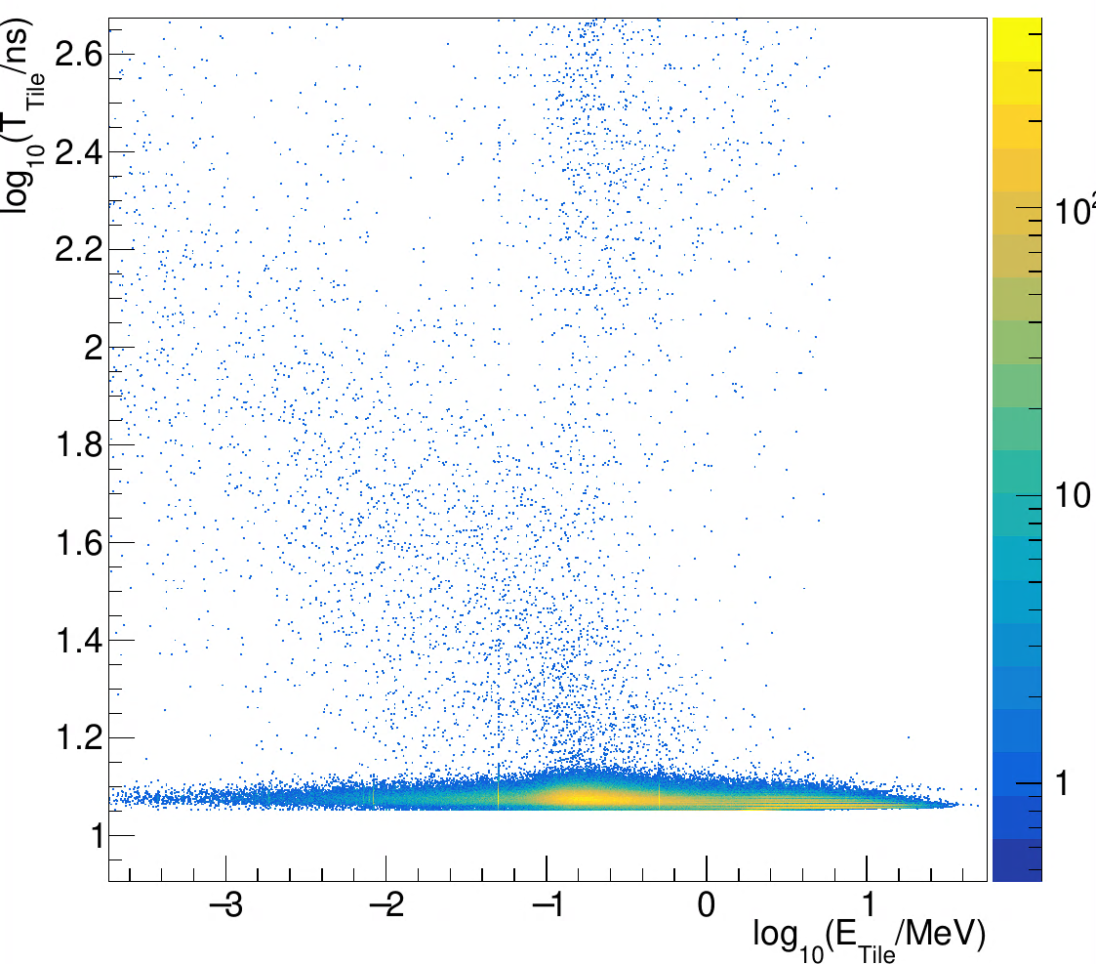
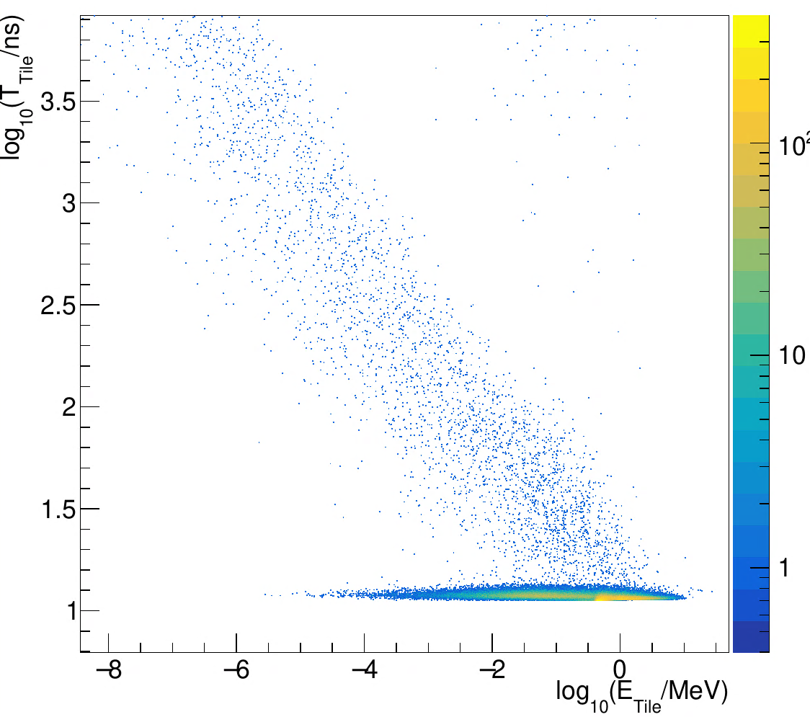
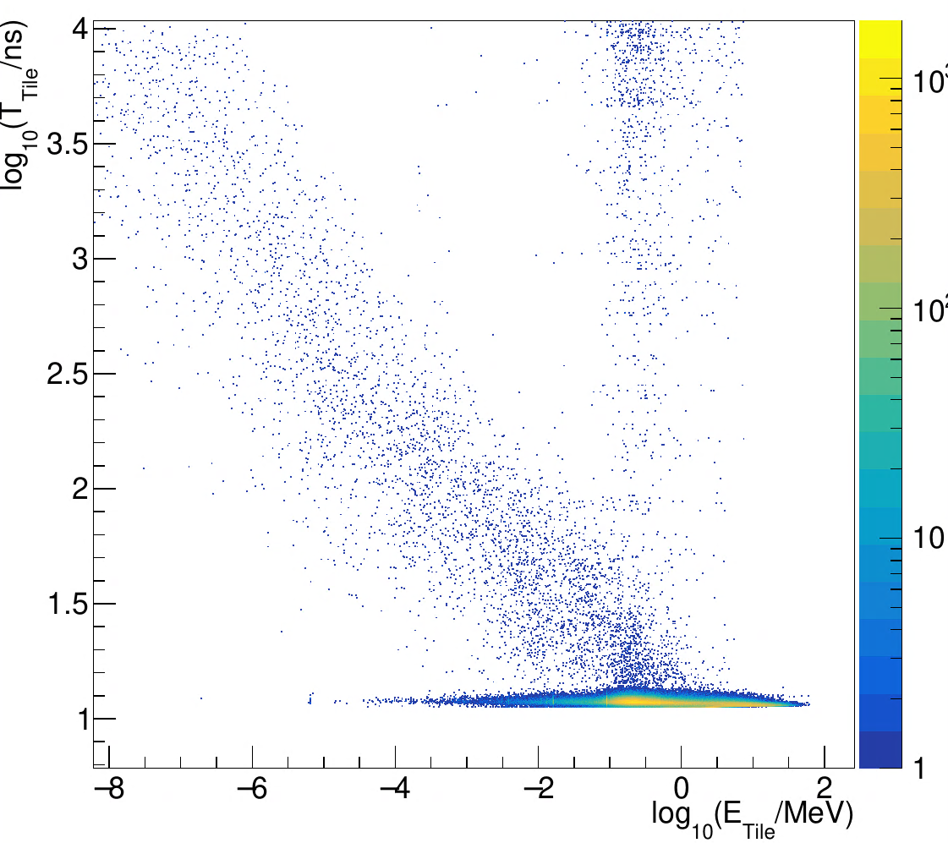
HCAL: Tiles time & energy distribution
Birks’ constant, energy threshold and timing cut not included
Incident particle: kaon0L and e- (1GeV)
Scintillating Glass
Plastic Scintillator
BGO
kaon0L
e-

Slide 6
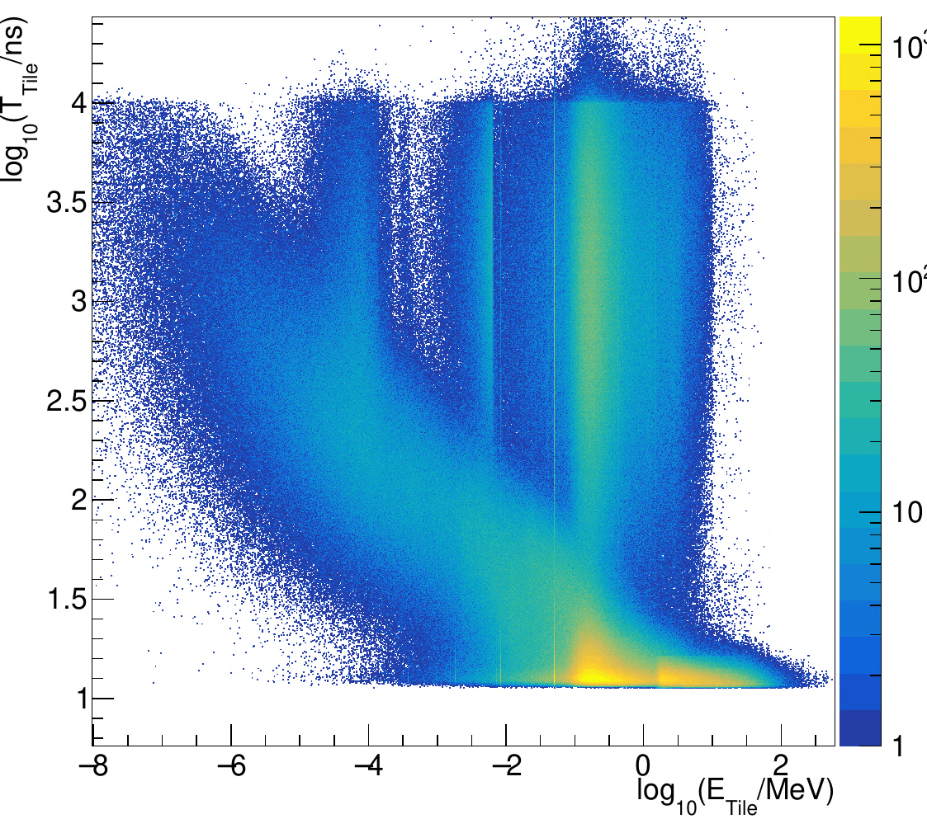
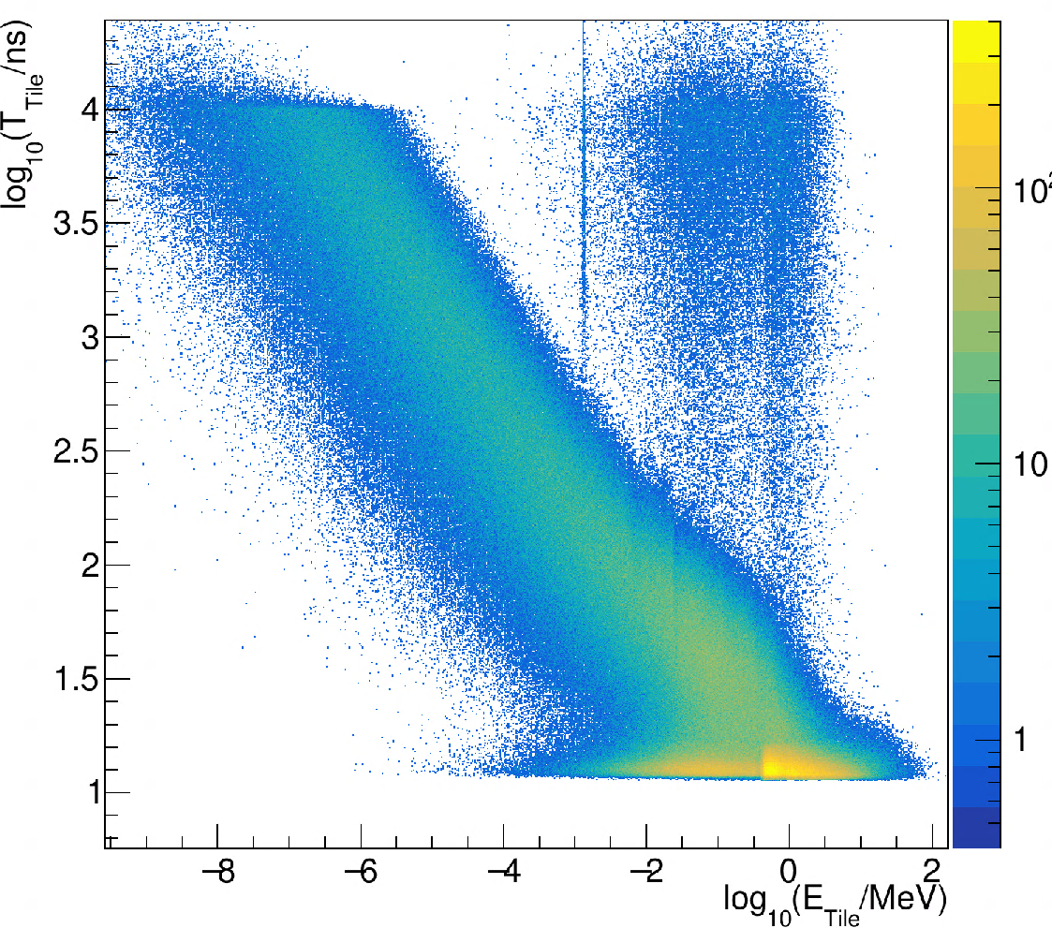
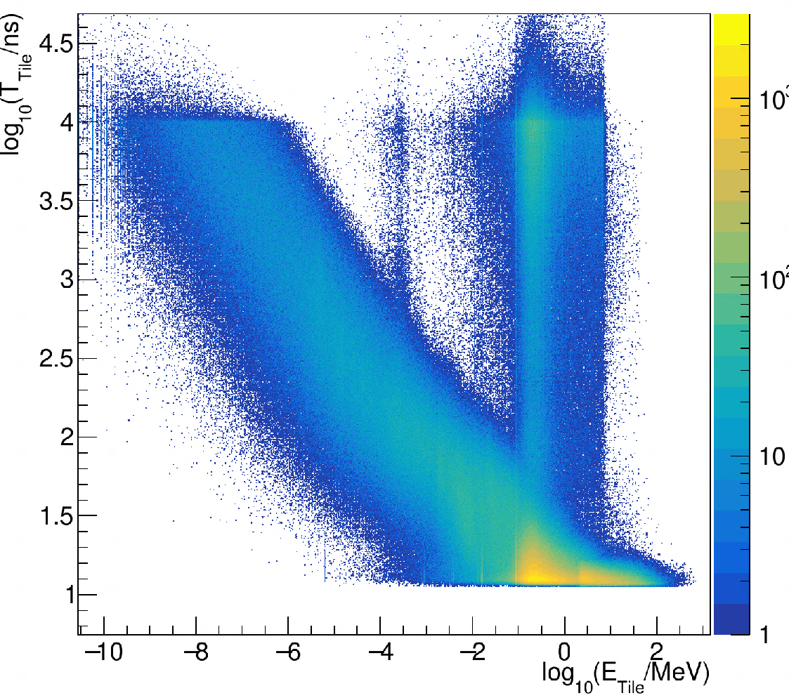
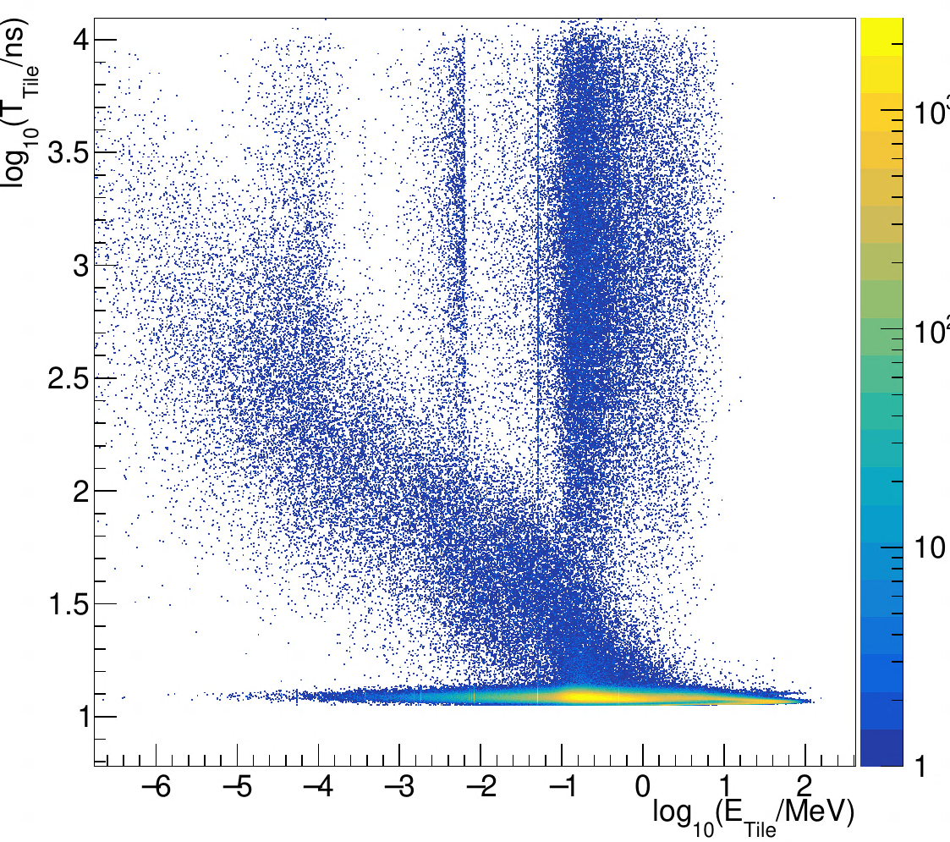
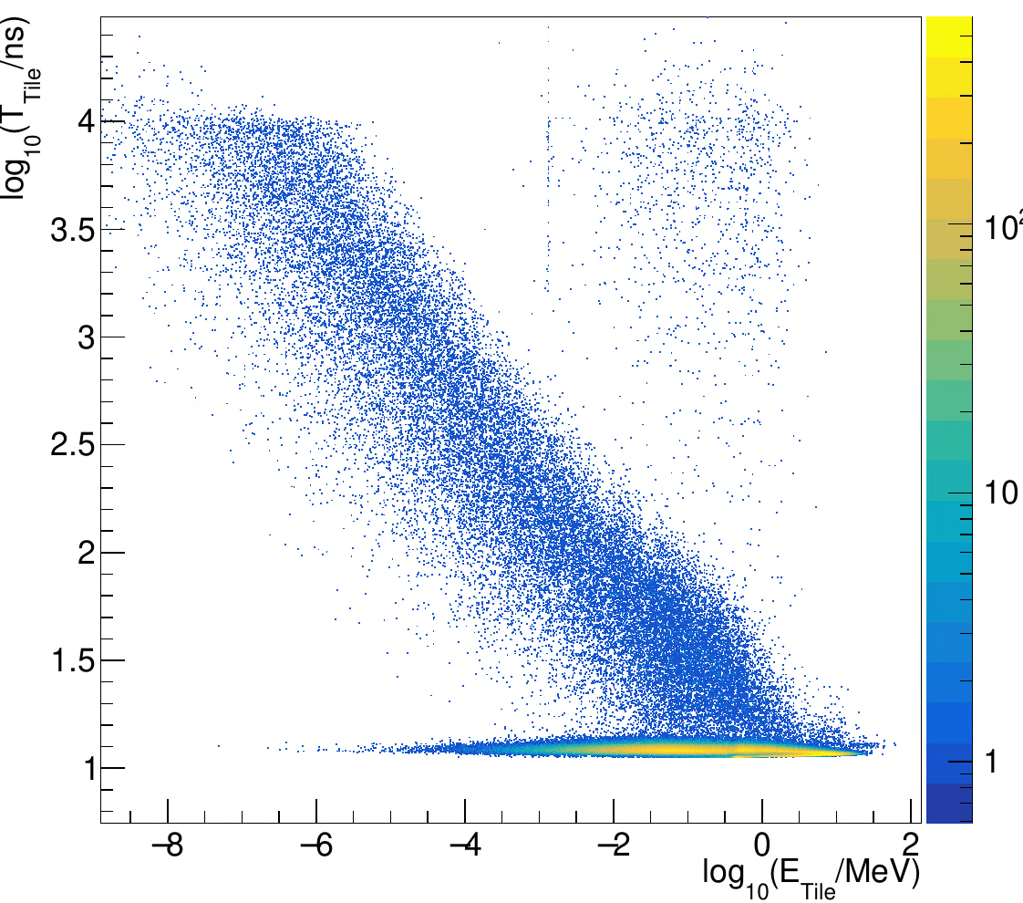
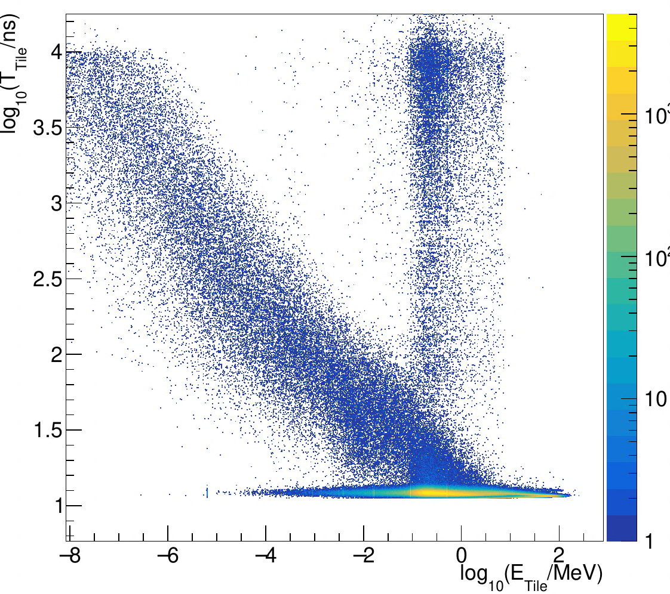
HCAL: Tiles time & energy distribution
Birks’ constant, energy threshold and timing cut not included
Incident particle: kaon0L and e- (10GeV)
Scintillating Glass
Plastic Scintillator
BGO
kaon0L
e-

Slide 7
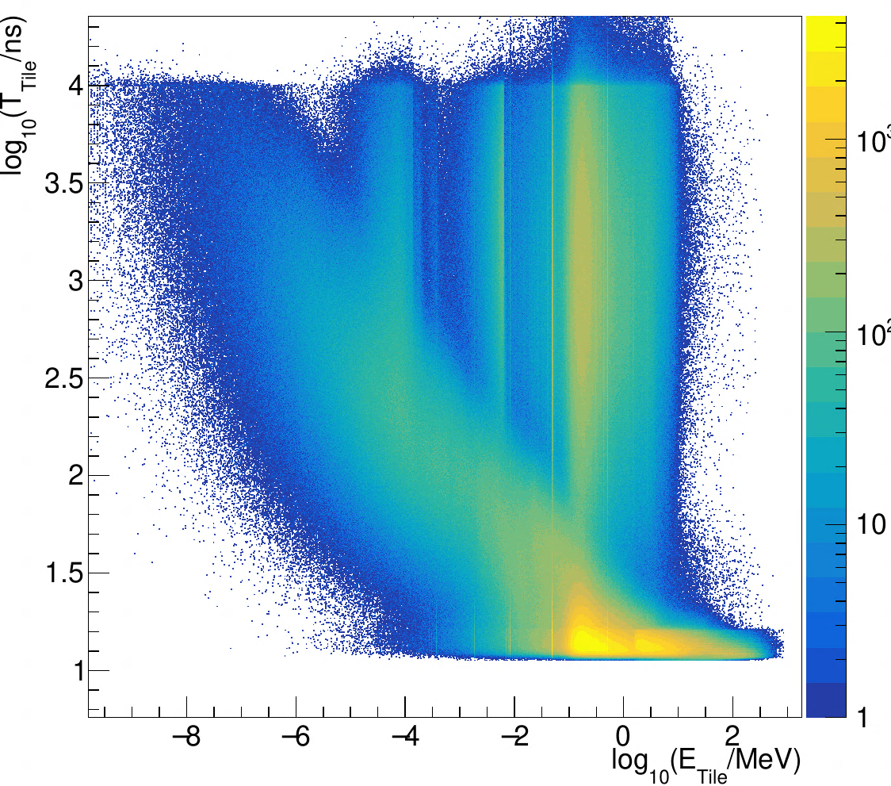
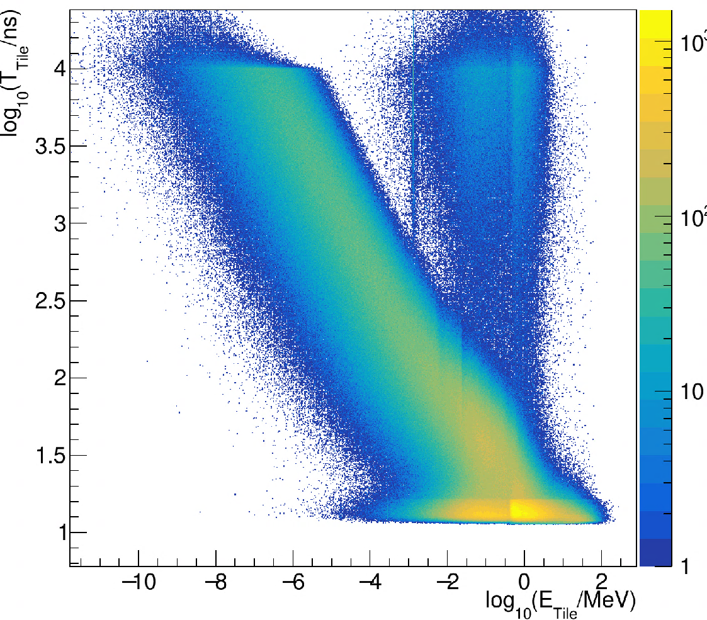
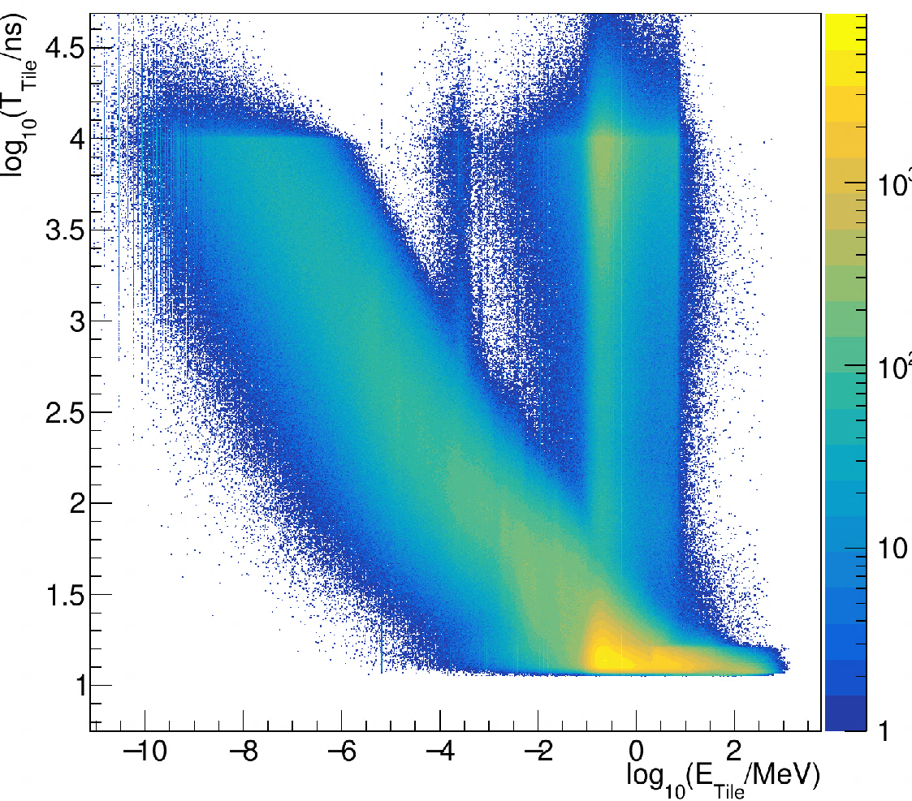
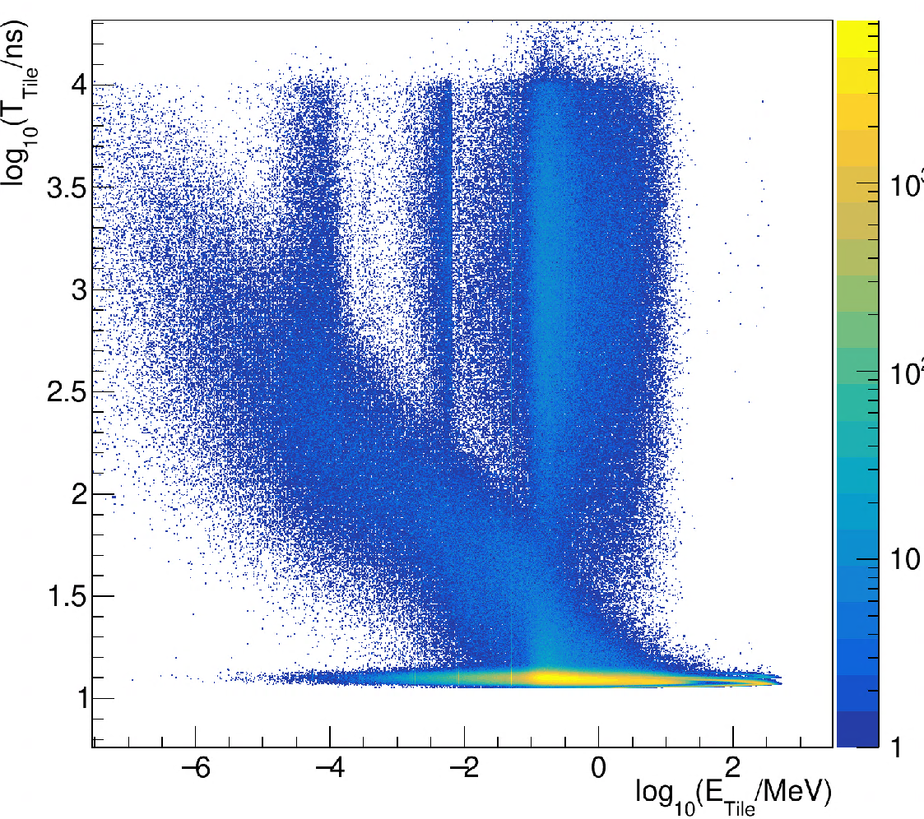
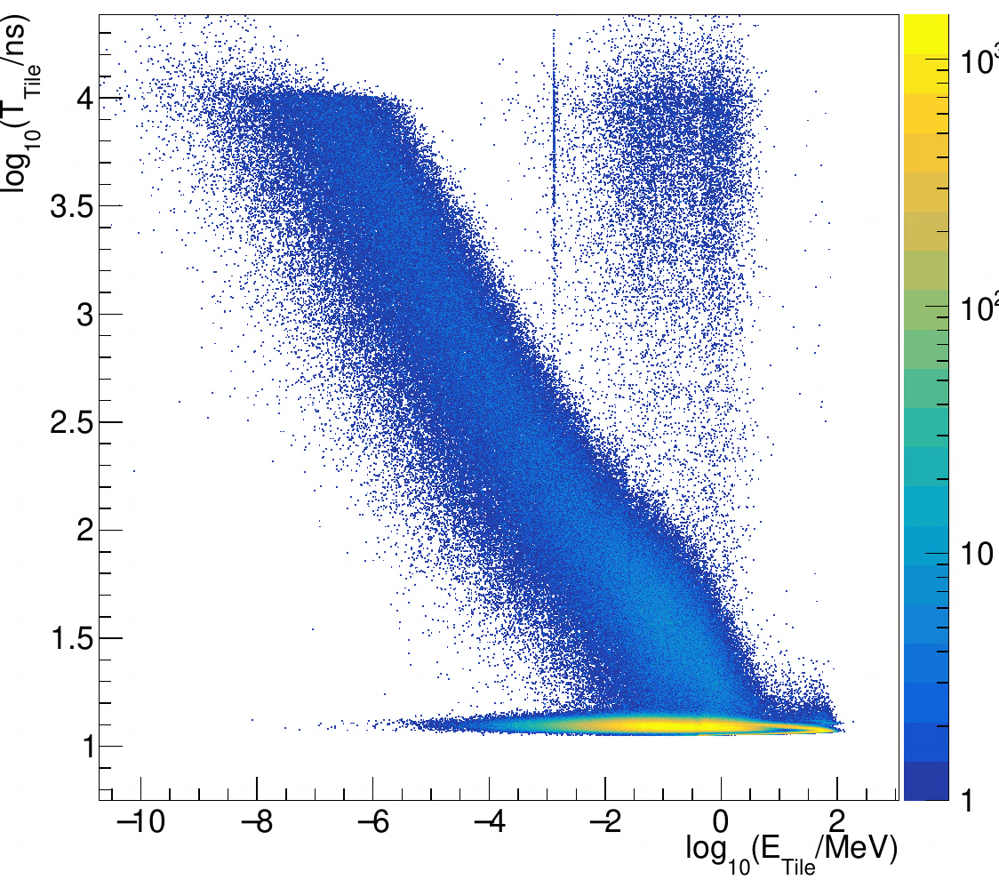
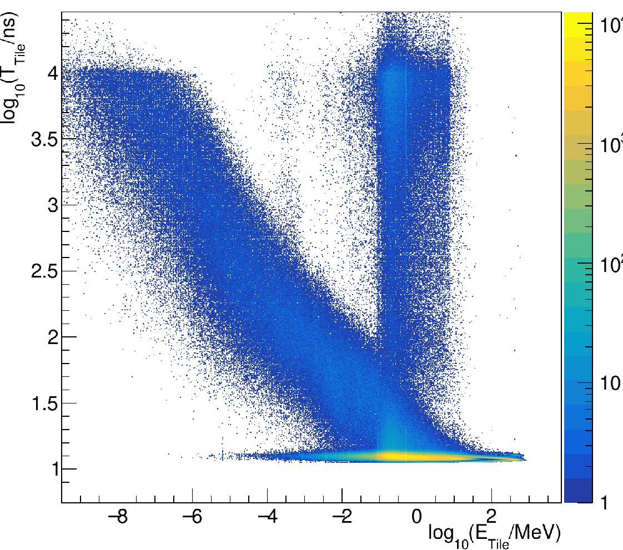
HCAL: Tiles time & energy distribution
Birks’ constant, energy threshold and timing cut not included
Incident particle: kaon0L and e- (100GeV)
Scintillating Glass
Plastic Scintillator
BGO
kaon0L
e-

Slide 8
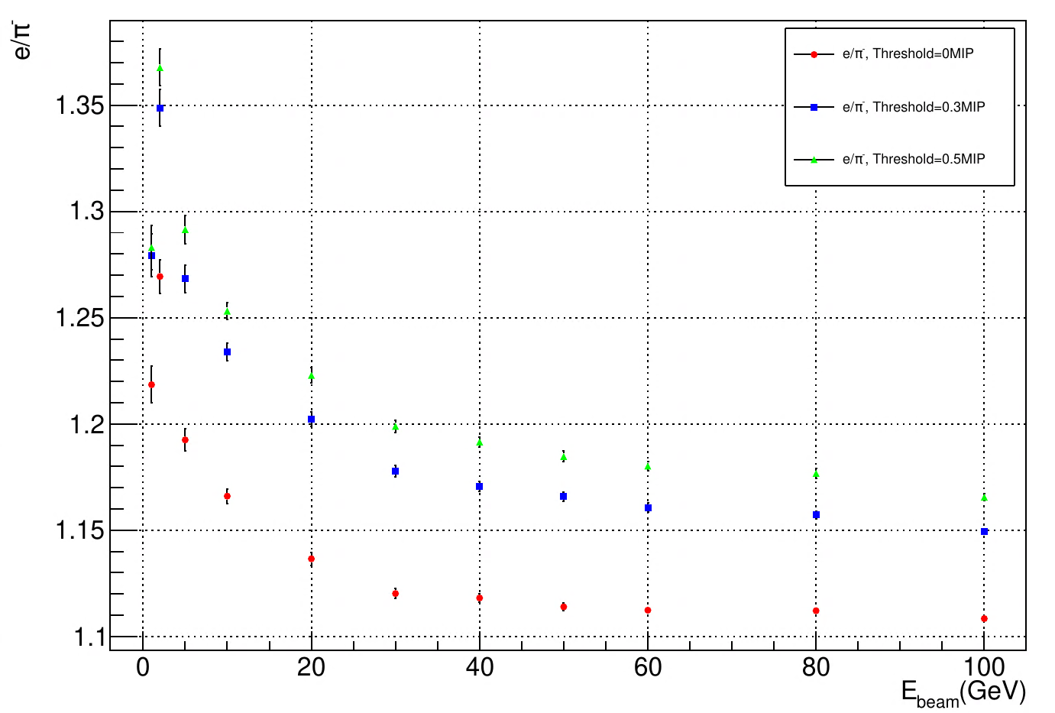
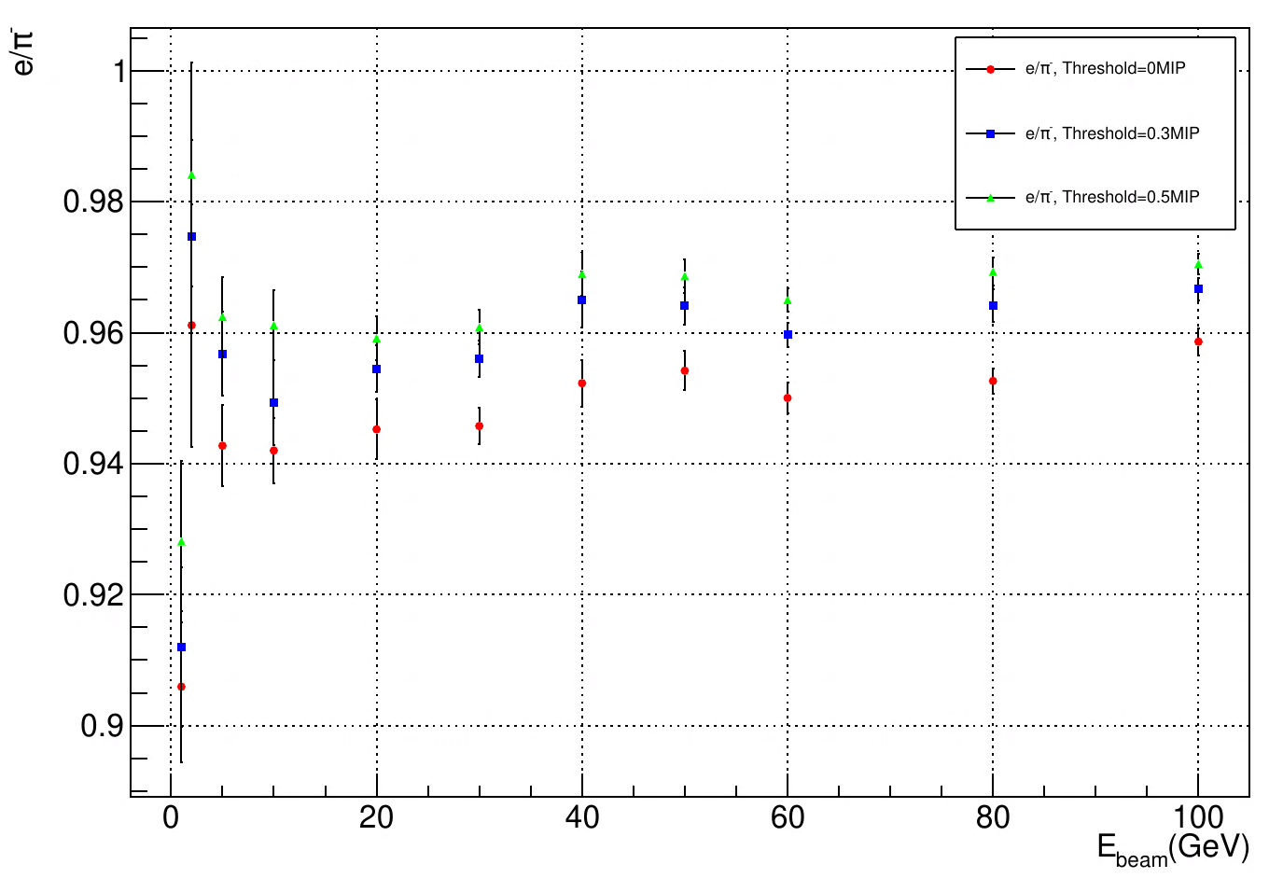
Scintillator HCAL: e/π- ratio
Impact of energy threshold for e/π- ratio
Birks’ constant and timing cut not included
Energy threshold: 0MIP, 0.3MIP, 0.5MIP
Scintillating Glass
Plastic Scintillator

Slide 9
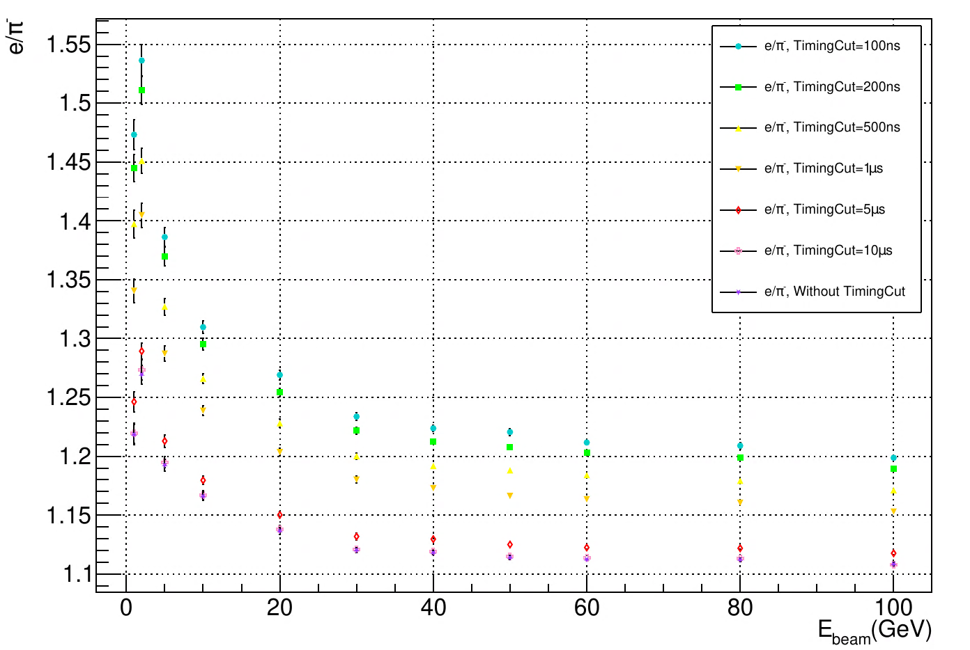
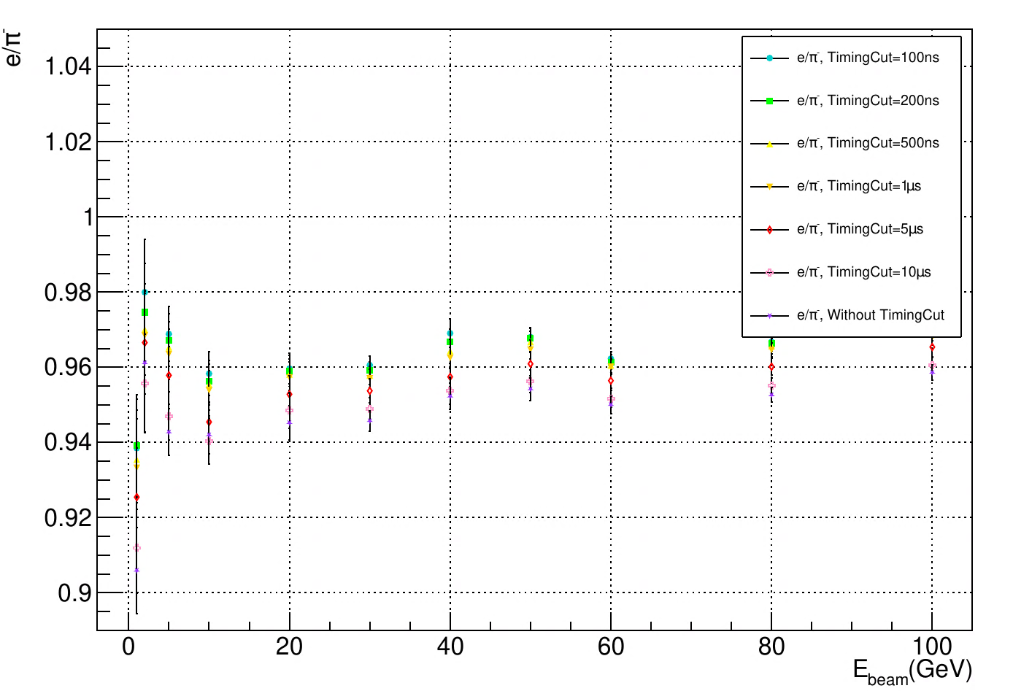
Scintillator HCAL : e/π- ratio
Impact of timing cut for e/π- ratio
Birks’ constant and energy threshold not included
Timing Cut: 100ns, 200ns, 500ns, 1μs, 5μs, 10 μs
Scintillating Glass
Plastic Scintillator

Slide 10
Part Ⅱ
Cosmic Ray Experiment of Scintillating Glass

Slide 11
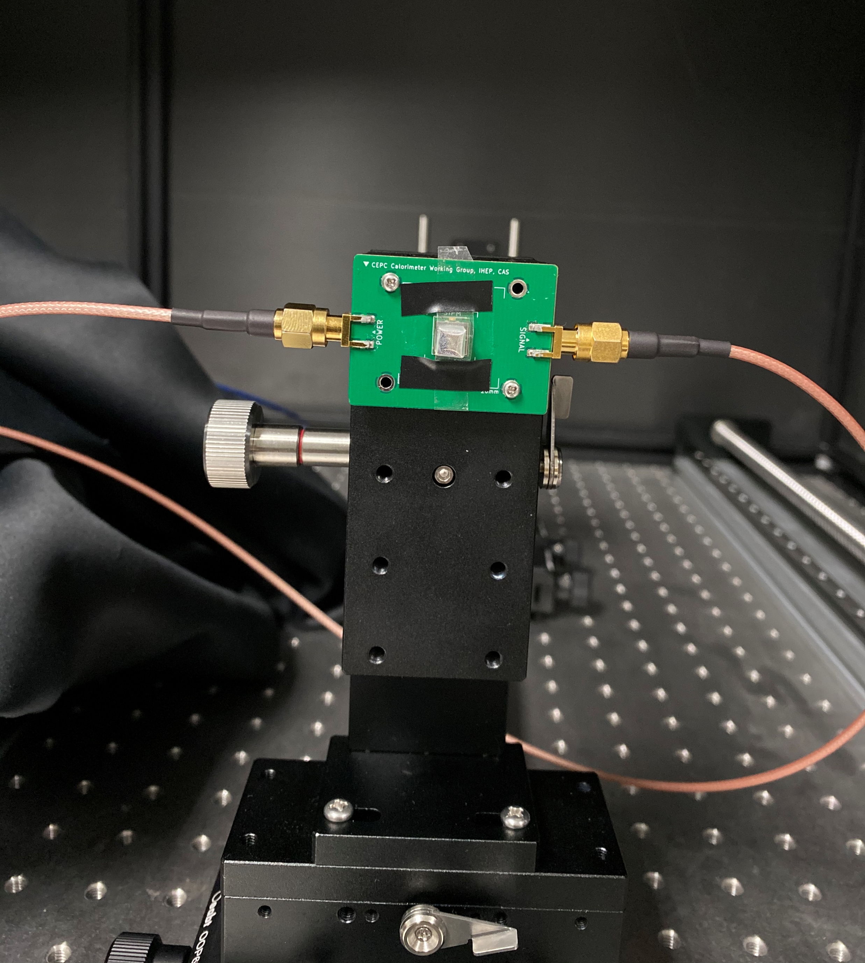
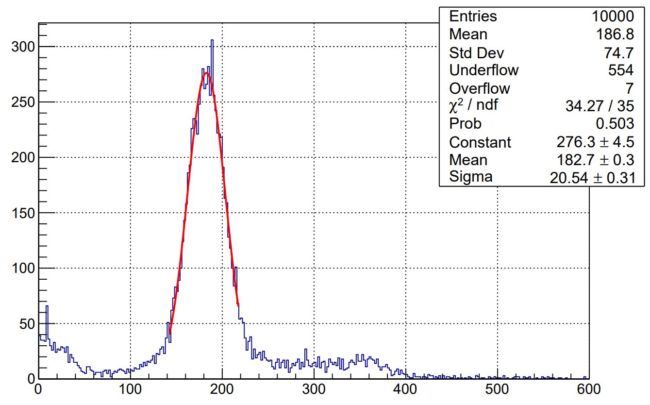
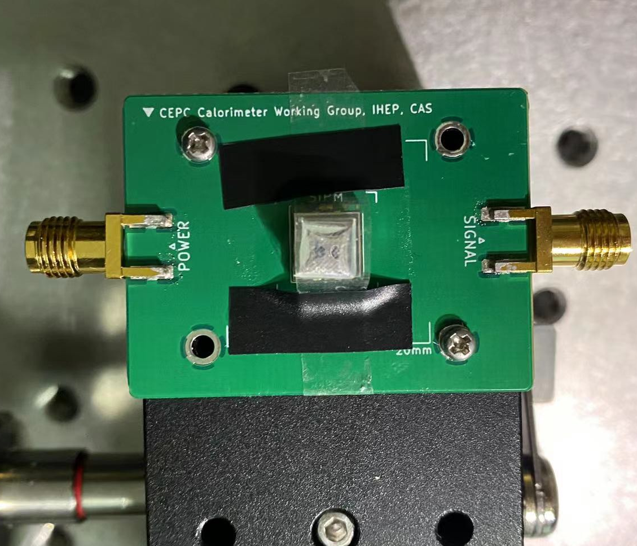
Cosmic Ray Experiment of Scintillating Glass
Sample: #7, ~ 4.5×4.5×3 mm3
Coupling of Sample and SiPM: Air
SiPM: single photon

Slide 12
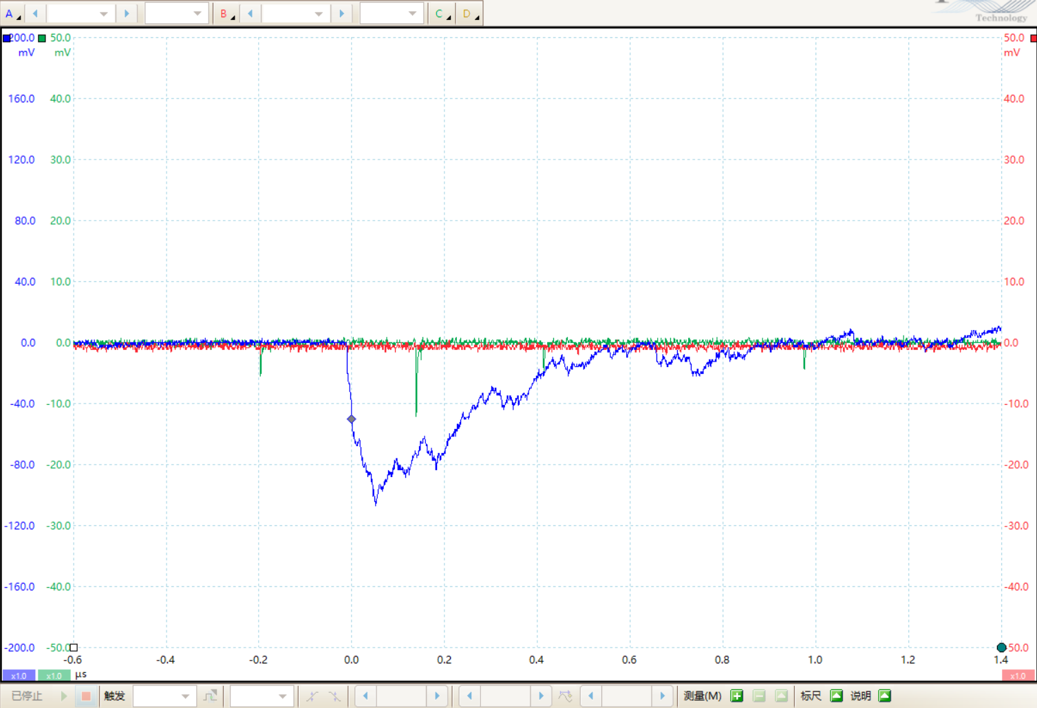
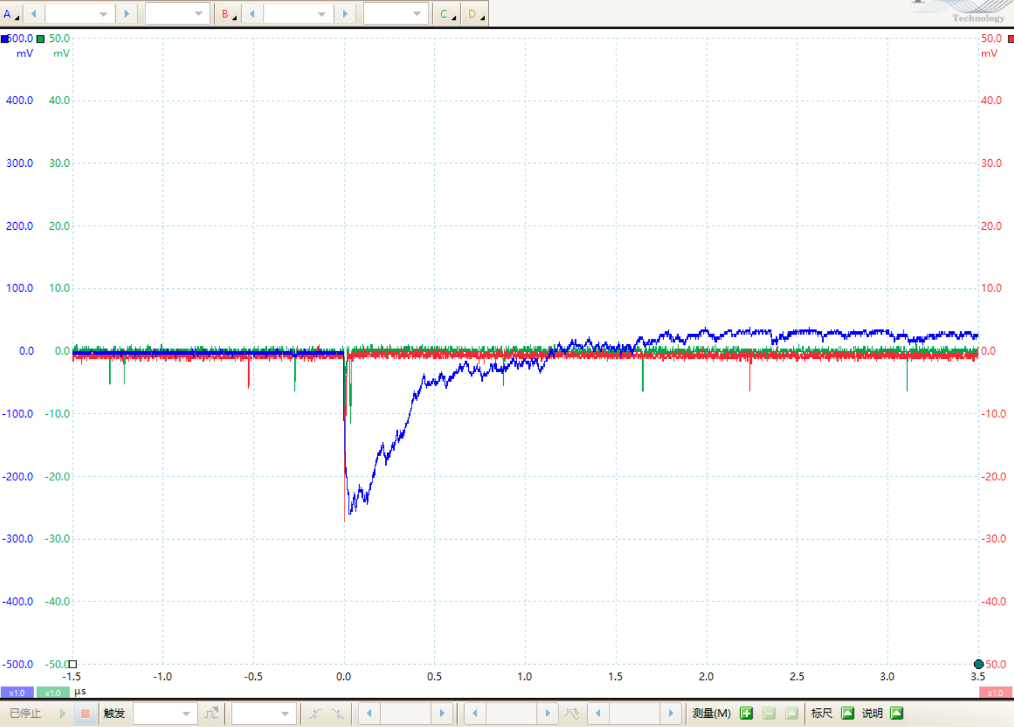
Cosmic Ray Experiment of Scintillating Glass
Auto trigger, 50mV

Slide 13
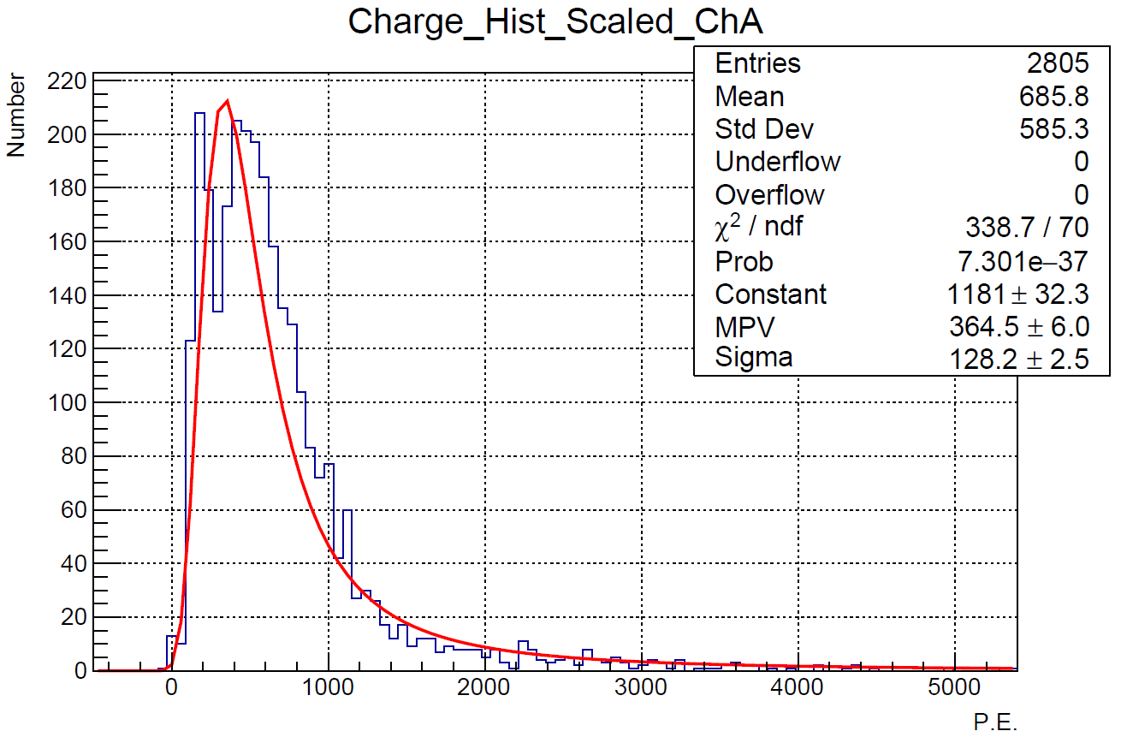
Cosmic Ray Experiment of Scintillating Glass
SiPM: single photon

