Slide 1

Hough Transformation in ECAL
Zhang Yang
05/Jan/2022

Slide 2

Outline
Motivation
Steps of Hough Transformation
  use local maximum
  do Hough transformation
  find peaks in Hough space
  output tracks
performance

Slide 3
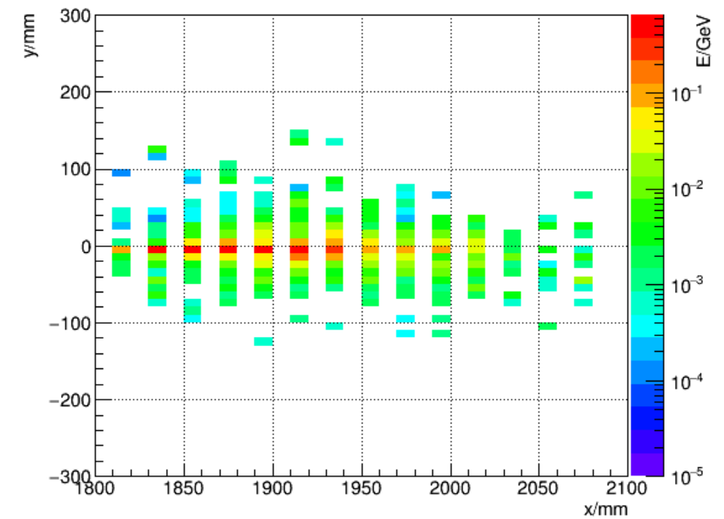
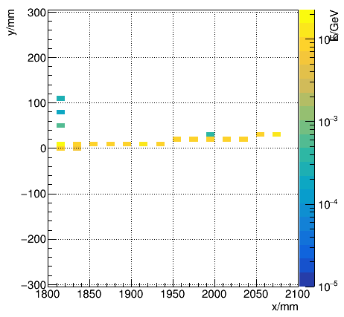
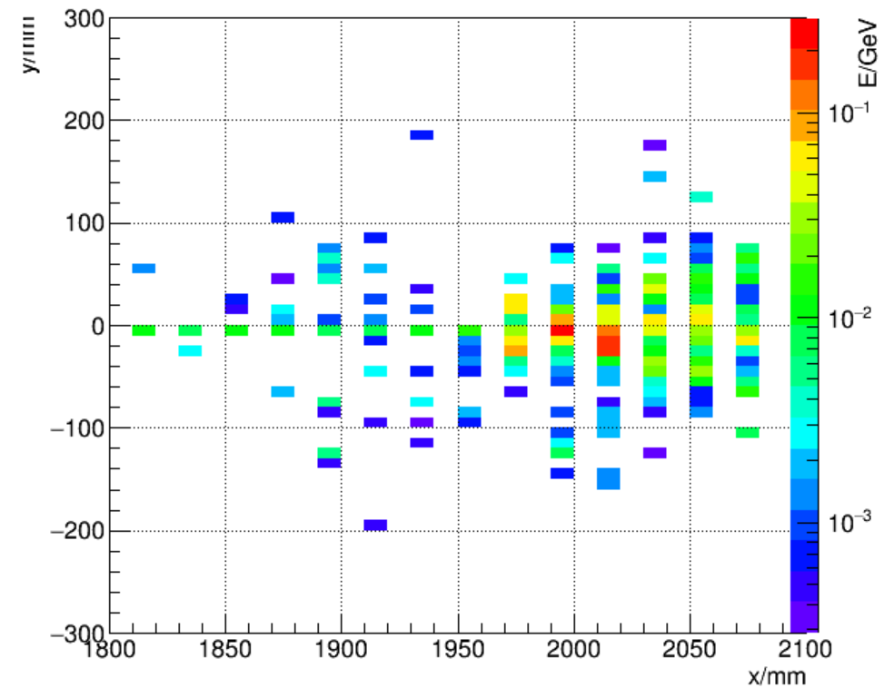
Motivation
To find every particle(shower) in ECAL
  find the core of EM shower
  find the track of MIP and hadronic shower
EM shower
MIP shower
hadronic shower

Slide 4
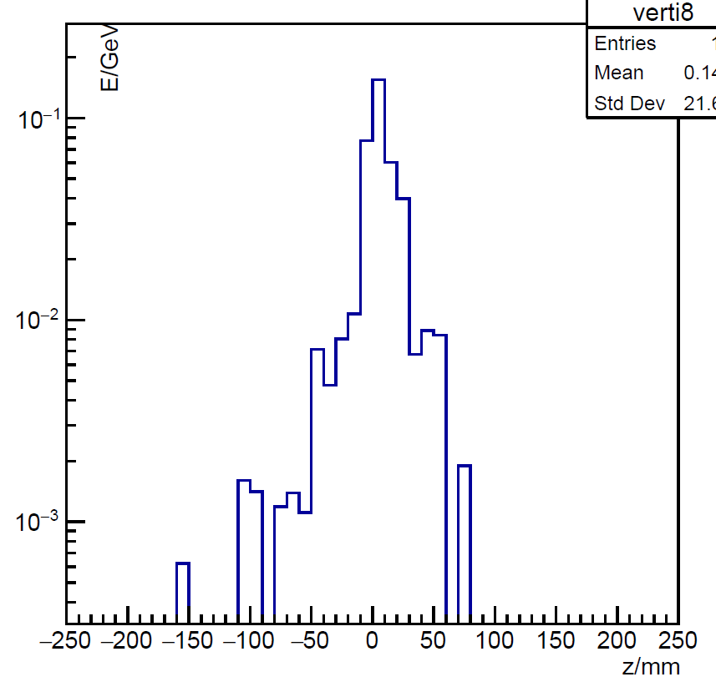
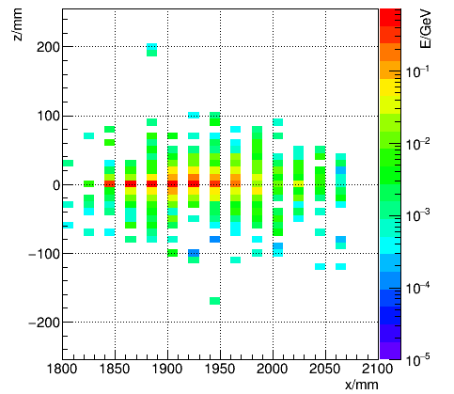
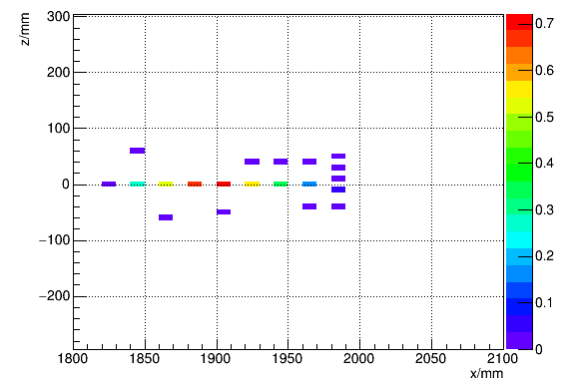
Steps: use local maximum
Too many hits in each events
Only use local maximums(>5MeV, greater than both sides)
Local maximum
5MeV

Slide 5
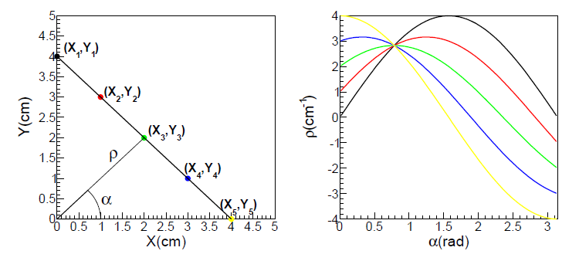
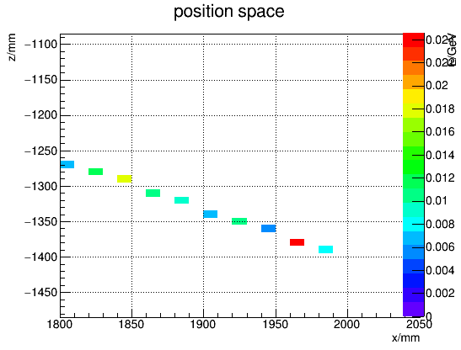
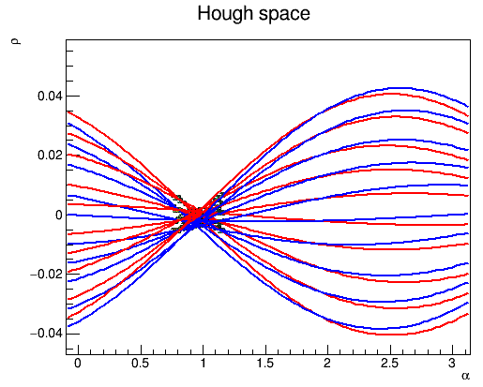
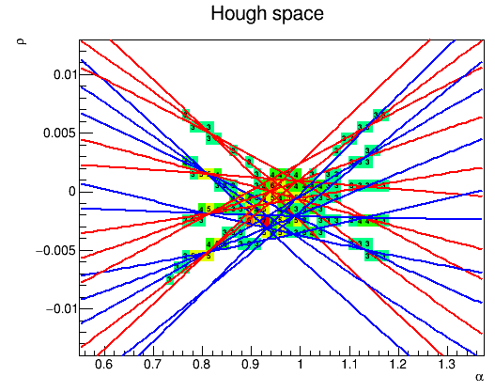

Steps: Do Hough transformation
Hough transformation:
  $ρ=x\cos{α}+x\sin{α}$
Most of the tracks are not “perfect” straight lines
  the Hough curves do not intersect so well

Slide 6
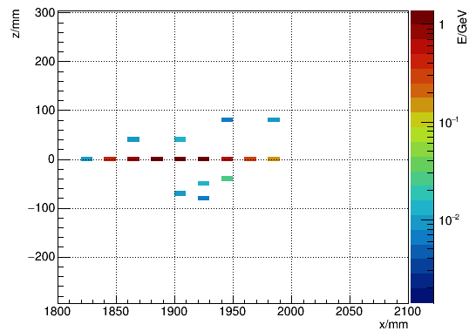
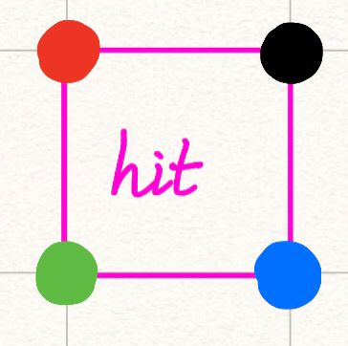
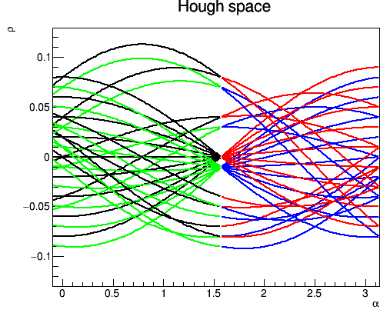
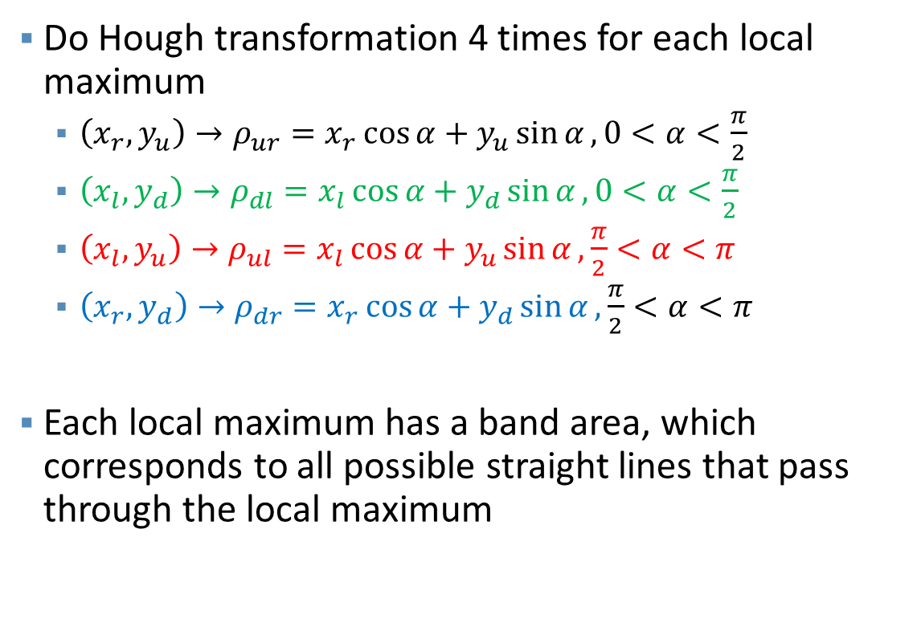
Steps: Do Hough transformation
Do Hough transformation 4 times for each local maximum
  $\left(x_{r},y_{u}\right)→ρ_{ur}=x_{r}\cos{α}+y_{u}\sin{α},0<α<\frac{π}{2}$
  $\left(x_{l},y_{d}\right)→ρ_{dl}=x_{l}\cos{α}+y_{d}\sin{α},0<α<\frac{π}{2}$
  $\left(x_{l},y_{u}\right)→ρ_{ul}=x_{l}\cos{α}+y_{u}\sin{α},\frac{π}{2}<α<π$
  $\left(x_{r},y_{d}\right)→ρ_{dr}=x_{r}\cos{α}+y_{d}\sin{α},\frac{π}{2}<α<π$
Each local maximum has a band area, which corresponds to all possible straight lines that pass through the local maximum

Slide 7
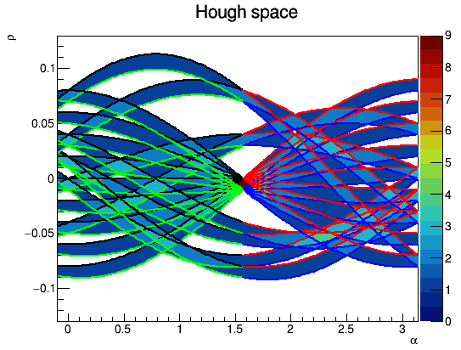
Steps: find peaks in Hough space
Divide Hough space into small bins(~800*800 TH2)
Fill these bins according to the band area
Find peaks in Hough space
Each peak corresponds to a track

Slide 8
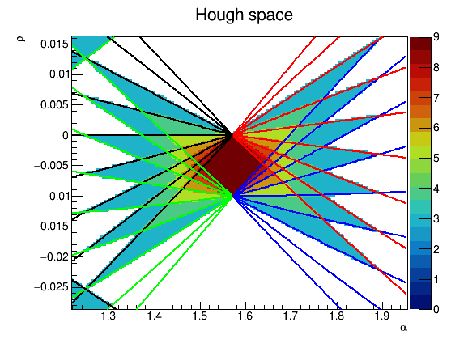
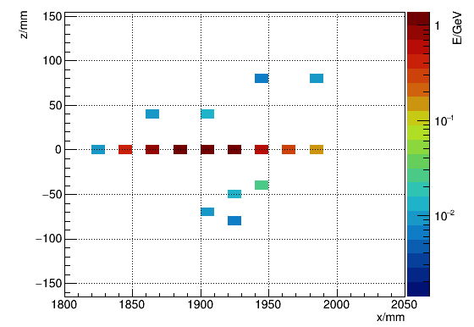
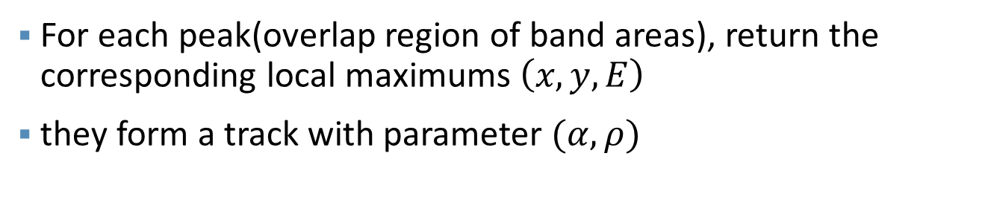
Steps: Output tracks
For each peak(overlap region of band areas), return the corresponding local maximums $\left(x,y,E\right)$
they form a track with parameter $(α,ρ)$

Slide 9
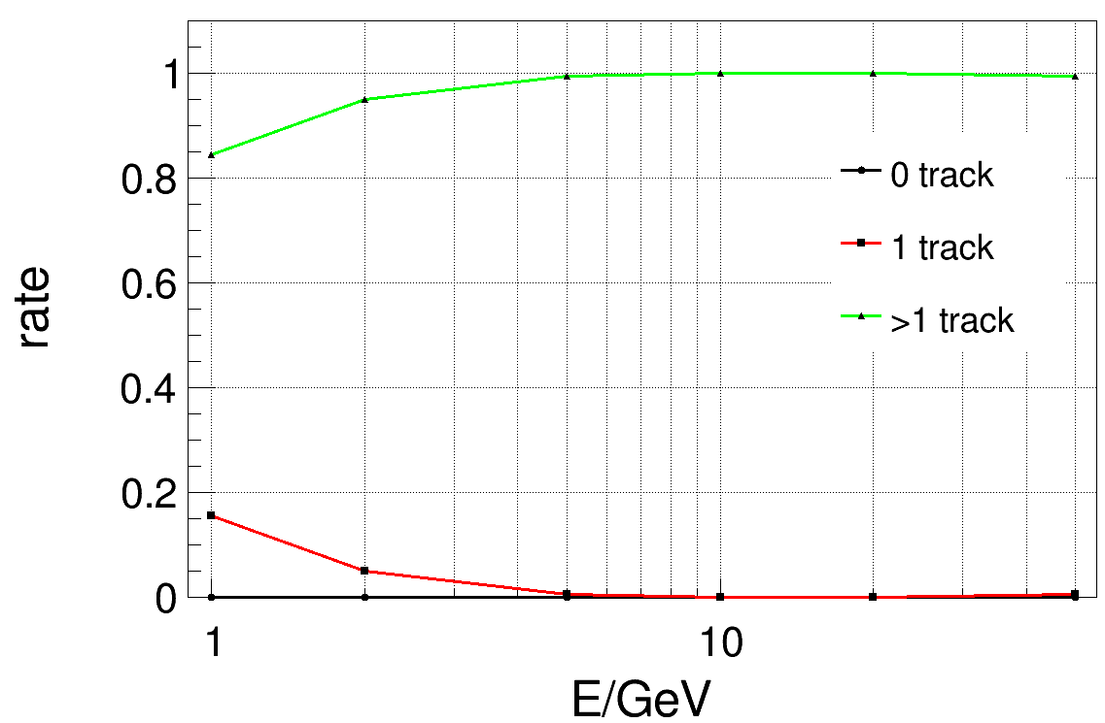
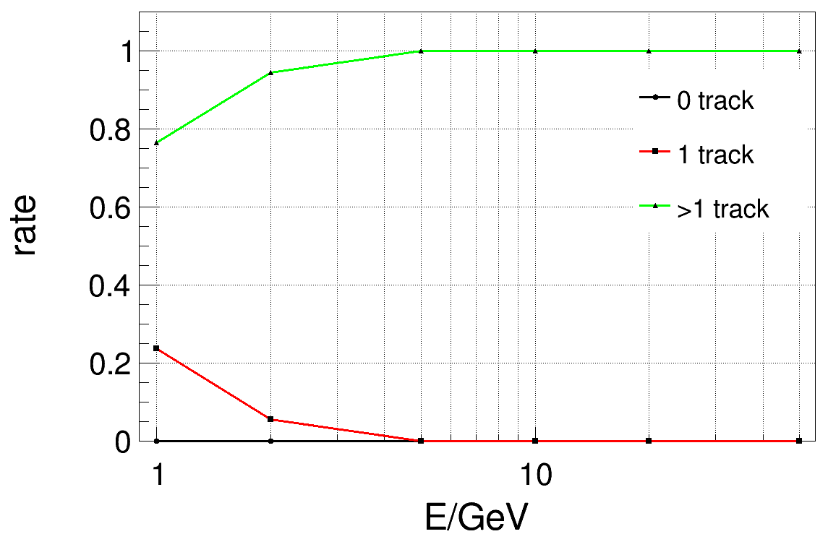
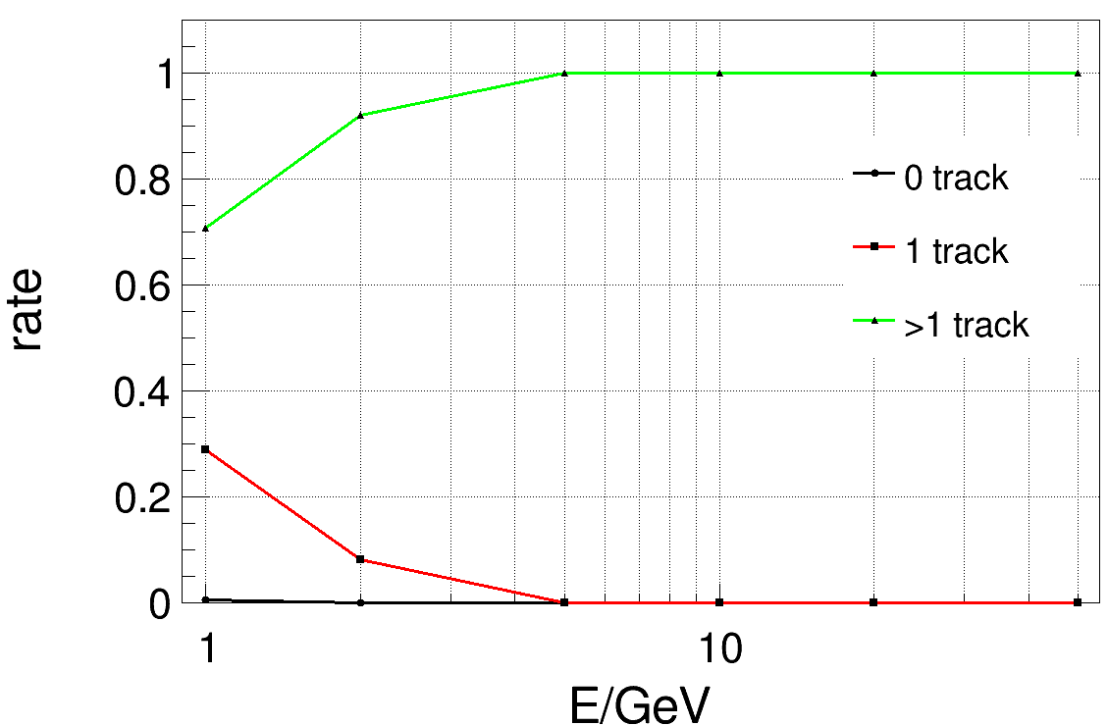
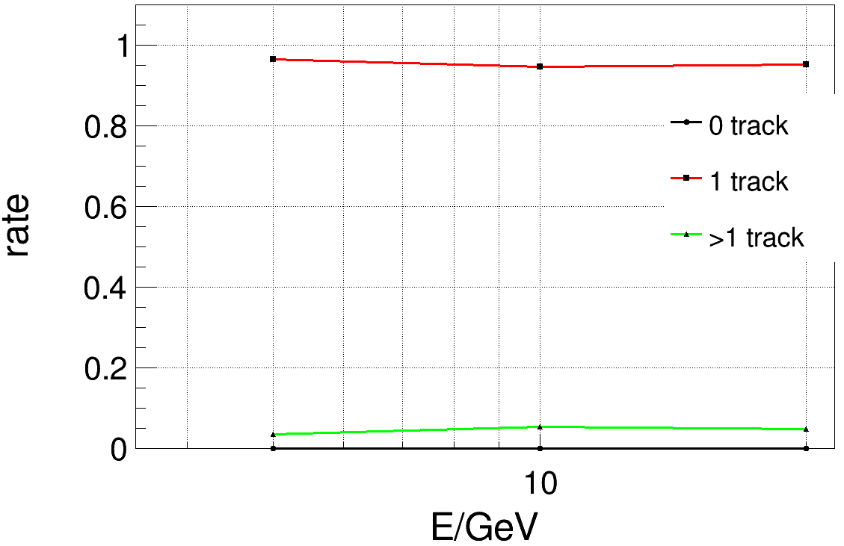
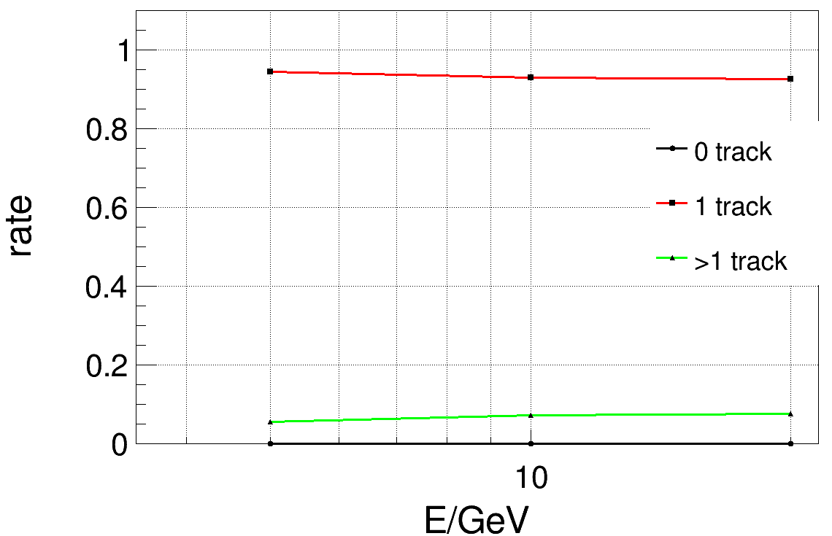
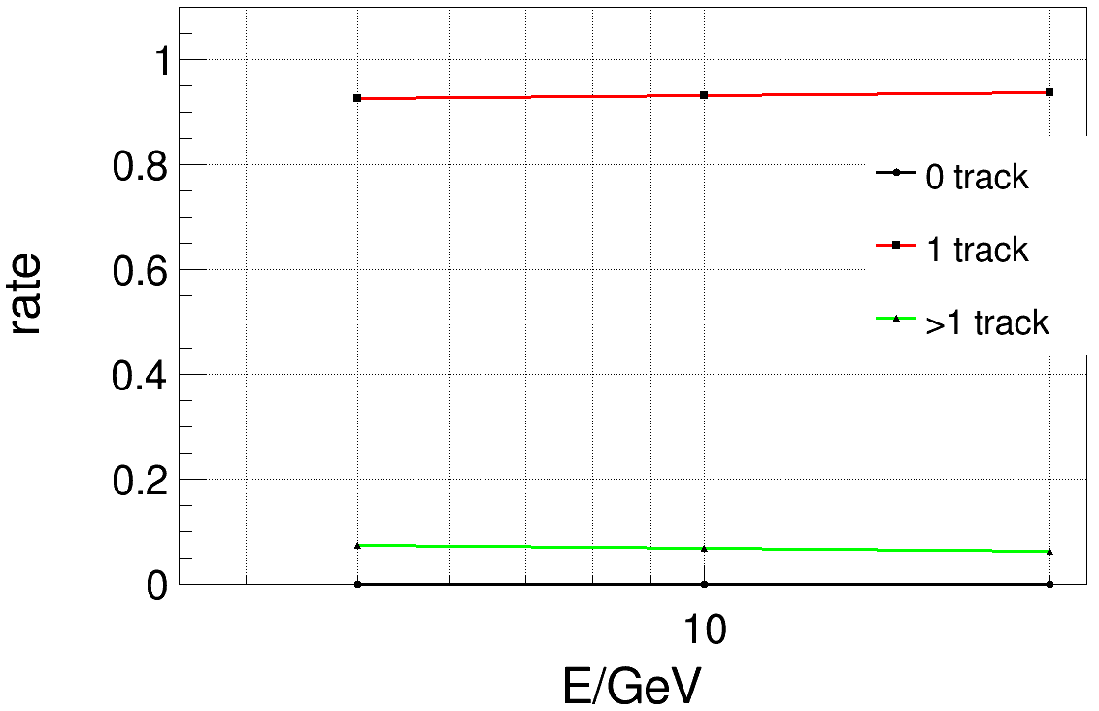








Performance
For $γ$, almost all shower core will be recognized
  Due to the fluctuation of local maximums, most EM shower will find more than one tracks
For $μ$, over 90% events will find one track
$$stave 6, θ=90°$$
$$stave 9, θ≈34°$$
$$stave 11, θ≈43°$$
$$μ$$
$$stave 6, θ=90°$$
$$stave 9, θ≈34°$$
$$stave 11, θ≈43°$$

Slide 10
Back up

Slide 11
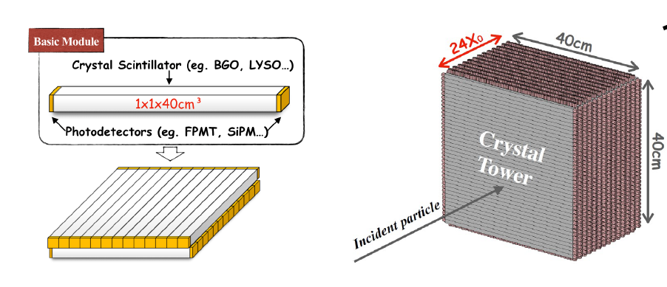
ECal
y
x
z

Slide 12
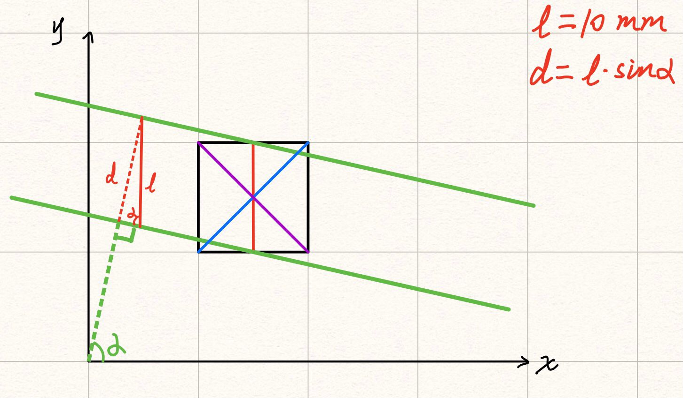
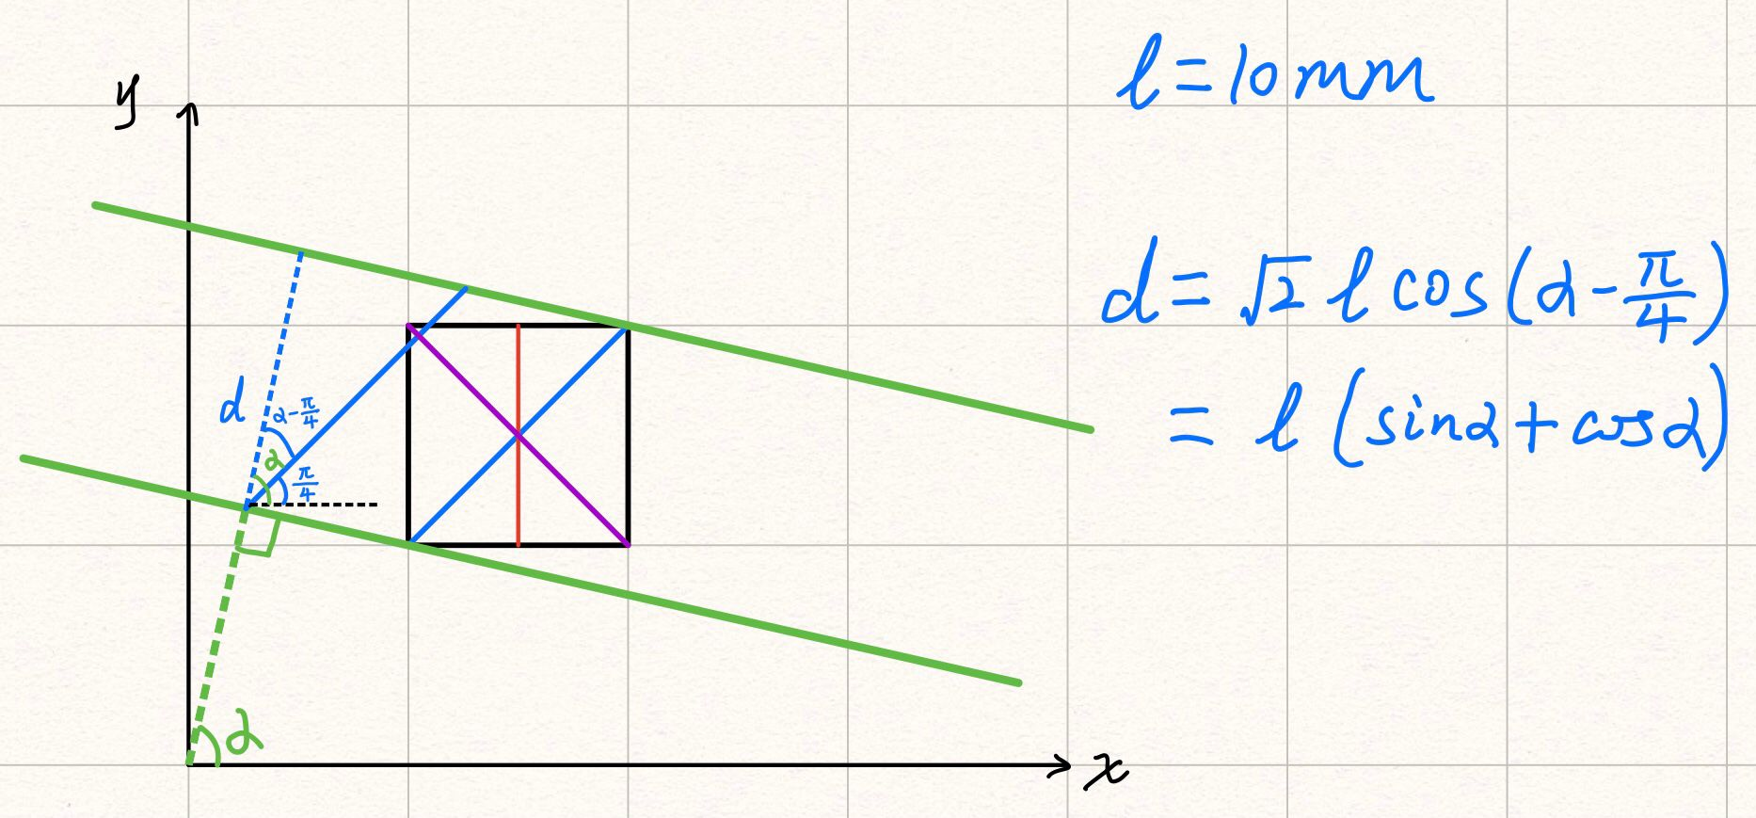
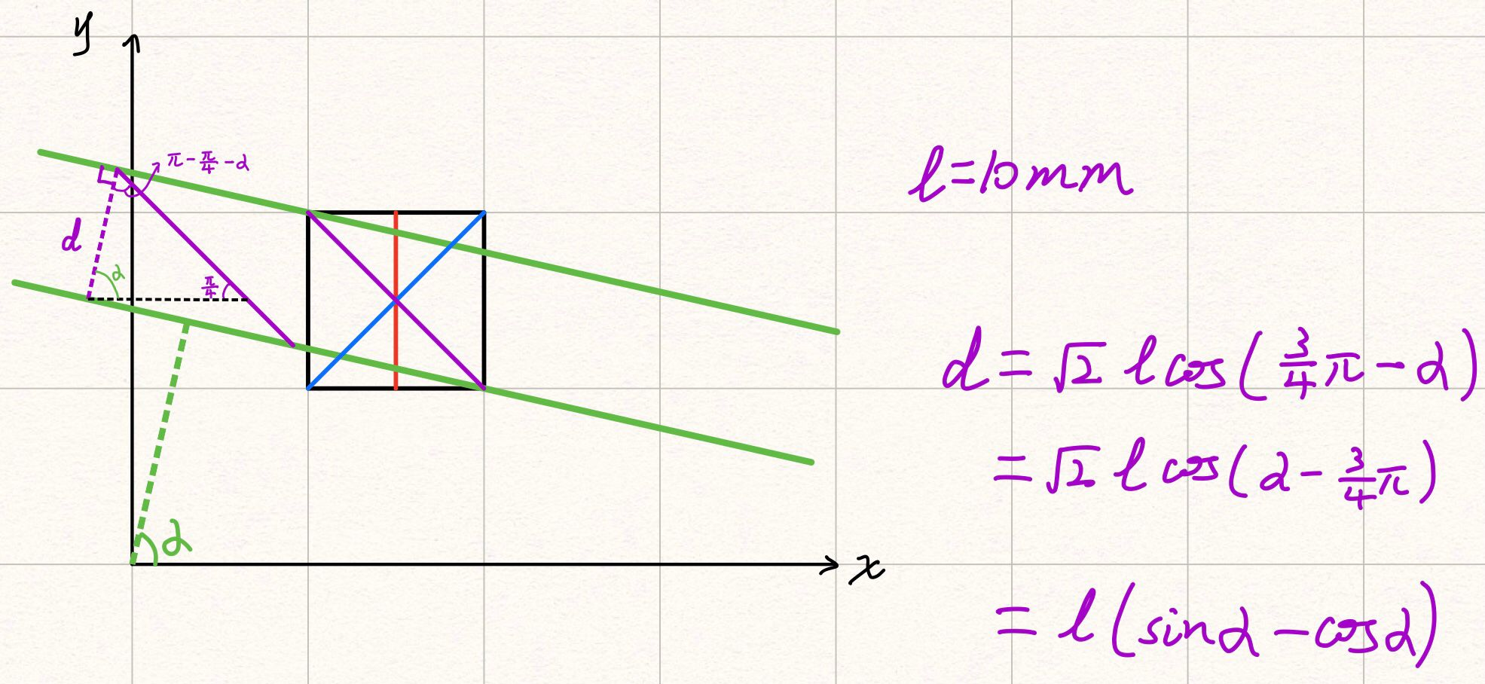
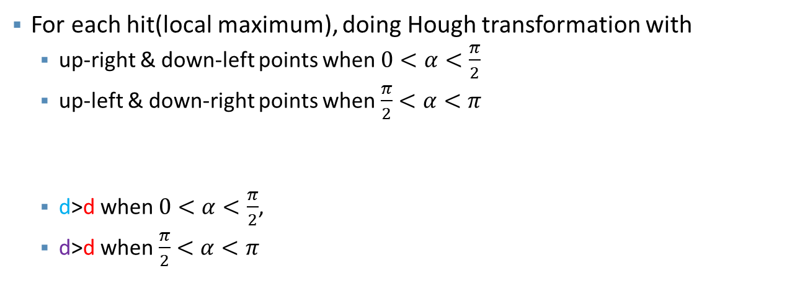
Hough transformation
For each hit(local maximum), doing Hough transformation with
  up-right & down-left points when $0<α<\frac{π}{2}$
  up-left & down-right points when $\frac{π}{2}<α<π$
  d>d when $0<α<\frac{π}{2}$,
  d>d when $\frac{π}{2}<α<π$

Slide 13
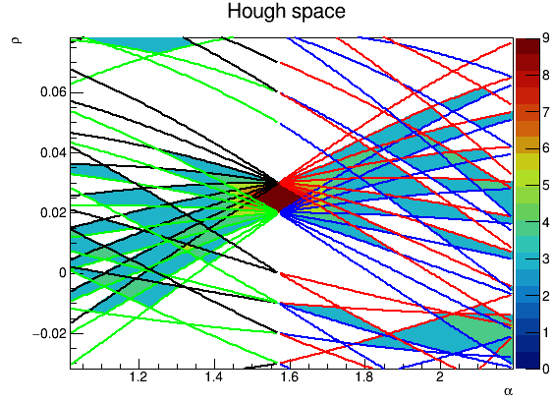
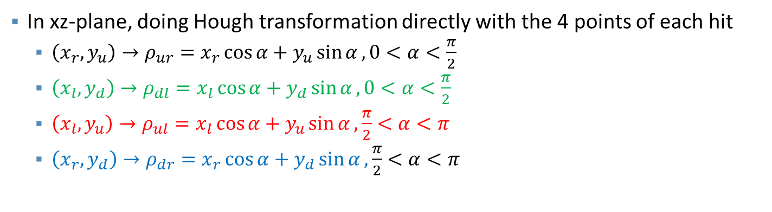
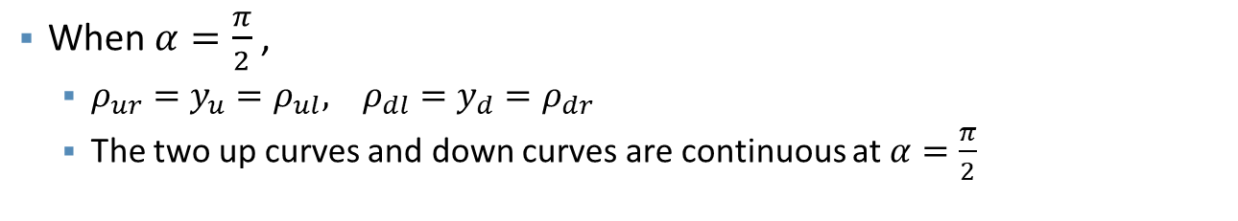
Hough transformation
In xz-plane, doing Hough transformation directly with the 4 points of each hit
  $\left(x_{r},y_{u}\right)→ρ_{ur}=x_{r}\cos{α}+y_{u}\sin{α},0<α<\frac{π}{2}$
  $\left(x_{l},y_{d}\right)→ρ_{dl}=x_{l}\cos{α}+y_{d}\sin{α},0<α<\frac{π}{2}$
  $\left(x_{l},y_{u}\right)→ρ_{ul}=x_{l}\cos{α}+y_{u}\sin{α},\frac{π}{2}<α<π$
  $\left(x_{r},y_{d}\right)→ρ_{dr}=x_{r}\cos{α}+y_{d}\sin{α},\frac{π}{2}<α<π$
When $α=\frac{π}{2}$ ,
  $ρ_{ur}=y_{u}=ρ_{ul}, ρ_{dl}=y_{d}=ρ_{dr}$
  The two up curves and down curves are continuous at $α=\frac{π}{2}$

Slide 14
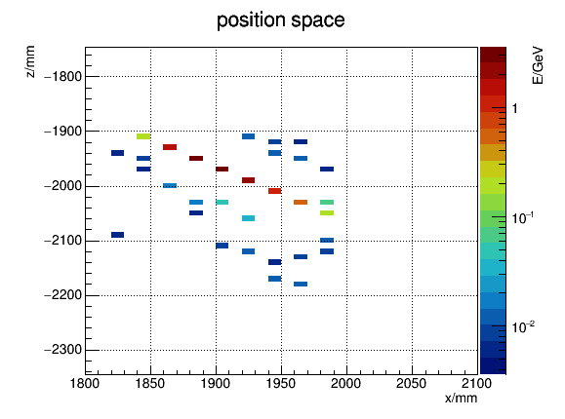
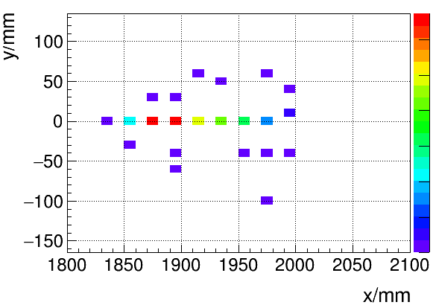
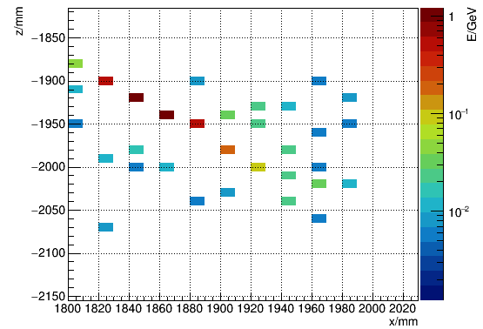
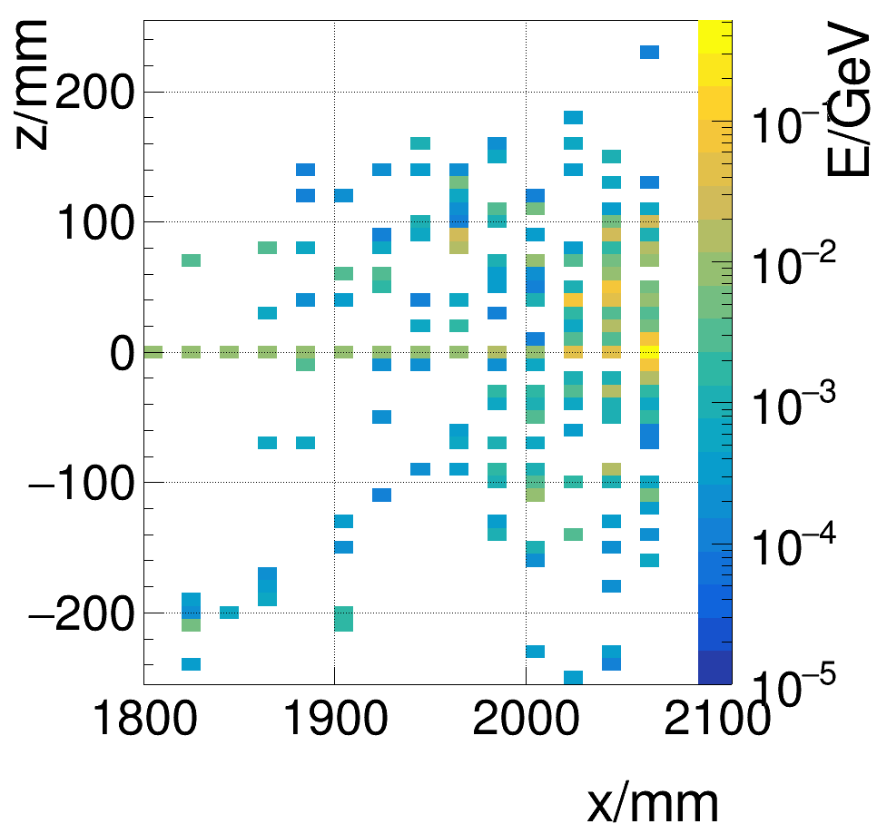
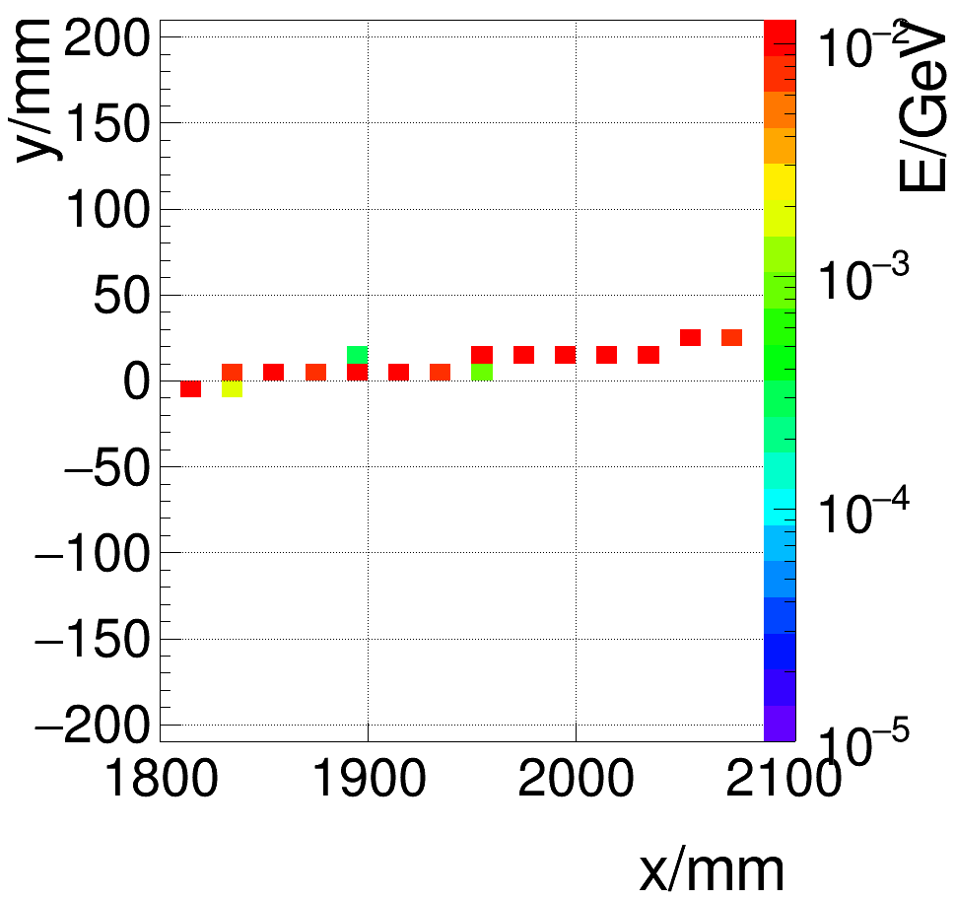
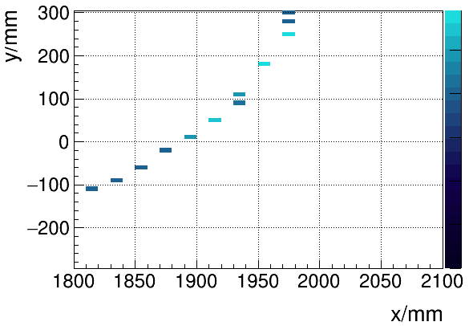
more showers

