Slide 1
An resonance free circular electron accelerator
ChenTao

Slide 2
General method
General method to maintain polarization during acceleration :
tune-jump method;
Using snakes ;
——Very effective in the proton machine
In the Relativistic Heavy Ion Collider (RHIC) two full helical snakes help maintain polarization during its acceleration cycle to energies as high as 255 GeV.
Difficulty for accelerating electrons :
helical dipoles:
  large orbit excursions
  radiative effects
Solenoid:
  The strength of fields must ramp through a very large range scale
  Need very high Peak field

Slide 3
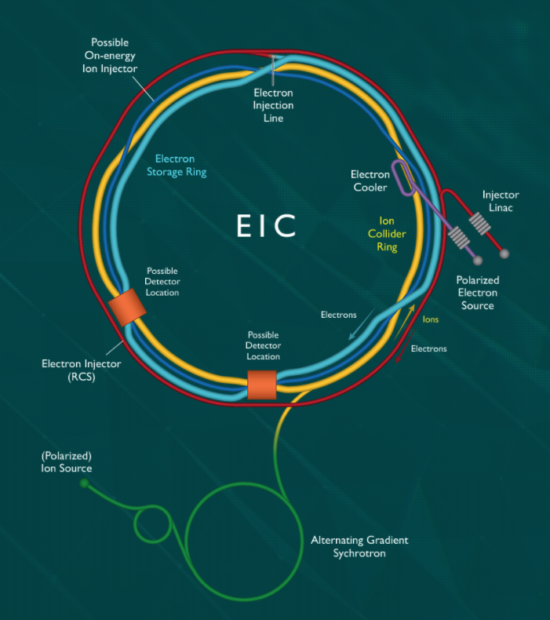
EIC electron ring injector
EIC in Brookhaven National Labs (BNL)
EIC electron ring injector:
To provide vertically spin polarized electrons at energies up to
18 GeV for injection into a storage ring;
Once injected into the storage ring they will be rotated into the longitudinal plane for collisions;
In the past it was believed that such a device would cause profound polarization loss due the combined effects of many depolarizing resonances.
However we have recently devised a lattice which by virtue
of the symmetry of construction and high operating tunes,
avoids all significant depolarization sources in the energy
range of its operation

Slide 4
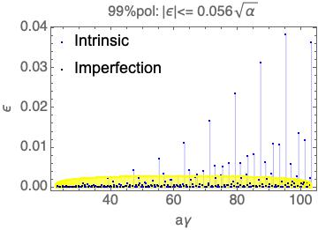
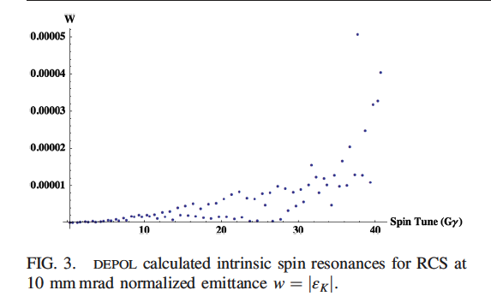
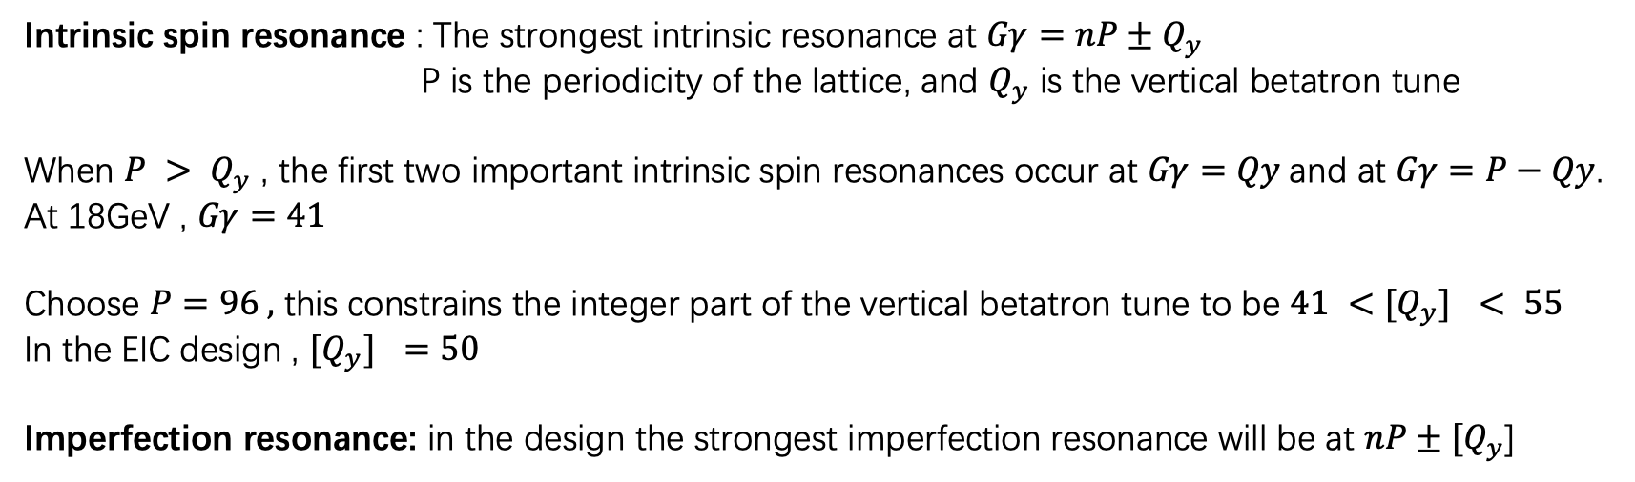
RESONANCE FREE DESIGN
Intrinsic spin resonance : The strongest intrinsic resonance at $Gγ=nP±Q_{y}$
P is the periodicity of the lattice, and $Q_{y}$ is the vertical betatron tune
When $P > Q_{y}$ , the first two important intrinsic spin resonances occur at $Gγ=Qy$and at $Gγ=P−Qy$.
At 18GeV , $Gγ=41$
Choose $P=96 ,$ this constrains the integer part of the vertical betatron tune to be $41 <{[Q}_{y}] < 55$
In the EIC design , ${[Q}_{y}] =50$
Imperfection resonance: in the design the strongest imperfection resonance will be at $nP±{[Q}_{y}$]

Slide 5


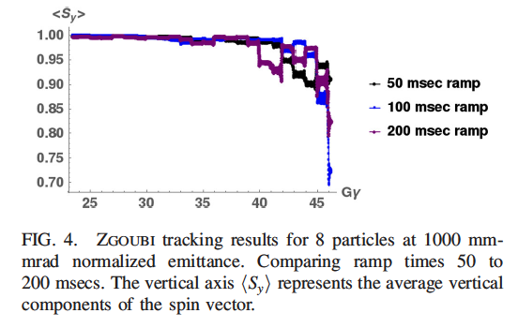
POLARIZATION PERFORMANCE
Froissart-Stora formula:
For well-isolated resonances, The FS formula can be used to approximate the influence of resonance:
Using this one can take the product of all the intrinsic spin resonances crossed
from 400 MeV to 18 GeV (Gγ = 0.907 to 40.82):
Result: for normalized RMS emittance as high as $ε_{0}=1000$mm mrad ,$P_{f}>98\%$
Actually injected RMS emittance : 55mm mrad
Simulation results with ZGOUBI code:
(all resonances are considered)

Slide 6
References
1. PHYSICAL REVIEW ACCELERATORS AND BEAMS 21, 111003 (2018)
2. S. Y. Lee, Spin Dynamics and Snakes in Synchrotrons(1997)

