Slide 1


Probing proton structure at LHCb
尹航
味物理讲座
Jan. 6th, 2022

Slide 2

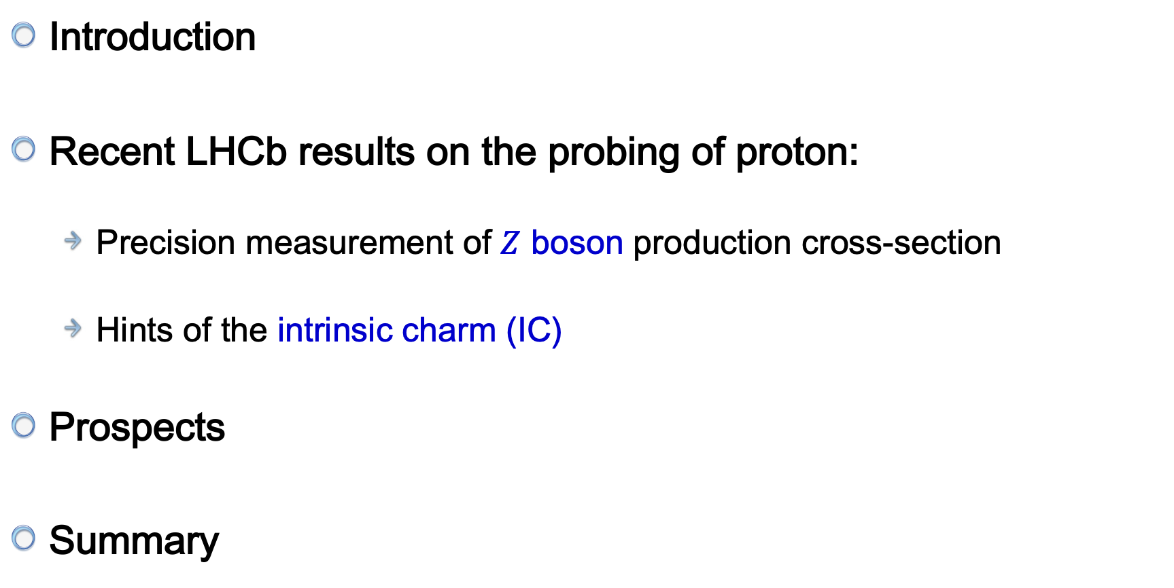
Outline
Introduction
Recent LHCb results on the probing of proton:
  Precision measurement of $Z$ boson production cross-section
  Hints of the intrinsic charm (IC)
Prospects
Summary
arXiv:2112.07458
Submitted to JHEP
arXiv:2109.08084
Submitted to PRL

Slide 3
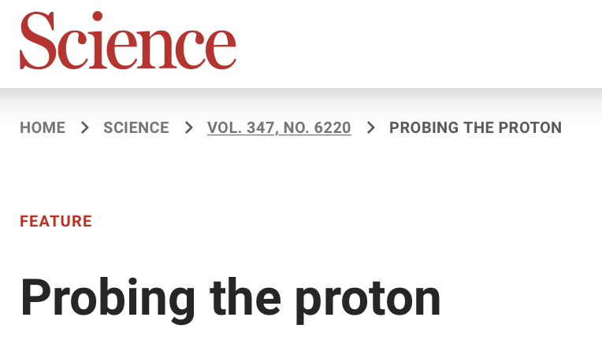


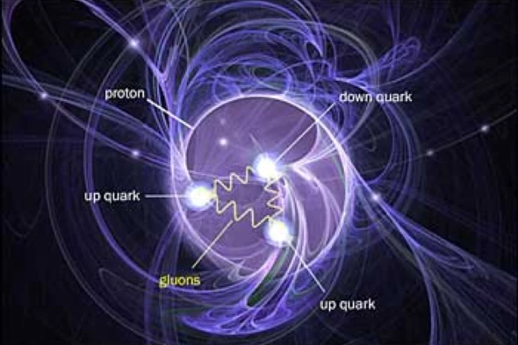
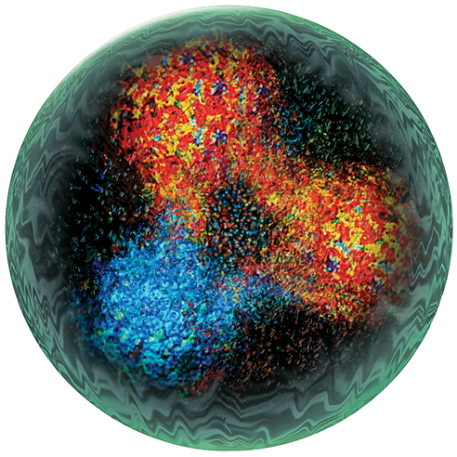
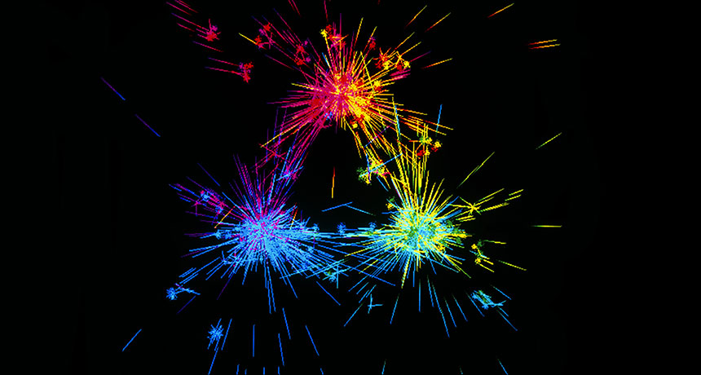
The proton in the spotlight
Non-zero gluon polarisation
Scientific American (2014)
ScienceNew 2018

Slide 4
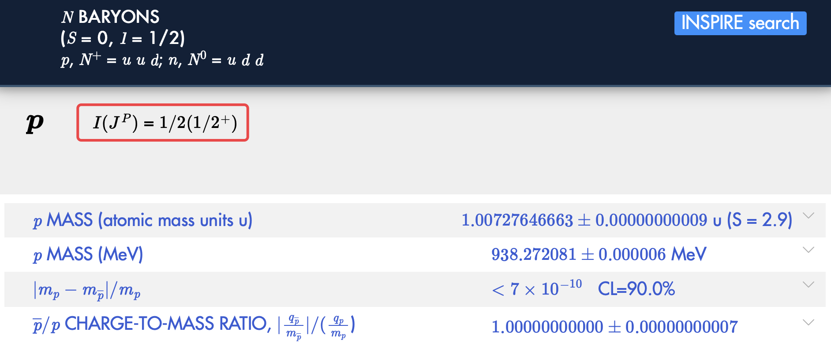
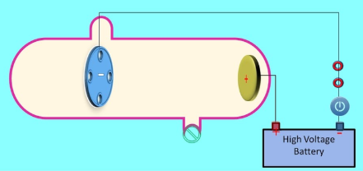
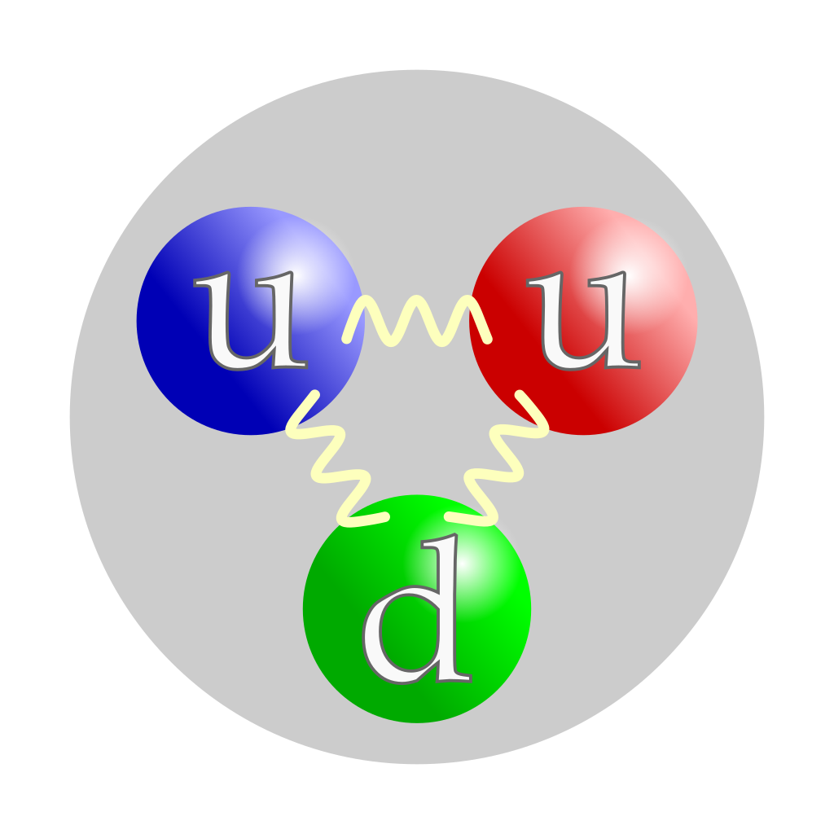
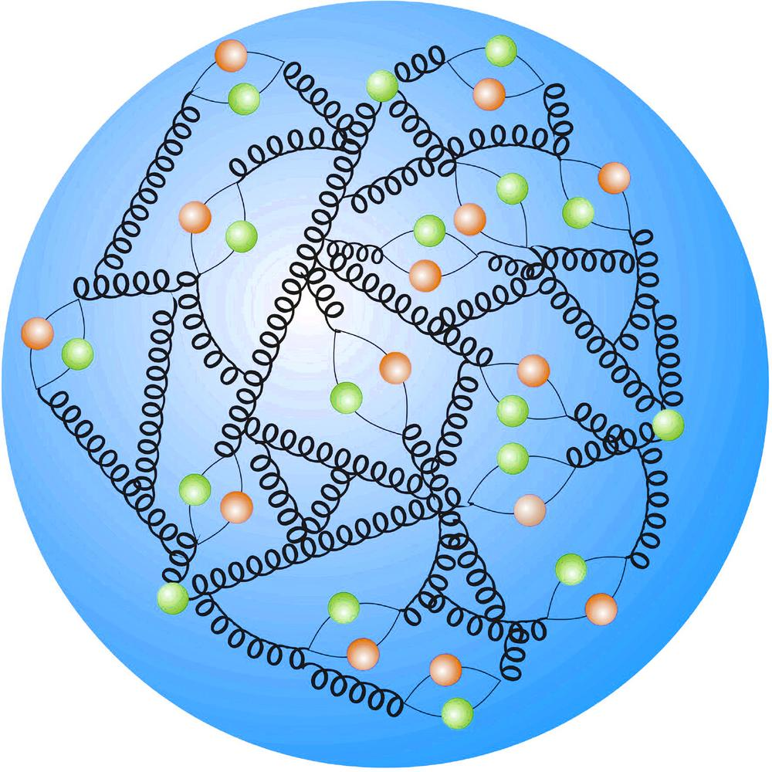
About proton
Canal ray: 1886, Eugen GoldStein
Discovered by Ernest Rutherford, 1917
PDG 2021
QCD bound state of quarks and gluons
  Origin of mass?
  Origin of spin?
  Gluon dominated matter?
  3D imaging?
  Heavy quark content?
  ….

Slide 5
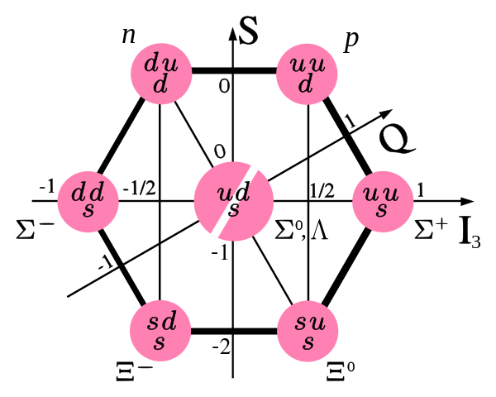
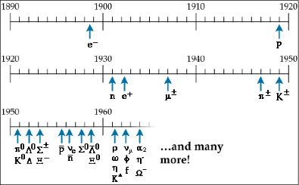
Quark model
Gell-Mann and Zweig proposed a way to construct the numerous hadrons using three fundamental particles (1964): quarks
The particle Zoo

Slide 6
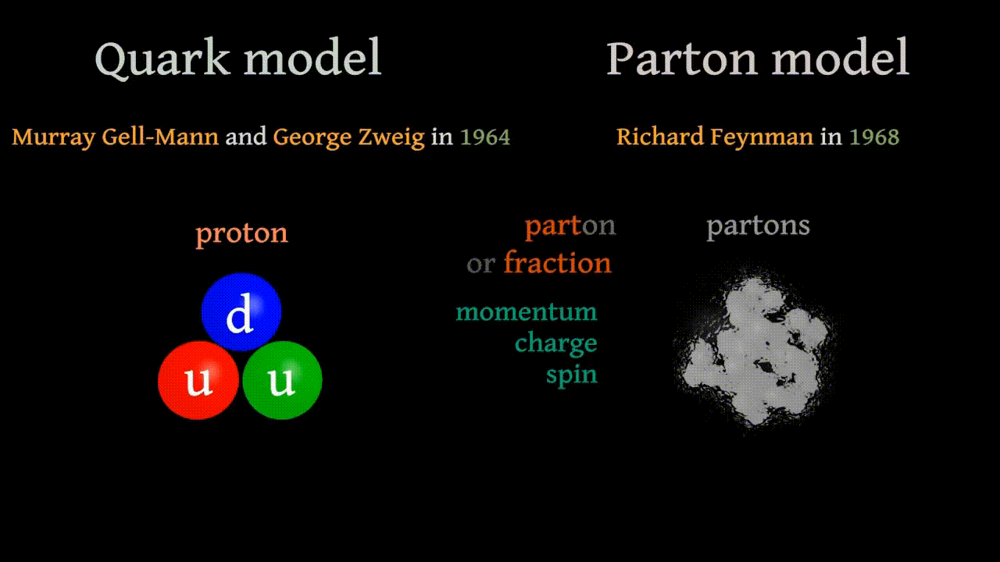
Parton model

Slide 7
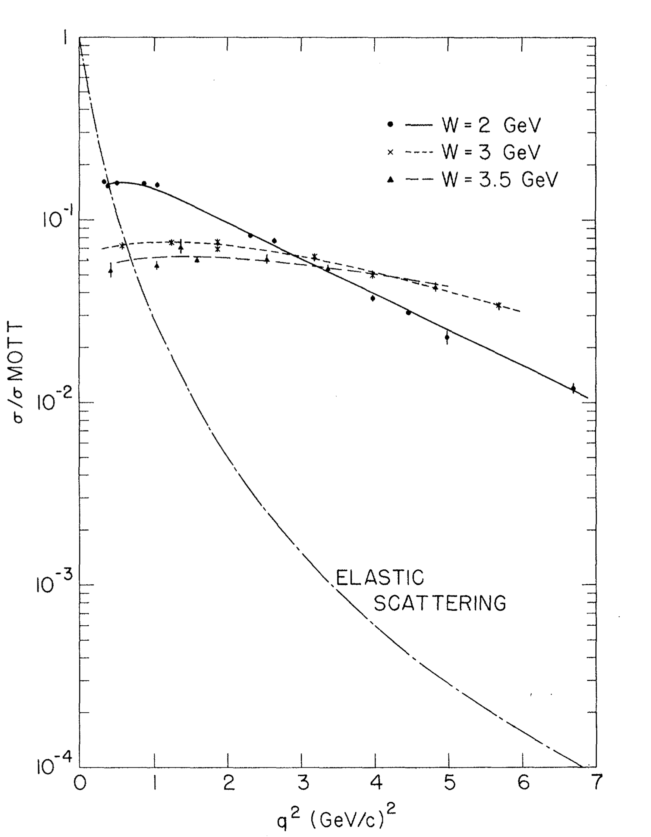
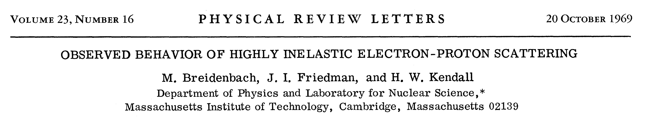
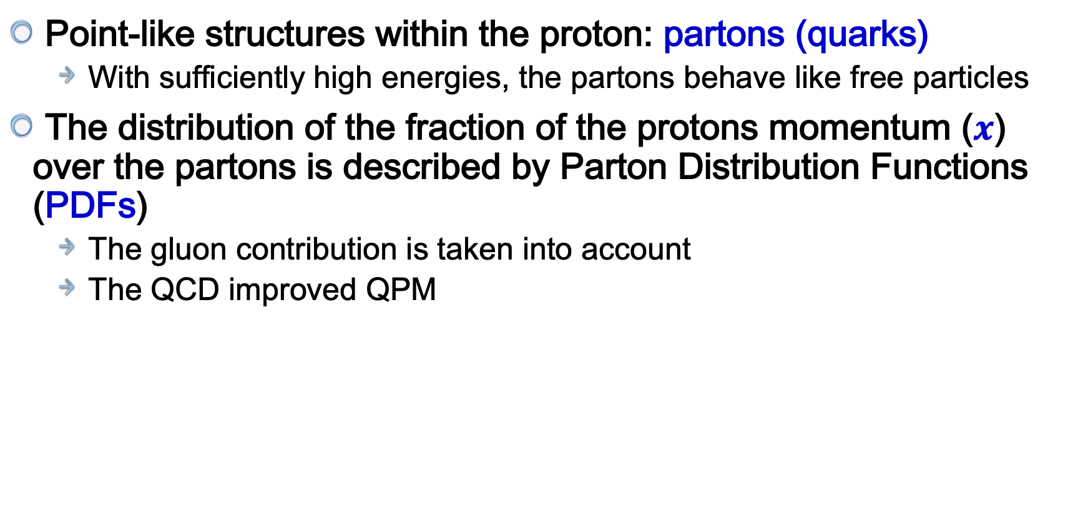
Quark parton model (QPM)
Point-like structures within the proton: partons (quarks)
  With sufficiently high energies, the partons behave like free particles
The distribution of the fraction of the protons momentum ($x$) over the partons is described by Parton Distribution Functions (PDFs)
  The gluon contribution is taken into account
  The QCD improved QPM
SLAC-MIT experiment

Slide 8

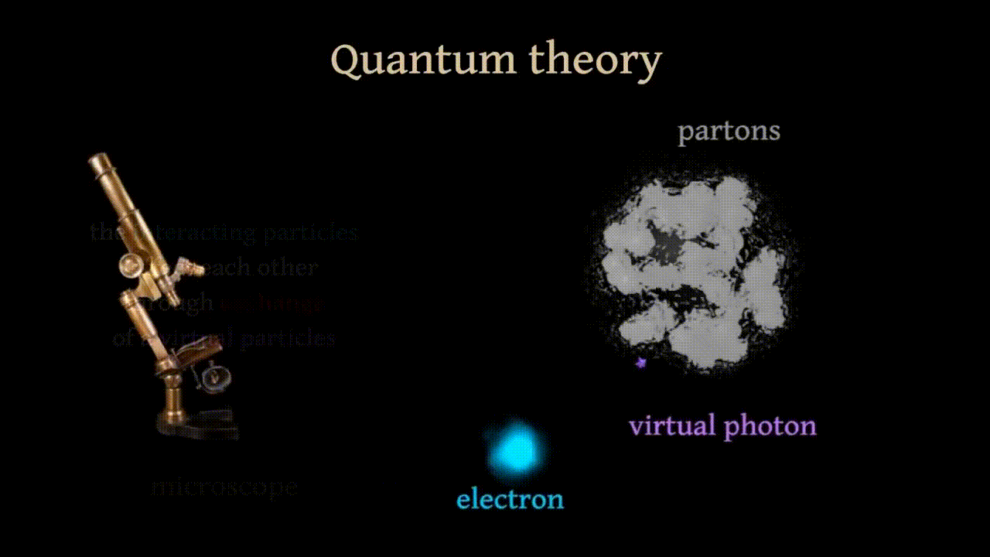
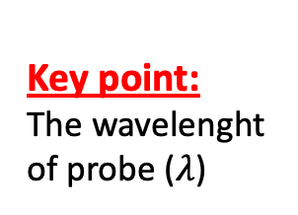
Deep Inelastic Scattering (DIS)
Use virtual particle
(photon) as probe
Key point:
The wavelenght
of probe ($λ$)

Slide 9
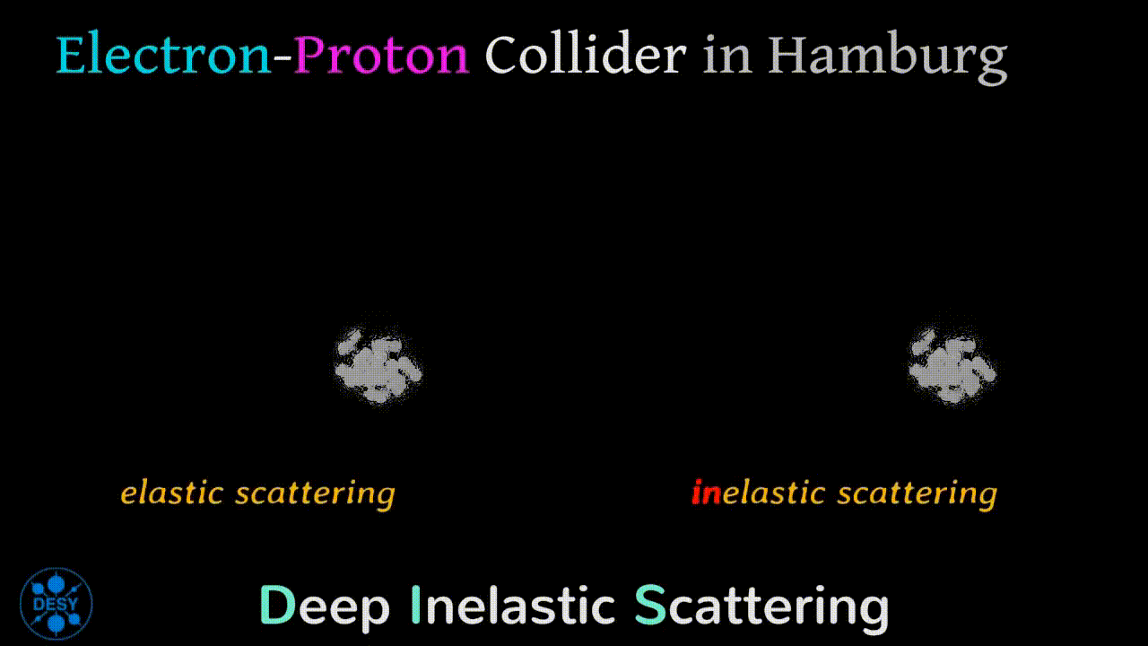
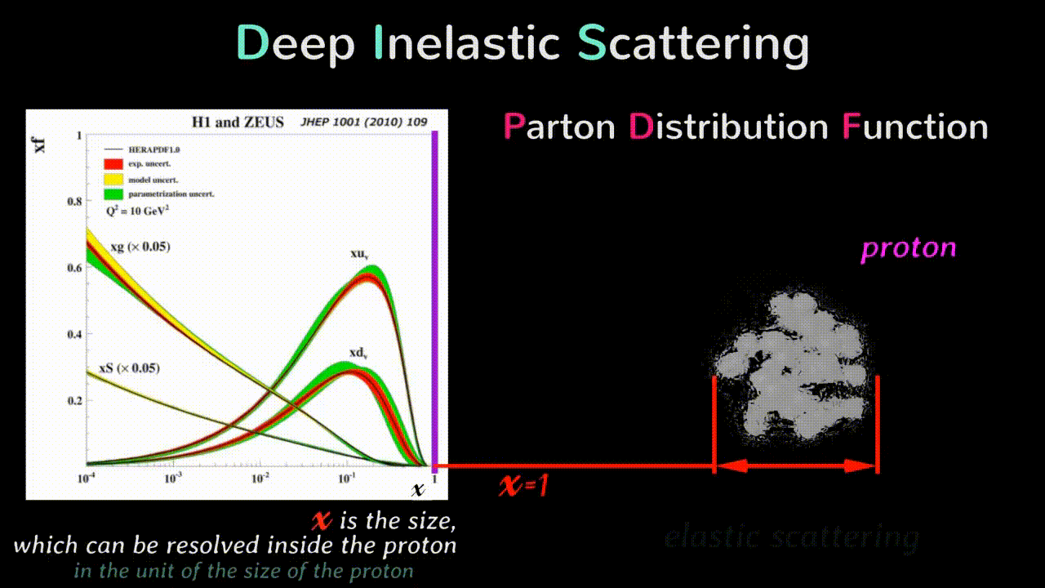
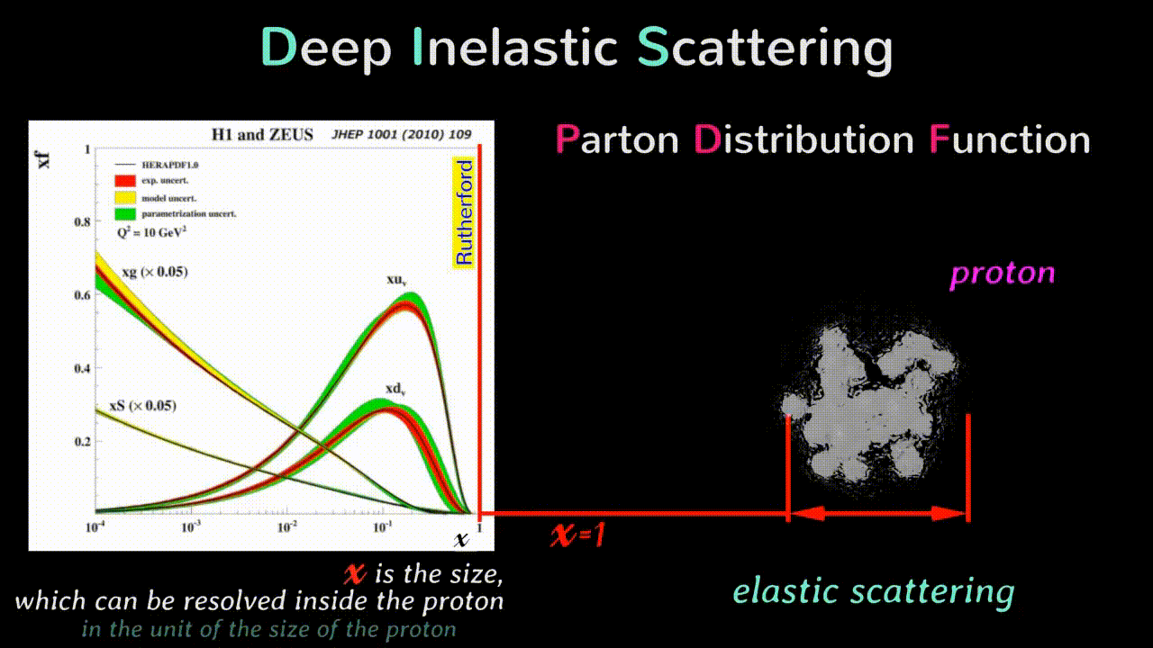
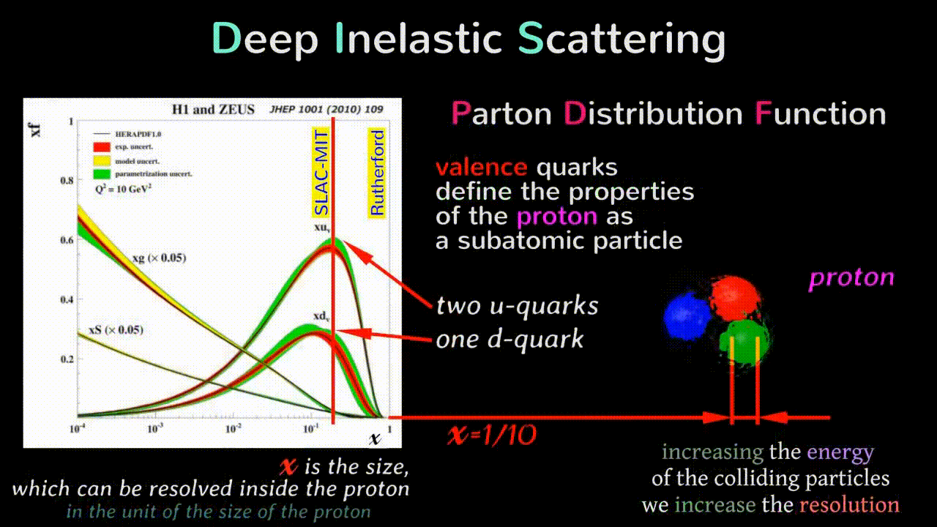
How to probe proton?

Slide 10
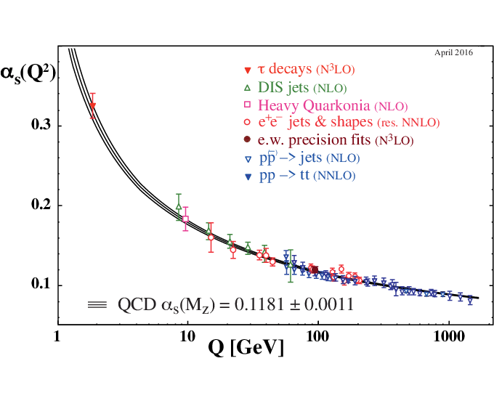
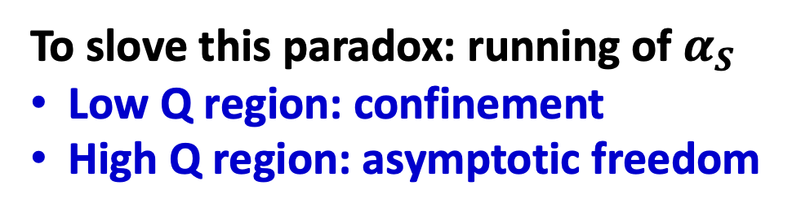
The paradox
The QPM is very success in the past decades
But, there is a paradox:
  Quarks are strongly bound into hadrons
  Quarks act as free “partons” in DIS
To slove this paradox: running of $α_{S}$
Low Q region: confinement
High Q region: asymptotic freedom

Slide 11
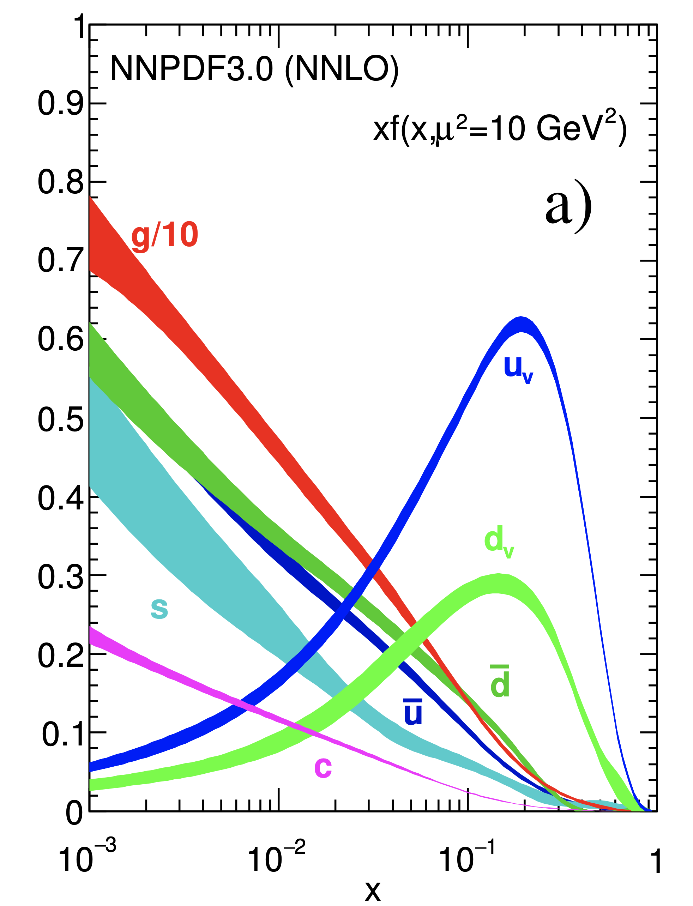
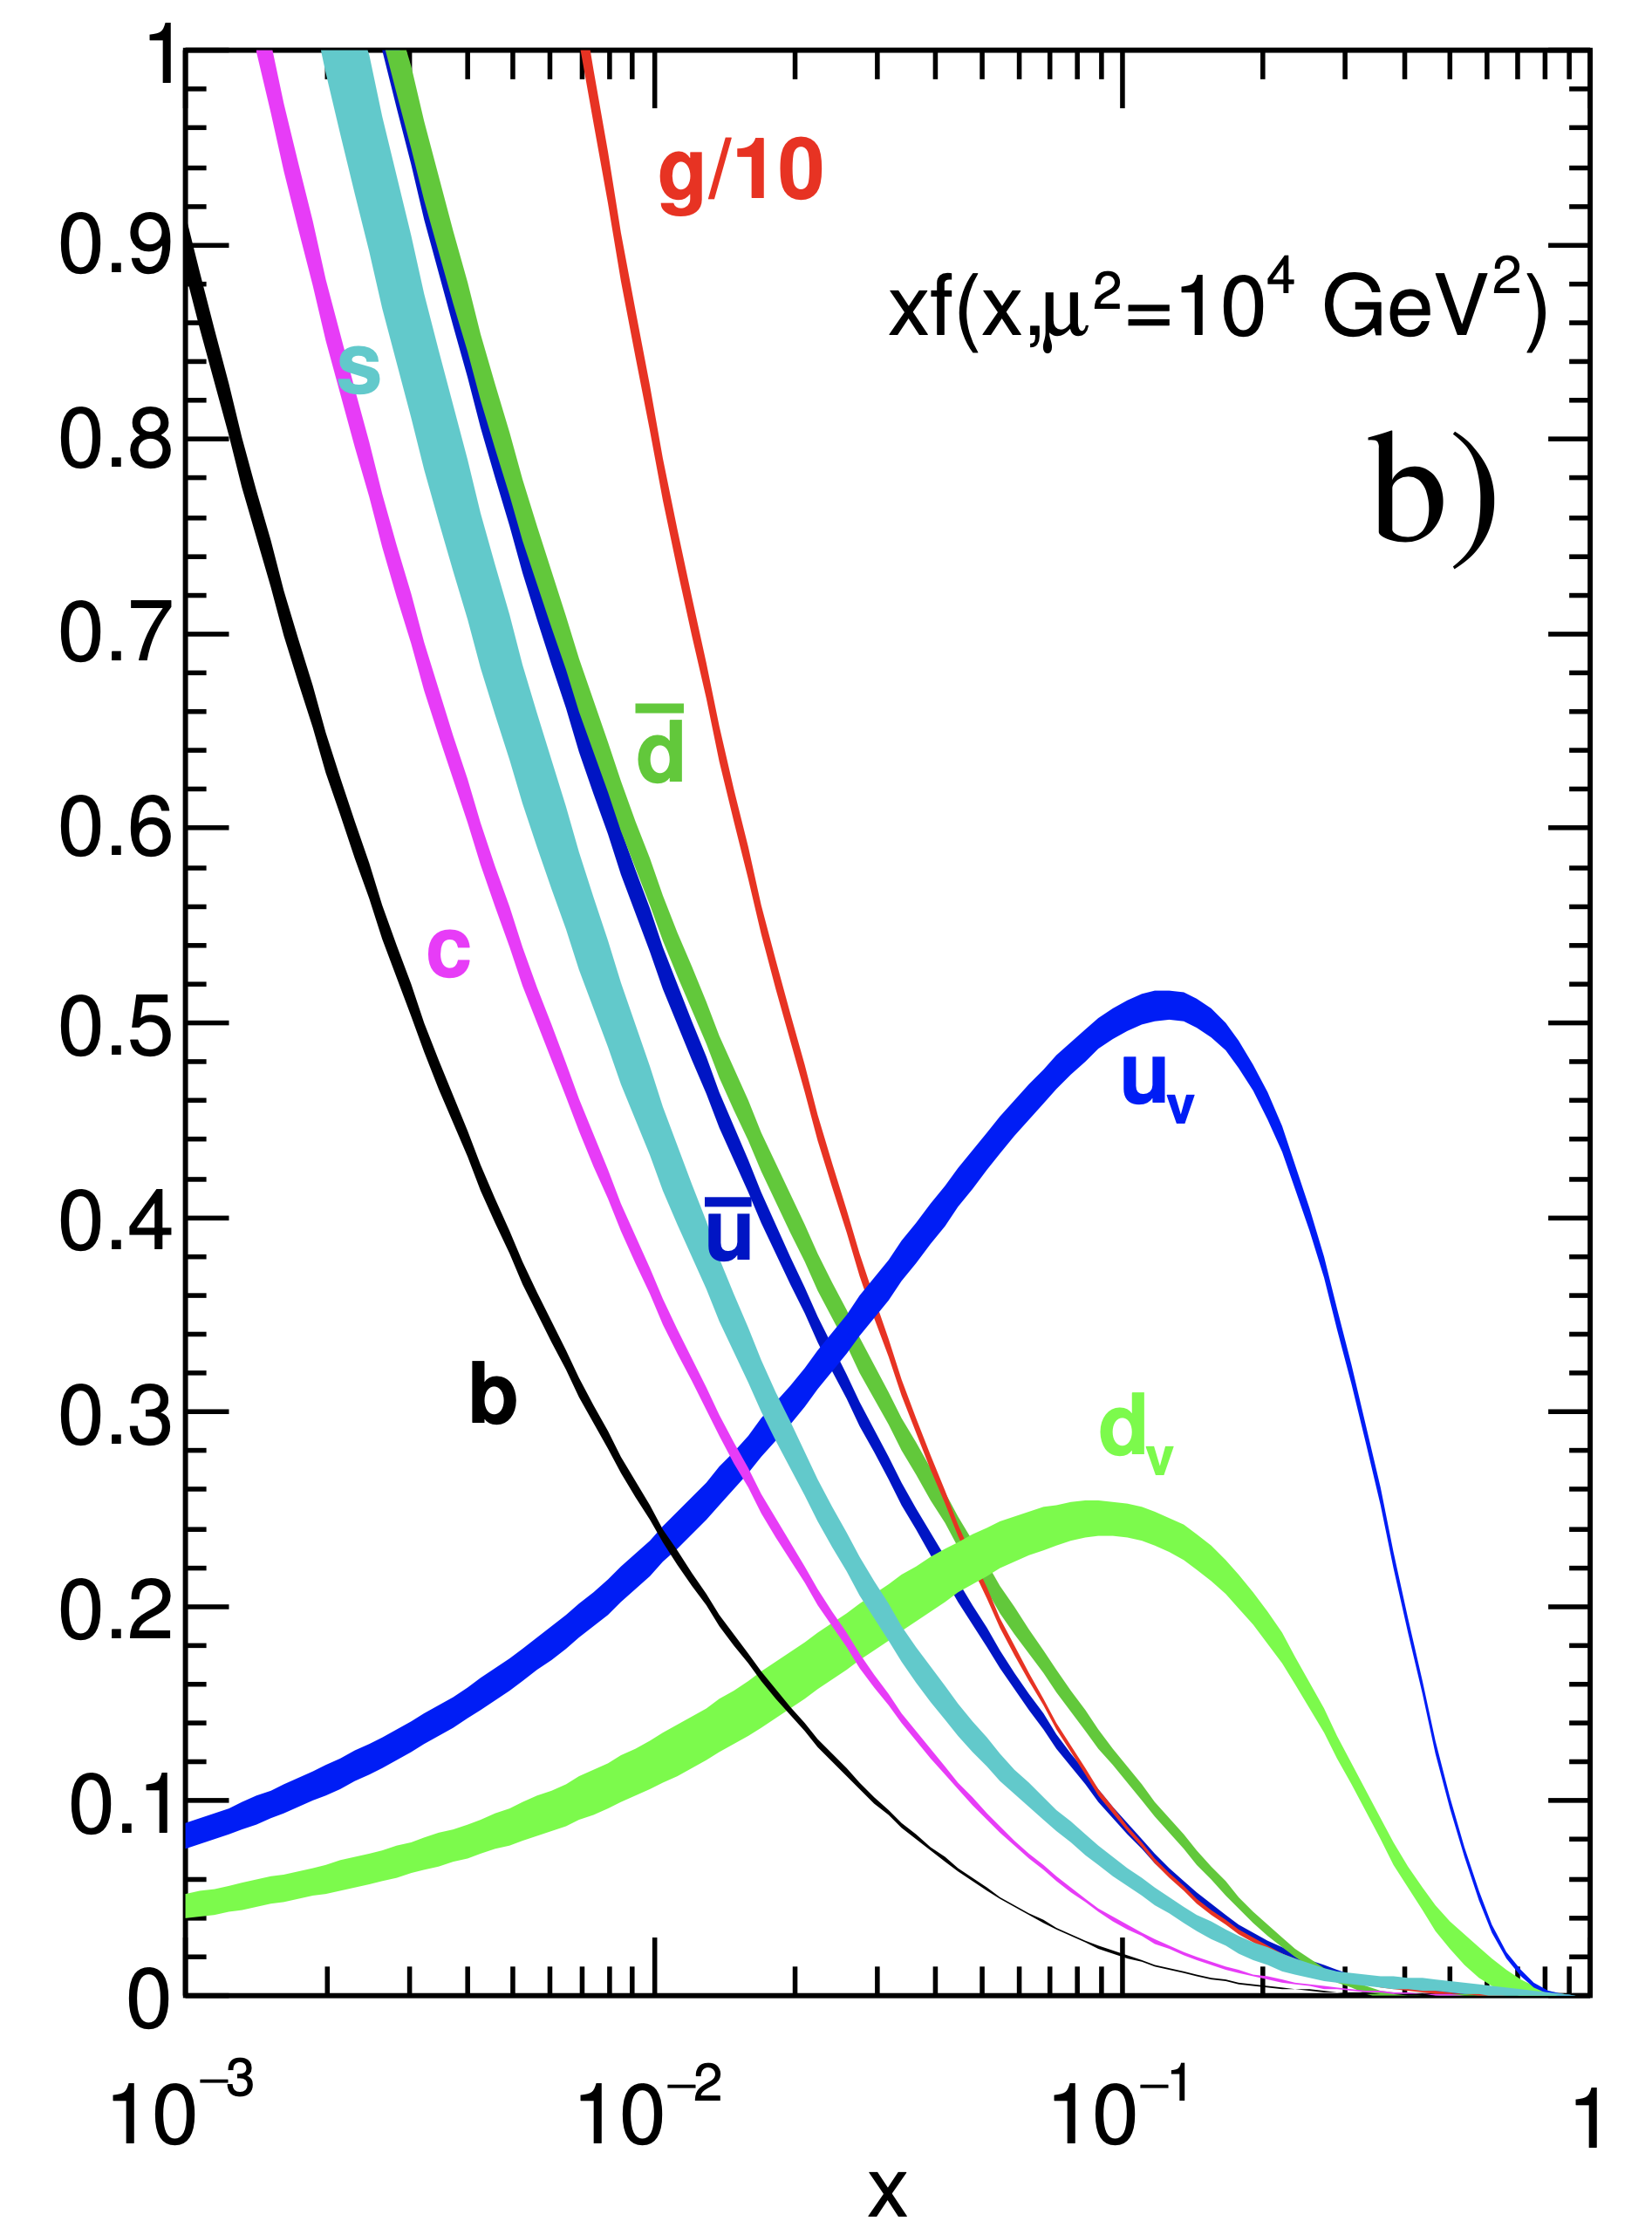
Proton PDFs
Universal distributions containing long-distance structure of hadron: the QCD factorisation theorem
At least 11 PDFs (5 quarks + anti-quarks + gluon)

Slide 12
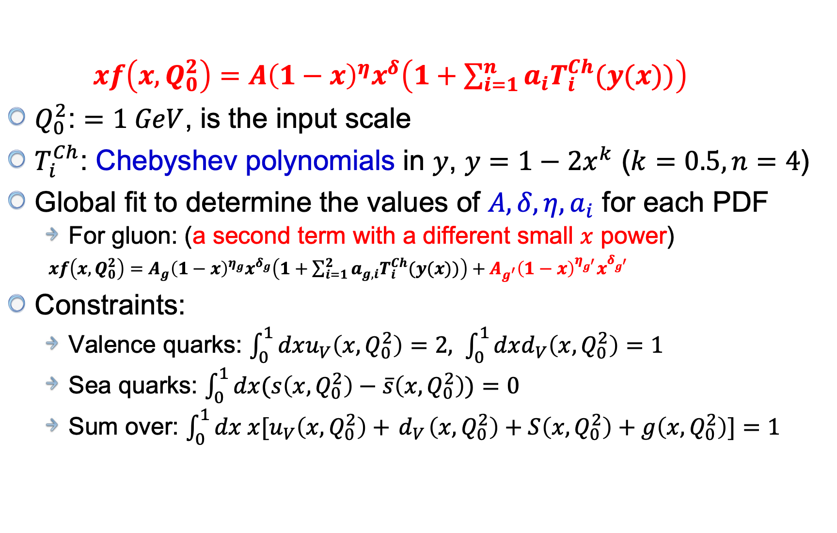
PDFs parameterisations
EPJC 73, 2318 (2013)
$xf\left(x,Q_{0}^{2}\right)=A{\left(1−x\right)}^{η}x^{δ}\left(1+\sum_{i=1}^{n}{a_{i}T_{i}^{Ch}(y(x))}\right)$
$Q_{0}^{2}$: $=1 GeV$, is the input scale
$T_{i}^{Ch}$: Chebyshev polynomials in $y$, $y=1−2x^{k}$ ($k=0.5, n=4$)
Global fit to determine the values of $A,δ,η,a_{i}$ for each PDF
  For gluon: (a second term with a different small $x$ power)
  $xf\left(x,Q_{0}^{2}\right)=A_{g}{\left(1−x\right)}^{η_{g}}x^{δ_{g}}\left(1+\sum_{i=1}^{2}{a_{g,i}T_{i}^{Ch}(y(x))}\right)+A_{g^{′}}{\left(1−x\right)}^{η_{g^{′}}}x^{δ_{g^{′}}}$
Constraints:
  Valence quarks: $\int_{0}^{1}{dxu_{V}\left(x,Q_{0}^{2}\right)=2, }$ $\int_{0}^{1}{dxd_{V}\left(x,Q_{0}^{2}\right)=1 }$
  Sea quarks: $\int_{0}^{1}{dx(s\left(x,Q_{0}^{2}\right)−\overline{s}\left(x,Q_{0}^{2}\right))=0 }$
  Sum over: $\int_{0}^{1}{dx{ x[u}_{V}\left(x,Q_{0}^{2}\right)+{ d}_{V}\left(x,Q_{0}^{2}\right)+S\left(x,Q_{0}^{2}\right)+g\left(x,Q_{0}^{2}\right)]=1 }$

Slide 13
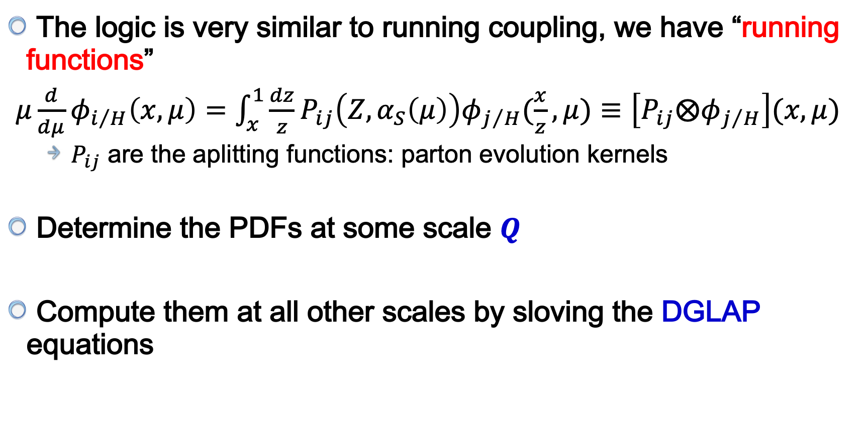
DGLAP function?
The logic is very similar to running coupling, we have “running functions”
$μ\frac{d}{dμ}φ_{i/H}\left(x,μ\right)=\int_{x}^{1}{\frac{dz}{z}}P_{ij}\left(Z,α_{S}\left(μ\right)\right)φ_{j/H}(\frac{x}{z},μ)≡\left[P_{ij}⨂φ_{j/H}\right](x,μ)$
  $P_{ij}$ are the aplitting functions: parton evolution kernels
Determine the PDFs at some scale $Q$
Compute them at all other scales by sloving the DGLAP equations

Slide 14
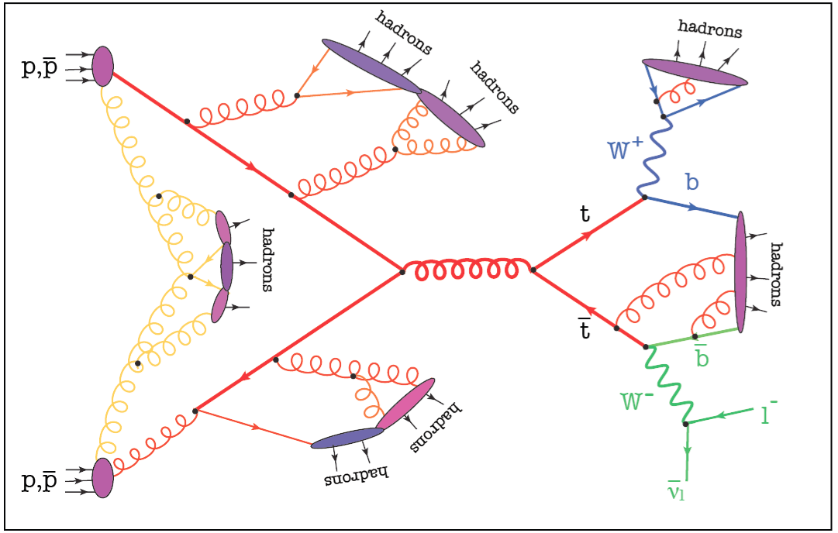
Hadron collider
Proton-proton collision

Slide 15
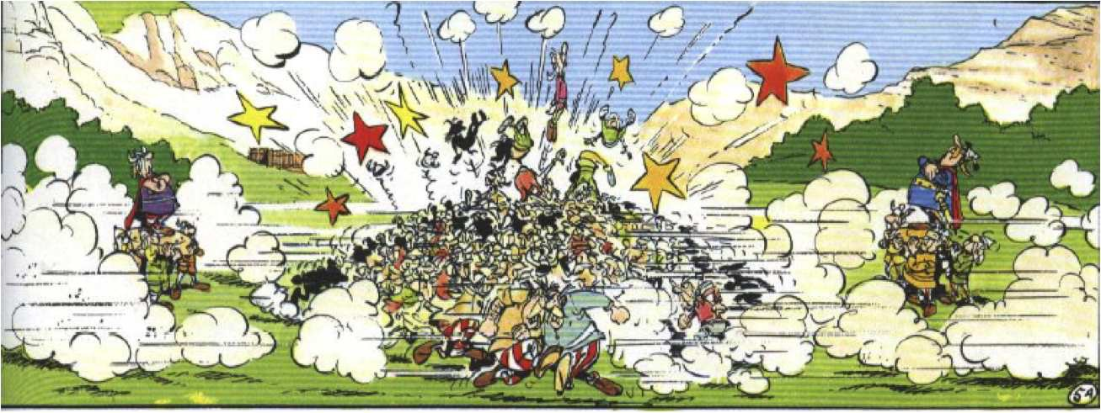
Hadron collider

Slide 16

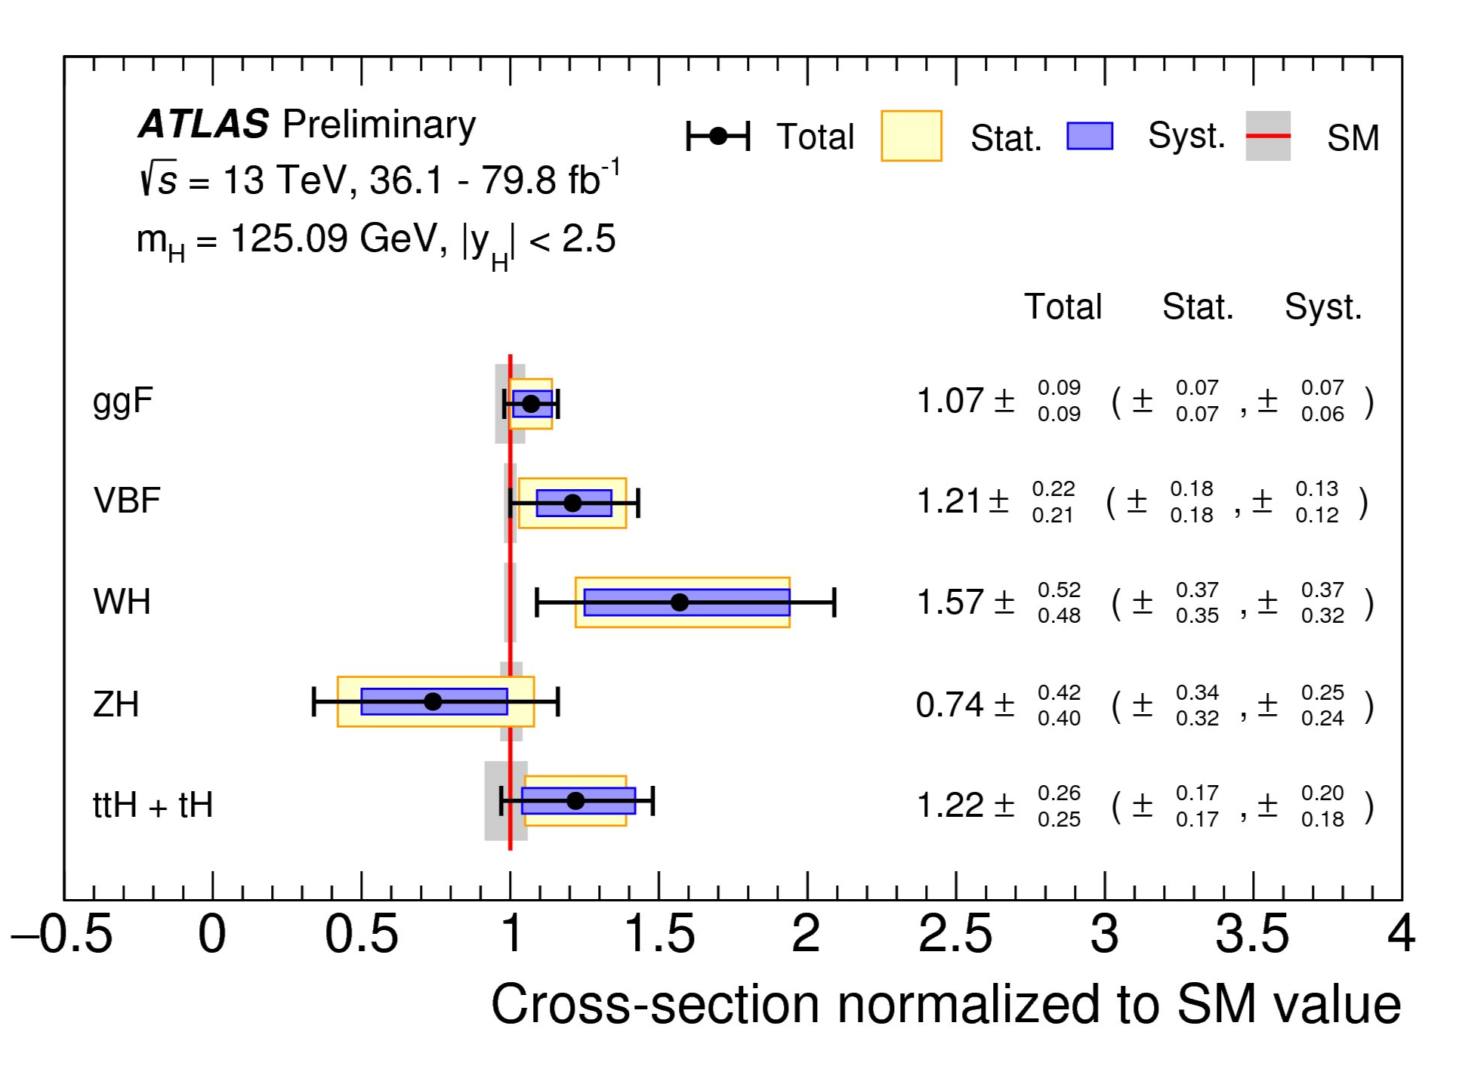
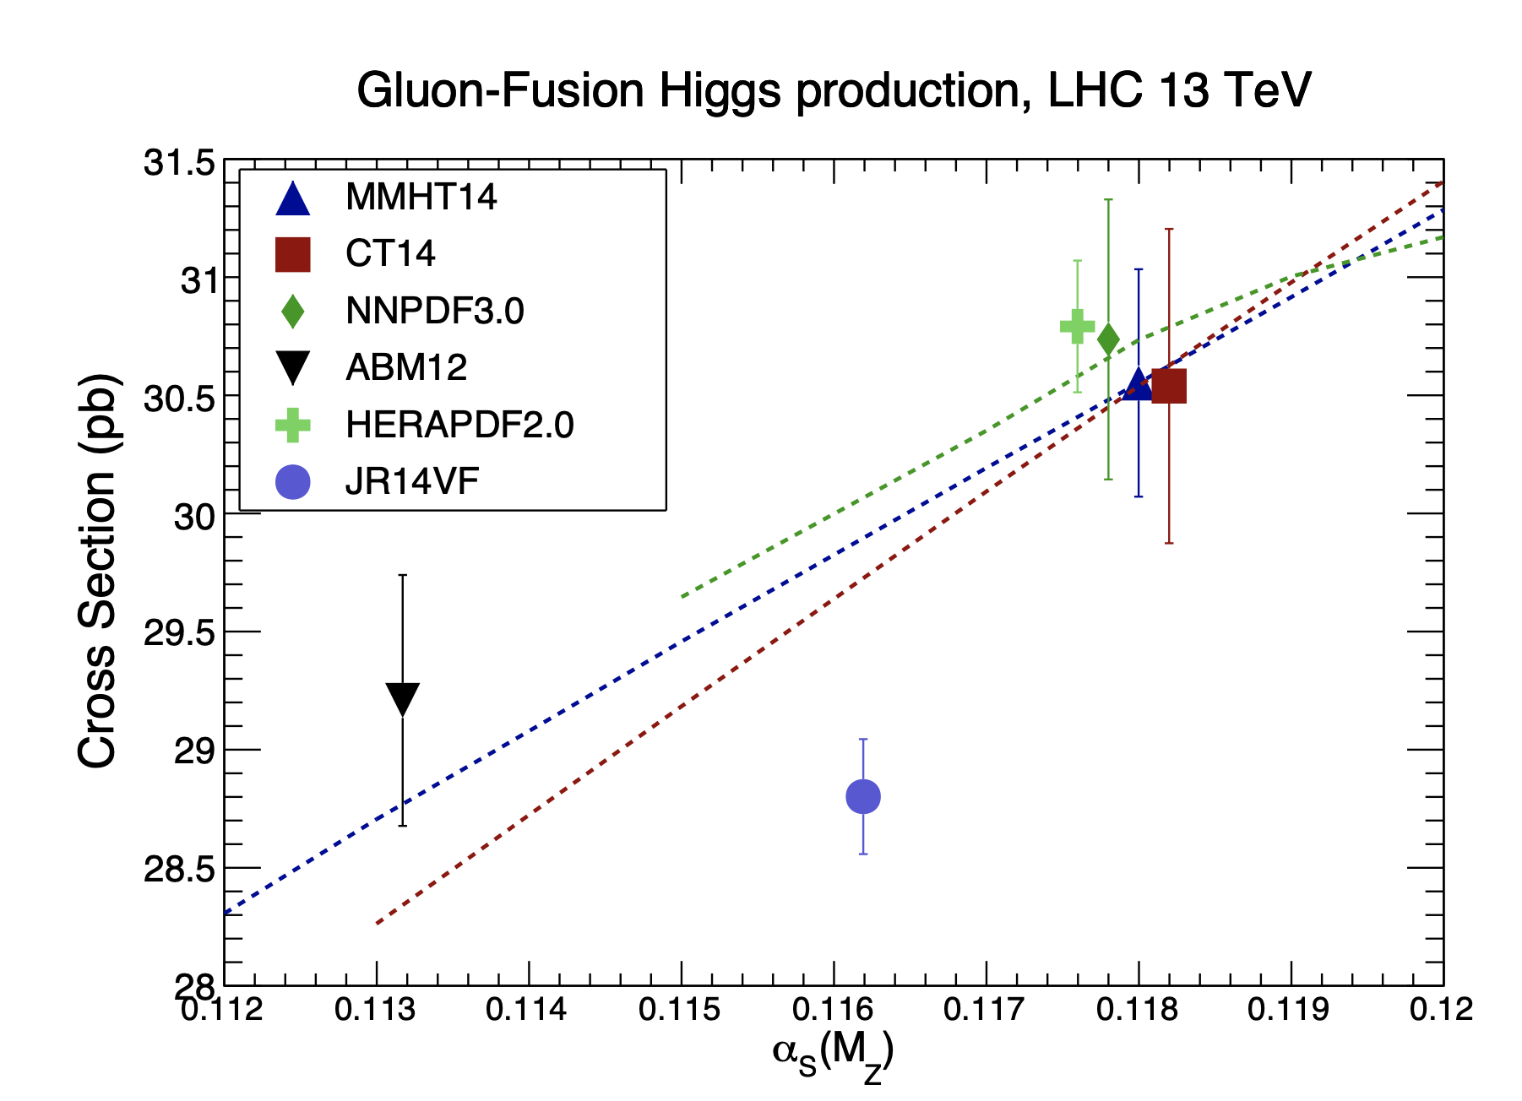
Impacts from PDFs
Higgs boson production cross-section
  PDFs uncertainty is one of dominat uncertainties
arXiv:1610.07922

Slide 17
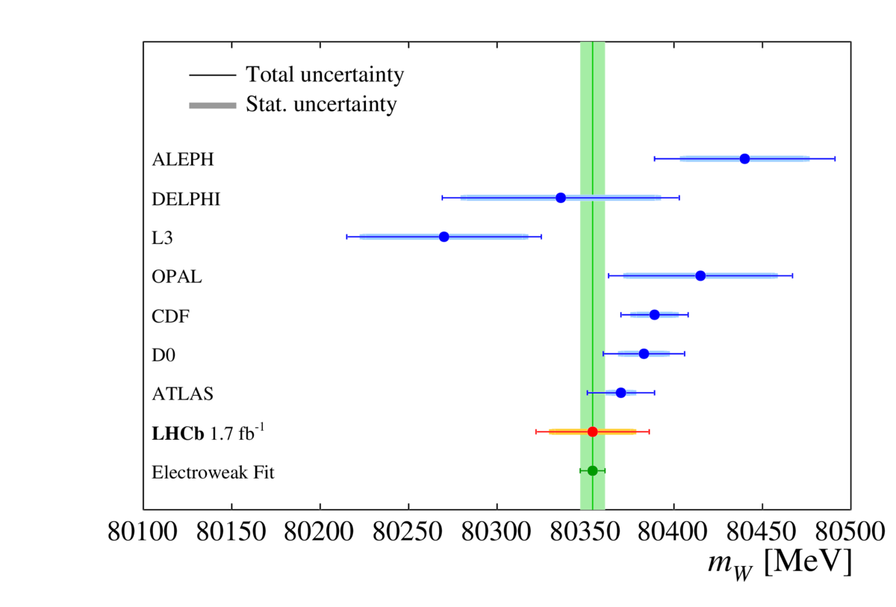
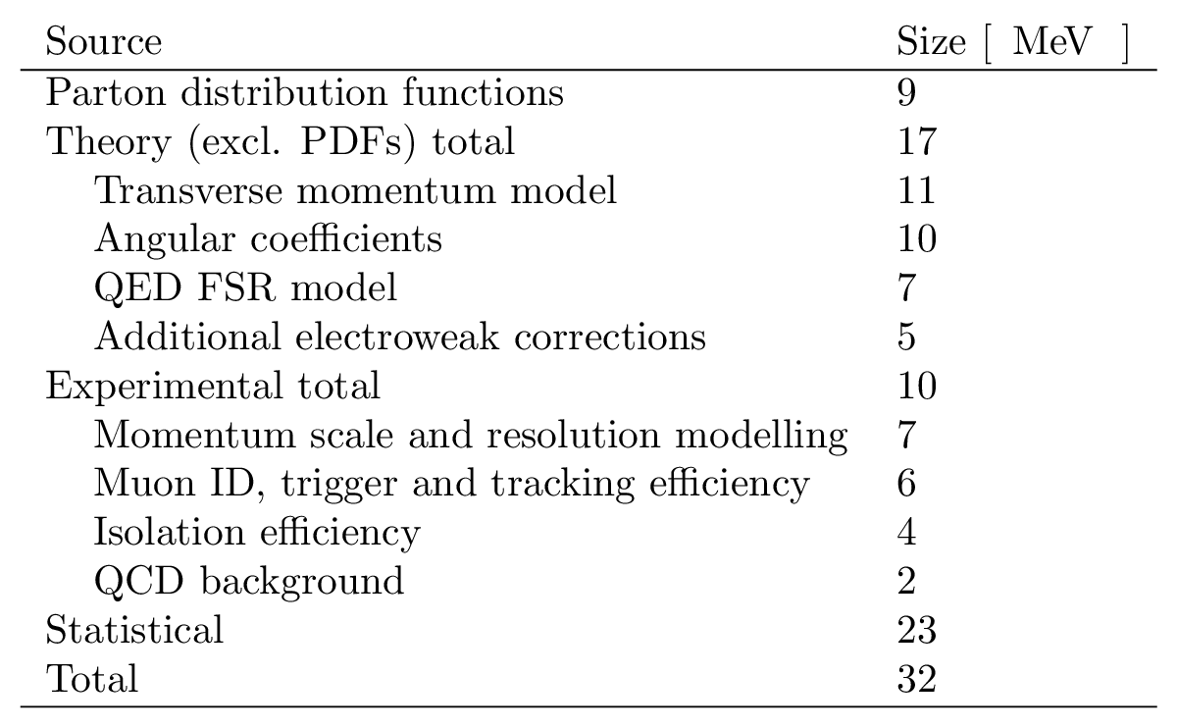

Impacts from PDFs
arXiv:2109.01113
Submitted to JHEP
Recently, LHCb published the first measurement of the $W$boson mass
  PDFs uncertainty is one of dominat uncertainties

Slide 18
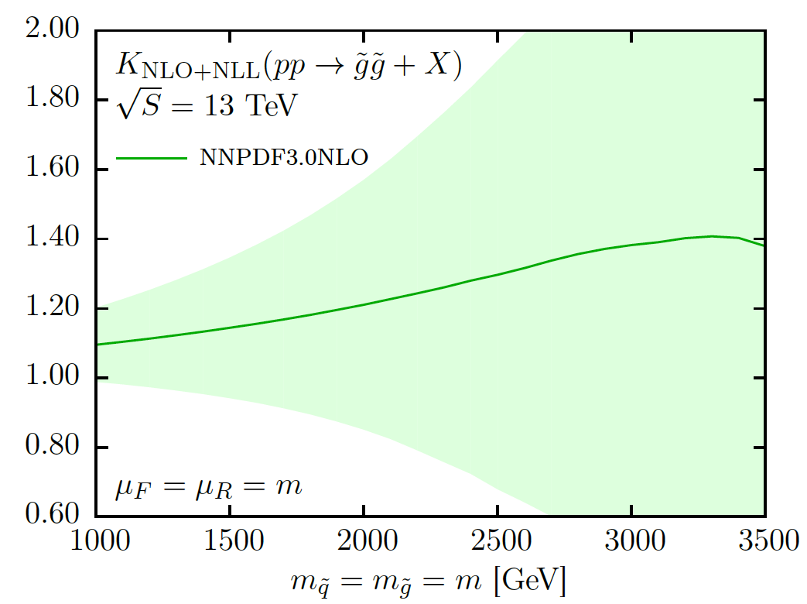
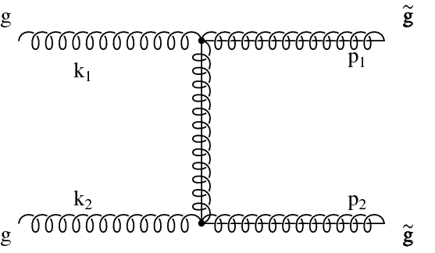

Impacts from PDFs
EPJC 76, 53 (2016)
PDFs uncertainty in the production of NP heavy resonances up to 100%
Limited knowledge of gluon PDFs in the large $x$ region

Slide 19

LHCb detector
The LHCb detector is single-arm forward spectrometer
  Designed for the heavy flavour physics, with $2<η<5$
  Extended to EW measurements: excellent performance of tracking and muon detector
Muon Chambers
Vertex
Locator
Magnet
Tracking Stations
RICH
Detectors
Calorimeters

Slide 20
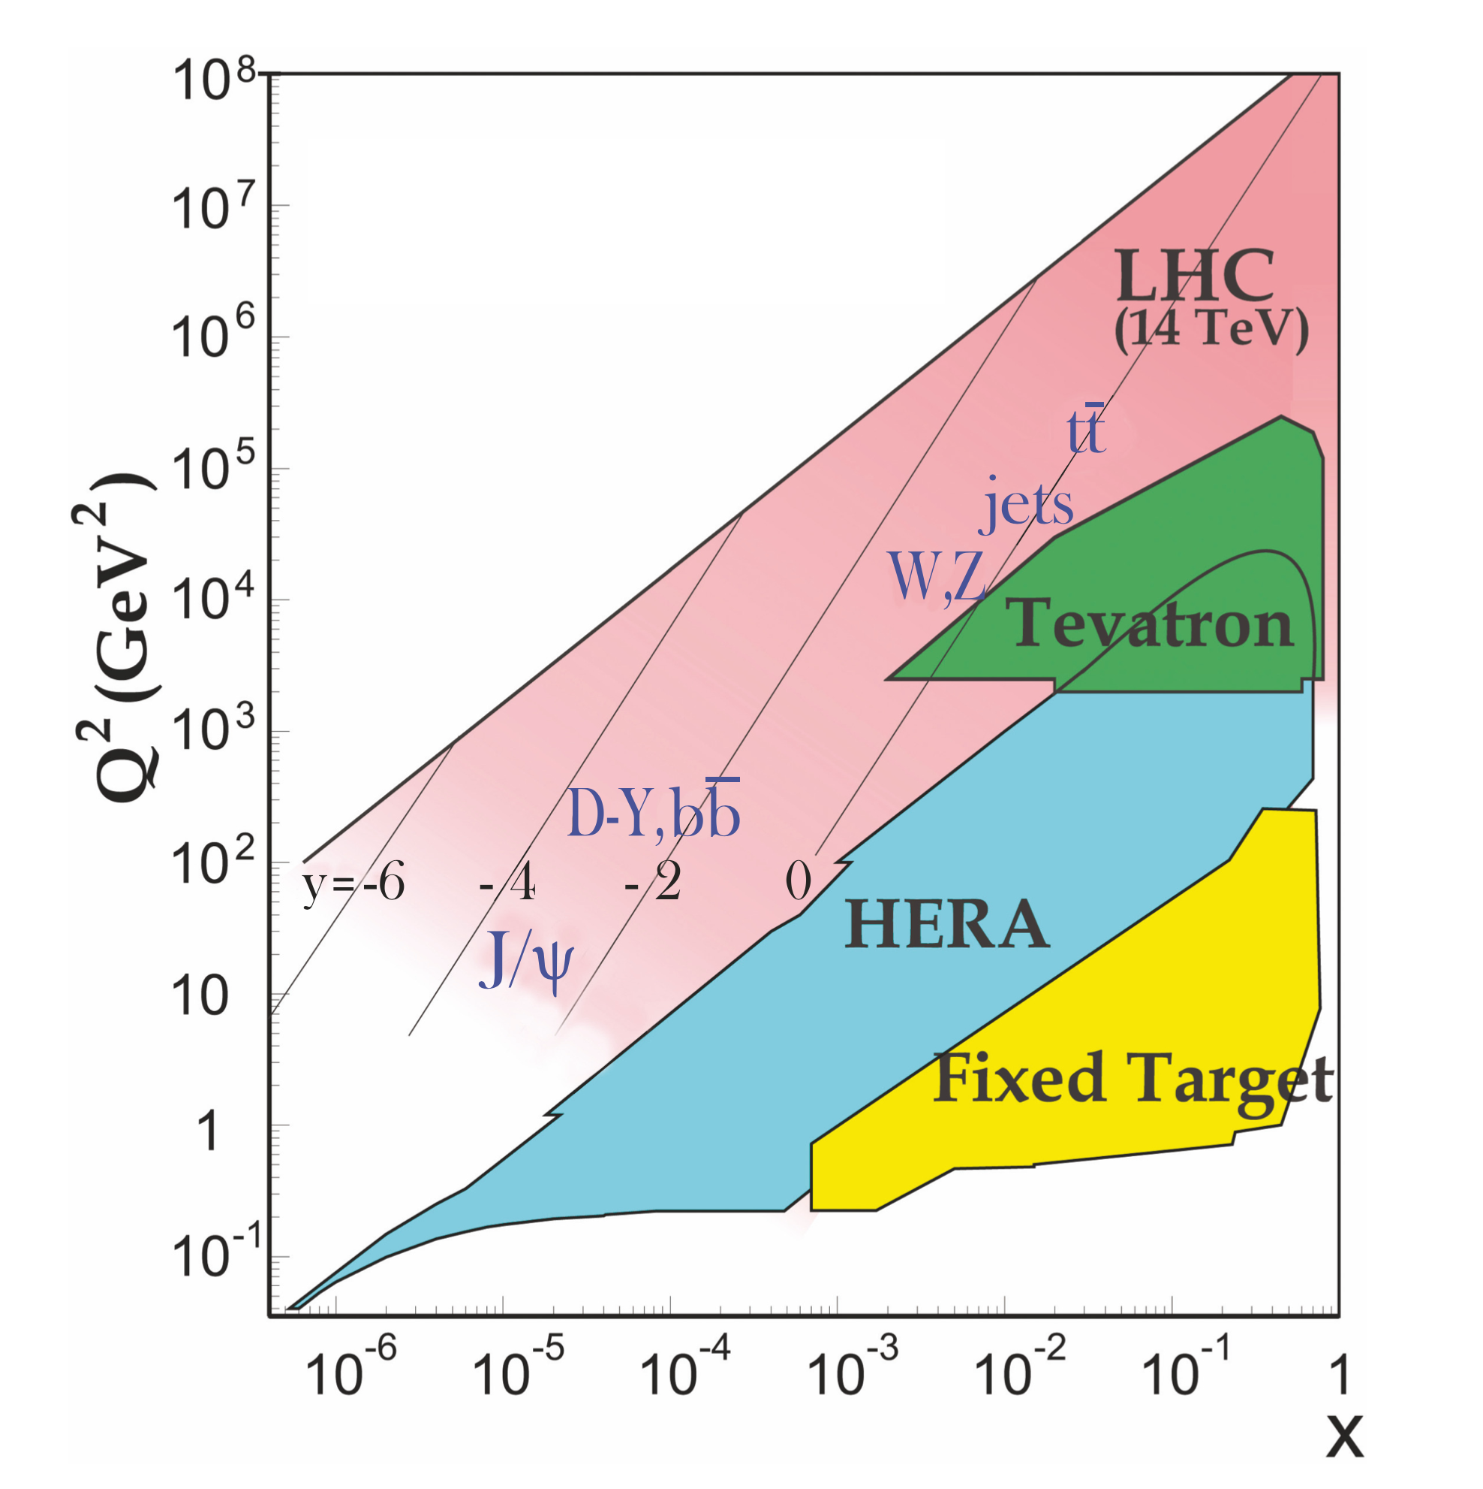
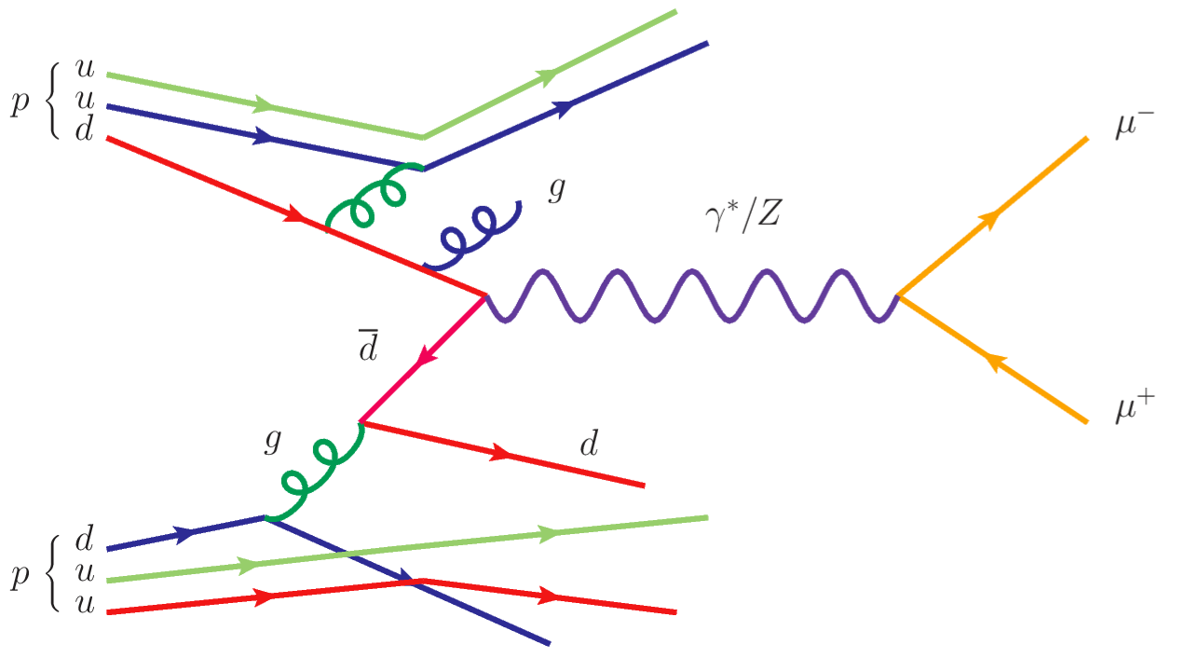

EW physics @ LHCb
The $x$ value of interacting partons are correlated with the boson production
  Rapidity: $y=\frac{1}{2}ln\frac{x_{1}}{x_{2}}$
  Large rapidity: either very large $x$ or very small $x$

Slide 21
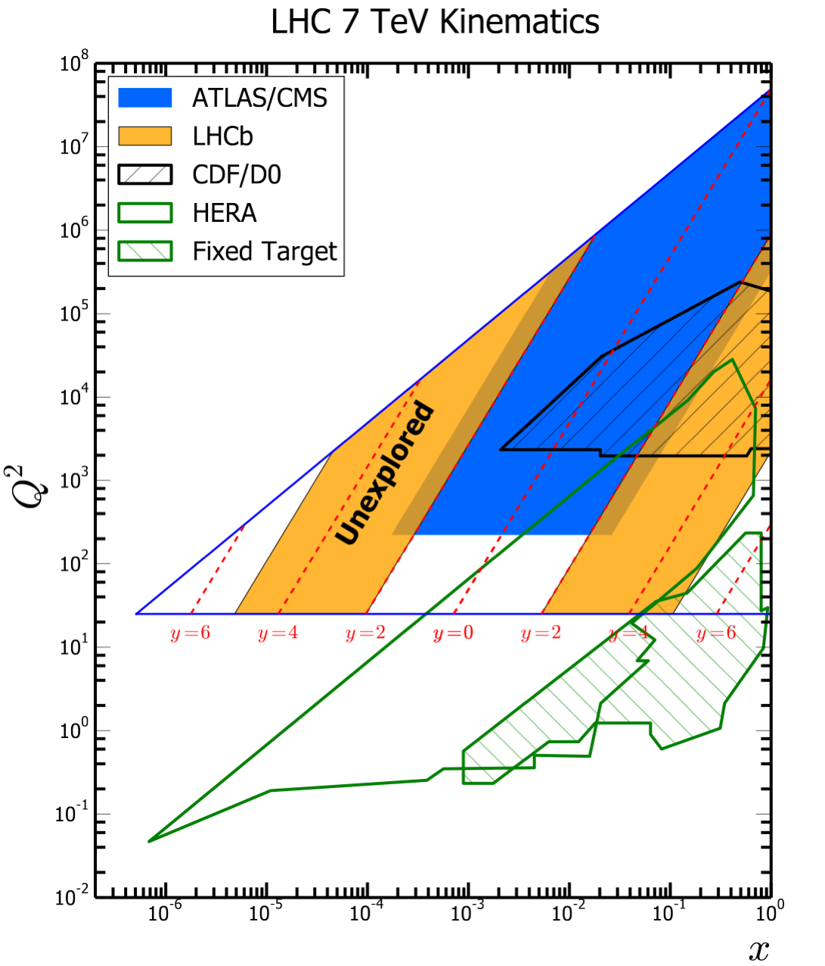
EW physics @ LHCb
The $x$ value of interacting partons are correlated with the boson production
  Rapidity: $y=\frac{1}{2}ln\frac{x_{1}}{x_{2}}$
  Large rapidity: either very large $x$ or very small $x$

Slide 22
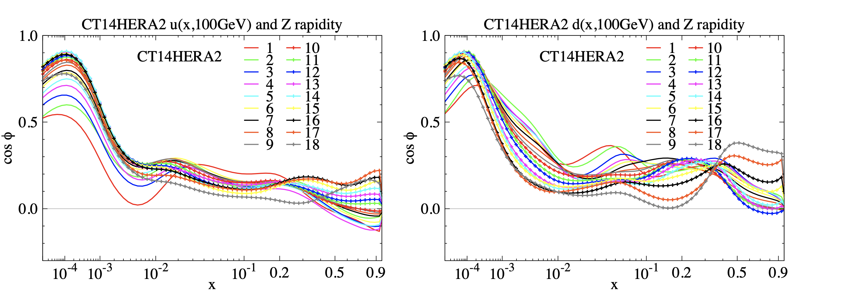

LHCb data and PDFs
Chinese Phys. C 45 (2021) 023110
Strong correlations between LHCb $Z$ boson rapidity and high-$x$ PDFs are seen
  For both $u$ and $d$ quarks

Slide 23
Z boson production cross-section measurement

Slide 24
Motivation
Z boson Cross-sections can be used to test the SM
Potential to improve constraints on parton distribution functions (PDFs)
Measurements of the Z boson rapidity are particularly important for constraining u-, d-quark PDFs

Slide 25
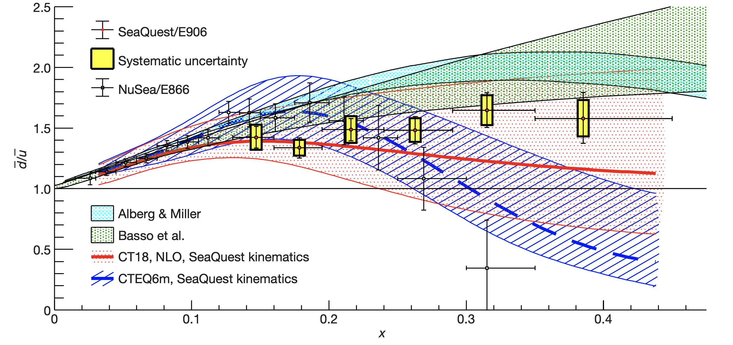
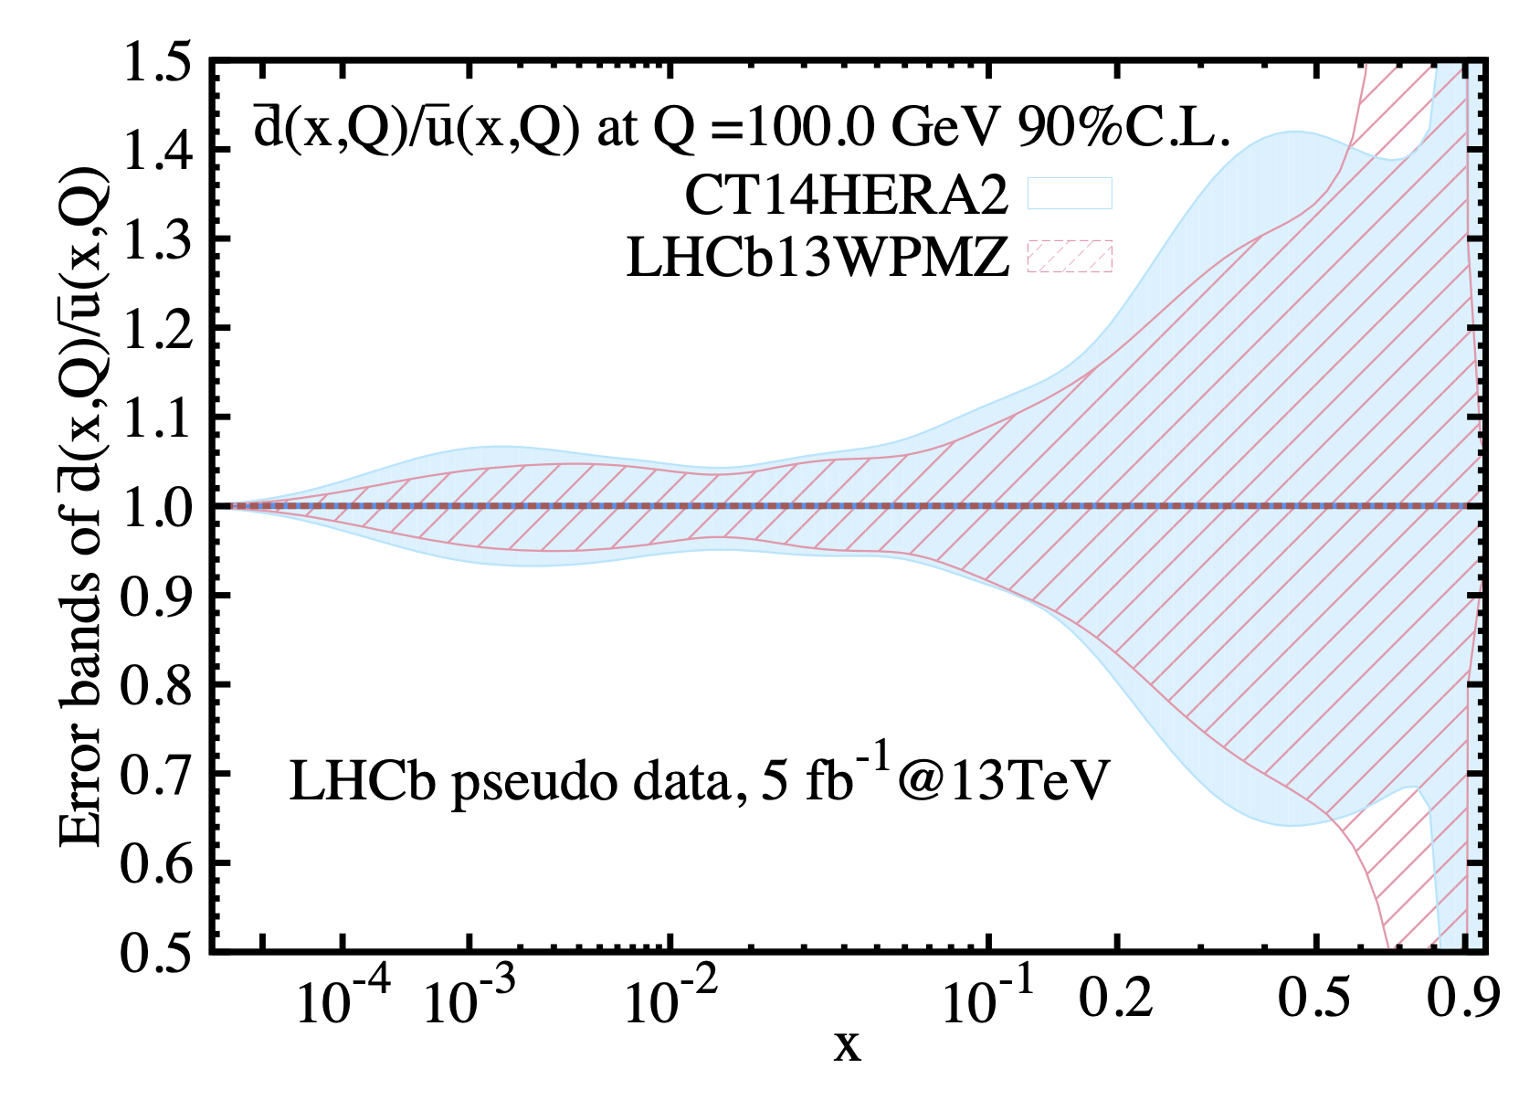
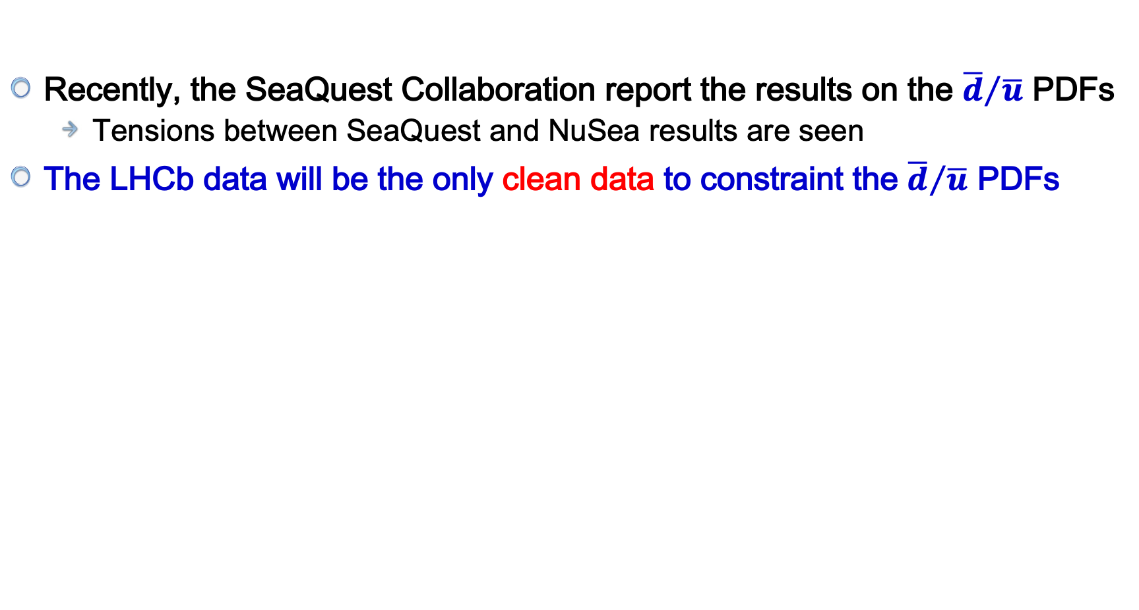
Results from SeaQuest
Recently, the SeaQuest Collaboration report the results on the ${\overline{d}}/{\overline{u}}$ PDFs
  Tensions between SeaQuest and NuSea results are seen
The LHCb data will be the only clean data to constraint the ${\overline{d}}/{\overline{u}}$ PDFs
Nature 590, 561 (2021)
Chinese Phys. C 45 (2021) 023110

Slide 26
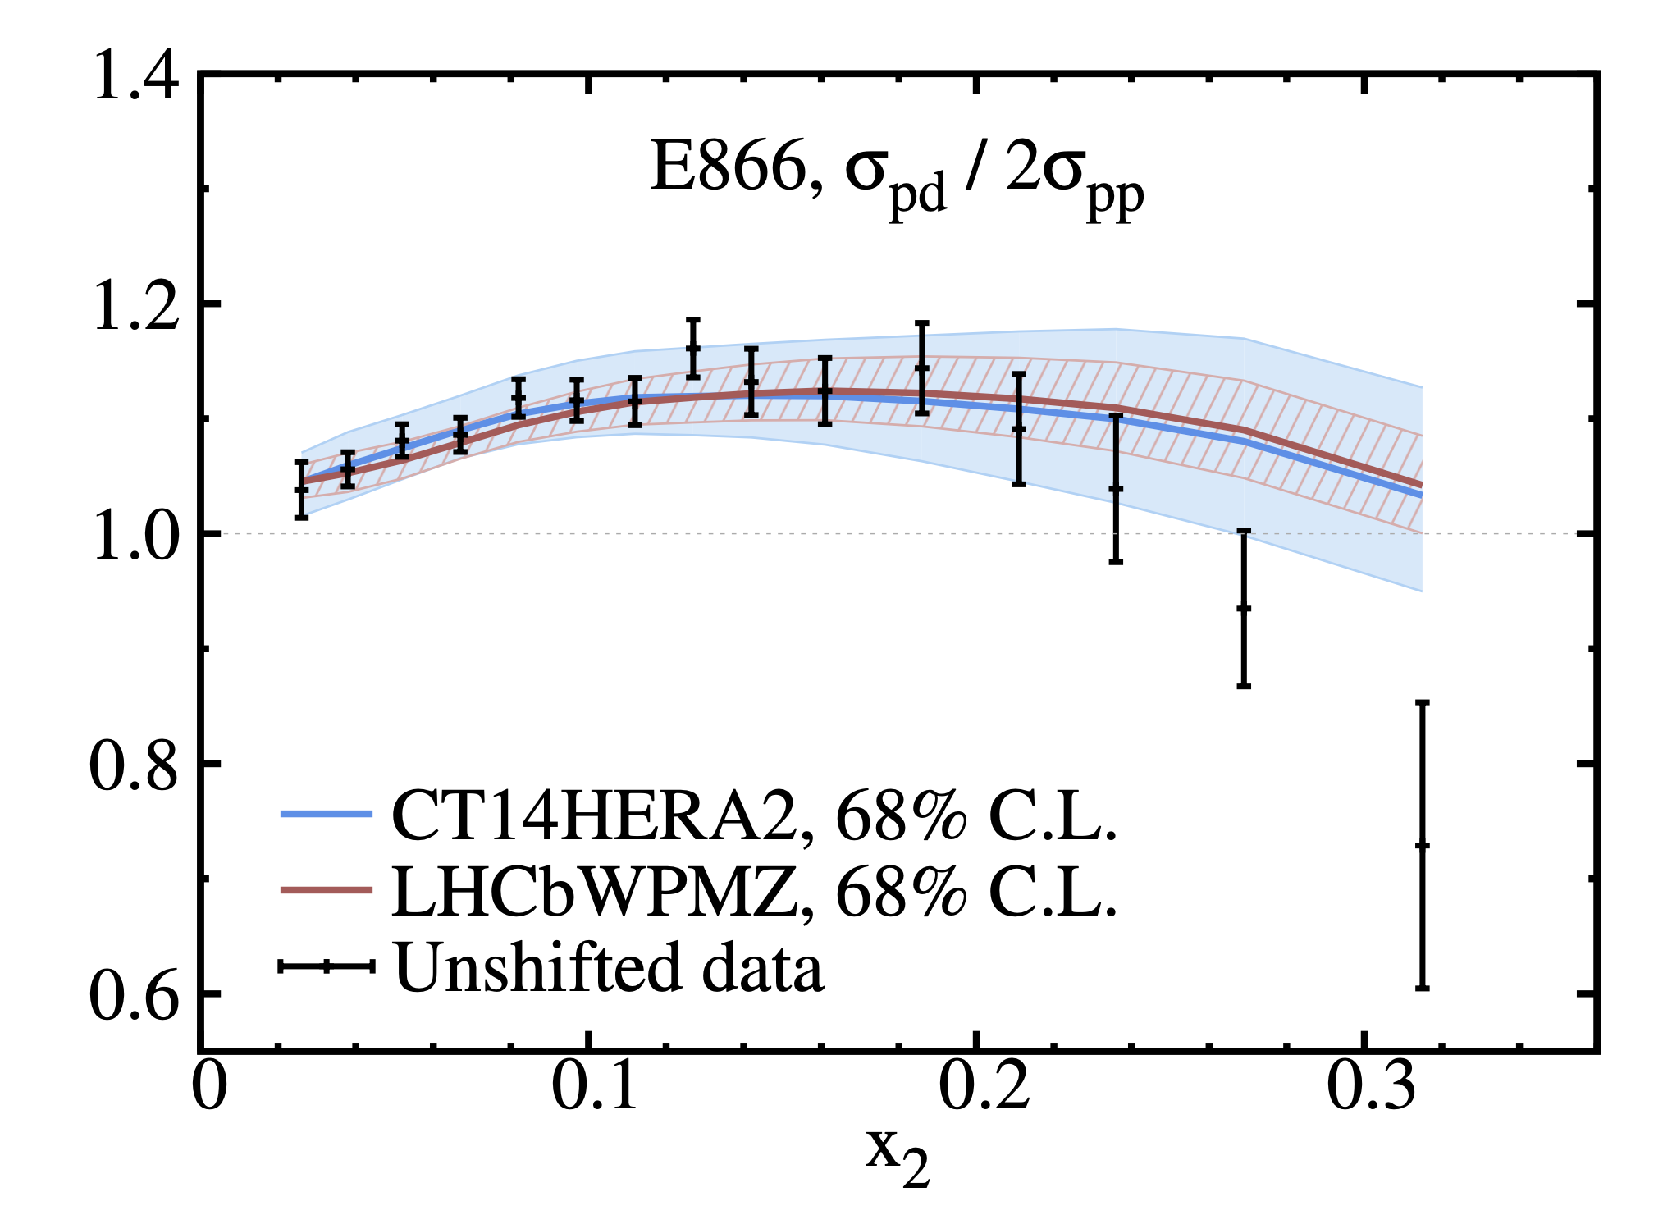
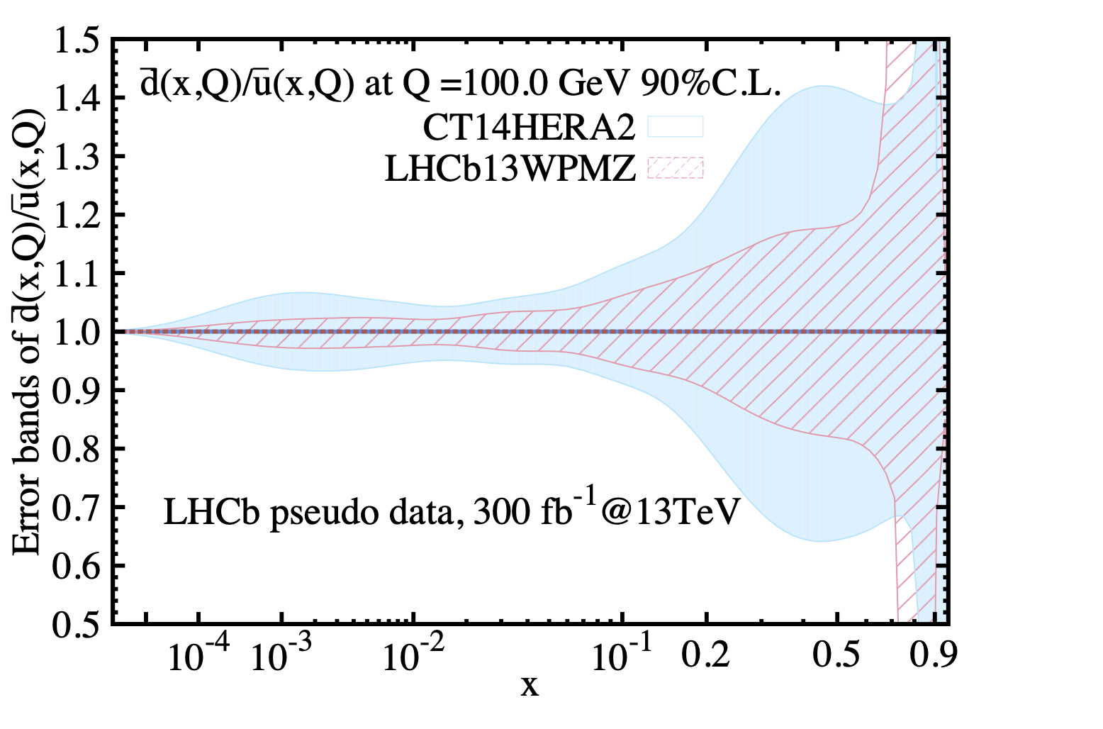

A confirmation from the LHCb?
Chinese Phys. C 45 (2021) 023110
With 300 $fb^{−1}$ LHCb, pp collision data @ 13 TeV in future

Slide 27



Event selection
Very simple selection
Trigger: One muon fires single muon trigger path
Background contribution: ~2%

Slide 28



Strategy: cross-section measurement
Fiducial region: Muons with $2<η<4.5$，$P_{T}>20 GeV/c$，$60<M_{μμ}<120 GeV/c^{2}$
Cross-section measured in bin of $Z y$, $P_{T}$ and $φ_{η}^{∗}$ is given by
Integrated cross-section obtained by summing the differential cross-section

Slide 29



Corrections
Detector level alignment
Efficiency correction
Unfolding
Final-state radiation: back to Born level

Slide 30

Systematic uncertainties
Luminosity determination precision: 2%
Tracking Systematic
  The systematic uncertainty on each muon track is determined to be 0.47%

Slide 31


Differential cross section: Z-rapidity
Reasonable agreeement between data and predictions
Some trends in the lower rapidity region

Slide 32



Differential cross section: $Z−p_{T}$ and $φ_{η}^{∗}$
Reasonable agreement between data and predictions
Provide a stringent test on different QCD calculations

Slide 33


Double differential cross-section
The first double differential cross-section measurement in the forward region

Slide 34


Integrated cross section
arXiv:2112.07458
Submitted to JHEP
The most precise measurement in the
Forward region @ 13 TeV

Slide 35
Intrisic charm

Slide 36

Intrinsic charm
Two types of parton contributions
The extrinsic quarks/gluons:
  Generated on a short time scale in association with a large transverse-momentum reaction
The intrinsic quarks/gluons:
  Exist over a time scale independent of any probe momentum, they are associated with the found state hadron dynamics
Intrinsic charm:
  Long-lived charm component: longer than the interaction time of the probe
  BHPS model: Brodsky, Hoyer, Peterson, and Sakai (1980)
    non-negligible $uudc\overline{c}$ component (independen of PDFs)

Slide 37





Intrisic charm: Experiments
First evidence for IC
Nuc. Phys. B 213, 31 (1983)
PRL 102, 192002 (2009)
Phys. Lett. B 719 (2013) 354-361

Slide 38





How to probe intrinsic charm at LHCb?
Ratio measurement:
IC may enhance $c$-jet production at high $y(Z)$
Challenges: $c$-jet tagging and its efficiency

Slide 39




Event selection
After selection, 69k $Z$+jet candidates
Binning scheme:
  Three $η$ bins [2.00, 2.75, 3.50, 4.50]
  Four $p_{T}\left(jet\right)$ bins [15, 20, 30, 50, 100] GeV
Unfolding to remove detector response
$p_{T}$of $c$-tagged jet

Slide 40





Jet and $c$-jet
Jet reconstuction: particle-flow algorithm using the anti-$k_{T}$ clustering algorithm (FastJet)
Displaced-Vertex (DV) tagger: to separate $c$-jet from $b$-jet and light jets
  Inputs: mass, momentum, position, direction
  $≤4$ tracks: to reject $b$-hadron decays
Simultaneously fit of $m_{cor}$and $N_{trk}$

Slide 41




$C$-jet tagger efficiency
Source of dominant systematic uncertainty
Cannot fully trust simulation, must perform a data-driven calibration
  Use tag-and-probe method: a data/MC correction
  Numerator: DV-tagged $c$-jet yield in probe sample, get from fitting
  Denominator: the number of $c$-jet with exclusive decay mode, such as $D^{0}→K^{−}π^{+}$ and $D^{+}→K^{−}π^{+}π^{+}$
  Corrections: detector response, branching fraction, fragmentation fraction
Topically efficiency: $(23.9±1.4)\%$ in the 20-30 GeV $p_{T}$(jet) bin

Slide 42

Uncertainty

Slide 43


Results
arXiv:2109.08084
Submitted to PRL
The measured result has a sizeable enhancement at forward $Z$ rapidity region
  Consistent with LFQCD + IC
  Indicate a valence-like IC component in the proton wave function

Slide 44
Prospects

Slide 45

What can be done further at LHCb?
$W$ charge asymmetry
$W$ cross section measurement
$Z$ angular coefficient measurement
$V$+jet:
  $V=W,Z$
  Jet: light hadron, $c$-jet, $b$-jet

Slide 46




$W$ boson charge asymmetry
Probe valence quark: $u$ and $d$ quarks
Asymmetries:
  $W$ boson charge asymmetry: $A=\frac{\frac{dσ}{dy_{W}^{+}}−\frac{dσ}{dy_{W}^{−}}}{\frac{dσ}{dy_{W}^{+}}+\frac{dσ}{dy_{W}^{−}}}$
  However, there is a neutrino in the final state
  Lepton charge asymmetry: $A=\frac{\frac{dσ}{dy_{l}^{+}}−\frac{dσ}{dy_{l}^{−}}}{\frac{dσ}{dy_{l}^{+}}+\frac{dσ}{dy_{l}^{−}}}$

Slide 47

$W$ boson charge asymmetry
Probe valence quark: $u$ and $d$ quarks
Asymmetries:
  $W$ boson charge asymmetry: $A=\frac{\frac{dσ}{dy_{W}^{+}}−\frac{dσ}{dy_{W}^{−}}}{\frac{dσ}{dy_{W}^{+}}+\frac{dσ}{dy_{W}^{−}}}$
  However, there is a neutrino in the final state
  Lepton charge asymmetry: $A=\frac{\frac{dσ}{dy_{l}^{+}}−\frac{dσ}{dy_{l}^{−}}}{\frac{dσ}{dy_{l}^{+}}+\frac{dσ}{dy_{l}^{−}}}$
JHEP 01 (2016) 155

Slide 48





$W$ cross section measurement
Probe the $s$ quark PDFs
Use $W$ and $Z$ boson cross-section ratio
  $R=\frac{σ\left(W^{+}\right)+σ\left(W^{−}\right)}{σ(Z)}$
  In the first order: $R∝\frac{u\overline{s}+\overline{u}s}{u\overline{u}+d\overline{d}}≈\frac{s+\overline{s}}{\overline{u}+\overline{d}}$
$u, d, s, c$ …
Phys. Rev. D 103, 014013 (2021)

Slide 49




$Z$ angular coefficient measurement
$A_{2}$ is sensitive to the Boer-Mulders transverse momentum dependent PDFs (TMD)
LHCb Run-2 result: close to submission
  Low mass, middle mass and high mass region
  Study $A_{2}$ vs. $Z p_{T}$

Slide 50


$V$+Jet and other measurements
Strangeness
Large-x gluon
(anti-) quarks
Large-x gluon
Medium-x gluon
Medium-x gluon

Slide 51

Summary
The knowledge of the PDFs is crucial for precision measurements at hadron colliders
With detector instrumented in the forward region, the LHCb results could provide unique information for the PDFs fitting
  Very large or small $x$ region
  Sea quark PDFs
  Instrisic charm PDFs
  ….
The EW processes play a key role in the LHCb proton structure studies
Stay tuned for new results !

Slide 52

Physics @LHCb
Better understanding of the SM
Challenging the SM
QCD
QED and Weak

Slide 53

Backup

Slide 54

Parton-Parton interactions
Interaction between the partons which constitute the hadrons
  Not well defined parton energy, but energy distribution
PDFs are parameterizations of the partonic content of the proton
At hadron colliders, the cross-section calculation is a convolution of the cross-section at parton level and PDFs:
  $σ_{X}=\sum_{a,b}{\int_{0}^{1}{dx_{a}dx_{b}f(x_{a},flav_{a},Q^{2})f(x_{b},flav_{b},Q^{2})}⋅σ_{ab→X}(x_{a},x_{b},Q^{2})}$
Sum over initial partonic states a,b
Parton Distribution Function
Hard scatterring cross-section

Slide 55



PDFs analyses
Predictions are calculated with NNLO (QCD) and NLO (EW) accuracy using either analytic formulae for NC/CC DIS processes, or $K$-factor techniques for other processes
Global fit: adjusting agreement between predictions ($T$) and data ($D$)
  $χ^{2}=\sum_{i}{\frac{{\left[D_{i}−T_{i}\left(1−\sum_{j}{γ_{ij}b_{j}}\right)\right]}^{2}}{δ_{i,uncor}^{2}T_{i}^{2}+δ_{i,stat}^{2}D_{i}T_{i}}+\sum_{j}{b_{j}^{2}}+\sum_{i}{log\frac{δ_{i,uncor}^{2}T_{i}^{2}+δ_{i,stat}^{2}D_{i}T_{i}}{δ_{i,uncor}^{2}D_{i}^{2}+δ_{i,stat}^{2}D_{i}^{2}}}}$
  Includes uncorrelated, statistical uncertainties, also the correlated one ($γ$) using nuisance parameters $b$
Partial $χ^{2}$
Correlated $χ^{2}$
Log penalty

Slide 56


DGLAP function
Dokshitzer-Gribov-Lipatov-Altarelli-Parisi (DGLAP) evolution equations
  Vladimir Gribov and Lev Lipatov in 1972 [Sov. J. Nucl. Phys. 15:438 (1972)]
  Yuri Dokshitzer in 1977 [Sov. Phys. JETP 46:641 (1977)]
  Guido Altarelli and Giorgio Parisi in 1977 [Nuclear Physics B. 126 298–318]
2015 High Energy and Particle Physics Prize (EPS)
Giorgio Parisi
The Nobel Prize in Physics 2021
Notes:
Guido Altarelli, Lev Lipatov, Yuri Dokshitzer and Giorgio Parisi recived their prize
for the discovery of the interplay of disorder and fluctuations in physical systems from atomic to planetary scales.
Vladimir Gribov 弗拉基米尔·格里博夫
Lev Lipatov :列夫·尼卡拉耶维奇·里帕特夫
Guido Altarelli : 圭多·阿塔雷利
为了理解质子内部的复杂结构和演化规律，人们通常采用QCD演化方程进行描述。其主要原理是：目前的QCD理论不能从第一性原理出发计算夸克和胶子的分布，而通过演化方程，可以从某已知的初始分布(实验测量或者模型预言)得到其它情况下的分布。其中，使用得最普遍的是帕里西等人提出的DGLAP方程。DGLAP方程，是由三组研究人员独立发现的，DGLAP分别代表着五个发现者的姓氏首字母：1972年，苏联理论物理学家Gribov和Lipatov提出部分子密度的演化方程;1977年，帕里西和Altarelli用一种简洁的方法独立推导出类似的演化方程——AP方程;也是在1977年，苏联学者Dokshitzer独立提出了演化方程。DGLAP方程是分布函数随探针尺度变化的演化方程：夸克和胶子分布函数随探针尺度的变化，是由辐射胶子或胶子变为正反夸克的概率所决定的。自DGLAP方程提出来以后，科学家们进一步提出了更多的演化方程，比如BFKL方程、BK方程和JIMWLK方程，等等。这些演化方程是高能粒子物理的基石.

Slide 57


E906/SeaQuest experiment @Fermilab

Slide 58


New Muon Collaboration (NMC)
Gottfried Sum Rule
  $S_{G}=\frac{1}{3}+\int_{0}^{1}{\frac{2}{3}\left({\overline{u}}_{p}\left(x\right)−{\overline{d}}_{p}\left(x\right)\right)dx}$
Symmetric sea implies $S_{G}=\frac{1}{3}$
NMC experiment (LD2, LH2, 90 GeV and 280 GeV $μ$-beam)
  $S_{G}=\int_{0}^{1}{\frac{\left(F_{2}^{p}−F_{2}^{n}\right)dx}{x}=0.235±0.026}$
  Violation of symmetric sea quark contributions!

Slide 59



Flavor asymmetry in light quark sea
Asumming charge symmetry, ignoring nuclear effects of deuterium
And heavy quark contributions
Naively, we should expect flavour symmetry between $\overline{u}$ and $\overline{d}$
E866/NuSea experiment reveals a striking asymmetry in the sea
Distribution at moderate x

Slide 60



$φ_{η}^{∗}$angle
Probe same physics $Z$ boson $p_{T}$, but smaller uncertainty
$φ_{η}^{∗}=\tan\left({φ_{acop}}/2\right)sin⁡(θ_{η}^{∗})$
  $φ_{acop}$: acoplanarity angle, $π−Δφ_{ll}$
  $Δφ_{ll}$: the difference in azimuthal angle, $φ$, between two lepton candidates
  $θ_{η}^{∗}$: scattering angle of the leptons with respect to the proton beam in the rest frame of dilepton system:
    $\cos\left(θ_{η}^{∗}\right)=tanh⁡[{η^{−}−η^{+}}/2]$

Slide 61


Correlation matrix

Slide 62

TMD
The genenral PDFs describes the parton inside a proton
Only have one longitudinal freedom, $x$
  quarks are perfectly collinear
Transverse Momentum Dependent PDFs: TMD
  Admit a finite quark transverse momentum $k_{T}$
  Provide 3D image of hadrons in momentum space
  Correlation between parton momentum and hadron spin

Slide 63

TMD

Slide 64

Boer-Mulders function
By D. Boer, P. J. Mulders (1997):
  Phys. Rev. D 57 (1998), 5780
Represents a correlation between quark $k_{T}$ and transverse spin in an unpolarized hadron
  A time-reversal odd, chiral-odd TMD PDFs
  Lead to an azimuthal $cos⁡(2φ)$ dependence in Drell-Yan
Time-reversal odd distribution functions in leptoproduction
Notes:
Nonperturbative effects can lead to violation of the Lam-Tung relation via a correlation between
the transverse spin and transverse momentum of the initial-state quark or antiquark,
represented by the Boer-Mulders transverse-momentum-dependent (TMD) parton distribution function (PDFs)~\cite{Boer:1999mm}.
Significant violation of the Lam-Tung relation has been observed in pion-induced Drell-Yan measurements,
It is unclear if nonperturbative spin-momentum correlations in the proton, described by the Boer-Mulders distribution,
could lead to such variations as no phenomenological calculations are available.
None of the comparison calculations used in the comparison include this type of nonperturbative effect.

Slide 65

Boer-Mulders function
A correlation between quark $k_{T}$ and transverse spin
in an unpolarized hadron!
By D. Boer, P. J. Mulders (1997):
  Phys. Rev. D 57 (1998), 5780
Transverse momentum
Parton momentum as a fraction of proton momentum
Time-reversal odd distribution functions in leptoproduction

Slide 66

Boer-Mulders function
By D. Boer, P. J. Mulders (1997):
  Phys. Rev. D 57 (1998), 5780
A proton with a momentum $P$
Time-reversal odd distribution functions in leptoproduction

Slide 67
Boer-Mulders function
By D. Boer, P. J. Mulders (1997):
  Phys. Rev. D 57 (1998), 5780
A three dimensional Fourier transform
Time-reversal odd distribution functions in leptoproduction

Slide 68
Boer-Mulders function
By D. Boer, P. J. Mulders (1997):
  Phys. Rev. D 57 (1998), 5780
A specific path of the Wilson line L, depends on the process
in a calculable and predictable way
Time-reversal odd distribution functions in leptoproduction

Slide 69

Boer-Mulders function
By D. Boer, P. J. Mulders (1997):
  Phys. Rev. D 57 (1998), 5780

Slide 70

Target luminosity

Slide 71



$F_{2}(x,Q^{2})$ results
For the $e^{−}p→e^{−}X$ inelastic scattering
$\frac{d^{2}σ}{dxdQ^{2}}=\frac{4πα^{2}}{Q^{4}}\left[\left(1−y\right)\frac{F_{2}\left(x,Q^{2}\right)}{x}+yF_{1}(x,Q^{2})\right]$
  $F_{1}\left(x,Q^{2}\right) ,F_{2}\left(x,Q^{2}\right)$: structure functions
  $F_{1}\left(x,Q^{2}\right)$: pure magnetic structure function
  $F_{2}\left(x,Q^{2}\right)$ : electromagnetic structure function
  Independent of $Q^{2}$: Bjorken scaling
  Callan-Gross relation: $F_{2}\left(x\right)=2xF_{1}(x)$
In the low $x$ region,
  Clear violations of scaling
  At high $Q^{2}$ (shorter wave-length) resolve finer
  structure

Slide 72

Leading-Order and Higher-Order amplitudes

Slide 73





Higher-Order calculation
$\frac{dσ}{dq_{T}^{2}}\sim \frac{1}{q_{T}^{2}}\sum_{n=1}^{∞}{\sum_{m=0}^{2n−1}{α_{S}^{(n)}\ln^{(m)}\left(\frac{Q^{2}}{q_{T}^{2}}\right)}}$, with $L≡ln\left(\frac{Q^{2}}{q_{T}^{2}}\right)$
$\sim \frac{1}{q_{T}^{2}}\left\{α_{S}(L+1)\right.$
$+α_{S}^{2}(L^{3}+L^{2}+L+1)$
$+α_{S}^{3}({L^{5}+L^{4}+L}^{3}+L^{2}+L+1)$
$+ \left.⋯\right\}$
In the low $q_{T}$ region, $α_{S}ln⁡(\frac{Q^{2}}{q_{T}^{2}})≈1$
For example, $0.1×ln⁡(\frac{{90}^{2}}{3^{2}})\sim 1$ !!
Even larger than 1.

Slide 74

Higher-Order calculation: resummation
$\frac{dσ}{dq_{T}^{2}}\sim \frac{1}{q_{T}^{2}}\sum_{n=1}^{∞}{\sum_{m=0}^{2n−1}{α_{S}^{(n)}\ln^{(m)}\left(\frac{Q^{2}}{q_{T}^{2}}\right)}}$, with $L≡ln\left(\frac{Q^{2}}{q_{T}^{2}}\right)$
$\sim \frac{1}{q_{T}^{2}}\left\{[α_{S}(L+1)\right.+α_{S}^{2}\left(L^{3}+L^{2}\right)+α_{S}^{3}\left(L^{5}+L^{4}\right)+⋯]$
$+{[ + α}_{S}^{2}\left(L+1\right) +α_{S}^{3}\left(L^{3}+L^{2}\right)+⋯]$
$+[ + α_{S}^{3}\left(L+1\right) +⋯]$
$+ \left.⋯\right\}$

Slide 75

Higher-Order calculation: Collins-Soper-Sterman
$\frac{dσ}{dq_{T}^{2}}\sim \frac{1}{q_{T}^{2}}\sum_{n=1}^{∞}{\sum_{m=0}^{2n−1}{α_{S}^{(n)}\ln^{(m)}\left(\frac{Q^{2}}{q_{T}^{2}}\right)}}$, with $L≡ln\left(\frac{Q^{2}}{q_{T}^{2}}\right)$
$\sim α_{s}^{n}\left(C_{0}+C_{1}α_{S}+⋯\right)exp\left[\left(\sum_{n=1}{α_{s}^{n}L^{n+1}c_{n} }\right)+\left(\sum_{n=1}{α_{s}^{n}L^{n}d_{n} }\right)+\left(\sum_{n=1}{α_{s}^{n}L^{n−1}e_{n} }\right)+⋯\right]$
LL,NLL
LL
NNLL
NLL
NNLL

Slide 76

Fixed-Order vs. Resummation
Chinese Phys. C 45 (2021) 023110

Slide 77

Impacts from the future LHCb data
Chinese Phys. C 45 (2021) 023110

Slide 78

Impacts from the future LHCb data
Chinese Phys. C 45 (2021) 023110

Slide 79

Impacts from the future LHCb data
Chinese Phys. C 45 (2021) 023110

Slide 80

LHCb previous results
arXiv:1705.04468

Slide 81

LHCb previous results
arXiv:1705.04468

