Slide 1
顶夸克物理简介
张华桥 （高能物理研究所）

Slide 2
Outline
顶夸克的发现史：从预言到发现
顶夸克的性质介绍：
  顶夸克的产生与衰变
  顶夸克的性质测量
  顶夸克的质量
  顶夸克与希格斯粒子的耦合
顶夸克与新物理 （高质量）
总结与展望

Slide 3
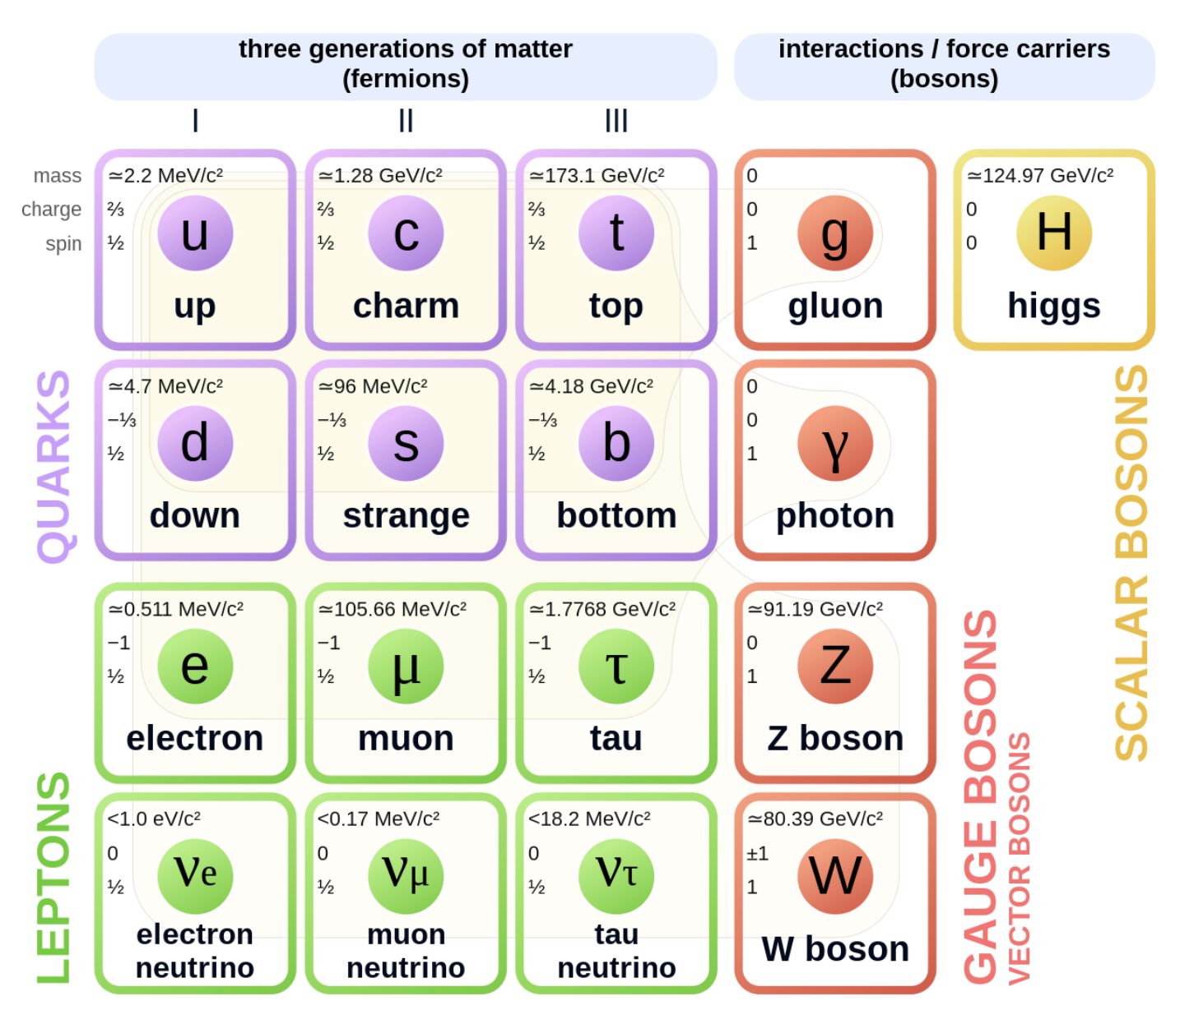
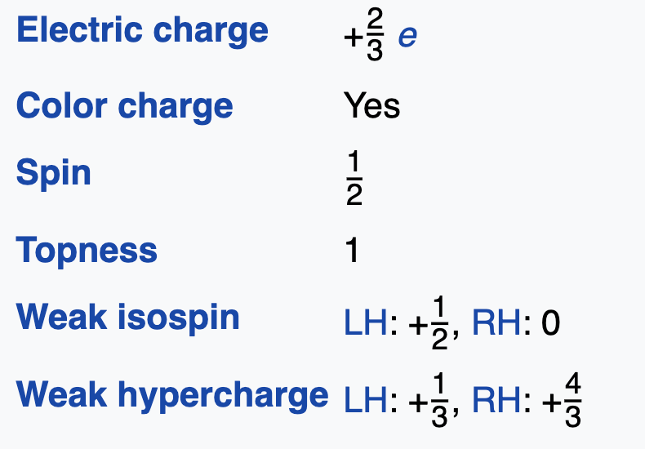
Top quark resume
Mass: ~173 GeV
  The known heaviest element
Life time: ~4*10⁻²⁵
  Decay before hadronization
Large Yukawa Couplings
  With Higgs: Yt=√2Mt/vev ~1
Produced with strong or electroweak interaction
Decay CKM mechanism
Precision test of SM
  α_{s}(Mt) ~ 0.1
  pQCD calculation accurate
大胖子，急性子，还喜欢和希格斯粒子结对子

Slide 4
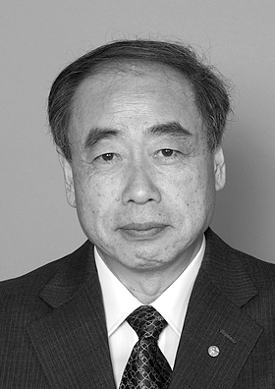
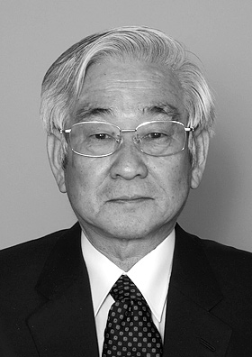
History of top quark
1973, Kobayashi 和 Maskawa为了解释K介子衰变中的CP破坏现象，预言了第三代夸克存在
DESY
SLAC
JAPAN
1996: Tevatron 终于发现顶夸克
2009: LHC “顶夸克”工厂运行
Nobel Prize 2008
没找到
Makoto Kobayashi
Toshihide Maskawa
"for the discovery of the origin of the broken symmetry which predicts the existence of at least three families of quarks in nature."

Slide 5
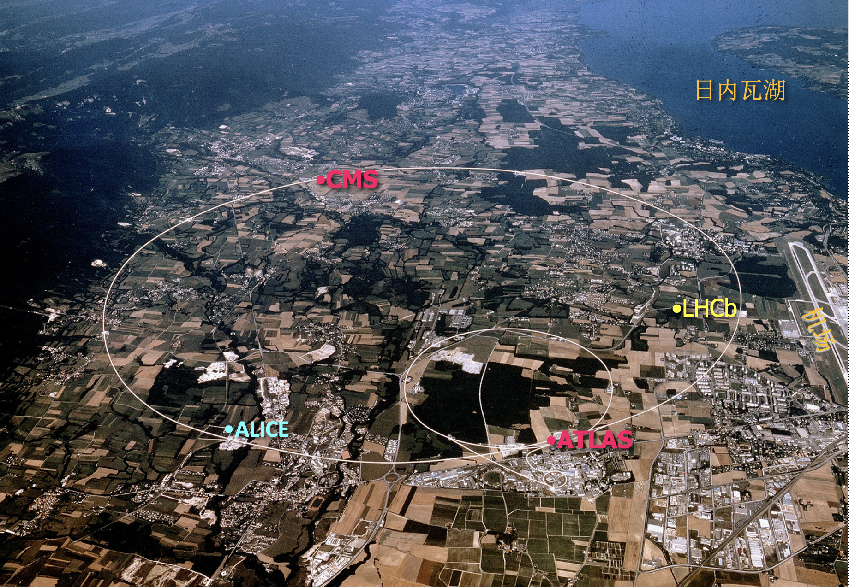
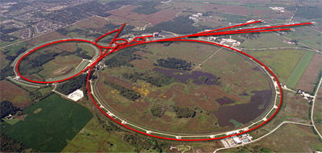
Proton-(anti) proton collider
Tevatron： 1983–2011
主环周长6.3公里，位于美国芝加哥费米实验室（Fermilab）
质心能量～2TeV，发现顶夸克
LHC： 2009-今
主环周长27km，跨越瑞士法国国境的欧洲核子中心（CERN），总投资40亿美元，发现希格斯粒子
世界能量最高最大的加速器，质心系能量14TeV(14x10¹²eV)

Slide 6
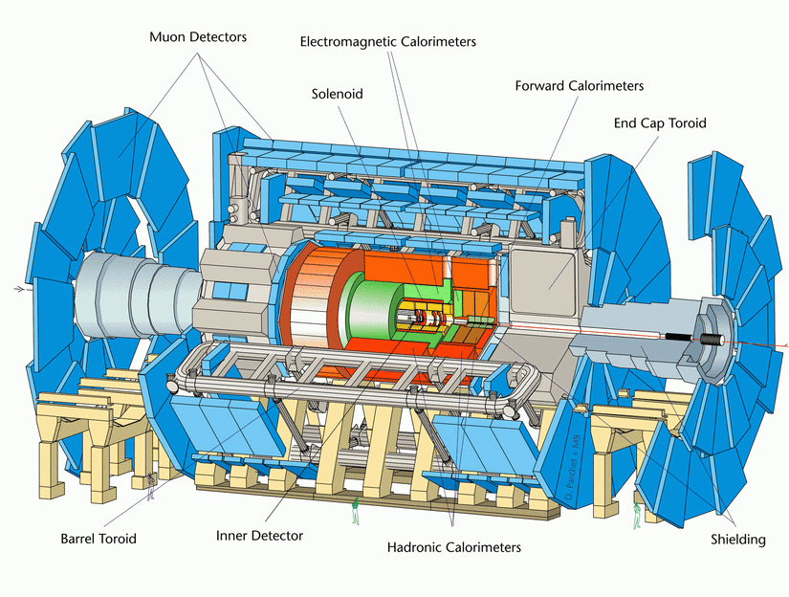
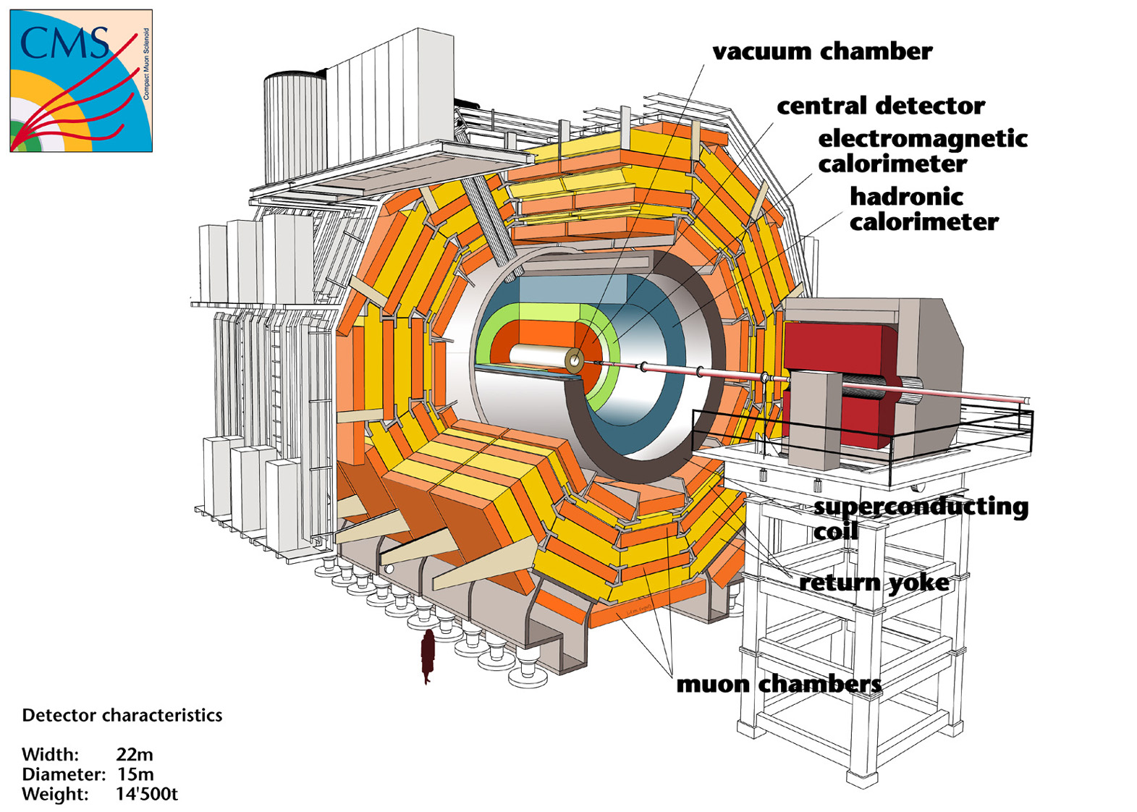

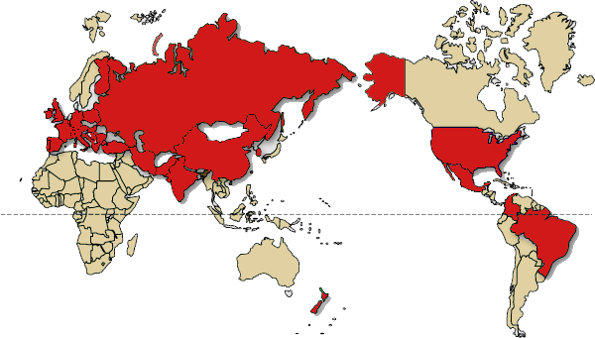
ATLAS和CMS介绍

Slide 7
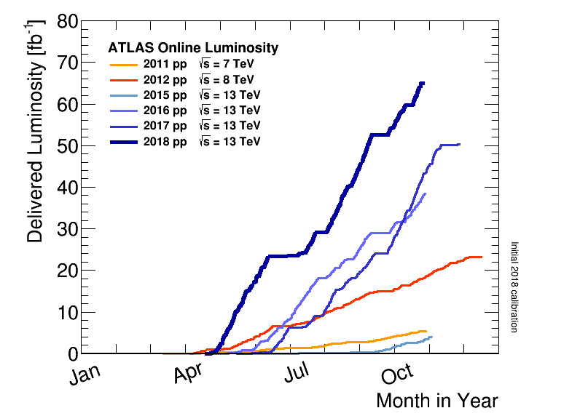
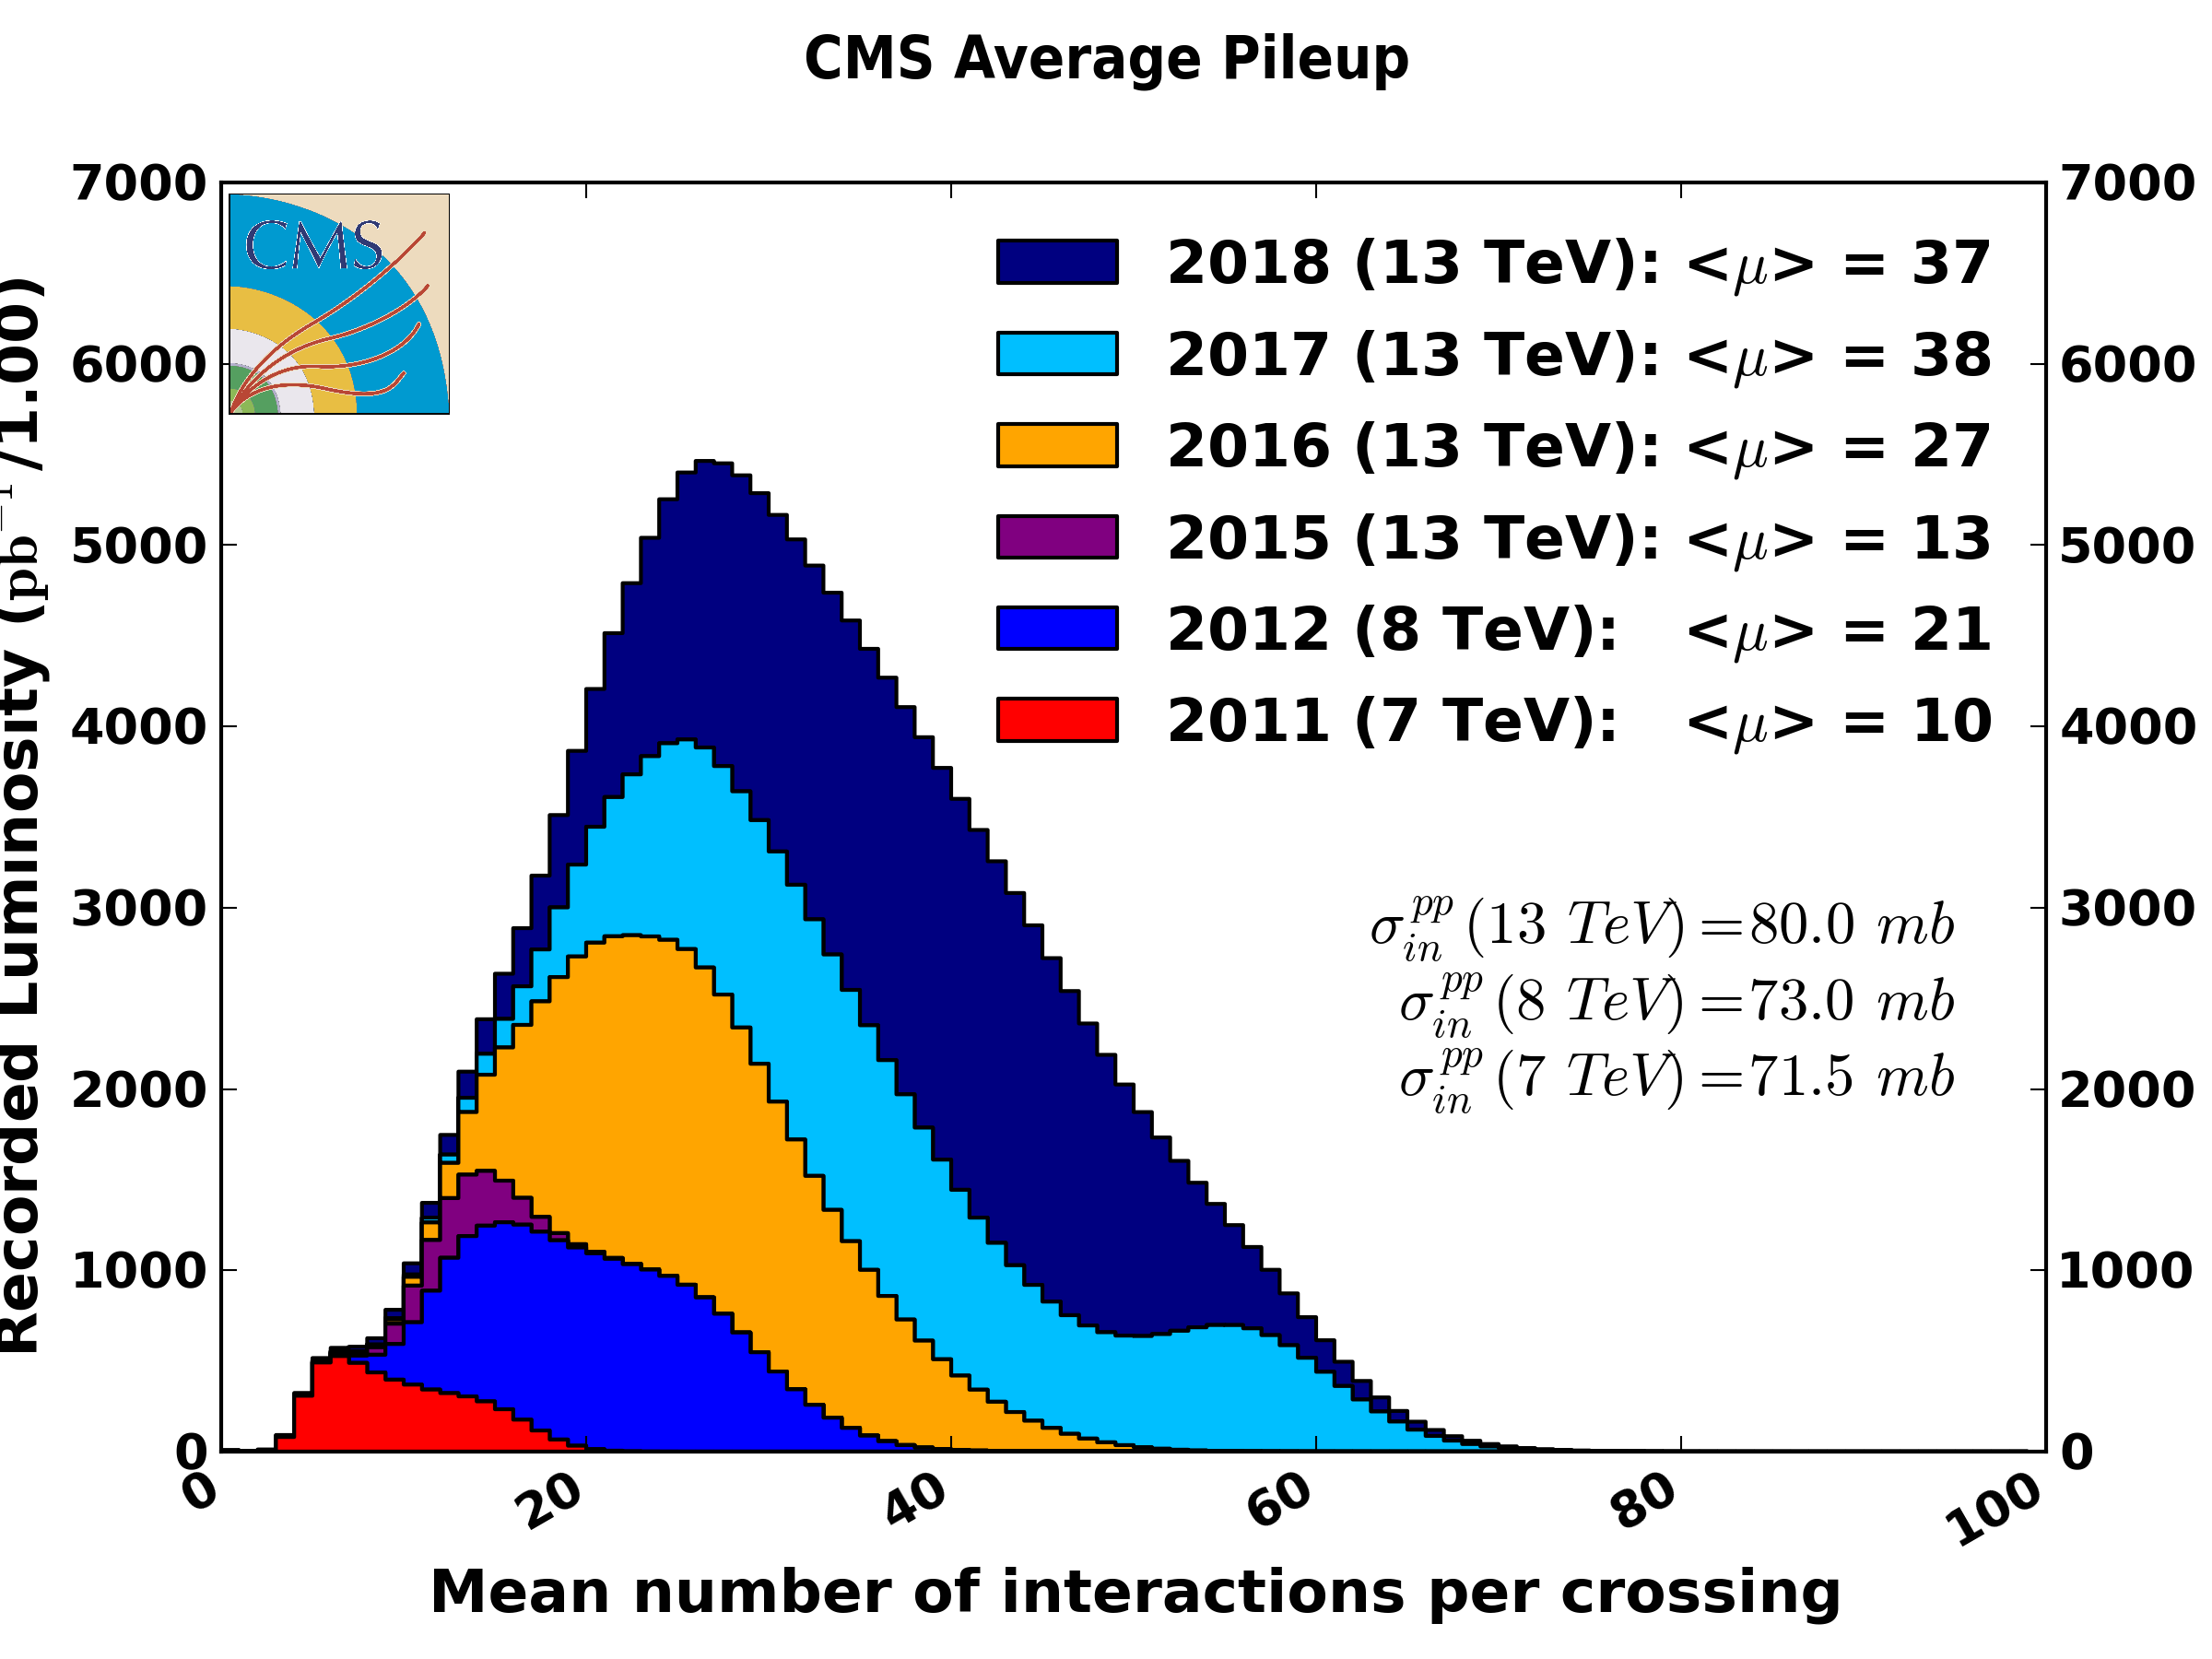
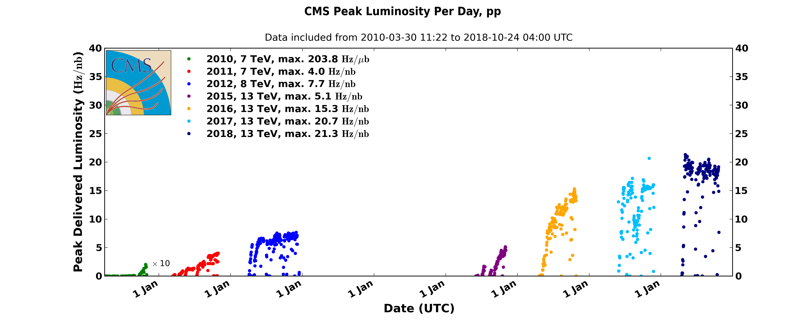
Data taking status: Big Success
Data taken from 2010-2018
  7TeV → 8 TeV → 13 TeV
Integrated Luminosity (Delivered)
 | 7TeV | 8TeV | 13TeV
ATLAS | 5.5 fb⁻¹ | 22.8fb⁻¹ | 158fb⁻¹
CMS | 6.1 fb⁻¹ | 23.3fb⁻¹ | 163fb⁻¹
～1亿个顶夸克
2018
2016
2017
2011
2012
2010
2015
* >94% of detector channels active

Slide 8
顶夸克的产生与衰变

Slide 9
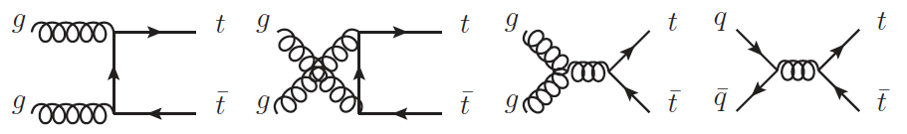
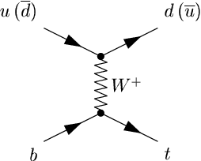
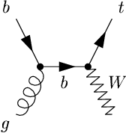
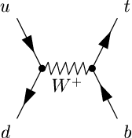
顶夸克的产生 （LHC/Tevatron）
通过强相互作用，或者通过电弱相互作用产生
LHC有可以预计的未来最大的top样本
t-channel
Wt
s-channel
Notes:
Parton density: gluon dominate

Slide 10
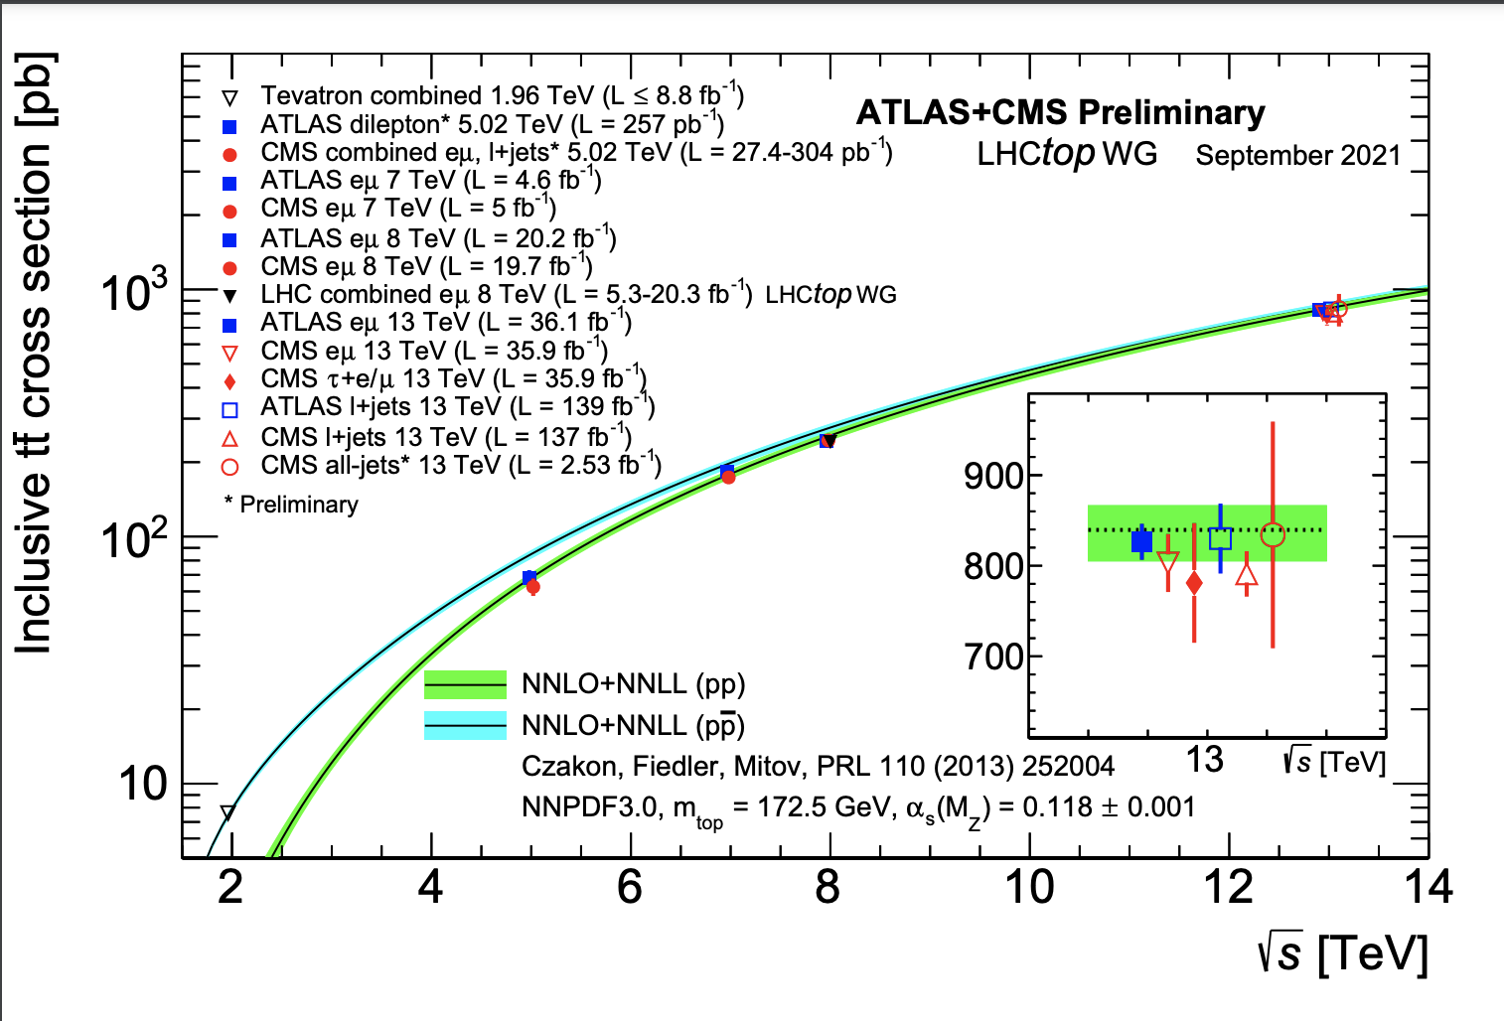
Pair production （强作用过程）
在LHC上的产生截面比希格斯粒子大2个量级
164⁺¹³₋₁₀ pb @ 7TeV
238⁺²²₋₂₄ pb @ 8TeV
830 pb @ 13TeV

Slide 11
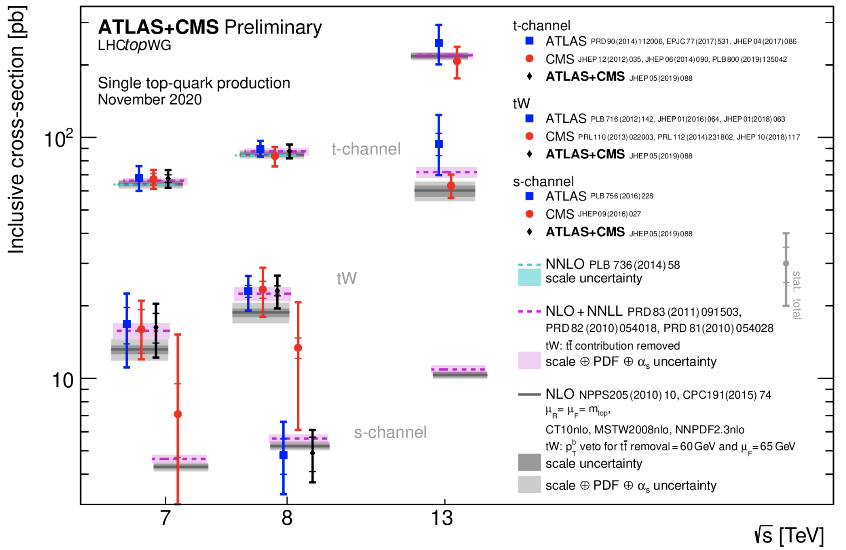
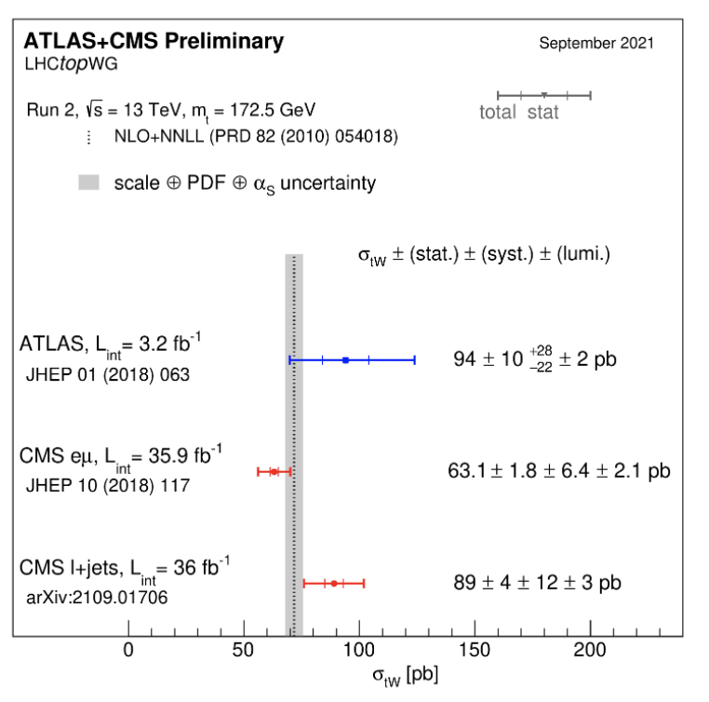
Single production （电弱过程）
产生截面约为pair production的1/100 到1/4
t-channel
tW
s-channel
64.6^{+2.7}_{-2.0} pb @ 7TeV
15.7±1.1 pb @ 7TeV
4.6±0.2 pb @ 7TeV
87.8^{+3.4}_{-1.9} pb @ 8TeV
22.4±1.5 pb @ 8TeV
5.6±0.2 pb @ 8TeV
First observation
2009 @ Tevatron
First observation
2014 @ LHC
First observation
2014 @ Tevatron

Slide 12
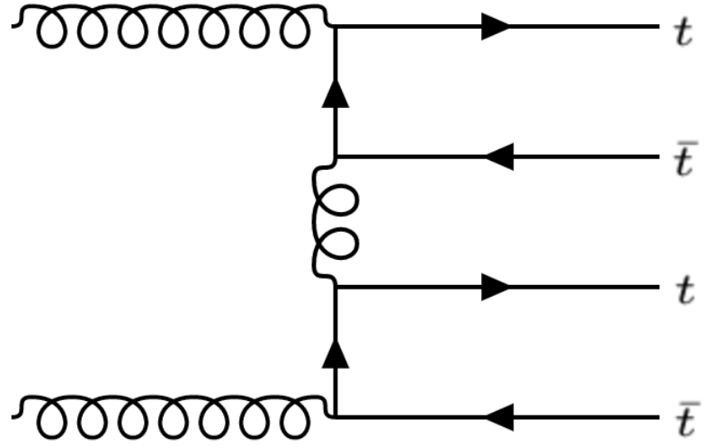
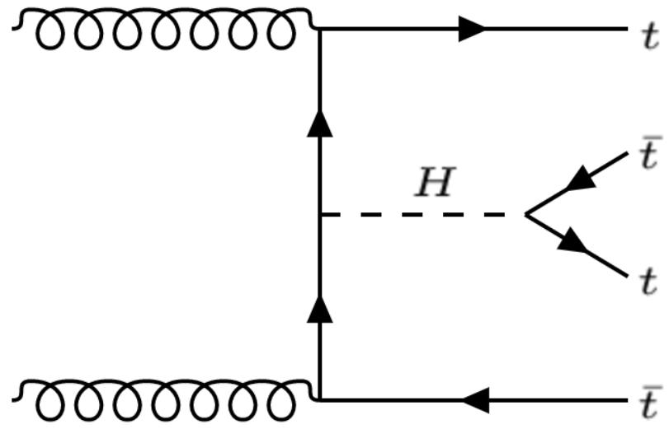
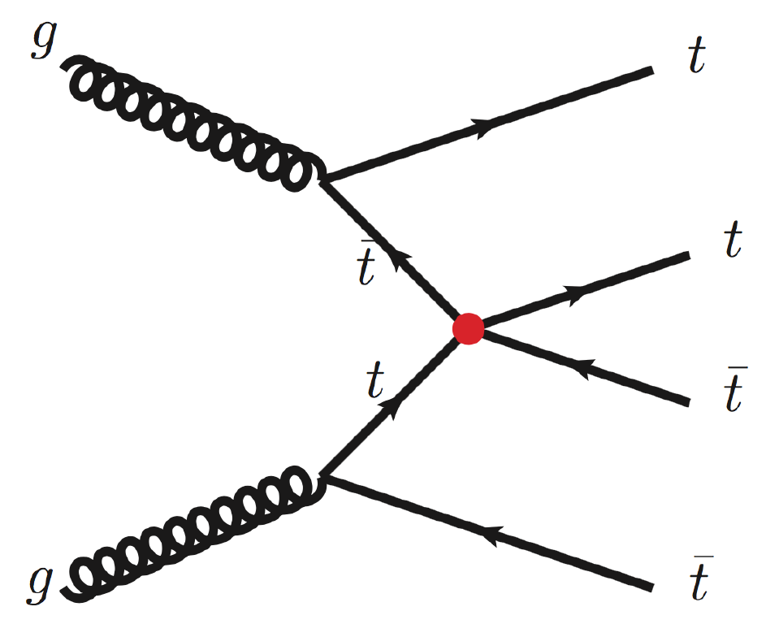
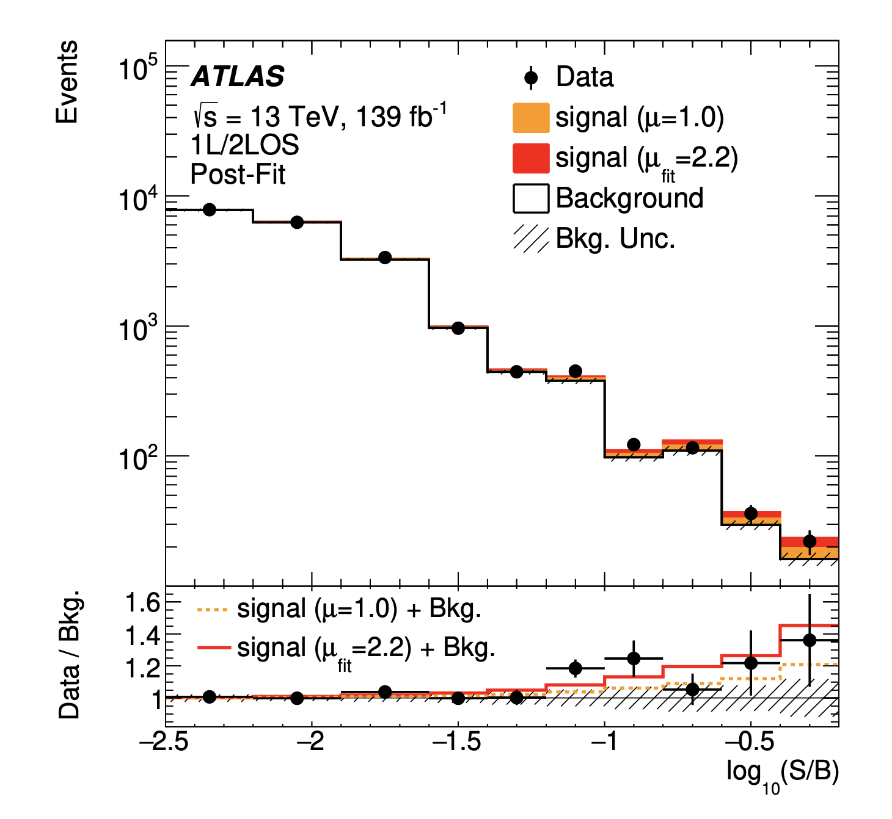
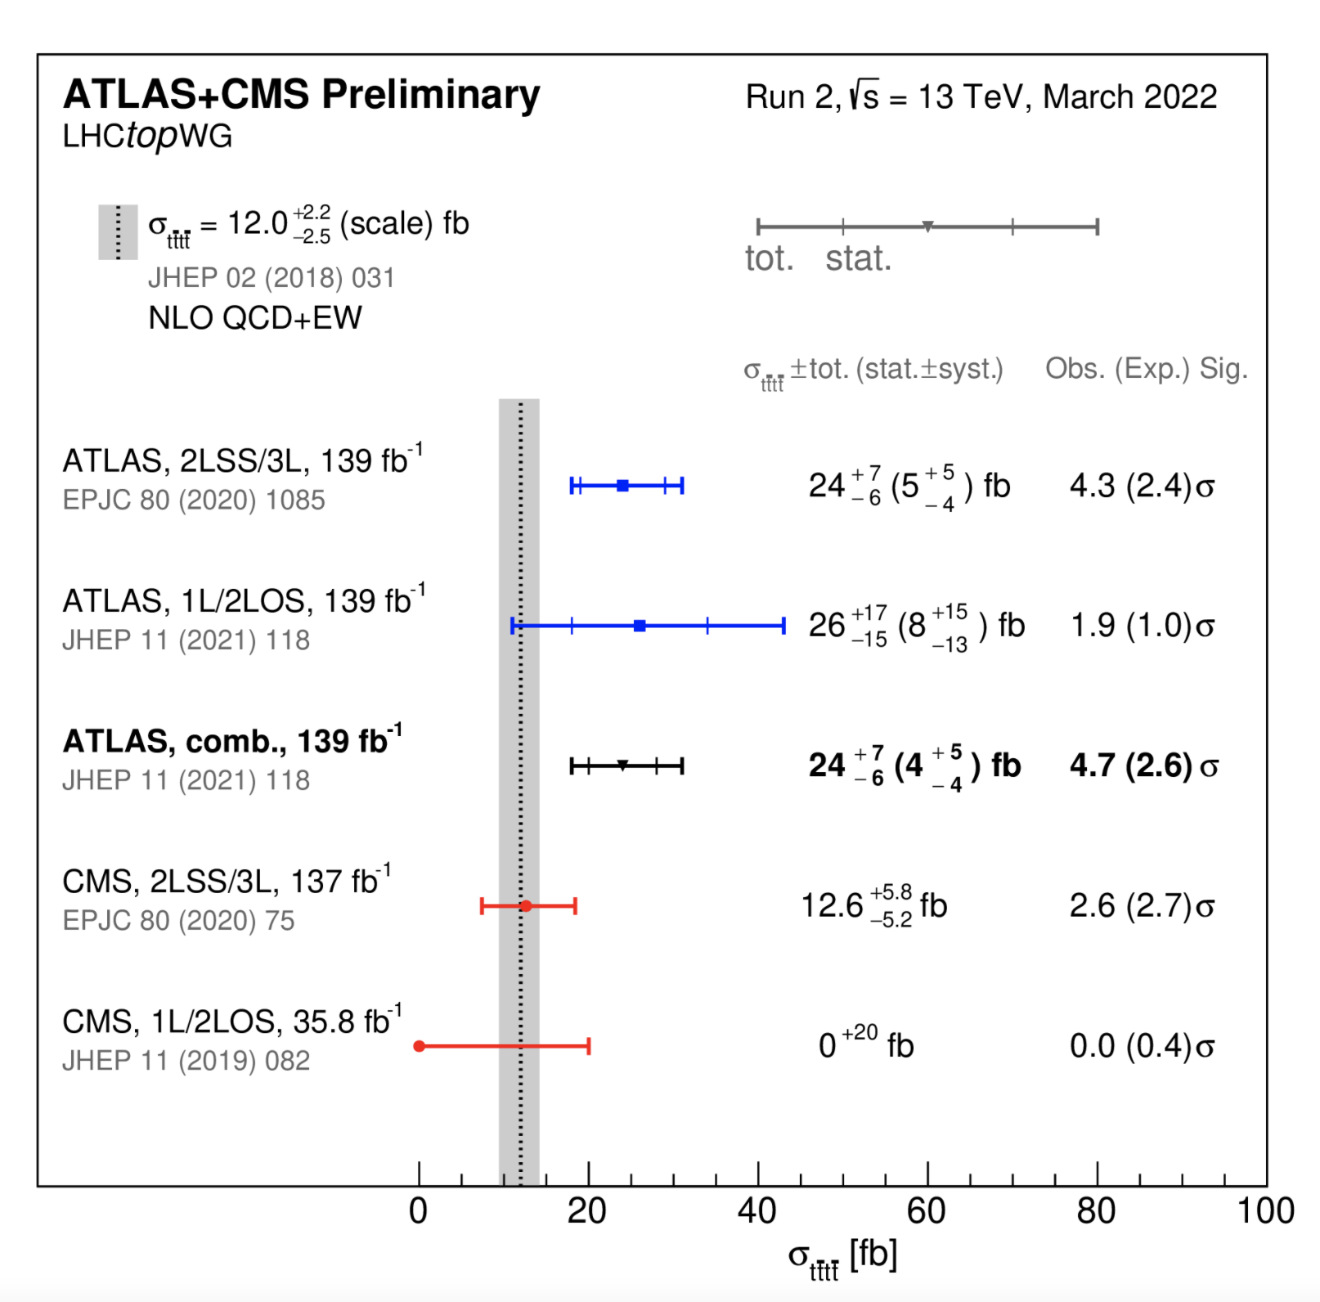
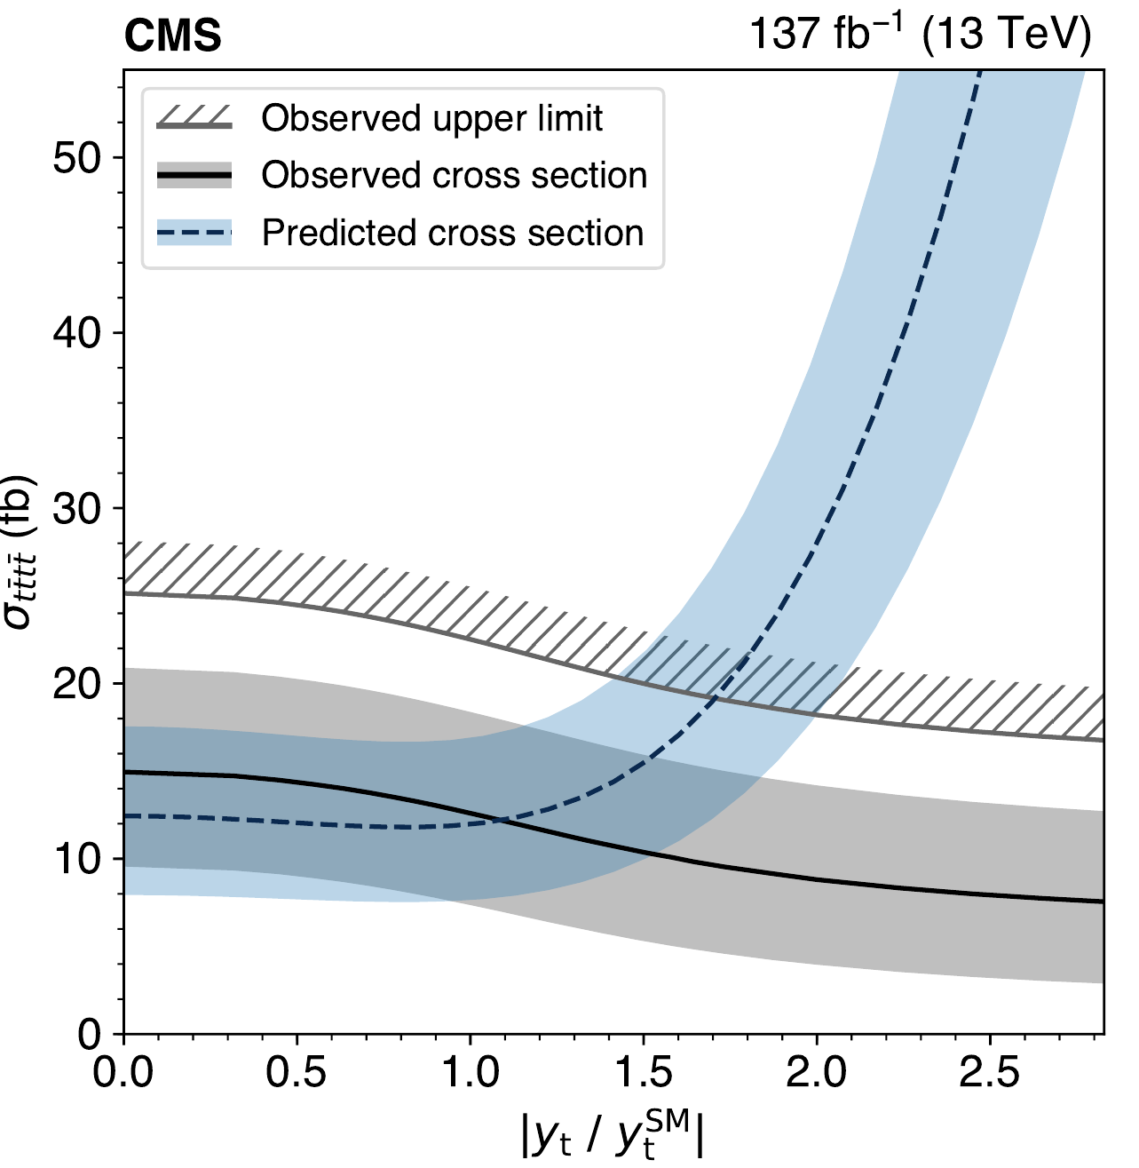
Four top production (ttH/是否混有新的作用？)
SM 4 top theory prediction: 12fb (+- 20%) @ 13 TeV
Observed（exp.) 4.3(2.4) sigma standard deviation
JHEP 11(2021) 118

Slide 13
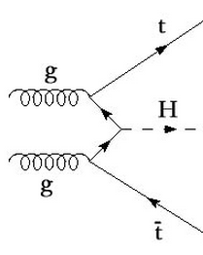
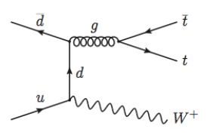
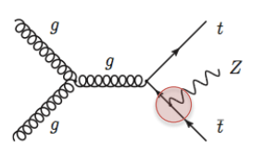
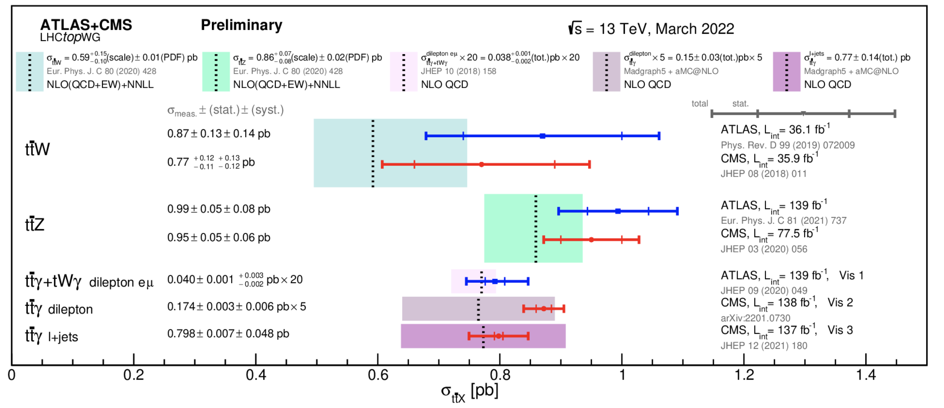
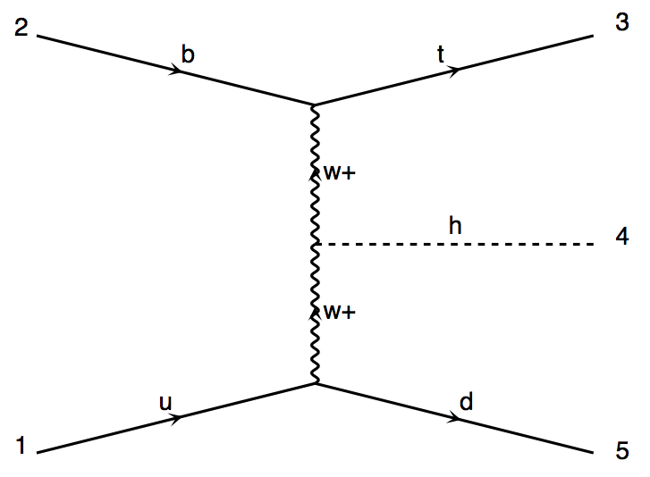
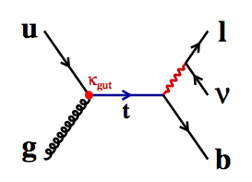
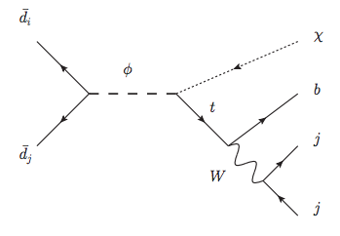
其他顶夸克的稀有伴随产生过程
3top？新物理！
ttH
ttW
ttZ
tHj
FCNC
b
t
tX (RPV)
W
H
W
u
d
4/18/22

Slide 14
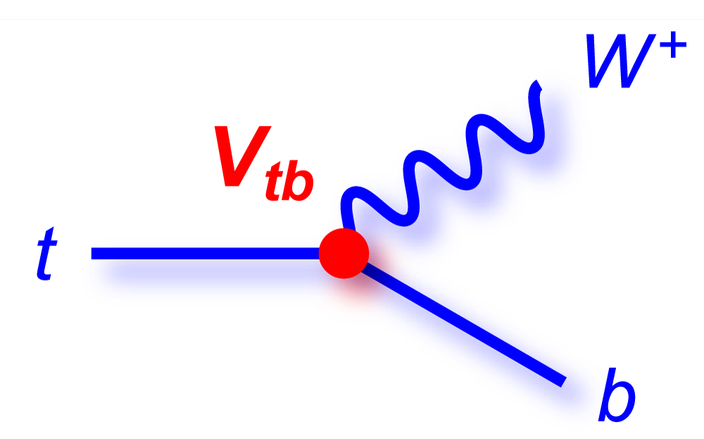
顶夸克的衰变
S
d
S
d
Check top decay products properties
  Top polarization/W helicity
  Charge Higgs searches
Check extra radiations
With Top pair
  Spin Correlations
H

Slide 15
顶夸克的性质

Slide 16
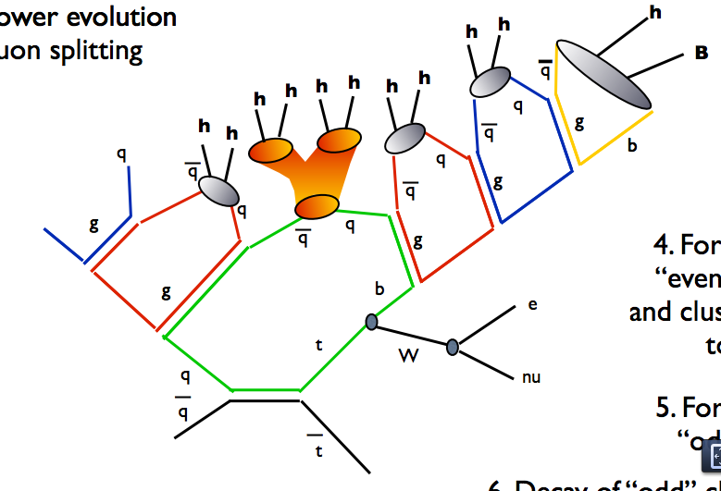

Top quark: the only “naked” quark
Lifetime: ~4*10⁻²⁵ Sec：
  Typical hadronization time ~3*10⁻²⁴ Sec
  Decay before hadronization
Only place to study a “naked” quark properties
  Mass
  Spin
  Polarization
  Vtb
  Charge
“1夸克态”
“2夸克态”
“3夸克态”
“4夸克态”
“5夸克态”
Top quark is a laboratory to precise test SM

Slide 17
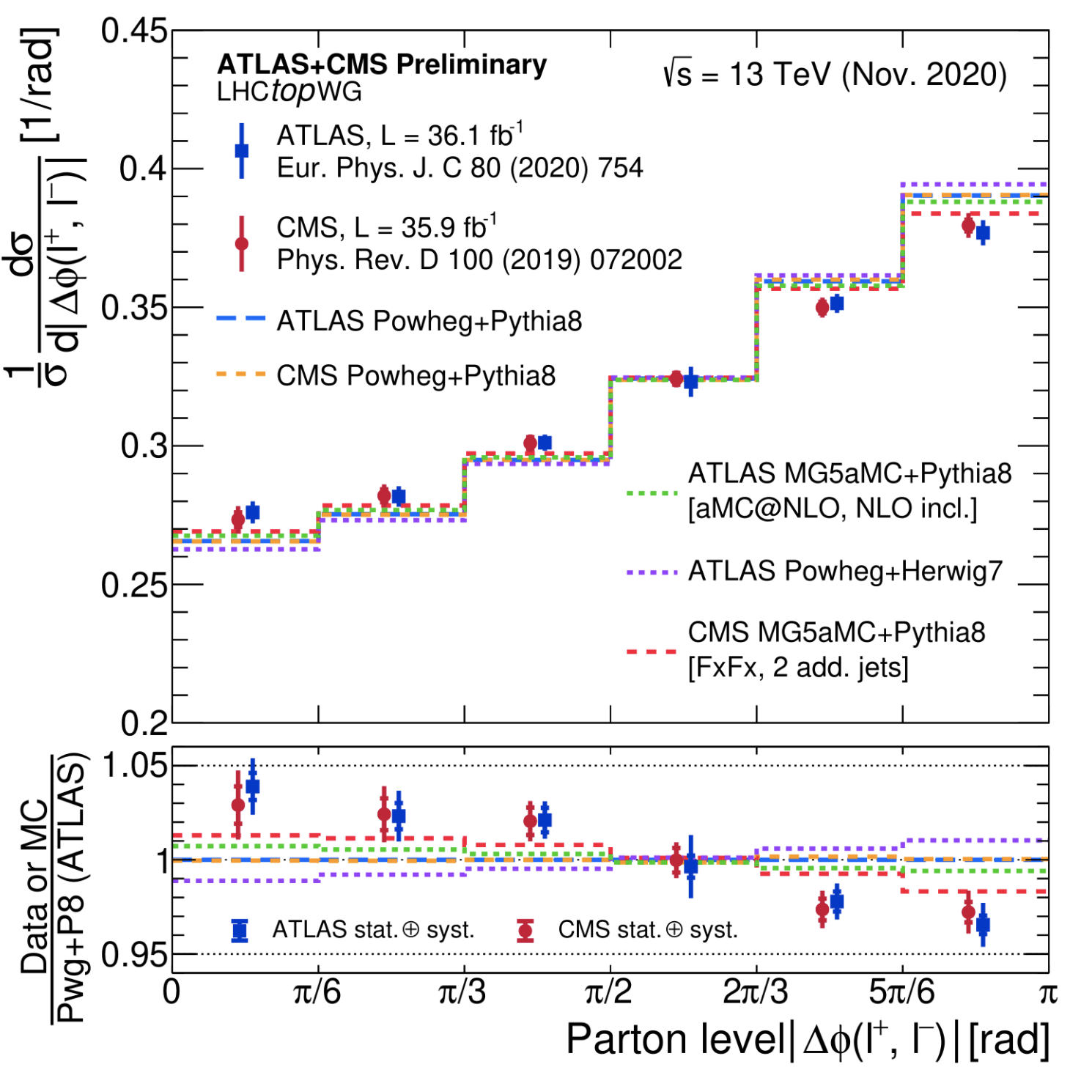
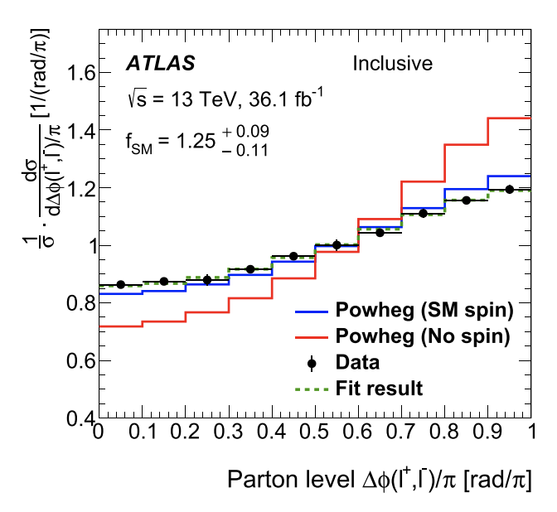
Spin correlation in top-antitop system
Top quark lifetime: 4*20⁻²⁵
Hadronization time: 3*20⁻²⁴
Spin decorrelation time (∼10⁻²¹ s)
Dilepton angle in ttbar system preserve top spin information
Unfolding to partton level
probe of new physics in production
Notes:
The lifetime of the top quark is shorter than the timescale for hadronisation (∼10−23 s) and is much shorter than the spin decorrelation time (∼10−21 s) [1]. As a result, the spin information of the top quark is transferred directly to its decay products. Top quark pair production (tt ¯) in QCD is parity invariant and hence the top quarks are not expected to be polarised in the Standard Model (SM); however, the spins of the top and the anti-top quarks are predicted to be correlated

Slide 18
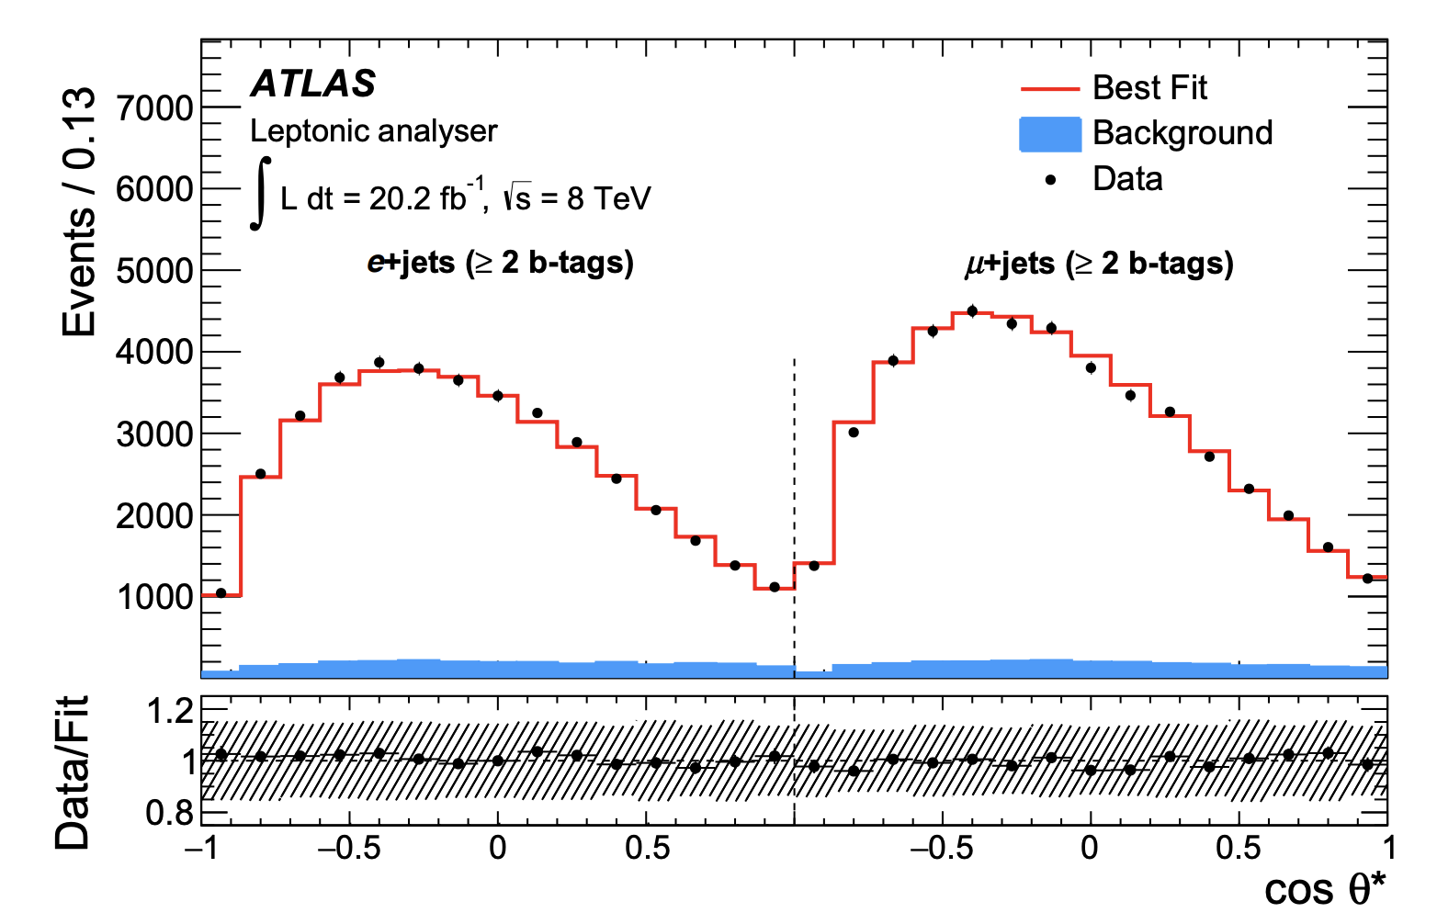
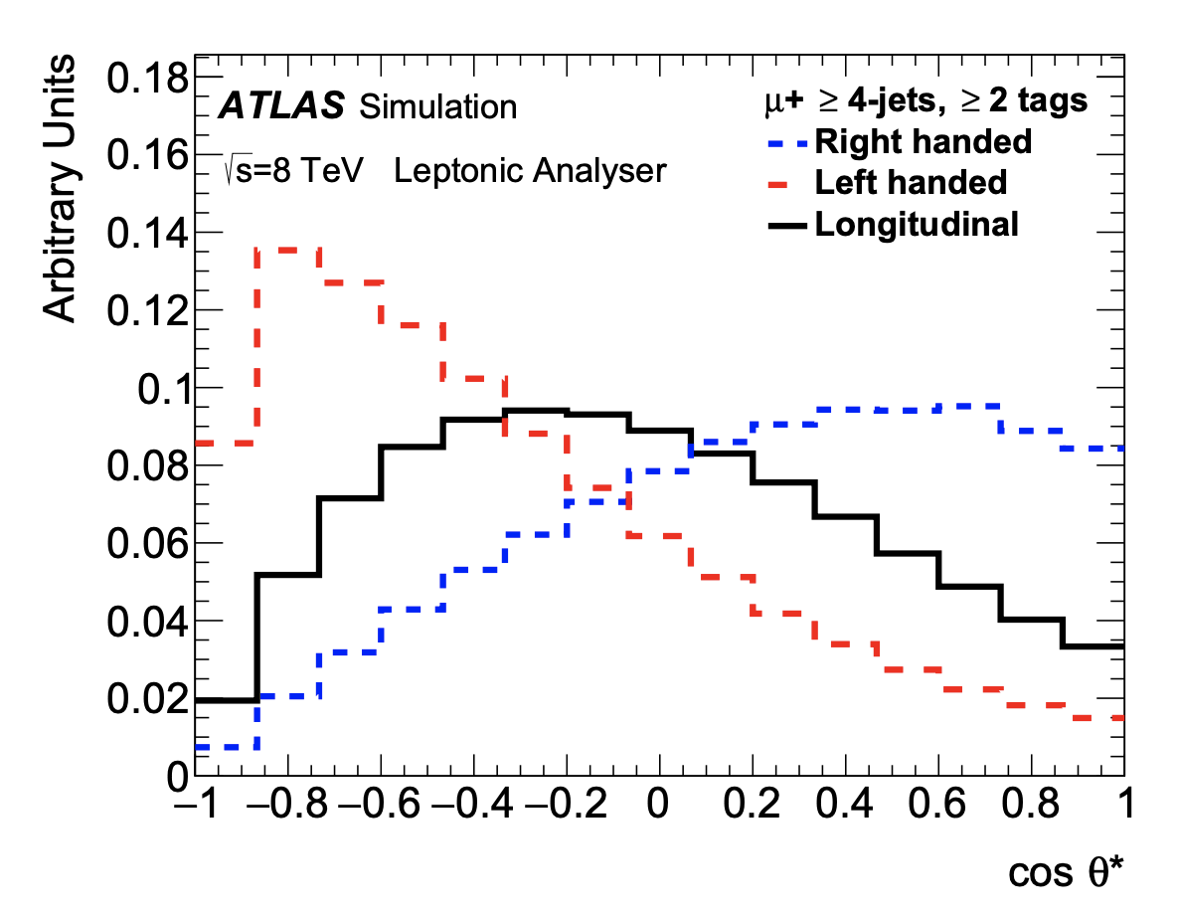
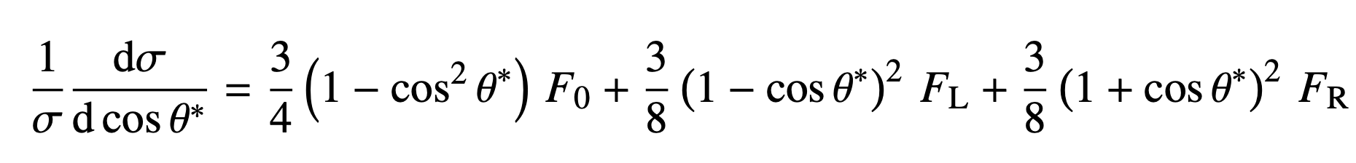
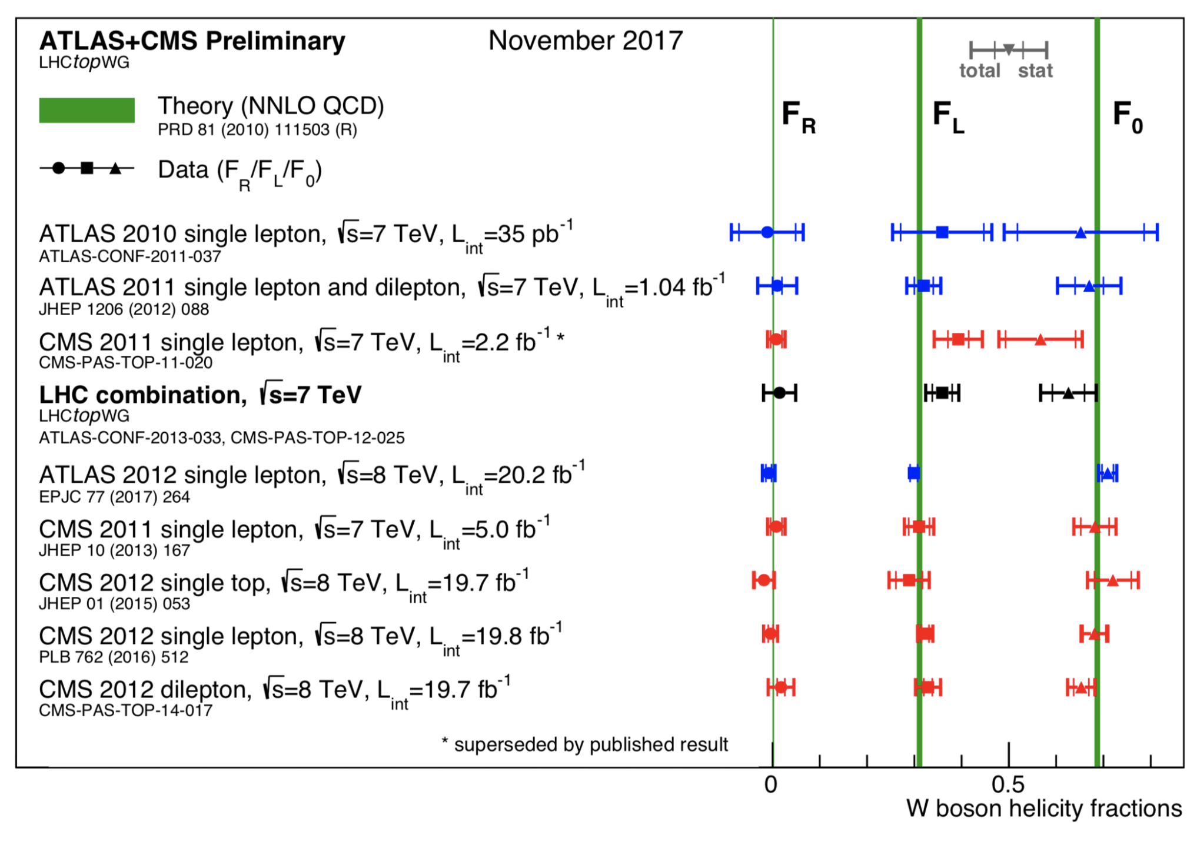
W helicity （螺旋性）
Define 𝜃* in W rest frame
  angle between charged lepton and the rev. b quark
Fit 𝜃* distribution with 3 components: F₀, F_{L}, F_{R}
Measured in single top and top pair events

Slide 19
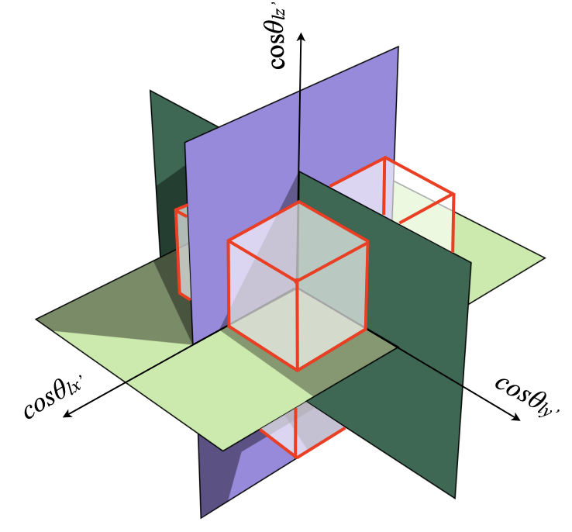
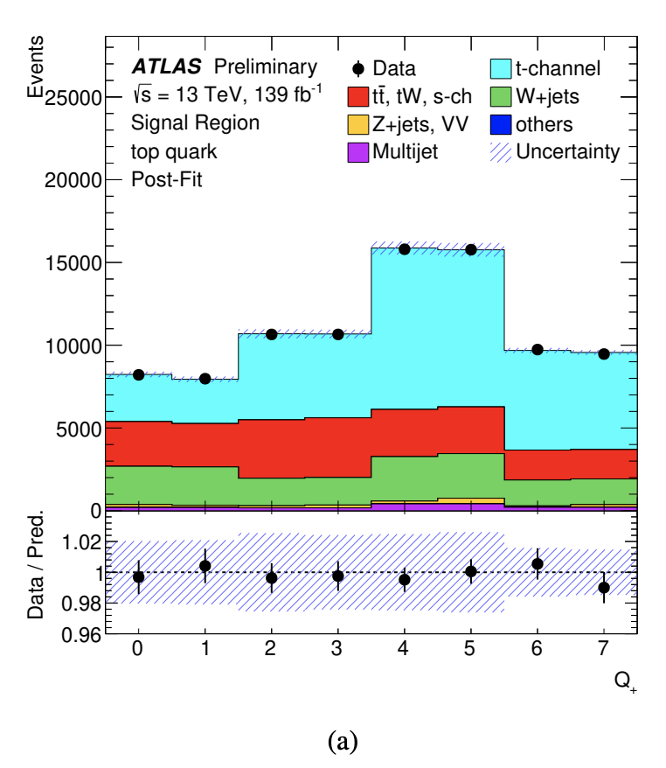
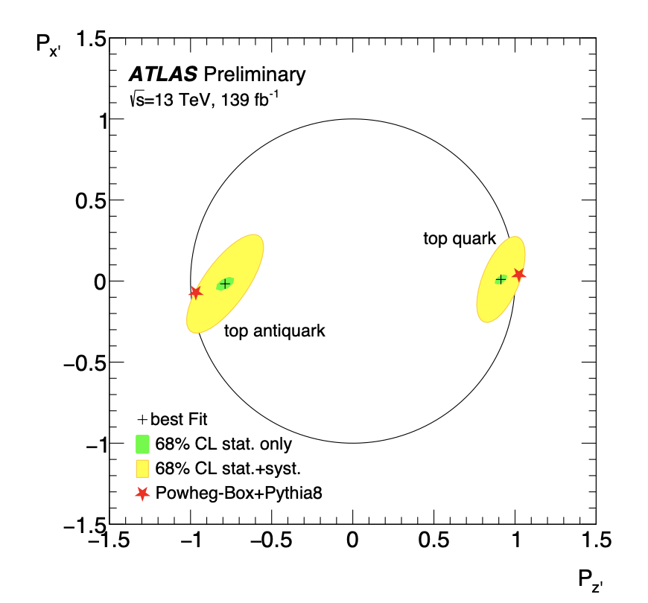
W polarization
Measured in single top t-channel (l+b+q+MET)
Angles constructed using spectator jet in top quark rest frame
  𝑧ˆ ：direction of the momentum of the spectator quark, 𝑞’ (FS light jet),
  𝑦ˆ ：𝑧ˆ × 𝑞 , 𝑞 is the direction of the incoming light quark
Octant variable constructed fitted by slicing phase space
Strong polarization in z-direction(as expected)，little in others
Notes:
single top quarks are produced with their spin completely aligned along the direction of the down-type quarks [5, 6]. In the case of the production of single top quarks, for the dominant subprocess, this direction is the spectator-quark direction; while for the subdominant subprocess it is the direction of the incoming down-type antiquark. In the case of top-antiquark production, the spin aligns in the direction opposite to that of the incoming down-type quark in the dominant subprocess, and opposite to that of the spectator antiquark in the subdominant process. Thus, the degree of polarisation for a sample of top-quark or top-antiquark events depends on the mix of dominant and subdominant production processes and the relative alignment between the beam line and spectator-quark directions, averaged over the sample selected. In all cases the direction is relative to the rest frame of the top quark or antiquark.

Slide 20
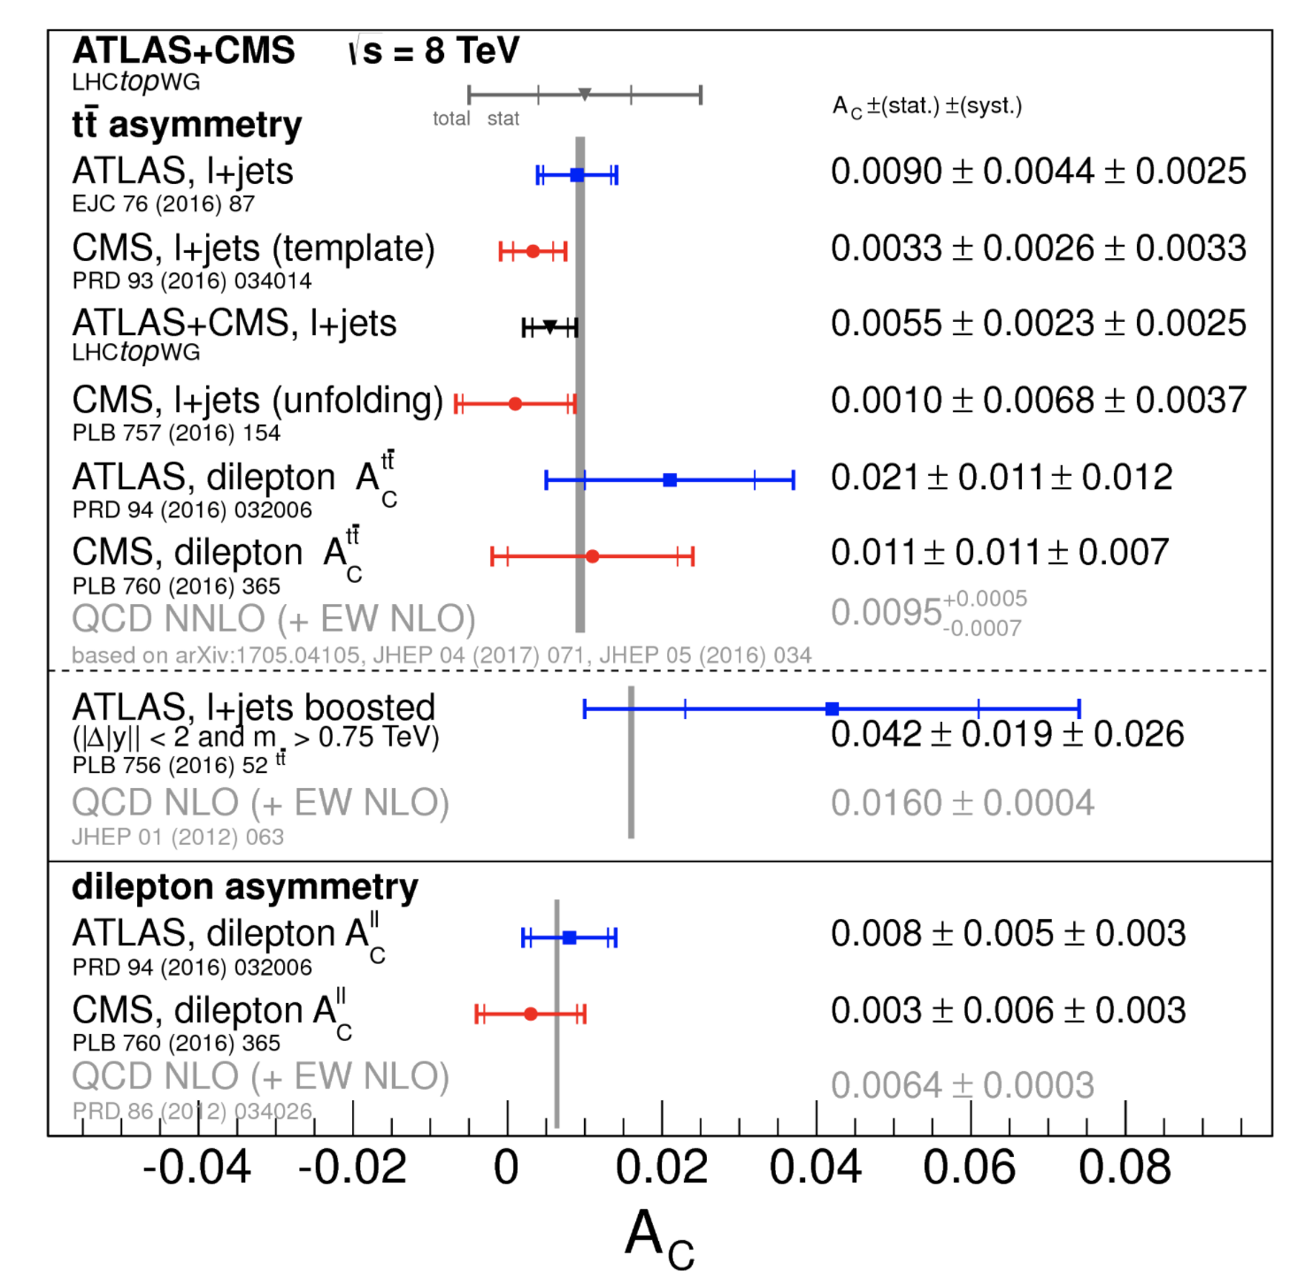
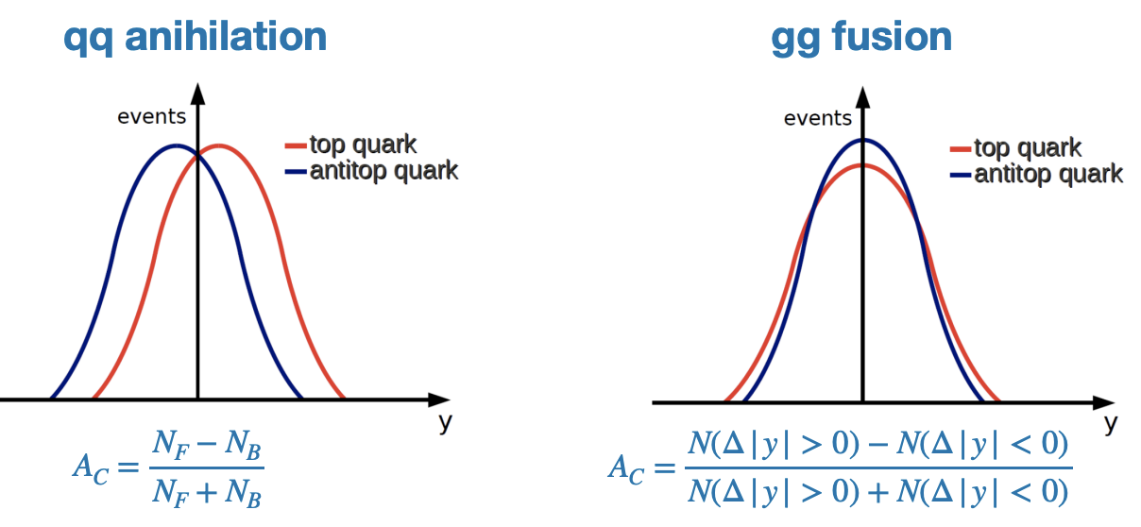
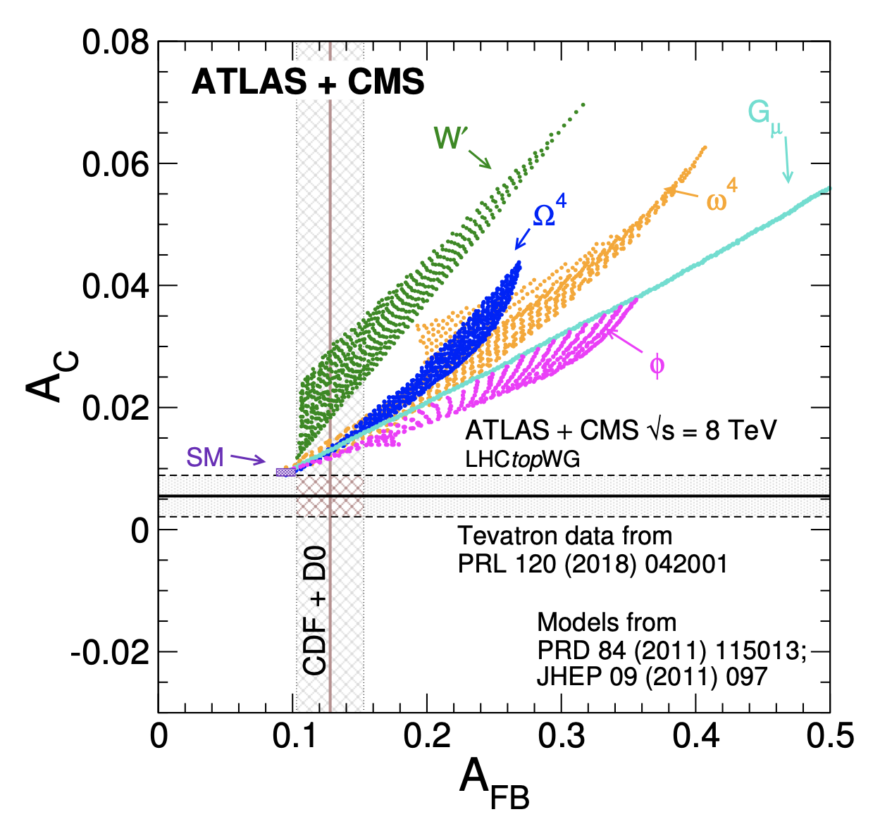
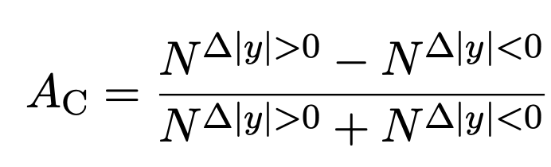

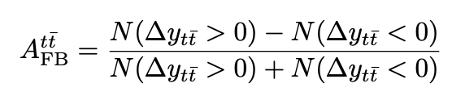

Charge asymetry in top-antitop system

Slide 21
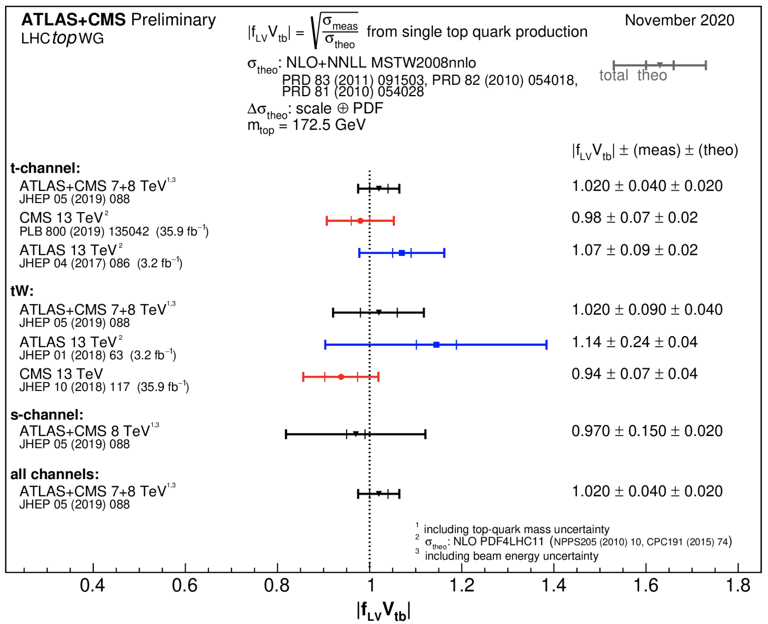
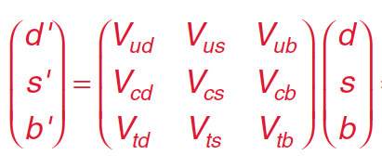



Vtb的精确（直接）测量
CKM机制
CKM矩阵给出了CP破坏的微观机制, 提供正反物质不对称的来源

Slide 22



u/d PDF ratio
PLB 800 (2020) 135042
Measure the ratio of top and anti-top t-channel production cross-section
  Ratio of integrated u/d quark parton distribution function

Slide 23
顶夸克的质量

Slide 24




顶夸克质量（1）
JHEP 08 (2012) 098
Metastable Universe?
PRD 97, 056006 (2018)
Main uncertainties from Top-quark Mass

Slide 25



顶夸克质量（2）
不是实验错了，就是新物理 --- 韩涛
粒子物理大厦将倾
到底是W重了，还是top轻了？

Slide 26


顶夸克质量测量方法
Template method
  Based on a full (tt ̄ → lepton+jets, tt ̄ → all-jets, and tt ̄ → Emiss+jets) or partial (tt ̄ → di-lepton, and single-top quark) reconstruction of the kinematics underlying the top-quark(s) decay, probability density functions (templates) for observables sensitive to the underlying mtop, and to additional parameters, are constructed based on MC simulation.
Matrix element method
  based on the likelihood to observe a sample of selected events in the detector. For each event a probability is calculated as a function of the assumed values of each parameter to be measured (e.g. mtop and JSF), using a leading-order matrix element incorporating the differential cross-sections of the physics processes relevant to the analysis
Ideogram method
  Combination of the 2
Reviews in Physics Volume 1, November 2016, Pages 60-76

Slide 27

顶夸克质量测量结果
2014年世界平均
173.34±0.36(stat)±0.67(syst) GeV
CMS最新实验测得的顶夸克质量下降到171.77+-0.38GeV
CMS-PAS-TOP-20-008
真空目前还稳定吗？

Slide 28
顶夸克与希格斯粒子的耦合

Slide 29

How to confirm the new observed boson is higgs?
  Spin/Parity
  Couplings to boson
  Couplings to fermions =>Yukawa coupling
Top quark Yukawa Coupling （跟上帝粒子到底有多铁）
  With Higgs: Yt=√2Mt/vev ~1 （top loops so important）
  ~Only Yukawa coupling that could be directly measured @ LHC
Large Yt suggest special role of top in the electroweak symmetry breaking (EWSB)
New physics concerning to EWSB preferably couple to top quark

Slide 30










Observation of ttH production
4th June 2018, LHCP/PRL and others…
Phys. Rev. Lett. 120, 231801

Slide 31






Measurement of top-Higgs interactions
希格斯粒子：基本粒子的质量起源
与玻色子耦合
Higgs 机制
2012年发现希格斯时发现
与费米子耦合
第五种力
截止目前发现三种(第三代)
与自己自耦合
第六种力
LHC取数到2035年发现？
2013年诺贝尔奖
决定原子的半径，真空是否稳定，（宇宙的命运）
宇宙是否存在相变
LHC质子-质子对撞决定了难以精确测量

Slide 32



ttH at LHC
σ_{ttH} ∝ (Yt)²
~1% of total Higgs
~0.06% of ttbar
~1/10¹¹ of total interaction
obv
direct detection

Slide 33






How to hunt ttH
每产生100个希格斯粒子中仅有一个ttH
末态复杂：有8-10个末态粒子，组合众多
Higher cross-section
Higher purity
arXiv:1804.03682
JHEP 08 (2018) 066
arXiv:1804.02716
JHEP11(2017)047

Slide 34
ttH cross section and H-tt CP structure
ttH: sensitive to top-Higgs coupling
Observed in 2018 by combine H→bb/𝛾𝛾/WW/ZZ/𝛕𝛕 FS
Followed by observations in individual channel 𝛾𝛾/ML
H-tt CP structure also studied
 | ATLAS |  | CMS
t/ttH,H→bb | ATLAS-CONF-2020-058 | Run2(1.3/3.0) | CMS-PAS-HIG-18-030 | 2016+2017
t/ttH,H→WW | ATLAS-CONF-2019-045 | 2016+2017 | EPJC 81 (2021) 378 | Run2
t/ttH,H→𝛕𝛕 | ATLAS-CONF-2019-045 | 2016+2017 | EPJC 81 (2021) 378 | Run2
t/ttH,H→ZZ | ATLAS-CONF-2019-045 arXiv:2004.03969 (4l) | 2016+2017 run2 | EPJC 81 (2021) 378 | Run2
t/ttH,H→𝛾𝛾 | PRL 125 (2020) 061802 | Run2(5.2/4.4) | PRL 125 (2020) 061801 | Run2(6.6/4.7)
ttH,H→inv | ATLAS-CONF-2020-052 | run2 | CMS-PAS-HIG-18-008 | 2016(re-interp)

Slide 35




ttH cross section and H-tt CP structure
Cross section accuracy ~25%, pure CP-odd excluded @ 3.7𝜎
CMS-PAS-21-006

Slide 36








tH+x searches
tHq: not experimentaly observed yet
Sensitive to top-Higgs; W-Higgs coupling interference phase
Via H-t coupling
Via H-W coupling
@ 95 CL

Slide 37
顶夸克与新物理

Slide 38

FCNC(味改变中性流）
FCNC: ~10⁻¹⁴
  Forbidden at tree level
  Strongly suppressed at higher orders via the GIM
BSM allows FCNC
  RPV SUSY
  Two higgs doublets
Variaous FCNC process continiously tested
No FCFC found so far
Still room for BSM

Slide 39




Top tagger / boost top
大多数新物理模型预言大质量粒子
  大质量粒子更倾向衰变到顶夸克： 顶夸克横动量很高➔ boosted
A jet
Top jets
Eff~80%

Slide 40






New physics with top(boosted) quarks
tt
tb
tW
tttt
SUSY
DM
New heavy resonance couples to top quark
  Decay to top quark or associate produced with top quark

Slide 41
总结
Standard Model tested precisely with top quark at LHC
  Both at the pQCD and electroweak sector
  So far, no significant deviation from SM is observed
Cross section and property measurement agrees with SM predictions
  No sign of new physics with top quark signature
  But we believe they were hidden somewhere
Requires more precise knowledge of top mass
  A TLEP/Higgs factory/ILC of ~350 GeV Ecm needed?
More results will come with 13 TeV data
  Stay tuned
Lastes details:
https://twiki.cern.ch/twiki/bin/view/AtlasPublic/TopPublicResults
https://twiki.cern.ch/twiki/bin/view/CMSPublic/PhysicsResultsTOP

Slide 42






展望
未来15年左右，LHC将新获取20倍现有数据的数据
中国100kM
欧洲100kM
美国 snow mass 2022：正负电子/质子，谬子对撞机，直线对撞机
日本直线11-30Km

