Slide 1
Derivation of Touschek lifetime in a special case
Fu Hongjin
Physics Group of Accelarator Center

Slide 2
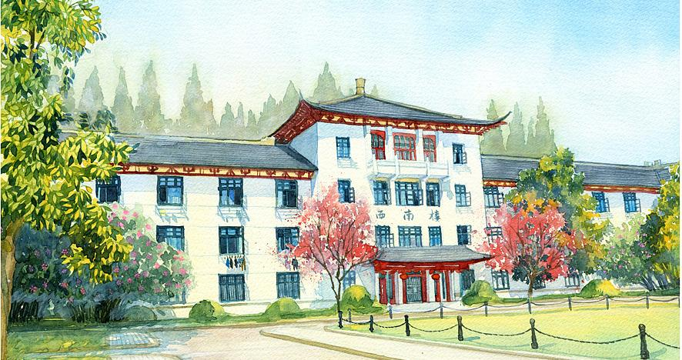
1.Lorentz Transformation in the Minkovoski space
Note that Four-dimension momentum of a particle in a inertia system
Four-dimension momenta tranfrom in two inertia systems A and B in this way.(Suppose B moves at constant velocity v in A）

Slide 3
2.looking back at Moller Scattering
In the nonrelativistic case, the differential cross section of two leading orders of Moller Scattering for polarized electons is
In terms of the definition of differential cross section, we can derive the rate of reaction naturaly in which electrons scattered into a certain differential solid anglenaturaly only if we substitute dN/Ndt for dw/dt ,
N is the number of electrons scattered into the differential solid angle in each bunch,n is the number density ,so nv is the flow density ,

Slide 4
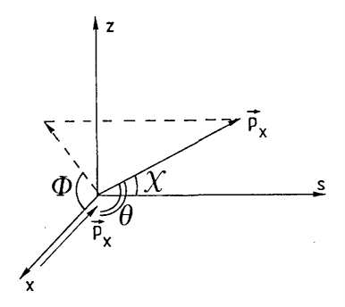
3. Derivation of Touschek lifetime
In order to simplify calculation , we ignore sycrotron oscillision and vertical ocsillision. We regard the two elecrons with non-relativistic betatron oscillision while the longititude orbital motion is extremely relativistic.We spuppose that when scattering hanpen ,the electrons have horizontal momentum of the same magnitude but in contrary directions.In the CMS, the two electrons only have horizontal momentum of the same , but after being scattered, they can obain longititude momentum, as the illusation depicts.That is to say, we need lorentz transformation between Lab systems and CMS. Besides , we only handle Touschek lifetime caused by the single scattering.
When the longititude momentum obtained in Moller Scattering is over the momentum acceptance of the accalerator , the loss of electron beam occurs ,and the result is so-called Touschek effect.

Slide 5
Total cross section
First, lets analyze the problem in CMS.Hence,the motion is non-relatistic.
The magnitude of momentun is constant.Note the increase of longititude momentum in as
To get the condition on occurrence of Touschek effect, we need to tranfer into lab system and we can find ,so the total crossing section for Touschek effect is ( )

Slide 6
Since we have got the total crossing section and lifetime is observed in the lab system, we choose the lab system to do work.
The total rate can be written as
We need to use beam parameters to express it.
ρ is a distribution function of horizontal phase space.Since , let
after integral calculation on u1 which is irrelevant to cross section, we have the result

Slide 7
The scattering involves two particles, sp the rate of loss is as two times as the rate of collision, and in CMS we have
we can get
use ,then

Slide 8
Finally the touschek lifetime is

Slide 9
References
1.J.Le Duff ,Single and Multiple Touschek Effects , CERN-89-01,CERN Accelarator School
2. A. Piwinski, The Touschek Effect in Storing Focusing ring, 1998,DESY 98-179
3.Tae-Yeon Lee, Jinhyuk Choi, H.S. Kang, Simple determination of Touschek and beam-gas scatterting lifetimes from a measured beam lifetime, 2005,Nuclear Instruments and Methods in Physics Research A

