Slide 1
Resolution calculation by Python
Jiang XiaoJie

Slide 2
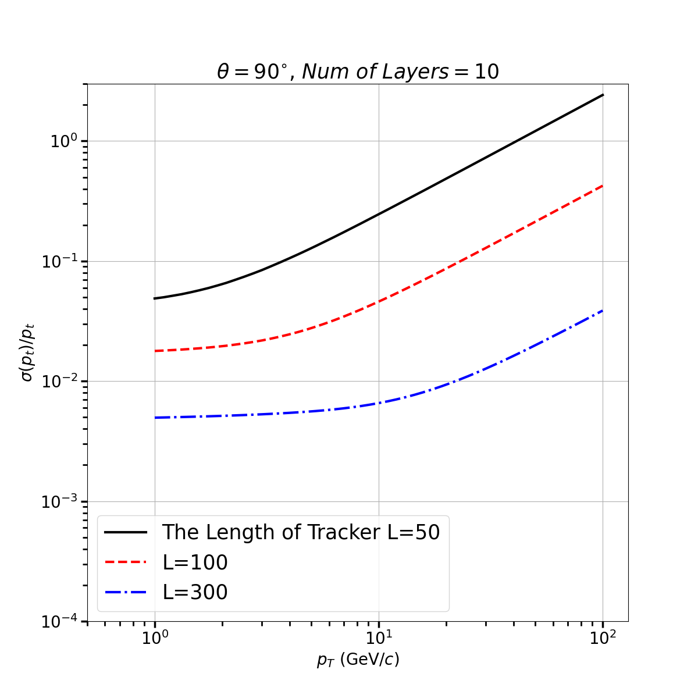
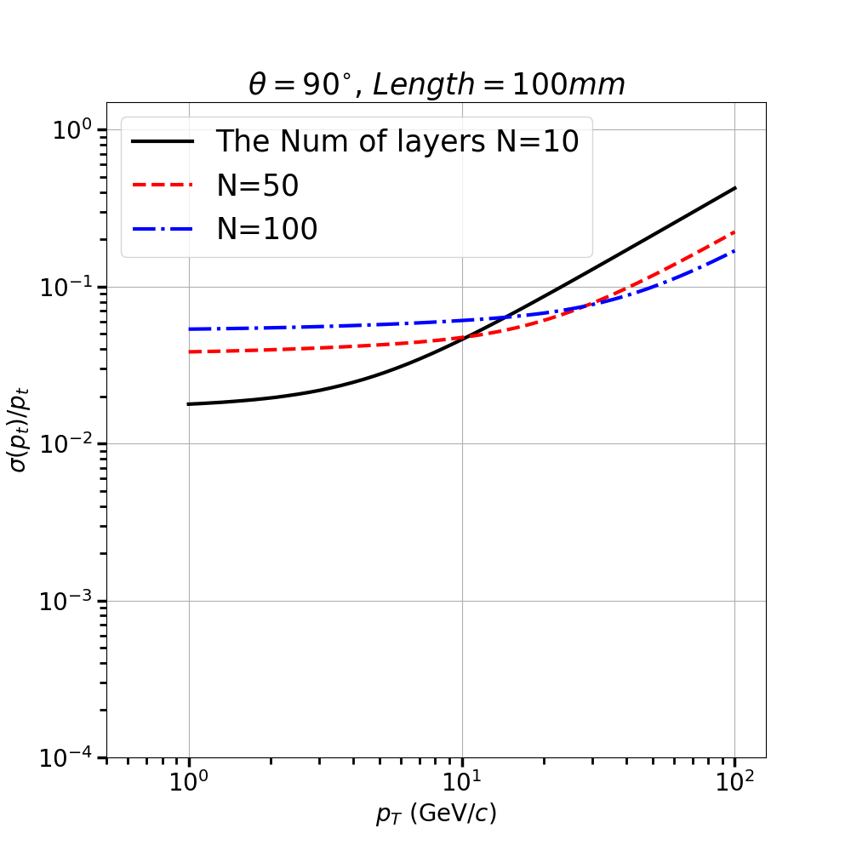
$\frac{∆P_{T}}{p_{T}}=aP_{T}⊕b\cosh^{\frac{1}{2}}{\text{η}}$ $a∝\frac{1}{{L_{0}}^{2}},\frac{1}{N^{1/2}}$ $b∝\frac{1}{L_{0}},N^{1/2}$

Slide 3
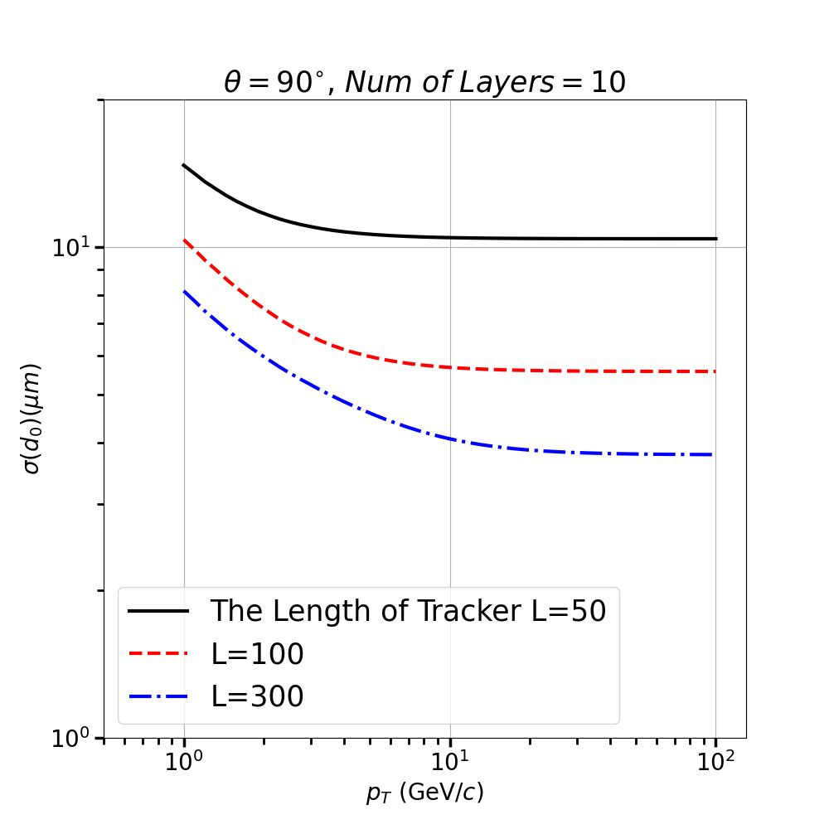
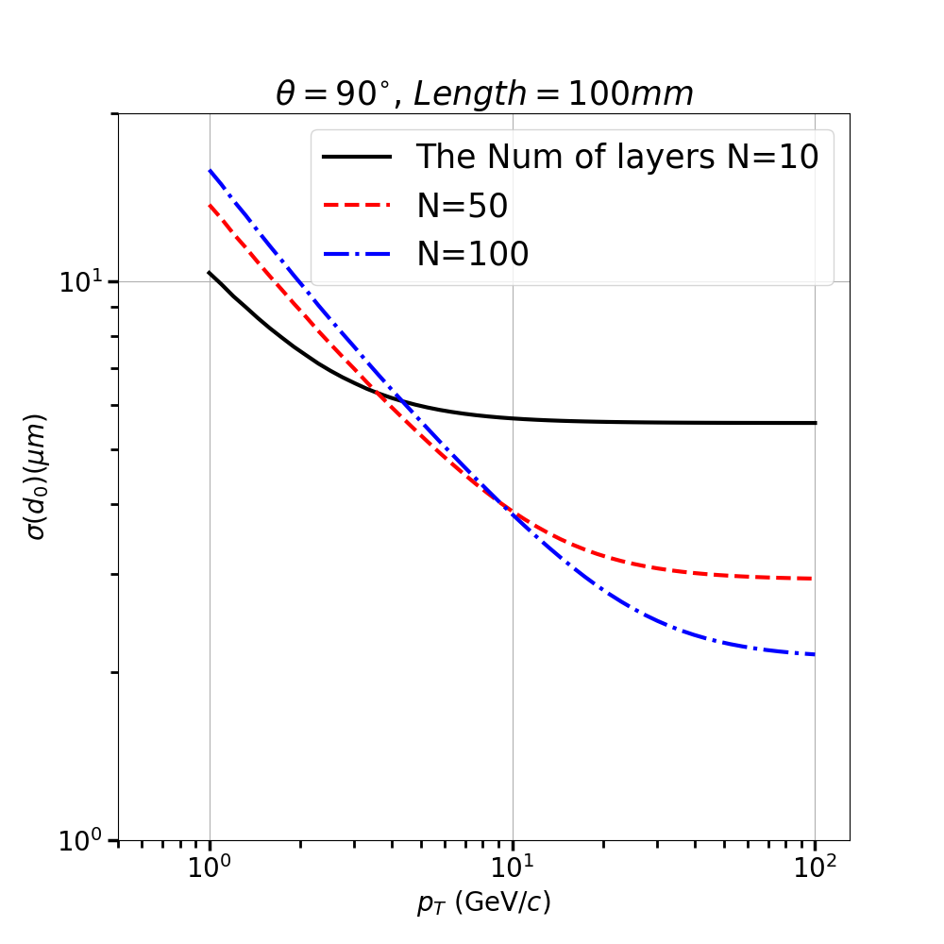
$∆d_{0}=a⊕\frac{b\cosh^{\frac{1}{2}}{\text{η}}}{P_{T}}$ a has negative relation to L,N b has a negative relation to L, but a little positive relation to N.

Slide 4
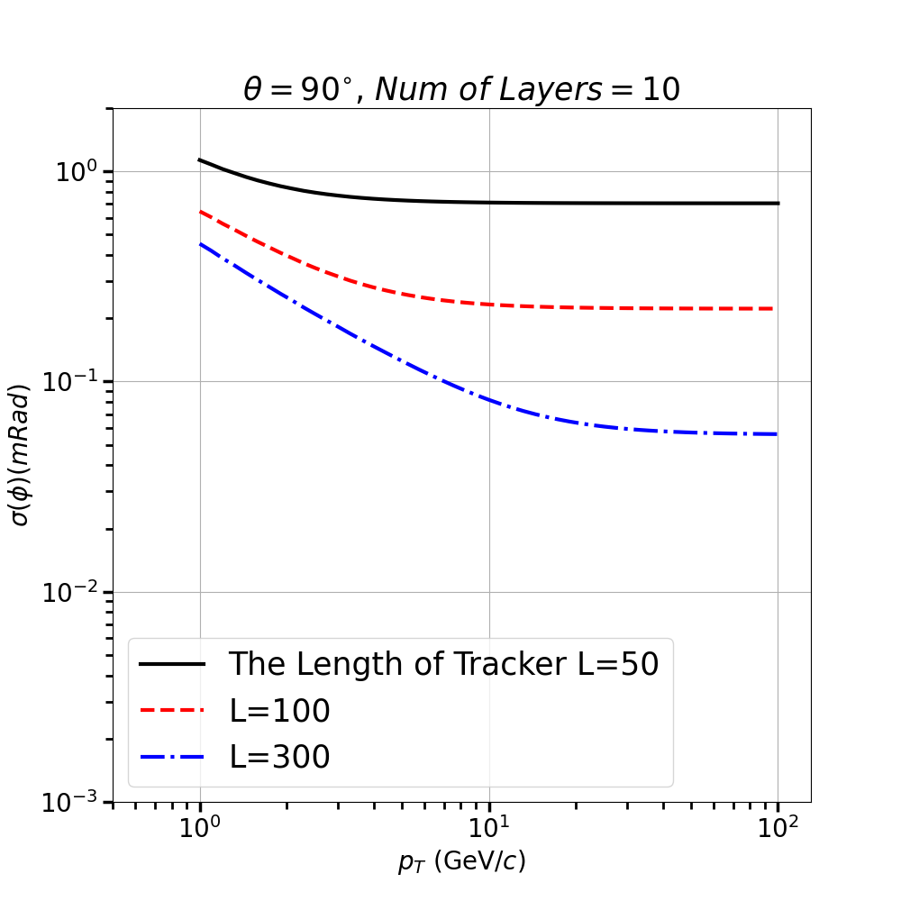
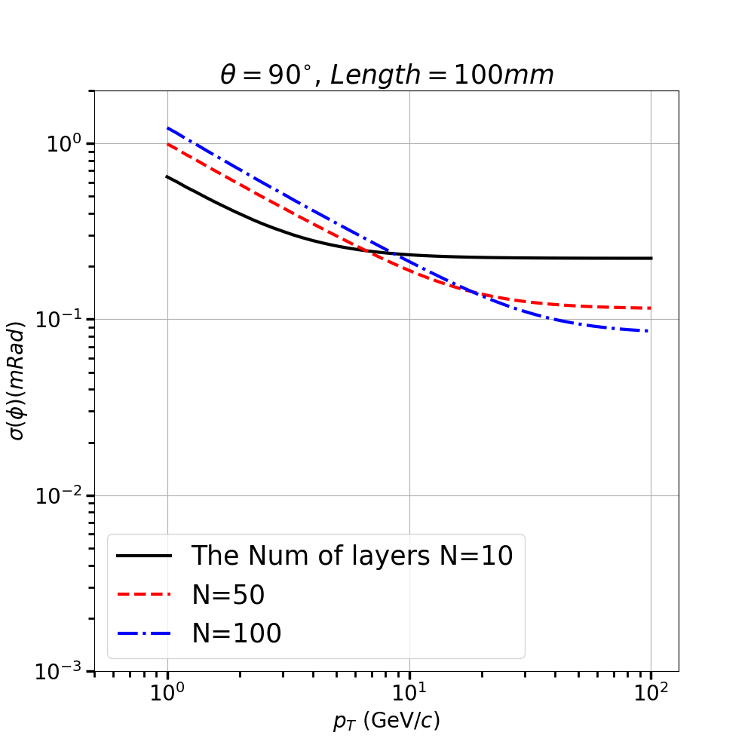
$∆φ=a⊕\frac{b\cosh^{\frac{1}{2}}{\text{η}}}{P_{T}}$ similar to d0

Slide 5
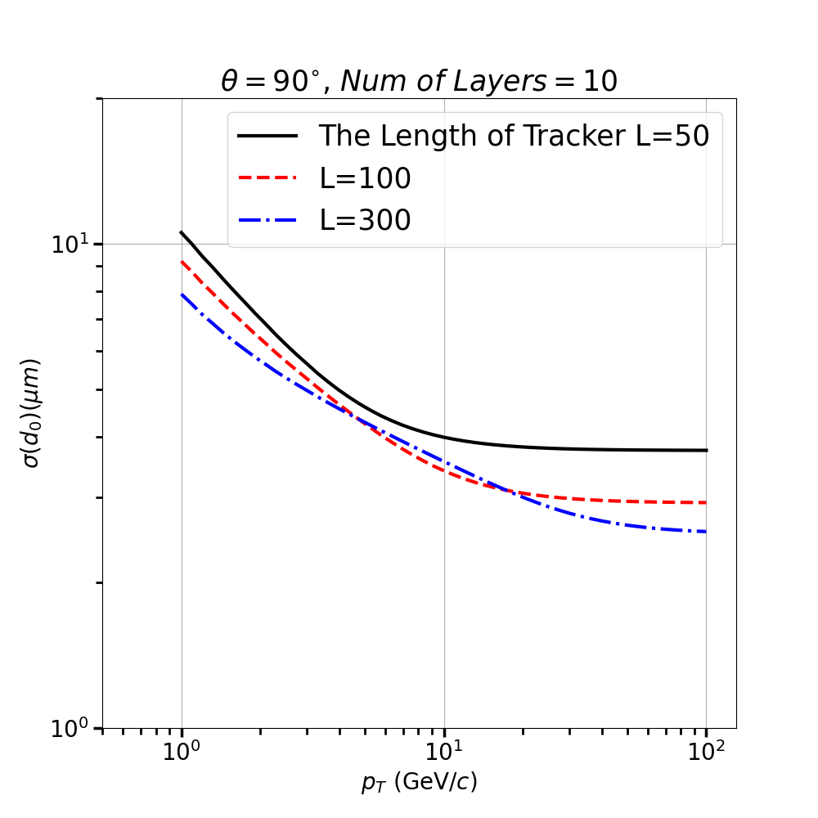
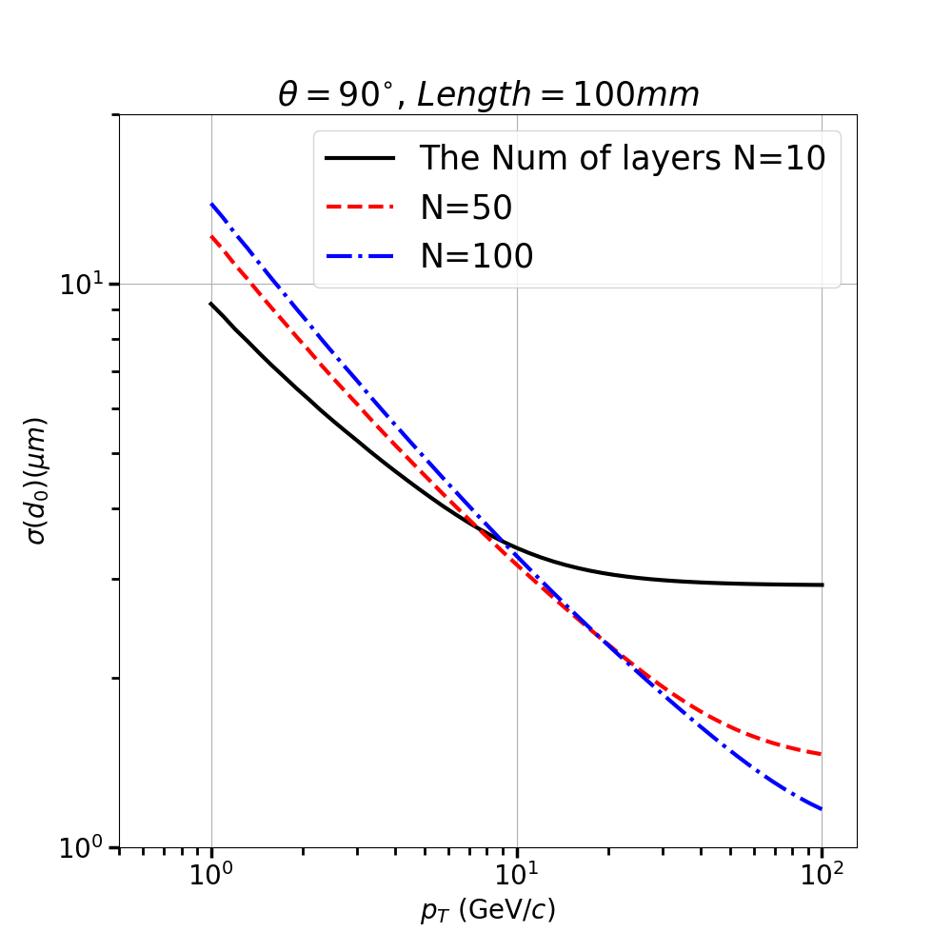
$∆Z_{0}=a⊕\frac{b\cosh^{\frac{3}{2}}{\text{η}}}{P_{T}}$ similar to d0

Slide 6
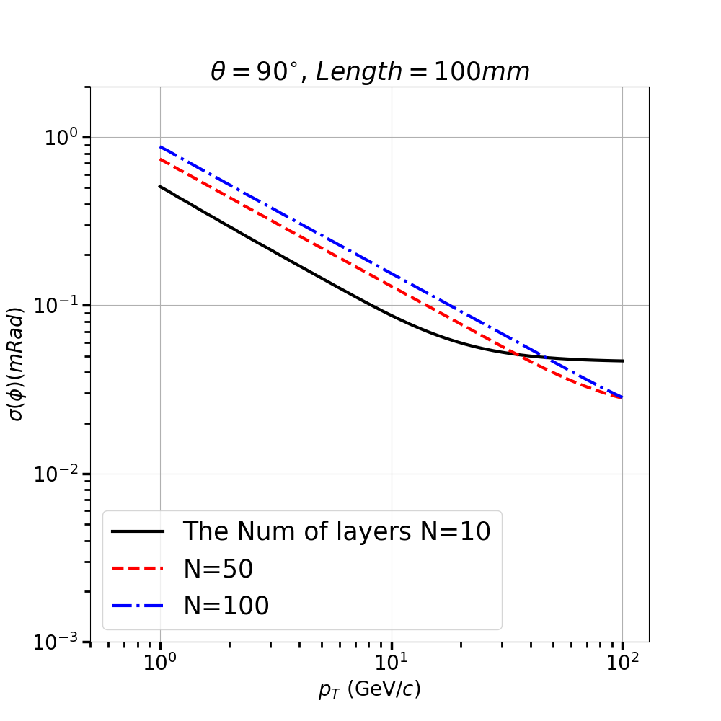
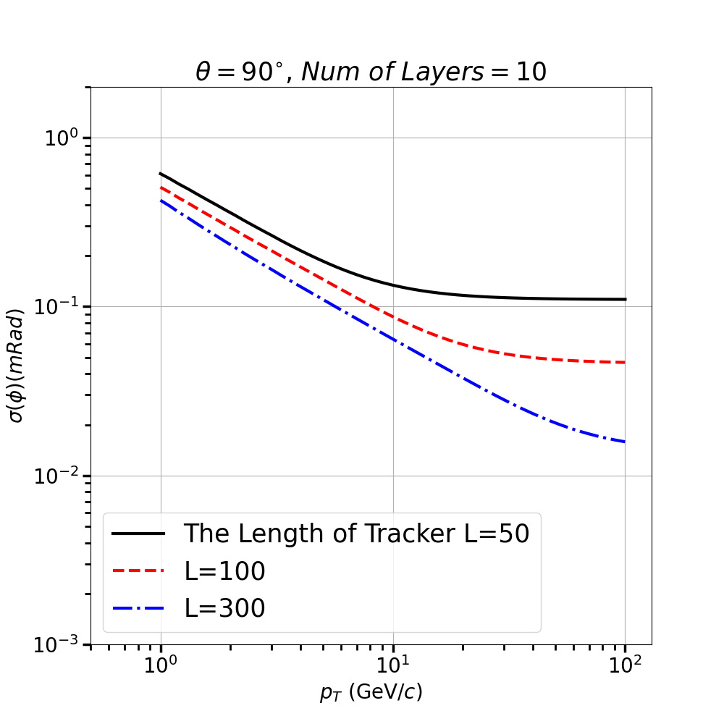
$∆θ=\frac{a}{\cosh^{2}{\text{η}}}⊕\frac{b}{P_{T}\cosh^{\frac{1}{2}}{\text{η}}}$ $a∝\frac{1}{L_{0}},\frac{1}{N^{1/2}}$ b has no relation to L0，N

Slide 7
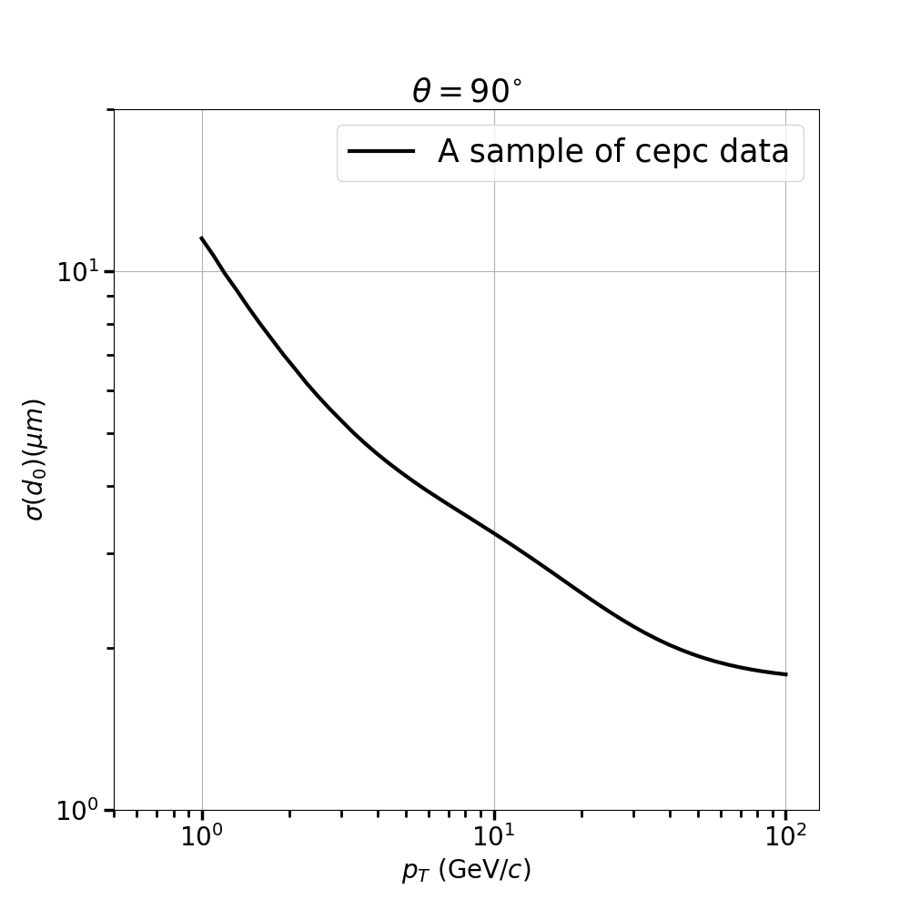
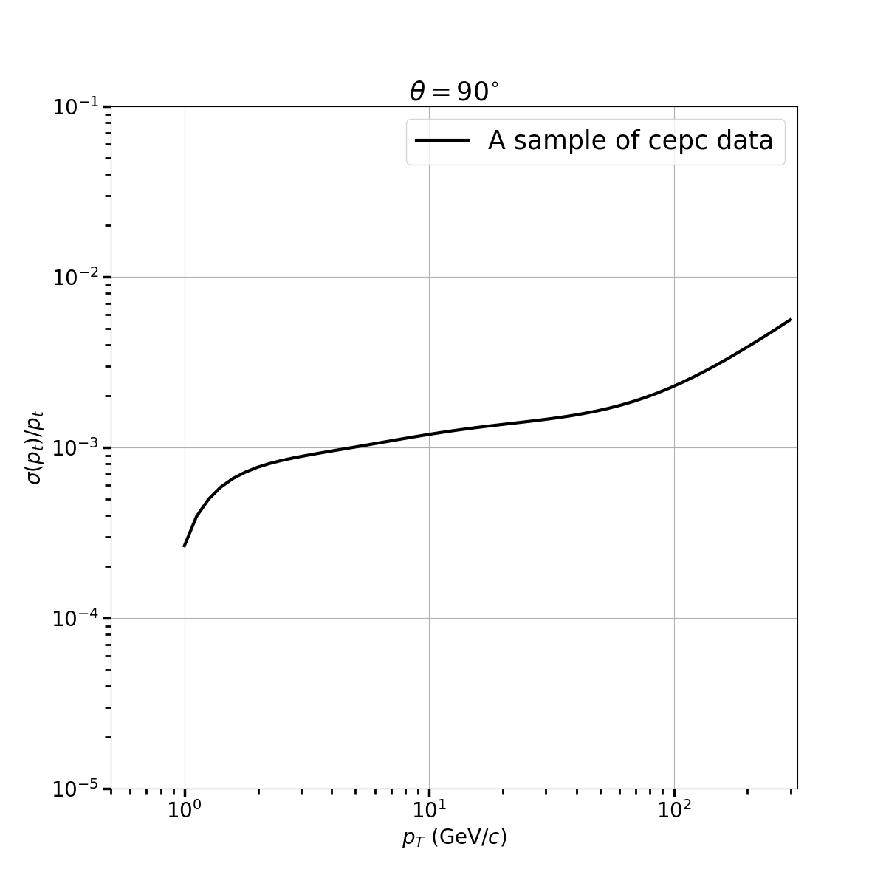
CEPC resolution calculation（by “z-compare ” file）r（radius of beampipe）=14mm L(radius of SET)=1810mm，N(the num of layers)=81

Slide 8
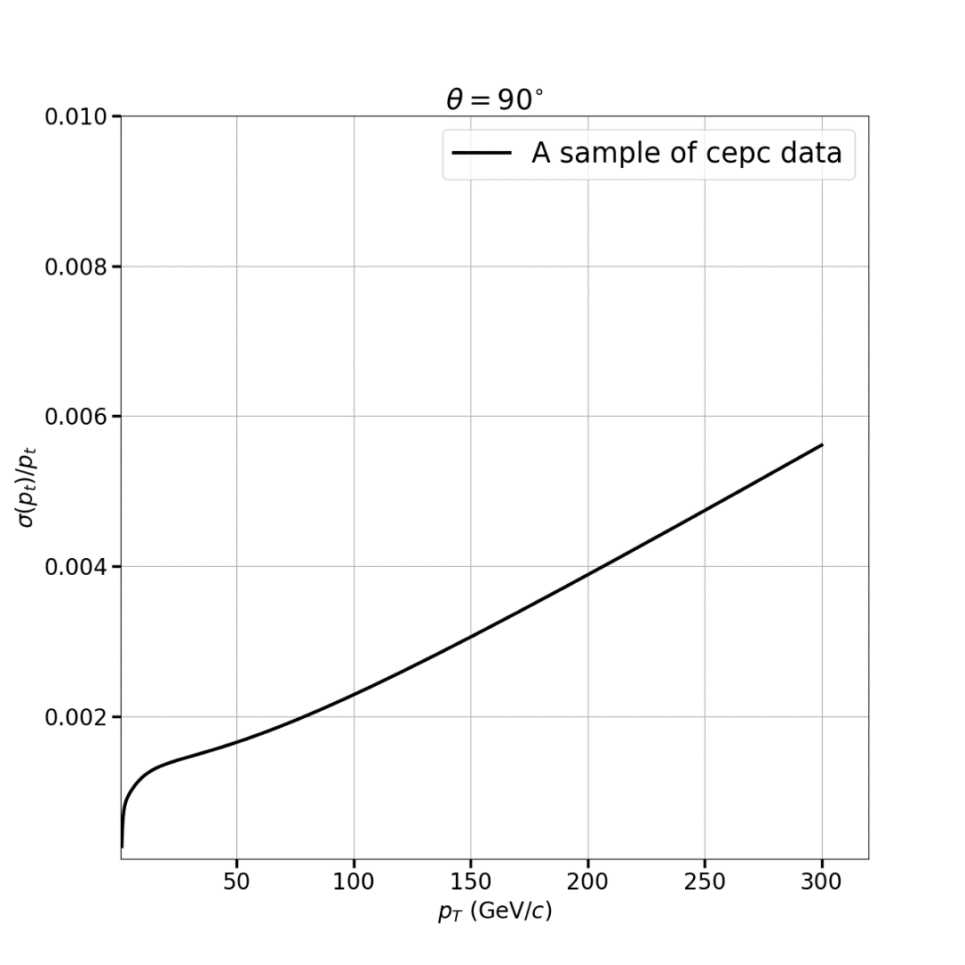
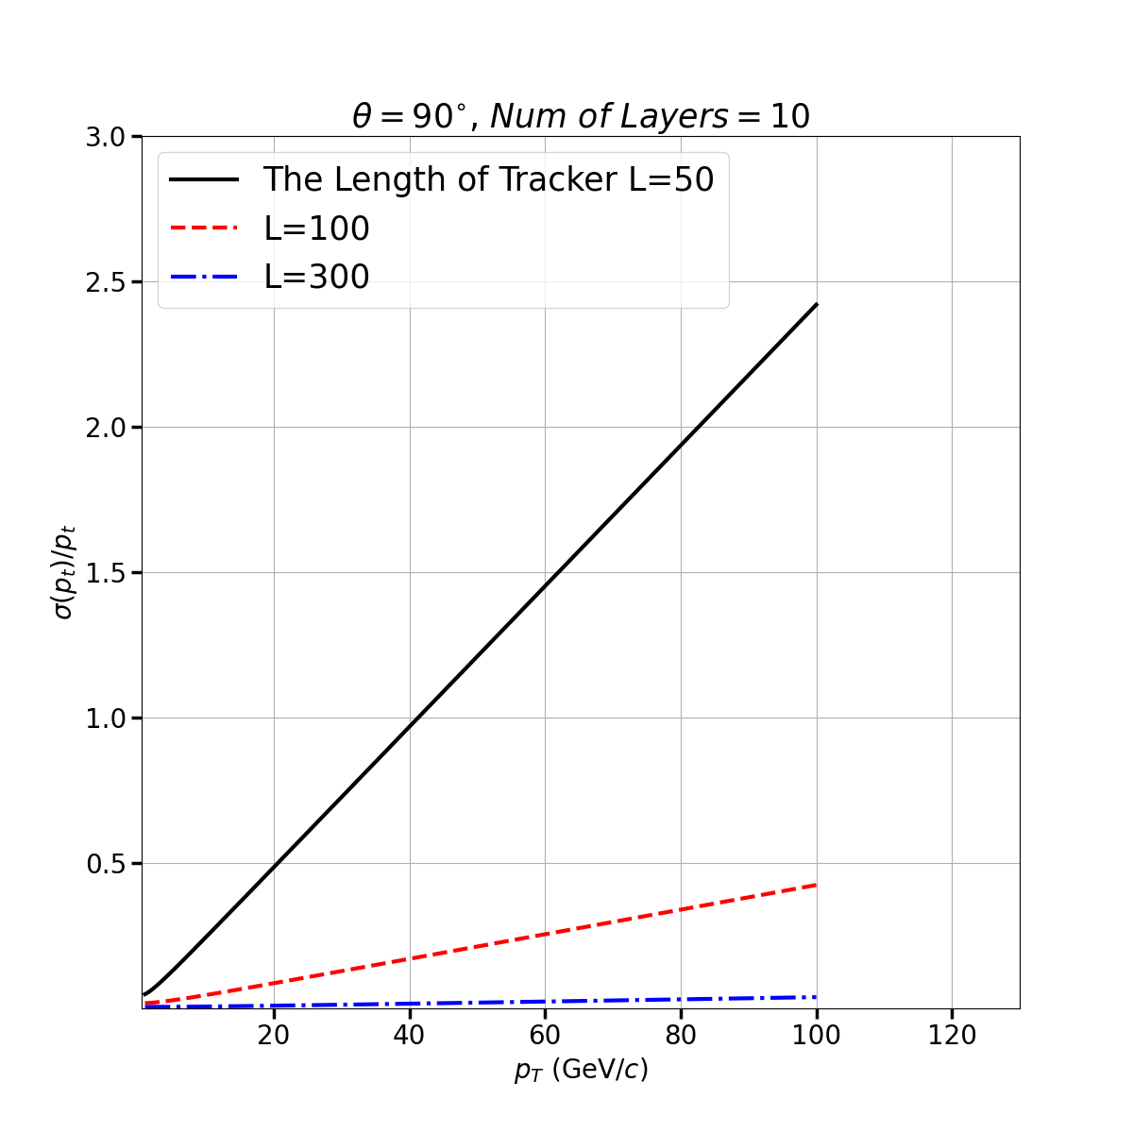
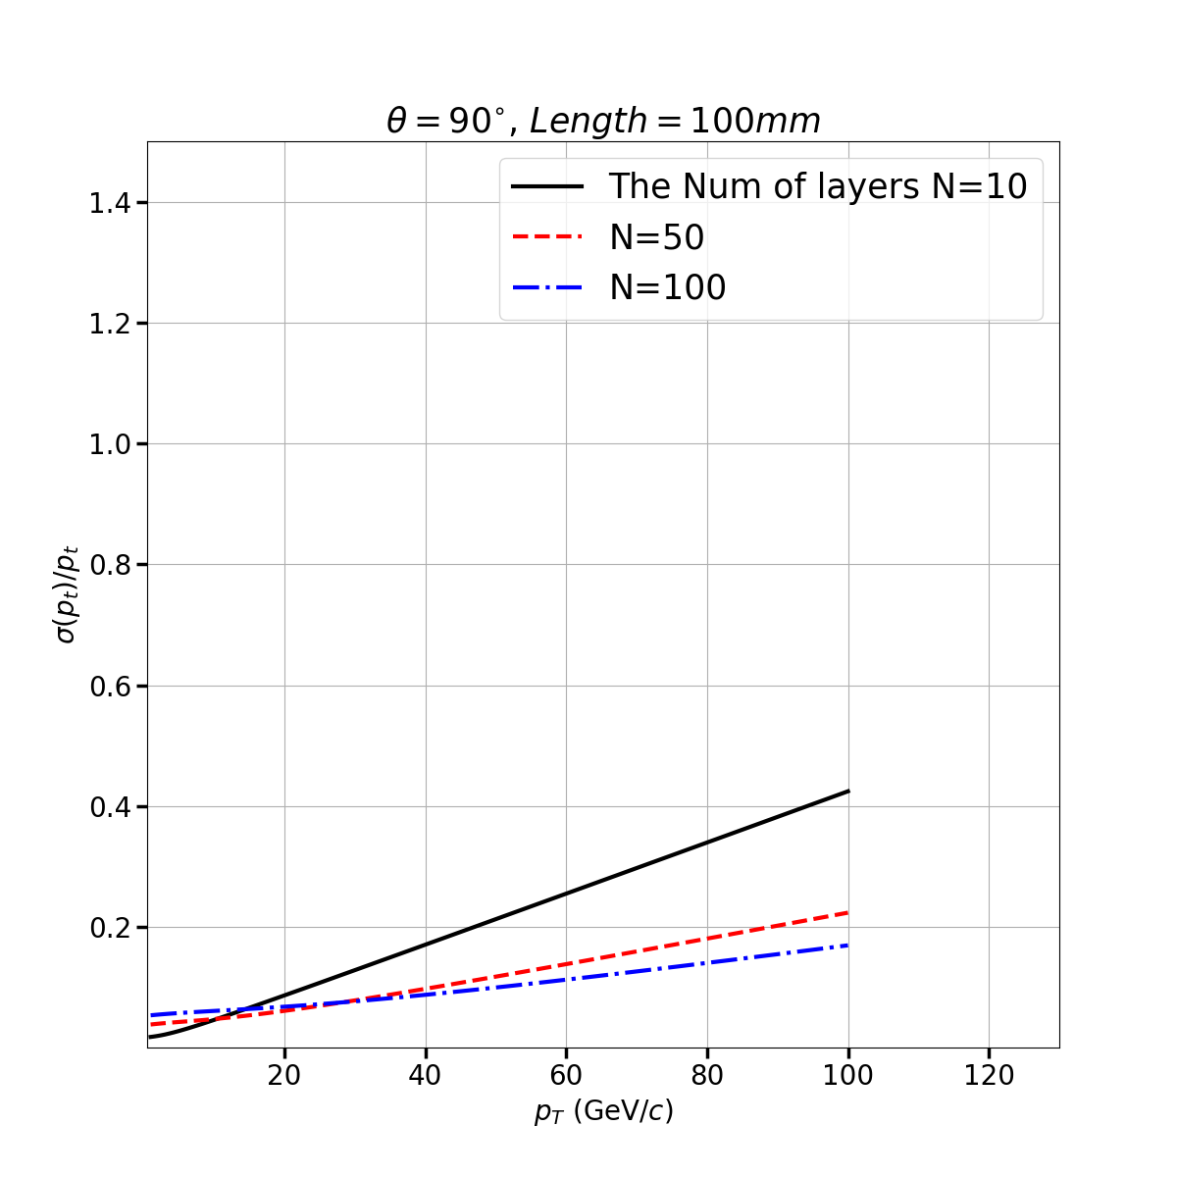
When we don’t use the semilog-axis, the difference will be more significant

