Slide 1
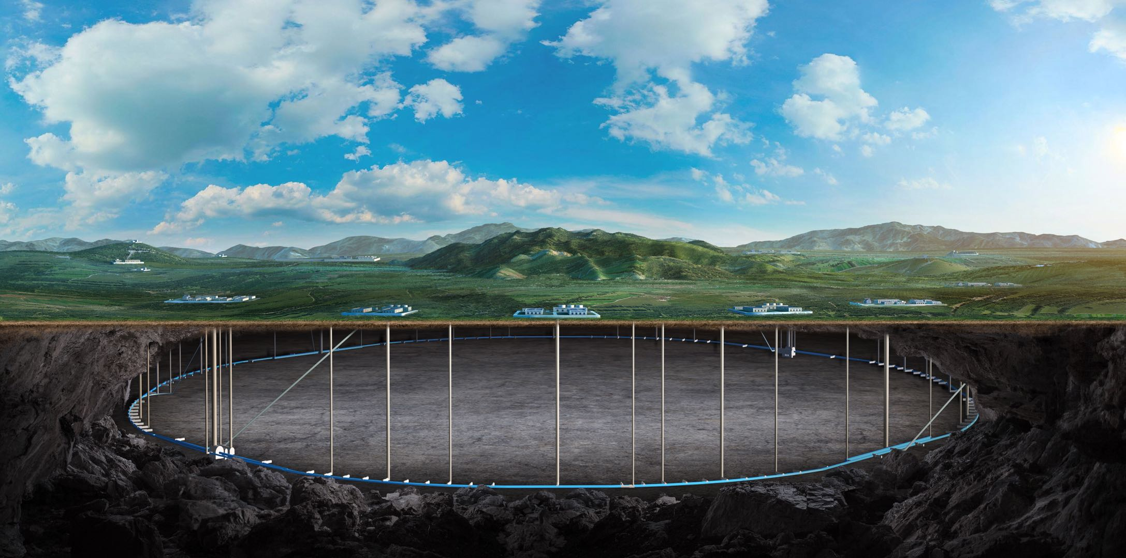
CEPC Day, 29 January 2022
Overall plan for CEPC Accelerator TDR
Yuhui Li
On behalf of the CEPC Acc. team

Slide 2
Content
Introduction & Target
Check points and necessary conditions
Preliminary Index
General arrangement and organization
Challenges
Summary

Slide 3
Introduction
CEPC-Accelerator TDR is an important milestone in CEPC Project Timeline
TDR is one of the emphasis tasks for the accelerator division in 2022

Slide 4
Targets and Vision
CEPC parameters have been updated for higher luminosity compare to CDR
- New physical design & parameters will be summarized in TDR
Important key technologies R&D have been carried out based on CDR
- Technical results & achievements will be included in TDR
CEPC accelerator TDR demonstrates the maturity of CEPC project, sketch the framework
TDR should reflect the highest abilities about the accelerator design and technology

Slide 5
Check Points and Necessary Conditions
Parameter consistency
- linac
- damping ring
- booster
- collider ring
- MDI …
Completion in various systems
- Lattice compatible to all energies,
- DA with errors for all energies,
- beam-beam effects,
- collective instability
Operation feasibility
- machine protection,
- radiation dose,
- control system,
- mechanical deformation
TDR parameters @ 30MW compatible to all energies: Higgs, tt bar, W, Z
• Lattice • Dynamic Aperture • Magnet Error • Impedance • beam-beam effect
Related investigations started
Key components satisfy the requirements:
• ttbar energy • 50MW upgrade @ all energies

Slide 6
Key Technology Summary
SRF cavity & complete module: full of achievements & experience
High efficiency klystron: first step results, milestone is coming,…
HTS magnets for SPPC: 12T,…
Room temperature magnets: weak field dipoles, dual aperture magnets, various kickers, septum, power supplies, electro-static deflector, …
Superconducting final focus QUAD: snake shape coil, CCT, …
Injection prototyping: S-band structure, RF pulse compressor, positron source,
Instrumentation: BPM, feedback,……
Vacuum chambers: Coating for a long tube, …

Slide 7
Content I --- Collider Ring
1.1 Main parameters update for High luminosity
1.2 Accelerator Physics
1.2.1 Bare lattice and dynamic aperture (arc region, straight section, IR)
1.2.2 Beam-beam effect
1.2.3 Collective instability
1.2.4 Injection & Extraction scheme
1.2.5 Machine Detector Interface
1.2.6 Beam loss and collimator
1.2.7 High Energy Synchrotron Radiation Source (SR wigglers and transporting lines)
1.2.8 Self Polarization for Z

Slide 8
Content I --- Collider Ring
1.3 Technical Systems
1.3.1 Superconducting RF System (650M)
1.3.2 RF Power Source and distribution
1.3.3 Room temperature magnets (dual aperture magnets)
1.3.4 Superconducting magnets in IR (SCQ, Solenoid)
1.3.5 RVC in MDI
1.3.5 Special Magnets (kickers, electro-static separators)
1.3.6 Vacuum System (chambers, valves, connectors)
1.3.7 Mechanical System
1.3.8 Instrumentation & Feedback system
1.3.9 Control System

Slide 9
Content II --- Booster
2.1 Main parameters update
2.2 Accelerator Physics
2.2.1 Optics (arc region, straight section)
2.2.2 Error study
2.2.3 Beam instability
2.2.4 Injection & Extraction scheme
2.3 Technical Systems
2.3.1 Superconducting RF System (1.3 GHz)
2.3.2 RF Power source
2.3.3 Magnets (weak field dipole)
2.3.4 Magnets Power Supplies
2.3.5 Vacuum System
2.3.6 Instrumentation
2.3.7 Mechanical System

Slide 10
Content III --- Linac
3.1 Parameters (new baseline of 20GeV)
3.2 Electron Source
3.3 Positron Source
3.4 Accelerator Physics
3.4.1 Beam Dynamics Design for Linac
3.4.2 Damping ring
3.5 Technical Systems
3.5.1 Normal conducting acceleration structure (Linac & damping ring)
3.5.2 RF power source
3.5.3 Magnets (incl. special magnets)
3.5.4 Instrumentation and beam diagnostics
3.5.5 Control System
3.5.6 Mechanical System
3.6 Plasma Acceleration
3.6.1 Conceptual Design as backup injection (PWFA)
3.6.2 Dechirp Experiment

Slide 11
Content IV --- Global Implementation and technologies
4.1 Transport lines
4.1.1 Connection lines linac-damping
4.1.2 Connection lines linac-booster
4.1.3 Connection lines booster-collider
4.1.4 Connection lines collider-dumps
4.2 Timing and Beam Pattern
4.3 Control System
4.4 Cryogenic System
4.5 Survey and Alignment
4.6 Machine protection
4.7 Installation logistic
4.8 Electrical Documentation

Slide 12
Content V --- SPPC
5.1 SppC Parameters
5.2 Accelerator Physics
5.3 High Field Superconducting Magnets
5.4 CEPC-SppC Compatibility

Slide 13
Content VI --- Facilities
6.1 PAPS for SRF, beam test, Magnets, Power Suppliers
6.2 Vacuum Experimental Facility
6.3 Magnet Measurement Center in Dongguan
6.4 SC Magnet Experiment test stand
6.5 Instrumentation

Slide 14
Content VII --- Cost and Power Consumption
7.1 Collider Ring
7.2 Booster
7.3 Linac
7.4 Infrastructure

Slide 15
Content VIII --- Siting and Civil Engineering
8.1 Auxiliary Facilities
8.1.1 Electricity (30MW and 50MW)
8.1.2 Cooling water
8.1.3 Ventilation
8.1.4 Waste heat re-use
8.1.5 Green Energy and Sustainable Development

Slide 16
General arrangement
Jan-May: Content Discussion, research convergence
June: IARC Review
July-Dec: TDR editorial process
Weekly monographic discussion & meeting:
- clarify the weak points
- complete solvable problems
- if problems require too much time:
• figure out state of the art solution
• describe the conceptual countermeasures

Slide 17
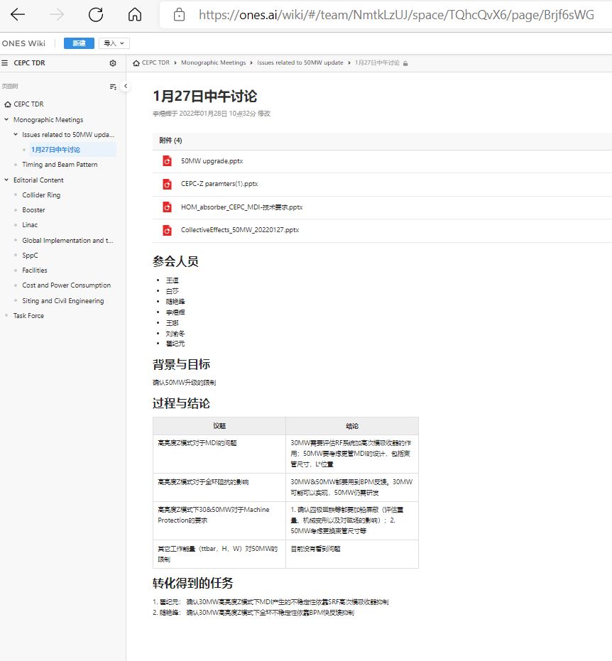
On-line Documentation
Commercial online documentation system: ONES
- multi user access
- multi user edit

Slide 18
Task Distribution – Physical Design
Physical Design:
Collider:
Yiwei Wang (Lattic, DA,……), Bing Wang (Error for DA), Na Wang (collective instability), Yuan Zhang (Beam-beam effect)
Booster:
Dou Wang (Lattic, DA,……), Daheng Ji (Error for DA), Yudong Liu(collective instability)
Linac:
Meng Cai (S2E Simulations,……), Dou Wang (damping ring), Xiaoping Li, Tianmu Xin (Gun)
MDI:
Sha Bai (radiation background, heat load,…), Zhongjian Ma, Guangyi Tang (Machine Protection)
Haijing Wang(Mechanics), Miaofu Xu (Cryogenicstat), Haoyu Shi (Detector)
SppC:
Jingyu Tang (physical design,…), Qingjin Xu (HTS Magnets)
Transport lines:
Xiaohao Cui (lattice, injection & extraction), Dou Wang (conceptual design)
Timing & pattern:
Dou Wang, Cai Meng, Jinghui Chen, Gang Li, Ge Lei
Plasma Acc. :
Dazhang Li, Ming Zeng

Slide 19
Task Distribution – Key technologies
Technology:
SRF System:
Jiyuan Zhai (overall parameters,……), Peng Sha (650M cavity)
RF power source:
Zusheng Zhou (P&C-band klystron, )
Normal conducting RF Cavity:
Jingru Zhang (S-&C- band Acc. Structure, pulse compressor, e+ source )
Injection & Extraction:
Jinghui Chen (kickers, septum, fast pulser,…), Bing Chen (electrostatic deflector)
Normal conducting Magnets:
Wen Kang (Booster Dipoles), Mei Yang (Dual Aperture Mags: Dipole, quads, sextupole)
HTS Magnets:
Qingjin Xu (Dipoles, CCT, ……)
Instrumentation:
Junhui Yue, Yanfeng Sui (BPM, BLM, ……)
Vacuum System:
Yongsheng Ma (NEG coating)
Control System:
Gang Li (issues for 100km ring)
Cryogenic System:
Rui Ge, Mei Li
Mechanical System:
Haijing Wang

Slide 20
Challenges
Tasks conflict:
- Lack of experts time: HEPS, BII-U, ……
Task difficulties:
- CEPC requires world leading accelerator capabilities:
physics, technologies, architecture, ……

Slide 21
Summary
CEPC accelerator TDR requires considerable work and manpower
Conflict with other important projects
Challenge but doable

