Slide 1


Status of the Silicon Tracker
Yiming Li (IHEP, CAS)
On behalf of the CEPC silicon tracker community
CEPC Day, 29 Jan 2022

Slide 2
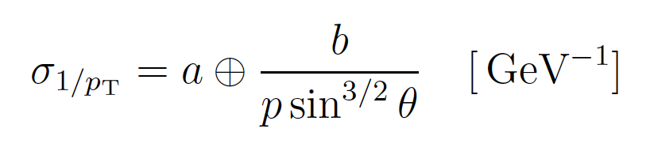


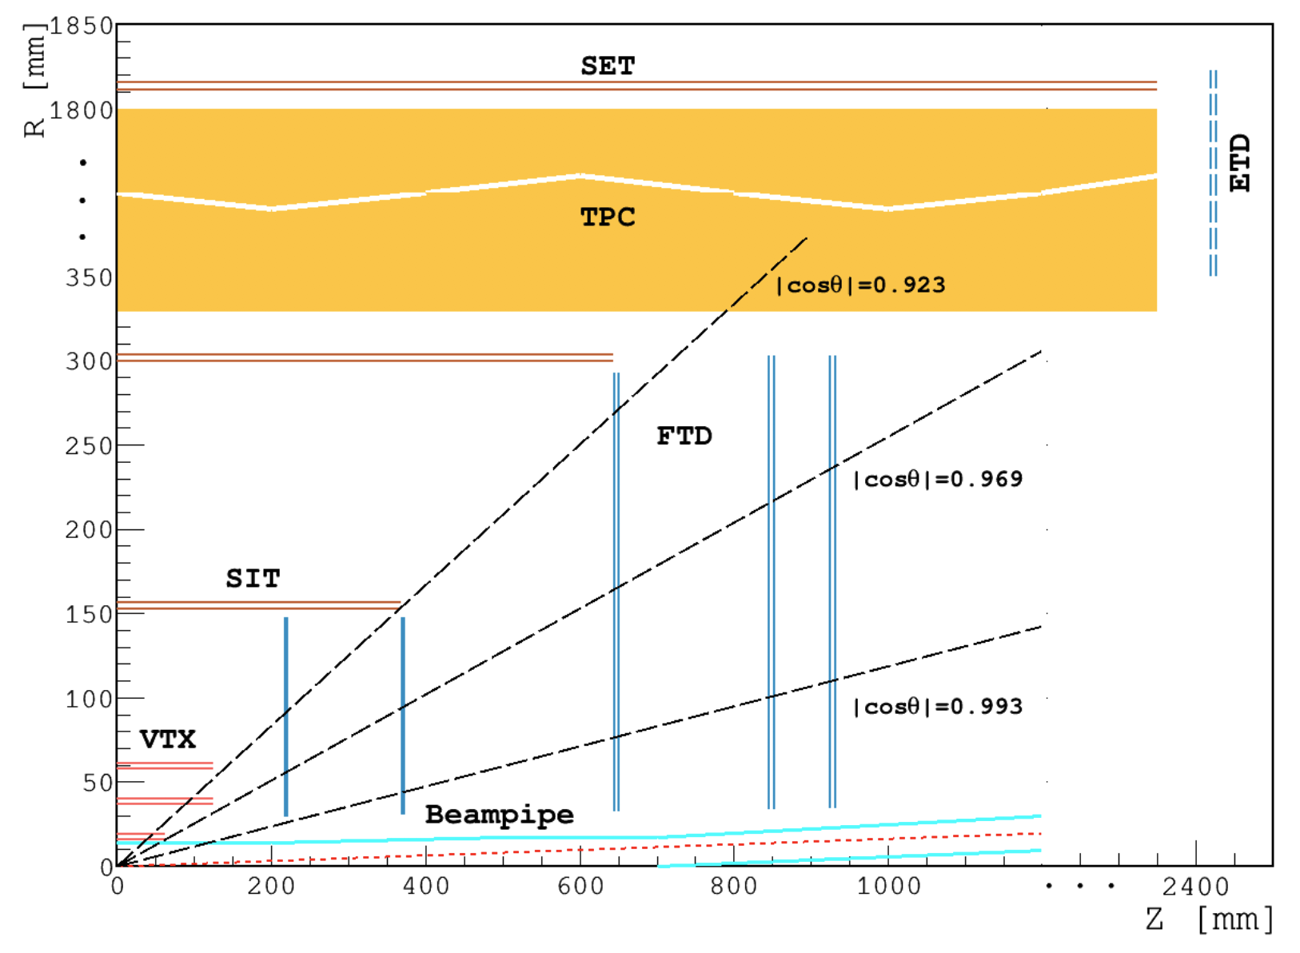
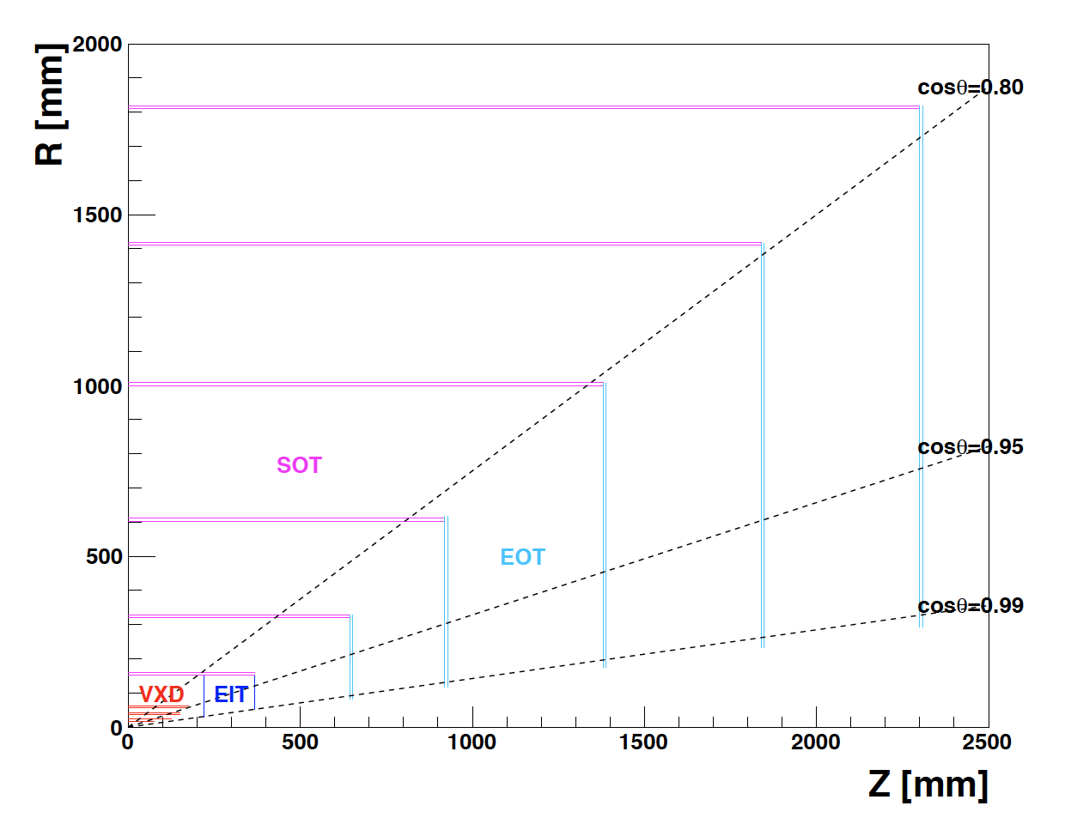
Si Tracker for CEPC
CEPC requires a high-resolution and low-material tracking system
Large area of silicon!
  > 70 m² for baseline design: Silicon + TPC
  ~ 140 m² for Full Silicon Tracker
CMOS is the promising technology for cost effectiveness and performance
Baseline design
Full Silicon Tracker

Slide 3
CMOS Si tracker collaborators
Convenors: Harald Fox (U. Lancaster), Meng Wang (SDU)
Australia
  University of Adelaide
China
  Harbin Institute of Technology
  Institute of High Energy Physics, CAS
  Northwestern Polytechnical University
  Shandong University
  T. D. Lee Institute – Shanghai Jiao Tong University
  University of Science and Technology of China
  University of South China
  Zhejiang University
Germany
  Karlsruhe Institute für Technologie
Italy
  INFN Sezione di Milano, Università degli Studi di Milano e Università degli Studi dell’Insubria
  INFN Sezione die Pisa e Università di Pisa
  INFN Sezione di Torino e Università degli Studi di Torino
UK
  Lancaster University
  Queen Mary University of London
  STFC – Daresbury Laboratory
  STFC – Rutherford Appleton Laboratory
  University of Bristol
  University of Edinburg
  University of Liverpool
  University of Oxford
  University of Sheffield
  University of Warwick

Slide 4
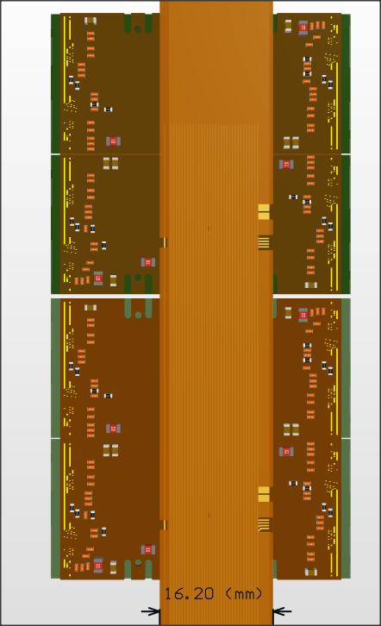
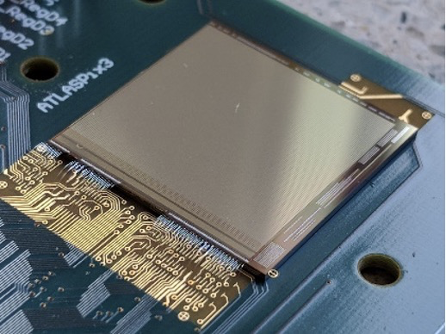
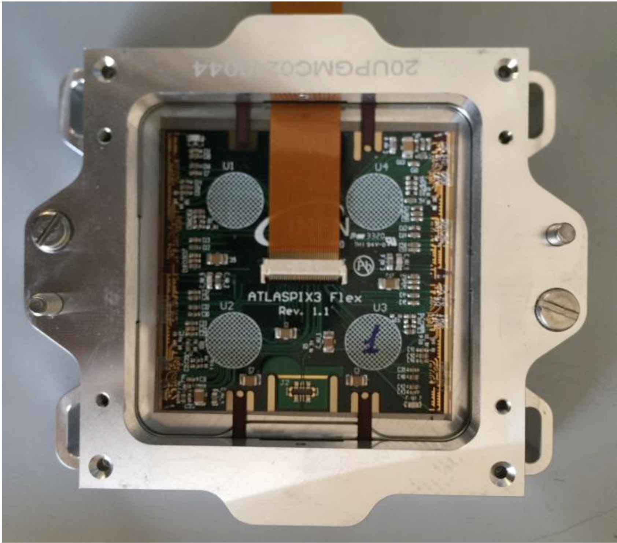
Prototyping Overview
Stave(let)
Single chip
…
Power IN/OUT
Quad module
HV
Data IN/OUT
…

Slide 5
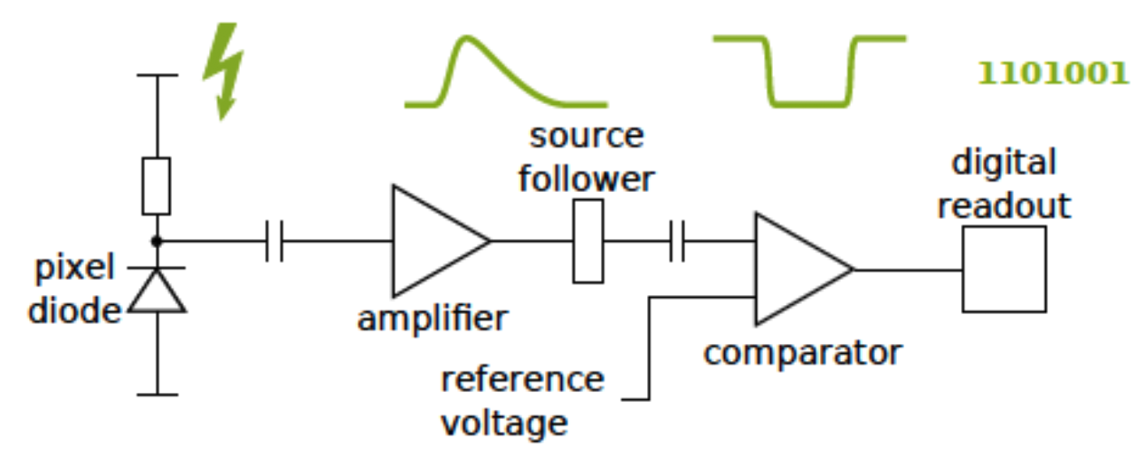
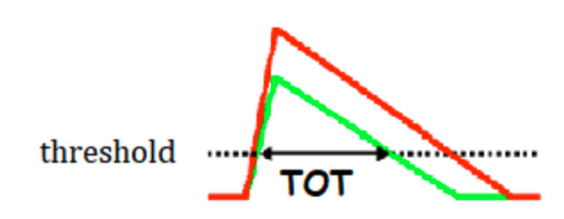

ATLASPix3 sensor
  TSI 180nm HV process on 200 $Ω$cm substrate
  Pixel size 50 $×$ 150 $μ$m²
  132 columns $×$ 372 rows (20.2 $×$ 21 mm² chip)
  Triggerless/triggered readout possible
  Binary with ToT information
  Power consumption ~140 mW/cm²
I. Peric et al., High-Voltage CMOS Active Pixel Sensor, IEEE JSSC, Volume: 56, Issue: 8, Aug. 2021
https://ieeexplore.ieee.org/document/9373986
Time-over-Threshold (ToT) as proxy of signal amplitude
Mainly working with ATLASPix3.0 (some thinned to 150um)
ATLASPix3.1 delivered in Feb 2021

Slide 6
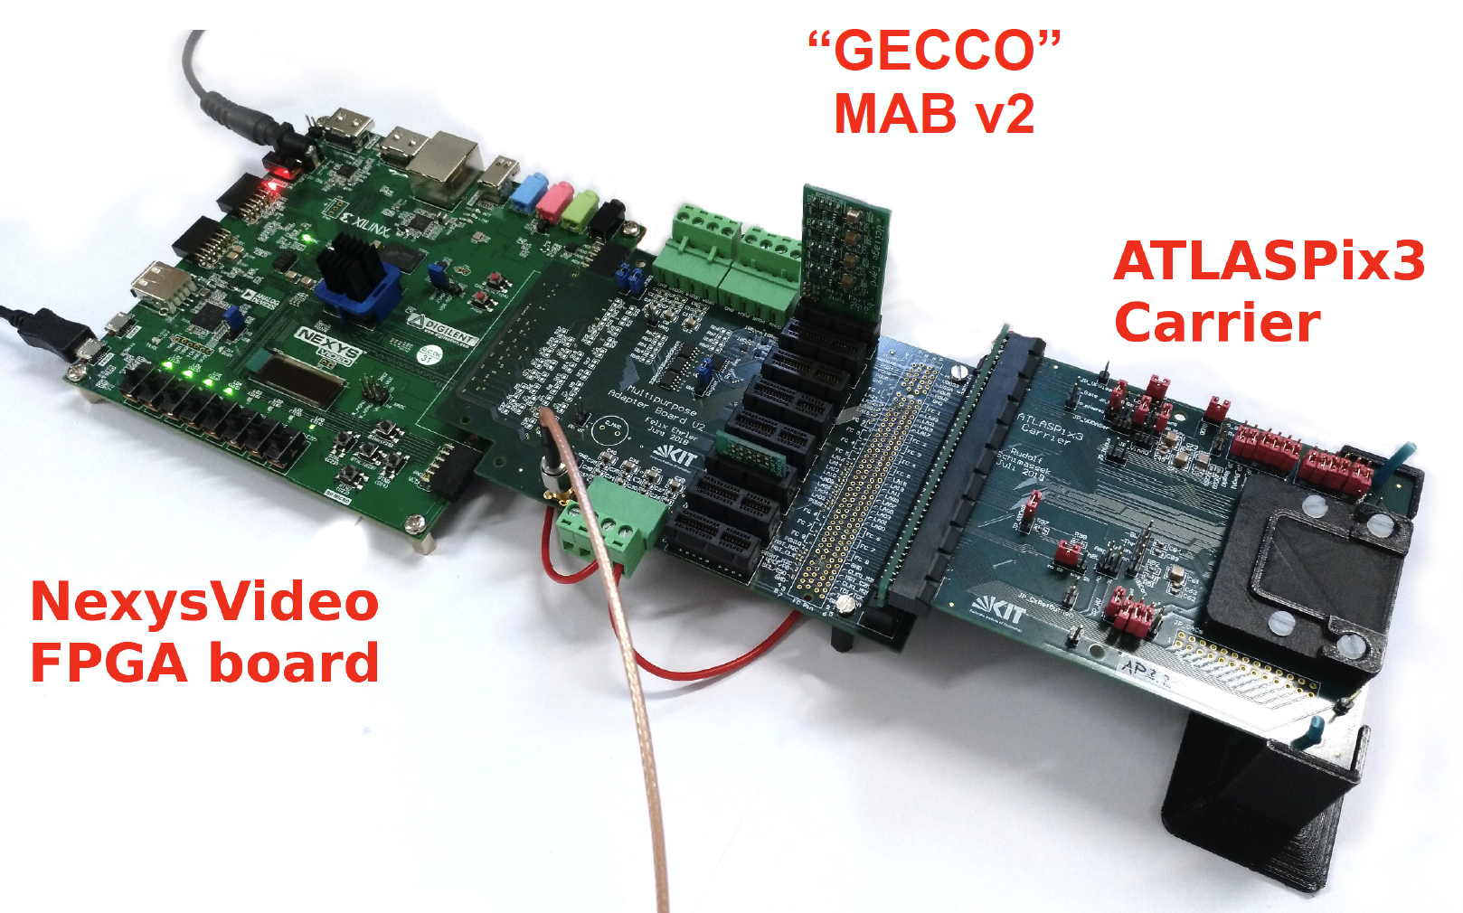

Single-chip programme
Experience gained with single chip tests (up to last CEPC Day)
  GEneric Configuration and COntrol System - designed at KIT
  LFP-FMC connection to Nexys FPGA, PCIe x16 to DUT, allows extensive tests
  Carrier board for ATLASPix3 single-chip
O(65) GECCO boards and carrier boards produced in China
Chips & boards distributed globally and multiple institutes set up lab tests

Slide 7
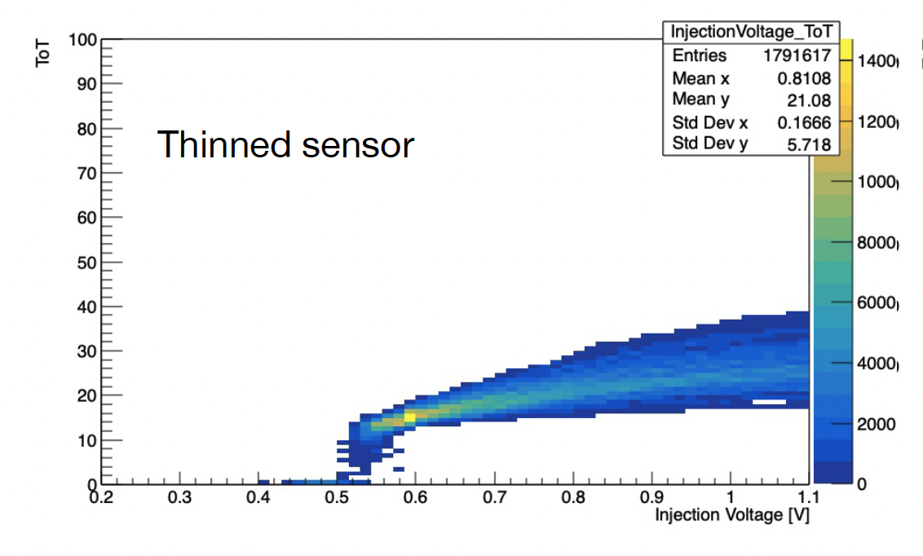
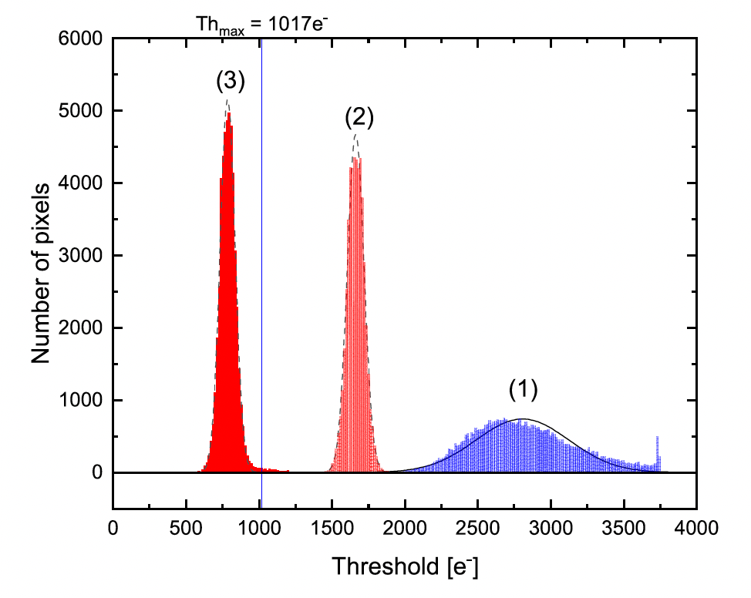
Single chip tests
ATLASPix3 responses to cosmic ray or various radioactive sources (⁵⁵Fe, ⁹⁰Sr, ²⁴¹Am) are observed at different sites
Thresholds at 800e noise <~ 80e
ToT response
Test with injection charge: (1) untuned
(2, 3) tuned with higher / lower thresholds

Slide 8
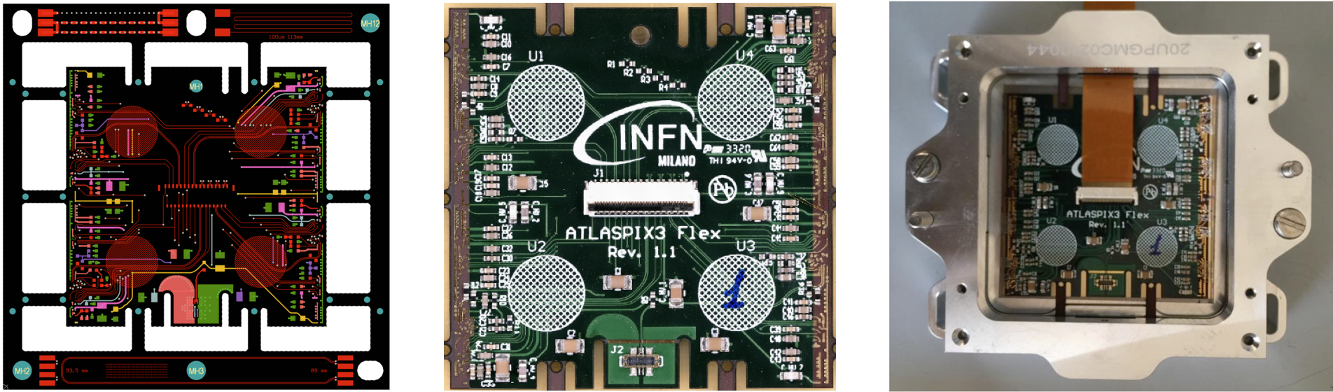
Quad module
Four chips sharing services by common power connections and configuration lines
Inspired by ATLAS ITk quad module concept for large area application
Bianca Raciti, PSD 2021 poster

Slide 9
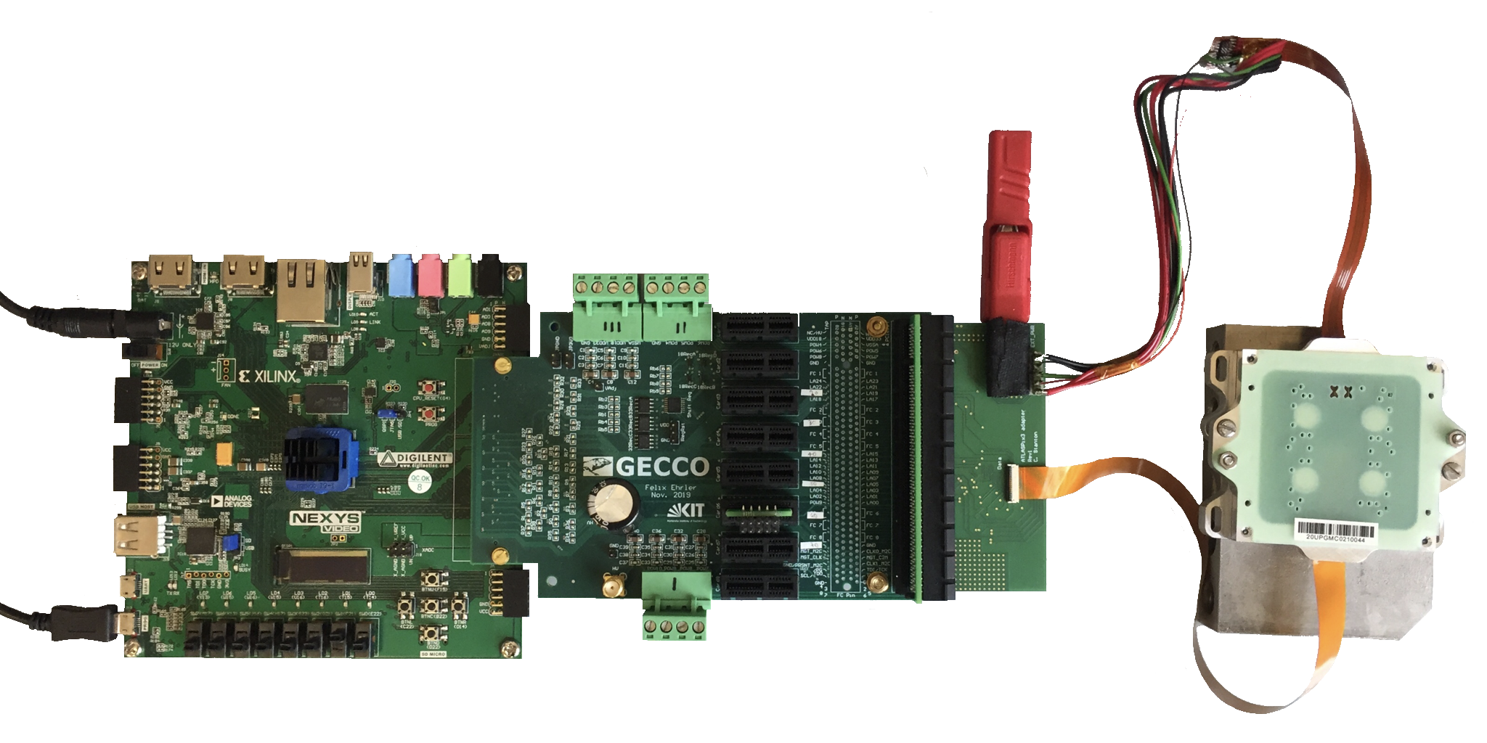
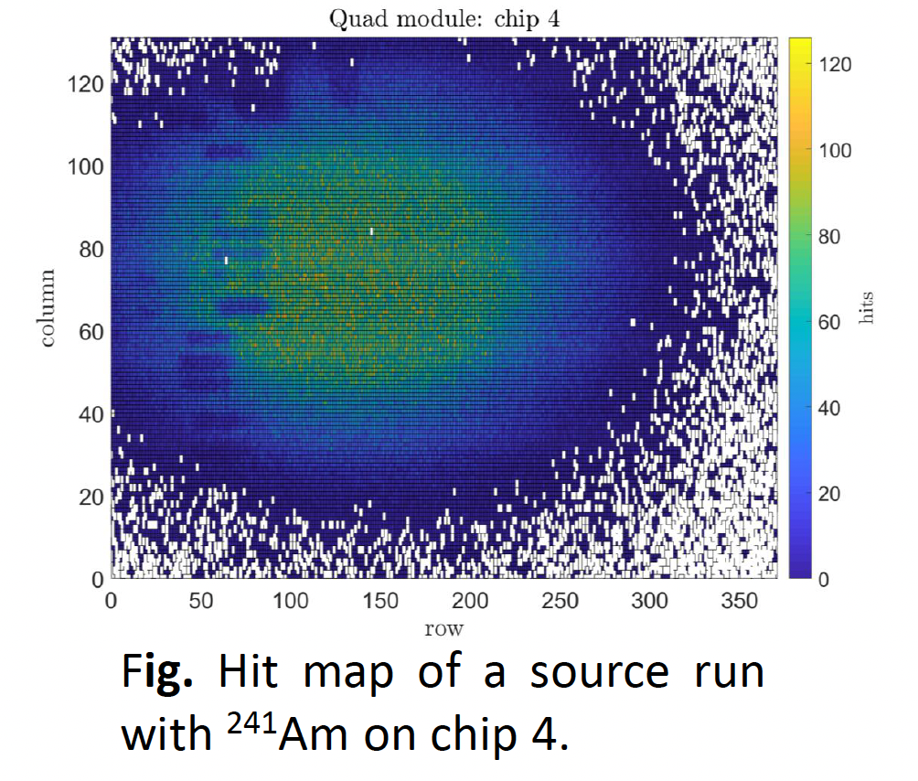
Quad module test
Data flex and power cables designed by INFN Milano, under verification
Adapter card for connecting to GECCO
9 quads with ATLASPix3.0 assembled, test ongoing
  All chips can be configured on a quad
  Single chip responsive to radiative source
Custom power cable
Adapter card
Bianca Raciti, PSD 2021 poster
Data flex

Slide 10
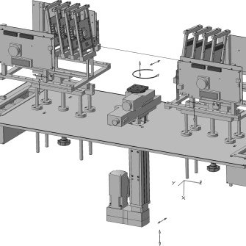
Plan for testbeam
Motivation:
  Ultimate test of a sensor system
  Measure efficiency and position resolution
  Study performance with angled tracks
Beam time at DESY booked for 4th April
Jaap Veltuis, talk at SiTracker meeting 20 Jan 2022

Slide 11
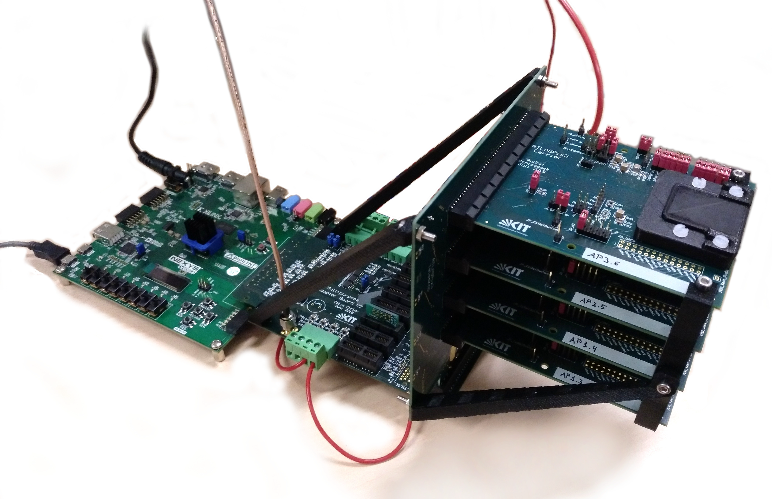
DUT configuration
KIT produced telescope cards carrying 4 sensors with ~2.5 cm spacing
Two stations of 4-sensors in zipper configuration – closest as possible
No need for trigger: each sensor provides hits and time stamps
Test setup being assembled by Bristol/Edinburgh/Lancaster
Telescope module
Telescope module

Slide 12
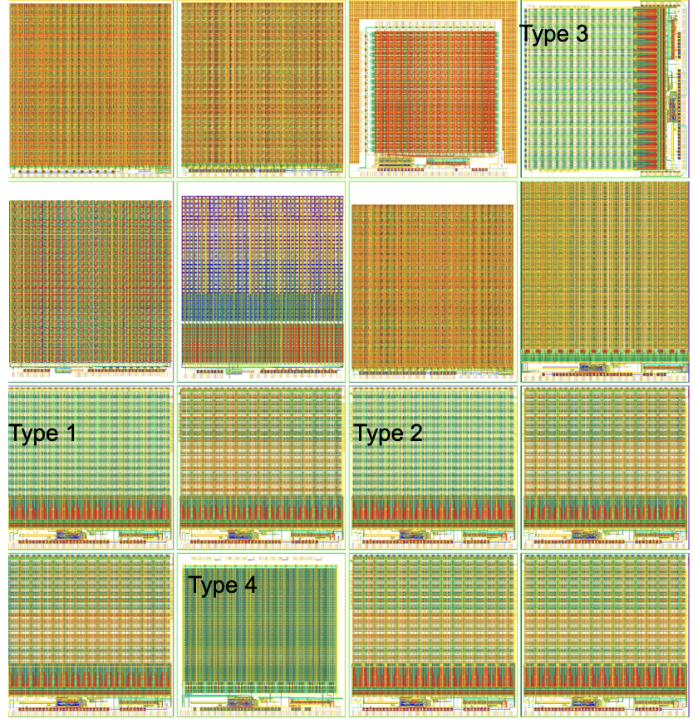
New sensor development
Matrix | Pixel size µm | Pixel type | Amplifier | Comparator
1 | 25x165 | HVCMOS | N/C MOS | NMOS
2 | 25x165 | HVCMOS | N/P MOS | CMOS
3 | 25x165 | HVCMOS | NMOS | distributed
4 | 25x35 | DMAPS | NMOS | CMOS
Improved sensor designs for tracking at electron colliders
  Joint engineering run with LHCb 2020
  Designs for CLIC, CEPC, DESY telescope upgrade (TELEPIX)
  Pixels 25µm X 165µm
Key improvement
  Reduced pixel size
  Different amplifier/comparator types
  Reduced power consumption
Ivan Peric, UK-CEPC tracker workshop, https://indico.ph.ed.ac.uk/event/103/

Slide 13
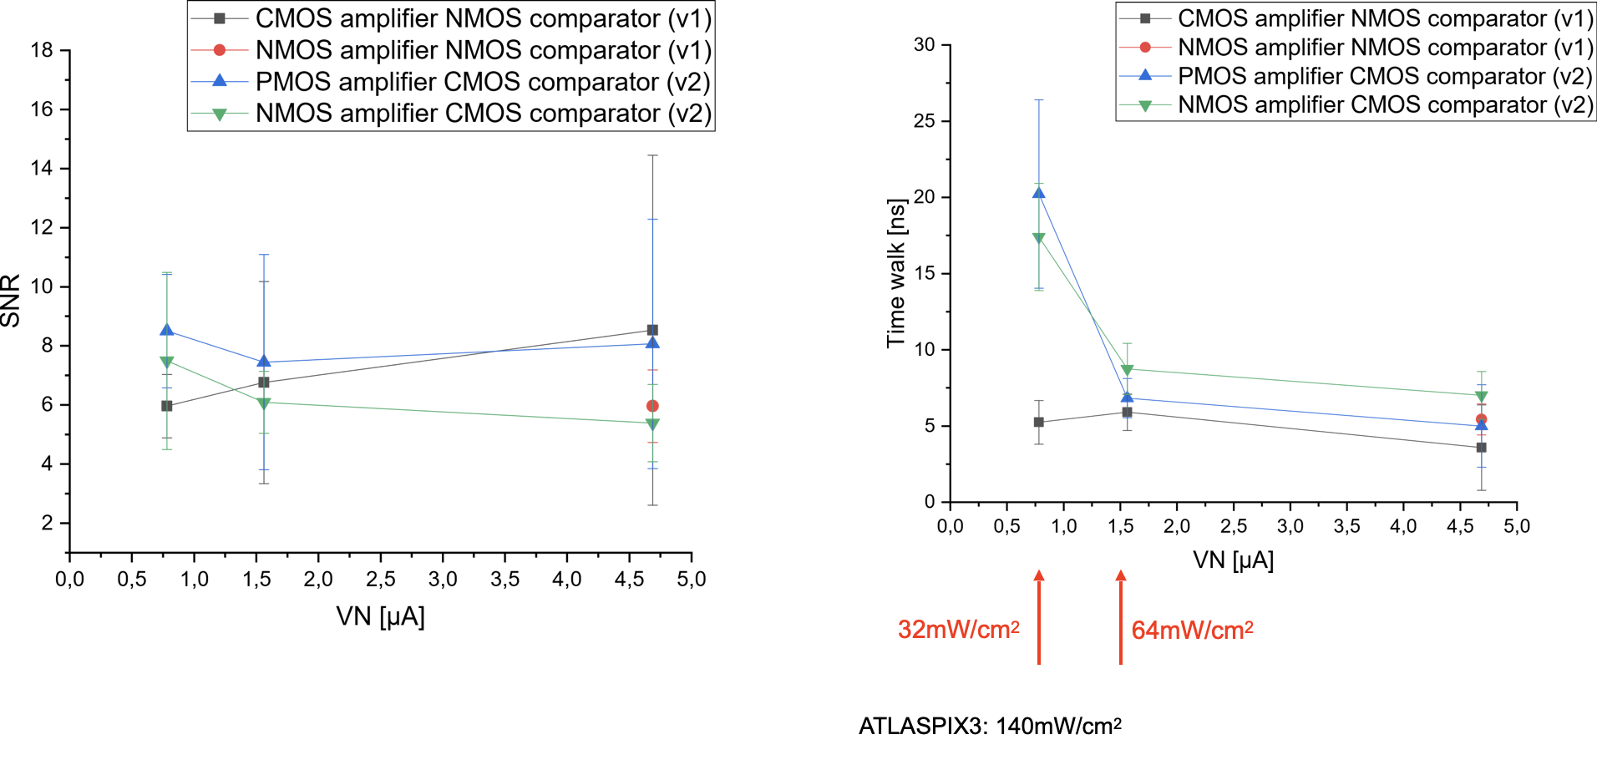
Preliminary measurements and implications
Pixel matrices with three amplifier types have been operated with smallest possible threshold
Signal to noise ratio (from ToT) and time walk for signals larger than 3200e have been measured
CMOS amplifier has smallest time walk
Low power consumption is possible (up to factor of 4 reduction compared with ATLASPix3)
Ivan Peric, UK-CEPC tracker workshop, https://indico.ph.ed.ac.uk/event/103/

Slide 14
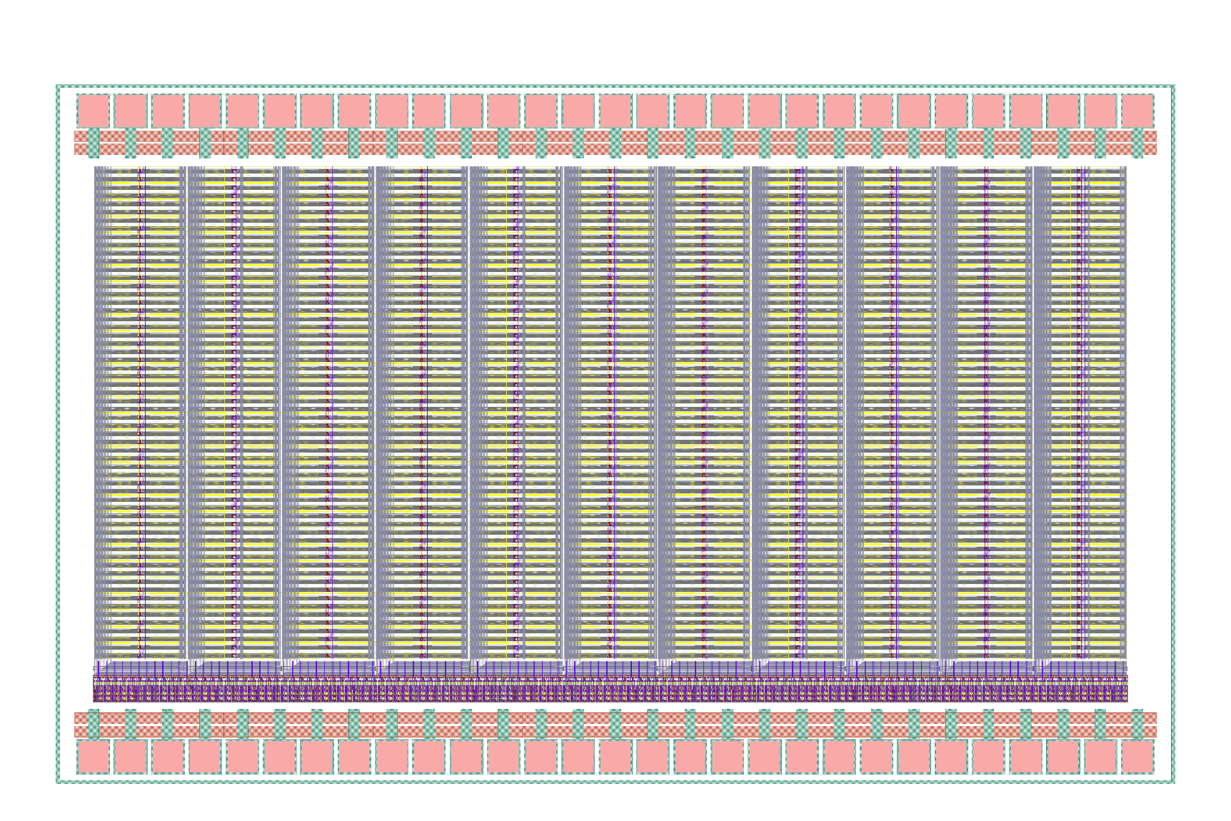
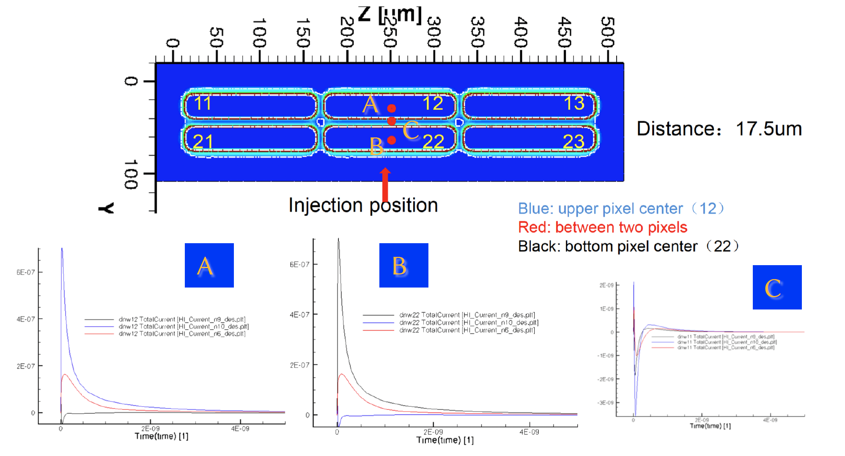
Sensor in 55nm technology
HLMC (上海华力) offers 55nm technology with similar layers as TSI
Test sensors designs will be submitted within a MPW run
Originally planned for Aug 2021, seeking opportunity in Mar 2022
An area of 3mm*4mm is targeted
KIT design for test sensors
IHEP simulation for 6-pixel test structure

Slide 15
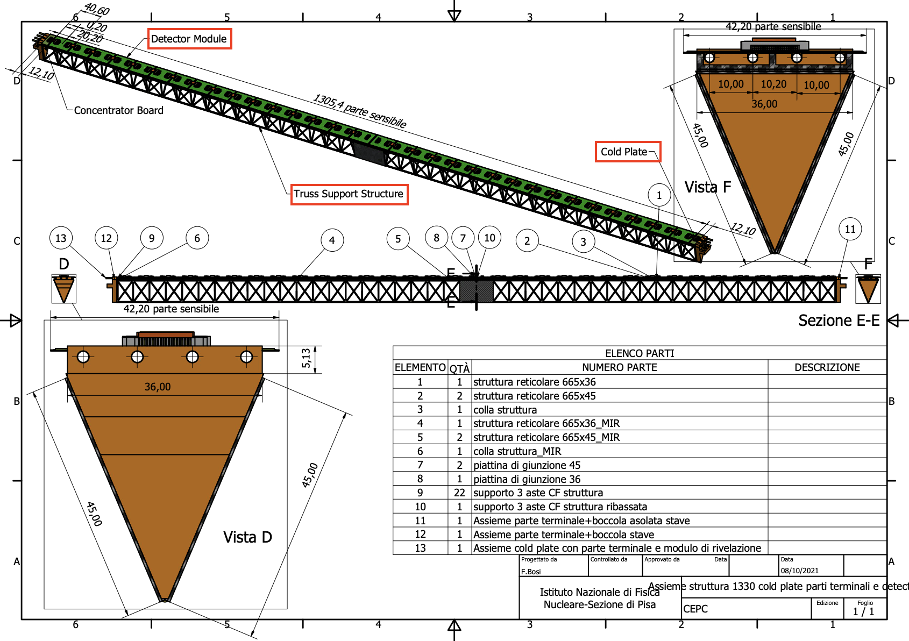
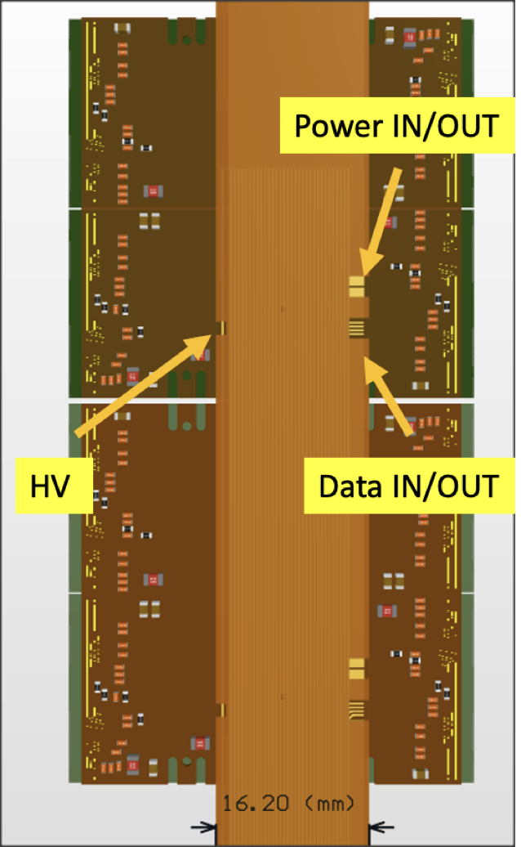
Mechanics design
System design concept (SIT2)
  Truss structure for long stave hosting 16 quads
  Distribute power and data signals along the stave
F. Palla, F. Bosi, A. Andreazza, F. Sabatini, UK-CEPC tracker workshop, https://indico.ph.ed.ac.uk/event/103/

Slide 16
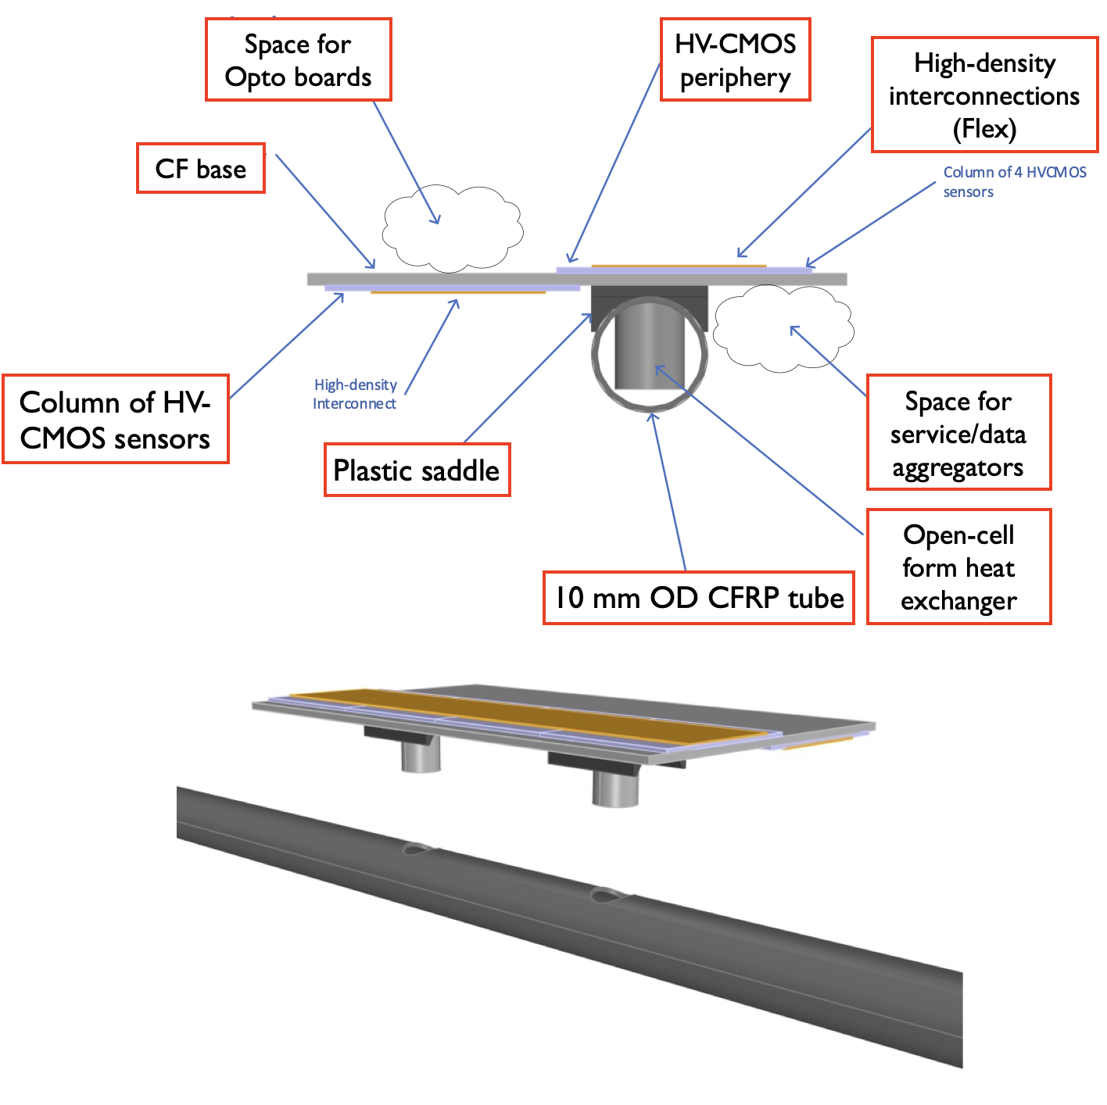
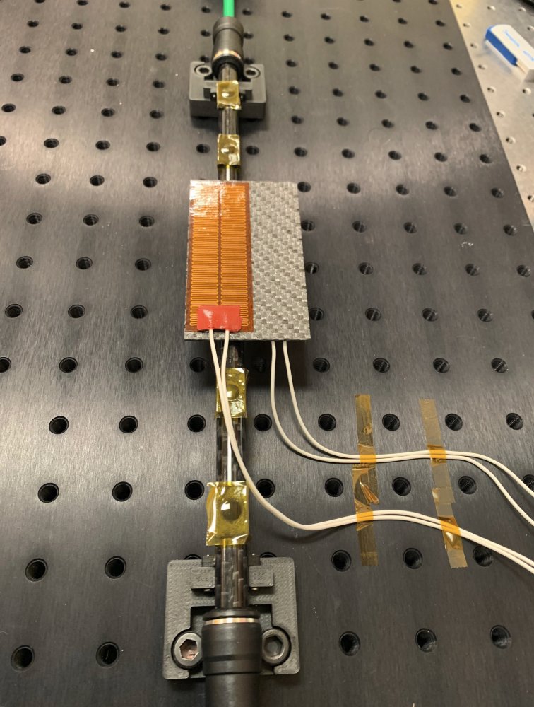
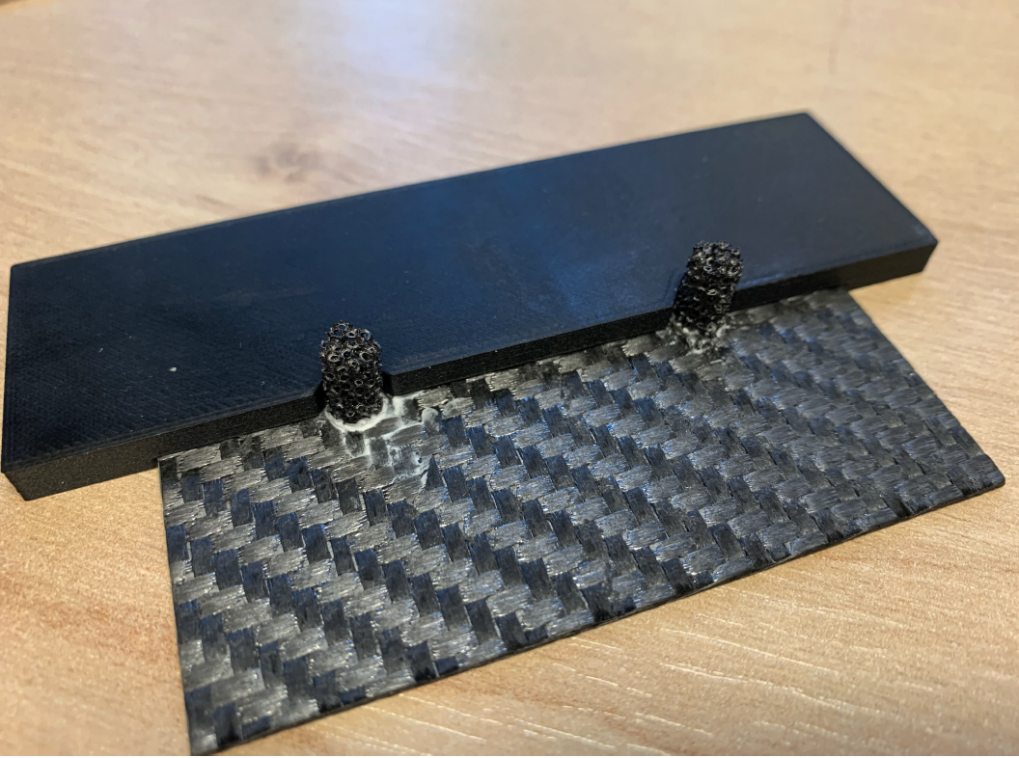
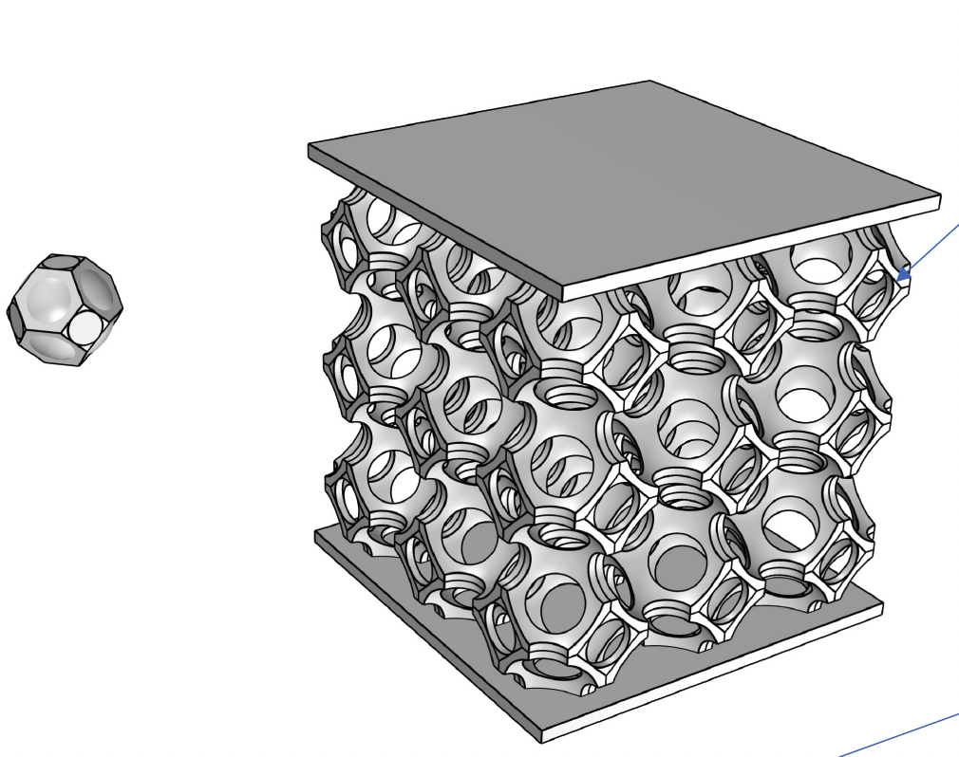
Mechanics prototyping (for SIT-I)
  Sensors glued to CF base
  Base attaches to support tube via saddles
  Saddles have apertures through which the foam heat exchangers pass and glue to the base
Thermal performance of foam under study
  Pre-prototyping ongoing
  Thermal conductivities under characterization
  FEA models under development
T. Jones, UK-CEPC tracker workshop, https://indico.ph.ed.ac.uk/event/103/

Slide 17
DAQ development
GECCO works in prototyping phase but not solution for the system
Efforts ongoing to investigate the feasibility of other readout system
  VLDB: used for LHCb upgrade, successfully commissioned in real beam
  Now managed to read the data stream by “hacking” the data stream in FPGA
  In synergy with LHCb upgrade efforts
Ruoshi Dong (IHEP-KIT joint postdoc fellow)

Slide 18
Summary
The SiTracker community has accumulated a lot of experience with single chip ATLASPix3 sensors
  Progress are being made with quad modules towards a demonstrator stavelet
  The system will be tested at real beam in April
  New ATLASPix3.1 sensors are being distributed, new results expected
New sensors are under development dedicated to CEPC need
  Hopefully with 55nm technology
Mechanical design for the system and pre-prototyping are progressing
http://cepc.ihep.ac.cn/~cepc/cepc_twiki/index.php/Si_Tracker

Slide 19
backup

Slide 20
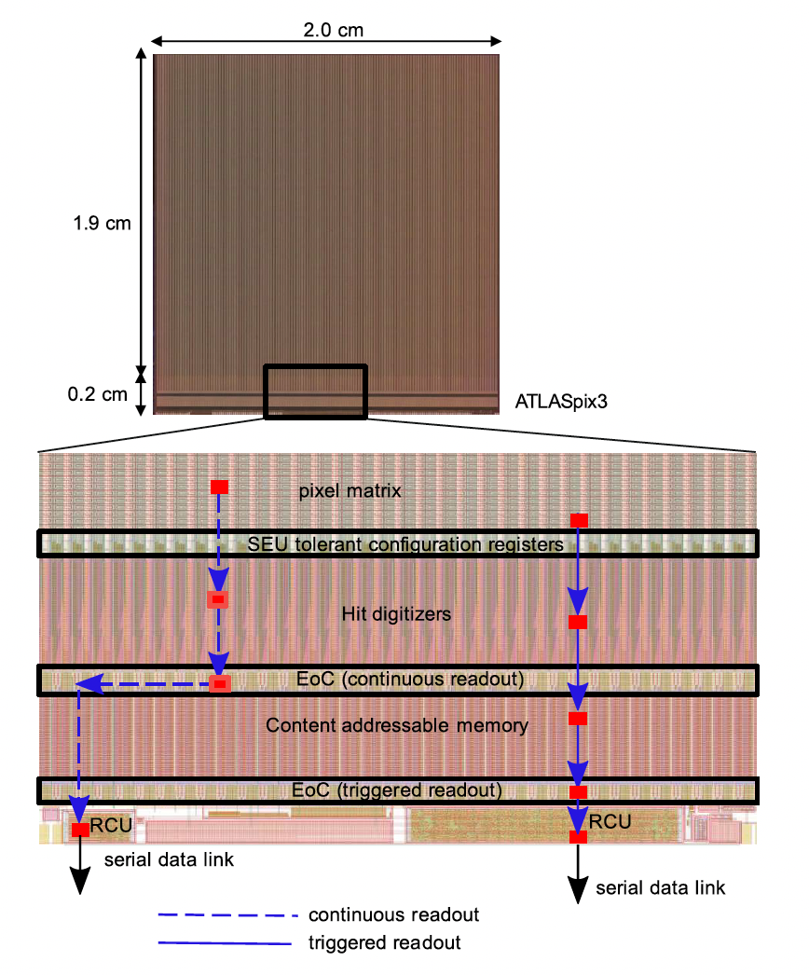
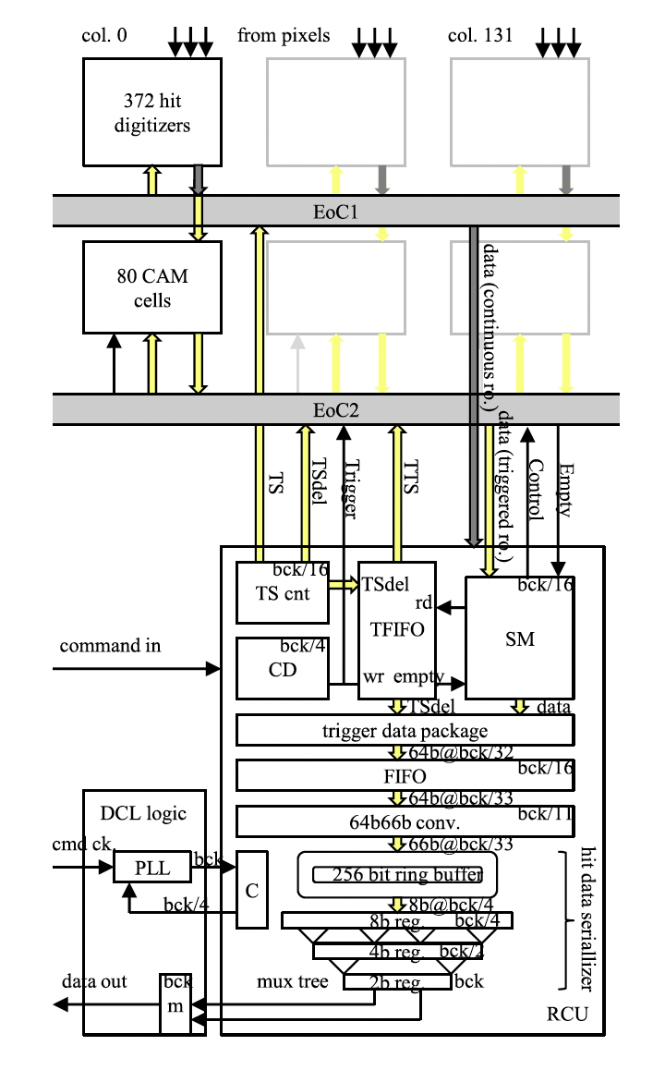
ATLASPix3 readout electronics

