Slide 1

Timing and bunch pattern compatibility study
@High luminosity Z scheme
环形正负电子对撞机
Circular Electron Positron Collider
CEPC DAY Jan. 29 2022
C. Meng, D. Wang, X. Cui, G. Lei, J. R. Zhang,
G. Li, J. Gao, Y. H. Li, X. P. Li, T. M. Xin, et al.

Slide 2
Outline
Background & Motivation
Basic Consideration
Linac scheme
Summary

Slide 3
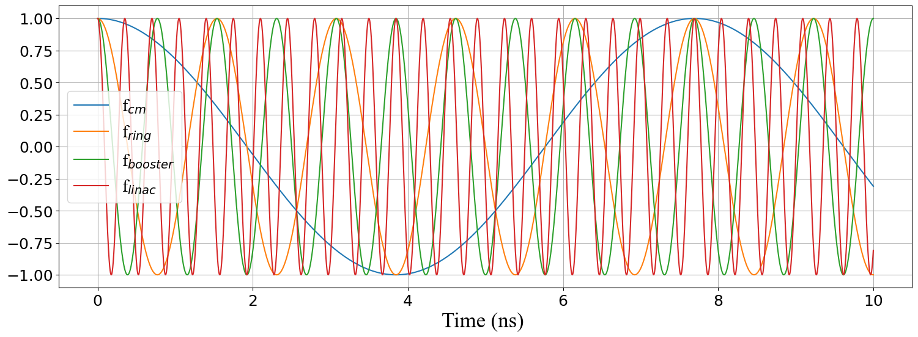
Background
CEPC is a 100km ring collider
  Revolution time = 100km/C = 0.333ms
  Revolution frequency f_{rev} = 3kHz
Linac repetition frequency is 100Hz or 200Hz
  RF interval is 10ms or 5ms, only about 30 or 15 revolution time
Harmonic number
  h= f_{rf} / f_{rev}
  Maximum bunch number
Frequency lock
  f_{cm} as common frequency
  f_{Linac}=m*f_{cm}
  f_{Booster}=n*f_{cm}
  f_{Ring}=k*f_{cm}

Slide 4
Motivation
Requirement
High luminosity Z scheme @30MW need more bunch number
  Minimum bunch number per second of Linac should be larger than
  11920/((153-10)/2) ≈168, which is larger than the repetition frequency of Linac(100Hz)
  Need speed up the Linac injection
 |  | ttbar |  | Higgs |  | W |  | Z
SR power /beam | MW | 30 | 50 | 30 | 50 | 30 | 50 | 30 | 50
Bunch number | / | 37 | 58 | 240 | 415 | 1230 | 2162 | 11920 | 19912
Train number | / | 37 | 58 | 240 | 415 | 1230 | 2162 | 149 | 152
Bunch number/train | / | 1 | 1 | 1 | 1 | 1 | 1 | 80 | 131
Interval for top up* | s | 65 |  | 38 |  | 155 |  | 153
Bunch spacing | ns |  |  |  |  |  |  | 23.076 | 15.384
Bunch spacing (bucket number) |  |  |  |  |  |  |  | 15 | 10
* Beam current in collider decays by 3%.
168 280

Slide 5
Motivation
Solution
In order to speed up the Linac injection, provide more bunches in the limit time, we can increase the repetition frequency or increase bunch number per pulse.
There are three schemes:
  S1: Increase the repetition frequency from 100Hz to 200Hz
    Power source, modulator and so on
  S2: Double-bunch acceleration scheme( two bunch per pulse @ 100Hz)
    To filling the required bucket pattern, the SHB frequency should be changed from 143MHz/572MHz to 119.17MHz/(476.76MHZ or 715.0MHz )
    Difficulties on BPM, LLRF, commissioning
  S3: The thermal electron gun and bunching system (ESBS) is replaced by RF gun
    More flexible injection scheme
    The Linac have better potential in terms of compatibility

Slide 6
Consideration
Common frequency
Coincidence clock
RF pulse of the Linac

Slide 7
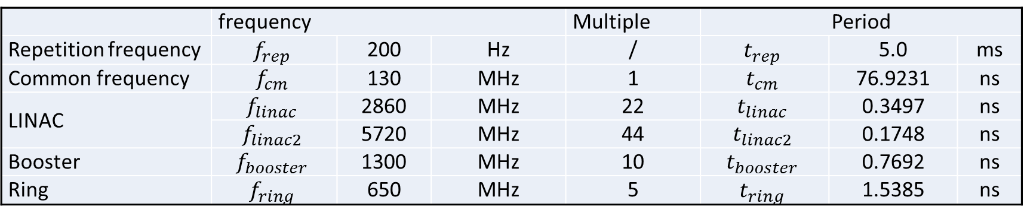
Common frequency
RF frequency of the Linac, booster and ring is 2860MHz,1300MHz and 650MHz
  Greatest common divisor (GCD) is 130MHz
  All RF frequency is based on the common frequency
The circumference of the booster and the ring is same and the frequency of the ring is half of the booster, so all the following consideration is based on the ring frequency and parameters, such as bucket number, bunch interval, harmonic number et al.
The initial bucket in this article is denoted as a zero-numbered bucket, that is, the bucket number starts from 0.
 | frequency |  |  | Multiple | Period
Repetition frequency | $$f_{rep}$$ | 200 | Hz | / | $$t_{rep}$$ | 5.0 | ms
Common frequency | $$f_{cm}$$ | 130 | MHz | 1 | $$t_{cm}$$ | 76.9231 | ns
LINAC | $$f_{linac}$$ | 2860 | MHz | 22 | $$t_{linac}$$ | 0.3497 | ns
 | $$f_{linac2}$$ | 5720 | MHz | 44 | $$t_{linac2}$$ | 0.1748 | ns
Booster | $$f_{booster}$$ | 1300 | MHz | 10 | $$t_{booster}$$ | 0.7692 | ns
Ring | $$f_{ring}$$ | 650 | MHz | 5 | $$t_{ring}$$ | 1.5385 | ns

Slide 8
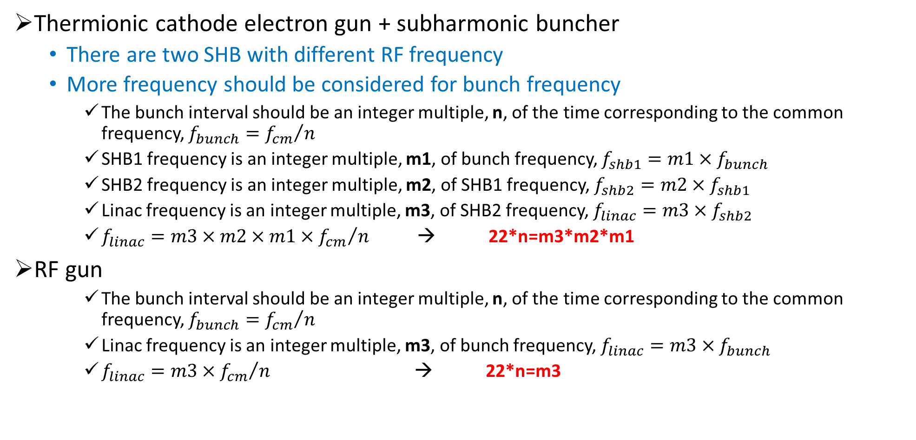
Scheme
Thermionic cathode electron gun + subharmonic buncher
  There are two SHB with different RF frequency
  More frequency should be considered for bunch frequency
    The bunch interval should be an integer multiple, n, of the time corresponding to the common frequency, $f_{bunch}={f_{cm}}/n$
    SHB1 frequency is an integer multiple, m1, of bunch frequency, $f_{shb1}=m1×f_{bunch}$
    SHB2 frequency is an integer multiple, m2, of SHB1 frequency, $f_{shb2}=m2×f_{shb1}$
    Linac frequency is an integer multiple, m3, of SHB2 frequency, $f_{linac}=m3×f_{shb2}$
    $f_{linac}={m3×{m2×m1×f}_{cm}}/n$ → 22*n=m3*m2*m1
RF gun
    The bunch interval should be an integer multiple, n, of the time corresponding to the common frequency, $f_{bunch}={f_{cm}}/n$
    Linac frequency is an integer multiple, m3, of bunch frequency, $f_{linac}=m3×f_{bunch}$
    $f_{linac}={m3{×f}_{cm}}/n$ → 22*n=m3

Slide 9
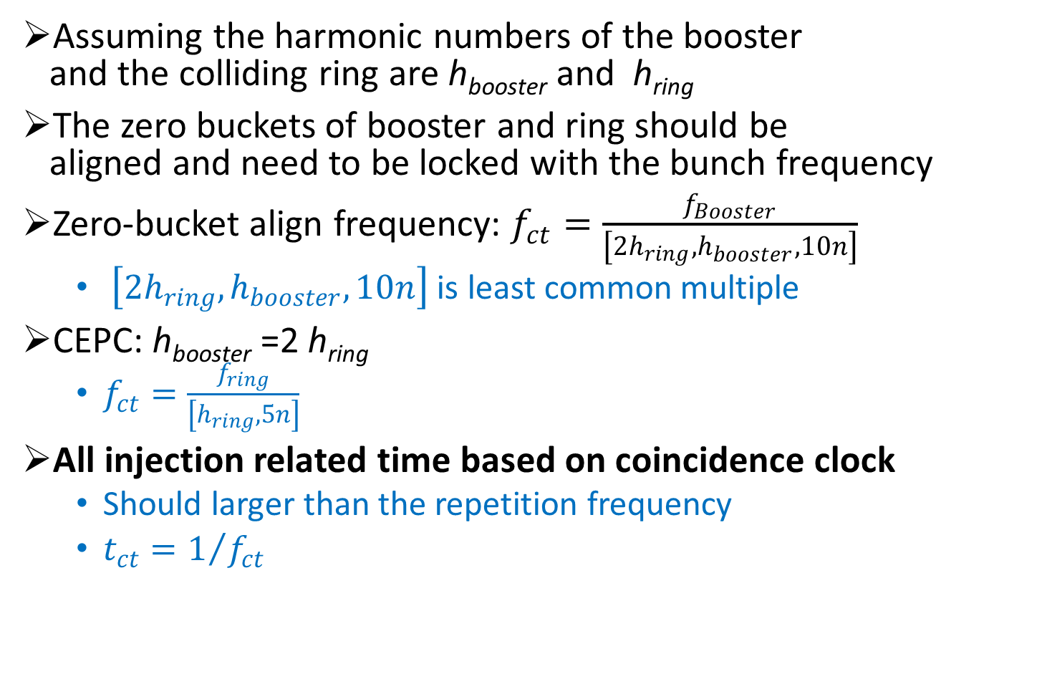
Coincidence clock
Scheme1
Assuming the harmonic numbers of the booster
and the colliding ring are h_{booster} and h_{ring}
The zero buckets of booster and ring should be
aligned and need to be locked with the bunch frequency
Zero-bucket align frequency: $f_{ct}=\frac{f_{Booster}}{\left[{2h}_{ring},h_{booster},10n\right]}$
  $\left[{2h}_{ring},h_{booster},10n\right]$ is least common multiple
CEPC: h_{booster} =2 h_{ring}
  $f_{ct}=\frac{f_{ring}}{\left[h_{ring},5n\right]}$
All injection related time based on coincidence clock
  Should larger than the repetition frequency
  $t_{ct}=1/{f_{ct}}$

Slide 10
Injection scheme
Repetition frequency + Coincidence clock → zero bucket time, t₁
Bucket section: delay M bucket time relative to the zero bucket, t₂
  If t₁+ t₂ < t_{rep}, general injection
  If t₁+ t₂ > t_{rep}, specific injection, define the injection trigger train firstly

Slide 11
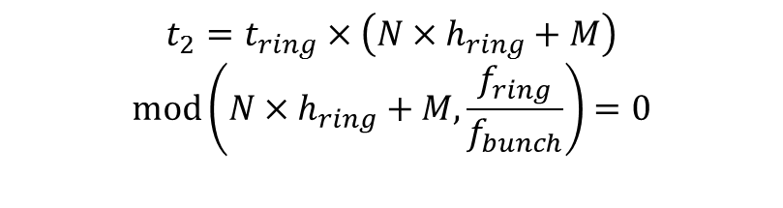
Injection scheme
Repetition frequency + Coincidence clock → zero bucket time, t₁
Bucket section: delay M bucket time relative to the zero bucket, t₂
$$t_{2}=t_{ring}×\left(N×h_{ring}+M\right)$$
$$mod\left(N×h_{ring}+M,\frac{f_{ring}}{f_{bunch}}\right)=0$$
N is the number of turns

Slide 12
RF pulse of Linac
CEPC is a 100km ring collider
  Revolution time = 100km/C = 0.333ms
Linac repetition frequency is 200Hz
  Interval is 5ms, only about 15 revolution time
Minimum RF pulse interval 1ms is possible ?
  So far yes !

Slide 13
Linac Scheme
Based on thermionic cathode electron gun
  Scheme-1
  Scheme-2
Based on RF gun
  Scheme-3

Slide 14
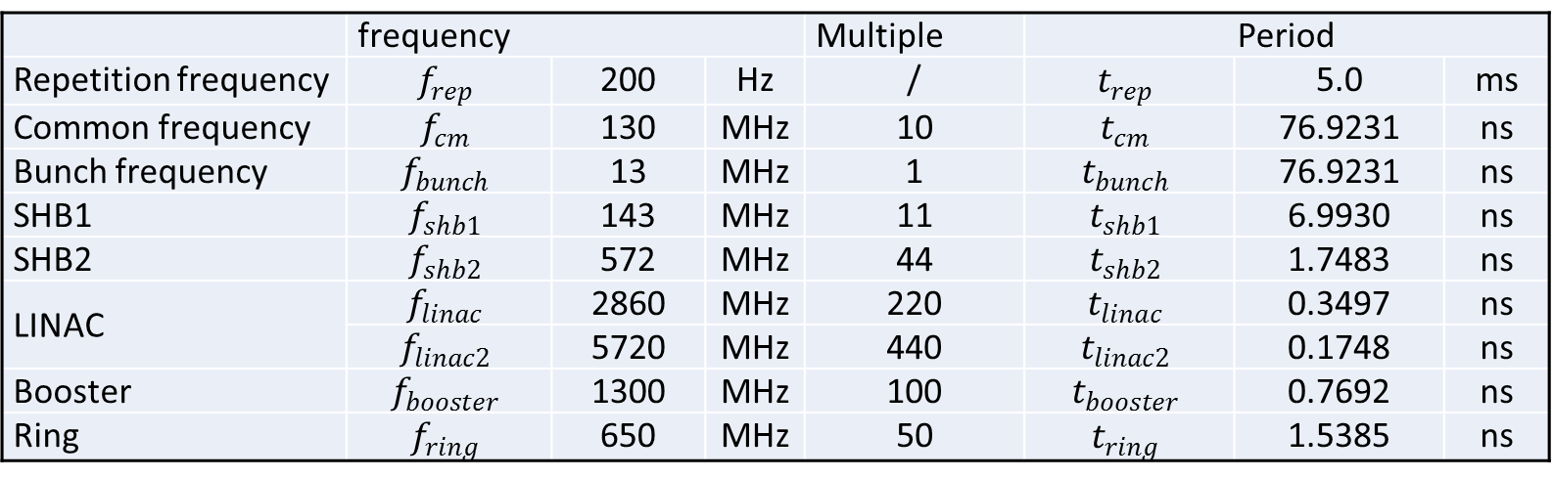
Scheme-1
The baseline scheme have two SHB with frequency as 143MHz/572MHz
  22*n=m3*m2*m1
  n=10，m1=11，m2=4，m3=5
  Bunch interval is 76.9ns, corresponding to 50 bucket, this scheme can increase repetition frequency (200Hz) and can’t be two-bunch acceleration.
 | frequency |  |  | Multiple | Period
Repetition frequency | $$f_{rep}$$ | 200 | Hz | / | $$t_{rep}$$ | 5.0 | ms
Common frequency | $$f_{cm}$$ | 130 | MHz | 10 | $$t_{cm}$$ | 76.9231 | ns
Bunch frequency | $$f_{bunch}$$ | 13 | MHz | 1 | $$t_{bunch}$$ | 76.9231 | ns
SHB1 | $$f_{shb1}$$ | 143 | MHz | 11 | $$t_{shb1}$$ | 6.9930 | ns
SHB2 | $$f_{shb2}$$ | 572 | MHz | 44 | $$t_{shb2}$$ | 1.7483 | ns
LINAC | $$f_{linac}$$ | 2860 | MHz | 220 | $$t_{linac}$$ | 0.3497 | ns
 | $$f_{linac2}$$ | 5720 | MHz | 440 | $$t_{linac2}$$ | 0.1748 | ns
Booster | $$f_{booster}$$ | 1300 | MHz | 100 | $$t_{booster}$$ | 0.7692 | ns
Ring | $$f_{ring}$$ | 650 | MHz | 50 | $$t_{ring}$$ | 1.5385 | ns

Slide 15
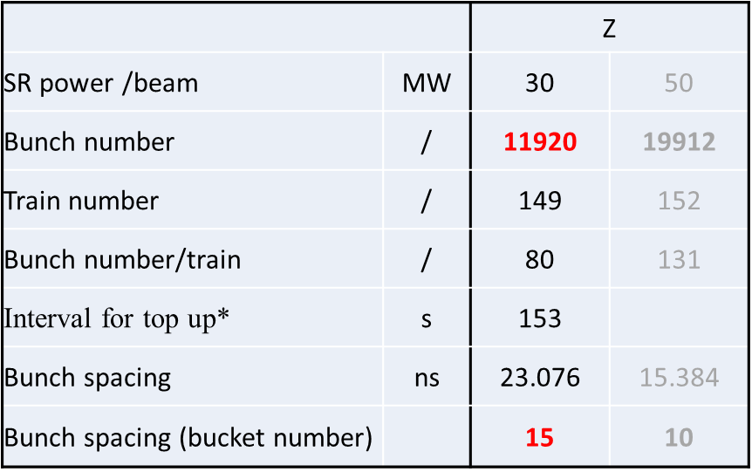
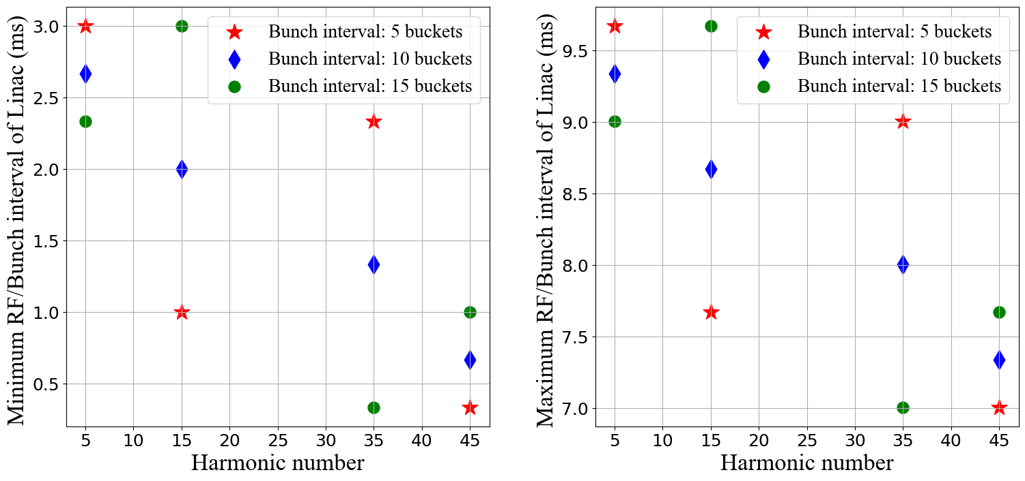

Scheme-1
To fill the bunch pattern, $\left[h_{ring}, 50\right]$=5
  $h_{ring}$= 50* N + 5, 15, 35, 45
  $f_{ct}=\frac{f_{ring}}{\left[h_{ring},50\right]} ≈300Hz$
$h_{ring}$=216805
  C=99.995km
Minimum RF interval
  3 ms

Slide 16
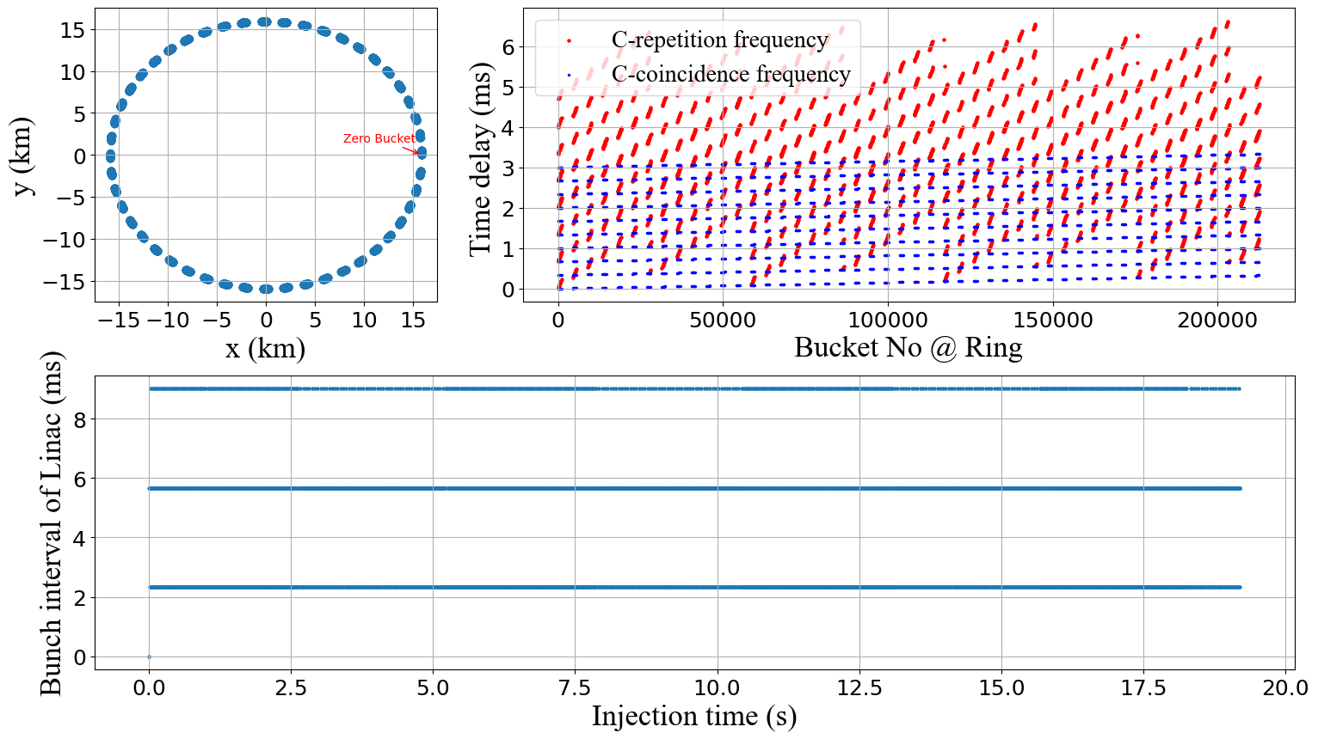
Scheme-1

Slide 17
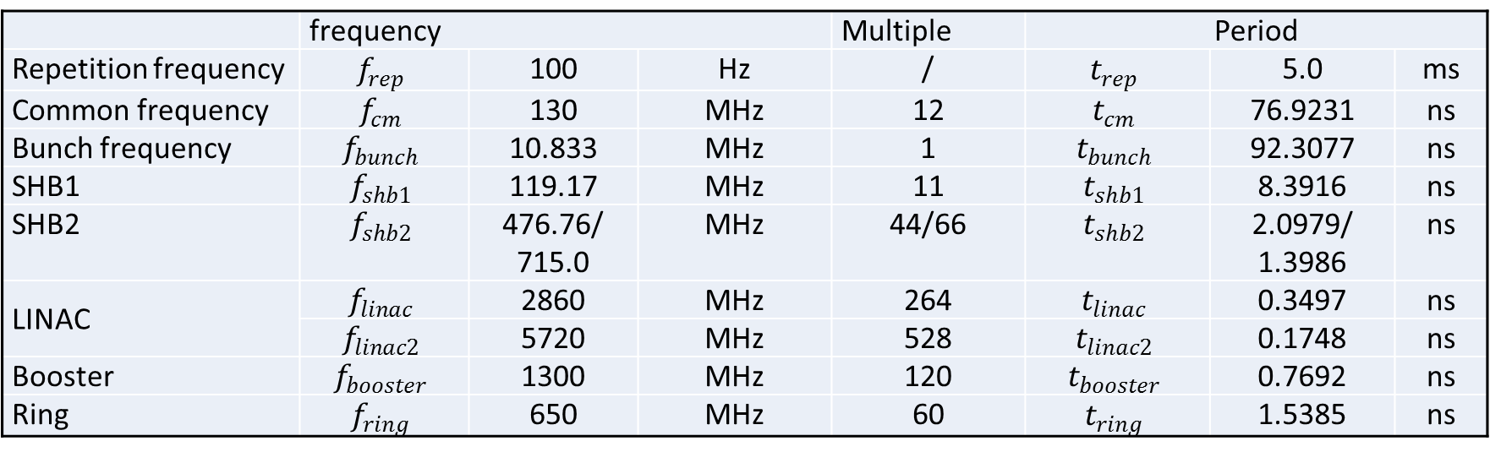
Scheme-2
If use two-bunch acceleration, we need change the SHB frequency
  22*n=m3*m2*m1
  n=12，m1=11，m2=4/6，m3=6/4
  Bunch interval is 92.3ns, corresponding to 60 bucket, can be two-bunch acceleration (100Hz)
    this scheme can increase repetition frequency (200Hz)
 | frequency |  |  | Multiple | Period
Repetition frequency | $$f_{rep}$$ | 100 | Hz | / | $$t_{rep}$$ | 5.0 | ms
Common frequency | $$f_{cm}$$ | 130 | MHz | 12 | $$t_{cm}$$ | 76.9231 | ns
Bunch frequency | $$f_{bunch}$$ | 10.833 | MHz | 1 | $$t_{bunch}$$ | 92.3077 | ns
SHB1 | $$f_{shb1}$$ | 119.17 | MHz | 11 | $$t_{shb1}$$ | 8.3916 | ns
SHB2 | $$f_{shb2}$$ | 476.76/ 715.0 | MHz | 44/66 | $$t_{shb2}$$ | 2.0979/ 1.3986 | ns
LINAC | $$f_{linac}$$ | 2860 | MHz | 264 | $$t_{linac}$$ | 0.3497 | ns
 | $$f_{linac2}$$ | 5720 | MHz | 528 | $$t_{linac2}$$ | 0.1748 | ns
Booster | $$f_{booster}$$ | 1300 | MHz | 120 | $$t_{booster}$$ | 0.7692 | ns
Ring | $$f_{ring}$$ | 650 | MHz | 60 | $$t_{ring}$$ | 1.5385 | ns

Slide 18
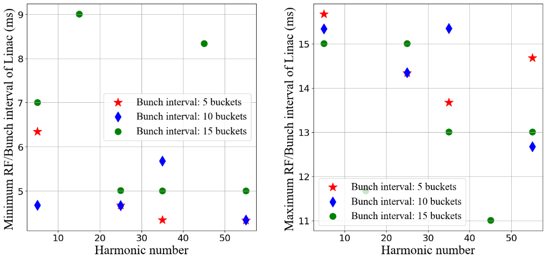

Scheme-2
To fill the bunch pattern, $\left[h_{ring}, 60\right]$=5 or 15
  $h_{ring}$= 60* N + 5, 15,25, 35, 45,55
  $f_{ct}=\frac{f_{ring}}{\left[h_{ring},60\right]} ≈250Hz$
$h_{ring}$=216845
  C=100.013km
Minimum RF interval
  7 ms

Slide 19
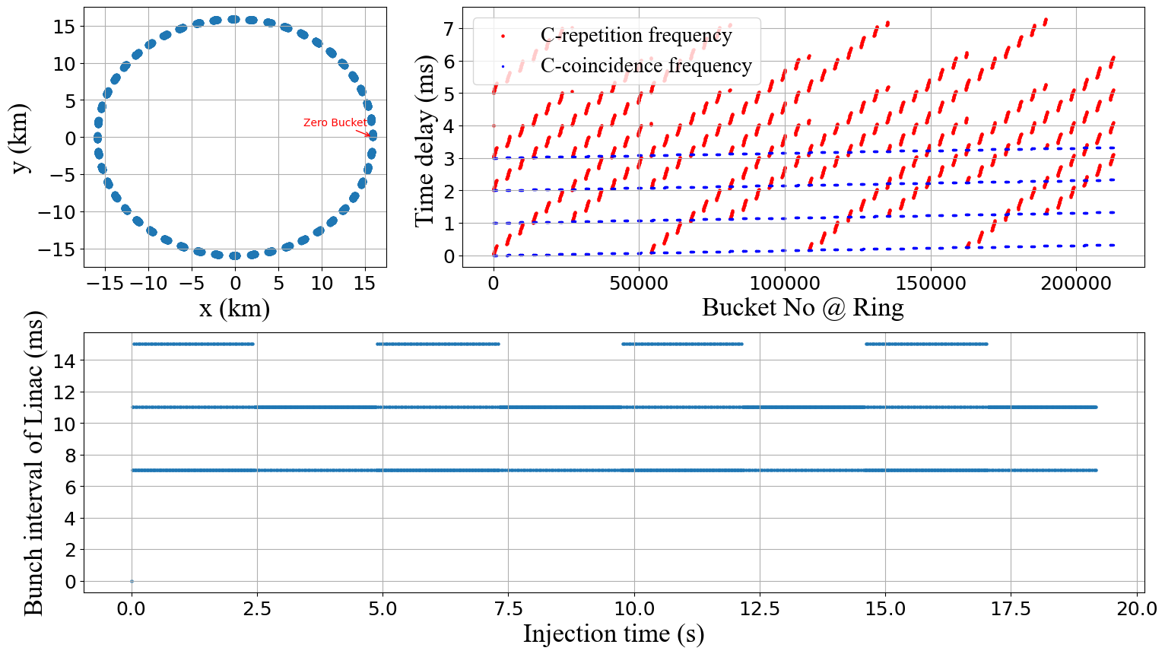
Scheme-2

Slide 20
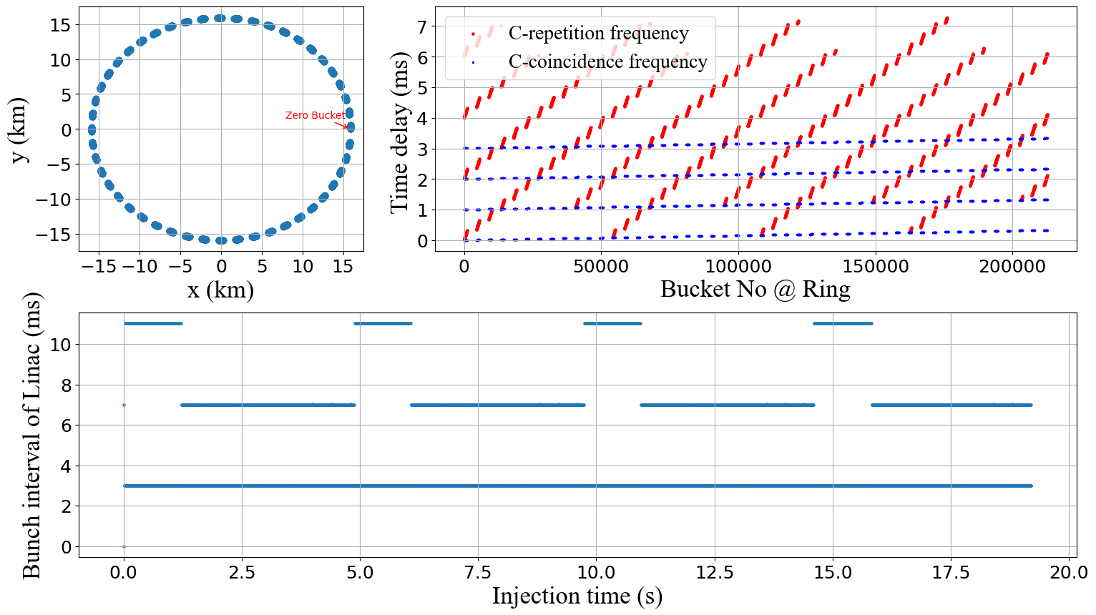
Scheme-2
This scheme can increase repetition frequency (200Hz)
Minimum RF interval
  3 ms

Slide 21
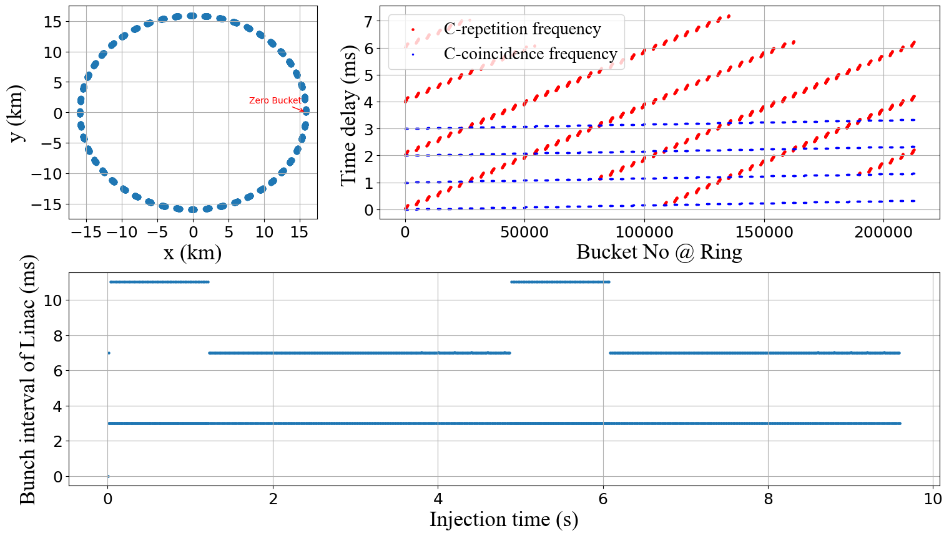
Scheme-2
200Hz + Two-bunch acceleration
Minimum RF interval
  3 ms

Slide 22
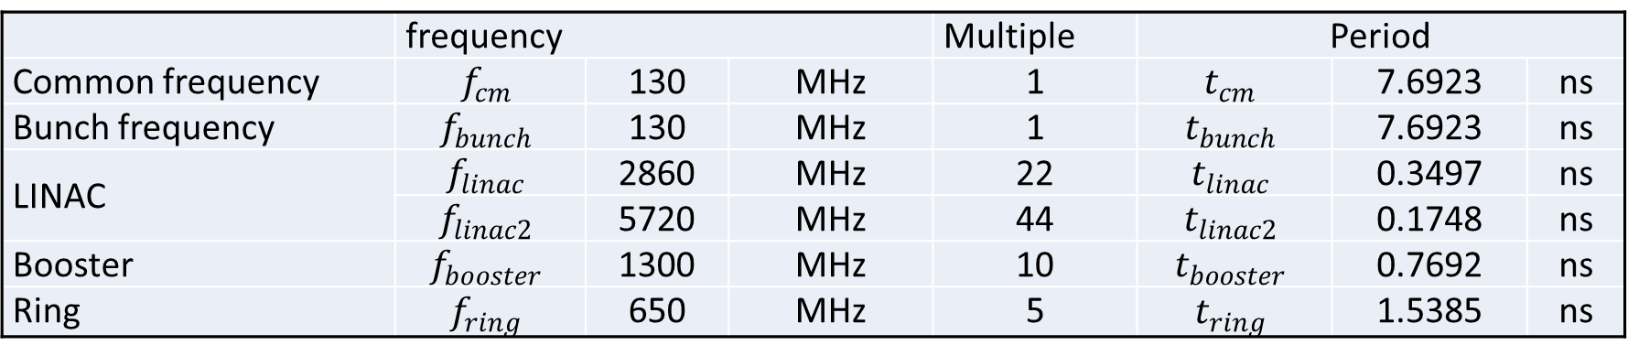
Scheme-3
RF gun
  22*n=m3
  n=1
  Bunch interval is 7.69ns, corresponding to 5 bucket, can be two-bunch acceleration (100Hz)
    this scheme can increase repetition frequency (200Hz)
 | frequency |  |  | Multiple | Period
Common frequency | $$f_{cm}$$ | 130 | MHz | 1 | $$t_{cm}$$ | 7.6923 | ns
Bunch frequency | $$f_{bunch}$$ | 130 | MHz | 1 | $$t_{bunch}$$ | 7.6923 | ns
LINAC | $$f_{linac}$$ | 2860 | MHz | 22 | $$t_{linac}$$ | 0.3497 | ns
 | $$f_{linac2}$$ | 5720 | MHz | 44 | $$t_{linac2}$$ | 0.1748 | ns
Booster | $$f_{booster}$$ | 1300 | MHz | 10 | $$t_{booster}$$ | 0.7692 | ns
Ring | $$f_{ring}$$ | 650 | MHz | 5 | $$t_{ring}$$ | 1.5385 | ns

Slide 23
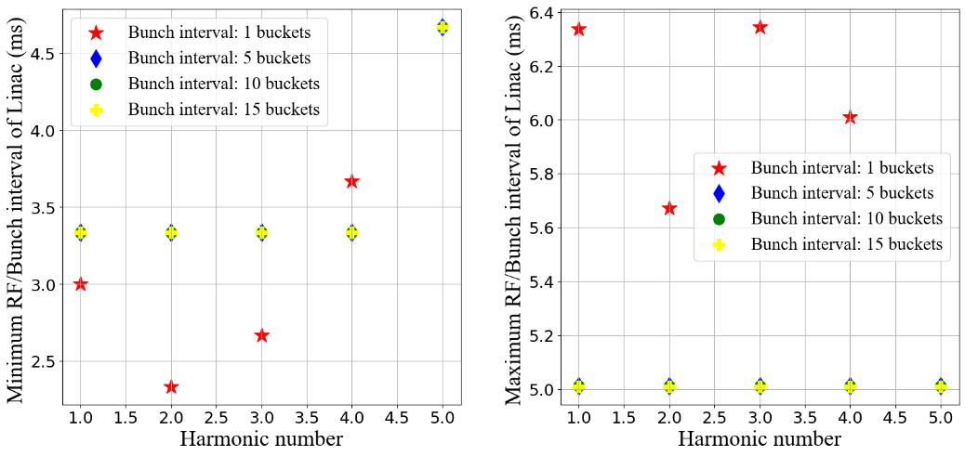

Scheme-3
To fill the bunch pattern, $\left[h_{ring}, 5\right]$=1,2,3,4,5
  $h_{ring}$= 5* N + 1,2,3,4,5
  $f_{ct}=\frac{f_{ring}}{\left[h_{ring},5\right]} ≈3000Hz or 600Hz$
$h_{ring}$=216845
  C=100.013km
Minimum RF interval
  4.67 ms
Suggested
  216844

Slide 24
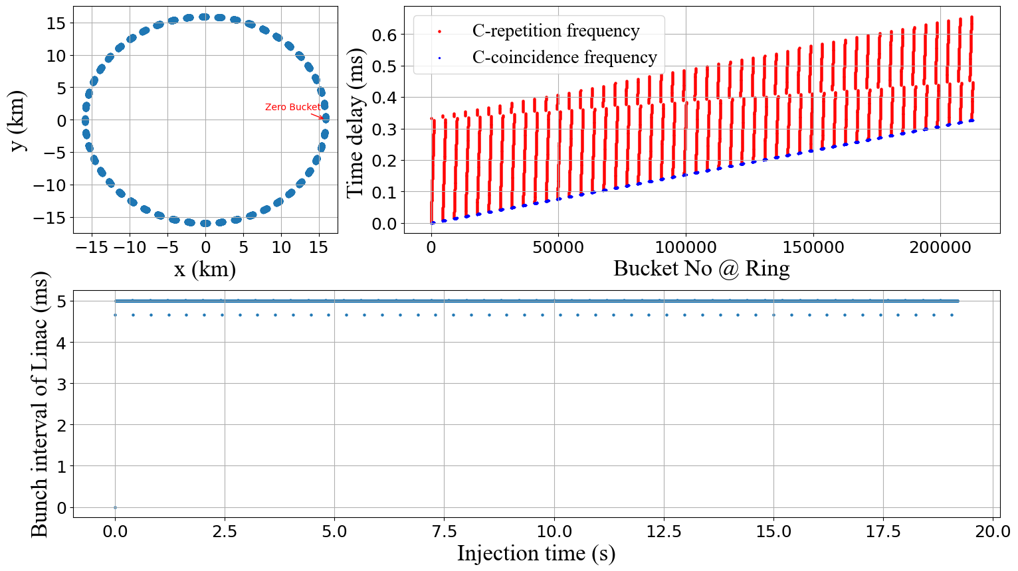
Scheme-3
200Hz
200Hz

Slide 25
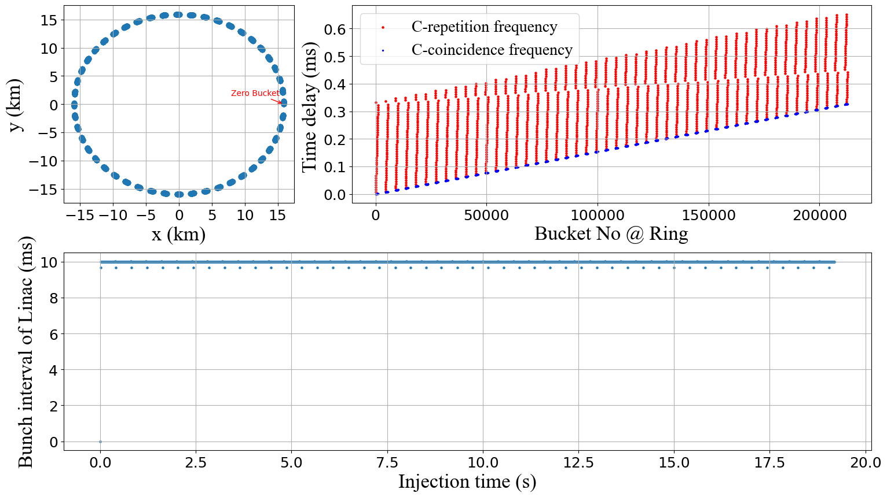
Scheme-3
Two-bunch acceleration@100Hz

Slide 26
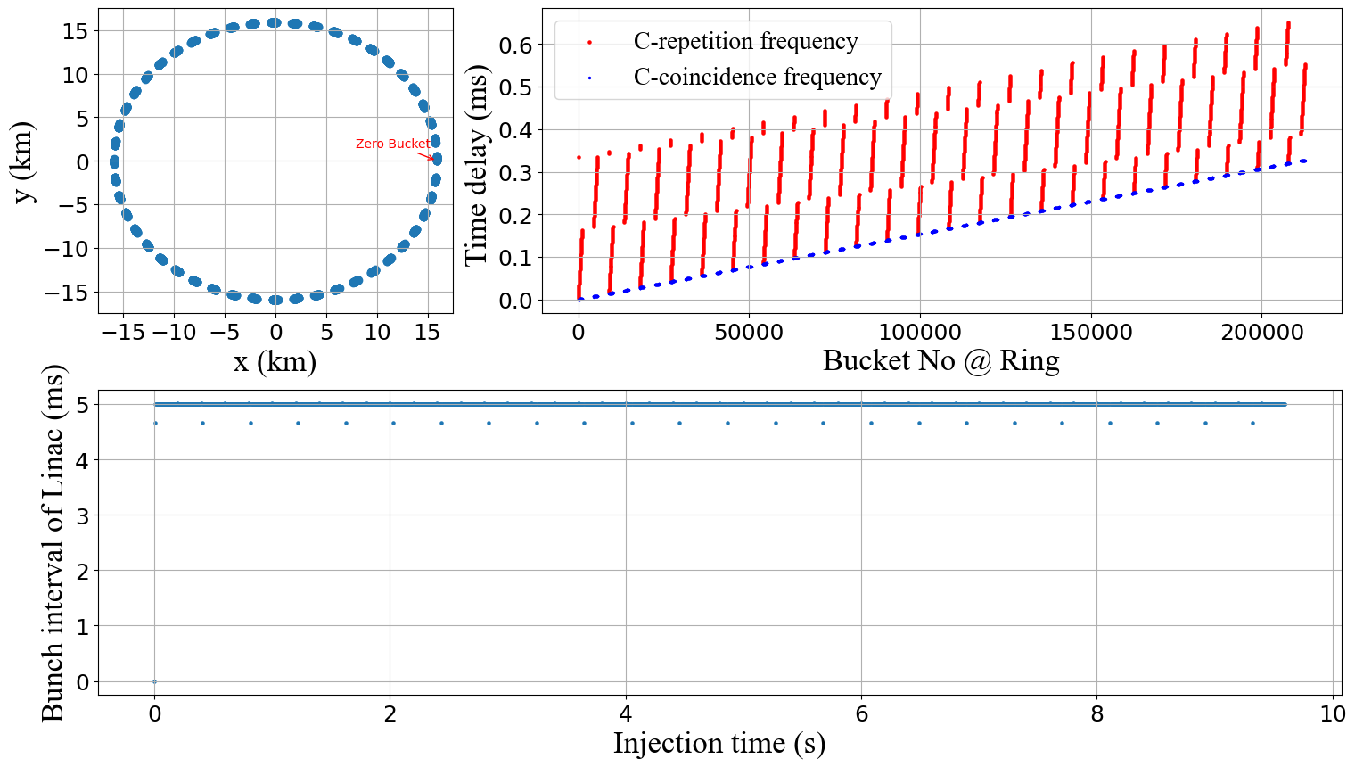
Scheme-3
Two-bunch acceleration@200Hz

Slide 27
Summary
Only timing
Baseline scheme with 200Hz scheme can meet the requirements of high luminosity Z scheme @ 30MW
Baseline scheme with two-bunch acceleration scheme can’t meet the requirements of high luminosity Z scheme @ 30MW, we should change the SHB frequency. In this case, all scheme can works.
RF gun scheme can meet the requirements of high luminosity Z scheme @ 30MW.
 |  | High luminosity Z scheme @ 30MW
 |  | 200Hz | Two-bunch acceleration@100Hz | Two-bunch acceleration@200Hz | Harmonic number | comments
Based on thermionic cathode electron gun | Scheme1 | Yes | No | No | 216805 | Baseline SHB
 | Scheme2 | Yes | Yes | Yes | 216845 | Modified SHB
RF gun | Scheme3 | Yes | Yes | Yes | 216845 | 216844

Slide 28
Summary
Only timing
Considering compatibility, it is recommended:
  The baseline scheme update the bunch system design, using the new frequency SHBs
  Or develop the RF gun to replace the thermionic cathode electron gun
 |  | High luminosity Z scheme @ 30MW
 |  | 200Hz | Two-bunch acceleration@100Hz | Two-bunch acceleration@200Hz | Harmonic number | comments
Based on thermionic cathode electron gun | Scheme1 | Yes | No | No | 216805 | Baseline SHB
 | Scheme2 | Yes | Yes | Yes | 216845 | Modified SHB
RF gun | Scheme3 | Yes | Yes | Yes | 216845 | 216844
Thank you for your attention!

