Slide 1
Update of the dynamic aperture for the CEPC collider ring
Yiwei Wang
for the CEPC Accelerator Physics Group
CEPC day, Jan 29, 2022, IHEP

Slide 2
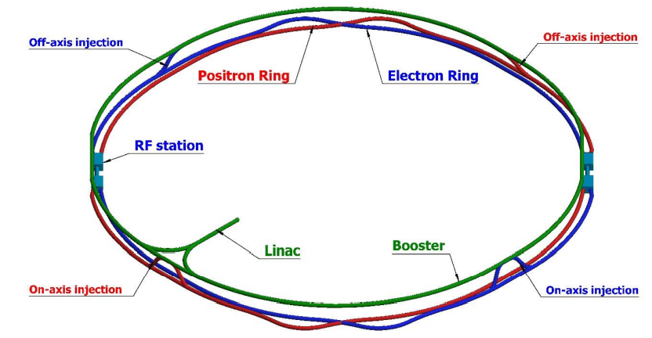
Design requirement of the CEPC collider ring
SR power 30MW (50 MW upgradable), 100km, 2 IPs
Crab waist collision
Local chromaticity correction for the interaction region
Non-interleaved sextupoles
Correction of sawtooth orbit
Shared cavities for two beam @ tt, Higgs
Dual aperture dipole and quadrupole magnets
Spin polarized beam @ Z
Asymmetric interaction region
Compatible of $t\overline{t}$/H/W/Z modes
Compatible with SPPC
*ref: K. Oide, arXiv:1610.07170; M. Zobov et al, Phys. Rev. Lett. 104, 174801(2010); A. Milanese, PRAB 19, 112401 (2016); CEPC pre-CDR; CEPC-CDR

Slide 3
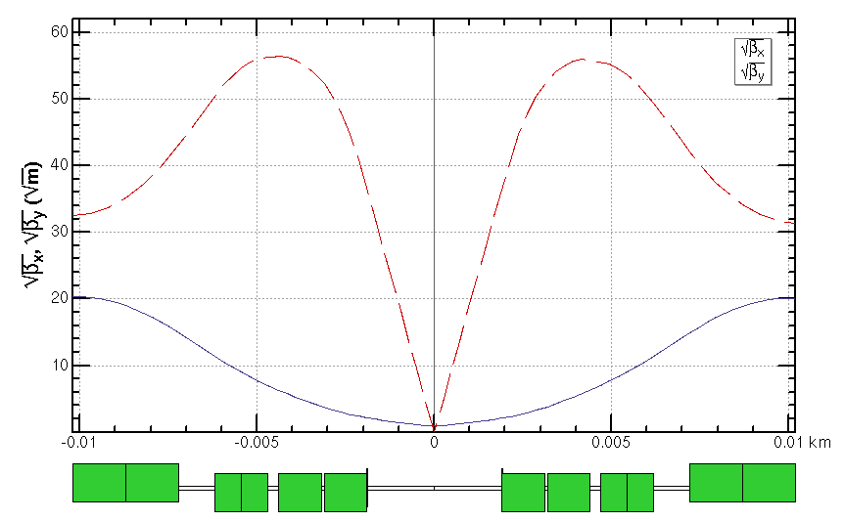
Interaction region for all modes
For the interaction region, the IP beta functions are refitted with the different combination of final doulets and the matching quadruples.
*ref: FCC-ee CDR
 | L [m] | Strength [T/m]
 |  | ttbar | Higgs | W | Z
Q1AIRU | 1.21 | -141 | -141 | -94 | -110
Q1BIRU | 1.21 | -59 | -85 | -56 | +65
Q2IRU | 1.5 | -51 | +95 | +63 | 0
Q3AIRU | 1.5 | +40 | 0 | 0 | +2
Q3BIRU | 1.5 | +40 | 0 | 0 | +2
Q1AIRD | 1.21 | -142 | -142 | -95 | -110
Q1BIRD | 1.21 | -64 | -85 | -57 | +65
Q2IRD | 1.5 | -47 | +96 | +64 | 0
Q3AIRD | 1.5 | +40 | 0 | 0 | +2
Q3BIRD | 1.5 | +40 | 0 | 0 | +2
ttbar
Q3BIRU
Q3AIRU
Q2IRU
Q1BIRU
Q1AIRU
Q1AIRD
Q1BIRD
Q2IRD
Q3AIRD
Q3BIRD
 | QD | QF
Z | Q1A | Q1B
W/H | Q1A+Q1B | Q2
ttbar | Q1A+Q1B+Q2 | add quad Q3A and Q3B
Strength of other modes doesn’t exceeded the one of Higgs mode.

Slide 4
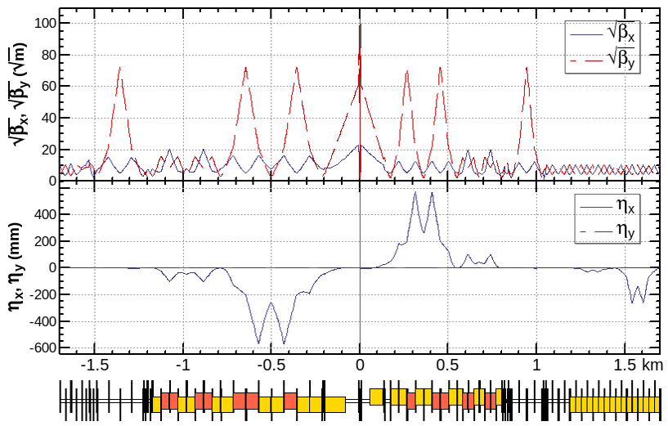
Interaction region for all modes (cont.)
For the interaction region, the IP beta functions are refitted with the different combination of final doulets and the matching quadruples.
*ref: FCC-ee CDR
CW
CCX
CCY
FT
 | L [m] | Strength [T/m]
 |  | ttbar | Higgs | W | Z
Q1AIRU | 1.21 | -141 | -141 | -94 | -110
Q1BIRU | 1.21 | -59 | -85 | -56 | +65
Q2IRU | 1.5 | -51 | +95 | +63 | 0
Q3AIRU | 1.5 | +40 | 0 | 0 | +2
Q3BIRU | 1.5 | +40 | 0 | 0 | +2
Q1AIRD | 1.21 | -142 | -142 | -95 | -110
Q1BIRD | 1.21 | -64 | -85 | -57 | +65
Q2IRD | 1.5 | -47 | +96 | +64 | 0
Q3AIRD | 1.5 | +40 | 0 | 0 | +2
Q3BIRD | 1.5 | +40 | 0 | 0 | +2
ttbar
beam
Q3BIRU
Q3AIRU
Q2IRU
Q1BIRU
Q1AIRU
Q1AIRD
Q1BIRD
Q2IRD
Q3AIRD
Q3BIRD
 | QD | QF
Z | Q1A | Q1B
W/H | Q1A+Q1B | Q2
ttbar | Q1A+Q1B+Q2 | add quad Q3A and Q3B
Strength of other modes doesn’t exceeded the one of Higgs mode.

Slide 5
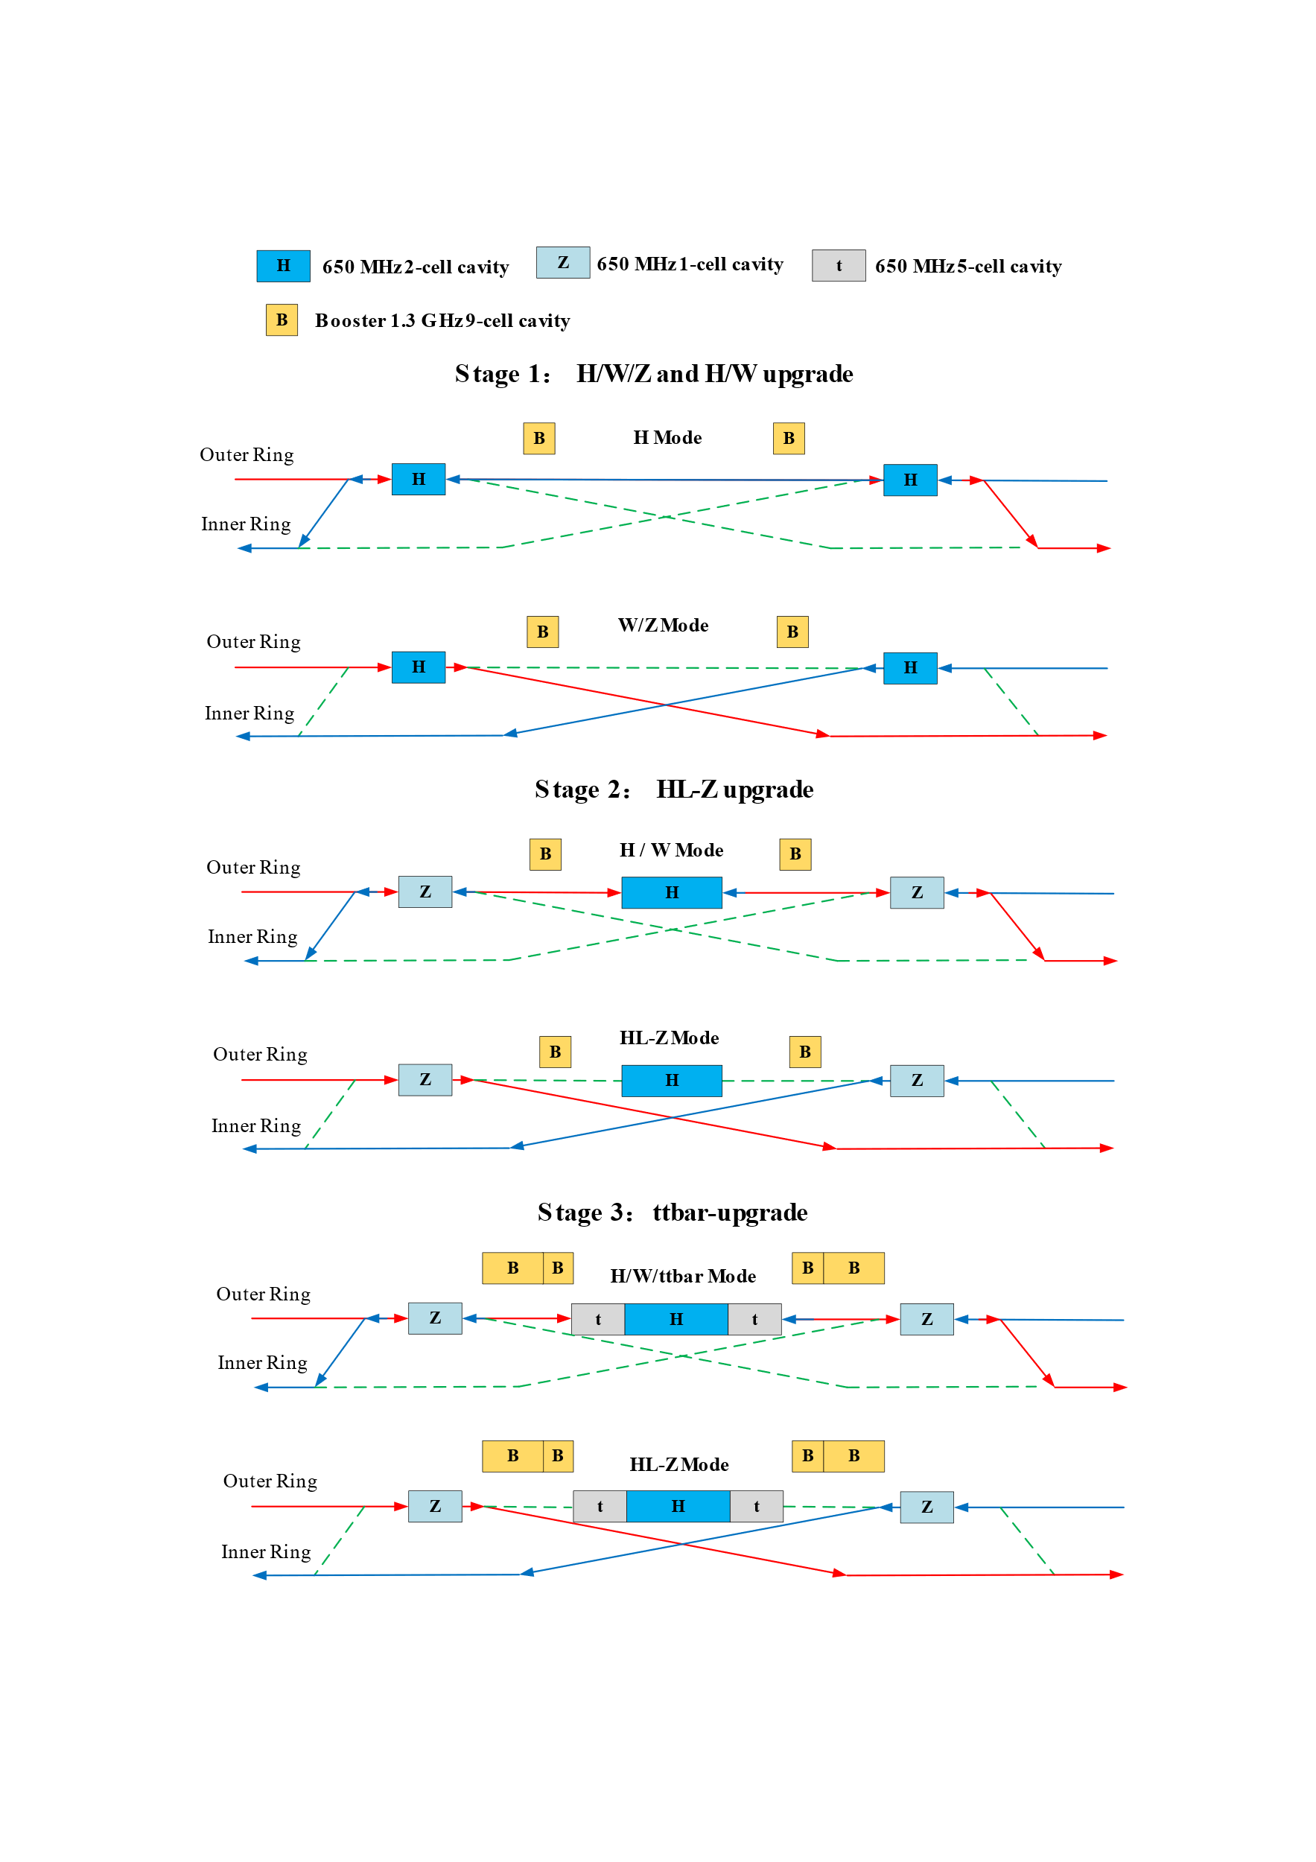
RF staging for compatible modes
1st priority of the Higgs running and flexible switching
Low cost at early stage
Get high luminosity for all modes
Stage 1 (H/W run)
Layout and parameters are same with CDR except longer central part
Medium or low luminosity at Z
Stage 2 (HL-Z upgrade)
Move Higgs cavities to center and add high current Z cavities.
By-pass low current H cavities.
Stage 3(ttbar upgrade)：
Add ttbar cavities (low current, high gradient, high Q)
Nb3Sn@4.2 K or others to significant reducing the cost of cryo-system and AC power.
by J. Y. Zhai, Yiwei Wang

Slide 6
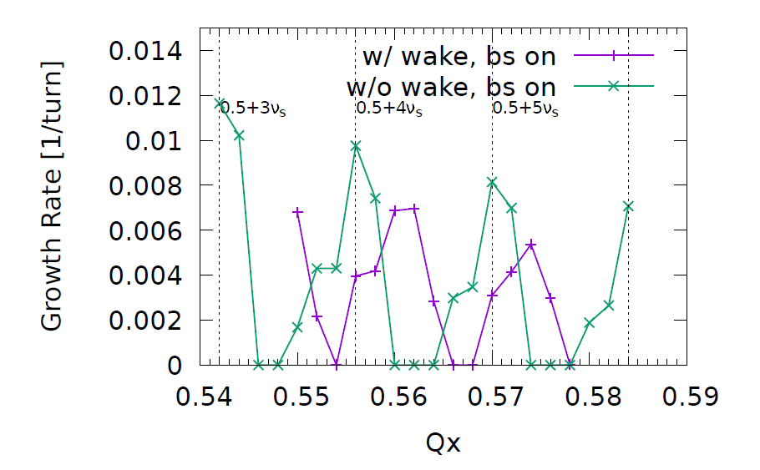
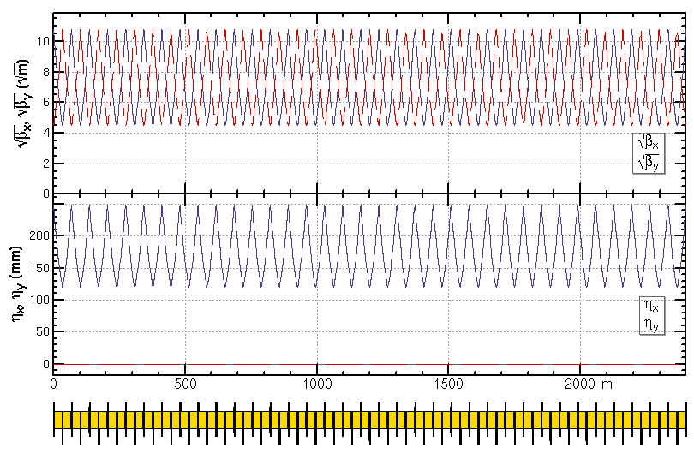
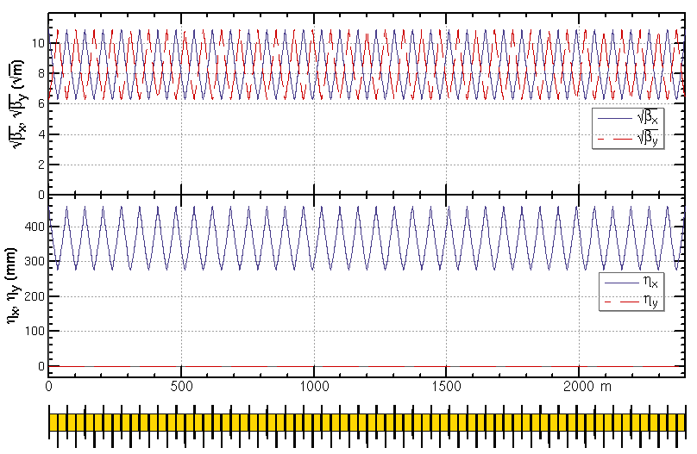
ARC region for all modes
Z and W modes need larger momentum compaction factor αp and thus larger emittance εx, Qs
To suppress the impedance induced instability at Z mode
To increase stable tune area if considering beam-beam effect and impedance consistently at W and Z modes
Microwave instability
stable tune area with both beam-beam and impedance (Z mode 90/90)
Na Wang,
CEPC Day, March 2020
Yuan Zhang
Phase advance reduced from 90° to 60° for W and Z modes
H/tt mode 90°/ 90°
W/Z mode 60°/ 60°

Slide 7
Status of beam parameters
 | ttbar | Higgs | W | Z
Number of IPs | 2
Circumference [km] | 100.0
SR power per beam [MW] | 30
Half crossing angle at IP [mrad] | 16.5
Bending radius [km] | 10.7
Energy [GeV] | 180 | 120 | 80 | 45.5
Energy loss per turn [GeV] | 9.1 | 1.8 | 0.357 | 0.037
Piwinski angle | 1.21 | 5.94 | 6.08 | 24.68
Bunch number | 35 | 249 | 1297 | 11951
Bunch spacing [ns] | 4524 | 636 | 257 | 25 (10% gap)
Bunch population [10^10] | 20 | 14 | 13.5 | 14
Beam current [mA] | 3.3 | 16.7 | 84.1 | 803.5
Momentum compaction [10^-5] | 0.71 | 0.71 | 1.43 | 1.43
Beta functions at IP (bx/by) [m/mm] | 1.04/2.7 | 0.33/1 | 0.21/1 | 0.13/0.9
Emittance (ex/ey) [nm/pm] | 1.4/4.7 | 0.64/1.3 | 0.87/1.7 | 0.27/1.4
Beam size at IP (sigx/sigy) [um/nm] | 39/113 | 15/36 | 13/42 | 6/35
Bunch length (SR/total) [mm] | 2.2/2.9 | 2.3/3.9 | 2.5/4.9 | 2.5/8.7
Energy spread (SR/total) [%] | 0.15/0.20 | 0.10/0.17 | 0.07/0.14 | 0.04/0.13
Energy acceptance (DA/RF) [%] | 2.3/2.6 | 1.7/2.2 | 1.2/2.5 | 1.3/1.7
Beam-beam parameters (ksix/ksiy) | 0.071/0.1 | 0.015/0.11 | 0.012/0.113 | 0.004/0.127
RF voltage [GV] | 10 | 2.2 | 0.7 | 0.12
RF frequency [MHz] | 650 | 650 | 650 | 650
HOM power per cavity (5/2/1cell)[kw] | 0.4/0.2/0.1 | 1/0.4/0.2 | -/1.8/0.9 | -/-/5.8
Longitudinal tune Qs | 0.078 | 0.049 | 0.062 | 0.035
Beam lifetime (bhabha/beamstrahlung)[min] | 81/23 | 39/40 | 60/700 | 80/18000
Beam lifetime [min] | 18 | 20 | 55 | 80
Hour glass Factor | 0.89 | 0.9 | 0.9 | 0.97
Luminosity per IP[1e34/cm^2/s] | 0.5 | 5.0 | 16 | 115
Y.W. Wang, D. Wang, Y. Zhang, J. Y. zhai, S.Bai, Y.D. Liu, N. Wang, C. X. Cui, C.H. Yu, J. Gao et al
*Yiwei Wang et al, IPAC21, WEPAB033

Slide 8
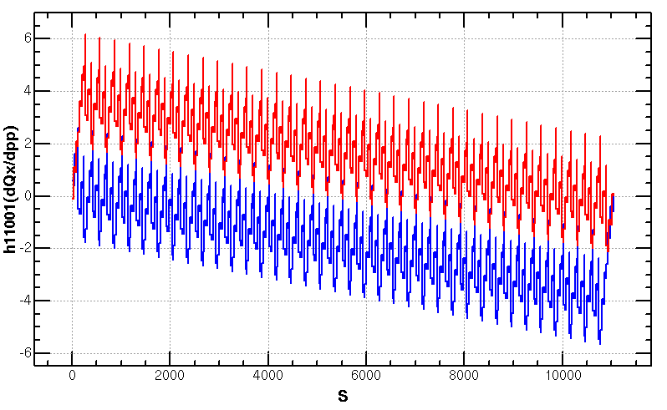
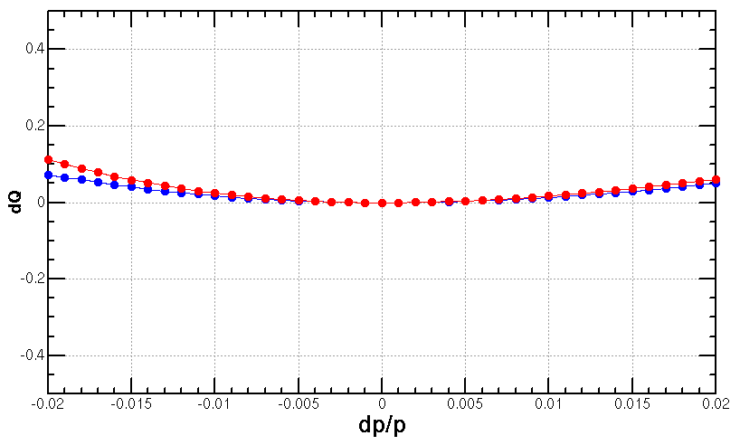
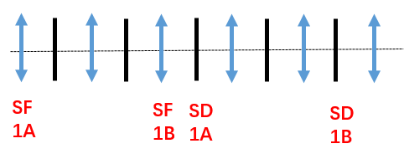
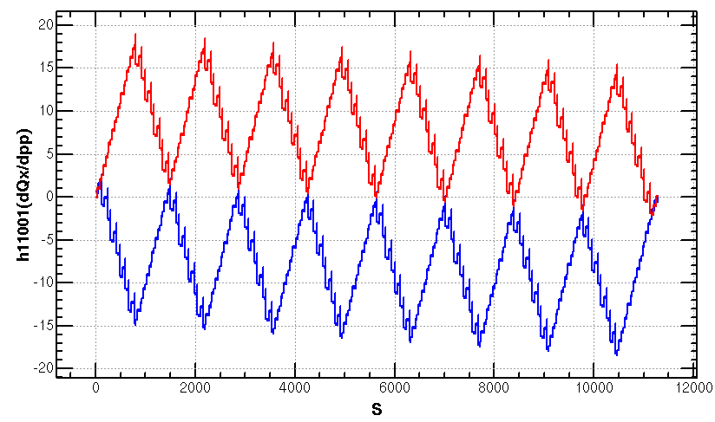
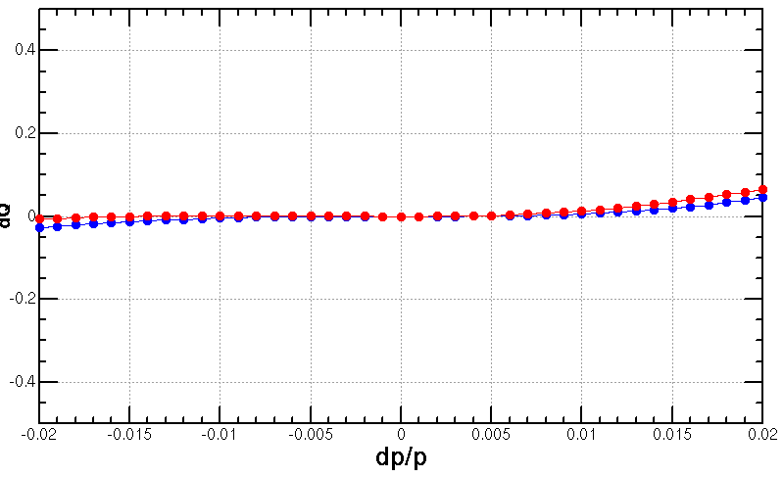
Optimization of the ARC aberration at ttbar and Higgs modes
2nd order chromaticity is a main aberration for the optimization of momentum acceptance with 2-repeated sextupole scheme.
In previous versions, 2nd order chromaticity generated in the ARC region are corrected with IR knobs (phase advance or K1).
However, the IR knobs will generate distortions at IP (beta, alfa and dispersion) especially for the horizontal plane.
A lattice with 8-repeated sextupoles scheme
much less 2nd order chromaticity for the horizontal plane
Scheme with 2 repeated sextupoles
Proposed by K. Oide
Q’’=313, 410
Q’’=9, 145
Scheme with 8 repeated sextupoles
Proposed by Tianjian Bian

Slide 9
Optimization of the ARC aberration at W and Z modes
The distribution of sextupoles for Higgs & ttbar mode allowed to select –I sextupole pairs for W &Z mode.
6*6=36 cases for 23 cells
There are much more combinations if choose different cases in each arc section (184 cells)
SF
1A
SF
1B
SF
2A
SF
2B
SF3A
SF
3B
SF
4A
SF
4B
SD
1A
SD
1B
SD
2A
SD
2B
SD3A
SD
3B
SD
4A
SD
4B
-I
-I
-I
-I
@ dp/p=1%
1st pair | 2nd pair
(1A, 2A) | (2B,3B) | (3A,4A) | (3B,4B)
(1B, 2B) | - | (3A,4A) | (3B,4B)
(2A, 3A) | - | - | (3B,4B)

Slide 10
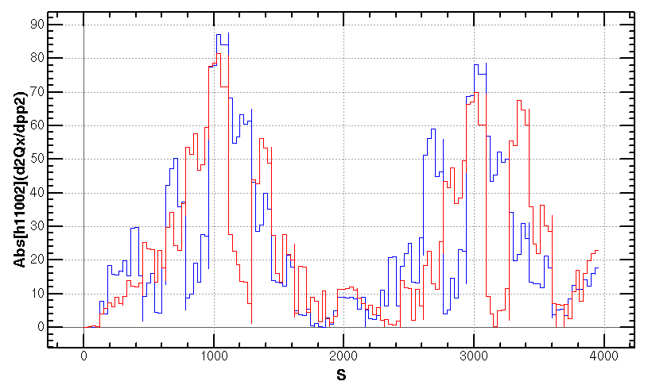
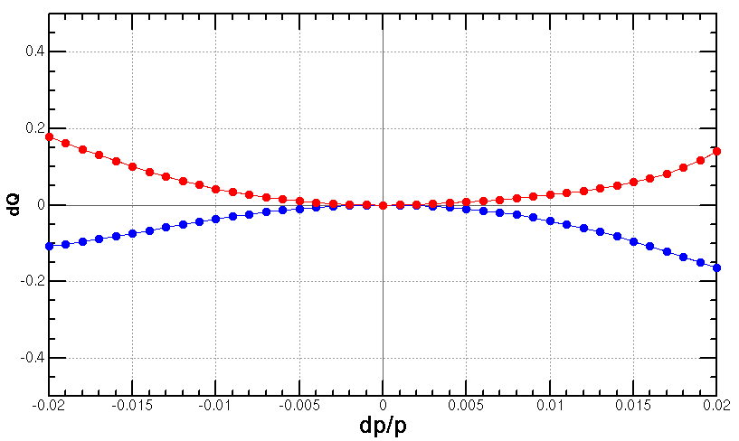
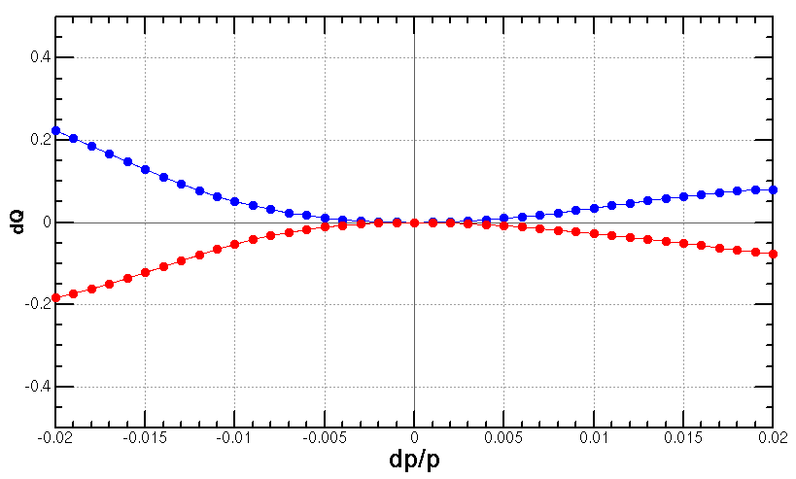
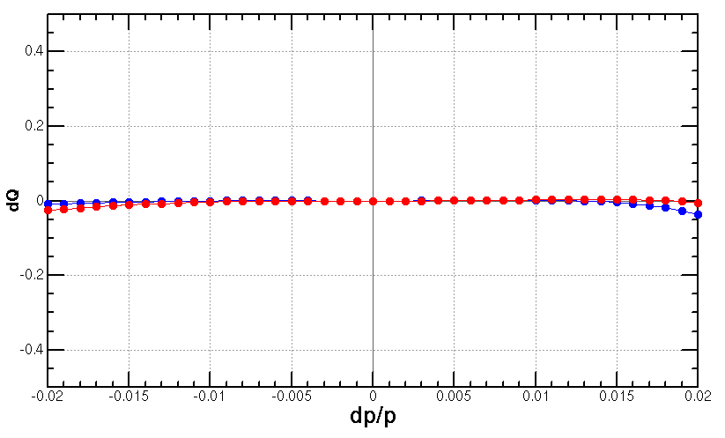
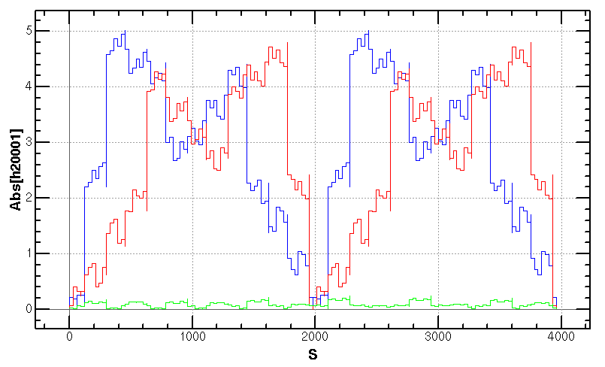
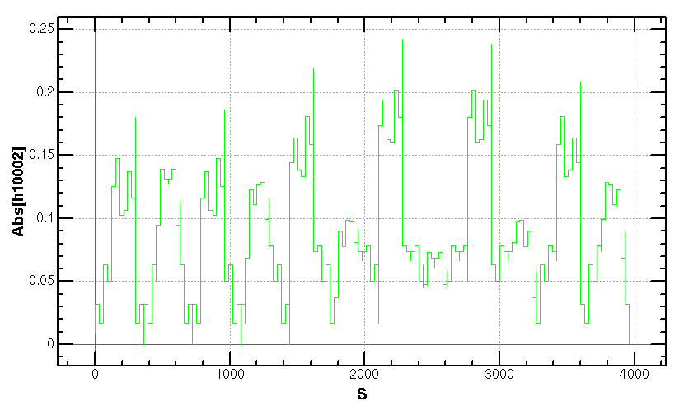
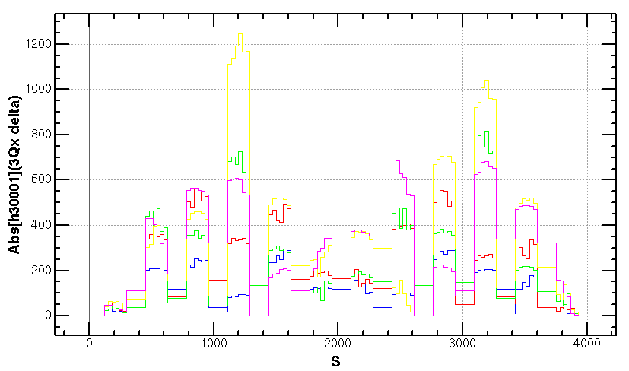
Optimization of the ARC aberration at W and Z modes (cont.)
Cancellation of main aberration has period of 23*3 cells.
case {4,3}
case {3,4}
case {4,3}+{3,4}
+

Slide 11
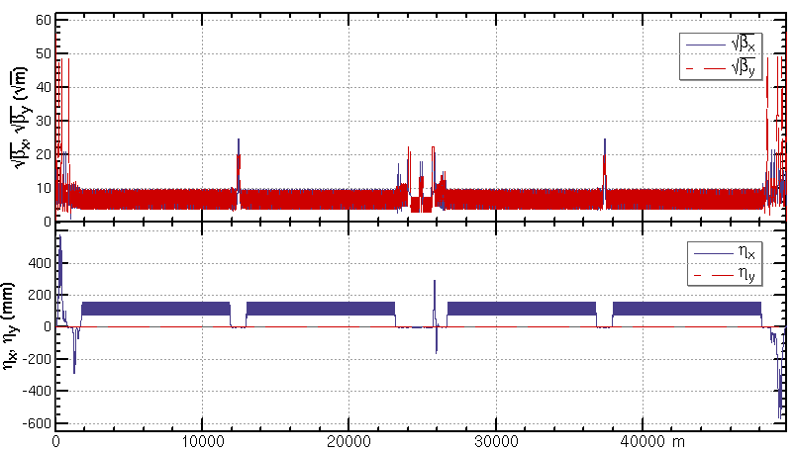
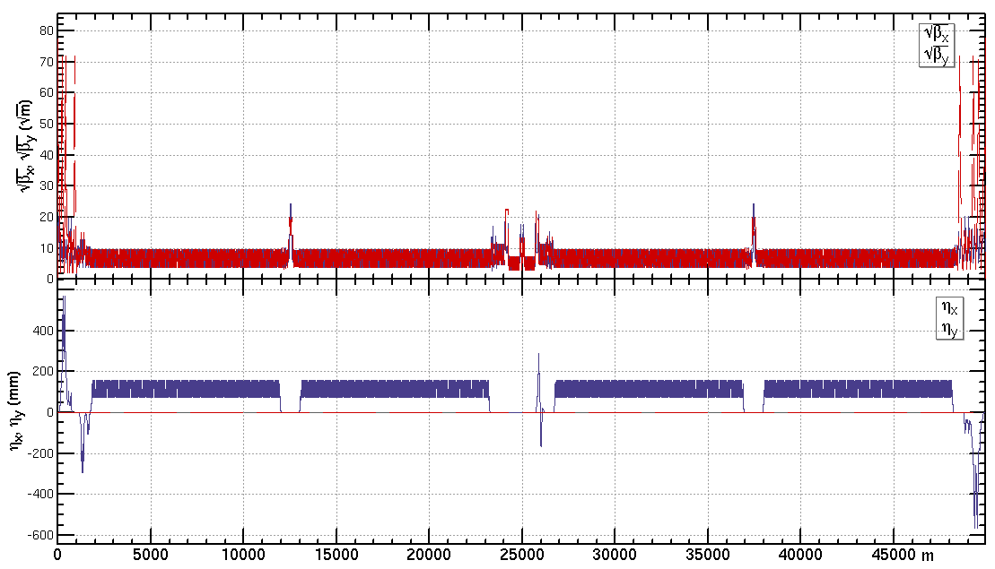
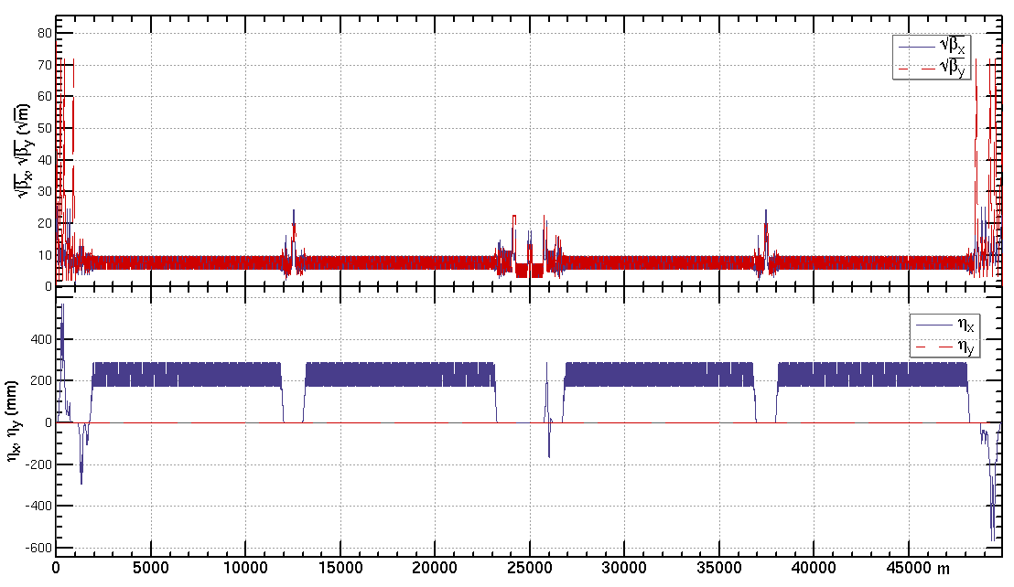
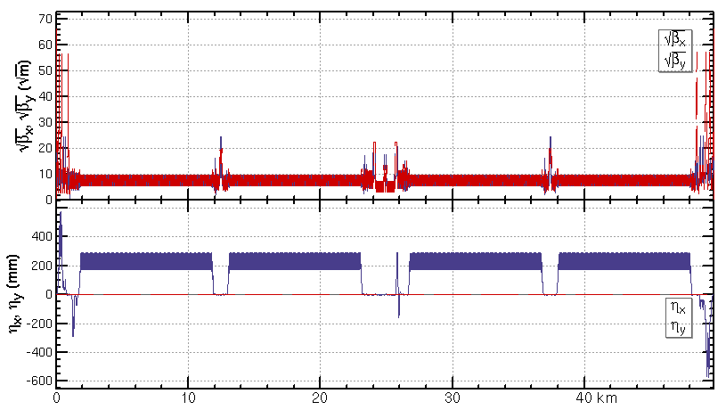
Lattice of half ring
ttbar: εx=1.4nm, β=1.04m/2.7mm
Higgs: εx=0.64nm, β=0.33m/1mm
W: εx=0.87nm, β=0.21m/1mm
Z: εx=0.27nm, β=0.13m/0.9mm
The new RF layout has not been implemented in these lattices.

Slide 12
Dynamic aperture requirement
 | CEPC Higgs | FCC-ee Higgs
Horizontal Emittance in collider/booster [nm] | $0.64$/ 1.26 | 0.63 / 0.55
DA requirement from injection | $$14{ σ}_{x}×7{ σ}_{y}$$ off axis $$7{ σ}_{x}×7 σ_{y}$$ on axis | $${ 11 σ}_{x} ×{5 σ}_{y}$$ off axis $${5 σ}_{x} ×5 σ_{y}$$ on axis
Beam lifetime (mainly bhabha and beamstrahlung) [min] | 20 | 18
Energy acceptance requirement from beam lifetime [%] | 1.7 | 1.7
循环束发射度: 0.64 nm.rad, 注入束发射度: 1.26 nm.rad
循环束Beta 1800米， 注入束Beta 680米。
循环考虑5 Sigma，注入考虑单边4 Sigma,
切割板2mm
DA requirement | CEPC Higgs | FCC-ee Higgs
with on-axis injection | ${\text{7}σ}_{x}×15σ_{y}×$1.7% | ${5 σ}_{x} ×15σ_{y}×$1.7%
with off-axis injection | ${\text{14}σ}_{x}×15σ_{y}×$1.7% | ${\text{1}1σ}_{x}×15σ_{y}×$1.7%
5.4 mm
7.4 mm CEPC
4.6mm FCC-ee
2 mm
* need beam-beam simulation to check for y

Slide 13
Dynamic aperture requirement
X. H. Cui, Y. Zhang, Y. W. Wang
 | ttbar | Higgs | W | Z
Horizontal Emittance in collider/booster [nm] | $1.4$ / 2.83 | $0.64$/ 1.26 | $0.87$/ 0.56 | $0.27$ / 0.19
DA requirement from injection | $${\text{13.9} σ}_{x}×7 σ_{y}$$ off axis | $$14.4{ σ}_{x}×7{ σ}_{y}$$ off axis $$7{ σ}_{x}×7 σ_{y}$$ on axis | $${\text{10.5} σ}_{x}×5 σ_{y}$$ off axis | $${\text{11.8} σ}_{x}×5{ σ}_{y}$$ off axis
Beam lifetime (mainly bhabha and beamstrahlung) [min] | 18 | 20 | 55 | 80
Energy acceptance requirement from beam lifetime [%] | 2.3 | 1.7 | 1.2 | 1.3
DA requirement | ttbar | Higgs | W | Z
with on-axis injection | - | ${\text{7}σ}_{x}×15σ_{y}×$1.7% | - | -
with off-axis injection | ${\text{13.9}σ}_{x}×{20σ}_{y}×$2.3% | ${\text{14.4}σ}_{x}×15σ_{y}×$1.7% | ${\text{1}\text{0.5}σ}_{x}×9σ_{y}×$1.2% | ${\text{1}\text{1.8}σ}_{x}×9σ_{y}×$1.3%
* need beam-beam simulation to check for y

Slide 14
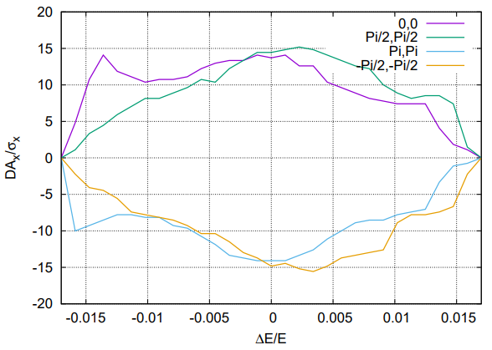
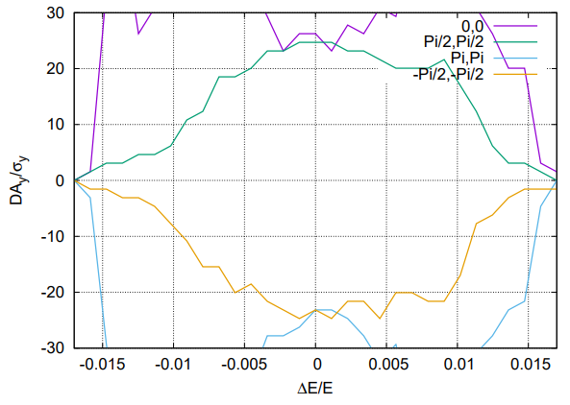
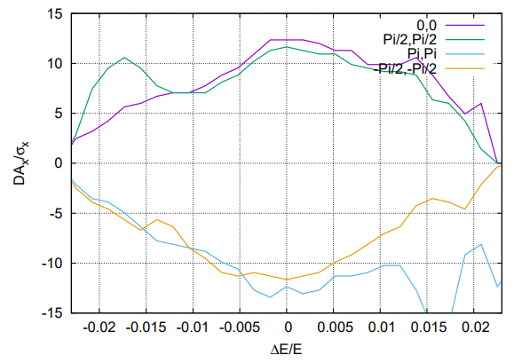
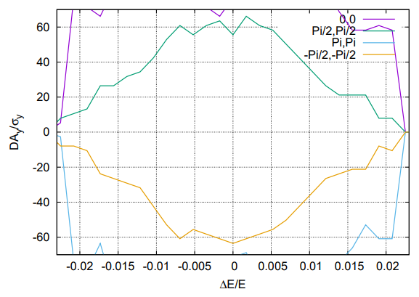
Dynamic aperture status @ Higgs and ttbar
Tracking to get DA without errors, with turns for one transvers damping time, with 4 initial phases
DA optimized with 84 variables (64 arc sextupoles + 8 IR sextupoles + 4 multipoles + 8 phase advance)
Further optimization is under going (totally 256 arc families)
Effects included in tracking
Synchrotron motion
Radiation loss in all magnets
Tapering
Crab waist sextupole
Maxwellian fringes
Kinematic terms
Finite length of sextupole
Higgs
1.7 %
1.7 %
ttbar
2.3 %
2.3 %

Slide 15
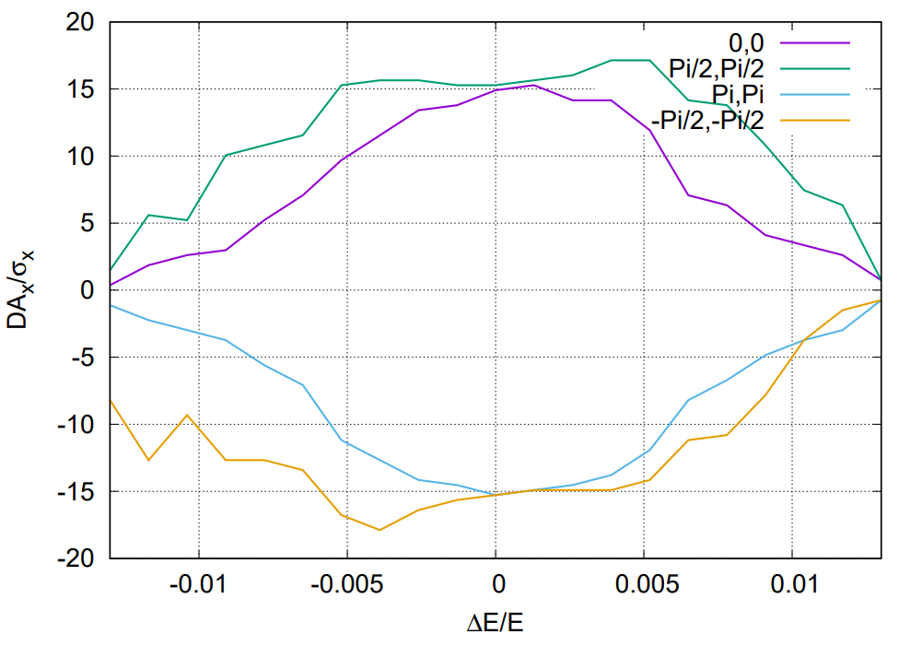
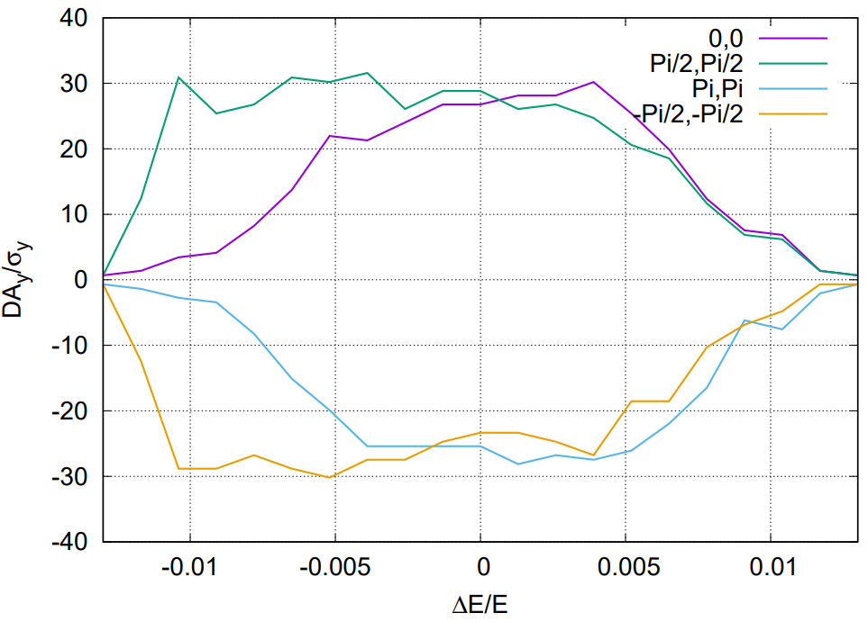
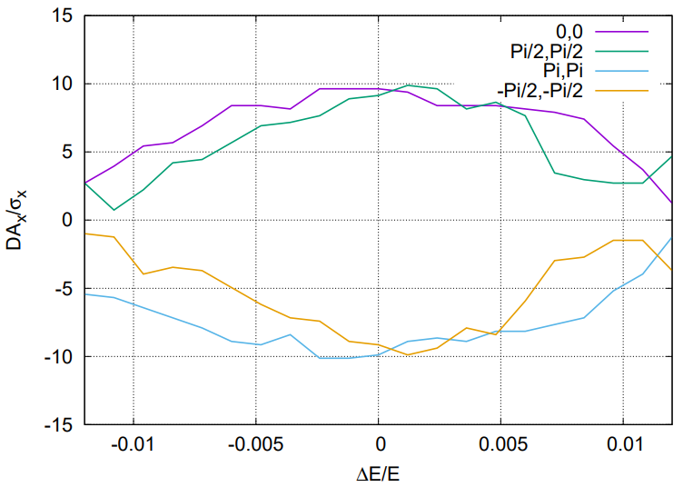
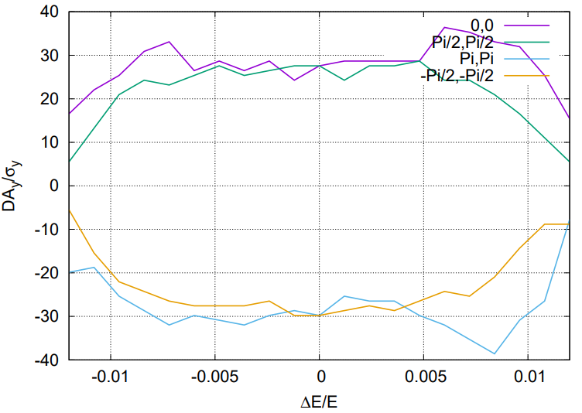
Dynamic aperture status @ Z and W
Tracking to get DA without errors, with turns for one transvers damping time, with 4 initial phases
DA optimized with 116 variables (96 arc sextupole families + 8 IR sextupoles + 4 multipoles + 8 phase advance)
Further optimization is under going (160 arc familes to be turned on)
Effects included in tracking
Synchrotron motion
Radiation loss in all magnets
Tapering
Crab waist sextupole
Maxwellian fringes
Kinematic terms
Finite length of sextupole
1.3 %
1.3 %
Z
W
1.2 %
1.2 %

Slide 16
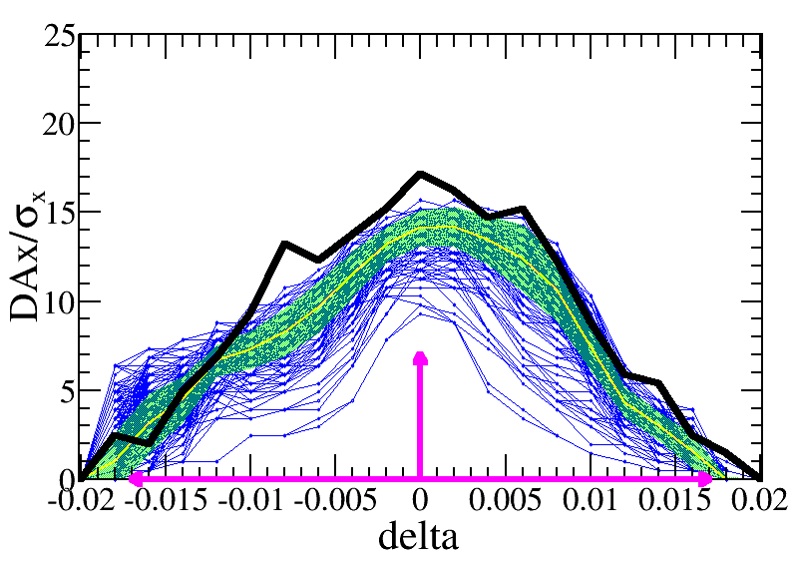
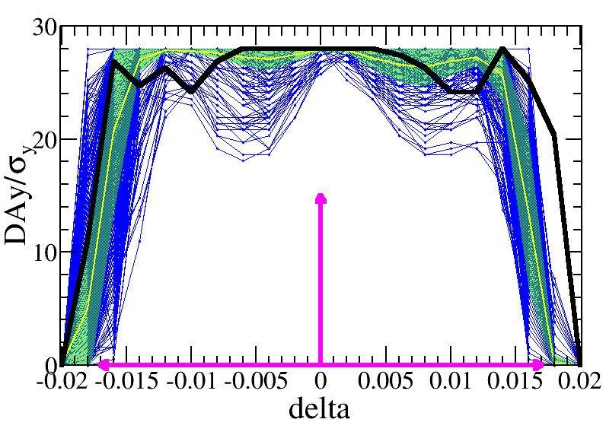
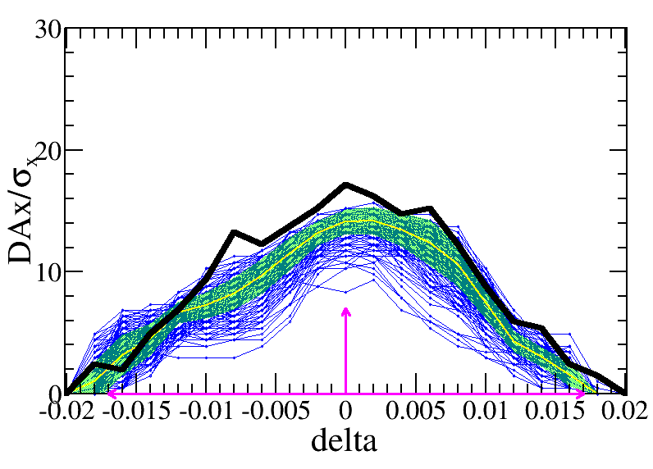
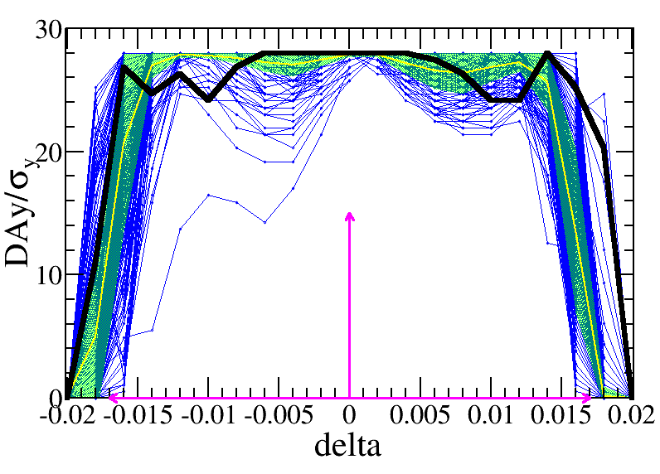
Dynamic aperture with error @ Higgs
Bin Wang,
Yuanyuan Wei,
Yiwei Wang
Error correction with 50 and 100 um misalignment in IR quadrupoles
closed orbit distortion (COD) and dispersion free steering (DFS) correction has been done
DA with 418 and 270 (out of 1000) error seeds satisfy the on-axis injection requirements
Further optimization with 100 um misalignment in IR quadrupoles is undergoing.
Component | Δx (mm) | Δy (mm) | Δθ_{z} (mrad) | Field error
Dipole | 0.10 | 0.10 | 0.1 | 0.01%
Arc Quadrupole | 0.10 | 0.10 | 0.1 | 0.02%
IR Quadrupole | 0.05 | 0.05 | 0.05
Sextupole | 0.10 | 0.10 | 0.1
IR=50μm
Component | Δx (mm) | Δy (mm) | Δθ_{z} (mrad) | Field error
Dipole | 0.10 | 0.10 | 0.1 | 0.01%
Arc Quadrupole | 0.10 | 0.10 | 0.1 | 0.02%
IR Quadrupole | 0.10 | 0.10 | 0.10
Sextupole | 0.10 | 0.10 | 0.1
IR=100μm
Lattice version cepc.lat.diff.8713.346.2p used
εx=0.64nm, β=0.33m/1mm, L*=1.9m
—DA w/o error
—DA of each seed
—mean value
—statistic errors
—requirement

Slide 17
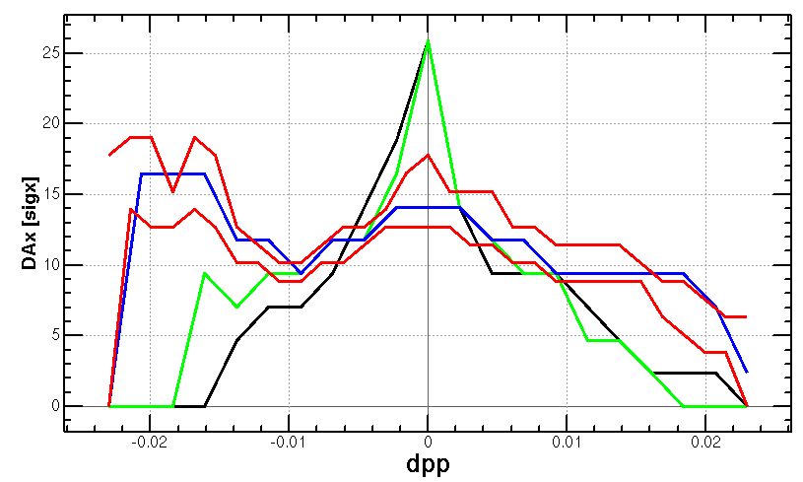
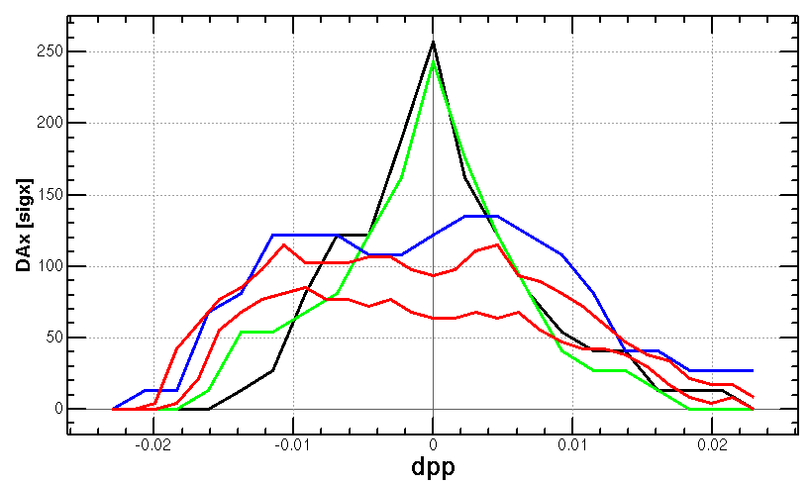
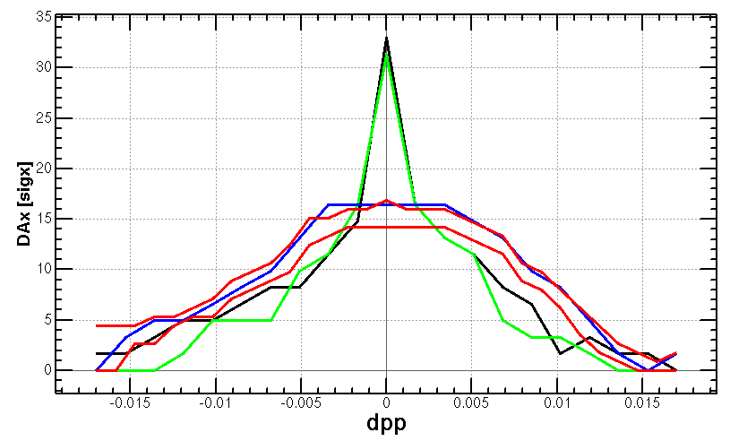
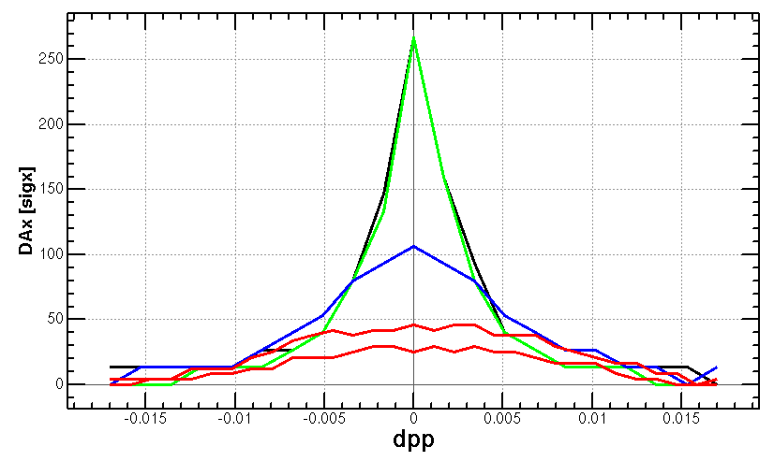
Dynamic aperture status @ Higgs and ttbar
Tracking to get DA without errors, with turns for one transvers damping time, with 4 initial phases
DA optimized with 84 variables (64 arc sextupoles + 8 IR sextupoles + 4 multipoles + 8 phase advance)
Further optimization is under going (totally 256 arc families)
Effects included in tracking
Synchrotron motion
Radiation loss in all magnets
Tapering
Crab waist sextupole
Maxwellian fringes
Kinematic terms
Finite length of sextupole
ttbar
Higgs

Slide 18
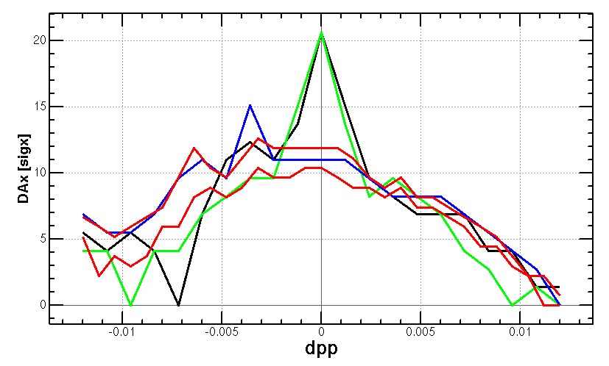
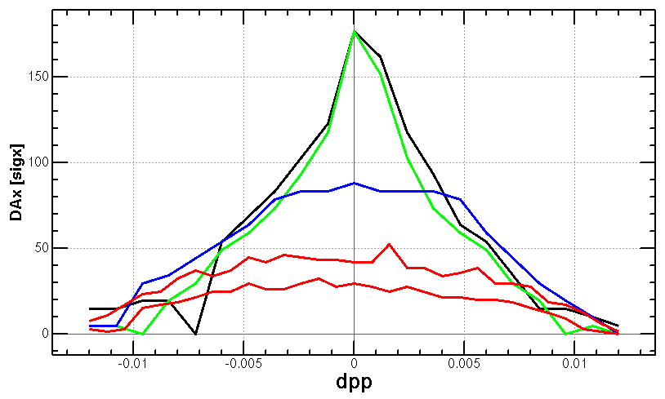
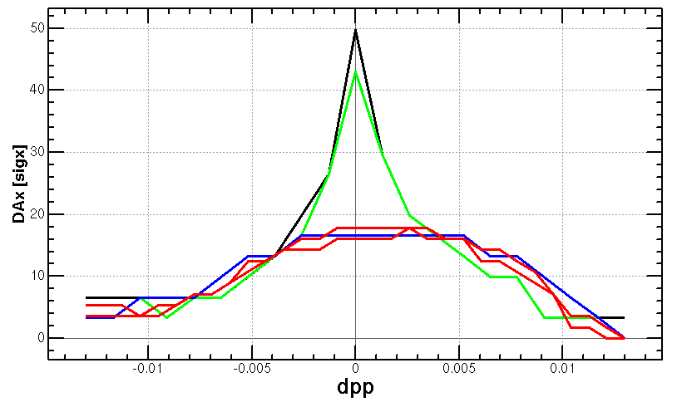
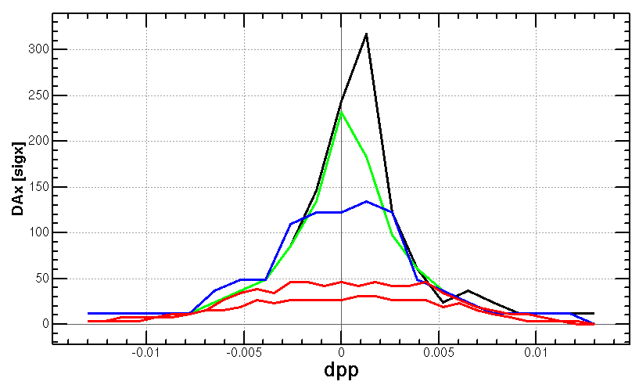
Dynamic aperture status @ Z and W
Tracking to get DA without errors, with turns for one transvers damping time, with 4 initial phases
DA optimized with 116 variables (96 arc sextupole families + 8 IR sextupoles + 4 multipoles + 8 phase advance)
Further optimization is under going (160 arc familes to be turned on)
Effects included in tracking
Synchrotron motion
Radiation loss in all magnets
Tapering
Crab waist sextupole
Maxwellian fringes
Kinematic terms
Finite length of sextupole
W
Z

Slide 19
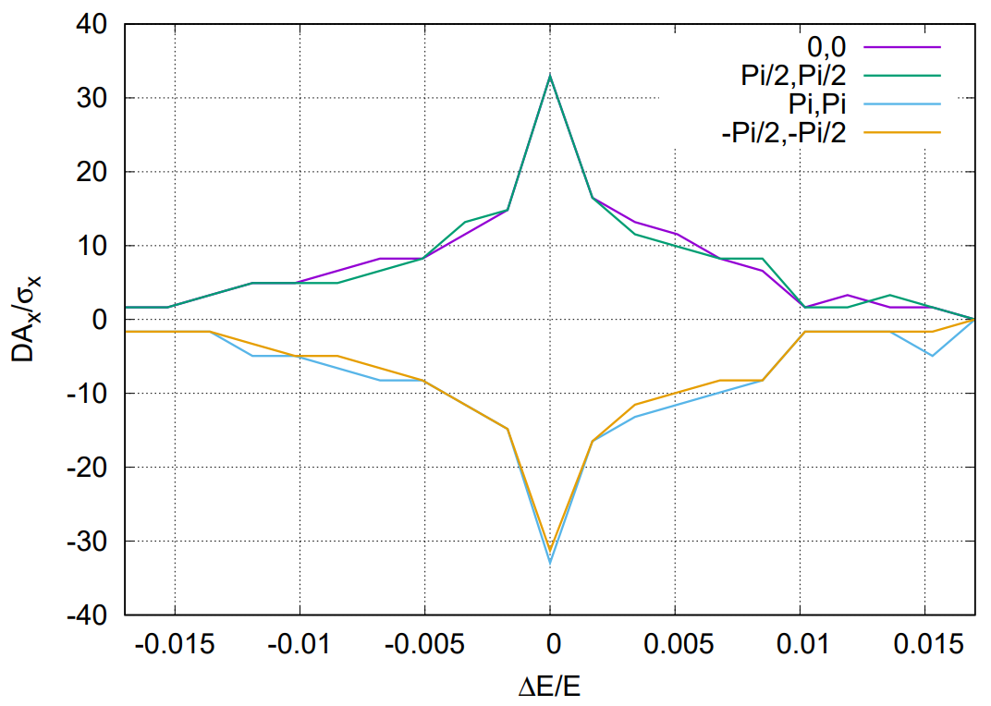
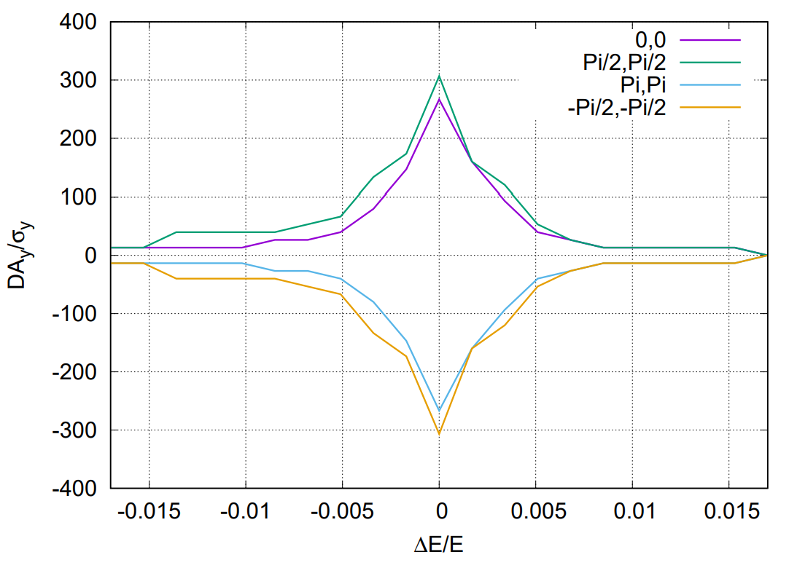
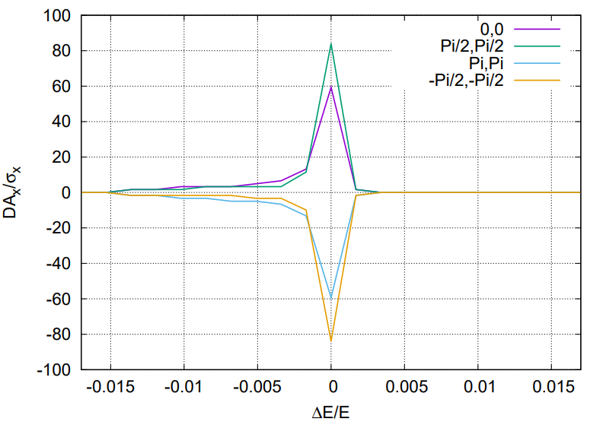
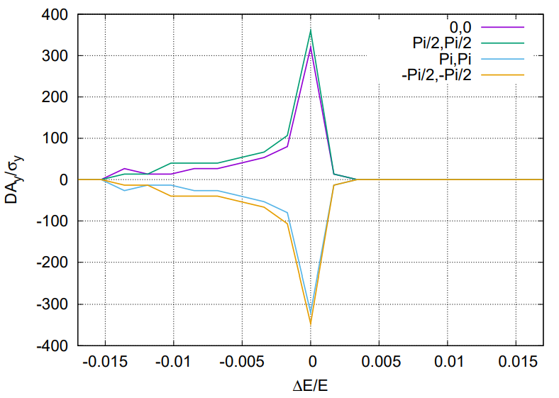
Further optimization of the on-momentum DA
On-momentum DA
turn off the multipoles for high order chromaticity correction (ttbar/Higgs)
With more arc sextupoles (96 =>256 W/Z)
Off-momentum DA
With more families of arc sextupoles (64 =>256 for ttbar/Higgs, 96 =>256 W/Z)
RESULT_Higgs_wo_rf
33，300
@MRF
1st result for Higgs mode
without refitting of the sextupoles
RESULT_Higgs_wo_rf_wo_ir_chromx_chromhighorderx_k3_k4_wo_ir_chromhighordery_k3_k4_w_arc，
70, 350
@MRF

Slide 20
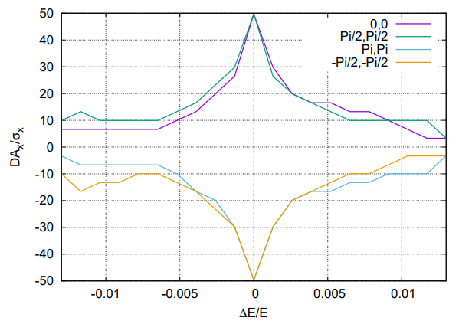
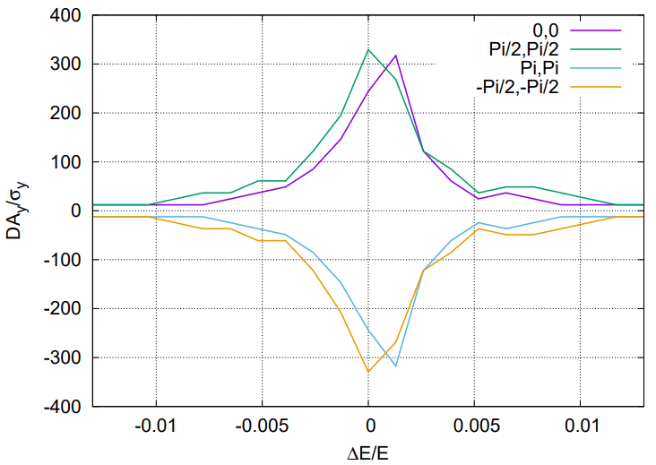
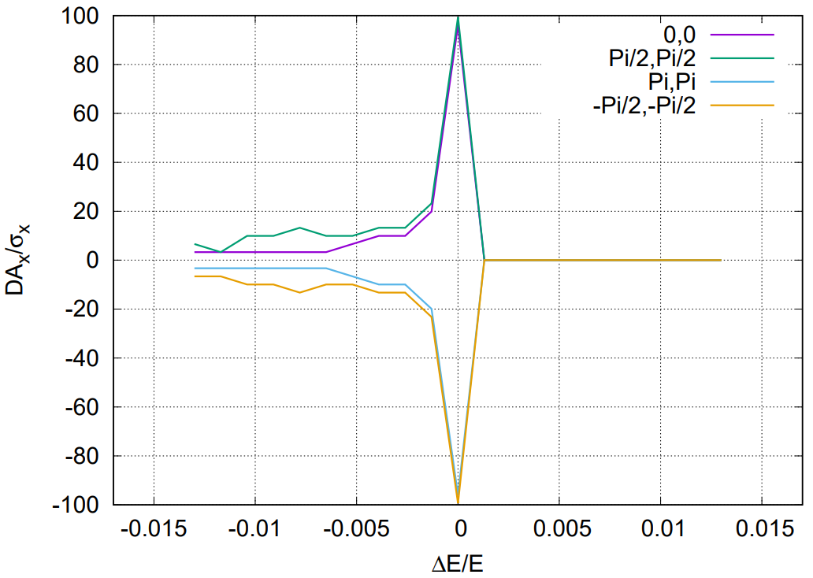
Further optimization of the on-momentum DA
RESULT_ttbar_wo_rf
50，320
@MRF
1st result for Z mode
without refitting of the sextupoles
RESULT_ttbar_wo_rf_wo_ir_chromx_chromhighorderx_k3_k4_wo_ir_chromhighordery_k3_k4_w_arc，
100, 330
@MRF

Slide 21
Further optimization of the on-momentum DA
RESULT_ttbar_wo_rf
25，250
@MRF
1st result for ttbar mode
without refitting of the sextupoles
RESULT_ttbar_wo_rf_wo_ir_chromx_chromhighorderx_k3_k4_wo_ir_chromhighordery_k3_k4_w_arc，
60, 400
@MRF

Slide 22
Further optimization of the on-momentum DA
RESULT_ttbar_wo_rf
20，210
@MRF
1st result for W mode
without refitting of the sextupoles
RESULT_ttbar_wo_rf_wo_ir_chromx_chromhighorderx_k3_k4_wo_ir_chromhighordery_k3_k4_w_arc，
60, 240
@MRF

Slide 23
Possible way for further optimization
DA optimization with lattice
FD length
IR photon background
IR geometry
Length of straight sections
Booster emittance

Slide 24
Summary
The high luminosity scheme of CEPC collider ring with 30MW has been designed by mainly squeezing the βy* and emittance.
New aberration correction scheme in ARC region, compatible final quadrupoles in IR
Phase advance reduced from 90° to 60° for W/Z mode to suppress impedance instability and increase stable tune area
Dynamic aperture w/o error for four modes achieve the requirement of energy acceptance. The DA can be further optimized with more arc sextupole families.
The imperfection correction to the high luminosity lattice is on going.
With transverse alignment of 50um and 100um for final quadrupoles and 100um for other magnets
The dynamic aperture @ Higgs with 418 and 270 out of 1000 error seeds satisfy the on-axis injection requirements

Slide 25
backup

Slide 26
Optimization of final doublet design for Higgs
CEPC is mainly optimized at Higgs energy. The final doublet design was mainly optimized for Higgs.
Status of the FD @ Higgs：L*=1.9m, LQ1=2.5m, LQ2=1.5m, d=0.3m, KQ1A=142T/m, KQ1B=85T/m, KQ2=96T/m
Minimum of radiation power occurs at KQ1B/KQ1A≈0.6
Strength, length of Q1, Q2 and their distance are mainly constrained by superconducting, mechanical installation, vacuum technologies in the MDI.
—relative chromaticity on y plane
—relative radiation power on y plane
Minimum of radiation power occurs at KQ1B/KQ1A≈0.6
Different length of Q1A and Q1B doesn’t affect much on the minimum of the power and chromaticity. This provides more freedom of the FD technical design.

