Slide 1
The Cryostat for MDI Superconducting Magnets
Miaofu Xu, Penghui Li, Zhengze Chang, Shaopeng Li, Rui Ge
Cryogenics Group, Accelerator Research Center Institute of High Energy Physics(IHEP) 2022.1.29; Email: xumf@ihep.ac.cn

Slide 2
Contents
Introduction and Technical Requirement
Solution of Cryogenic System
Mechanical Design
Calculation and Simulation Results
Summary and Plan

Slide 3
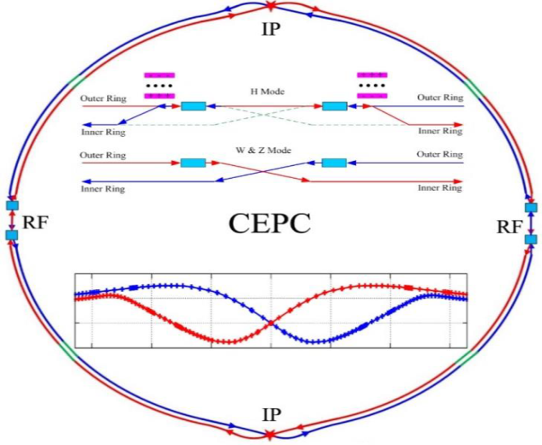
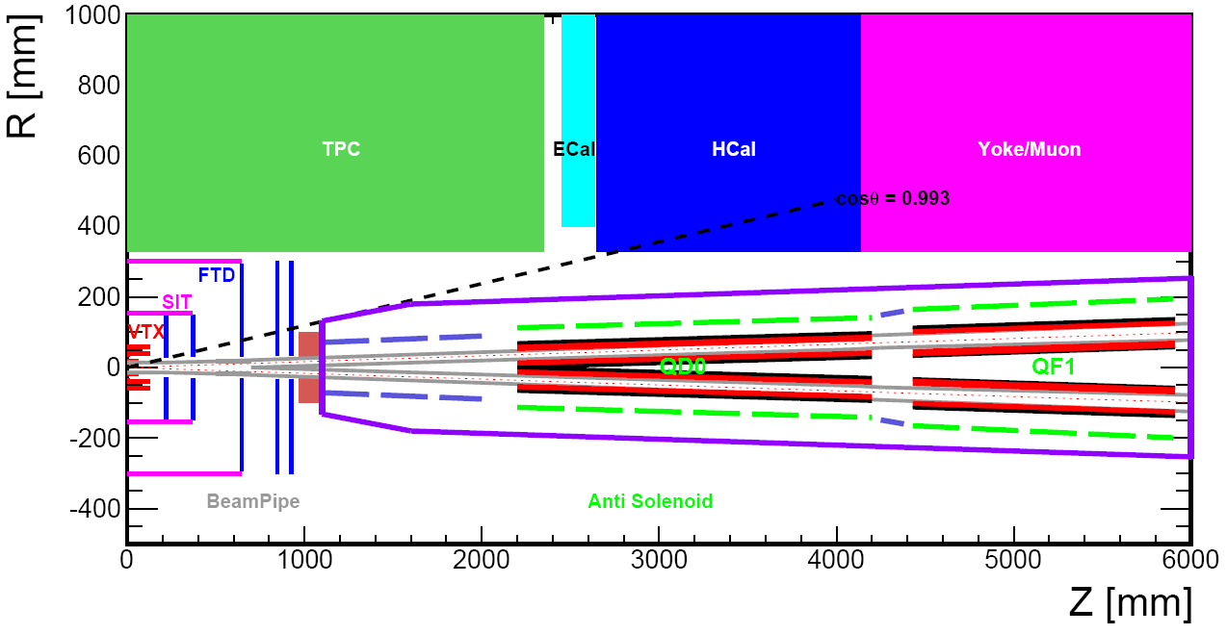
Introduction
CEPC is a Circular Electron Positron Collider with a circumference about 100 km，beam energy up to 120 GeV Proposed by IHEP
Both sides of the collision points in the interaction region of CEPC collider ring require compact high gradient final focus quadrupole magnets
The primary goal of the cryostat design is to create reliable safe cryogenic system with the possibility of failure-free operation for SC magnets with helium refrigerator

Slide 4
Basic Parameter of SC Magnet
The requirements of the Final Focus quadrupoles(QD0 and QF1) are based on the length of 2.2 m, beam crossing angle of 33 mrad in the interaction region
ITEM | QD0 | QF1 | Anti-Solenoids
Central field gradient (T/m) | 136 | 110
Cooling type | LHe | LHe | LHe
Operating current (A) | 2080 | 2300 | 1000
Magnetic storage energy (KJ) | 25 | 30.5 | 715
Operating temperature（K） | 4.5K | 4.5K | 4.5K
Magnet length (m) | 2 | 1.48 | 1.1+2+1.7
X direction Lorentz force/octant(KN) | 68 | 110 | ？
Y direction Lorentz force/octant(KN) | -140 | -120 | ？
The total weight of magnet is about 1T, the total energy release to cryogenic system when magnet quench is about 400KJ in 2 second
From Yingshun Zhu

Slide 5
Contents
Introduction and Technical Requirement
Solution of Cryogenic System
Mechanical Design
Calculation and Simulation Results
Summary and Plan

Slide 6
The Solution of Cryogenic System
The Tevatron proton-antiproton collider at Fermi National Laboratory is an accelerator with superconducting magnets cooled by supercooled liquid helium. (美国费米国家实验室的Tevatron质子-反质子对撞机)
The superconducting magnets of the Proton-proton collider (RHIC) at Bullhaven National Laboratory are cooled by supercritical helium.(美国布尔海文国家实验室的质子-质子对撞机RHIC)
CESR of the Electron-positron collider and its detector CLEOII in Newman Laboratory of Cornell University in the United States, superconducting magnets are cooled by supercooled helium, and each superconducting quadrupole magnet has a low temperature heat load of 2W. (美国康奈尔大学纽曼实验室的正负电子对撞机CESR及其探测器CLEOII)
Superconducting magnets at the Electron-proton collider HERA at the Synchrotron Laboratory in Hamburg, Germany, are cooled by supercritical helium at 4.4K. (德国汉堡同步加速器实验室的电子-质子对撞机HERA)
The HAdron Collider (LHC) at CERN uses superfluid helium with a cooling medium of 1.8 to 1.9K. (欧洲粒子物理中心的强子对撞机)
Magnets at the National Institute of High Energy Physics' Electron-positron Collider KEKB are cooled with supercooled liquid helium at 1.5 Bara at 4.5K. (日本国家高能物理研究所的正负电子对撞机KEKB)
Notes:
超流氦冷却具有如下两个优点，超流氦的黏度极低，很容易渗透到磁体绕组的缝隙中进行良好的换热；另一个优点是超流氦具有特别高的体积比热容和导热系数(是相同温度下铜比热2000倍，铜导热系数1000倍)。高的比热容有助于稳定磁体的工作温度，高导热系数则利于磁体发热的排出

Slide 7
Cryogenic System of
BEPC-II/BEPCII-U IR SC Magnet
Conventional helium cooling mode: SHe is directly provided by helium refrigerator
Helium circulation pump cooling mode: She is provided by helium circulating pump
The inlet pressure is determined by the resistance loss of the superconducting magnet and the length of cryogenic transport line

Slide 8
New Challenges
First time to design this type cryostat
The length of IR SC magnets----1350.2$mm→$5322mm
Beam energy----2.8Gev $→$120Gev
The distance from refrigerator to cryostat
The stored energy of SC magnet
The total weight of SC magnet----0.2T$→$1T
Current Lead----1300A $→$2300A
Quench protection system and power system

Slide 9
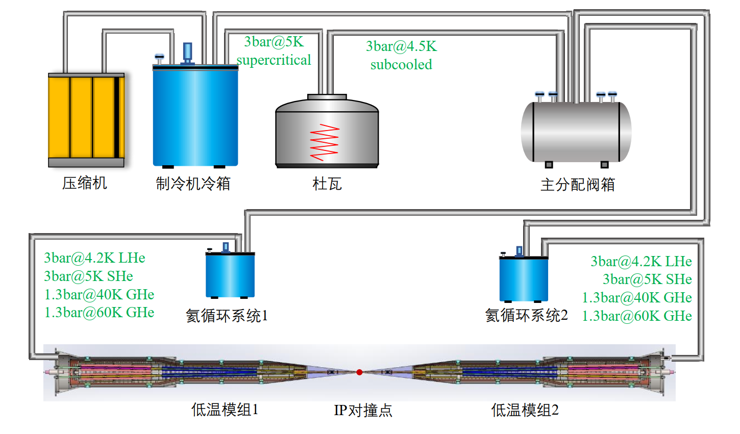
Flow Chart for Cryostat (one site)

Slide 10
The Solution of Cryogenic System
Application cases of large flow forced flow cooling ---- supercritical helium cycle pump:
The electron-proton collider HERA at the electron synchrotron laboratory (DESY) in Hamburg, Germany, uses a 45g/s helium circulating pump. 德国汉堡电子同步加速器实验室（DESY）
The Atlas-LHC at CERN in Geneva, Switzerland, uses two 600g/s helium circulation pumps and two 1.2Kg/s helium circulation pumps. 瑞士日内瓦的欧洲联合核子研究中心
The Superconducting magnet Test Facility at the Atomic Energy Research Institute of Japan.日本原子能研究所
TOSKA at the Institute of Technical Physics at the Karlsruhe Research Center in Germany.德国卡尔斯鲁厄研究中心技术物理研究所
Refrigerator
Refrigerator
LHe
LHe
helium circulating pump
SC Magnet
SC Magnet
Conventional helium cooling mode
Helium circulation pump cooling mode

Slide 11
The Solution of Cryogenic System
Advantages of using a helium circulating pump:
It can promote the cooling cycle of the magnet and increase the flow rate of the cooling medium to improve the cooling effect of the superconducting magnet, so as to improve the stability of the superconducting magnet
The cooling medium flow rate of the magnet cooling cycle can be easily changed without changing the flow rate of the refrigerator. The thermal disturbance generated in the adjustment process will be absorbed by the liquid helium tank, and then slowly transmitted to the refrigerator
The inlet pressure of the superconducting magnet can be increased to ensure that the outlet cooling medium is still supercritical helium, so as to avoid two-phase flow in the cold channel of the superconducting magnet.
Disadvantages:
The inductor helium circulating pump adds to the heat load of the cryogenic system
Notes:
可以促进磁体的冷却循环, 加大冷却介质流量以提高超导磁体的冷却效果， 从而提高超导磁体的稳定性。
可以方便的改变磁体冷却循环的冷却介质流量而不需要改变制冷机的节流路流量, 此调节过程中产生的热扰动会首先被液氦槽或过冷槽吸收, 再慢慢地传送到制冷机。
可以提高超导磁体的入口压力, 保证出口冷却介质仍为超临界氦, 从而避免超导磁体内冷通道发生两相流。

Slide 12
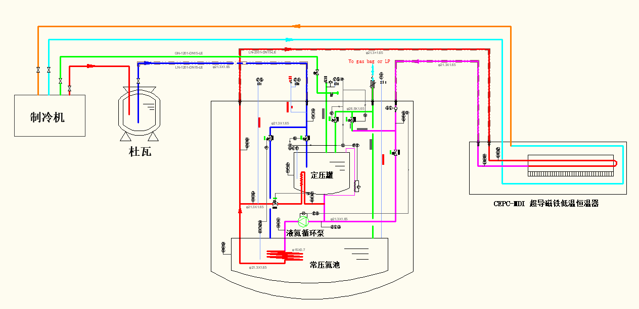
Supercooled helium circulation system

Slide 13
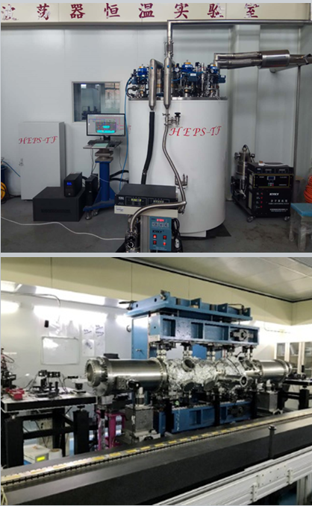
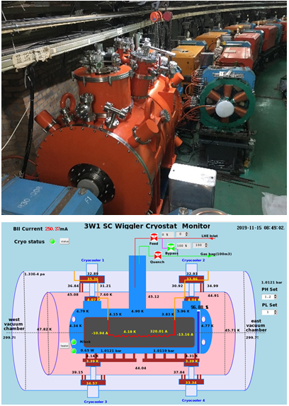
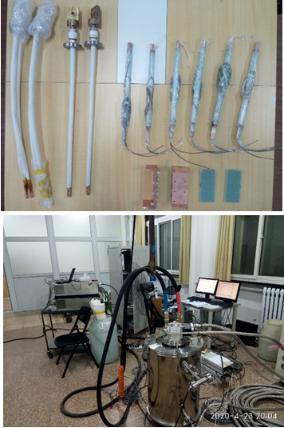
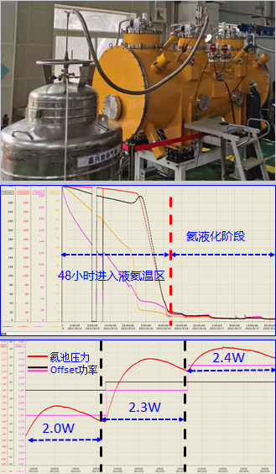
Technical Reserve
Supercooler cooler at liquid nitrogen temperature---CPMU of HEPS-TF/HEPS project
3W1 SC Wiggler cryogenic system----assembly/dressing/commissioning/normal operation
SC Undulator cryogenic system----Thermal siphon cycle/ cryogenic test
Current lead cryogenic test system---- work with power system and quench protection system
BEPC-II IR SC magnet cryogenic system----normal operation

Slide 14
Contents
Introduction and Technical Requirement
Solution of Cryogenic System
Mechanical Design
Calculation and Simulation Results
Summary and Plan

Slide 15
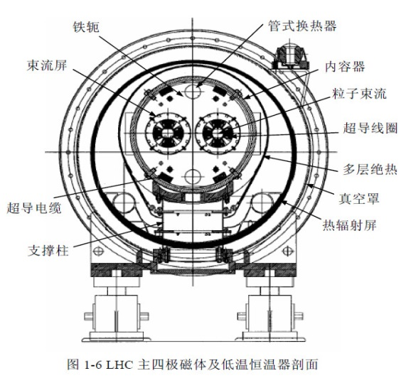
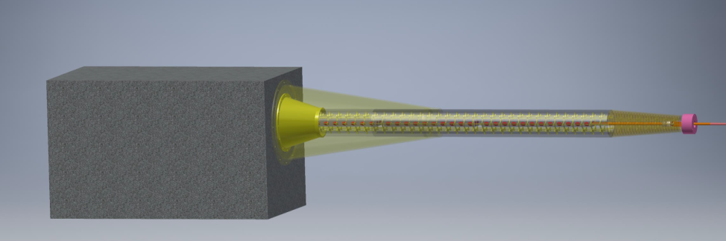
Mechanical Design
BEPC-II IR SC Magnet cryostat
The KEK SC magnets are cooled with the sub-cooled LHe
at 20 g/s and 0.16 MPa (~40 W).
Conceptual design of the cryostat of MDI FCC-ee

Slide 16
Mechanical Design
We are not at the level of a real, detailed, mechanical design
1132 mm
5322 mm
From support to the side flange of cryostat
33 mrad cone
IP
SUPPORT
CRYOSTAT

Slide 17
Mechanical Design
The total weight of cryostat is about 2.5 T
IP
Anti-solenoid coils
QD0
Thermal shield
QF1
Beam pipe

Slide 18
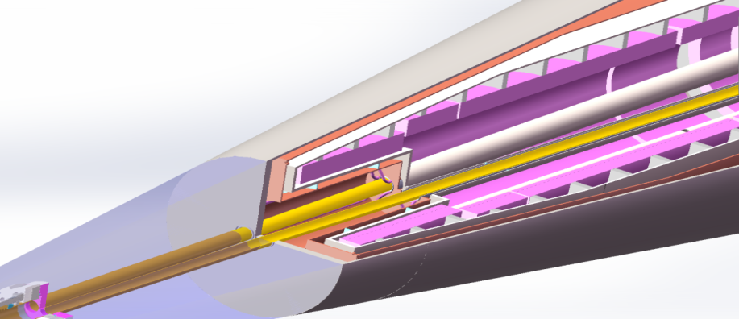
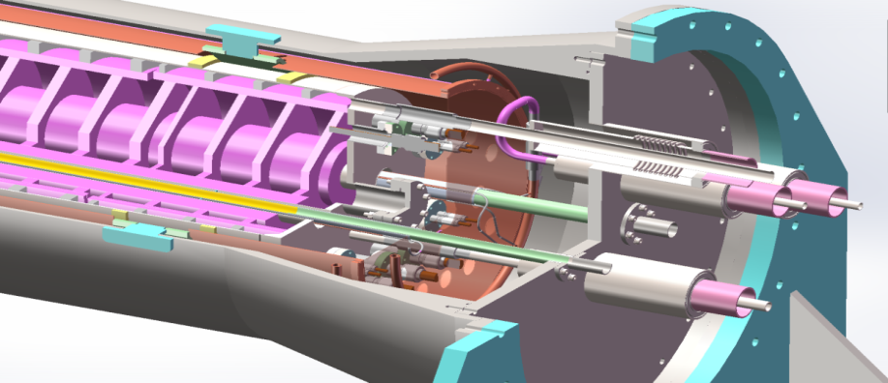
Mechanical Design---supports
LHe tank
thermal shield
SC Magnets
enlargement

Slide 19
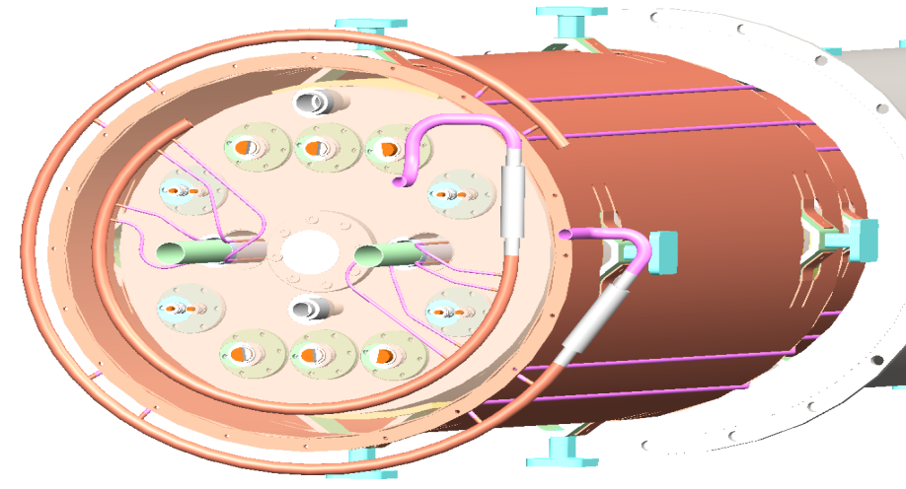
Connectors and Support
GN2 or GHe outlet
GHe outlet
LHe inlet
LN2 or GHe inlet
Thermal shield support
Helium tank support-QD0
Helium tank support-QF1

Slide 20
Contents
Introduction and Technical Requirement
Solution of Cryogenic System
Mechanical Design
Calculation and Simulation Results
Summary and Plan

Slide 21
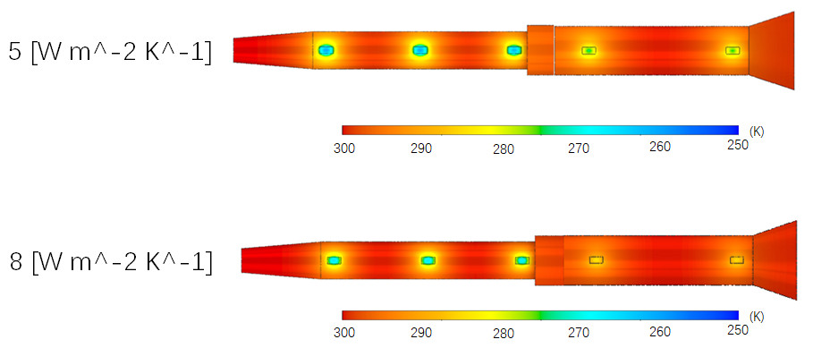
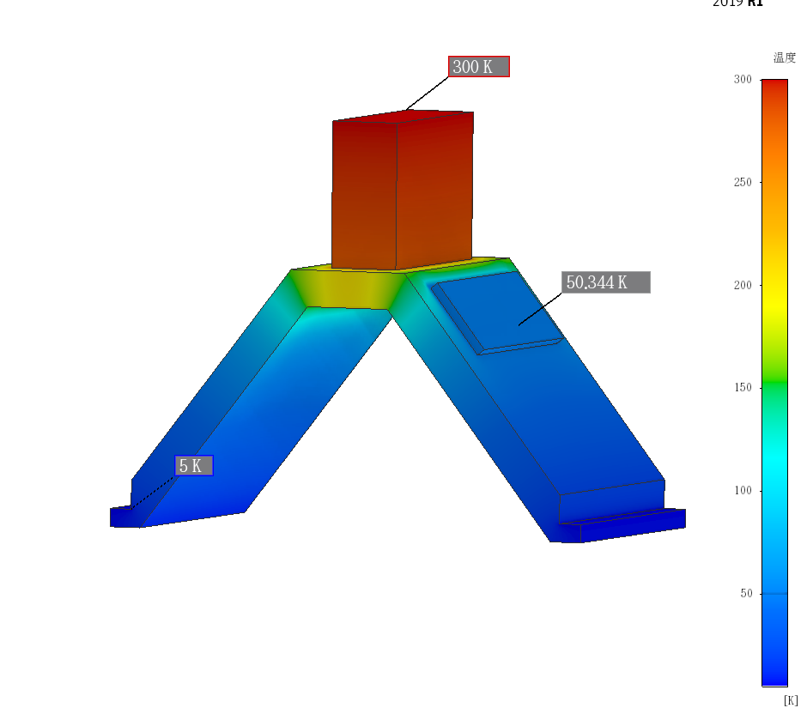
Vacuum chamber---temperature field
1
2
3
4
5
Calculation conditions: the outermost layer is set as convective boundary condition, the surface that the support structure contacts with the helium tank is set as 5K, and the surface that contacts with the cold screen is set as 60K
Support numbers
convective heat transfer coefficient | 1 | 2 | 3 | 4 | 5
5W m^-2 K^-1 | 268.97 K | 268.98 K | 270.52 K | 282.76 K | 283.32 K
8W m^-2 K^-1 | 273.14 K | 273.14 K | 274.09 K | 285.34 K | 286.65 K

Slide 22
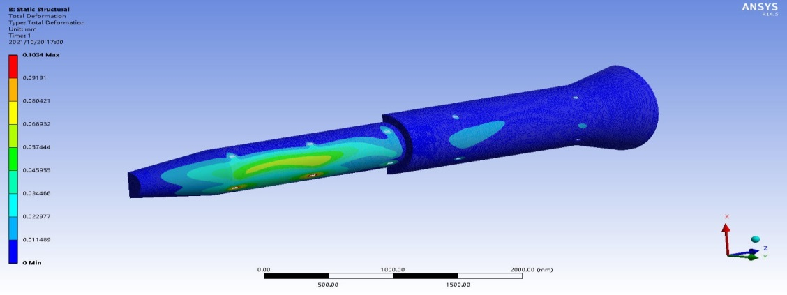
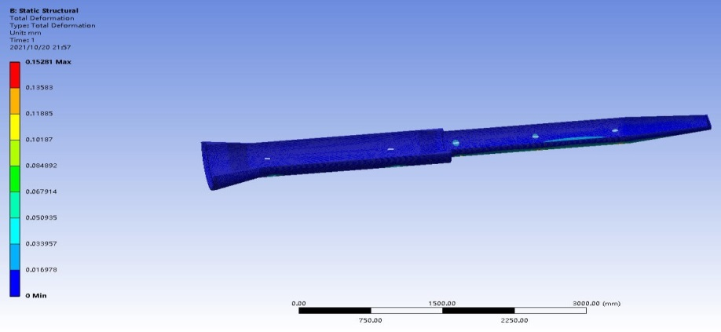
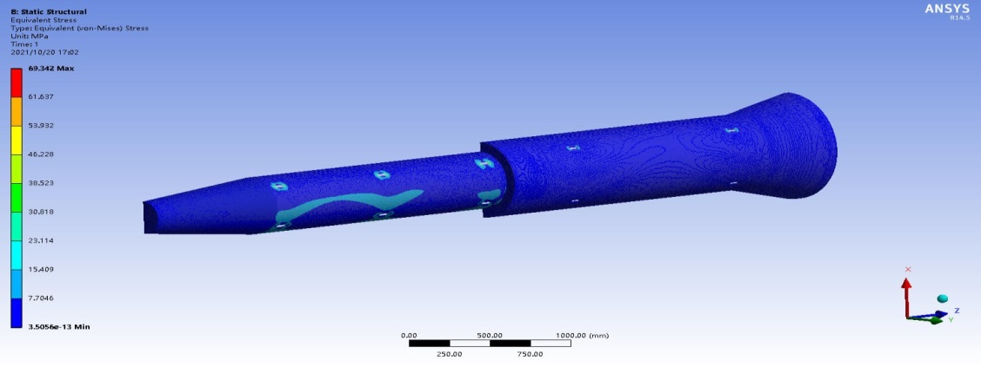
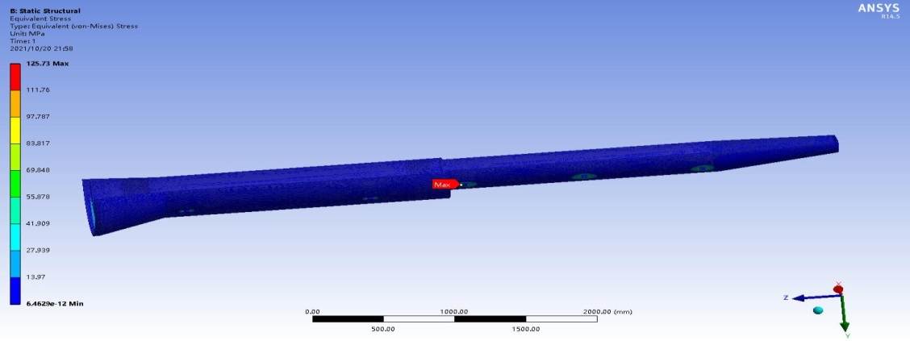
Vacuum chamber---stress analysis
Maximum deformation is 0.1mm@P_{OUT}1Bar
Maximum deformation is 0.15mm@P_{IN}1.2Bar
Maximum stress 69.343MPa@P_{OUT}1Bar
Maximum stress 125.73MPa@P_{IN}1.2Bar

Slide 23
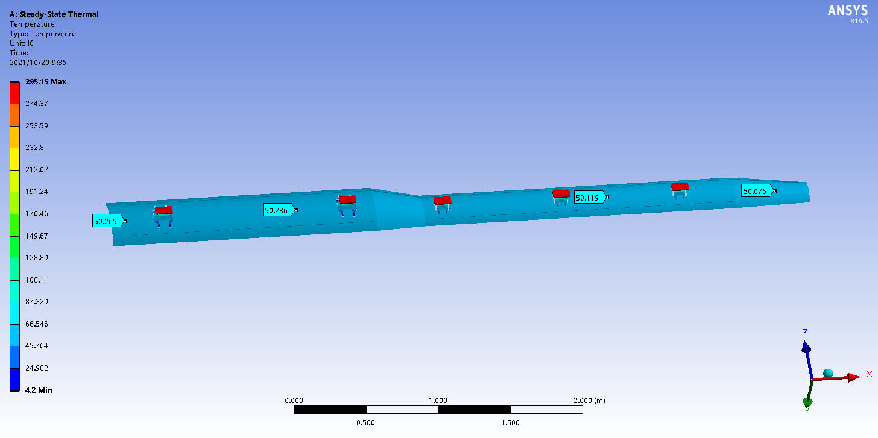
Thermal shield and supports--temperature field
Thermal shield: inlet 40K cold helium; outlet 70K cold helium.
set the temperature of cold screen coil is 50K
The average temperature of thermal shield is 50.15K，
The temperature uniformity is good

Slide 24
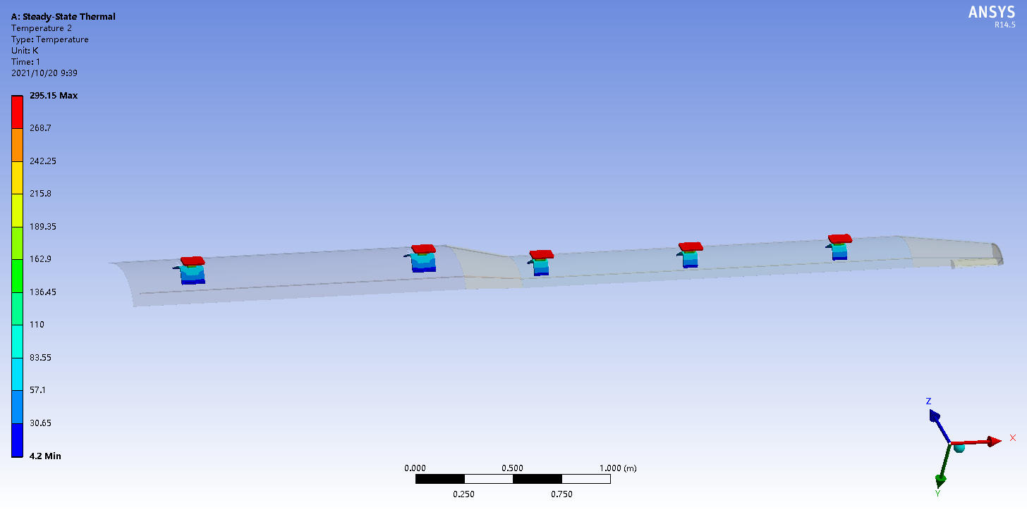
Thermal field analysis of thermal shields and supports
Boundary conditions: T_{INLET}=40K cold helium gas，T_{OUTLET}=70K;
Set thermal shield coils temperature is 50K.
Heat load of thermal shield：7.12*4=28.48W@50K
Heat load for 4.2K temperature zone：2.01*4=8.04W@4.2K

Slide 25
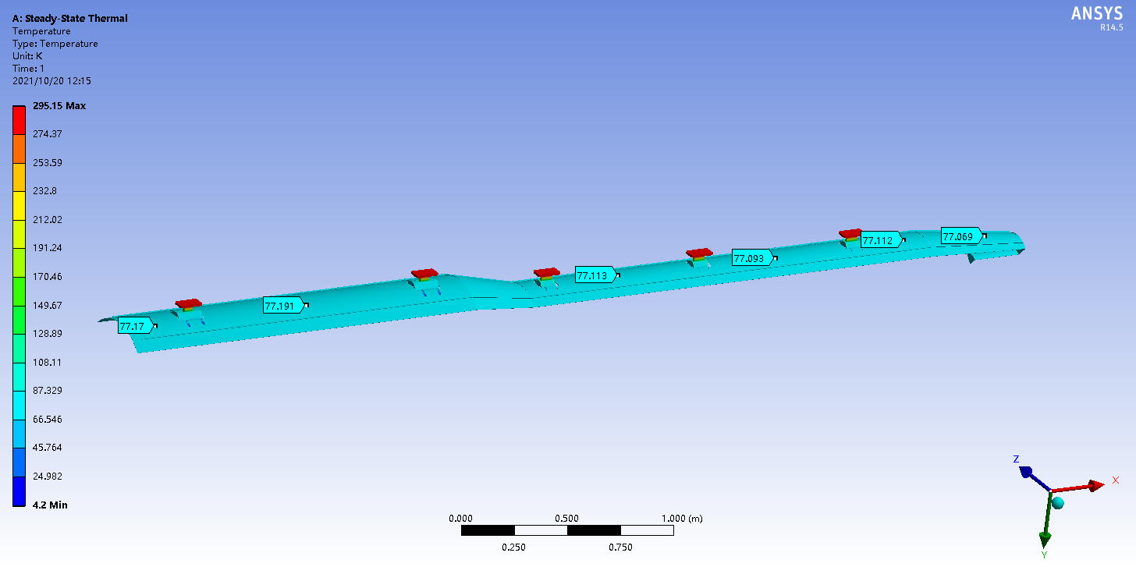
Thermal field analysis of thermal shields and supports
Thermal shield cooled by liquid nitrogen， Set thermal shield coils temperature is 77K
The average temperature of thermal shield is 77.15K，
The temperature uniformity is good

Slide 26
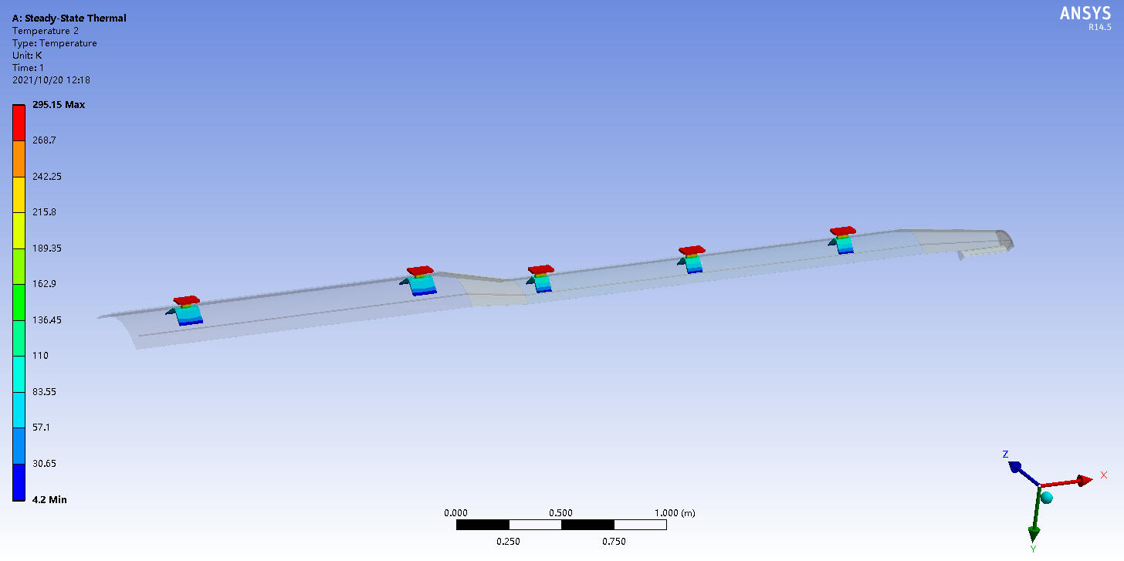
Thermal field analysis of thermal shields and supports
Thermal shield cooled by liquid nitrogen， Set thermal shield coils temperature is 77K
Heat load of thermal shield：5.35*4=21.4W@77K
Heat load for 4.2K temperature zone：3.42*4=13.68W@4.2K

Slide 27
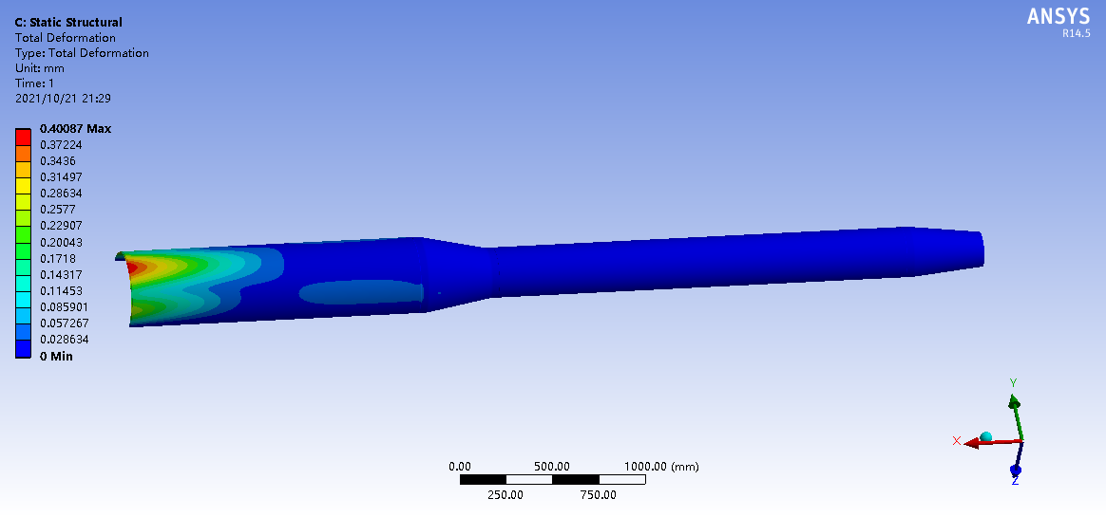
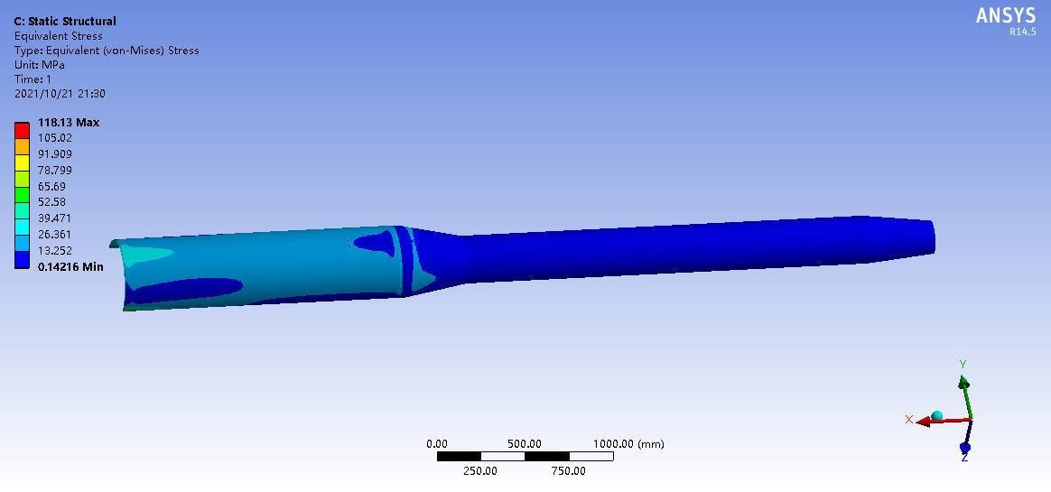
Stress analysis of helium tank
Material:316L，E=1.93E11Pa，Poisson’s ratio: 0.27，$[σ_{allow}]$=120.3MPa
Maximum deformation为0.4mm@P_{IN}3Bar
Maximum stress 118.13MPa@P_{IN}3Bar

Slide 28
Current lead design calculation
2080A current lead design parameters
 | Copper section | HTS section
Rated current | 2080A
Cooling mode | 4.5K helium | Conduction cooling
Temperature zone | 300K-60K | 60K-4.5K
Structure | Copper exchanger | HTS+stainless steel
Heat load | <120W @2080A | <1W
Flow rate | 0.14g/s | -
Isolation voltage | 1000V
1000A current lead design parameters
 | Copper section | HTS section
Rated current | 1000A
Cooling mode | 4.5K helium | Conduction cooling
Temperature zone | 300K-60K | 60K-4.5K
Structure | Copper exchanger | HTS+stainless steel
Heat load | <60W @1000A | <0.5W
Flow rate | 0.07g/s | -
Isolation voltage | 1000V
2300A current lead design parameters
 | Copper section | HTS section
Rated current | 2300A
Cooling mode | 4.5K helium | Conduction cooling
Temperature zone | 300K-60K | 60K-4.5K
Structure | Copper exchanger | HTS+stainless steel
Heat load | <135W @2300A | <1W
Flow rate | 0.16g/s | -
Isolation voltage | 1000V
Include 1 QD0 coil、1 QF1 coil、1 Anti-Solenoids coil and 4 correcting coils，need two connectors each coil
Use binary air cooled conduction current lead
Cold source---40K~60K helium gas/ liquid nitrogen and 4.5K liquid helium

Slide 29
Summary and plan
Summary
The preliminary design of cryogenic system of IR SC quadrupole magnet is completed. The high flow forced flow cooling scheme is adopted---- Super-cooled helium circulation system
The preliminary structure design of the cryostat is completed, and the structural strength check and the temperature field analysis under different working conditions are carried out
The preliminary calculation of current lead is completed， binary air cooled conduction current lead scheme is adopted
Plan
Discuss the finally support structure between cryostat and detector
Discuss the finally value of heat load released to cryogenic system when magnet quench----400KJ/2s, magnet system, power system and quench protection system
Alignment requirement
Prototype R&D---- It is necessary

Slide 30
Thanks for your attentions !

