Slide 1
Update of SRF System Design
Jiyuan Zhai
CEPC Day, IHEP, January 29, 2022

Slide 2
Outline
SRF system TDR layout and parameters update
SRF system upgrade
SRF key issues
  RF feedback for FM CBI (Collider Z mode, beam feedback requirement)
  Transient beam loading (Collider Z train, H/tt gap & on-axis asymmetry; Booster H/tt half fill, Z train)
  HOM CBI damping (Collider and Booster, beam feedback requirement)
  HOM power handling (Collider and Booster W/Z current limit and cavity type)
  Booster ramp MP and LFD, duty factors (beam, RF, cryogenics, HOM)

Slide 3
Dou Wang (IHEP)
CEPC Collider TDR Parameters
 | ttbar | Higgs | W | Z
Number of IPs | 2
Circumference [km] | 100.0
SR power per beam [MW] | 30
Half crossing angle at IP [mrad] | 16.5
Bending radius [km] | 10.7
Energy [GeV] | 180 | 120 | 80 | 45.5
Energy loss per turn [GeV] | 9.1 | 1.8 | 0.357 | 0.037
Piwinski angle | 1.21 | 5.94 | 6.08 | 24.68
Bunch number | 35 | 249 | 1297 | 11951
Bunch spacing [ns] | 4524 | 636 | 257 | 23 (10% gap)
Bunch population [10¹⁰] | 20 | 14 | 13.5 | 14
Beam current [mA] | 3.3 | 16.7 | 84.1 | 803.5
Momentum compaction [10⁻⁵] | 0.71 | 0.71 | 1.43 | 1.43
Beta functions at IP (βx/βy) [m/mm] | 1.04/2.7 | 0.33/1 | 0.21/1 | 0.13/0.9
Emittance (εx/εy) [nm/pm] | 1.4/4.7 | 0.64/1.3 | 0.87/1.7 | 0.27/1.4
Beam size at IP (σx/σy) [um/nm] | 39/113 | 15/36 | 13/42 | 6/35
Bunch length (SR/total) [mm] | 2.2/2.9 | 2.3/3.9 | 2.5/4.9 | 2.5/8.7
Energy spread (SR/total) [%] | 0.15/0.20 | 0.10/0.17 | 0.07/0.14 | 0.04/0.13
Energy acceptance (DA/RF) [%] | 2.3/2.6 | 1.7/2.2 | 1.2/2.5 | 1.3/1.7
Beam-beam parameters (ξx/ξy) | 0.071/0.1 | 0.015/0.11 | 0.012/0.113 | 0.004/0.127
RF voltage [GV] | 10 | 2.2 | 0.7 | 0.12
RF frequency [MHz] | 650 | 650 | 650 | 650
Longitudinal tune νs | 0.078 | 0.049 | 0.062 | 0.035
Beam lifetime (bhabha/beamstrahlung)[min] | 81/23 | 39/40 | 60/700 | 80/18000
Beam lifetime [min] | 18 | 20 | 55 | 80
Hour glass Factor | 0.89 | 0.9 | 0.9 | 0.97
Luminosity per IP[10³⁴/cm²/s] | 0.5 | 5.0 | 16 | 115

Slide 4
CEPC Booster TDR Parameters
Dou Wang (IHEP)
Injection energy: 10 GeV → 20 GeV
Max energy: 120 GeV → 180 GeV
Lower emittance ─ new lattice (TME)
Extraction
Injection
*Diameter of beam pipe is 55mm for re-injection with high single bunch current @120GeV.

Slide 5
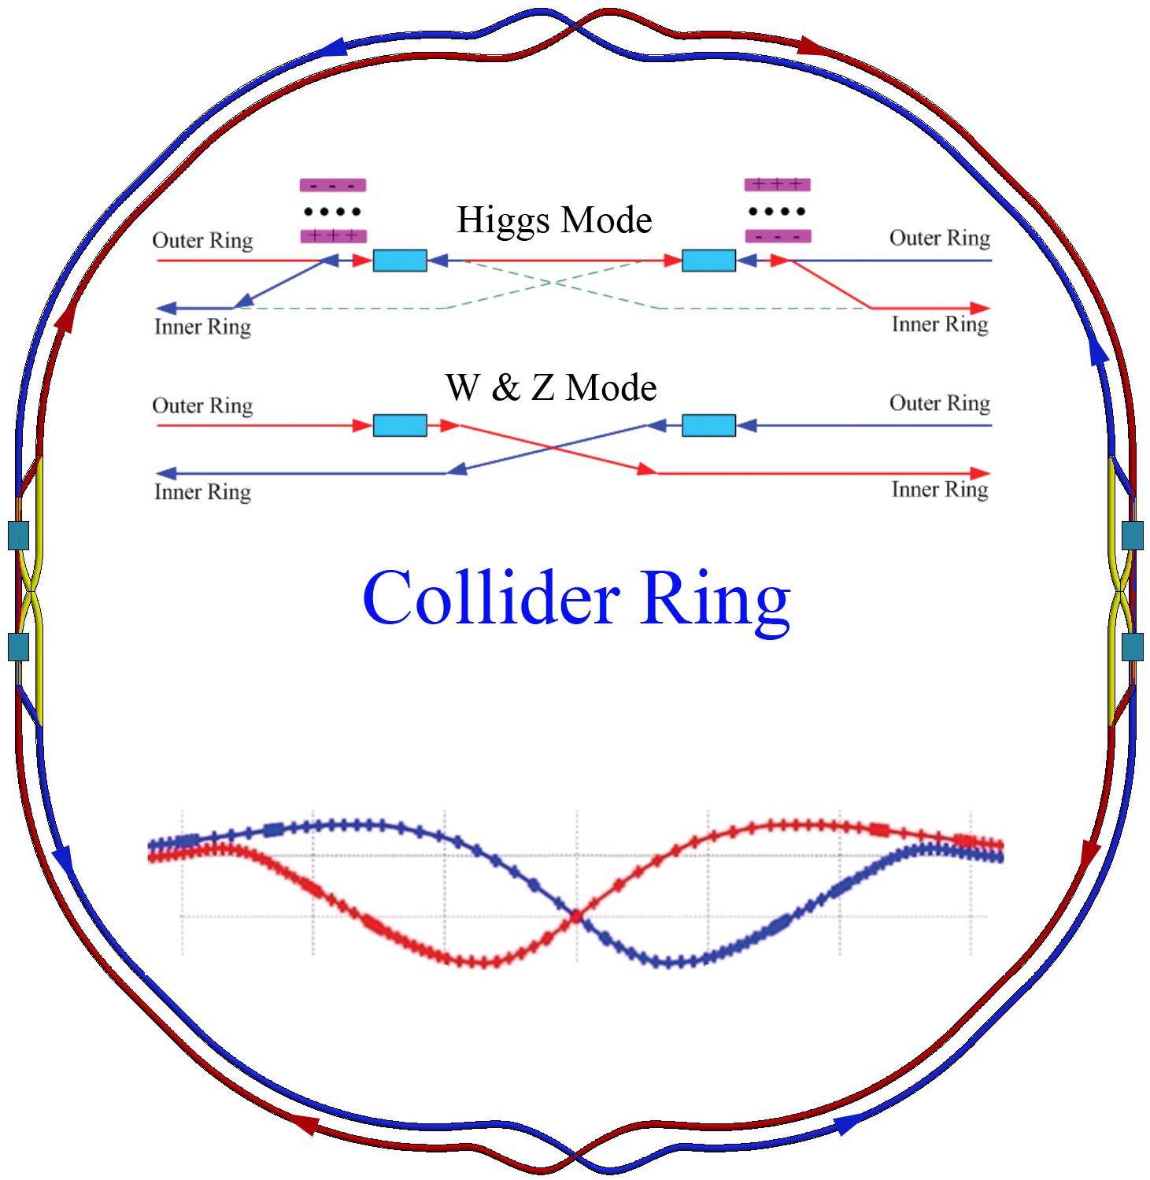
CEPC TDR RF Layout
CDR
CEPC IARC suggests RF cavity by-passes in both Collider ring and Booster ring for TDR parameters.
200 m
half H: 160 m
Z: 80 m
t: 240 m

Slide 6
CEPC TDR RF Parameters (Collider Ring)
Version. 2022.01.12. Machine parameters: 2021.11 30 MW SR power per beam for each mode. ttbar and Higgs half fill with common cavities for two rings, W and Z with separate cavities for two rings, Z use high current 1-cell cavity with RF bypass | ttbar |  | Higgs | W | Z
 | Additional 5-cell cavities | Existing 2-cell cavities
Luminosity / IP [10³⁴ cm⁻²s⁻¹] | 0.5 |  | 5 | 16 | 115
RF voltage [GV] | 10 (7.8 + 2.2) |  | 2.2 | 0.7 | 0.12
Beam current / beam [mA] | 3.4 |  | 16.4 | 84 | 803
Bunch charge [nC] | 32 |  | 22 | 21.6 | 22.4
Bunch length [mm] | 2.9 |  | 3.9 | 4.9 | 8.7
650 MHz cavity number | 240 | 240 | 240 | 120/ring | 30/ring
Cell number / cavity | 5 | 2 | 2 | 2 | 1
Gradient [MV/m] | 28.5 | 20 | 20 | 12.7 | 8.7
Q₀ @ 2 K at operating gradient (long term) | 5E10 | 2E10
HOM power / cavity [kW] | 0.4 | 0.16 | 0.45 | 0.93 | 2.9
Input power / cavity [kW] | 194 | 56 | 250 | 250 | 1000
Optimal Q_{L} | 1E7 | 7E6 | 1.6E6 | 6.4E5 | 7.5E4
Optimal detuning [kHz] | 0.01 | 0.02 | 0.1 | 0.9 | 13.3
Cavity number / klystron | 4 | 12 | 2 | 2 | 1
Klystron power [kW] | 1400 | 1400 | 800 | 800 | 1400
Klystron number | 60 | 20 | 120 | 60 | 60
Cavity number / cryomodule | 4 | 6 |  |  | 1
Cryomodule number | 60 | 40 |  |  | 30
Total cavity wall loss @ 2 K [kW] | 9.5 | 4.7 |  | 1.9 | 0.45
Z lower lumi in Stage 1.
If start from Stage 2: W~1/2 Lumi, Z~1/10 Lumi.

Slide 7
CEPC TDR RF Parameters (Booster Ring)
Version. 2022.01.12. Machine parameters: 2021.11 30 MW Collider SR power per beam for each mode. 20 GeV injection. | ttbar | Higgs off/on-axis | W | Z high current
Extraction beam energy [GeV] | 180 | 120 | 80 | 45.5
Extraction average SR power [MW] | 0.087 | 0.09 | 0.01 | 0.004
Bunch charge [nC] | 0.96 | 0.7 | 0.73 | 0.83
Beam current [mA] | 0.11 | 0.5/1 | 2.7 | 14.3
Injection RF voltage [GV] | 0.438 | 0.197 | 0.122 | 0.122
Extraction RF voltage [GV] | 9.3 | 2.05 | 0.59 | 0.28
Extraction bunch length [mm] | 1.9 | 1.9 | 1.6 | 0.9
Cavity number (1.3 GHz 9-cell) | 336 | 96 | 64 | 16
Extraction gradient [MV/m] | 26.7 | 20.6 | 8.9 | 17.1
Q₀ @ 2 K at operating gradient (long term) | 1E10
Q_{L} | 4E7 | 1E7
Cavity bandwidth [Hz] | 33 | 130
Peak HOM power per cavity [W] | 0.4 | 1.2/2.3 | 7.8 | 105
Input peak power per cavity [kW] | 7.5 | 16/21.4 | 15 | 31
SSA peak power [kW] (one cavity per SSA) | 10 | 25 | 25 | 40
Cryomodule number (8 cavities per module) | 42 | 12 | 8 | 2
Higgs and ttbar half fill for injection timing with Collider ring. Transient beam loading tolerable.
Transient beam loading of the booster for Higgs on-axis injection tolerable.
Standard quasi-CW TESLA cryomodules for Higgs, W and ttbar.
Two high current 8x9-cell cryomodules for Z with RF bypass, as well as more SSAs (or RF power transfer and combine from Higgs SSAs?) even for 50 MW upgrade. Not the limit for booster Z beam current ramp up.
High gradient high Q 9-cell cavities for ttbar. Narrow bandwidth high gradient cavity voltage ramping through the multipacting region to be studied.
SR, RF power, HOM power, cryogenic duty factors to be calculated with the real time structures.

Slide 8
SRF System Upgrade
Assumed upgrade sequence and run time, klystron lifetime 10 years:
H/W 30/50 MW, Z 10 MW (7+1+2 yrs?)
Collider: 240 2-cell, 250/417 kW input / 1kW HOM per CAV, 120 1 MW KLY (2 CAVs/KLY)
Booster: 96 9-cell, 25 kW SSA (50 MW: more injections other than increasing SSA power)
Z 30/50 MW (3 yrs?)
Collider: bypass +60/100 high current and deep damping 1-cell, 1 MW input / 5 kW HOM per CAV, 60/100 new 1.4 MW KLY. Beam feedback not needed for cavity HOM CBI.
Booster: bypass +32 high current 1.3 GHz cavities (4 modules), 32 40/60 kW SSA
ttbar 30/50 MW (5 yrs?)
Collider: +240 high Q high gradient 5-cell, 200/330 kW input per CAV, 80 1.4 MW KLY power transfer from Z (300 m?), 4 5-cell CAVs / KLY, 14 2-cell CAVs / KLY.
Booster: 336 (+240) 9-cell, +240 10 kW SSA
H/W at ttbar stage?

Slide 9
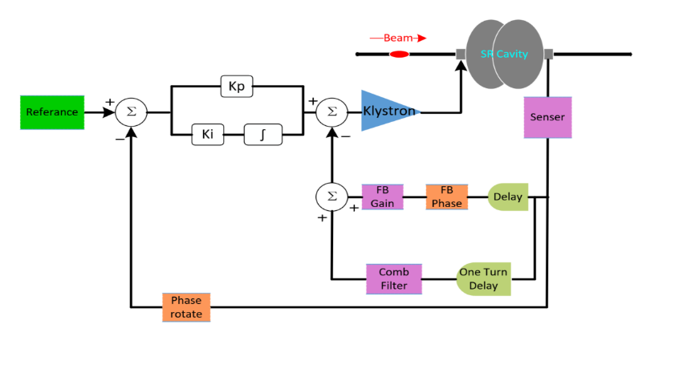
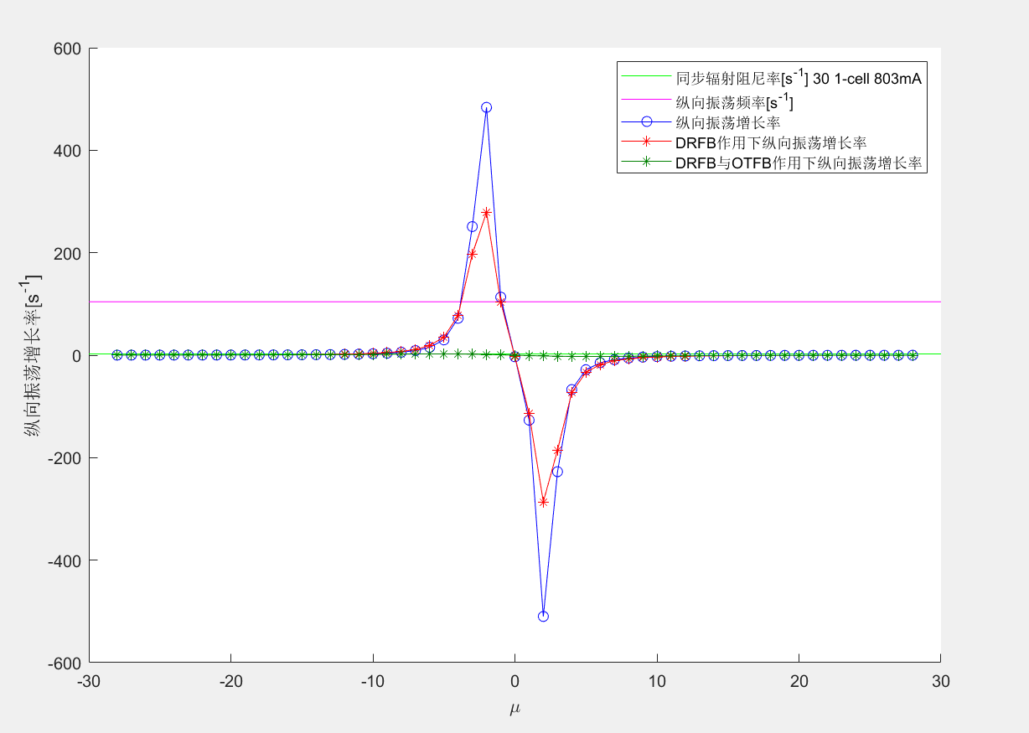
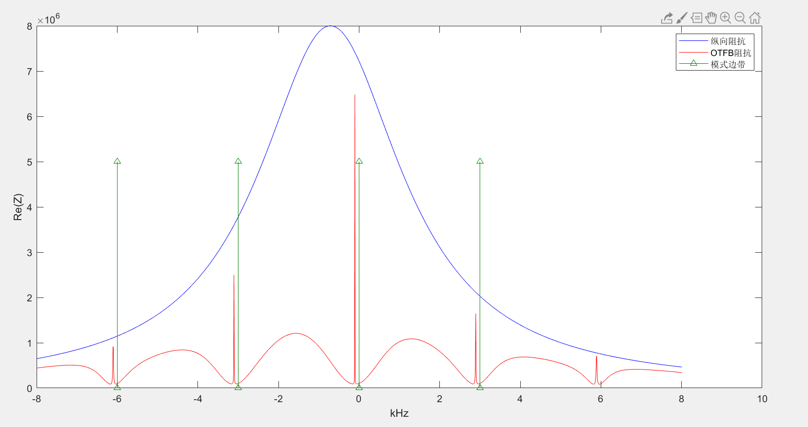
RF Feedback for Cavity FM CBI of HL-Z
Direct RF Feedback and One Turn Delay Feedback.
Stable for 30 MW and 50 MW Z.
Check feedback stability and optimize.
6.7 kHz detuning
OTFB G =100
DRFB Kp = 1.2
106 Hz (9.5 ms)
2.4 Hz (410 ms)
Mode by mode feedback for a few remained unstable modes.
Trade-off between beam (bunch by bunch) feedback and RF feedback.
Longitudinal bunch-by-bunch feedback time ~ 40 ms ?
Impedance reduction by the comb filter

Slide 10
CEPC SRF TDR and Upgrade Hardware Specifications
Suitable for 30/50 MW SR per beam | H, W, Z high gradient & high Q | HL-Z high current & power | ttbar very high gradient & high Q
Collider 650 MHz Cavity at 2 K | 2-cell VT 4E10 @ 22 MV/m HT 2E10 @ 20 MV/m OP 1.5E10 @ 20 MV/m | 1-cell 1E10 @ 8.7 MV/m | 5-cell VT 6E10 @ 32 MV/m HT 5E10 @ 32 MV/m OP 5E10 @ 28.3 MV/m
Booster 1.3 GHz 9-cell Cavity at 2 K | VT 3E10 @ 24 MV/m HT 3E10 @ 22 MV/m OP 1E10 @ 20 MV/m | 1E10@17 MV/m | VT 3E10 @ 32 MV/m HT 2E10 @ 32 MV/m OP 1E10 @ 26.7 MV/m
650 MHz Input Coupler variable | 300/500 kW variable | 1000 kW | 300 kW variable
650 MHz HOM Coupler | 1 kW | \ | 1 kW
650 MHz HOM Absorber | 5 kW | 10 kW | \

