Slide 1
The competition between chiral density wave and two-flavor LOFF phase of color superconductivity in the NJL model
Chengfu Mu, Huzhou University
Collaborated with M. Hosein Gholami, Technische Universitat Darmstadt
Prof. Michael Buballa, Technische Universitat Darmstadt

Slide 2
Outline
Motivation
The NJL model with diquarks
The T − μ phase diagram
The μ − δμ phase diagram
Summary and Outlook

Slide 3
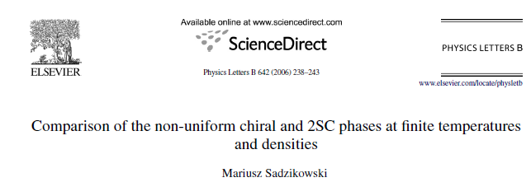
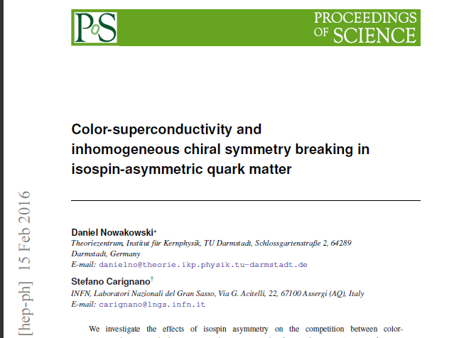
Our work is based on:

Slide 4
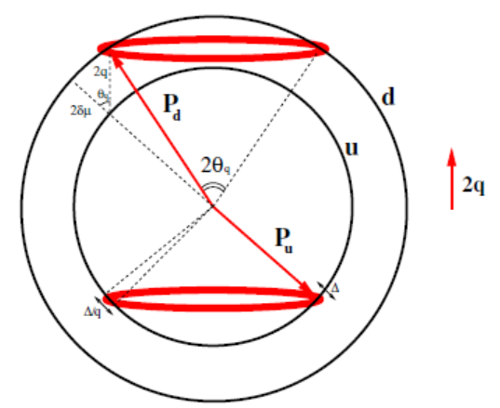
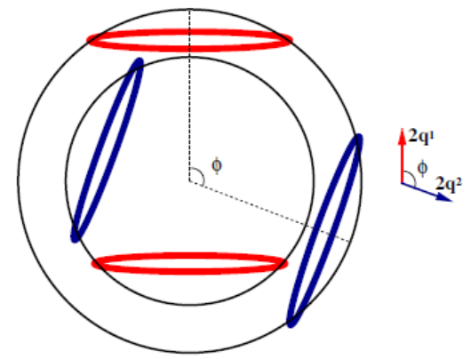
Motivation: two kinds of inhomogeneous phases
Mismatced Fermi surfaces
Pictorial description of the LOFF pairing,
Which carries the nonzero total momentum

Slide 5
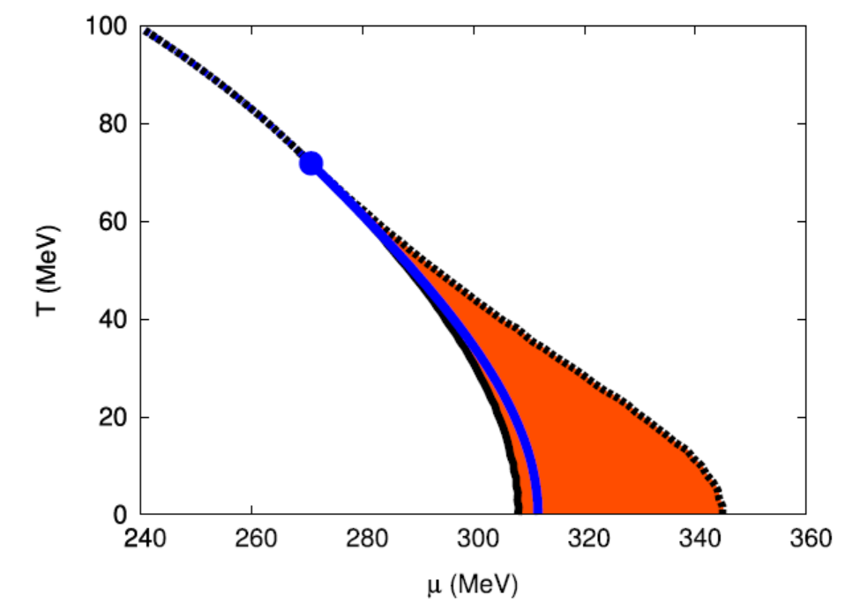
Phase diagram for the NJL model, allowing for chiral density wave (CDW)-type modulations

Slide 6
The NJL Lagrangian
Under the mean field approximation

Slide 7
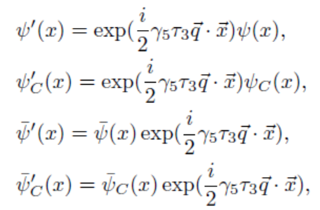
Making the chiral field transformation
q is the wave vector related with CDW
q’ is the total momentum of LOFF pair

Slide 8
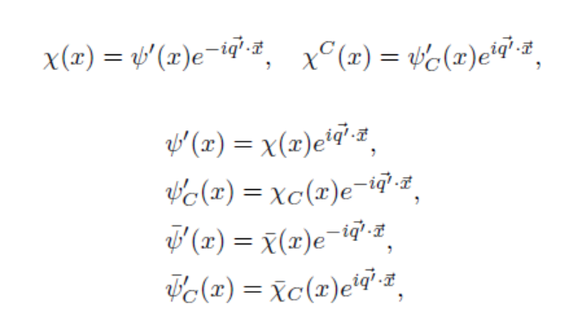
introduce the auxiliary quark fields
The partition function can be obtained by integrating over the fermionic fields

Slide 9
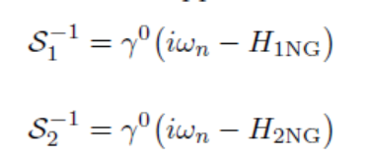

Slide 10
subtract the unphysical divergence term proportional to Λ²q²
M. Sadzikowski, Physics Letters B 642, 238-243 (2006)

Slide 11
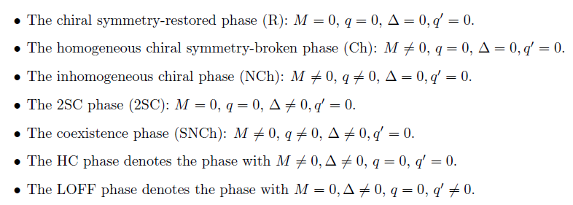
For LOFF part, we apply He’s subtraction scheme
Kenji Fukushima, and Kei Iida, Larkin-Ovchinnikov-Fulde-Ferrell state in two-color quark matter, Phys. Rev. D 76, 054004 (2007).
Lianyi He, Meng Jin, and Pengfei Zhuang, Phys. Rev. D 74, 036005 (2006).

Slide 12
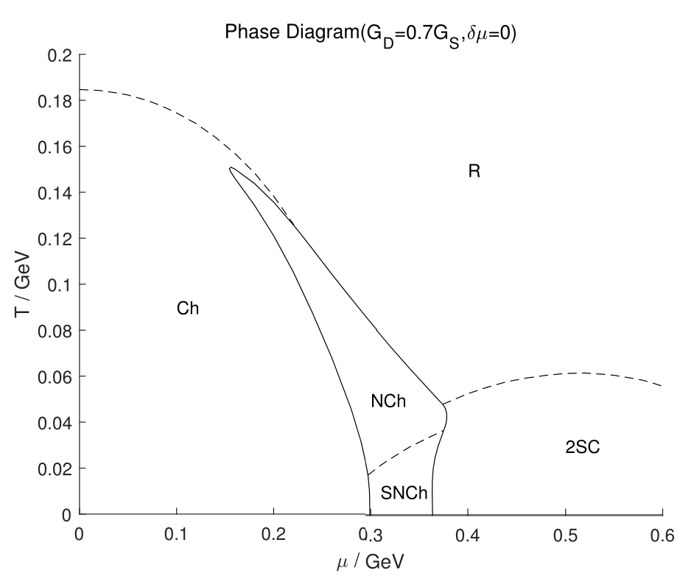
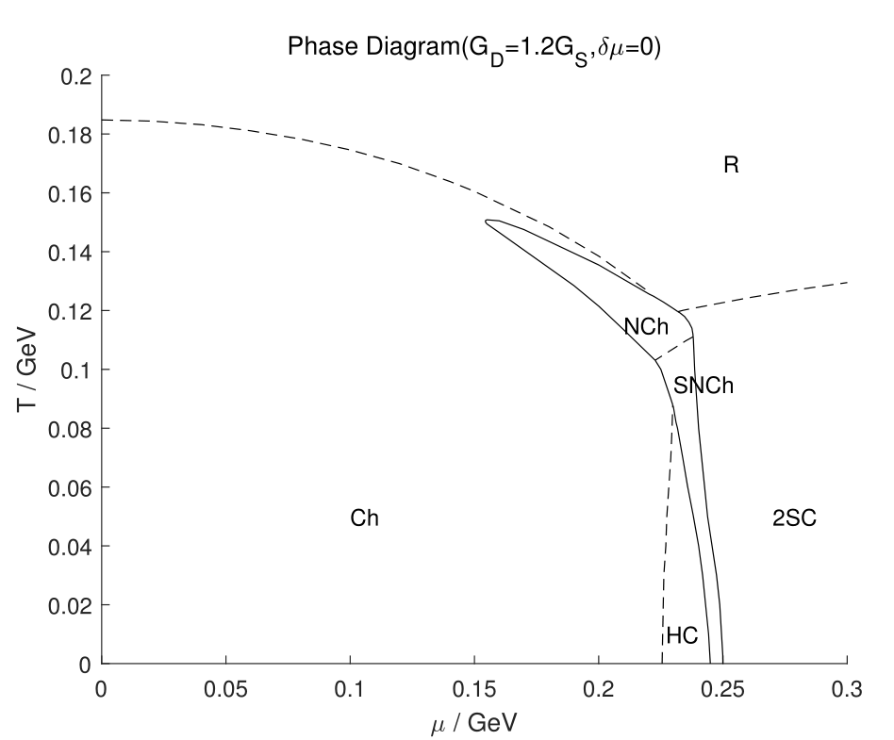
The T − μ phase diagram
The T − μ phase diagrams for GD = 0.7GS and GD = 1.2GS at δμ = 0
The solid lines denote the first order phase transitions and the dashed lines denote the second order phase transitions.

Slide 13
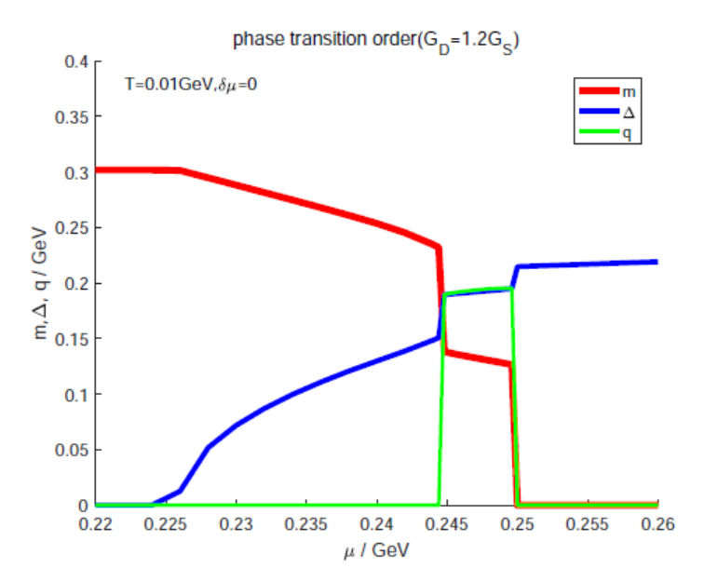
The order parameters as function of μ for G_{D} = 1.2GS at δμ = 0 and q′= 0.

Slide 14
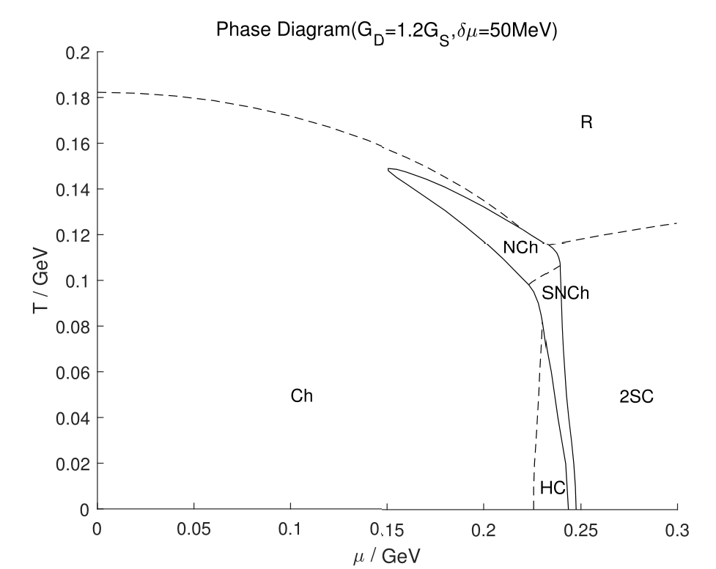
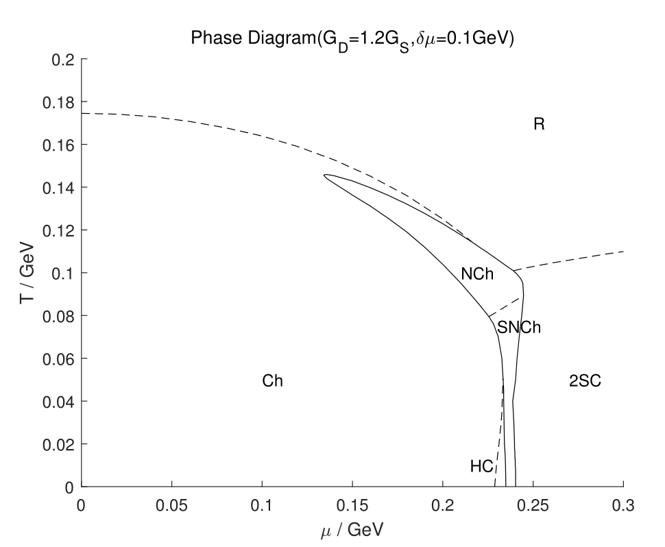
The T − μ phase diagram for G_{D} = 1.2G_{S} at δμ = 0.05GeV and δμ = 0.1GeV. HC region becomes narrower with increasing δμ.

Slide 15
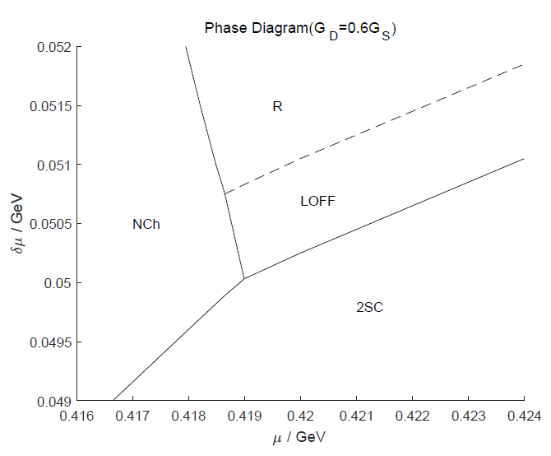
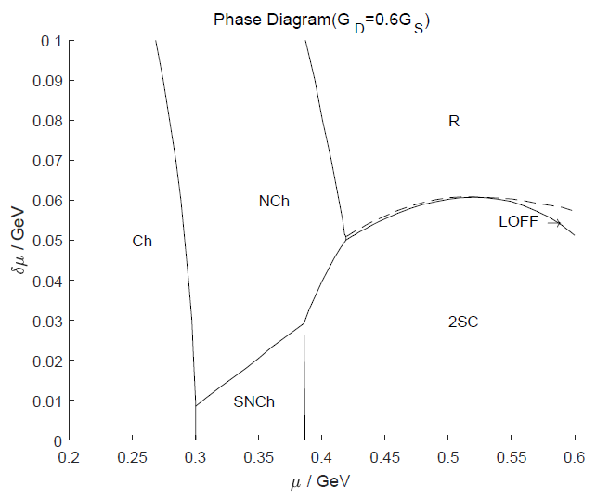
The μ − δμ phase diagram
The G_{D} = 0.6G_{S}.

Slide 16
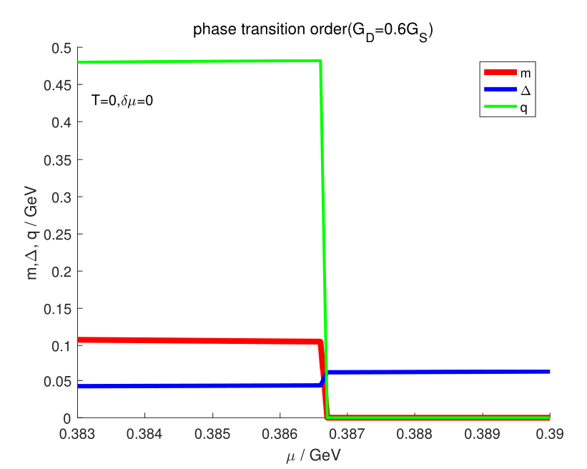
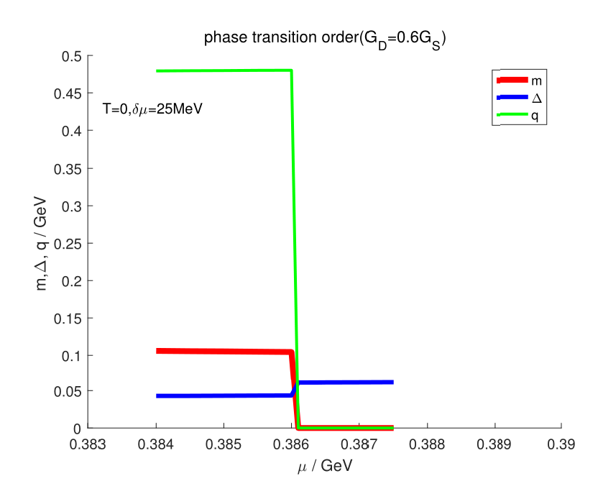
The transition between SNCh and 2SC phase is first order

Slide 17
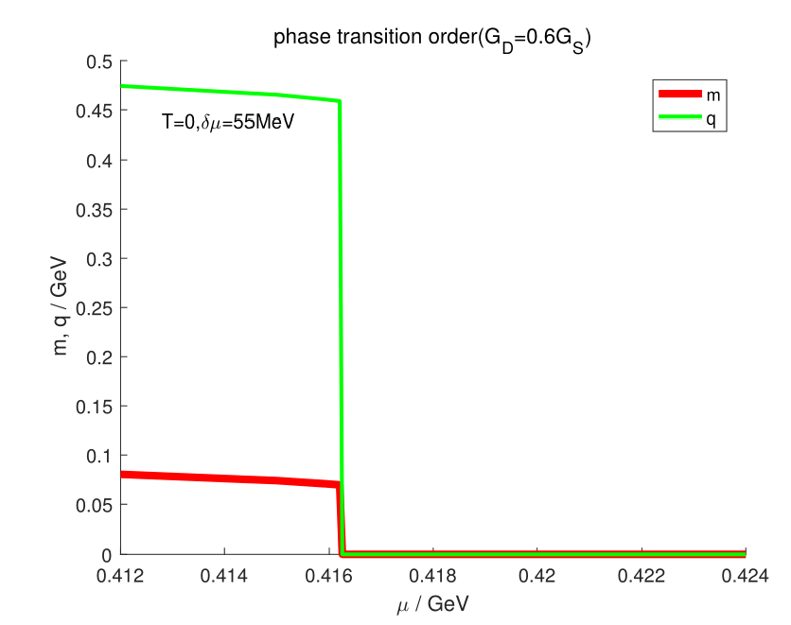
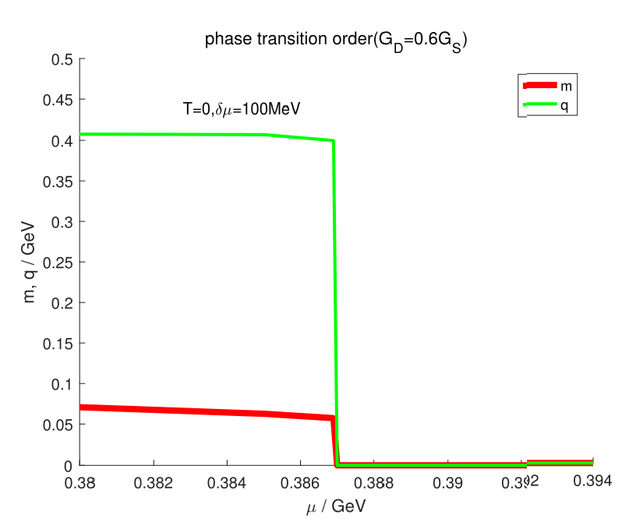
The transition between NCh and R phase is first order

Slide 18
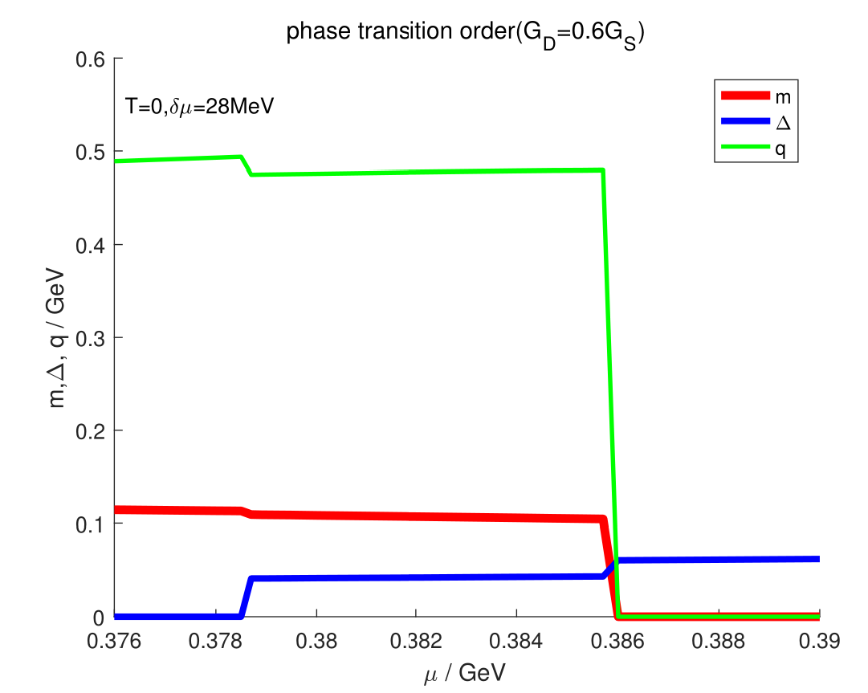
The transition between SNCh and NCh phase is first order
The transition between SNCh and 2SC phase is first order

Slide 19
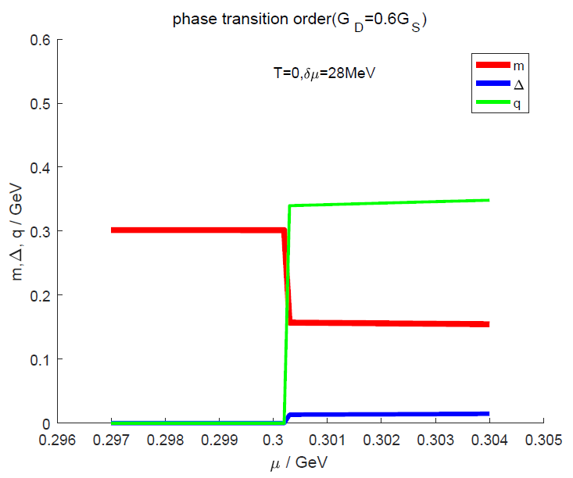
The transition between NCh and Ch phase is first order

Slide 20
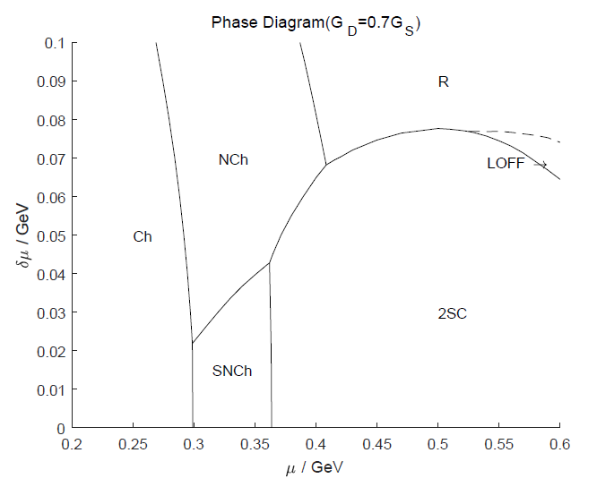
The G_{D} = 0.7G_{S}

Slide 21
summary
We have studied the competition between the CDW and LOFF phases in the framework of two flavor NJL model in chiral limit at finite temperature and density. We find the HC phase with M ̸= 0,Δ ̸= 0, ⃗q = 0, ⃗q′ = 0 will occur between the chiral phase and SNCh phase if G_{D} is large enough.
A first order phase transition connects the chiral density wave and LOFF phase if the ratio of G_{D}/G_{S} is less than 0.68, which is independent of the relative direction of chiral wave vector ⃗q and LOFF pair momentum ⃗q′. There are two tricritical points in which chiral density wave, LOFF, 2SC and restored phase coincide, respectively.
When G_{D}/G_{S} is approximately larger than 0.68, the inhomogeneous chiral condensate is separated with the LOFF by 2SC and restored phase. There is no physical tetracritical point in the μ − δμ phase diagram

Slide 22
Outlook
Other regularization schemes
For example: Pauli-Villars schemes, proper-time scheme, four momentum cutoff
Thank you !

