Slide 1
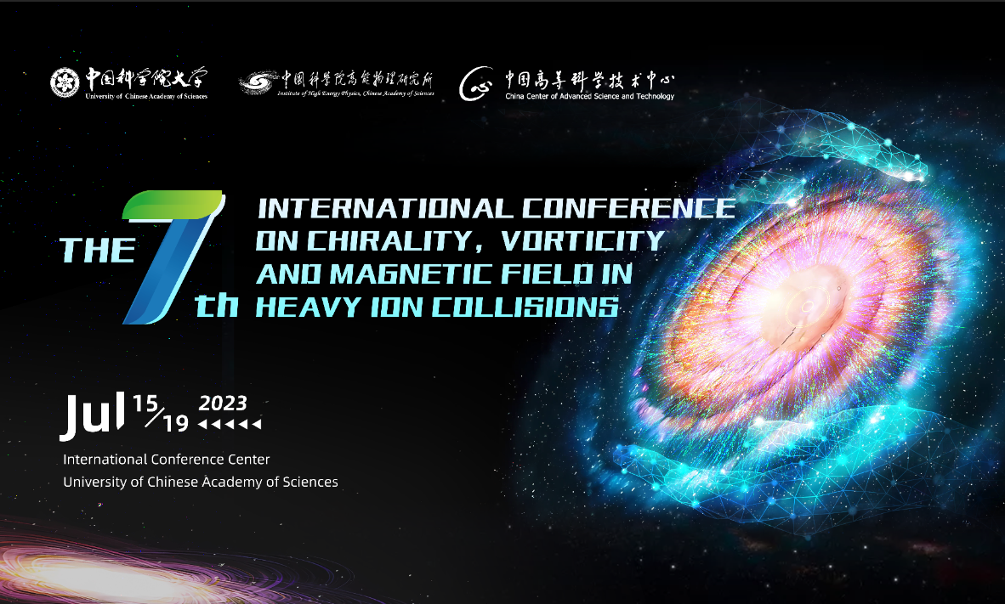
Phenomenological study of anomalous chiral effects in heavy-ion collisions
Guo-Liang Ma
（Fudan University）

Slide 2
Outline
Introduction
Isobar collision simulations
Reexamine two-plane method
Summary and outlook

Slide 3
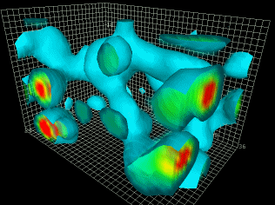
Detect QCD vacuum and symmetry with CME
Looking for QCD vacuum fluctuation
CME induces
dipole electric charge separation
Topological charge: $Q_{w}≠0$
Chiral imbalance： $Q_{w}=N_{L}−N_{R}≠0$
Local P or CP violation in strong interactions

Slide 4
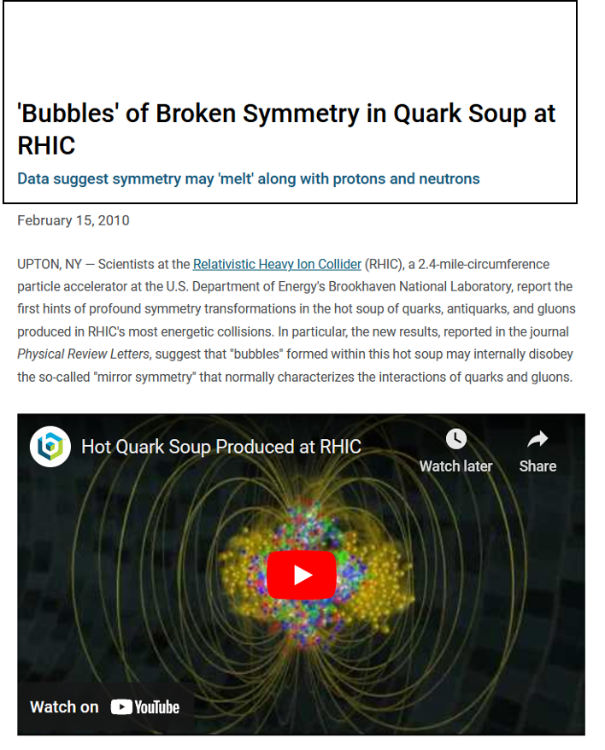
CME experimental observable: charge azimuthal correlation 𝛾
𝛾=
Voloshin 2004
Non-flow/non-parity effects:
largely cancel out
Directed flow: vanishes
if measured in a symmetric rapidity range
P-even quantity:
still sensitive to charge separation
STAR, PRL 103, 251601 (2009)
The first STAR experiment result is consistent with 'Dipole Charge Separation’ as expected by CME.

Slide 5
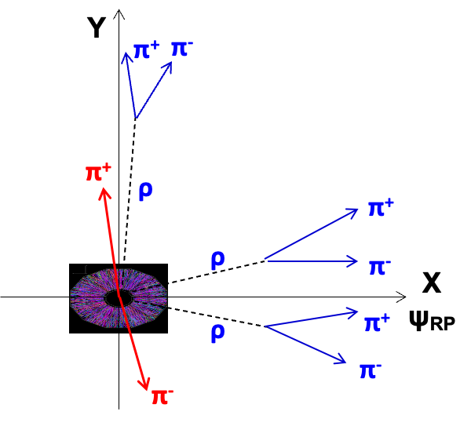
Background vs signal
Fuqiang 2009; Bzdak, Koch, Liao 2010; Pratt, Schlichting 2010; …
Backgrounds: elliptic flow, resonance, LCC etc.
Recent STAR results indicate that the CME fraction inside Δγ is small, and the background is dominant!
What is a good way to reduce the influence of the background to find the signal？

Slide 6
Isobar collisions
WTD, XGH, GLM, GW, Phys. Rev. C 94 (R), 041901 (2016)
400 million simulation events at 2/3 background scale, relative difference between two isobar collisions reaches 5%, and the significance is 5σ.
Blind analysis:
In 2018, STAR collected isobar data (1.8B Ru+Ru && 2.0B Zr+Zr) to check if the CME expectation.
Five teams conducted blind analysis.
CME expectation:

Slide 7
First isobar results from STAR experiment
CME expectation:
The five experimental analysis groups agreed that "The ratios are generally less than 1, and no obvious CME signal is found.”
How to understand these results?

Slide 8
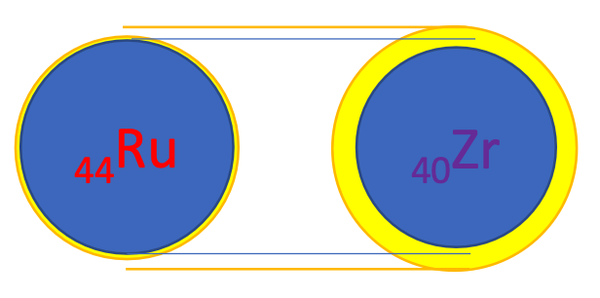
Why different backgrounds between isobar collisions
STAR, Phys.Rev.C 105 (2022) 1, 014901
Differences in multiplicity distribution, <Nch> and v2 between two isobar systems.
Related to nuclear deformation/structure.
Haojie Xu et al. PRL 121 (2018) 022301
Hanlin Li et al. PRC 98 (2018) 054907

Slide 9
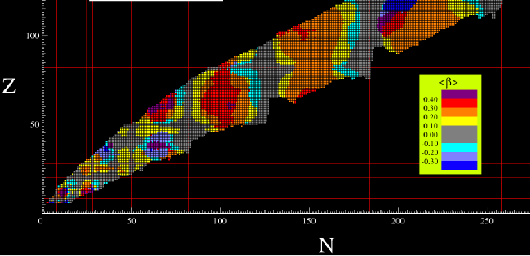
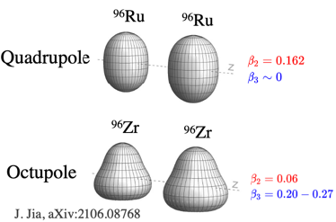
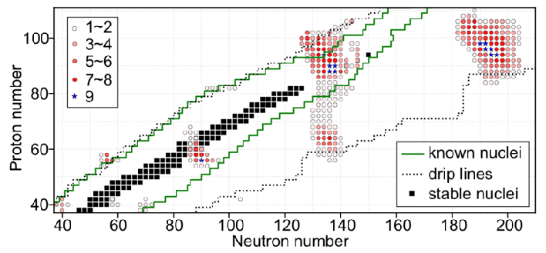
Nuclear structure in relativistic heavy-ion collisions
β2-landscape
1.1
1.0
β3-landscape
0.9
STAR, Phys.Rev.C 105 (2022) 1, 014901
H. Li et al., Phys.Rev.C 98 (2018) 5, 054907
H. J. Xu, Phys.Lett.B 819 (2021) 136453
J. Jia, Phys.Rev.C 105 (2022) 4, 044905
J. Jia, Phys.Rev.C 105, 014905 (2022)
C. Zhang and J. Jia, Phys.Rev.Lett. 128 (2022), 022301
G. Giacalone et al., Phys.Rev.Lett. 127 (2021), 242301
J. Jia and C. Zhang, Phys.Rev.C 107 (2023) 2, L021901
The ratios of observables between systems are sensitive to nuclear deformation/structure
When God closes a door, he opens a window

Slide 10
Can CME survive from final state interactions?
dipole
final state
interaction
effects
STAR, PRL 103, 251601 (2009)
DE Kharzeev
Can the initial CME survive final-state interactions (FSI) in relativistic heavy-ion collisions?
How to simulate the evolution of CME?

Slide 11
Hydrodynamics and transport model
Hydrodynamics:
Transport model:
N

Slide 12
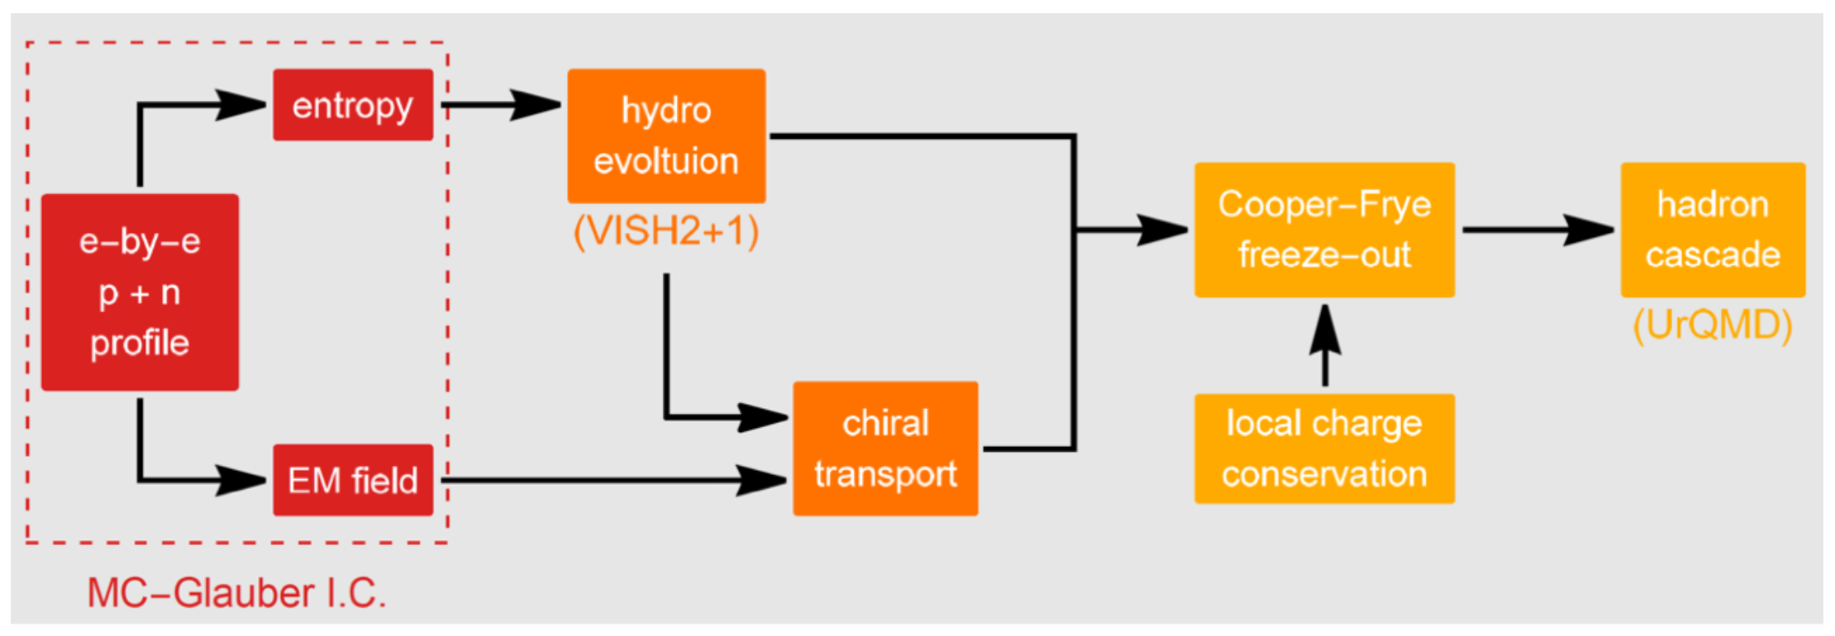
EBE-AVFD: event-by-event anomalous- viscous fluid dynamics
Shuzhe Shi, Hui Zhang, Defu Hou, Jinfeng Liao, Phys. Rev. Lett. 125, 242301 (2020)
Implications of the isobar-run results from EBE-AVFD:
（6.8+/-2.6）%
Dmitri E. Kharzeev, Jinfeng Liao, Shuzhe Shi, Phys.Rev.C 106 (2022) 5, L051903

Slide 13
Relativistic QKT, Gao & Liang, PRD 100, 056021 (2019)

Slide 14
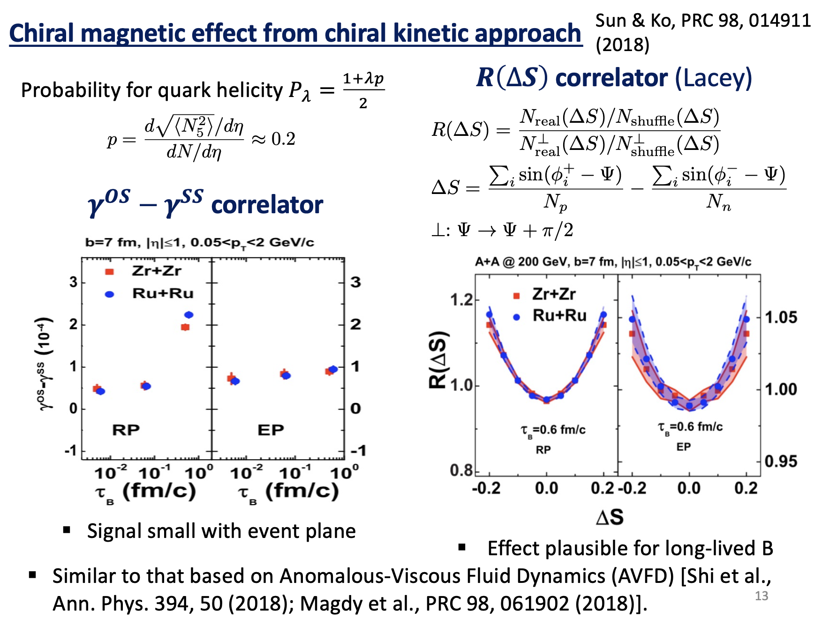

Slide 15
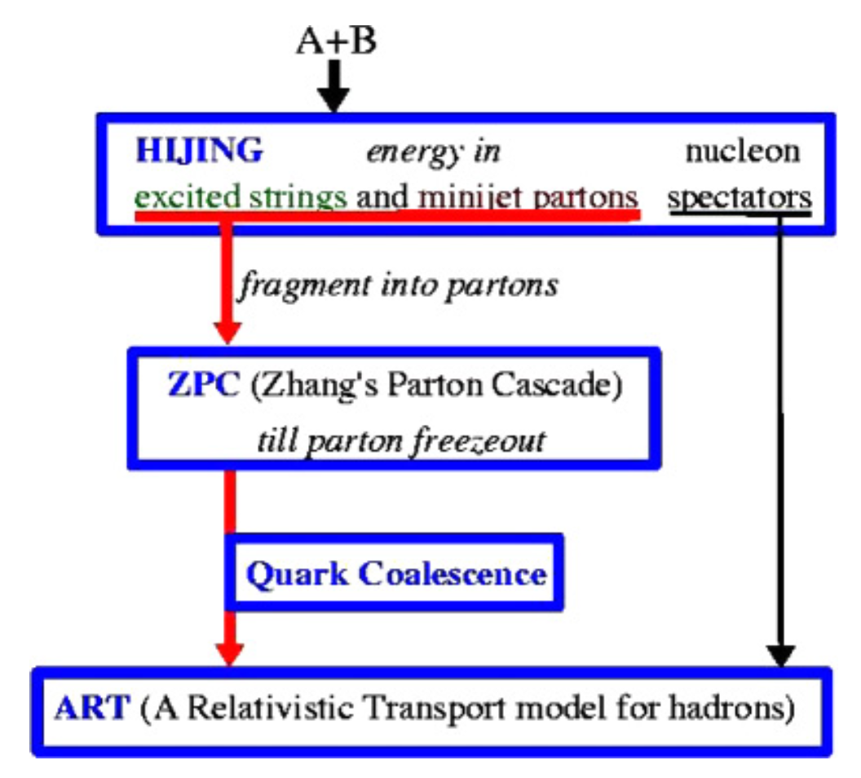
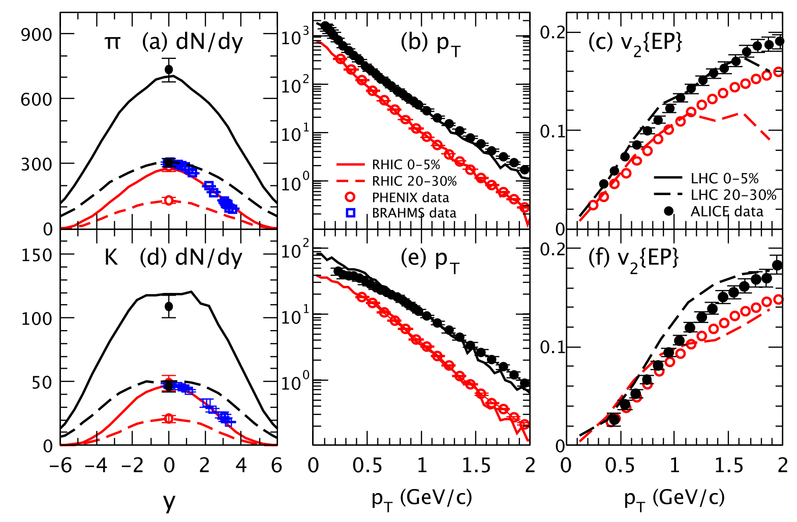
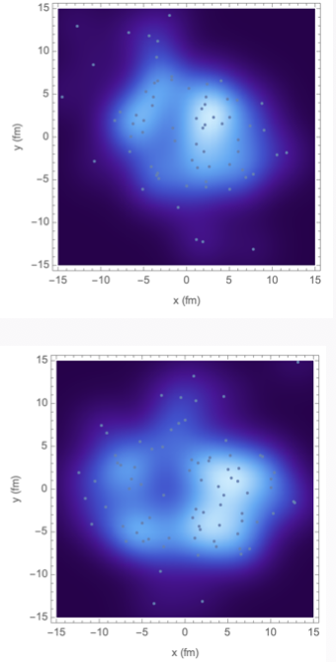
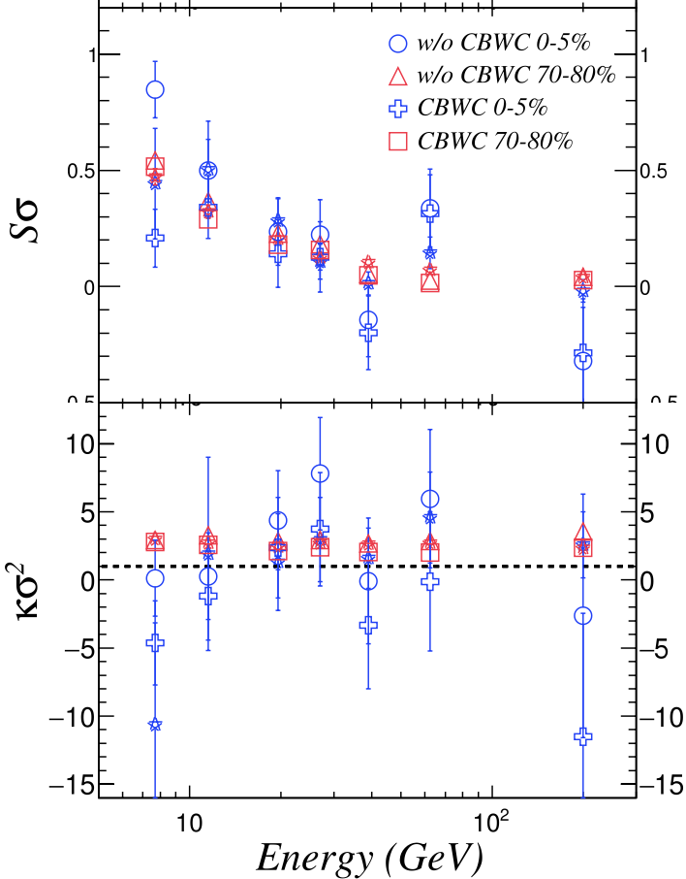
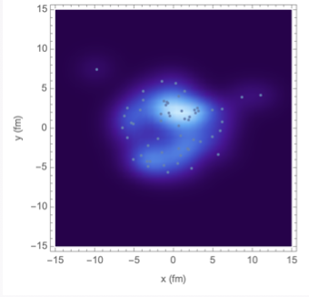
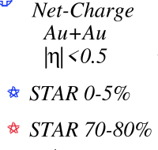
A multi-phase transport (AMPT) model
Zi-Wei Lin, Phys.Rev.C 90 (2014), 014904
Zi-Wei Lin, Che Ming Ko, Bao-An Li, Bin Zhang, Subrata Pal, Phys.Rev.C 72, 064901 (2005)
Final hadronic state
version with charge conservation
The AMPT model can well describe the rapidity and pT distributions and collective flow.
It can well describe net-charge fluctuations after fixing charge conservation problem.
Initial hadronic state
Zi-Wei Lin &&
Guo-Liang Ma
version without charge conservation
Ling Huang, Guo-Liang Ma，Chin.Phys.C 45 (2021) 074110

Slide 16
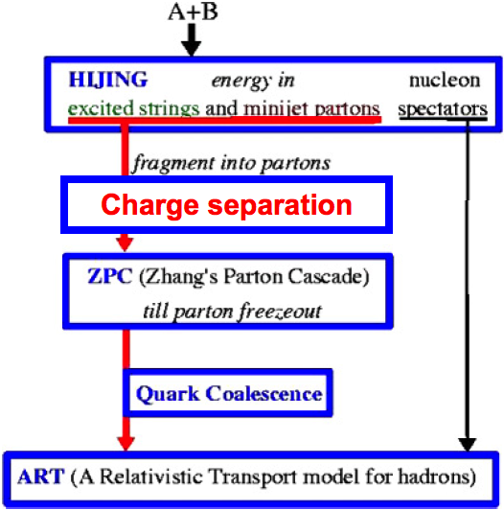
AMPT model with CME-type charge separation
(1) Introduction
Z. W. Lin, C. M. Ko et al. PRC 72, 064901 (2005)
dipole
dipole charge separation
u
u
u
u
CME percentage:
f%=(N⁺upward-N⁺downward)/(N⁺upward+N⁺downward)
Introduce initial dipole charge separation (CME):
We switch the momentum of f% of the downward moving u quarks with those of the upward moving u-bar quarks, and likewise for d-bar and d quarks.
Study the FSI effect on charge separation:
Including parton cascades, hadronization, and resonance decays, assuming that the electromagnetic field vanishes rapidly.

Slide 17
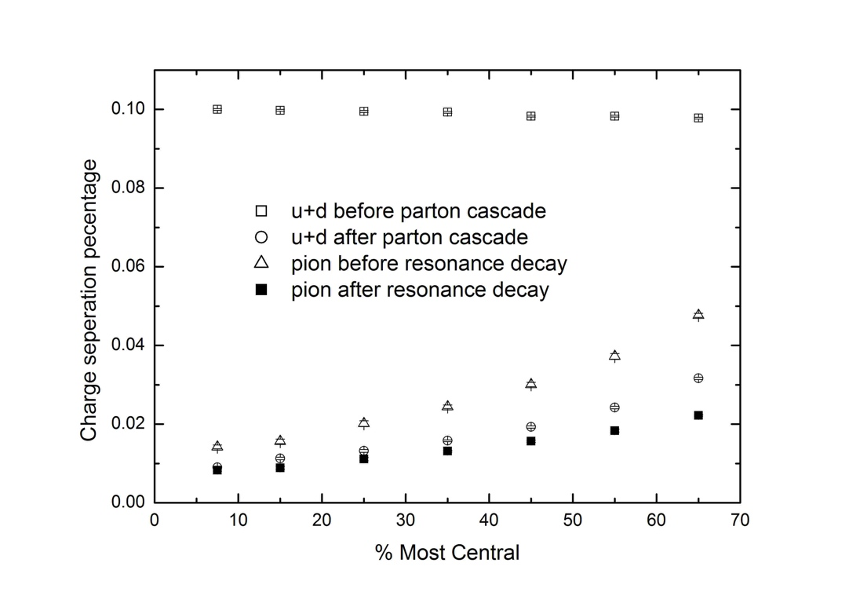
AMPT results on the observable 𝛾
GLM && B. Zhang, Phys. Lett. B 700 (2011) 39
◻︎u+d in initial state
△pion after hadronization
○u+d after parton cascade
◼︎pion after resonance decay
𝛾 = background + CME signal
An initial charge separation ~10% is needed to describe Au+Au data
Nonlinear sensitivity: 𝛾 can not respond to a CME strength of f<=5%
FSI effect : Only a small faction of CME can survive

Slide 18
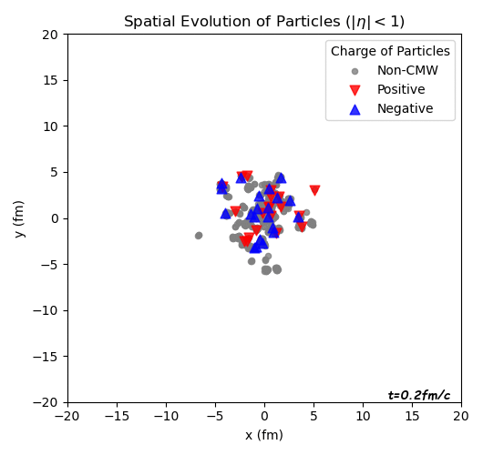
Parton cascade effect on the CME signal
Au+Au 200 GeV (b=8fm), AMPT+CME(10%)
0 mb
3 mb
Non-CME
Non-CME
Negative (CME)
Negative (CME)
(CME)
Positive (CME)
Positive (CME)
J

Slide 19
Simulating isobar collisions using AMPT
(1) Introduction
Initialization of isobar
dipole charge separation

Slide 20
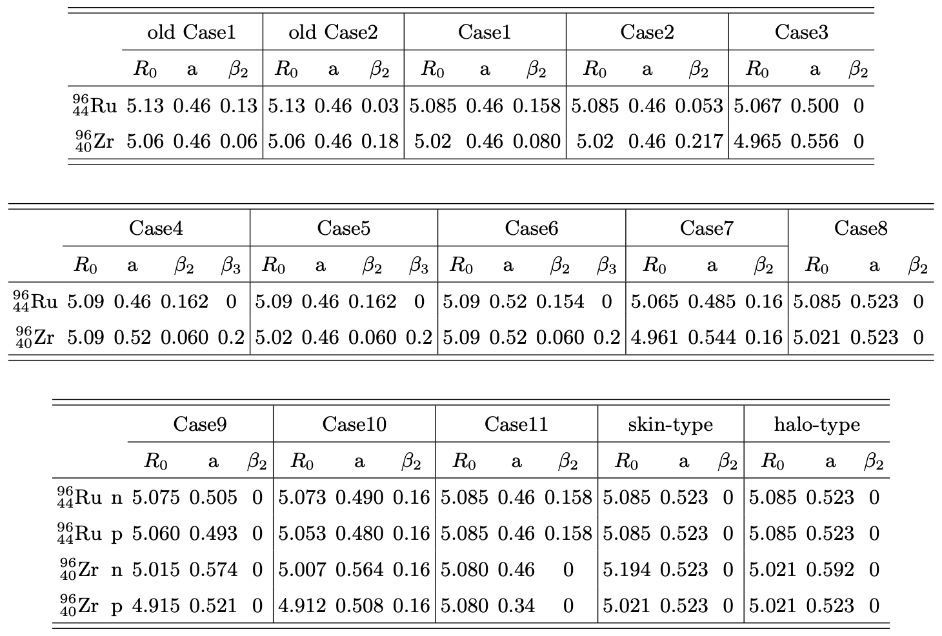
Initialization of isobar nuclei with geometry
Woods-Saxon form of spatial distribution of nucleons:
dipole charge separation
Which is better or worse?
Three ratios are our judging criteria：
Mult. dist. ratio
<Nch> ratio vs centrality
v2 ratio vs centrality
1 M events for each case are used to test if it can pass the criterion test.

Slide 21
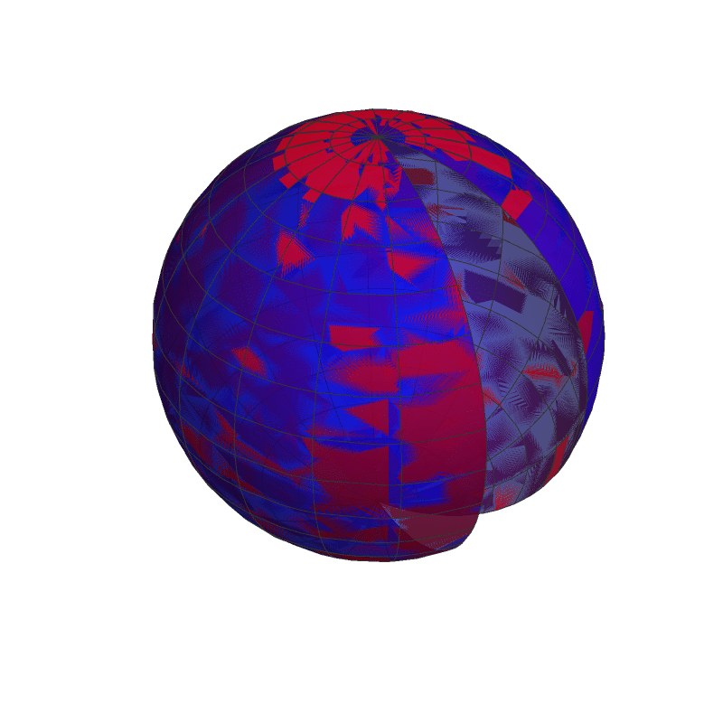
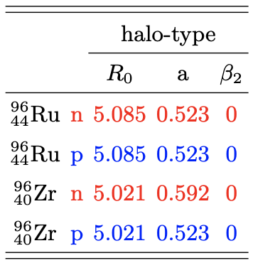
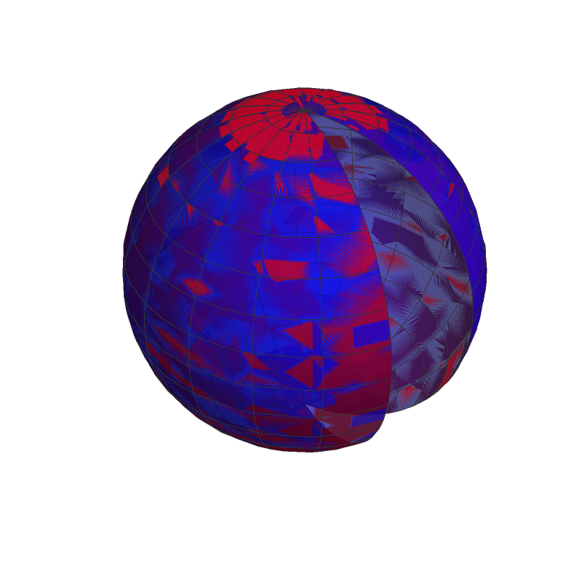
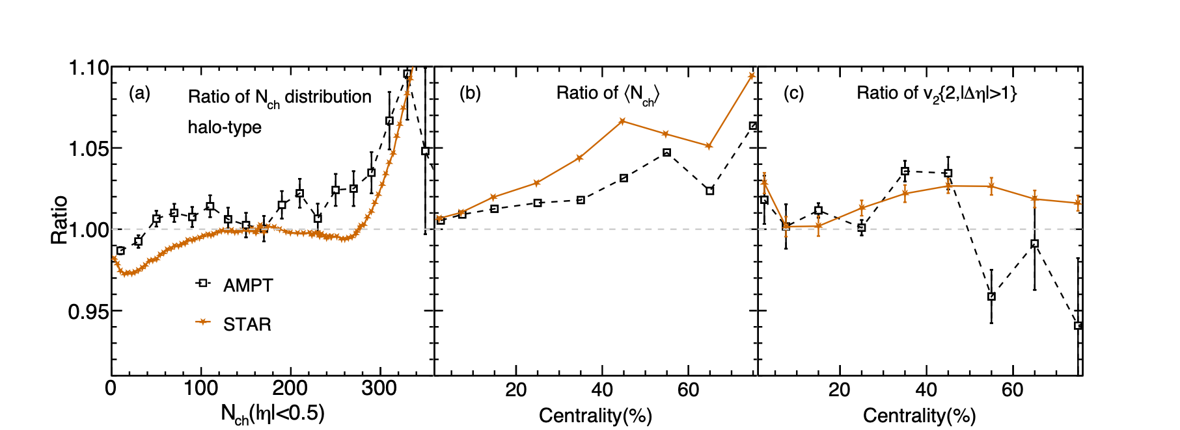
Champion player：Halo-type
Ru
Ru
Solid: Ru+Ru, Dash: Zr+Zr
Red: neutron, Blue: proton
Zr
Zr
+
+
H. j. Xu, H. Li, X. Wang, C. Shen and F. Wang, Phys. Lett. B 819, 136453 (2021)
Ru+Ru/Zr+Zr
𝝌2 index：

Slide 22
Simulating CME in isobar collisions using AMPT
(1) Introduction
Initialization of halo-type isobar
+
dipole charge separation
CME
f=(N⁺upward-N⁺downward)/(N⁺upward+N⁺downward)
f(Ru+Ru)/f(Zr+Zr)~(44/40)²
CME current || B field

Slide 23
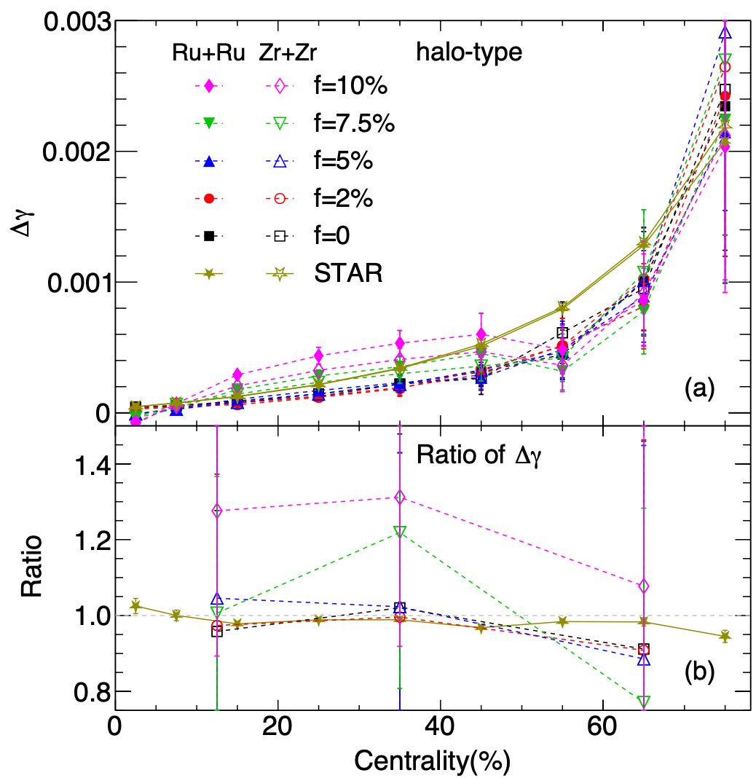
CME observable: Δ𝛾/v2 ratio
Xin-Li Zhao and GLM, Phys. Rev. C 106, 034909 (2022)
$f≤5\%$is close to the experimental result.
$f=2\%$ and$f=5\%$ look consistent with $f=0$.
Consistent with the latest results from AVFD.
Ru+Ru/Zr+Zr
（6.8+/-2.6）%
0-20%
20-50%
50-80%
Dmitri E. Kharzeev, Jinfeng Liao, Shuzhe Shi, Phys.Rev.C 106 (2022) 5, L051903

Slide 24
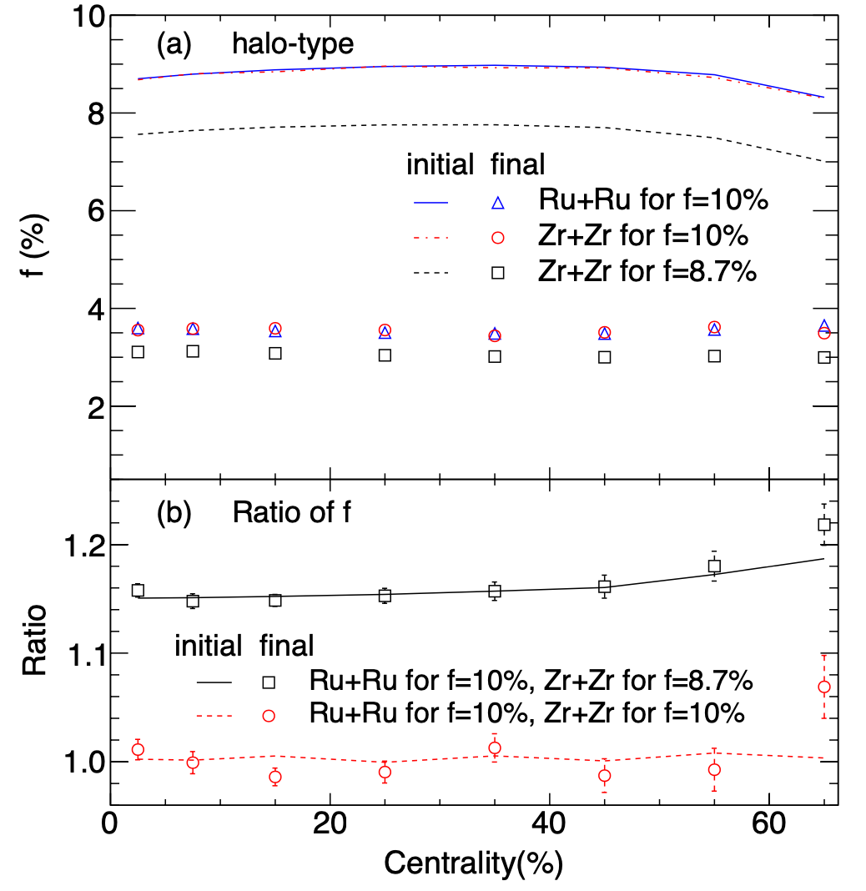
FSI effects in isobar collisions
Xin-Li Zhao and GLM, Phys. Rev. C 106, 034909 (2022)
FSI greatly reduce the CME signal.
The isobar difference in the CME signal is preserved up to the final state.
However, the signal is too small to be observed due to nonlinear sensitivity.
Is there a good way to extract the CME signal?
Ru+Ru/Zr+Zr
July 18, Afternoon Session-I
Xinli Zhao (15:20-15:35 )

Slide 25
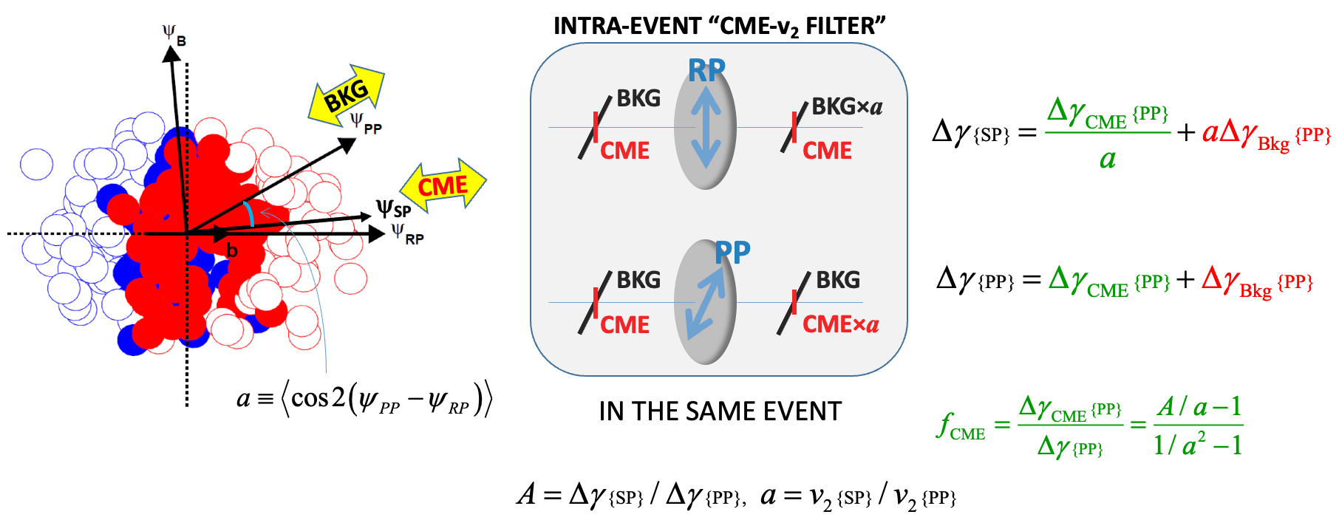
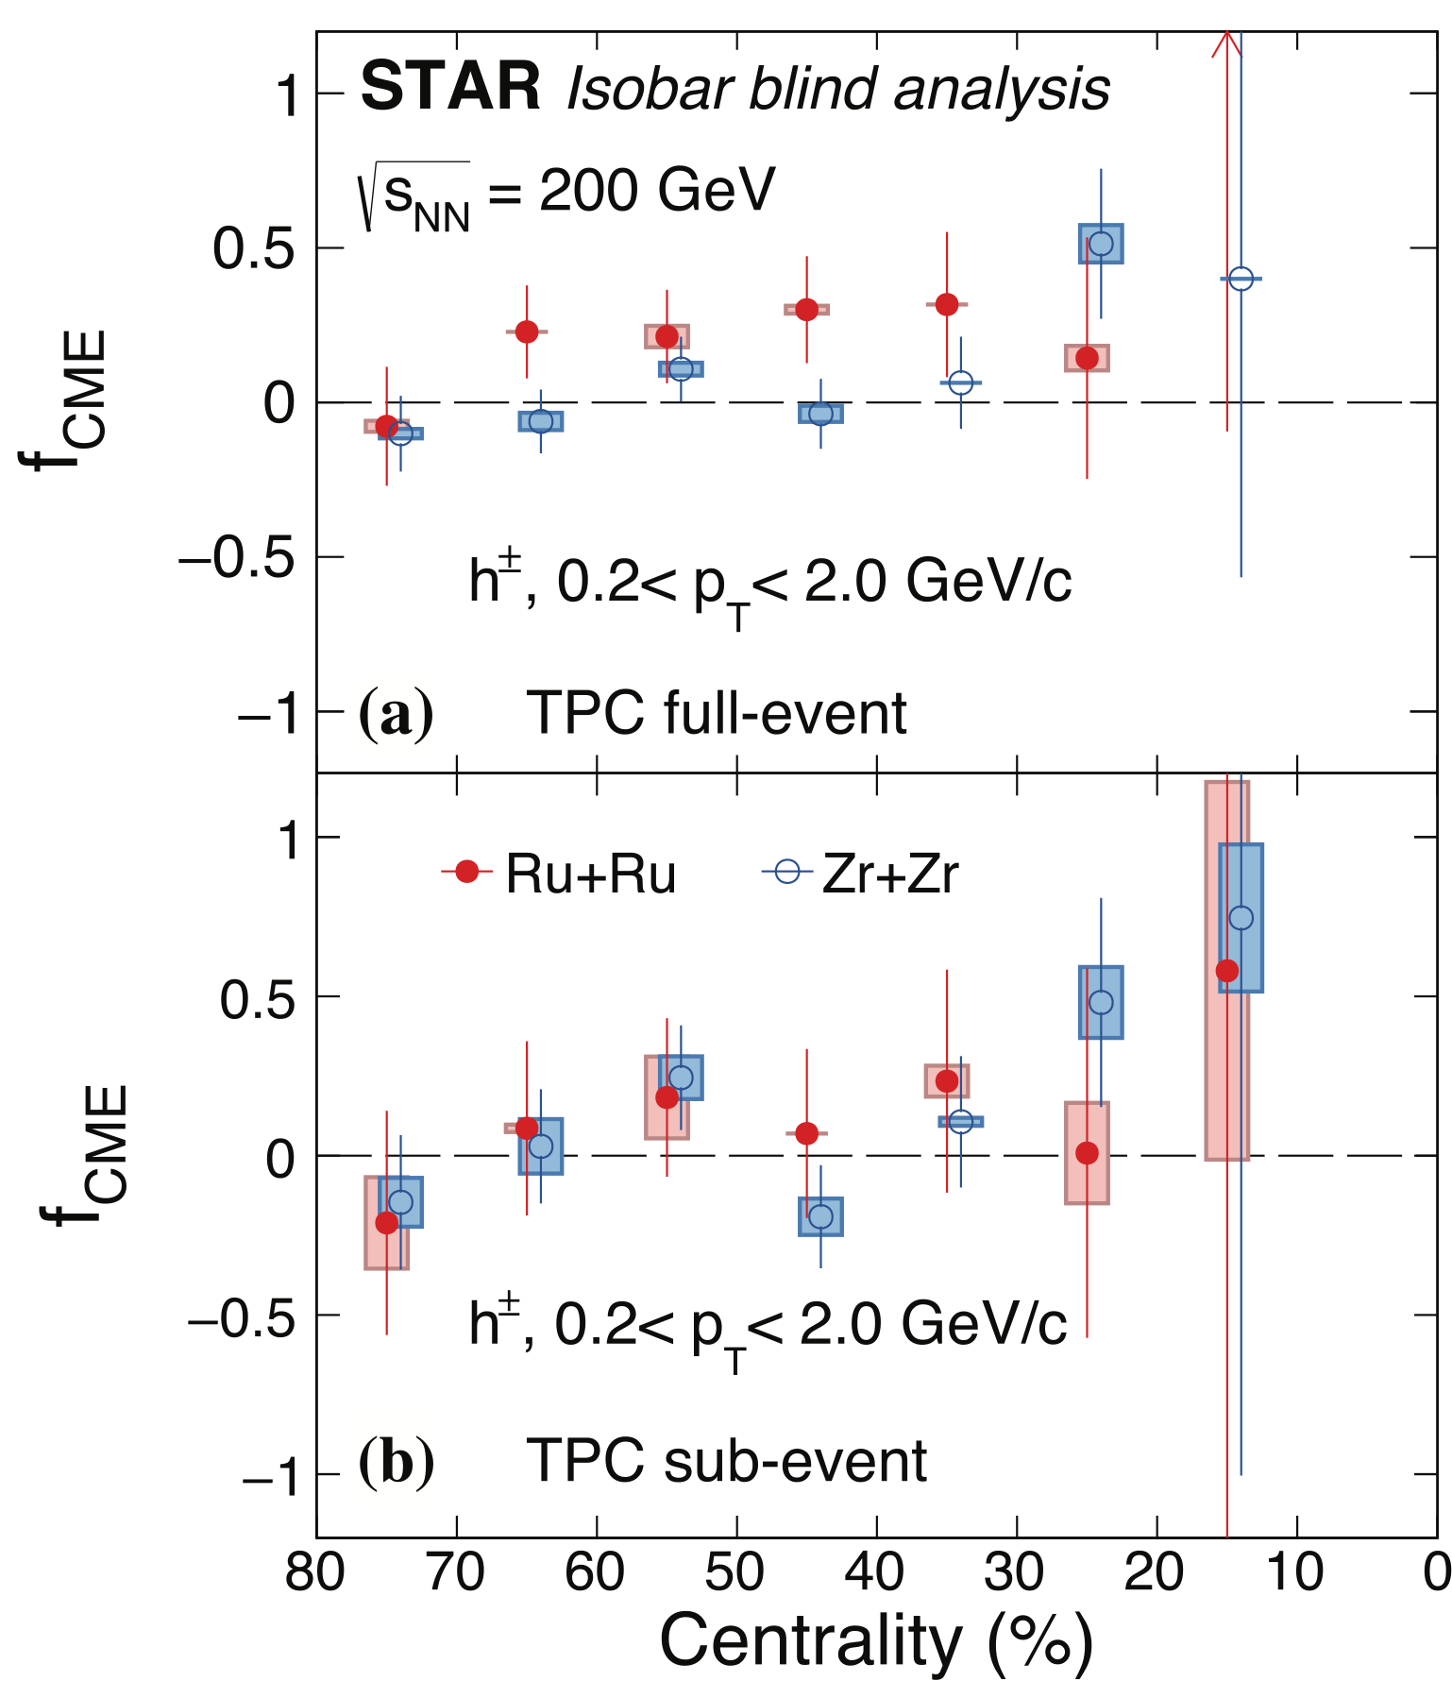
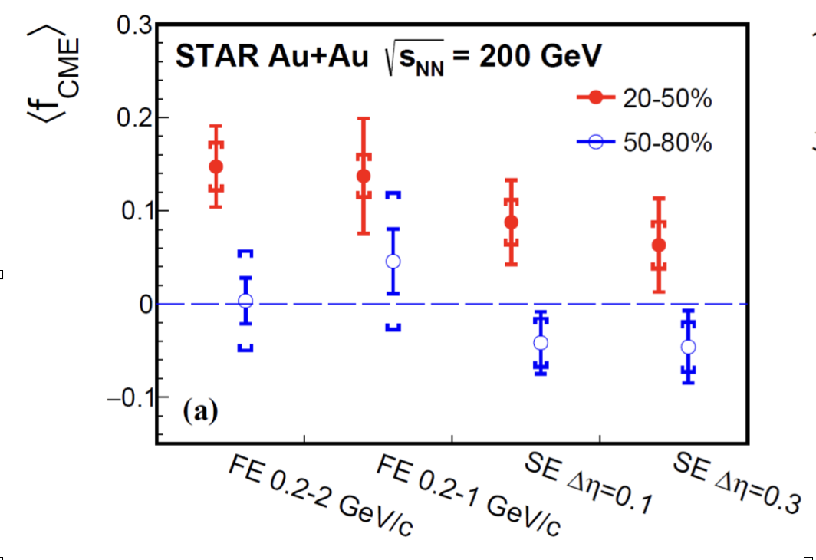
Filtering CME and BG by the two-plane method
Haojie Xu, Fuqiang Wang, et al., CPC 42 (2018) 084103
Isobar data: CME signal is consistent with zero in isobar collisions.
Au+Au data:a limited CME signal but with less significance

Slide 26
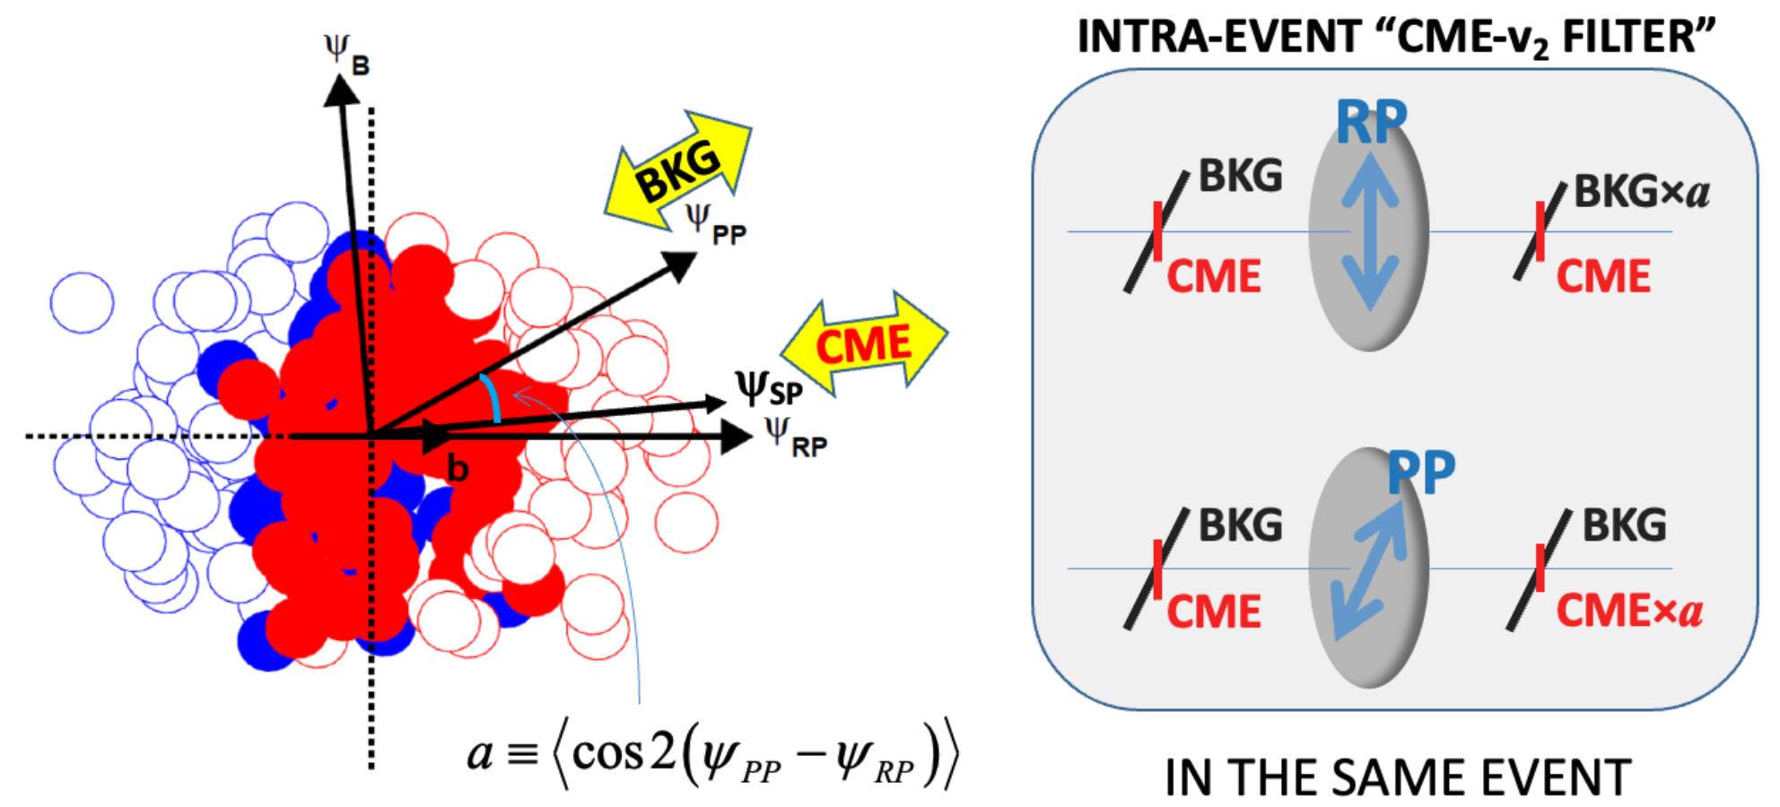
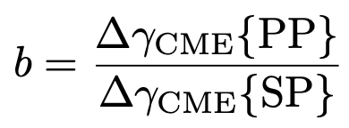
Are the transmittances for CME and BG same?
a: BKG transmittance
b: CME transmittance
a≟b
CME x b
b=a
b ≠ a
The transmittance for CME b is not experimentally measurable, but can be calculated using a theoretical model.
In AMPT model :

Slide 27
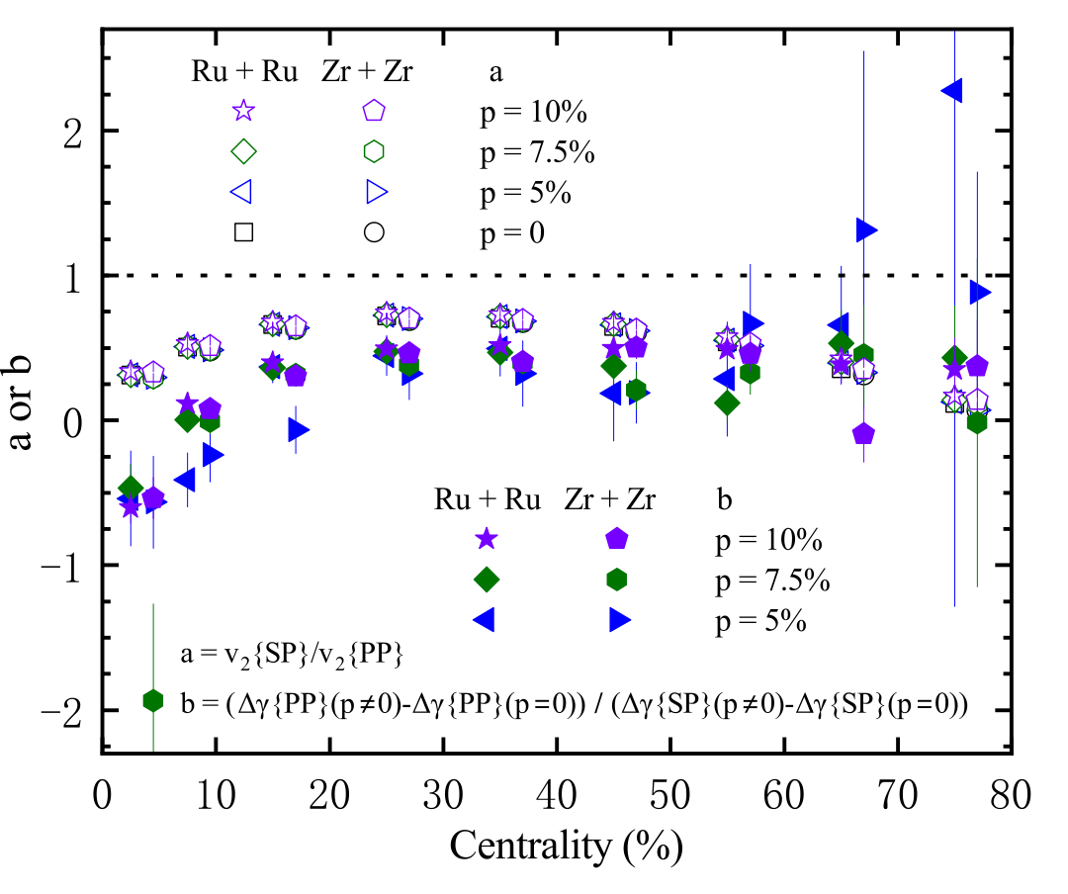
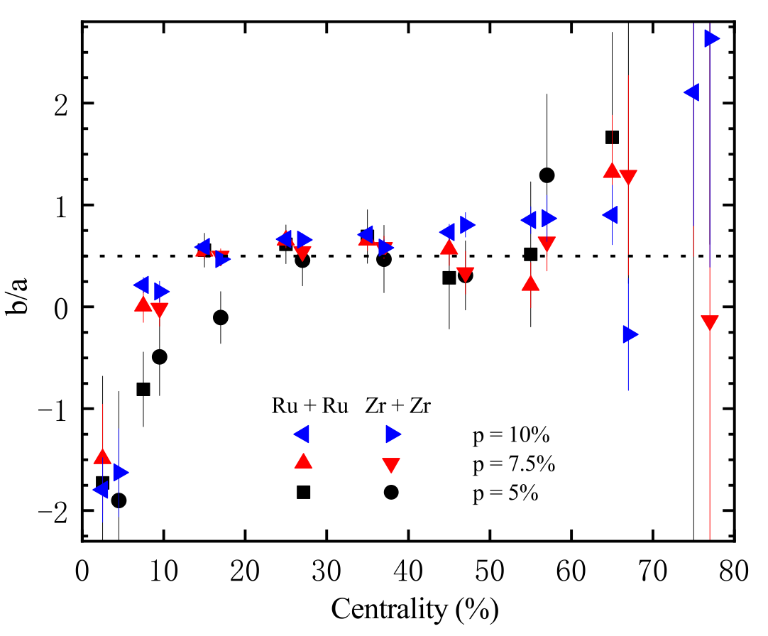
Comparing two transmittances
Bang-Xiang Chen, Xin-Li Zhao and GLM, arXiv:2301.12076
a: BKG transmittance
b: CME transmittance
a≟b
CME x b
b is smaller than a, about 1/2 of a in isobar collisions(20-50%).

Slide 28
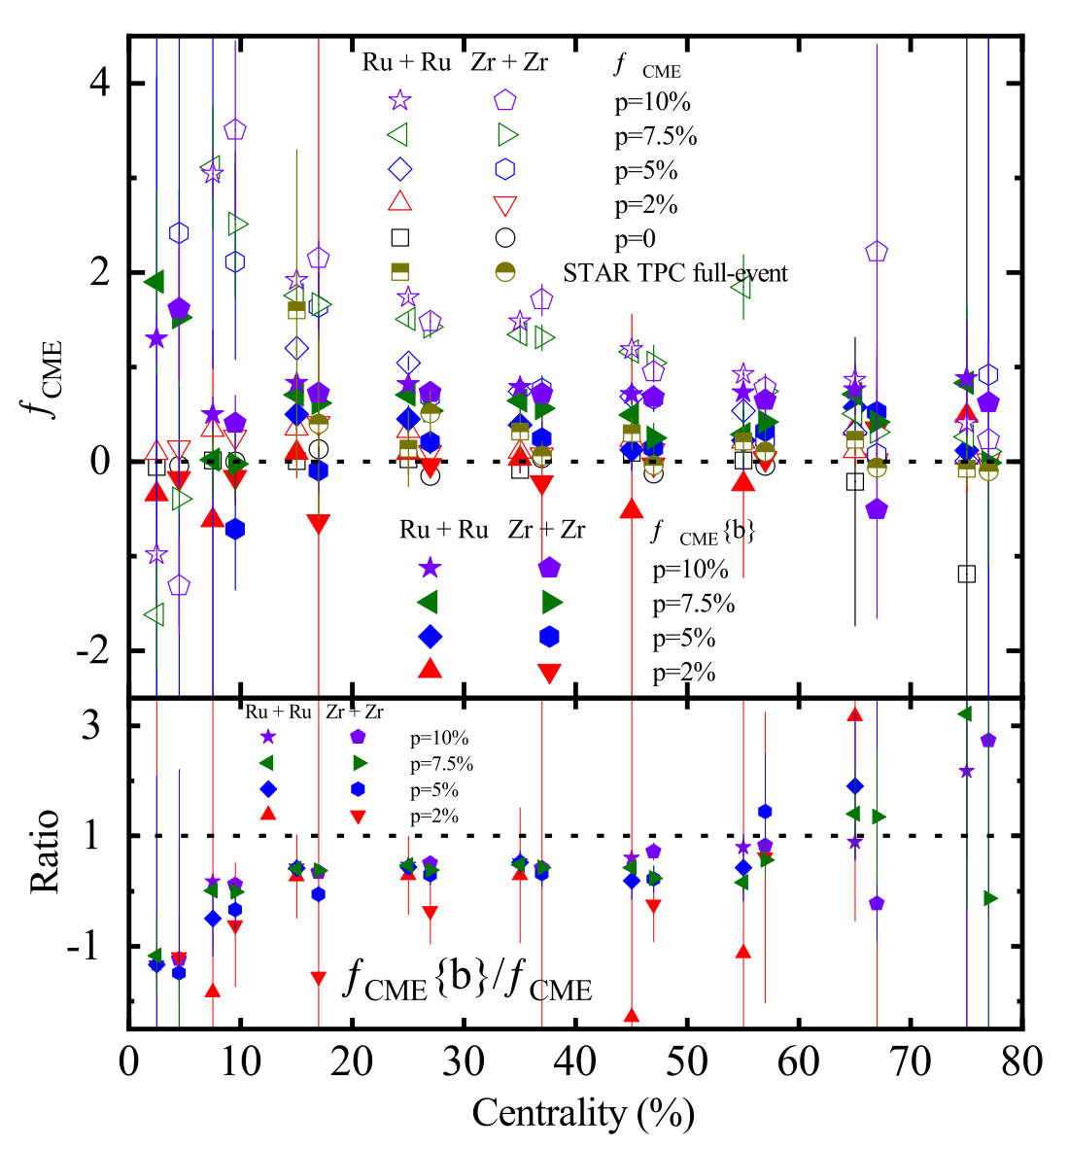
What is the impact of b on fCME
Bang-Xiang Chen, Xin-Li Zhao and GLM, arXiv:2301.12076
(1)
open symbols
(2)
solid symbols
After including b, fCME will be decreased.
Which one is closer to the real one?

Slide 29
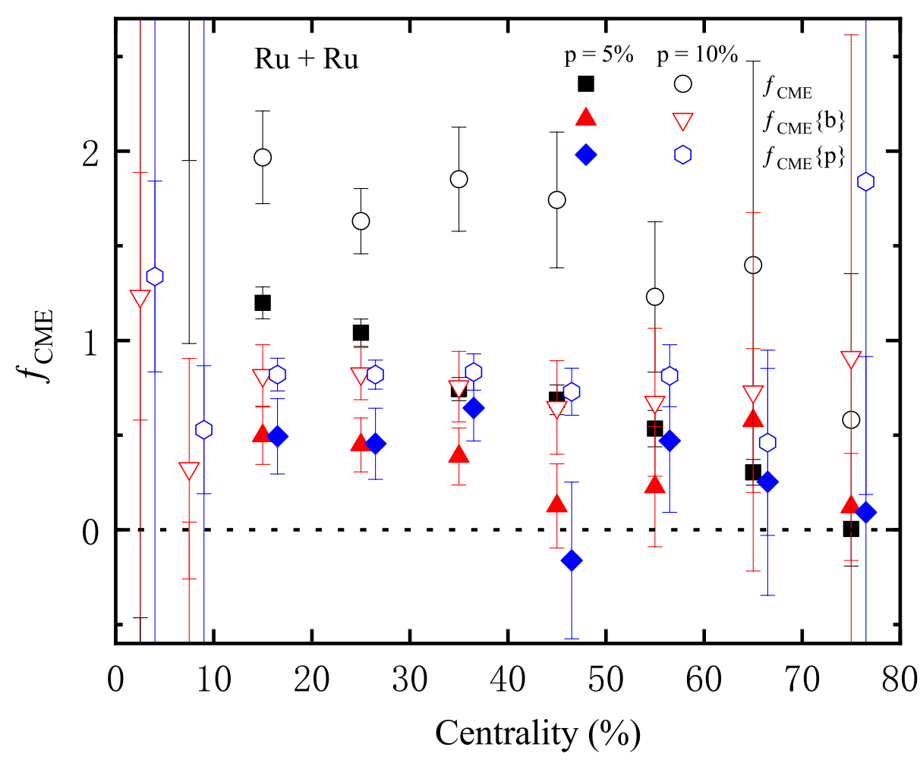
Which fCME is more real
Bang-Xiang Chen, Xin-Li Zhao and GLM, arXiv:2301.12076
(1)
black symbols
(2)
red symbols
(3)
blue symbols
fCME {b} with b will be closer to the real value fCME {p}than fCME without b.
The current experimental way (without b) may overestimate fCME.

Slide 30
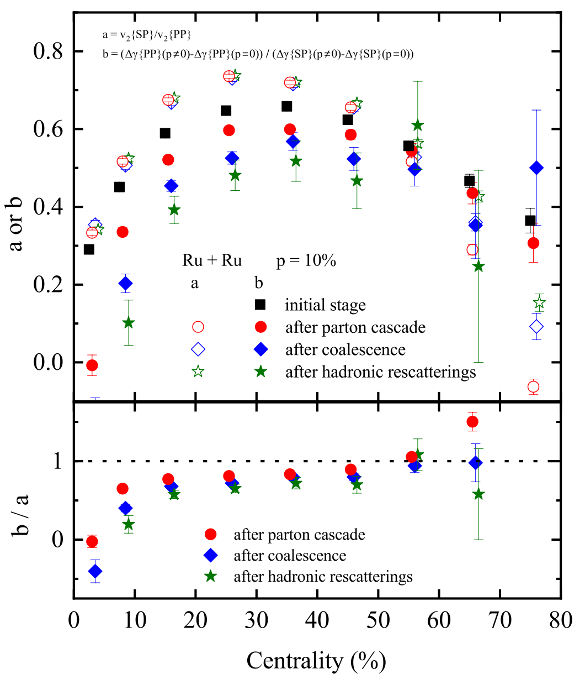
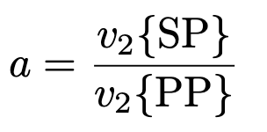
Why a and b are different
Bang-Xiang Chen, Xin-Li Zhao and GLM, arXiv:2301.12076
a: BKG transmittance
b: CME transmittance
a≟b
The a is independent of stage evolution.
The b decreases stage by stage due to the decorrelation of CME relative to SP and PP?
a and b are more different in Au+Au? Can it decrease the currently observed finite fCME in Au+Au?

Slide 31
Summary && Outlook
Background
CME
Final-state interactions greatly reduce the CME signal
Non-linear sensitivity of CME observations to the CME signal
Very low strength of CME signals in isobar collisions.
The b correction to the two-plane method lead to a reduction in CME fraction
More accurate search for CME in higher statistical Au+Au data in the future

Slide 32
Thank you！

