Slide 1
The 7th International Conference on Chirality, Vorticity and Magnetic Field in Heavy Ion Collisions
Accessing Topological Fluctuations of Gauge Fields with Chiral Magnetic Effect
Anping Huang, UCAS
Collaborators: Shuzhe Shi, Shu Lin, Xingyu Guo, Jinfeng Liao
Physical Review D 107 (3), 034012
Thursday, July 16, 2023
Notes:
My topic is thermal production of charms and charmonia in quark-gluon plasma. This work is collaborated with Kai Zhou, Carsten Greiner and Pengfei Zhuang.

Slide 2
Outline
Introduction
Motivation
Framework
Numerical Results
Summary
Notes:
This is the outline of my talk. Firstly, I will give a introduction. Then I will describe thermal production of charms in QGP. Subsequently, the mechanism of thermal charmonium production in QGP will be also indicated. I will present our numerical results on thermal production of charms and charmonia at LHC energy 2.76TeV and 5.5TeV and FCC energy 39TeV. At the end I will give summary for our work.

Slide 3
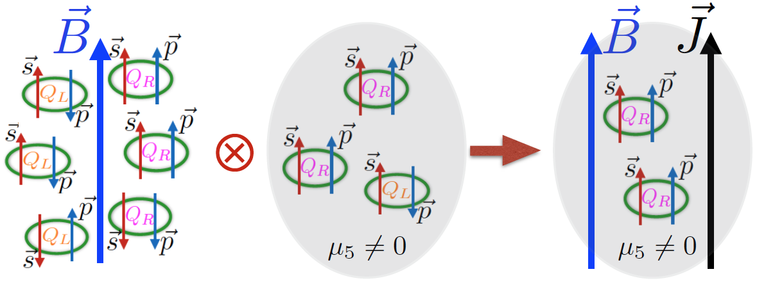
Introduction
Chiral Magnetic Effect (CME)
D.E. Kharzeev, J. Liao
Two ingredients of CME: B field and chiral imbalance

Slide 4
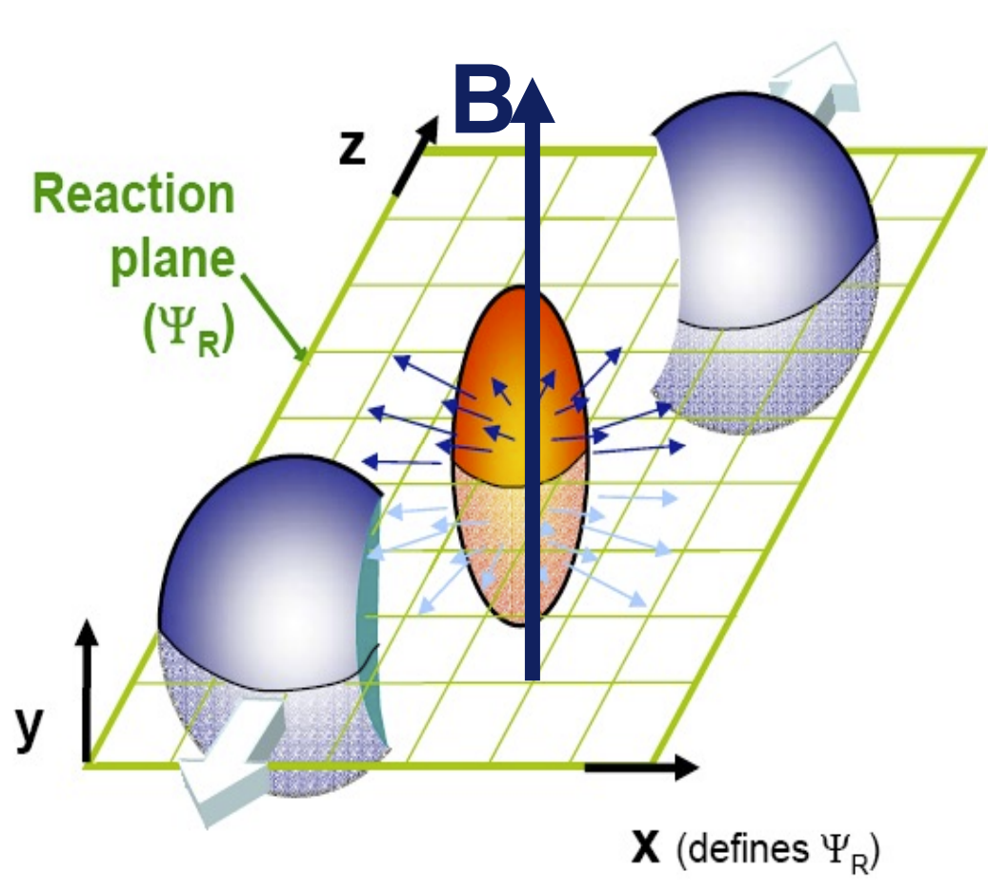
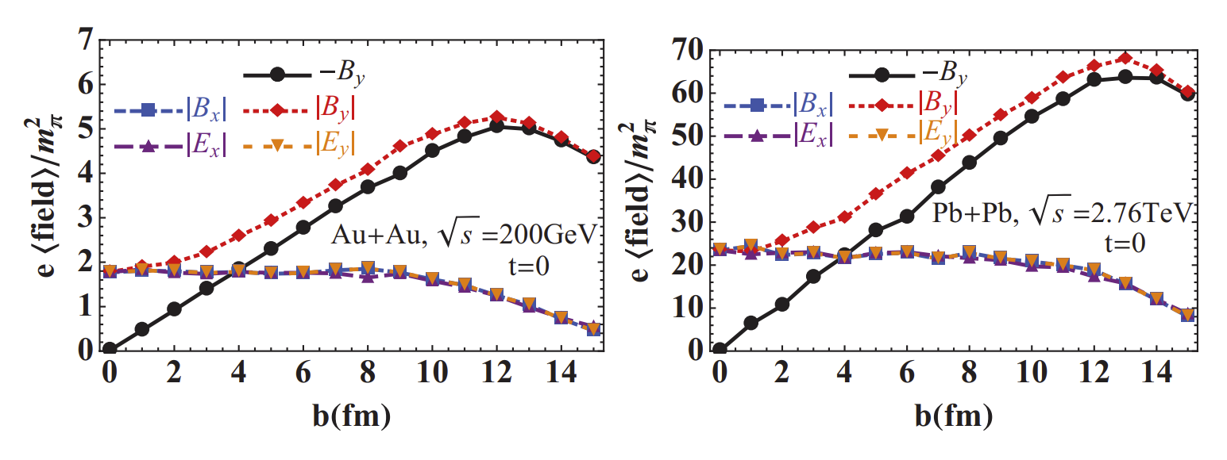
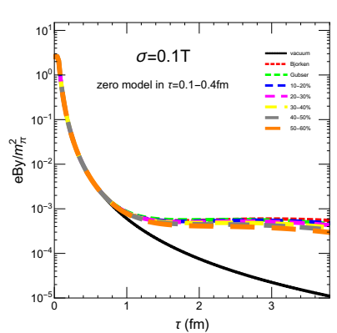
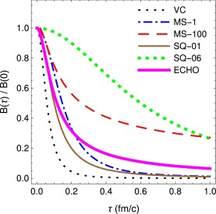
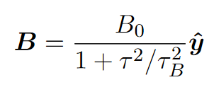
Introduction
B field and its evolution
Wei-Tian Deng, Xu-Guang Huang, PHYSICAL REVIEW C 85, 044907 (2012)
DK, McLerran, Warringa, Nucl Phys A803(2008)227
In this work, we use this model SQ-06
$τ_{B}=0.6$ fm
AH, et al, PRC 107 (3), 034901
AH, et al, PLB 777, 177-183

Slide 5
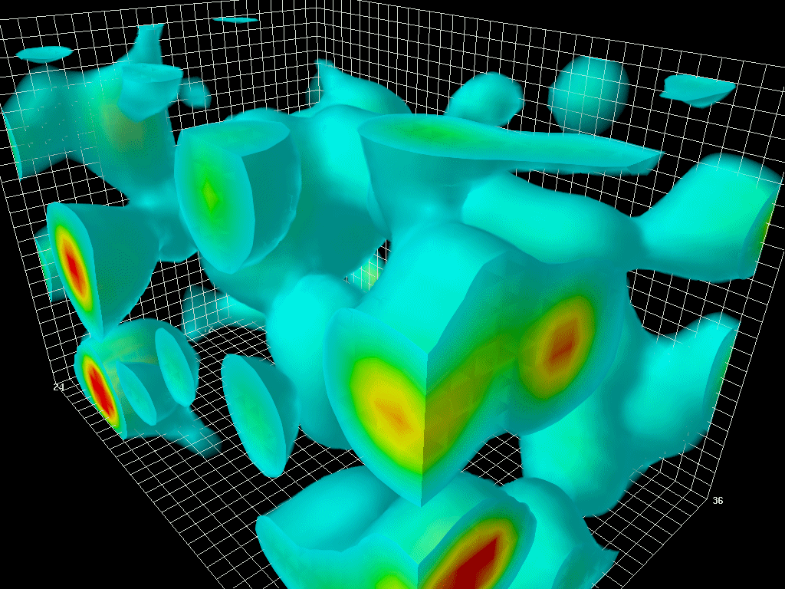
Introduction
chiral imbalance
$N_{R}^{f}−N_{L}^{f}=N_{5}=2{\tilde{Q}}_{w},$ ${\tilde{Q}}_{w}=\int{d^{4}x\{−\frac{g^{2}ε^{μνρσ}}{32π^{2}}Tr\left\{G_{μν}G_{ρσ}\right\}\}}$
Topological transitions in QCD vacuum
Areas of high energy density are rendered in red and regions of moderate energy density are rendered in blue. Low-energy regions are not rendered so we can see into the volume.
Derek Leinweber
arXiv:1903.08308v1

Slide 6
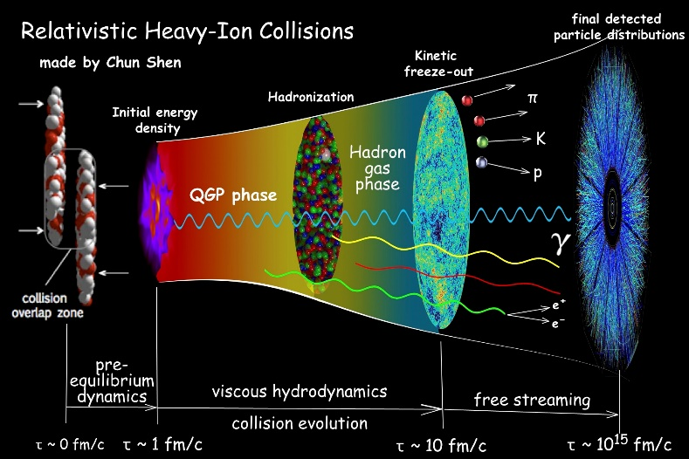
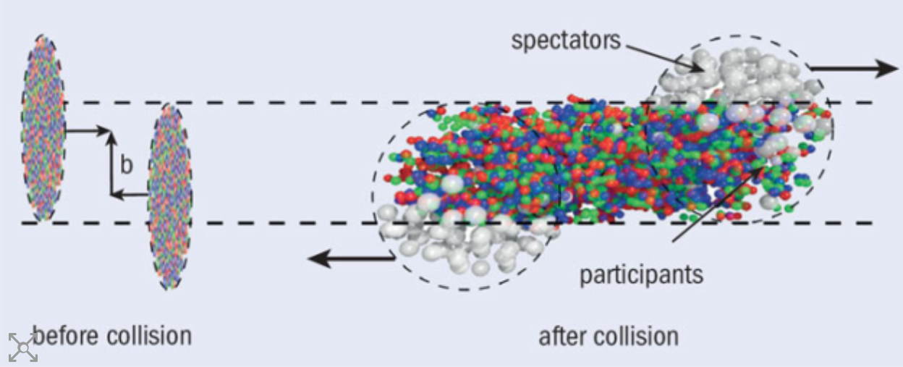
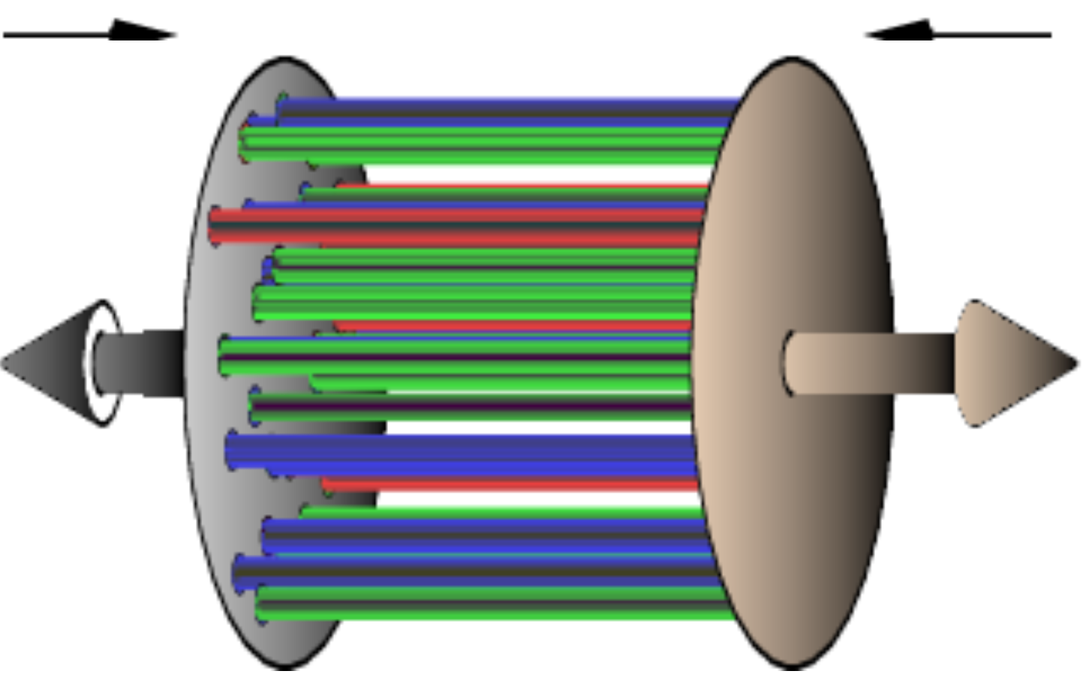
Introduction
The axial charge Initial condition is unknown, there are two methods to give.
1. A given value (old scheme)
2. MC sample method
$$n_{5}/s=c$$
For each collision event, one randomly sample a total of $N_{coll}$glasma flux tubes on the transverse plane and get the axial charge by the above relation.
6

Slide 7
Introduction
The sign (±) is randomly determined for each binary nucleon collision.
$$n_{5}(τ_{0},x,y,η)=\sum_{i=1}^{N_{coll}}{n_{5,i}(τ,x,y,η)}$$
$N_{5}=$ ${∫dw n}_{5}(τ,x,y,η$)
$${\tilde{Q}}_{w}=N_{5}/2$$
The ${\tilde{Q}}_{w}$fluctuates from event to event with equal chance of being positive or negative and what one can hope for is to determine its average variance $Q_{w}$≡${\sqrt{<{\tilde{Q}}_{w}^{2}>}}_{event}$ event associated with such fluctuations over the fireball spacetime domain.
7

Slide 8
Introduction
There are some sources that will affect the axial current evolution.
1. During the hydrodynamic evolution, there exist random topological fluctuations of the gluon fields that would necessarily influence the axial current evolution.
$$∂_{μ}J_{5,f}^{μ}=2q=−\frac{g^{2}ε^{μνρσ}}{16π^{2}}Tr\left\{G_{μν}G_{ρσ}\right\}$$
$${\hat{D}}_{μ}J_{5,f}^{μ}=−\frac{n_{5,f}}{τ_{cs}}$$
In Milne space
I. Iatrakis, Shu Lin, and Yi Yin, Phys. Rev. Lett., 114(25):252301, 2015.
JHEP, 09:030, 2015.
$$τ_{cs}=χ∗\frac{T}{2Γ_{cs}}, { Γ}_{cs}=30{\left(α_{s}T\right)}^{4}$$
$τ_{cs}$ is an relaxation time for the topological charge fluctuations. over this time scale, the q approaches equilibrium value.

Slide 9
Introduction
2. During the hydrodynamic evolution, the mass effect and electromagnetic would also influence the axial current evolution
$${\hat{D}}_{μ}J_{5,f}^{μ}=−\frac{N_{c}Q_{f}^{2}}{2π^{2}}E⋅B−\frac{n_{5,f}}{τ_{total}}$$
In Milne space
De-fu Hou and Shu Lin, PRD, 98(5):054014, 2018.
$τ_{tota}=χ∗\frac{T}{2Γ_{total}},Γ_{total}$= ${ Γ}_{m}+{ Γ}_{cs}$
$${ Γ}_{m}=0.013{\left(m_{f}T\right)}^{2}, { Γ}_{cs}=30{\left(α_{s}T\right)}^{4}$$
$${ Γ}_{m}\sim 0.001 T^{4}, { Γ}_{cs}=0.24T^{4}$$
The mass effect is smaller than the Chern-Simons diffusion rate by a few orders of magnitude and thus negligible.

Slide 10
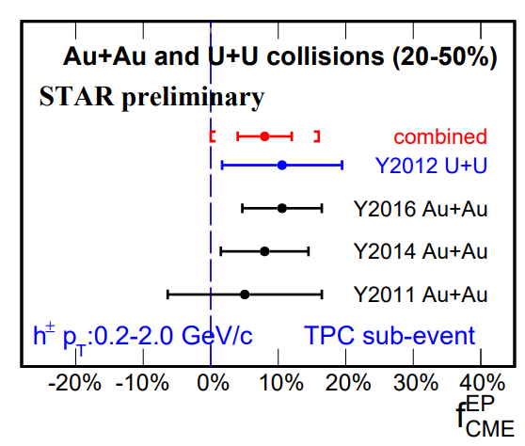
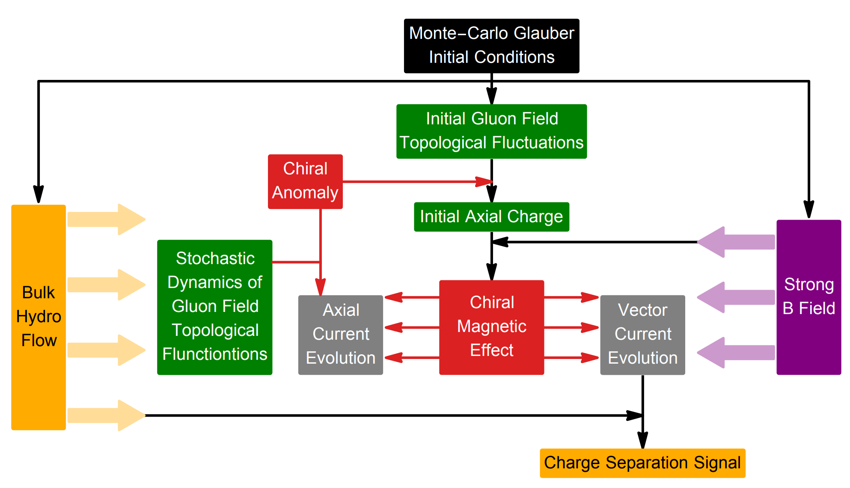
Motivation
Our motivation is accessing the topological fluctuations of the non-Abelian gauge fields by AVFD+STAR data.
$N_{R}^{f}−N_{L}^{f}=N_{5}=2{\tilde{Q}}_{w},$ ${\tilde{Q}}_{w}=\int{d^{4}x\{−\frac{g^{2}ε^{μνρσ}}{32π^{2}}Tr\left\{G_{μν}G_{ρσ}\right\}\}}$, $Q_{w}$≡${\sqrt{<{\tilde{Q}}_{w}^{2}>}}_{event}$
AH, et al, PRD 107 (3), 034012

Slide 11
Framework
The signal of CME
$$Δγ_{CME}=γ^{OS}−γ^{SS}=2{{(a}_{1}^{+})}^{2}$$
$$f_{CME}^{EP}=\frac{Δγ_{possible CME}}{Δγ_{inclusive}}=8±4\%$$

Slide 12
Framework
The flow chart of AVFD
$${\hat{D}}_{μ}T^{μν}=0$$
${\hat{D}}_{μ}J_{v,f}^{μ}=0$,
$${\hat{D}}_{μ}J_{5,f}^{μ}=−\frac{N_{c}Q_{f}^{2}}{2π^{2}}E⋅B−\frac{n_{5,f}}{τ_{total}}$$
AH, et al, PRD 107 (3), 034012

Slide 13
Framework
The bulk evolution is based on the MUSIC (2+1)D code package
Hydrodynamic: MUSIC (2+1)D
$${\hat{D}}_{μ}T^{μν}=0$$
Initial hydro start time $τ_{0}$= 0.4fm/c and shear viscosity parameter η/s = 0.08.

Slide 14
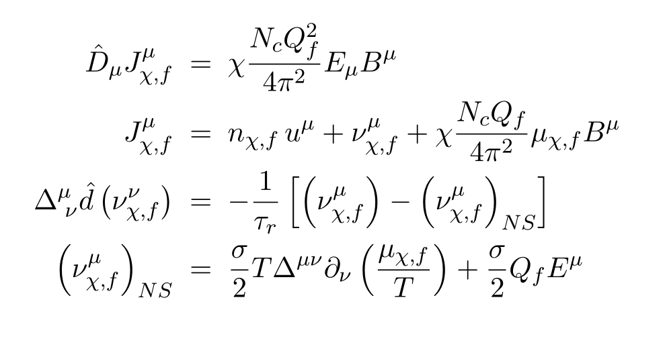
Framewor
Anomalous-Viscous Fluid Dynamics(Previous version)
${\hat{D}}_{μ}J_{v,f}^{μ}=0$,
$${\hat{D}}_{μ}J_{5,f}^{μ}=−\frac{N_{c}Q_{f}^{2}}{2π^{2}}E⋅B$$
Shuzhe Shi, et al, Annals Phys. 394:50–72, 2018 394:50–72, 2018

Slide 15
Framework
Anomalous-Viscous Fluid Dynamics(new version), included the stochastic dynamics of gluon field topological fluctuations
Case 1:
${\hat{D}}_{μ}J_{v,f}^{μ}=0$,
$${\hat{D}}_{μ}J_{5,f}^{μ}=−\frac{N_{c}Q_{f}^{2}}{2π^{2}}E⋅B$$
$τ_{cs}=χ∗\frac{T}{2Γ_{cs}}$,${ Γ}_{cs}=30{\left(α_{s}T\right)}^{4}$
Case 2:
${\hat{D}}_{μ}J_{v,f}^{μ}=0$,
$${\hat{D}}_{μ}J_{5,f}^{μ}=−\frac{N_{c}Q_{f}^{2}}{2π^{2}}E⋅B−\frac{n_{5,f}}{τ_{cs}}$$
${\hat{D}}_{μ}J_{v,f}^{μ}=0$,
$${\hat{D}}_{μ}J_{5,f}^{μ}=−\frac{N_{c}Q_{f}^{2}}{2π^{2}}E⋅B−\frac{n_{5,f}−θ(n_{5,f}) {\overline{n}}_{5,f}}{τ_{cs}}$$
Case 3:
${\overline{n}}_{5,f}$is the thermal equilibrium value of axial charge
I. Iatrakis, Shu Lin, and Yi Yin, Phys. Rev. Lett., 114(25):252301, 2015. JHEP, 09:030, 2015.

Slide 16
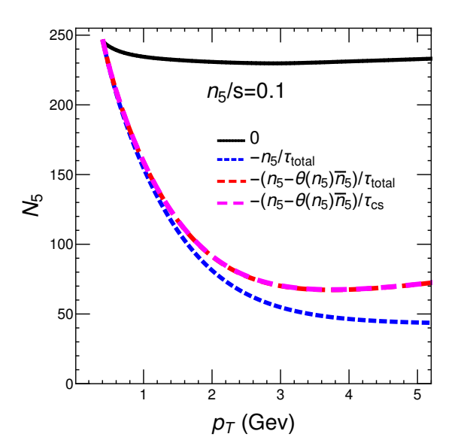
Results
1. Damping effect of total axial charge
$${\hat{D}}_{μ}J_{v,f}^{μ}=0$$
$τ_{B}=0.6$ fm
${\hat{D}}_{μ}J_{5,f}^{μ}=$0
$${\hat{D}}_{μ}J_{5,f}^{μ}=−\frac{n_{5,f}}{τ_{total}}$$
$${\hat{D}}_{μ}J_{5,f}^{μ}=−\frac{n_{5,f}−θ(n_{5,f}) {\overline{n}}_{5,f}}{τ_{total}}$$
$${\hat{D}}_{μ}J_{5,f}^{μ}=−\frac{n_{5,f}−θ(n_{5,f}) {\overline{n}}_{5,f}}{τ_{cs}}$$
AH, et al, PRD 107 (3), 034012

Slide 17
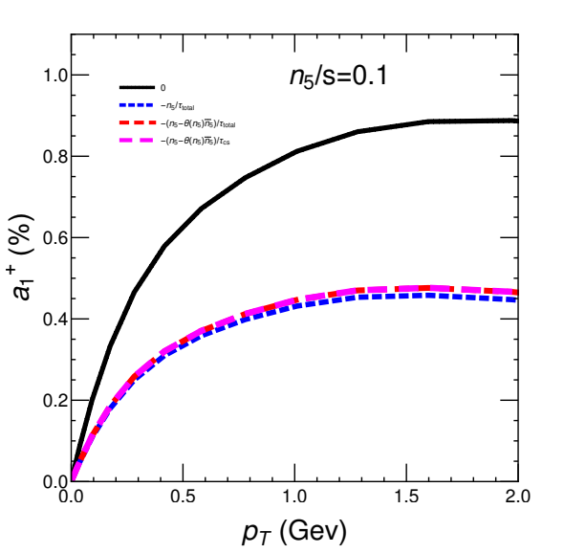
Results
2. CME signal for different damping cases
$${\hat{D}}_{μ}J_{v,f}^{μ}=0$$
$τ_{B}=0.6$ fm
${\hat{D}}_{μ}J_{5,f}^{μ}=$0
$${\hat{D}}_{μ}J_{5,f}^{μ}=−\frac{n_{5,f}}{τ_{total}}$$
$${\hat{D}}_{μ}J_{5,f}^{μ}=−\frac{n_{5,f}−θ(n_{5,f}) {\overline{n}}_{5,f}}{τ_{total}}$$
$${\hat{D}}_{μ}J_{5,f}^{μ}=−\frac{n_{5,f}−θ(n_{5,f}) {\overline{n}}_{5,f}}{τ_{cs}}$$
AH, et al, PRD 107 (3), 034012

Slide 18
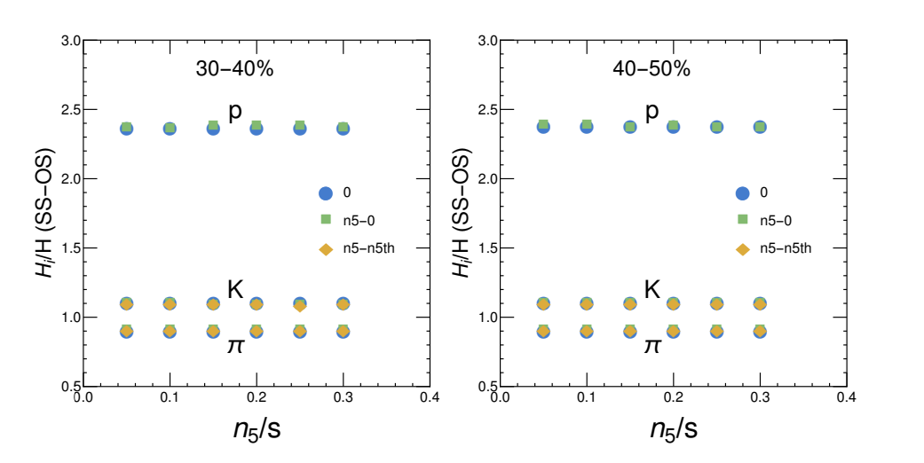
Results
3. The ratio of the H correlation is independent of the initial condition of axial charge for the constant initialization case.
$$H=2a_{1}^{2}$$
AH, et al, PRD 107 (3), 034012

Slide 19
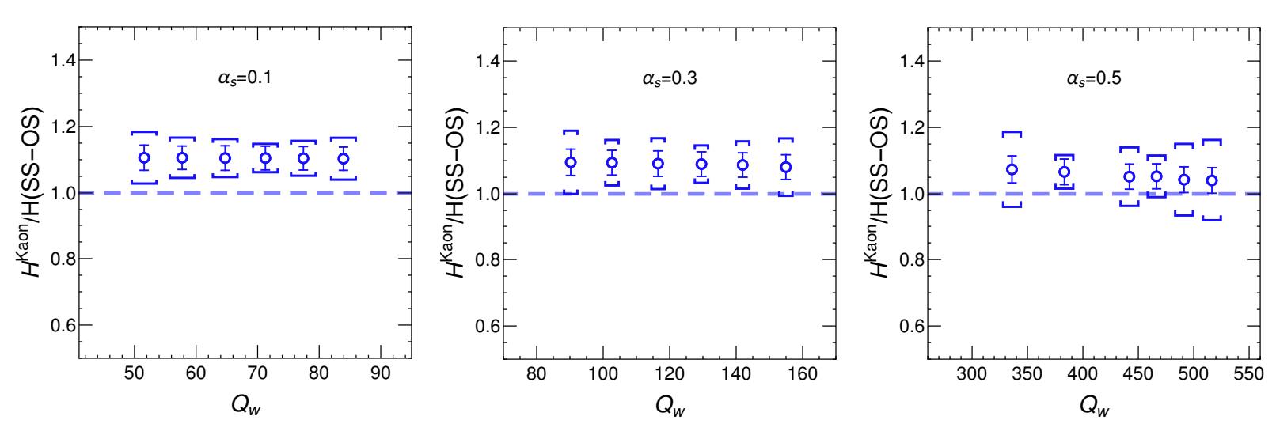
Results
4. The ratio of the H correlation is still independent of the initial condition of axial charge for the random sample initialization case.
$$H=2a_{1}^{2}$$
AH, et al, PRD 107 (3), 034012

Slide 20
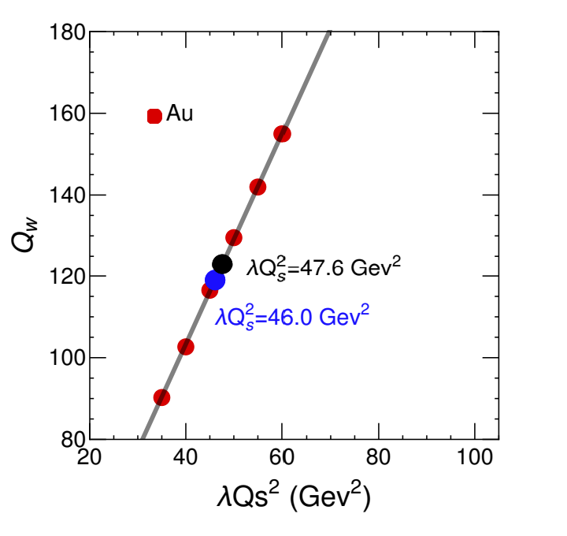
Results
5. The relation between $Q_{w}$ and ${λQ}_{s}^{2}$

Slide 21
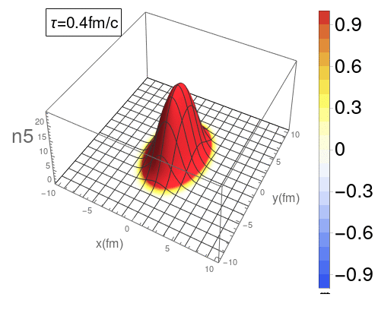
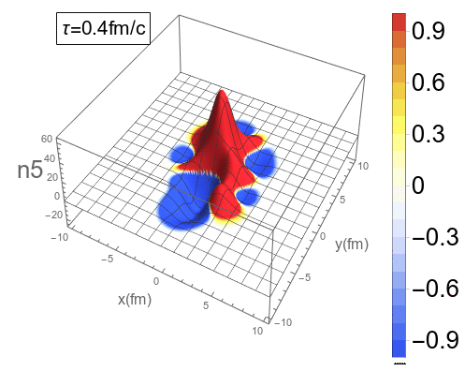
Results
6.1 The evolution of the axial charge density in 3D
Smooth
One of the events
Initialize $n_{5}$ with a given ratio
Initialize $n_{5}$ with a random sample from the flux tube
$${\hat{D}}_{μ}J_{v,f}^{μ}=0$$
$${\hat{D}}_{μ}J_{5,f}^{μ}=−\frac{n_{5,f}}{τ_{cs}}$$

Slide 22
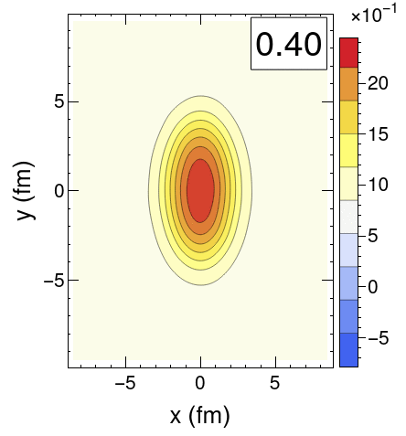
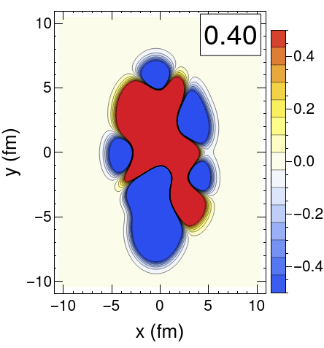
Results
6.2 The evolution of the axial charge density in 2D
Smooth in 2D
One of the events in 2D
Initialize $n_{5}$ with a given ratio
Initialize $n_{5}$ with a random sample from the flux tube
$${\hat{D}}_{μ}J_{v,f}^{μ}=0$$
$${\hat{D}}_{μ}J_{5,f}^{μ}=−\frac{n_{5,f}}{τ_{cs}}$$

Slide 23
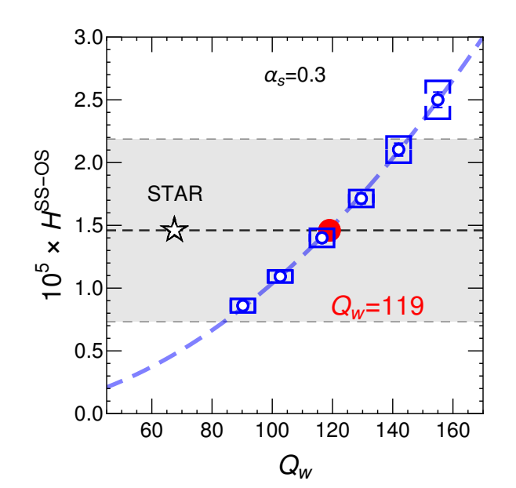
Results
7.1 Counting Topological Winding number of gluon Fields
$$n_{5}(τ_{0},x,y,η)=\sum_{i=1}^{N_{coll}}{n_{5,i}(τ,x,y,η)}$$
$N_{5}=$ ${∫dw n}_{5}(τ,x,y,η$)
$N_{5}=$ ${∫dw n}_{5}(τ,x,y,η$)
$${\tilde{Q}}_{w}=N_{5}/2$$
$${\tilde{Q}}_{w}=N_{5}/2$$
$Q_{w}$≡${\sqrt{<{\tilde{Q}}_{w}^{2}>}}_{event}$
AH, et al, PRD 107 (3), 034012

Slide 24
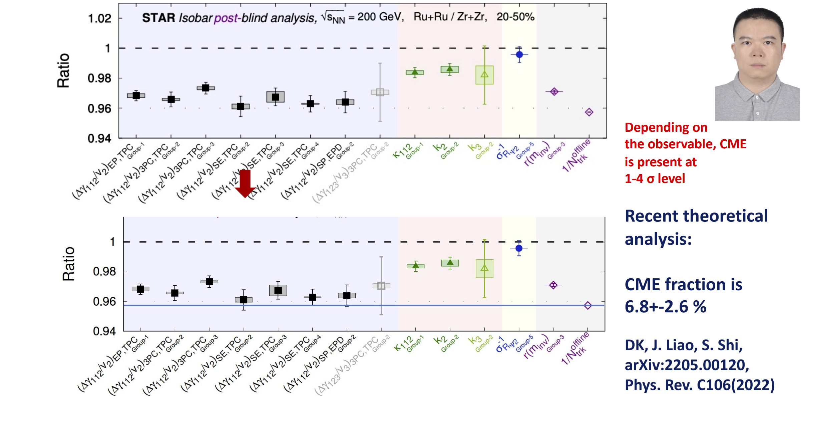
Results
7.1 Counting Topological Winding number of gluon Fields
From Dmitri’s talk
AH, et al, PRD 107 (3), 034012

Slide 25
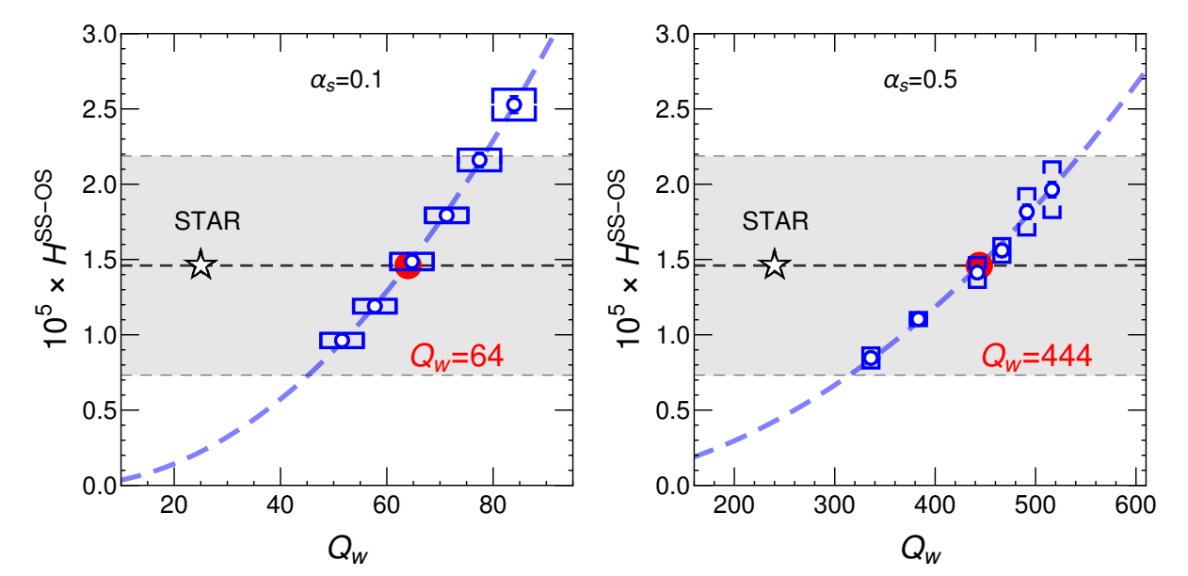
Results
6.2 Counting Topological Winding number of gluone Fields
AH, et al, PRD 107 (3), 034012

Slide 26
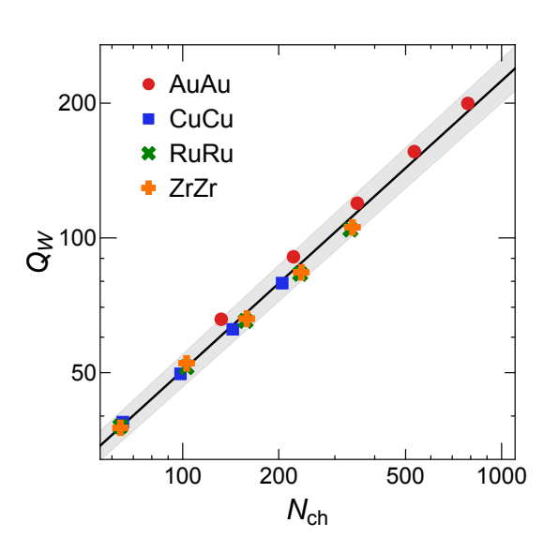
Results
7. Winding number versus the charged hadron multiplicity$N_{ch}$
It would be exciting to test this novel finding with future experimental analyses.
AH, et al, PRD 107 (3), 034012

Slide 27
Summary
1. Included the stochastic dynamics of gluon field topological fluctuations in AVFD.
2. Get the winding number $Q_{w}=119$ when $α_{s}=0.3$.
3. Get a relation between the initial topological fluctuations $Q_{w}$ and the charged hadron multiplicity $N_{ch}$ like as

Slide 28
Thank You!

Slide 29
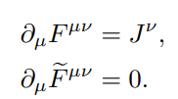
Supplement
The flow chart of AVFD
$${\hat{D}}_{μ}T^{μν}=0$$
${\hat{D}}_{μ}J_{v,f}^{μ}=0$,
$${\hat{D}}_{μ}J_{5,f}^{μ}=−\frac{N_{c}Q_{f}^{2}}{2π^{2}}E⋅B−\frac{n_{5,f}}{τ_{cs}}$$

Slide 30
Supplement
The future structure of AVFD
$${\hat{D}}_{μ}T^{μν}=0$$
${\hat{D}}_{μ}J_{v,f}^{μ}=0$,
$${\hat{D}}_{μ}J_{5,f}^{μ}=−\frac{N_{c}Q_{f}^{2}}{2π^{2}}E⋅B−\frac{n_{5,f}}{τ_{total}}$$
${\hat{D}}_{μ}F^{μν}=J^{ν}$,
${\hat{D}}_{μ}{\tilde{F}}^{μν}=$0,

Slide 31
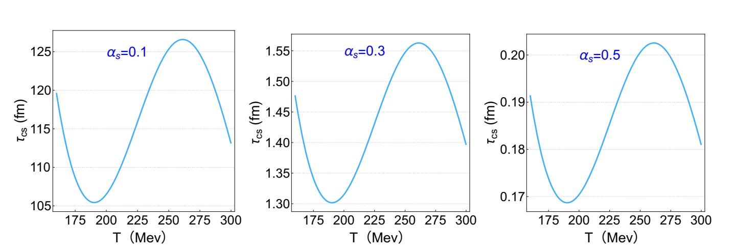
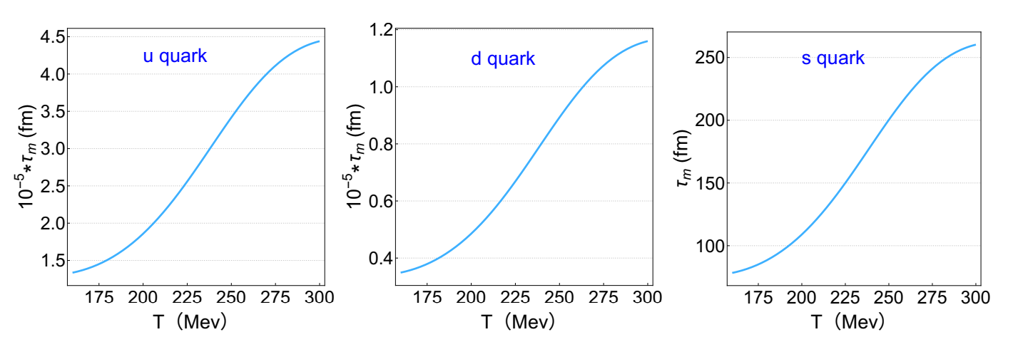
Supplement
Anomalous-Viscous Fluid Dynamics(new version)
$$τ_{total}=τ_{m}+τ_{cs},$$
$$τ_{m}=χ∗\frac{T}{2Γ_{m}}, { Γ}_{m}=0.013{\left(m_{f}T\right)}^{2}$$
$$τ_{cs}=χ∗\frac{T}{2Γ_{cs}}, { Γ}_{cs}=30{\left(α_{s}T\right)}^{4}$$

Slide 32
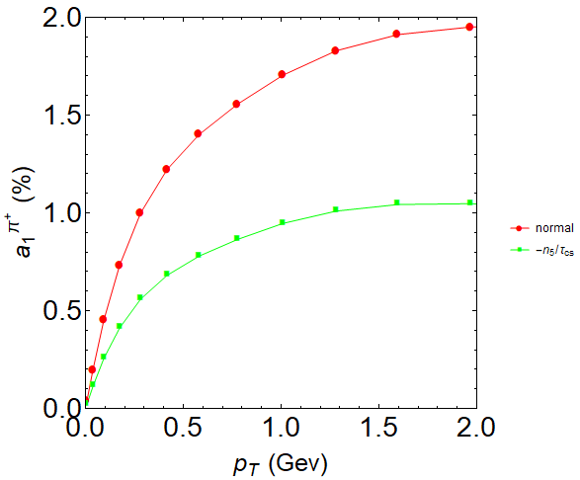
Supplement
The Chern-Simons diffusion effect is very considerable.
Red line: $∂_{μ}J_{5}^{μ}=0$
Green line: $∂_{μ}J_{5}^{μ}=−\frac{n_{5}}{τ_{cs}}$
$$τ_{cs}=χ∗\frac{T}{2Γ_{cs}}, { Γ}_{cs}=30{\left(α_{s}T\right)}^{4}$$
$τ_{B}=0.6$ fm
Smooth case

Slide 33
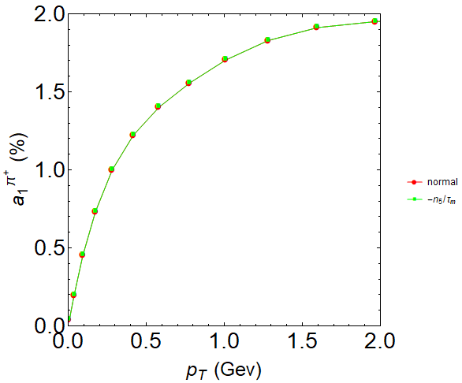
Supplement
The mass effect can be neglected.
Red line: $∂_{μ}J_{5}^{μ}=0$
Green line: $∂_{μ}J_{5}^{μ}=−\frac{n_{5}}{τ_{m}}$
$$τ_{m}=χ∗\frac{T}{2Γ_{m}}, { Γ}_{m}=0.013{\left(m_{f}T\right)}^{2}$$
$τ_{B}=0.6$ fm
Smooth case

