Slide 1
Hyperon polarization and its correlation with directed flow in heavy ion collisions
Ze-Fang Jiang
Collaborators: Shanshan Cao, Xiang-Yu Wu, Ben-Wei Zhang
Presented on 19th July 2023, UCAS, Beijing China
Based on arXiv:2307.04257 and Phys. Rev. C 107, 034904 (2023)

Slide 2
Outline
1. Introduction
2. Theory framework
• tilted initial condition
• (3+1)-D hydrodynamic CLVisc
• spin polarization
3. Numerical results
4. Summary

Slide 3
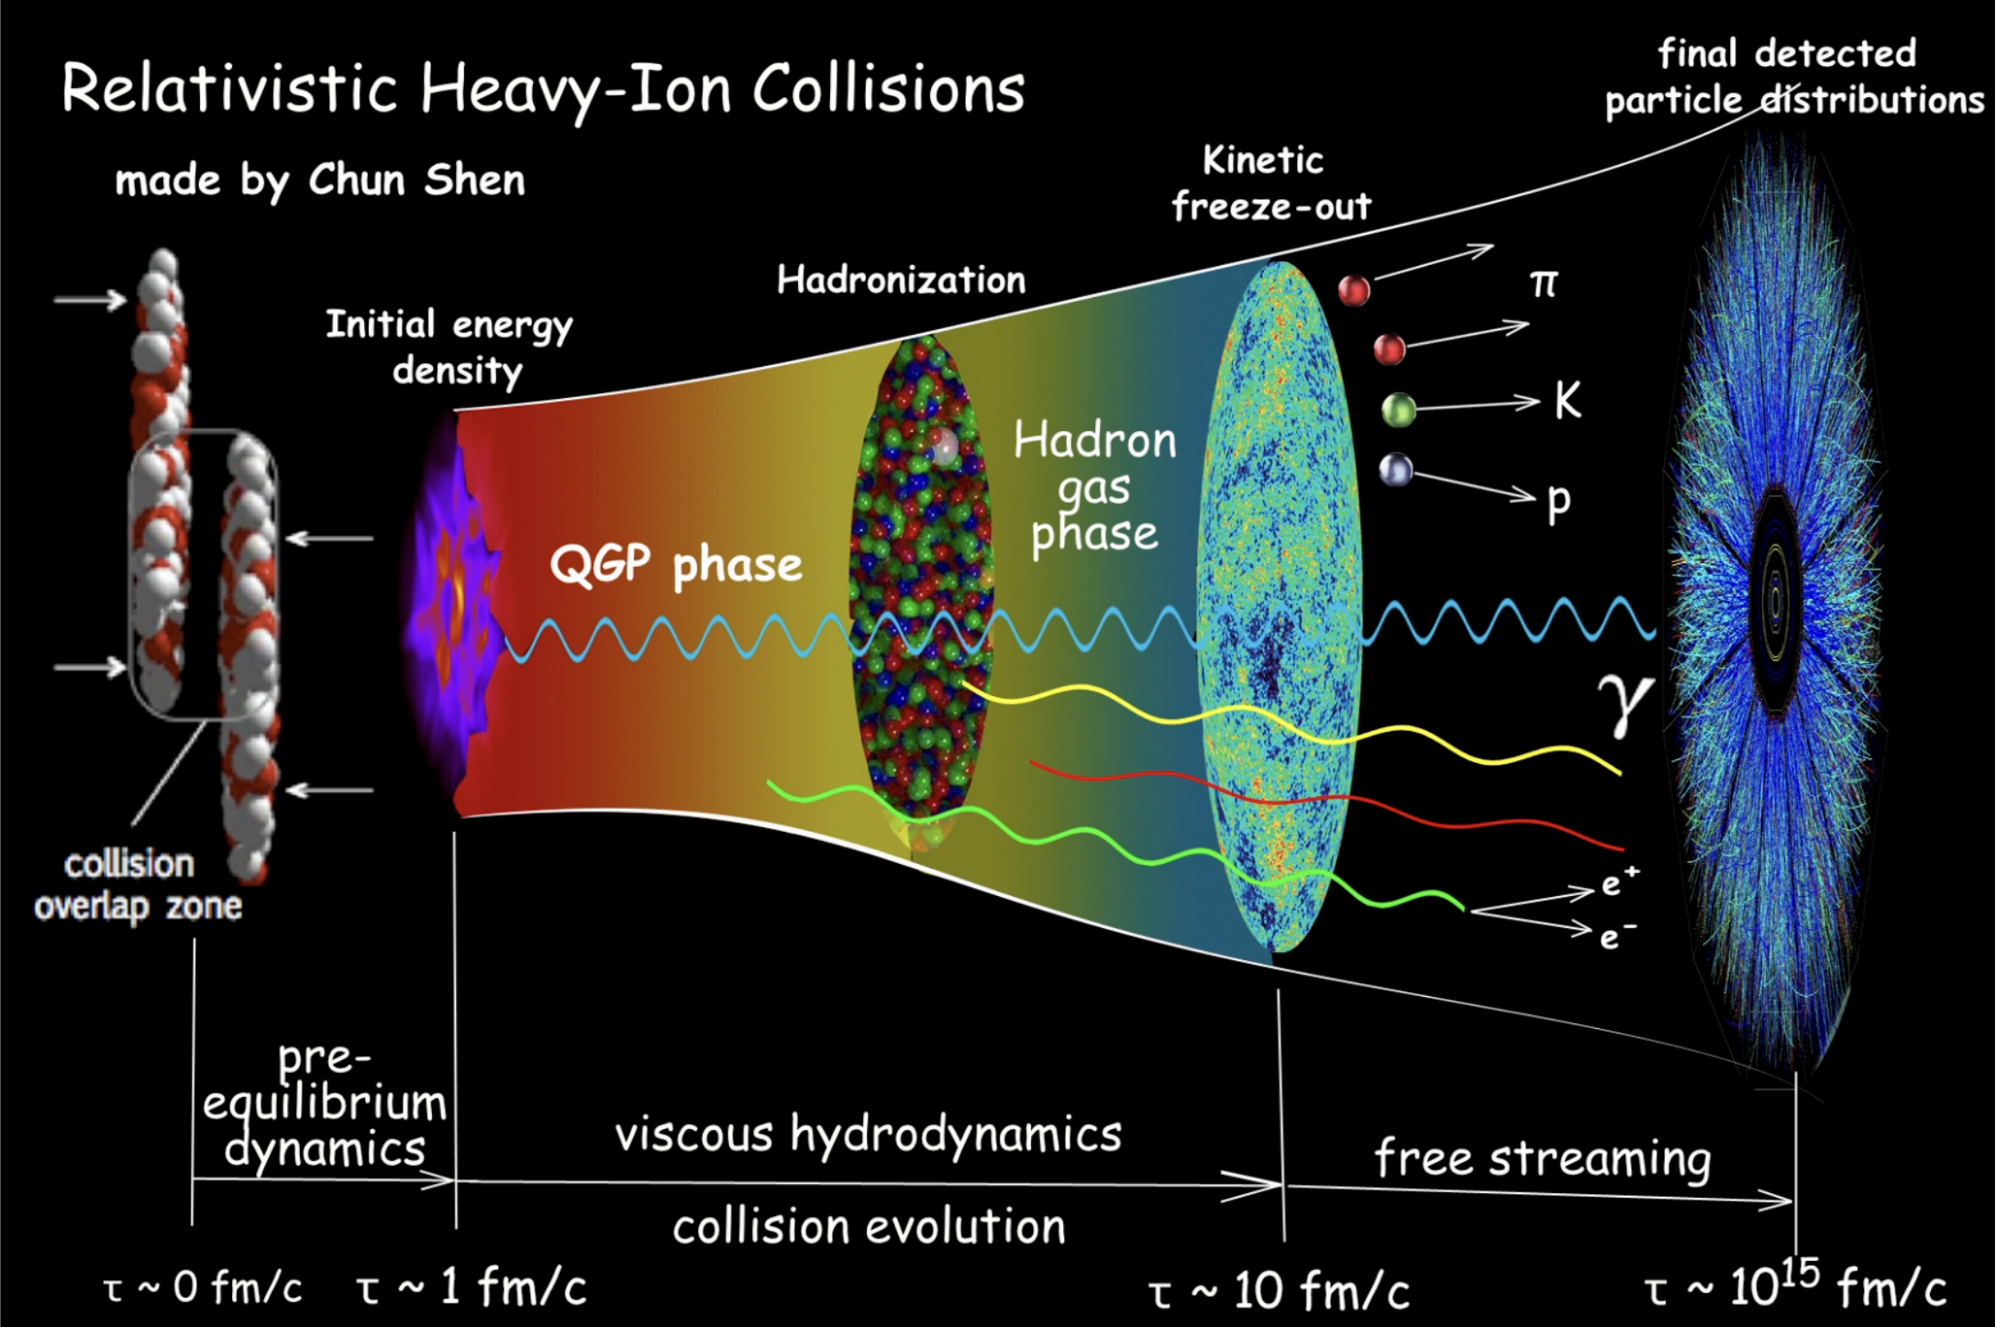
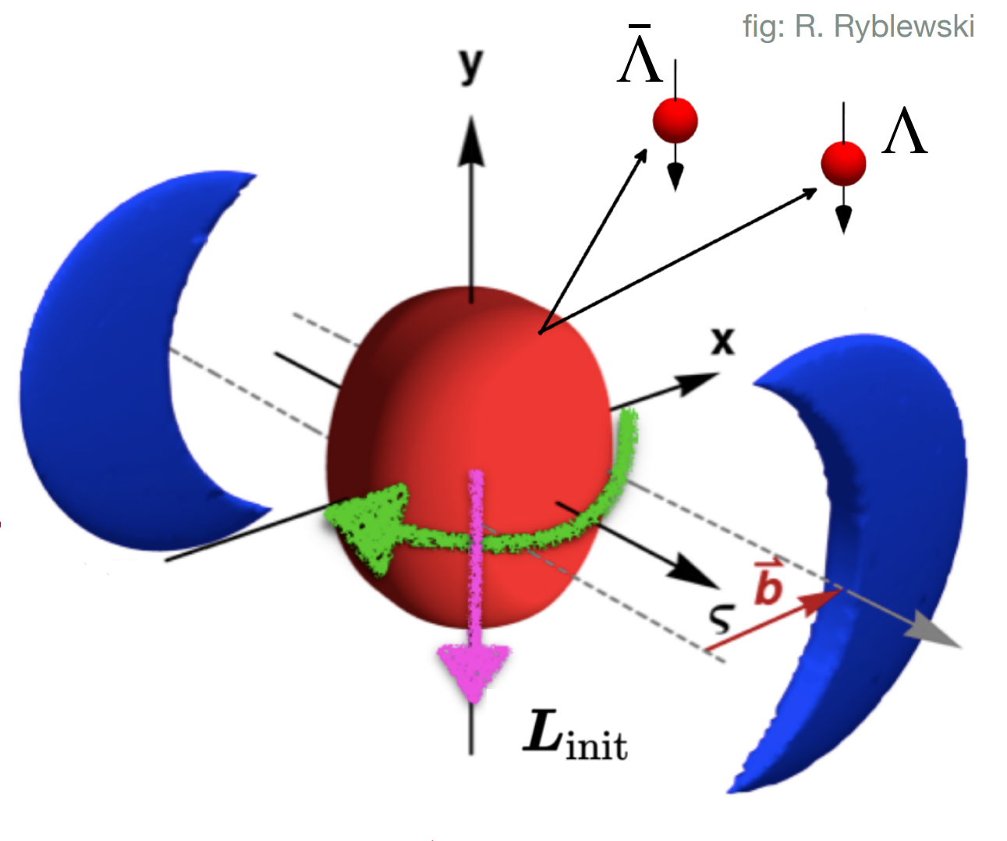
Introduction
B
“ Standard Model ” of heavy ion collision
…the hottest, least viscous – and most votrical-
fluid produced in the laboratory…

Slide 4
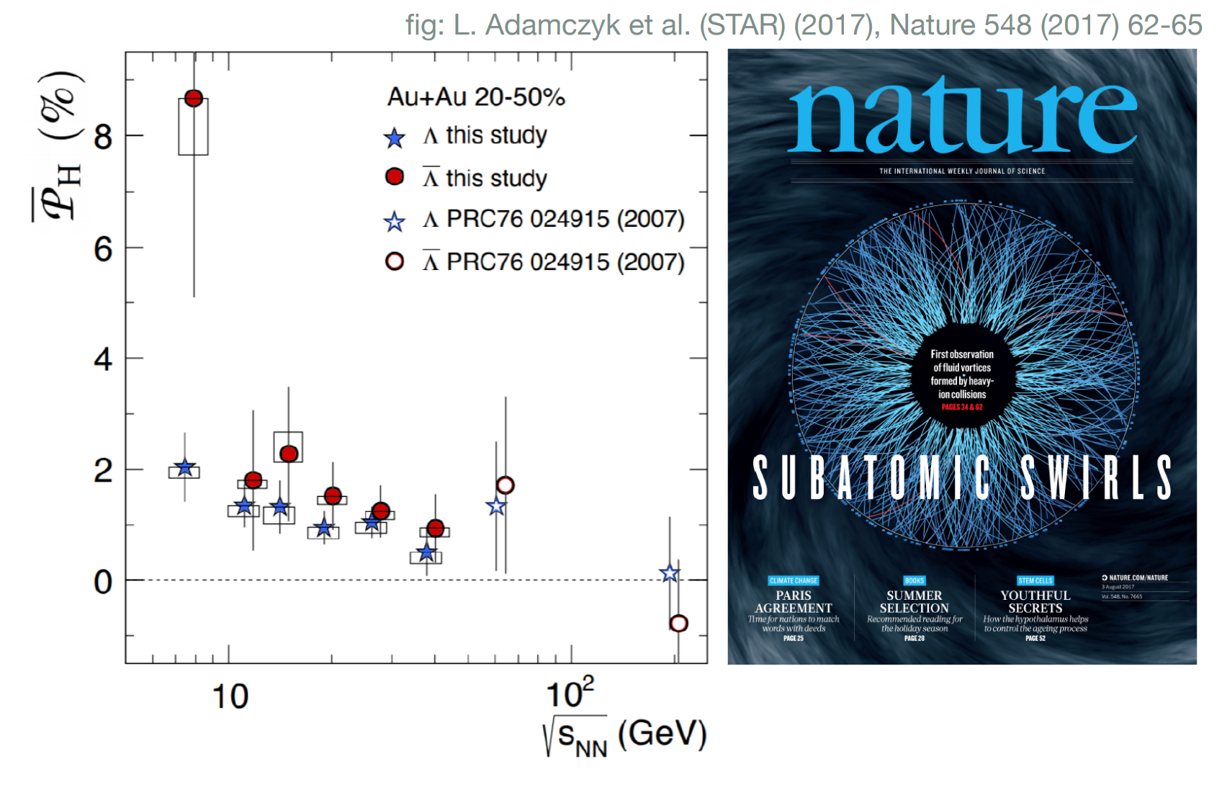
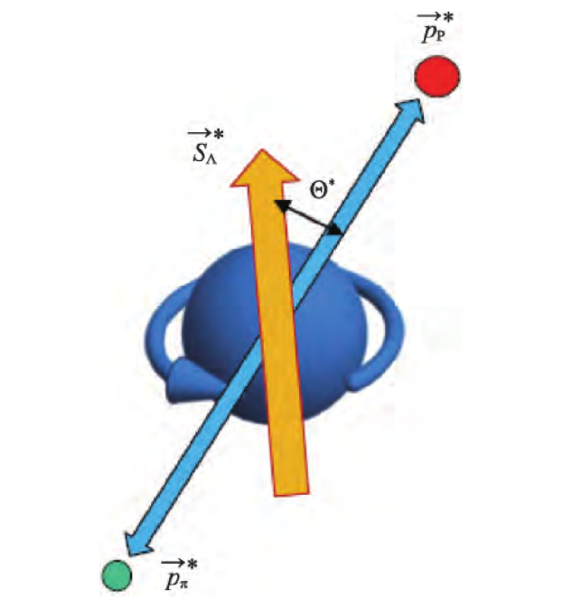
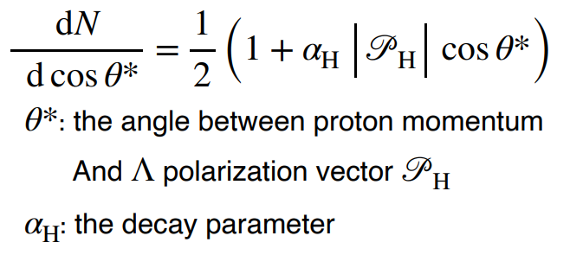
Introduction: global polarization
Using screened potential model to calculate the global quark polarization
Z. T. Liang, X. N. Wang, Phys. Rev. Lett. 94 (2005) 102301
$Λ$ and $\overline{Λ}$ hyperons are “self-analysing”, $Λ→p+π$,
the proton tends to be emitted along the spin direction of the parent hyperons

Slide 5
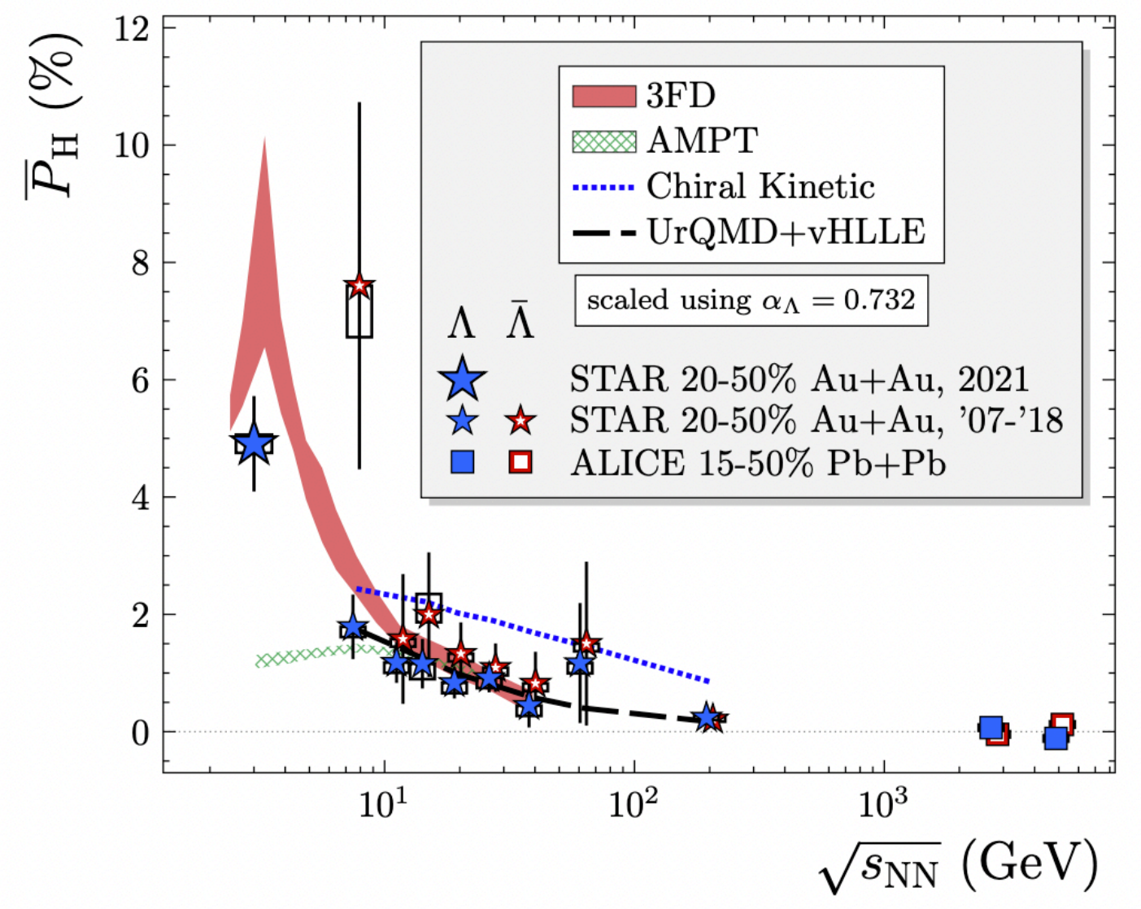
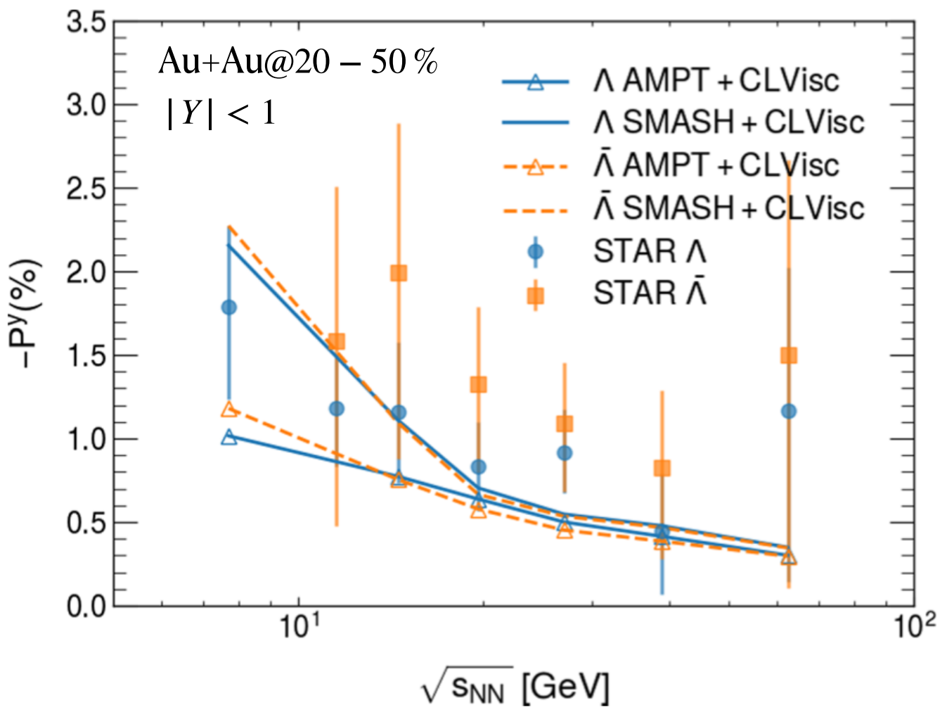
Introduction: global polarization
Fig: CLVisc 2.0, Xiangyu Wu
Hydrodynamic model and transport model reproduce the global polarization of $Λ$ hyperons above 7.7 GeV
The global polarization is sensitive to the initial state of the system

Slide 6
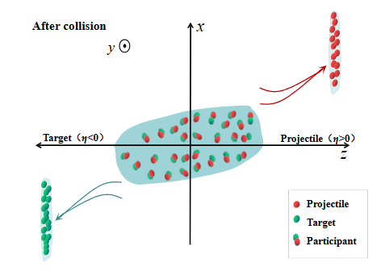
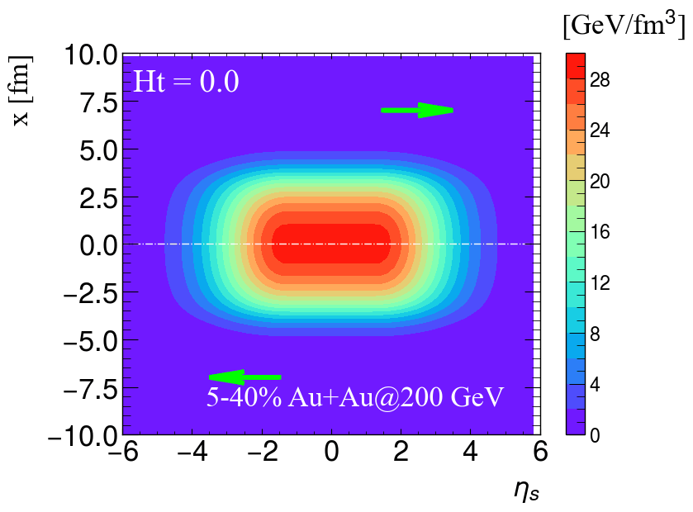
Initial condition: longitudianl tilted geometry of QGP
Jiang, Wu, Cao, Zhang, Phys. Rev. C 107, 034904 (2023)
Based on the results of directed flow, a counter-clockwise tilted of the medium profile is expected in the reaction plane
Ht
A larger value of Ht gives a more tilted fireball in the reaction plane.
The total weight function:
The initial energy density:
The initial local baryon density:

Slide 7
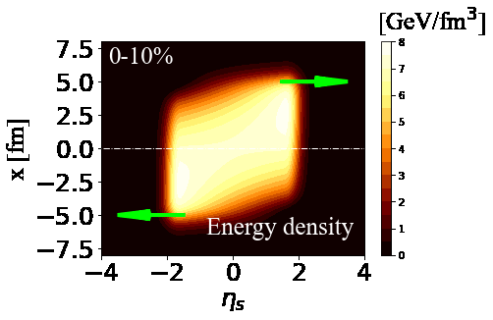
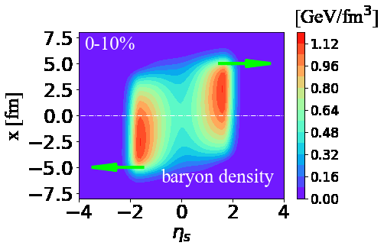
Initial condition: initial fluid velocity field
Ryu, Jupic, Shen, Phys. Rev. C 104 (2021) 5, 054908
At the initial proper time $τ_{0}$, the initial energy-momentum tensor components are:
This $f_{v} ∈[0,1]$ parameter allows one to vary the magnitude of the longitudinal flow velocity gradient.
The transverse expansion is ignored: $T^{τx}=T^{τy}=0$ at $τ=τ_{0.}$
Au+Au @ 27 GeV

Slide 8
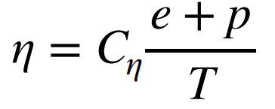
Hydrodynamic evolution: (3+1)-D CLVisc
Wu, Qin, Pang, Wang, Phys. Rev. C 105 (2022) 3, 034909
Energy-momentum conservation and net baryon current conservation:
Equation of motion of dissipative current:
The shear viscosity:
The baryon diffusion:
Equation of state: NEOS-BQS

Slide 9
Spin polarization
Yi, Pu, Yang, Phys. Rev. C 104 (2021) 6, 064901
The polarization pseudo vector for spin$\frac{1}{2}$ particles
axial charge current density
fermions number density
For massless fermions, S(p) can be decomposed into different sources

Slide 10
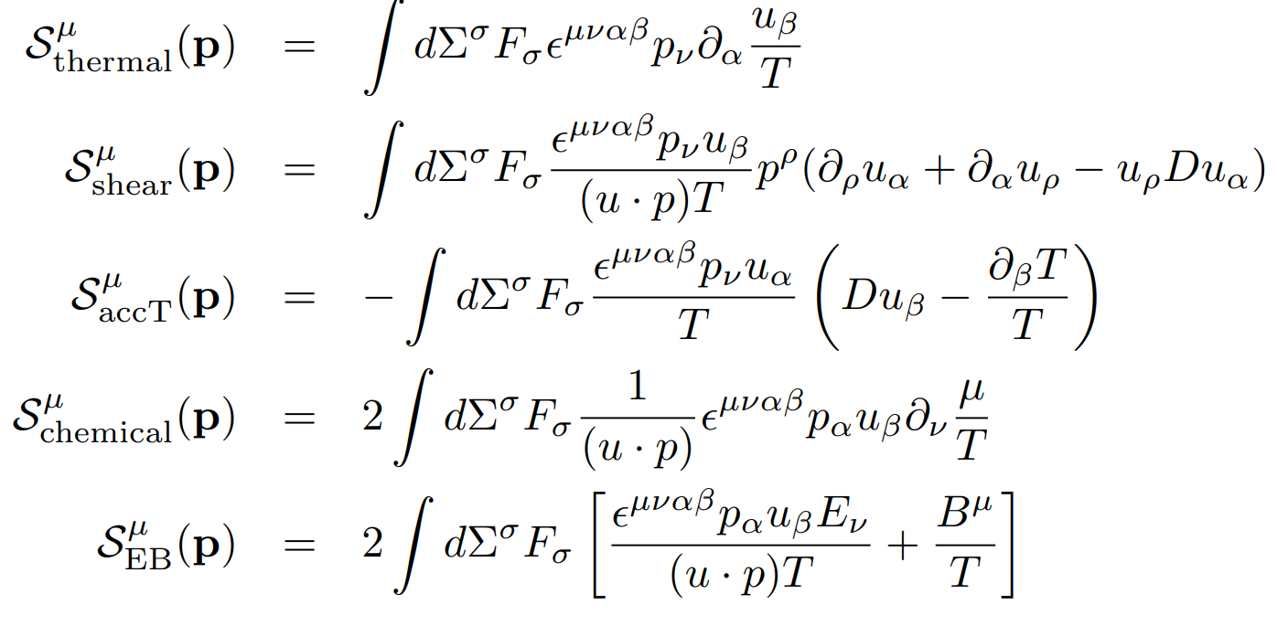
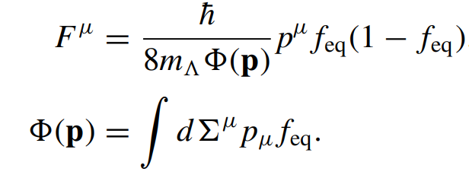
Spin polarization
Yi, Pu, Yang, Phys. Rev. C 104 (2021) 6, 064901
Thermal vorticity
Shear viscous tensor
Fluid acceleration
Gradient of chemical potential
Electromagnetic Fields
Here,

Slide 11
Spin polarization
Wu, Yi, Qin, Pu, Phys.Rev.C 105 (2022) 6, 064909
The polarization vector of $Λ$ and $\overline{Λ}$ hyperons in its rest frame can be constructed as
Here, s = $\frac{1}{2}$ is the spin of the particle.
Finally, the local polarization is given by averaging over the momentum and rapidity:

Slide 12
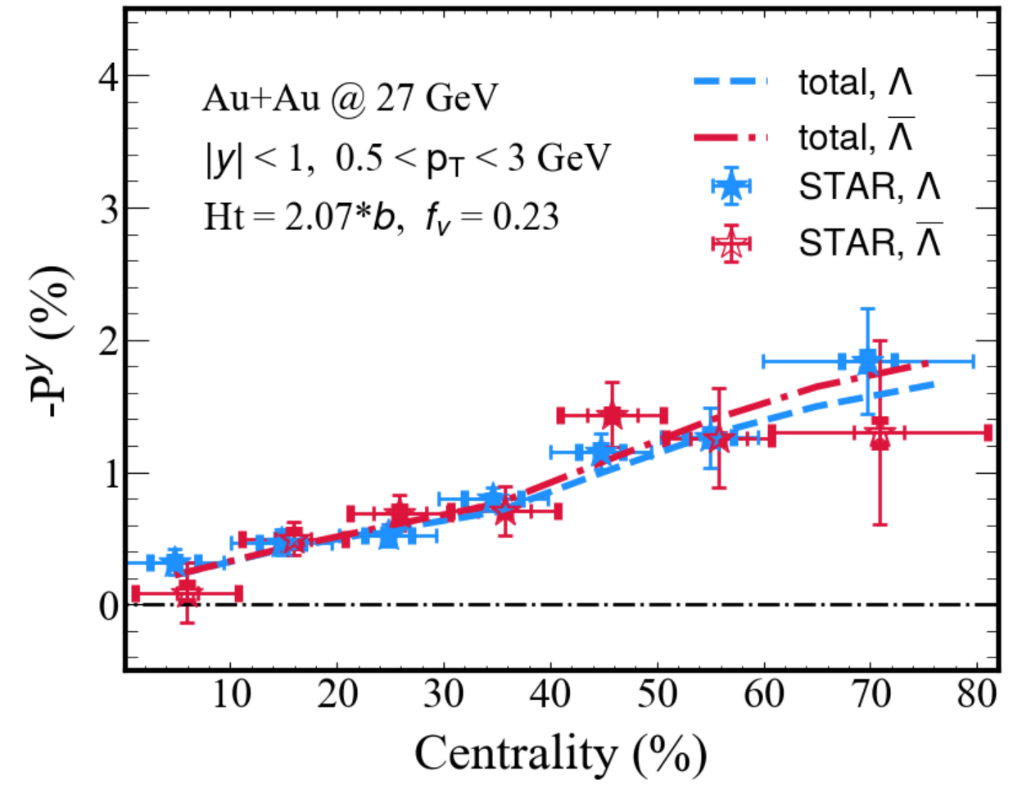
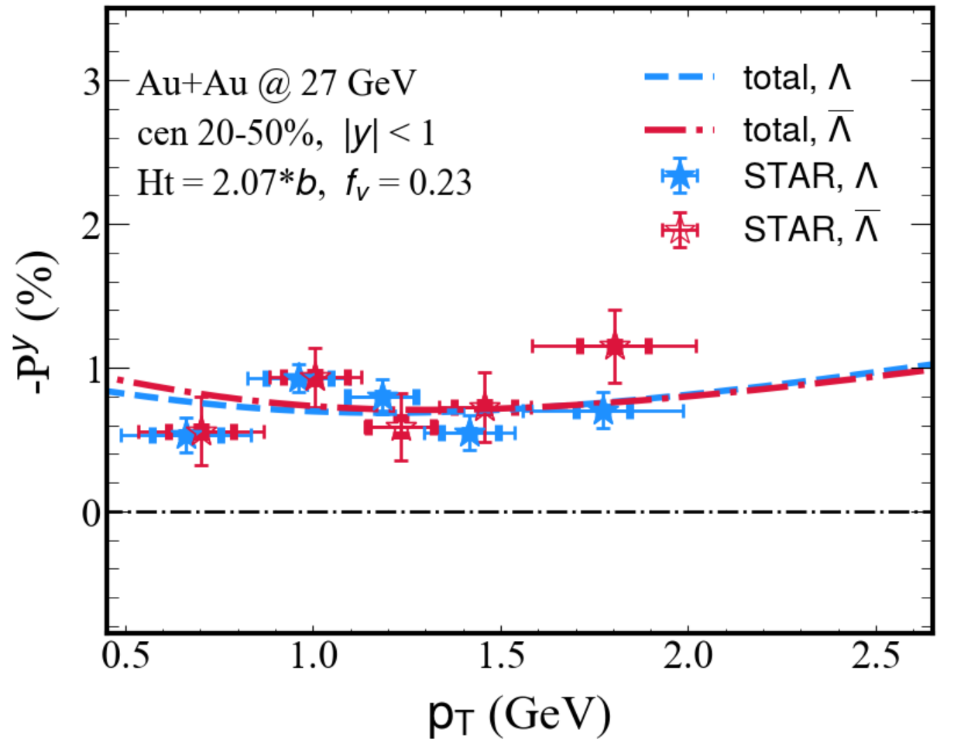
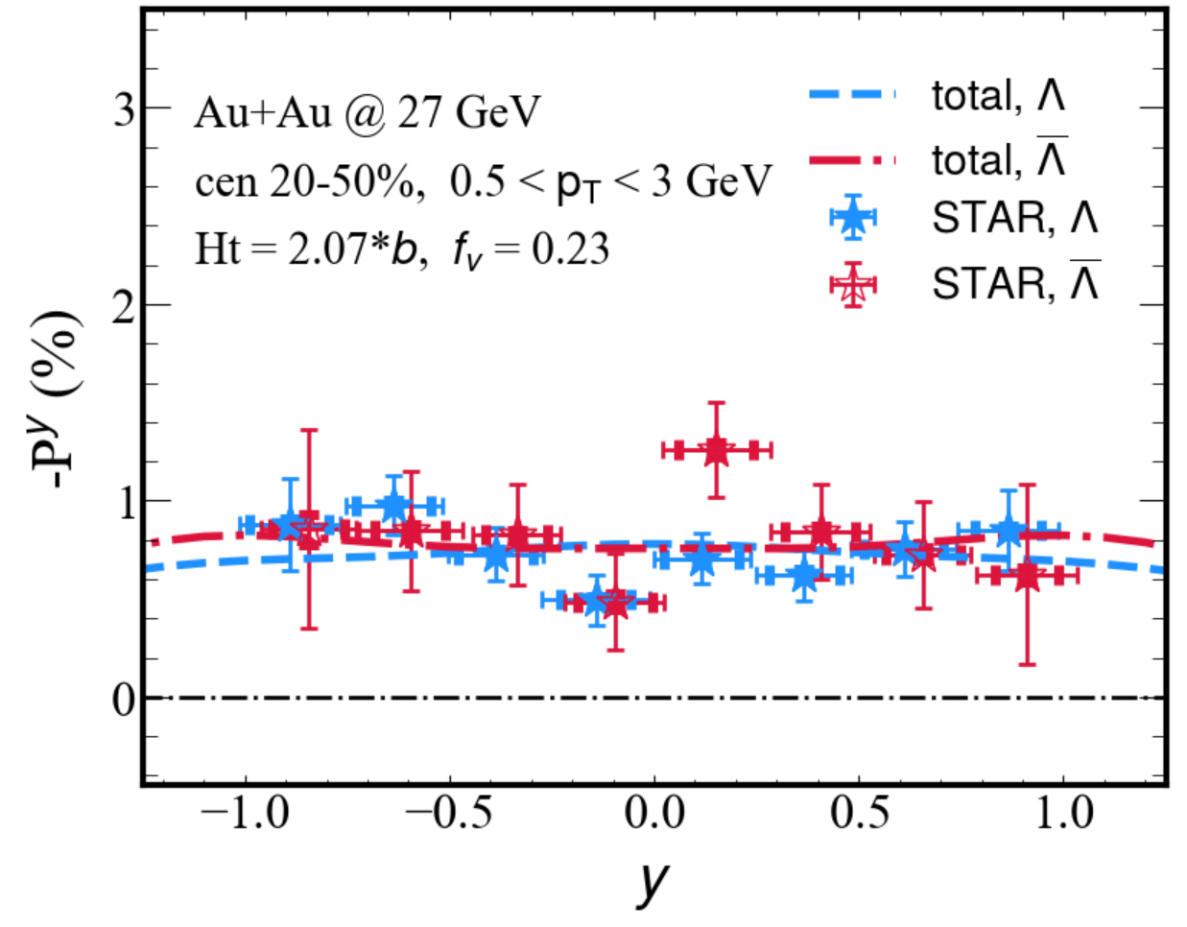
Global polarization @ 27 GeV
STAR, arXiv: 2305.08705
Modified optical Glauber model coupled with CLVisc reproduce the STAR data.
Total = thermal + shear + accT + Chemical

Slide 13
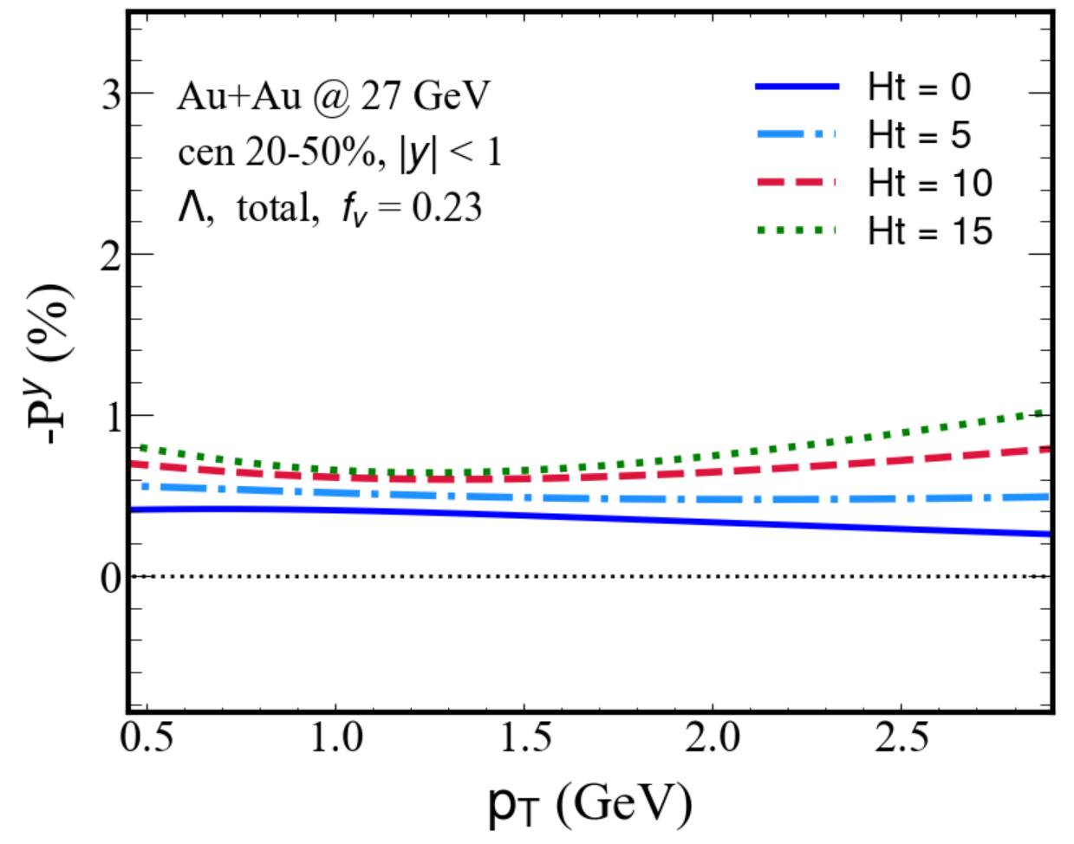
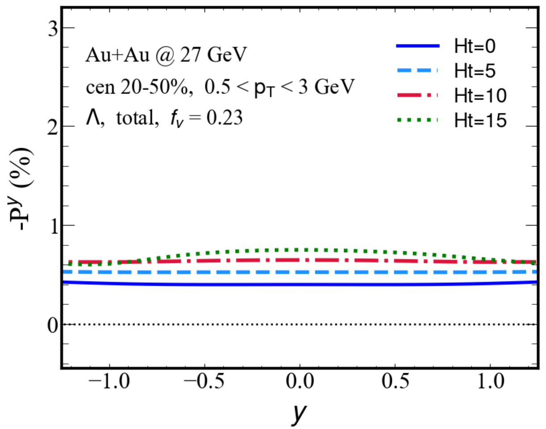
Global polarization (effects of the tilted geometry)
The magnitude of -P^{y} is amplified with increasing Ht from 0 to 15.
A non-monotonic behavior of polarization with respect to p_{T} appears when Ht is large.

Slide 14
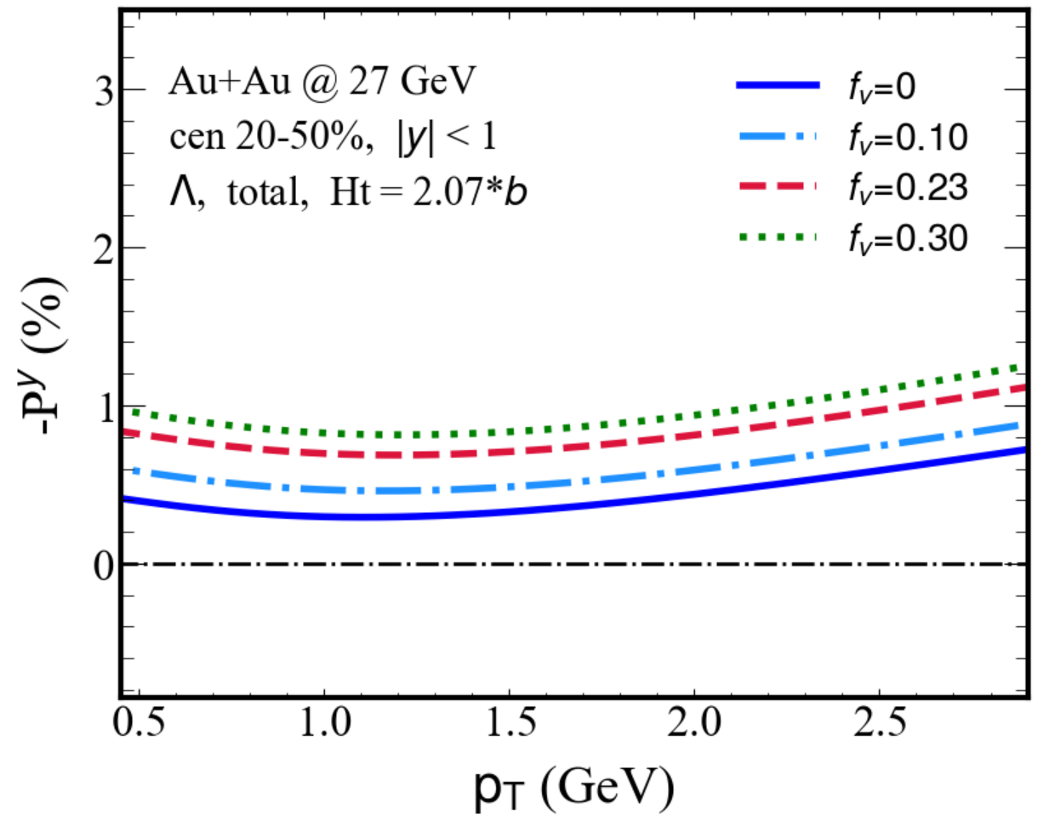
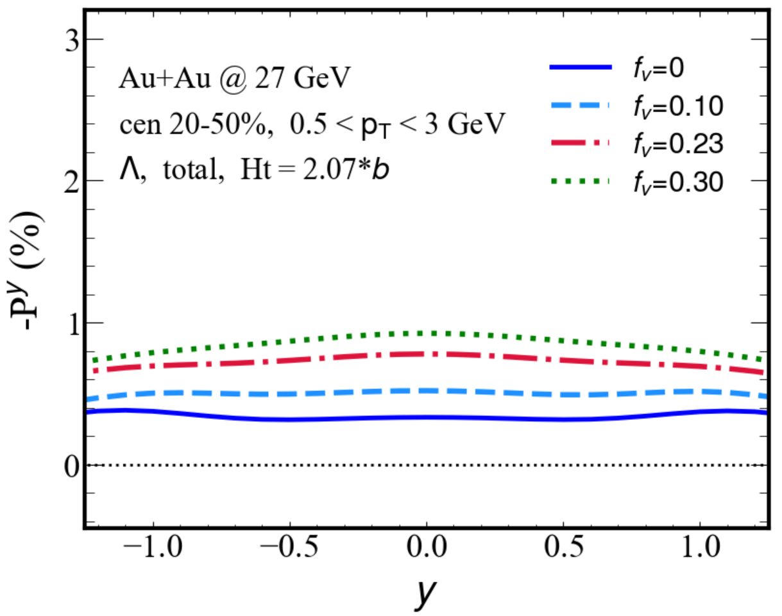
Global polarization (effects of longitudinal flow)
The stronger longitudinal velocity gradient (or larger f_{v}) leads to a larger magnitude of the global vorticity and therefore the global polarization of hyperons.

Slide 15
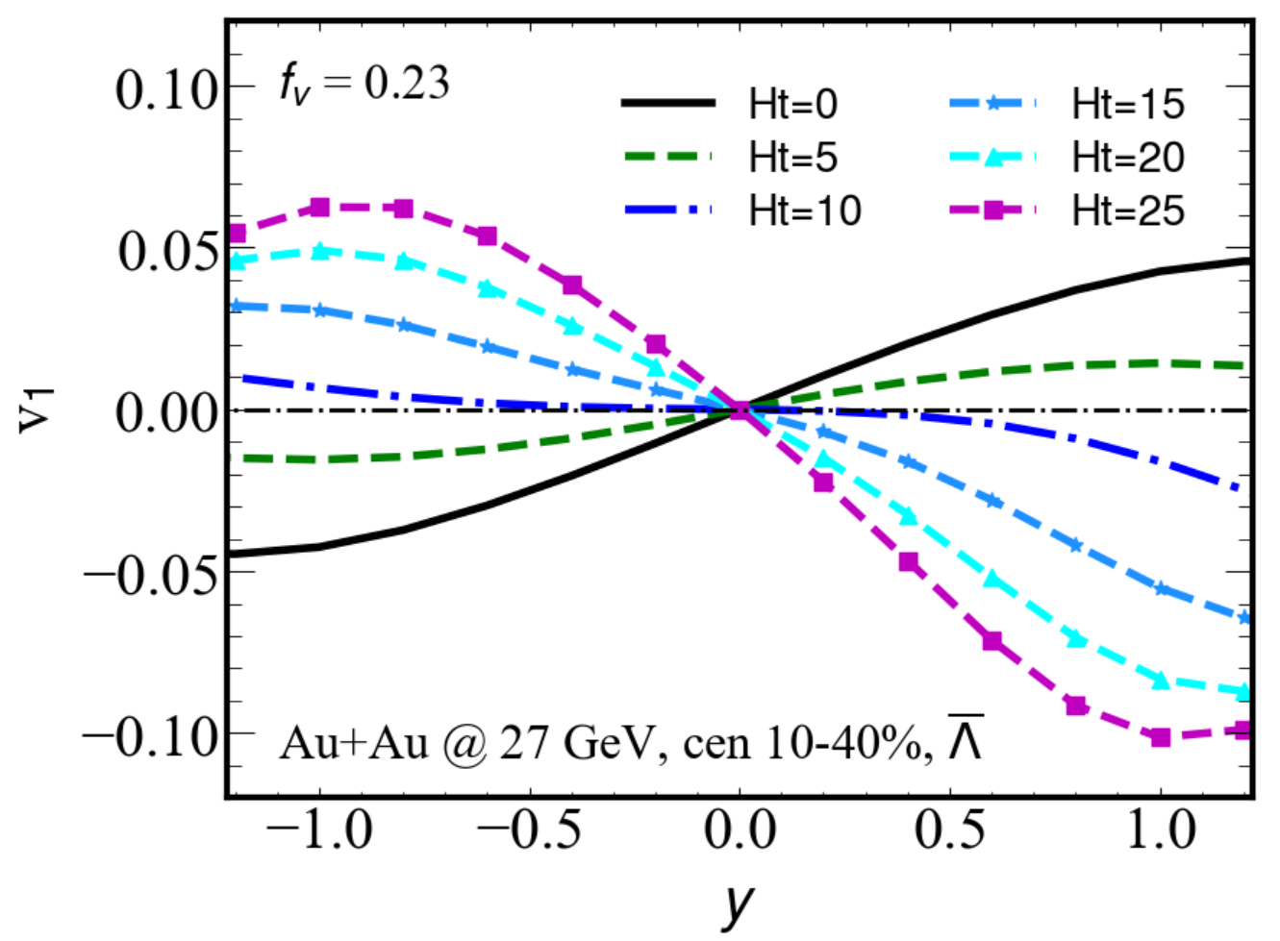
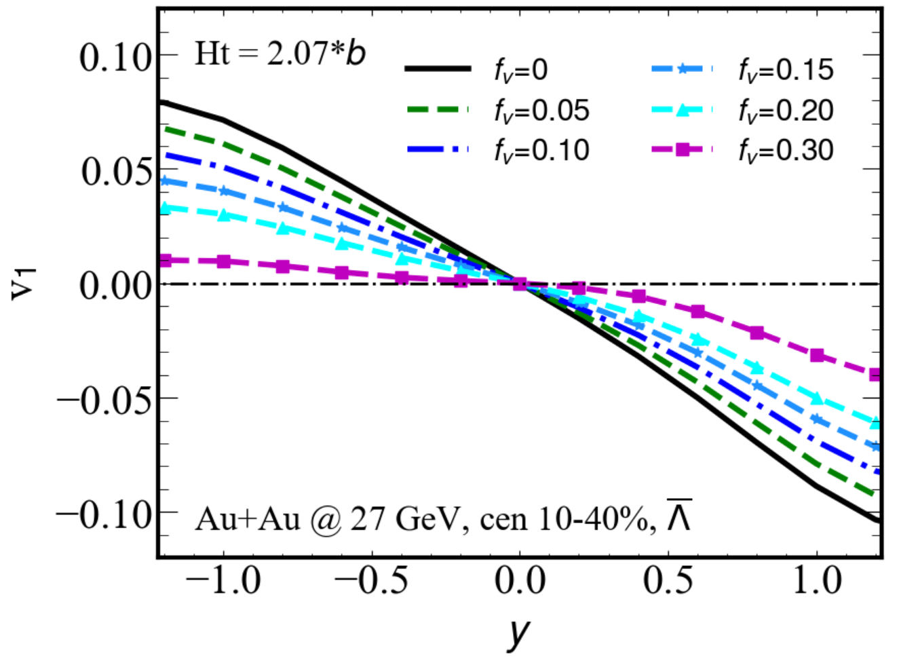
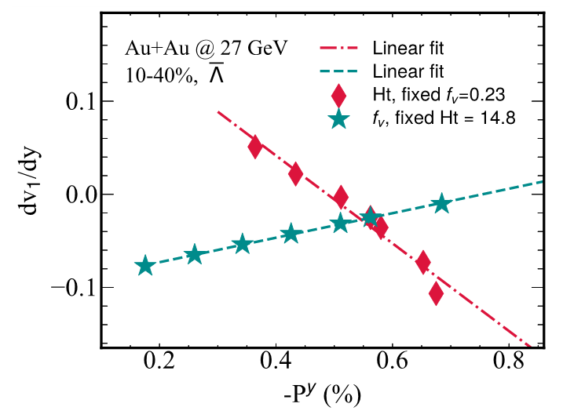
Correlation between global polarization and directed flow
When Ht is fixed, increasing f_{v} increases dv₁/dy and -P^{y}, resulting in a positive correlation.
When f_{v} is fixed, increasing Ht increases -P^{y} but decreases dv₁/dy , resulting in an anti- correlation.

Slide 16
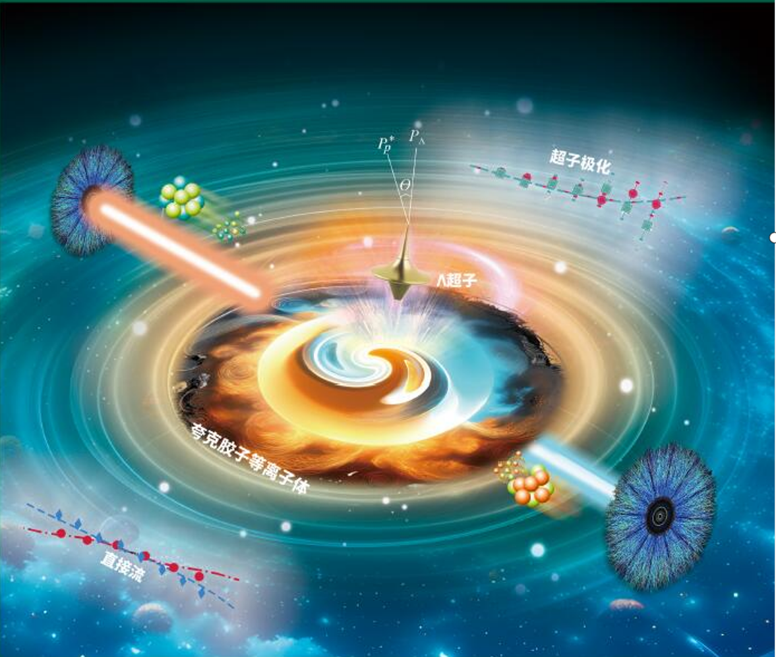
Summary
We discuss the effects of tilted geometry and initial longitudinal flow of the QGP on the hyperon polarization.
We propose a possible correlation between hyperon polarization and directed flow.
Thank you
谢 谢

Slide 17
Backup

Slide 18
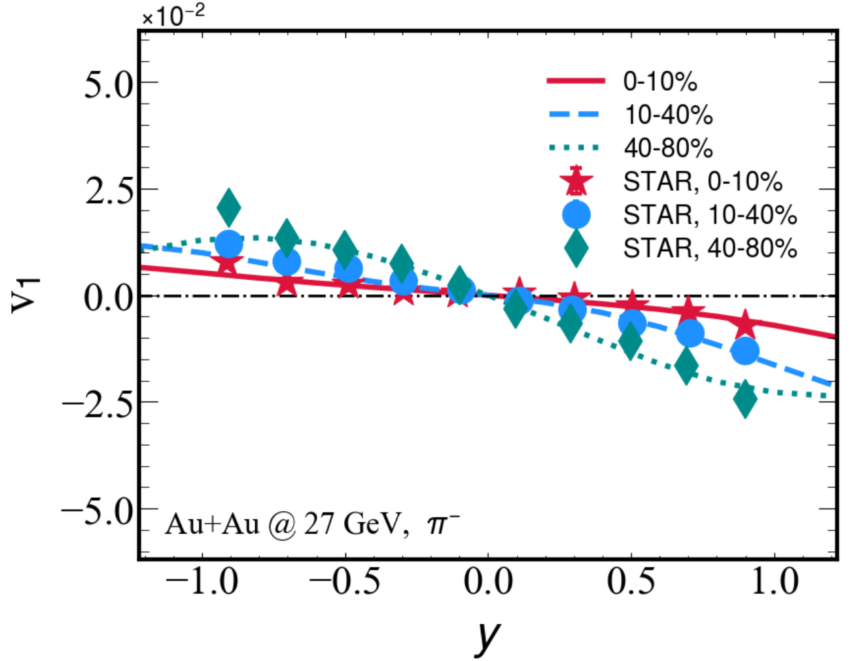
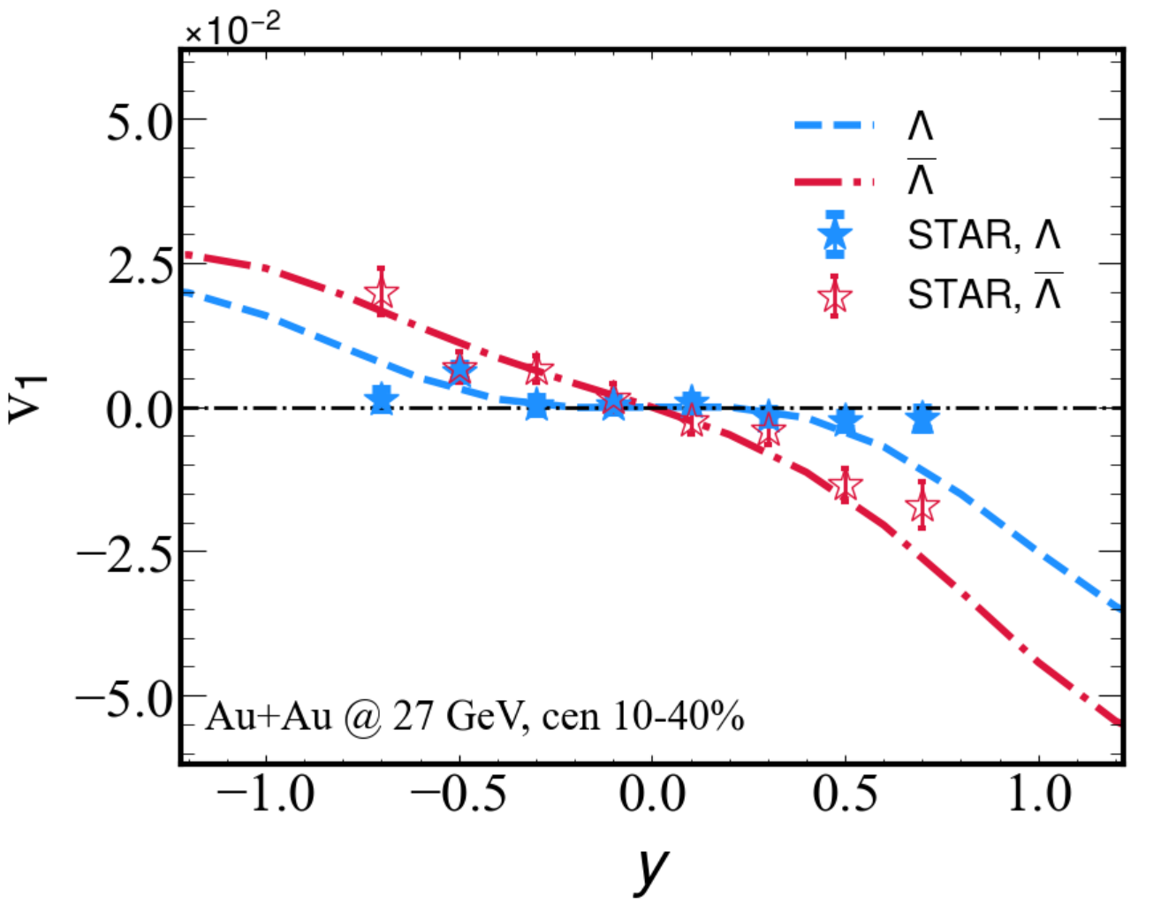
directed flow v₁
Jiang, Wu, Cao, Zhang, Phys. Rev. C 107, 034904 (2023)
v₁ is sensitive to the QGP volume, size, asymmetry shape and velocity field in transverse plane.
Longiduianl shape and size of the QGP can be reconstructed from v₁ data!

Slide 19
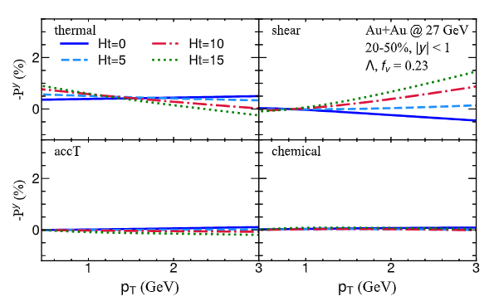
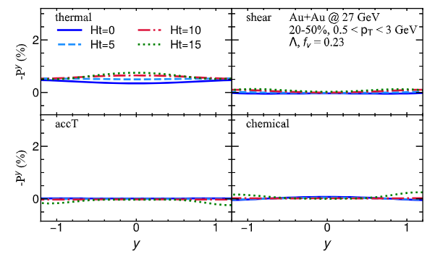
Global polarization (different tilted fireball)

Slide 20
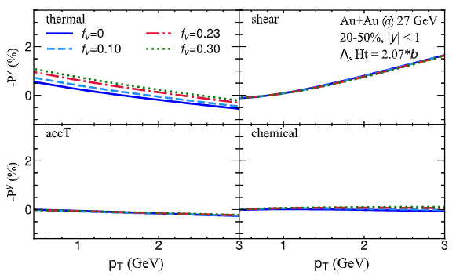
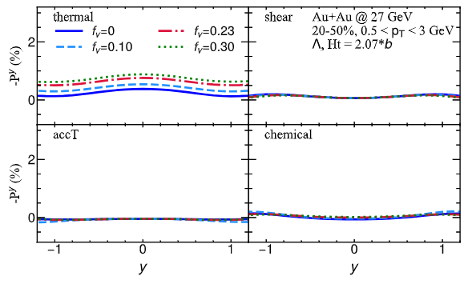
Global polarization (different velocity field)

Slide 21
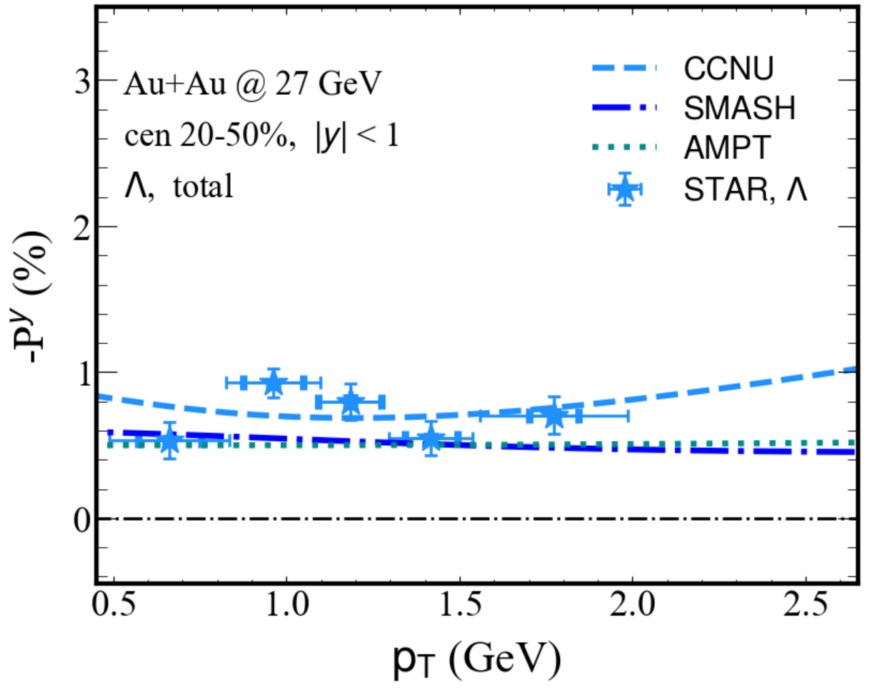
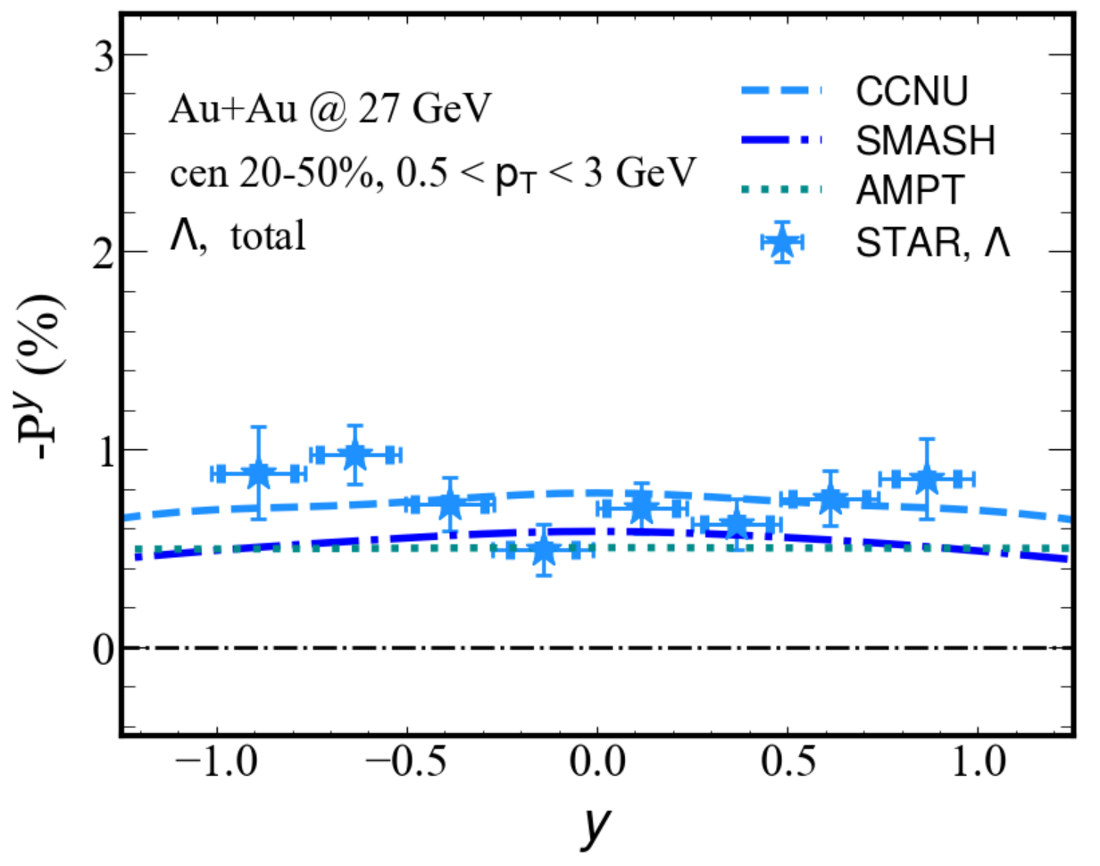
Global polarization (different initial conditions)
The tilted initial condition (CCNU) generates a larger -P^{y} than the SMASH and AMPT models in both transverse momentum and rapidity distribution
All three initial conditions are capable of describing the STAR measurement data

Slide 22
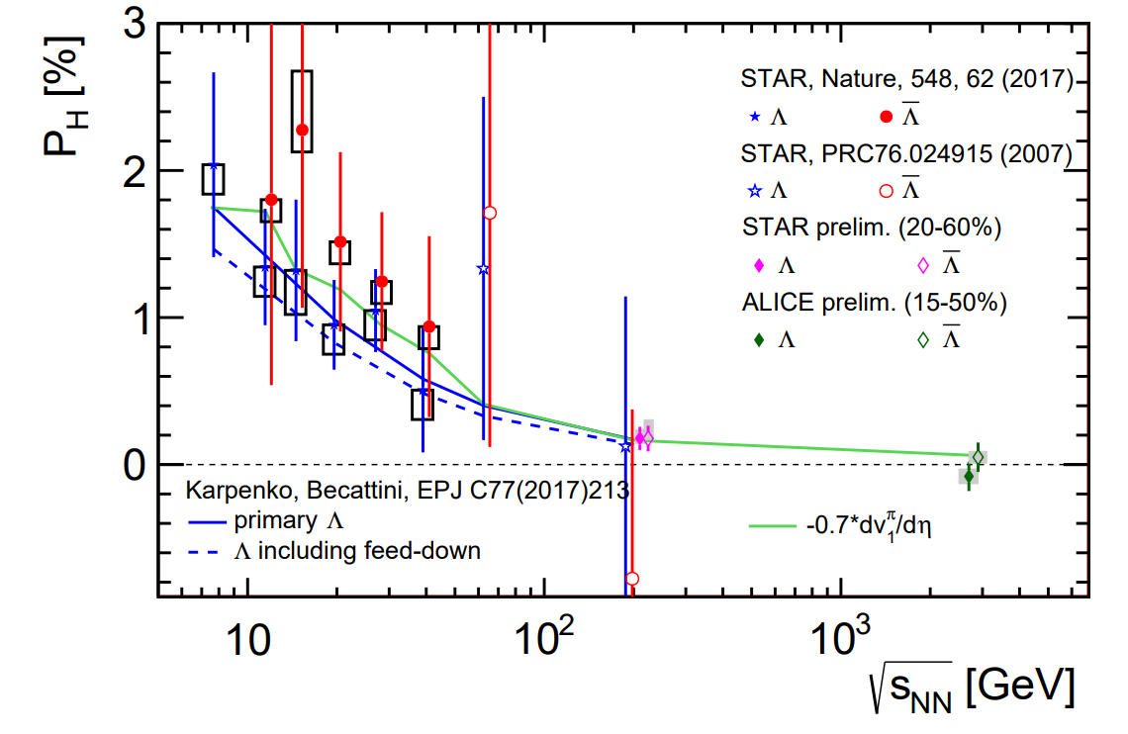
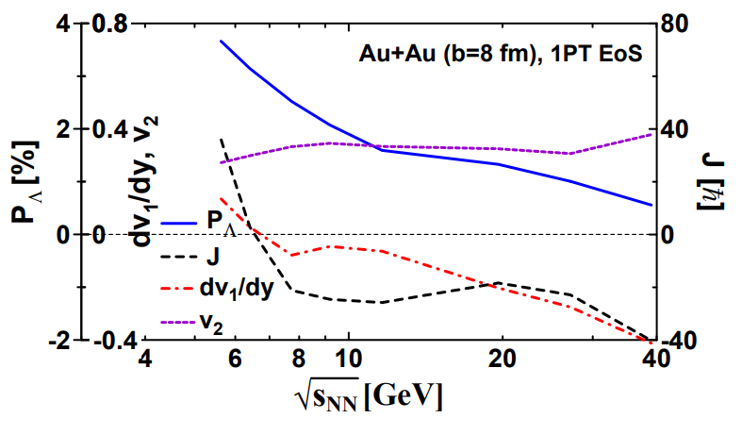
Possible correlation of global polarization and directed flow
Sergei A. Voloshin EPJ Web Conf. 171 (2018) 07002
Yu. B. Ivanov Phys. Rev. C 102 (2020) 2, 024916
Can we use the available data on v₁ slope for an estimate of the global polarization at different collisions?

Slide 23
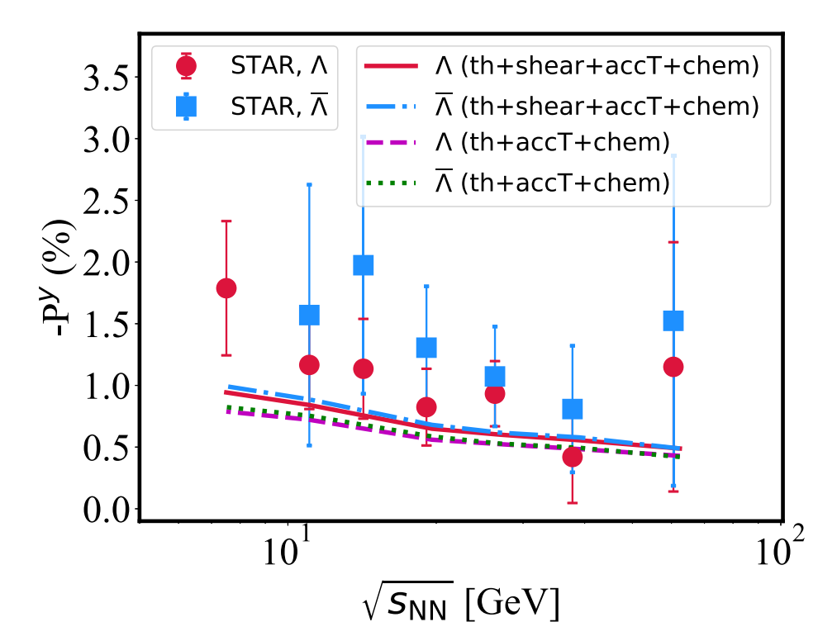
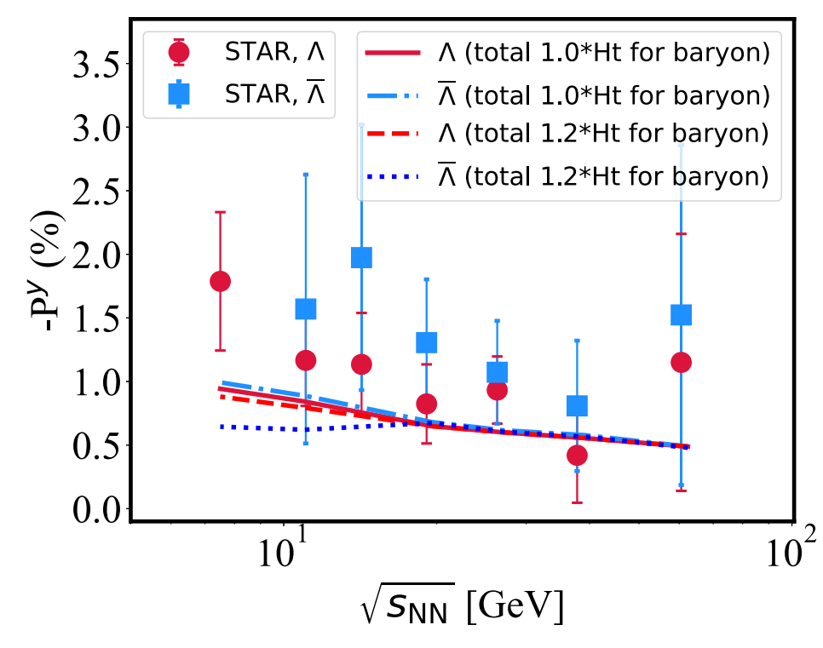
Global polarization
Notes:
一方面认为它携带了高能核核碰撞极早期的信息；
另一方面，它可以帮助人们寻找和了解自然界费米尺度下可能存在的强电磁场。

