Slide 1
Development of 3+1D glasma simulation in Milne coordinates and its application to central and non-central collisions
Hidefumi Matsuda (Fudan Univ.)
Collaborator : Xu-Guang Huang (Fudan Univ.)
Chirality2023@Beijing

Slide 2
1
8
Background
Method
Numerical Results
① Check of our method
② Application to the central and non-central collisions
Summary

Slide 3
1
8
Background
Method
Numerical Results
① Check of our method
② Application to the central and non-central collisions
Summary

Slide 4
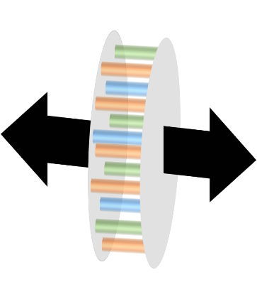
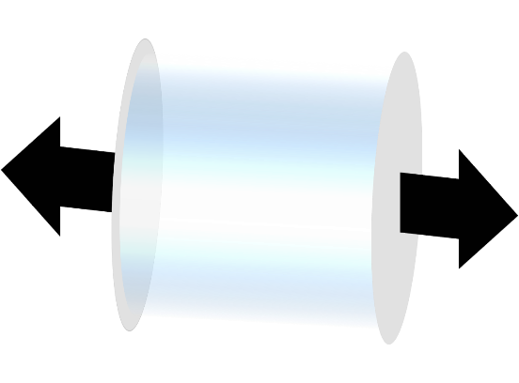
1
Initial stage in HIC
15
Color glass condensate ($τ<0$ fm/c)
Soft parton
~ Classical Yang-Mills (CYM) field
Hard parton
~ classical color charge
Relativistic viscous fluid ($τ≳τ_{hydro}$ fm/c)
Glasma
✔ Highly occupied gluonic matter
✔ CYM dynamics plays important role in its evolution

Slide 5
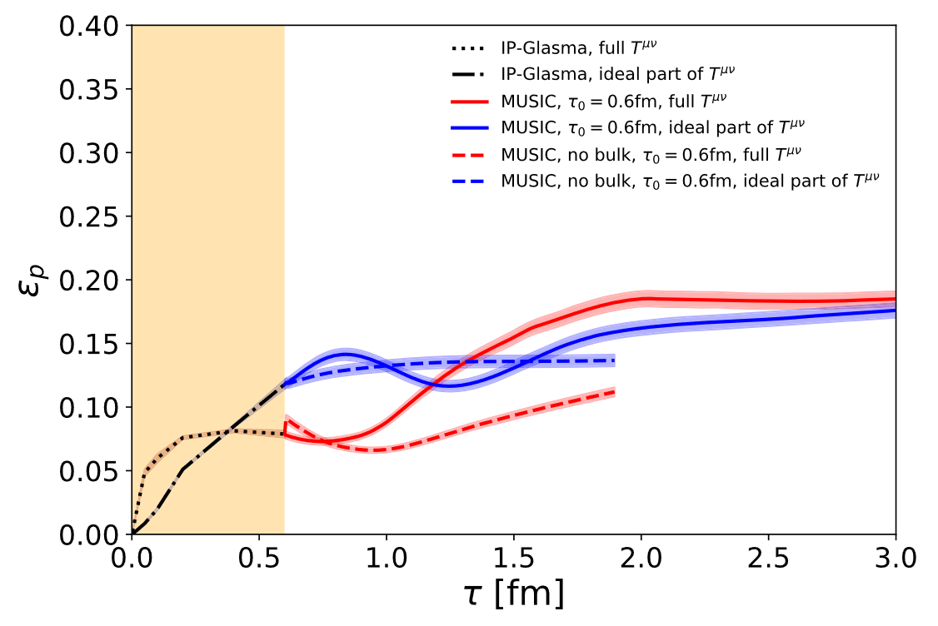
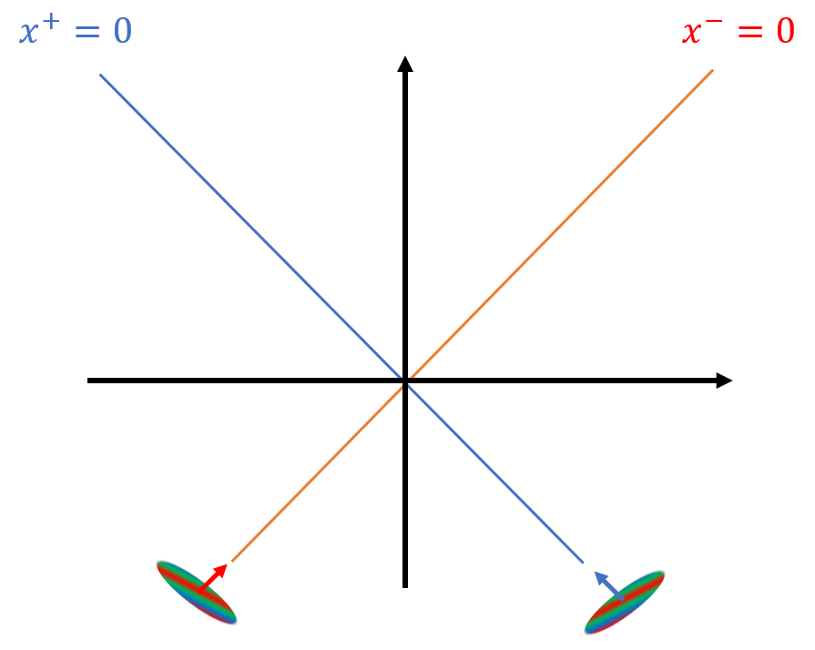
2
Glasma simulation
15
Glasma simulation using CYM field plays important role in bridge between moment of collision and subsequent hydrodynamic evolution
<Many applications>
Study of features of glasma; thermalization, pressure isotropization, instabilities, chaos, vorticity, etc.
Providing initial condition of subsequent hydrodynamics
IP-glasma
B. Schenke, C. Shen and P. Tribedy (2018)
Hydrodynamics
Boost invariance assumption for study of midrapidity region is widely used

Slide 6
3
3D glasma simulation
15
3D glasma simulation has been paid much attention recently
Fluctuation from CGC effective theory
B. Schenke and S. Schlichting, Phys. Rev. C 94, 044907 (2016). S. McDonald, S. Jeon, C. Gale, Nucl. Phys. A 982, (2019).; Nucl. Phys. A 1005, 121771 (2021).
Longitudinal shape of nucleus and recoil effect
A. Ipp and David I. Müller, Phys. Lett. B 771, (2017).; Eur. Phys. J. A 56, 9, 243 (2020). D. Gelfand, A. Ipp and D. Müller, Phys. Rev. D 94, 014020 (2016). D. Avramescu, V. Băran, V. Greco, A. Ipp and, David.I. Müller, and Marco Ruggieri, Phys. Rev. D 107, 114021 (2023). S. Schlichting and P. Singh, Phys. Rev. D 103, 1, 014003 (2021).

Slide 7
3
3D glasma simulation
15
3D glasma simulation has been paid much attention recently
Fluctuation from CGC effective theory
B. Schenke and S. Schlichting, Phys. Rev. C 94, 044907 (2016). S. McDonald, S. Jeon, C. Gale, Nucl. Phys. A 982, (2019).; Nucl. Phys. A 1005, 121771 (2021).
Longitudinal shape of nucleus and recoil effect
A. Ipp and David I. Müller, Phys. Lett. B 771, (2017).; Eur. Phys. J. A 56, 9, 243 (2020). D. Gelfand, A. Ipp and D. Müller, Phys. Rev. D 94, 014020 (2016). D. Avramescu, V. Băran, V. Greco, A. Ipp and, David.I. Müller, and Marco Ruggieri, Phys. Rev. D 107, 114021 (2023). S. Schlichting and P. Singh, Phys. Rev. D 103, 1, 014003 (2021).

Slide 8
3
3D glasma simulation
15
3D glasma simulation has been paid much attention recently
Fluctuation from CGC effective theory
B. Schenke and S. Schlichting, Phys. Rev. C 94, 044907 (2016). S. McDonald, S. Jeon, C. Gale, Nucl. Phys. A 982, (2019).; Nucl. Phys. A 1005, 121771 (2021).
Longitudinal shape of nucleus and recoil effect
A. Ipp and David I. Müller, Phys. Lett. B 771, (2017).; Eur. Phys. J. A 56, 9, 243 (2020). D. Gelfand, A. Ipp and D. Müller, Phys. Rev. D 94, 014020 (2016). D. Avramescu, V. Băran, V. Greco, A. Ipp and, David.I. Müller, and Marco Ruggieri, Phys. Rev. D 107, 114021 (2023). S. Schlichting and P. Singh, Phys. Rev. D 103, 1, 014003 (2021).
Numerically much expensive

Slide 9
3
3D glasma simulation
15
3D glasma simulation has been paid much attention recently
Fluctuation from CGC effective theory
B. Schenke and S. Schlichting, Phys. Rev. C 94, 044907 (2016). S. McDonald, S. Jeon, C. Gale, Nucl. Phys. A 982, (2019).; Nucl. Phys. A 1005, 121771 (2021).
Longitudinal shape of nucleus and recoil effect
A. Ipp and David I. Müller, Phys. Lett. B 771, (2017).; Eur. Phys. J. A 56, 9, 243 (2020). D. Gelfand, A. Ipp and D. Müller, Phys. Rev. D 94, 014020 (2016). D. Avramescu, V. Băran, V. Greco, A. Ipp and, David.I. Müller, and Marco Ruggieri, Phys. Rev. D 107, 114021 (2023). S. Schlichting and P. Singh, Phys. Rev. D 103, 1, 014003 (2021).
Numerically much expensive
We propose new formulation for more efficient 3D glasma simulation

Slide 10
1
8
Background
Method
Numerical Results
① Check of our result
② Application to the central and non-central collisions
Summary

Slide 11
4
key point
15
Previous simulations use lattices in Minkowski coordinates
Our simulation uses lattice in Milne coordinates
z
=
$$η$$
z
Our simulation requires relatively small lattice size in longitudinal direction

Slide 12
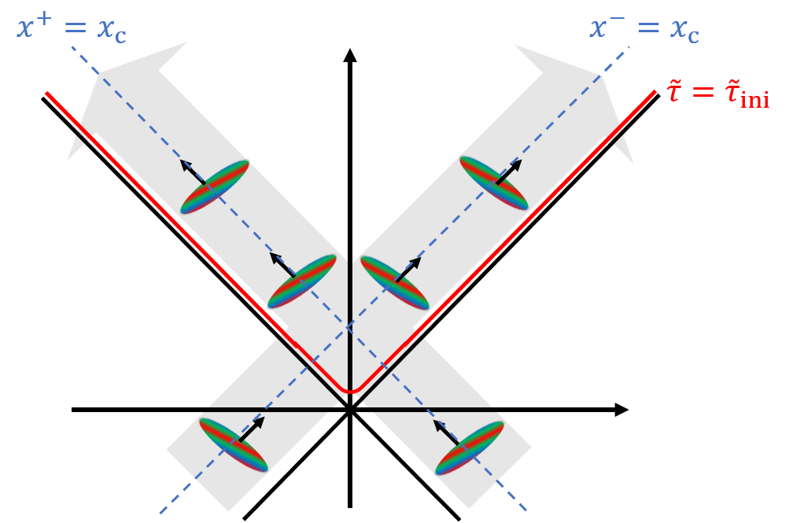
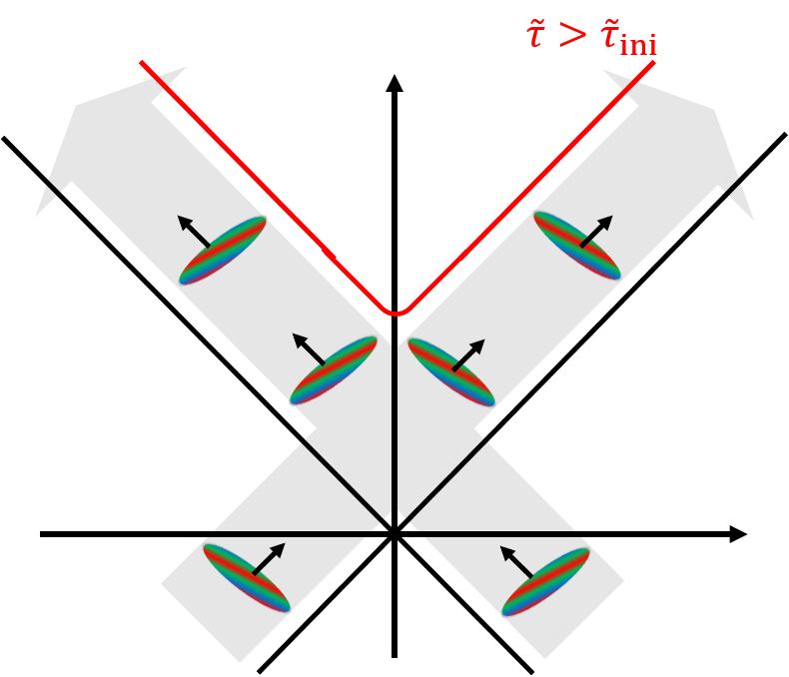
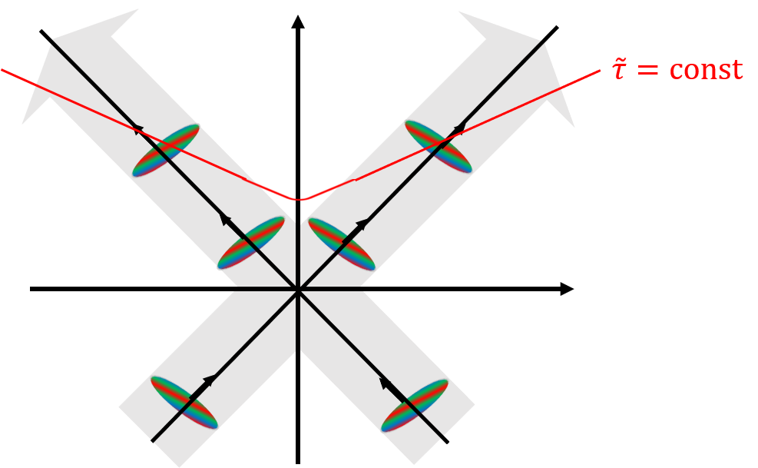
5
Strategy
15
Use two kinds of Milne coordinates
Milne coordinates for calculation: $\tilde{τ}=\sqrt{2x^{−}x^{+}},\tilde{η}=\frac{1}{2}ln\frac{x^{+}}{x^{−}}$
Usual Milne coordinates : $\tilde{τ}=\sqrt{2(x^{−}−x_{c})(x^{+}−x_{c})},\tilde{η}=\frac{1}{2}ln\frac{x^{+}−x_{c}}{x^{−}−x_{c}}$
* $x_{c}$: center position of nuclei in light-cone coordinates ($x^{∓}=\left(t∓z\right)/\sqrt{2}$)
✔ Put initial condition of two incoming nuclei
✔ Evolve the CYM field and classical color current
✔ Do general coordinates transformation
$A,E,J$ ${\left.​\right|}_{\tilde{τ}={\tilde{τ}}_{ini}}$
$$D_{μ}F^{μν}=J^{μ},D_{μ}J^{μ}=0$$
$$T^{\tilde{μ}\tilde{ν}} → T^{μν}$$

Slide 13
6
Initial condition and Evolution equation
15
Initial classical color current: incoherent sum of two incoming classical color current
Fock-Schwinger gauge: $A^{\tilde{τ}}=0$
Initial transverse components of gauge fields and color electric fields
: incoherent sum of those from two incoming nuclei
Longitudinal components of gauge fields and color electric fields
: given so as to satisfy the Gauss law
$$J^{μ}=J^{(1)μ}+J^{(2)μ}=δ^{μ+}ρ^{(1)}+δ^{μ−}ρ^{(2)}$$
dominant component at high energy
$A_{i}=A_{i}^{\left(1\right)}+A_{i}^{\left(2\right)}$, $E^{i}=E^{\left(1\right)i}+E^{\left(2\right)i}$
$A_{i}^{\left(1/2\right)},E_{i}^{\left(1/2\right)}$ : solution of $D_{μ}F^{μ}=J^{(1/2)μ}$
$A_{\tilde{η}}=0$, $E^{\tilde{η}}=i[A_{i}^{\left(1\right)},A_{i}^{\left(2\right)}]$
Each current is assumed to evolve according to the continuity equation: $D_{μ}J^{\left(1/2\right)μ}=0$
CYM field evolve according to its E.O.M. : $D_{μ}F^{μi}=J^{i}$

Slide 14
1
8
Background
Method
Numerical Results
① Check of our method
② Application to the central and non-central collisions
Summary

Slide 15
1
8
Background
Method
Numerical Results
① Check of our method
② Application to the central and non-central collisions
Summary

Slide 16
7
Numerical result ①: Check of our method
15
Setup : consistent with those used for Fig.8 and 9 in S. Schlichting and P. Singh‘s paper
[Phys. Rev. D 103, 1, 014003 (2021).]
$ρ^{(1/2)}\left(x^{∓},x_{⊥}\right)=N_{1D}(x^{∓}−x_{c},R/\sqrt{2}γ)$ $Γ^{\left(i\right),a}\left(x_{⊥}\right)$
$<Γ^{\left(i\right),a}\left(x_{⊥}\right)Γ^{\left(j\right),b}\left({x^{′}}_{⊥}\right)> =δ^{ij}δ^{ab}\frac{Q_{s}^{2}}{2}N_{1D}(\overset{⃑}{x_{⊥}}−\overset{⃑}{{x^{′}}_{⊥}};l_{⊥})$
Nucleus’s radius: $R=8/Q_{S}$
gamma factor: $γ=16,32,64$ and $128$
Squared color charge density: ${\left(g^{2}\overline{μ}\right)}^{2}=Q_{s}^{2}/2$
Transverse correlation length: $l_{⊥}=\frac{\sqrt{2}}{5Q_{s}}$
Number of lattice grid: $L_{⊥}^{2}×L_{η}={128}^{2}×224$, ${128}^{2}×448$ and ${128}^{2}×896$
Longitudinal system size: $−5≤η≤5$
Infrared regulator: $Λ_{IR}=200$ MeV

Slide 17
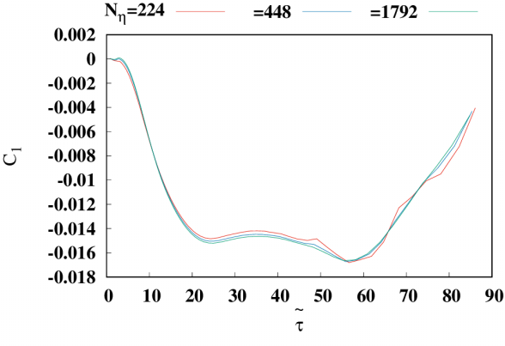
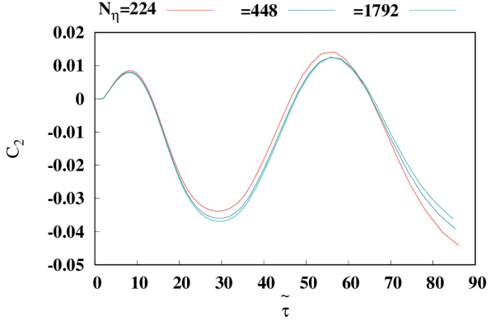
8
Numerical result ①: Check of our method
15
<Check continuity equations>
1. $\tilde{τ} ∂_{\tilde{τ}}τ^{\tilde{τ}\tilde{τ}}=−\left(τ^{\tilde{τ}\tilde{τ}}+{\tilde{τ}}^{2}τ^{\tilde{η}\tilde{η}}+ej\right)$
* $τ^{μν}≡\frac{∫T^{μν}}{V}, ej≡\frac{∫E^{\tilde{η}}J^{\tilde{η}}}{V}$
2. ${τ^{3}τ}^{\tilde{τ}\tilde{η}}=const.$
$$C_{1}≡\frac{−\left(τ^{\tilde{τ}\tilde{τ}}{\tilde{τ}}^{2}τ^{\tilde{η}\tilde{η}}+ej\right)}{\tilde{τ}∂_{\tilde{τ}}τ^{\tilde{τ}\tilde{τ}}}−1$$
$$C_{2}≡\frac{{{\tilde{τ}}^{3}τ}^{\tilde{τ}\tilde{η}}}{{{\tilde{τ}}^{3}τ}^{\tilde{τ}\tilde{η}}{\left.​\right|}_{\tilde{τ}={\tilde{τ}}_{ini}}}−1$$
✔ Violations of continuity equations are not large
and stable under the change of a lattice spacing

Slide 18
9
Numerical result ①: Check of our method
15
<Reproduce previous calculations>
Transverse pressure:
Our calculations (50 events average)
Previous result (1 event)
from Phys. Rev. D 103, 1, 014003 (2021).
✔ Our simulations successfully reproduce previous results using a lattice 4.57 times smaller
in longitudinal direction!!

Slide 19
1
8
Background
Method
Numerical Results
① Check of our method
② Application to the central and non-central collisions
Summary

Slide 20
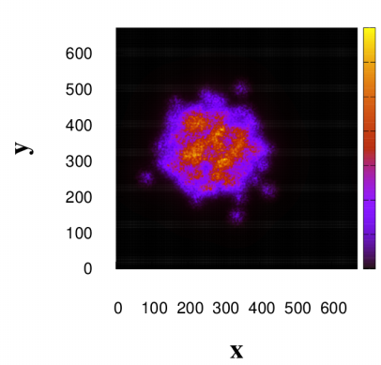
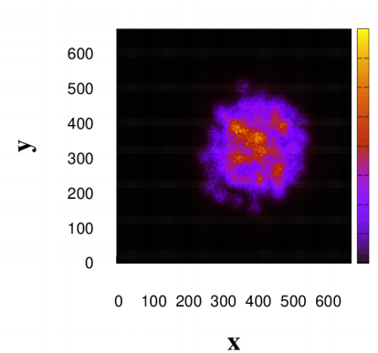
10
Numerical result ②: Au-Au collision at RHIC
15
Setup : mimicking a Au-Au collision at √(𝑠_NN )=200 GeV
✔ Total color charge at initial time is expressed as incoherent sum of i-th nuleon’s one
whose center position ($b^{∓},b_{1},b_{2}$) is randomly sampled by Woods-Saxon distribution
$ρ^{(1/2)}\left(x^{∓},x_{⊥}\right)=\sum_{i=1}^{A}{ρ_{i}^{\left(1/2\right)}\left(x^{∓},x_{⊥}\right)}$
✔ $ρ_{i}^{\left(1/2\right)}\left(x^{∓},x_{⊥}\right)=N_{1D}(x^{∓}−b^{∓},R_{n}/\sqrt{2}γ)N_{2D}(\overset{⃑}{x_{⊥}}−\overset{⃑}{b_{⊥}},R_{n}) Γ_{i}^{\left(1/2\right)}\left(x^{∓},x_{⊥}\right)$
$<ρ_{i}^{(1/2)a}\left(x^{∓},x_{⊥}\right)ρ_{j}^{(1/2)b}\left({x′}^{∓},{x′}_{⊥}\right)> =g^{2}μ\left(x^{∓}+{x^{′}}^{∓},\overset{⃑}{x_{⊥}}+\overset{⃑}{{x^{′}}_{⊥}}\right)N_{1D}(x^{∓}−{x^{′}}^{∓},l_{∓})N_{2D}(\overset{⃑}{x_{⊥}}−\overset{⃑}{{x′}_{⊥}},x_{⊥})$

Slide 21
11
6
Numerical result ②: Au-Au collision at RHIC
15
8
Nucleus’s radius: $R=6.38$ (fm)
Nucleon’s radius: $R_{n}=0.61$ (fm)
Thickness of nucleus: $a=0.535$ (fm)
Number of nucleons: $A=197$
gamma factor: $γ=108$
Squared color charge density: ${\left(g^{2}μ\right)}^{2}{\left.​\right|}_{center of nucleon}=Q_{s,n}=0.5$ GeV
Ultraviolet regulator(perp.) : $l_{⊥}=2.5Q_{s,n}$
Ultraviolet regulator(longi.) : $l_{lon}=\frac{R_{n}}{γ}$
Number of lattice grid: $L_{⊥}^{2}×L_{η}={672}^{2}×1792$
Longitudinal system size: $−4≤η≤4$
Impact parameter: $b=0, R$
$\text{Infrared} \text{regulator}\text{: }Λ_{IR}=200 \text{MeV}$
✔ Total color charge at initial time is expressed as incoherent sum of i-th nuleon’s one
whose center position ($b^{∓},b_{1},b_{2}$) is randomly sampled by Woods-Saxon distribution
$ρ^{(1/2)}\left(x^{∓},x_{⊥}\right)=\sum_{i=1}^{A}{ρ_{i}^{\left(1/2\right)}\left(x^{∓},x_{⊥}\right)}$
✔ $ρ_{i}^{\left(1/2\right)}\left(x^{∓},x_{⊥}\right)=N_{1D}(x^{∓}−b^{∓},R_{n}/\sqrt{2}γ)N_{2D}(\overset{⃑}{x_{⊥}}−\overset{⃑}{b_{⊥}},R_{n}) Γ_{i}^{\left(1/2\right)}\left(x^{∓},x_{⊥}\right)$
$<ρ_{i}^{(1/2)a}\left(x^{∓},x_{⊥}\right)ρ_{j}^{(1/2)b}\left({x′}^{∓},{x′}_{⊥}\right)> =g^{2}μ\left(x^{∓}+{x^{′}}^{∓},\overset{⃑}{x_{⊥}}+\overset{⃑}{{x^{′}}_{⊥}}\right)N_{1D}(x^{∓}−{x^{′}}^{∓},l_{∓})N_{2D}(\overset{⃑}{x_{⊥}}−\overset{⃑}{{x′}_{⊥}},x_{⊥})$

Slide 22
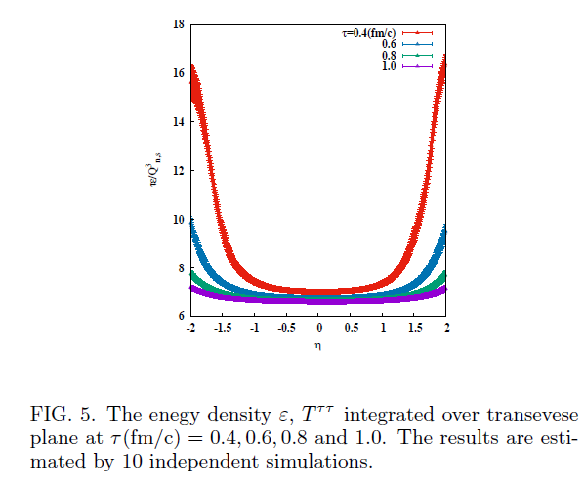
12
6
Numerical result ②: Au-Au collision at RHIC
15
8
<Energy density $ε=∫dxdyT^{ττ}/V_{⊥}$(central collision)>
Energy density of outgoing nucleus
Energy density of outgoing nucleus
✔ Nearly boost invariant
✔ Scaled well by $τ$ at $τ≥0.6$ fm/c → rarefied gas-like expansion?
Energy density of glasma

Slide 23
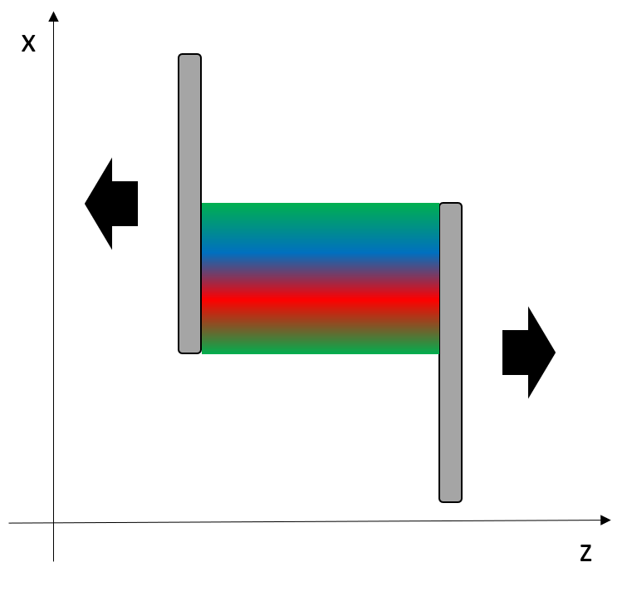
13
6
Numerical result ②: Au-Au collision at RHIC
15
8
<Angular momentum (noncentral collision)>
Conserved charge: $L_{2}={∫dx^{2}dx^{1}dητ (zT^{τ1}−xT}^{τ3})$
We focus on this contribution created in the noncentral collision,
and calculate the following quantity,
$$<τT^{τ3}>≡∫dx^{1}dx^{2}τ⋅T^{τ3}/V_{⊥}$$
$$l_{2}≡−∫dx^{1}dx^{2}τ⋅xT^{τ3}/V_{⊥}$$
$10$ event average
✔ Large value of $<τT^{τ3}>$ in the large $η$ region
→ contribution of outgoing nuclei
✔ $<τT^{τ3}>$ is positive (negative) at $η>0 (η<0)$
→ energy of glasma expanding around $η=0$
$$<τT^{τ3}>/Q_{n.s}^{4}$$

Slide 24
14
6
Numerical result ②: Au-Au collision at RHIC
15
8
<Angular momentum (noncentral collision)>
Conserved charge: $L_{2}={∫dx^{2}dx^{1}dητ (zT^{τ1}−xT}^{τ3})$
We focus on this contribution created in the noncentral collision,
and calculate the following quantity,
$$<τT^{τ3}>≡∫dx^{1}dx^{2}τ⋅T^{τ3}/V_{⊥}$$
$$l_{2}≡−∫dx^{1}dx^{2}τ⋅xT^{τ3}/V_{⊥}$$
$10$ event average
✔ Angular momentum of glasma at small $η$ is consistent
with 0 within the margein of error
→ there is no (or little) angular momentum generation
→ Why?
recoil effect don't lead to angular momentum generation?
Our setup fail to mimic Au-Au collisions?
(we employ simple initial nucleus model
instead of CGC based model)
→ we are still determing…
$$l_{2}/Q_{n.s}^{4}$$

Slide 25
1
8
Background
Method
Numerical Results
① Check of our method
② Application to the central and non-central collisions
Summary

Slide 26
15
Summary
15
[Done]
✔ We have tried to develop new 3D glasma simulation using Milne coordinates
✔ We have successfully reproduced result in the previous paper using about 4.5
small lattice size.
✔ We have formulated the 3D glasma with event-by-event fluctuation of nucleon
position, and have simulated the evolution of the glasma with setup mimicking
central and non-central collision of Au-Au at RHIC.
✔ Obtained angular momentum is consistent with 0 within the error.
[Future work]
✔ Make this model more realistic
✔ Combine with hydrodynamic simulation
S. Schlichting and P. Singh‘s paper (2021)
Combine with IP-Sat model to get more realistic color charge density at initial time

