Slide 1
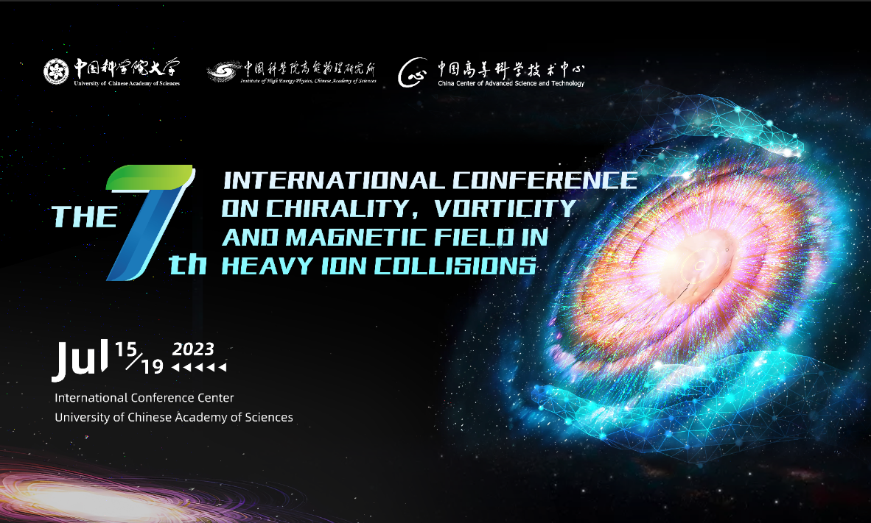
Search for Chiral Magnetic Effect using upgraded AMPT model
in Au+Au collisions at √$s_{NN}$=200 GeV
Zilin Yuan
University of Chinese Academy of Sciences
collaborator:
Anping Huang,Guoliang Ma,Wenhao Zhou, Mei Huang
Beijing, July 15-19, 2023

Slide 2
Contents
Background
Framework
Result
Summary
Notes:
, Summary

Slide 3
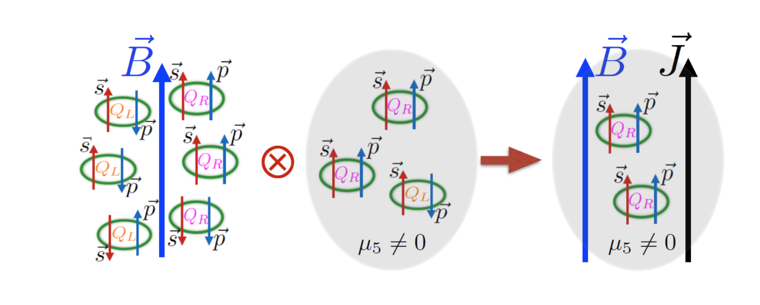
Background
the chiral magnetic effect (CME) leads to an electric charge separation along the strong magnetic field.
$$J_{CME}=\frac{e^{2}}{2π^{2}}μ_{5}B$$
Fig.1 local parity and charge-parity violation leads to an electric charge current in the presence of a strong magnetic field.

Slide 4
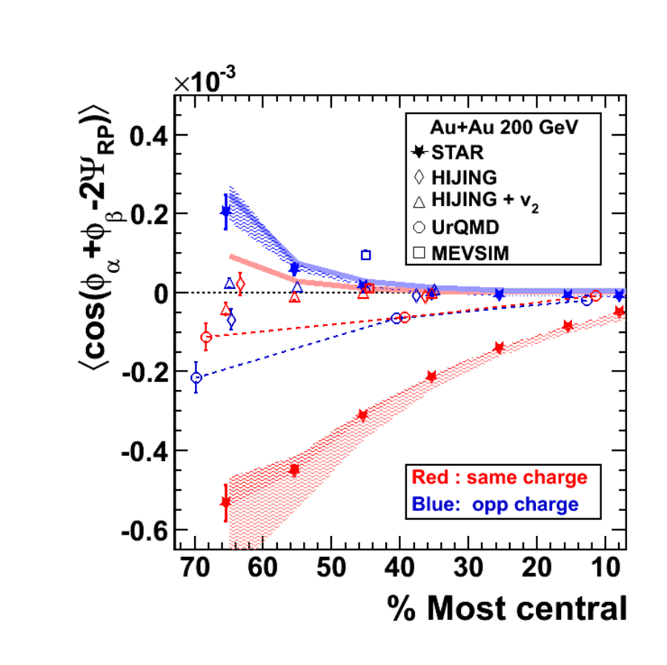
Background
One of the Chiral Magnetic Effect signal is
the two-particles correlation:
$\left\langle a_{1,α}a_{1,β}\right\rangle$ term reflects the charge separation along the magnetic field
$$γ_{bkg}=\frac{N_{2p}}{N_{total}^{2}}<\cos\left(φ_{α}+φ_{β}−2φ_{clust}\right)>v_{2}\sim \frac{v_{2}}{N}$$
Fig.2 $γ$ detected by STAR in 200 GeV Au+Au collision.
Phys.Rev.C 81 (2010) 054908

Slide 5
Background
To study non-equilibrium chiral systems with anomaly
on the hydrodynamic model,
the chiral kinetic theory have been developed.
Equations of motion:
$$\dot{x}= \hat{p}+ \dot{p}×b$$
$$\dot{p}=QE+Q \dot{x}×B$$
Where $b=\frac{λ\hat{p}}{2{\left|p\right|}^{2}}$ , $λ$ is the helicity $±1$
solving for $\dot{x}$:
$$\sqrt{G}\dot{\vec{x}}= \hat{p}+Q^{2}E×B+QB(\hat{p}∙b)$$
$$\sqrt{G}\dot{p}=E+Q\hat{p}×B+Q^{2}b(E∙B)$$
$G={(1+b∙B)}^{2}$
Phys.Rev.Lett. 109 (2012) 162001

Slide 6
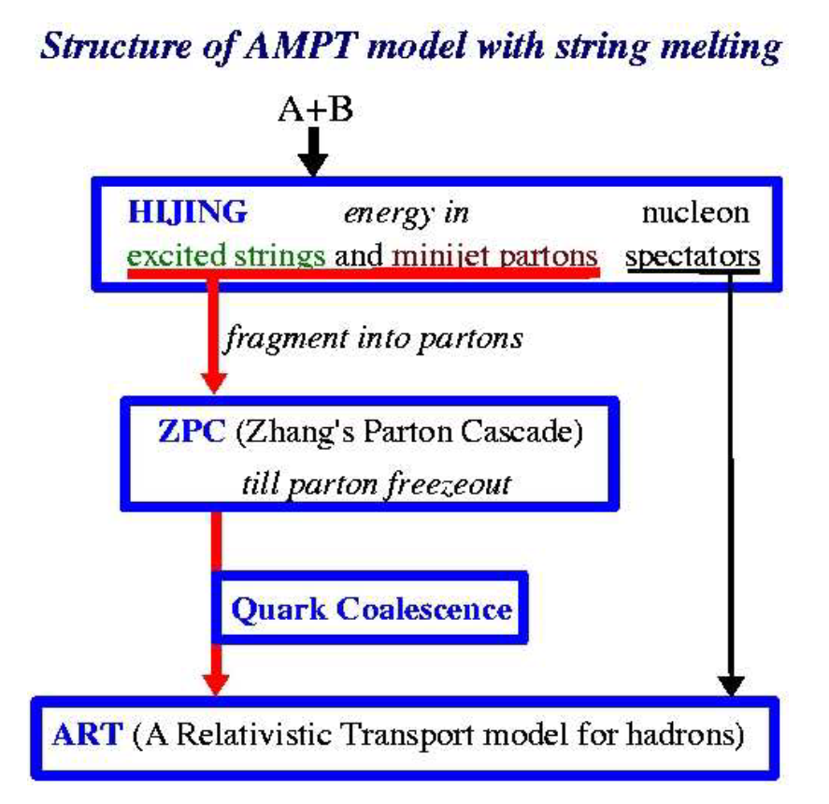
Framework
A Multi-Phase Transport Model
Advantages:
Contains partonic interactions and hadronic interactions.
includes inelastic channels in hadronic interactions
Matches many observables
Disadvantages:
Not include magnetic field and spin
Not consider inelastic channels in partonic interactions
Can not explain CME
Phys.Rev.C 72 (2005) 064901
So, we program a new partonic interactions part named the Chiral Anomaly Transport model.

Slide 7
Framework: the Chiral Anomaly Transport model (CAT) structure
HIJING Initial Conditions
Initial Partons Distribution
Magnetic Field
Chiral Kinetic Theory
Coordinate System Charge Separation
Initial Axial Charge
CAT
Quark Collisions
and Coalescence
Momentum System Charge Separation
Chiral Magnetic Effect Signal

Slide 8
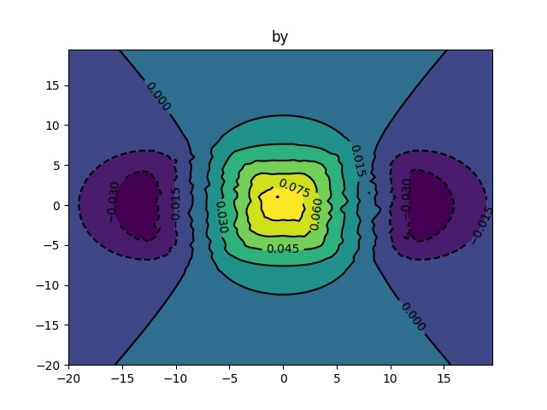
Framework
Electromagnetic field comes from spectator proton
eBy(Gev$)$
$${eB}_{ }(t)=\frac{eB_{0}}{1+{(t/τ_{B})}^{2}}$$
Phys.Rev.C 84 (2011) 064605
y(fm)
particles are given a new property - helicity
Initial axial charge is given by
$$n_{5}=\frac{μ_{5}^{3}}{3π^{2}}+\frac{μ_{5}T^{2}}{3}$$
X(fm)
PHYSICAL REVIEW D 88, 054009 (2013)
Fig.4 Magnetic field along y-axis distribution in the transverse plane, b=10fm.
chiral chemical potential is
$μ_{5}=7.5+18\sqrt{\left|eB\right|}$

Slide 9
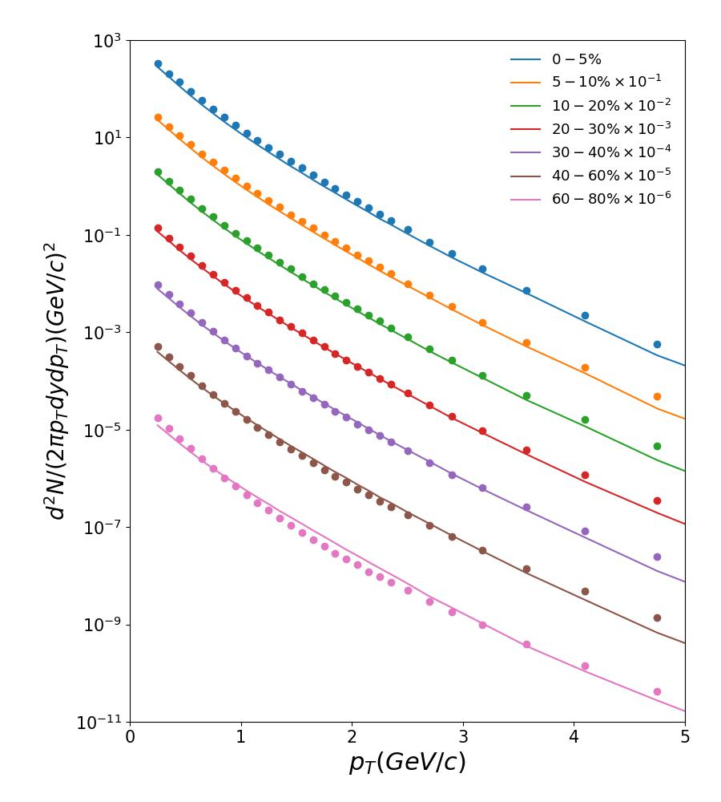
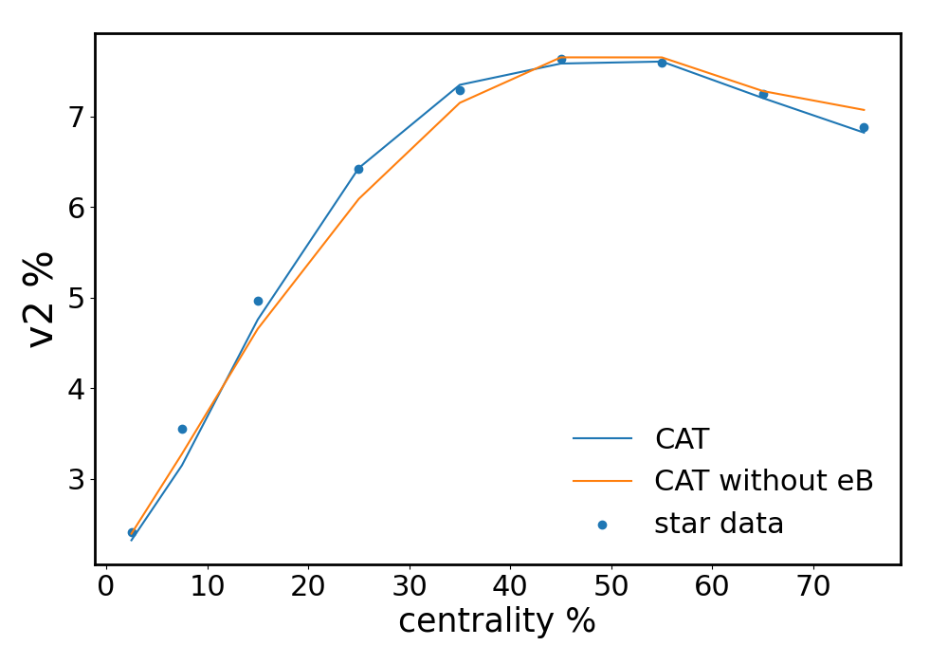
Framework
$$γ_{bkg}=\frac{N_{2p}}{N_{total}^{2}}<\cos\left(φ_{α}+φ_{β}−2φ_{clust}\right)>v_{2}\sim \frac{v_{2}}{N}$$
The background is credible.
Fig.5 and Fig.6 $v_{2}$ and the multiplicity of charged hardon from CAT(lines) and STAR(dots)

Slide 10
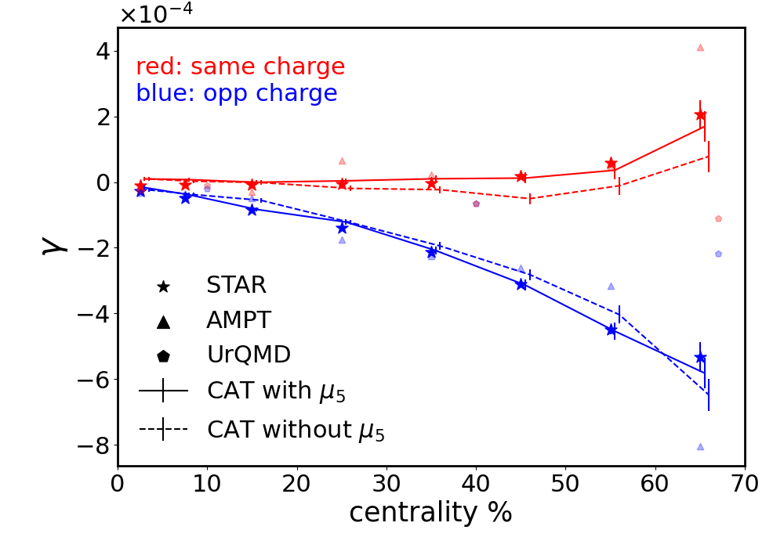
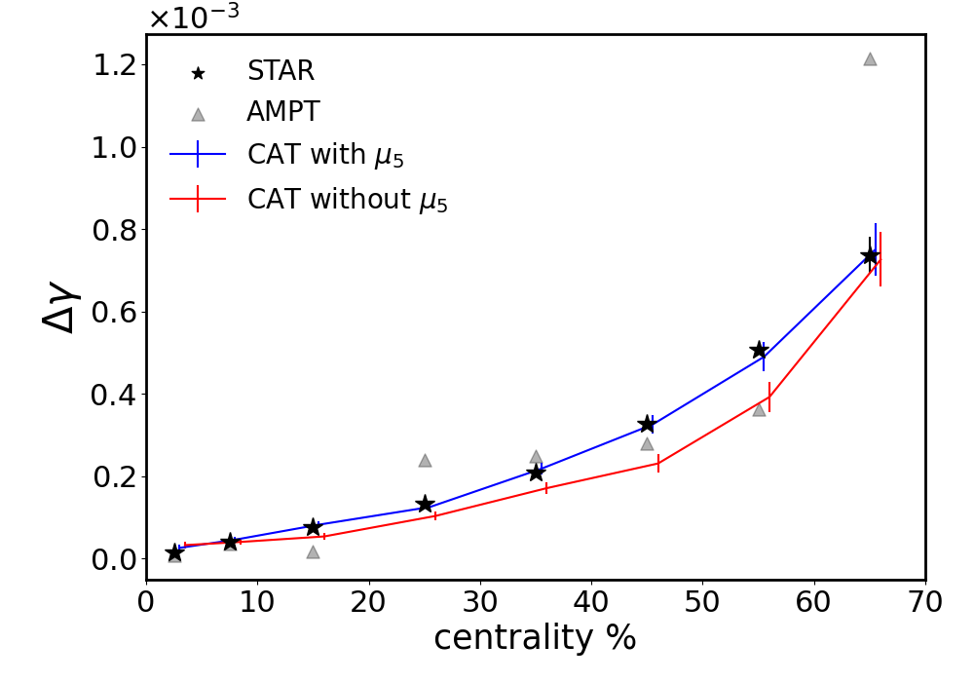
Result
The result corresponds to the data, when consider the chiral anomaly and magnetic field.
The result without chiral anomaly is considered as pure background.
Fig.7
Fig.8

Slide 11
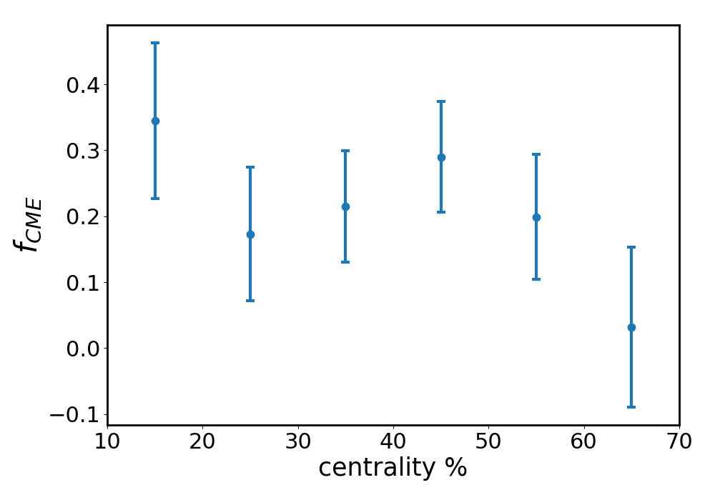
Result
the CME signal fraction is
$$f_{CME}=\frac{{Δγ}_{tot}−{Δγ}_{bkg}}{Δγ_{tot}}$$
Fig.9

Slide 12
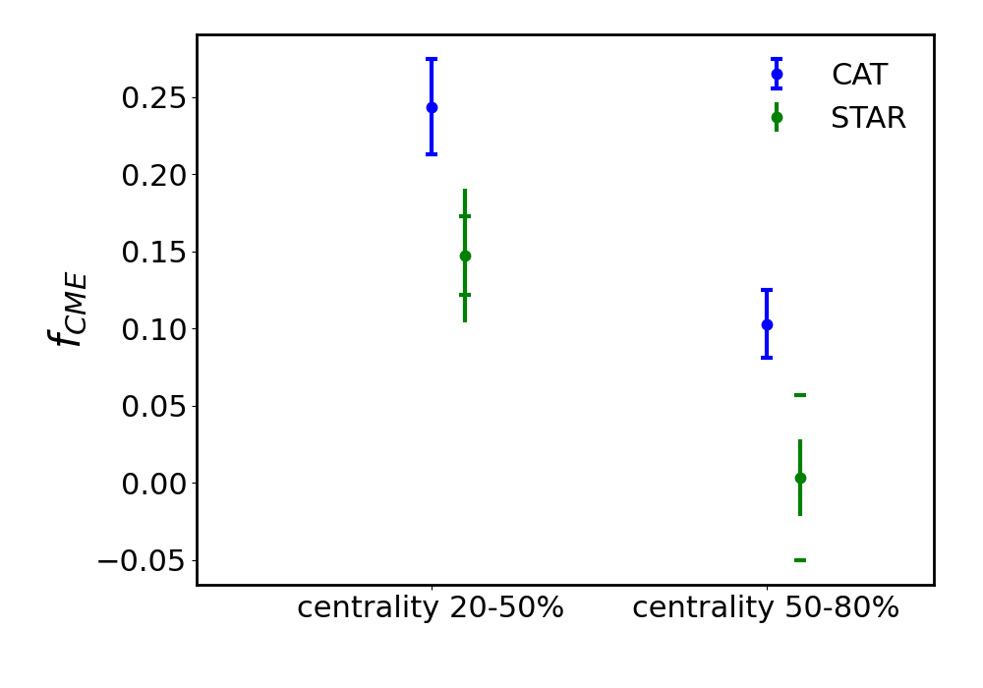
Result
the CME signal fraction is
$$f_{CME}=\frac{{Δγ}_{tot}−{Δγ}_{bkg}}{Δγ_{tot}}$$
$f_{CME}$is $24.36±3.06\%$ in $20−50\%$ centrality and $10.27±2.20\%$ in $50−80\%$ centrality.
Fig.10 Compared to STAR result*,
we get a bigger CME signal.
Phys.Rev.Lett. 128 (2022) 9, 092301

Slide 13
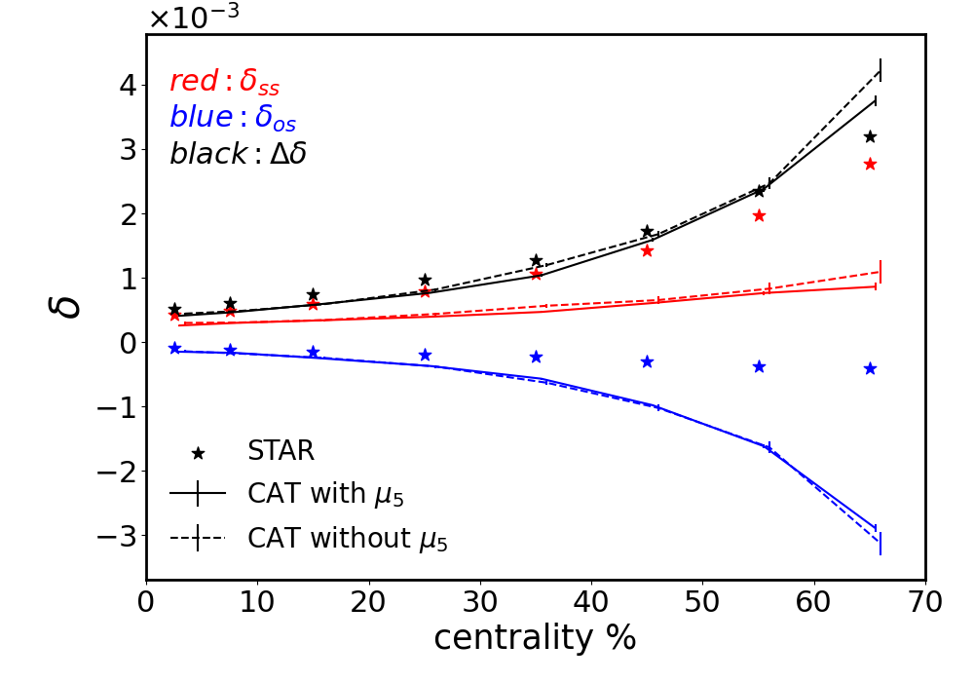
Result
Another CME observable:
$$δ=<cos⁡(φ_{α}−φ_{β})>$$
$δ_{os} and δ_{ss}$ are inconsistent.
But the $Δδ=δ_{os}−δ_{ss}$ is consistent with the data.
CAT do not include a charge independent background P of$δ$.
Fig.11

Slide 14
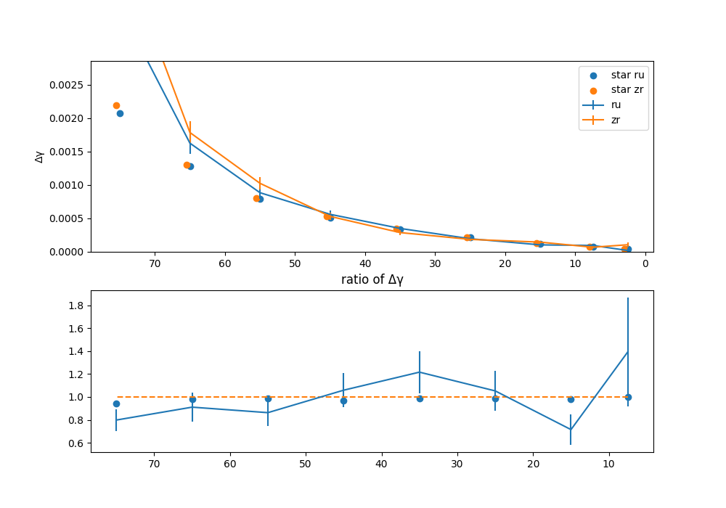
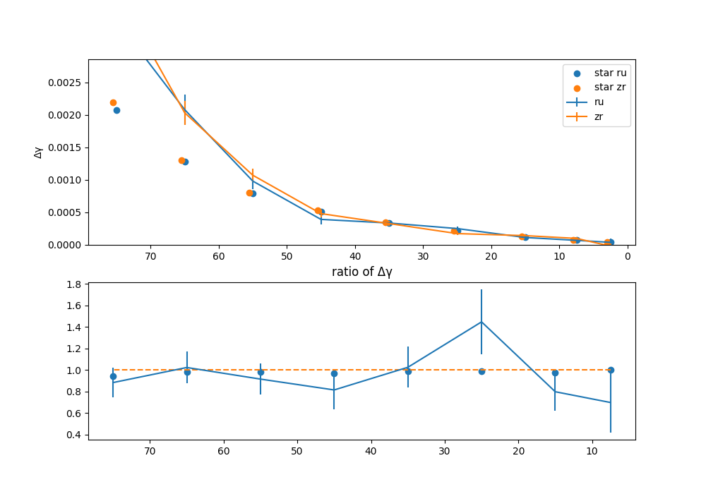
Result
In isobar collisions
It is much bigger than the data at peripheral.
There are large fluctuations.
Fig.10 $Δγ$and the ratio for two run with the same parameters

Slide 15
Summary and outlook
The chiral anomaly transport model could explain the $Δγ and Δδ$ in 200GeV Au+Au collisions.
The background in the model is much small, so the CME signal fraction $f_{CME}$is $24.36±3.06\%$ in $20−50\%$ centrality and $10.27±2.20\%$ in $50−80\%$ centrality.
This model can not explain the data in low energy Au+Au collisions, where hadronic interaction become important.
There are large fluctuations in isobar collisions.

Slide 16
Thank You!

Slide 17
Fig.7

Slide 18
Fig.8

Slide 19
Appendix
$$γ=\left\langle \cos\left(φ_{α}+φ_{β}\right)\right\rangle ≡\left\langle \cos\left(φ_{α}\right)\cos\left(φ_{β}\right)\right\rangle −\left\langle \sin\left(φ_{α}\right)\sin\left(φ_{β}\right)\right\rangle$$
$$δ=\left\langle \cos\left(φ_{α}−φ_{β}\right)\right\rangle ≡\left\langle \cos\left(φ_{α}\right)\cos\left(φ_{β}\right)\right\rangle +\left\langle \sin\left(φ_{α}\right)sin⁡(φ_{β})\right\rangle$$
($δ$-$γ$)/2$=\left\langle \sin\left(φ_{α}\right)\sin\left(φ_{β}\right)\right\rangle =\left\langle a_{α}a_{β}\right\rangle +B_{OUT}$
$$\text{(}δ\text{+}γ\text{)/2}=\left\langle \cos\left(φ_{α}\right)\cos\left(φ_{β}\right)\right\rangle =\left\langle v_{α}v_{β}\right\rangle +B_{IN}$$

Slide 20
The spatial distribution of nucleons can be described by the following 2-parameter Fermi mass density of the Woods-Saxon (WS) form

Slide 21
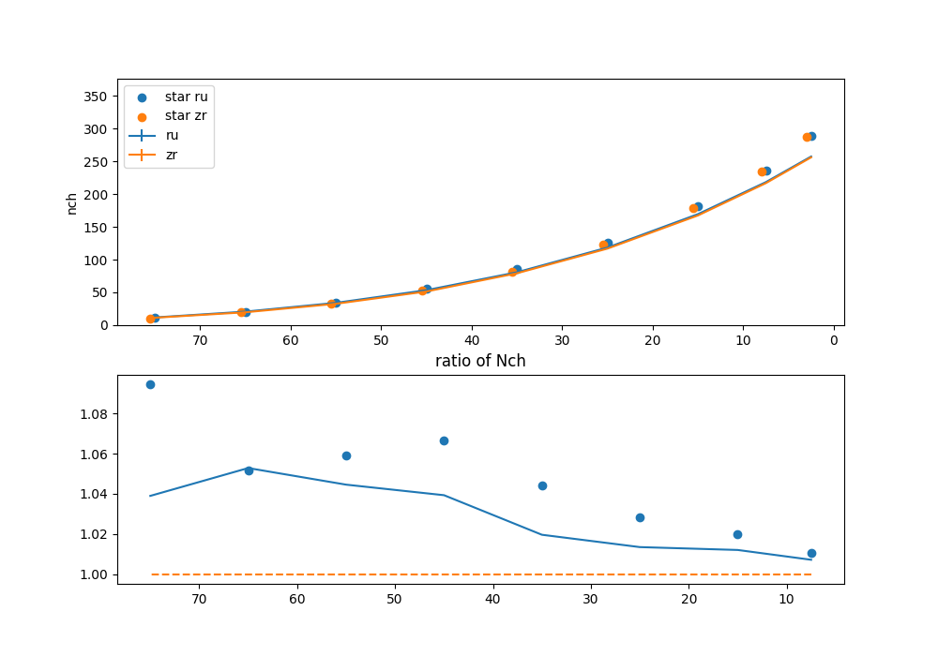
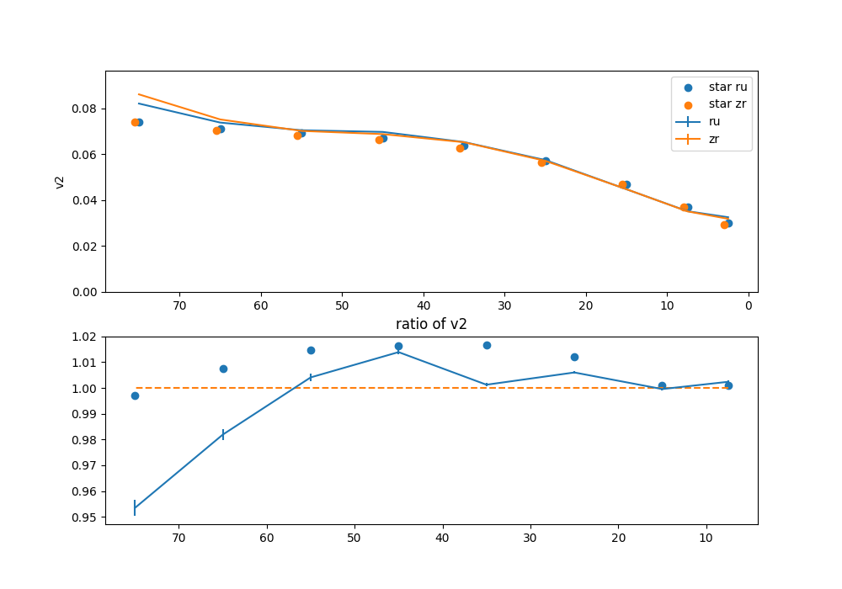
$Nch$ and the ratio for isobar collisions
$v_{2}$ and the ratio for isobar collisions

Slide 22
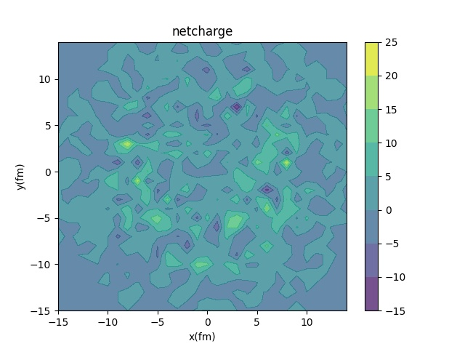
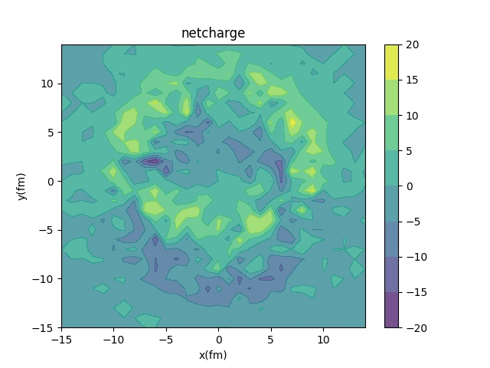
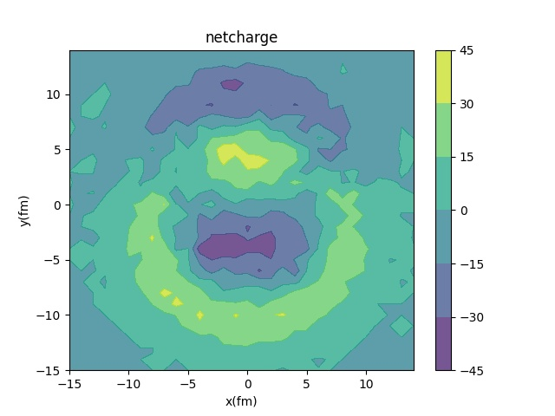
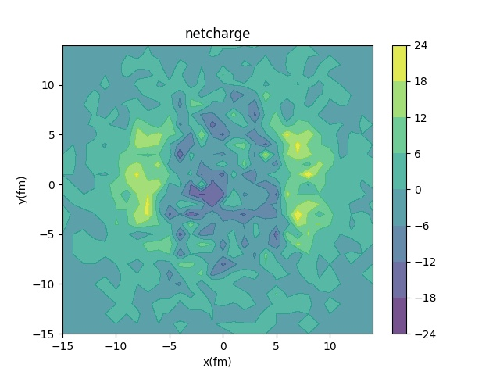
Charge distribution at t=8 fm ,b=10fm
No electromagnetic field without anomaly
Fast decay magnetic field $τ_{B}=1fm$ with anomaly
Slowly decay magnetic field
$τ_{B}=4fm$ with anomaly
Slowly decay magnetic field
$τ_{B}=4fm$ without anomaly

Slide 23
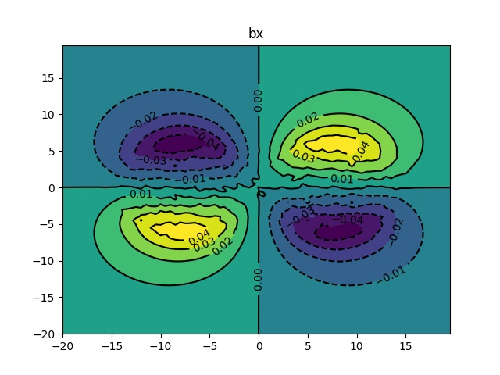
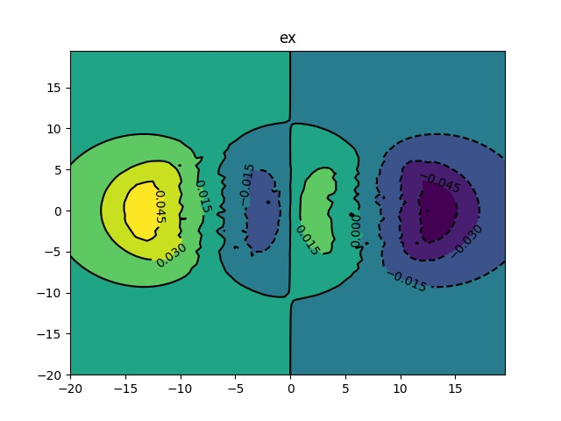
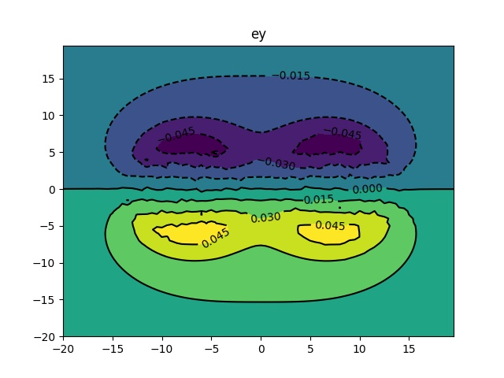
eBx($m_{π}^{2})$
eBy($m_{π}^{2})$
eEx($m_{π}^{2})$
eEy($m_{π}^{2})$

