Slide 1


Gravitational Waves and Primordial Black Holes
Induced by QCD Phase Transitions in the Early Universe
Jingdong Shao, UCAS
Collaborator: Prof. Huang Mei, UCAS
2023.07.19
The 7th International Conference on Chirality, Vorticity and Magnetic Field in the Heavy Ion Collisions
Notes:
照片为学生拍摄的礼堂

Slide 2

1
Motivation
2
Work
3
Conclusion
目录
Contents
Notes:
图片可以替换

Slide 3

01
Motivation

Slide 4
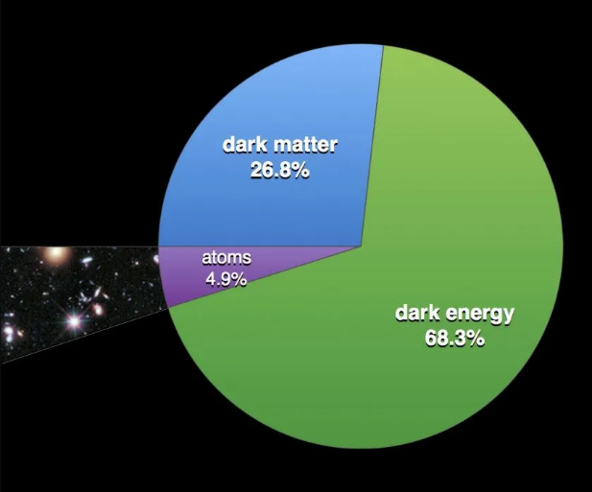


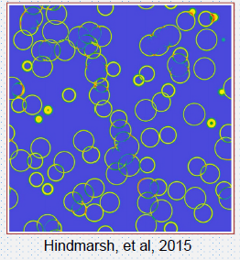
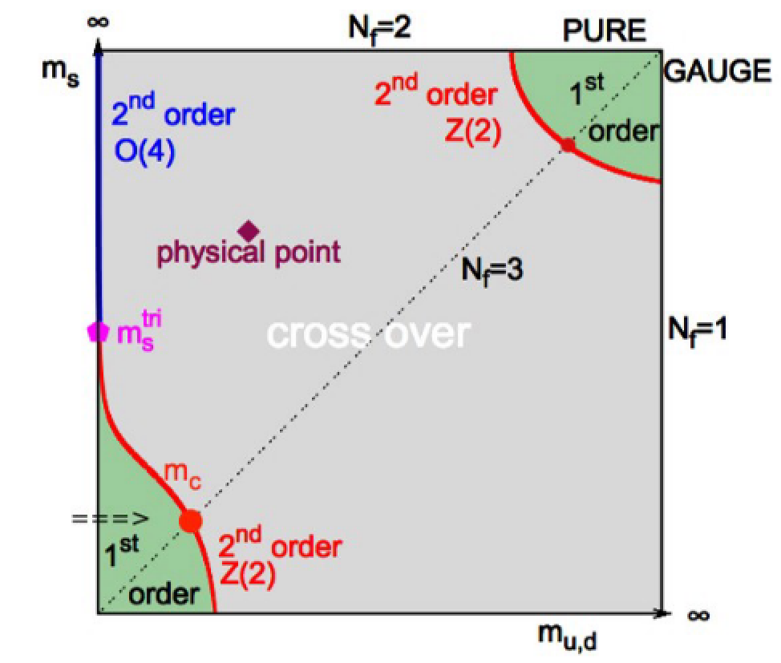

Motivation
Searching for imprints of QCD epoch in the
early universe through GWs and primordial black holes
Our universe is composed of 5% visible matter, 27% dark matter and 68%dark energy,
99% mass of visible matter is obtained from chiral symmetry breaking of QCD.
At around ${10}^{−5}$s, the early universe experience QCD phase transition.
1st order PT (FOPT) in QCD epoch:
①pure gluon system,
②Topological phase transition

Slide 5
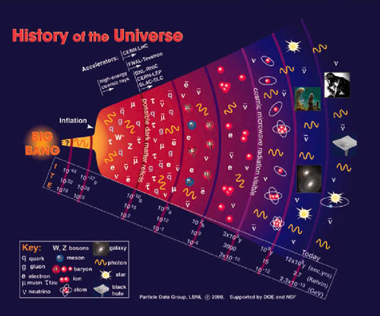
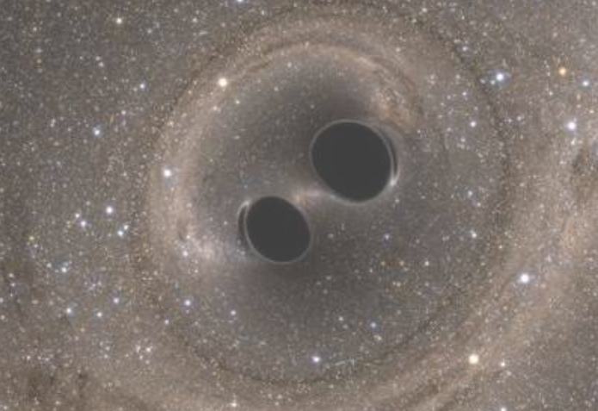
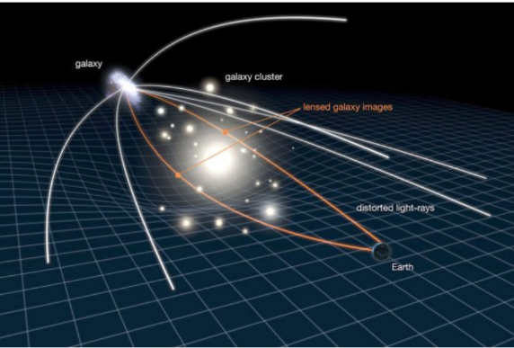
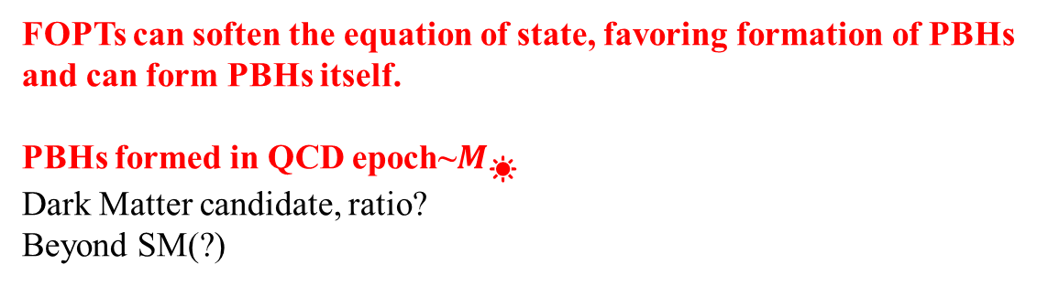
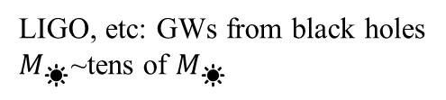
Motivation
Searching for imprints of QCD epoch in the
early universe through GWs and primordial black holes
Primordial black hole
Iguaz et al. 2204.07027
GW events from PBHs
GWs from QCD FOPTs
Astrowatch.net
LIGO, etc: GWs from black holes
$M_{☀}$~tens of $M_{☀}$
PBHs
FOPTs can soften the equation of state, favoring formation of PBHs
and can form PBHs itself.
PBHs formed in QCD epoch~$M_{☀}$
Dark Matter candidate, ratio?
Beyond SM(?)

Slide 6
02
Work
◎Topological Phase Transition
◎Pure Gluon System

Slide 7


Topological Phase transition
Thermodynamics potential
First order phase transition
Gravitational waves
Possibility of formation of PBHs with the mechanism proposed by
Jing Liu et al. 2106.05637
QCD$θ$ vacuum structure
Chirality imbalanced system: a FOPT
Described by Integer Chern-Simons Number $Q_{w}, N_{cs}$
Transition at low or zero temperature: instanton
Transition at finite temperature: sphaleron

Slide 8
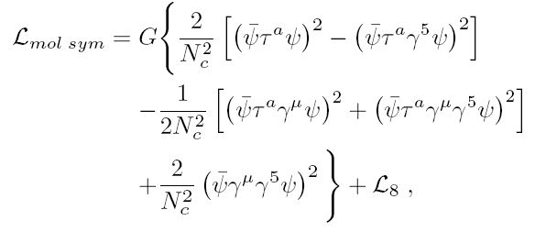

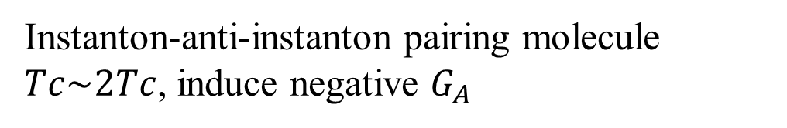
Topological Phase transition
Instanton-anti-instanton pairing molecule
$Tc\sim 2Tc$, induce negative $G_{A}$
Schafer, Shuryak, Verbaarschot 9406210

Slide 9
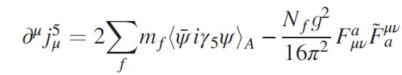

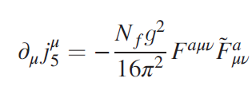
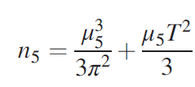

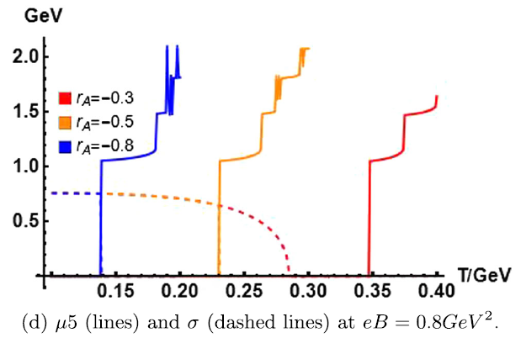




Topological Phase transition
P and CP violation
Chiral limit
Sphaleron transition rate:
Chiral imbalance density $n_{5}$
Instanton-anti-instanton pairing
Self-consistent
$$μ_{5}\sim 2GeV$$
$$μ_{5}\sim 1.5GeV$$
Moore et al. 1011.1167
Jingyi Chao et al. 1305.1100

Slide 10

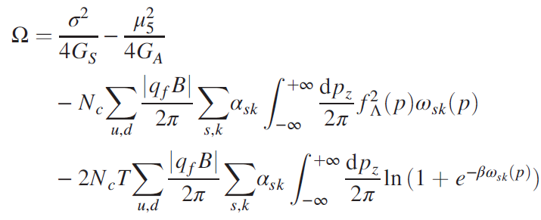
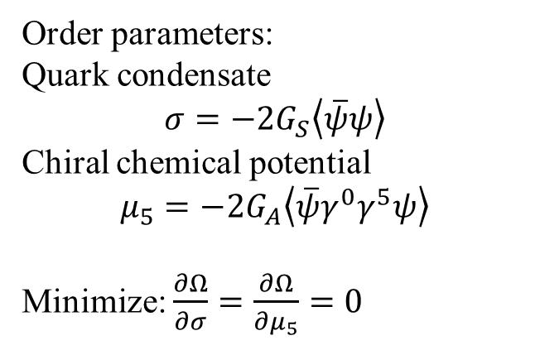
Topological Phase transition
Repulsive axial vector interaction with magnetic field
Order parameters:
Quark condensate
$$σ=−2G_{S}\left\langle \overline{ψ}ψ\right\rangle$$
Chiral chemical potential
$$μ_{5}=−2G_{A}\left\langle \overline{ψ}γ^{0}γ^{5}ψ\right\rangle$$
Minimize: $\frac{∂Ω}{∂σ}=\frac{∂Ω}{∂μ_{5}}=0$
Lang Yu et al.1404.6969

Slide 11
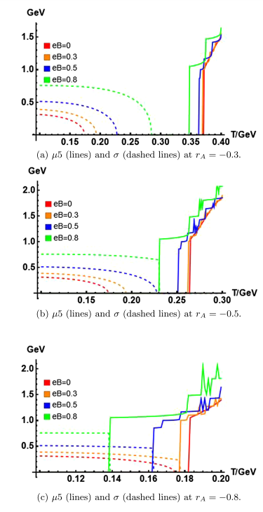
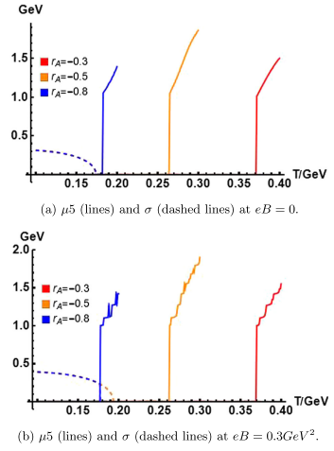
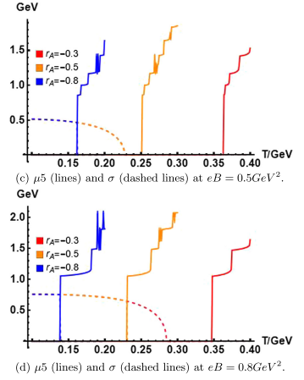
Topological Phase transition
1st order phase transition with local P and CP violation
J. Shao and M. Huang, Phys.Rev. D 107 043011 (2023)
doi:10.1103/PhysRevD.107.043011 [arXiv:2209.13809 [hep-ph]].

Slide 12
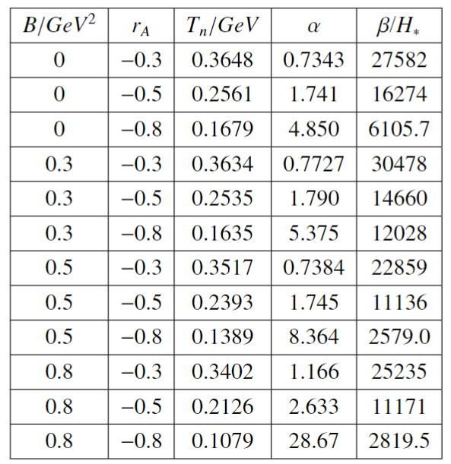
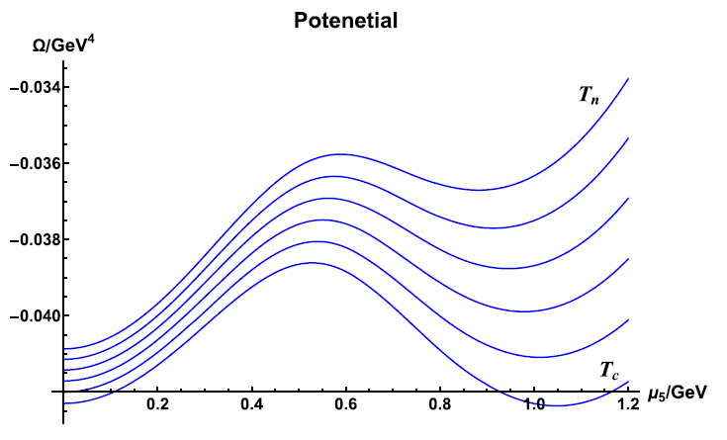
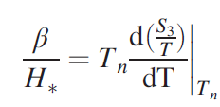

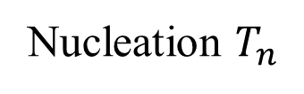
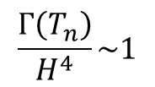
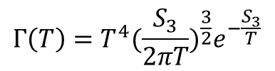
QCD Phase Transition: Bubble Nucleation
J. Shao and M. Huang, Phys.Rev. D 107 043011 (2023)
doi:10.1103/PhysRevD.107.043011 [arXiv:2209.13809 [hep-ph]].
The bubble nucleation rate per Hubble volume per time
$$Γ\left(T\right)=T^{4}{(\frac{S_{3}}{2πT})}^{\frac{3}{2}}e^{−\frac{S_{3}}{T}}$$
Nucleation $T_{n}$
$$\frac{Γ\left(T_{n}\right)}{H^{4}}\sim 1$$
Transition rate
$$v_{w}\sim 0.3$$
Caprini et al. 1512.06239
(Yidian Chen et al. 2212.06591)

Slide 13



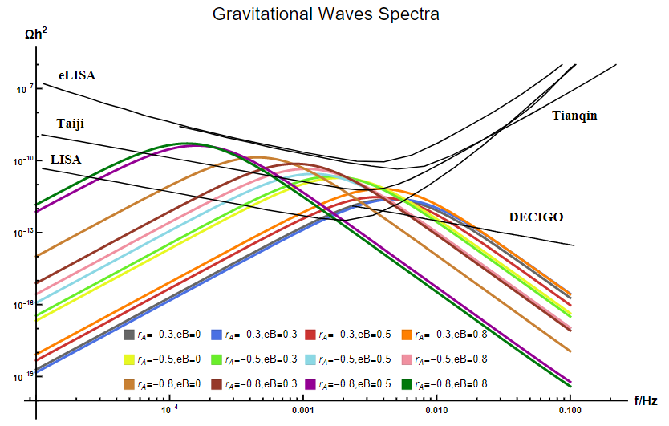
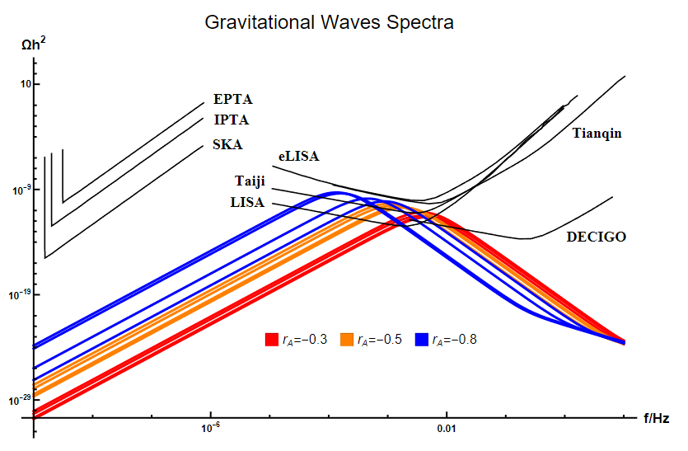
GWs
Caprini et al. 1512.06239
①Collisions of bubble
②Sound waves in the plasma after ①(main)
③Magnetohydrodynamic (MHD) turbulence in the plasma
J. Shao and M. Huang, Phys.Rev. D 107 043011 (2023)
doi:10.1103/PhysRevD.107.043011 [arXiv:2209.13809 [hep-ph]].

Slide 14



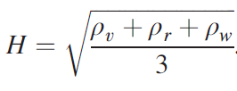


Formation of PBH through delayed phase transition mechanism
The bubble nucleation rate per Hubble volume per time
Jing Liu et al. 2106.05637
The volume fraction of the remaining false vacuum
Friedmann equation
The evolution of energy density

Slide 15
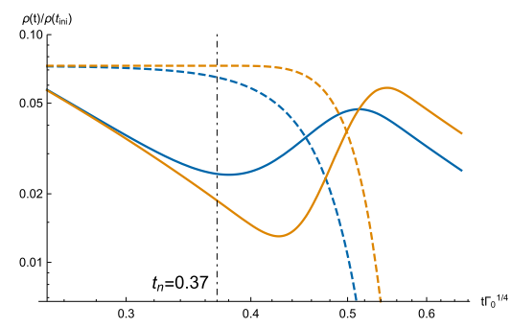
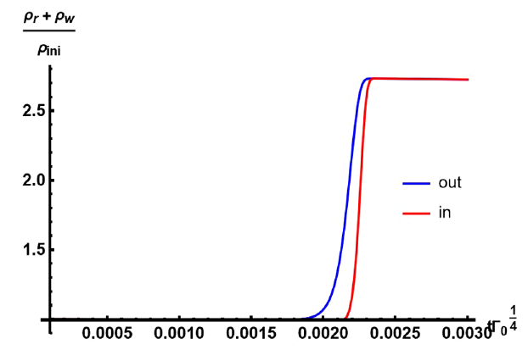
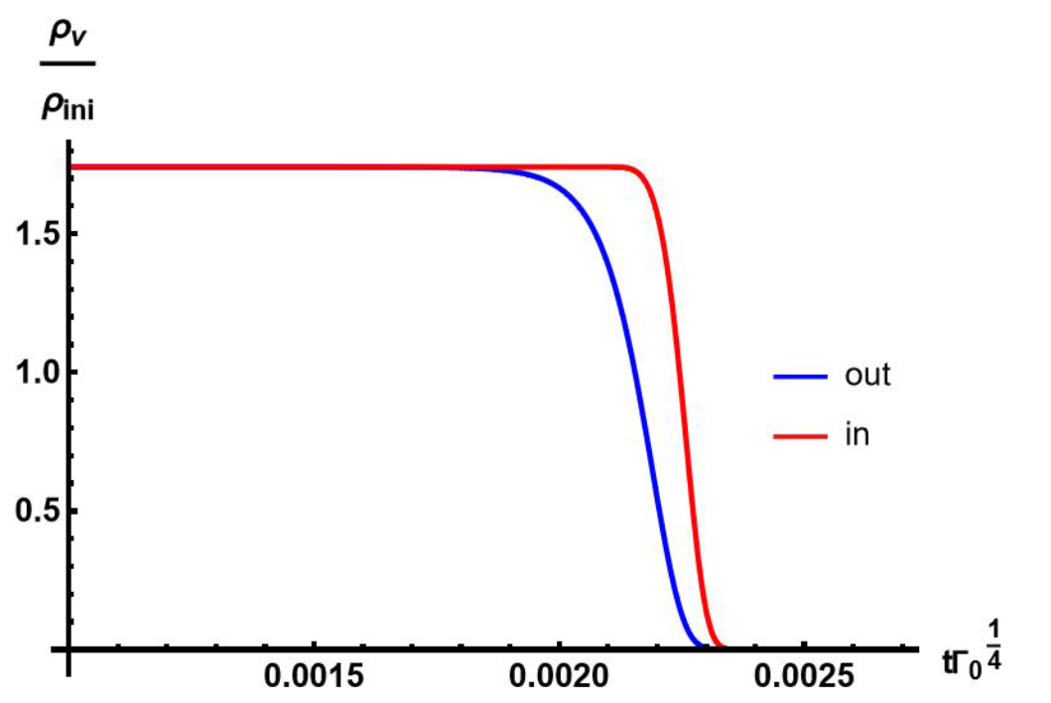
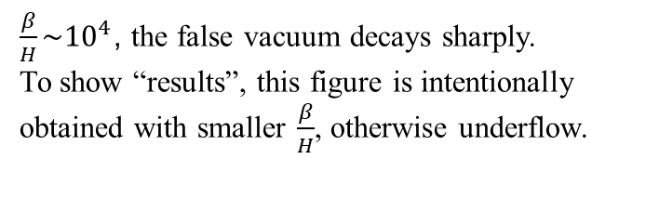
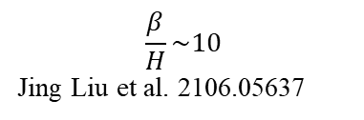
Formation of PBH through delayed phase transition mechanism
$\frac{β}{H}\sim {10}^{4}$, the false vacuum decays sharply.
To show “results”, this figure is intentionally obtained with smaller $\frac{β}{H}$, otherwise underflow.
$$\frac{β}{H}\sim 10$$
Jing Liu et al. 2106.05637
With large $\frac{β}{H}$, delayed phase transition can hardly form PBHs
J. Shao and M. Huang, Phys.Rev. D 107 043011 (2023)
doi:10.1103/PhysRevD.107.043011 [arXiv:2209.13809 [hep-ph]].

Slide 16


Pure Gluon System:1st order deconfinement phase transition
Gluon only, pure gauge system
Polyakov loop as the order parameter
$L\left(\vec{x}\right)=Pe^{i\int_{0}^{1/T}{A_{4}\left(\vec{x},t\right)dt}}$
Lattice QCD data
Fitted effective potential
First order phase transition
Threshold
PBH mass function

Slide 17
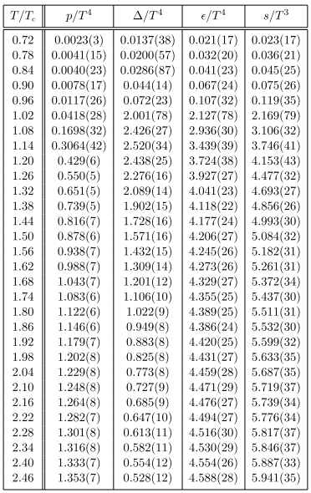
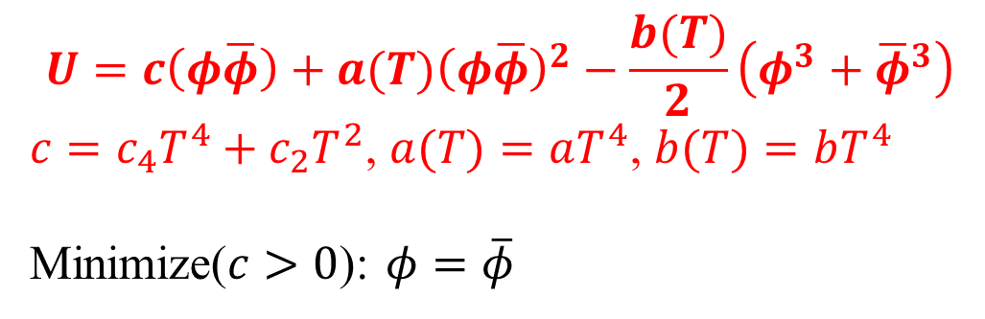
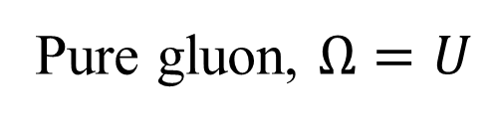
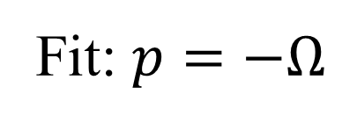
Pure Gluon System
Polyakov-loop model for pure gluon system.
Fukushima, 1705.00718
$$U=c\left(φ\overline{φ}\right)+a(T){\left(φ\overline{φ}\right)}^{2}−\frac{b(T)}{2}\left(φ^{3}+{\overline{φ}}^{3}\right)$$
$c=c_{4}T^{4}+c_{2}T^{2}$, $a(T)=aT^{4}$, $b(T)=bT^{4}$
Minimize($c>0$): $φ=\overline{φ}$
Fit: $p=−Ω$
Pure gluon, $Ω=U$
Lattice result on the EOS for pure gluon system.
Caselle et al. 1801.03110

Slide 18
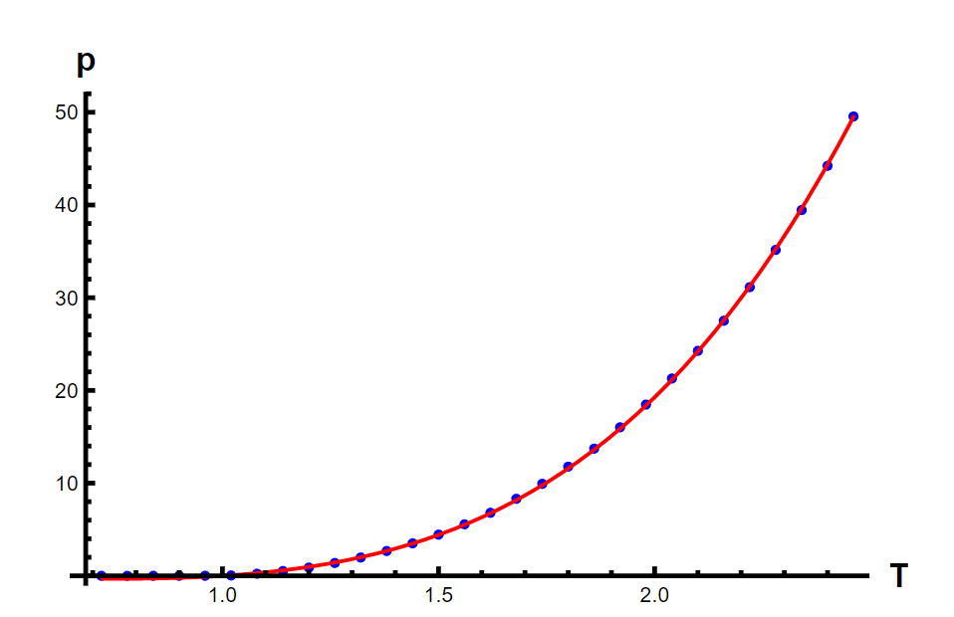
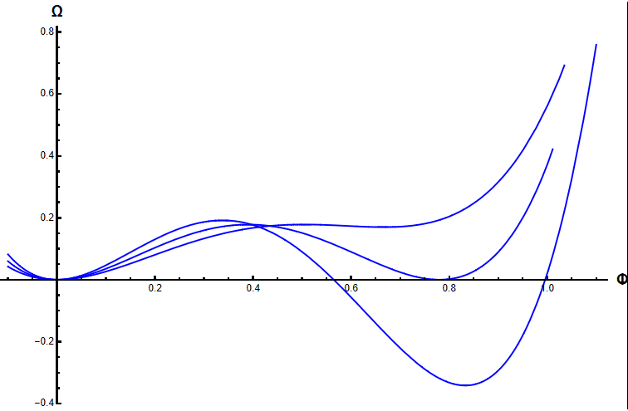






Pure Gluon System
See Wei-Chih Huang et al. 2012.11614 for more similar results
$$a$$ | $$b$$ | $$c_{4}$$ | $$c_{2}$$
7.6891 | 12.0000 | 2.6218 | 2.0601
$$U=(c_{4}T^{4}+c_{2}T^{2})φ^{2}+aT^{4}φ^{4}−bT^{4}φ^{3}$$
J. Shao and M. Huang, in preparation.
$$T_{c}\sim 276MeV$$
$$\frac{β}{H_{n}}\sim 17742$$
$$T=0.9$$
$$T=1$$
$$T=1.2$$

Slide 19
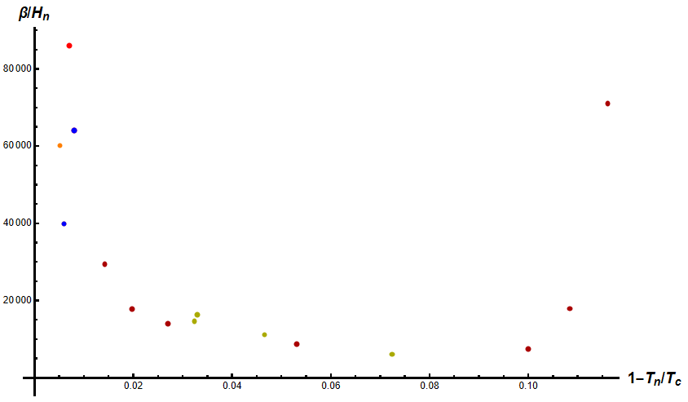

$β/H_{n}$ is large in QCD phase transitions!
Pure Gluon System
Red & Orange: holography
Blue: holography, EW
Dark Red: pure gluon system
Dark Yellow: chirality imbalance
J. Shao and M. Huang, in preparation.

Slide 20
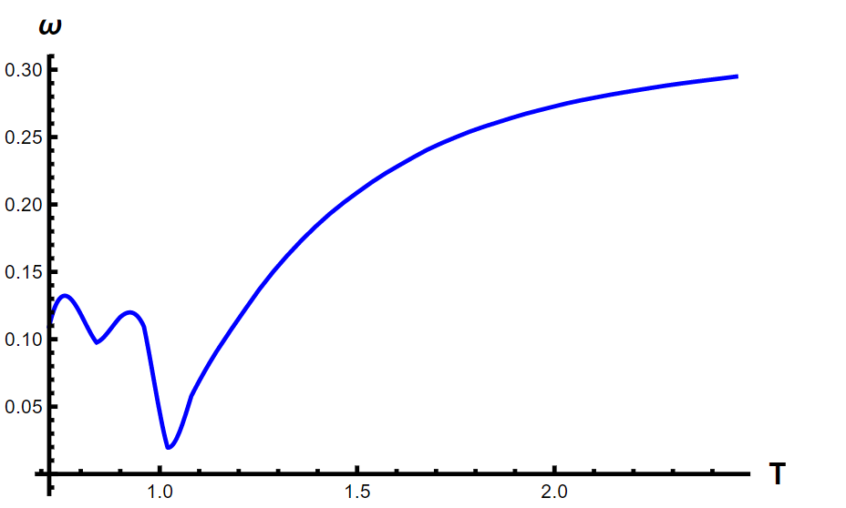
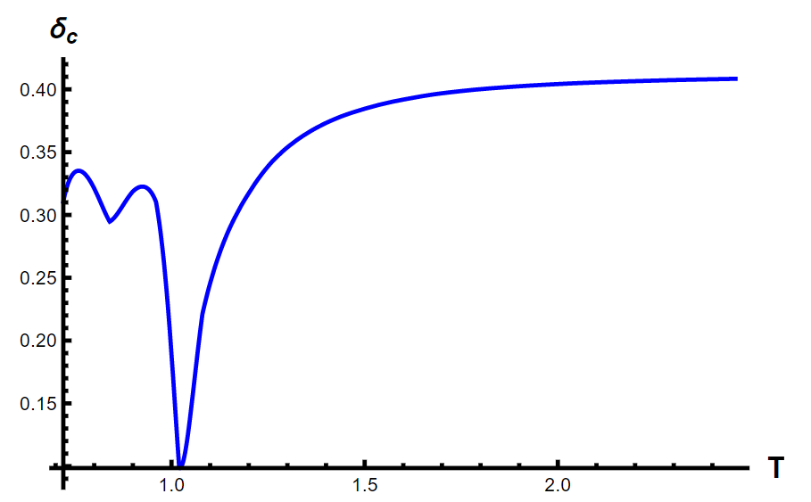
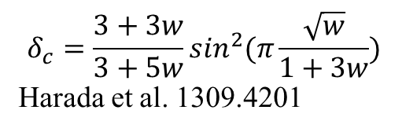
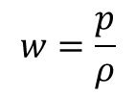
Pure Gluon System
Small sound velocity around Tc in 1st order QCD phase transitions!
$$w=\frac{p}{ρ}$$
$$δ_{c}=\frac{3+3w}{3+5w}\sin^{2}(π\frac{\sqrt{w}}{1+3w})$$
Harada et al. 1309.4201
J. Shao and M. Huang, in preparation.

Slide 21
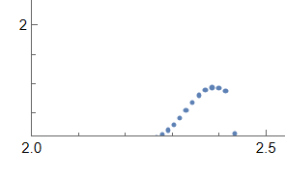
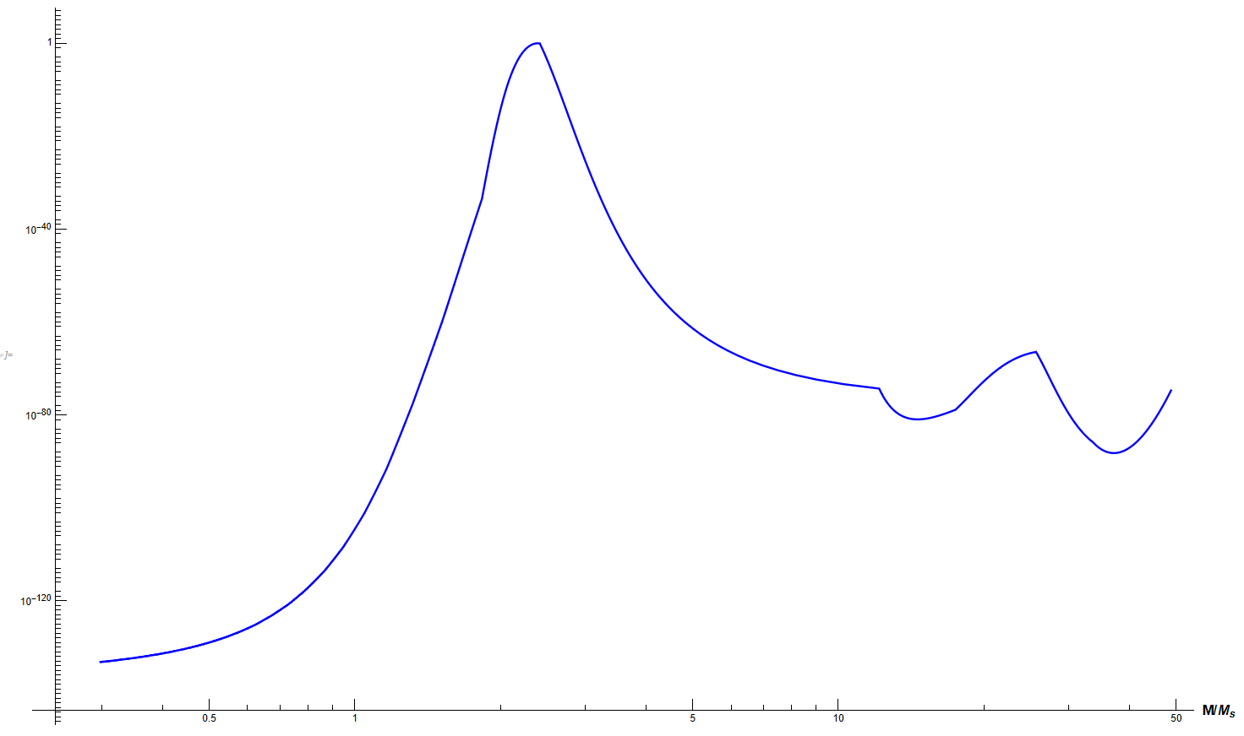
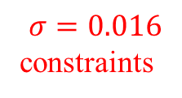
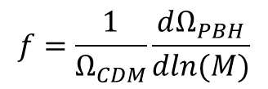





Pure Gluon System
Mass ~ Horizon mass$\frac{4π}{3}ρH^{−3}$
$$M_{H}\left(T\right)\sim 2×{10}^{5}\frac{t}{1s}M_{☀}\sim {10}^{5}M_{☀}{\left(\frac{T}{1MeV}\right)}^{−2}{(\frac{g_{eff}}{10.75})}^{−\frac{1}{2}}$$
Gaussian perturbation: $p\left(δ\right)=\frac{1}{\sqrt{2π}σ}e^{−\frac{δ^{2}}{2σ^{2}}}$
$$f=\frac{1}{Ω_{CDM}}\frac{dΩ_{PBH}}{dln(M)}$$
High Peak!
~1
$$β=(2)\int_{δ_{c}}^{∞}{p(δ)dδ}$$
$β=erfc⁡(\frac{δ_{c}}{\sqrt{2}σ})$,
$β_{eq}=\frac{a_{eq}}{a}β=\sqrt{\frac{M_{eq}}{M}}β$,
$$M_{eq}=2.8×{10}^{17}M_{☀}$$
$$σ=0.016$$
constraints
Zucheng Chen et al. 2108.1174
J. Shao and M. Huang, in preparation.
$$Ω_{PBH}=\int_{M_{min}}^{M_{max}}{dln(M)β_{eq}(M)}$$
$$Ω_{PBH}\sim 0.01Ω_{CDM}$$
J. Shao and M. Huang, in preparation.

Slide 22
03
Conclusion

Slide 23

Conclusion and Outlook
QCD PT of chirality imbalance and pure gluon system is of first-order.
GWs from FOPT are detectable.
In the case of large $\frac{β}{H}$ in QCD PT , delayed phase transition mechanism is not suitable for the formation of PBHs, therefore we use
primordial energy density fluctuations
FOPT favors formation of PBHs by decreasing sound speed $v_{s}^{2}$ thus $δ_{c}$
In QCD epoch, mass function has a peak like Dirac $δ$ function at $M\sim M_{☀}$, $\frac{Ω_{PBH}}{Ω_{CDM}}\sim 1\%$

Slide 24

Conclusion and Outlook
For future work, we will
understand whether large $\frac{β}{H}$ is a universal feature for strongly coupled system and why $\frac{β}{H}$ is large;
Observables of local P and CP violation related to QCD phase transitions;

Slide 25



Thanks

