Slide 1

The quark-meson model under magnetic fields within FRG approach
The 7th International Conference on Chirality, Vorticity and Magnetic Field in Heavy Ion Collisions
Rui Wen
University of Chinese Academy of Sciences
Based on: Rui Wen, Shi Yin, Wei-jie Fu, Mei Huang arXiv:2306.04045

Slide 2
Outline
Introduction
The quark-meson model within FRG
The effective action
Regulators and propagators
Flow equations
Numerical results
Summary

Slide 3
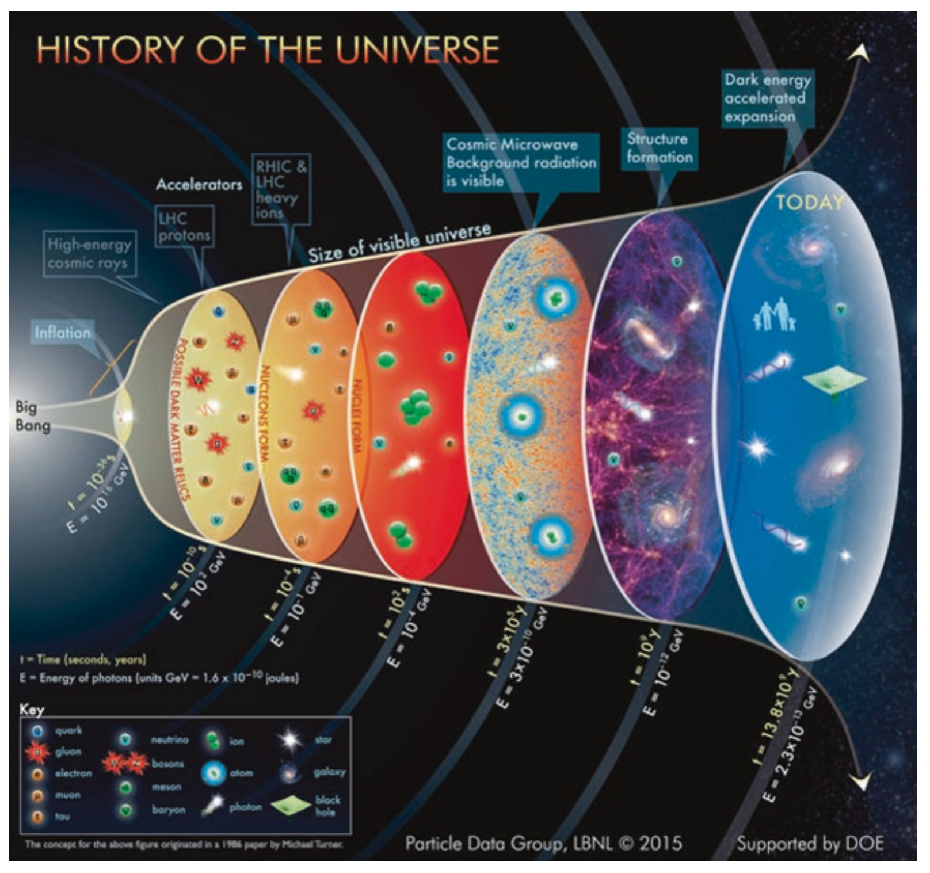
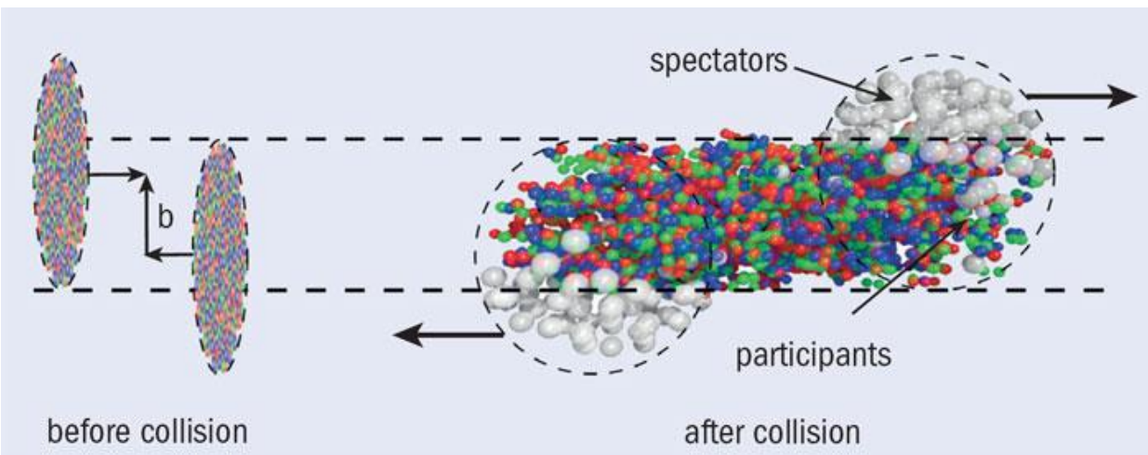
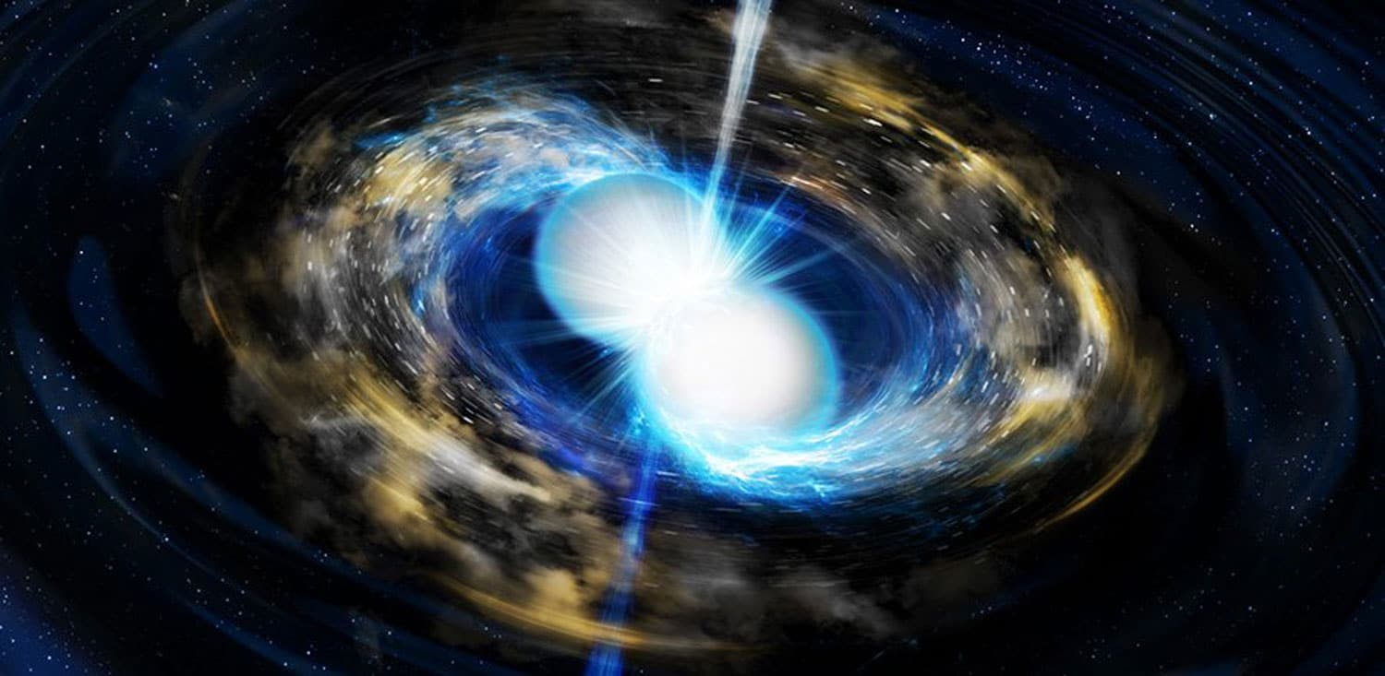
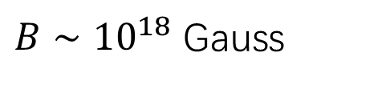
Introduction
early universe
Toia A 2013 CERN Courier April 31
$B∼{10}^{18}$ Gauss
magnetars

Slide 4
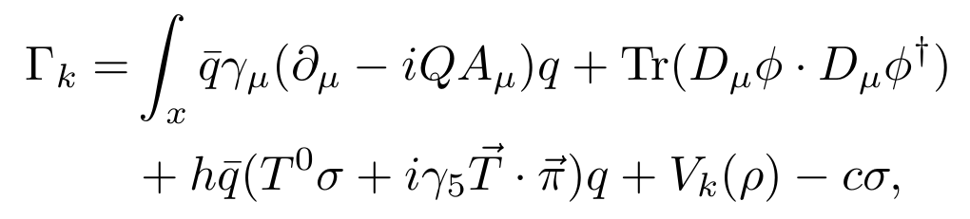
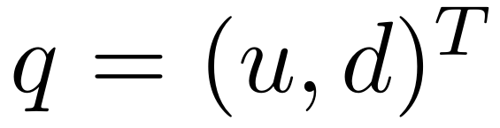
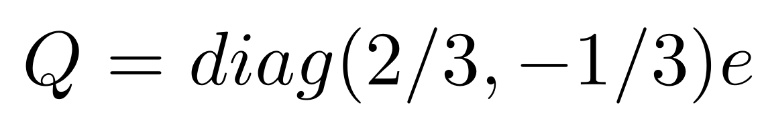
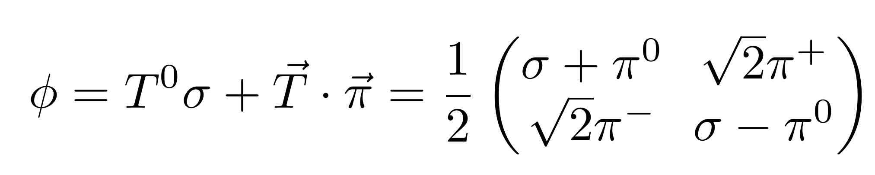
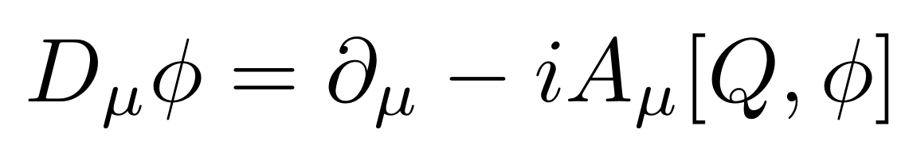

The effective action
The effective action of two-flavor quark-meson model in Euclidean space
The quark fields
The meson fields
The covariant derivative of meson fields
magnetic field along z-direction

Slide 5
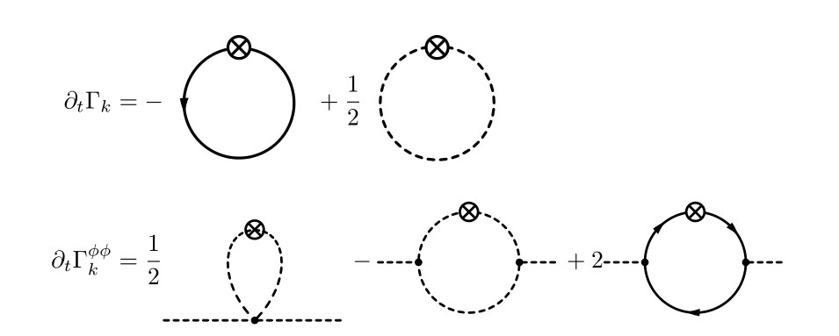
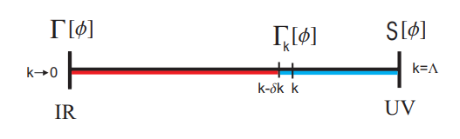
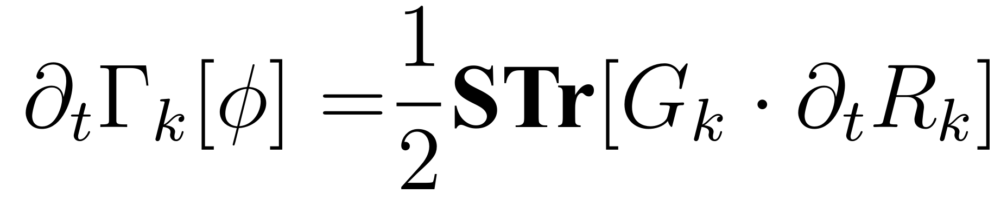

Functional renormalization group
and flow equations
Wetterich equations

Slide 6
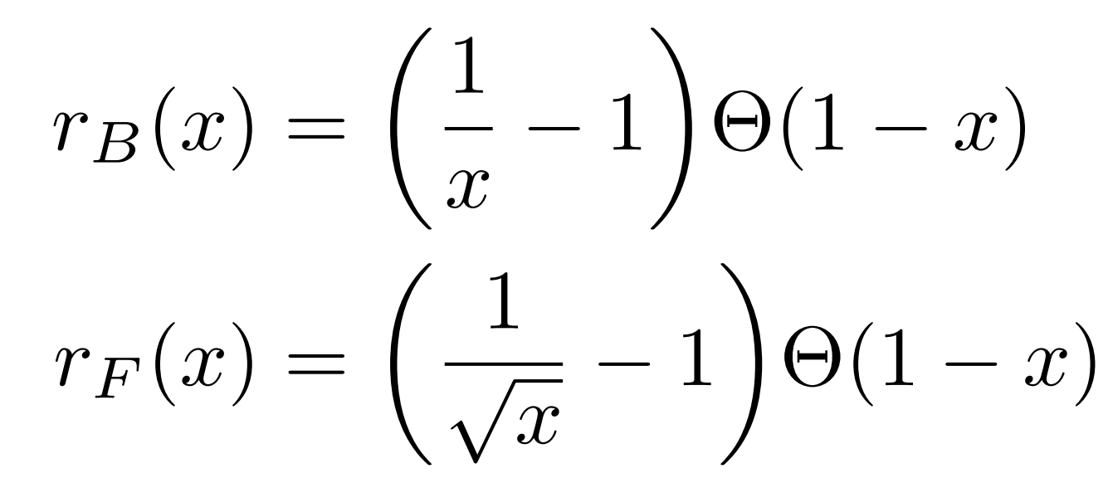
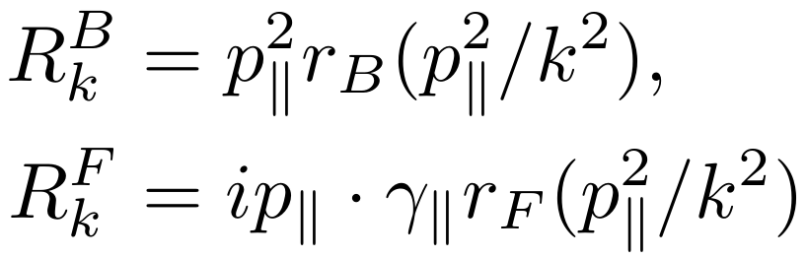
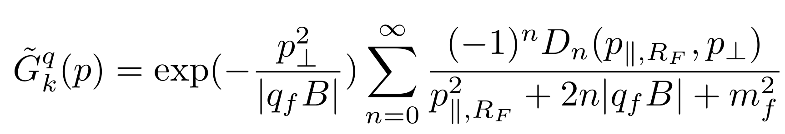
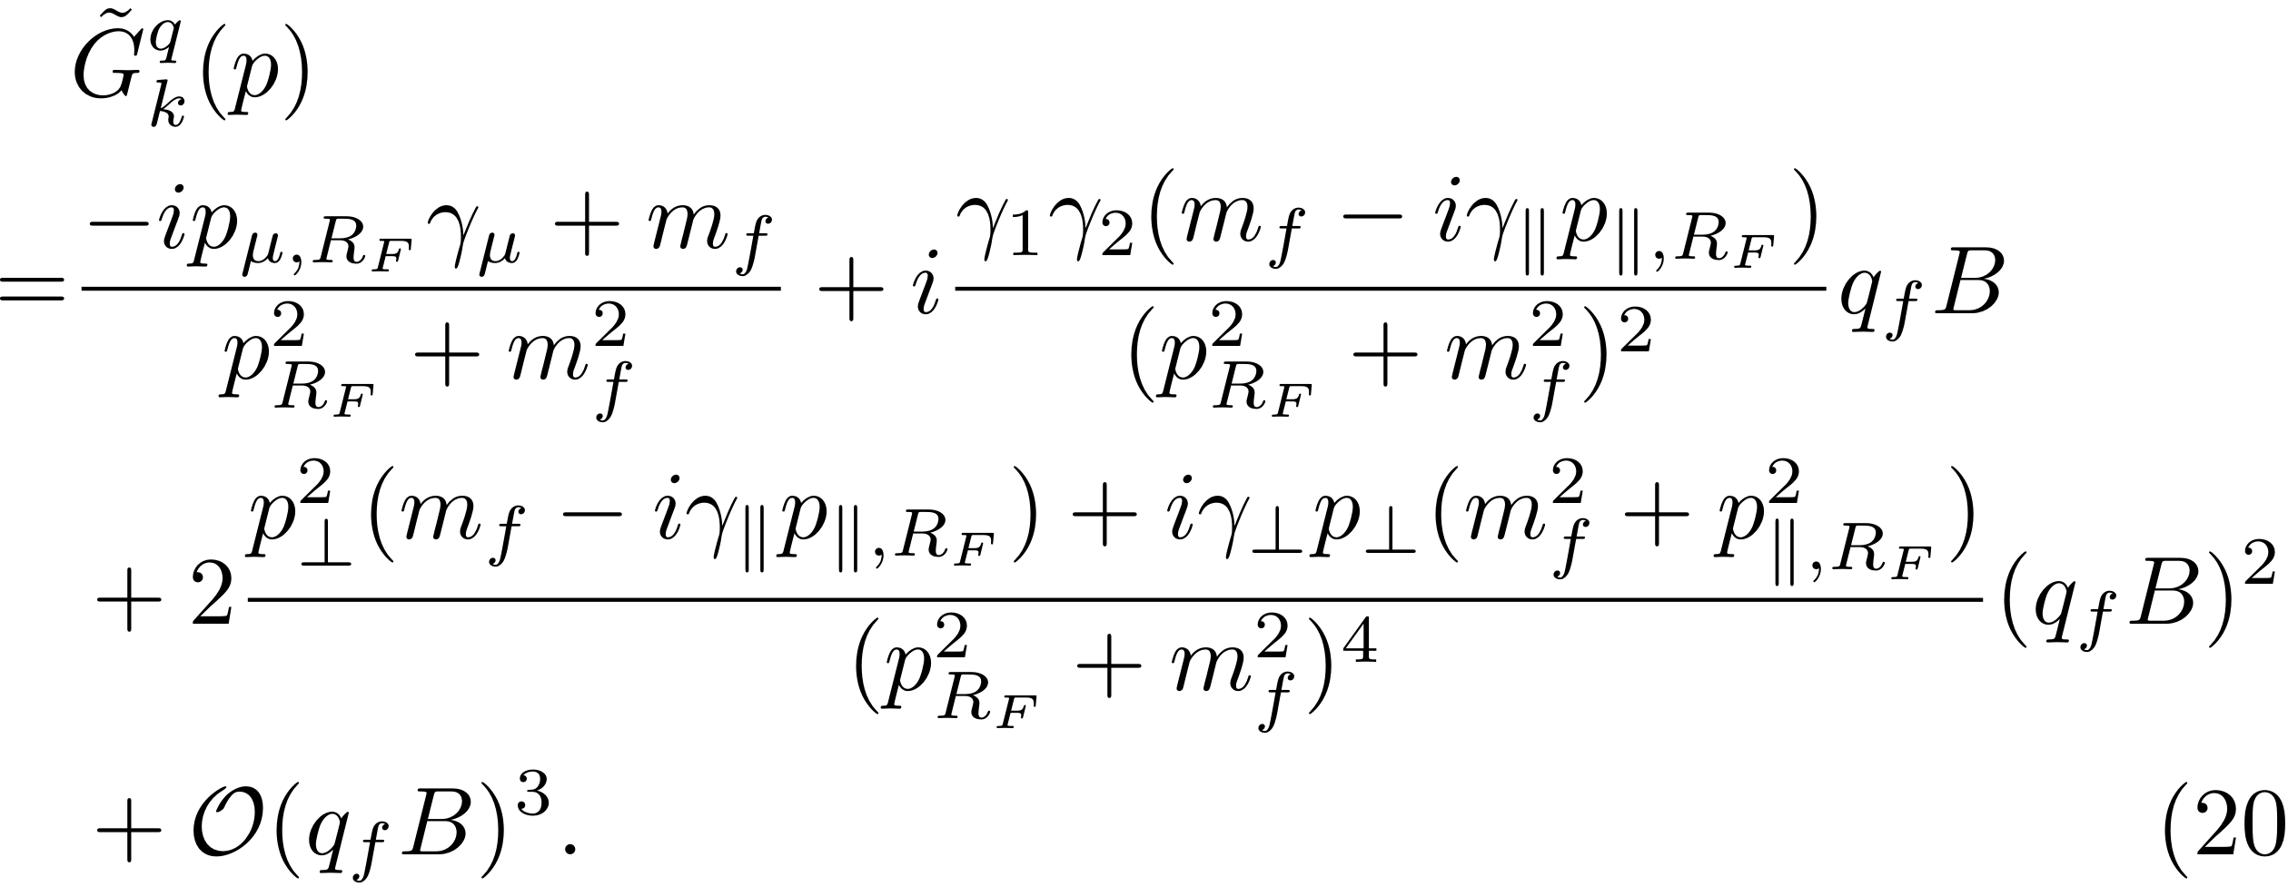
The regulators
The quark propagator
Landau levels representation
weak-field expansion
The charged meson propagators Landau levels representation weak-field expansion

Slide 7
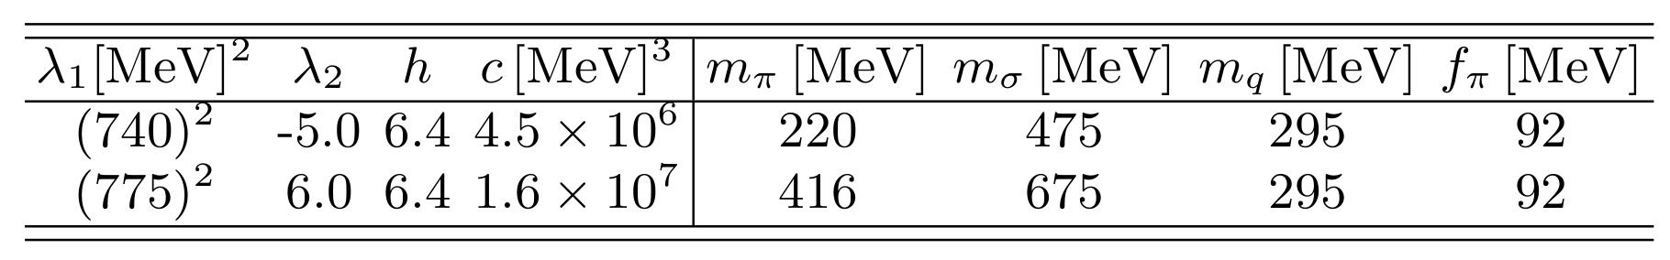
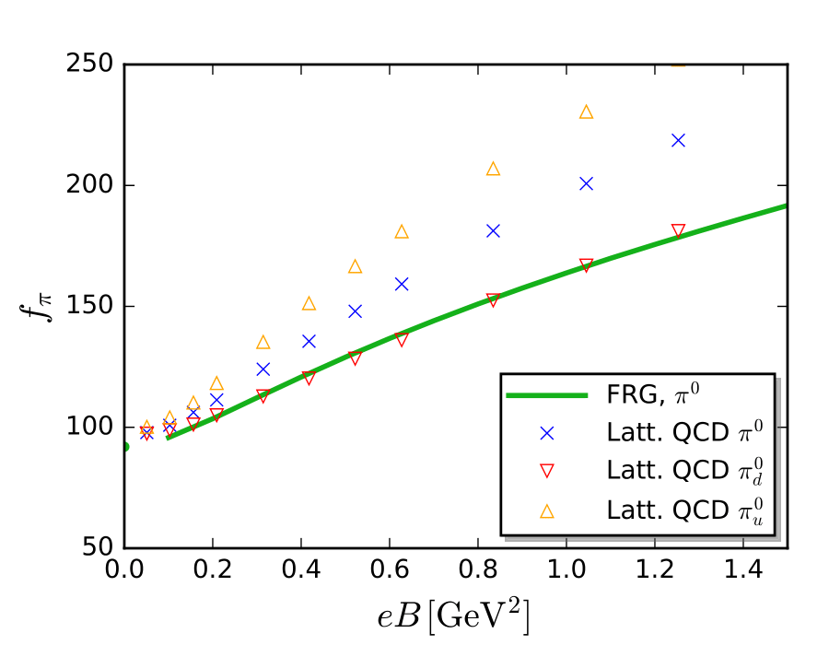
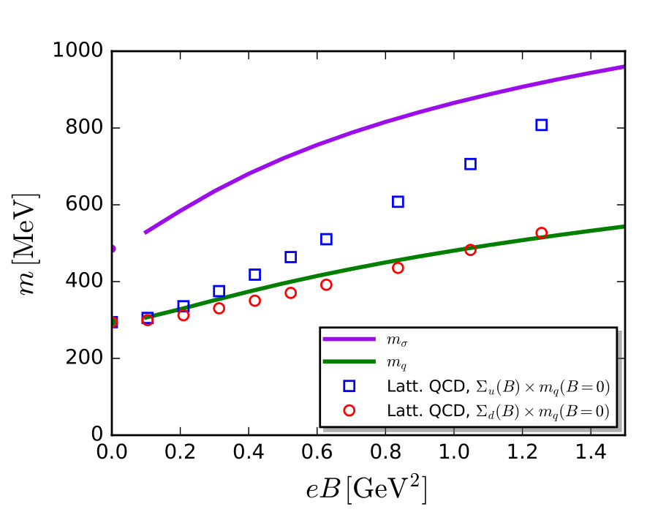
Numerical results
Pion decay constant
Quark mass and σ meson mass
magnetic catalysis
H. T. Ding, S. T. Li, A. Tomiya, X. D. Wang, and Y. Zhang Phys. Rev. D 105, 034514 (2022)

Slide 8
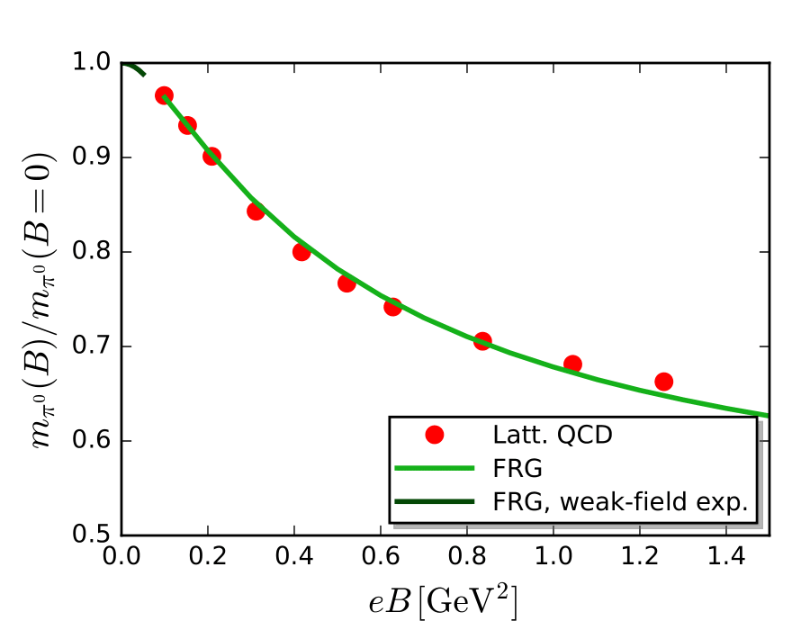

The neutral pion mass ${\text{m}}_{π^{0}}$
H. T. Ding, S. T. Li, A. Tomiya, X. D. Wang, and Y. Zhang Phys. Rev. D 105, 034514 (2022)

Slide 9
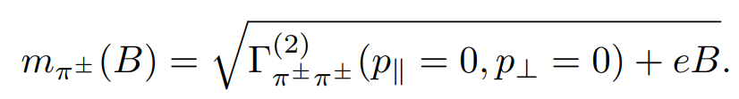
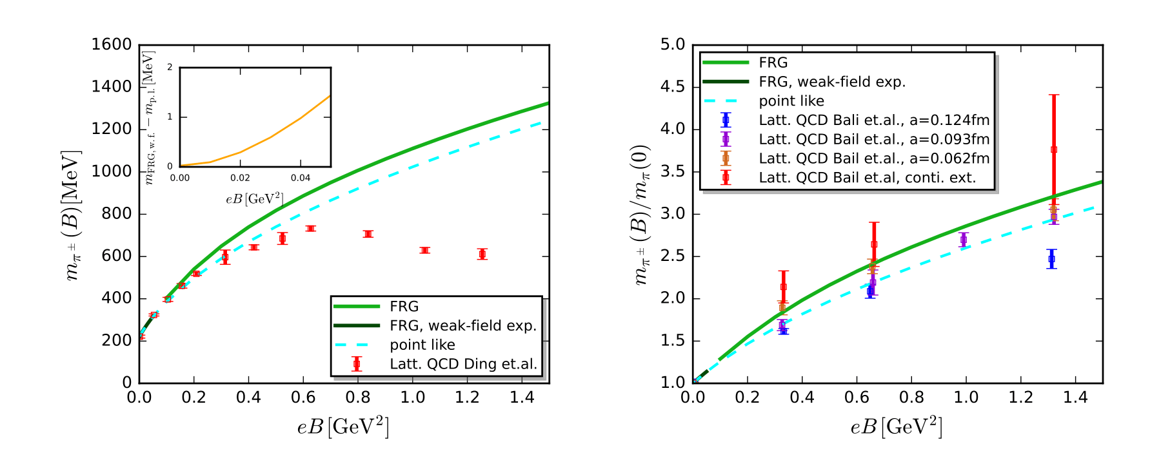




Charged pion mass ${\text{m}}_{π^{±}}$
${\text{m}}_{π}$(0) = 220 MeV
${\text{m}}_{π}$(0) =416 MeV
H. T. Ding, S. T. Li, A. Tomiya, X. D. Wang, and Y. Zhang Phys. Rev. D 105, 034514 (2022)
G. S. Bali, B. B. Brandt, G. Endrödi, and B. Gläßle Phys. Rev. D 97, 034505 (2018)

Slide 10
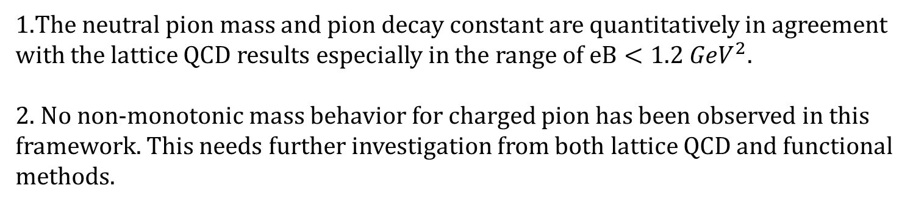
Summary and outlook
1.The neutral pion mass and pion decay constant are quantitatively in agreement with the lattice QCD results especially in the range of $eB<1.2 {GeV}^{2}$.
2. No non-monotonic mass behavior for charged pion has been observed in this framework. This needs further investigation from both lattice QCD and functional methods.
We will go beyond the LPA truncation and include the strange quark
and vector meson in future work.
Thanks for your attention

Slide 11
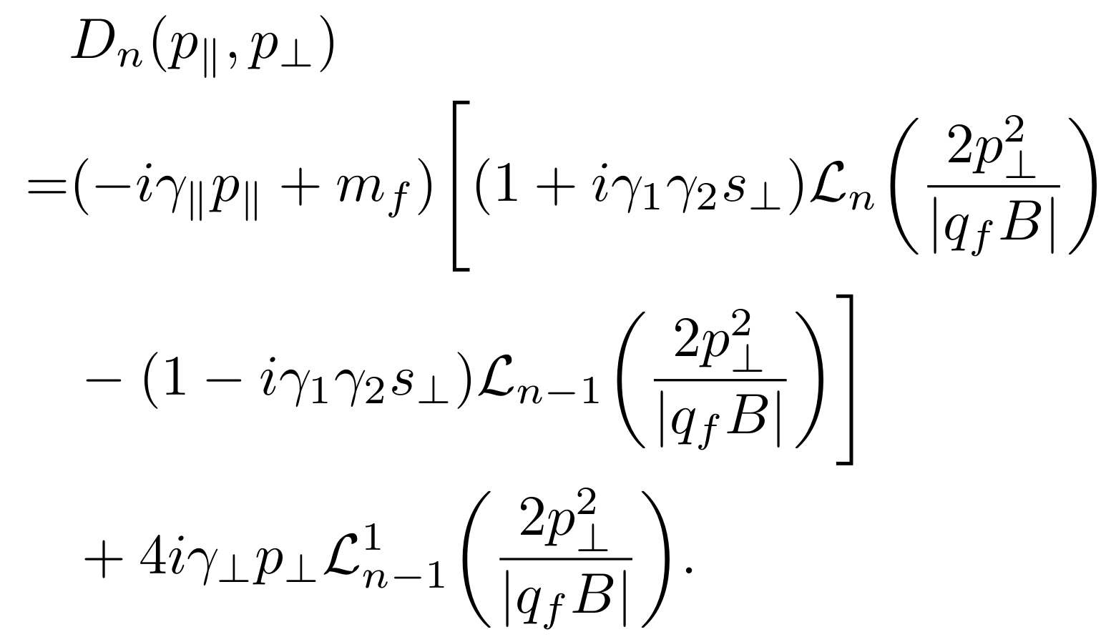
Backup
The quark propagator

Slide 12
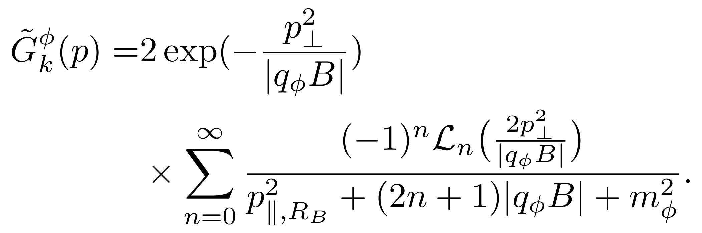
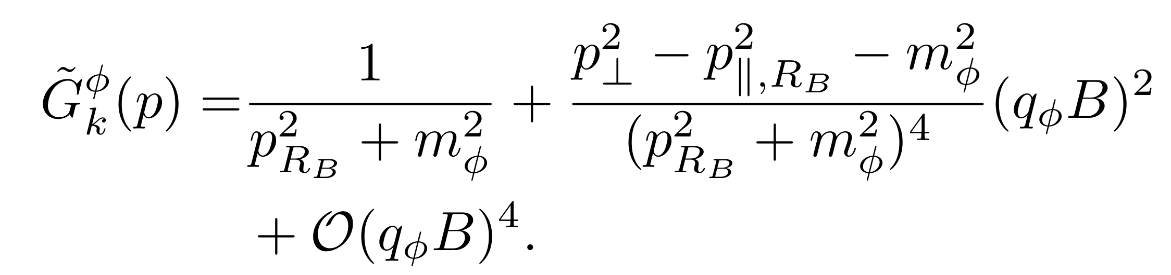
The meson propagator
Landau levels representation
weak-field expansion

Slide 13
