Slide 1
Compton scattering physics
These expressions are derived from the first principle
Shanhong Chen
2022-01-18

Slide 2
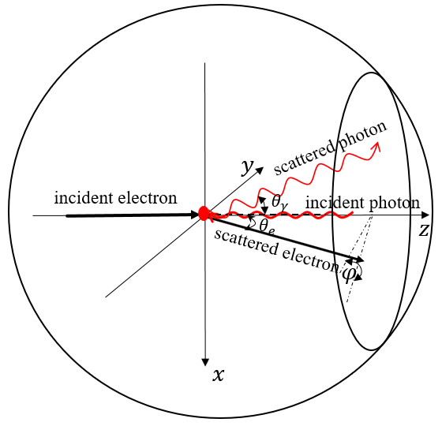
Compton scattering scheme
The relationship between the scattered energy of photon ($w$) and scattered angle of photon ($θ_{γ}$)
Fig. 1 Schematic explanation of the Compton scattering kinematics in the laboratory frame. A head-on collision geometry is considered in our case. The direction of the incident electron is along the positive direction of the z-axis. x-axis is perpendicular to the plane of the storage ring. -y is directed towards the center of the ring. $φ$ is the azimuthal angle of the plane perpendicular to z-axis. $θ_{e}$and $θ_{γ}$ denote the scattering angles of the electrons and photons respectively.
The four momentum of the initial electron and the initial photons are given by:
$$p=\left(ε_{0},0, 0,\vec{p}\right)$$
$$k=\left(ω_{0},0, 0,−\vec{k}\right)$$
The $p^{′}$ and $k^{′}$ denotes the four momentum of the scattered electron and the scattered photon, respectively
$$p^{′}=\left(ε,\vec{p^{′}}sinθ_{e},0,\vec{p^{′}}cosθ_{e}\right)$$
$$k^{′}=\left(ω,−\vec{k^{′}}sinθ_{γ},0,\vec{k^{′}}cosθ_{γ}\right)$$

Slide 3
Compton scattering scheme
The relationship between the scattered energy of photon ($w$) and scattered angle of photon ($θ_{γ}$)
From four-momentum conservation: $p+k=p^{′}+k^{′}$, the relationship between the scattered angle of photon $θ_{γ}$ and scattered energy can be expressed as followed:
$${\left(p+k−k^{′}\right)}^{2}={\left(p^{′}\right)}^{2}$$
$$p∙k−p∙k^{′}−k∙k^{′}=0$$
$$ε_{0}ω_{0}+\left|\vec{p}\right|ω_{0}−{\left(ε\right.}_{0}ω−\left|\vec{p}\right|ωcosθ_{γ})−{\left(ω\right.}_{0}ω+ω_{0}ωcosθ_{γ})=0$$
$$ω=ω_{0}\frac{ε_{0}+\left|\vec{p}\right|}{\left.ε_{0}−\left|\vec{p}\right|cosθ_{γ}+ω_{0}(1+cosθ_{γ}\right)}$$
$$ω=ω_{0}\frac{1+β}{\left.1−βcosθ_{γ}+\frac{ω_{0}}{ε_{0}}(1+cosθ_{γ}\right)}$$

Slide 4
The scattered energy of photon
The maximum scattered energy of photon ($w_{max}$)
$$ω=ω_{0}\frac{1+β}{\left.1−βcosθ_{γ}+\frac{ω_{0}}{ε_{0}}(1+cosθ_{γ}\right)}$$
Both numerator and denominator times 1 + β:
$$ω=ω_{0}\frac{(1+β)(1+β)}{\left.\frac{1}{γ^{2}}+\frac{(1+β)β}{2}θ_{γ}^{2}+\frac{{(1+β)ω}_{0}}{ε_{0}}(2−\frac{1}{2}θ_{γ}^{2}\right)}$$
$$cosθ_{γ}≈1−\frac{1}{2}θ_{γ}^{2}$$
Because of $ω_{0}$ ≤ me ≤ $ε_{0}$ (For example: $ε_{0}$ = 45.5GeV; me = 0.511MeV; $ω_{0}$ = 1.24eV), β ≈ 1
$$ω=ω_{0}\frac{4}{\frac{1}{γ^{2}}+θ_{γ}^{2}+\frac{ω_{0}}{ε_{0}}(4−θ_{γ}^{2})}$$
$$ω=ω_{0}\frac{4}{\frac{1}{γ^{2}}+θ_{γ}^{2}+\frac{{4ω}_{0}}{ε_{0}}}$$
$θ_{γ}^{2}$ ≤ $4$
$$w_{max}=\frac{4γ^{2}ω_{0}}{1+\frac{{4γ^{2}ω}_{0}}{ε_{0}}}$$

Slide 5
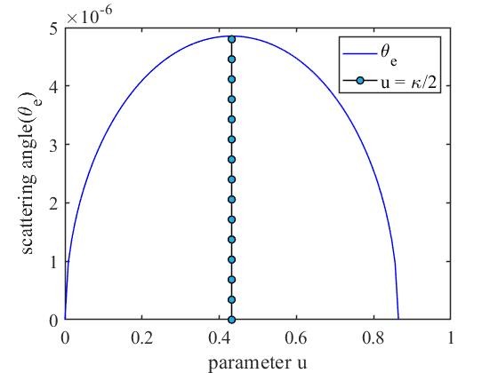
The scattered angle of particles
Here, we define a parameter u, which is the ratio of scattered energy of photon to electron:
$$u=\frac{ω}{ε}=\frac{ω}{ε_{0}+ω_{0}−ω}=\frac{θ_{e}}{θ_{γ}}$$
$$u_{max}=\frac{ω_{max}}{ε_{0}+ω_{0}−ω_{max}}$$
$${κ=u}_{max}≈\frac{4γ^{2}ω_{0}}{ε_{0}}$$
replacing ω and ω0 with the parameter u and κ :
$$u=\frac{ω}{ε}≈\frac{ω}{ε_{0}−ω}$$
$$θ_{γ}=\frac{1}{γ}\sqrt{\frac{κ}{u}−1}$$
$$ω_{0}=\frac{κε_{0}}{4γ^{2}}$$
$$θ_{e}=uθ_{γ}=\frac{u}{γ}\sqrt{\frac{κ}{u}−1}=\frac{1}{γ}\sqrt{κu−u^{2}}$$

Slide 6
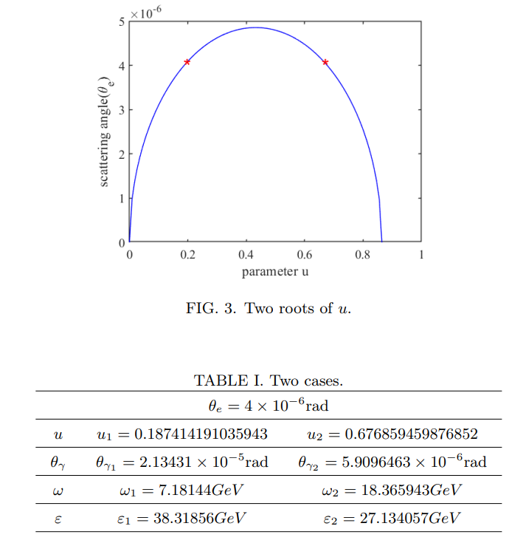
The scattered angle of particles
How to understand?

Slide 7
Booster to the rest frame of electron
rest frame (*)
$$z$$
In rest frame of electron, the four-momentum of the scattered electrons is:
Scattered
electron
Incident electron
$$θ^{∗}$$
$$φ^{∗}$$
$$p_{f}^{∗}=\left[\begin{matrix}E_{f}^{∗} \\ \vec{p_{f}^{∗}}sinθ^{∗}cosφ^{∗} \\ \begin{matrix}\vec{p_{f}^{∗}}sinθ^{∗}s{inφ}^{∗} \\ \vec{p_{f}^{∗}}cosθ^{∗}\end{matrix}\end{matrix}\right]$$
Incident photon
$$s$$
Scattered
photon
$$x$$
LAB frame
In LAB frame, the four-momentum of the scattered electrons is: (Boosted)
$$z$$
Scattered
electron
$${p_{f}=\left[\begin{matrix}\begin{matrix}γ & 0 \\ 0 & 1\end{matrix} & \begin{matrix}0 & −γβ \\ 0 & 0\end{matrix} \\ \begin{matrix}0 & 0 \\ −γβ & 0\end{matrix} & \begin{matrix}1 & 0 \\ 0 & γ\end{matrix}\end{matrix}\right]p}_{f}^{∗}=\left[\begin{matrix}{γE}_{f}^{∗}−γβ\vec{p_{f}^{∗}}cosθ^{∗} \\ \vec{p_{f}^{∗}}sinθ^{∗}cosφ^{∗} \\ \begin{matrix}\vec{p_{f}^{∗}}sinθ^{∗}s{inφ}^{∗} \\ −{γβE}_{f}^{∗}+γ\vec{p_{f}^{∗}}cosθ^{∗}\end{matrix}\end{matrix}\right]$$
Incident electron
$$θ_{e}$$
$$φ$$
$$θ_{γ}$$
Incident photon
$$s$$
Scattered
photon
$$x$$
7

Slide 8
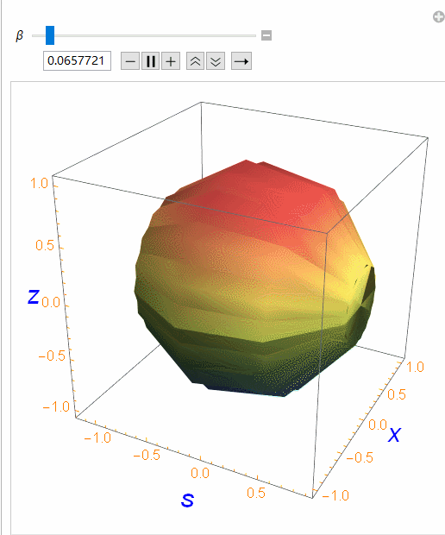
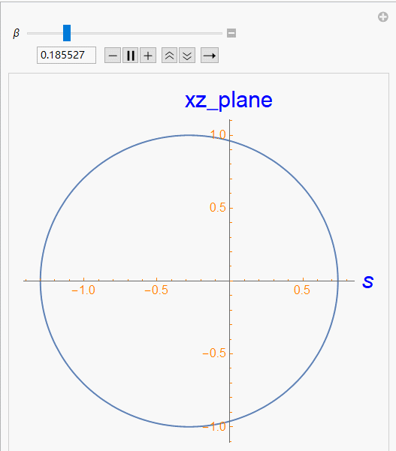
The relationship between momentum in LAB frame and scattered angle in the rest frame of the electron
Set: $\left|\vec{p_{f}}\right|$=1, $m=1,$ $βε[0,0.999999]$
$γ=\frac{1}{\sqrt{1−β^{2}}}$ $E=\sqrt{m^{2}+{\left|\vec{p}\right|}^{2}}$
Fig. 1 $p_{f} (3D)$
Fig. 2 $p_{f} (2D)$
8

Slide 9
Several examples
Without any approximate treatment
Example 1
The relationship between the scattered energy of photon ($w$) and scattered angle of photon ($θ_{γ}$)
$$ω=ω_{0}\frac{1+β}{\left.1−βcosθ_{γ}+\frac{ω_{0}}{ε_{0}}(1+cosθ_{γ}\right)}$$
An example
Electron mass $m_{e}$ | Lorentz factor $$γ$$ | $$γ=\frac{1}{\sqrt{1−β^{2}}}$$ | Beam energy $ε_{0}$ | Laser energy $$ω_{0}$$
$$m_{e}=0.511MeV$$ | $$γ=2$$ | $$β=\frac{\sqrt{3}}{2}$$ | $$ε_{0}=γm_{e}=1.022MeV$$ | $$ω_{0}=1eV$$
From equation above, the relationship between the scattered energy of photons and the scattered angle of photons can be obtained. Meanwhile, the scattered energy of photons can reach 13.928eV when the scattered angle of photons $θ_{γ}=0$.
$$u_{max}=\frac{ω_{max}}{ε_{0}+ω_{0}−ω_{max}}=\frac{ω_{0}\frac{1+β}{1−β+\frac{ω_{0}}{ε_{0}}}}{ε_{0}+ω_{0}−ω_{0}\frac{1+β}{1−β+\frac{ω_{0}}{ε_{0}}}}=1.363×{10}^{−5}$$

Slide 10
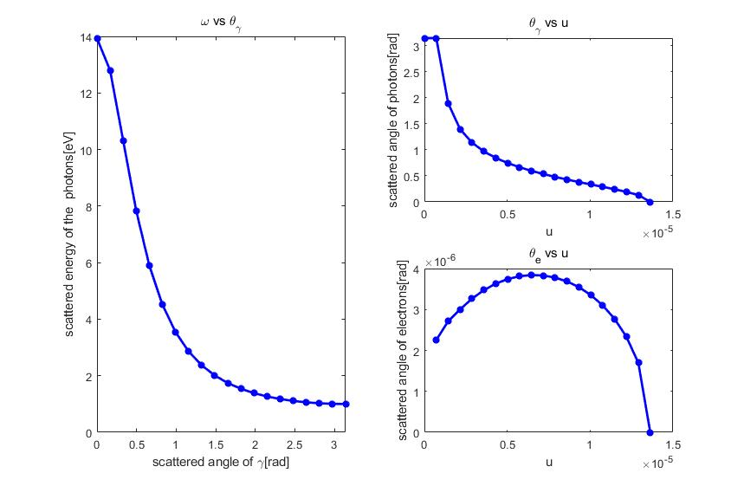
Several examples
Example 1
$$cosθ_{γ}=\frac{\frac{\left(1+u\right)\left(1+β\right)ω_{0}}{\left.{u(ε}_{0}+ω_{0}\right)}−\frac{ω_{0}}{ε_{0}}−1}{\frac{ω_{0}}{ε_{0}}−β}$$
$$θ_{e}=uθ_{γ}$$
Example 1
Lorentz factor $$γ$$ | $$γ=\frac{1}{\sqrt{1−β^{2}}}$$ | Beam energy $ε_{0}$ | Laser energy $$ω_{0}$$
$$γ=2$$ | $$β=\frac{\sqrt{3}}{2}$$ | $$ε_{0}=γm_{e}=1.022MeV$$ | $$ω_{0}=1eV$$

Slide 11
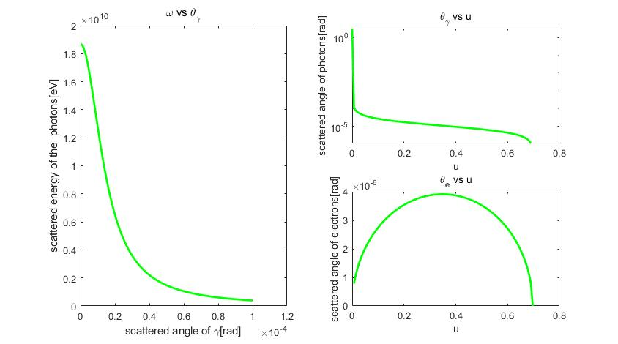
Several examples
Example 2
$$cosθ_{γ}=\frac{\frac{\left(1+u\right)\left(1+β\right)ω_{0}}{\left.{u(ε}_{0}+ω_{0}\right)}−\frac{ω_{0}}{ε_{0}}−1}{\frac{ω_{0}}{ε_{0}}−β}$$
$$θ_{e}=uθ_{γ}$$
Example 2
Lorentz factor $$γ$$ | $$γ=\frac{1}{\sqrt{1−β^{2}}}$$ | Beam energy $ε_{0}$ | Laser energy $$ω_{0}$$
$$γ=89041$$ | $$β≈1$$ | $$ε_{0}=γm_{e}=45.5GeV$$ | $$ω_{0}=1eV$$

Slide 12
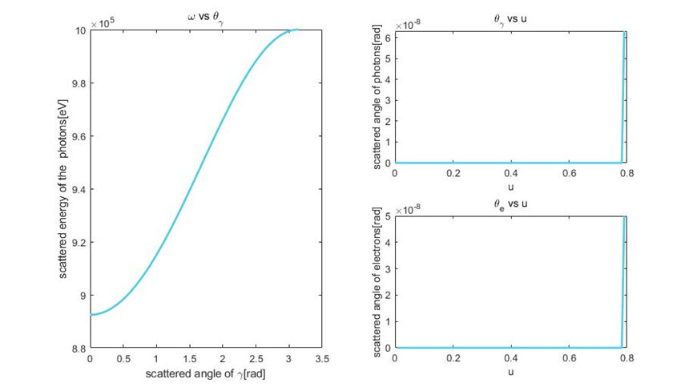
Several examples
Example 3
$$cosθ_{γ}=\frac{\frac{\left(1+u\right)\left(1+β\right)ω_{0}}{\left.{u(ε}_{0}+ω_{0}\right)}−\frac{ω_{0}}{ε_{0}}−1}{\frac{ω_{0}}{ε_{0}}−β}$$
$$θ_{e}=uθ_{γ}$$
Example 3
Lorentz factor $$γ$$ | $$γ=\frac{1}{\sqrt{1−β^{2}}}$$ | Beam energy $ε_{0}$ | Laser energy $$ω_{0}$$
$$γ=2$$ | $$β=\frac{\sqrt{3}}{2}$$ | $$ε_{0}=γm_{e}=1.022MeV$$ | $$ω_{0}=1MeV$$

Slide 13
To understand……

Slide 14
Back-up

