Slide 1


JUNO-TAO Status and Prospect
Ruhui Li (on behalf of JUNO)
Institute of High Energy Physics

Slide 2
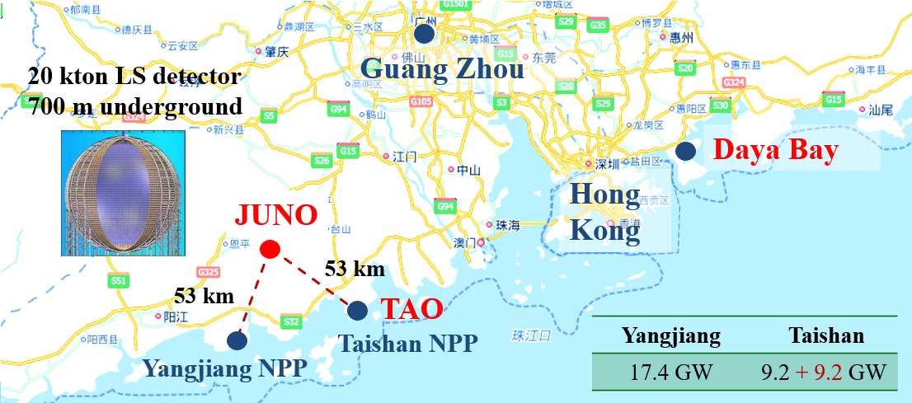

JUNO-TAO
TAO: Taishan Antineutrino Observatory
A satellite experiment of JUNO
Measure reactor neutrino w/ sub-percent E resolution
Location:
  30 m from Taishan
  NPP core (4.6 GW)

Slide 3
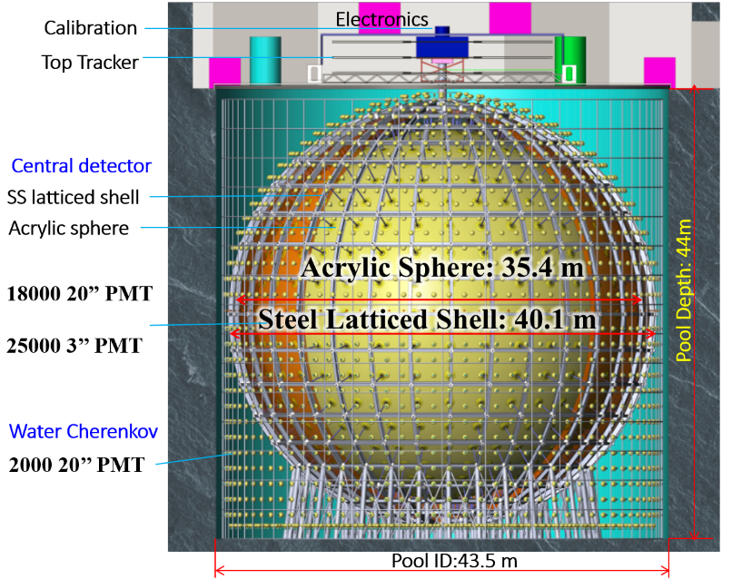
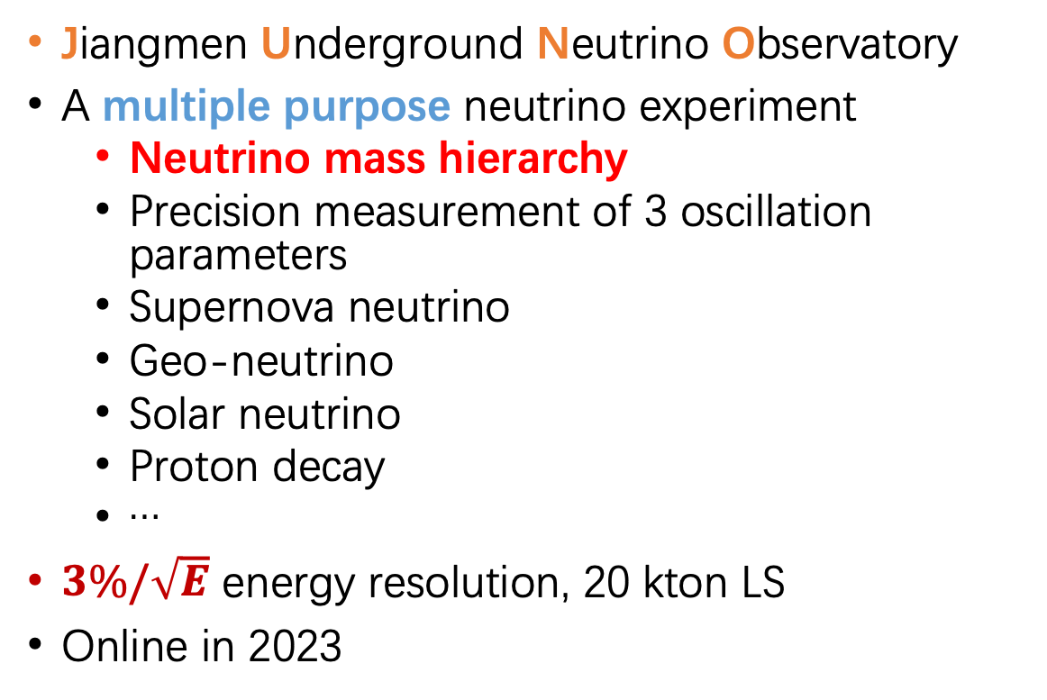
JUNO
Jiangmen Underground Neutrino Observatory
A multiple purpose neutrino experiment
  Neutrino mass hierarchy
  Precision measurement of 3 oscillation parameters
  Supernova neutrino
  Geo-neutrino
  Solar neutrino
  Proton decay
  …
$3\%/\sqrt{E}$ energy resolution, 20 kton LS
Online in 2023

Slide 4
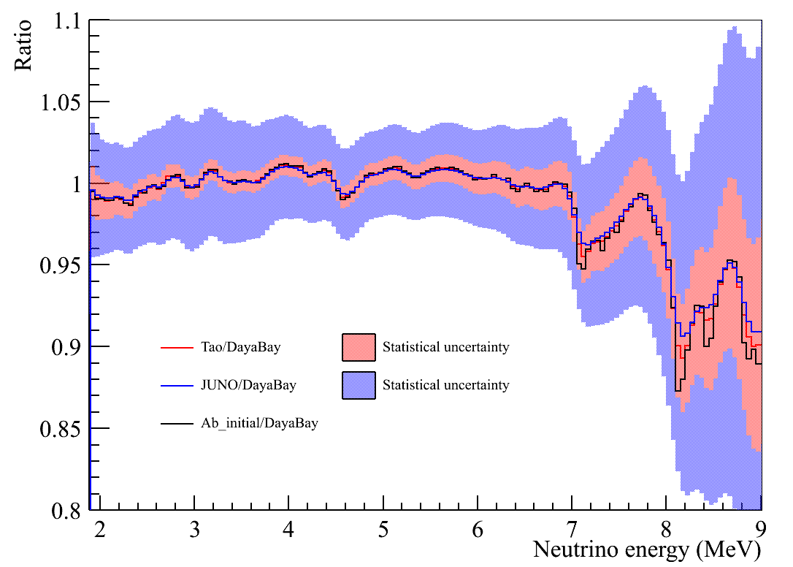
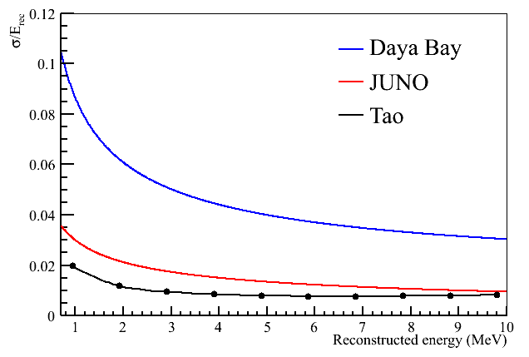
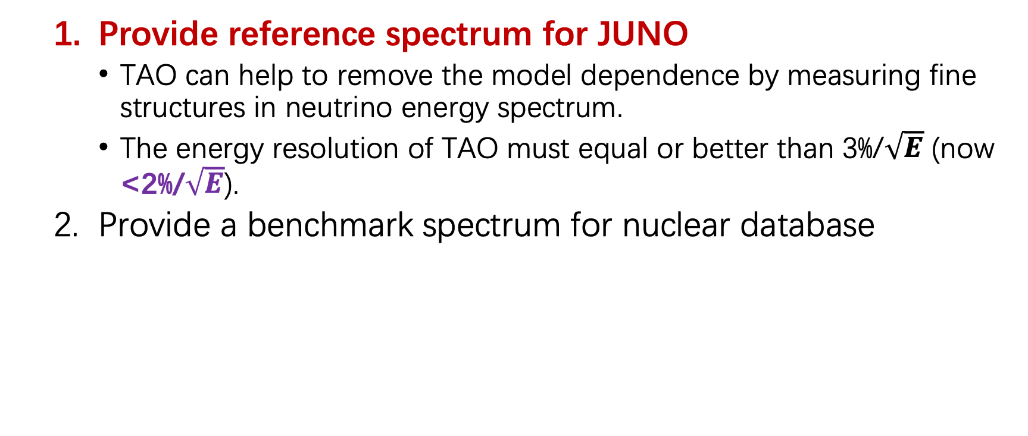
TAO Motivation
  Provide reference spectrum for JUNO
    TAO can help to remove the model dependence by measuring fine structures in neutrino energy spectrum.
    The energy resolution of TAO must equal or better than 3%/$\sqrt{E}$ (now <2%/$\sqrt{E}$).
  Provide a benchmark spectrum for nuclear database

Slide 5
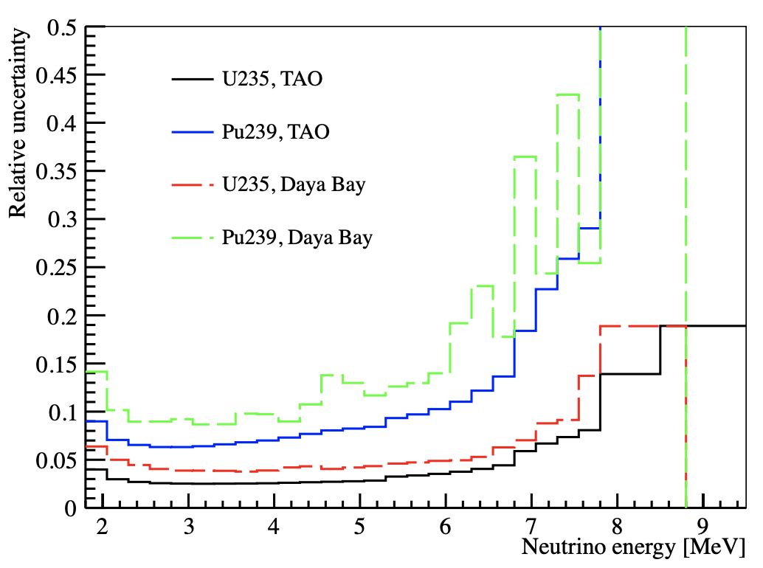
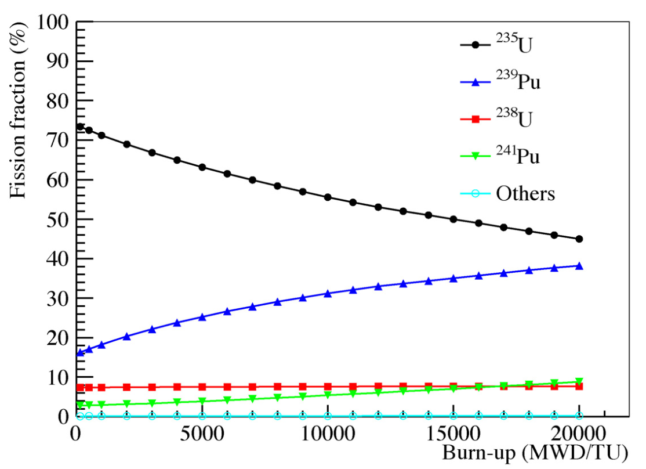
TAO Motivation
  3. Measuring isotopic neutrino spectrum
  Reactor monitoring
  Sterile neutrino

Slide 6
TAO Detector
Inner
Outside
Gd-LS ⇨ acrylic vessel ⇨ SiPM & support ⇨ LAB buffer ⇨ cryogenic vessel ⇨ water & HDPE shield ⇨ muon veto
-9.6 m underground
~ 10 m² SiPM coverage (95%)
1.8 m diameter, 2.8 ton GdLS
(1 ton for fiducial volume cut)
Operate at -50°C
4000 IBD/day (2000 w/ FV)

Slide 7
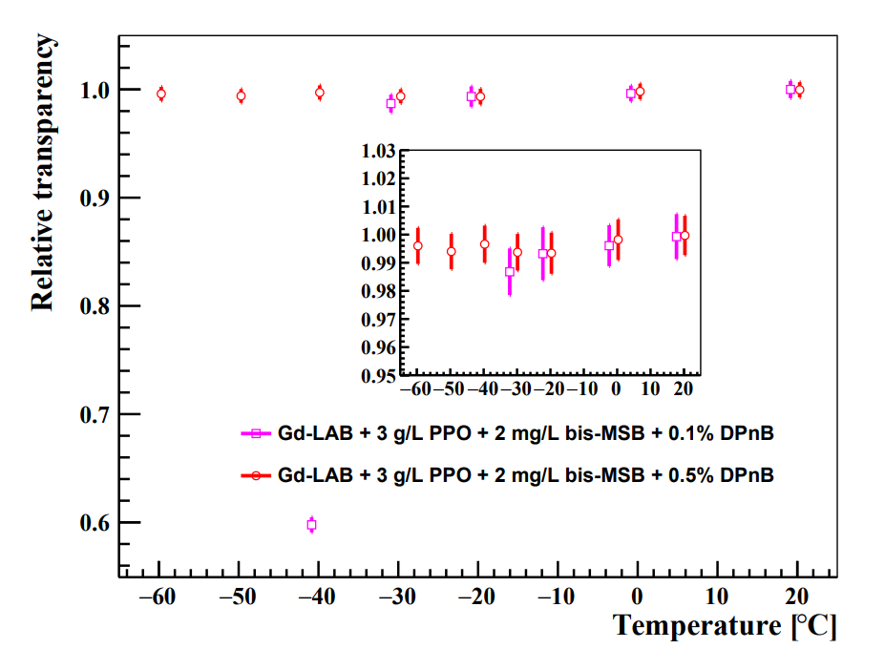
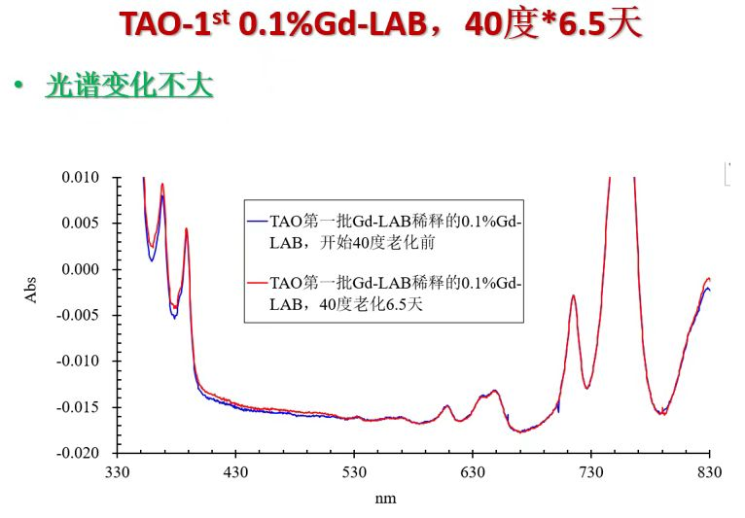
GdLS & LAB Buffer
Recipe: Gd-LAB + 3 g/L PPO + 2 mg/L bis-MSB + 0.5% DPnB
High light yield/flash point/transparency
Good stability at -50°C
3200 L, production ongoing in IHEP, will be finished in Sept. 2022
DOI: 10.1016/j.nima.2021.165459

Slide 8
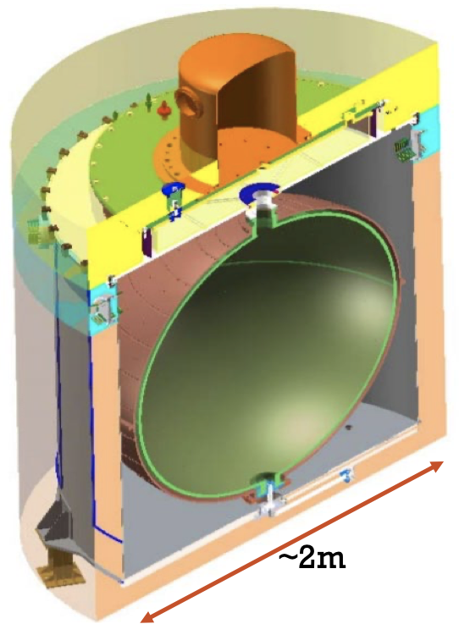
GdLS & LAB Buffer
Plan to dope Gd in buffer LAB for neutron reduction
  Neutrons spill in & out at the edge of the GdLS bring backgrounds
    GdLS neutron capture time ~28 𝜇s, LAB neutron capture time ~200 𝜇s
    Long capture time neutrons will go out of the veto time window
  Doping Gd can reduce ~1/3 backgrounds
Compatibility with materials in low temperature are confirmed

Slide 9
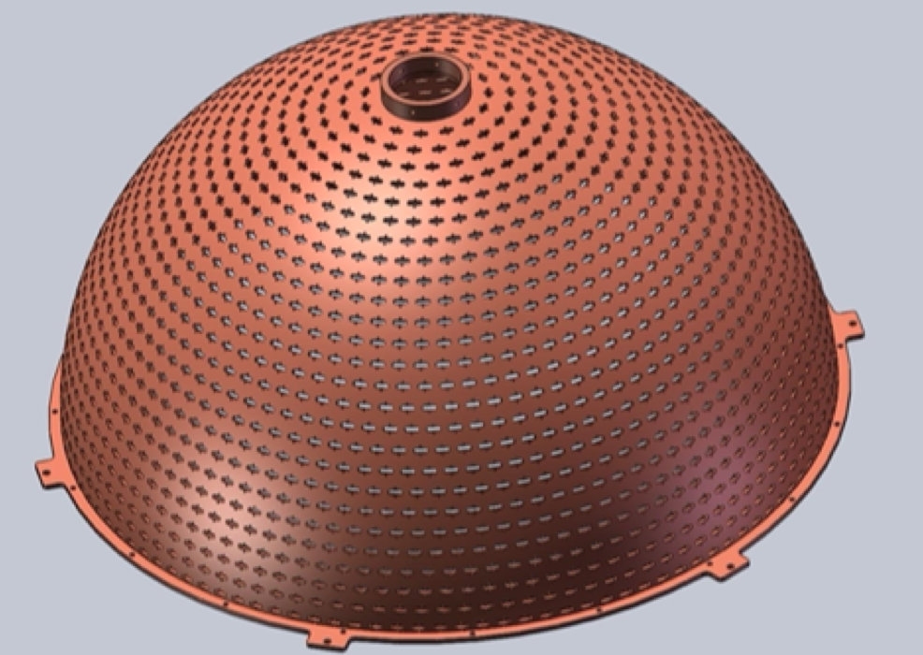
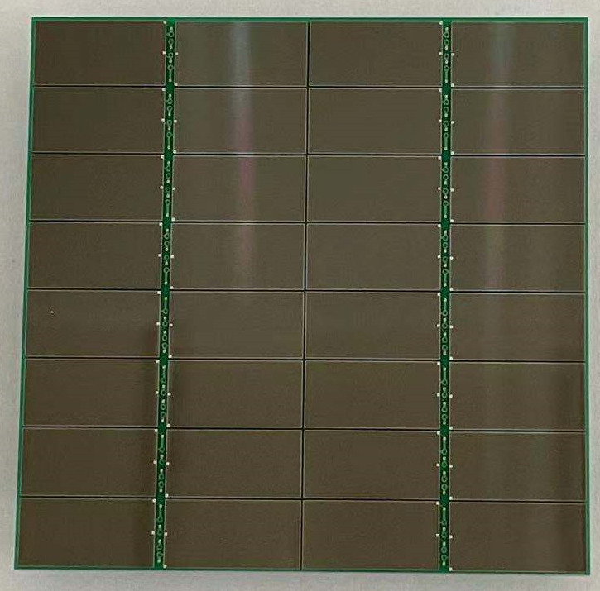
SiPM
Tile 50.8 x 50.8 mm², 4024 tiles from HPK
~ 8000 channels, charge resolution per channel ⩽ 15%
Supported & cooled by copper shell
Work at -50°C to lower dark noise by 2-3 orders
Characterizations have been conducted
Efforts on QA/QC are ongoing, production will be
completed in March, 2023

Slide 10
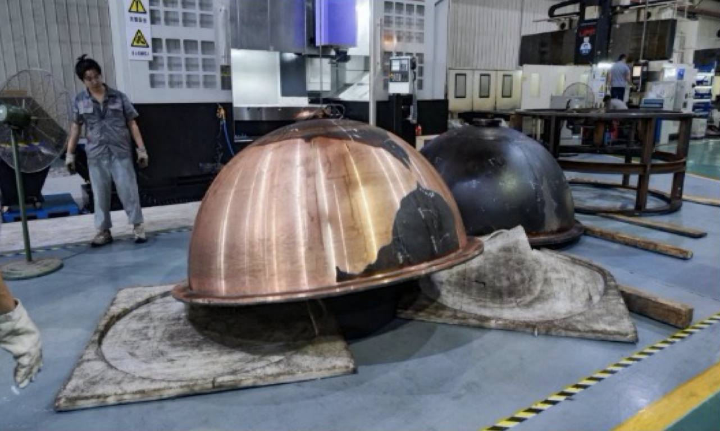
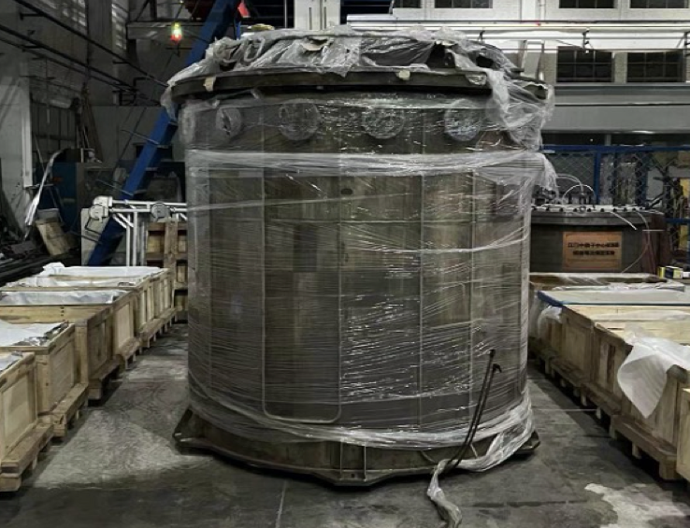
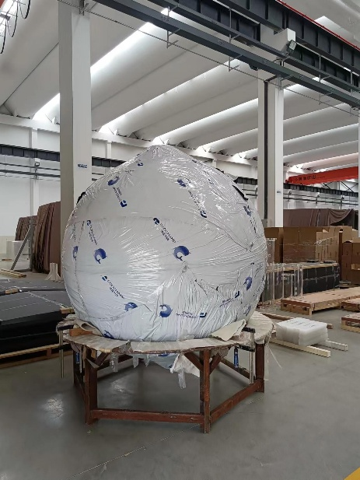
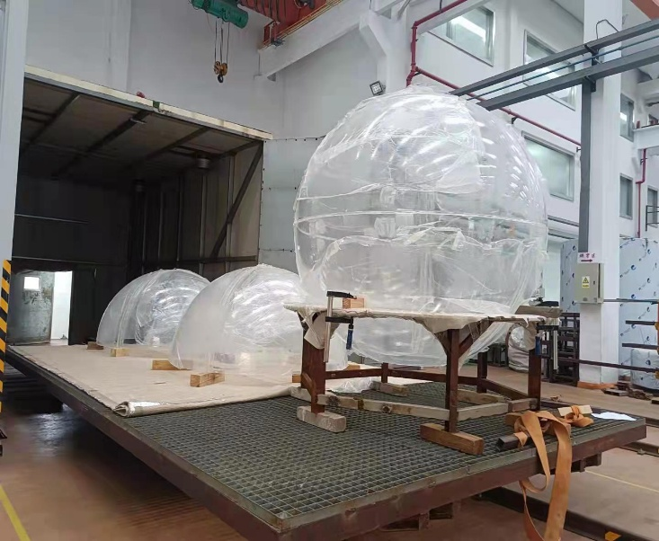
Central Detector
Copper shell
  Cutting → Forming →Welding → Machining →Coating(PTFE)
  Machining ends in middle September
Stainless steel tank
  Production finished in May 2022
  Acceptance check was passed
Acrylic sphere
  Production finished in Nov. 2021

Slide 11
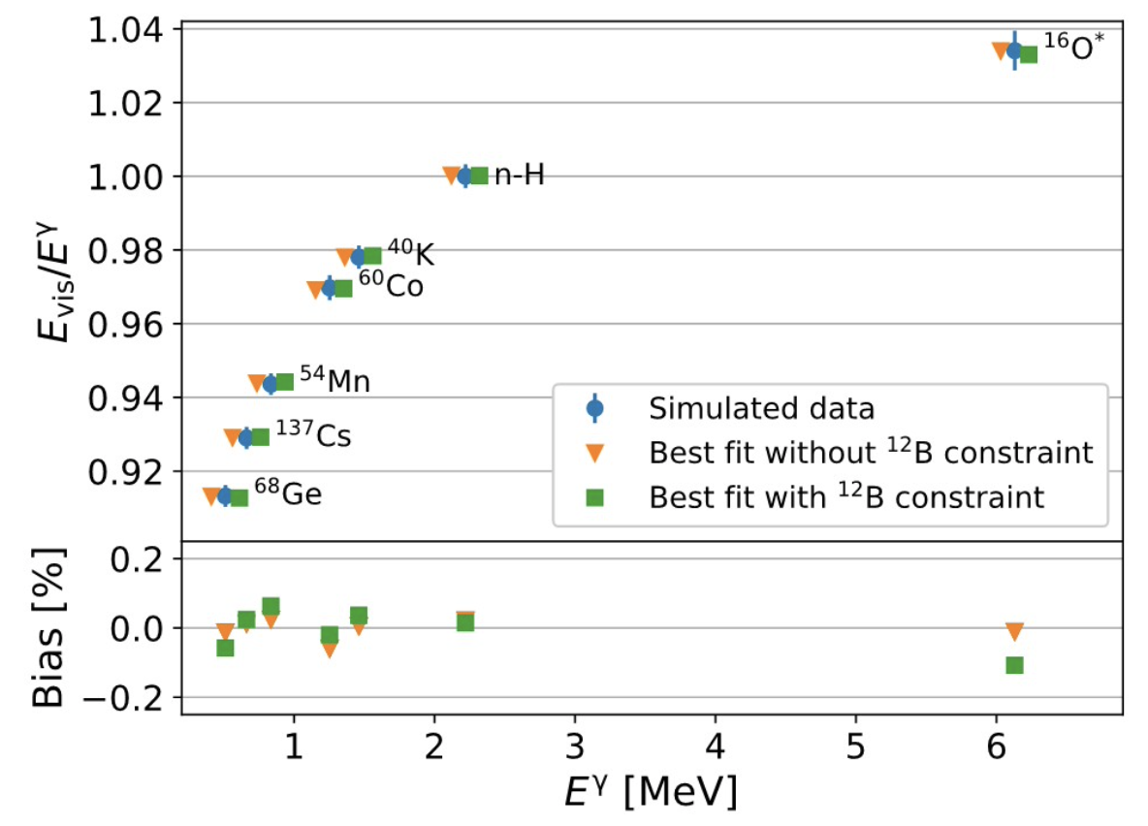
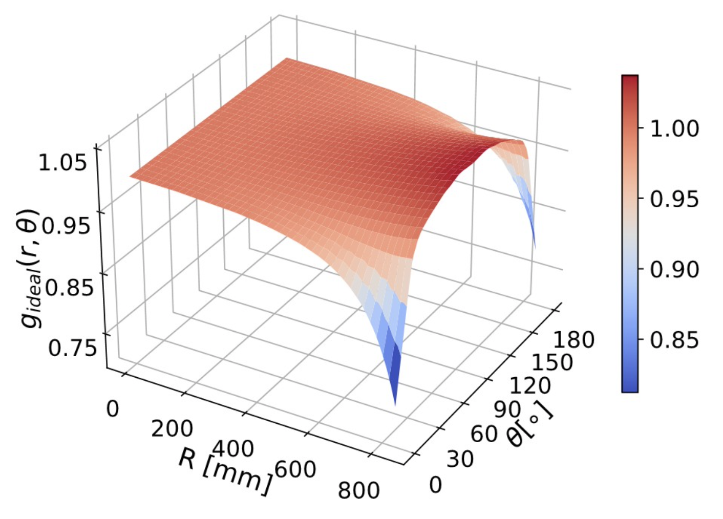
Calibration
Non-linearity
  Use gamma sources(¹³⁷Cs, ⁵⁴Mn, ⁴⁰K, ⁶⁰Co, ⁶⁸Ge, ²⁴¹Am-¹³C)
  For electron & positron, physics non-linearity <0.6%
  w/ ¹²B data of three years, physics non-linearity <0.4%
Non-uniformity
  Use ACU & CLS to deploy 110 positions for gamma source
  w/ FV, residual non-uniformity is <0.2%
  Energy resolution degradation <0.05%
  Energy bias <0.3%
arXiv: 2204.03256

Slide 12
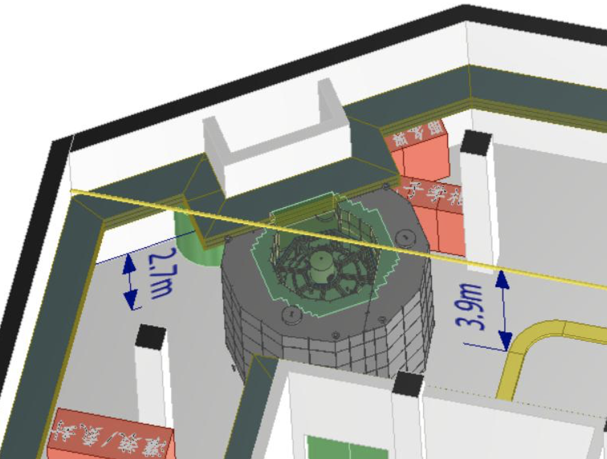
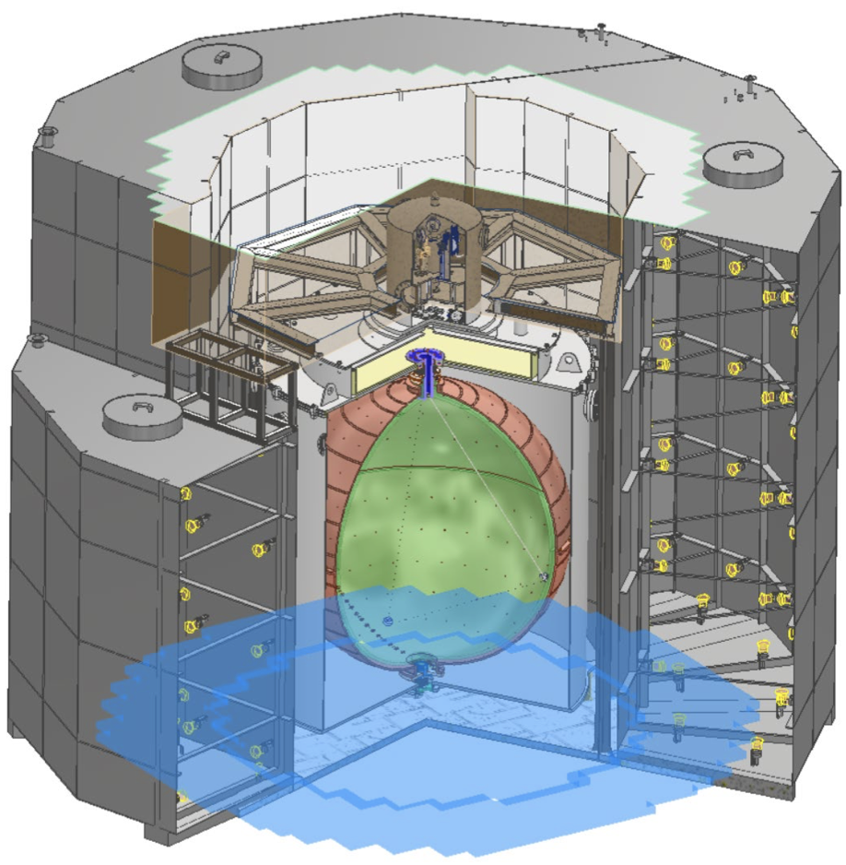
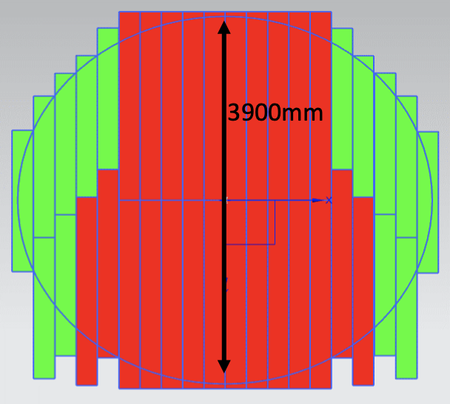
Muon Veto
Two combined active shielding, design is completed
Top plastic scintillator
  4 layers with each 2cm thickness, 1 mm gap between strips
  Muon veto efficiency ~ 99% (3/4)
  More details in Guang Luo’s talk
Water tank
  Dodecagon, 1.2 m thickness, 3 standalone parts
  300 3” PMTs, muon veto efficiency > 99%
arXiv: 2206.01112

Slide 13
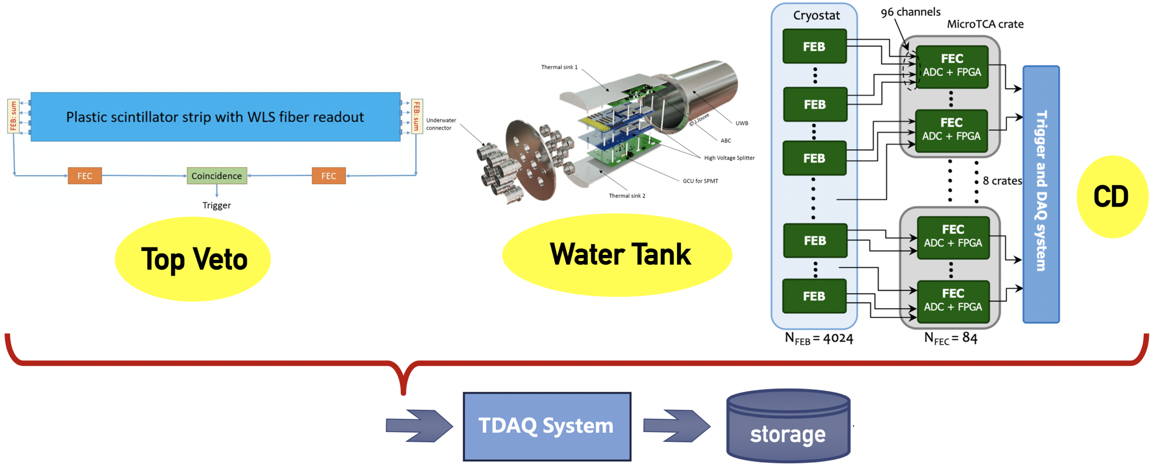
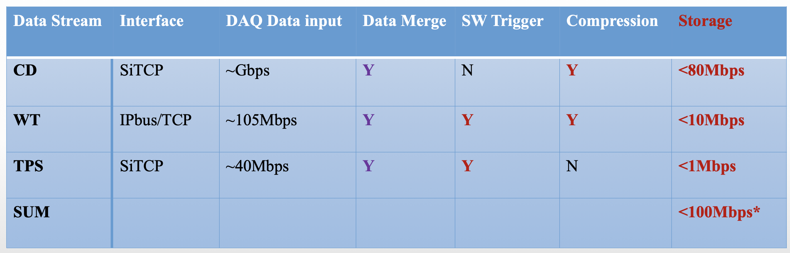
Electronics & TDAQ
Electronics of central detector (CD)
  FEB based on discrete components
  Waveform digitized by ADC (250MHz)
  FPGA calculates Q/T, sent to TDAQ
Electronics of veto detectors
  Same strategy with CD for TPS
  Same with 3’’ PMTs electronics in JUNO

Slide 14
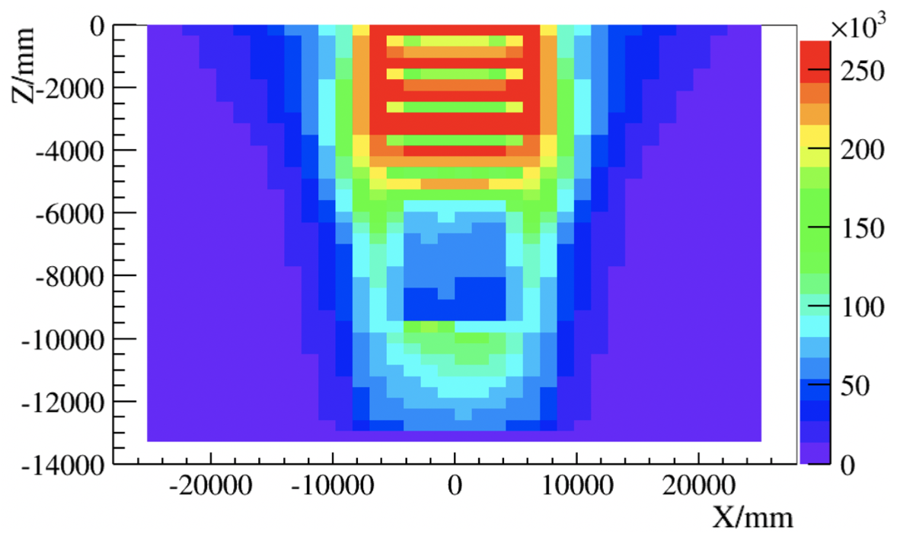
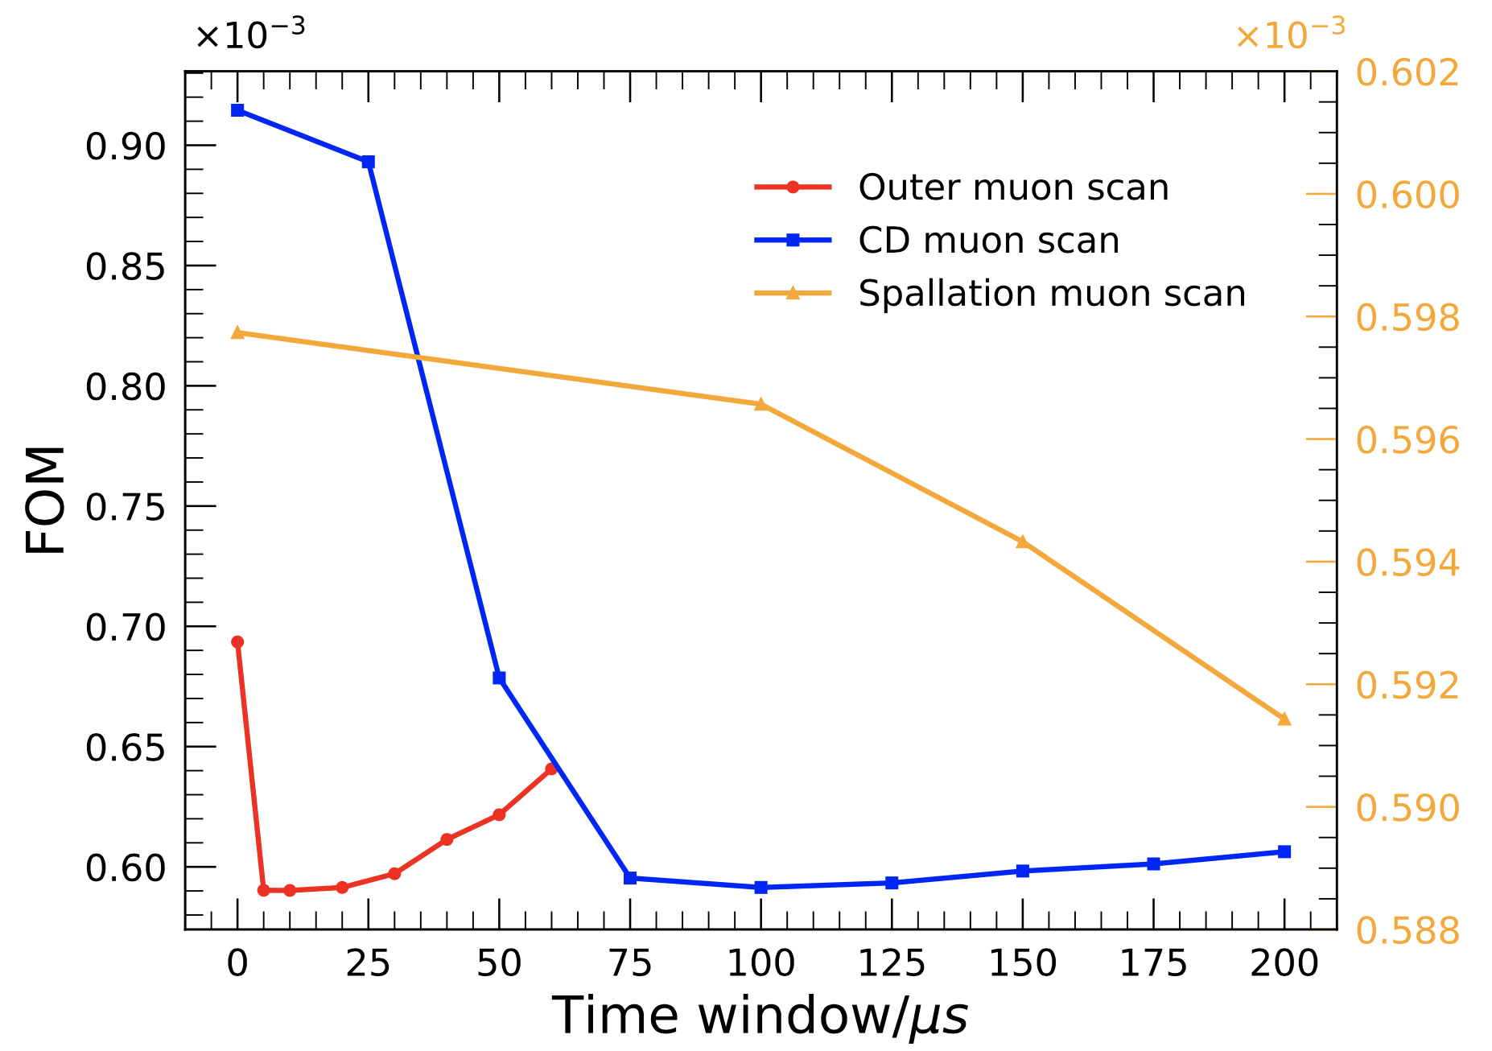
Background Simulation
IBD | 1838/day
Singles from radioactivity | 100 Hz
Muon rate | 67 Hz/m²
IBD-like before veto | 3682/day
IBD-like after veto | 44/day
Accidental background | 129/day
⁸He & ⁹Li | <20/day
Neutron Distribution
Veto Strategy Optimization
B/S is 2.4%, w/ PSD it will be 1.8%.
Risk: High Energy environmental neutrons
arXiv: 2206.01112

Slide 15
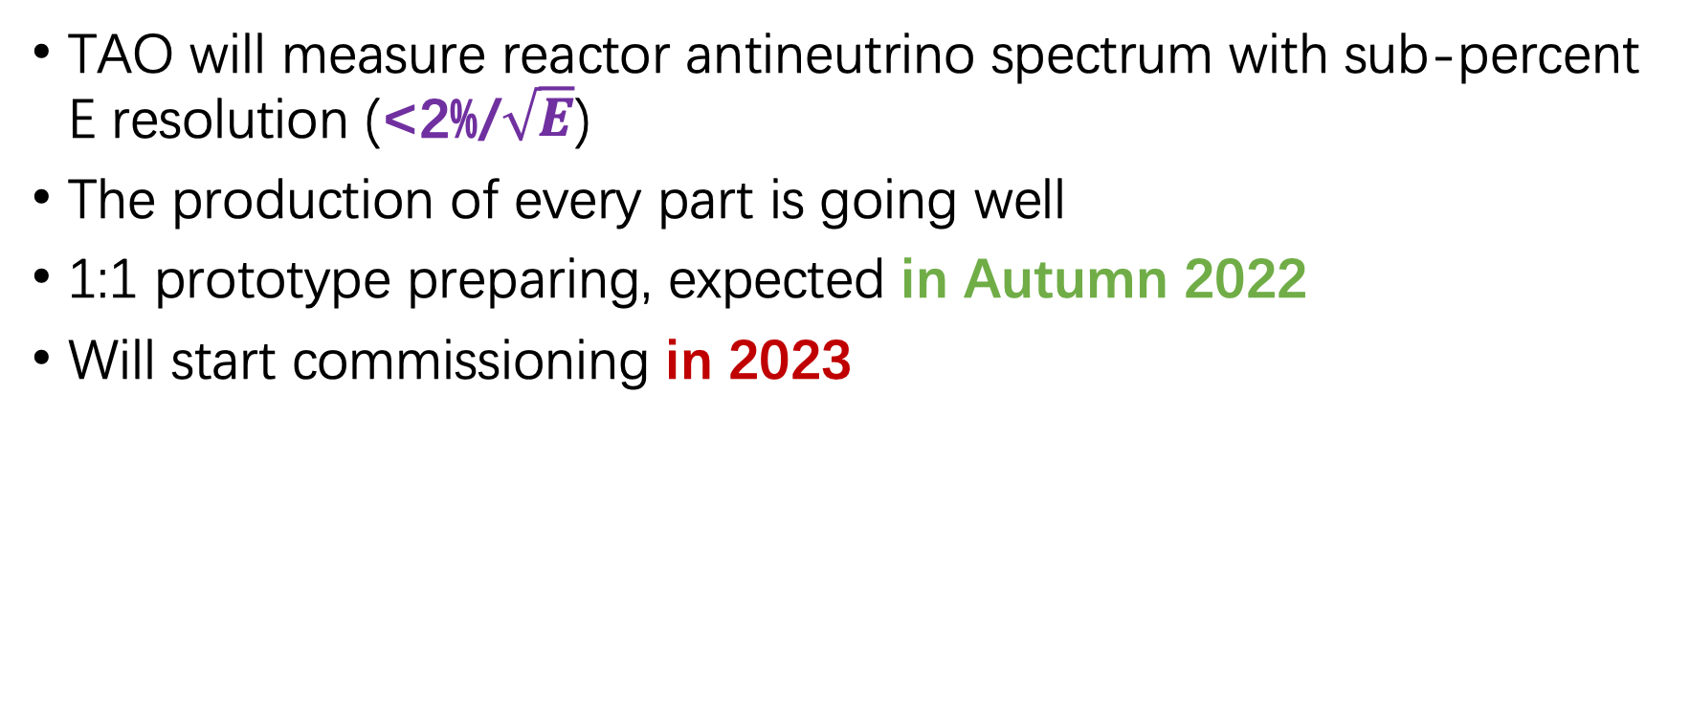
Summary
TAO will measure reactor antineutrino spectrum with sub-percent E resolution (<2%/$\sqrt{E}$)
The production of every part is going well
1:1 prototype preparing, expected in Autumn 2022
Will start commissioning in 2023

