Slide 1


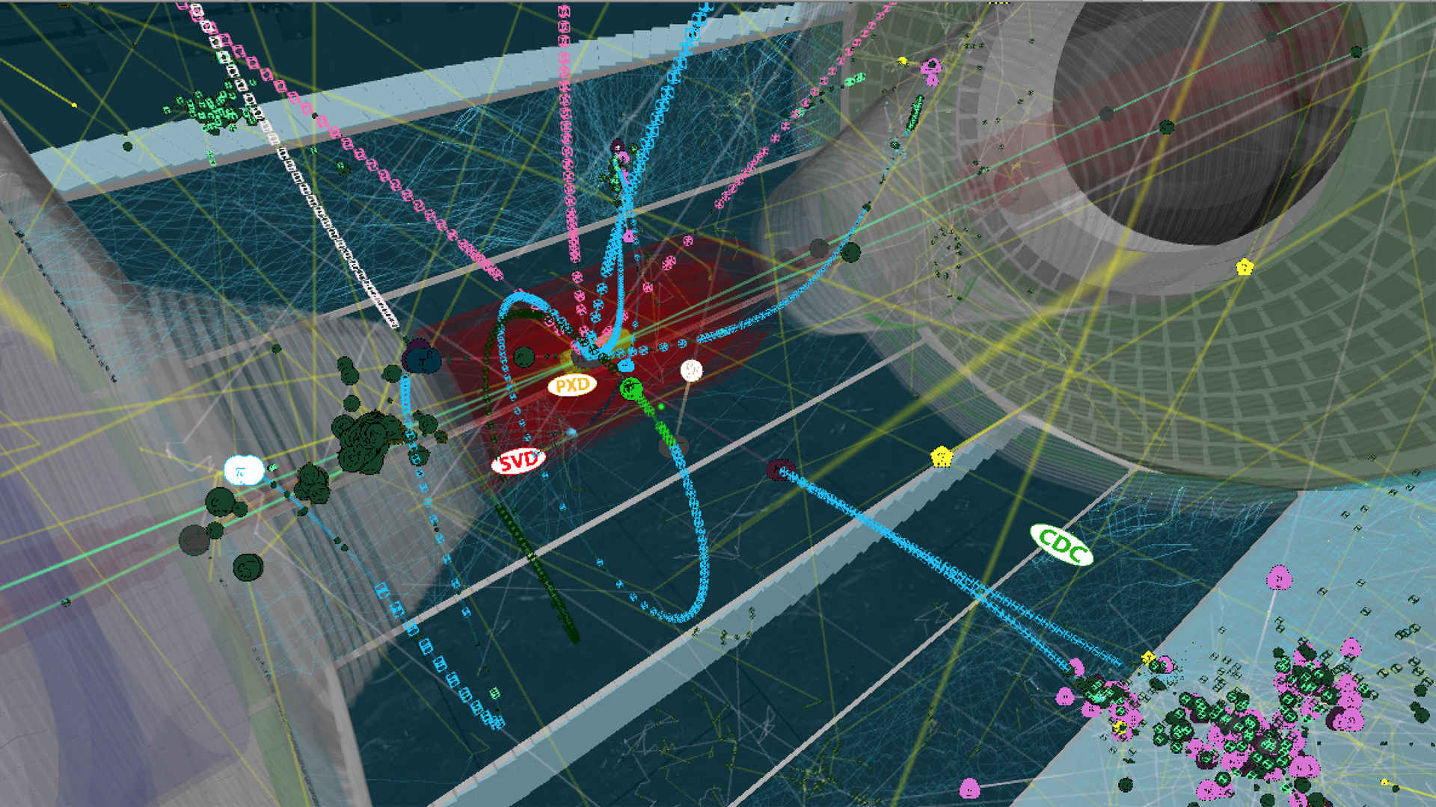
Belle II实验上的CKM矩阵和CP破坏研究
王小龙 复旦大学
第四届重味物理与量子色动力学研讨会
湖南大学，2022年7月30日

Slide 2
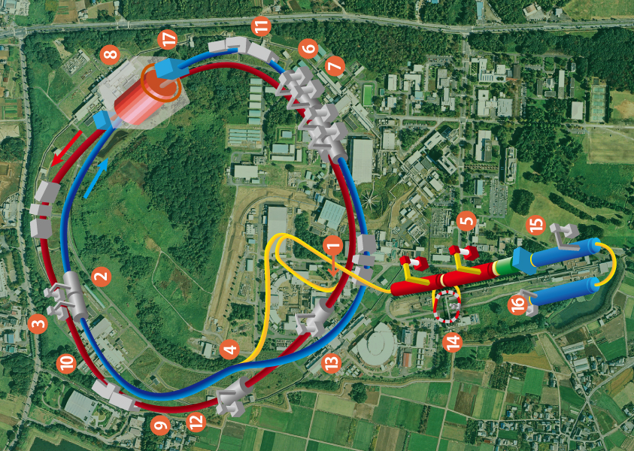
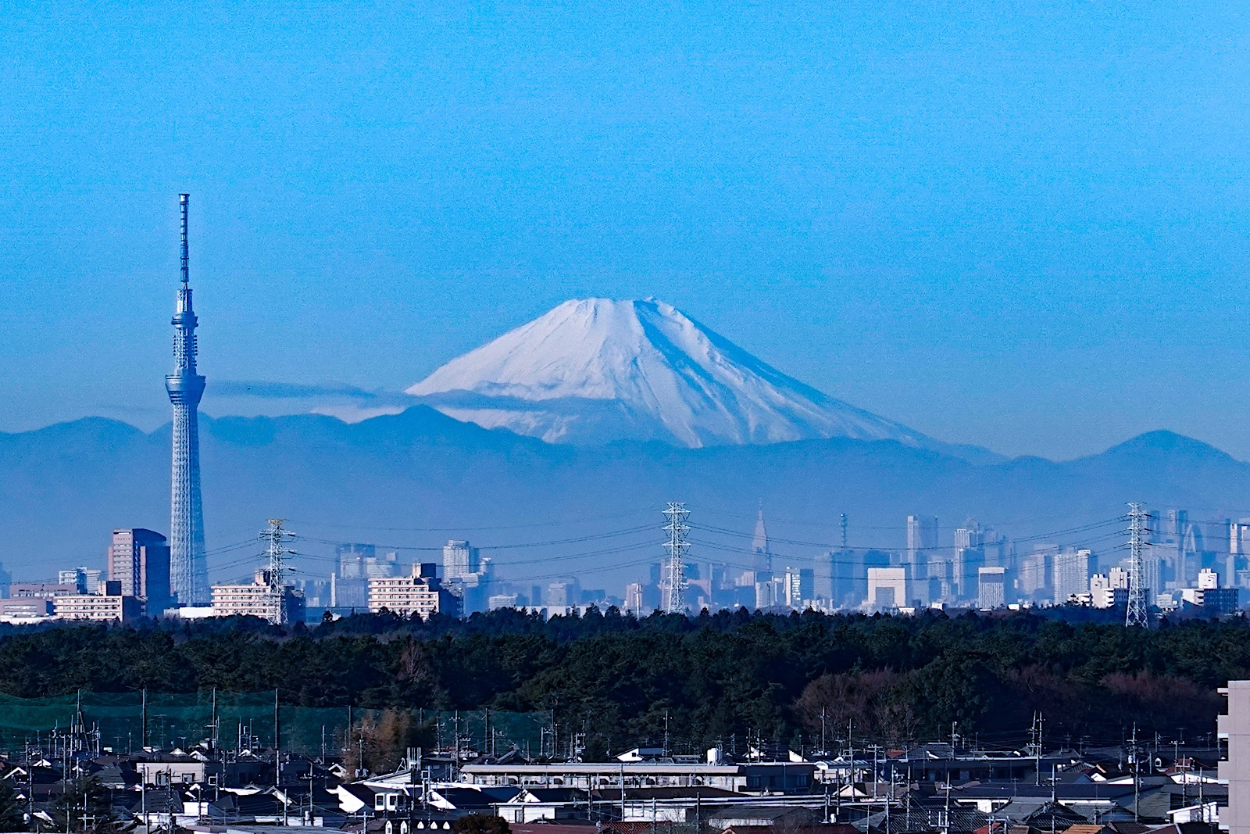
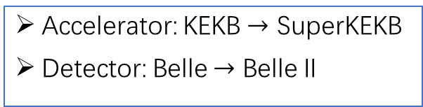


$$1.5 km$$
东京
日本高能加速器研究机构(KEK)
Belle II探测器
南
北
$$1.0 km$$
SuperKEKB加速器
Accelerator: KEKB $→$ SuperKEKB
Detector: Belle $→$ Belle II
周长3公里

Slide 3
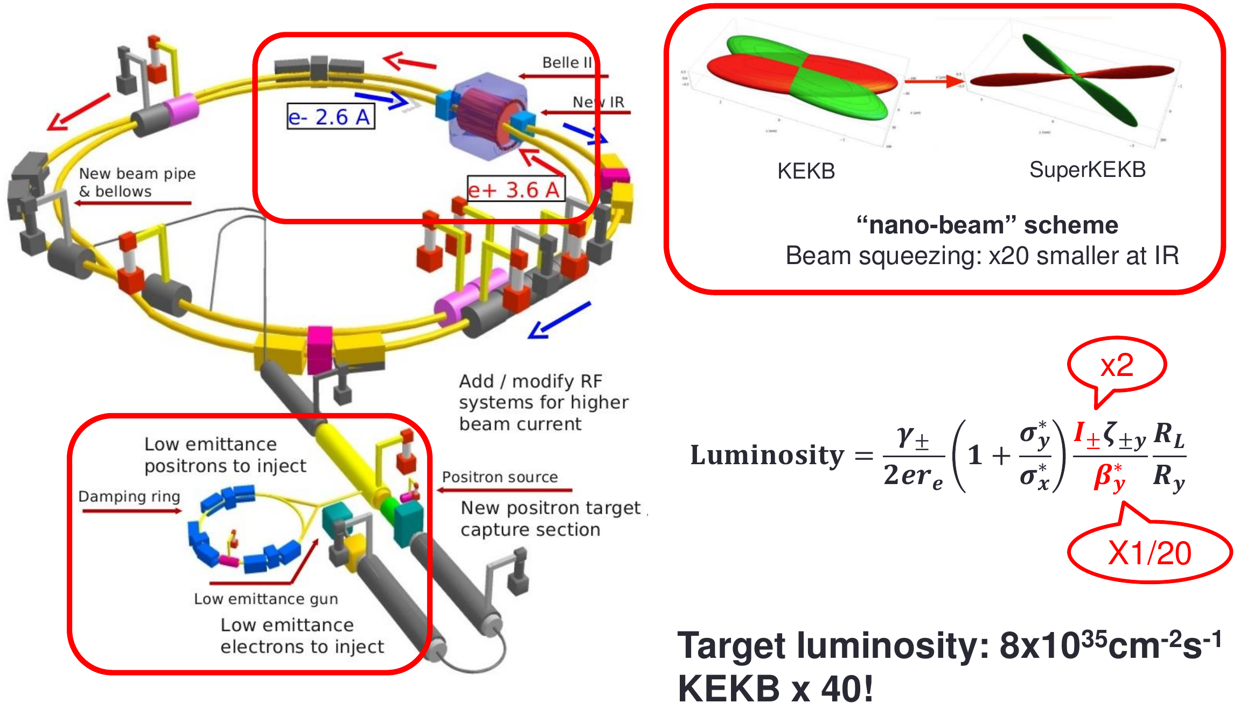
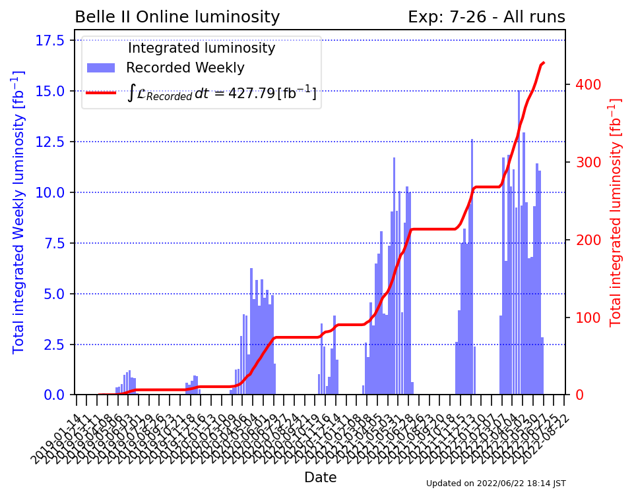
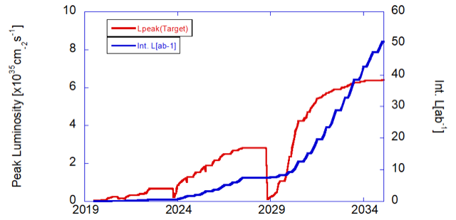
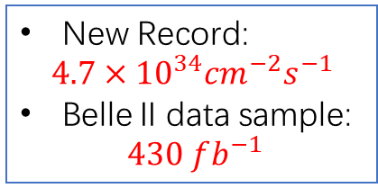
SuperKEKB accelerator
New Record:
$$4.7×{10}^{34}cm^{−2}s^{−1}$$
Belle II data sample:
$$430 fb^{−1}$$

Slide 4
Belle II Physics

Slide 5
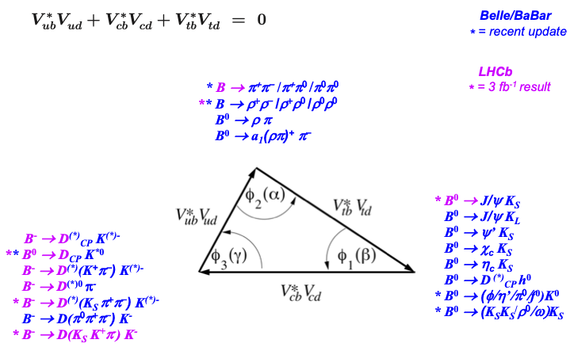

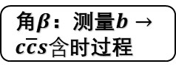
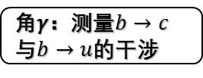
Determining the CKM matrix
角$α$：同位旋分析测量
角$β$：测量$b→c\overline{c}s含$时过程
角𝛾：测量$b→c$与$b→u$的干涉

Slide 6
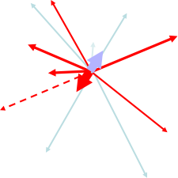


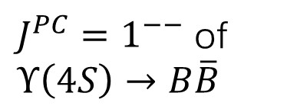

Full-reconstruction tag for missing-energy B decays
Fully-reconstructed Btag
$J^{PC}=1^{−−}$ of $Υ\left(4S\right)→B\overline{B}$
For $B^{0}{\overline{B}}^{0}$ mixing
All remaining particles (detected or not) belong to Bsig
➠ missing-energy decays, absolute branching fractions, inclusive rates, …

Slide 7
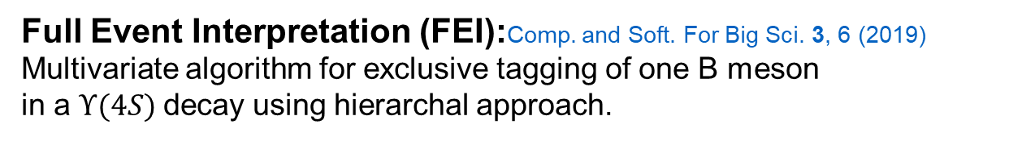
Full-event-interpretation (FEI) tagging at Belle II
Full Event Interpretation (FEI):Comp. and Soft. For Big Sci. 3, 6 (2019)
Multivariate algorithm for exclusive tagging of one B meson
in a $Υ(4S)$decay using hierarchal approach.
Over 100 𝐵 meson decay channels
and over 10,000 decay cascades
Improved efficiency up to 50%
relatively with respect to
conventional approaches!
arXiv:2008.06096

Slide 8

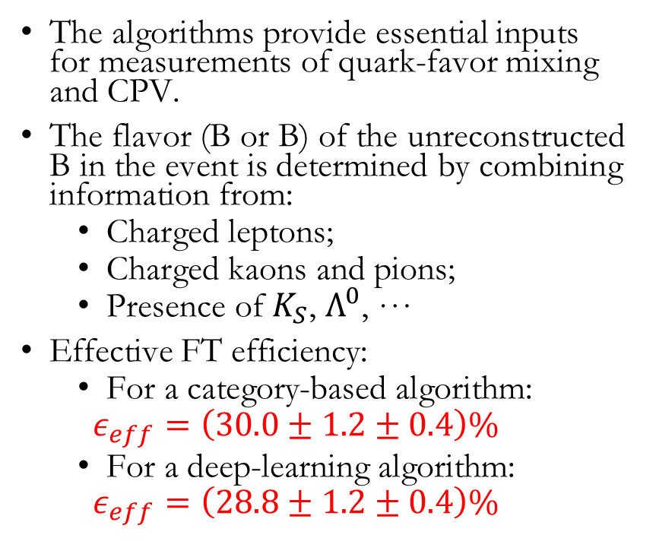
B Flavor Tagger
F. Abudinén et al., Eur. Phys. J. C 82, 283 (2022)
category-based flavor tagger
The algorithms provide essential inputs for measurements of quark-favor mixing and CPV.
The flavor (B or B) of the unreconstructed B in the event is determined by combining information from:
  Charged leptons;
  Charged kaons and pions;
  Presence of $K_{S}$, $Λ^{0}$, …
Effective FT efficiency:
  For a category-based algorithm:
  $$ε_{eff}=\left(30.0±1.2±0.4\right)\%$$
  For a deep-learning algorithm:
  $$ε_{eff}=\left(28.8±1.2±0.4\right)\%$$
$$B^{0}→D^{(∗)−}h^{+}$$
DNN (deep-learning neural network) flavor tagger based on a deep-learning multi-layer perceptron (MLP)
Dilution factor: $r=1−2w$，where $w$ is the wrong tag fraction

Slide 9

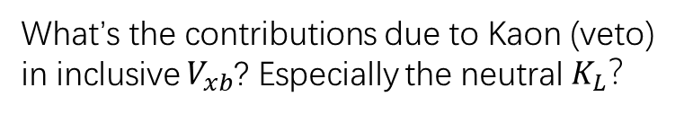
Inclusive vs exclusive $V_{xb}$
Long standing tension between inclusive and exclusive Vxb determinations:
What’s the contributions due to Kaon (veto) in inclusive $V_{xb}$? Especially the neutral $K_{L}$？

Slide 10




Inclusive and exclusive $B→X_{c}lν$
$$62.8 fb^{−1}$$
Inclusive $B→X_{c}lν$:
Branching ratio of $B^{−}→D^{0}l^{−}ν$:
Dominant systematics from continuum modeling, lepton ID, and signal shape.
arXiv: 2110.02648 [hep-ex]
arXiv: 2111.09405 [hep-ex]

Slide 11
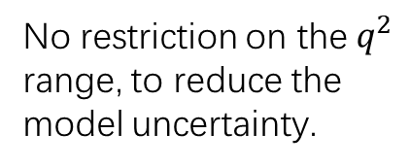


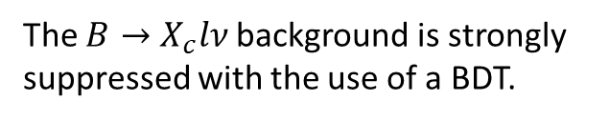
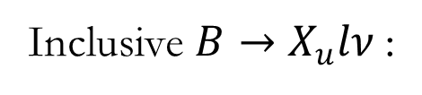

Exclusive $|V_{ub}|$ at Belle
arXiv: 2104.13354 [hep-ex]
Branching ratios of $B^{−}→η^{(′)}l^{−}ν$:
$$711 fb^{−1}$$
Inclusive $B→X_{u}lν$:
Phys. Rev. D104, 012008 (2021)
Signal-side only reconstruction to increase the efficiency.
The $B→X_{c}lν$background is strongly suppressed with the use of a BDT.
No restriction on the $q^{2}$ range, to reduce the
model uncertainty.

Slide 12

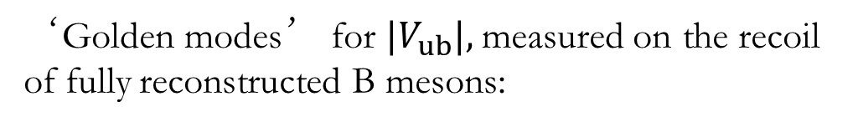

Exclusive $|V_{ub}|$at Belle II
arXiv: 2111.00710 [hep-ex]
‘Golden modes’ for $|V_{ub}|,$measured on the recoil of fully reconstructed B mesons:
$$62.8 fb^{−1}$$

Slide 13
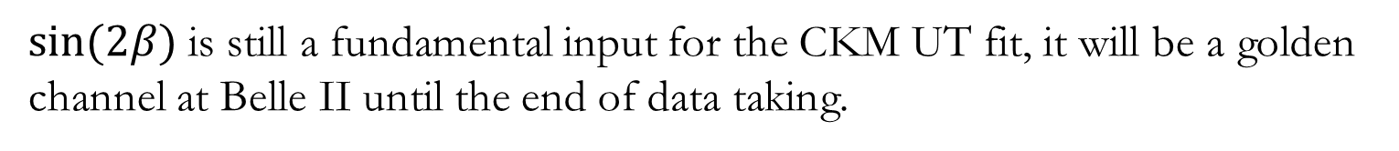

Time dependent CPV in B decays
$<Δz> \sim 130 μm$at Belle II
$sin(2β)$is still a fundamental input for the CKM UT fit, it will be a golden channel at Belle II until the end of data taking.

Slide 14


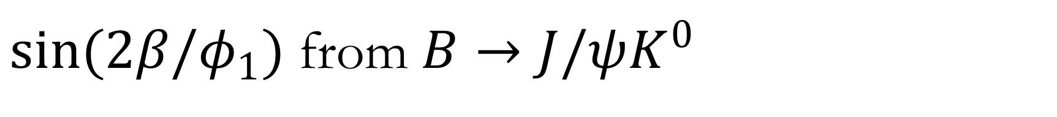


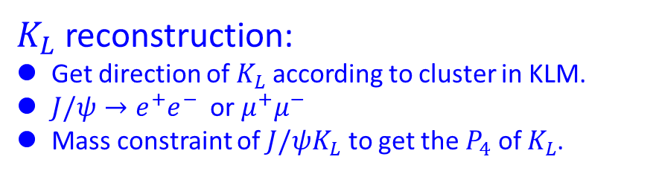
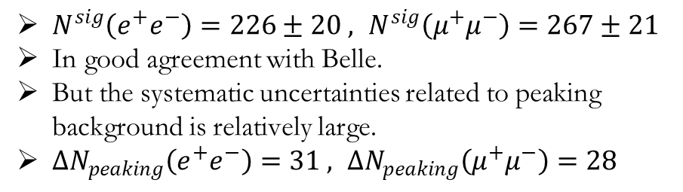
$sin(2β/φ_{1})$ from $B→J/ψK^{0}$
$$B→J/ψK_{L}$$
arXiv: 2106.13547 [hep-ex]
$K_{L}$ reconstruction:
Get direction of $K_{L}$ according to cluster in KLM.
$J/ψ→e^{+}e^{−}$ or $μ^{+}μ^{−}$
Mass constraint of $J/ψK_{L}$ to get the $P_{4}$ of $K_{L}$.
$$B→J/ψK_{S}$$
$$e^{+}e^{−}$$
$$μ^{+}μ^{−}$$
$N^{sig}\left(e^{+}e^{−}\right)=226±20 , N^{sig}\left(μ^{+}μ^{−}\right)=267±21$
In good agreement with Belle.
But the systematic uncertainties related to peaking background is relatively large.
$ΔN_{peaking}\left(e^{+}e^{−}\right)=31 , ΔN_{peaking}\left(μ^{+}μ^{−}\right)=28$

Slide 15

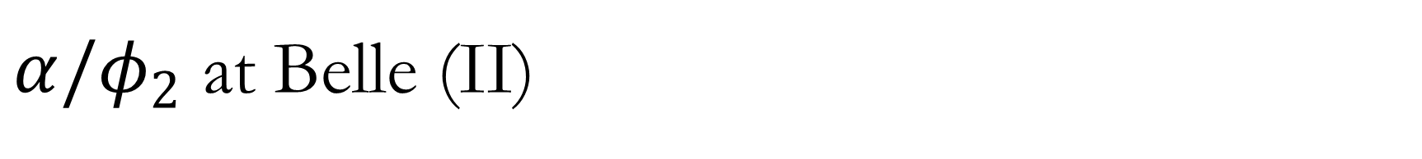
$α/φ_{2}$ at Belle (II)
The measurement of $φ_{2}$ from $B→ππ$ (or $ρρ$) is from isospin analysis:
Observables:
  Branching fractions: $π^{±}π^{0}$, $π^{+}π^{−}$, $π^{0}π^{0}$
  Direct CP (time-independent) asymmetries: $A^{+−}$, $A^{00}$
  Time-dependent CP asymmetries: $S^{+−}$, $S^{00}$
  We expect to push the sensitivity to $Δα∼1^{o}$.
Gronau and London,
PRL 65 (1990), 3381

Slide 16
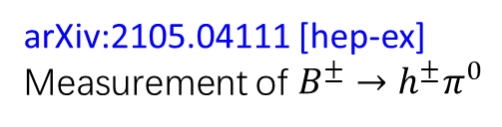
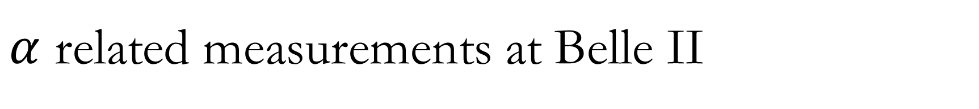
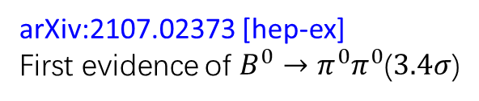
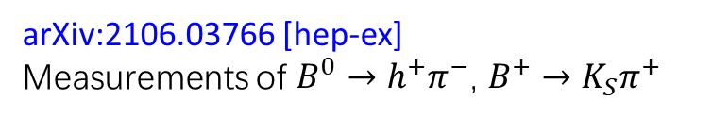
$α$ related measurements at Belle II
arXiv:2105.04111 [hep-ex]
Measurement of $B^{±}→h^{±}π^{0}$
arXiv:2106.03766 [hep-ex]
Measurements of $B^{0}→h^{+}π^{−}$, $B^{+}→K_{S}π^{+}$
arXiv:2107.02373 [hep-ex]
First evidence of $B^{0}→π^{0}π^{0}$($3.4σ$)

Slide 17
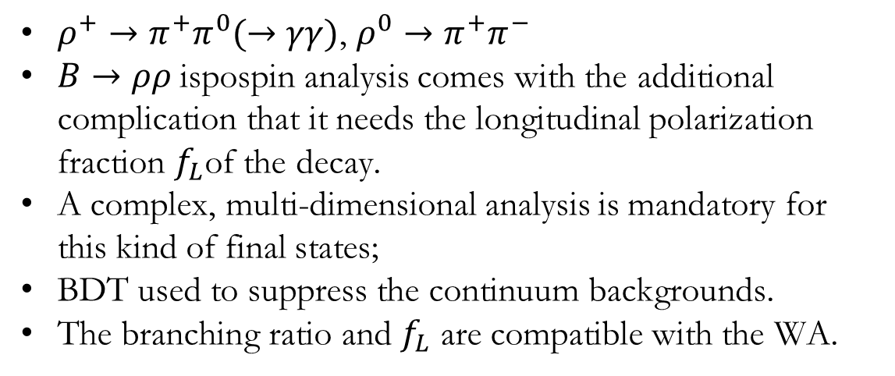
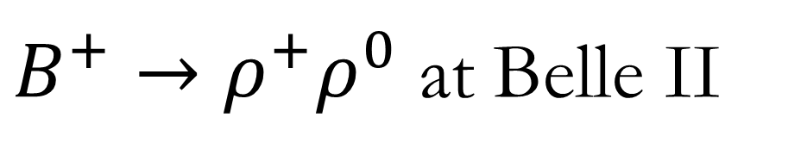
$B^{+}→ρ^{+}ρ^{0}$ at Belle II
arXiv:2109.11456 [hep-ex]
arXiv:2206.12362 [hep-ex]
$ρ^{+}→π^{+}π^{0}(→γγ)$, $ρ^{0}→π^{+}π^{−}$
$B→ρρ$ispospin analysis comes with the additional complication that it needs the longitudinal polarization fraction $f_{L}$of the decay.
A complex, multi-dimensional analysis is mandatory for this kind of final states;
BDT used to suppress the continuum backgrounds.
The branching ratio and $f_{L}$ are compatible with the WA.

Slide 18
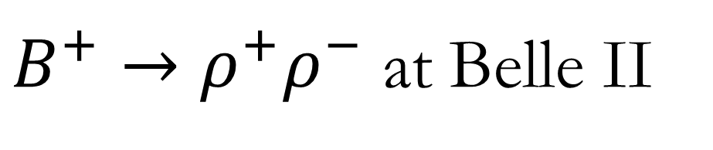
$B^{+}→ρ^{+}ρ^{−}$ at Belle II

Slide 19
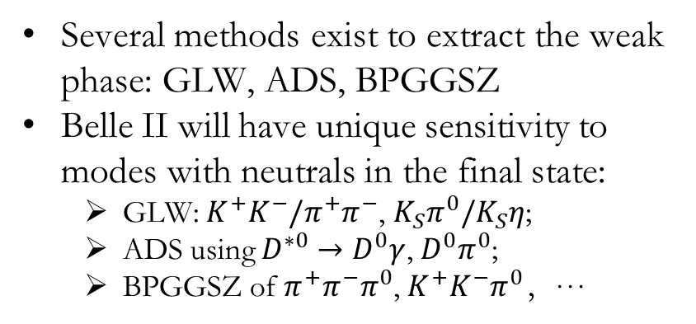
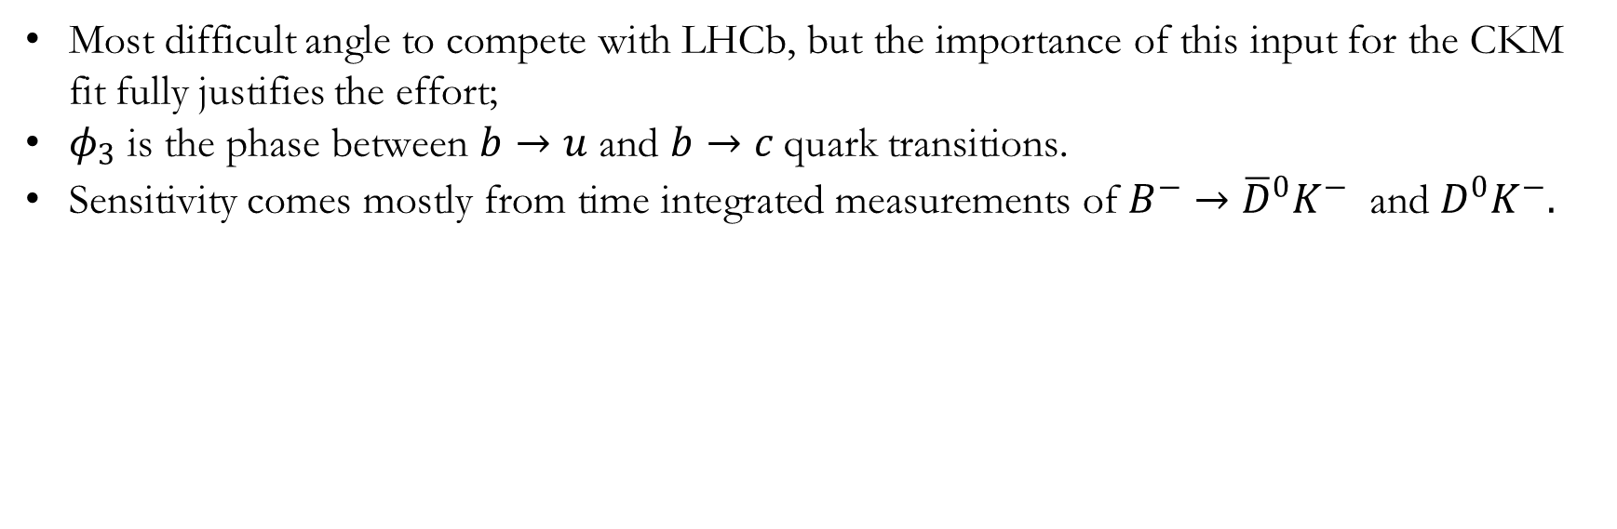
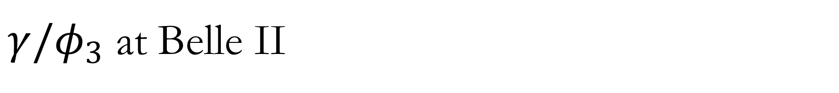
$γ/φ_{3}$ at Belle II
Most difficult angle to compete with LHCb, but the importance of this input for the CKM fit fully justifies the effort;
$φ_{3}$ is the phase between $b→u$ and $b→c$quark transitions.
Sensitivity comes mostly from time integrated measurements of $B^{−}→{\overline{D}}^{0}K^{−}$ and $D^{0}K^{−}.$
Several methods exist to extract the weak phase: GLW, ADS, BPGGSZ
Belle II will have unique sensitivity to modes with neutrals in the final state:
  GLW: $K^{+}K^{−}/π^{+}π^{−}$, $K_{S}π^{0}/K_{S}η$;
  ADS using $D^{∗0}→D^{0}γ$, $D^{0}π^{0}$;
  BPGGSZ of $π^{+}π^{−}π^{0}$, $K^{+}K^{−}π^{0}$，…
(From Niharika Rout )

Slide 20
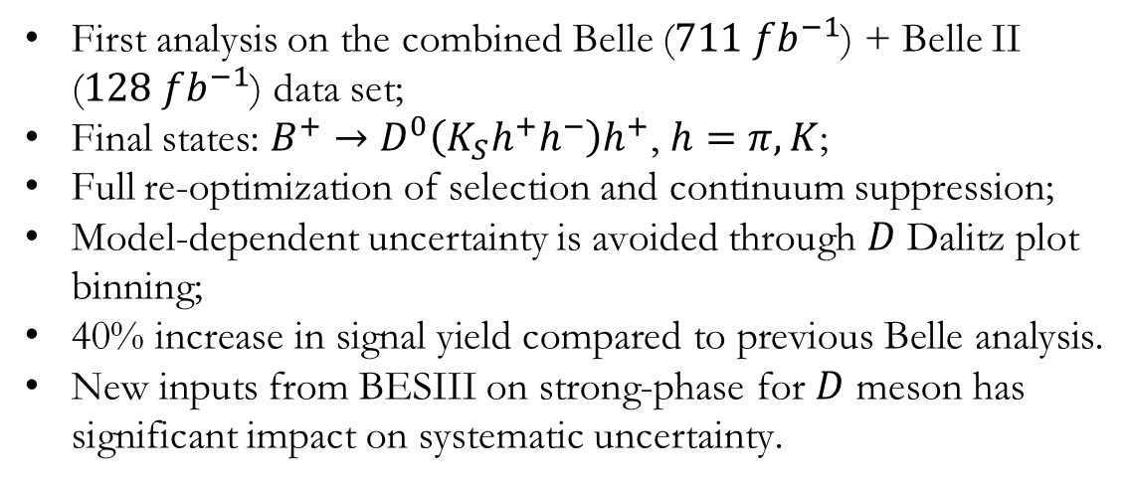
BPGGSZ at Belle (II) model independent
F. Abudinén et al, Belle + Belle II
JHEP02(2022)063
First analysis on the combined Belle ($711 fb^{−1}$) + Belle II ($128 fb^{−1}$) data set;
Final states: $B^{+}→D^{0}\left(K_{S}h^{+}h^{−}\right)h^{+}$, $h=π, K$;
Full re-optimization of selection and continuum suppression;
Model-dependent uncertainty is avoided through $D$ Dalitz plot binning;
40% increase in signal yield compared to previous Belle analysis.
New inputs from BESIII on strong-phase for $D$ meson has significant impact on systematic uncertainty.

Slide 21
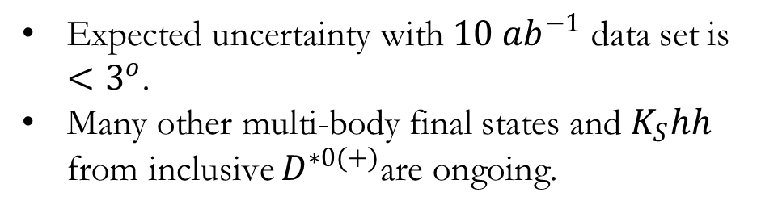
Future prospects
Expected uncertainty with $10 ab^{−1}$ data set is $<3^{o}$.
Many other multi-body final states and $K_{S}hh$ from inclusive $D^{∗0(+)}$are ongoing.

Slide 22
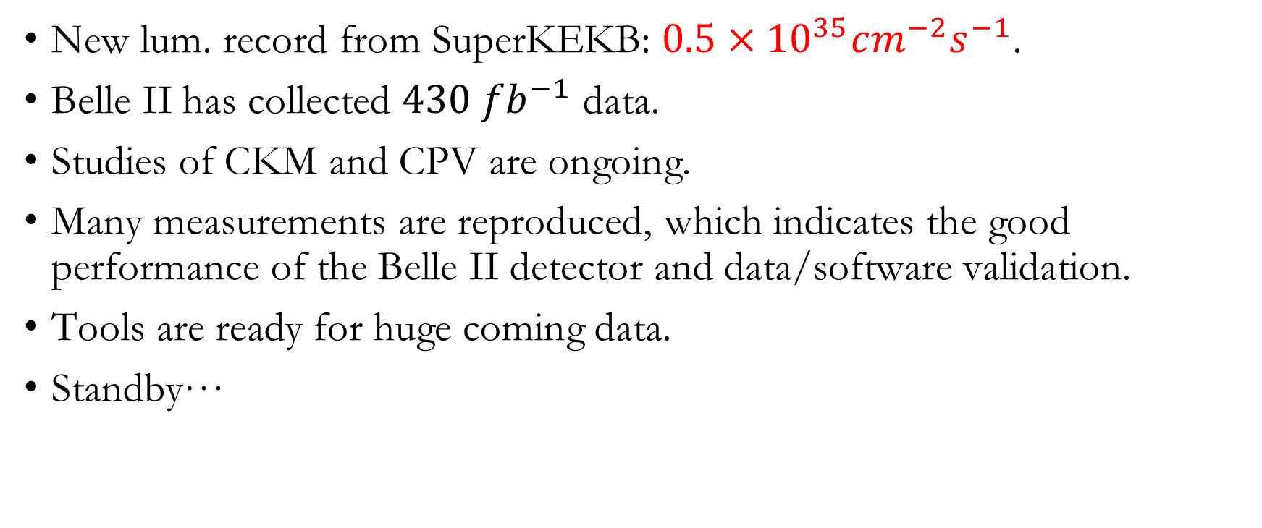
Summary
New lum. record from SuperKEKB: $0.5×{10}^{35}cm^{−2}s^{−1}$.
Belle II has collected $430 fb^{−1}$ data.
Studies of CKM and CPV are ongoing.
Many measurements are reproduced, which indicates the good performance of the Belle II detector and data/software validation.
Tools are ready for huge coming data.
Standby…
Thank you!

Slide 23
Backup

Slide 25
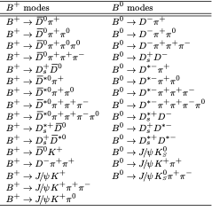


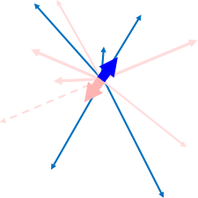
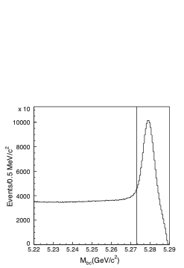

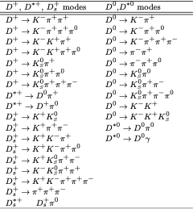

Full-reconstruction tag for missing-energy B decays
>5000 distinct decay modes
Beam-constrained mass:
PRD 97, 012005 (2018)
~2.4 x 10⁶ B± tags
Total efficiency ≈0.3%

Slide 26
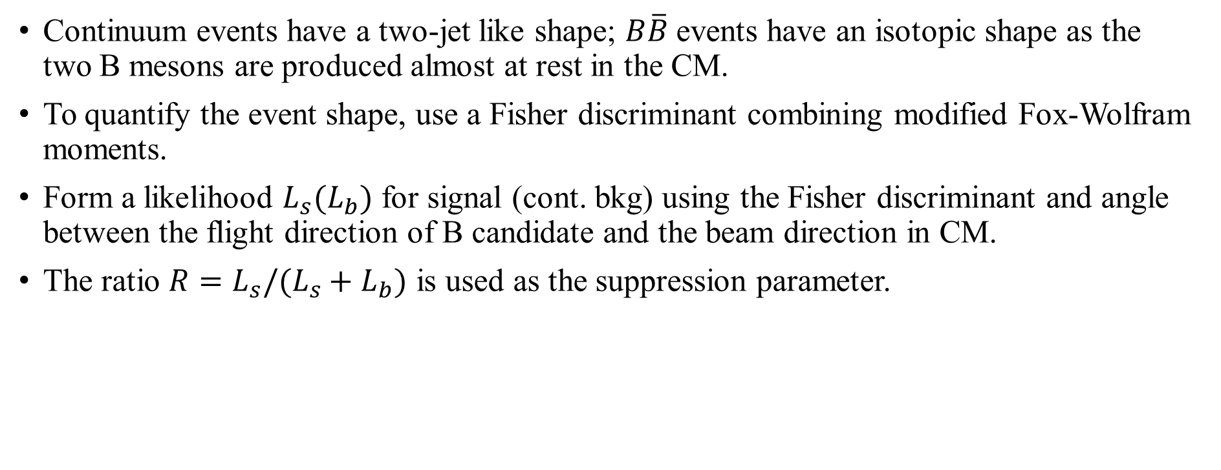
Suppression of continuum backgrounds
Continuum events have a two-jet like shape; $B\overline{B}$events have an isotopic shape as the two B mesons are produced almost at rest in the CM.
To quantify the event shape, use a Fisher discriminant combining modified Fox-Wolfram moments.
Form a likelihood $L_{s}(L_{b})$ for signal (cont. bkg) using the Fisher discriminant and angle between the flight direction of B candidate and the beam direction in CM.
The ratio $R=L_{s}/(L_{s}+L_{b})$ is used as the suppression parameter.

Slide 27
More for continuum suppression

Slide 28

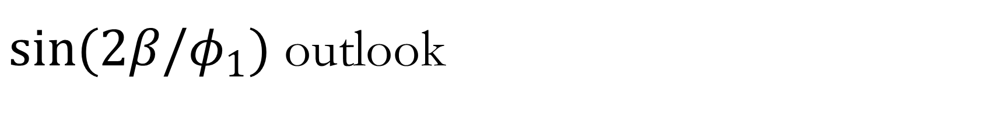
$sin(2β/φ_{1})$ outlook
$sin(2β/φ_{1})$ from $J/ψK^{0}$ with $50 ab^{−1}$ data will be systematics dominated.
Irreducible systematic uncertainties from alignment of the vertex detector and Doubly Cabibbo Suppress Decays on the tag side.
Penguin pollution can no longer be ignored and must be constraint from $B→J/ψπ^{0}$ and other SU(3) related channels.

Slide 29


$|V_{ub}|$and $|V_{cb}|$at Belle (II)
$$62.8 fb^{−1}$$
M. Merola / C. Niebuhr, EPS 2021

Slide 30
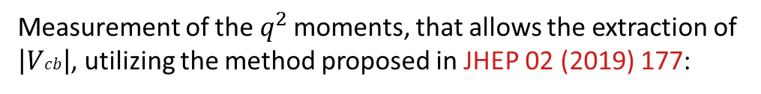
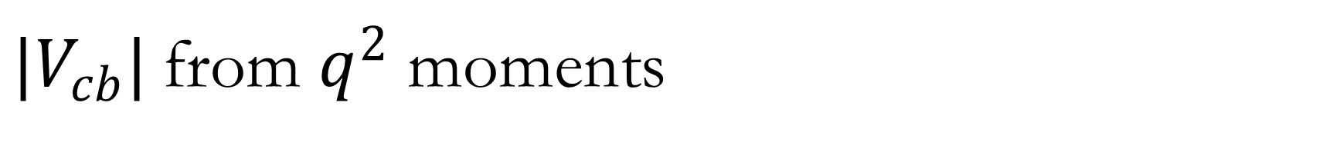
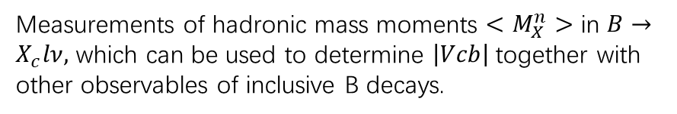
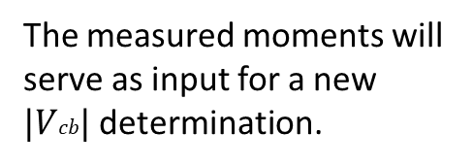


$|V_{cb}|$from $q^{2}$ moments
Belle II: arXiv: 2009.04493 [hep-ex]
Measurement of the $q^{2}$ moments, that allows the extraction of $\left|Vcb\right|$, utilizing the method proposed in JHEP 02 (2019) 177:
Belle, full data set ($711 fb^{−1}$)
arXiv: 2109.01685 [hep-ex]
$q^{2}$ of the $B$ meson system to the $X_{c}$ system.
Analysis performed on the recoil of a fully reconstructed B meson (Hadronic Tagging)
The measured moments will serve as input for a new $|Vcb|$determination.
More careful studies for the systematic uncertainties.
Measurements of hadronic mass moments $<M_{X}^{n}>$ in $B→X_{c}lν,$ which can be used to determine $\left|Vcb\right|$together with other observables of inclusive B decays.

