Slide 1
Energy and position resolution of
Crystal Fan Ecal for CEPC
Xiao Zhao, Huaqiao Zhang
16/02/2022

Slide 2
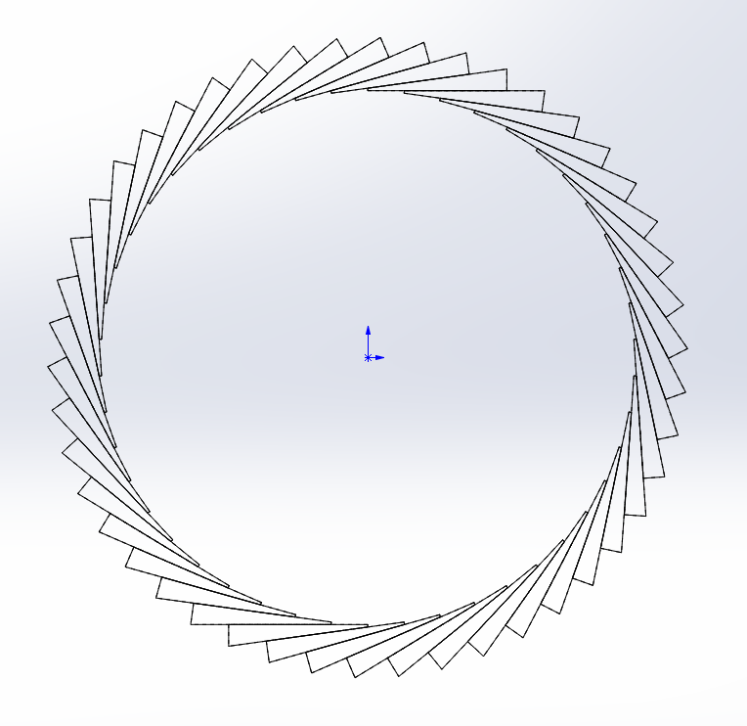
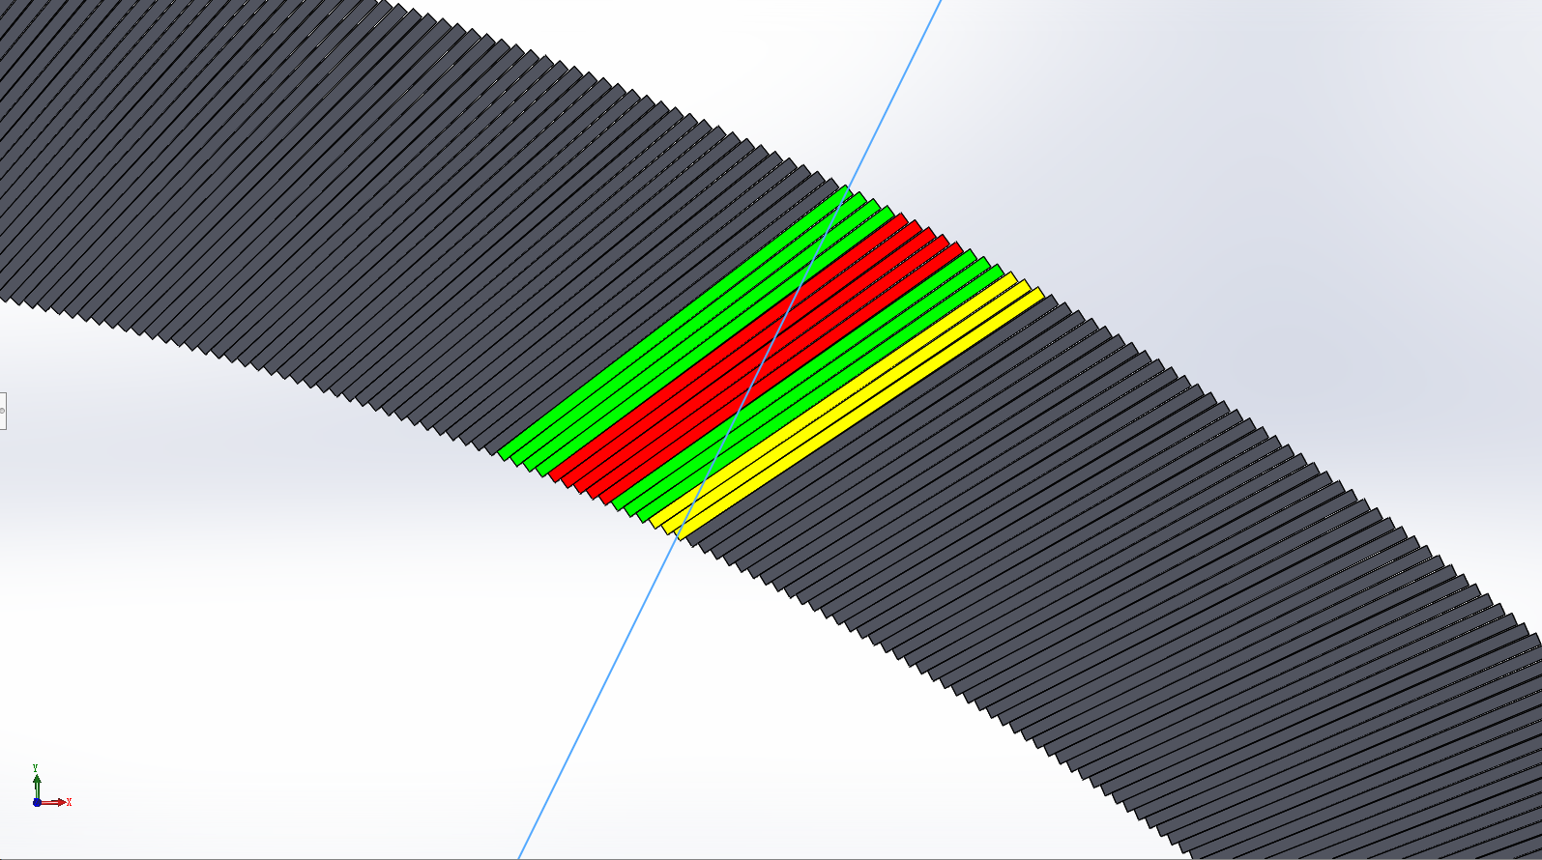
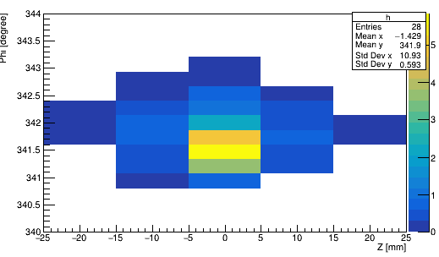
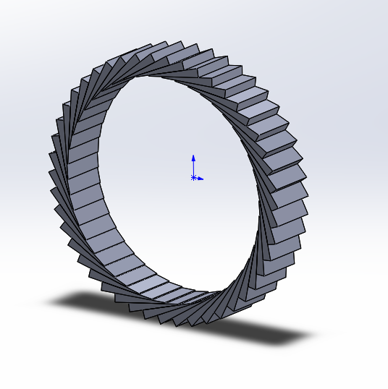
Basic concept
alpha
Crystal not pointing back to IP (Z axis)
  Angle with inner det. radius is alpha
  alpha <= 90°
  Uniform along Z
  Transverse Segmentation
    Different number of layers
  r2 = 1.9 m, r1 = 2.2 m
D
r1
φ
r2
Cited : Huaqiao Zhang, New idea of Crystal fan(晶扇) Ecal for CEPC
Huaqiao Zhang, New idea for Crystal ECAL configuration

Slide 3
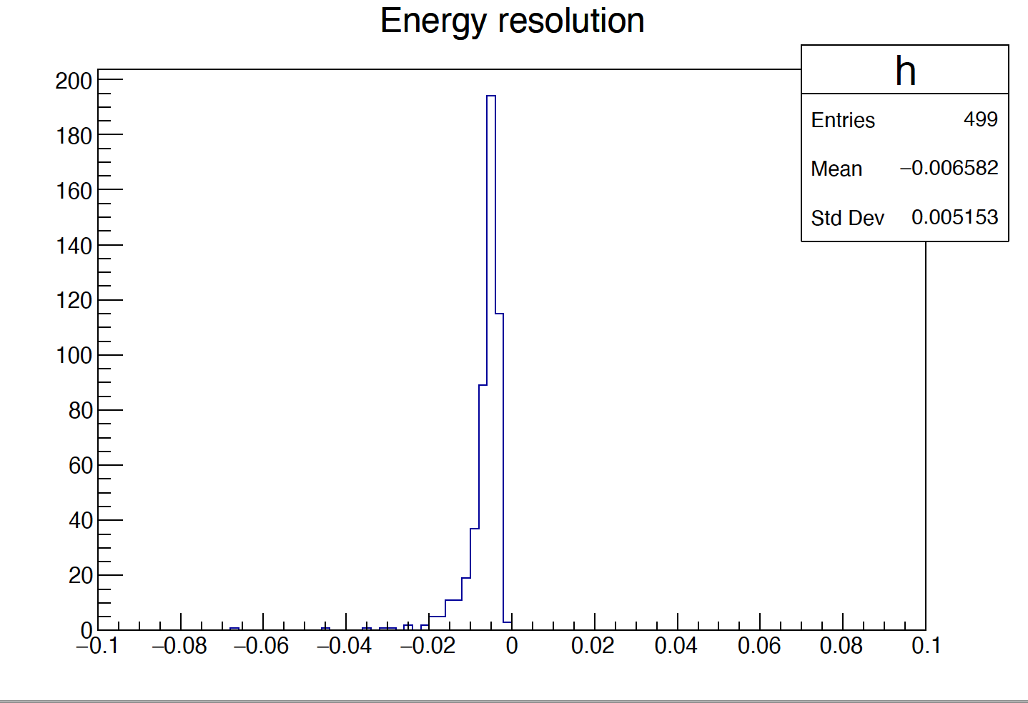
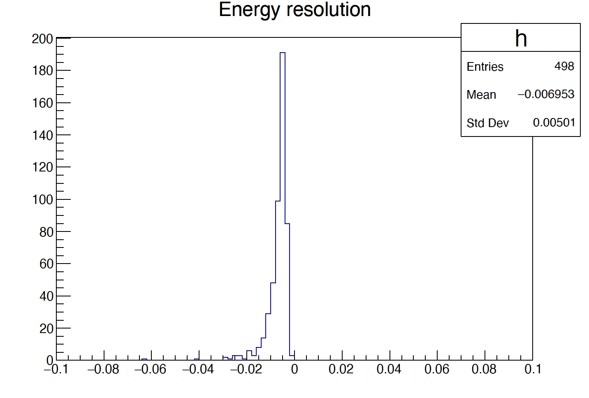
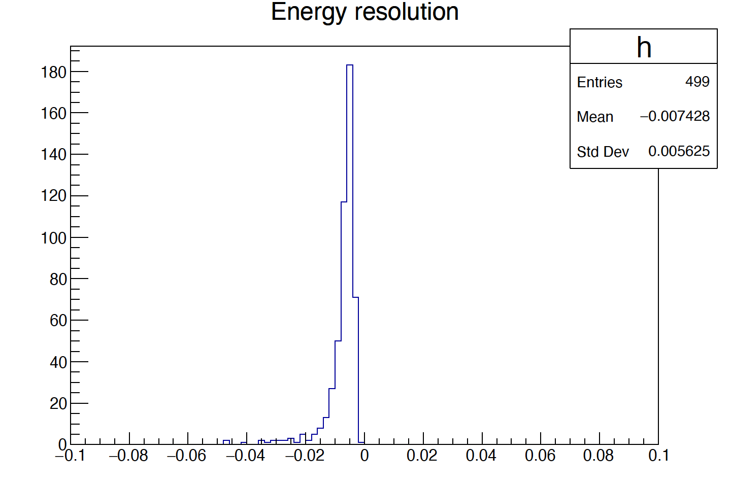
Energy resolution
  The following plots are done with event generated using
  phi = 10~350°， theta = 90°，E =30 GeV photon
5 layer
10 layer
14 layer
E resolution ~0.5%

Slide 4
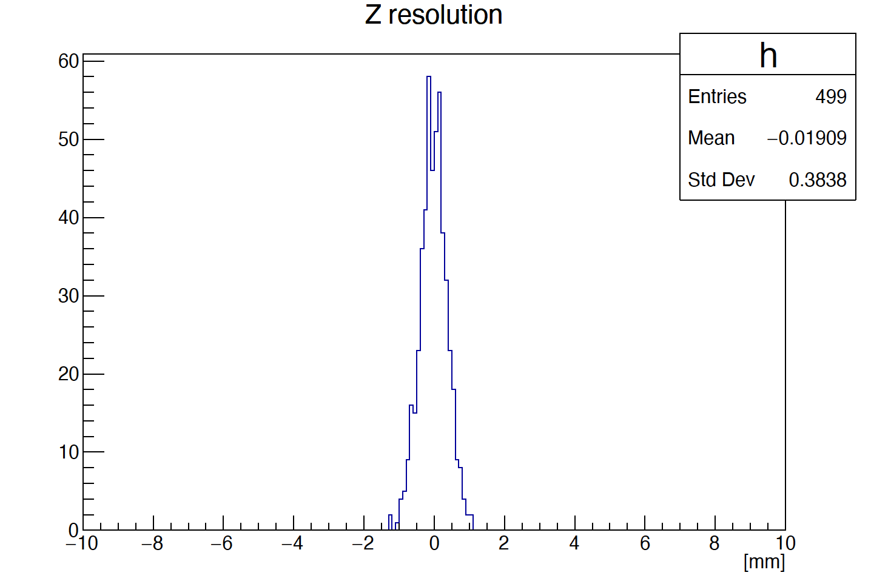
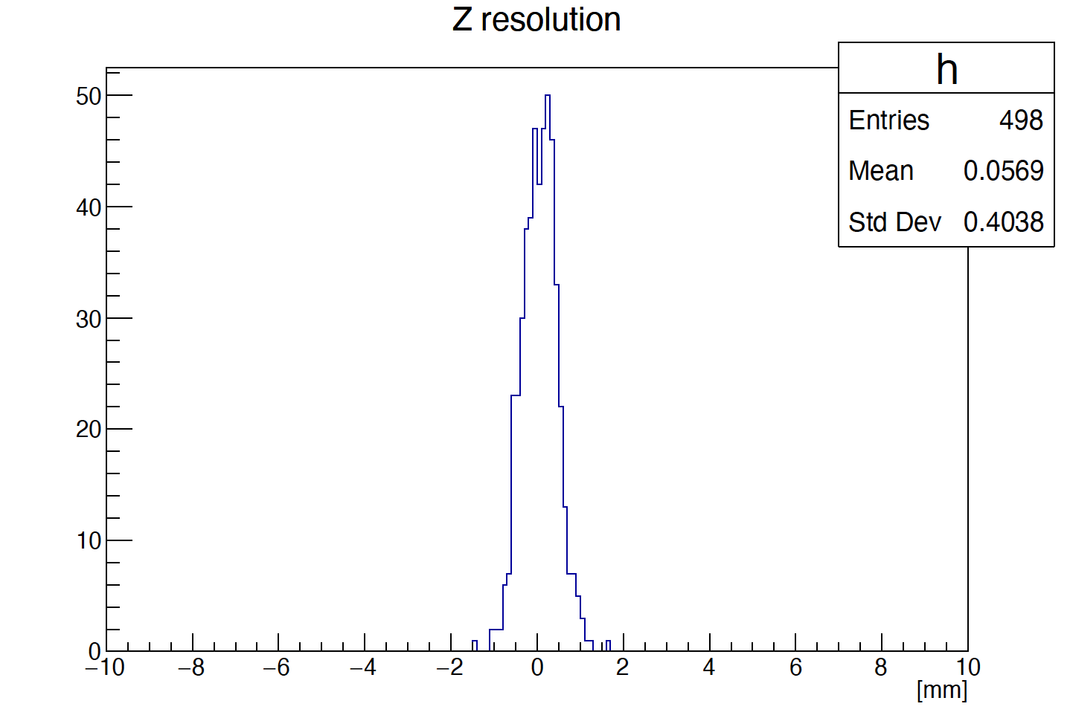
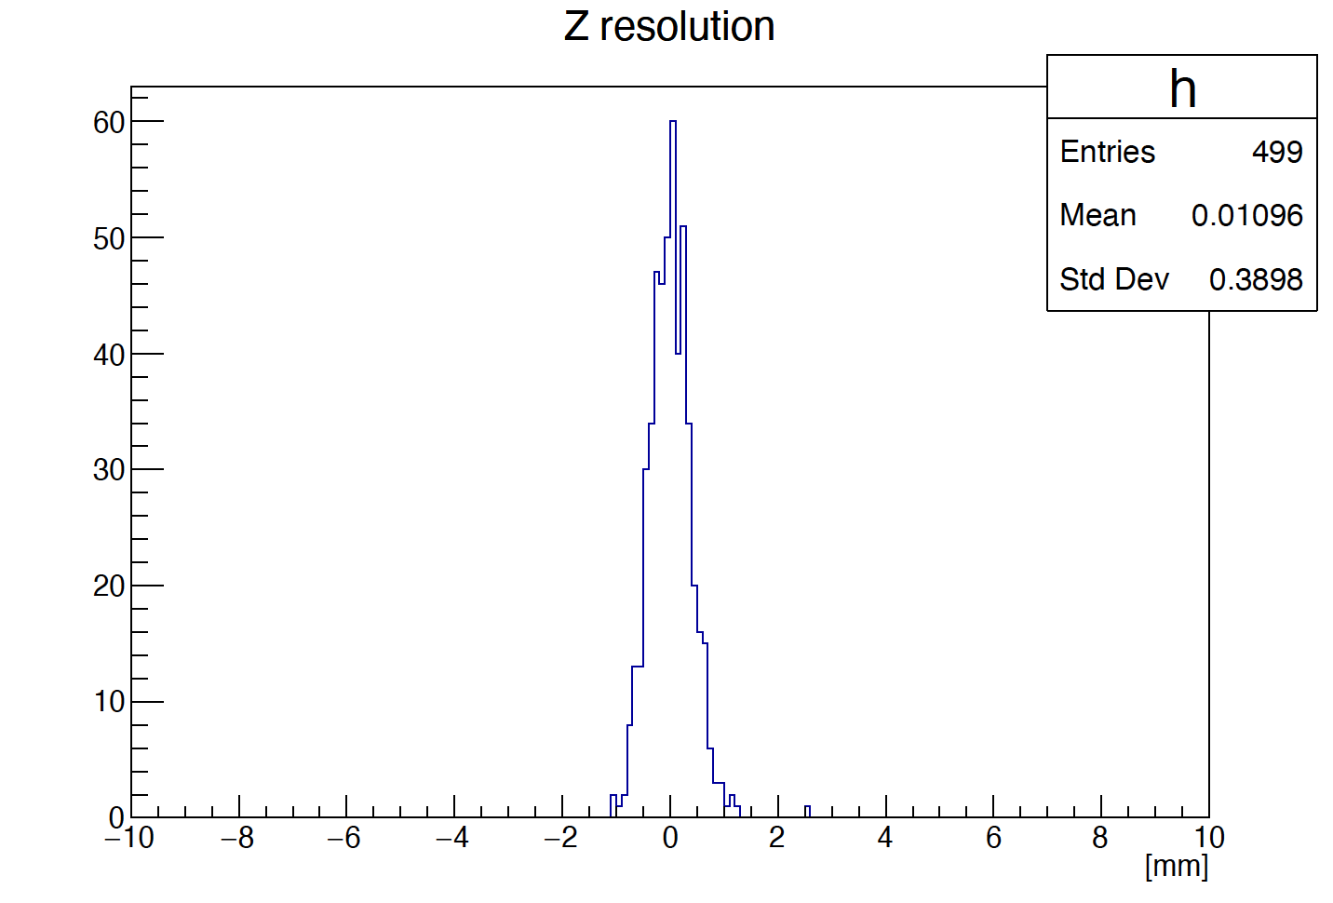
Z resolution
5 layer
10 layer
14 layer
Z resolution ~0.4 mm

Slide 5
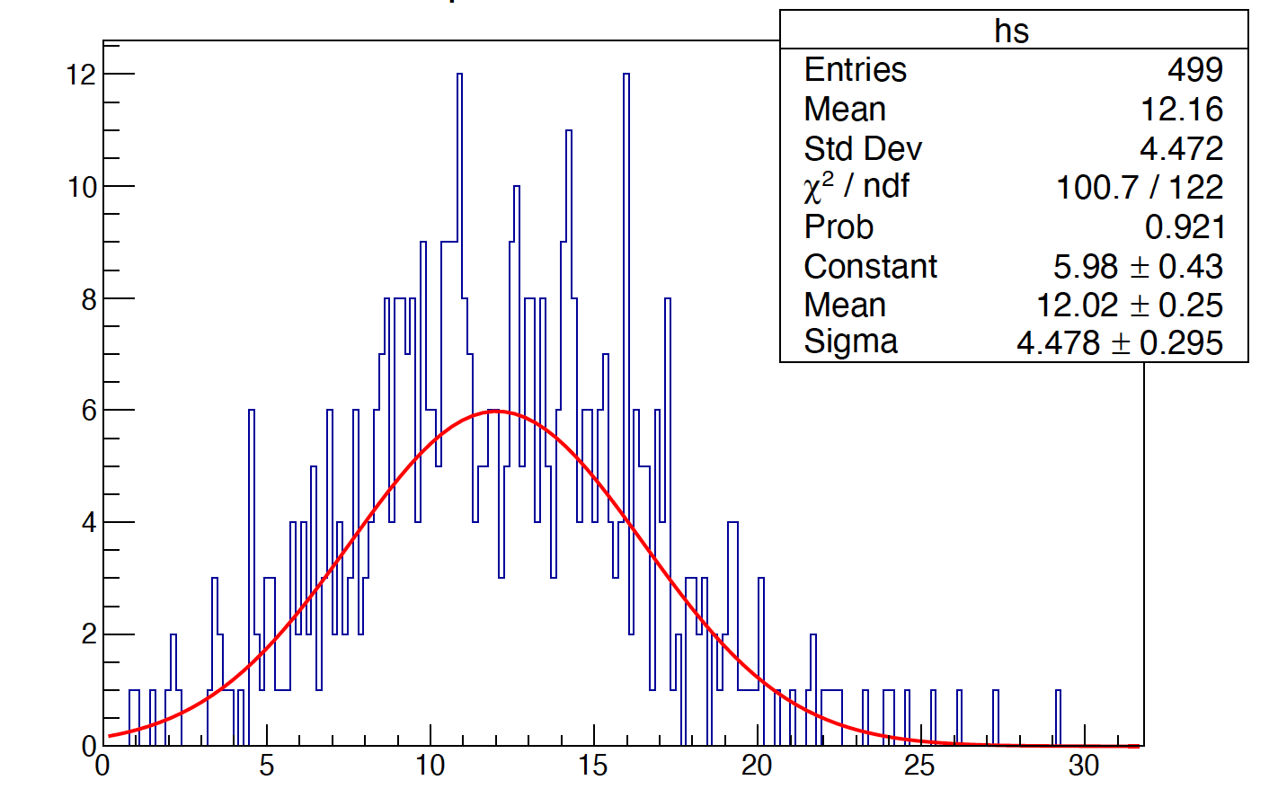
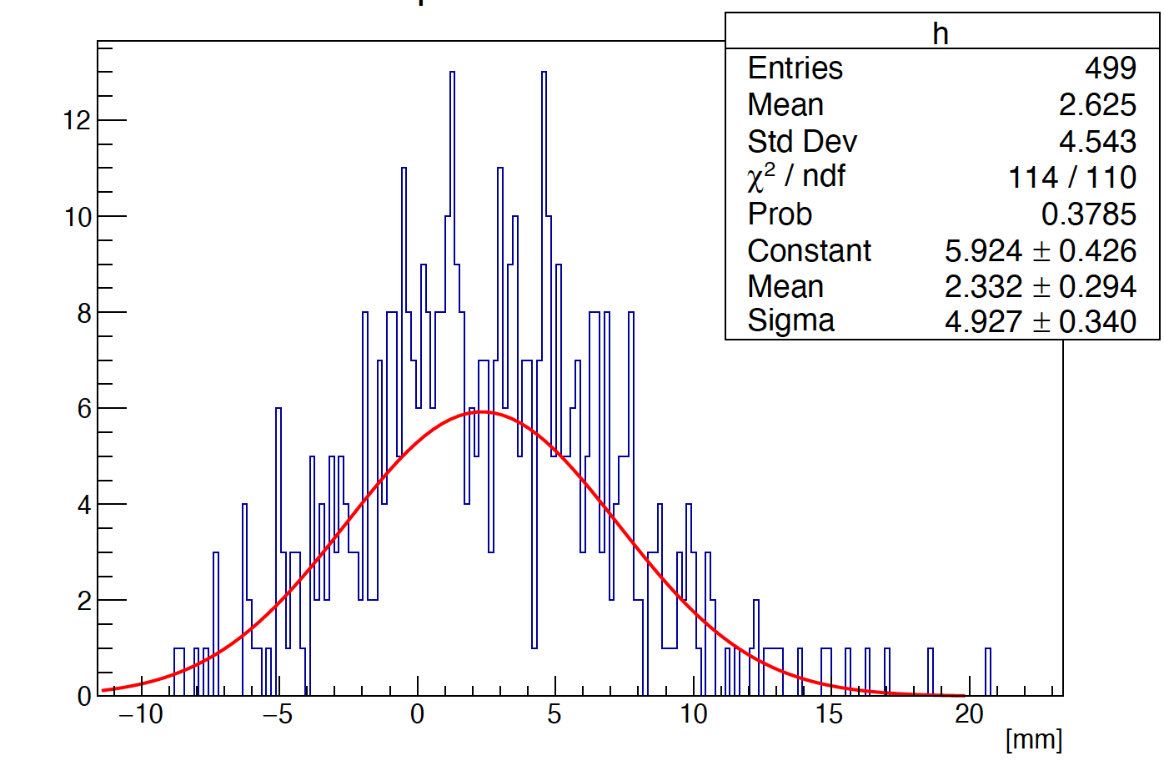
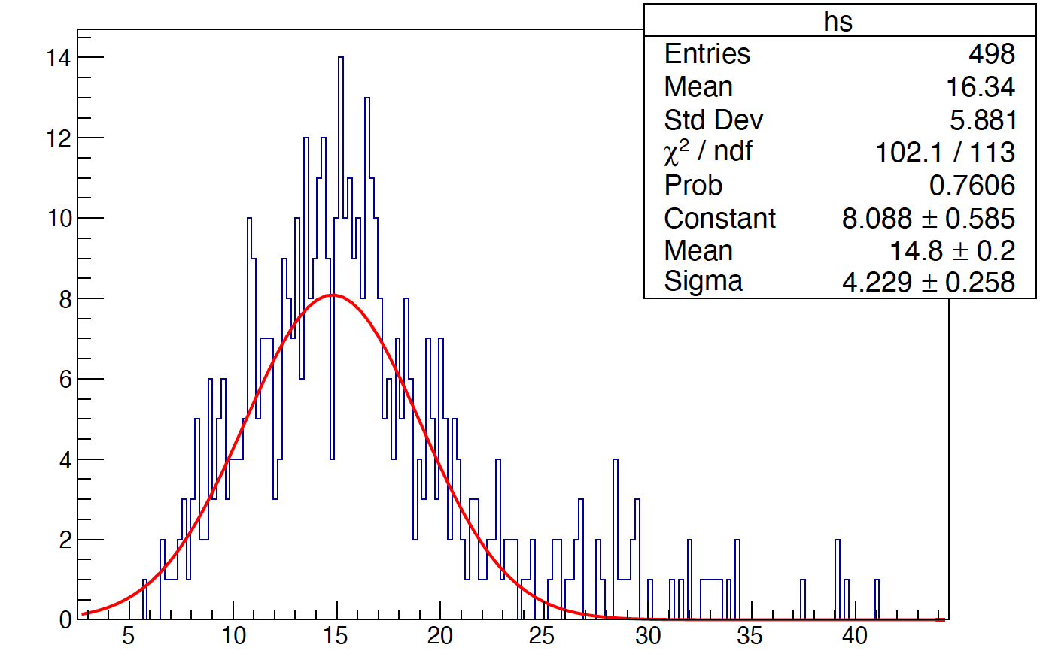
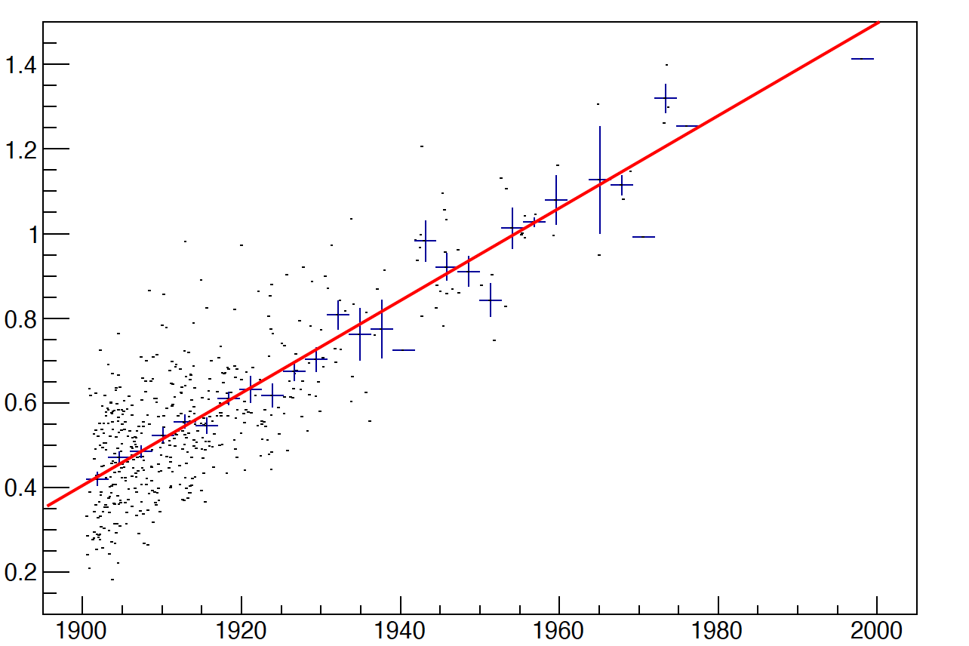
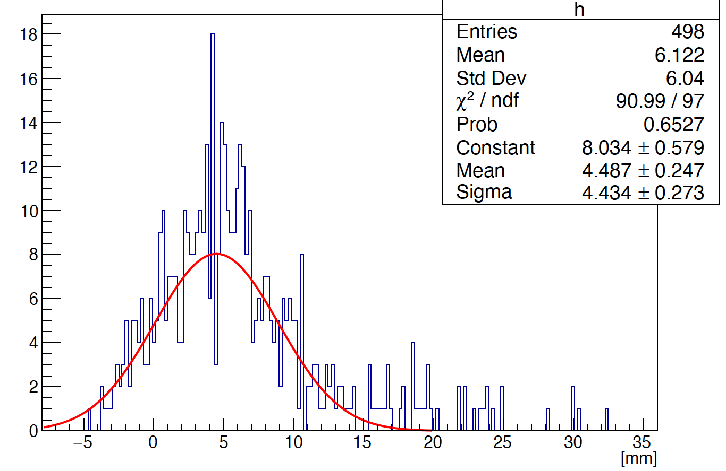
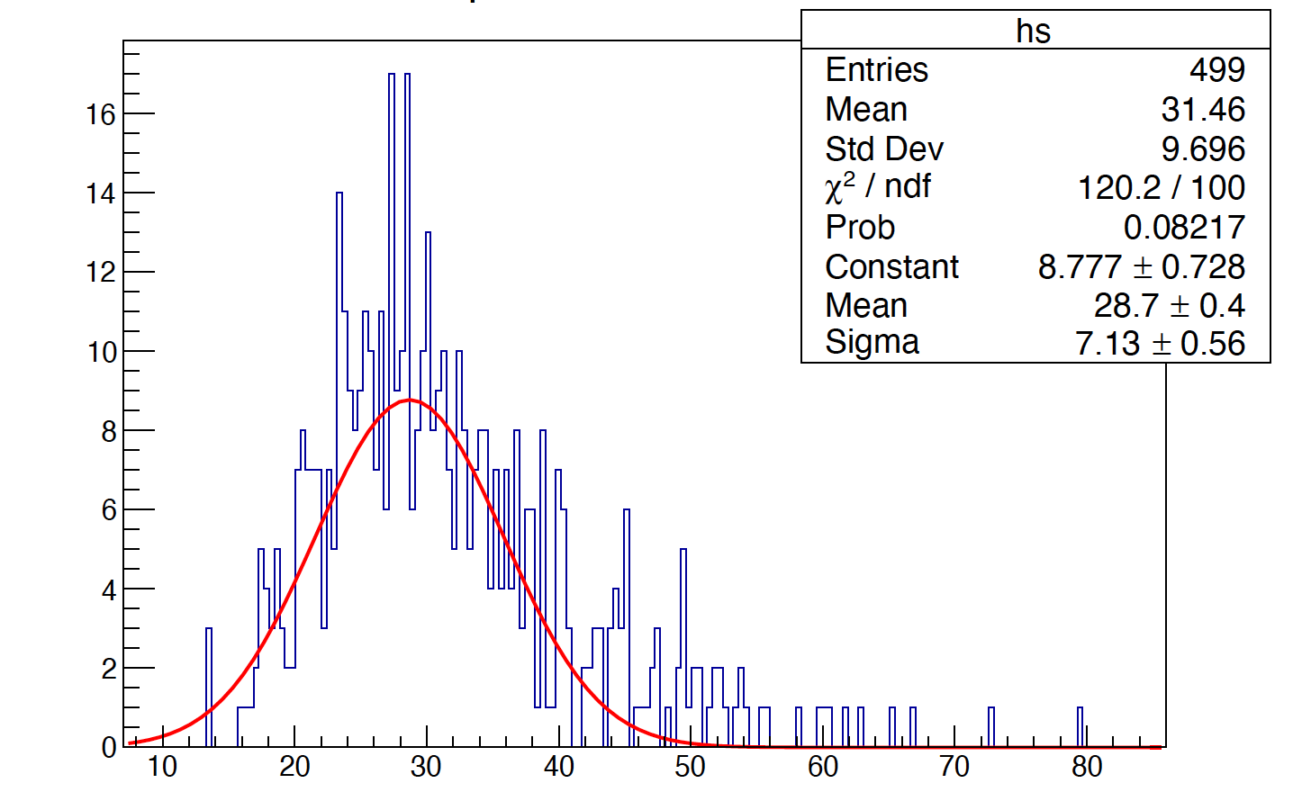
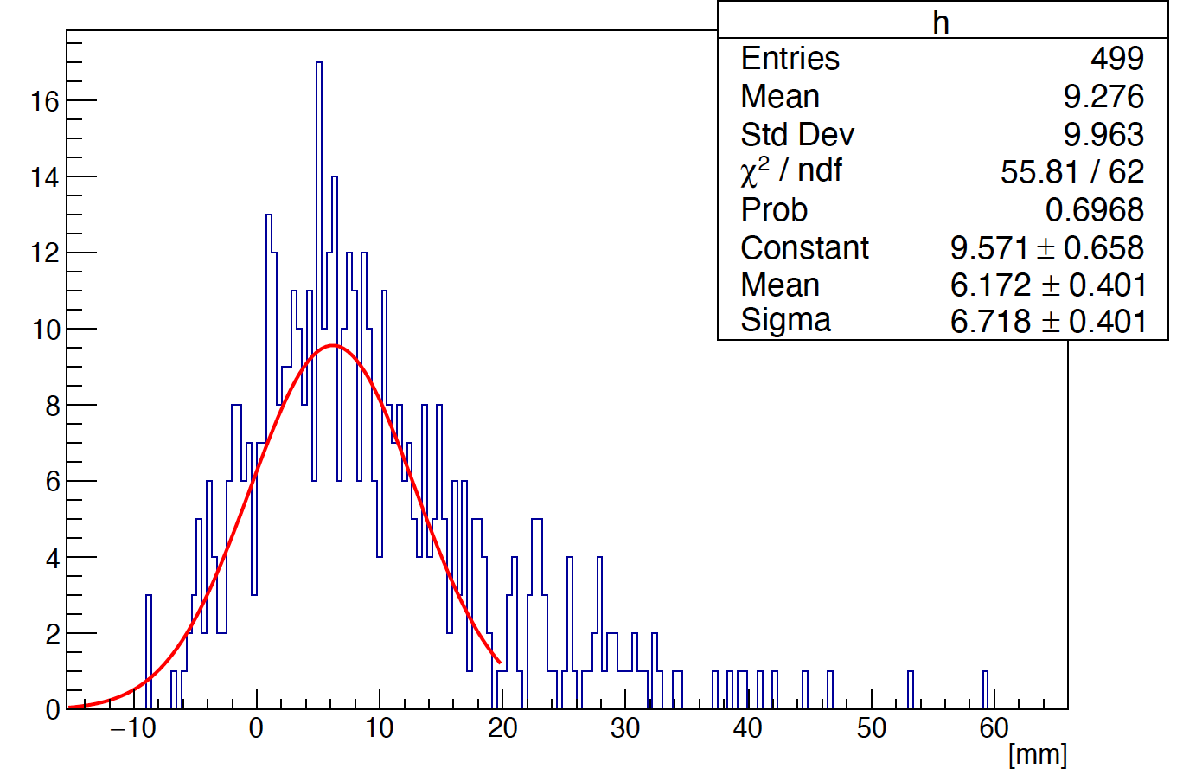
Phi reconstruction (method 1)
The bias is introduced by the shower start point through the rotated crystal angle (alpha)
A liner fit (use truth start point) is used to fix the bias
5 layer
phi
10 layer
R
14 layer

Slide 6
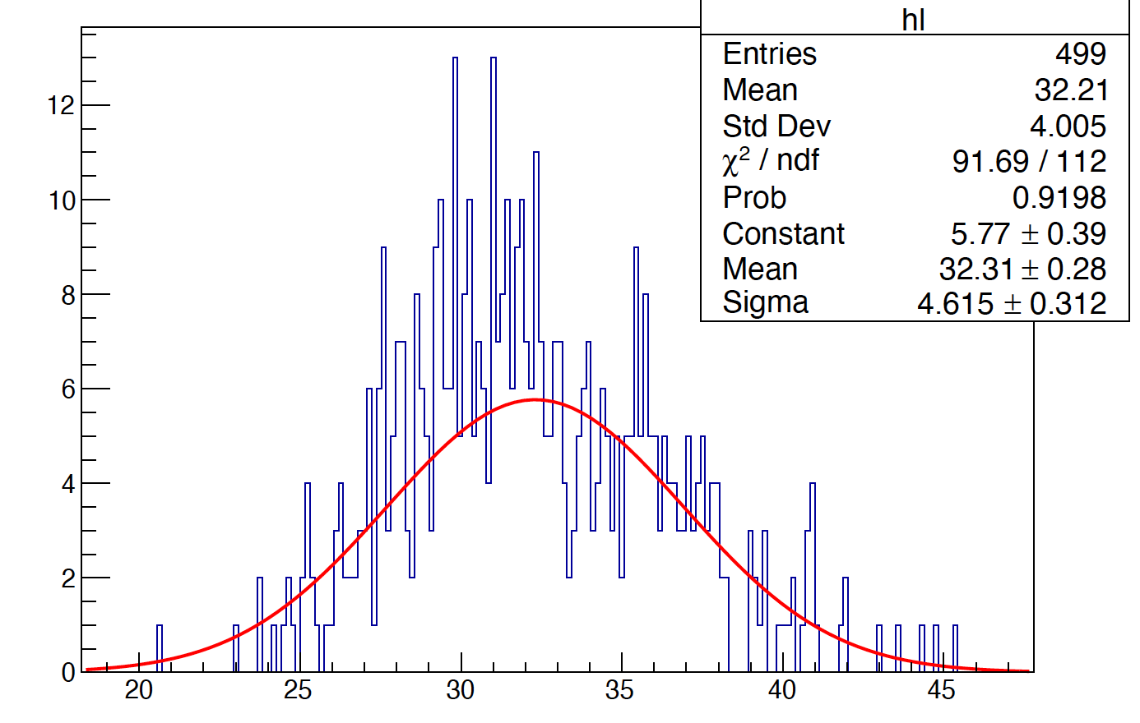
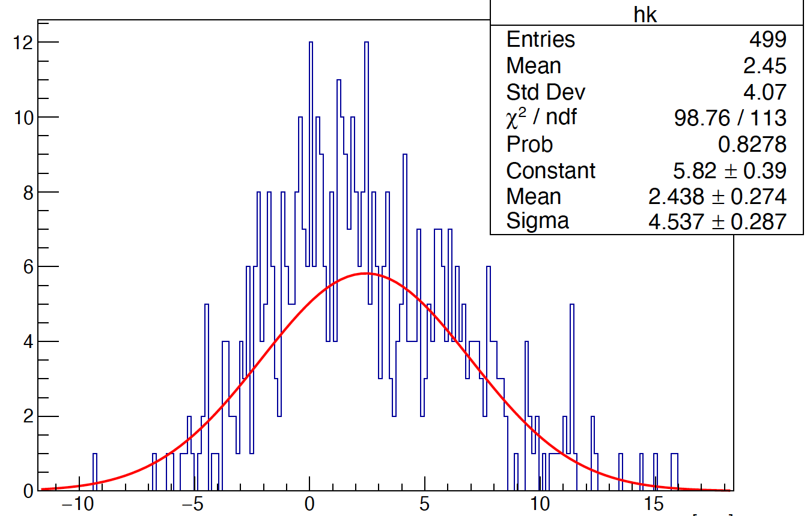
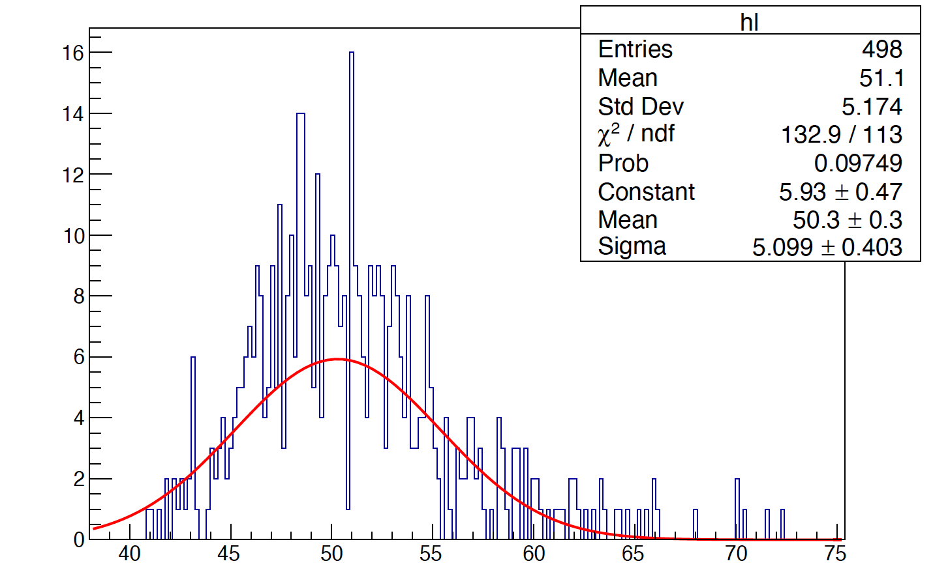
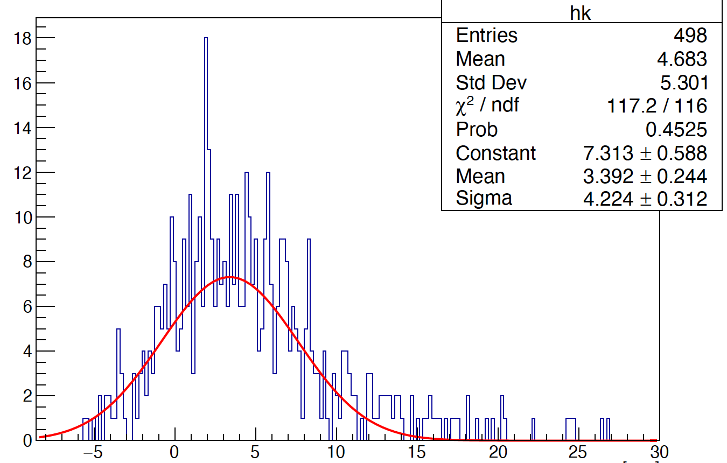
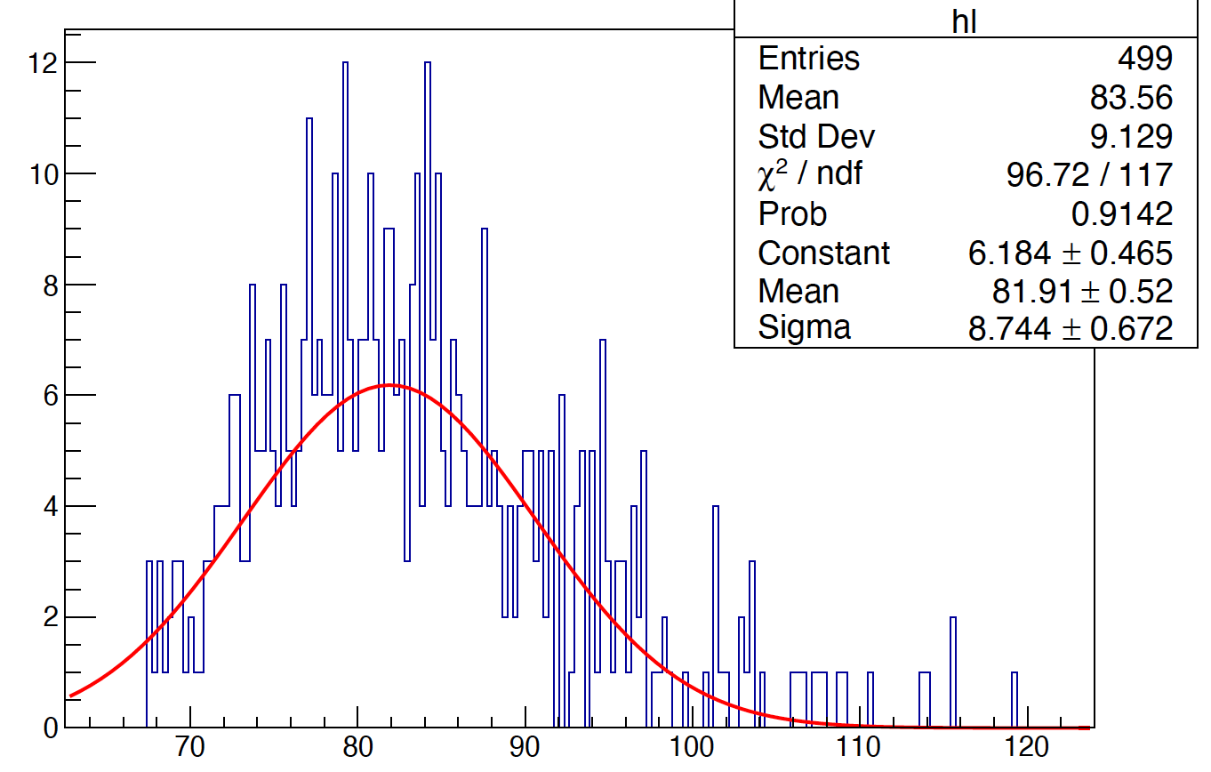
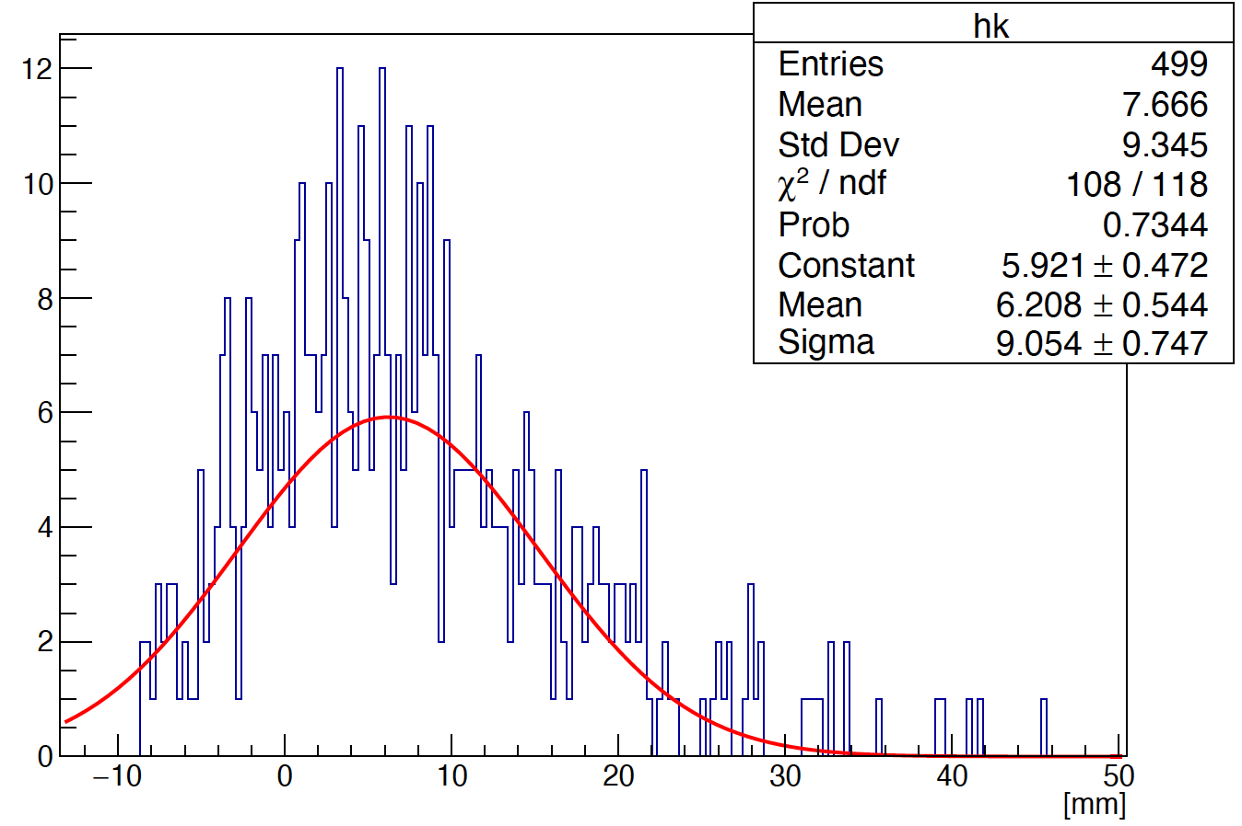

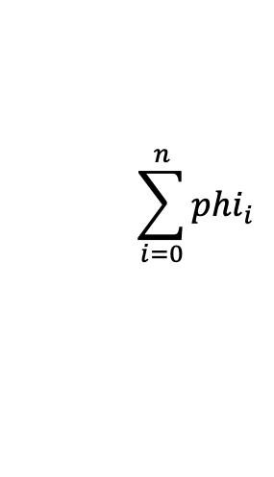
Phi reconstruction (method 2)
5 layer
phi is obtained by the method of
averaging phi :
10 layer
$$\sum_{i=0}^{n}{{phi}_{i}}$$
$$phi= \frac{1}{n}$$
Liner fit
14 layer

Slide 7
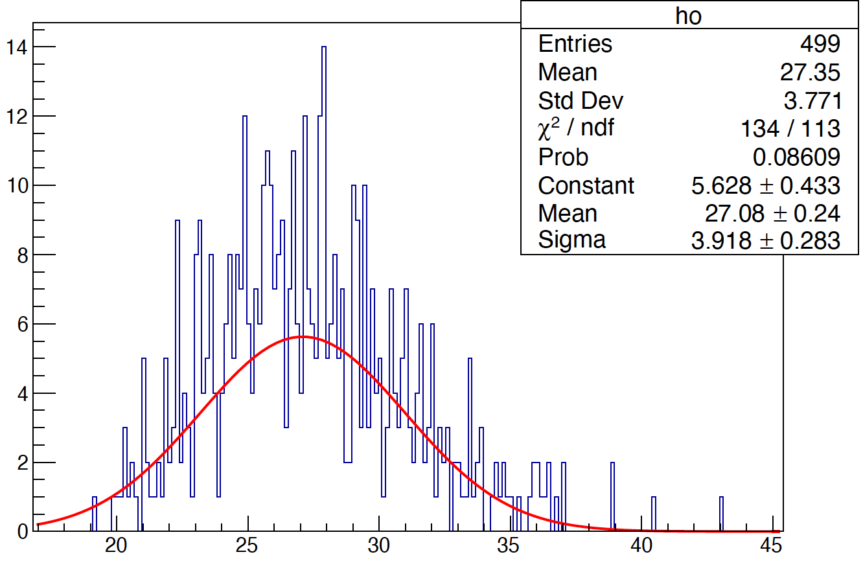
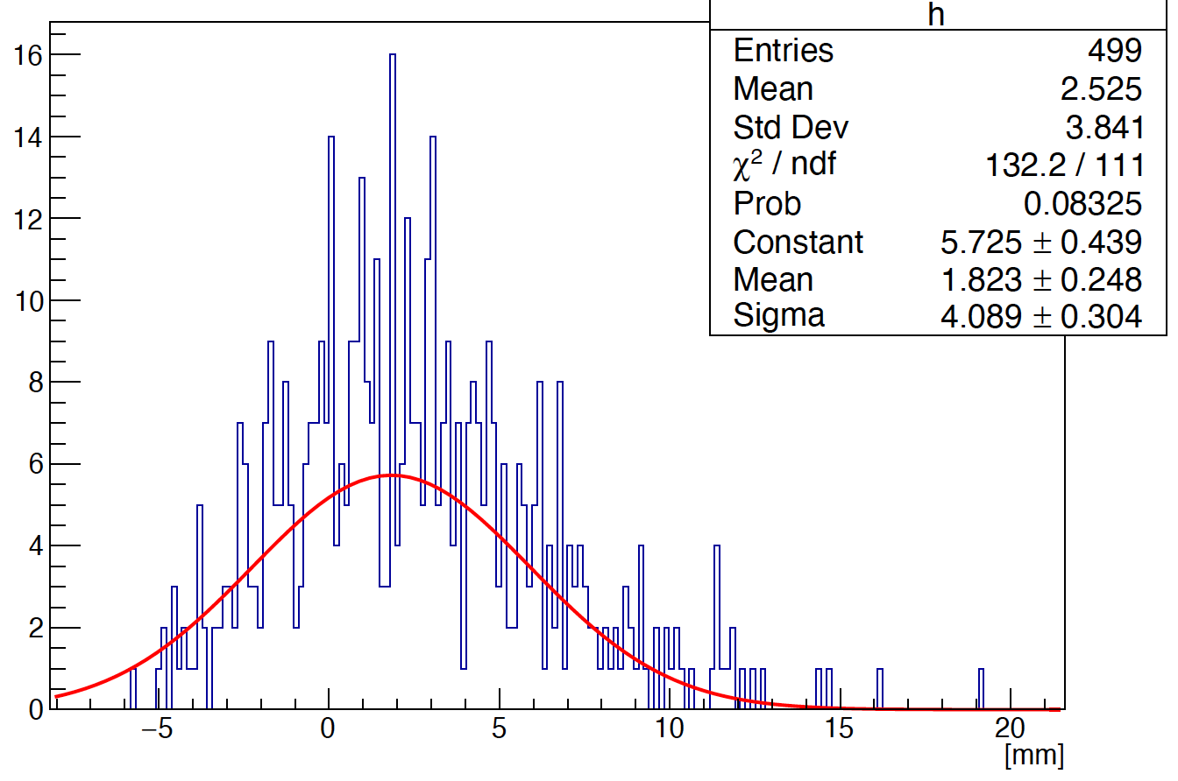
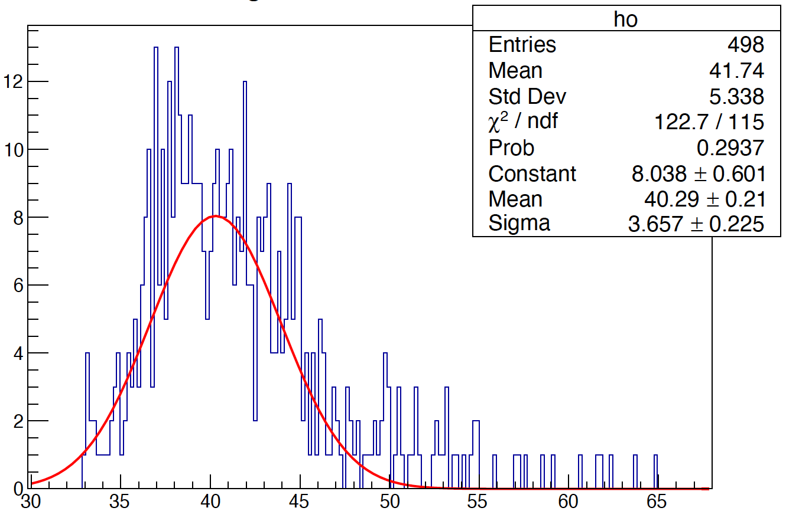
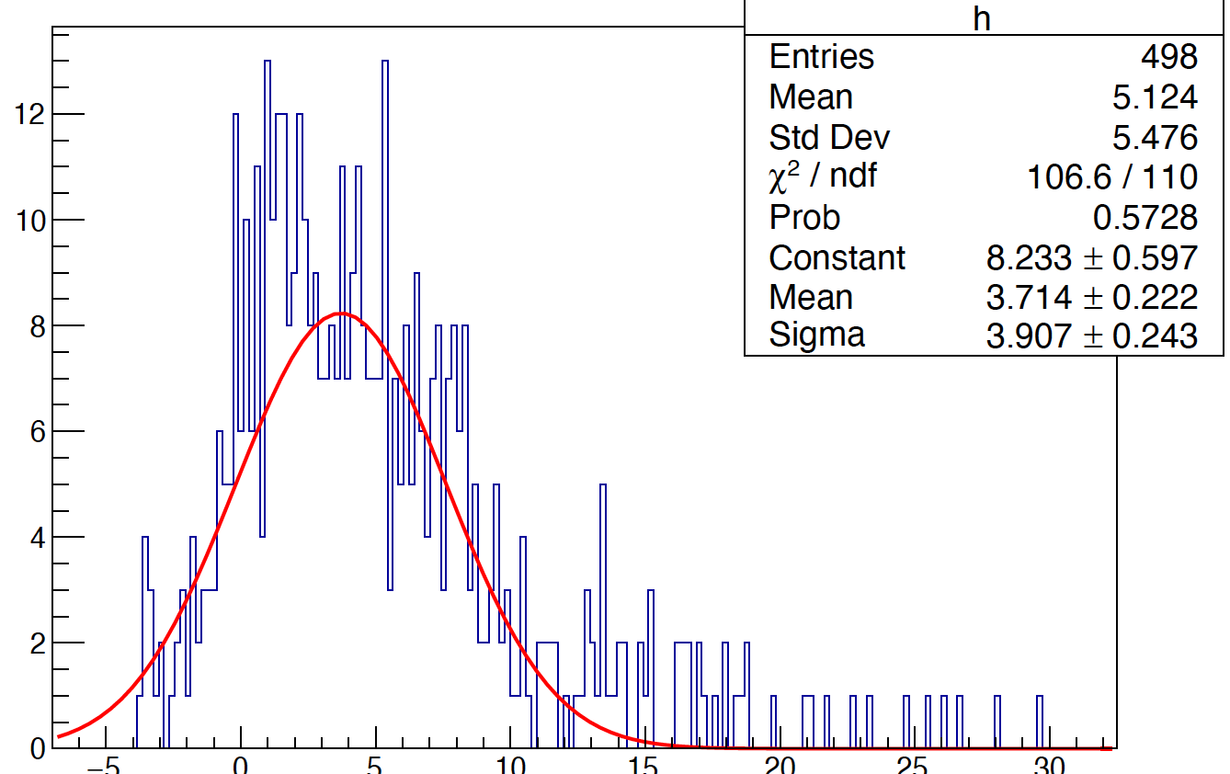
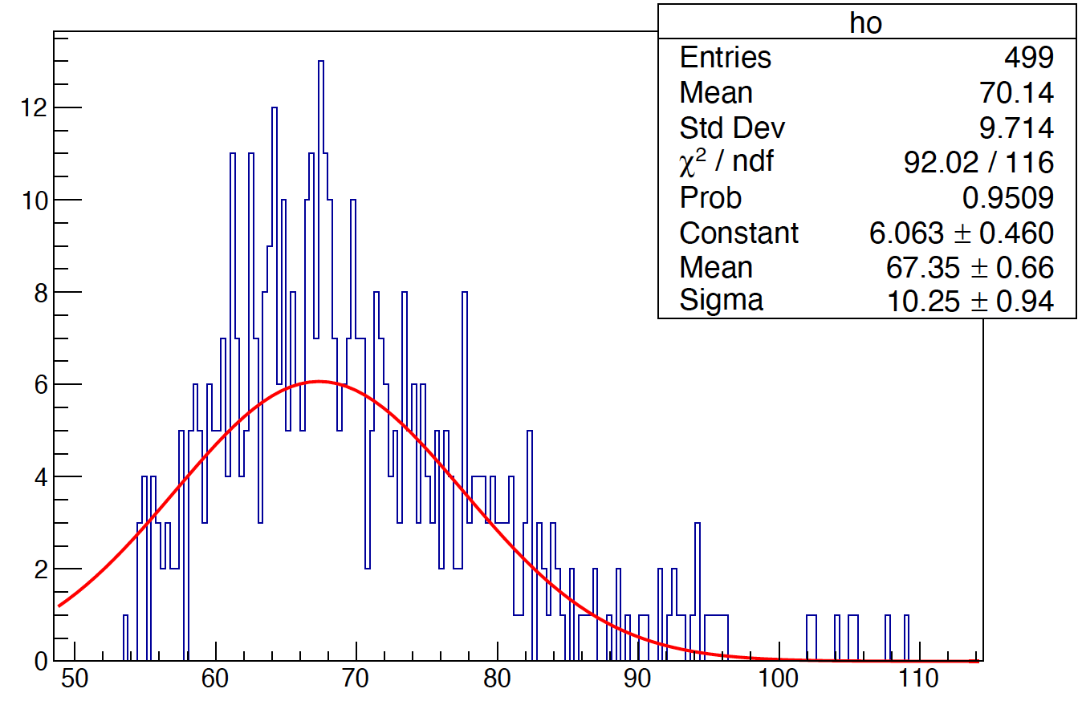
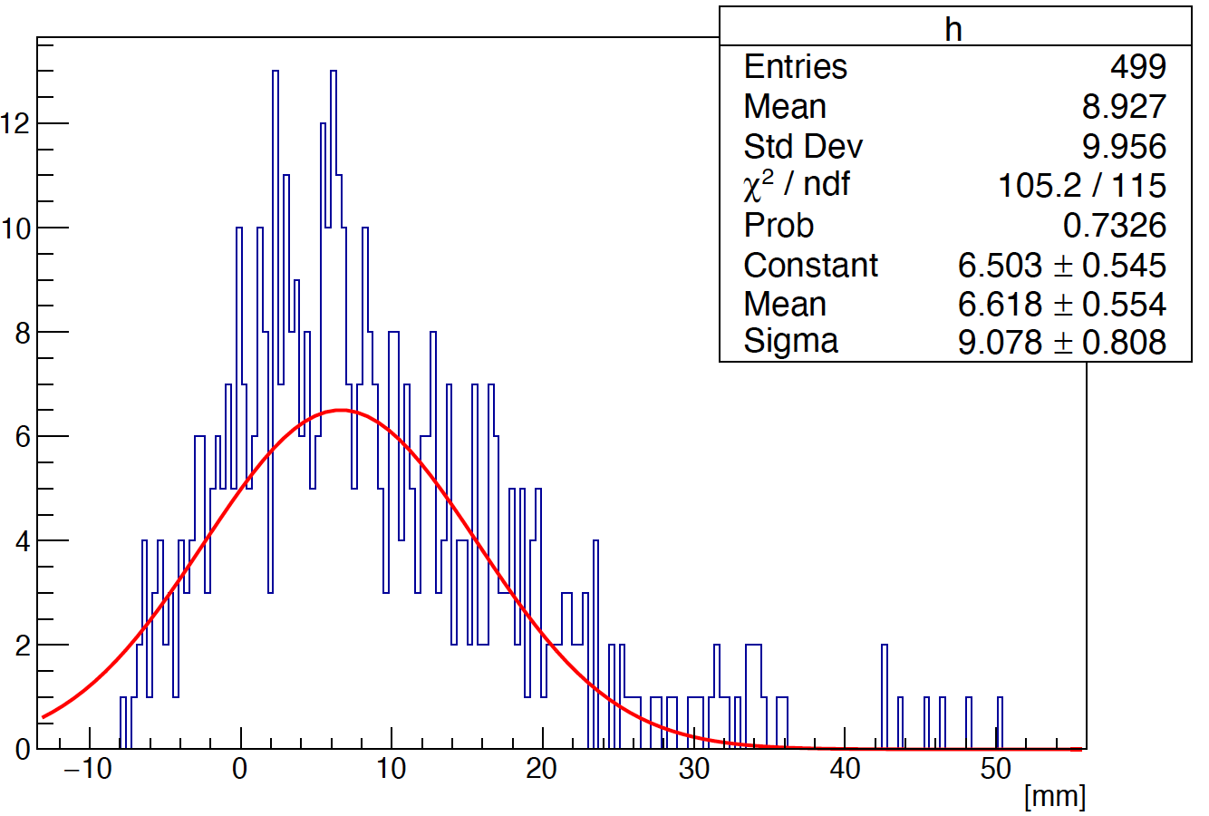
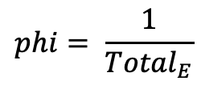

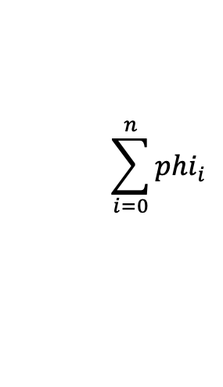
Phi reconstruction (method 3)
5 layer
phi is obtained by the method of weighting average phi :
$$phi= \frac{1}{{Total}_{E}}$$
$$\sum_{i=0}^{n}{{phi}_{i}}$$
*
$$E_{i}$$
10 layer
Liner fit
14 layer

Slide 8
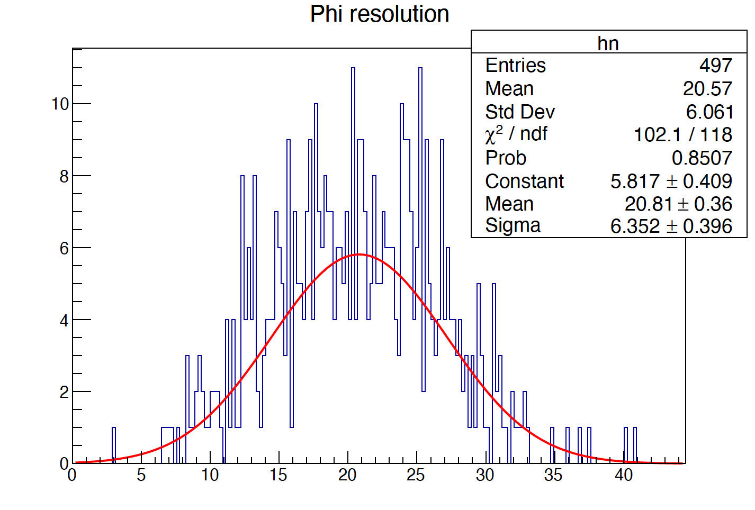
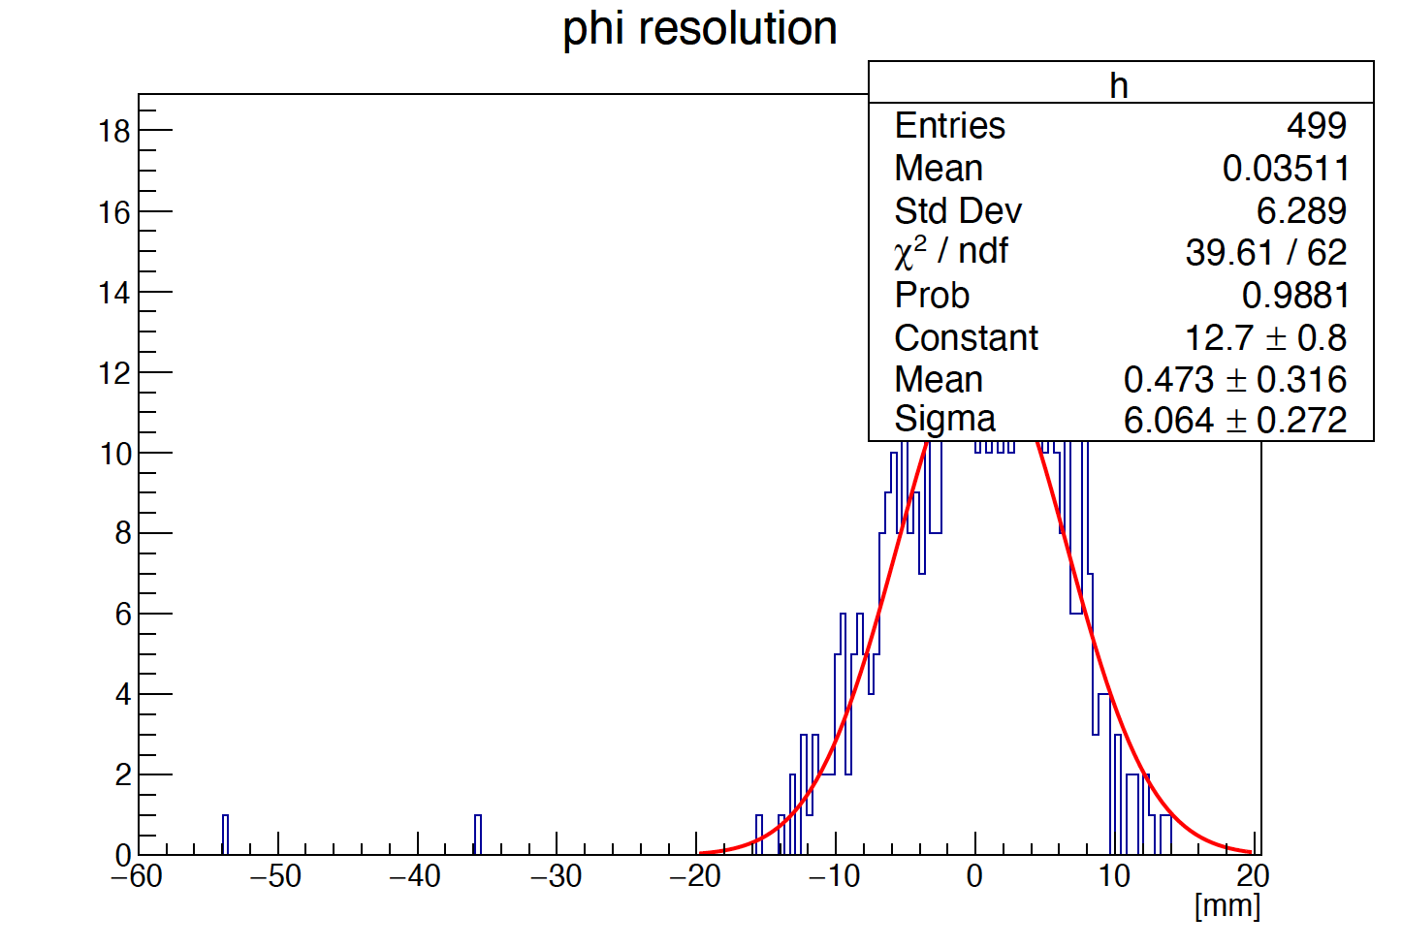
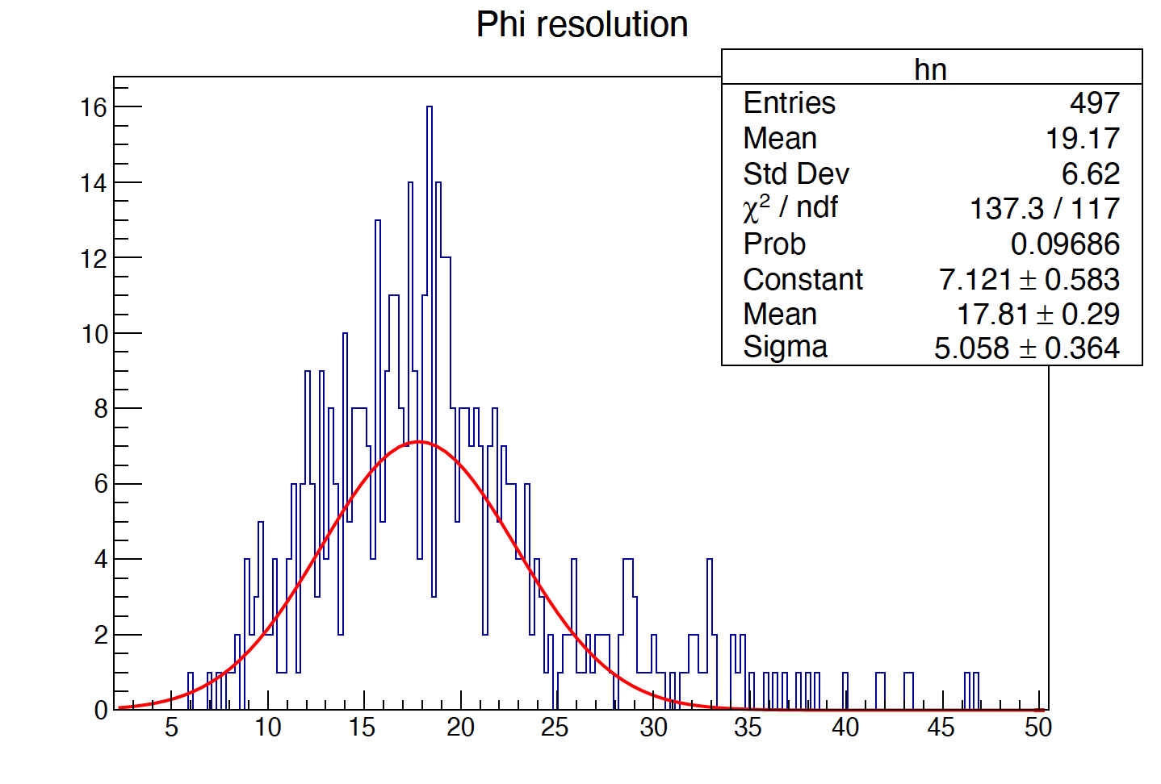
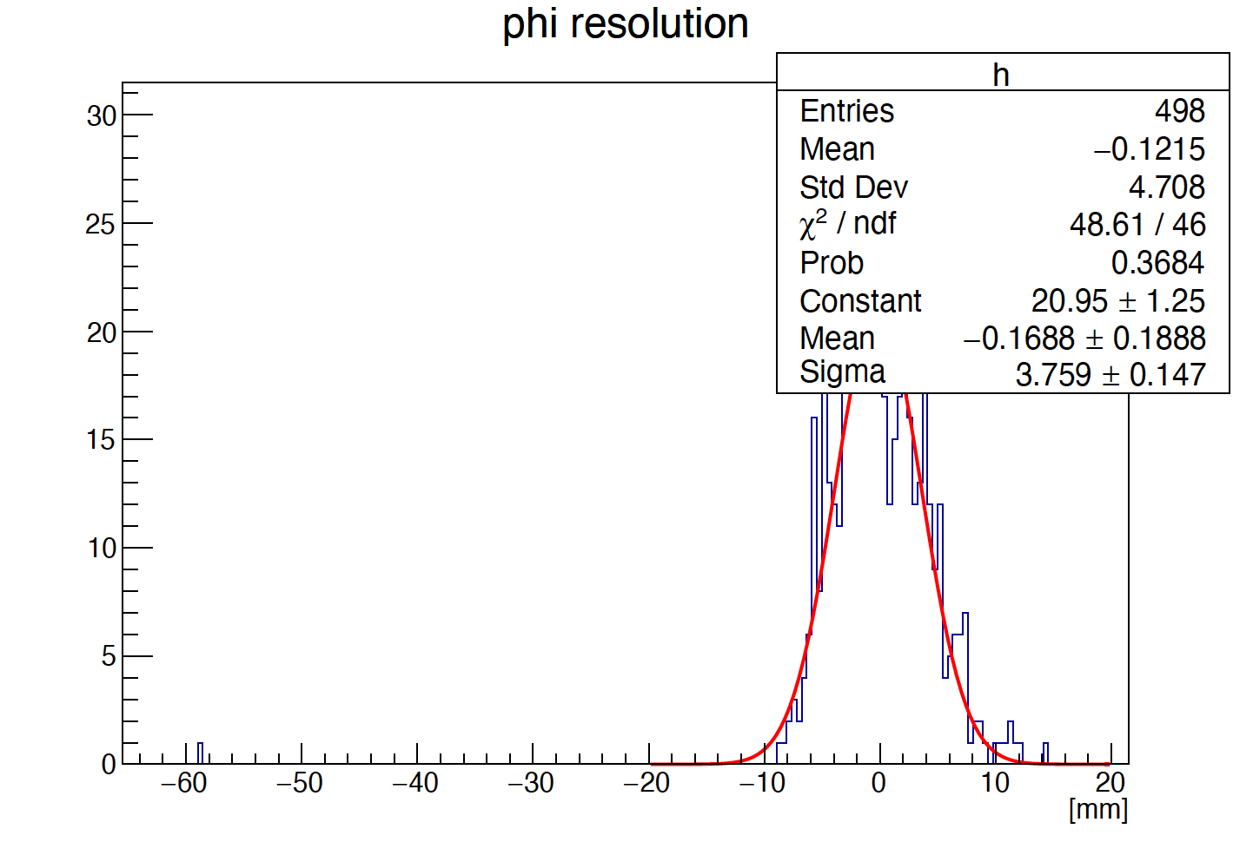
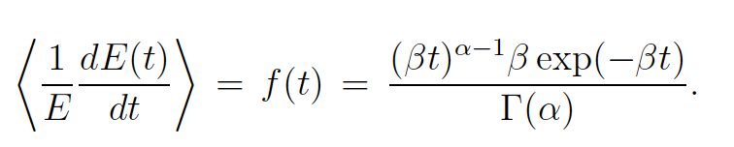
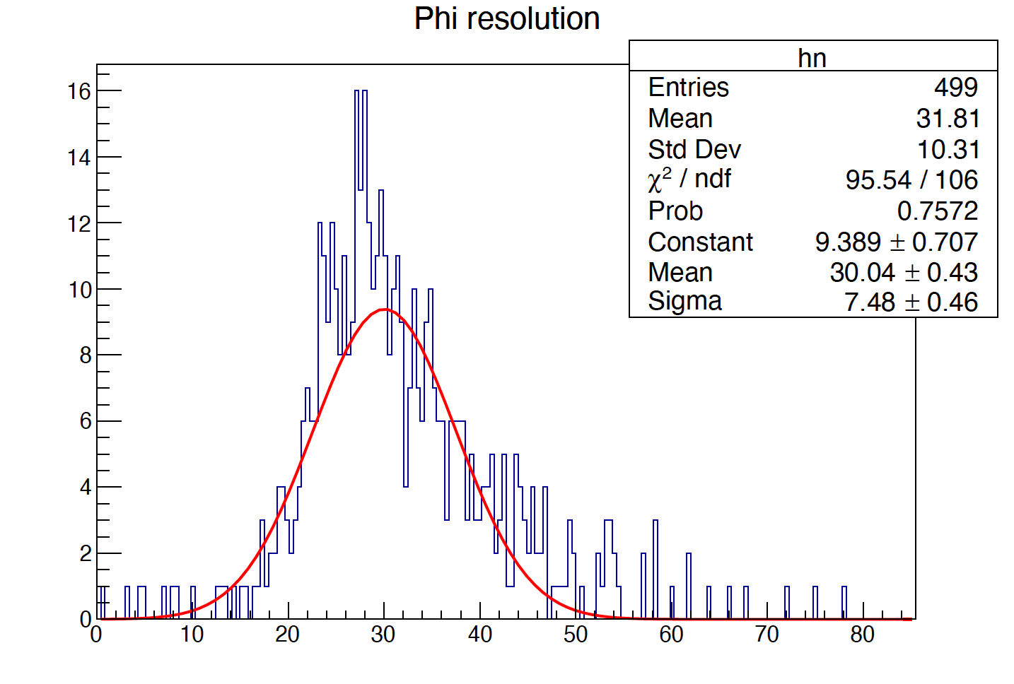
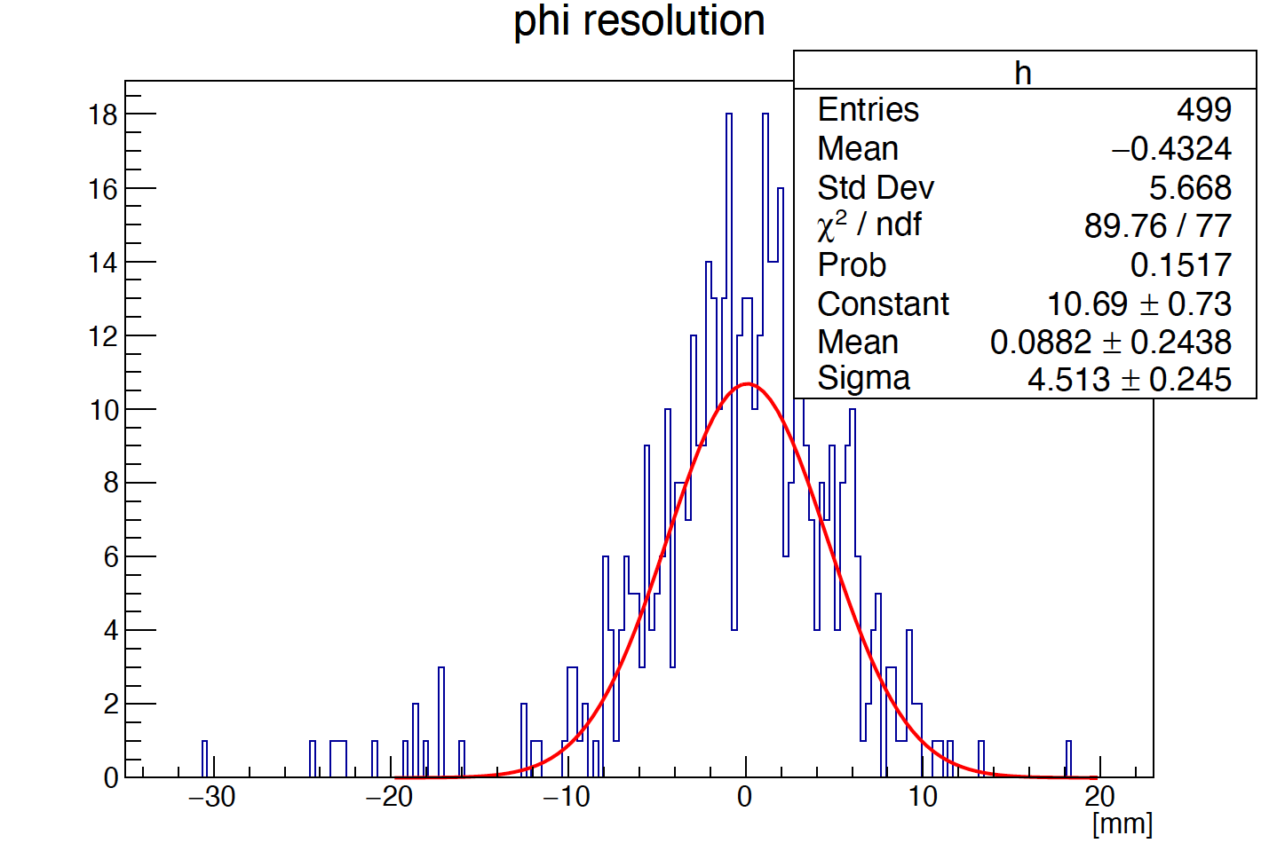
How to get shower start point?
The shower profiles can be described by the function：
5 layer
F(α,β,t,φ,r)
When rotation angle is 90°, longitudinal shower profiles can be described as :
10 layer
Liner fit
To improve the accuracy of phi resolution :
  Parameter α and β of can be obtained by fitting MC data
14 layer

Slide 9
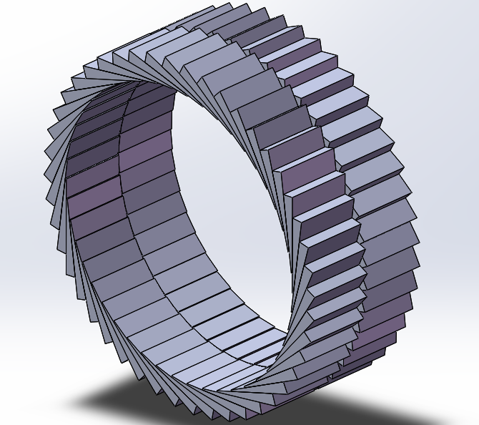
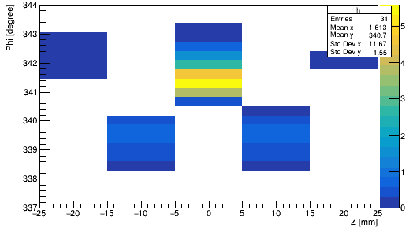
Cross Crystal Fan
To improve the phi resolution accuracy:
  crossing even and odd layers
  Odd layer： alpha’= -alpha

Slide 10
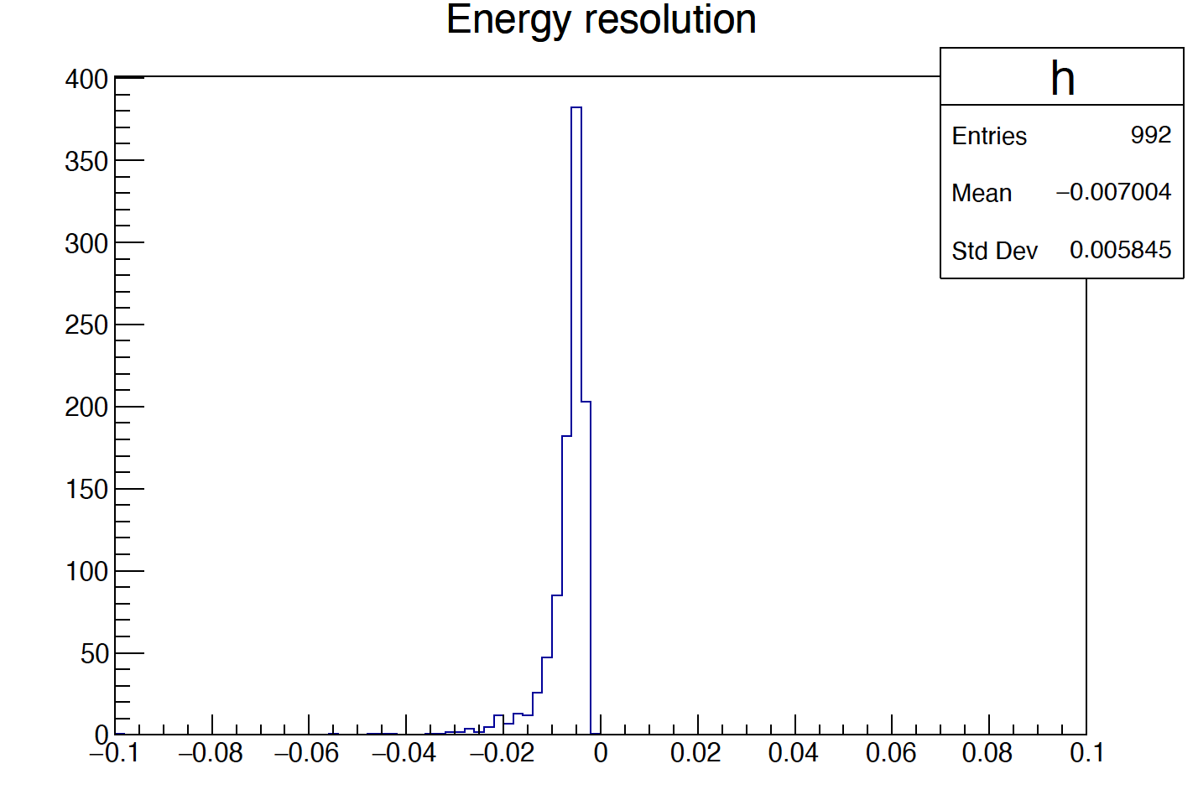
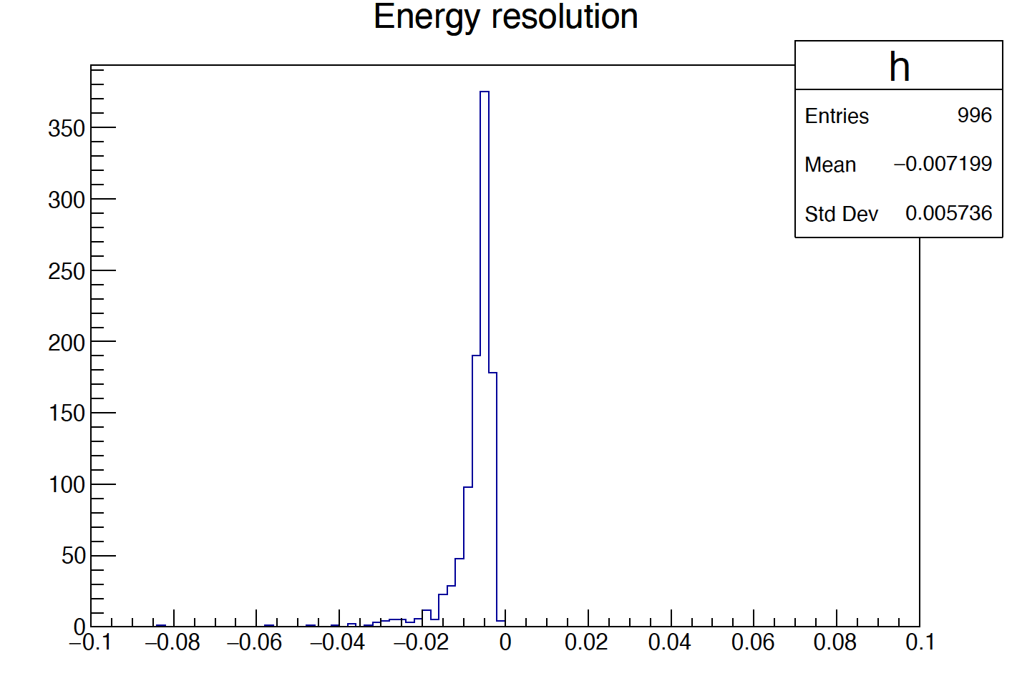
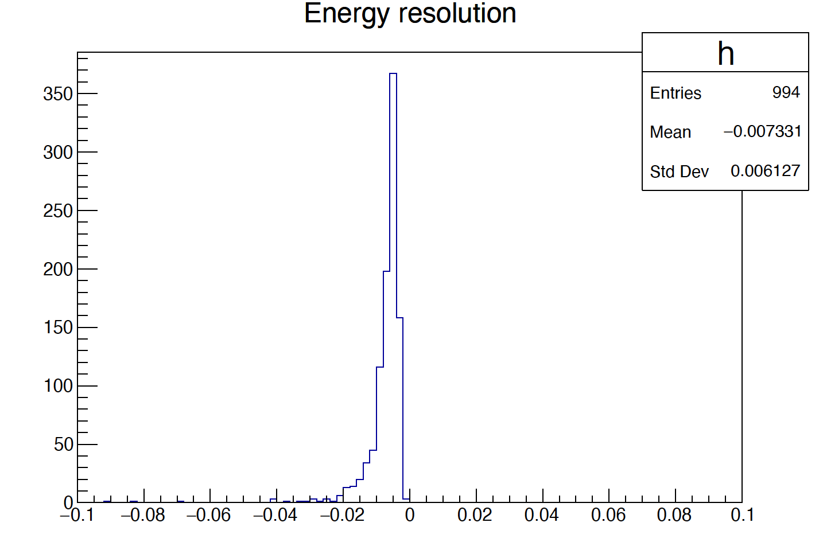
E resolution
5 layer
10 layer
14 layer
E resolution ~ 0.57%（10 layer）

Slide 11
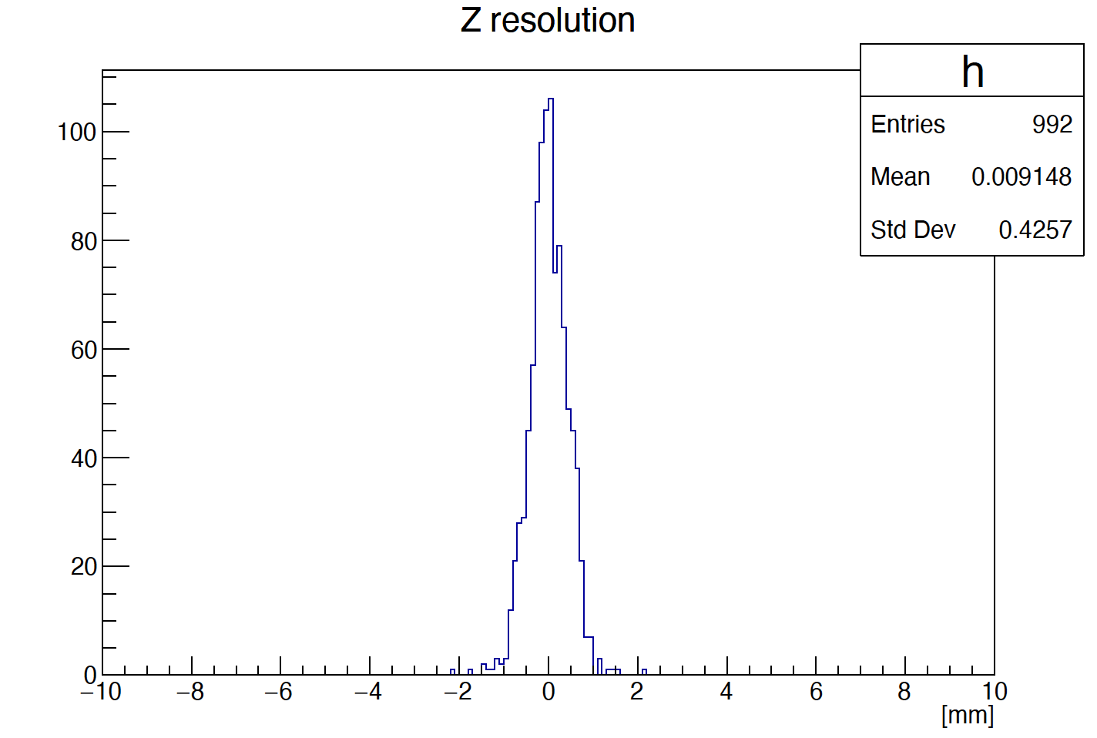
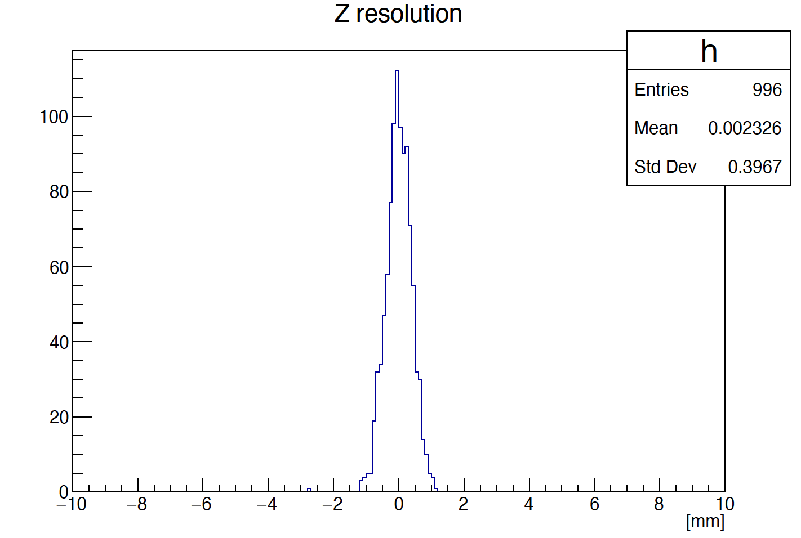
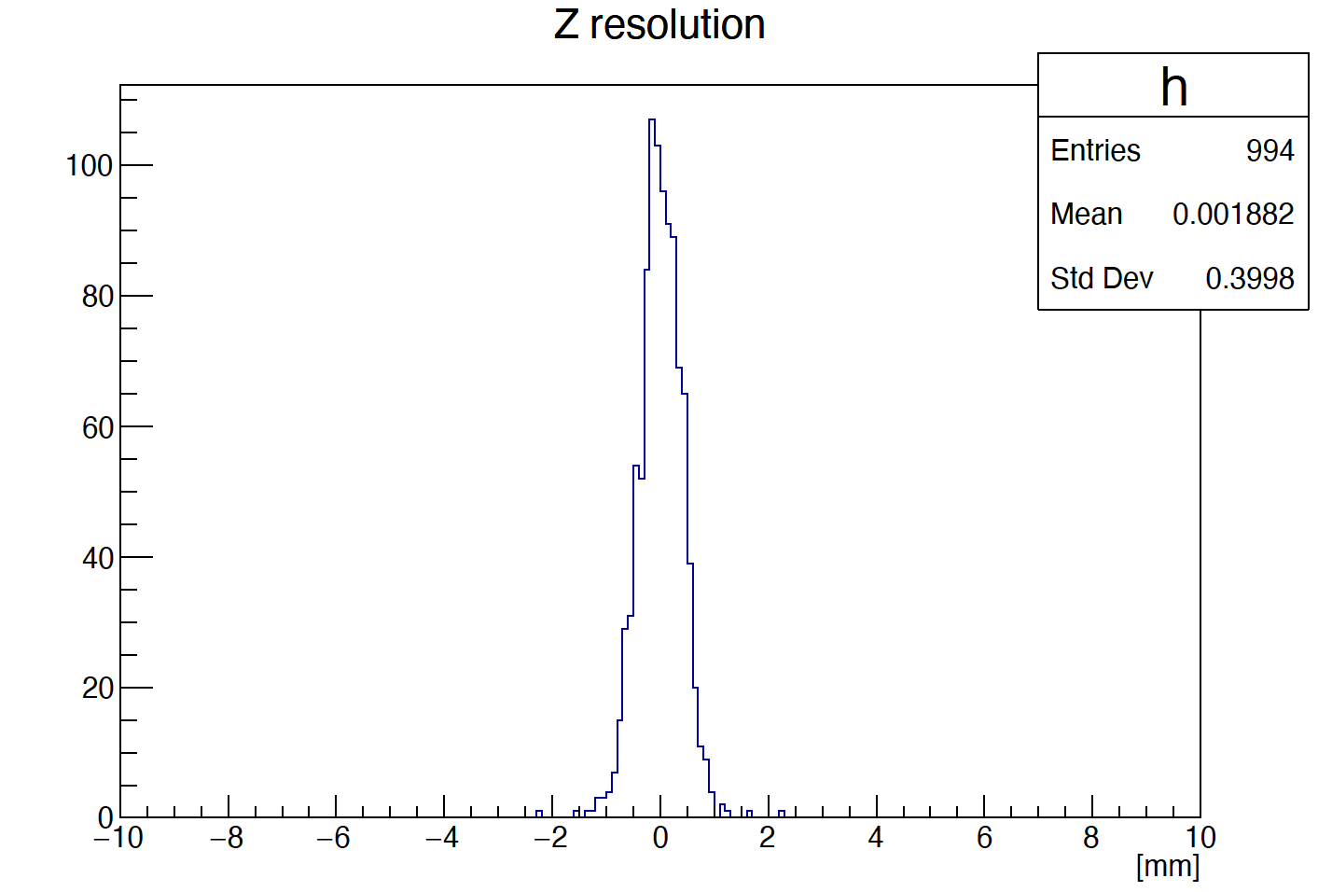
Z resolution
5 layer
10 layer
14 layer
Z resolution ~ 0.4 mm（10 layer）

Slide 12
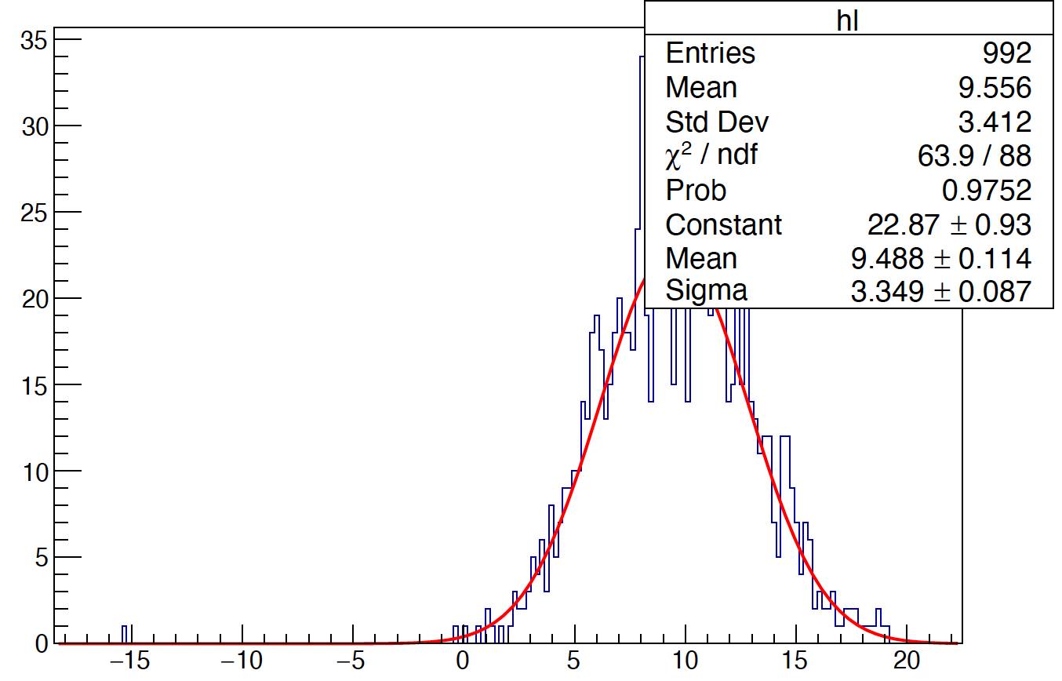
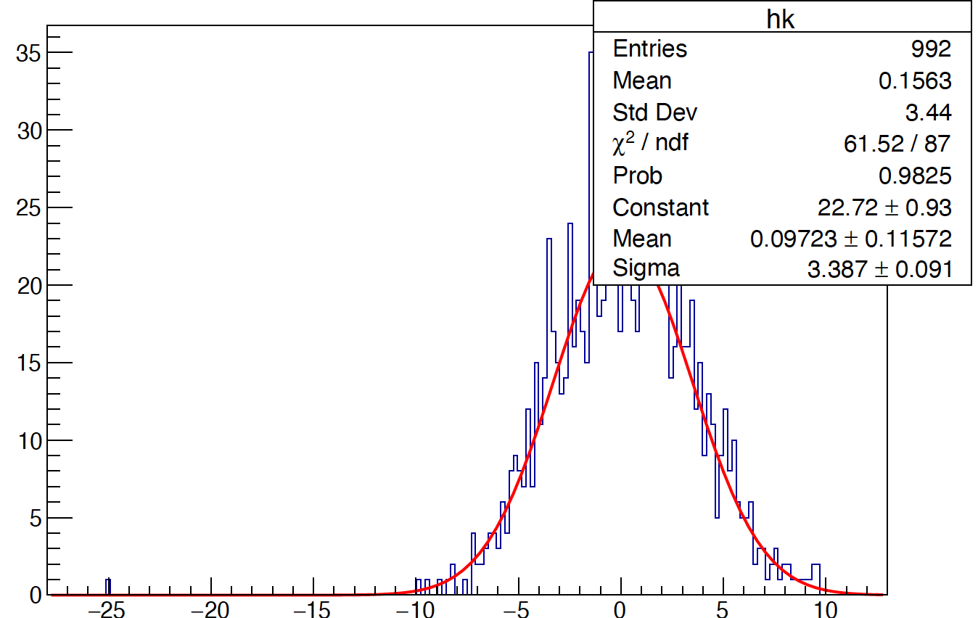
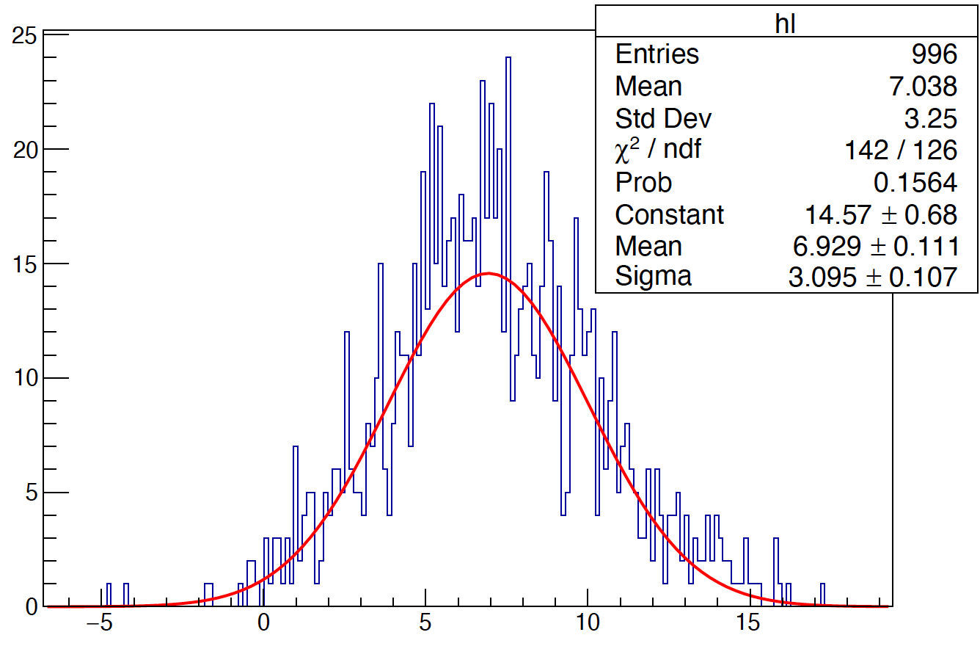



Phi reconstruction (method 2)
5 layer
phi is obtained by the method of
averaging phi :
10 layer
$$\sum_{i=0}^{n}{{phi}_{i}}$$
$$phi= \frac{1}{n}$$
Liner fit
14 layer

Slide 13






Phi reconstruction (method 3)
5 layer
$$phi= \frac{1}{{Total}_{E}}$$
$$\sum_{i=0}^{n}{{phi}_{i}}$$
*
$$E_{i}$$
10 layer
Liner fit
14 layer

Slide 14




Phi resolution
By crossing the odd layers, a phi resolution of ~ 2.4 mm is obtained
Liner fit

Slide 15
Summary
Shower resolution ( 30GeV photon)
  Z resolution ~ 0.4 mm
  E resolution ~ 0.57%
  Phi resolution ~ 2.9 mm
Next step:
  γ/γ and γ/π separation based on cross Crystal Fan Ecal
  Obtain shower start point by getting function F(α,β,φ,t,r) （maybe）

