Slide 1

Status of new technologies exploration
  ZHOU Yang
  On behalf of the pixel detector study group
  2022.2.16

Slide 2
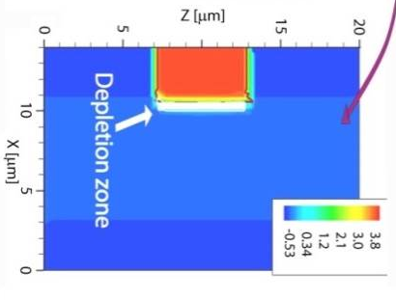
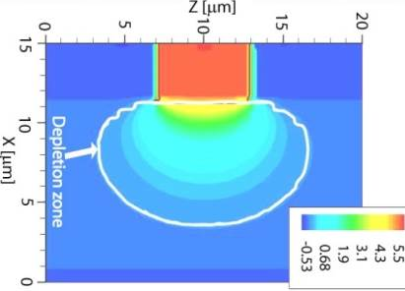
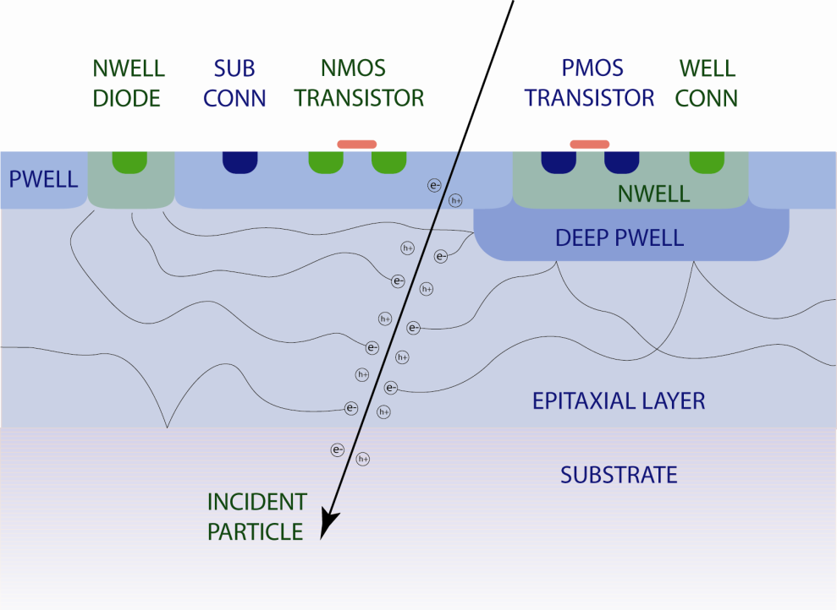
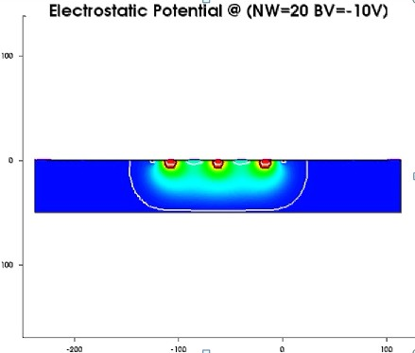
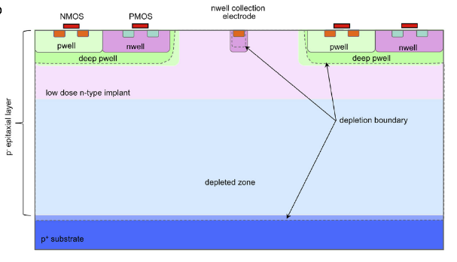
A brief sketch of technology moving used by CMOS pixel sensors developed for vertex detector
Technology nodes used was shrinking with industry progress. Brings benefits like: more functions integrated, faster charge collection, lower power per function.
diffusion
diffusion
~2008
~2010
~2014
~2020
？
Charge collection: mainly on diffusion
diffusion drift
drift，
Epi: ~10cm？
Epi-thickness: 14-20 μm
Epi:~20 μm
Quadruple-well CMOS: both type of transistors admitted in the pixel array
> 1k Ω·cm
TOWER 0.18μm
Fully depleted
> 1k Ω·cm
ESPROS 0.15 μm
TOWER 0.18 μm modified
Non-depleted, thick
epi substrate:
several Ω·cm
AMS 0.6 μm
Semi-depleted, HR
epi substrate
500 – 2k Ω·cm
AMS 0.35 μm
Leading-edge technology node
TOWER 65 nm
HLMC 55 nm
> 10 years of development, the main technology for ALICE-ITK2, CBM-MVD, and CEPC vertex detector R&D

Slide 3
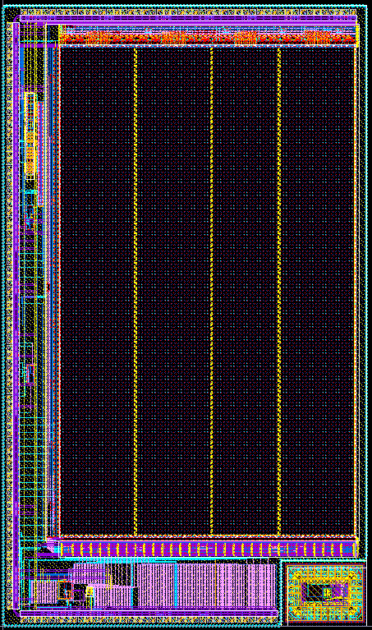
Sensor performances achieved in Jadepix series：
@developed by MOST1 Vertex detector study group
1×0.6 cm²
512×192 pixels
1.48×0.86 cm²
356×498 pixels
Layout of Jadepix3
Layout of Jadepix4，submitted： 2021.11.5
  Test performances:
  Noise：~15e-
  Readout speed：98.3μs/frame；
  Average power dissipation：~52.8mW/cm^{2；}
  Spatial resolution：σ_{x} ~2.7-4.4 μm, σ_{y} ~3.4-5 μm
While the pixel analogue FE and periphery circuits keep similar with JadePix3：changed the pixel readout structure.
time resolution improved：~100 μs -> ~1 μs;
paid by pixel size increased： 16μm×23μm -> 20μm×29μm
*Design details have been reported by Yunpeng on 2021/10/27

Slide 4
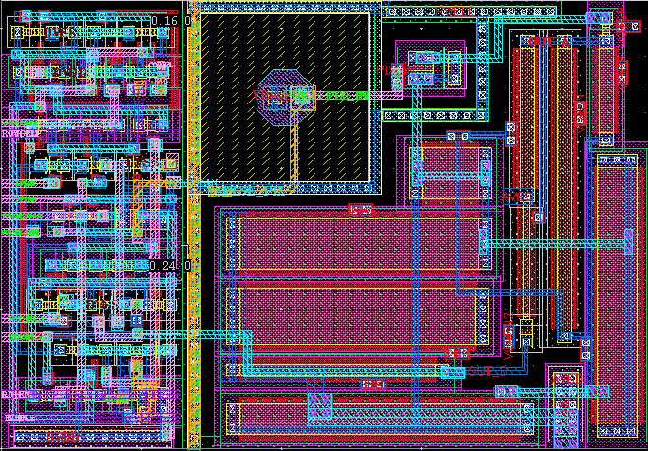
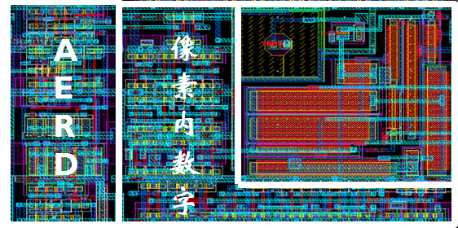
Interested performances may directly affected by new technologies
Layout of a pixel in JadePix3
Layout of a pixel in JadePix4
New technologies exploration introduced in this talk:
3D technology;
2. Smaller technology node;
3. Stitching technique
16 μm
20 μm
23.11 μm
29 μm
bring opportunities to shrink the pixel size of current design:
Specifications required by CEPC vertex sensor (from CDR)
Spatial resolution≤ 3µm | Required a pixel size ≤ 16 ×16 µm²
Material budget ≤ 0.15%X₀ /layer | Sensor back thinned down to ~50μm
Average power dissipation | <50 mW/cm²
Time resolution | ~1μs
Radiation tolerance | < 3.4 Mrad / year , <6.2 × 10¹² n_{eq}/ (cm² year)
may reduce the material budget to 1/3 of the requirement by removing the supporting structures.

Slide 5
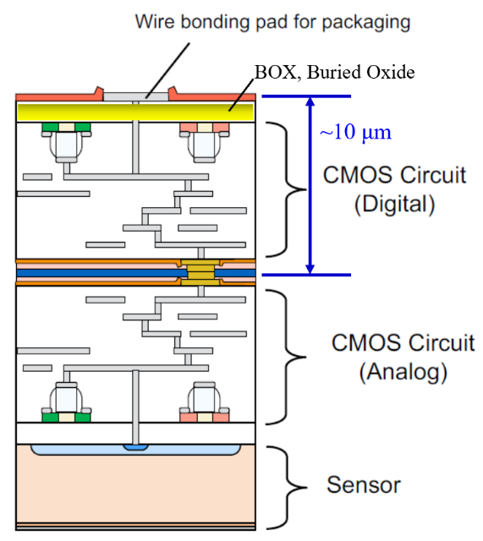
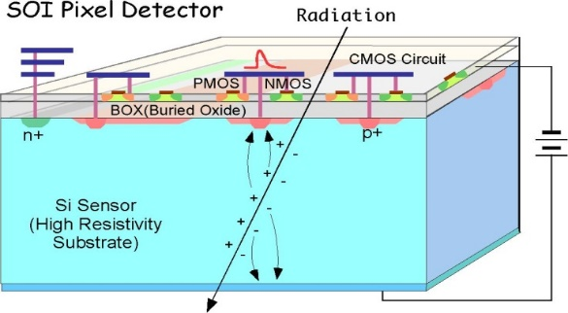
1. 3D technology： SOI-3D
Layout of a pixel in JadePix4
The idea is: split the pixel into two parts, then connected them vertically, so the pixel layout size could shrink to half.
Extra requirements for the 3D technology:
1. The bump size should be small enough to integrated at least two in the small pixel area;
2. The final thickness should meet the low material budget requirement.
20 μm
29 μm
Device Layer (40nm)
Buried Oxide (200nm)
Substrate (50-500μm)
3μm diameter Au bump
Sputtered Al Layer (200nm)
5
Sandwiched structure of SOI
First try was on the SOI 0.2μm 3D technology,
Supported buy :“高精度SOI像素顶点探测器研究”, NSFC key program, 2020-2024

Slide 6
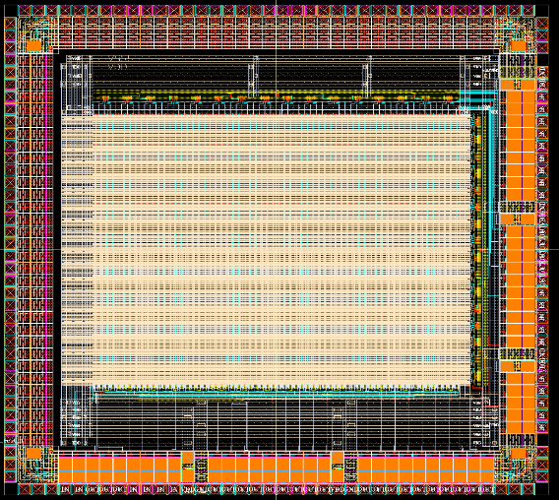
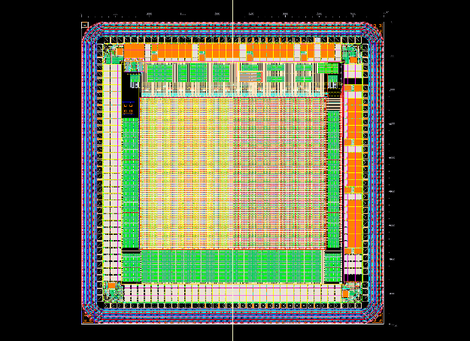
1. 3D technology： CPV4-3D design overview
Division of upper and lower functionalities
Lower tier
Upper tier
Control register
A-Pulse
Test-EN
Mask
Upper
D-Pulse
State
Hit
D-FF
AERD
readout
Reset
Amplifier/
Comparator
PDD
Strobe
Lower
Lower tier: PDD sensing diode + amplifier/comparator
Upper tier: Hit D-Flipflop + Control register + AERD readout
2 vertical connections in each pixel: comparator output and test switch;
Analog and Digital power/ground are also separated
Pixel size | 17.24×21.04 μm²
Time resolution | ~1 μs or ~3 μs in different operation mode
Pixel array | 128×128
Chip size | 4.5mm×4.5mm
Delivered | Nov. 2020
Layout of CPV4-3D
@ design details was introduced by Yunpeng on 2020/12/28

Slide 7
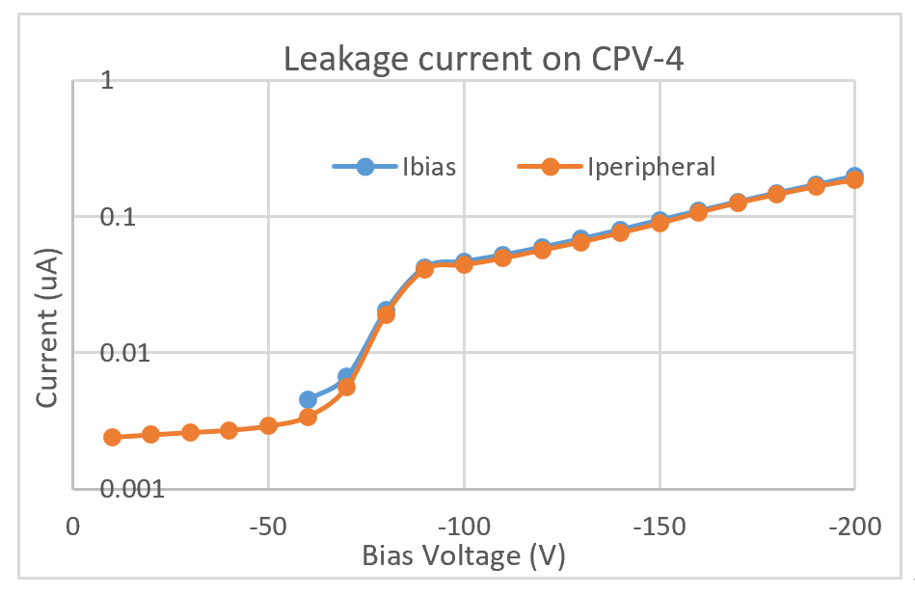
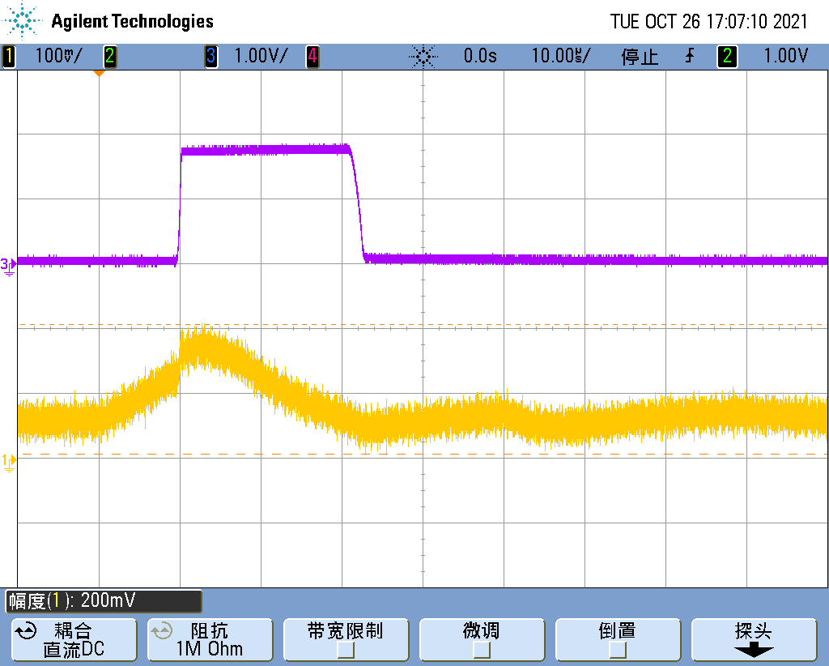
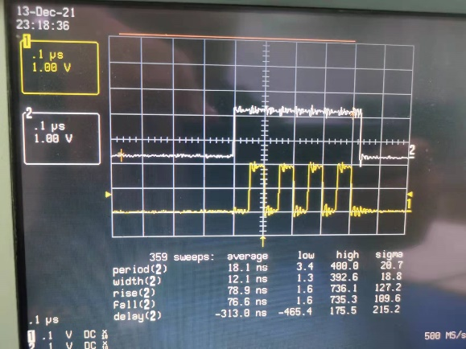
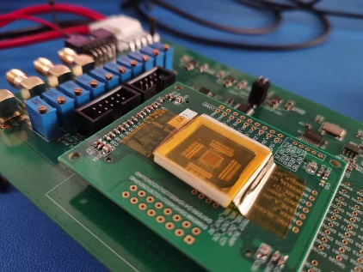
1. 3D technology : basic functions of the two sensors have been validated
Digital signal to digital sensor
Amplifier output
1. Leakage current on CPV4, the analogue sensor can be biased at -200V.
2. Pulse inject test of analogue sensor.
3. Pulse inject test of digital sensor.
-Valid signal from sensor (white line)
-Reset signal after read the pixel addresses. (yellow line, 4 pixels was fired)
CPV4 digital sensor bonding on test system

Slide 8
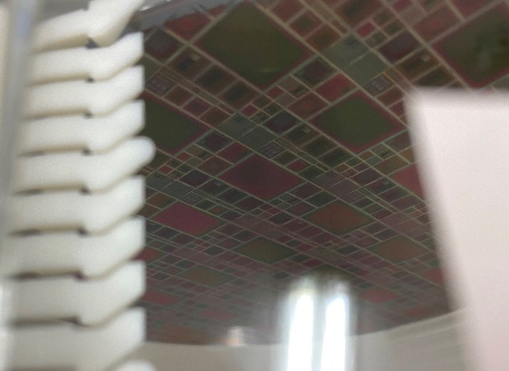
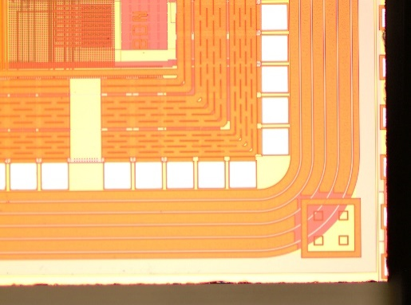
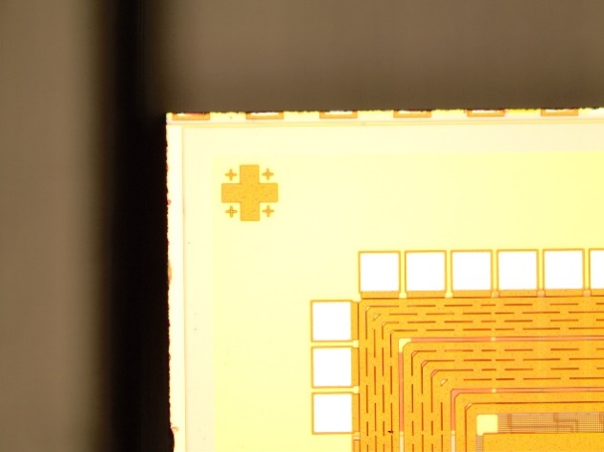
1. 3D technology: ongoing work
3D integration (by foundry in Japan) order is still in-progress;
A DAQ and test control system is in developing;
Ordered an extra wafer for 3D integration
Alignment mark on the two sensors

Slide 9
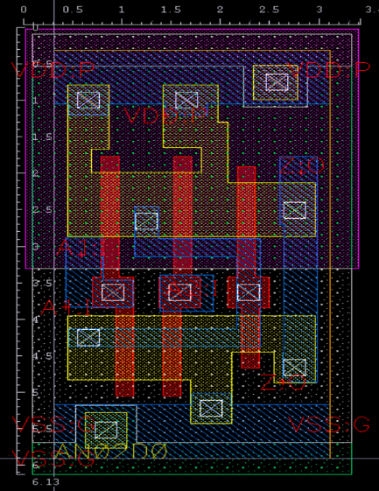
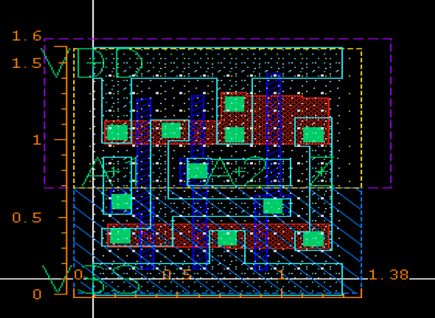
2. Smaller technology node： more possibilities
Per digital function: smaller layout size; lower power consumption (dynamic power could reduce 2.25 times if the core VDD reduced form 1.8V to 1.2V)
Layout of a pixel in JadePix4
20 μm
29 μm
~1/8
Digital part: 133 transistors, ~324 μm²
6*3 μm²
1.6*1.4 μm²
~1/8
Layout of a standard digital cell “and” in Tower 0.18μm (left) and HLMC 55nm process (right).
Digital part may be reduced to: ~16*2.5 μm²
It seems possible to realize current pixel design in 16*16 μm², using a smaller technology node around 65/55nm.

Slide 10
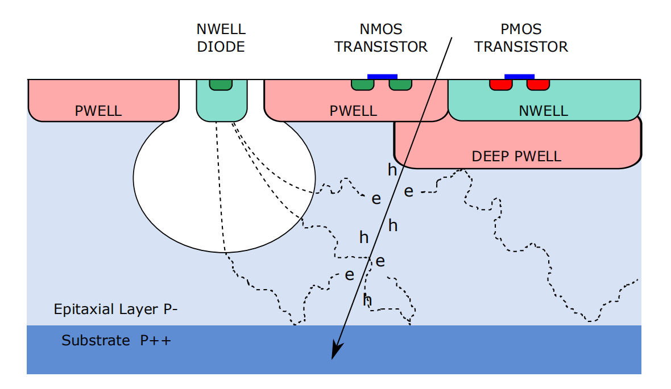
2. Smaller technology node： HLMC 55nm
Basic information:
55nm CIS process;
Voltage for core transistor 1.2V， for IO transistor: 3.3V;
Epi thinness: 5.4 μm
Resistance: 10Ωcm
Quadruple-well process:
  Deep P-well and deep N-well injection parameters were customer designed。(by TCAD simulation)
Supported by : 中俄“重离子超导同步加速器”国际合作研究项目, National key research and development program, 2020-2025
Design team from: IHEP, CCNU, IMP
Epi.
Some studies have been started in HLMC 55nm process:
  1. Process modification;
  2. Diode, and charge collection study;
  3. Necessary electronic function blocks design: DAC , buffer, PLL and so on.

Slide 11
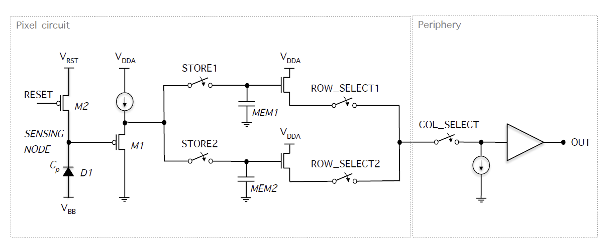
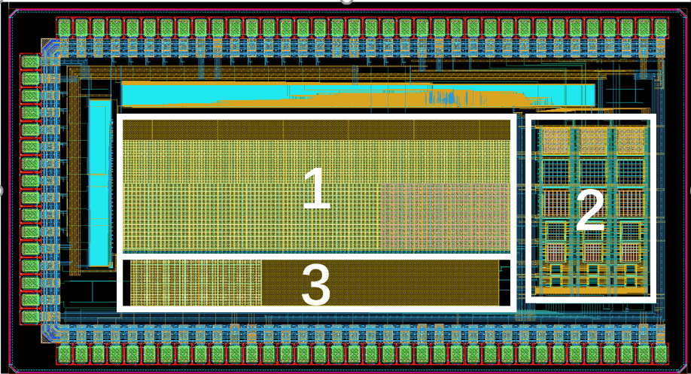
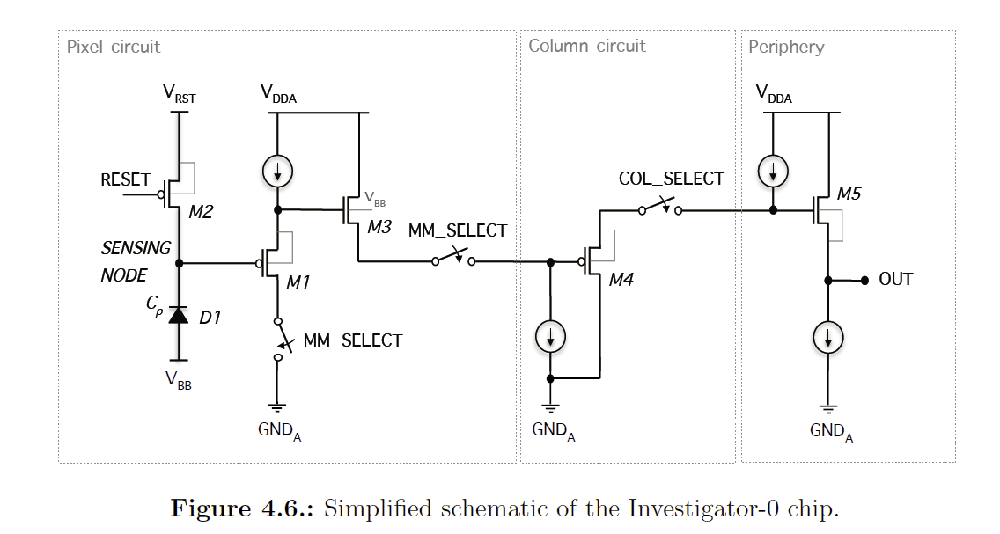
2. Smaller technology node： 1st prototype overview
Diode and charge collection study:
2.2×4 mm²
In-pixel circuits in block1: for charge collection amount study;
Layout of the first prototype on HL55nm process to study diode and charge collection，submitted: 2021.6
Including 42 sub pixel arrays：
3 type of pixel pitch size: 8 / 16 / 24 μm;
6 type diode structures: different surface and footprint size;
3 type of in-pixel circuits:
One pure diode matrix for leakage current/equivalent capacitances test
In-pixel circuits in block2: for charge collection time study;

Slide 12
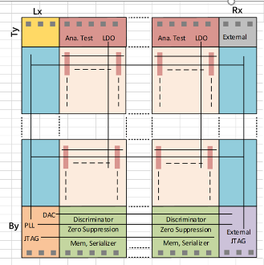
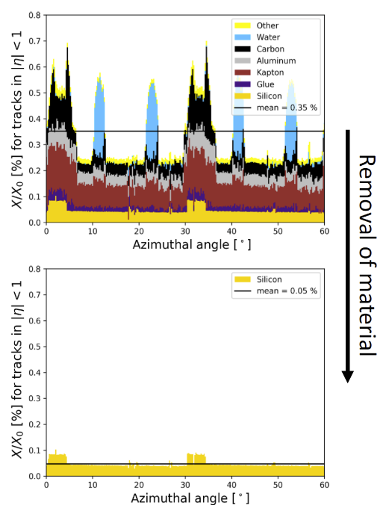
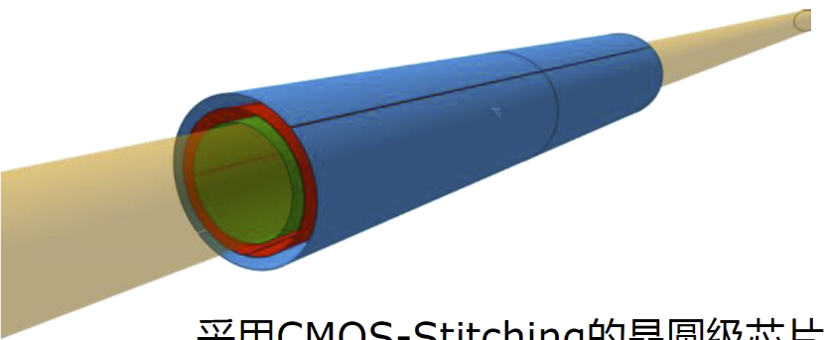
3. Stitching technique: wafer-scale sensor
~11cm
Supported by “基于大面积超薄CMOS像素传感器BESIII内径迹室关键技术研究”NSFC KEY Program, 2021 - 2024
Design aiming for the application of BESIII inner tracking system;
Deign team from: IHEP, Shandong University, Harbin Institute of Technology , Dalian Minzu University
Beyond CEPC expect:
Wafer-scale sensor, after thinned down to 50μm，can bend like a A4 paper，so the so-called “self-support”would be possible；
Material budget of the tracking detector system could be significantly reduced，less affect to particle multiple scattering。
Floor plan of our first chip design with large scale.
  Chip size 11cm *11cm,
  XFAB 0.35μm process;
  Rowling-shutter readout mode;
  Plan to submitted in Apr.
~10cm
Normally a chip size is limited by the mask size: < ~2cm×2cm；
Stitching-technique could extend the chip size ~100 times larger: < ~30cm ×30cm;
Material budget of one layer is possible down to ~0.05% X₀ （1/3 of CEPC expectation in CDR）

Slide 13
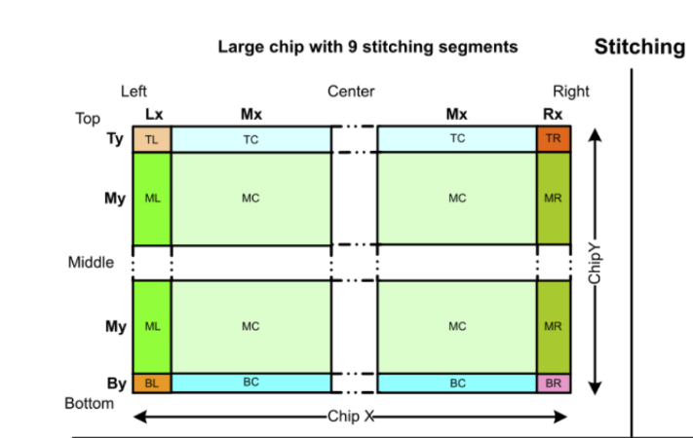
3. Stitching technique: general experiences
A wafer-scale sensor may include: ~100 MC, ~10 ML/MR/TC/BC, and 1 TL/TR/BR/BL;
The block layout with a same name have to be exactly the same. Need special consideration for the periphery/pixel circuits design, not only the function but also how to realize physically;
Parasitic Capacitances on long signal lines may increase from several ~pf to ~tens of pf. Has to do something to reduce this influence to the power and speed.
Power-ring, IR drop should be taking care;
Sketch map of how masks organized for a wafer-scale large sensor

Slide 14
Summary and Outlooks
Beside Towerjazz 0.18μm CIS process, 3 new technologies/techniques exploration is ongoing, which may bring more possibilities for CEPC vertex detector R&D: eg. Higher spatial resolution, lower power dissipation/per function, less material budget…….
Outlooks:
  Looking for an accessible foundry provide the technology has close features we expect;
  Design experiences in smaller technique node: eg. leakage current, average power, time resolution…….
  Design experiences and ideas for a wafer-scale chip;
  Further test of the CPV4-3D : eg. “yield”
An ideal technologies may have features like:
  65/55nm CIS;
  ~10μm thick, high resistance epi.
  Quadruple-well process;
  Custom process modification possible;
  Stitching technique support;

Slide 15
Thank you for your attention！

Slide 16
