Slide 1
国家重点研发计划
高能环形正负电子对撞机关键技术研发和验证
课题2：硅径迹探测器关键技术验证
报告人： 梁志均
项目负责人： João Guimarães da Costa
项目承担单位：中国科学院 高能物理研究所

Slide 2
国家重点研发计划
R&D and Verification of Key Technologies for a High Energy Circular Electron-Positron Collider
课题2：硅径迹探测器关键技术验证
报告人： 梁志均
项目负责人： João Guimarães da Costa
项目承担单位：中国科学院 高能物理研究所

Slide 3
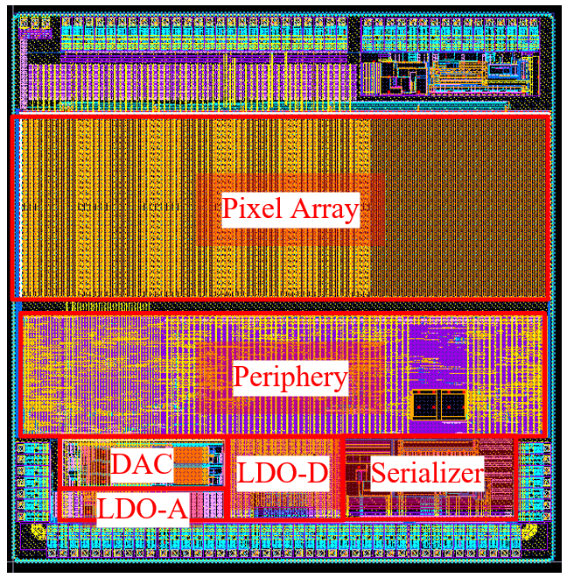
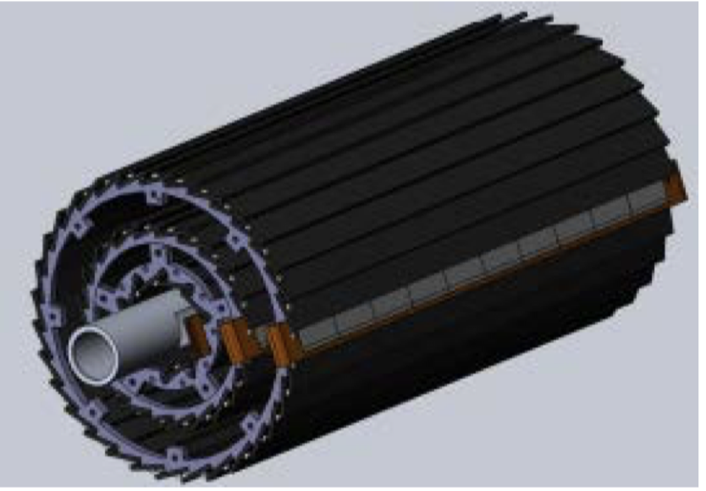
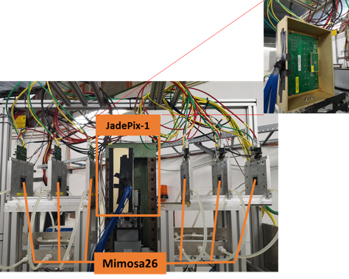
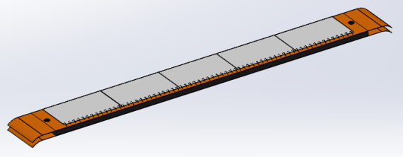
Overview of task2： vertex detector R & D
Can break down into sub-tasks:
CMOS imaging sensor chip R & D
Detector layout optimization, Ladder and vertex detector support structure R & D
Detector assembly
Data acquisition system R & D
CMOS imaging
sensor prototyping
Detector module (ladder)
Prototyping
Full size vertex detector Prototype
Beam test to
verify its spatial resolution
Notes:
Full size vertex detector

Slide 4
Research Team in task 2
4 institutes
课题2：IHEP - 中国科学院高能物理研究所
SDU - 山东大学
NJU - 南京大学
NWU - 西北工业大学
Institutes | Tasks
IHEP | Full CMOS chip modeling, Pixel Analog, PLL block Detector module (ladder) prototyping Data acquisition system R & D Vertex detector assembly and commissioning
CCNU/IFAE | CMOS sensor chip: Pixel Digital
NWPU | CMOS sensor chip: Periphery Logic, LDO
SDU | CMOS sensor chip: Bias generation, TCAD simulation Sensor test board design
NJU | Irradiation, test beam organization
Notes:
Total 51, average age is 39
Acc: 39=703/18
Silicon: 39=866/22
HCAL: 40=440/11
Total: 39

Slide 5
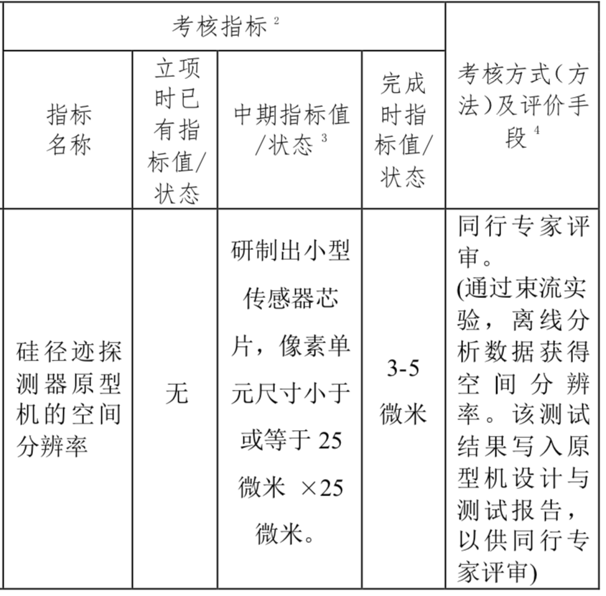
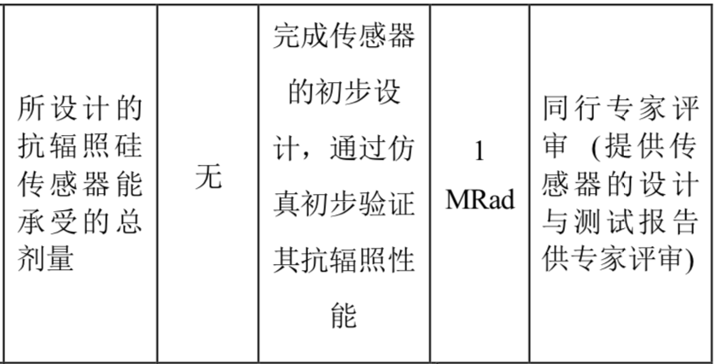
Achievement Presentation and Assessment Methods
Assessment index
Spatial resolution
- Mid-term: produce 25*25 μm pixel size chip
- Final : 3-5 μm resolution in Beam test
Silicon Detector
Radiation hardness
- mid-term: verified by TCAD simulation
- Final : Total ionization dose >1 Mrad

Slide 6
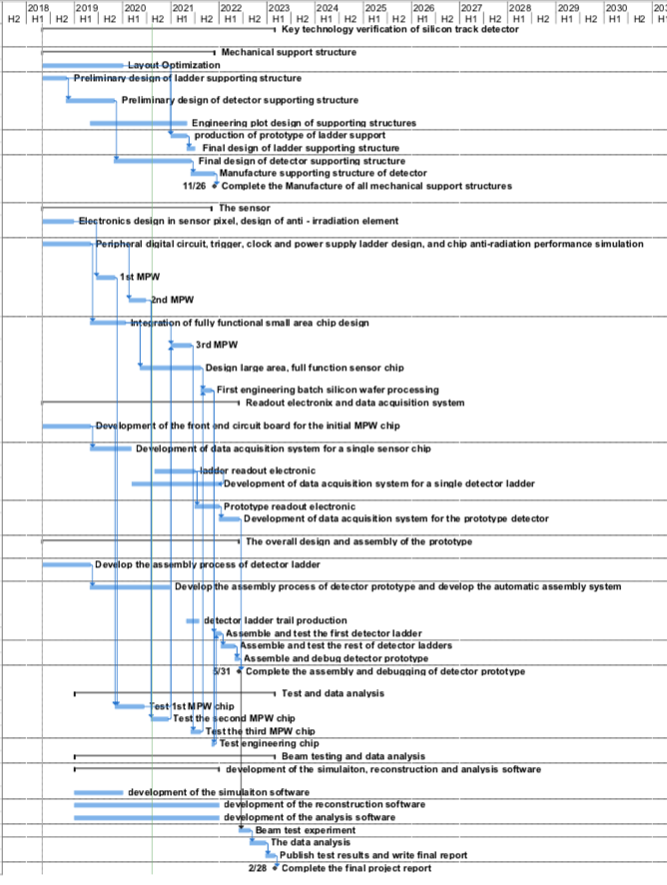
Overall plan of task2： Vertex detector R & D
3rd Year:
3rd CMOS sensor fabricated and tested
→ skipped , since 2nd MPW chip is working well
Final support structure engineering design completed
Fabricated support structure prototype for ladders
4th Year:
Competed R & D full-size TaichuPix sensor
Manufactured the support structure for whole detector
Assembling and installing the detector prototype
Completed DAQ system for whole detector
5th Year:
Completed detector assembly and commissioning
Test beam and data analysis
Finish assembling of prototype

Slide 7
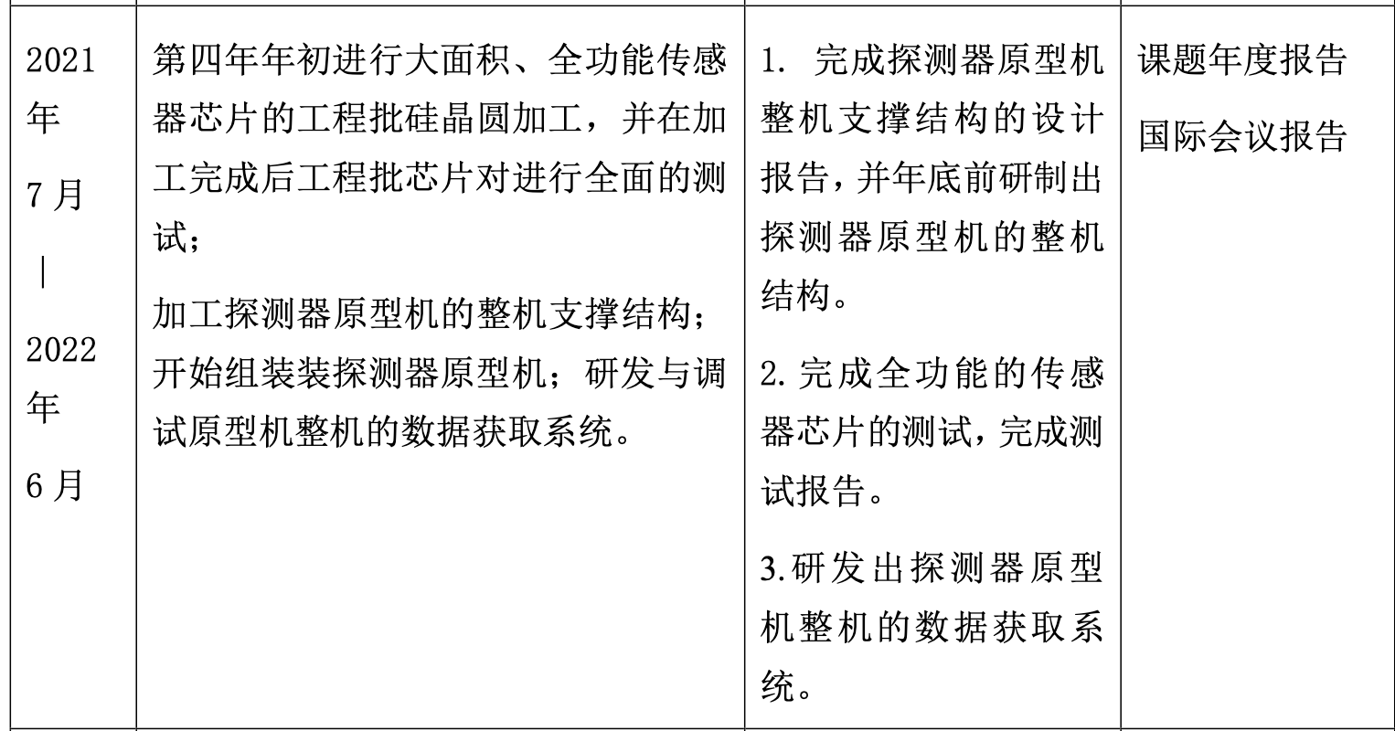
Goal for the this year(2021.7 –2022.6)
Achieve the target in task book for the 4th years
Build the support structure prototype for ladder
Finalize the full-size sensor testing , and write a testing report
Complete readout electronics and DAQ for vertex detector prototype

Slide 8
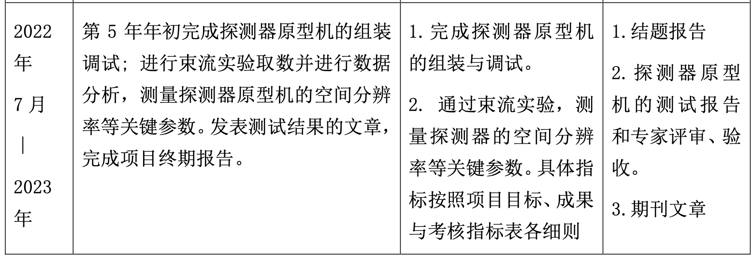
Goal for the next year(2022.7 –2023.6)
Achieve the target in task book for the 5th years
Complete testing for full-size sensor
Complete vertex detector prototype assembly
Test DAQ for vertex detector prototype
Test beam using vertex prototype, publish papers

Slide 9
Summary
More sensor tests are needed
Including Taichupix2 irradiation tests , beta tests …
Taichupix3 full-size sensor testing
Test board and flex cable designs for Taichupix3
Need to speed up the prototype assembly and DAQ development.
Assembly tooling and assembly procedure development
Global mechanics and support structure development
DAQ system development for multi-chips testing
Need to plan for test beam setup
 | Mid-term | Final goal | Status
Spatial resolution | Pixel size less than 25*25 μm | Spatial resolution 3~5 μm | Need test beam results
Radiation hardness | > 1MRad in simulation | >1MRad In radiation test | Test up to 30 Mrad. Need to double check with more statistics

Slide 10
ASIC
Taichupix3 Test boards and Flexible PCB design. FPGA readout board ( now ~ March 2022)
Taichupix3 probe card testing (June 2022 ~ July 2022): 1 week for setup, 5 wafers to test
Taichupix3 testing with test boards (June 2022 ~ September 2022): 1 wafer (50 chips)
Ladder
Thinning wafers : 3 wafers ( 100um, 50um ) (July – Augugst )
Ladder support production (now ~ April 2022)
Ladder Assembly with dummy (April~ May 2022)
Ladder Assembly with Taichupix3 (July ~Sep 2022)
DAQ
testing with fake data for multi-chips (now ~ June 2022)
Test with test boards ( June 2022)
Test with one ladder ( Sep 2022) , three double-side ladders ( 6 layer, 60 chips )
Prototype
First and second batch of support structure design and manufactured(now ~ June 2022 )
Vertex detector Assembly with full set of ladder supports installed (June 2022 )
Vertex detector Assembly with Taichupix3 ladder (Sep 2022 ~ Oct 2022)

Slide 11
Testbeam
Test beam at IHEP ( Sep 2022)
Test beam at DESY/CERN (Nov 2023)

