Slide 1






国家重点研发计划
高能环形正负电子对撞机关键技术研发和验证
课题2：硅径迹探测器关键技术验证
报告人： 梁志均
项目负责人： João Guimarães da Costa
项目承担单位：中国科学院 高能物理研究所

Slide 2
国家重点研发计划
R&D and Verification of Key Technologies for a High Energy Circular Electron-Positron Collider
课题2：硅径迹探测器关键技术验证
报告人： 梁志均
项目负责人： João Guimarães da Costa
项目承担单位：中国科学院 高能物理研究所

Slide 3
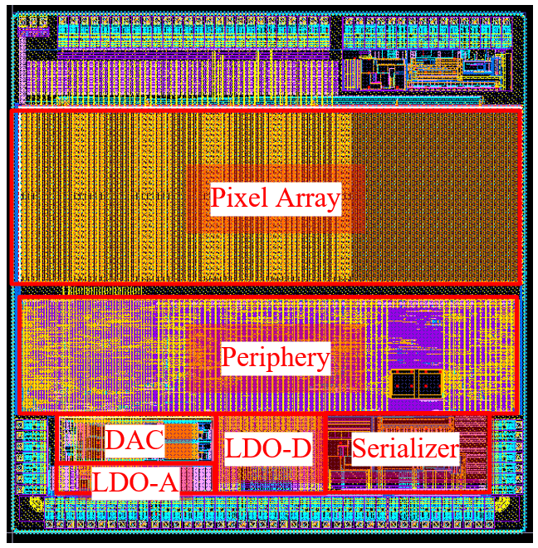
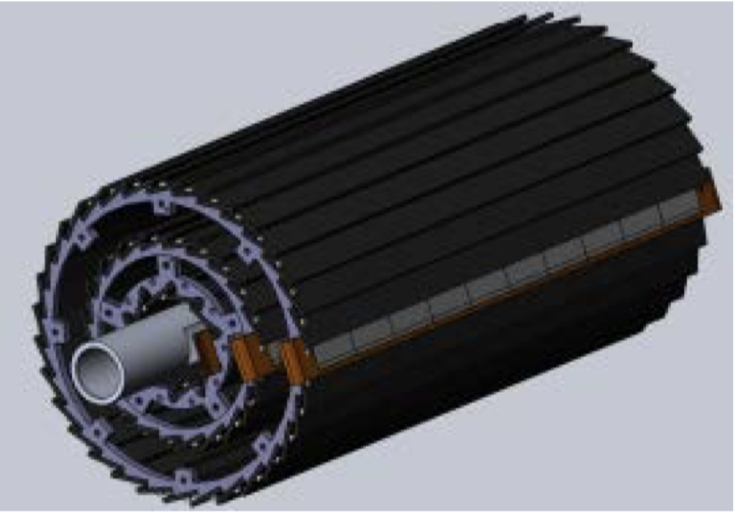
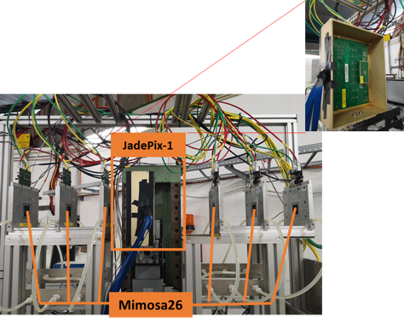
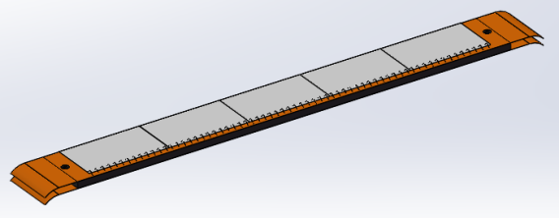

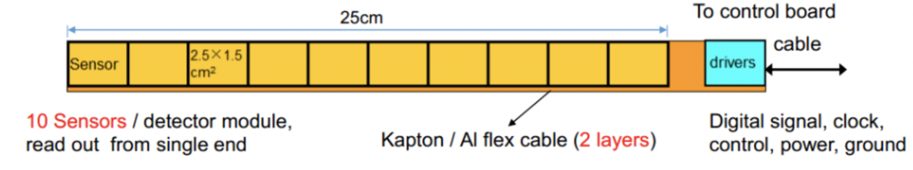
Overview of task2： vertex detector R & D
Can break down into sub-tasks:
  CMOS imaging sensor chip R & D
  Detector layout optimization, Ladder and vertex detector support structure R & D
  Detector assembly
  Data acquisition system R & D
CMOS imaging
sensor prototyping
Detector module (ladder)
Prototyping
Full size vertex detector Prototype
Beam test to
verify its spatial resolution
Notes:
Full size vertex detector

Slide 4
Research Team in task 2
4 institutes
课题2：IHEP - 中国科学院高能物理研究所
                SDU - 山东大学
                NJU - 南京大学
                NWU - 西北工业大学
Institutes | Tasks
IHEP | Full CMOS chip modeling, Pixel Analog, PLL block Detector module (ladder) prototyping Data acquisition system R & D Vertex detector assembly and commissioning
CCNU/IFAE | CMOS sensor chip: Pixel Digital
NWPU | CMOS sensor chip: Periphery Logic, LDO
SDU | CMOS sensor chip: Bias generation, TCAD simulation Sensor test board design
NJU | Irradiation, test beam organization
Notes:
Total 51, average age is 39
Acc: 39=703/18
Silicon: 39=866/22
HCAL: 40=440/11
Total: 39

Slide 5
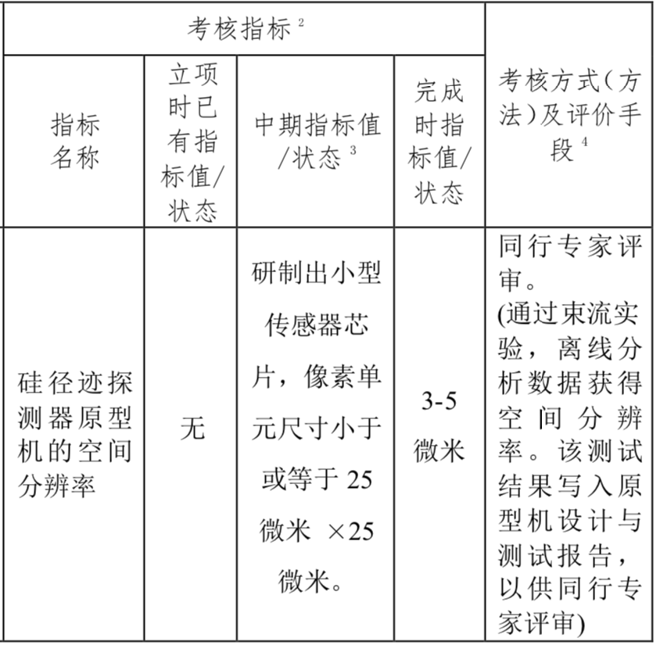
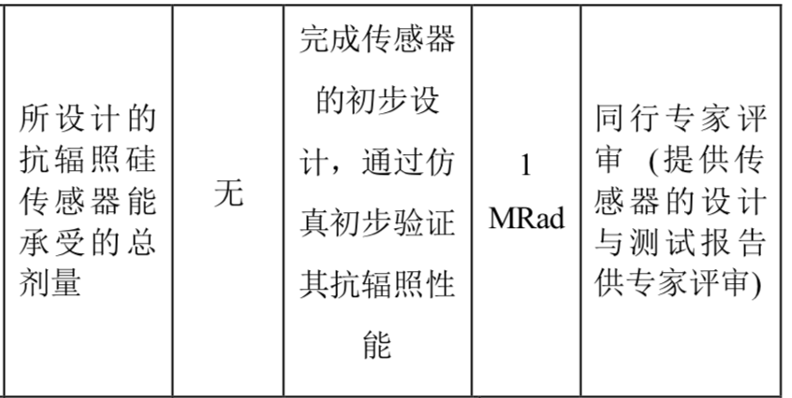
Achievement Presentation and Assessment Methods
Assessment index
Spatial resolution
  - Mid-term: produce 25*25 μm pixel size chip
  - Final : 3-5 μm resolution in Beam test
Silicon Detector
Radiation hardness
  - mid-term: verified by TCAD simulation
  - Final : Total ionization dose >1 Mrad

Slide 6
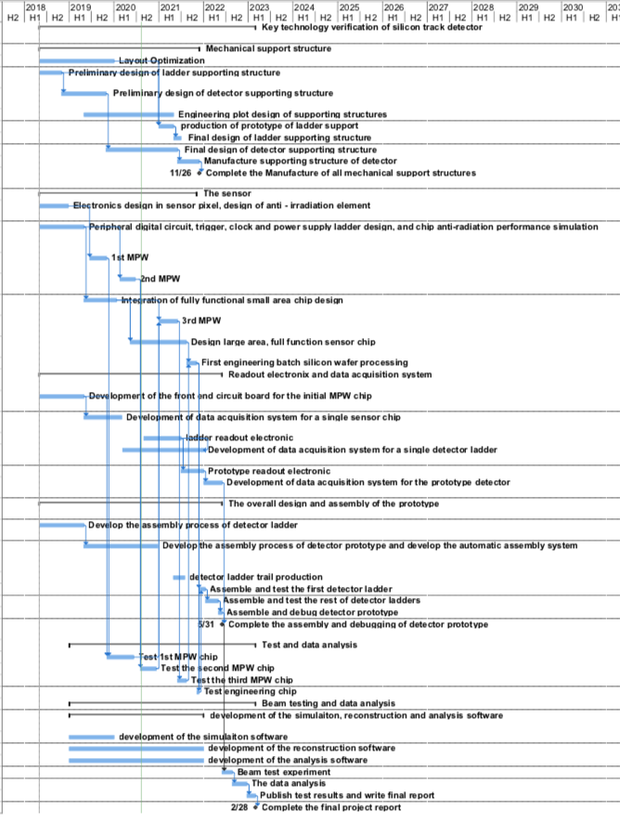
Overall plan of task2： Vertex detector R & D
3rd Year:
  3rd CMOS sensor fabricated and tested
    → skipped , since 2nd MPW chip is working well
  Final support structure engineering design completed
  Fabricated support structure prototype for ladders
4th Year:
  Competed R & D full-size TaichuPix sensor
  Manufactured the support structure for whole detector
  Assembling and installing the detector prototype
  Completed DAQ system for whole detector
5th Year:
  Completed detector assembly and commissioning
  Test beam and data analysis
  Finish assembling of prototype

Slide 7
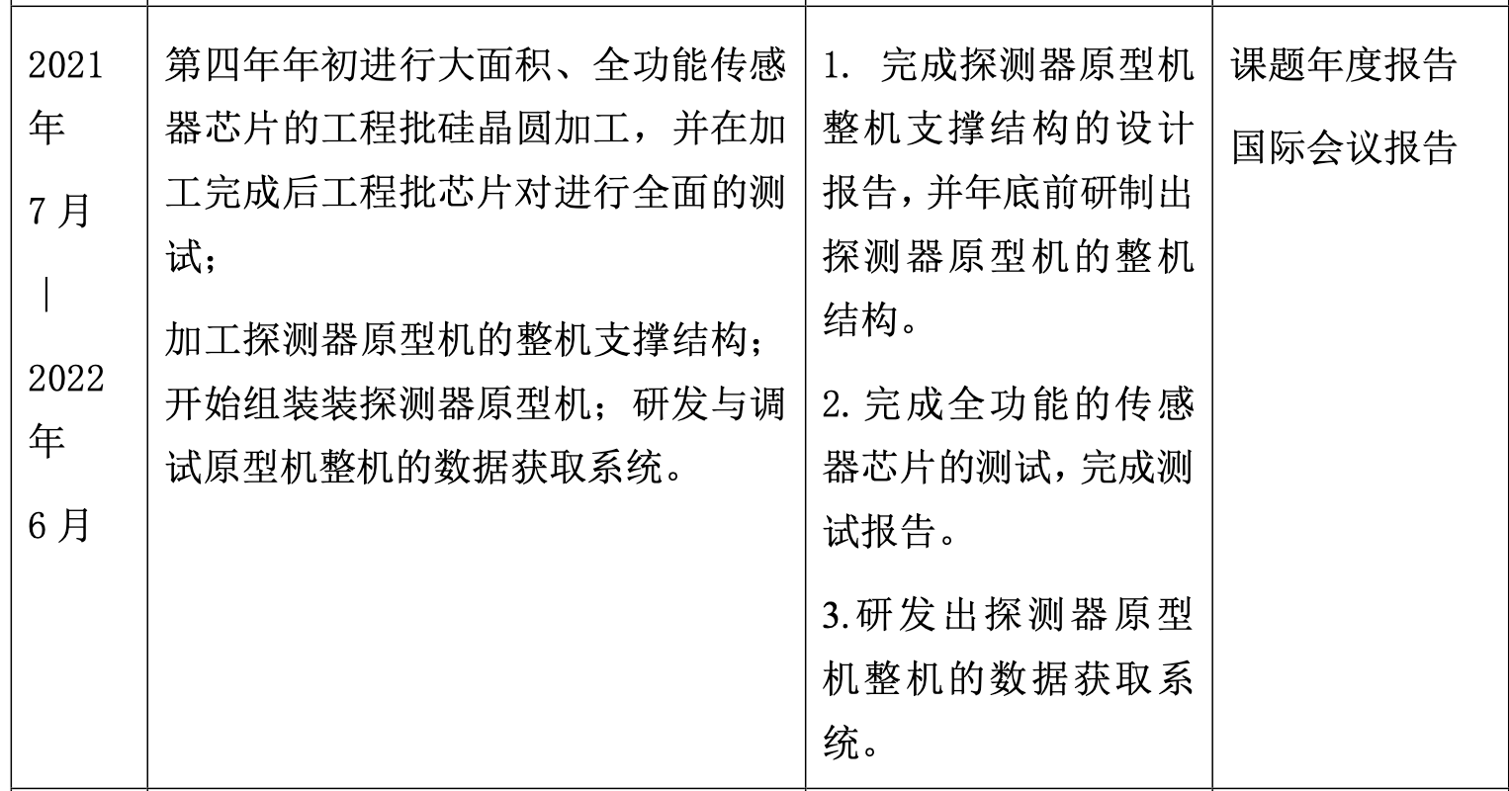
Goal for the this year(2021.7 –2022.6)
Achieve the target in task book for the 4th years
  Build the support structure prototype for ladder
  Finalize the full-size sensor testing , and write a testing report
  Complete readout electronics and DAQ for vertex detector prototype

Slide 8
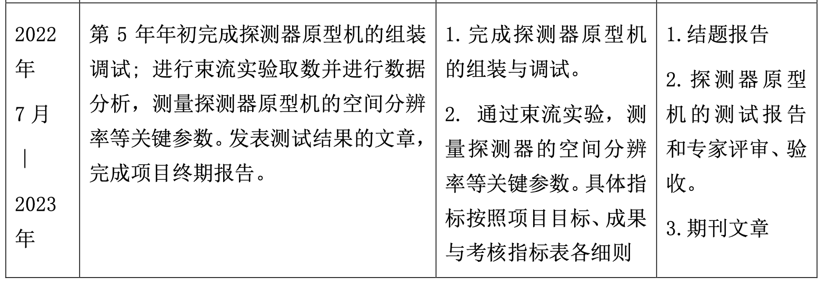
Goal for the next year(2022.7 –2023.6)
Achieve the target in task book for the 5th years
  Complete testing for full-size sensor
  Complete vertex detector prototype assembly
  Test DAQ for vertex detector prototype
  Test beam using vertex prototype, publish papers

Slide 9
Summary
More sensor tests are needed
  Including Taichupix2 irradiation tests , beta tests …
  Taichupix3 full-size sensor testing
  Test board and flex cable designs for Taichupix3
Need to speed up the prototype assembly and DAQ development.
  Assembly tooling and assembly procedure development
  Global mechanics and support structure development
  DAQ system development for multi-chips testing
Need to plan for test beam setup
 | Mid-term | Final goal | Status
Spatial resolution | Pixel size less than 25*25 μm | Spatial resolution 3~5 μm | Need test beam results
Radiation hardness | > 1MRad in simulation | >1MRad In radiation test | Test up to 30 Mrad. Need to double check with more statistics

Slide 10
plan
ASIC
  Taichupix3 Test boards and Flexible PCB design ( now ~ May 2022)
  Taichupix3 probe card testing (June 2022 ~ August 2022)
  Taichupix3 testing with test boards (June 2022 ~ September 2022):
Ladder
  Flexible PCB production: (July 2022 ~ Sept 2022): IHEP
  Ladder production (now ~ March 2022)
  Ladder Assembly with dummy (April~ May 2022)
  Ladder Assembly with Taichupix3 (Sep~Nov 2022)
Prototype
  Support structure design and manufactured(now ~ June 2022 )
  Vertex detector Assembly with dummy ladder (June 2022 ~ August 2022)
  Vertex detector Assembly with Taichupix3 ladder (Nov 2022 ~ Dec 2022)
Testbeam
  Test beam at IHEP (Dec 2022)
  Test beam at DESY/CERN (2023)

