Slide 1
Search for new physics from precision experiments
吕才典
lucd@ihep.ac.cn
中国科学院高能物理研究所
中国科学院大学

Slide 2
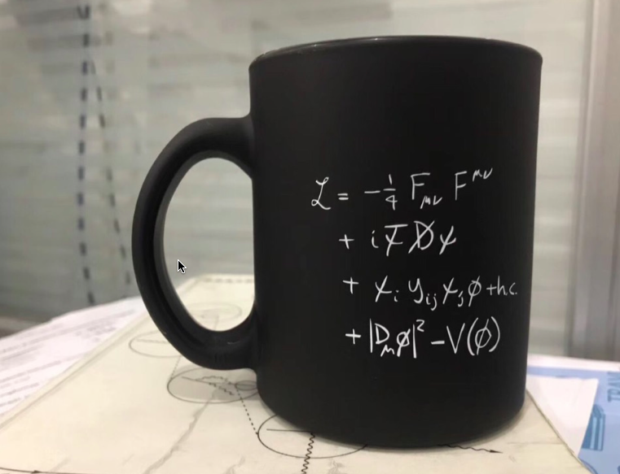
目前为止宇宙的万物理论

Slide 3

Search for new particle or new phenomena is always our major task in particle physics
There are two ways to achieve that: direct search or indirect search
Indirect search = precision study

Slide 4
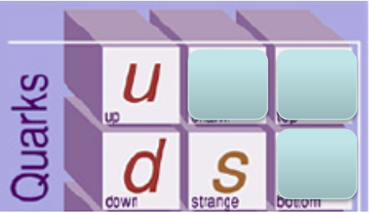
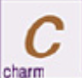

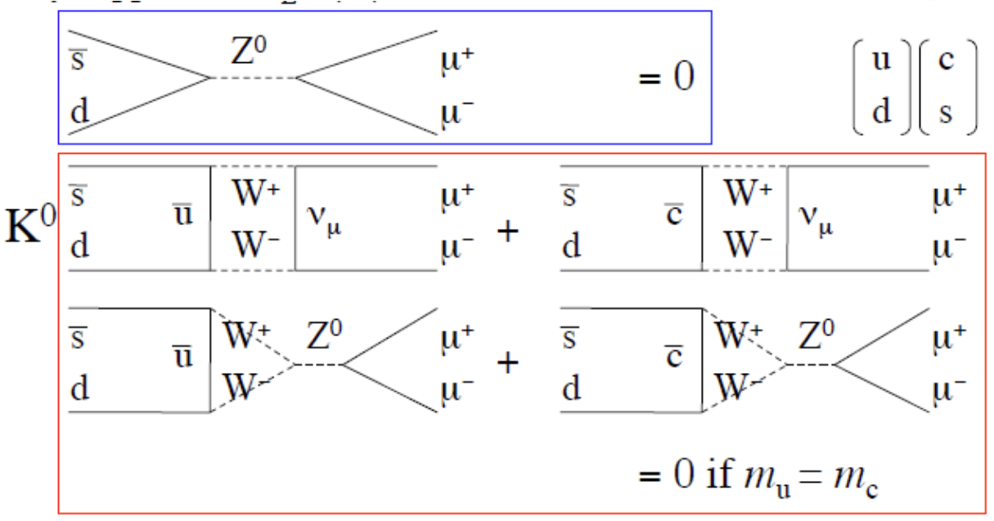
Example in the history
Long time ago, we had only 3 flavors of quarks: u,d,s.
Experimentally we found that
GIM
V_{us} V_{ud} ~ sinθ_{c}
θ_{c} Cabibbo angle
Divergent
Notes:
没有树图味道改变中性流

Slide 5
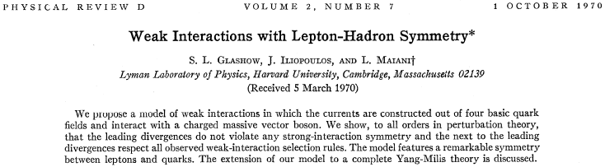
GIM 2x2

Slide 6
Example in the history
Long time ago, we had only 3 flavors of quarks: u,d,s.
Experimentally we found that
GIM
Divergent cancel
sinθ_{c}[ f(m_{u}) - f(m_{c}) ]= 0, if m_{u}= m_{c}
Notes:
没有树图味道改变中性流

Slide 7
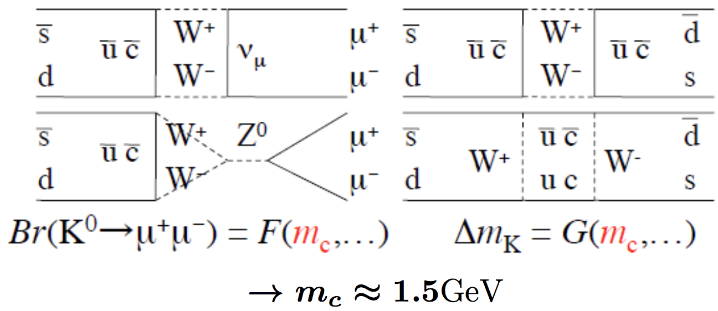
Later, more precise experiments found that
K-K mixing
Ting and Richter found that in 1974

Slide 8
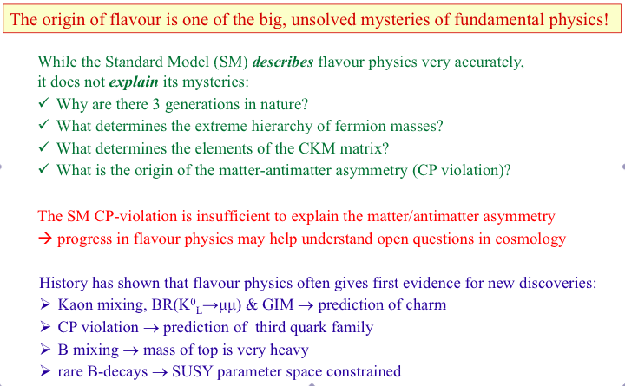
Flavor physics is important

Slide 9


The universe comes from Big Bang
Matter
Where does the anti-matter go?
Anti Matter

Slide 10
Necessary conditions
(A.Sakharov, Nobel Peace Prize Winner)
Baryon number violations: initial and final baryon numbers are different.
C and CP violation: partial decay widths are different.
Out of equilibrium: no reversing reaction installing the initial state.
Charge conjugate and Parity

Slide 11
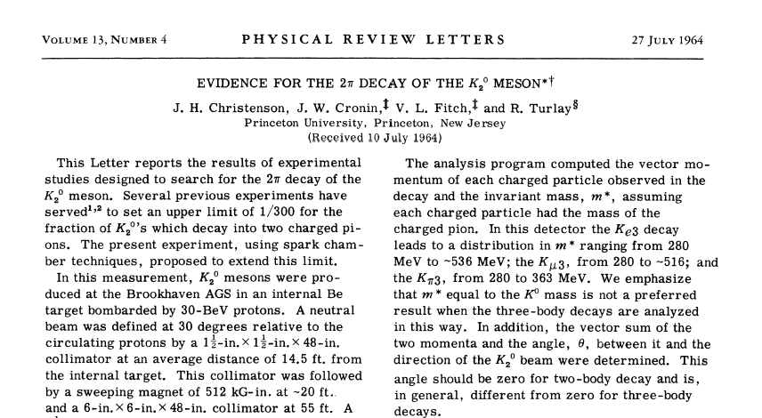
Experimental Discovery of CP Violation

Slide 12
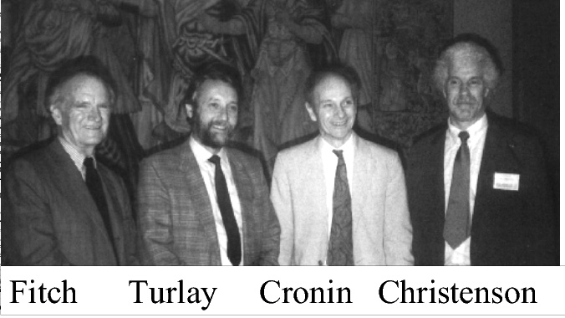
Nobel prize (’80) for the discovery of violations of fundamental symmetry principles in the decay of neutral K-mesons

Slide 13
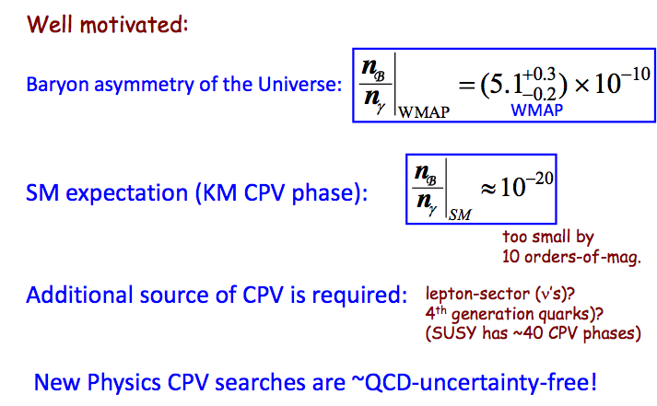
CP violation in the K and B meson decays can be explained by the Standard Model.
CP violation in the universe can not be explained by the Standard Model.
New source for CP violation beyond the Standard Model in the particle world?

Slide 14
Superweak theory of
Mixing induced CP violation
Eigenstate of strong interaction
CP eigenstate：
mass eigenstate
Mass eigenstate is a mixture of CP eigenstate．
CP conserving if ε=0 ．

Slide 15
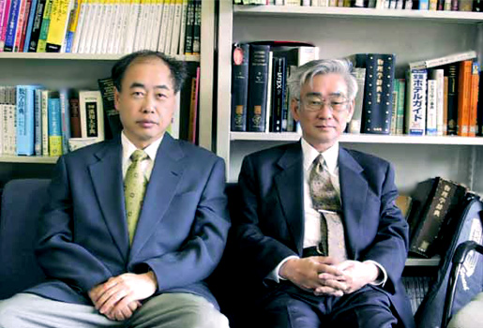
A lot of models have been proposed to explain the CP violation phenomena
In 1972, Kobayashi (b, 1944) & Maskawa (b, 1940) give a new explanition
Both received Ph.D. from Nagoya (’72 & ’67) and both joined Kyoto as an assistant (’72 & ’70).

Slide 16
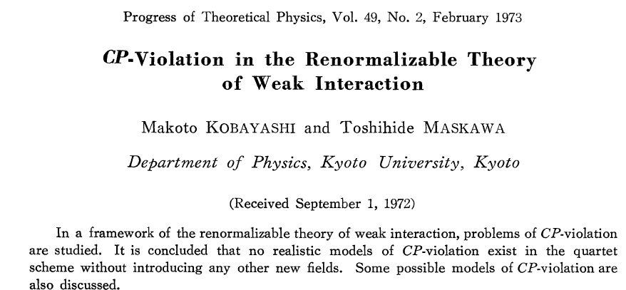
Nobel Prize of Physics in 2008
We accepted the Glashow-Weinberg-Salam theory of the weak interaction’s extension to the hadron…, because the fourth quark already existed for us in a sense. Sometimes it is said that our CP paper was written before the discovery of charm. In this sense, however, our paper came after the charm.
-- Kobayashi (1992)

Slide 17
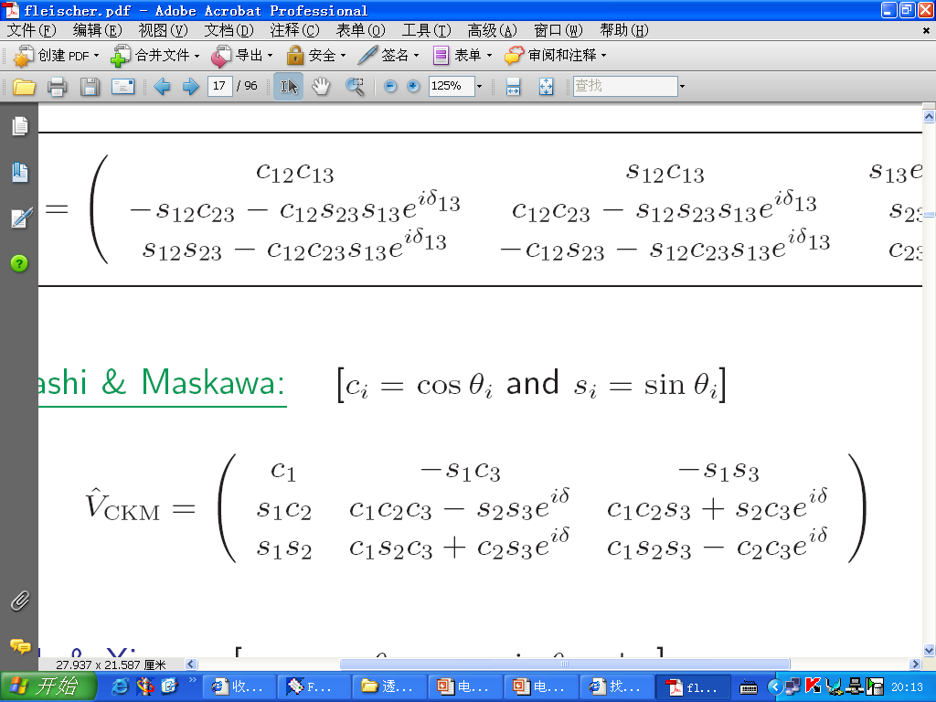
3-generations
CKM only provides opportunity for CP violation

Slide 18
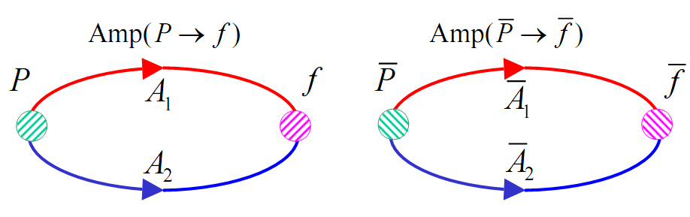
Direct CP violation is a key test of CKM

Slide 19
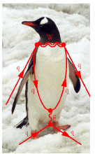
B→ππ Has Two Kinds of Diagrams with different weak phase
b W u Tree ∝ V_{ub}V_{ud}*
B π
d π
b W
t Penguin∝V_{tb}V_{td}*
B π
π
O₁,O₂
O₃,O₄,O₅,O₆

Slide 20
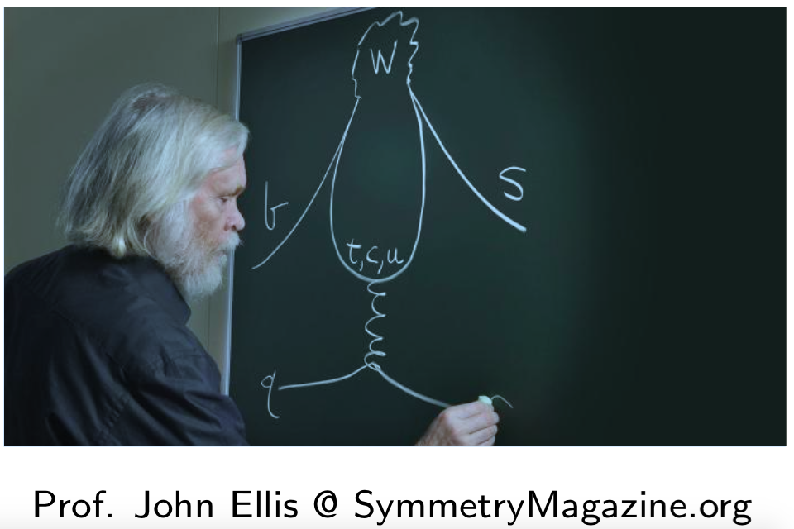

Slide 21
CP Violation in B→ π π (K)
(real prediction before exp.)
CP(%) | FA | BBNS | PQCD | Exp
π ⁺K – | +9±3 | +5±9 | –17±5 | –11.5±1.8
π ⁰K ⁺ | +8 ± 2 | 7 ±9 | –13 ±4 | +4 ± 4
π ⁺K ⁰ | 1.7± 0.1 | 1 ±1 | –1.0±0.5 | –2 ±4
π ⁺π – | –5±3 | –6±12 | +30±10 | +37±10
(2001)
(2004)

Slide 22
CP Violation in B→ π π (K)
(real prediction before exp.)
Including large annihilation fixed from exp.
CP(%) | FA | BBNS | PQCD | Exp
π ⁺K – | +9±3 | +5±9 | –17±5 | –9.7±1.2
π ⁰K ⁺ | +8 ± 2 | 7 ±9 | –13 ±4 | 4.7 ± 2.6
π ⁺K ⁰ | 1.7± 0.1 | 1 ±1 | –1.0±0.5 | 0.9 ±2.5
π ⁺π – | –5±3 | –6±12 | +30±10 | +38±7
Cheng,HY
-7.4 ± 5.0
0.28±0.10
4.9 ± 5.9
17 ± 1.3
(2001)
π K puzzle

Slide 23
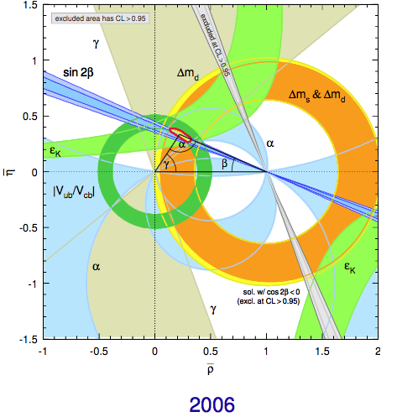
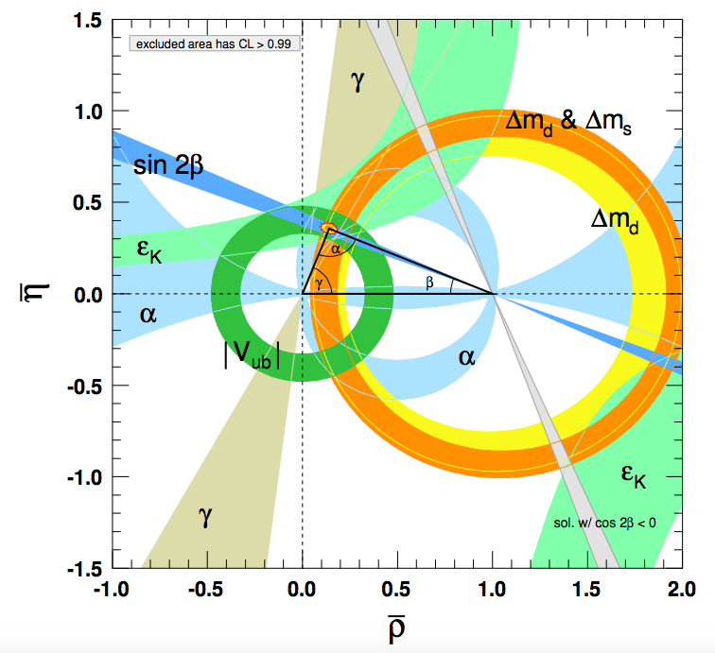
PDG2006 & 2020 Unitarity Triangle Comparison
2020

Slide 24

The key point of CP violation
If we found another world of civilization,
we have to make sure whether they are made of anti-matter, before we travel to them
This is very important (Annihilation)
Since the definition of matter/anti-matter, left/right is arbitrary, unless we have CP violation：

Slide 25
Heavy flavor physics is a very important hot topic in particle physics recently
People expect the new physics signal from the heaviest top quark, since it is very close to the electroweak breaking scale
But there are too few data of top quark production
Therefore beauty quark is our best chance for new physics signals, since they both belong to the third family

Slide 26
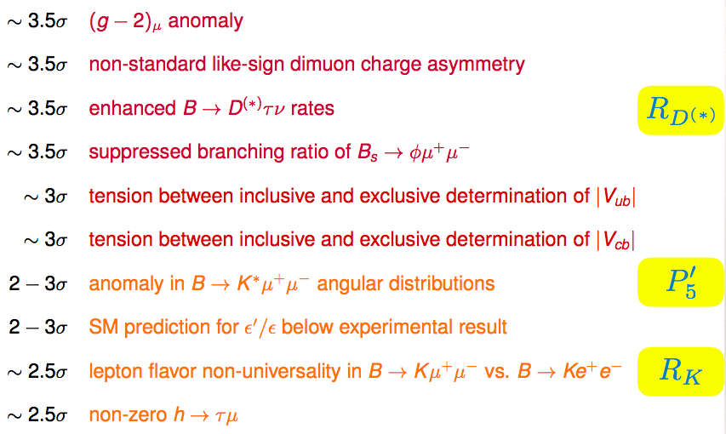
Current Flavor Anomalies
4.2 σ

Slide 27
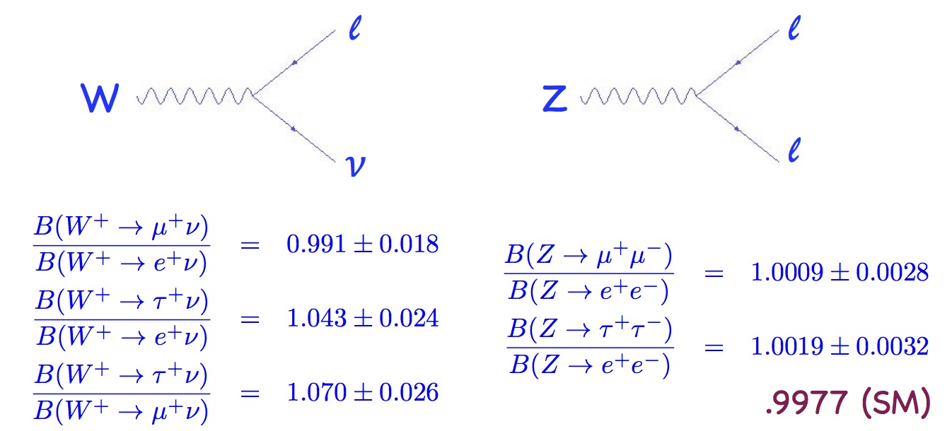
Lepton universality
Lepton couplings to gauge bosons in the standard model are all the same
Very well tested, PDG averages:

Slide 28
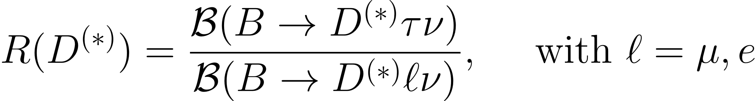
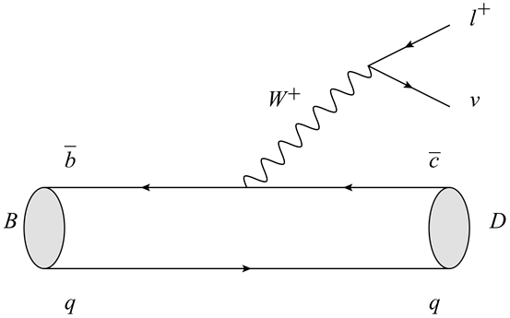
Introduction to R(D^{(*)})
SM predictions (2012):
R(D) = 0.297 ± 0.017 R(D*)= 0.252 ± 0.003
BABAR (2012):
R(D)=0.440±0.058±0.042 R(D*)=0.332±0.024±0.018
Type II 2HDM is said to be ruled out
3.4σ

Slide 29
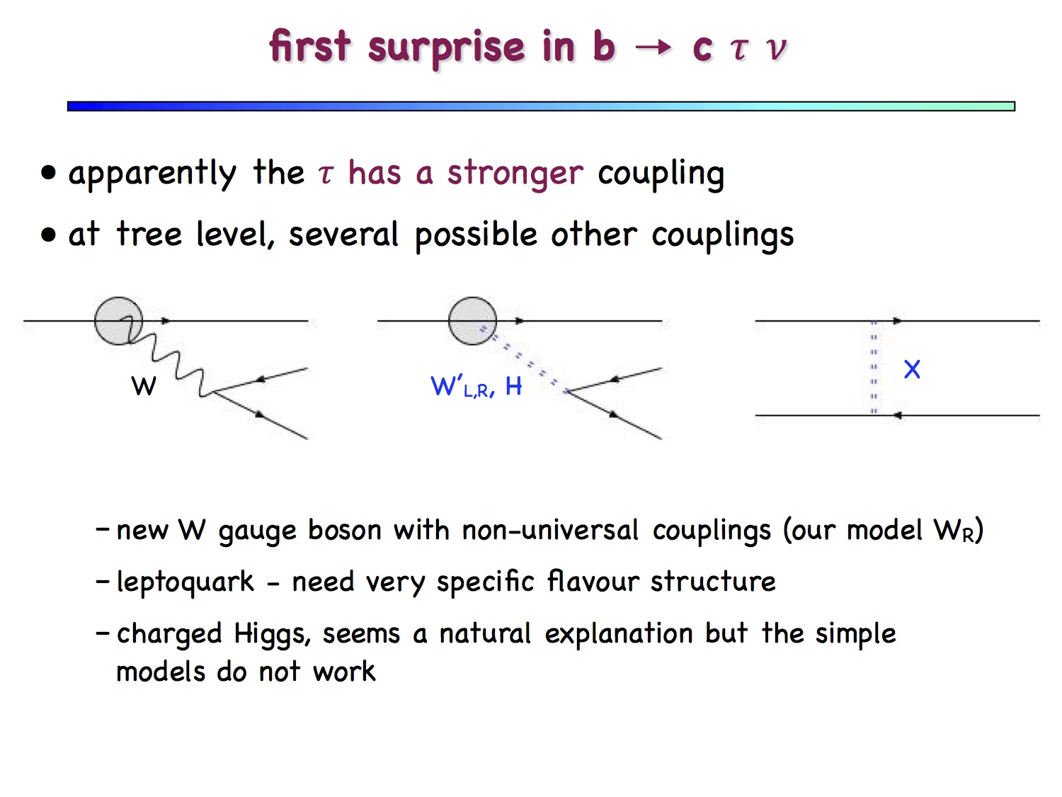
b c b c b τ
c ν

Slide 30
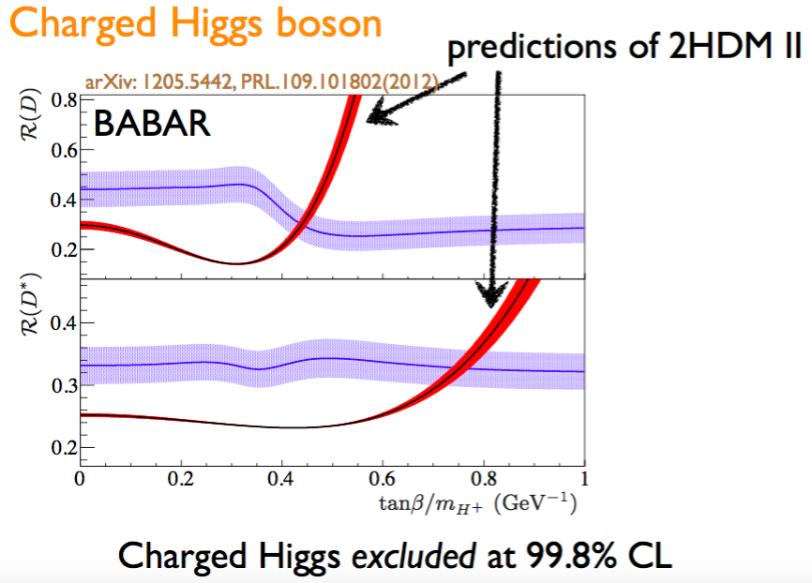

Slide 31
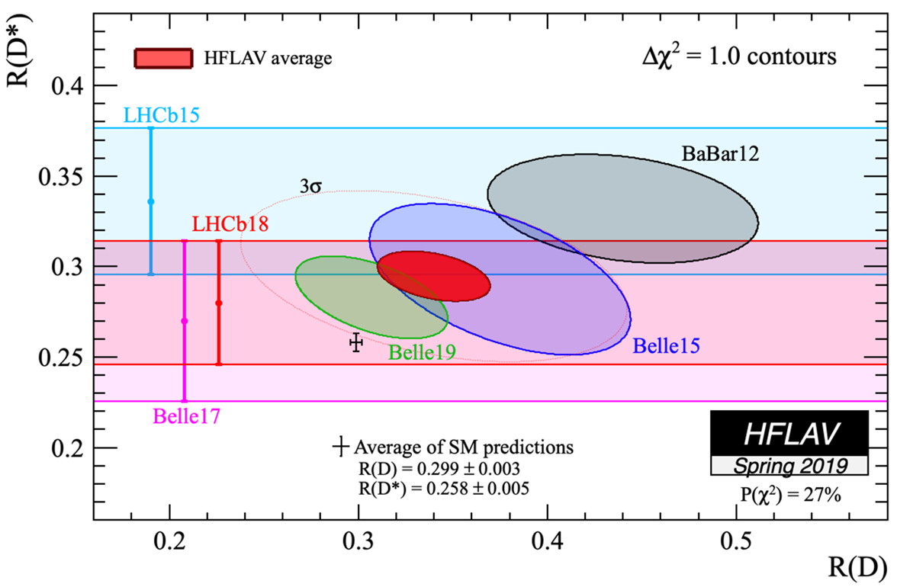
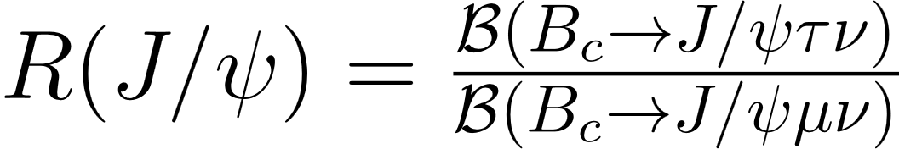

Current Experimental Status
The combined results of R(D^{(*)}) indicate about 3σ deviation from the SM predictions
R(D)=0.340±0.027±0.013
R(D*)=0.295±0.011±0.008
LHCb reported
= 0.71±0.17±0.18,
which deviate 2σ away from
the SM prediction
from LEP

Slide 32
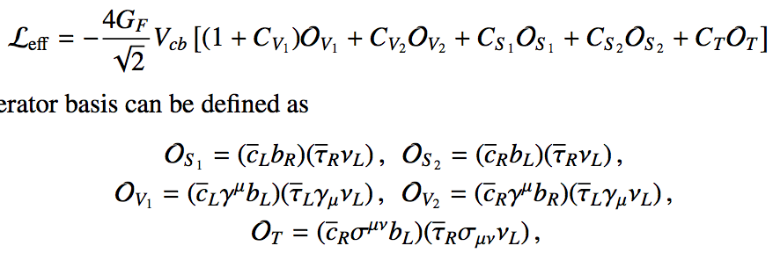
A combined model independent analysis of the R(D), R(D∗) and R(J/ψ) anomalies
All possible operators: Lorentz Invariant
Huang, Li, Lu, Paracha, Wang, PRD98 (2018) no.9, 095018
Notes:
洛伦兹不变性，时空对称性，能动量守恒等，实验可验证性

Slide 33
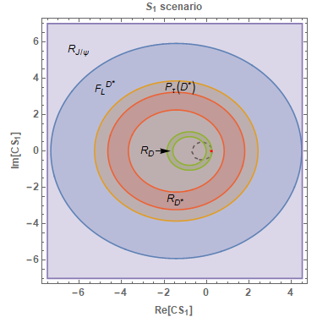
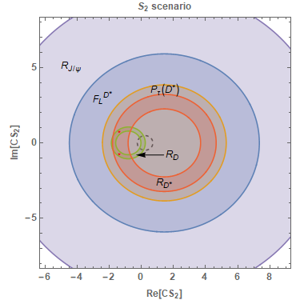
It is found that none of the single operators can explain simultaneously the current experimental measurements of the ratios R(D), R(D∗) and R(J/ψ) at the confidence level of 1σ
Even with 2σ Constraints, the NP scalar operators are also ruled out
Notes:
Simple charged Higgs ruled out

Slide 34
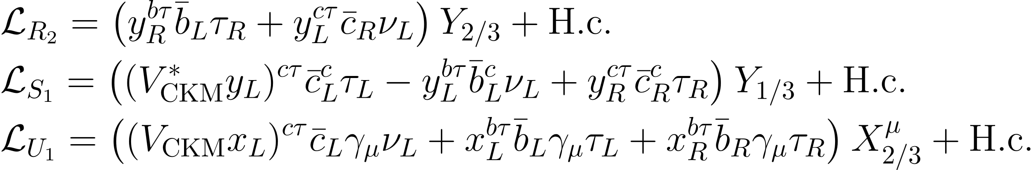
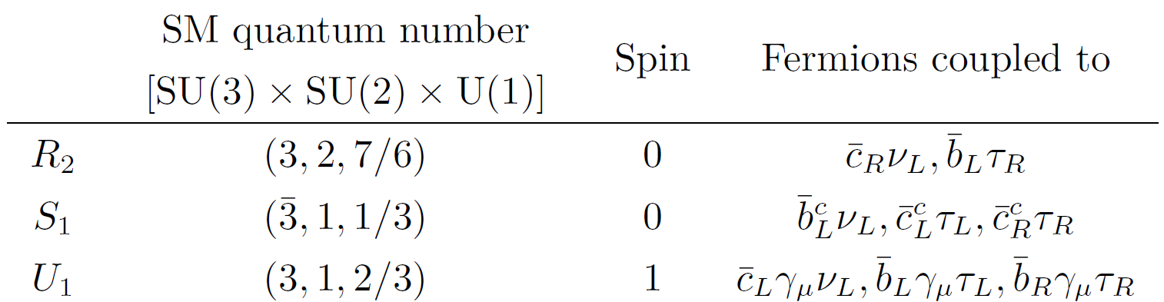
Leptoquark model
Cheung, Huang, Li, Lu, Mao Tang, NPB965 (2021) 115354
b ν
b τ
Lagrangian of Leptoquark
c ν
c τ

Slide 35
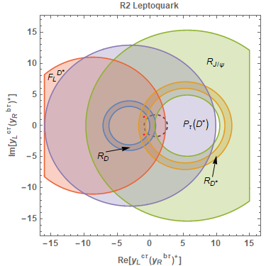
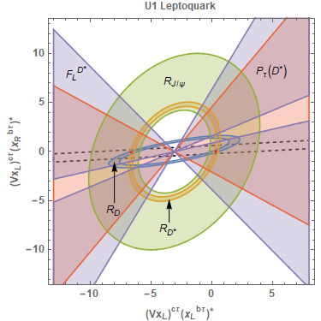
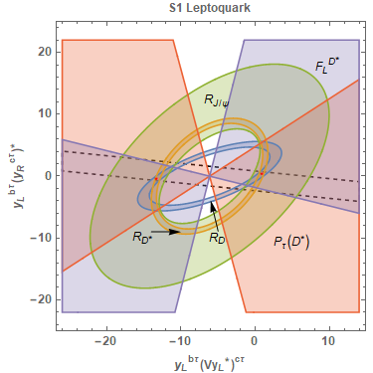
2σ Constraints on the Leptoquark couplings
Notes:
R2model和B_C→tao nu分支比矛盾

Slide 36
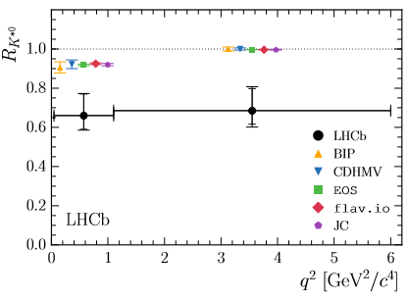


Violation of lepton flavor universality
theoretically very clean!
Observable | Expt (LHCb) | SM | σ
R(K), q²=[1, 6] GeV² | 0.745^{+0.090}_{-0.074}±0.036 | 1.00±0.01 | 2.6
R(K^{*0}), q²=[0.045, 1.1] | 0.66^{+0.11}_{-0.07}±0.03 | ∼ 0.920 | 2.1-2.3
R(K^{*0}), q²=[1.1, 6] | 0.69^{+0.11}_{-0.07}±0.05 | ∼ 0.996 | 2.4-2.5
arXiv:1705.05802
For q² < 6 GeV², SM predictions for b→ sμ⁺μ⁻ consistently overshoot the data (also for B_{s}→ φμ⁺μ⁻, Λ_{b}→ Λμ⁺μ⁻ ; both involve unknown hadronic uncertainties)
SM
Loop, GIM, CKM suppressed

Slide 37
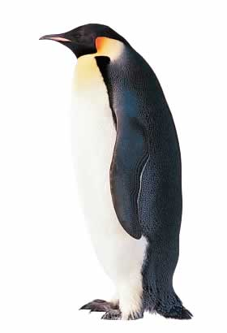
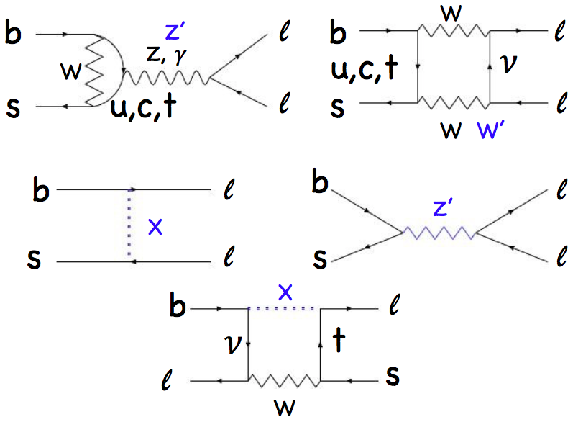
Second surprise in b→ s l+l-
apparently the μ has a weaker coupling than the electron
at tree and loop level, many possible other NP couplings
SM
Lepto-quark
supersymmetry

Slide 38
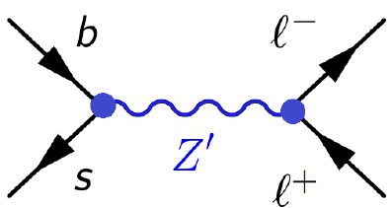
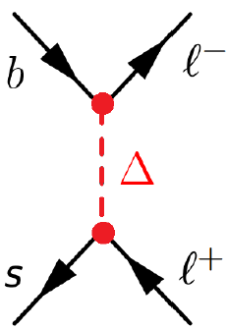
NP models capable of generating C_{9,10}^{NP} :
Tree level: Z’, SU(2)_{L} singlet or triplet
leptoquark, spin 0 or 1
SUSY with R-parity violating interactions
Loop level: Z’ penguin
new heavy scalars/vectors
F. Munir Bhutta, Z.R. Huang, CDLu, M.A. Paracha and W. Wang, Nucl. Phys. B979 (2022) 115763
Notes:
Third family

Slide 39

Flavour anomalies and New Physics
If confirmed by future analyses, what does this point to?
SM gauge interactions do not distinguish between different leptons, and Higgs exchange is irrelevant; hence need new particles beyond the SM with new types of interactions
U(1)τ-μ → new Z’ boson coupling with opposite sign to μ/τ
New particles with Yukawa-like interactions, leptoquarks (better: lepto-quark-bosons)
Notes:
Tree vs loop

Slide 40
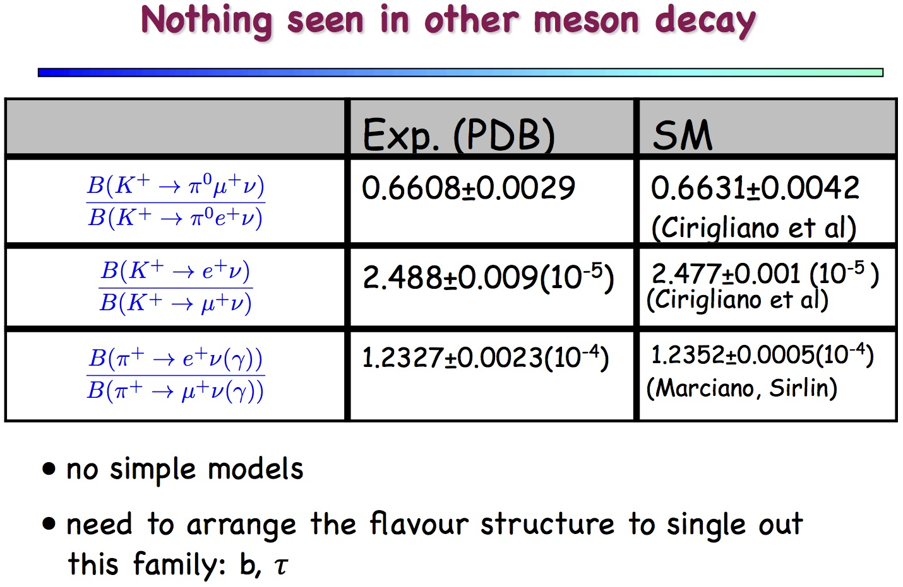

Slide 41
Rich physics in hadronic B/D decays
CP violation, FCNC, sensitive to new physics contribution…
b W u
B π
d(s) π (K)
W
b t
B π
π (K)
The standard model describes interactions amongst quarks and leptons
In experiments, we can only observe hadrons
pi K puzzle etc.
How can we test the standard model without solving QCD?
Notes:
几百种衰变道

Slide 42
QCD-methods based on factorization work well for the leading power of 1/mb expansion
  collinear QCD Factorization approach [Beneke, Buchalla, Neubert, Sachrajda, 99’]
  Perturbative QCD approach based on kT factorization [Keum, Li, Sanda, 00’; Lu, Ukai, Yang, 00’]
  Soft-Collinear Effective Theory Bauer, Fleming, Pirjol, Stewart, Phys.Rev. D63 (2001) 114020
  Quark model, QCD/Light-cone sum rules
Work well for most of charmless B decays, except for ππ, πK puzzle etc.

Slide 43

Hard dynamics should be calculated order by order in perturbative QCD
wave functions/Distribution amplitudes should be determined by a global fit to experimental data
This is done at inclusive decays such as deep inelastic e p scattering
People fit the experimental data using PDF
We try to do the same thing at the exclusive decays starting at the leading order
This can be improved later to high orders

Slide 44

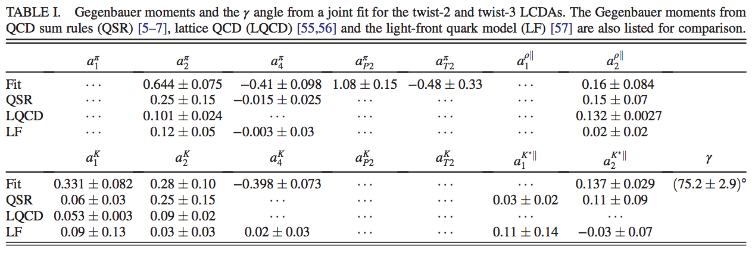

Global Fit for all B→PP, VP and PV decays with gamma as free parameter
BRs and CP asymmetries of 20channels as input
B_{(S)} meson LCDA parameter
ω_{B}=0.4GeV, ω_{Bs}=0.48GeV

Slide 45
Comparison of gamma measurement
HFLAV Collaboration
Less uncertainty than others
CKMfit Collaboration
UTfit Collaboration
Recent LHCb result
Hua, Li, Lu, Wang and Xing, PRD 104 (2021) 016025

Slide 46
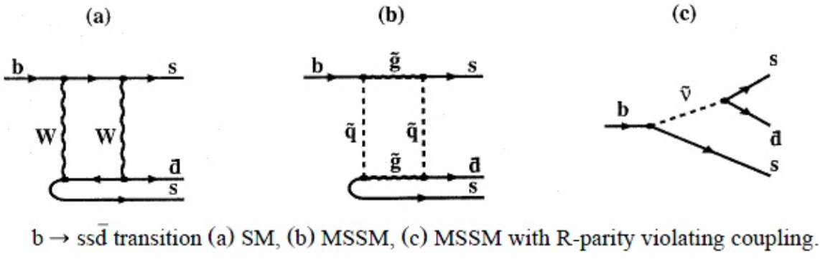
Search for new physics in hadronic B decays theoretically very complicated
K. Huitu, C.D. Lü, P. Singer D.X. Zhang, Phys. Rev. Lett. 81, 4313 (1998), hep-ph/9809566.
SM BRs: ~ 10 ⁻¹⁴,
Some New physics can reach 10 ⁻⁶

Slide 47
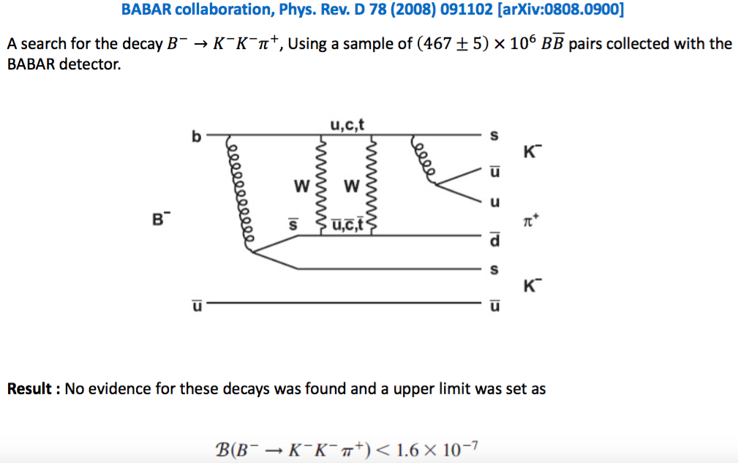
Experimental search starting from OPAL @ LEP, phys. Lett. B 476 (2000) 233, later searched also by Belle/Babar

Slide 48
Experimental search starting from OPAL @ LEP, phys. Lett. B 476 (2000) 233, later searched also by Belle/Babar
Similar channel B–→π–π–K⁺

Slide 49

Recent LHCb result:
Physics Letters B 765 (2017) 307–316
Recent theoretical results in Randall-Sundrum model: Chinese Physics C41 (2017) 053106
Br(b→ss d-bar) can reach to 10 ⁻¹⁰

Slide 50
高能对撞机是探测基本粒子内部结构的重要方法
夸克
电子
测不准关系x p ~ h
只有高能电子才能达到核子的内部与夸克相互作用，从而揭示核子的内部结构和相互作用性质
E = Mc²

Slide 51
Search for new particle or new phenomena is our major task in particle physics
There are two ways to achieve that: direct search or indirect search
Accordingly we have two directions in high energy physics experiments: high energy and high intensity ...
There are many high intensity experiments:
Beijing electron position collider (BEPC)
Daya Bay neutrino experiment (Jiangmen)etc.
B-factories (two machines)
There is even a super B-factory（Belle II）

Slide 52
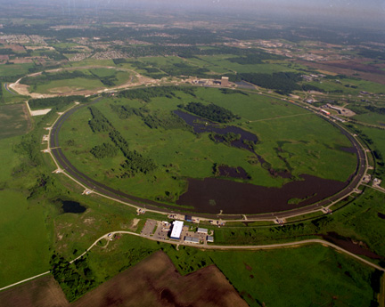
美国费米实验室2TeV质子对撞机
周长6.4公里
发现了最重的基本粒子：顶夸克
世界能量第二高的加速器

Slide 53
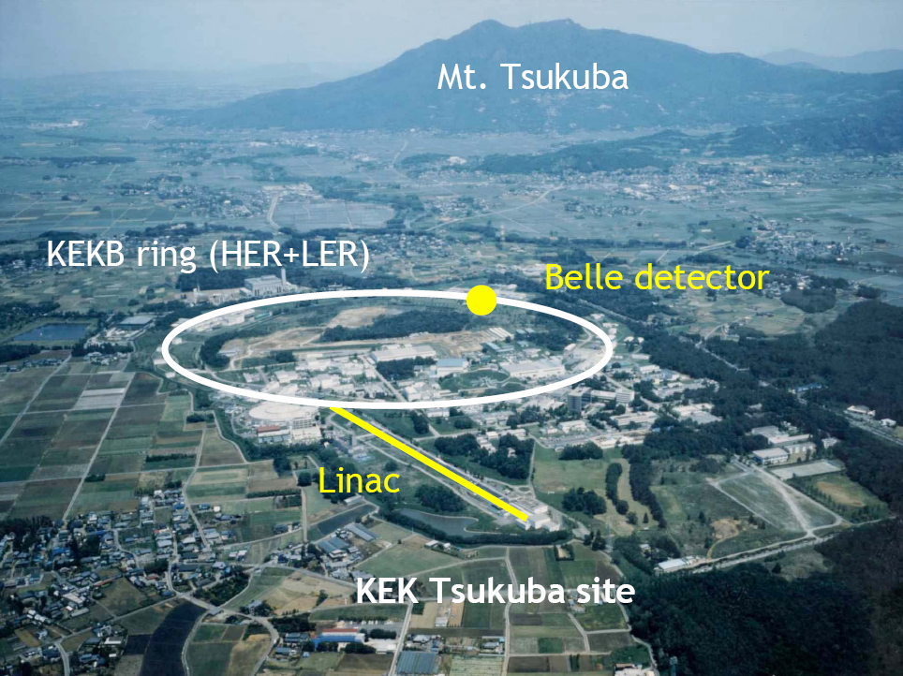
超级B介子工厂
3公里周长

Slide 54
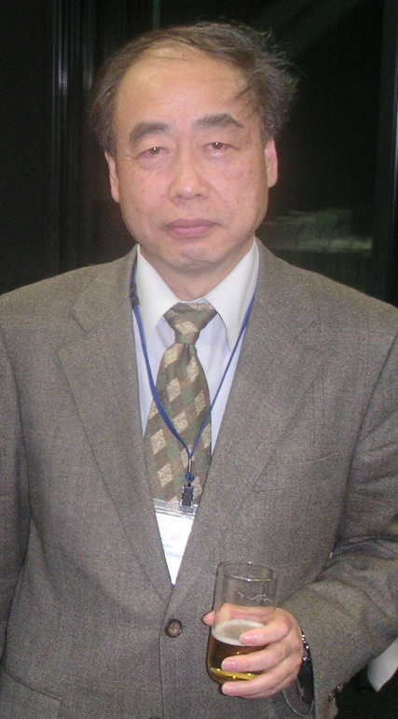
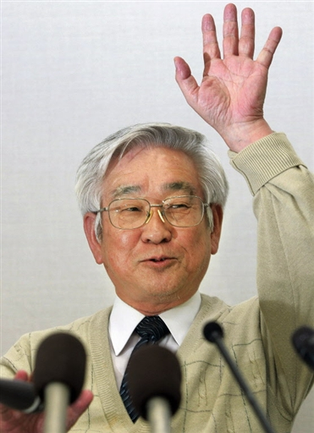
超级B介子工厂
直接CP破坏的发现导致了2008年的诺贝尔物理奖
3公里周长

Slide 55
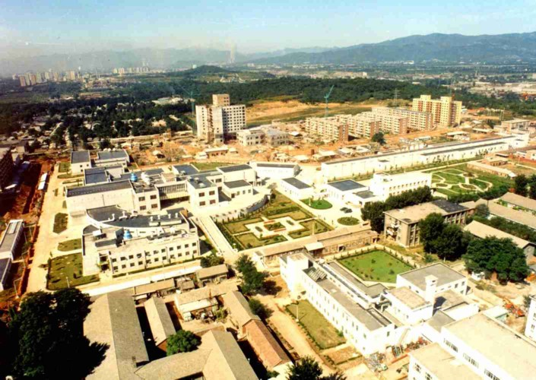
北京正负电子对撞机（BEPC）鸟瞰图
中国能量最高的加速器
八宝山
中国第一个博士和第一个博士后的诞生地
也是发出中国第一封电子邮件的地方

Slide 56

世界最大的粒子加速器
欧洲核子中心LEP/LHC储存环周长27公里

Slide 57
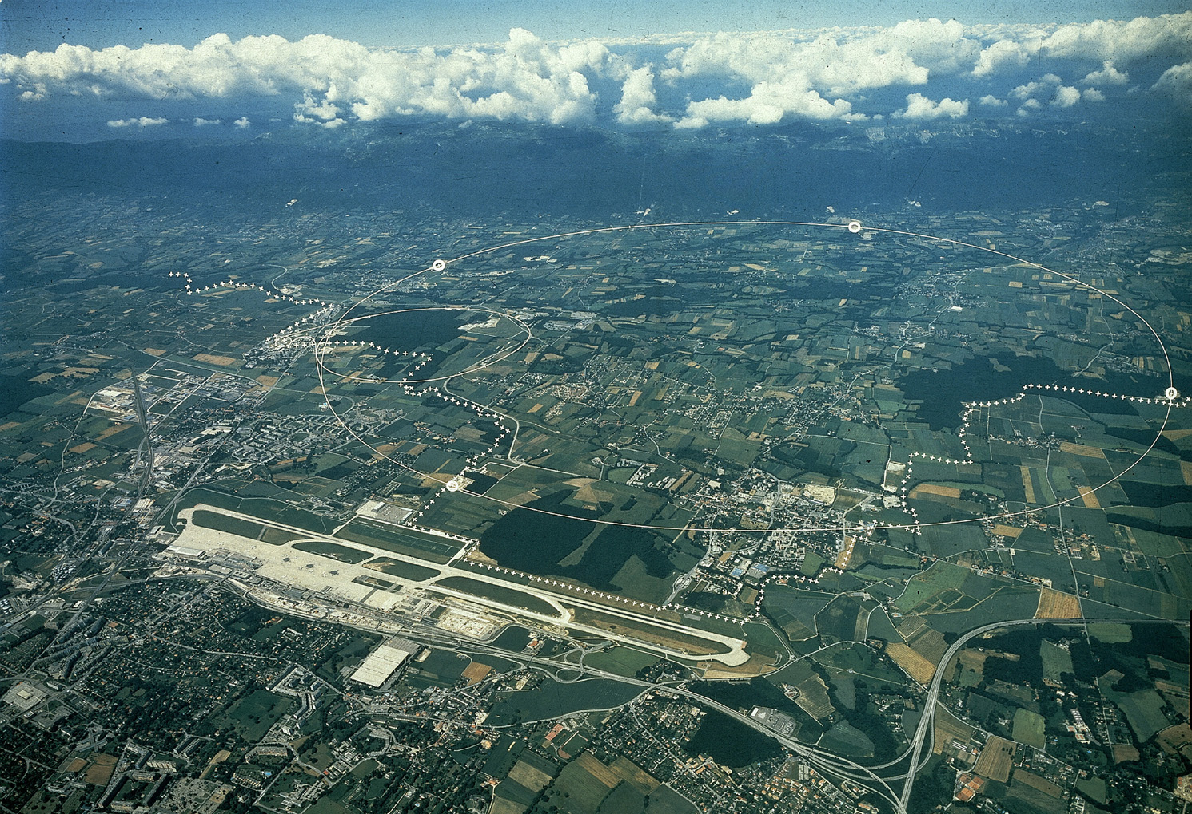
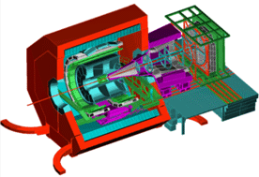



大型强子对撞机(LHC)
ALICE
ATLAS
CERN
CMS
LHCb
LHC: 27 km, the world’s largest proton-proton collider (7-14 TeV)
Where the WWW was born …

Slide 58

大型强子对撞机 (LHC)隧道(100多米的地下)
隧道 (26.7 公里)

Slide 59
ATLAS
（左边）
CMS
(右边)

Slide 60

08年6月的ATLAS探测器
在100多
米的地下

Slide 61

LHC era: 标准模型最后一个粒子－Higgs发现了
2012年7月4日CERN大会议室现场

Slide 62

2013年诺贝尔物理奖
The Nobel Prize in Physics 2013 was awarded jointly to François Englert and Peter W. Higgs “ for the theoretical discovery of a mechanism that contributes to our understanding of the origin of mass of subatomic particles, and which recently was confirmed through the discovery of the predicted fundamental particle, by the ATLAS and CMS experiments at CERN’s Large Hadron Collider”
➔中国组在探测器建造和Higgs发现中做出了重要贡献
ATLAS实验组：高能所、科大、南大、山大、上海交通大学
CMS实验组： 高能所、北大。。。

Slide 63

2013年诺贝尔物理奖－基于1964年的工作－－F. Englert and P. Higgs

Slide 64


希格斯机制(1964)
J. J. Sakurai Prize for Theoretical Particle Physics (2011)
F. Englert, R. Brout
PRL 13 (1964.8.31) 321
Peter W. Higgs
Phys. Lett. 12 (1964.9.15) 132
PRL 13 (1964.10.19) 508
G.S. Guralnik, C.R. Hagen and
T.W.B. Kibble, PRL 13 (1964.11.16) 585

Slide 65
21世纪初的的粒子物理！
“标准模型”已经建立
各种实验结果都与标准模型预言基本符合
随着加速器能量的提高，新的实验难度越来越大 -------资金困难。
高能物理的未来？
能预言吗?

Slide 66
21世纪----生命科学的世纪？
20世纪末21世纪初，电弱统一理论基础上的标准模型很好地与实验符合。
许多科学家，包括很多的粒子物理大家认为，粒子物理学已经走到了尽头，21世纪是生命科学的世纪

Slide 67


Slide 68



19世纪末20世纪初，经典物理学大厦建成
牛顿力学
麦克斯韦方程组
热力学、统计力学
例如，物理学泰斗开尔文爵士在物理学大会的演讲中宣布：后辈物理学家只要做些修补工作就行了
同时，他却敏锐注意到“地平线上还有两朵小小的乌云”，这恰恰成为20世纪物理学革命的源头，一个风云际会的科学的英雄时代从此拉开了序幕

Slide 69
21世纪初的的粒子物理！
数朵乌云在闪烁：
♠物质的最小单元是什么？至少 26个自由参数－太多
♥轻子和夸克为什么有三代？
♦质量的起源在哪里？ 它们的质量差别为什么那么大？
♣中微子究竟是Majarana还是Dirac粒子？
♠反物质、暗物质的疑问？ ♣ CP起源
♥有没有其他形式的物质？
♦ Higgs粒子是基本的吗？ 。。。

Slide 70

Higgs：一种新粒子
在Higgs发现之前, 所有已经发现的基本粒子只有两种：
自旋为 1 的玻色子 和
自旋 1/2 的费米子
Higgs 玻色子的自旋为0, 所以它不仅是一个新粒子，而且是一个新种类的基本粒子
这将开启一个粒子物理研究的新时代

Slide 71
强、弱、电三种力的大统一
强、弱、电低能区为三种不同的力，到极高能统一成一种力
缺乏实验证据（质子衰变）
SU(3)
1
SU(2)
1/45
U(1)
SU(5)
1
10
10¹⁵
√Q² GeV
简单SU(5)模型被排除，SO(10)或者超对称大统一模型还有可能

Slide 72
质量的起源
电磁相互作用的结合能+电子和原子核的质量→原子的质量
强相互作用的结合能→原子核的主要质量
电子和夸克的“内禀”质量是不是也是某种结合能?
内部结构？---未知的第五种相互作用？

Slide 73

质量的起源
在标准模型中，夸克与轻子通过Higgs机制和Yukawa相互作用获得质量－上帝粒子
但并没有给出质量的起源
理论本身无法预言质量的大小。
电子质量0.5 MeV, u、d夸克几个MeV, 而top夸克 175GeV，相差30万倍。
为什么差别这么大？
阶梯性、跷跷板模型

Slide 74
费米子质量问题
Koide公式 Yoshio Koide
Lett. Nuovo Cim. 34: 201, 1982；Phys. Lett. B120: 161, 1983：
巴尔末线系？
75.16 00 75.1604

Slide 75
基本粒子百年重大发现 vs 大国崛起
1897 – e discovery, J.J. Thompson (英国)
1919 – proton, Ernest Rutherford (英国)
1930 – neutron, James Chadwick (英国)
英国
“日不落帝国”

Slide 76
基本粒子百年重大发现 vs 大国崛起
1936 – μ, Carl D. Anderson (Caltech, 美国)
1956 – ν_{e} discovery (Homestake, 美国)
1962 – ν_{μ} discovery (BNL, 美国)
1968 – u and d quark (quark model, 美国)
1968 – strange quark(Kaon, 美国)
1974 – c quark (J/ψ, BNL, SLAC, 美国)
1977 – tau discovery (SLAC, 美国)
1977 – b quark (Upsilon, Fermilab, 美国)
1995 – top quark (Fermilab, 美国)
2000 – ν_{τ} discovery (Fermilab, 美国)
2001 – solar neutrino oscillation (SNO, 加拿大)
二战后美国成为
世界超级强国

Slide 77
基本粒子百年重大发现 vs 大国崛起
1979 – gluon (DESY, 德国)
1983 – W and Z (CERN, 欧洲)
1988 – atmospheric neutrino oscillation (日本)
2012 – reactor neutrino oscillation (Dayabay, 中国)
2012 – Higgs boson (CERN/LHC, 欧洲)
其它国家奋起直追，美国衰落之后？

Slide 78

我们需要一个Higgs工厂(对撞能量250GeV)
中国人首先提出了修建环形正负电子对撞机
Circular Electron-Positron collider (CEPC)
－并有希望将来升级成超级
质子－质子对撞机(SPPC)
70-100公里的足够长
的隧道 (能量70-100TeV）
挖掘机技术哪家强？
e⁺
e⁻

Slide 79
LEP (正负电子对撞机) → LHC(质子-质子对撞机)
W、Z工厂预言希格斯质量→发现希格斯
CEPC (希格斯工厂) → SPPC (质子-质子对撞机)
精确检验 → 新物理？
已知的弱、电磁、强相互作用都是规范相互作用，现在有了第5和第6种相互作用的证据
1. 汤川(Yukawa)作用力：由自旋为0的希格斯粒子传递，费米子和希格斯的耦合
2. 希格斯自作用力

Slide 80

新粒子的发现 ➔ “粒子工厂”
CERN/UA1,UA2
1983 发现W, Z
CERN/LEP (1989-2000)
W, Z 玻色子工厂(SMEW)
SLAC/BaBar (1999-2008)
KEK/Belle (1999-2010)
B夸克工厂 (CPV)
BNL/Samuel Ting(1974,J)
SLAC/B. Richter (1974,ψ)
SLAC/M. Perl (1975,τ)
CESR/CLEO(2001-2008)
中国IHEP/BEPC(2003-)
τ-c 工厂 (SMEW)
希格斯工厂？
希格斯工厂 ？
日本ILC (30km)
CERN/FCC (80-100km)
中国CEPC(70-100km)
CERN/LHC
(2012, Higgs)

Slide 81

欧洲的希格斯工厂计划

Slide 82

欧洲计划的直线对撞机

Slide 83

日本计划的国际直线对撞机

Slide 84
World Economic Power
US
EU
Japan
China
中国有能力

Slide 85
World HEP Accelerators
CEPC-SppC
LHC
ILC
Tevatron
KEKB
BEPC
大国地位

Slide 86
CEPC-SppC设计图
需要集中世界上最先进的加速器技术，包括最先进的超低温，超真空，超高频电源、高精密机械、电子学、大数据处理系统等等

Slide 87


CEPC-SppC 预研启动
环形正负电子对撞机(CEPC)-超级质子质子对撞机(SppC)
  2013年9月13日正式在北京召开启动会
  成立Institutional Board (IB) 、项目执行委员会(Steering Committee)、项目经理 (Project Manager)和理论、实验和加速器组的召集人(conveners)
  2018年：项目黄皮书(CDR)
  2018-2021年：预研项目建议书(TDR)
  2022-2030年：开始CEPC工程建设
  2030-2040年：开始CEPC运行取数
  2040-2065年：SppC启动工程建设
CEPC-SppC 大致时间表：

Slide 88

2018年11月14日，环形正负电子对撞机（CEPC）研究工作组正式发布CEPC的两卷《概念设计报告（CDR）》

Slide 89

十八届五中全会会议公报：
实施一批国家重大科技项目，在重大创新领域组建一批国家实验室，积极提出并牵头组织国际大科学计划和大科学工程。
科技部“国家重点研发计划”---36个专项：
大科学装置前沿研究专项概要..............

