Slide 1


Recent Progress of the High Field Superconducting Magnet R&D
中国科学院高能物理研究所
Institute of High Energy Physics, CAS
中科院高能所超导磁体组
Superconducting Magnet Group, IHEP
Superconducting Magnet Group
Accelerator Division
IHEP-CAS
2022.03.25

Slide 2
Outline
Progress of LPF3: a 16-T dipole magnet with graded common-coil configuration
Conceptual design of the 16-T dipole magnet with CCT coil configuration
Development status of the HTS transposed cable
Development status of the high field IBS coils
Performance study of a new epoxy resin IR-3 for high field applications
Development status of the HL-LHC CCT series magnets

Slide 3

中科院高能所超导磁体组
Superconducting Magnet Group, IHEP
01
Progress of LPF3: a 16-T dipole magnet with graded common-coil configuration

Slide 4
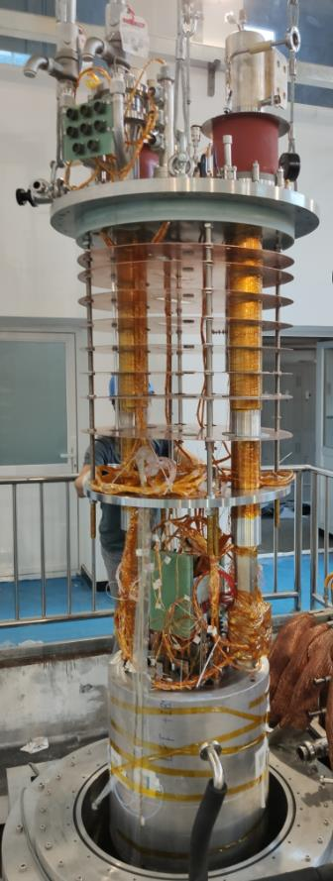
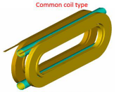
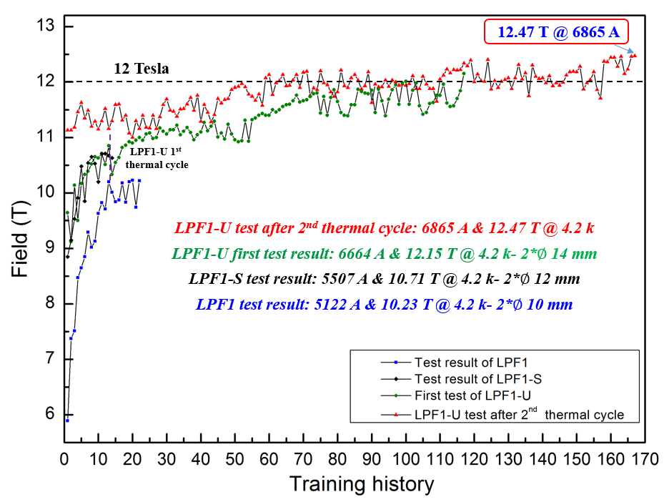
Performance of LPF1-U
New record
A maximum field of 12.47 T was achieved recently for the upgraded magnet of LPF1-U, beyond the dipolar field baseline required in SPPC.
Picture of LPF1-U

Slide 5
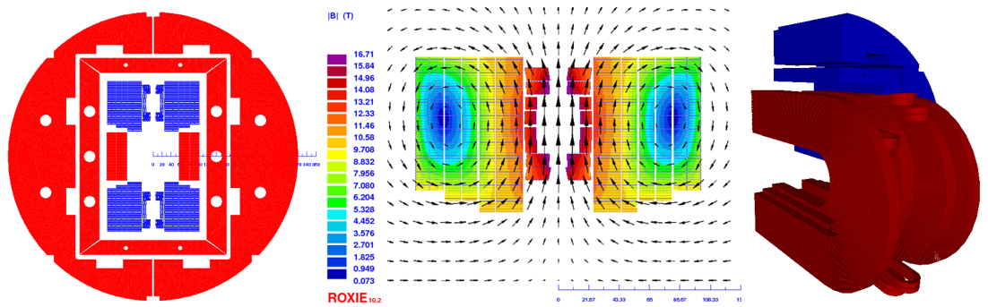
Electromagnetic design of LPF3
LTS (13 T) + HTS (3 T)
OD:640 mm
Nb₃Sn
YBCO
Nb₃Sn
Main field: 16 T
AP:30 mm
5
1
2
3
4
6
54
24
50
20
58
42
58
24
120 mm
The cross-section of LPF3
Field and flux distribution in coils
Coil layout (yoke 1/8)
Main parameters of LPF3
Current | 7580/143 A |  | Blocks | Block 1 | Block 2 | Block 3 | Block 4 | Block 5 | Block 6 | Block 7
Main field | 16.03 T |  | Peak field (T) | 12.81 | 10.68 | 10.82 | 10.58 | 10.48 | 10.38 | 16.18
 |  |  | LL ratio (%) | 77.66 | 75.61 | 77.56 | 76.15 | 78.45 | 77.87 | -
Peak field | 16.74 T |  | Blocks | Block 8 | Block 9 | Block10 | Block11 | Block12 | Block13 | Block14
 |  |  | Peak field (T) | 15.98 | 16.18 | 15.95 | 16.64 | 16.25 | 16.74 | 16.56
Harmonics | Max: 5.27 U |  | b3: -4.4 | b5: -5.27 | b7: -0.3 | b9:-1.62 | a2:-1.15 | a4: 2.77 | a6:-0.95 | a8:-0.15

Slide 6
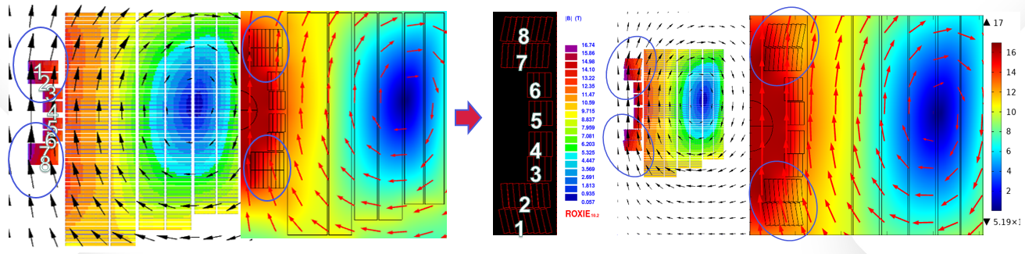
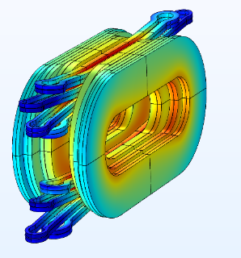
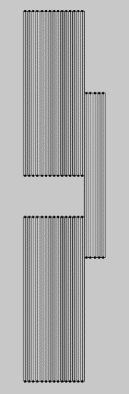
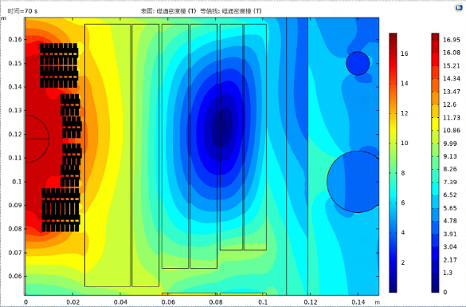
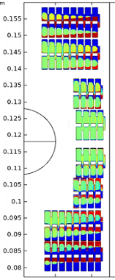

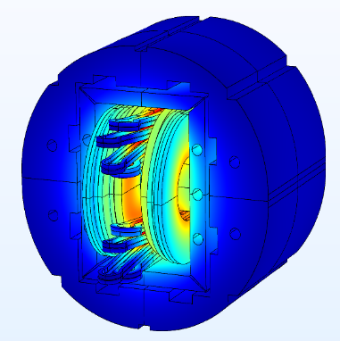
Electromagnetic design of LPF3 – HTS insert
The angle between the flux direction and the tape wide surface has been optimized
Block with SC
The effect of persistent current has also been analyzed and optimized
Harmonics | b3 | b5 | b7 | b9 | a2 | a4 | a6 | a8
Unit | -3.2 | -7.7 | -3.8 | -0.9 | 0.9 | -5.5 | -2.5 | -0.6

Slide 7
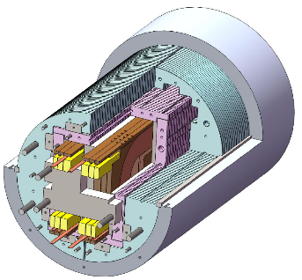
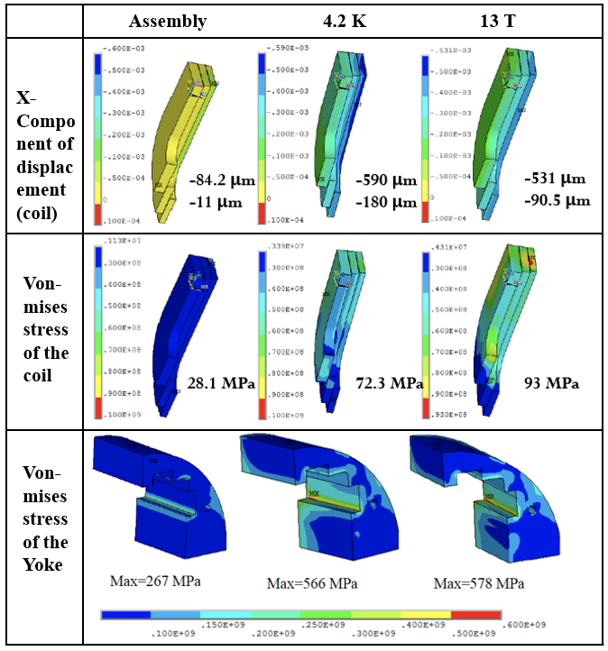
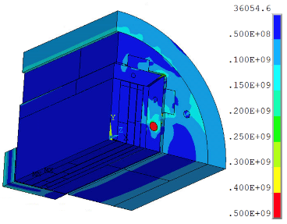
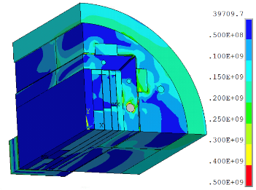
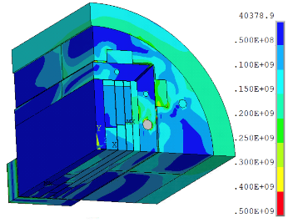
Mechanical design of LPF3
Magnet structure
Stress distribution in different loading steps
After assembly at RT: Peak stress on shell- 128 Mpa; On rod- 468 Mpa; On coils- 28.1 Mpa
Cooling down at 4.2 K: Peak stress on shell- 215 Mpa; On rod- 618 Mpa; On coils- 72.3 Mpa
Excited to 13 T: Peak stress on shell- 218 Mpa; On rod- 612 Mpa; On coils- 93 Mpa

Slide 8
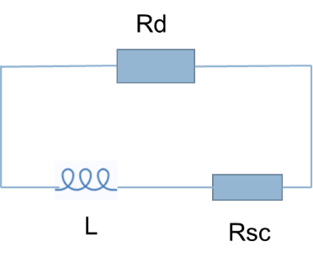
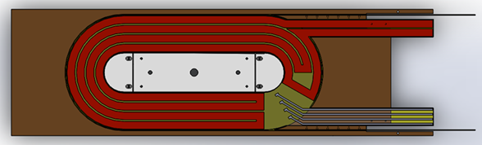
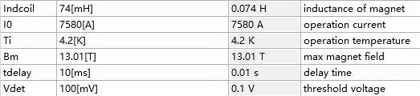
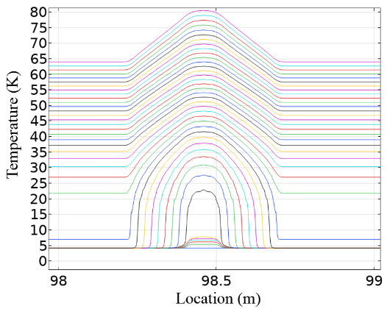
Quench protection analysis
A simplified circuit was established in COMSOL
A 1-dimensional adiabatic model was established
Varistor and heaters are applied to the quench protection of LPF3
Simplified circuit
Main parameter of the magnet
Heaters
Parameter of heaters
 | Thickness of stainless steel /μm | Resistance/Ω | Power（W/cm^2) | Charging voltage/V | Resistivity
coil1 | 50 | 2.505 | 50 | 389.76 | 0.5μΩ·m
coil2 | 100 | 1.698 | 50 | 339.6
coil3 | 100 | 1.878 | 50 | 375.6
The calculation indicates that the temperature of hot spot is 237 K and the max voltage is 952 V. Safe.
Temperature distribution near hot spots

Slide 9
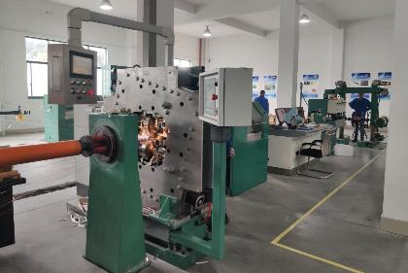
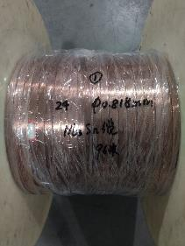
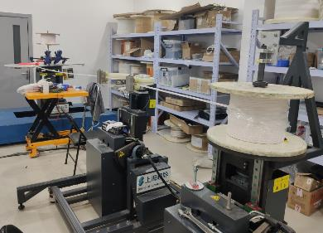
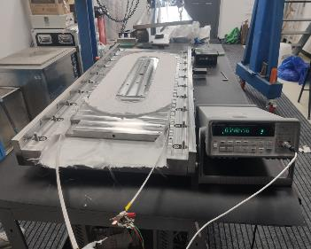
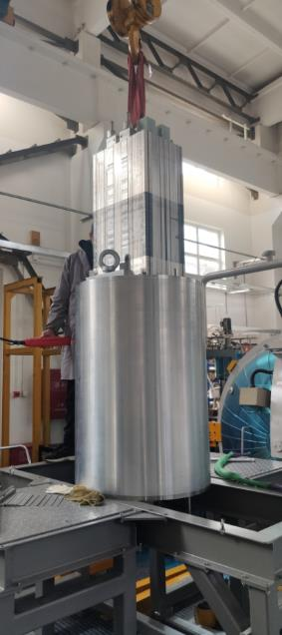
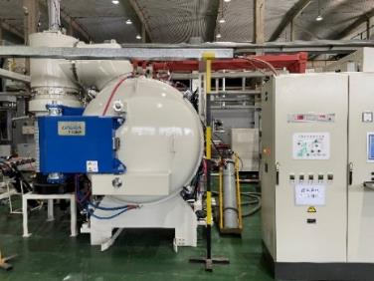
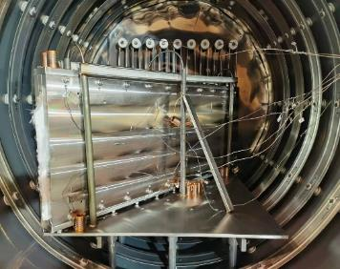
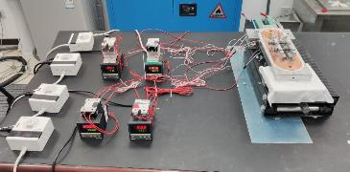

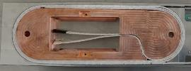
Fabrication status of LPF3
Nb₃Sn Rutherford cable fabrication
Coil fabrication
Heat treatment test
Inner splice soldering
Nb₃Sn Rutherford cable has been fabricated for LPF3
A dummy coil has been fabricated and heat treated to test the furnace property
The inner joints fabrication test and the pre-assembly of LPF3 has been carried out.
The coils of LPF3 is under construction and the fabrication of the LPF3 is expected to be competed in July.
Pre-assembly

Slide 10
中科院高能所超导磁体组
Superconducting Magnet Group, IHEP
02
Conceptual design of the 16-T dipole magnet with CCT coil configuration

Slide 11
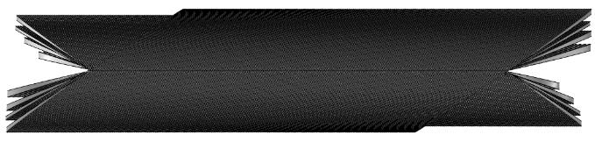
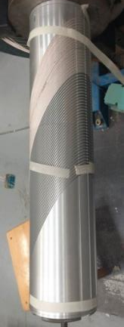
Designing a 16 T CCT Dipole with four coil modules
High lights:
Canted-Cosine-Theta (CCT) technology;
  Superior field quality;
  Stress management
  Developed industrial assembly line;
Graded Nb₃Sn Rutherford cables;
Multiple replaceable coil modules;
B_{M}
B_{O}
B_{I}
Ribs
The geometry of the 4 module CCT magnet
Spar
Major Geometry Parameters (To be optimized)
CCT subscale
Module No. | Tilt angle | Inner Radius [mm] | Outer Radius [mm] | Slot width [mm] | Slot depth [mm] | Strand number | Pitch [mm] | Turn No. | Coil length [m] | Strand length [km] | Peak field [T]
1 | 15° | 30 | 68.6 | 2 | 16.8 | 40 | 12 | 88 | 1.36/1.51 | 5.9 | 16.2
2 | 22.5° | 69.6 | 103 | 2 | 14.2 | 34 | 7.2 | 145 | 1.43/1.51 | 10.3 | 14.7
3 | 29° | 104 | 127.6 | 2 | 9.3 | 22 | 5.5 | 193 | 1.46/1.51 | 9.9 | 13.1
4 | 34° | 128.6 | 159 | 2 | 12.7 | 30 | 4.5 | 234 | 1.46/1.51 | 18.2 | 11.3
Iron York | \ | 180 | 300 | \ | \ | \ | \ | \ | 1.6 | \ | \

Slide 12
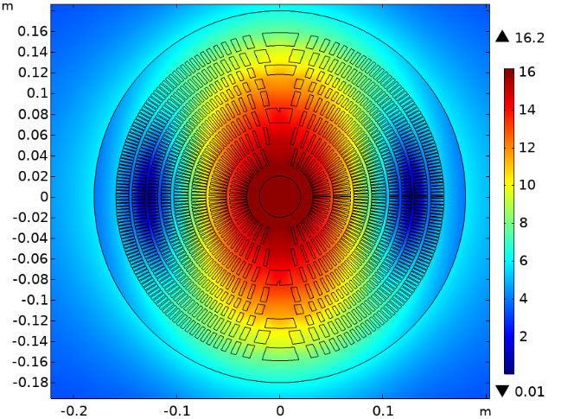
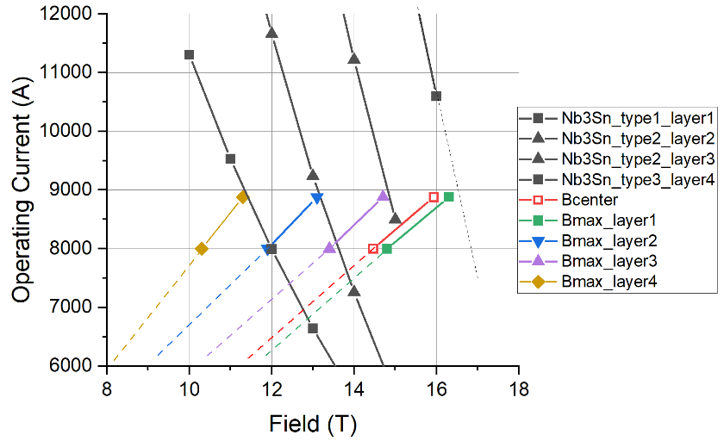
Designing a 16 T CCT Dipole with four coil modules
At 4.2 K, the magnet produces 16 T at 100% of the load-line, with 8.8 kA operating current.
Field distribution at the middle cross section
Load-line of the 4 coil modules

Slide 13
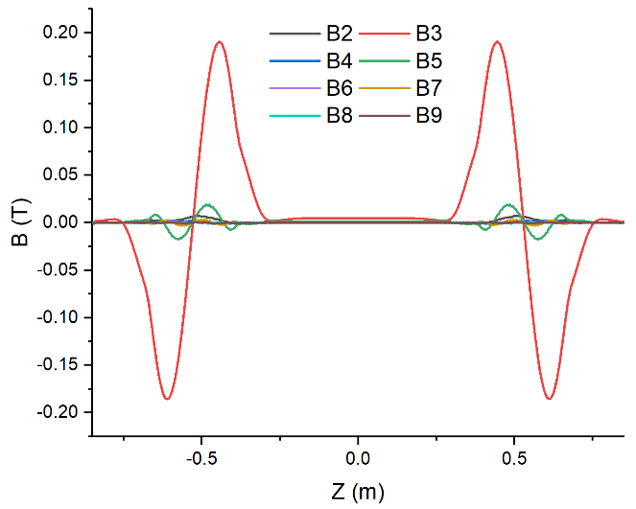
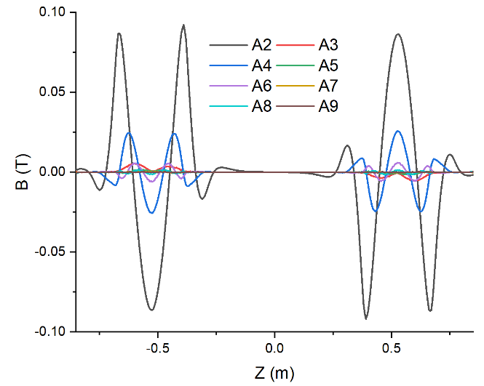
Designing a 16 T CCT Dipole with four coil modules
The CCT magnet has an intrinsic good field quality
High-order harmonics along axis - Bn
High-order harmonics along axis - An
Harmonics： 10⁻⁴ | b2 | a2 | b3 | a3 | b4 | a4 | b5 | a5 | b6 | a6 | b7 | a7 | b8 | a8
Cross section-2D | 0.6259 | 0.0119 | 2.9824 | -0.0006 | 0.0537 | 0.0002 | 0.5189 | 0.0002 | 0.0183 | -0.0020 | -0.0845 | 0.0016 | -0.0036 | 0.0009
Integrated-3D | 1.5989 | 0.0101 | 3.8649 | -0.0320 | 0.3047 | 0.0802 | 1.4069 | -0.0175 | 0.0750 | -0.3695 | 0.1163 | 0.0734 | -0.0223 | -0.2090

Slide 14
中科院高能所超导磁体组
Superconducting Magnet Group, IHEP
03
Development status of the HTS transposed cable

Slide 15
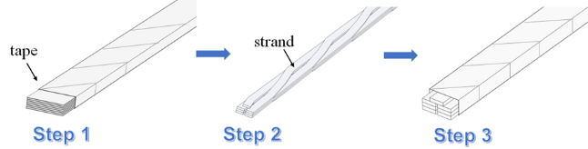
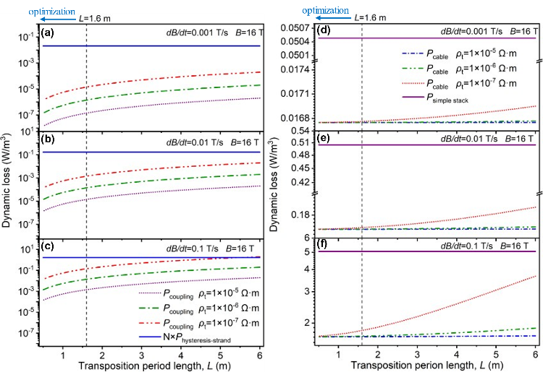
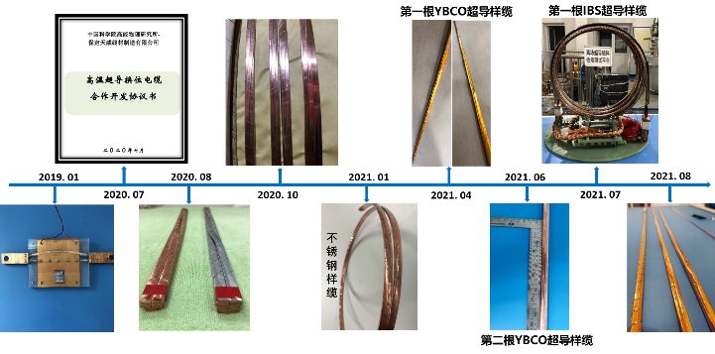
Recent progress of HTS transposed cable
Cable design
Dynamic loss of transposed cable
Schematic illustration of the transposed cable and the fabrication steps
The advantages of the designed cable:
High current-carrying compacity
Low dynamic loss
High mechanical stability
Figure 3. (a-c) Hysteresis loss and coupling loss of the X-cable at different magnetic field change frequencies and contact resistances.
(d-f) Dynamic loss of the X-cable and the simple stack with the same cross-section and current-carrying capacity as X-cable at different magnetic field change frequencies and contact resistances.
Time chart of research progress of transposed cables

Slide 16
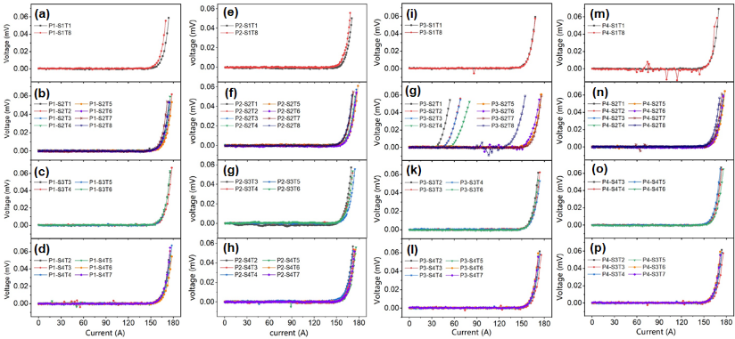
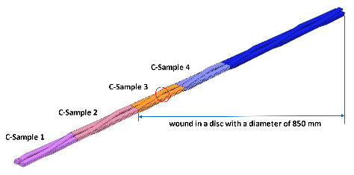
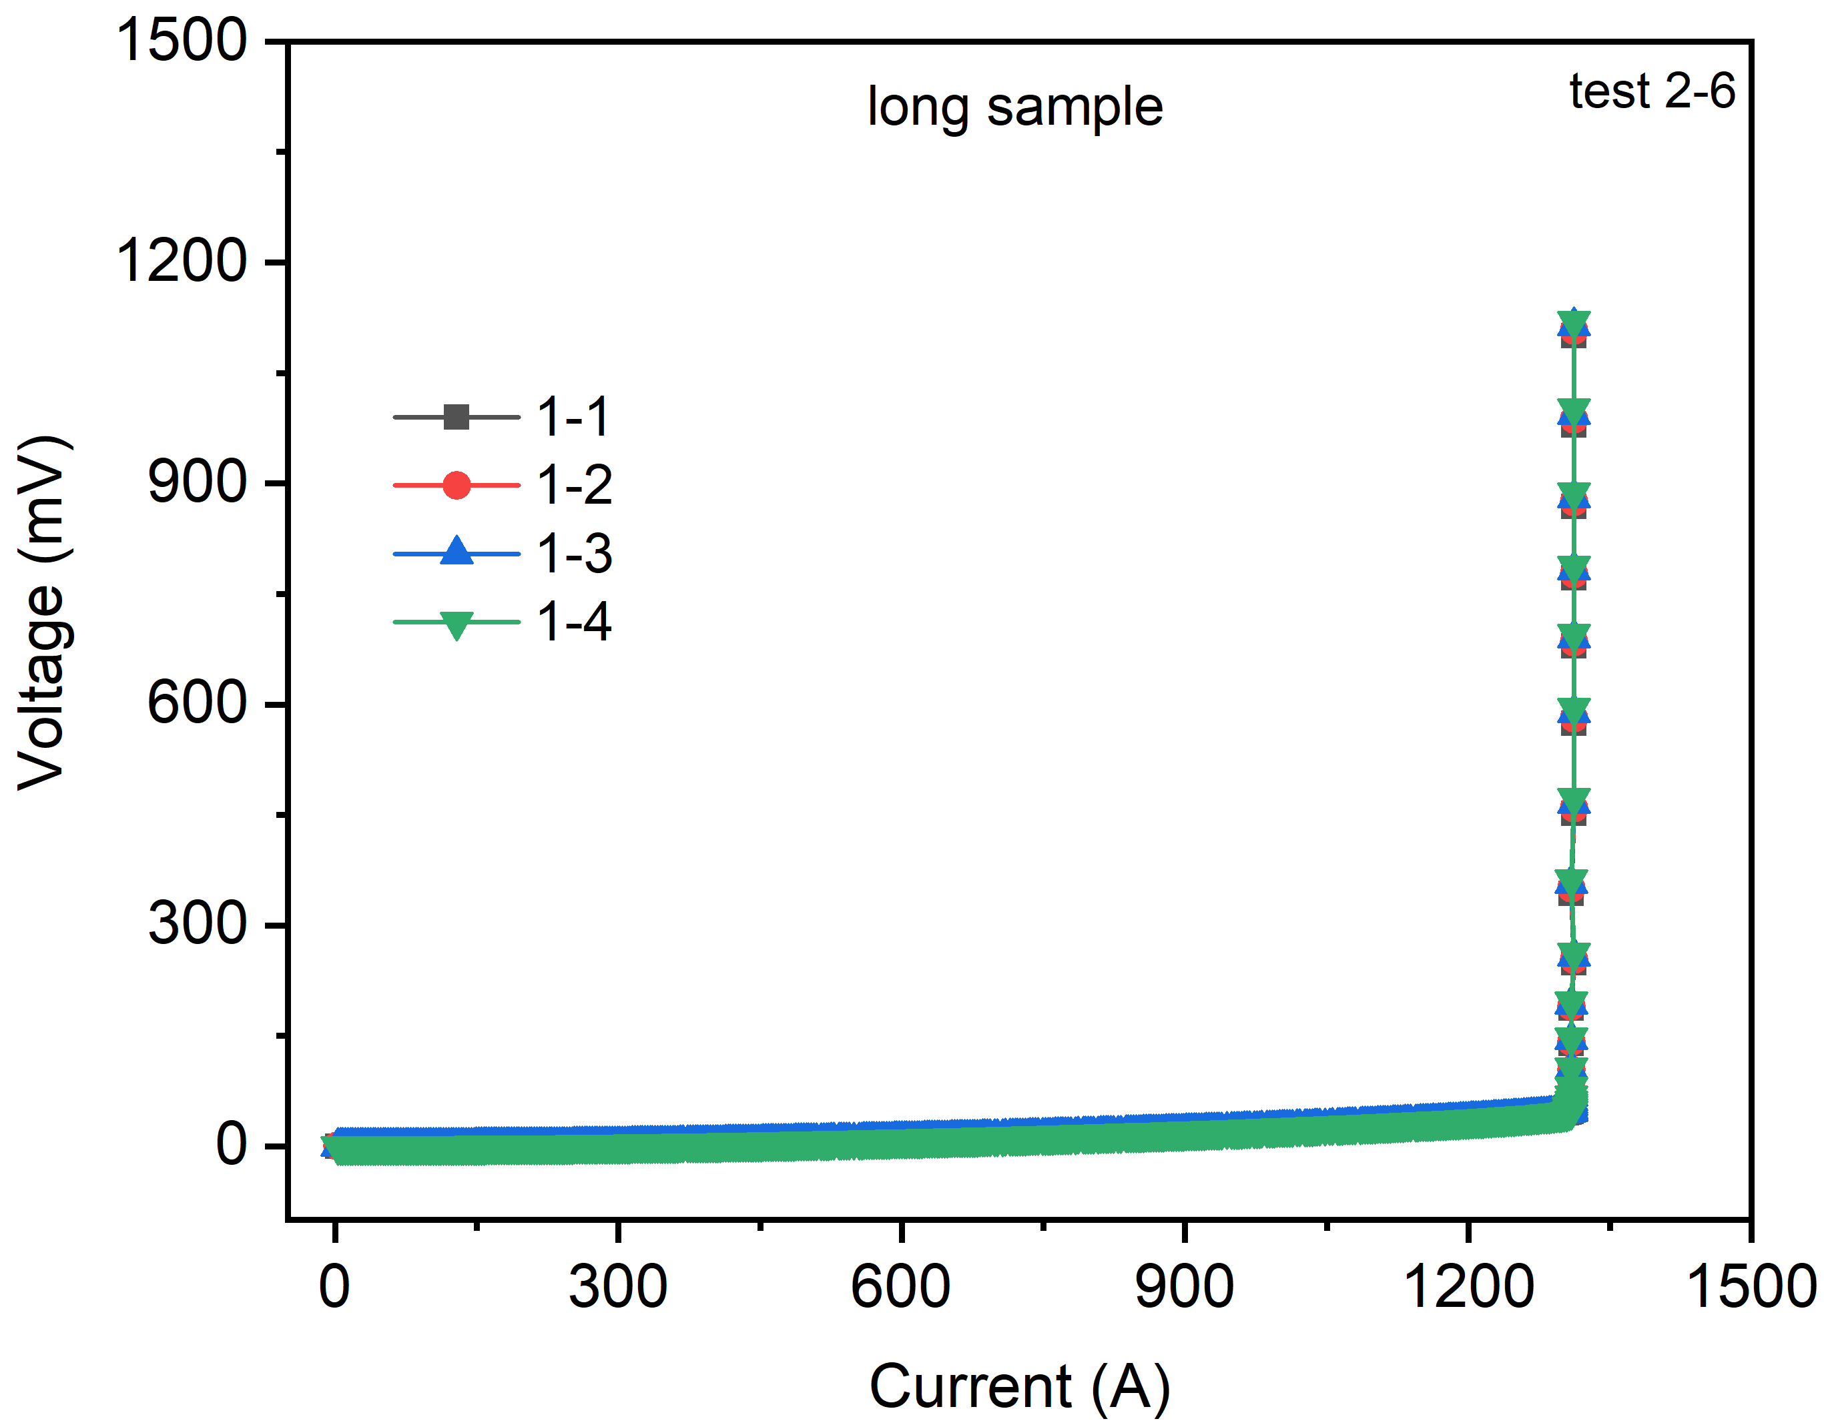
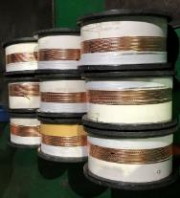
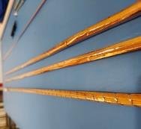
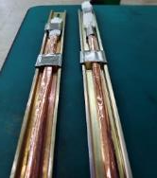
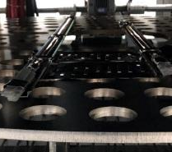


Recent progress of HTS transposed cable
REBCO transposed cable
10-m cable samples were firstly fabricated
Most of the tapes extracted from the cable showed almost no degradation.
The measured V-I curves of the REBCO tapes in the four samples cut from the prototype cable
IBS transposed cable
strand
cable
heat treatment
Terminal fabrication
test
The measured V-I curves of the IBS transposed cable

Slide 17
中科院高能所超导磁体组
Superconducting Magnet Group, IHEP
04
Development status of the high field IBS coils

Slide 18
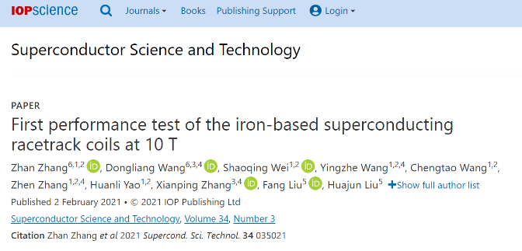
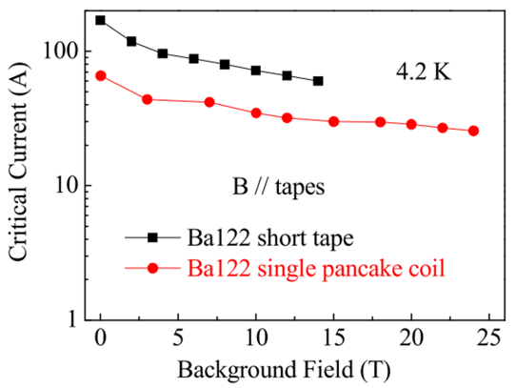
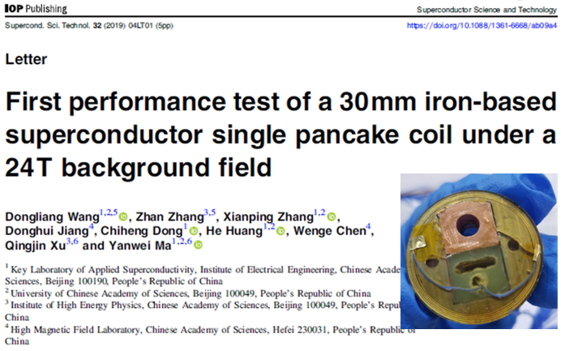
Development of Racetrack Coils with 100-m Long IBS Tapes
Two racetrack coils have been made using the 100 m length IBS tapes. The coils reached 86.7% of critical current of the short sample at 4.2 K and 10 T with highest compressive stress over 100 MPa.
Zhan Zhang et al 2021 Supercond. Sci. Technol. 34 035021
Ic of the IBS coil at 24 T reach 40% of that at zero magnetic field.
The IBS is promising for the high-field magnet application.
Wang, et al., Supercond. Sci. Technol,. 2019(32) 04LT01

Slide 19
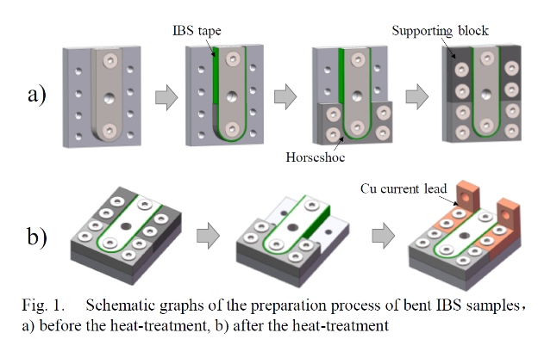
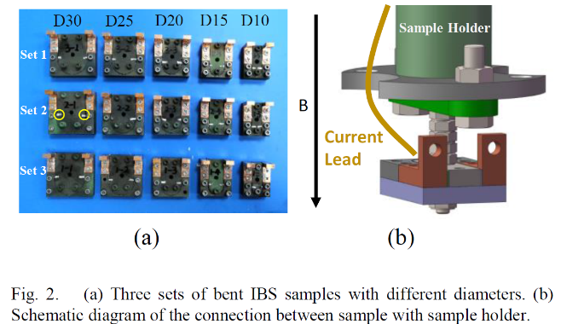
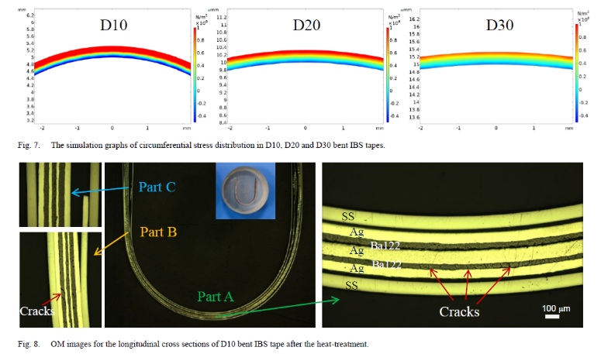
Development of IBS solenoid pancake coils
Effect of bending before annealing on the Ic of IBS tapes
The attenuation curve of Ic with decreasing bending diameters for IBS tapes was obtained.
Cracks appear regularly in part of the superconducting cores under tensile stress.
Chunyan Li et al IEEE TAS, VOL. 32, NO. 6, 2022

Slide 20










Development of IBS solenoid pancake coils
First Performance Test of IBS Solenoid Coil under 32 T
Ic measurement at 32 T
Ic: 75A
The Ic value for Φ34mm-17 turns-DPC is 60 A under 4.2 K and 32 T, which is a new breakthrough！
IBS coil with balloon ends are under construction.

Slide 21
中科院高能所超导磁体组
Superconducting Magnet Group, IHEP
Performance study of a new epoxy resin IR-3 for high field applications
05

Slide 22







Background
Almost all epoxy materials have to be imported.
For ReBCO coated conductors, epoxy impregnation often leads to performance degradation.
An appropriate epoxy formulation is therefore urgently required to prevent degradation.
Cleavage
Stress
< 1 MPa
Conductor
Epoxy
Transverse tensile Stress
<10 MPa
… …
Fig.1 Structure of ReBCO.
Fig.2 Performance degradation of ReBCO.
Fig.1 Chemical structures of components of IR-3.
Fig. 2. Thermal shock samples of (a) IR-3 and (b) CTD-101K.
Fig. 3. (a) Pot life and (b) DSC curves of IR-3 and CTD-101 K.
Low viscosity
High crack resistance
Advantage
of IR-3
Good mechanical properties
Sufficiently radiation resistant
Long pot life
Fig. 4. The (a) tensile, (b) Compressive, and (c) Impact strength of IR-3 and CTD-101K at 77 K after Co-60 γ radiation.
Can IR-3 be used in ReBCO superconducting coils ?

Slide 23












Performance of IR-3 impregnated ReBCO double-pancake coils
(a)
(b)
(c)
Fig.1. (a) Coil tooling, (b) Stainless-steel (SS) co-wound coil, and (c) Kapton insulation (KI) coil.
Fig.2. Cool-down tests
Fig.3. I_{c} of SS coils
Fig.4. I_{c} of KI coils
Table 1. Parameters of the SS ReBCO coils.
Table 2. Parameters of the KI ReBCO coils.
Fig.5.Thermal cycle of SS coils
Fig.6.Thermal cycle of KI coils
Fig.7.Over-current test results of KI coils
At 77 K in self-field, after thermal cycle tests, and at 4.2 K even to 10 T under about 15 Mpa tension stress, the IR-3 impregnated coils can avoid performance degradation.
IR-3 impregnated coil enabled the best cooling performance and the IR-3 impregnated coil showed superior electrical and thermal stabilities.
Fig.8. Ic tests at 4.2K under (a) 5T and (b) 10T.
Fig.9. Analysis result for the radial stress.

Slide 24














Performance of IR-3 impregnated ReBCO balloon-end coils
Upper layer
Lower layer
Fig.1. Coil tooling and schematic diagram
Fig.2. Schematic distribution of voltage tapes on the coil.
Table 1 Parameters of the Balloon-end ReBCO coil
(a)
(b)
Fig.3. I_{c} test at 77 K.
Fig.4. I_{c} test of SS coil at 77K (a) before and (b) after IR-3 impregnation
(a)
(b)
At 77 K in self-field, the IR-3 impregnated SS and KI ReBCO double-pancake coils can avoid performance degradation.
Fig.5. Process of IR-3 impregnation
Fig.6. I_{c} test of KI coil at 77K (a) before and (b) after IR-3 impregnation

Slide 25
中科院高能所超导磁体组
Superconducting Magnet Group, IHEP
06
Development status of the HL-LHC CCT series magnets

Slide 26






Development of CCT dipole magnets for HL-LHC
MCBRD01
The first set of CCT superconducting magnets MCBRD01 with satisfactory field strength and field quality, has been shipped to Europe in October, 2021.
MCBRD02
The assembly of the 2nd set of HL-LHC CCT superconducting magnets has been finished in Jan, 2022, and now the magnet is tested at IMP
Fabrication of a full size prototype magnet MCBRDP2 was completed in May, 2020. Both apertures reached the ultimate current.
MCBRDP2

Slide 27


Development of CCT dipole magnets for HL-LHC
2+9 apertures has been fabricated. Most of them can reach the design current, but with very long training history.
From CB09 an important modification to the design has been adopted, to improve the training performance of the CCT coils
CB05 and CB09 will be tested at IHEP next week
CB05 and 09 ready for stand-alone test at IHEP
Test results of coils CB01 to CB06

Slide 28

Summary
中国科学院高能物理研究所
Institute of High Energy Physics, CAS
中科院高能所超导磁体组
Superconducting Magnet Group, IHEP
As the next step of the high field accelerator magnet R&D, a 16-T dipole magnet named LPF3 has been designed and is under fabrication now.
As a candidate, a 16-T dipole magnet with CCT coil configuration has been proposed with lots of potentials.
The new HTS transposed cable under development shows promising performance for high field applications
I_{c} of the Iron-Based Superconducting coils reached 60 A at 32 T background field, a new breakthrough!
2 series plus 1 prototype CCT magnets have been developed for the HL-LHC project at CERN. The others are under fabrication. An important modification to the design has been adopted from CB09 to improve the training performance of the CCT coils

Slide 29
Thanks for your attention!

