Slide 1
Beam-Beam Simulations with Updated Longitudinal Impedance
Yuan Zhang, Na Wang, Dou Wang
Mar. 25th, 2022 (CEPC Day)

Slide 2
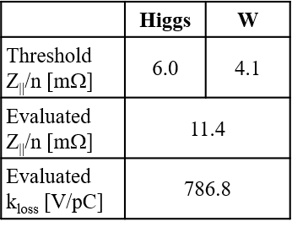
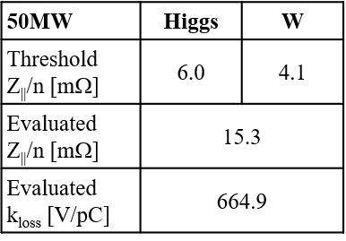
Motivation
Na Wang, CEPC DAY (2022-Feb-23)
Y. Zhang, IAS workshop, 2022
The updated impedance has higher value and may induce microwave unstable ⇒ influence on the luminosity needs to be further checked.
Stable tune area for Higgs is limited with old impedance model
w/o Collision:
Higgs, Collision:
Higgs, w/o ZL
Higgs,
w/ old ZL

Slide 3
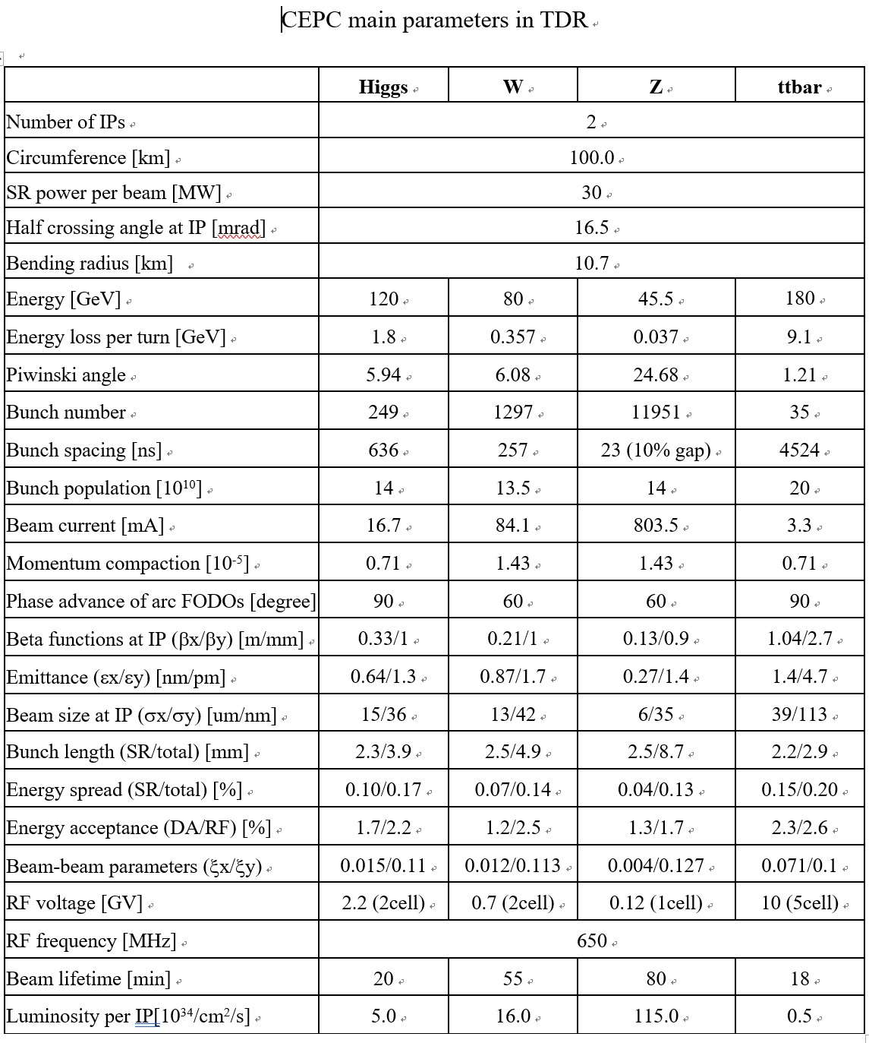

Slide 4
MWI check of Higgs (with IBB)
Collision Off
There exist no microwave instability!
Swap-out injection is not a worry more or less.

Slide 5
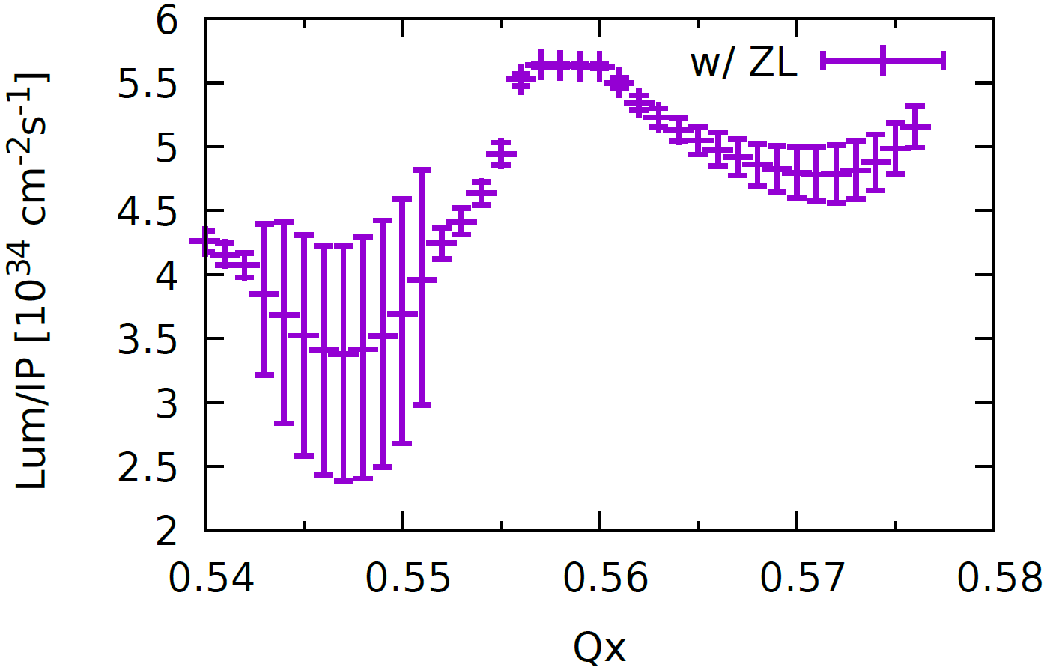
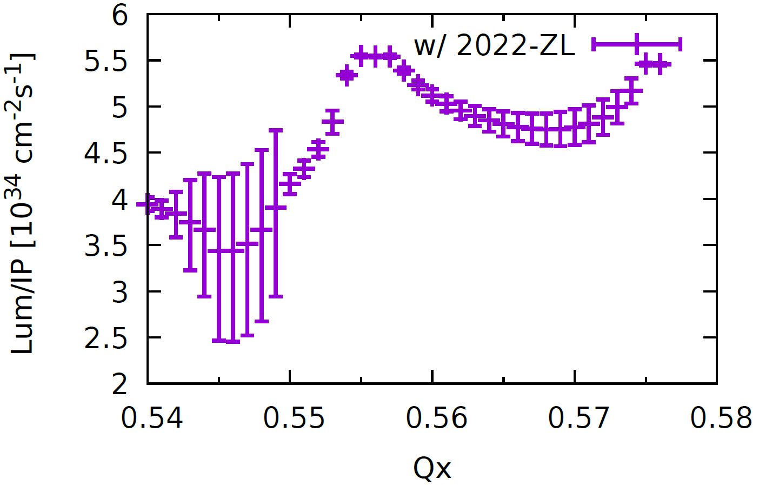
Higgs: $σ_{x} \& L$ versus Horizontal tune
Stable tune area is too limited
Old Impedance
New Impedance

Slide 6
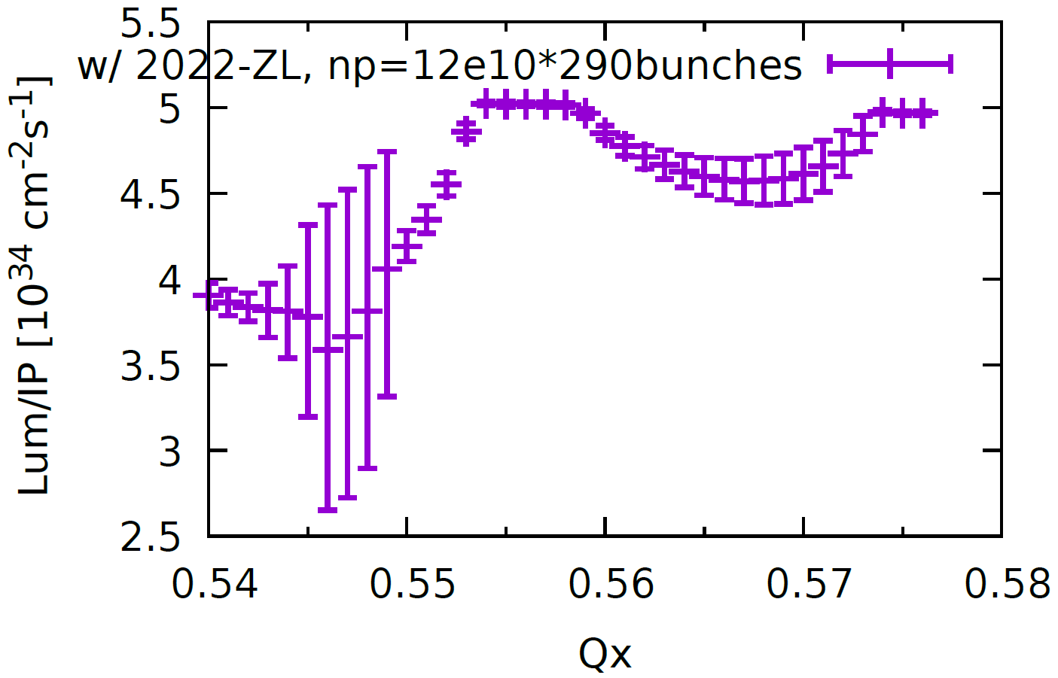
Optimization of Higgs Parameters: Lower bunch population (14e10->12e10)
14e10
12e10
Width of stable region:
0.002 -> 0.004
Luminosity:
5.5e34 -> 5e34

Slide 7
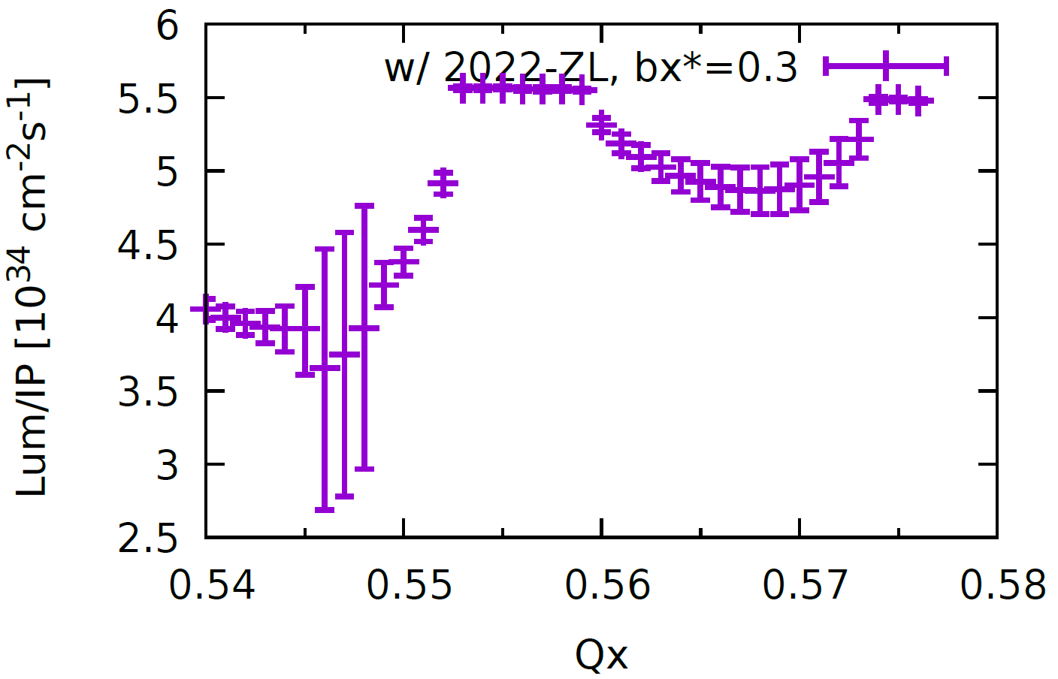
Higgs: $σ_{x}$ versus Horizontal tune Squeeze $β_{x}^{∗}$ (0.33 m-> 0.30 m)
0.33 m
0.30 m
Width of stable region:
0.002 -> 0.006
Luminosity:
5.5e34

Slide 8
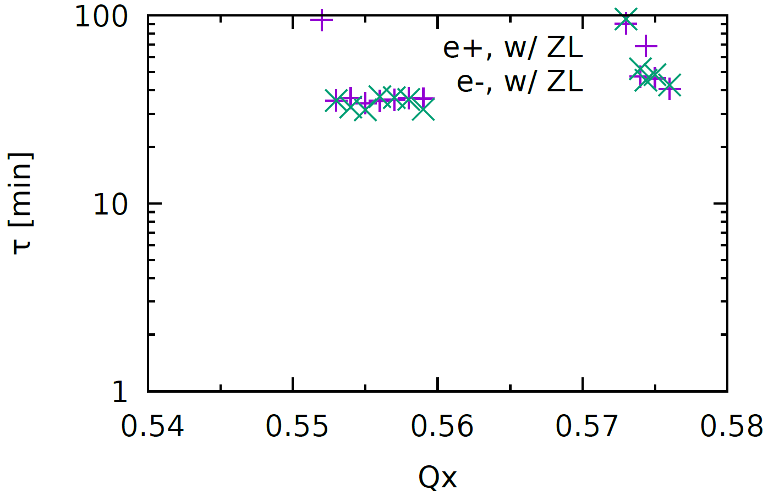
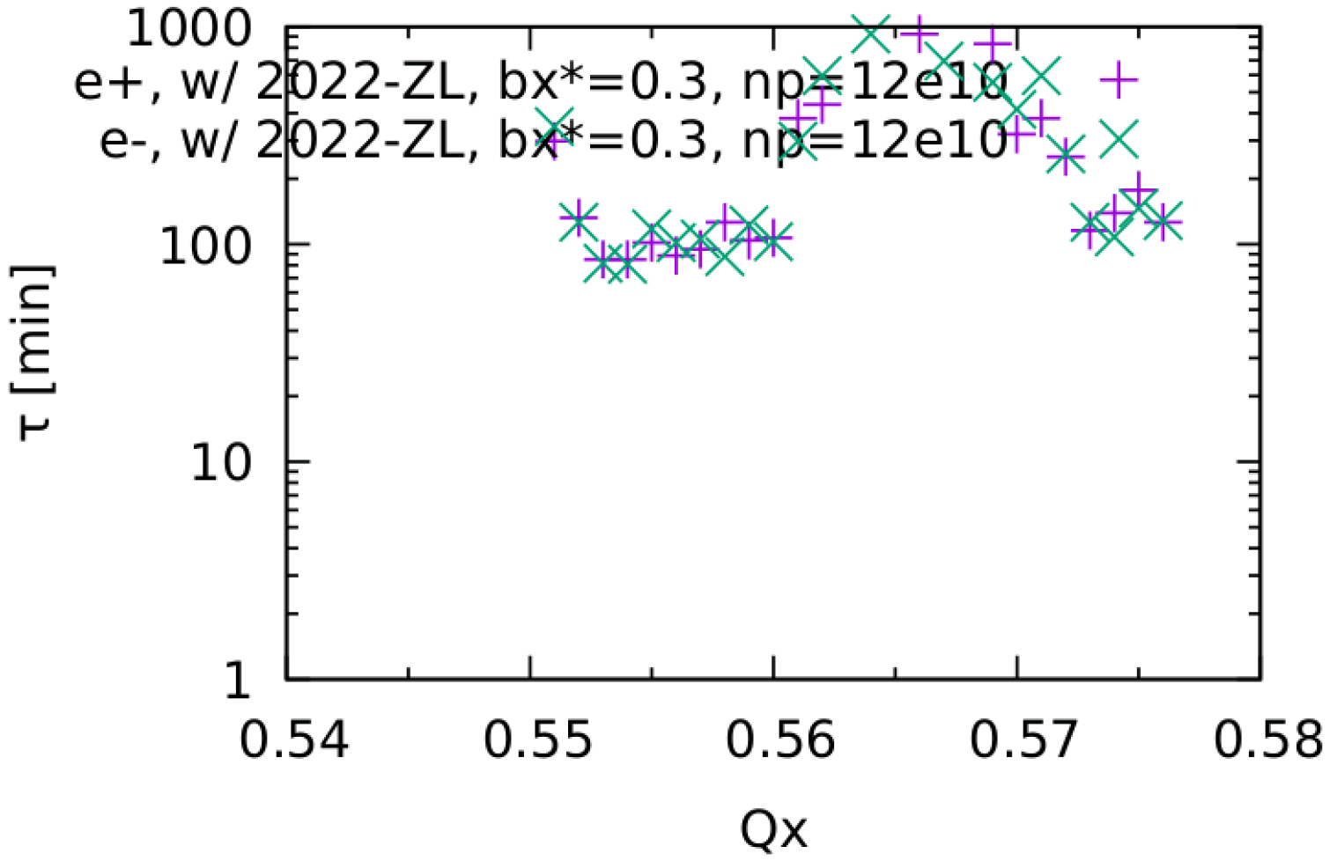
Higgs: Beamstrahlung Lifetime
Bx=0.33, np=14e10: ~40min
Bx*=0.33, np=12e10: ~100min
Bx*=0.30, np=14e10: ~30min
Bx*=0.30, np=12e10: ~80min

Slide 9
Higgs: Bx*=0.3m, ne=12e10 (Recommended)
Width of stable tune area: 0.007
Lum ~ 5e34
Luminosity
$σ_{x}$ versus Horizontal tune

Slide 10
W: $σ_{x}$ versus Horizontal tune
Stable tune area is still large enough, even squeezed.
Old Impedance
New Impedance

Slide 11
W: Luminosity versus Horizontal tune
Old Impedance
New Impedance

Slide 12
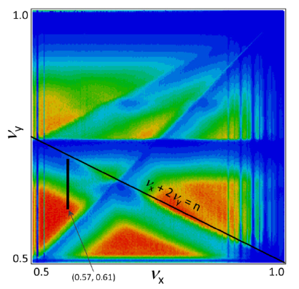
Z: $σ_{x}$ versus Horizontal tune
D. Shatilov, ICFA Beam Dyn.Newslett. 72 (2017) 30-41
1) Stable tune area is still large enough, even squeezed.
2) The stable region is even better. (with lattice nonlinearity)
Old Impedance
New Impedance

Slide 13
Z: Luminosity versus Horizontal tune
Old Impedance
New Impedance

Slide 14
about FCCee

Slide 15
K. Oide Mar. 17, 2022 @151st FCC-ee Optics Design Meeting & 22nd FCCIS WP2.2 Meeting

Slide 16
K. Oide Mar. 17, 2022 @151st FCC-ee Optics Design Meeting & 22nd FCCIS WP2.2 Meeting
Only difference between CEPC and FCCee at HIggs

Slide 17
K. Oide Mar. 17, 2022 @151st FCC-ee Optics Design Meeting & 22nd FCCIS WP2.2 Meeting

Slide 18
Summay
Higgs: bx*=0.3 m/np=12e10 is recommended for TDR
Beamstrahlung lifetime is increased from 50min to 80min, but still one order shorter than that of FCCee
W/Z is well with updated impedance
The (updated) parameters could afford expected increase of impedance budget (more or less)

