Slide 1
Improvement to the vacuum status by NEG coating as the solutions for the high lumi. Z & tt operation
Yongsheng Ma
2022.3.25

Slide 2
outline
Problem in vacuum of electron ring
Solution: Al vacuum chamber NEG coating

Slide 3

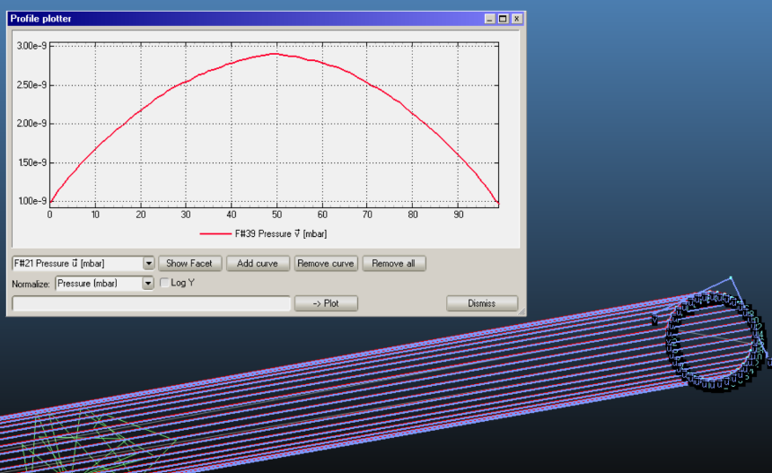
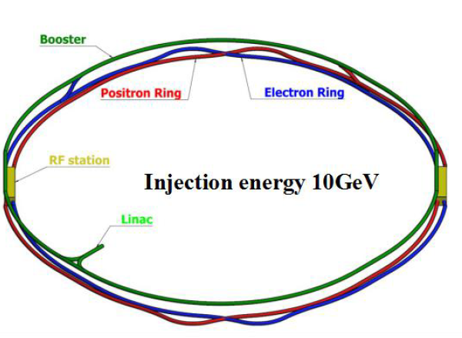
Preview of CEPC vacuum system
Vacuum of Electron Ring 6m long pipe
CDR Vacuum requirements
 | Material | Vacuum/ Torr | Cross Section
Booster | Extruded aluminum 6061 | 3 × 10⁻⁸ | φ56
Electron Ring | Extruded aluminum 6061 | 3 × 10⁻⁹ | 56×75 to φ56
Positron Ring | Extruded copper, NEG film |  | 56×75 to φ56
MDI | Copper/tungsten alloy, NEG film | 3 × 10⁻¹⁰ | φ20
Machine and Vacuum Parameters
 | E | I | ρ
 | Gev | A | m
Higgs | 120 | 0.0167 | 10700
W | 80 | 0.084 | 10700
Z | 45.5 | 0.803 | 10700
tt | 180 | 0.0033 | 10700
Notes:
Vacuum of Booster 、storage ring, MDI are all considered and under technical design. Conventional technical such as ion pump /Al will be used in CEPC. There is no especial issue exceed our control, except to balance the impedance and gas absorb ability of NEG film

Slide 4
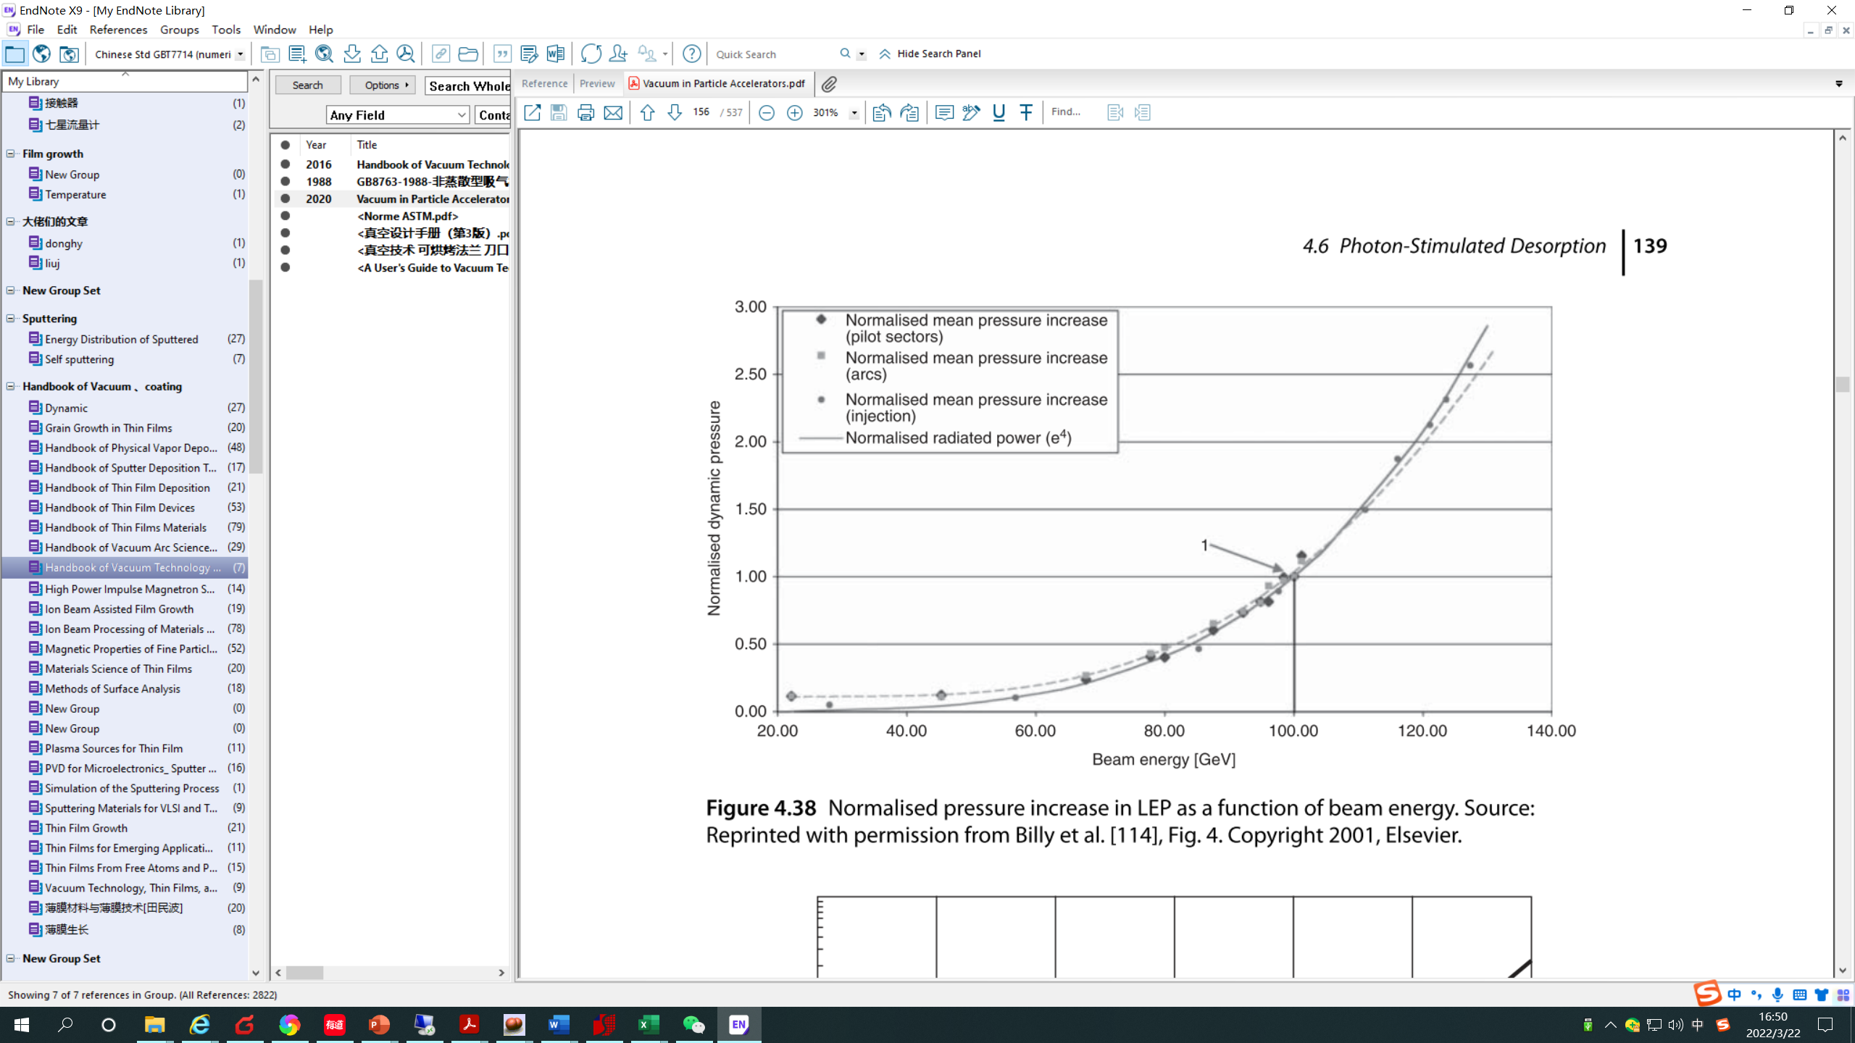
Problem
PSD （photon-stimulated desorption）as a Function of Critical Energy of SR
 | E | PSD
 | Gev | molecules/photon
Higgs | 120 | 2.00E-05
W | 80 | 1.00E-05
Z | 45.5 | 4.00E-06
tt | 180 | 1.35E-03
[4] MALYSHEV O B. Vacuum in Particle Accelerators [J]. 2020,

Slide 5
The requirement of vacuum value of Vacuum life time is 3×10⁻⁹ Torr
PSD （photon-stimulated desorption）& TD （thermal desorption）
CEPC 30MW
 | E | I | I | ρ | Psr | PSD | q_{td} | q_{lsr} | q | P_{s} | P_{max}
 | Gev | A | A | m | MW | molecules/photon | Torr·L/s·cm² | Torr·L/s·cm² | Torr·L/s·cm² | L/s | Torr
Higgs | 120 | 0.0167 | 0.0167 | 10700 | 28.64 | 2.00E-05 | 1E-12 | 8.21E-12 | 9.21E-12 | 100 | 4.40E-09
W | 80 | 0.084 | 0.084 | 10700 | 28.46 | 1.00E-05 | 1E-12 | 2.75E-11 | 1.48E-11 | 100 | 7.06E-09
Z | 45.5 | 0.803 | 0.803 | 10700 | 28.47 | 4.00E-06 | 1E-12 | 1.50E-10 | 3.09E-11 | 100 | 1.48E-08
tt | 180 | 0.0033 | 0.0033 | 10700 | 28.65 | 1.35E-03 | 1E-12 | 2.43E-12 | 1.65E-10 | 100 | 7.90E-08
CEPC 50MW
 | E | I | I | ρ | Psr | PSD | q_{td} | q_{lsr} | q | P_{s} | P_{max}
 | Gev |  | A | m | MW | molecules/photon | Torr·L/s·cm² | Torr·L/s·cm² | Torr·L/s·cm² | L/s | Torr
Higgs | 120 |  | 0.029 | 10700 | 49.74 | 2.00E-05 | 1E-12 | 1.43E-11 | 1.53E-11 | 100 | 7.29E-09
W | 80 |  | 0.147 | 10700 | 49.80 | 1.00E-05 | 1E-12 | 4.82E-11 | 2.51E-11 | 100 | 1.20E-08
Z | 45.5 |  | 1.39 | 10700 | 49.27 | 4.00E-06 | 1E-12 | 2.59E-10 | 5.28E-11 | 100 | 2.52E-08
tt | 180 |  | 0.0054 | 10700 | 46.89 | 1.35E-03 | 1E-12 | 3.98E-12 | 2.70E-10 | 100 | 1.29E-07
No NEG coating
[4] MALYSHEV O B. Vacuum in Particle Accelerators [J]. 2020,

Slide 6
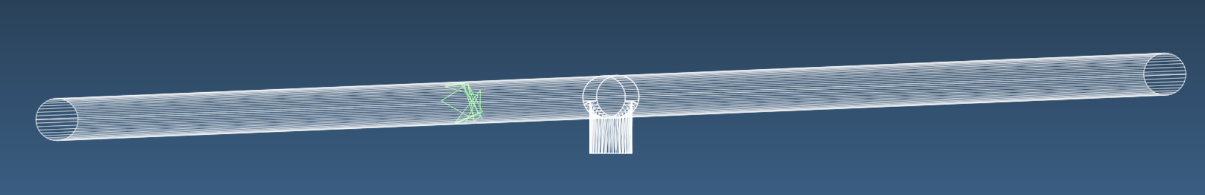
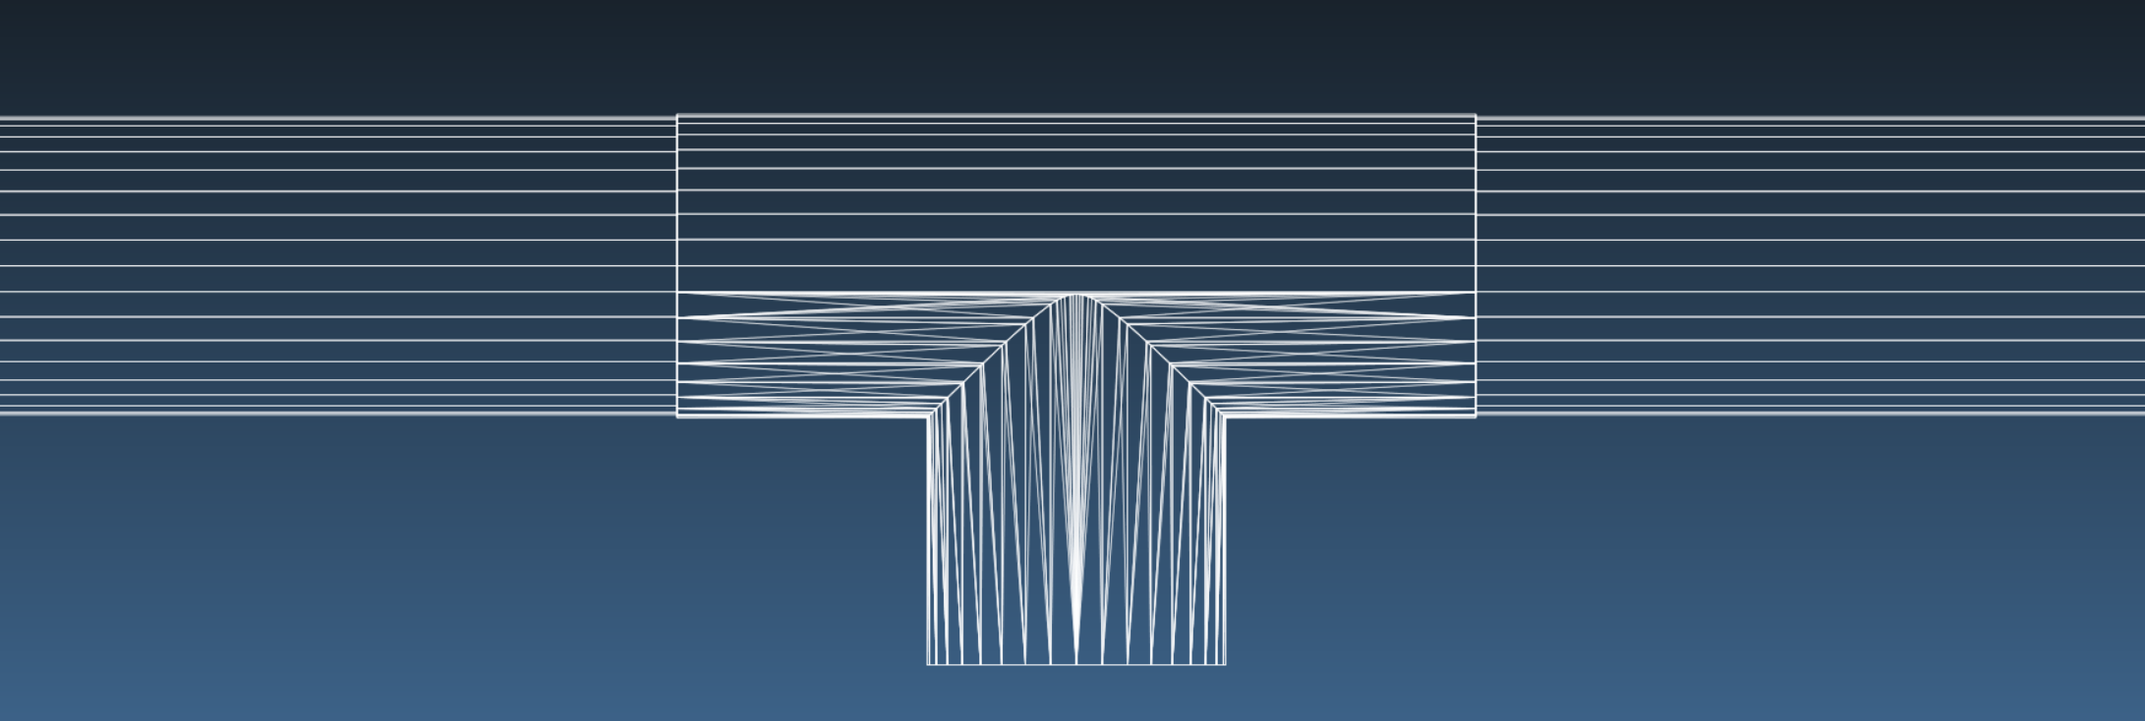
Molflow module of vacuum pipe
Solution: Al vacuum chamber NEG coating
50MW tt
30MW tt
50MW tt
Pump, gauge
Sticking factor is 0.002 (pumping speed H₂ is 0.088L/s·cm²)
Al vacuum chamber NEG coating
Activation temperature do not permit to exceed 180 ℃；
the mechanical stress and deformation due to a 200 °C bake were well within acceptable limits from ESRF tests. [5]
[5] KERSEVAN R. PERFORMANCE OF A NARROW-GAP, NEG-COATED,EXTRUDEDALUMINIUM VACUUM CHAMBER AT THE ESRF [J]

Slide 7
Pumping speed test of NEG coating
Life time test of NEG coating in Beijing
1 um

Slide 8
Absorbing speed of NEG coating at different activation temperature vs time
140h
150h
140h
130h
No63（2）降温27小时后测
After 11 months N2 storage
After 7 months Ne storage

Slide 9
Cost increase due to NEG coating of electron ring
NEG coating | Total length | Price | Cost
TiZrVHf | m | CNY/m | Million CNY
1:1:1:1 | 100,000 | 0.15 | 150

Slide 10
Thank You

