Slide 1
Ramping setup for CEPC booster ChenTao

Slide 2
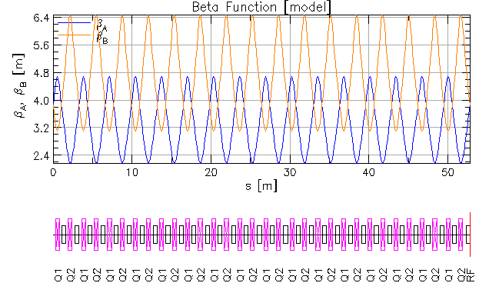
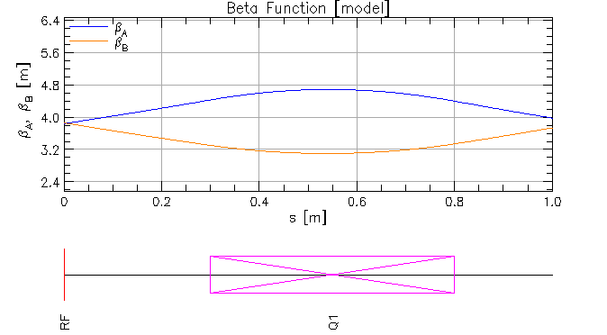
Benchmark to F-S formula
Use a simple ring :
For a certain $ε_{N}$ :
$ε=\frac{ε_{N}}{βγ} ;y=\sqrt{βε_{rms}} ; y^{′}=−α\sqrt{\frac{ε}{β}}$ ——tracking spin of the particle
Calculate resonance strength by DEPOL or theoretical formula
F-S equation: After crossing isolated resonance , the final polarization
and initial polarization satisfy the equation:
$$\frac{P_{f}}{P_{i}}=2e^{−π\frac{{\left|ε\right|}^{2}}{2α}}−1$$
$$β_{B}\left(0\right)=3.861m$$
$$α_{B}\left(0\right)=1.0097$$

Slide 3
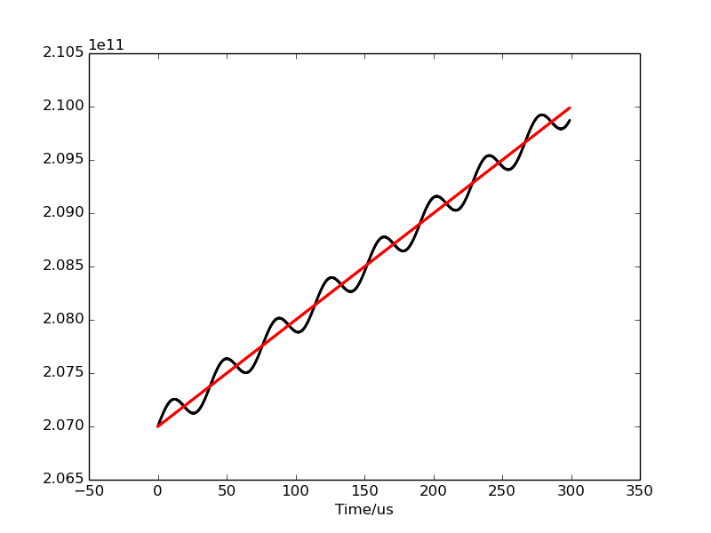
Benchmark to F-S formula
Ramping curve
Notice:
1. one resonance may be crossed twice or more times
Carefully choose parameters to avoid this
2. The crossing speed is not the previously set value
Calculate the crossing speed at the crossing point
Resonance location

Slide 4
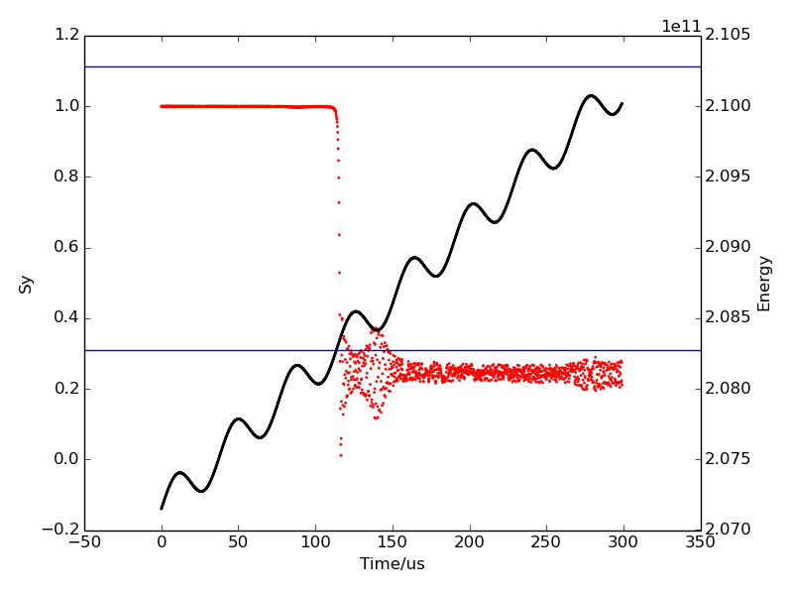
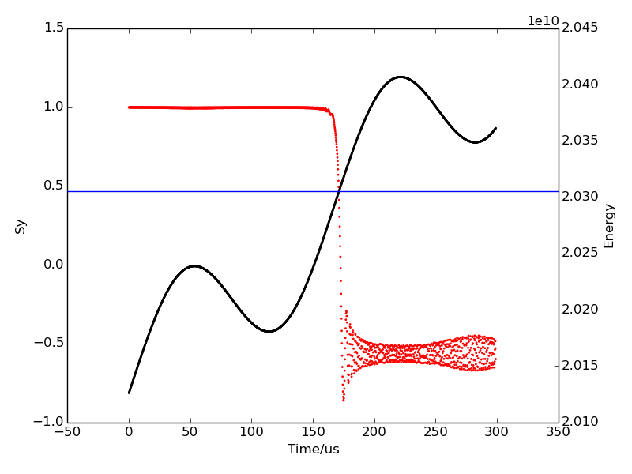
Benchmark to F-S formula
Result of a single proton:
normalized emittance=0.1
Resonance strength = 0.024768 at K=398.08
Slope at crossing point:
$\frac{dE}{dt}=\frac{2.08290125256 − 2.08255002618}{114.128123−113.071392}=3.32371∗{10}^{13}$eV/s
$$\frac{dGγ}{dθ}=0.00177949$$
$$\frac{P_{f}}{P_{i}}=2e^{−π\frac{{\left|ε\right|}^{2}}{2α}}−1=0.248$$
Electron:
normalized emittance=500
Resonance strength = 0.0151543
$$\frac{P_{f}}{P_{i}}=2e^{−π\frac{{\left|ε\right|}^{2}}{2α}}−1=−0.6389$$
4

Slide 5
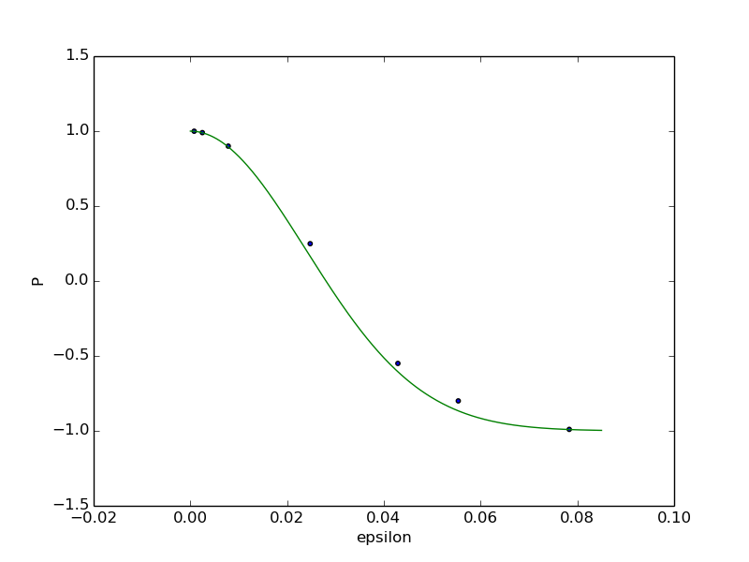
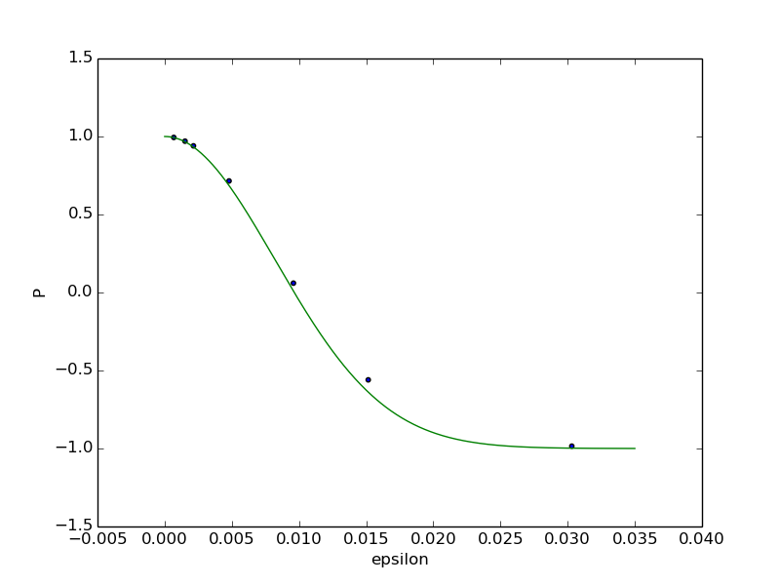
F-S formula vs. simulation
Result of proton
Result of electron
The blue line is theoretical curve Crossing speed fixed
The maximum difference between theoretical value and simulation is 10%

Slide 6
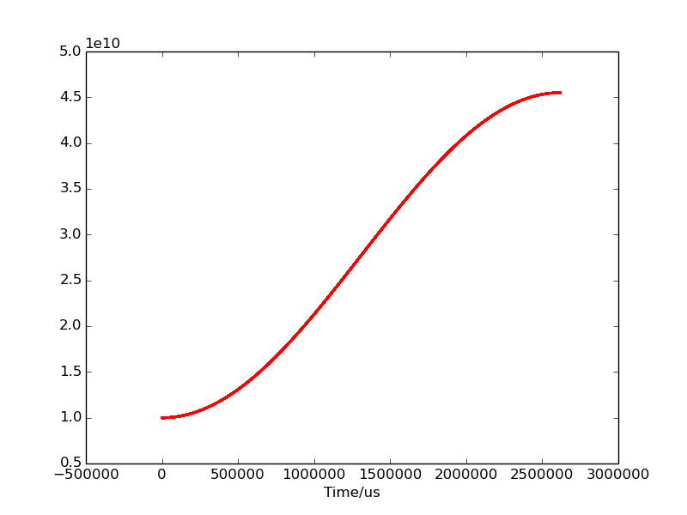
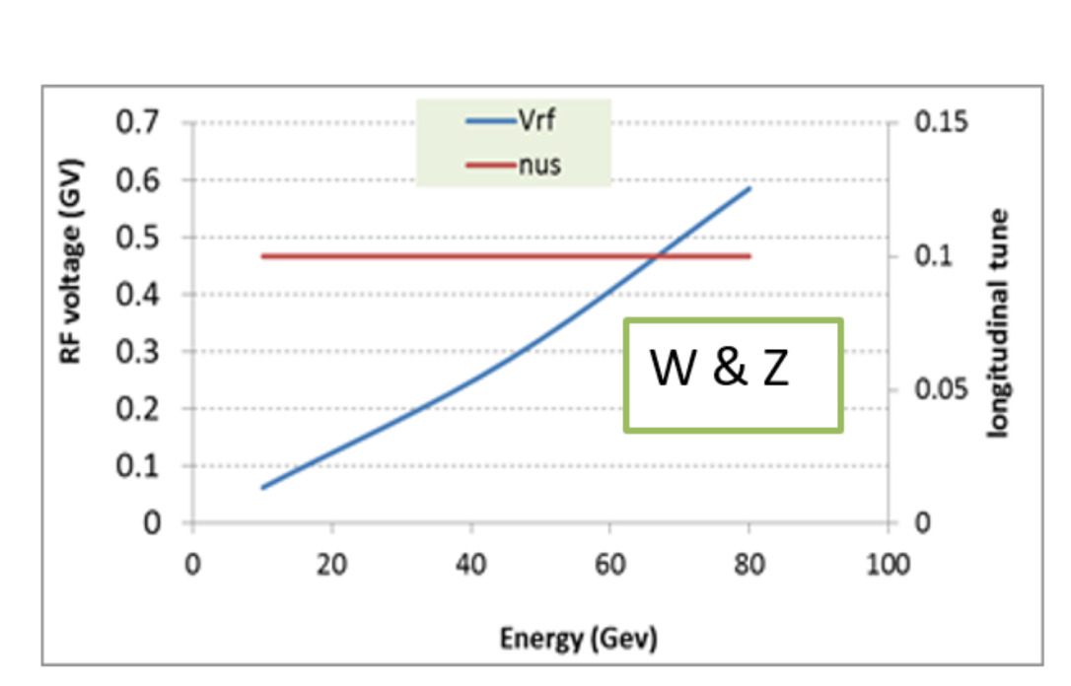
Ramping in CEPC booster
Designed ramping curve in CEPC booster:
During the ramping , the synchrotron tune is fixed:

Slide 7
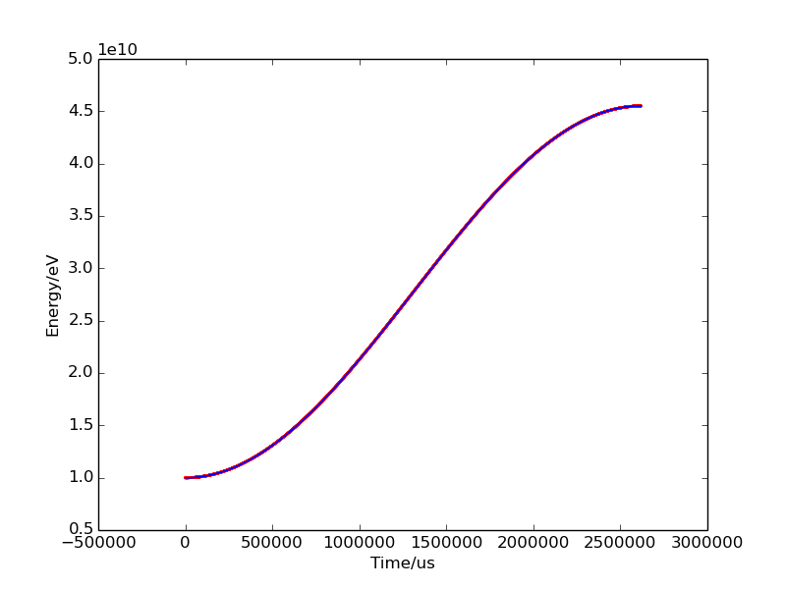
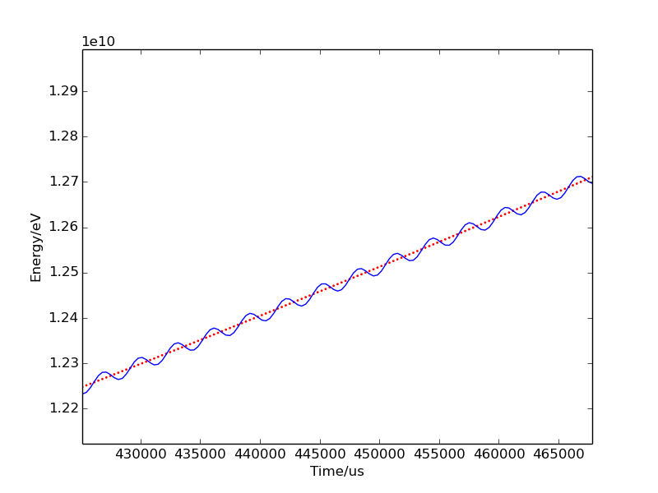
CEPC booster ramping simulation
one resonance may be crossed twice or more times ,
So Previous simulation results may need to be reanalyzed

Slide 8
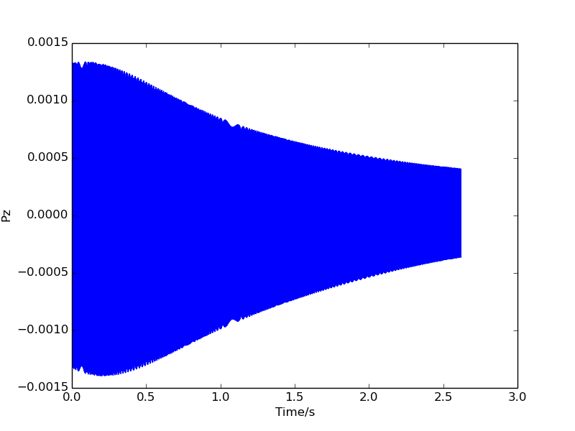
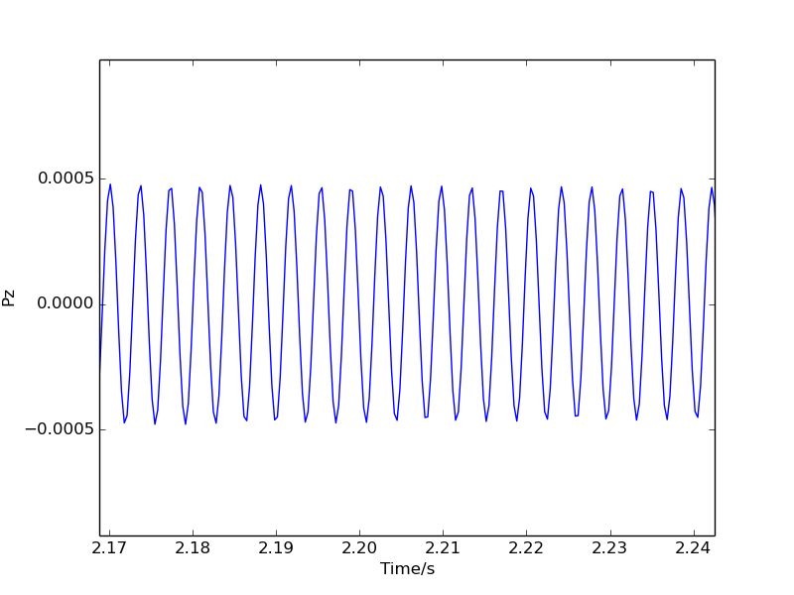
Synchrotron tune
$$P_{z}=\frac{ΔE}{E}$$

Slide 9
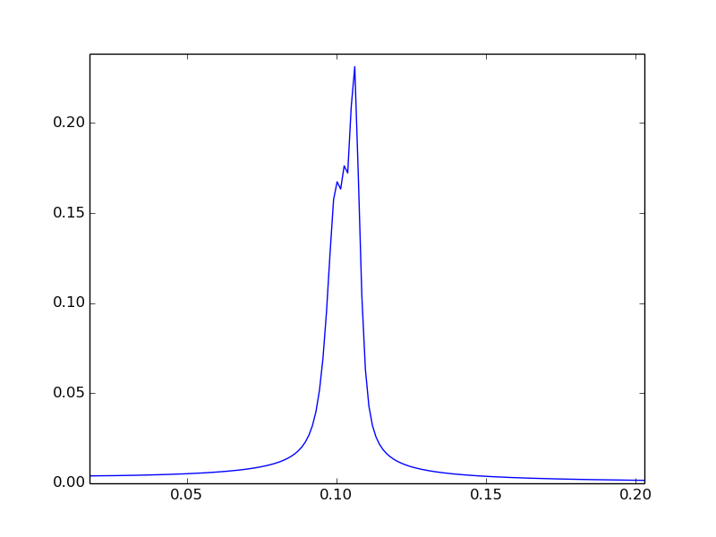
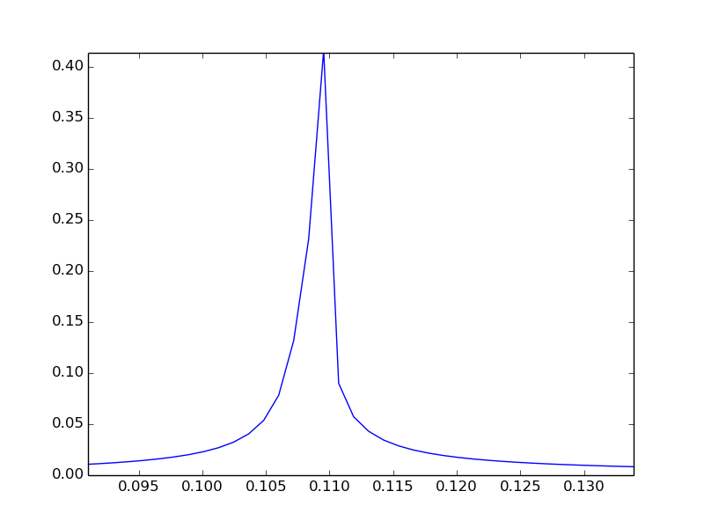
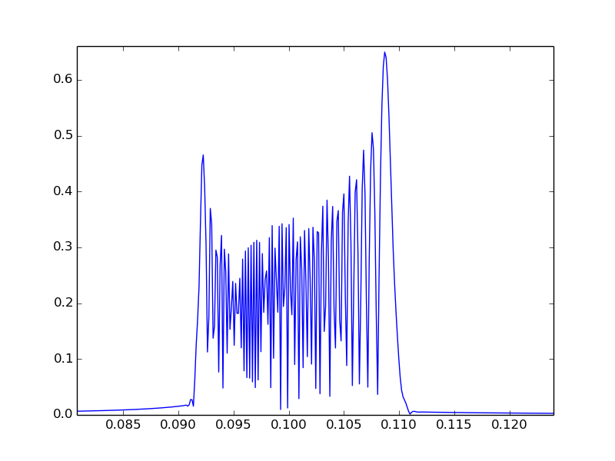
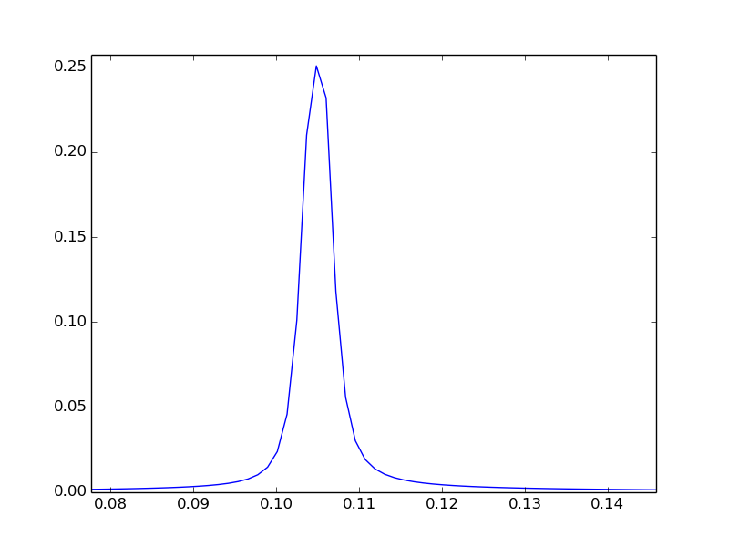
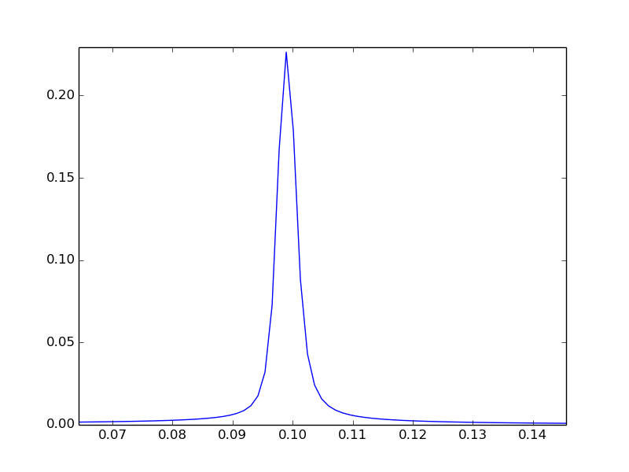
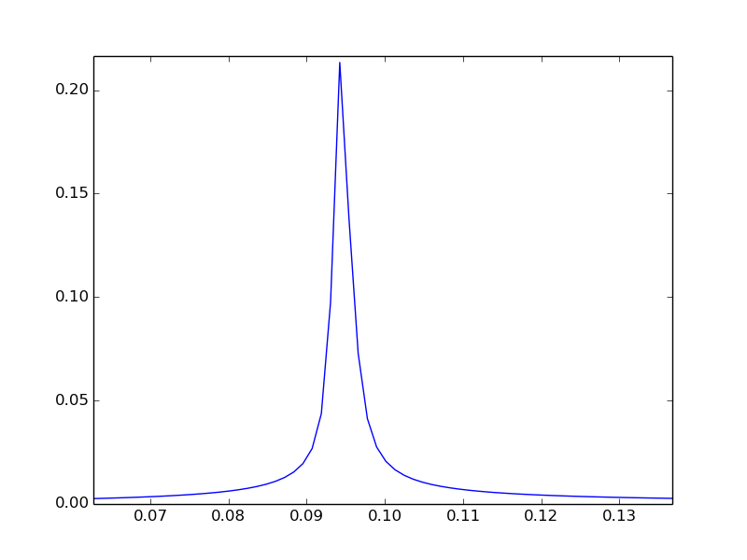
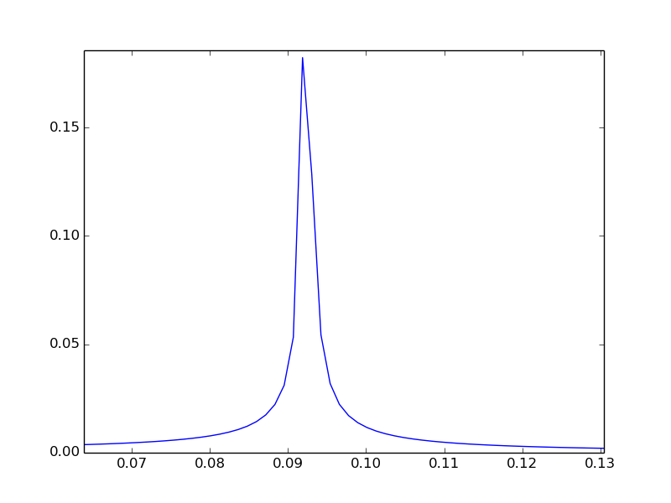
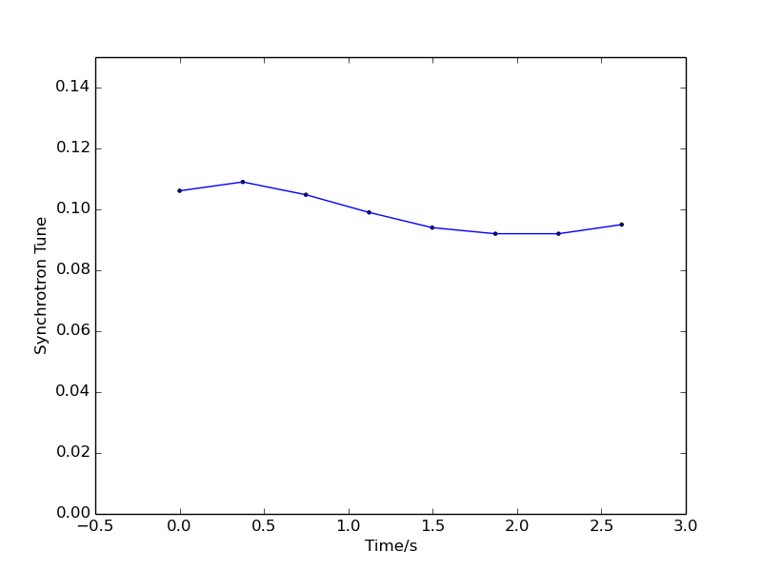
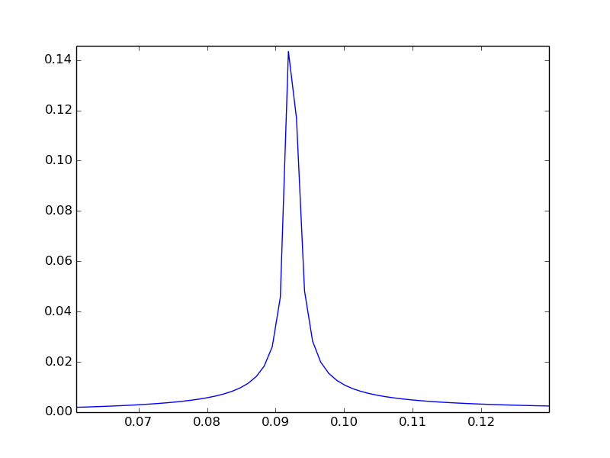
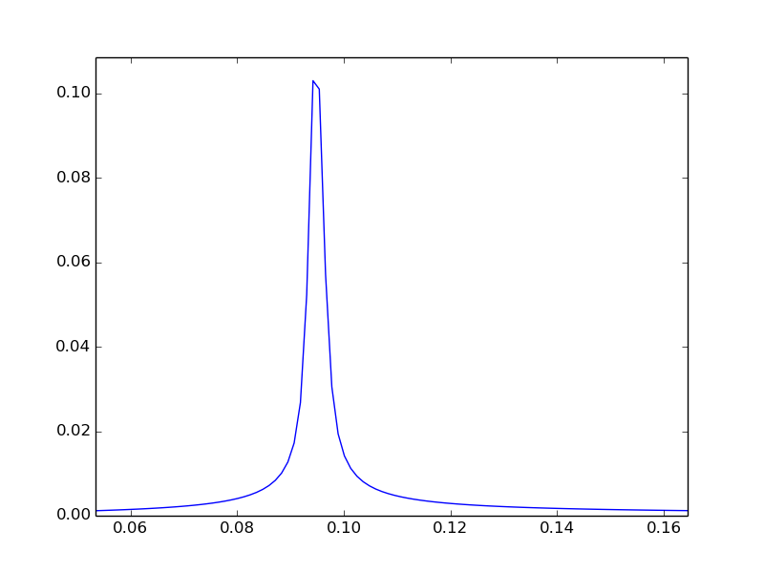
spectrum analysis
Fourier transform expansion of pz：
Divide pz into eight segments by time, and do Fourier analysis for each segment separately：
1
2
3
4
Synchrotron tune:
5
6
7
8

