Slide 1
Energy and position resolution of Crystal Fan Ecal for CEPC
Xiao Zhao, Huaqiao Zhang (Institute of High Energy Physics, CAS)
09/03/2022

Slide 2
Outline
Crystal Fan Ecal: basic concept
Energy and position resolution study
Comparison of different transverse segmentations (layers)
Comparison of different reconstruction method for Crystal Fan
Comparison of different structure
Reconstruction method for Cross Crystal Fan
Summary
Notes:
The impact on the detector performance is studied in different aspects

Slide 3
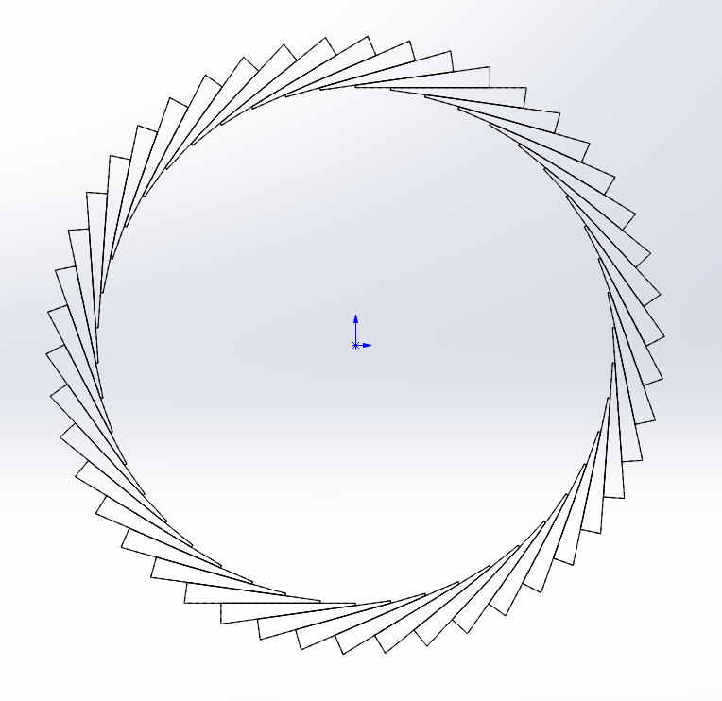
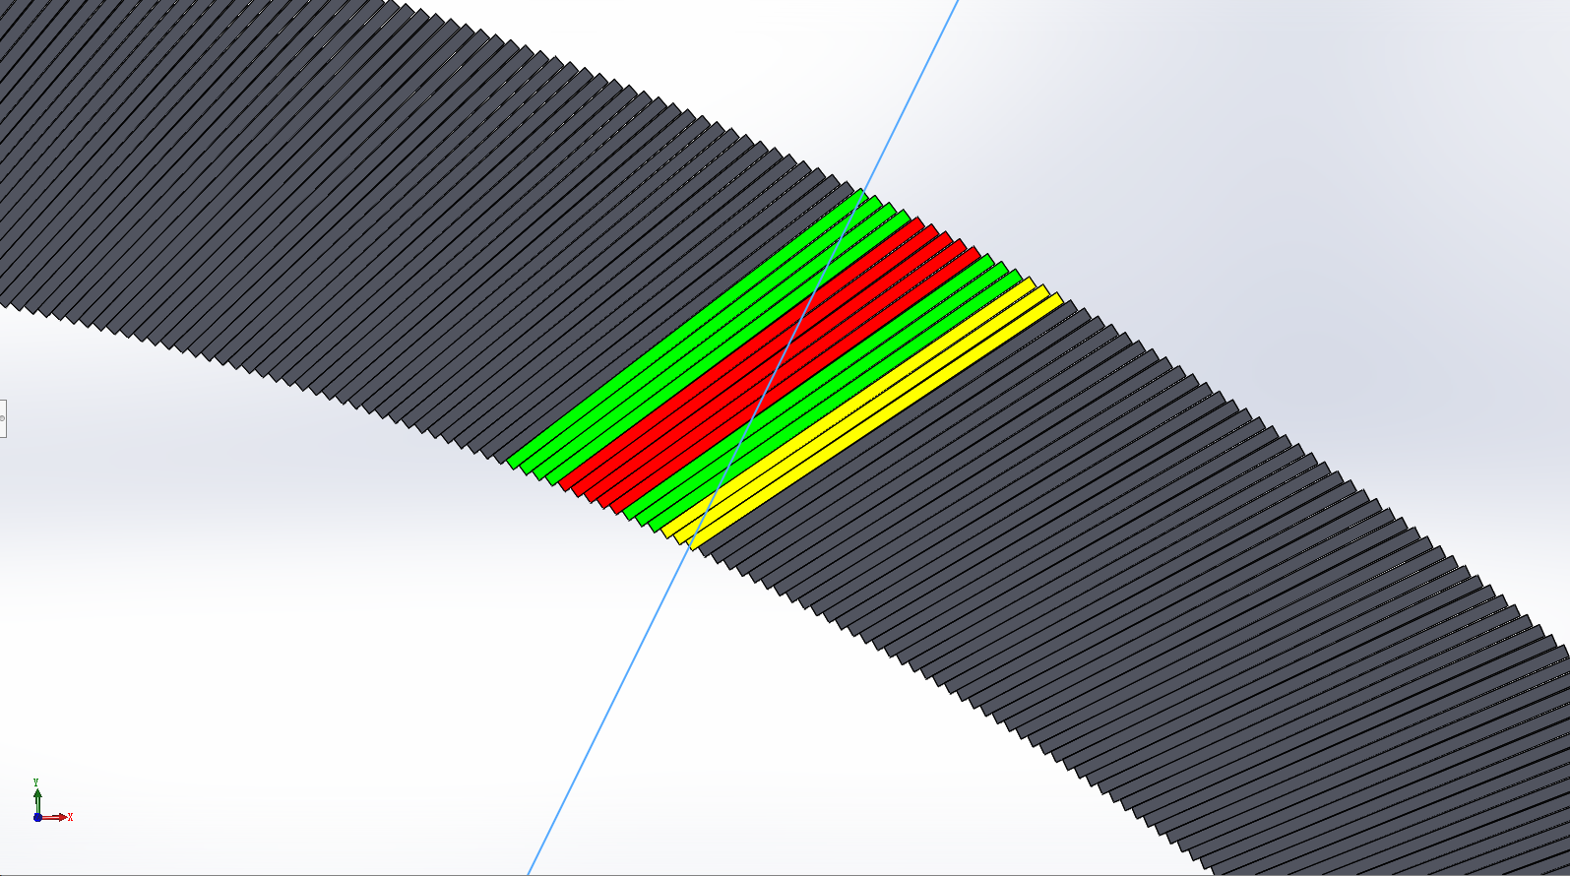
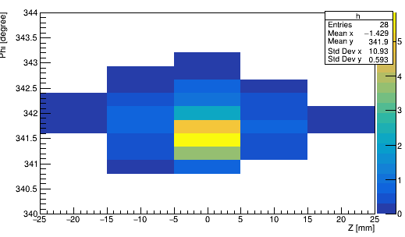
Basic concept
alpha
Alpha = 30 °
14 layers
Crystal not pointing back to IP (Z axis)
Angle with inner det. radius is alpha
alpha <= 90°
Transverse Segmentation
Different number of layers
Uniform along Z
r2 = 1.9 m, r1 = 2.2 m
D
r1
φ
r2
Cited : Huaqiao Zhang, New idea of Crystal fan(晶扇) Ecal for CEPC
Huaqiao Zhang, New idea for Crystal ECAL configuration
Notes:
The basic unit is a wedge-shaped crystal

Slide 4
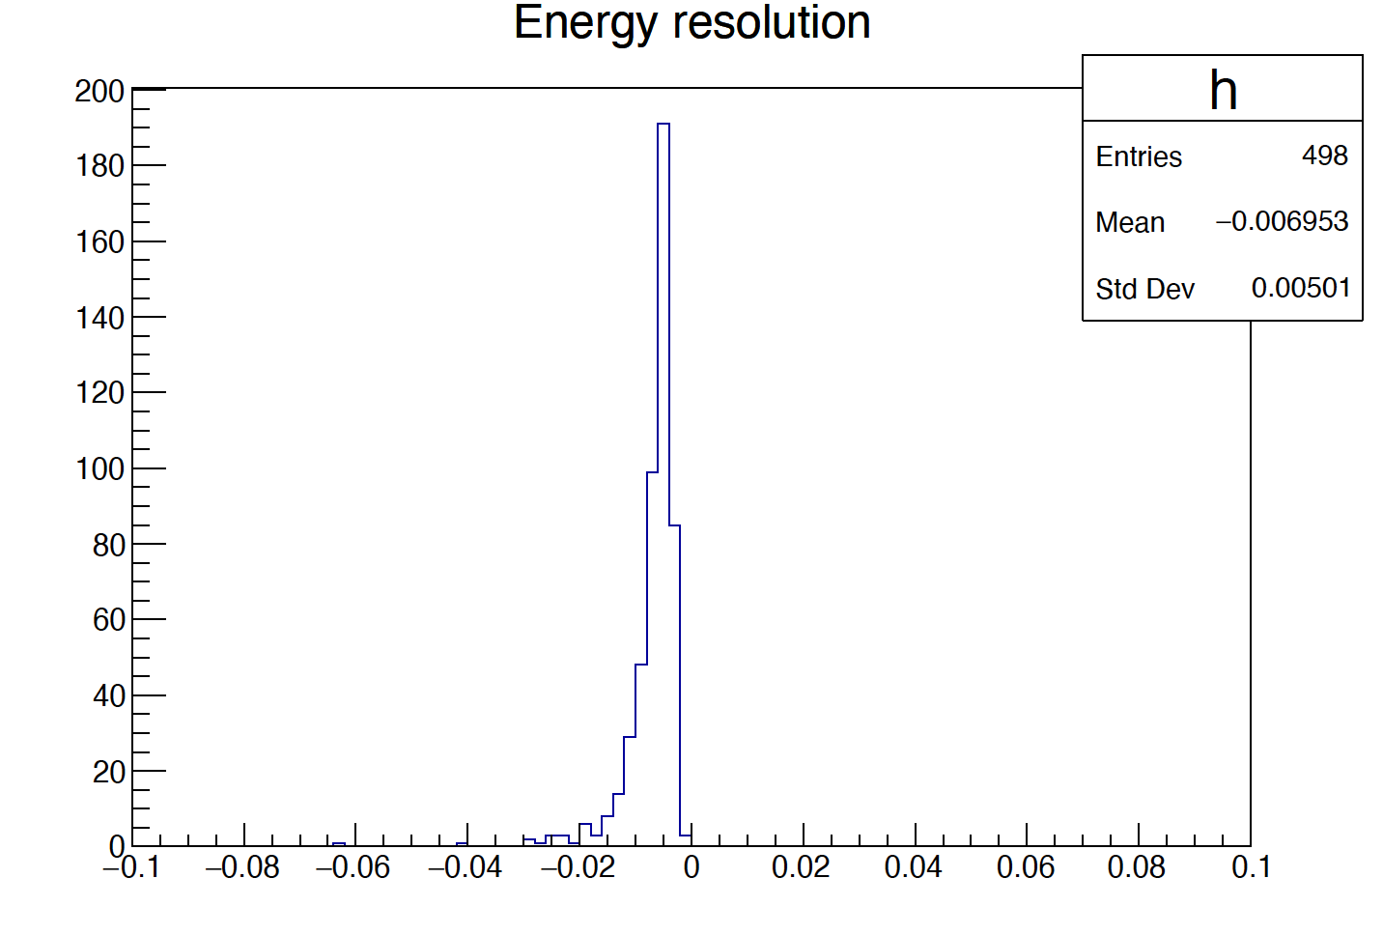
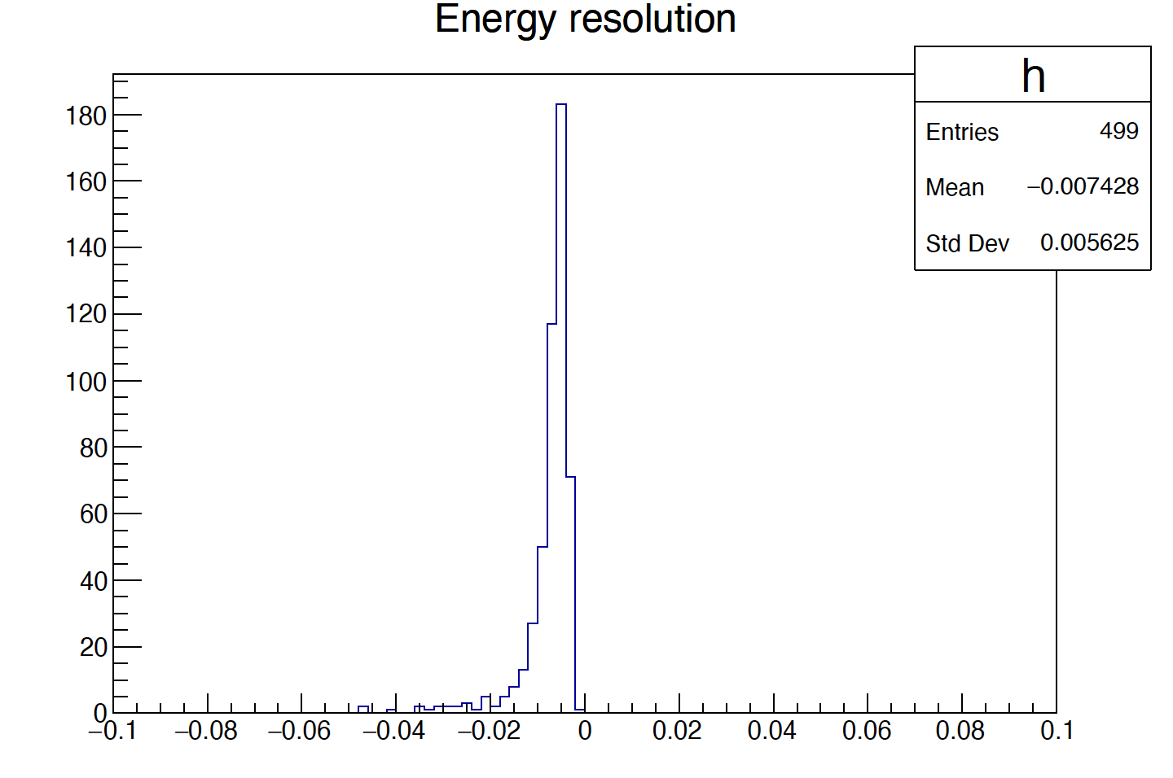
Energy resolution
The following plots are done with event generated using
phi = 10~350°， theta = 90°，E =30 GeV photon
14 layer
Alpha = 30°
5 layer
Alpha = 10°
10 layer
Alpha = 20°
E resolution ~0.5%

Slide 5
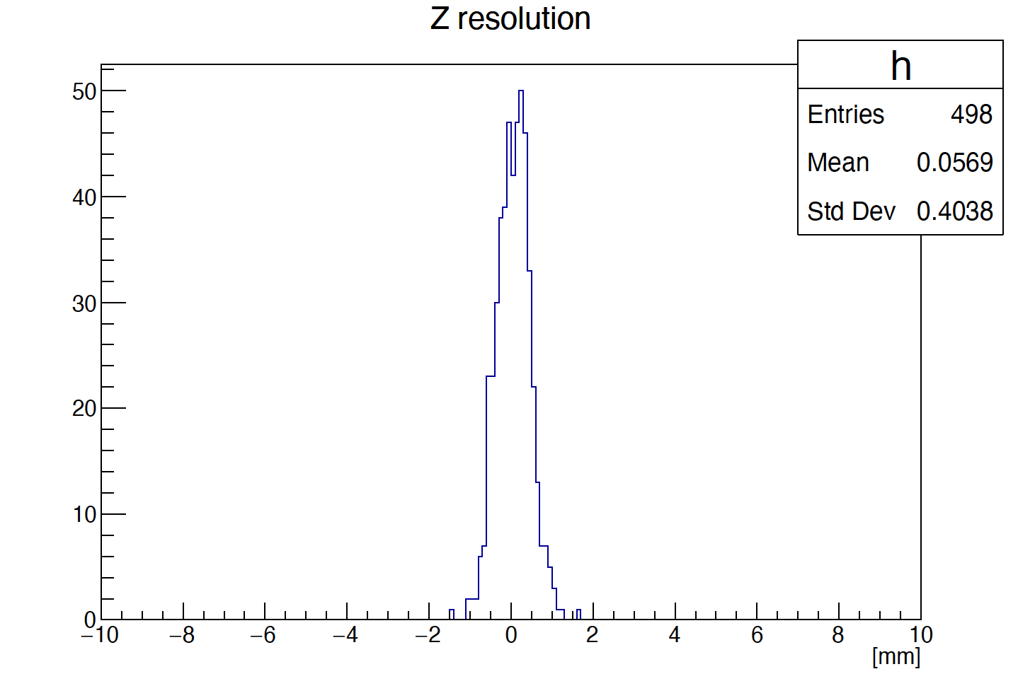
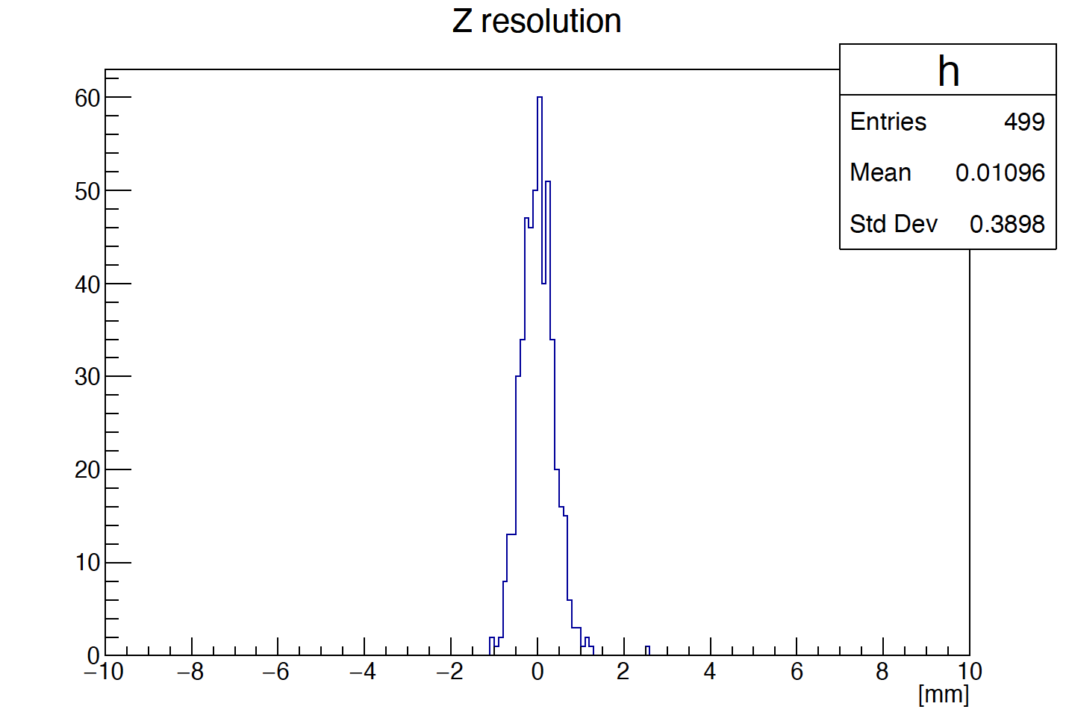
Z resolution
14 layer
Alpha = 30°
10 layer
Alpha = 20°
5 layer
Alpha = 10°
Z resolution ~0.4 mm

Slide 6
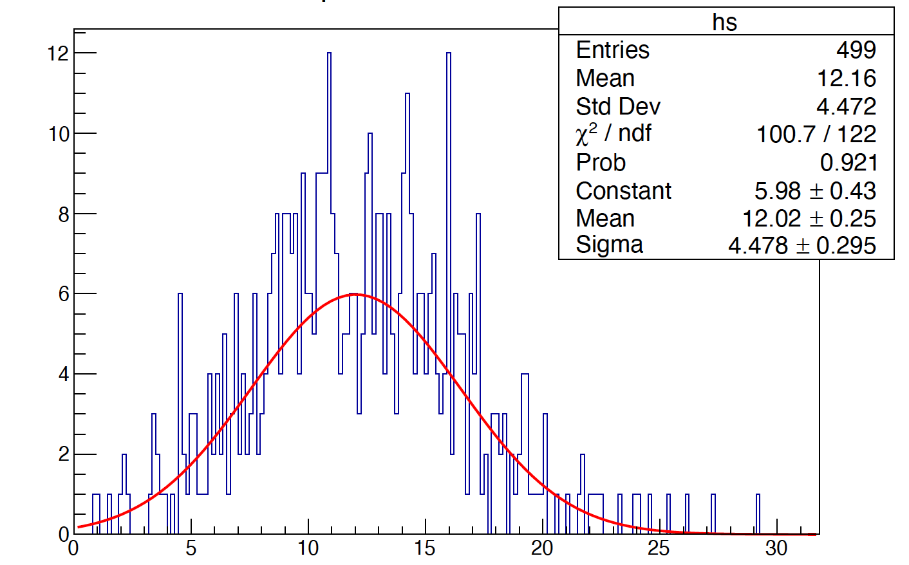
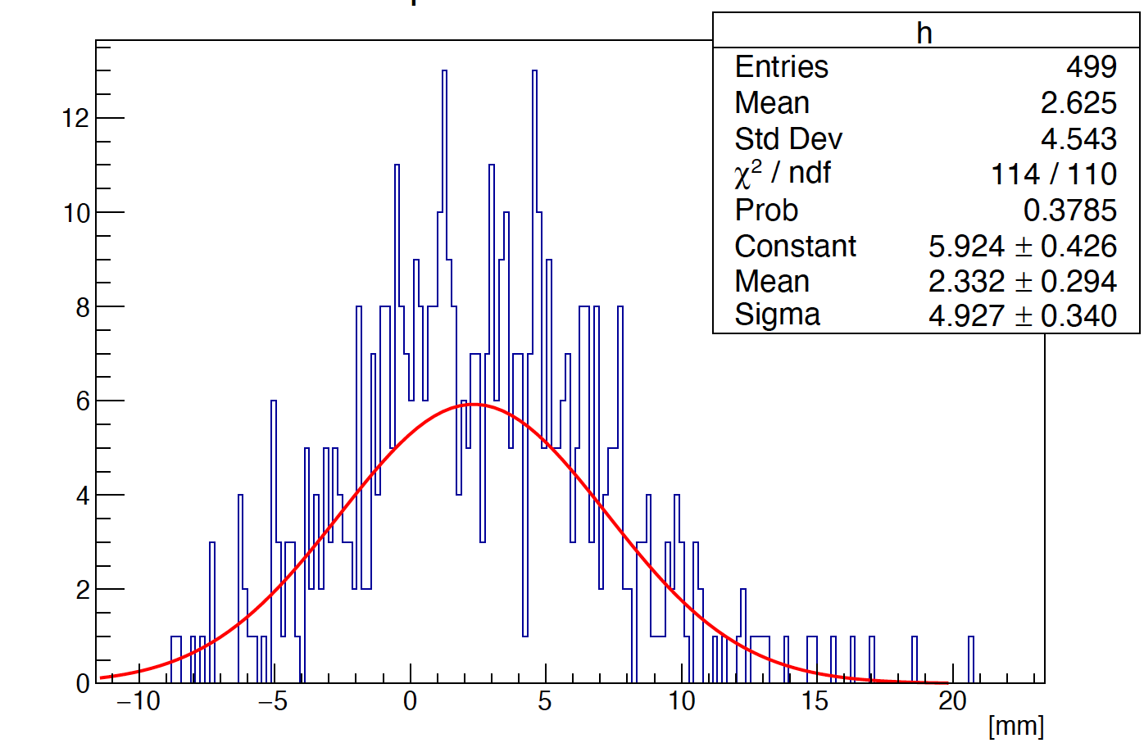
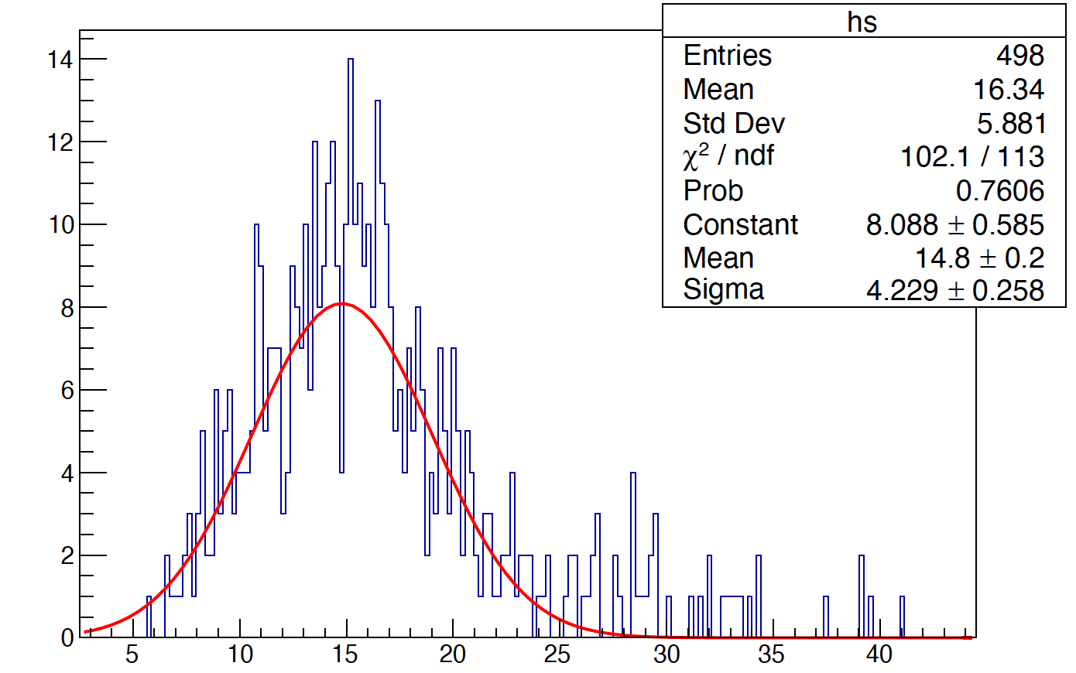
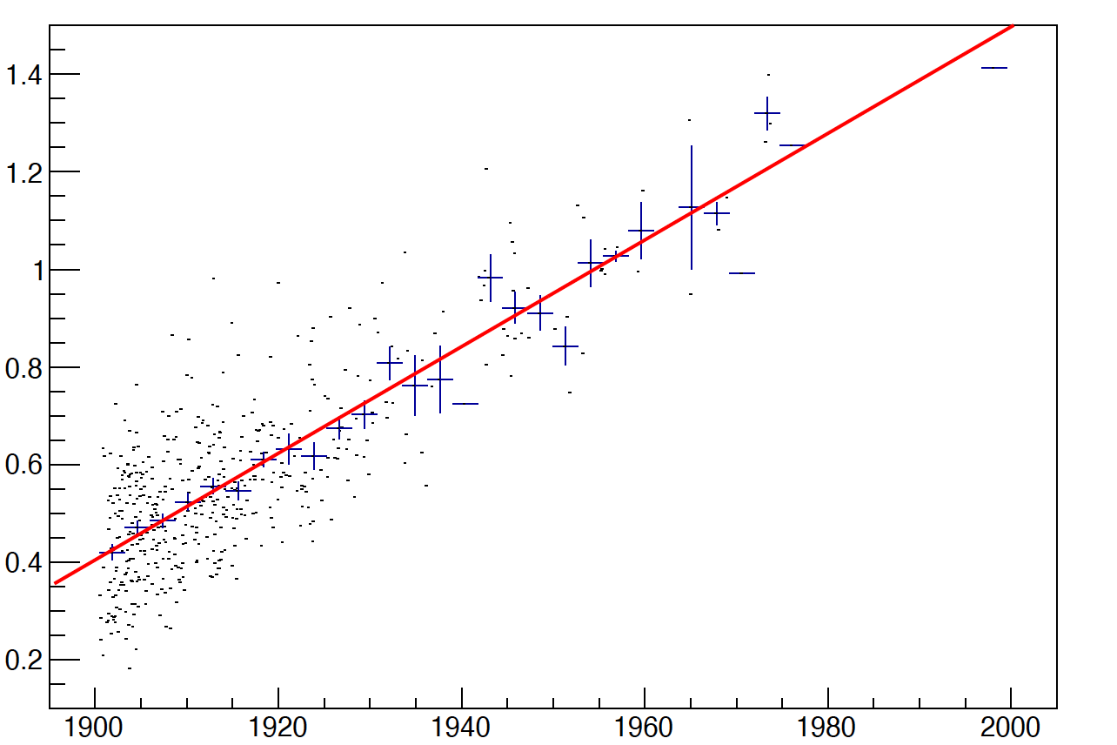
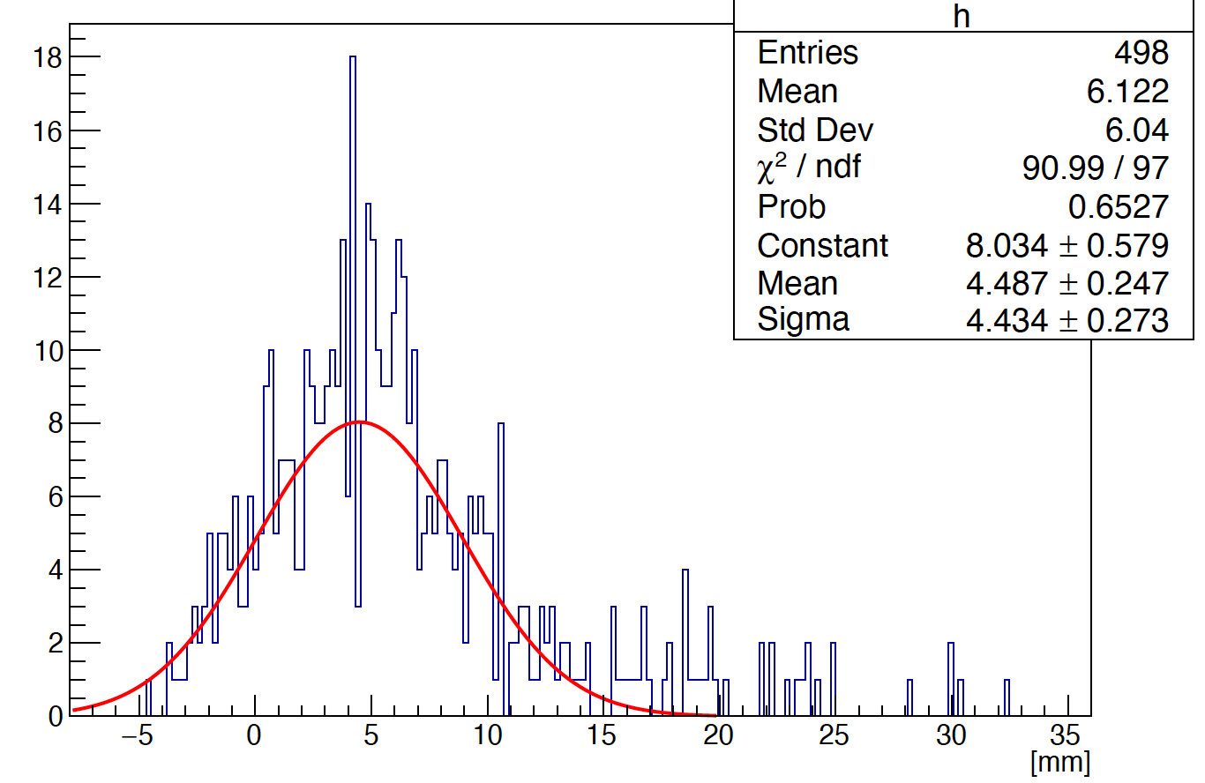
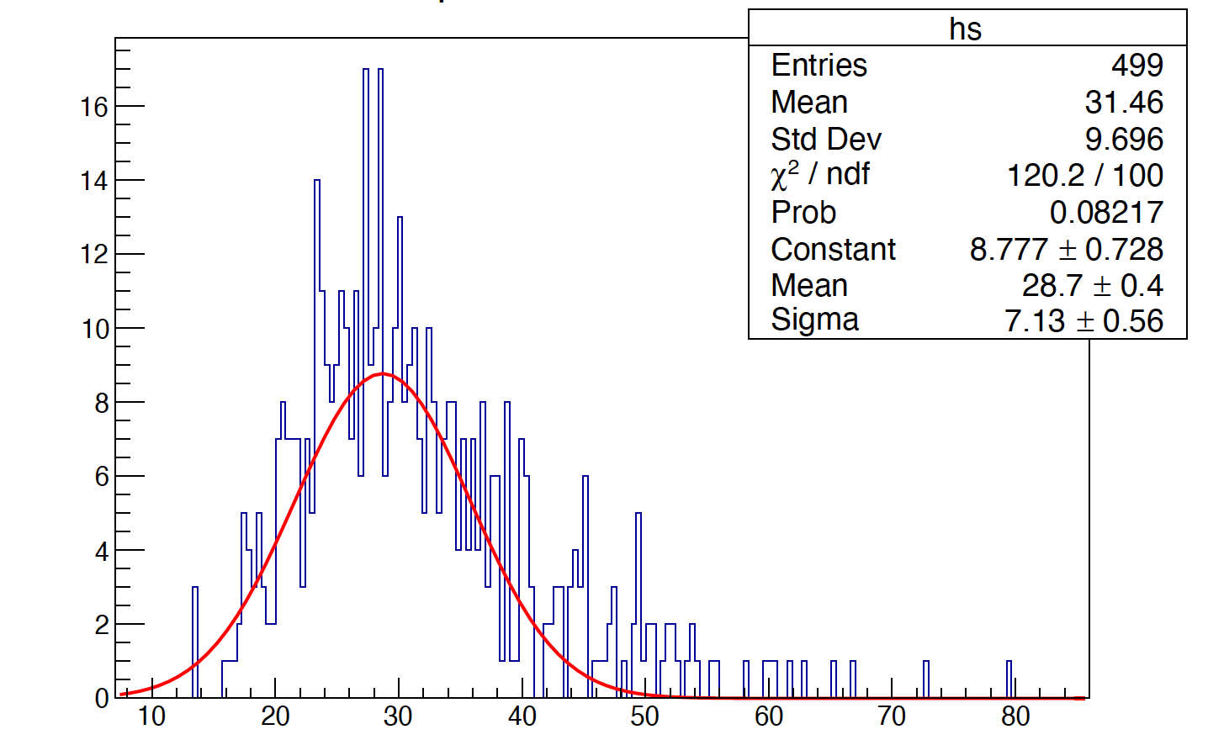
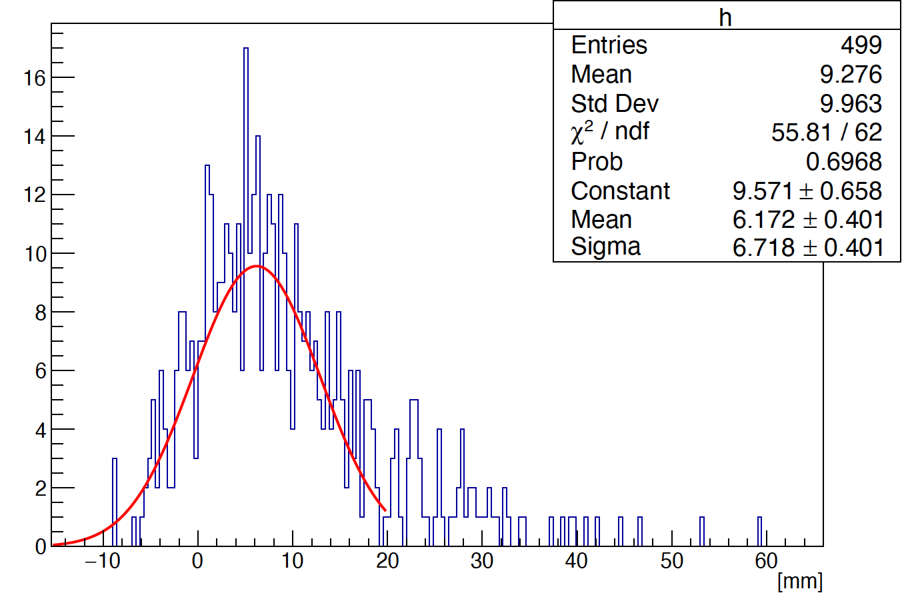
Phi reconstruction (method 1)
The bias is introduced by the shower start point through the rotated crystal angle (alpha)
A liner fit (use truth start point) is used to fix the bias
5 layer
phi
10 layer
R
14 layer

Slide 7
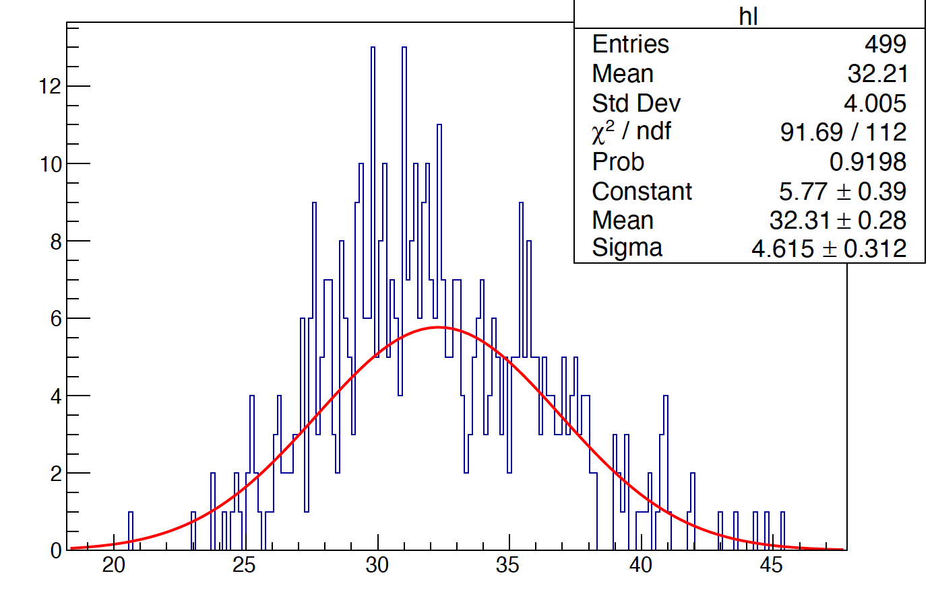
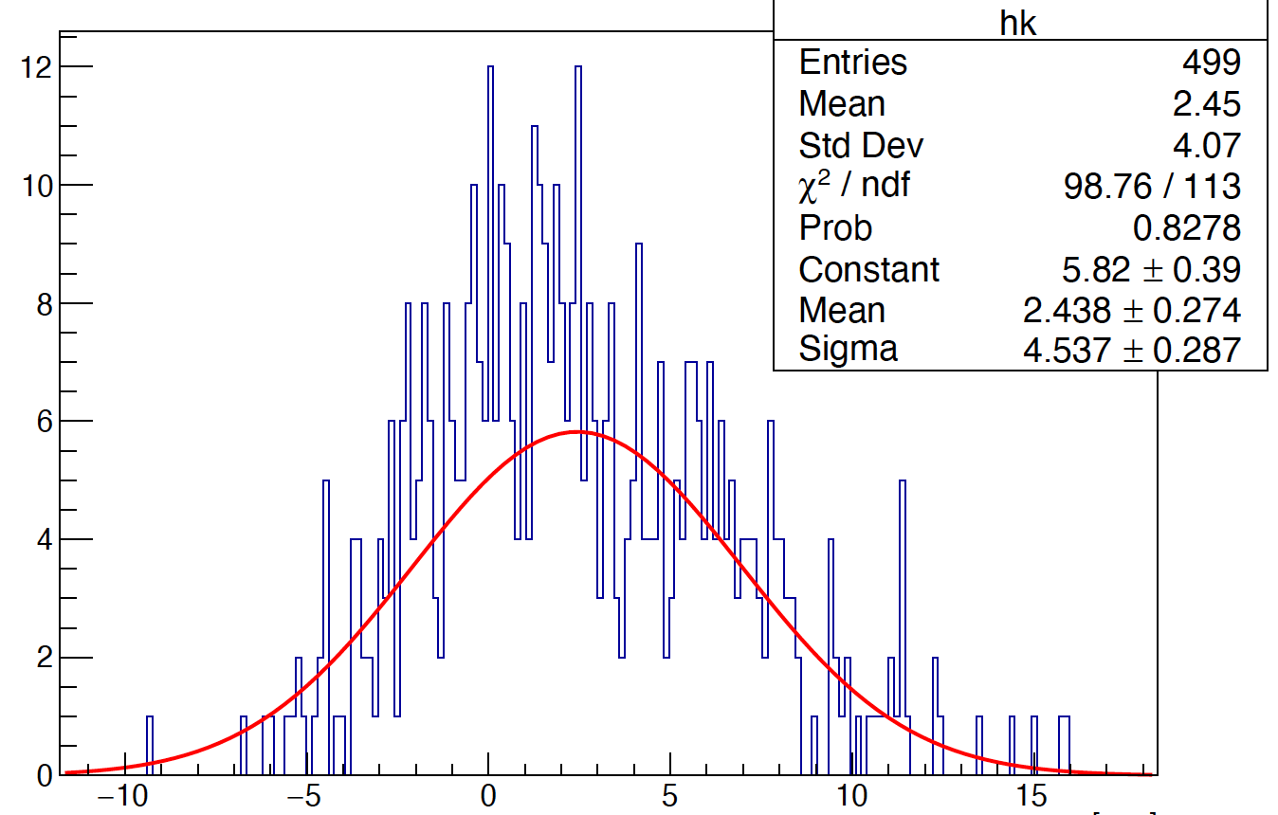
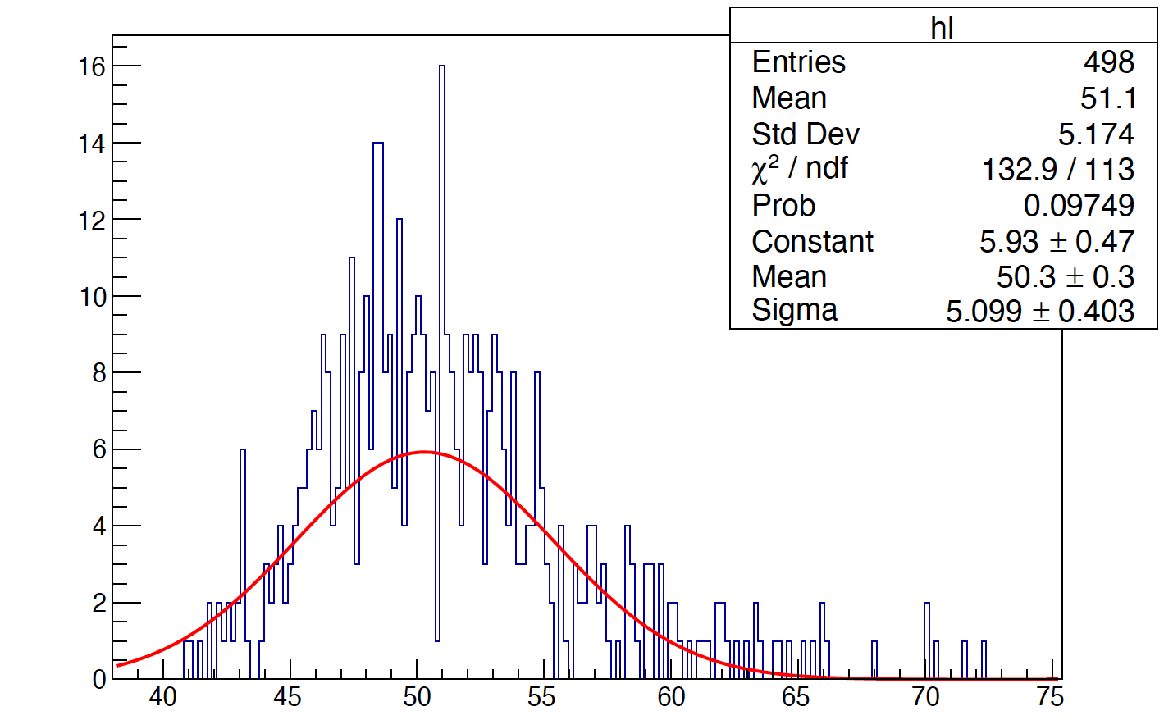
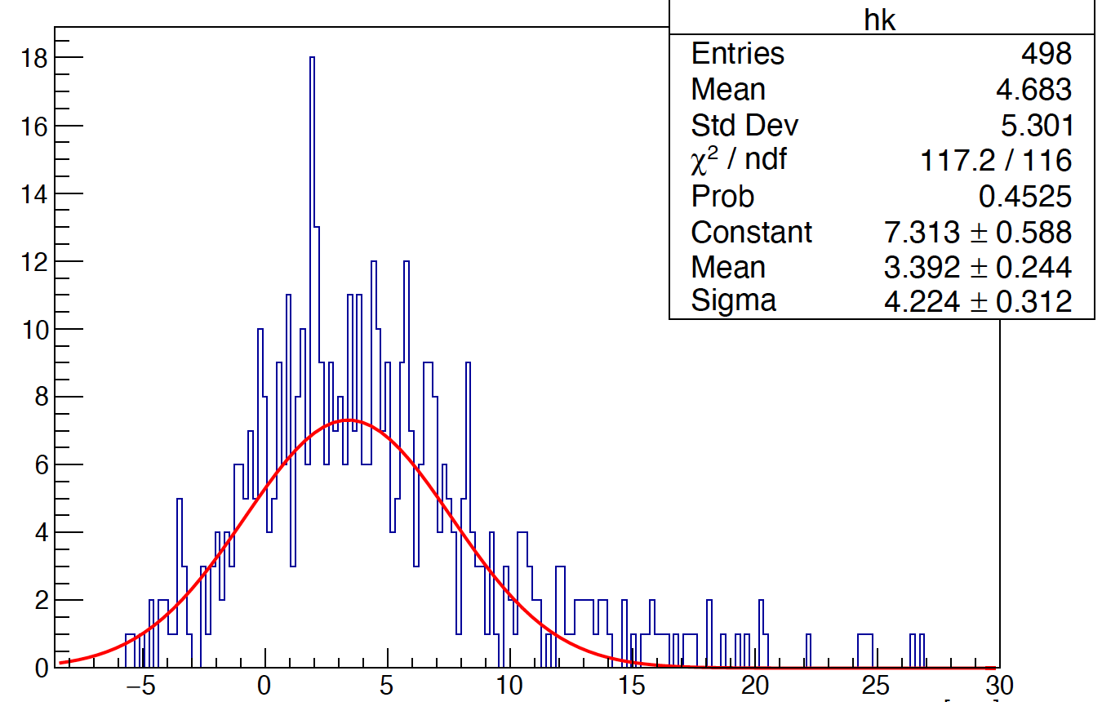
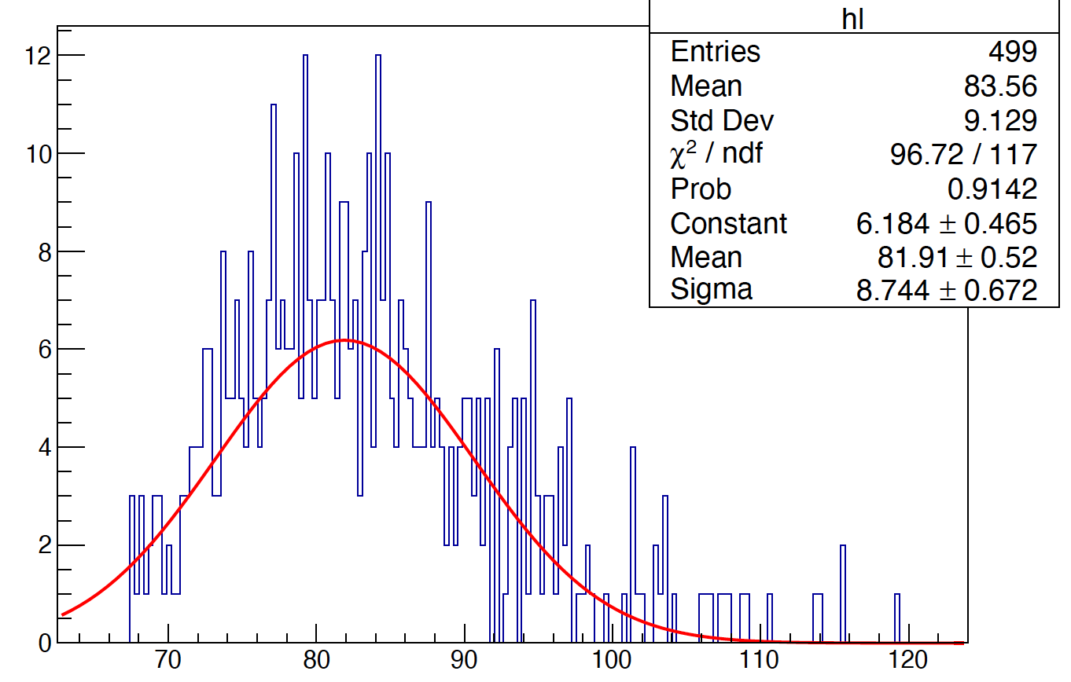
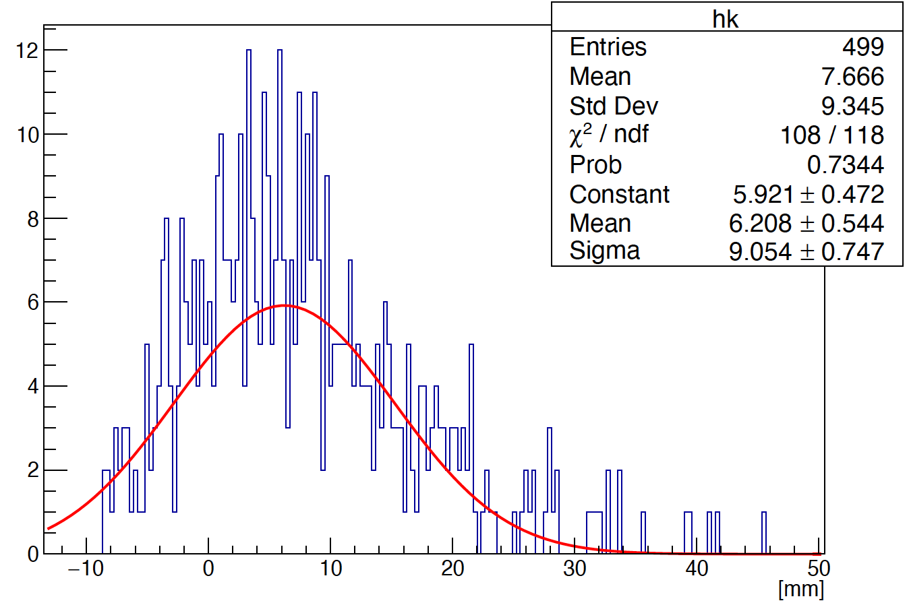
Phi reconstruction (method 2)
5 layer
phi is obtained by the method of
averaging phi :
10 layer
$$\sum_{i=0}^{n}{{phi}_{i}}$$
$$phi= \frac{1}{n}$$
Liner fit
14 layer

Slide 8
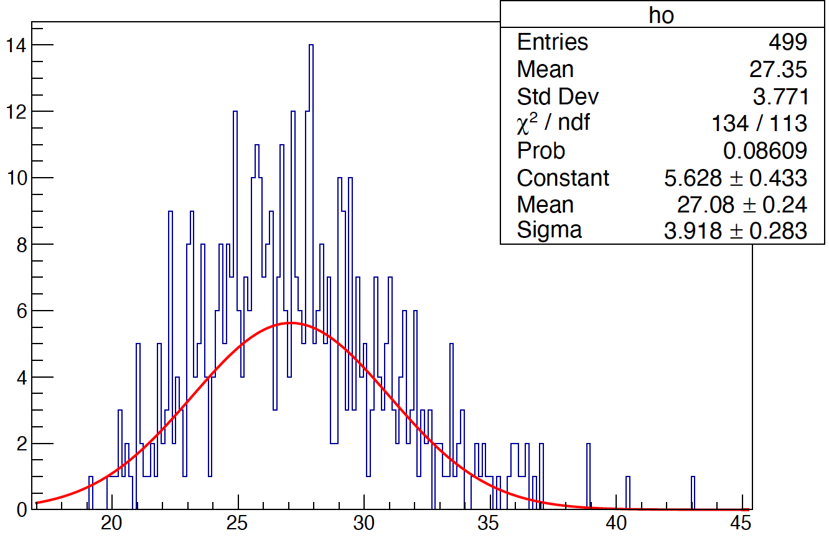
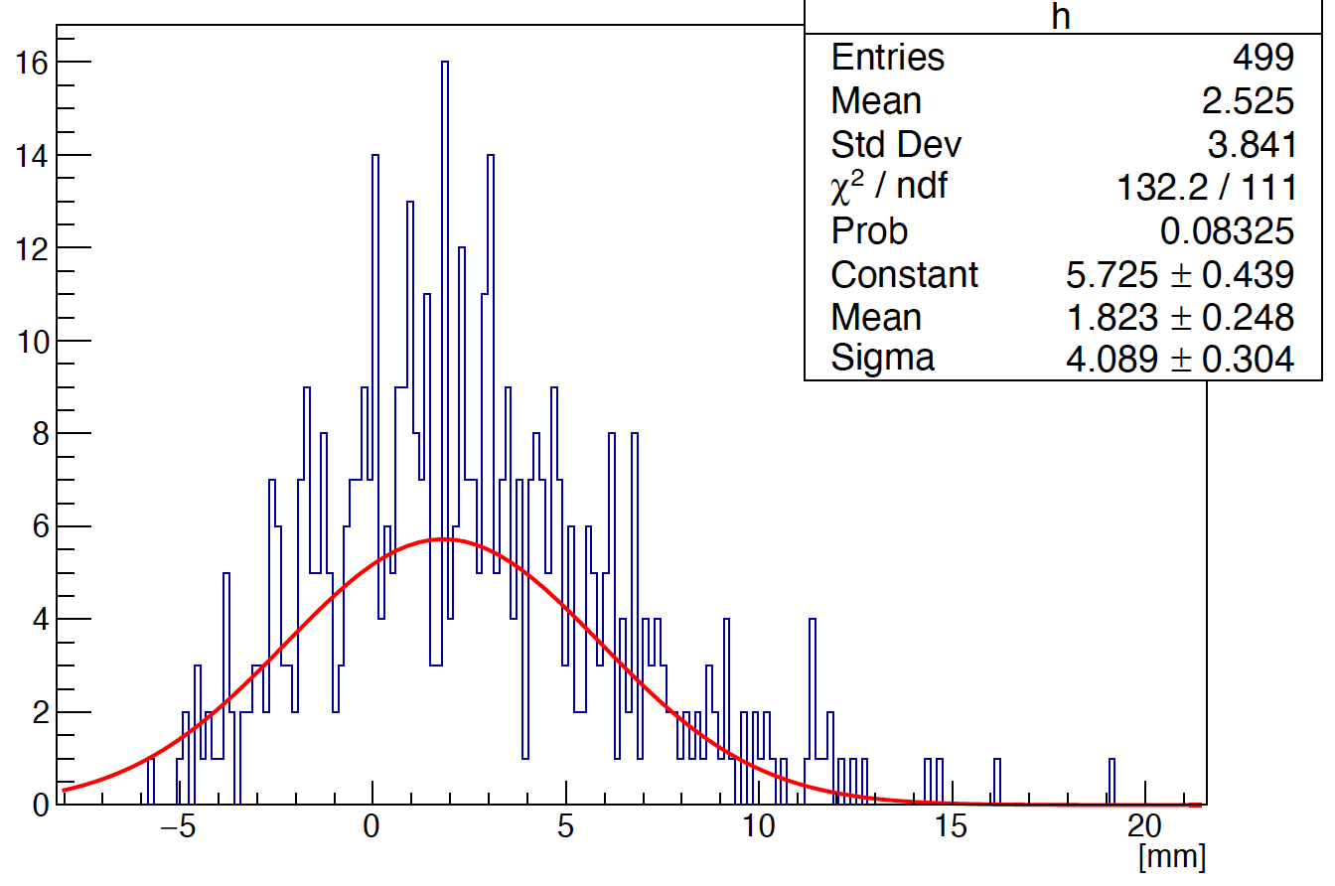
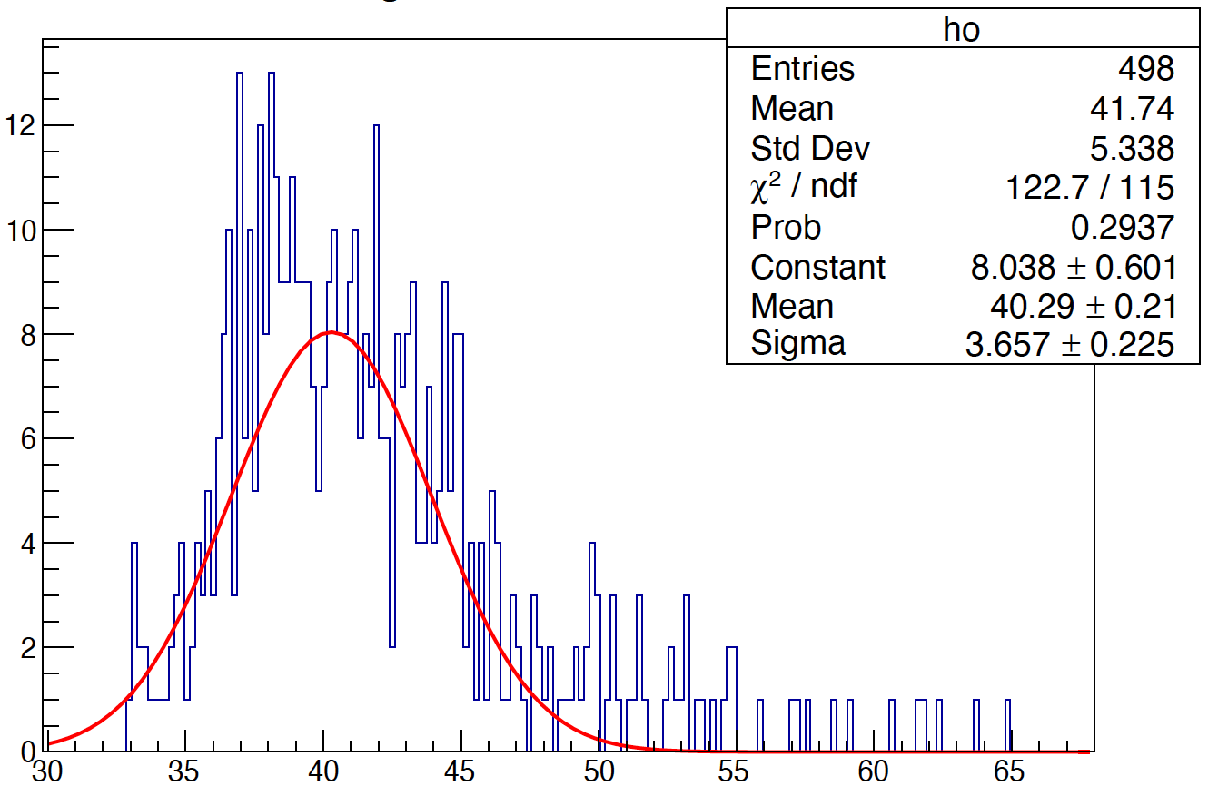
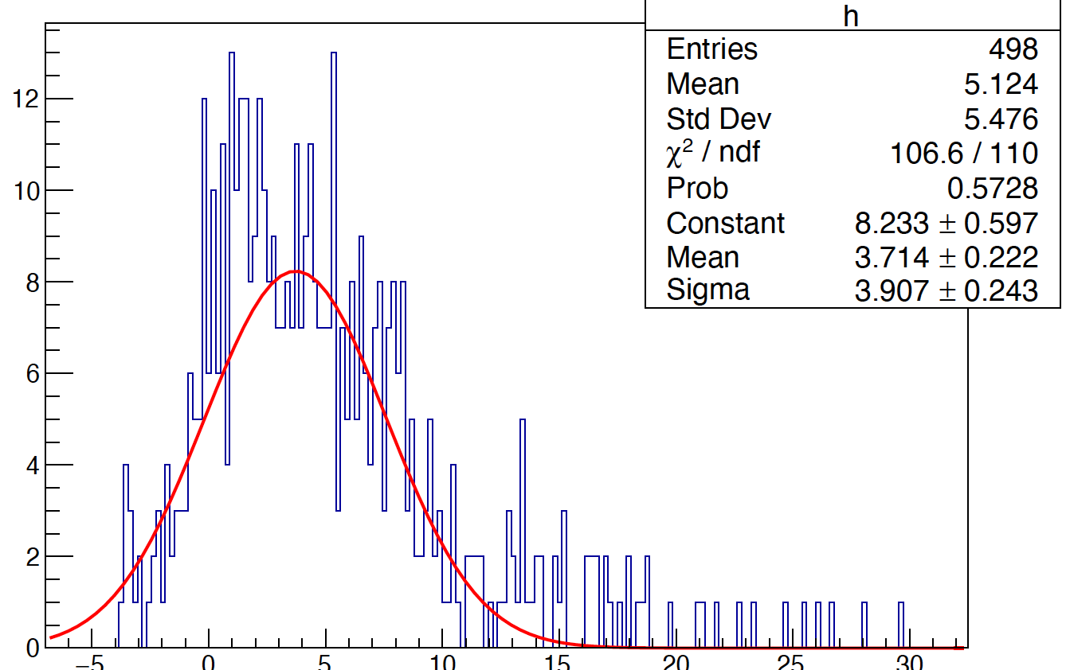
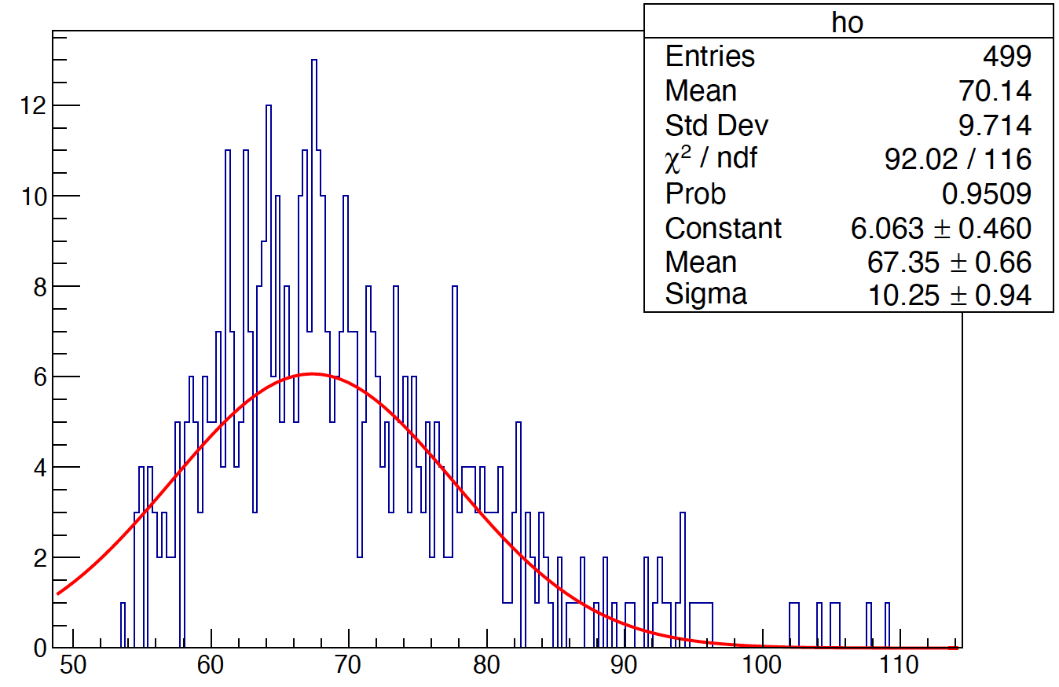
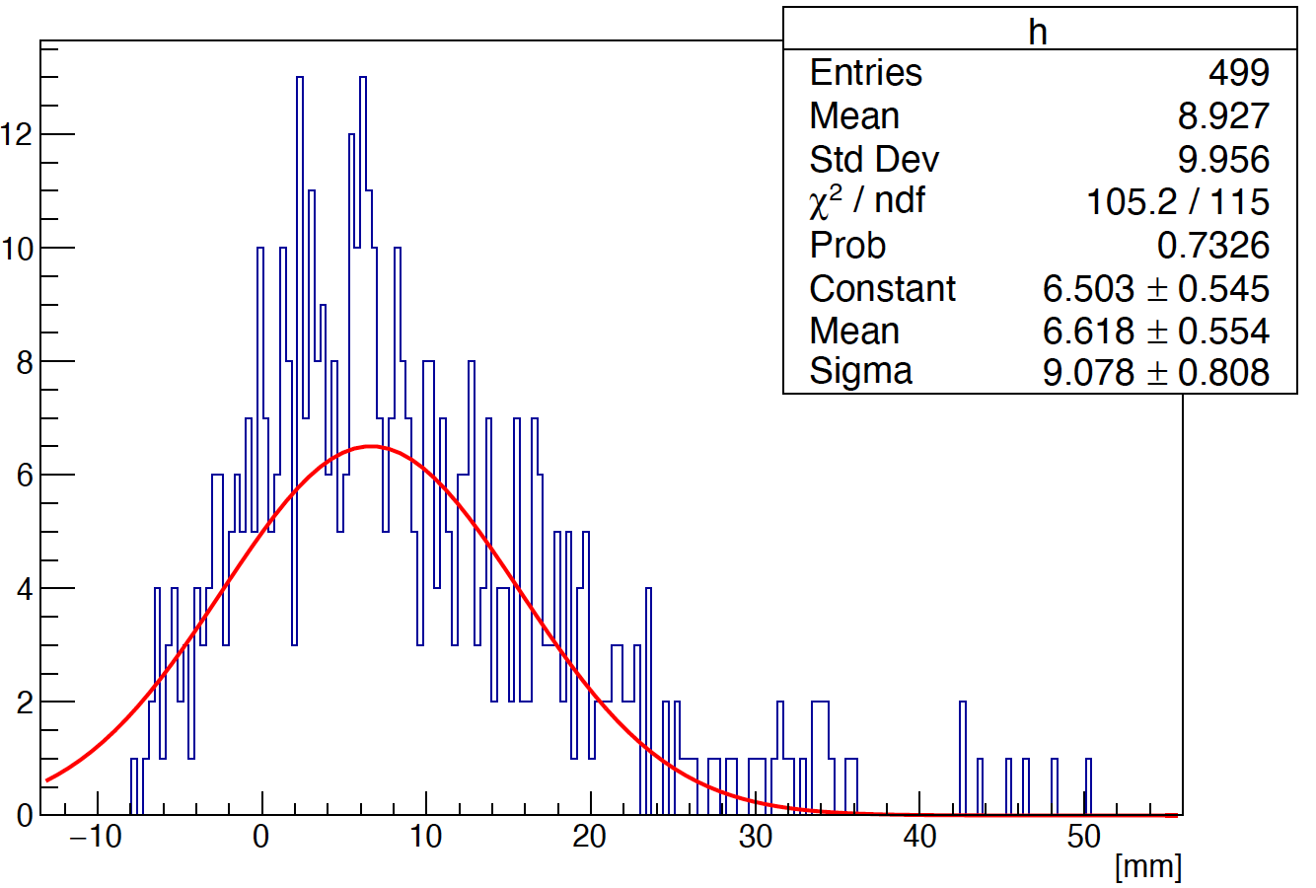
Phi reconstruction (method 3)
5 layer
phi is obtained by the method of weighting average phi :
$$phi= \frac{1}{{Total}_{E}}$$
$$\sum_{i=0}^{n}{{phi}_{i}}$$
*
$$E_{i}$$
10 layer
Liner fit
14 layer

Slide 9
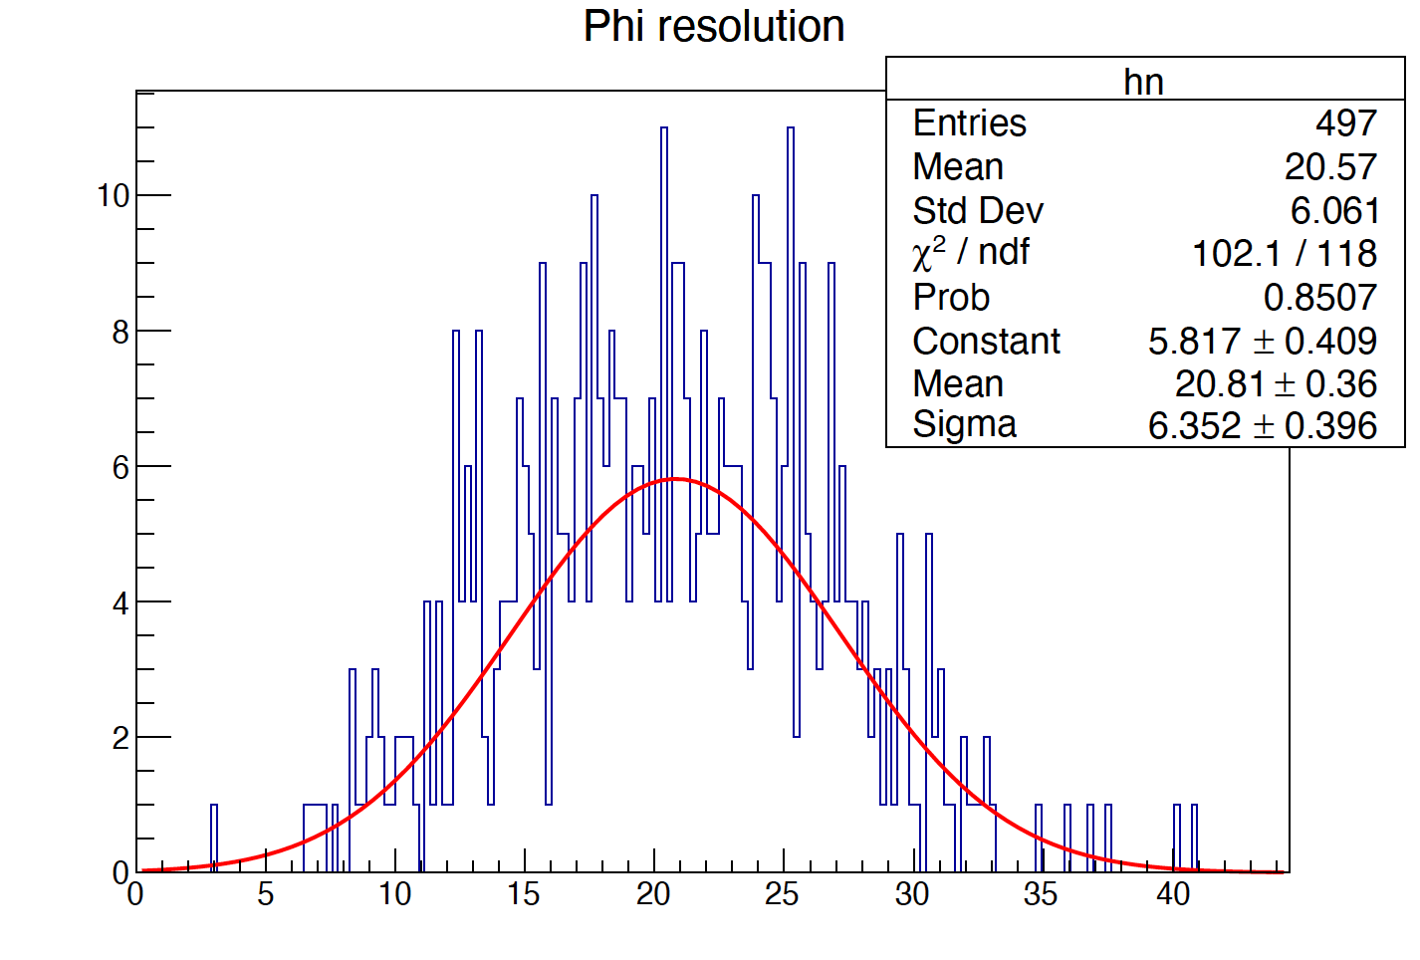
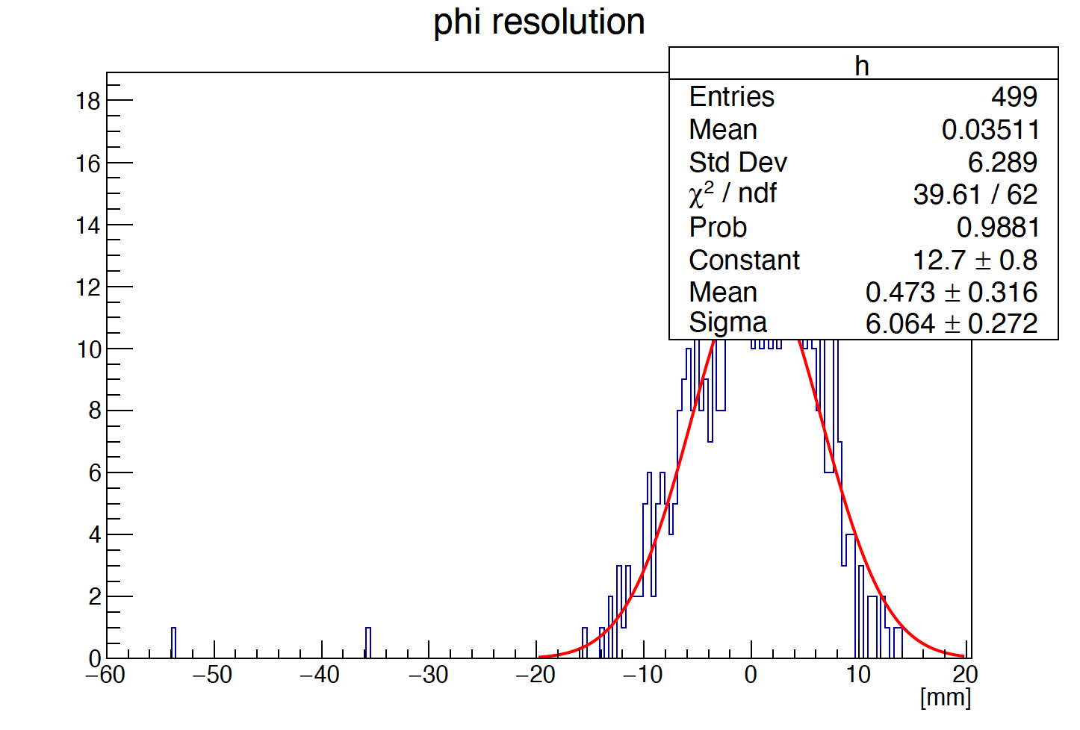
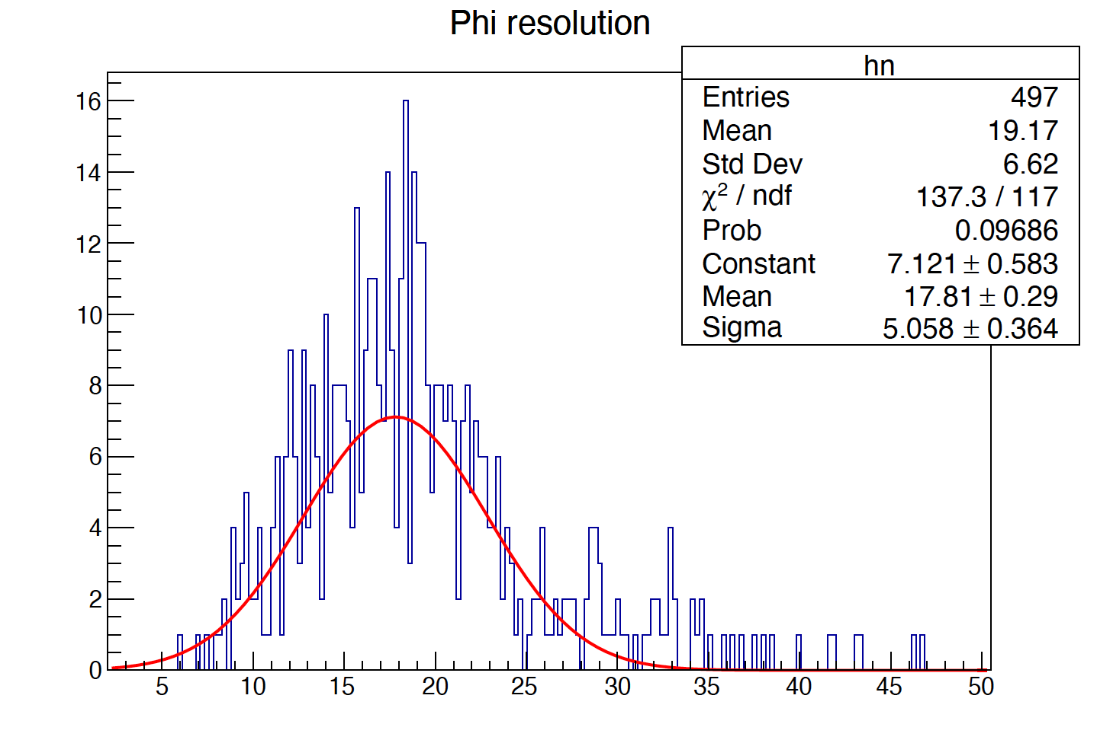
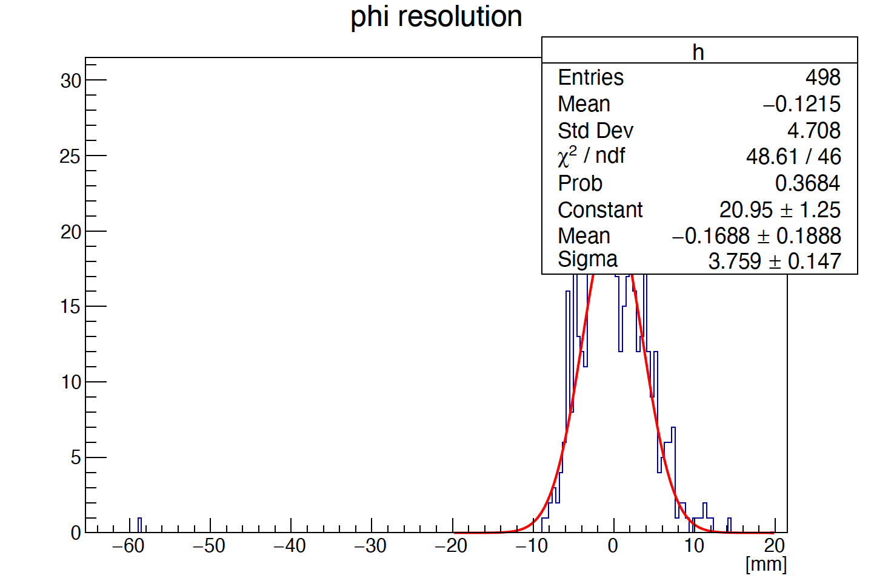
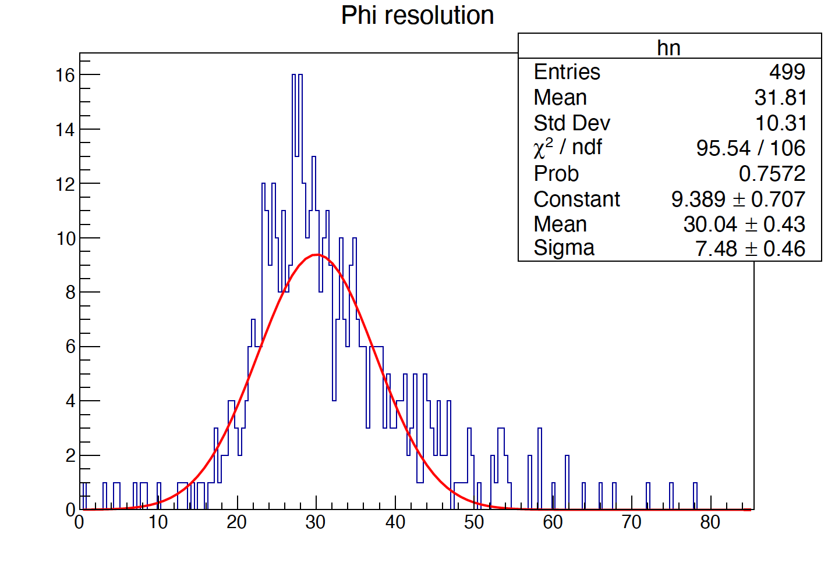
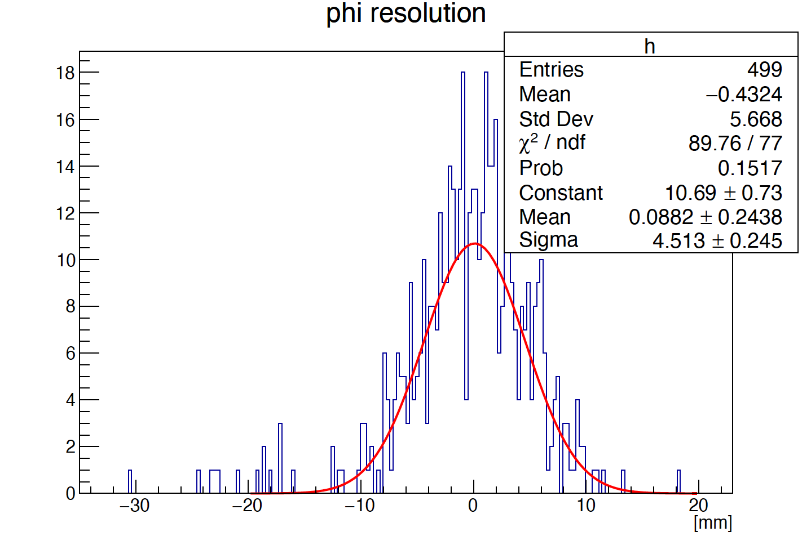
How to get shower start point?
The shower profiles can be described by the function：
5 layer
F(α,β,t,φ,r)
When rotation angle is 90°, longitudinal shower profiles can be described as :
10 layer
Liner fit
To improve the accuracy of phi resolution :
Parameter α and β of can be obtained by fitting MC data
14 layer

Slide 10
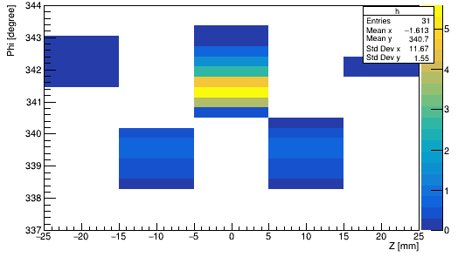
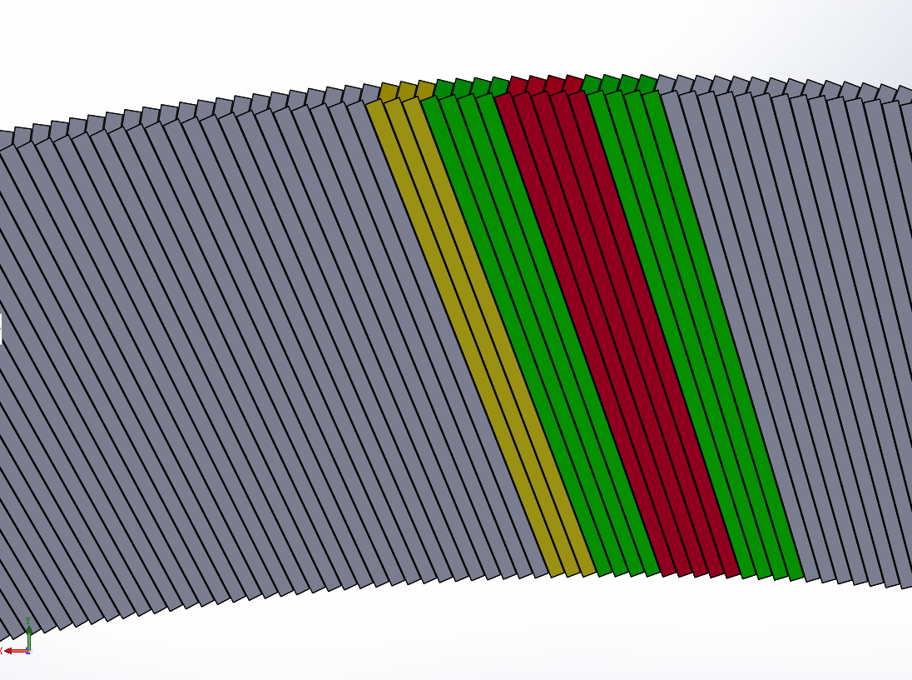
Cross Crystal Fan
To improve the phi resolution accuracy:
Crossing even and odd modules
Odd layer： alpha’= -alpha
Crystal Fan
Cross Crystal Fan

Slide 11
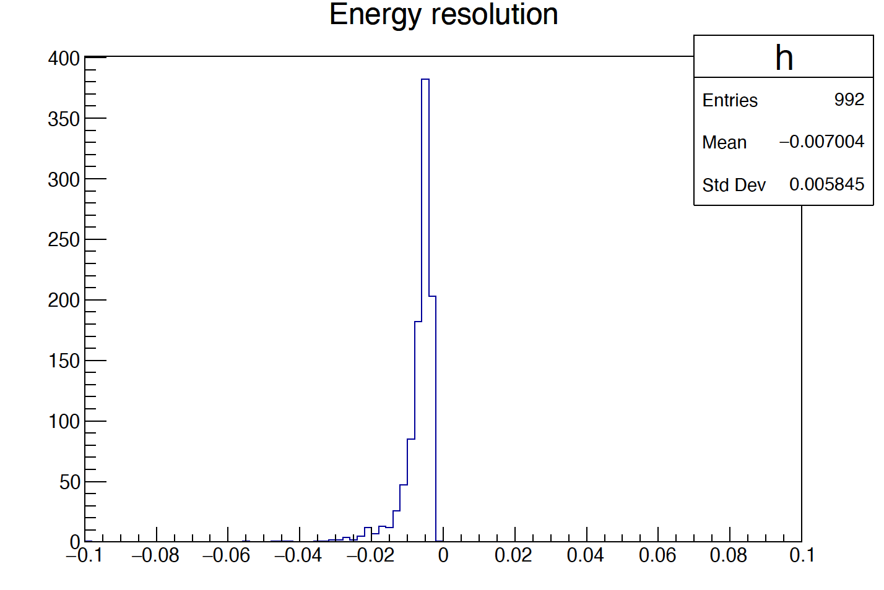
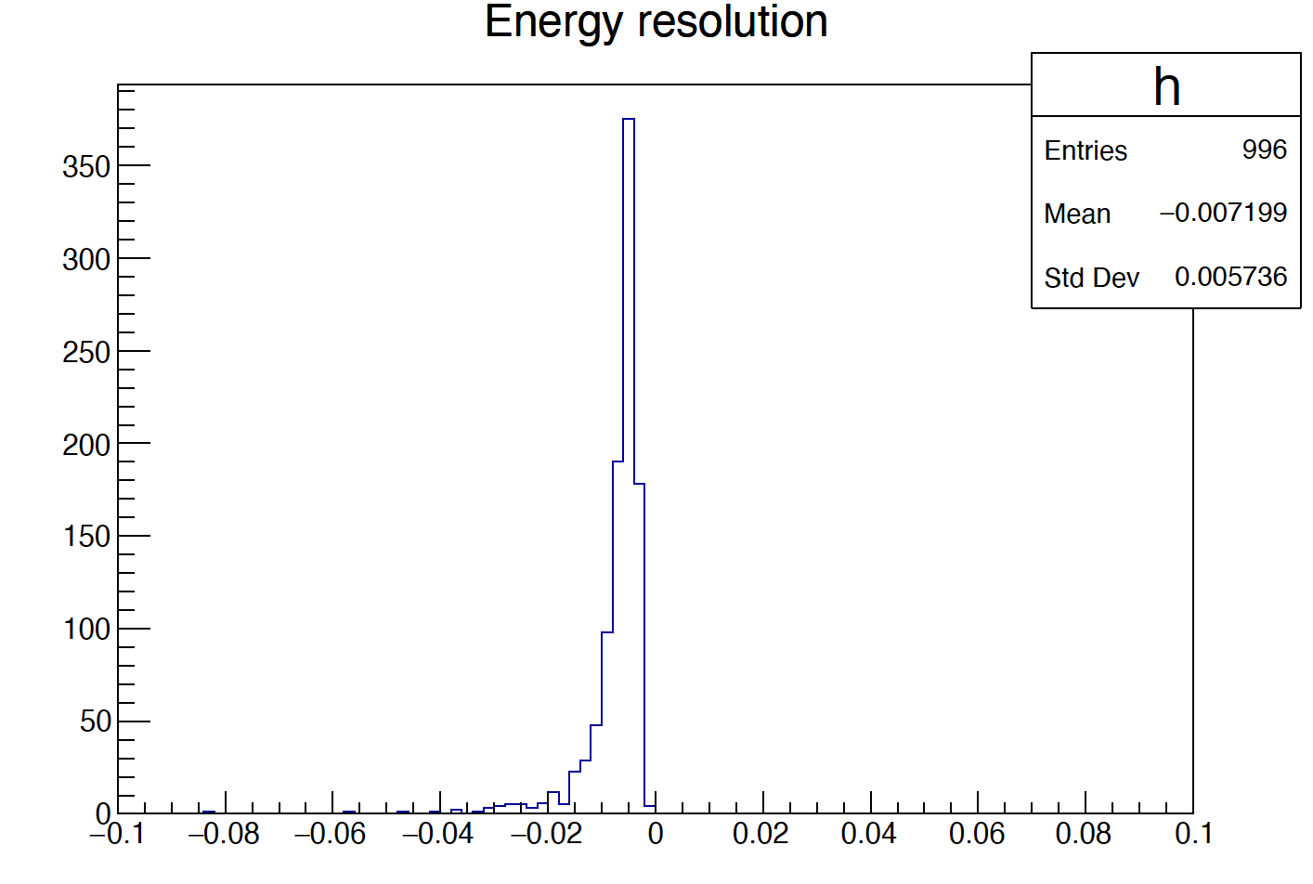
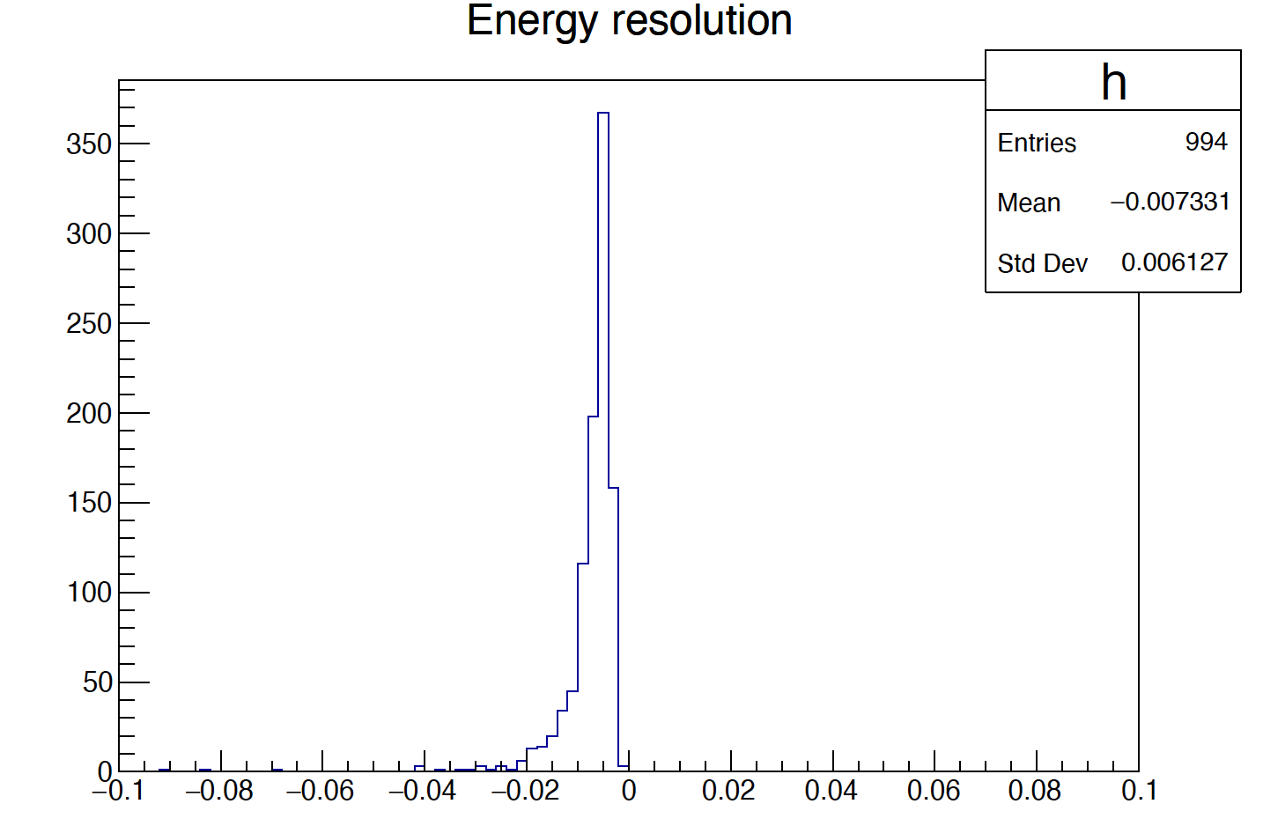
E resolution
5 layer
10 layer
14 layer
E resolution ~ 0.57%（10 layer）

Slide 12
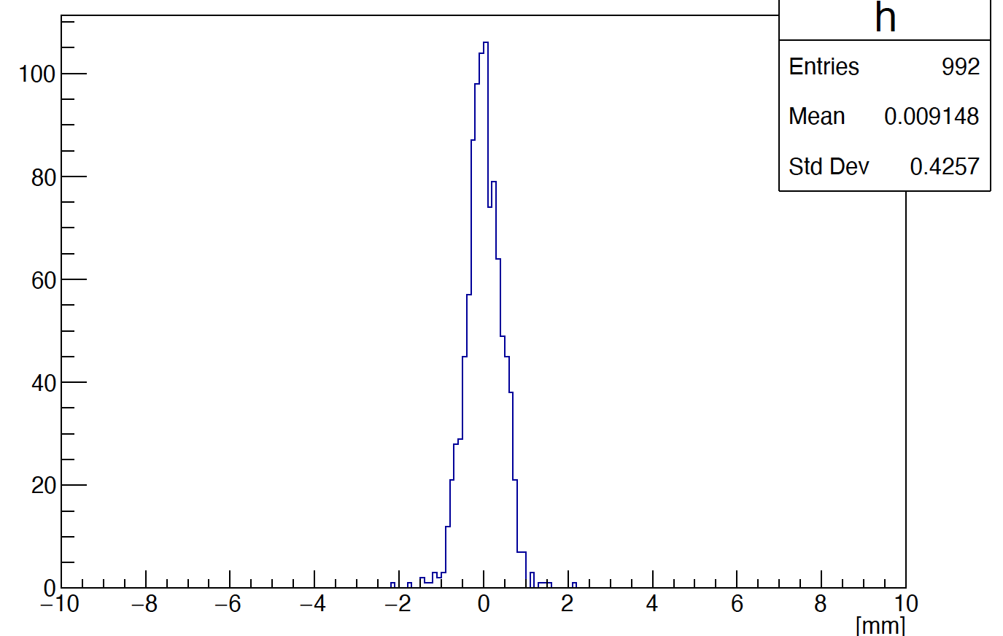
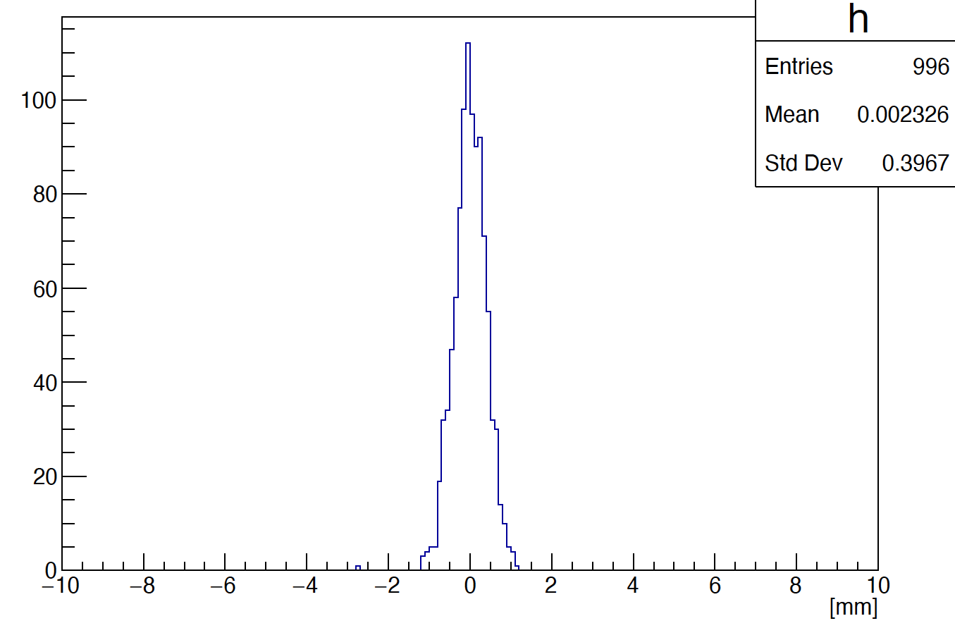
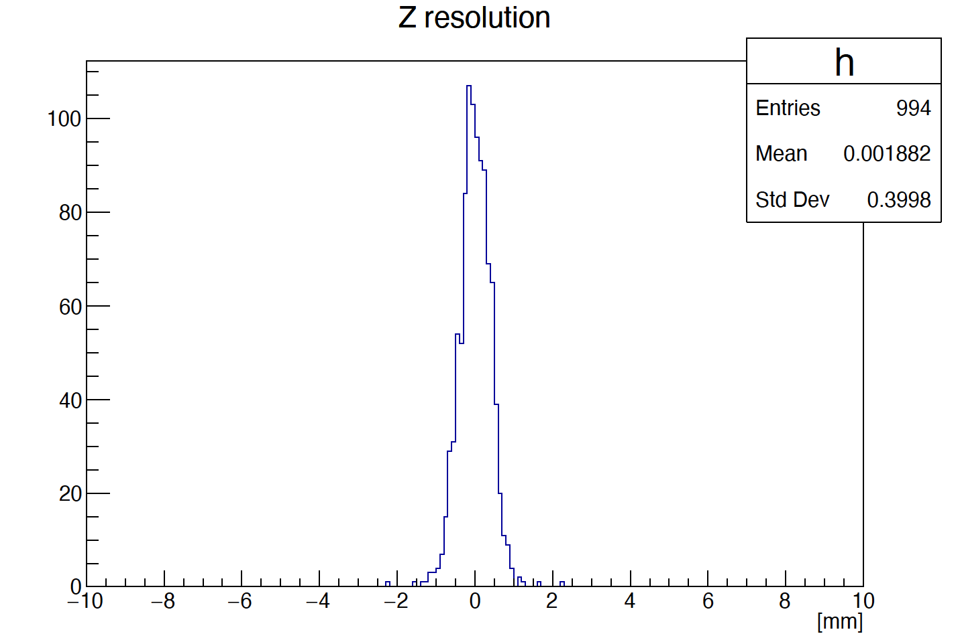
Z resolution
5 layer
10 layer
14 layer
Z resolution ~ 0.4 mm（10 layer）

Slide 13
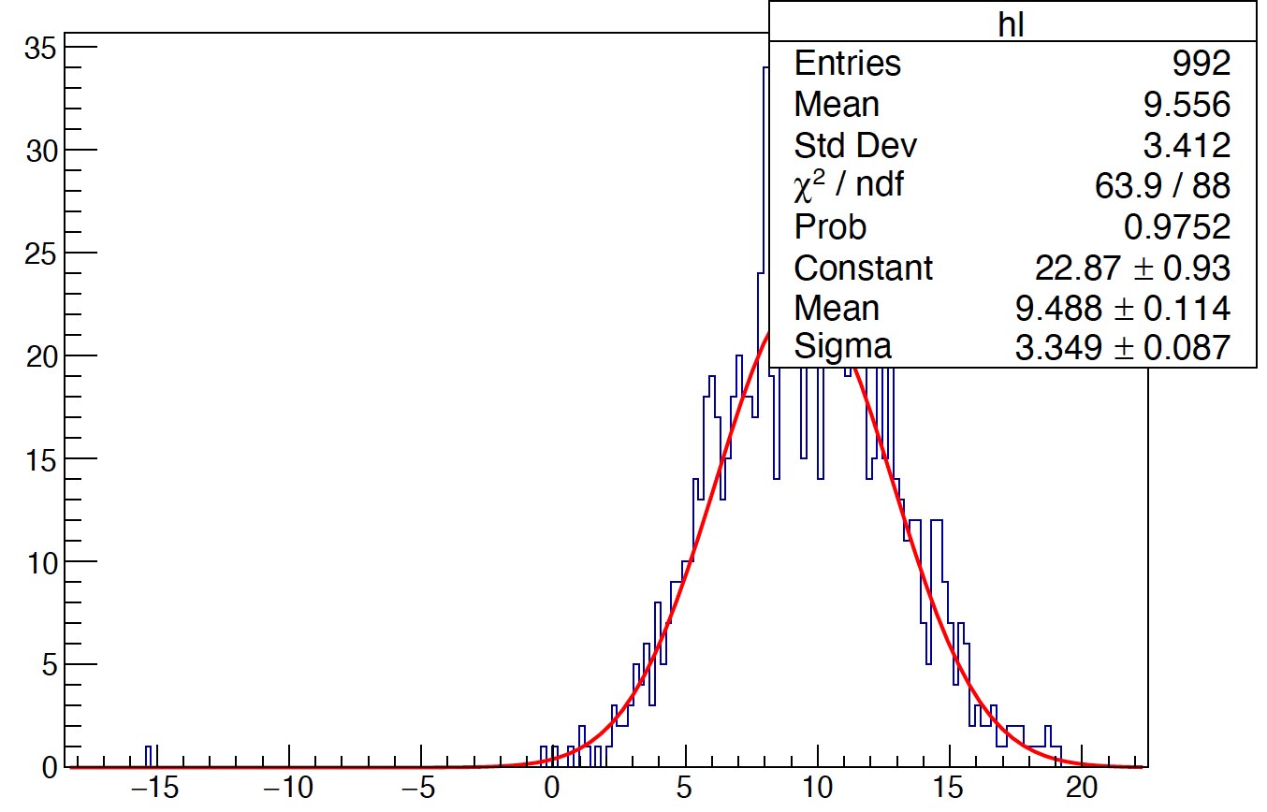
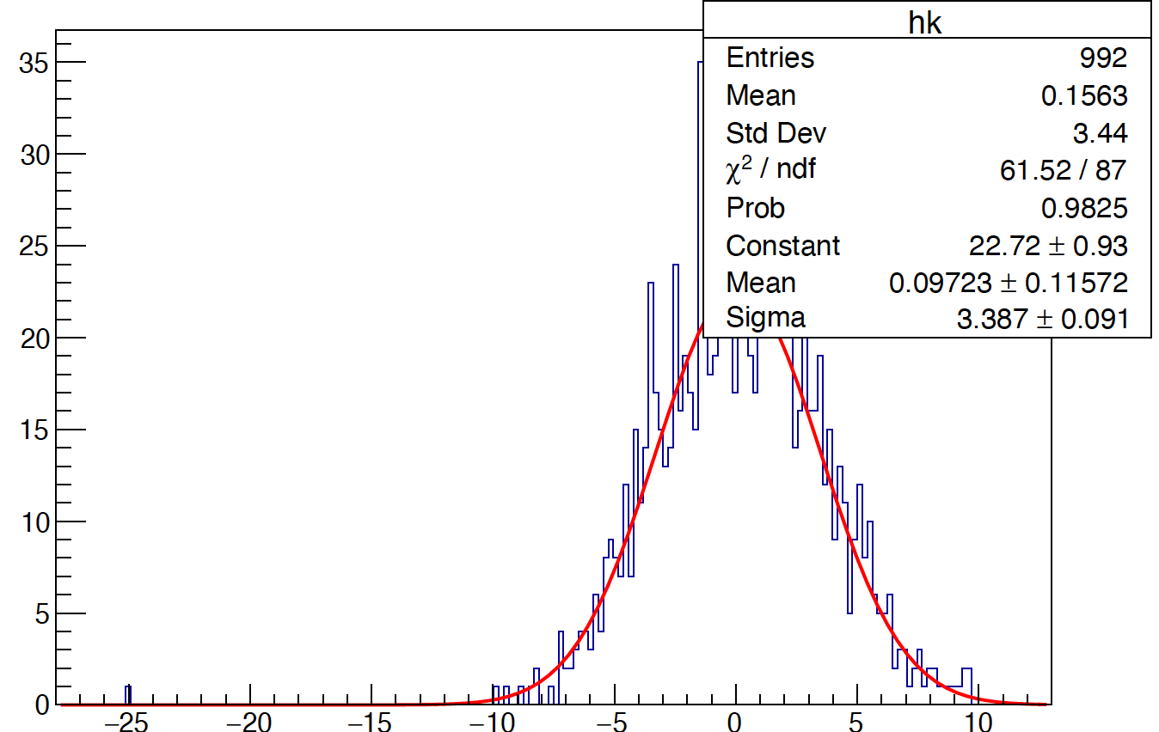
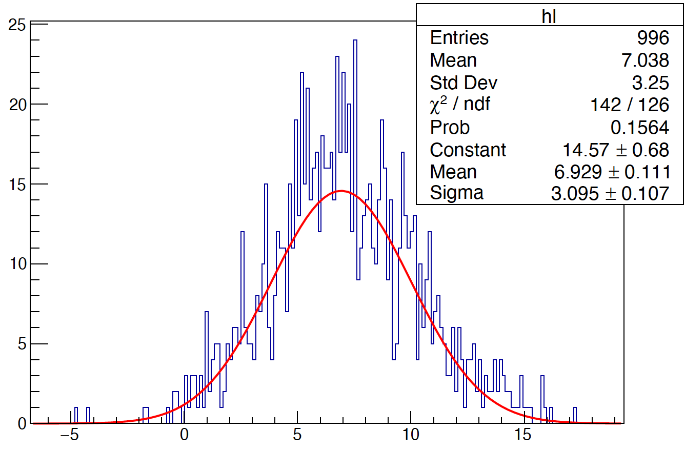
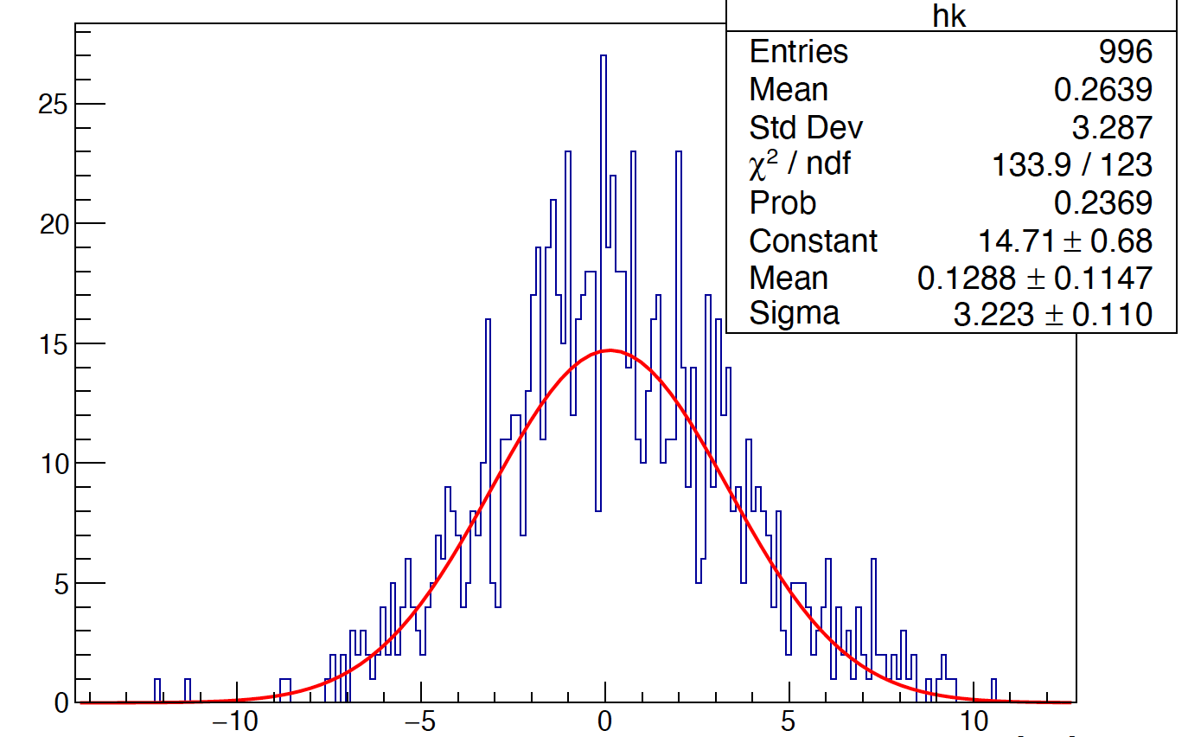
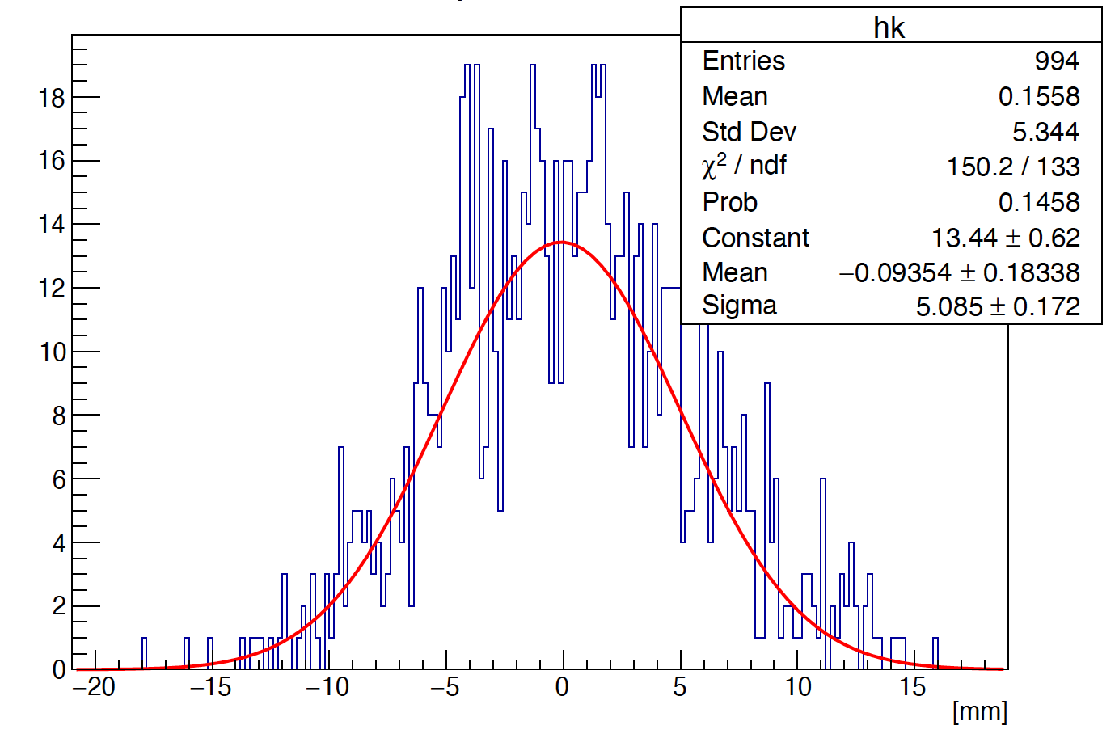
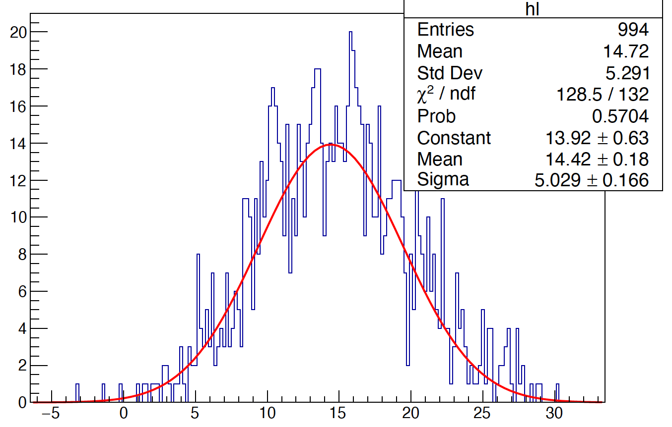
Phi reconstruction (method 2)
5 layer
phi is obtained by the method of
averaging phi :
10 layer
$$\sum_{i=0}^{n}{{phi}_{i}}$$
$$phi= \frac{1}{n}$$
Liner fit
14 layer

Slide 14
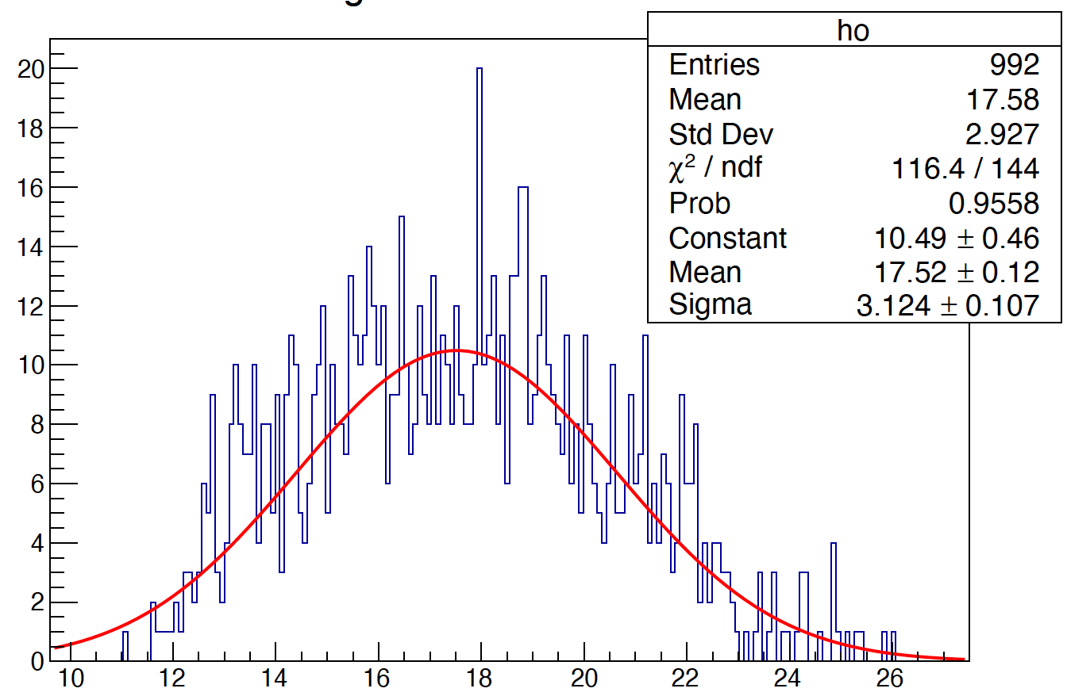
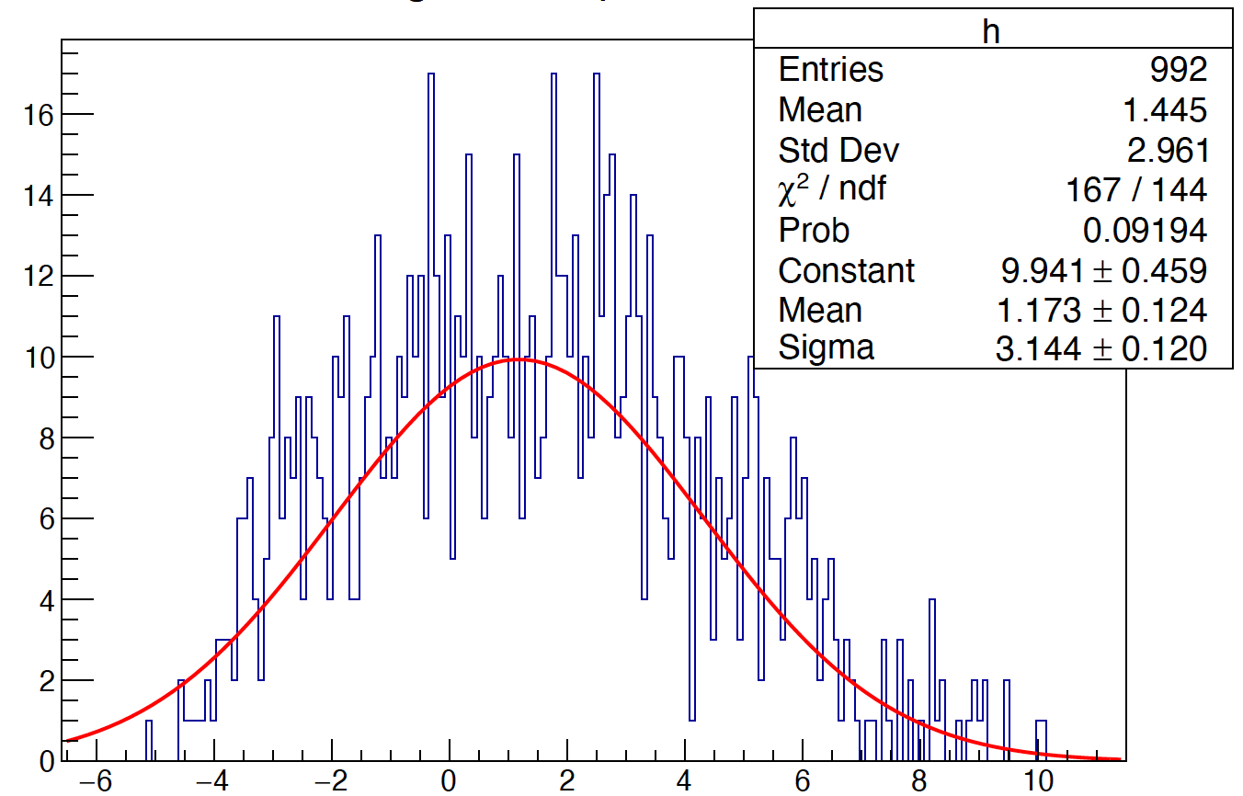
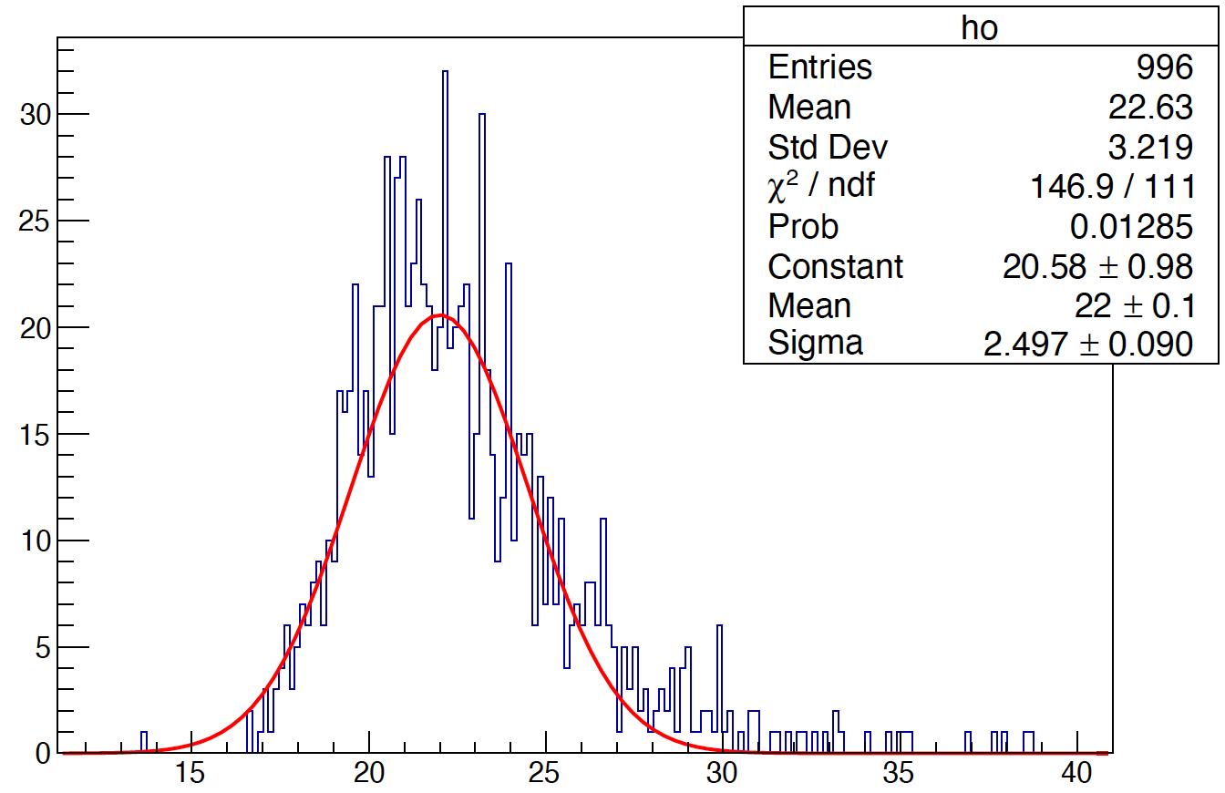
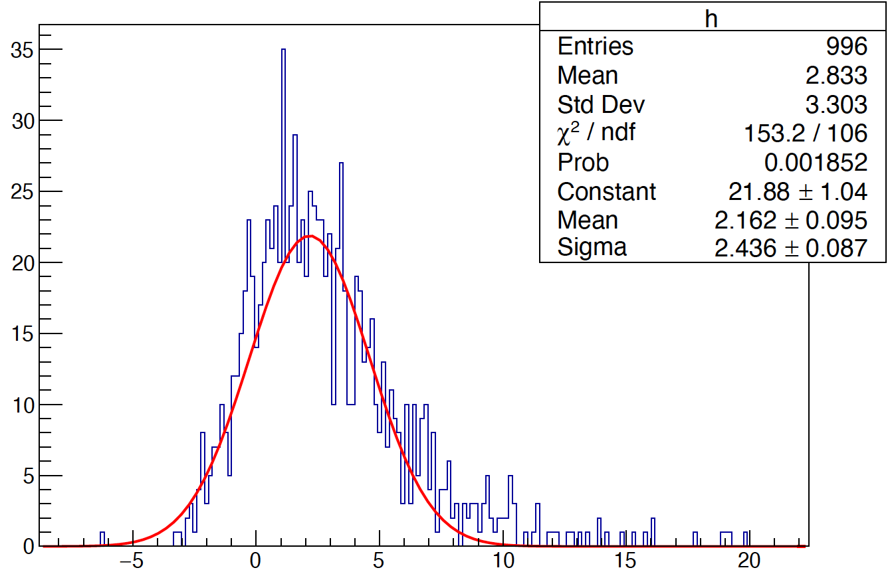
Phi reconstruction (method 3)
5 layer
phi is obtained by the method of weighting average phi :
$$phi= \frac{1}{{Total}_{E}}$$
$$\sum_{i=0}^{n}{{phi}_{i}}$$
*
$$E_{i}$$
10 layer
Liner fit
14 layer

Slide 15
Comparison of phi resolution
By crossing the odd layers, a phi resolution of ~ 2.4 mm is obtained
Liner fit

Slide 16
Reconstruction method for Cross Crystal Ecal
To improve Phi resolution and R resolution
Consider the cross point of two crystal bars as a hitbar (red points)
R resolution ~ 6.1 mm (30 GeV gamma)
Phi resolution ~1.3 mm
R resolution ~ 6.1 mm
10layer
30 GeV photon
R [mm]
Z [mm]
phi [degree]
Phi resolution ~ 1.3 mm
10layer
30 GeV photon

Slide 17
Reconstruction method for Cross Crystal Ecal
E resolution
Phi resolution
R resolution
Z resolution

Slide 18
Summary
Shower resolution of Cross Crystal Fan ECal ( 5 GeV photon)
Z resolution ~ 0.886 mm
Phi resolution ~ 1.6 mm
E resolution ~ 0.22%
R resolution ~ 6.31 mm
Next step:
γ/γ and γ/π separation based on cross Crystal Fan Ecal
Obtain shower start point by getting function F(α,β,φ,t,r) （maybe）

