Slide 1
Simulation of the CEPC Detector with Delphes
Yun youhui ,Wei zhiling , Li zepeng
Wu linghui ,Li Gang
Nov .25th,2021

Slide 2
Outline
Introduction
Tracker layout
Tracker performance
Calorimeter resolution
gamma resolution
jet resolution

Slide 3
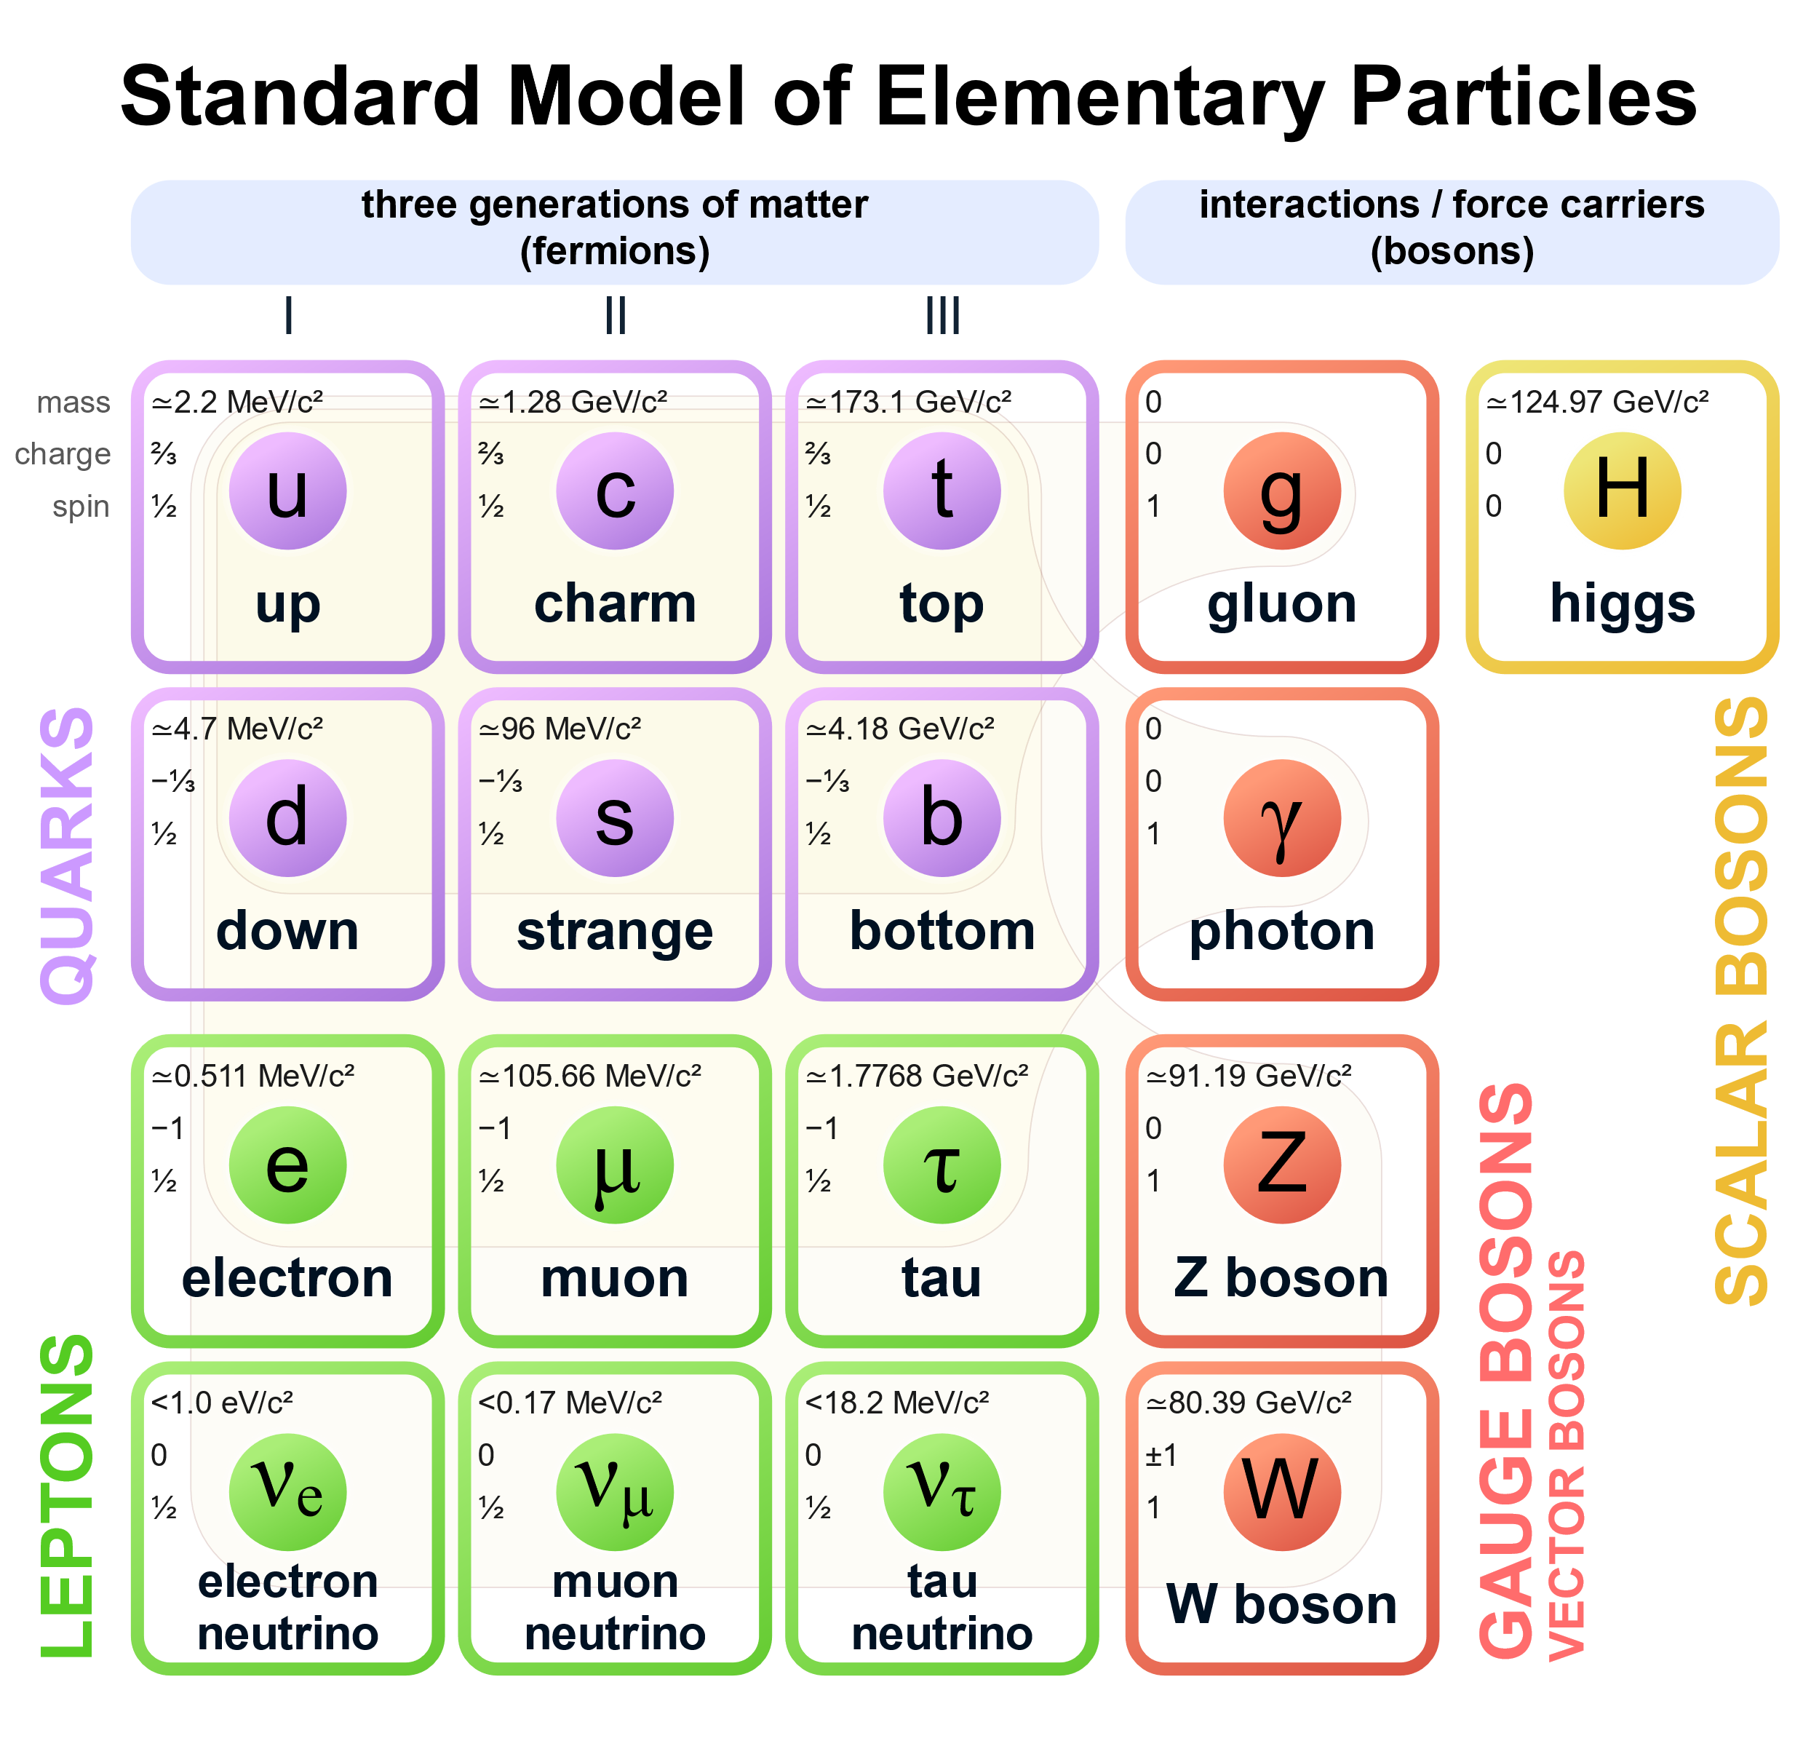
The Standard Model of particle physics describes three of the four known fundamental forces (the electromagnetic, weak, and strong interactions) .
The elementary particles can be clarified into four categories:quarks,
Leptons,gauge bosons and scalar bosons.

Slide 4
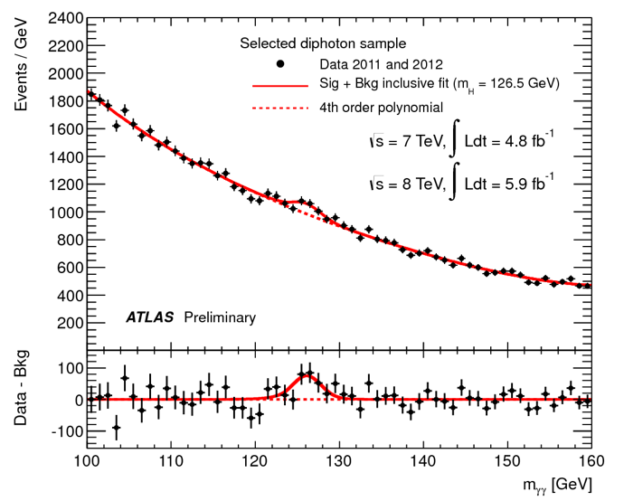
Higgs boson is essential to the SM,which requires bosons to have mass. They can interact with higgs field to acquire mass.
In 2012,the spokespeople of the ATLAS and CMS Collaborations showed their results consecutively, each finding an excess around 5σ at a mass of 125 GeV.
Higgs mechanism is proved to be true and the Nobel Prize in Physics was awarded to Peter Higgs and François Englert who put forward in 2013.

Slide 5
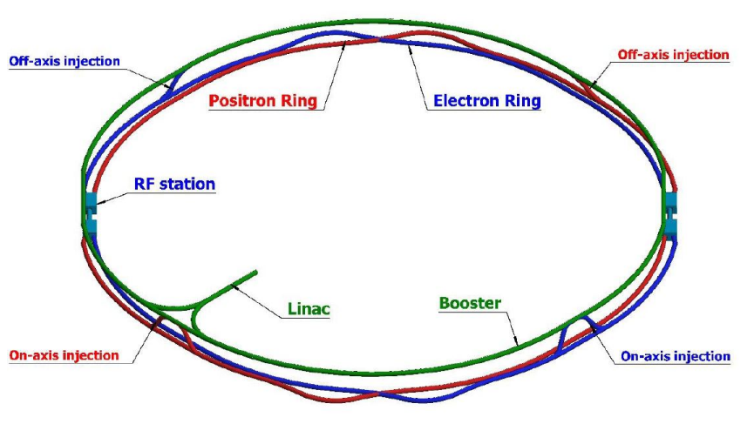
Physical motivation of CEPC
The CEPC aims to become a Higgs(Z) factory in China.
It may be updated to pp collider (SppC) in the future.
The CEPC can do:
1,High precision Higgs,EW measurement
2,Study of flavor physics and QCD
3,Probe physics beyond SM
4,……

Slide 6
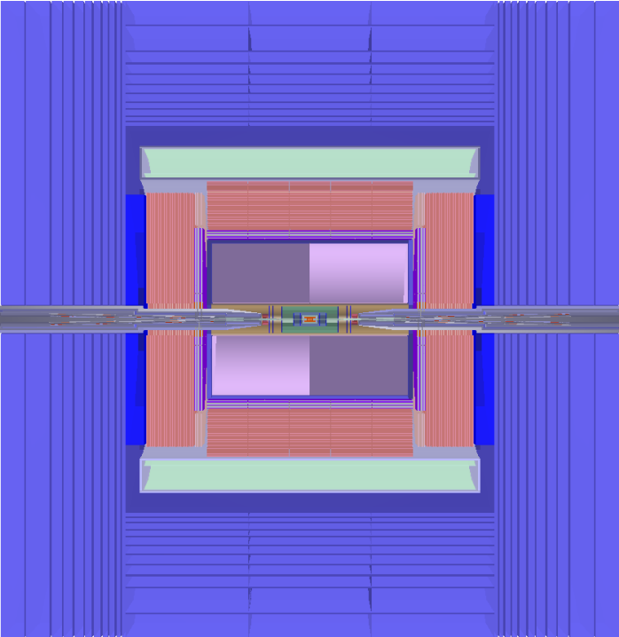
The Detector Design
VTX(Vertex Detector):
Six high spatial resolution pixel detector.
Accurate measurement of charged particle track parameters
Drift Chamber:
A cylinder with an inner diameter of 0.8 m and an outer diameter of 1.8 m.
Measuring the drift time to determine the position of particle.
Silicon Tracker:
Consist of SIT(Silicon Inner Tracker),SET(Silicon External Tracker),FTD(Forward Tracking Detector),ETD(Endcap Tracking Detector).
Provide high precison information of collision points on the trajectory.
Calorimeter:
ECAL:measure photon and neutral hadron deposition energy
HCAL:measure neutral hadron deposition energy
Superconducting magnets
Muon Detector

Slide 7
Tools
Generator:
Events are generated by Monte Carlo generator WHIZARD 1.95.
Simulate:
Delphes is used to simulate particles’ interactions with detectors fastly and we can change the card(.tcl) to meet need.
Analysis:
Get the useful information from root files to find detector performance.

Slide 8
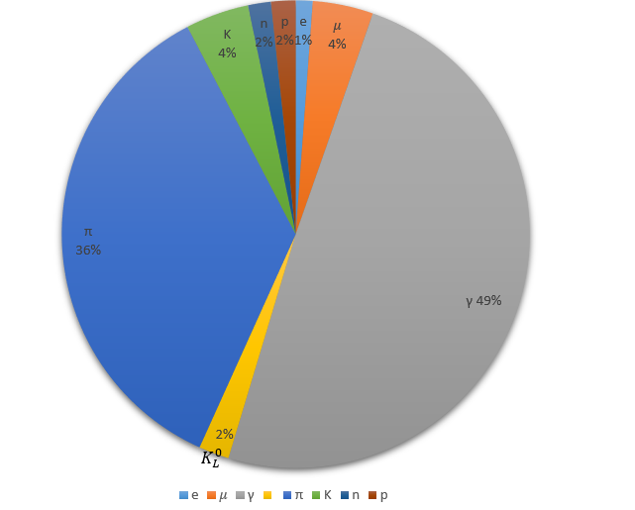
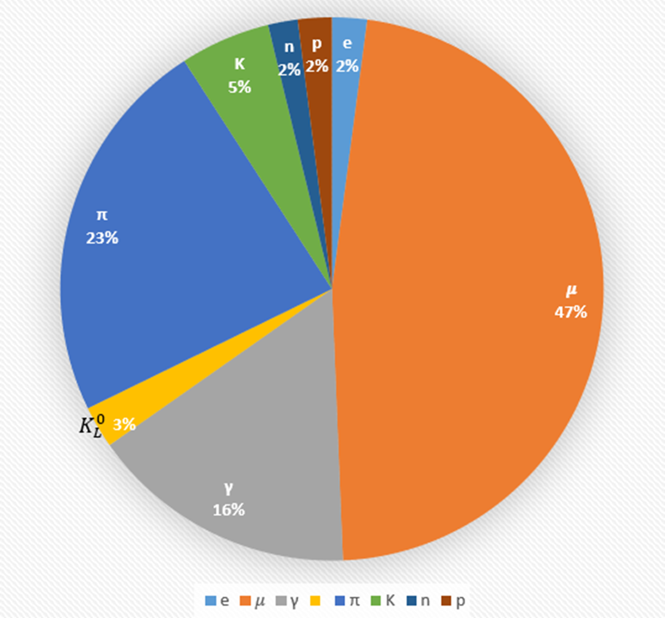
Particle momentum sum ratio
The particle number ratio
Both neglect neutrinos

Slide 9
Tracker layout
Detector | Layer | Radius(mm) | Halfz(m) | Material budget[x/X0]
VXD | 1 | 16 | 0.2 | 0.0015
 | 2 | 18 | 0.2 | 0.0015
 | 3 | 37 | 0.2 | 0.0015
 | 4 | 39 | 0.2 | 0.0015
 | 5 | 58 | 0.2 | 0.0015
 | 6 | 60 | 0.2 | 0.0015
Shell | 1 | 78 | 0.2 | 0.0015
SIT | 1 | 230 | 0.461 | 0.0065
 | 2 | 410 | 0.691 | 0.0065
 | 3 | 590 | 1.013 | 0.0065
 | 4 | 770 | 1.115 | 0.0065
Inner wall | 1 | 800 | 2.98 | 0.00104
DC | 66 | 800-1800 | 2.98 | 0.002
Outer wall | 1 | 1800 | 2.98 | 0.01346
SET | 1 | 1815 | 2.98 | 0.0065

Slide 10
Detector | Rin(mm) | Rout(mm) | Z(m) | Material budget[x/X0]
DSK1A | 29.5 | 151.9 | 0.22 | 0.0065
DSK1B | 29.5 | 151.9 | -0.22 | 0.0065
DSK2A | 30.5 | 151.9 | 0.371 | 0.0065
DSK2B | 30.5 | 151.9 | -0.371 | 0.0065
DSK3A | 32.5 | 298.9 | 0.643 | 0.0065
DSK3B | 32.5 | 298.9 | -0.643 | 0.0065
DSK4A | 34 | 309 | 0.844 | 0.0065
DSK4B | 34 | 309 | -0.844 | 0.0065
DSK5A | 34.6 | 309 | 0.925 | 0.0065
DSK5B | 34.6 | 309 | -0.925 | 0.0065
ETD1 | 800 | 1822 | 3.0 | 0.0065
ETD2 | 800 | 1822 | -3.0 | 0.0065
mainly placed according to Chengdong Fu‘s design and it can be improved latter.

Slide 12
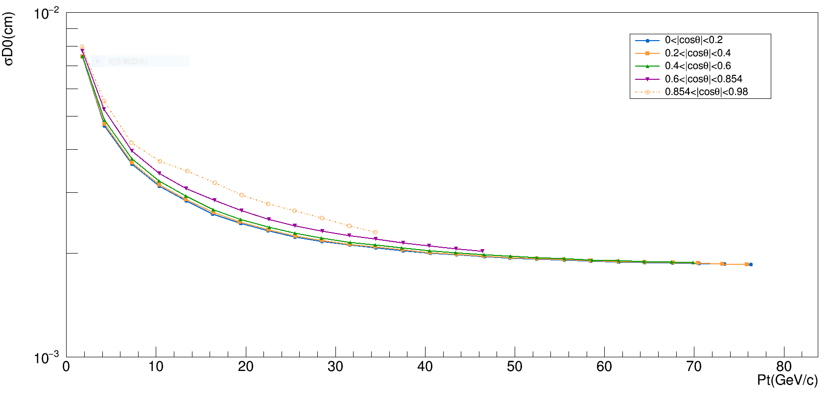
The tracker performance
$$σD0(mm)$$
The $σD0$ reduces as Pt increases ,increases as $|cosθ|$ increases.
finally reach about 2 $μm$.

Slide 13
$$σD0(mm)$$
While $cosθ$greater than about 0.85， $σD0$ deteriorates rapidly.

Slide 14
The $σPt/Pt$ increases as Pt increases and $|cosθ|$ increases.

Slide 15
While $cosθ$greater than about 0.85， $σPt/Pt$ deteriorates rapidly.

Slide 16
$$e^{−}$$
$$b$$
Considering this process($√$s=240GeV), we can choose the cut:
a $μ+$ and a $μ−$
Both momentum greater than 18.GeV
Invariant mass around 91 GeV
to find the two muons ,the recoil mass is related to Higgs.
$$e^{+}$$
$$μ^{+}$$

Slide 17
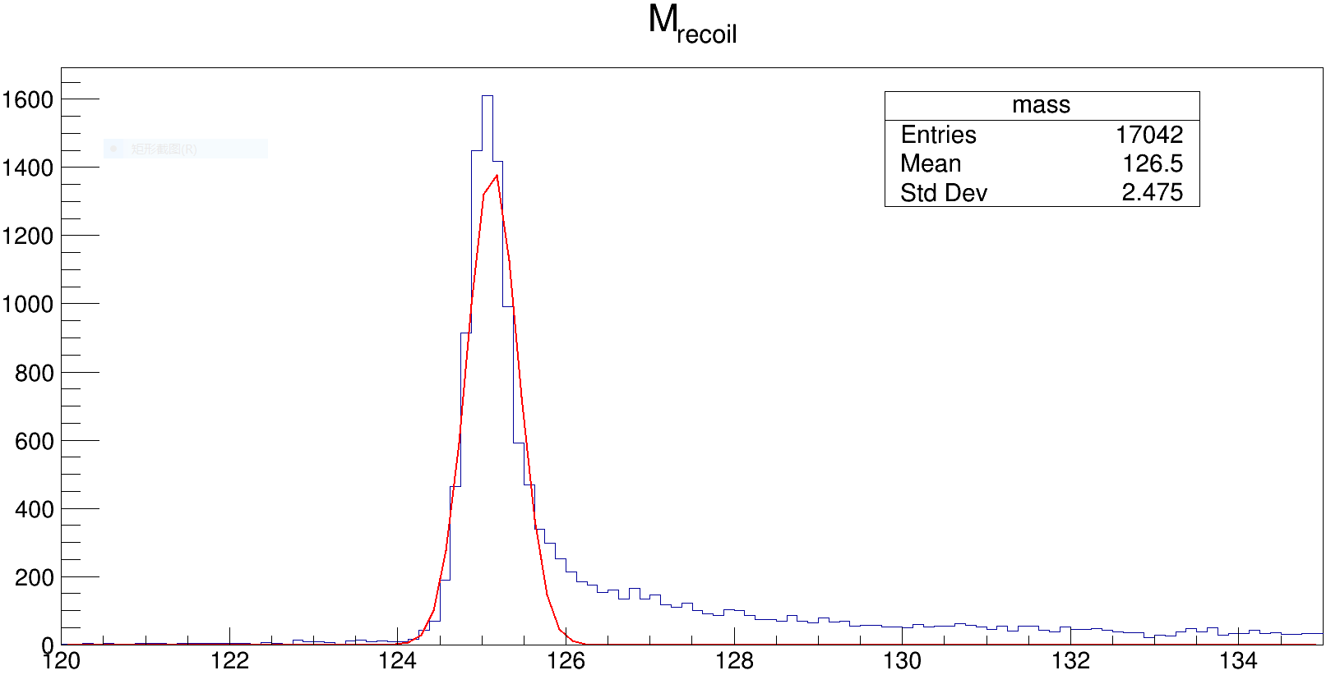
Total entries =17987， efficiency ≈94.7 %。
Muons invariant mass peak:90.8GeV。
Recoil invariant mass peak:125.1GeV，resolution：0.31GeV
Basically as expected.

Slide 18
Calorimeter Resolution
Set the resolution formula as a function of energy:
$$\frac{σ_{E}}{E}= \frac{a}{\sqrt{E}} \text{⊕} \frac{c}{E}\text{⊕} \text{b}$$
a , stochastic term:Fluctuations in the number of signal generating processes
c , noise term:Noise in readout electronics, ‘pile-up’ due to other particles from other collision events
b , constant term:Imperfections in calorimeter construction,Non-uniform detector response,etc.
Ignoring the noise term,
for ECAL, set $a_{E}$=0.03, $b_{E}$=0.01
for HCAL:set $a_{H}$=0.5,$b_{H}$=0.04.
consider H→γγ ,H→gg→2 jets,draw the invariant mass spectrum

Slide 19
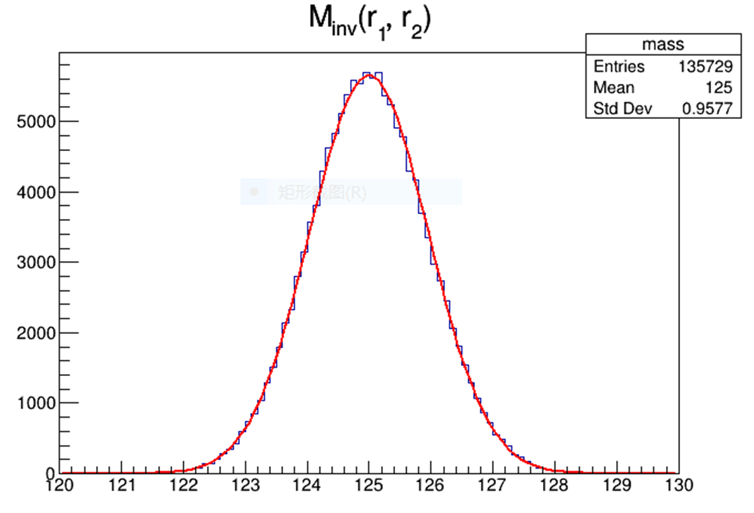
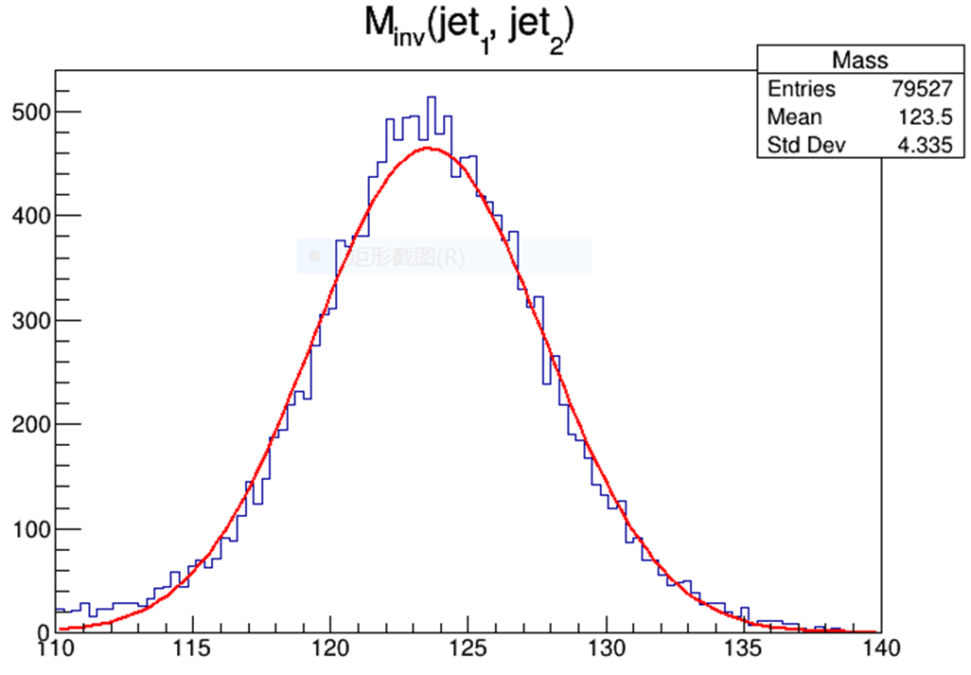
Mean = 124.996$±$0.0026 GeV ,
Resolution = 0.957 $±$0.0018 GeV
Mean = 123.57$±$0.033 GeV ,
Resolution = 4.21 $±$0.029 GeV

Slide 20
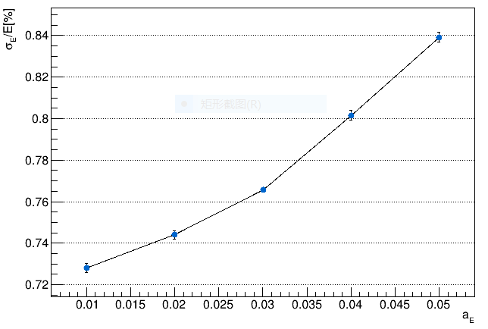
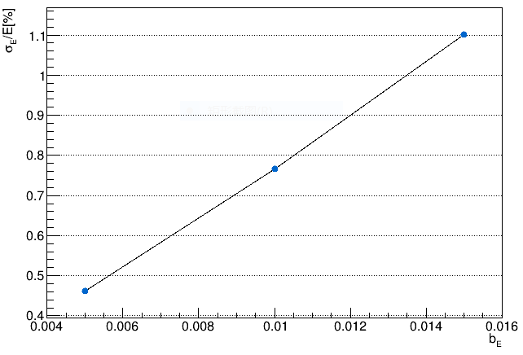
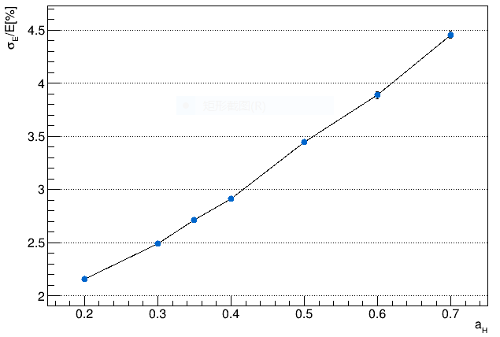
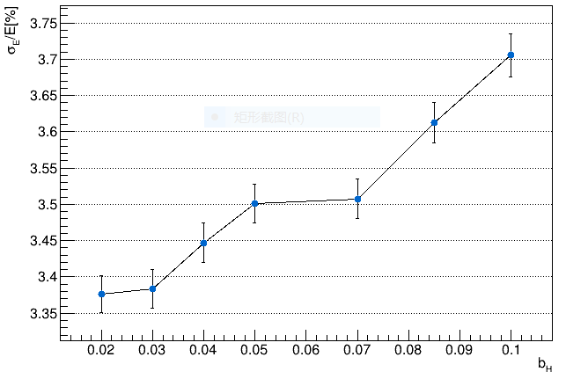
Scan resolution parameter

Slide 21
Thanks!

