Slide 1
Spin resonance crossing simulations with snake ChenTao

Slide 2
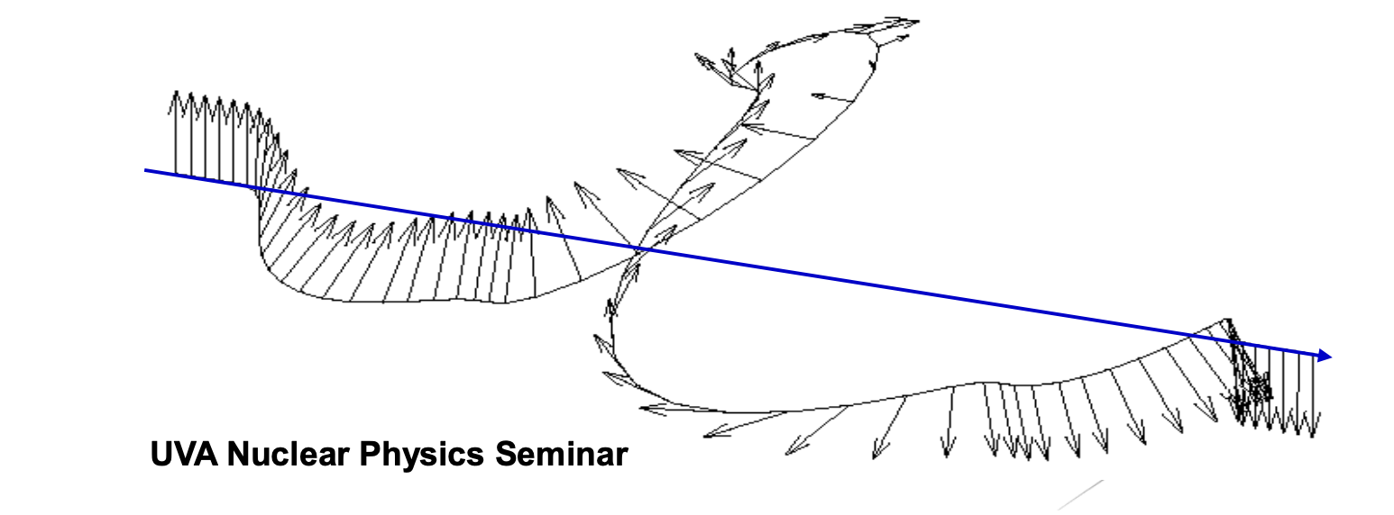
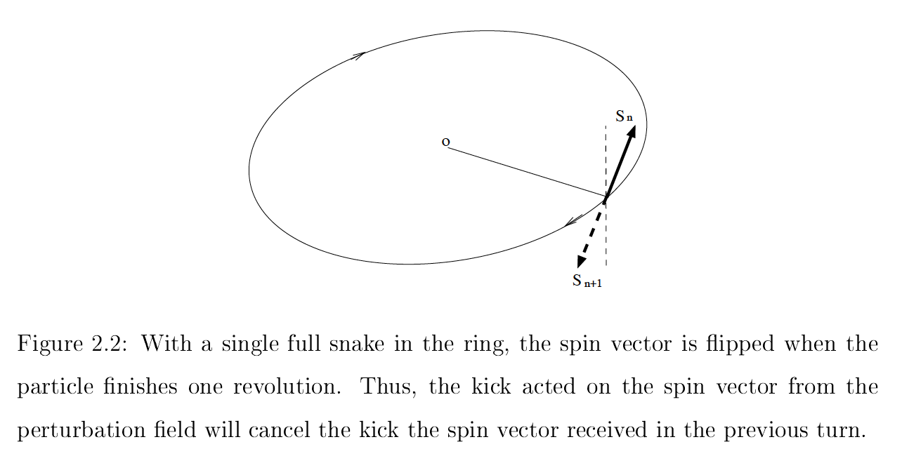
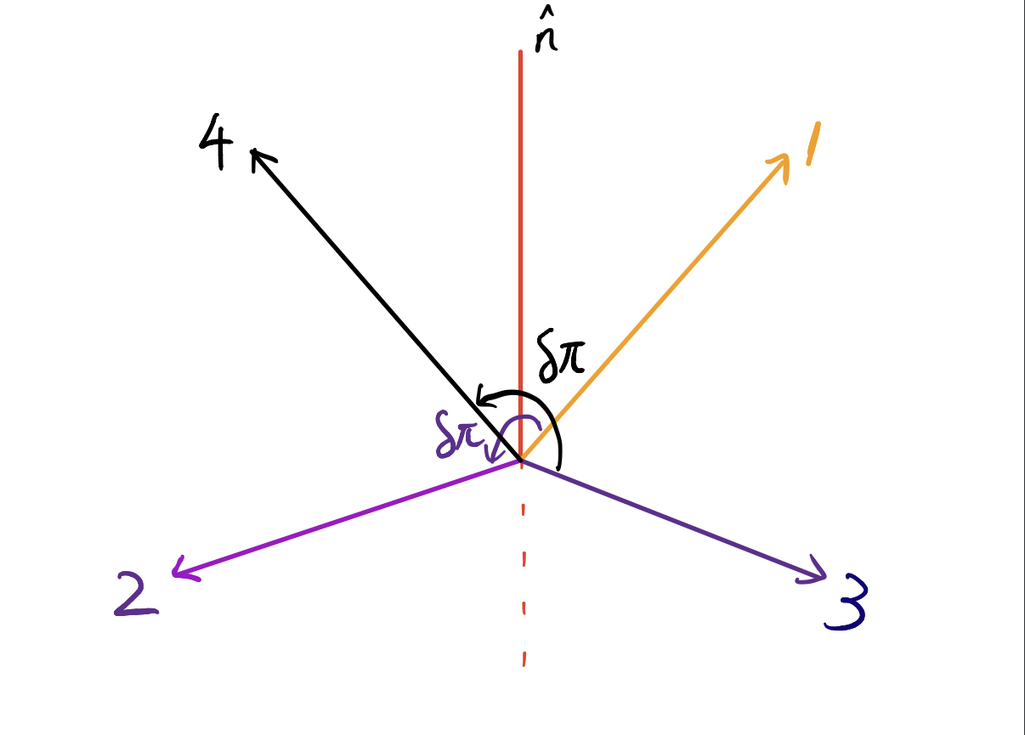
Siberian Snake
rotates spin vector by 180 degree and do not affect orbital motion
The perturbation on the spin from the accelerator lattice is canceled in successive turns
Partial snake : rotate degree less than 180 .

Slide 3
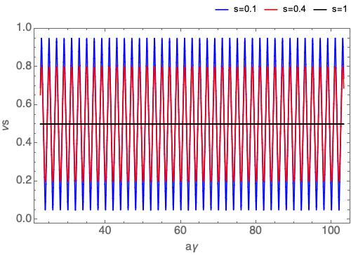
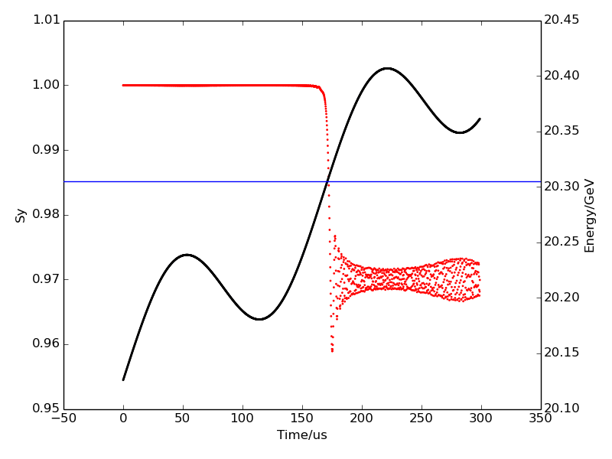
A synchrotron with a partial snake
The closed orbit spin tune satisfies: $\cos{πν_{s}=\cos{aγ}\cos{\frac{sπ}{2}}}$ for a synchrotron implemented with a partial snake whose spin rotation angle is s*π. To avoid depolarization due to the intrinsic resonances, the betatron tunes should be close to integer.
Closed orbit spin tune for partial snake with different s
Resonance crossing without snake
K=46.08
$$m_{0}γ$$

Slide 4
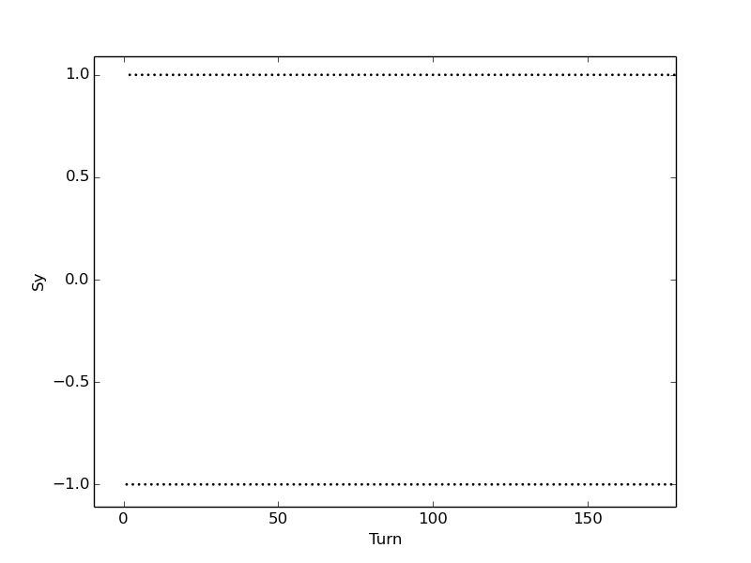
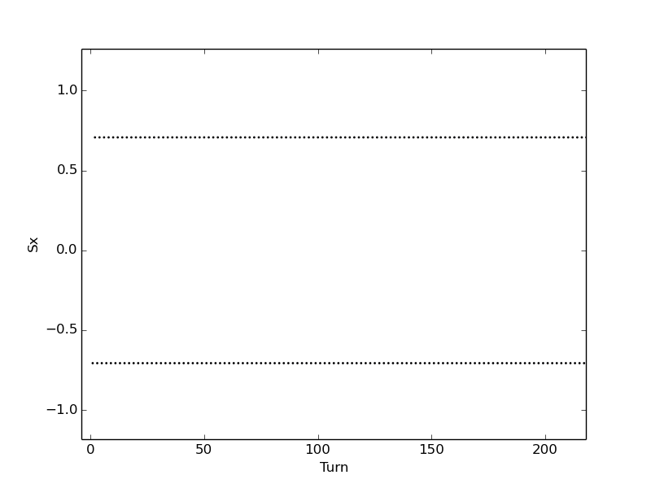
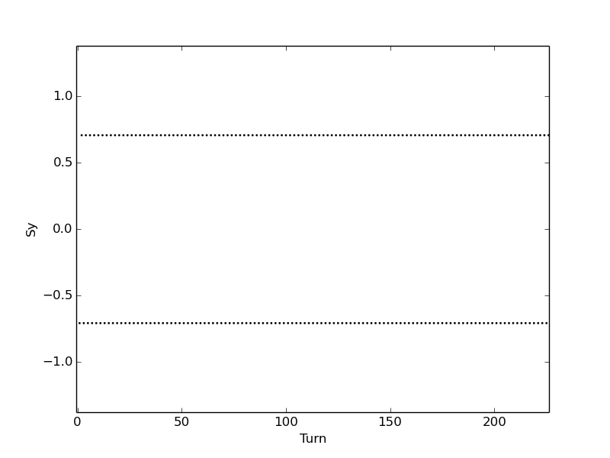
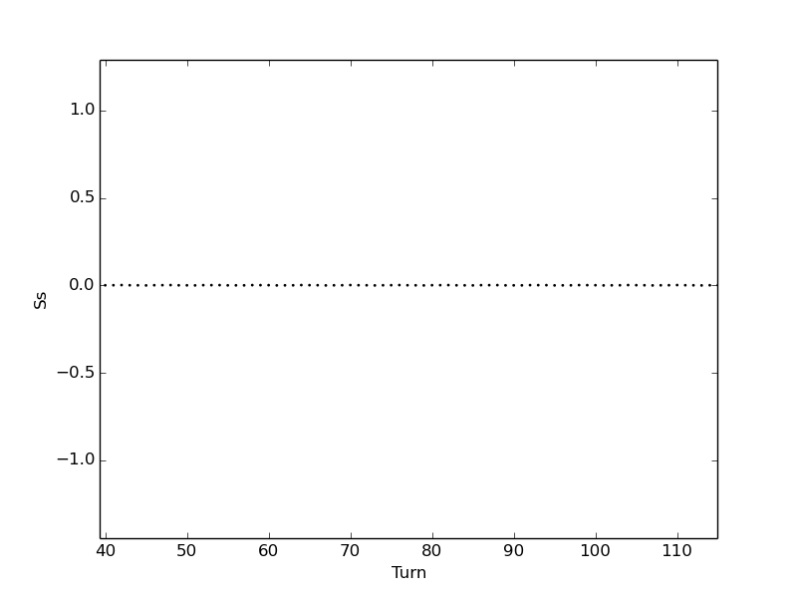
Benchmark of “custom snake”
沿 $\hat{s}$ 方向旋转的full-snake：
Initial spin(0,1,0):
$$S_{y}$$
Diagram of the simulation :
Turn
Initial spin(0.707,0.707,0)
$π$arc
y
x
RF
s
Spin flip
Observation point
$$S_{x}$$
$$S_{y}$$
$π$arc
$$S_{s}$$
The lattice distributes symmetrical in up and down direction
Turn
Turn
Turn

Slide 5
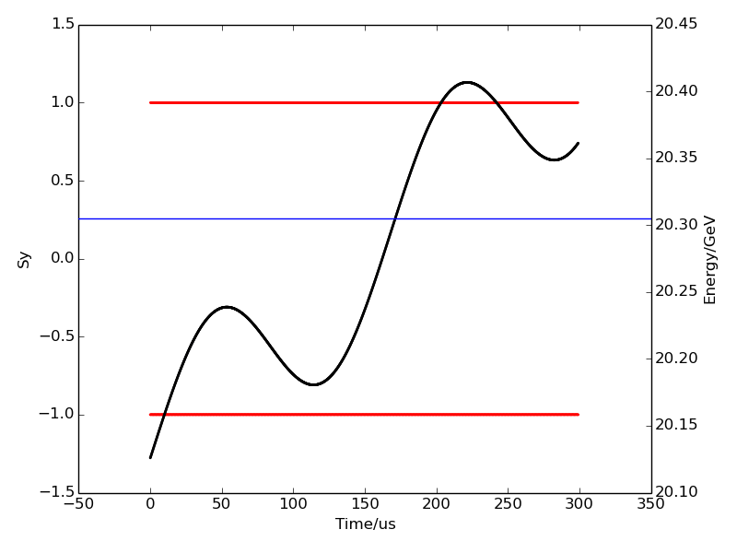
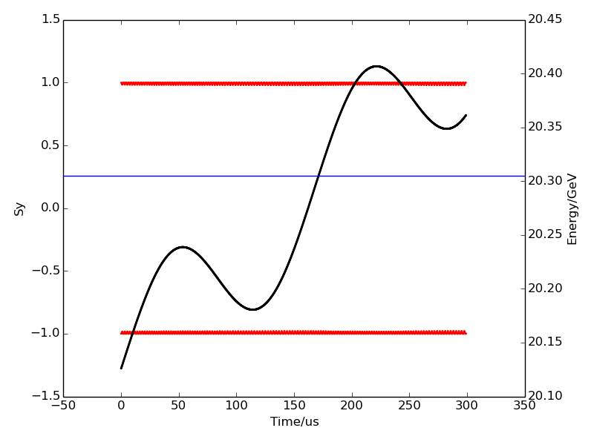
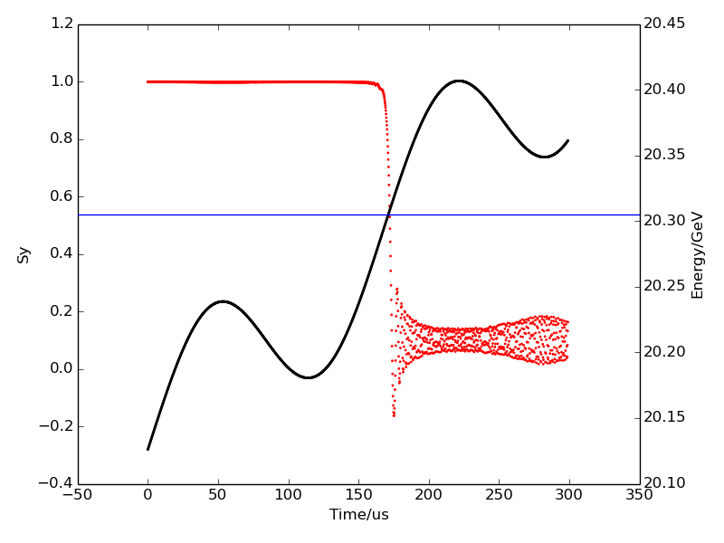
Cross isolated resonance
With snake
Without snake
K=46.08
K=46.08
normalized emittance=5 mm mrad
Resonance strength = 0.00151543
K=46.08
K=46.08
normalized emittance=200 mm mrad
Resonance strength = 0.00958445

Slide 6
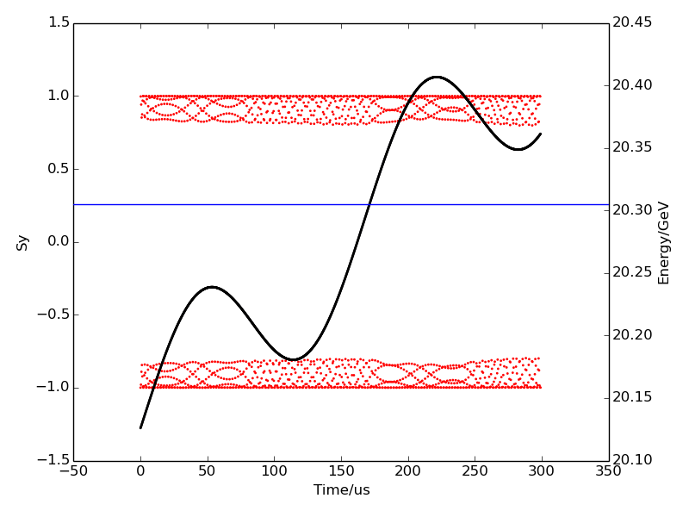
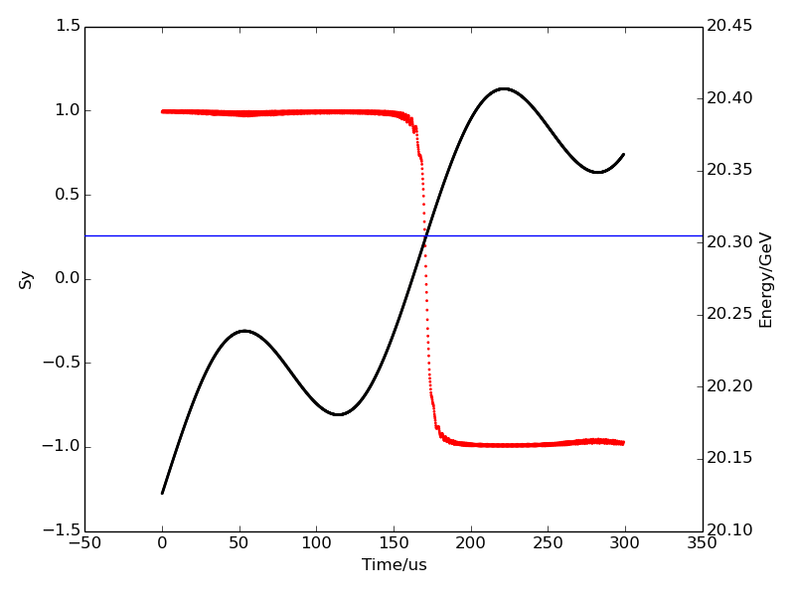
strong resonance
With shake
Without snake
K=46.08
K=46.08
normalized emittance=2000 mm mrad
Resonance strength = 0.0303087

Slide 7
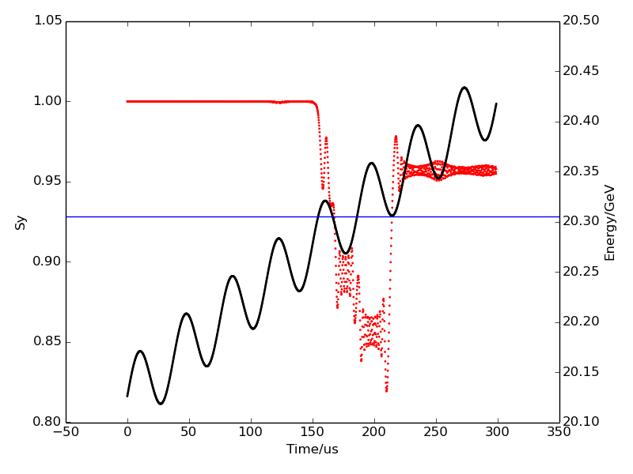
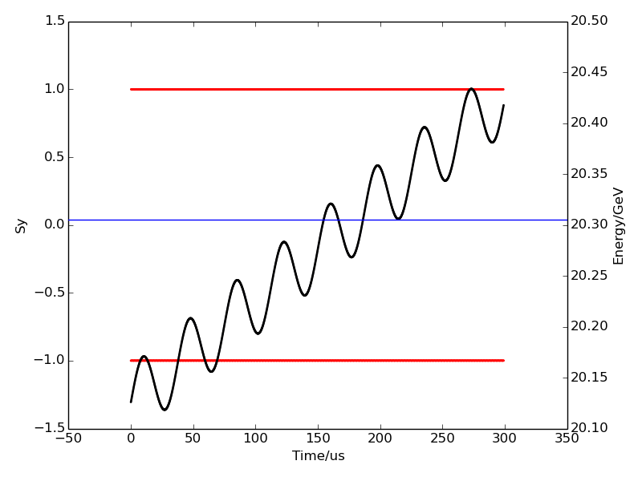
Cross multiple resonances
normalized emittance=10 mm mrad
Resonance strength = 0.00214315

Slide 8
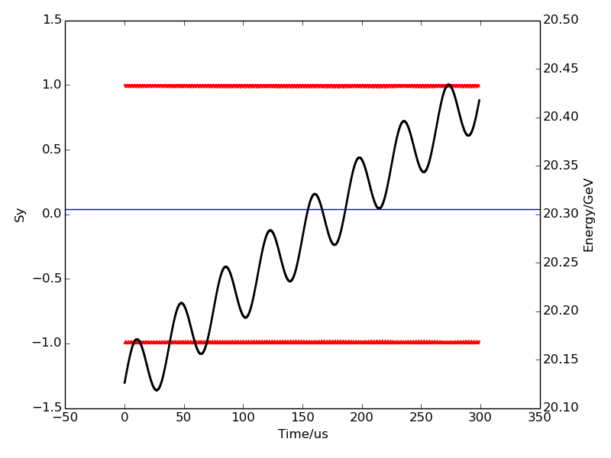
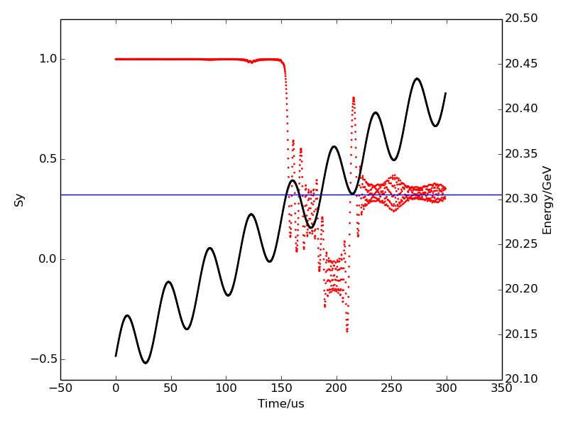
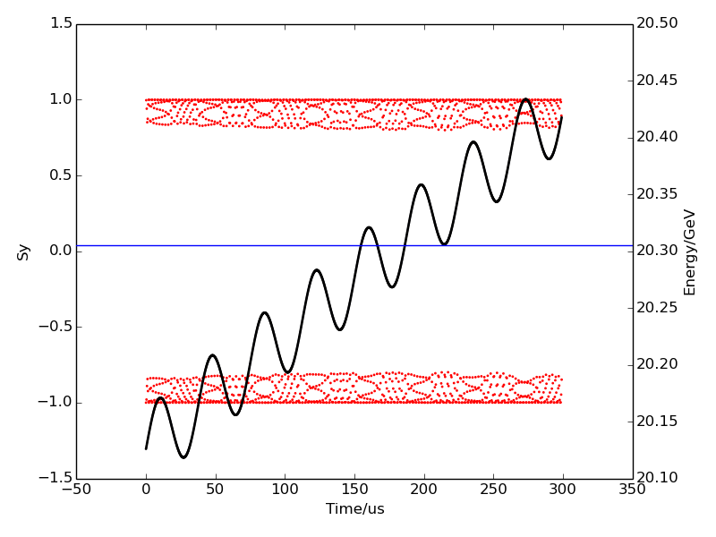
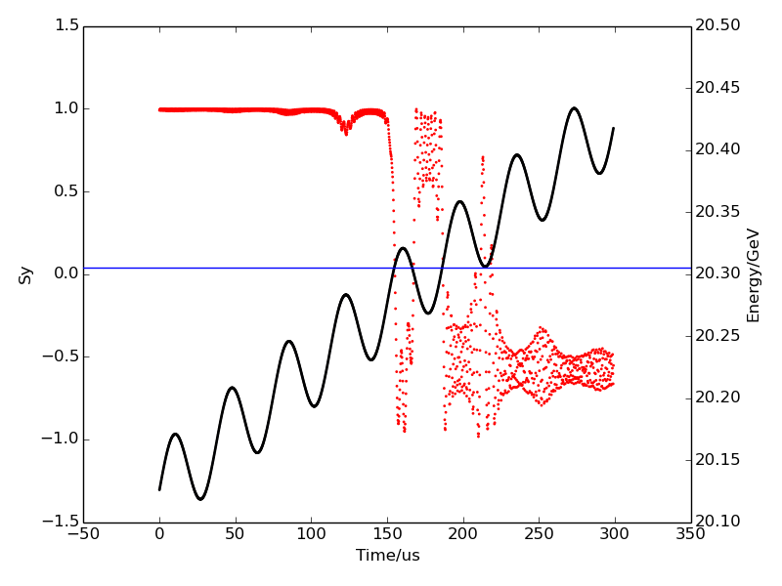
Cross multiple resonances
normalized emittance=200 mm mrad
Resonance strength = 0.00958445
normalized emittance=2000 mm mrad
Resonance strength = 0.0303087

Slide 9
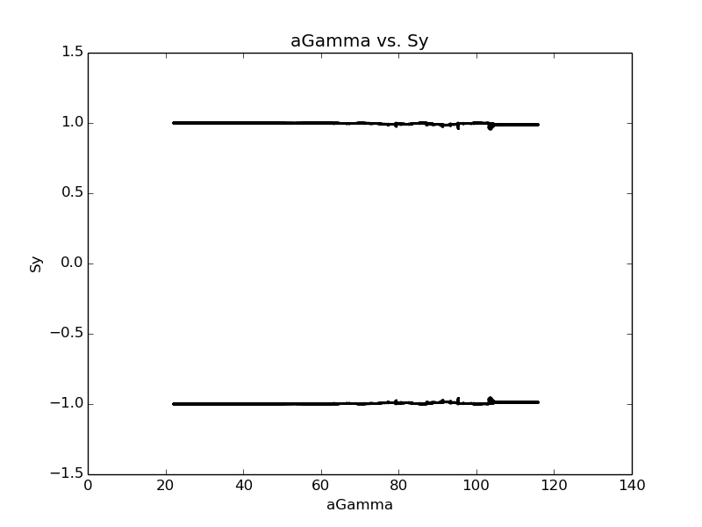
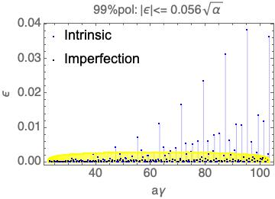
previous results
Lattice independent simulation result
Resonance in CEPC Booster

