Slide 1
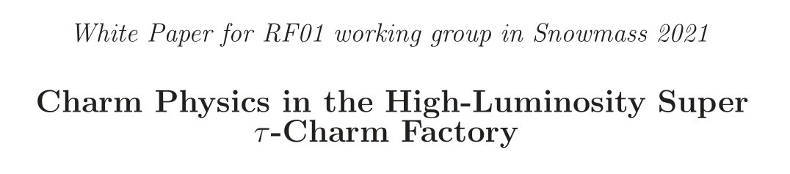
主 讲 人：乔佳辉
日 期：2022.03.21

Slide 2
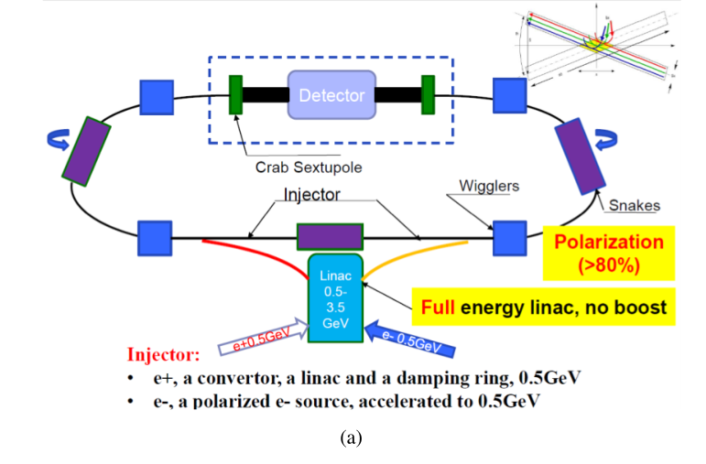
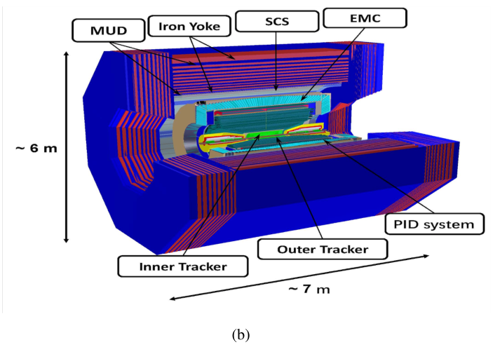
STCF

Slide 3
Introduction
Charmed meson
Charmed baryon
Summary

Slide 4
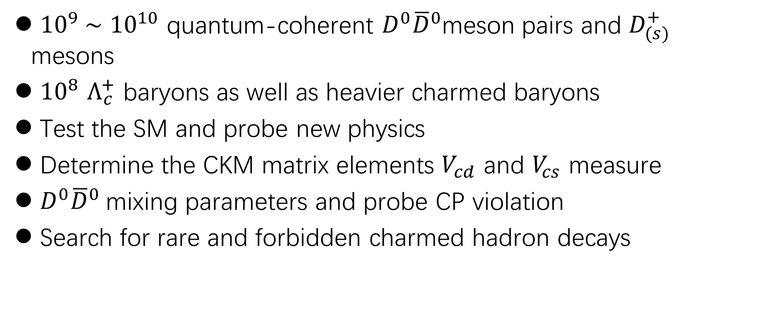
Introduction
${10}^{9}$∼ ${10}^{10}$ quantum-coherent $D^{0}{\overline{D}}^{0}$meson pairs and $D_{(s)}^{+}$ mesons
${10}^{8}$ $Λ_{c}^{+}$ baryons as well as heavier charmed baryons
Test the SM and probe new physics
Determine the CKM matrix elements $V_{cd}$ and $V_{cs}$ measure
$D^{0}{\overline{D}}^{0}$mixing parameters and probe CP violation
Search for rare and forbidden charmed hadron decays

Slide 5

Charmed meson
$D_{(s)}^{+}$leptonic decays
$D_{0}−{\overline{D}}^{0}$mixing -and CP violation
Rare and forbidden decays

Slide 6
Charmed baryon
Hadronic weak decays
Electromagnetic and weak radiative decays
CP violation

Slide 7

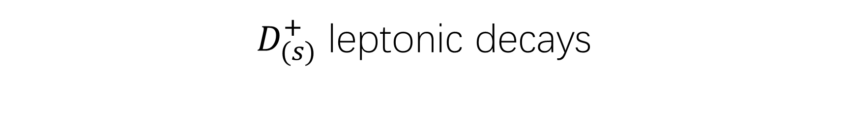
$D_{(s)}^{+}$ leptonic decays
Direct determination of the CKM matrix elements |$V_{cd}$| and |$V_{cs}$| pure-leptonic decays $D_{(s)}^{+}$ → $ℓ^{+}νℓ (for ℓ = e, µ, τ)$

Slide 8
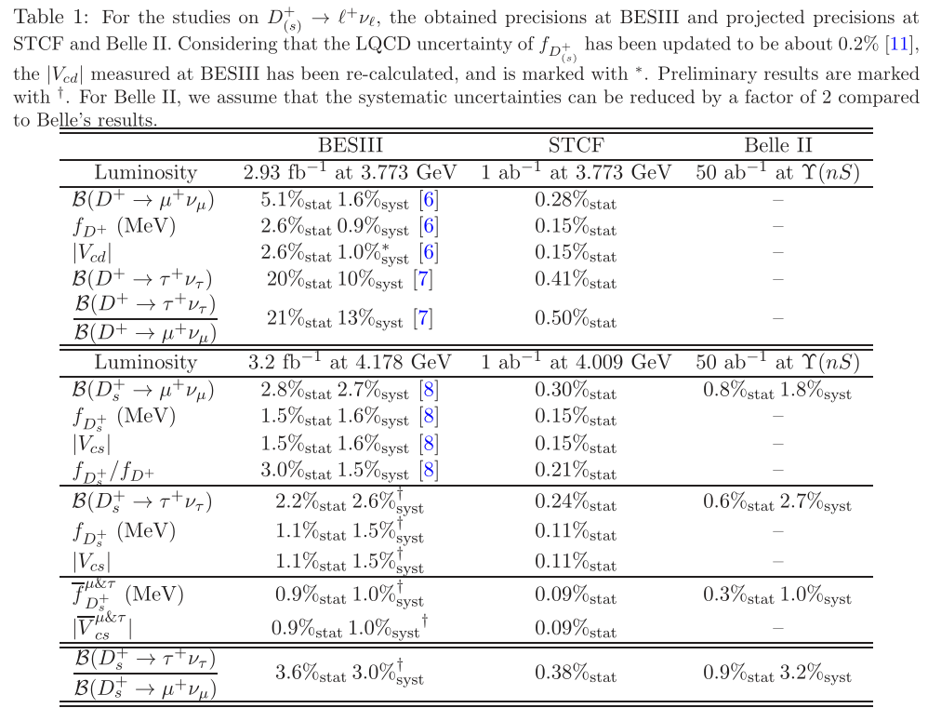

Slide 9
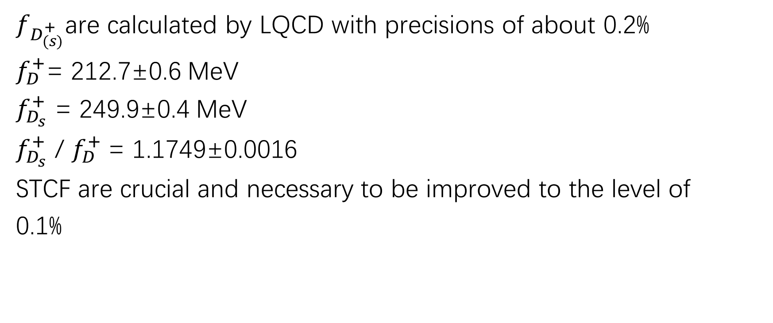
$f_{D_{(s)}^{+}}$are calculated by LQCD with precisions of about 0.2%
$f_{D}^{+}$= 212.7±0.6 MeV
$f_{D_{s}}^{+}$ = 249.9±0.4 MeV
$f_{D_{s}}^{+}$ / $f_{D}^{+}$= 1.1749±0.0016
STCF are crucial and necessary to be improved to the level of
0.1%

Slide 10
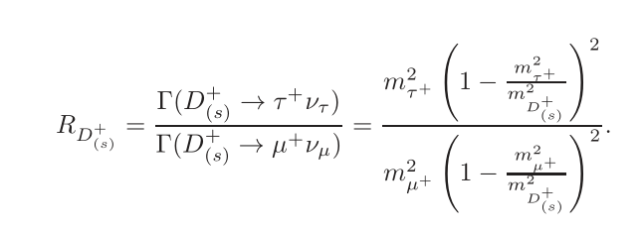

Lepton flavor universality (LFU) can also be tested in charmed meson leptonic decays.
$R_{D^{+}}$=2.67 ± 0.01 $R_{D_{s}^{+}}$= 9.75 ± 0.01
BESIII is 3.21 ± 0.64 (10.2 ± 0.5)

Slide 11
Summary
clean reaction environment
strictly constrained kinematics
well-controlled systematic uncertainties
a detector with excellent performance

Slide 12
谢谢！

