Slide 1






国家重点研发计划
高能环形正负电子对撞机关键技术研发和验证
课题2：硅径迹探测器关键技术验证
报告人： 梁志均
项目负责人： João Guimarães da Costa
项目承担单位：中国科学院 高能物理研究所

Slide 2
国家重点研发计划
R&D and Verification of Key Technologies for a High Energy Circular Electron-Positron Collider
课题2：硅径迹探测器关键技术验证
报告人： 梁志均
项目负责人： João Guimarães da Costa
项目承担单位：中国科学院 高能物理研究所

Slide 3
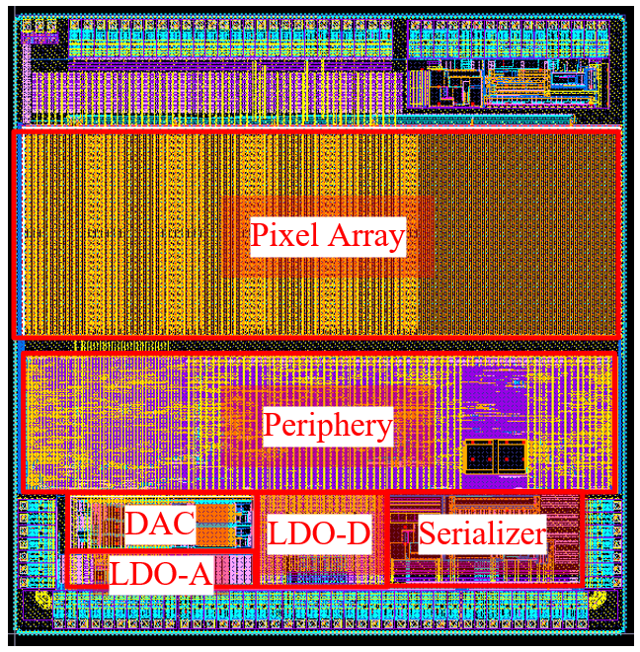
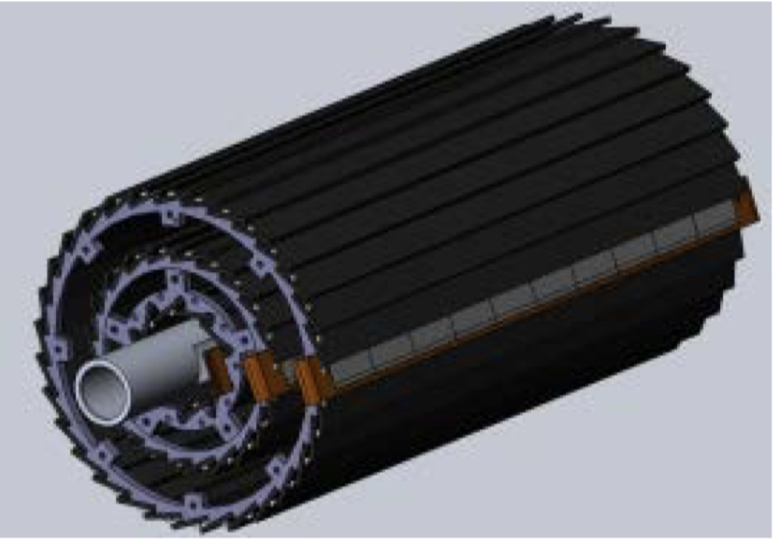
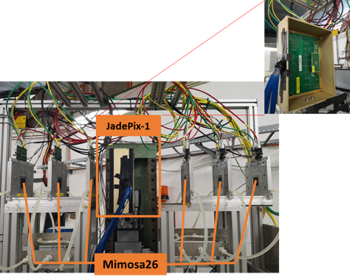
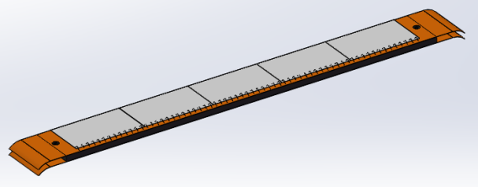

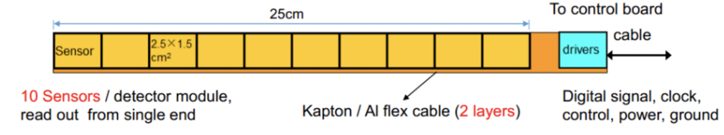
Overview of task2： vertex detector R & D
Can break down into sub-tasks:
  CMOS imaging sensor chip R & D
  Detector layout optimization, Ladder and vertex detector support structure R & D
  Detector assembly
  Data acquisition system R & D
CMOS imaging
sensor prototyping
Detector module (ladder)
Prototyping
Full size vertex detector Prototype
Beam test to
verify its spatial resolution
Notes:
Full size vertex detector

Slide 4
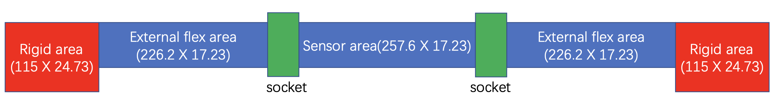
Minute of discussion last week
Flexible PCB board will be designed with Socket
Two design of Flexible PCB
  Thickness
    Two metal layer (default) : 0.1mm thick , 1mm reaffirmance layer on both end
    4-layer : 3mm thick
  Length: 14cm +27.3 cm(ladder) + 14 cm ~ 55.3cm
  Width： 17.23mm

Slide 5
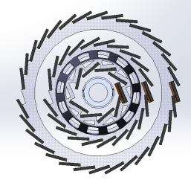
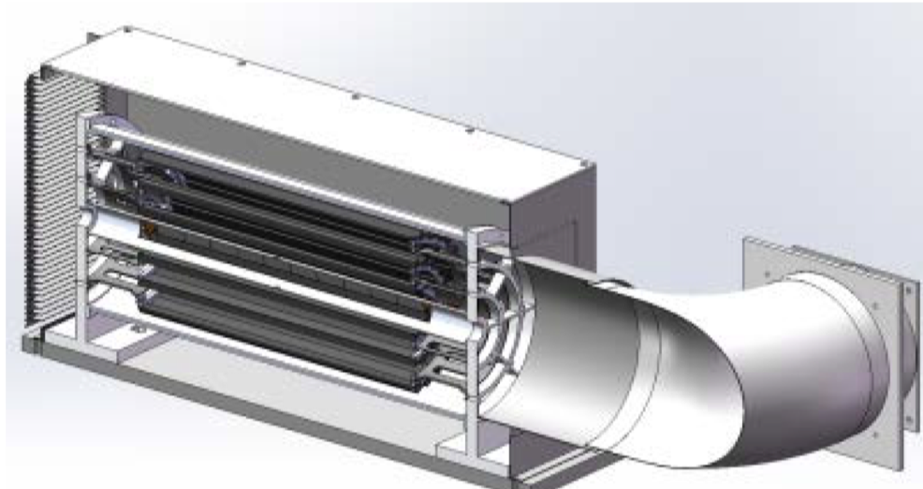
Minute of DAQ discussion
Aim to build a detector
  6 layer, in a line
  120 chips，6 double-layer ladders，
  24 --》 6 FPGA boards (readout from one side, two layer of ladder sharing one board)
  12 boards for cosmic
  2 global signal for FPGA board (one clock signal , one reset signal)
Triggerless mode, record all the data, and do analysis offline
Beam

Slide 6
Ladder support production
Submission 1 (fast company) : thicker carbon fiber 80 ladders
Submission 2 (good slow company): next finalize the design of ladder , 3+ months

Slide 7
Summary of last week discussion: Timeline
ASIC （ Taichupix3 Early July )
  Taichupix3 Test boards for one chip (finished the design , end of next week manufactured )
  and Flexible PCB design. FPGA readout board ( now ~ March 2022)
  Production (One week for test boards, for flex PCB , 2~3 weeks )
  Taichupix3 probe card testing (June 2022 ~ Aug 2022): 1 week for setup, 5 wafers to test
  Taichupix3 testing with test boards (June 2022 ~ September 2022): 1 wafer (50 chips)
Ladder
  Thinning wafers : 3 wafers ( 100um, 50um ) (July – Augugst )
  Ladder support production (now ~ April 2022)
  Ladder Assembly with dummy (April~ May 2022)
  Ladder Assembly with Taichupix3 (July ~Sep 2022)
DAQ
  testing with fake data for multi-chips (now ~ June 2022)
  Test with test boards ( June 2022)
  Test with one ladder ( Sep 2022)
  three double-side ladders ( 6 layer, 60 chips，6 ladder， 24 FPGA boards）
  )

Slide 8
Summary of last week discussion: Timeline
Prototype
  First and second batch of support structure design and manufactured(now ~ June 2022 )
  Vertex detector Assembly with full set of ladder supports installed (June 2022 )
  Vertex detector Assembly with Taichupix3 ladder (Sep 2022 ~ Oct 2022)
Testbeam
  Cosmic test setup (Sep 2022)
  Test beam at IHEP 2GeV ( Sep 2022)
  Test beam at DESY (4~7GeV electrons) (Nov 2022)
  Irradiation test for Taichu3: X ray machine if it is fixed, or BSRF station, or CO60

Slide 9
Topic of this week : PCB design and ladder dimension
Flexible PCB design /FPGA
Ladder dimension check (25mm width Flex PCB)?
ASIC dimension
Ladder support ( 272.9 mm * 16.8mm (17 or 17.2mm) * 2mm)
  Discuss with Jun on connector and width of PCB
  Jinyu checked the dimension and limitation of installing 6 ladders
  How we support the flex PCB head
  Jinyu Rotate the box
Test beam and cosmic tests
  Trigger less readout for chip, check with FPGA trigger
  Store all the data, trigger them offline
  Start with single chip test boards for cosmic (Aug 2022)
  Then we do single ladder for cosmic

Slide 10
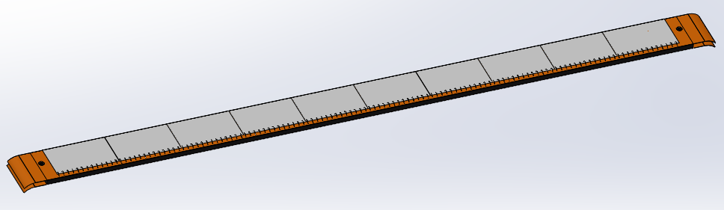
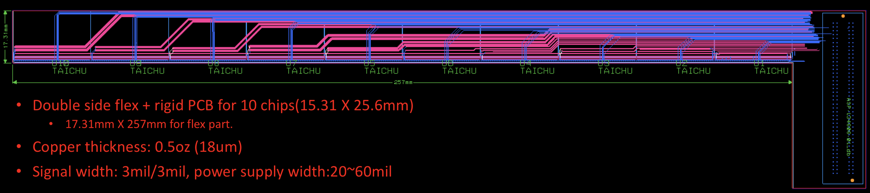
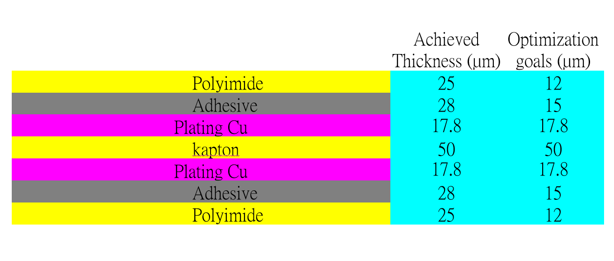
Completed preliminary version of detector module (ladder) design
  Detector module (ladder)= 10 sensors + support structure+ flexible PCB+ control board
  Sensors will be glued and wire bonded to the flexible PCB
  Flexible PCB will be supported by carbon fiber support structure
  Signal, clock, control , power, ground will be handled by control board through flexible PCB
3D model of the ladder
Schematic of ladder electronics
Profile of flexible PCB
Design of Flexible PCB prototype

Slide 11
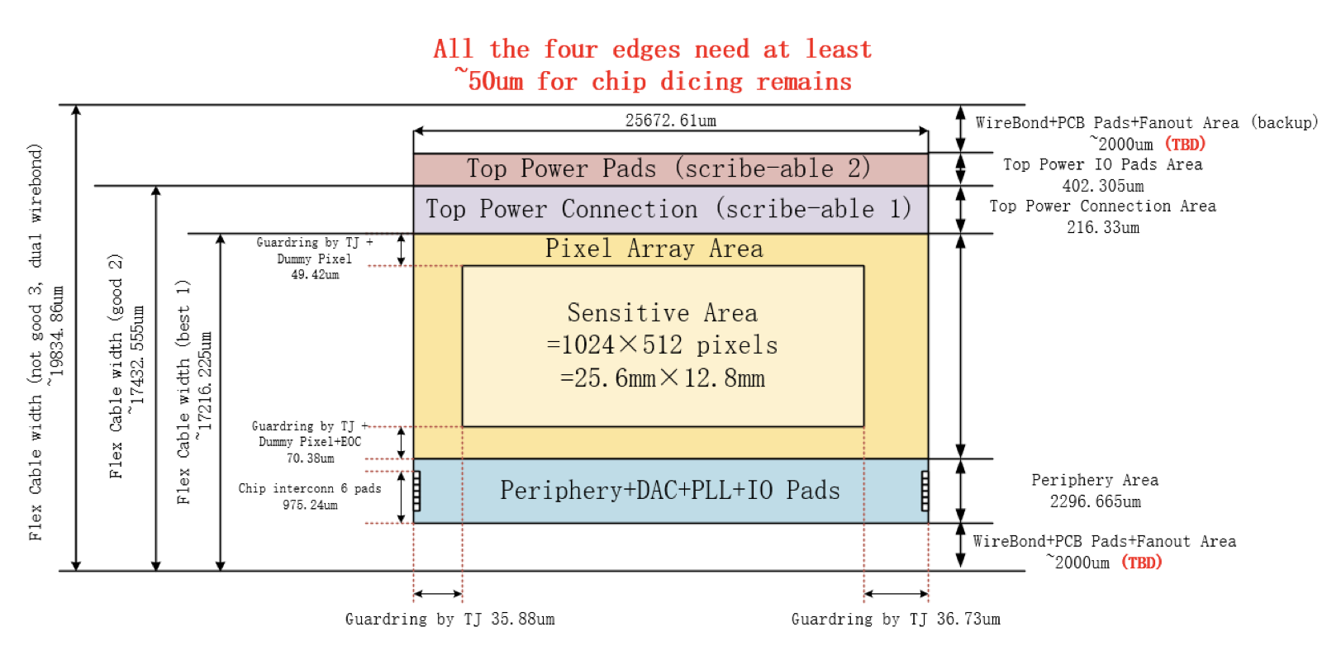
df

Slide 12
Plan for test beam
Expect to perform beam test in DESY(3 - 7GeV electron beams)
  IHEP test beam facility as backup plan (a few hundreds MeV - 2.5GeV electrons )
  6 layer in a line
Enclosure for detector with air cooling is developed for beam test
  Beam is shooting at one sectors of vertex detectors
Install one sector of ladder in vertex detector
Beam
Beam
Beam

Slide 13
Research Team in task 2
4 institutes
课题2：IHEP - 中国科学院高能物理研究所
                SDU - 山东大学
                NJU - 南京大学
                NWU - 西北工业大学
Institutes | Tasks
IHEP | Full CMOS chip modeling, Pixel Analog, PLL block Detector module (ladder) prototyping Data acquisition system R & D Vertex detector assembly and commissioning
CCNU/IFAE | CMOS sensor chip: Pixel Digital
NWPU | CMOS sensor chip: Periphery Logic, LDO
SDU | CMOS sensor chip: Bias generation, TCAD simulation Sensor test board design
NJU | Irradiation, test beam organization
Notes:
Total 51, average age is 39
Acc: 39=703/18
Silicon: 39=866/22
HCAL: 40=440/11
Total: 39

Slide 14
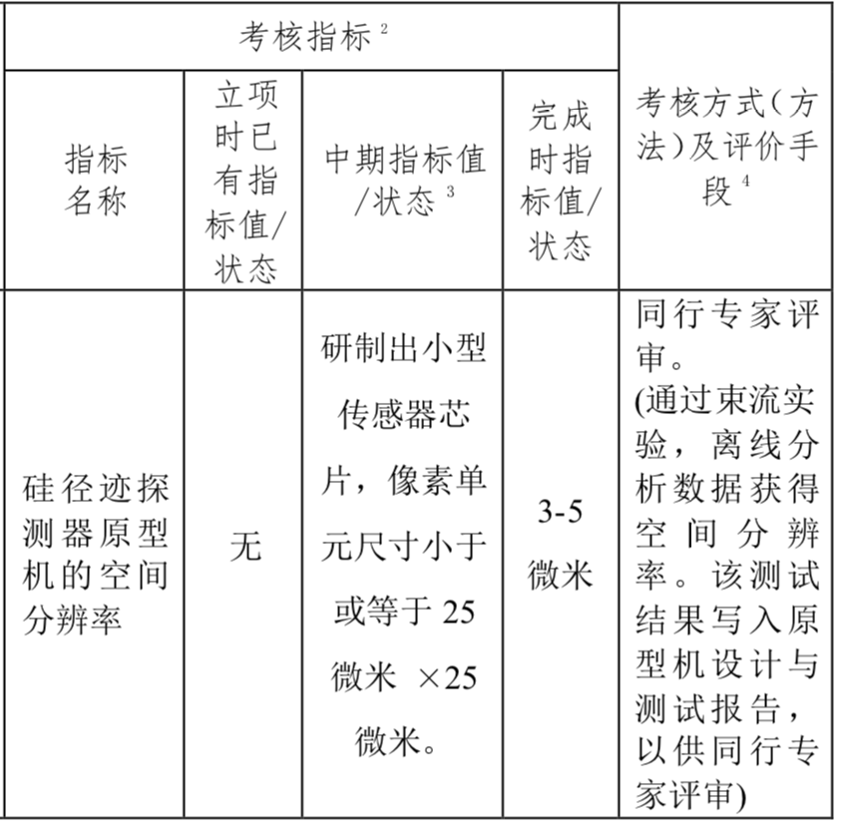
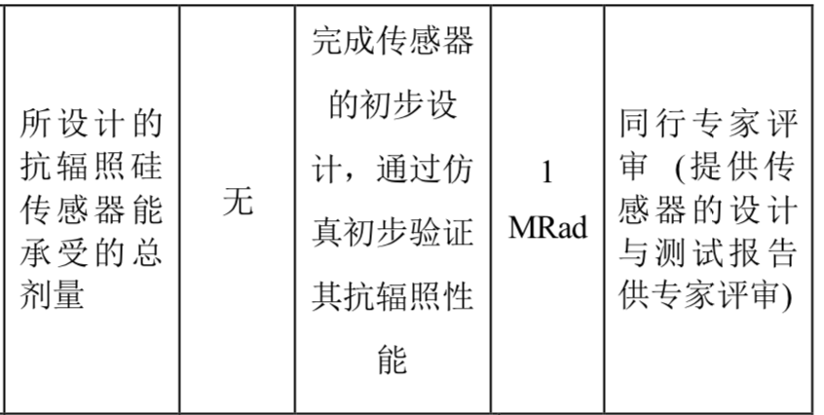
Achievement Presentation and Assessment Methods
Assessment index
Spatial resolution
  - Mid-term: produce 25*25 μm pixel size chip
  - Final : 3-5 μm resolution in Beam test
Silicon Detector
Radiation hardness
  - mid-term: verified by TCAD simulation
  - Final : Total ionization dose >1 Mrad

Slide 15
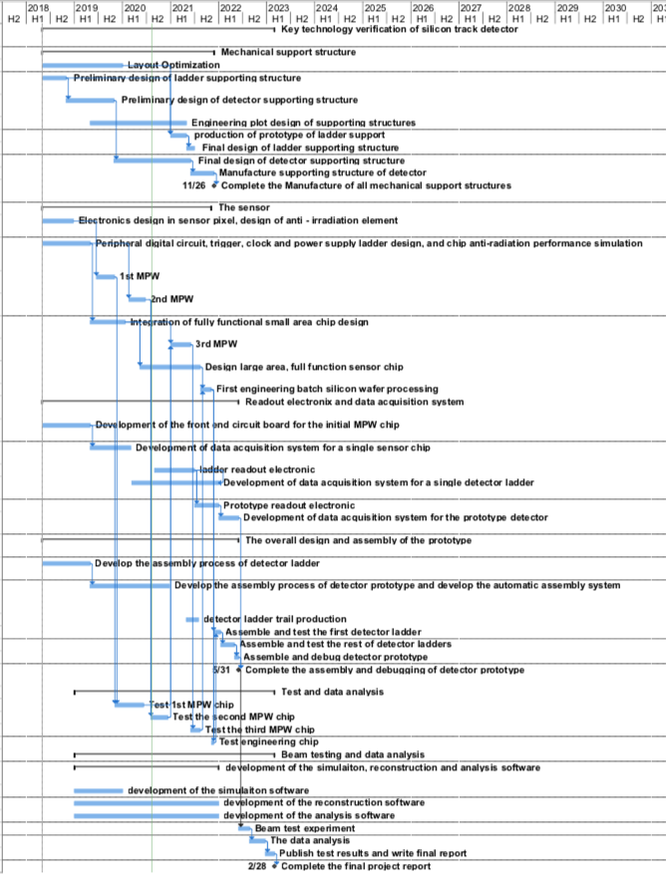
Overall plan of task2： Vertex detector R & D
3rd Year:
  3rd CMOS sensor fabricated and tested
    → skipped , since 2nd MPW chip is working well
  Final support structure engineering design completed
  Fabricated support structure prototype for ladders
4th Year:
  Competed R & D full-size TaichuPix sensor
  Manufactured the support structure for whole detector
  Assembling and installing the detector prototype
  Completed DAQ system for whole detector
5th Year:
  Completed detector assembly and commissioning
  Test beam and data analysis
  Finish assembling of prototype

Slide 16
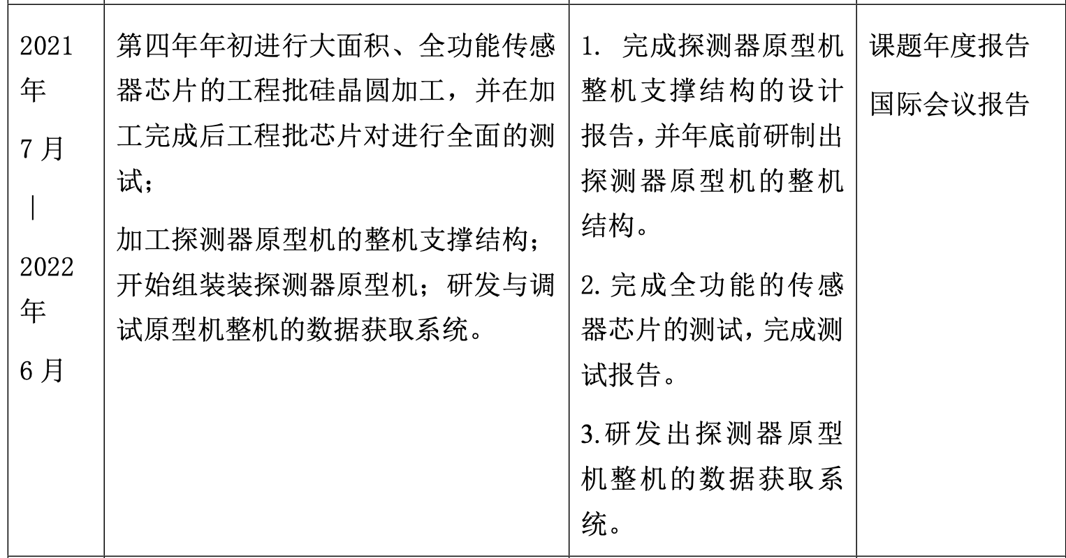
Goal for the this year(2021.7 –2022.6)
Achieve the target in task book for the 4th years
  Build the support structure prototype for ladder
  Finalize the full-size sensor testing , and write a testing report
  Complete readout electronics and DAQ for vertex detector prototype

Slide 17
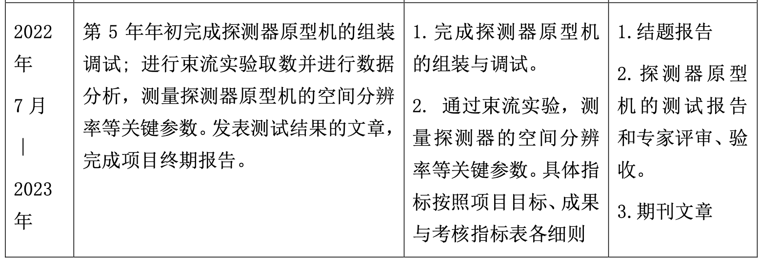
Goal for the next year(2022.7 –2023.6)
Achieve the target in task book for the 5th years
  Complete testing for full-size sensor
  Complete vertex detector prototype assembly
  Test DAQ for vertex detector prototype
  Test beam using vertex prototype, publish papers

Slide 18
Summary
More sensor tests are needed
  Including Taichupix2 irradiation tests , beta tests …
  Taichupix3 full-size sensor testing
  Test board and flex cable designs for Taichupix3
Need to speed up the prototype assembly and DAQ development.
  Assembly tooling and assembly procedure development
  Global mechanics and support structure development
  DAQ system development for multi-chips testing
Need to plan for test beam setup
 | Mid-term | Final goal | Status
Spatial resolution | Pixel size less than 25*25 μm | Spatial resolution 3~5 μm | Need test beam results
Radiation hardness | > 1MRad in simulation | >1MRad In radiation test | Test up to 30 Mrad. Need to double check with more statistics

Slide 19
Detector module (ladder) R & D
Completed preliminary version of detector module (ladder) design
  Detector module (ladder)= 10 sensors + support structure+ flexible PCB+ control board
  Sensors will be glued and wire bonded to the flexible PCB
  Flexible PCB will be supported by carbon fiber support structure
  Signal, clock, control , power, ground will be handled by control board through flexible PCB
3D model of the ladder
Schematic of ladder electronics
Profile of flexible PCB
Design of Flexible PCB prototype

Slide 20
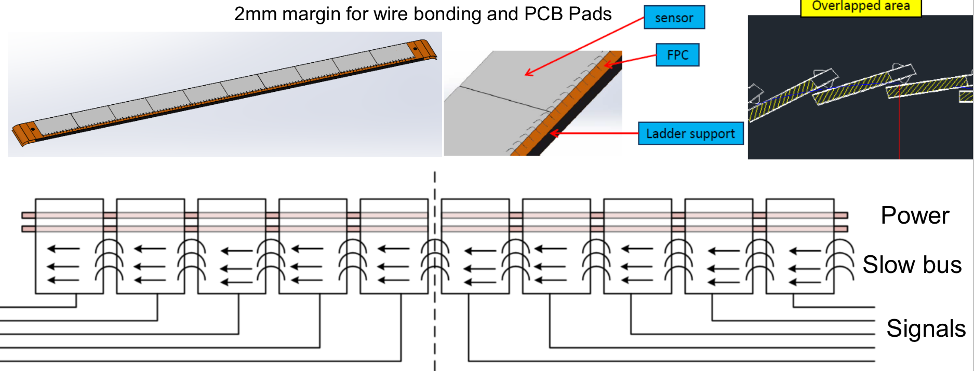
New idea in Taichu pixel design – inter-chip connection
Inter-chip connection for slow controls through wire bonding
→ Save some metal for PCB (reduce material budget)

Slide 21
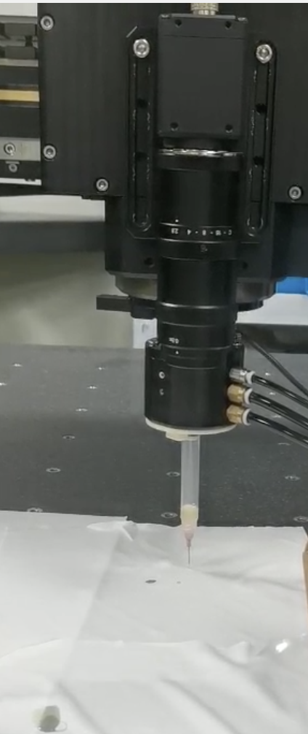
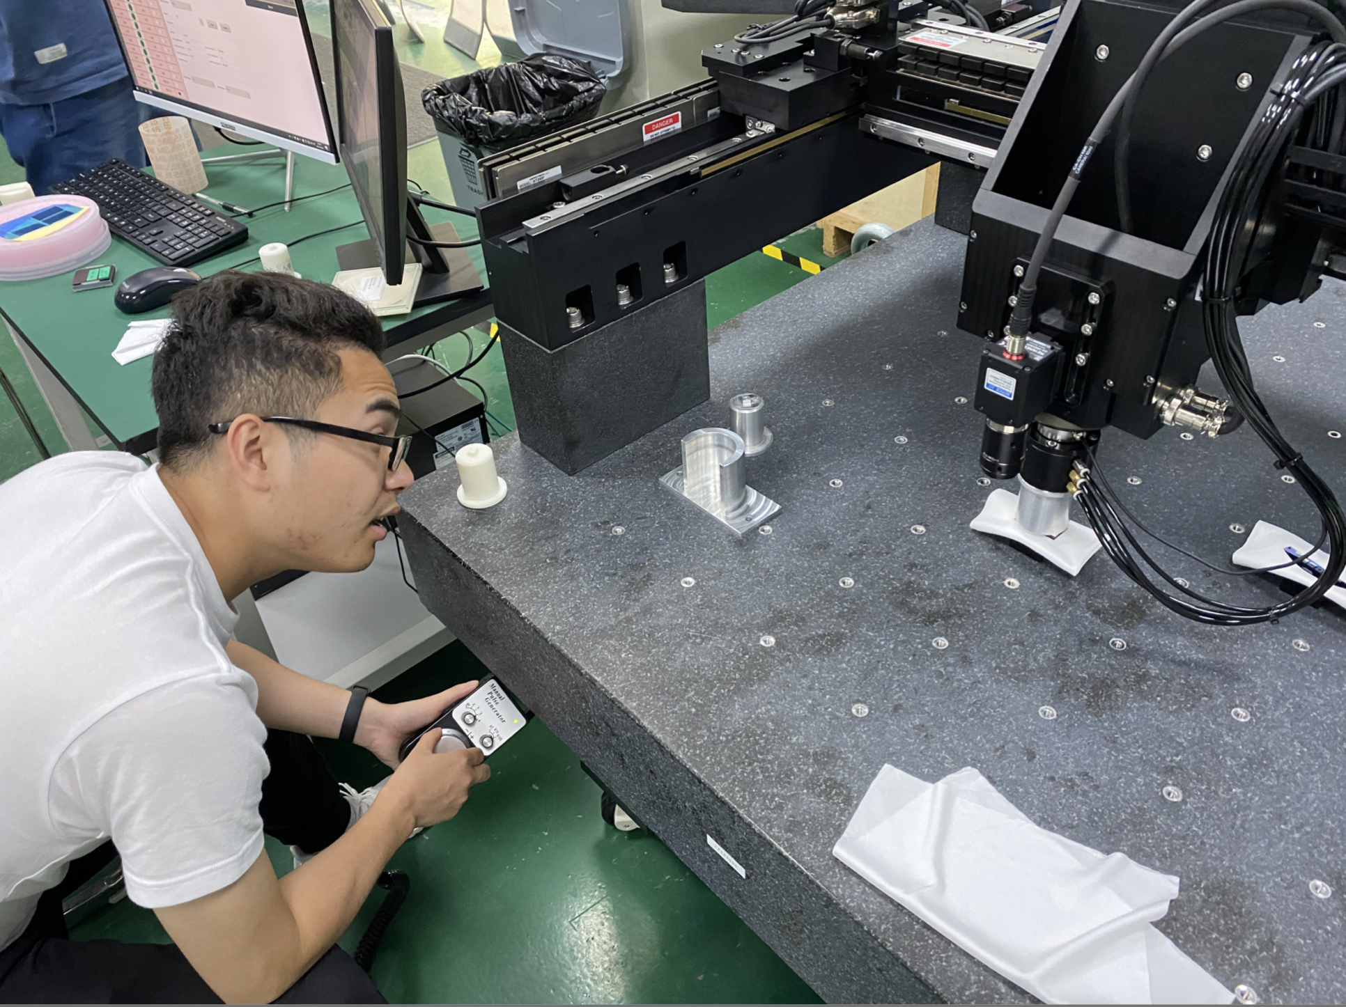
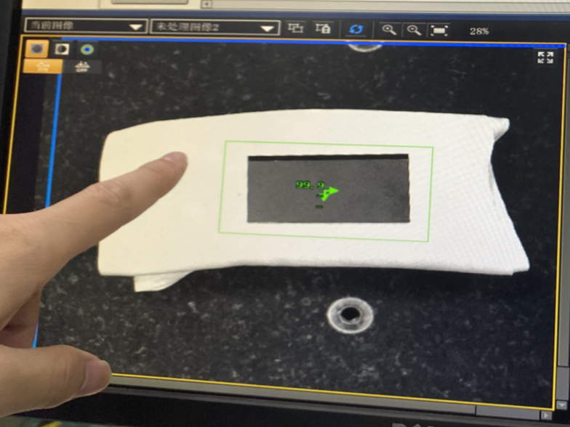
Gantry for vertex detector prototype assembly
3~5um good position resolution require high assembly precision
Cooperate with domestic company on R & D Gantry automatic module assembly.
  Pattern recognition with high resolution camera
  Automatic chip pick-up and positioning
  Automatic Glue dispending
automatic glue dispending
Gantry system
Pattern recognition

Slide 22
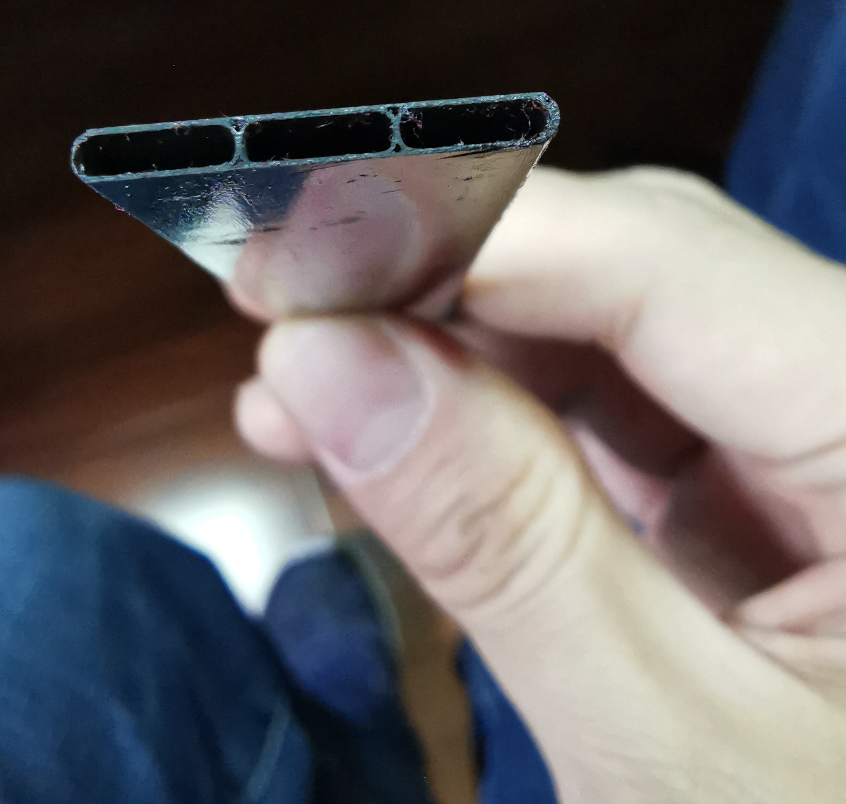
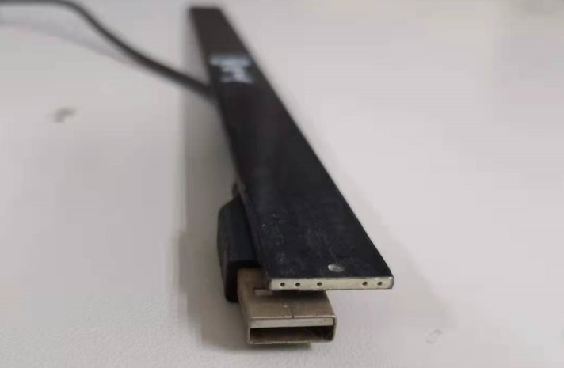
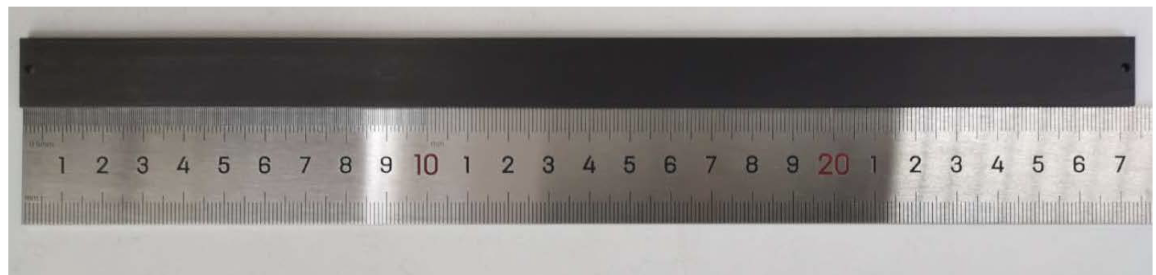
Carbon fiber Support structure of the ladder
Fabricated first support structure prototype of the ladder (IHEP designed)
  4 layer of carbon fiber, 0.12mm thick
  ~3 time thinner than conventional carbon fiber
  More details from Jinyu’s talk

Slide 23
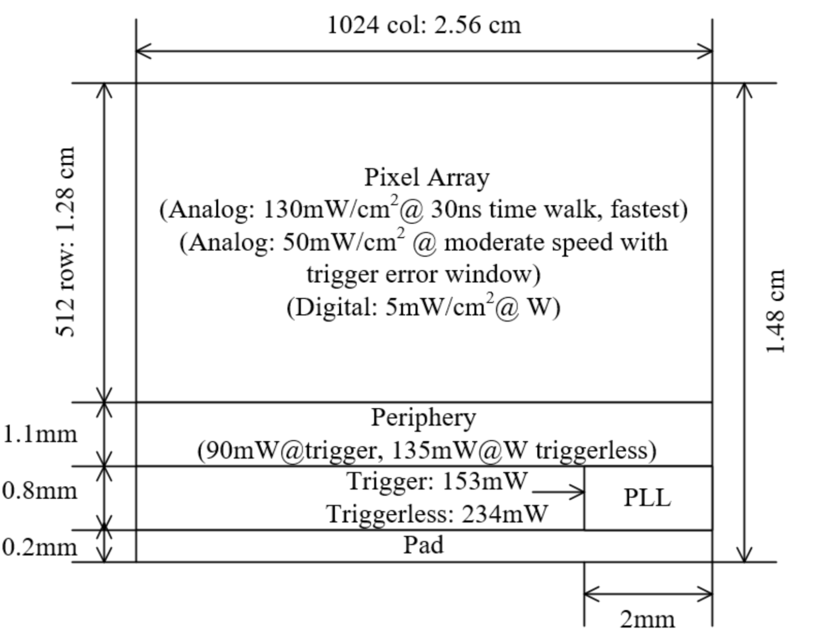
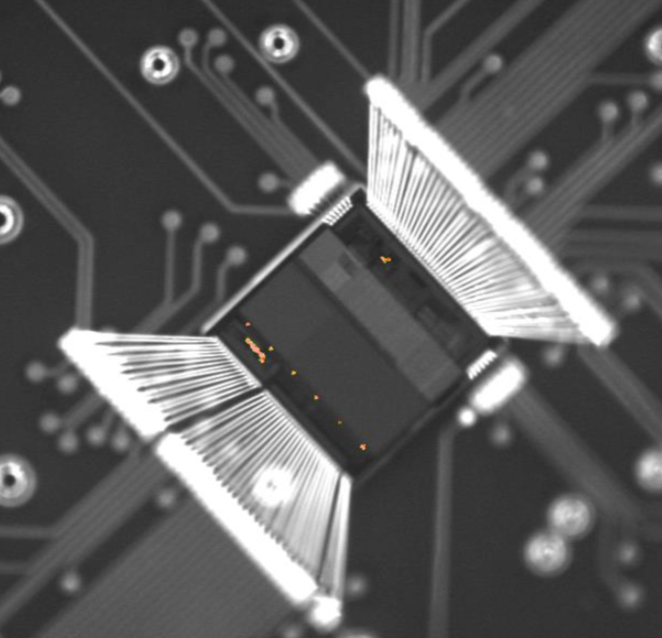
Cooling design
Air cooling is baseline design for CEPC vertex detector
Sensor Power dissipation:
  Taichupix : ≤ 100 mW/cm². (trigger mode) ; CEPC final goal : ≤ 50 mW/cm²
Cooling simulations of a single complete ladder
  Testbench setup has been designed and built for air cooling , vibration tests
The EMMI
(Emission Microscope)
For Taichupix2
Power consumption

Slide 24
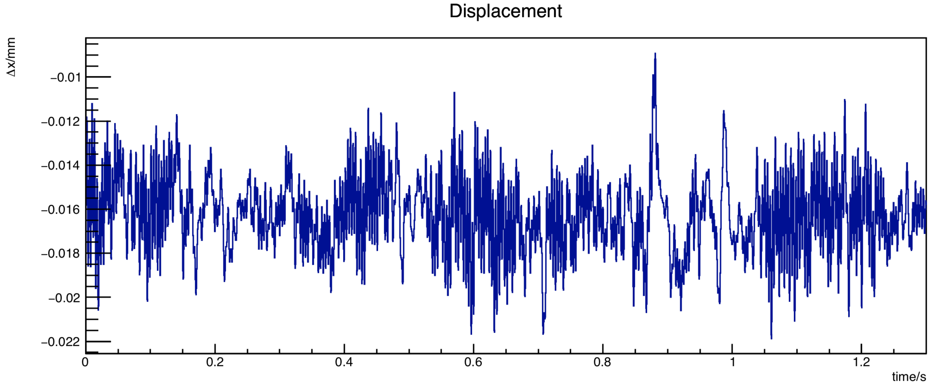
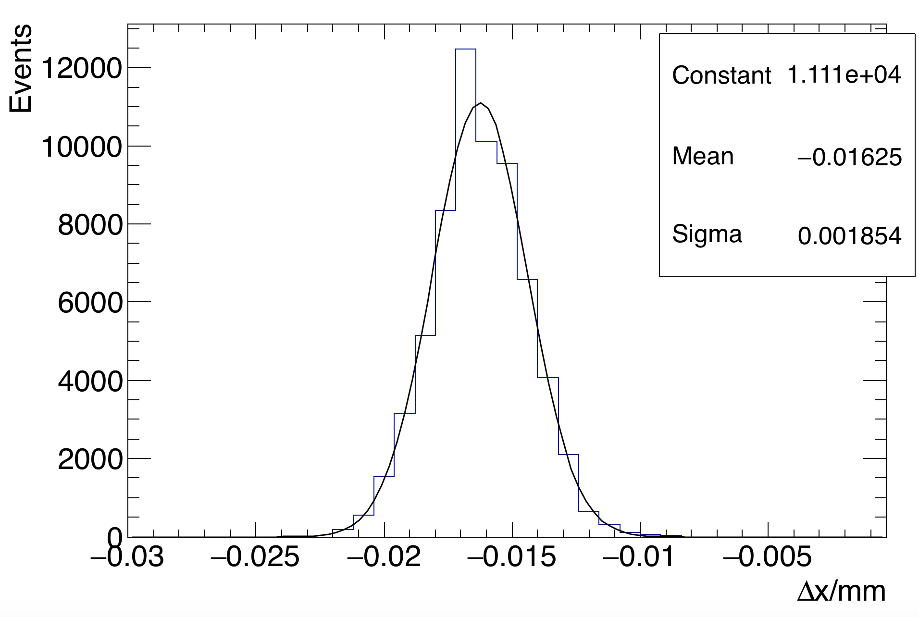
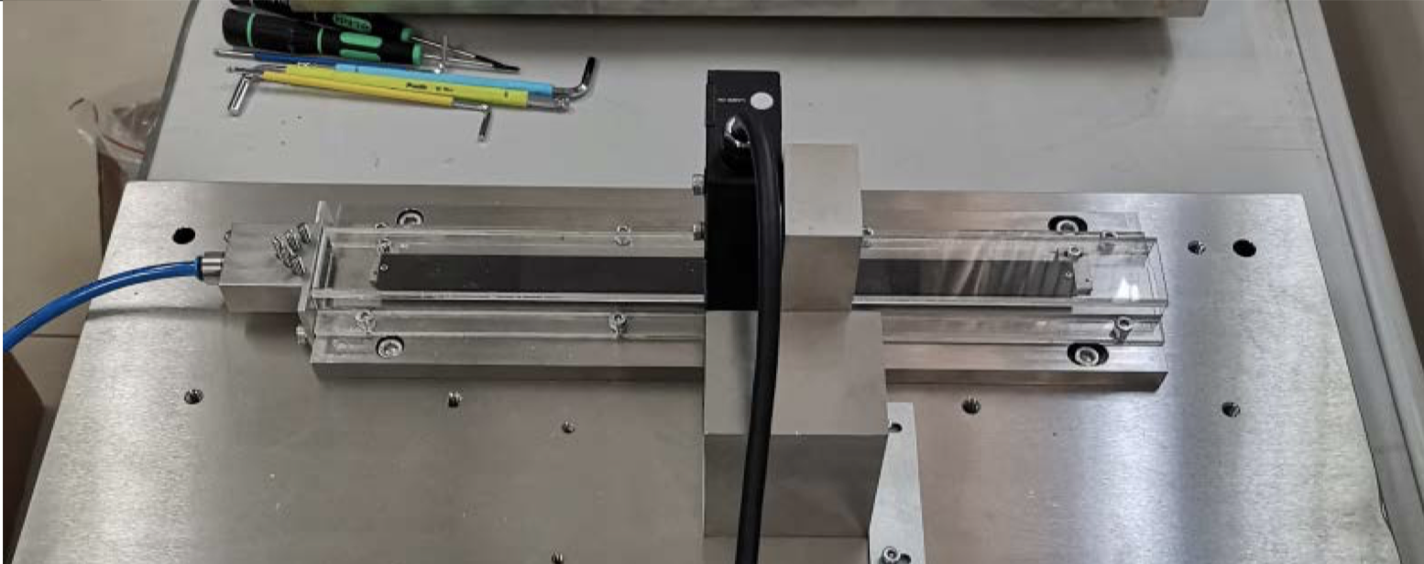
Air Cooling test
Test bench setup for air-cooling
Vibration follows Gaussian distribution
  Maximum displacement can above 10μm
  Core of Gaussian is still under control
Typical Vibration displacement during air cooling
Test setup prototype for ladder cooling
Use compressed air for cooling
(See more from Jinyu’s talk)
Laser interferometer
Air flow
Ladder support

Slide 25
Plan for test beam
Expect to perform beam test in DESY(3 - 7GeV electron beams)
  IHEP test beam facility as backup plan (a few hundreds MeV - 2.5GeV electrons )
Enclosure for detector with air cooling is developed for beam test
  Beam is shooting at one sectors of vertex detectors
Install one sector of ladder in vertex detector
Beam
Beam
Beam

Slide 26
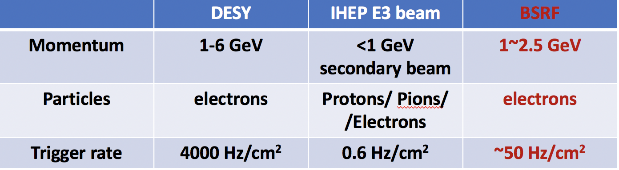
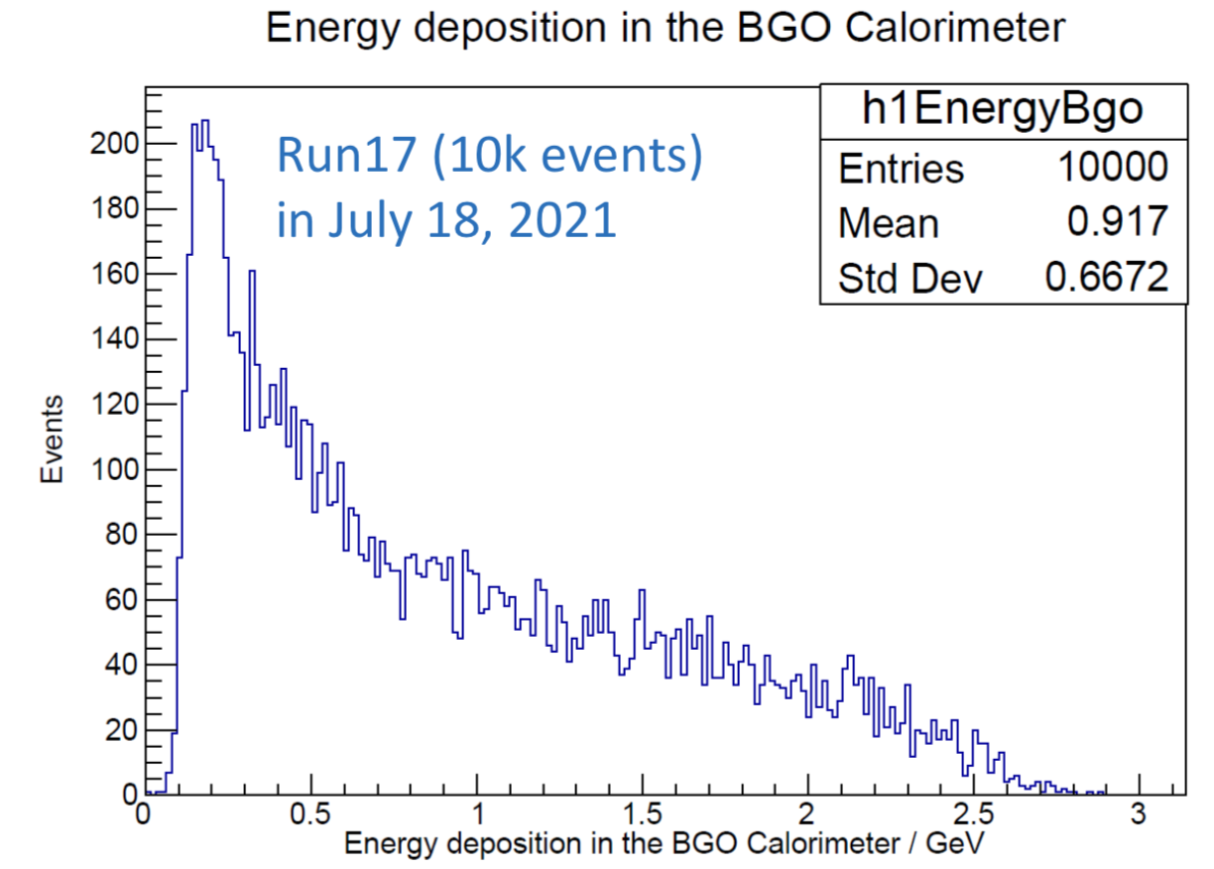
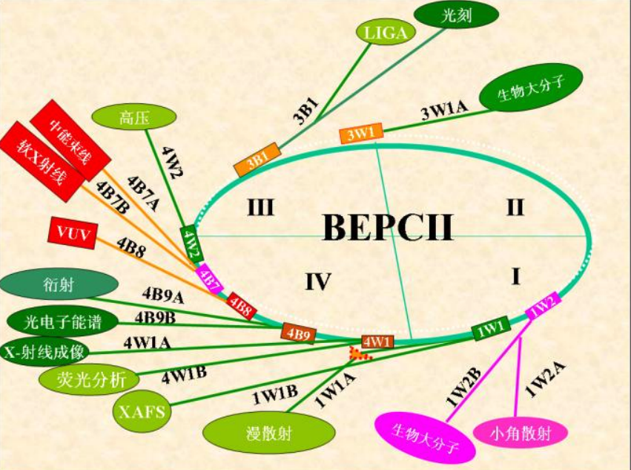
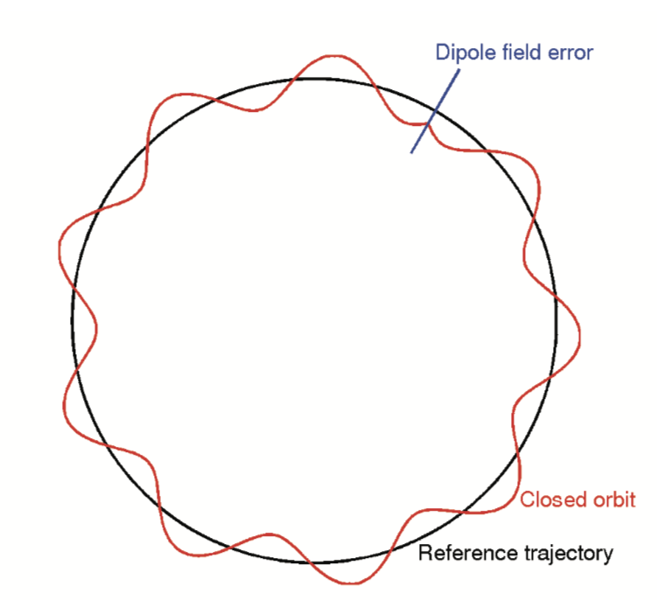
Plan for test beam (2)
New opportunity in Beijing Synchrotron Radiation Facility (BSRF)
  High energy electron (0.2~2.5 GeV) leakage from BEPC
  High trigger rate (up to 50Hz/cm²)
  Need to filter low energy particles for vertex test beam
Energy spectrum measured
by calorimeter (by Yong Liu)

Slide 27
Gantry for vertex detector prototype assembly
3~5um good position resolution require high assembly precision
Cooperate with domestic company on R & D Gantry automatic module assembly.
  Pattern recognition with high resolution camera
  Automatic chip pick-up and positioning
  Automatic Glue dispending
automatic glue dispending
Gantry system
Pattern recognition

