Slide 1
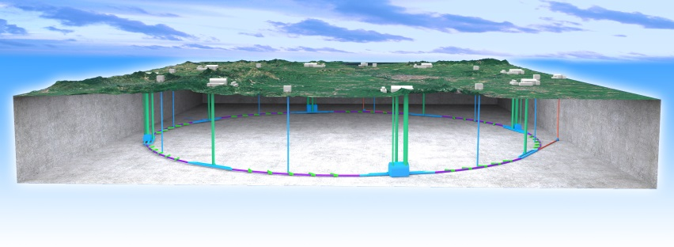

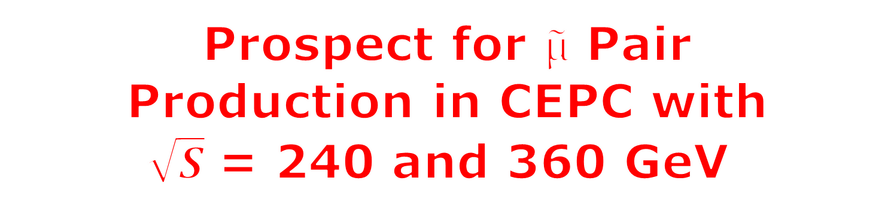
Prospect for $\tilde{µ}$ Pair
Production in CEPC with
$\sqrt{S}$ = 240 and 360 GeV
CEPC
Feng LU
CEPC Joint Workshop 2022
23-25 May 2022, Shanghai, China

Slide 2

Outline
Introduction
  SUSY
  Smuon search at CEPC
  240GeV 5.05ab⁻¹ 5% sys. result
360GeV anaysis & 1ab⁻¹ 5% sys. results
  Variables distributions
  Final selection
  N-1 plots
  Results: yields & Zn map
Summary

Slide 3
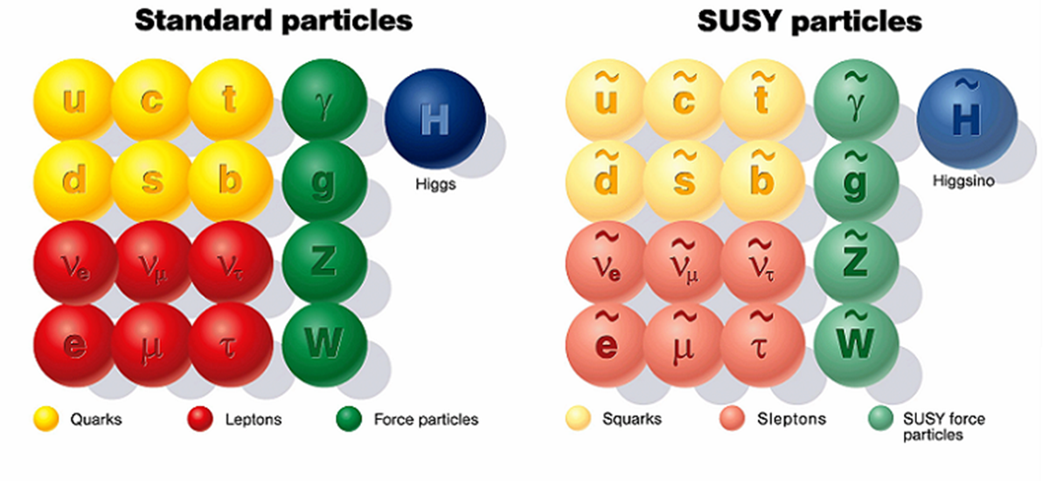
Introduction
SUSY reveals an unique symmetry between fermions and bosons:
Try to solve Dark matter ; hierarchy problem; gravity and gauge theory unification ...
May also for muon g-2@2021 4.2σ ; W mass@2022 7σ to SM predictions
Muon is unique lepton: mass not light and life not short, its SUSY partner: smuon, may
plays an essential role in SUSY sleptons search
CEPC provides good place to hunt it !
120
180
PDG@2021:
smuon mass > 94GeV, CL=95% ( CMSSM,1<tanβ<40, m_{smu} –m_{LSP} >10GeV )

Slide 4

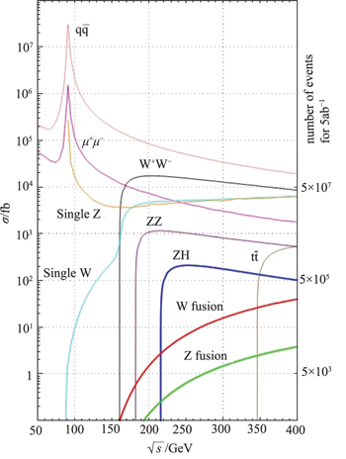
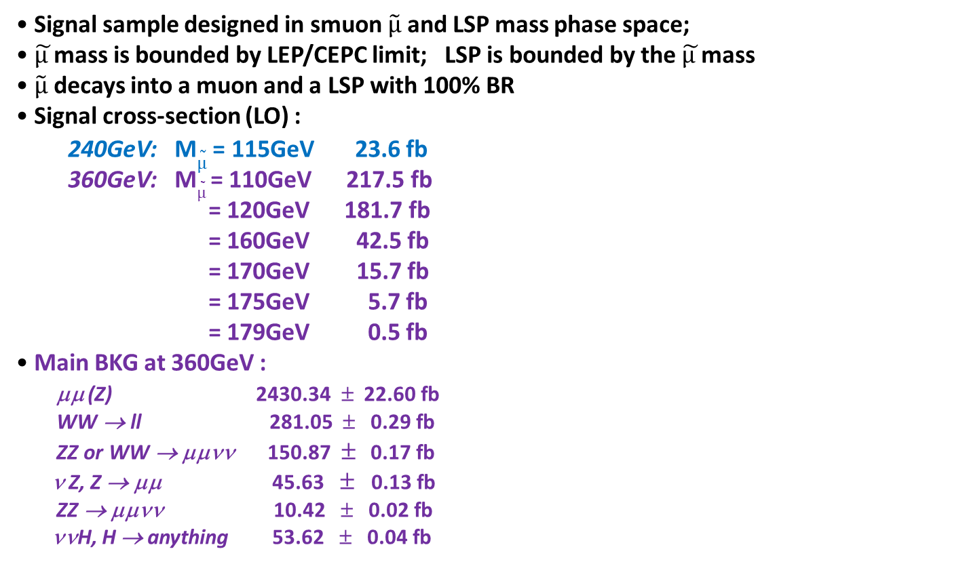
Smuon search at CEPC
• Signal sample designed in smuon $\tilde{µ}$ and LSP mass phase space;
• $\tilde{µ }$mass is bounded by LEP/CEPC limit; LSP is bounded by the $\tilde{µ }$mass
• $\tilde{µ}$ decays into a muon and a LSP with 100% BR
• Signal cross-section (LO) :
240GeV: M$\tilde{µ}$ = 115GeV 23.6 fb
360GeV: M$\tilde{µ}$ = 110GeV 217.5 fb
= 120GeV 181.7 fb
= 160GeV 42.5 fb
= 170GeV 15.7 fb
= 175GeV 5.7 fb
= 179GeV 0.5 fb
• Main BKG at 360GeV :
μμ (Z) 2430.34 ± 22.60 fb
WW → ll 281.05 ± 0.29 fb
ZZ or WW → μμνν 150.87 ± 0.17 fb
ν Z, Z → μμ 45.63 ± 0.13 fb
ZZ → μμνν 10.42 ± 0.02 fb
ννH, H → anything 53.62 ± 0.04 fb
ττ are
Channel not listed
ttbar ~300fb, its 4j+2b ~202fb , ννμμ + 2b ~3.4fb, ttbar can be well suppressed in smuon search (now no generator yet!)

Slide 5
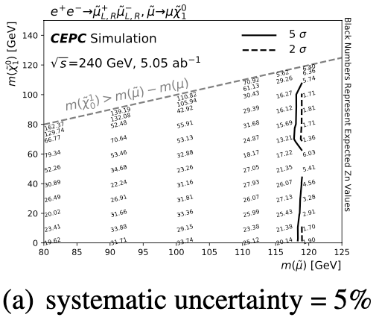
CEPC 240GeV 5.05ab⁻¹ (5% sys.) Results
N-1
plot
With 5% flat systematic, the discovery sensitivity can reach up to 117 GeV in
smuon mass arXiv:2105.06135

Slide 6
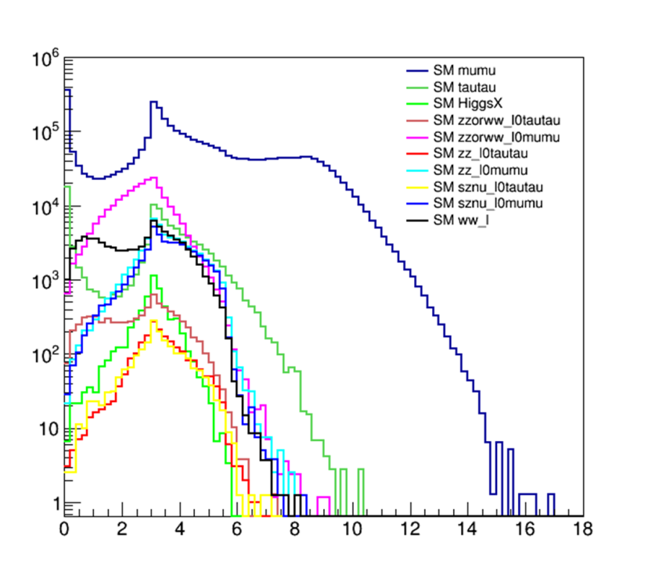
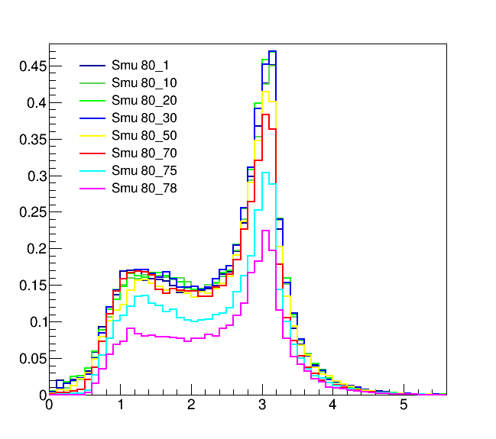
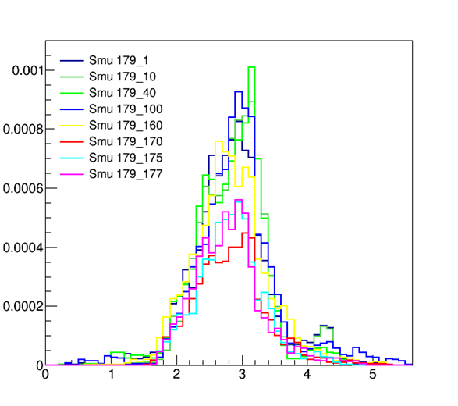
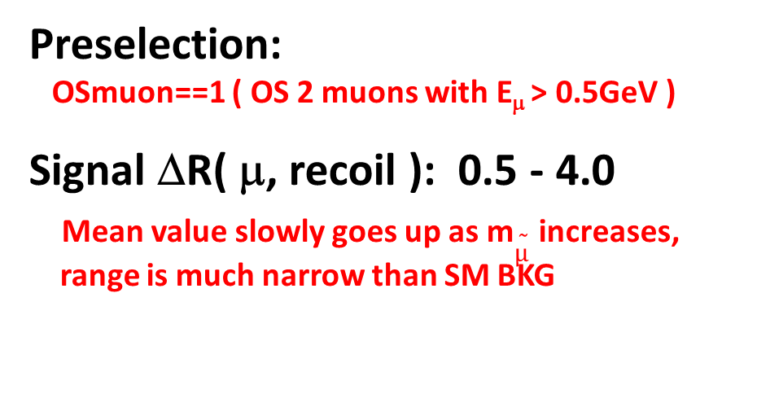
360GeV 1ab⁻¹ Analysis: Variables ΔR( μ, recoil )
SM
ΔR( μ, recoil )
ΔR( μ, recoil )
Preselection:
OSmuon==1 ( OS 2 muons with E_{μ} > 0.5GeV )
Signal ΔR( μ, recoil ): 0.5 - 4.0
Mean value slowly goes up as m$\tilde{µ}$ increases,
range is much narrow than SM BKG
ΔR( μ, recoil )

Slide 7
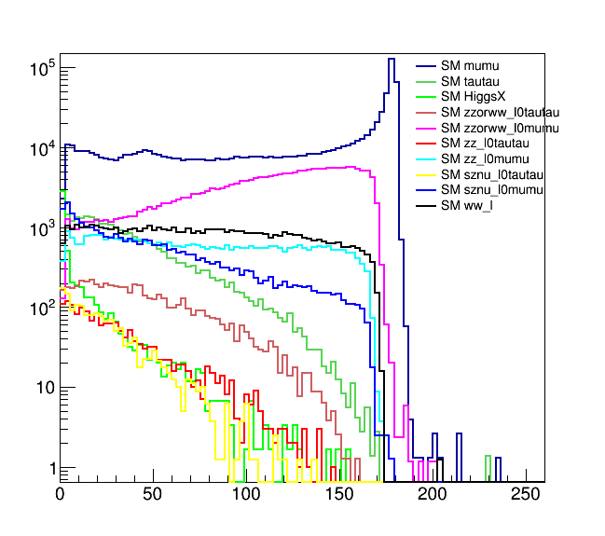
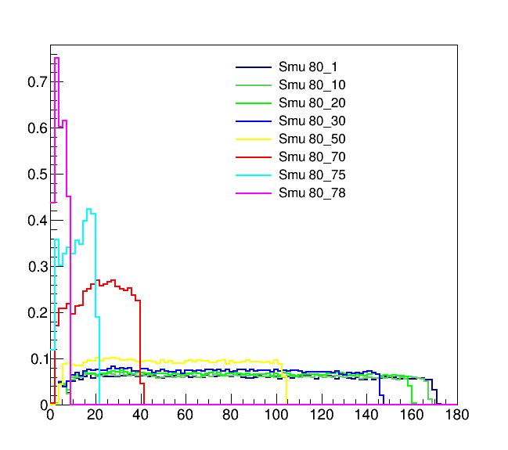
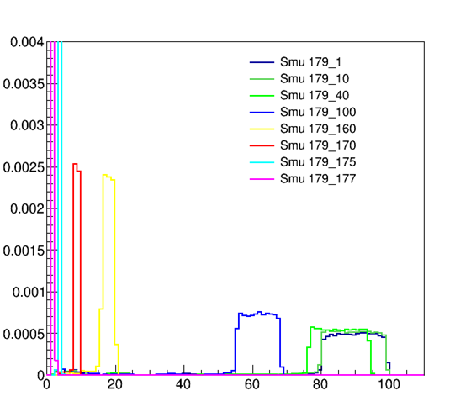

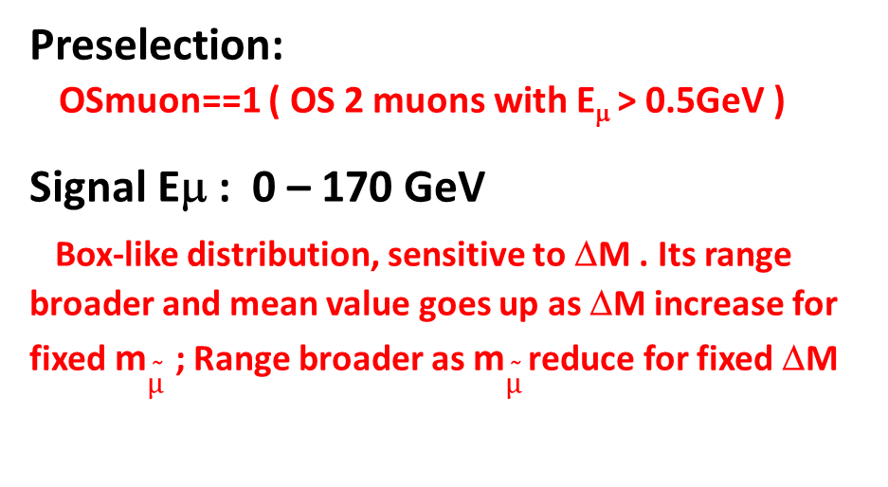
360GeV 1ab⁻¹ Analysis: Variables E_{μ}
ΔM = m$\tilde{µ}$ - m _{LSP}
E_{μ} (GeV)
E_{μ} (GeV)
Preselection:
OSmuon==1 ( OS 2 muons with E_{μ} > 0.5GeV )
Signal Eμ : 0 – 170 GeV
Box-like distribution, sensitive to ΔM . Its range broader and mean value goes up as ΔM increase for fixed m$\tilde{µ}$ ; Range broader as m$\tilde{µ}$ reduce for fixed ΔM
E_{μ} (GeV)

Slide 8
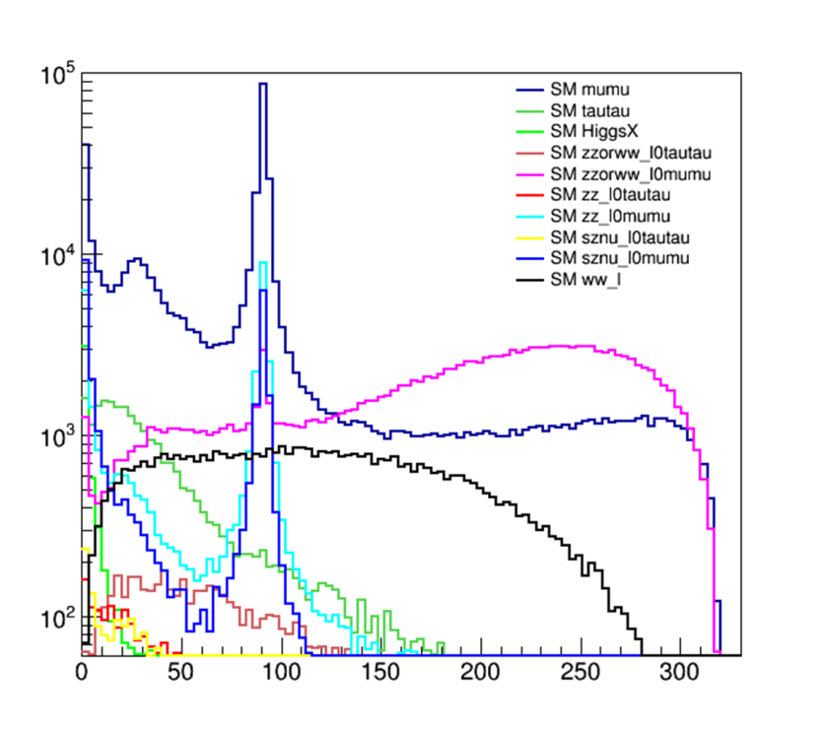
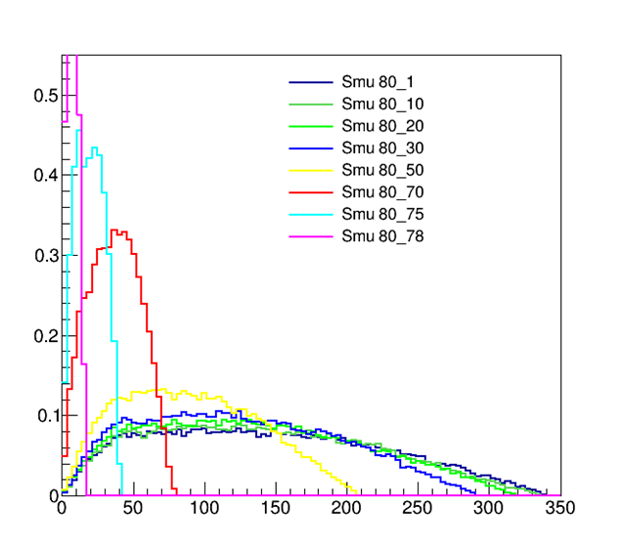
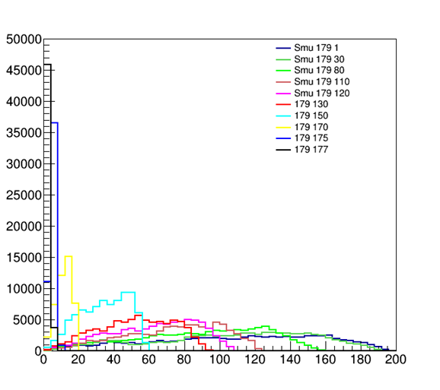
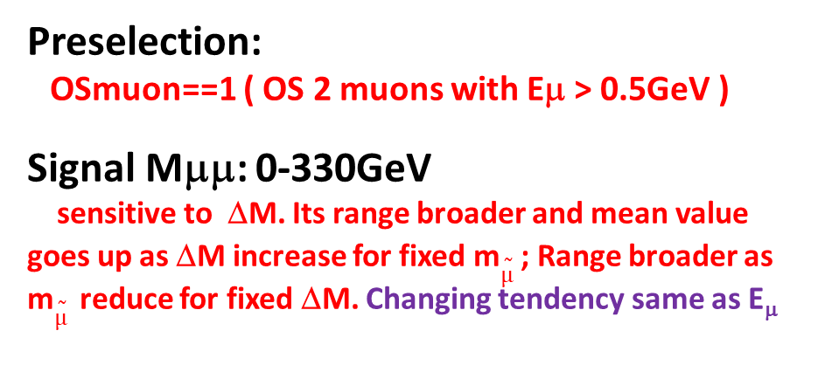
360GeV@1ab⁻¹ Analysis: Variables M_{μμ}
M_{μμ} (GeV)
M_{μμ} (GeV)
Preselection:
OSmuon==1 ( OS 2 muons with Eμ > 0.5GeV )
Signal Mμμ: 0-330GeV
sensitive to ΔM. Its range broader and mean value goes up as ΔM increase for fixed m$\tilde{µ}$ ; Range broader as m$\tilde{µ}$ reduce for fixed ΔM. Changing tendency same as E_{μ}
M_{μμ} (GeV)

Slide 9
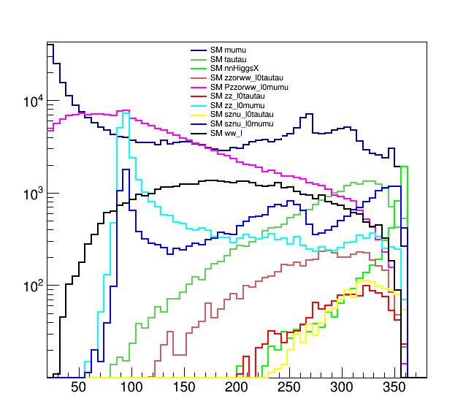
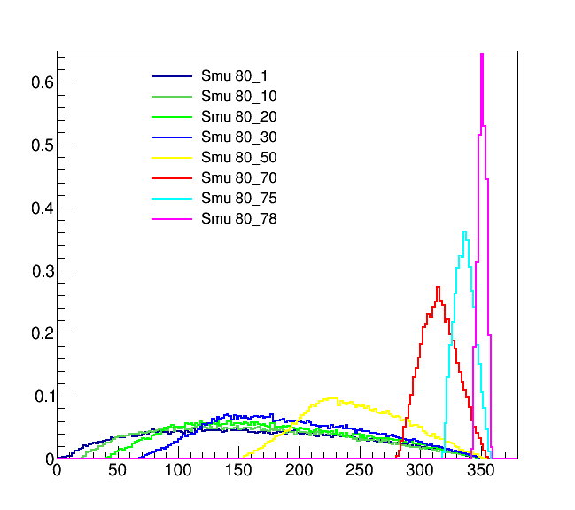
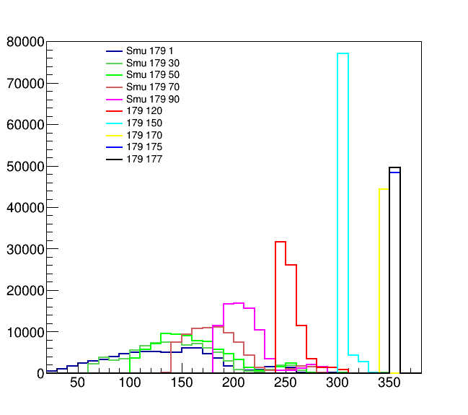
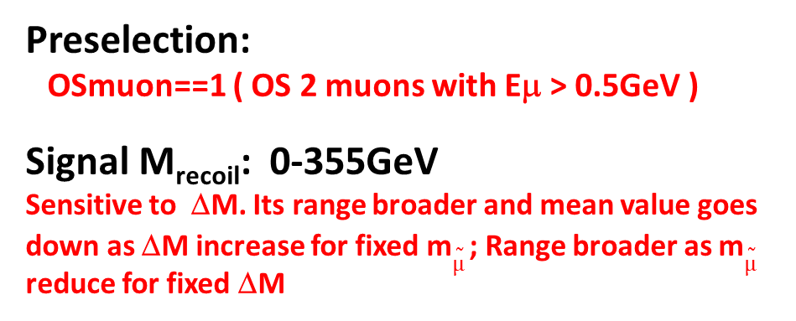
360GeV@1ab⁻¹ Analysis: Variables M_{recoil}
M_{recoil} (GeV)
M_{recoil} (GeV)
Preselection:
OSmuon==1 ( OS 2 muons with Eμ > 0.5GeV )
Signal M_{recoil}: 0-355GeV
Sensitive to ΔM. Its range broader and mean value goes down as ΔM increase for fixed m$\tilde{µ}$ ; Range broader as m$\tilde{µ}$ reduce for fixed ΔM
M_{recoil} (GeV)

Slide 10
Final selection
SR-highDeltaM ΔM > 100GeV | SR-midDeltaM 100GeV ≥ ΔM > 10GeV | SR-lowDeltaM ΔM ≤ 10GeV
==2 muons (OS, both energy > 0.5GeV)
ΔR(μ,recoil) < 2.8 | 1.9<ΔR(μ,recoil)<3.0 | 1.9<ΔR(μ,recoil) <2.8
E_{μ} > 60 GeV | E_{μ} < 80 GeV | -------------
M_{recoil} > 100 GeV | -------------- | M_{recoil} > 340 GeV
87 GeV > M_{μμ} || 95 GeV < M_{μμ} < 130 GeV | M_{μμ} < 80 GeV | -------------

Slide 11
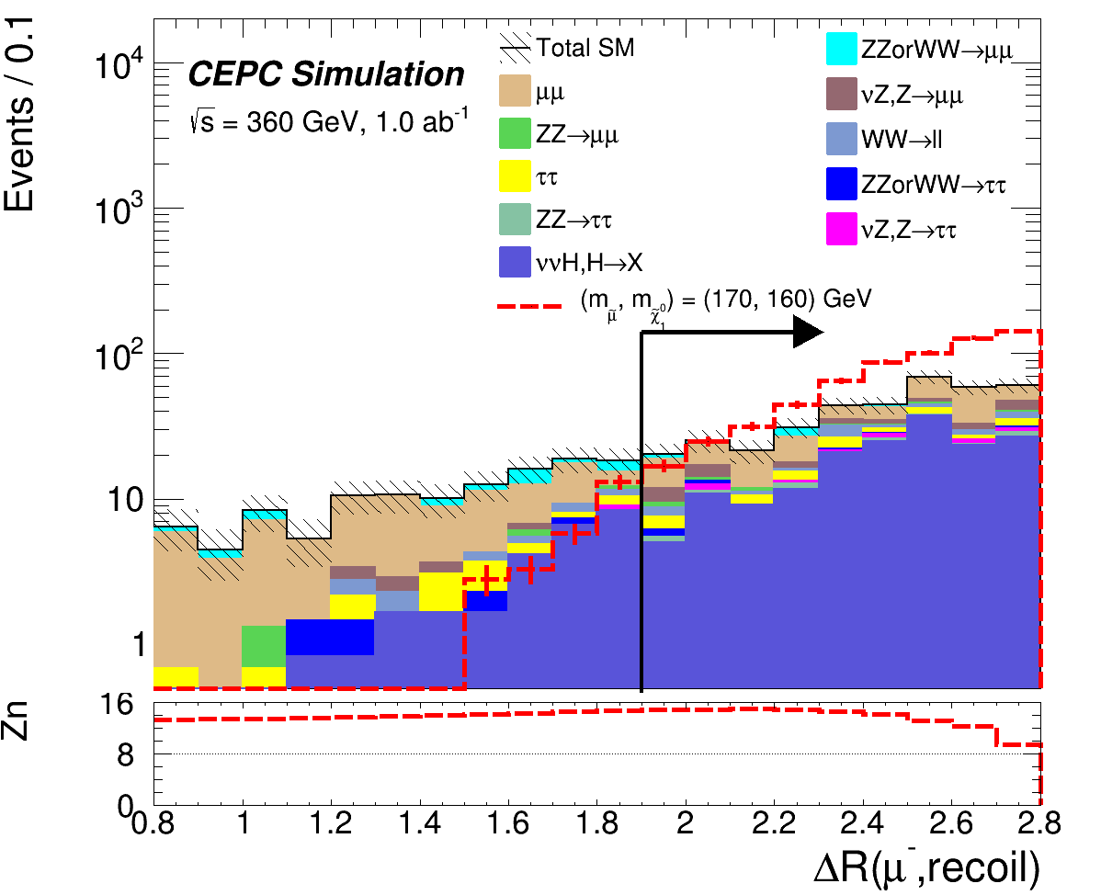
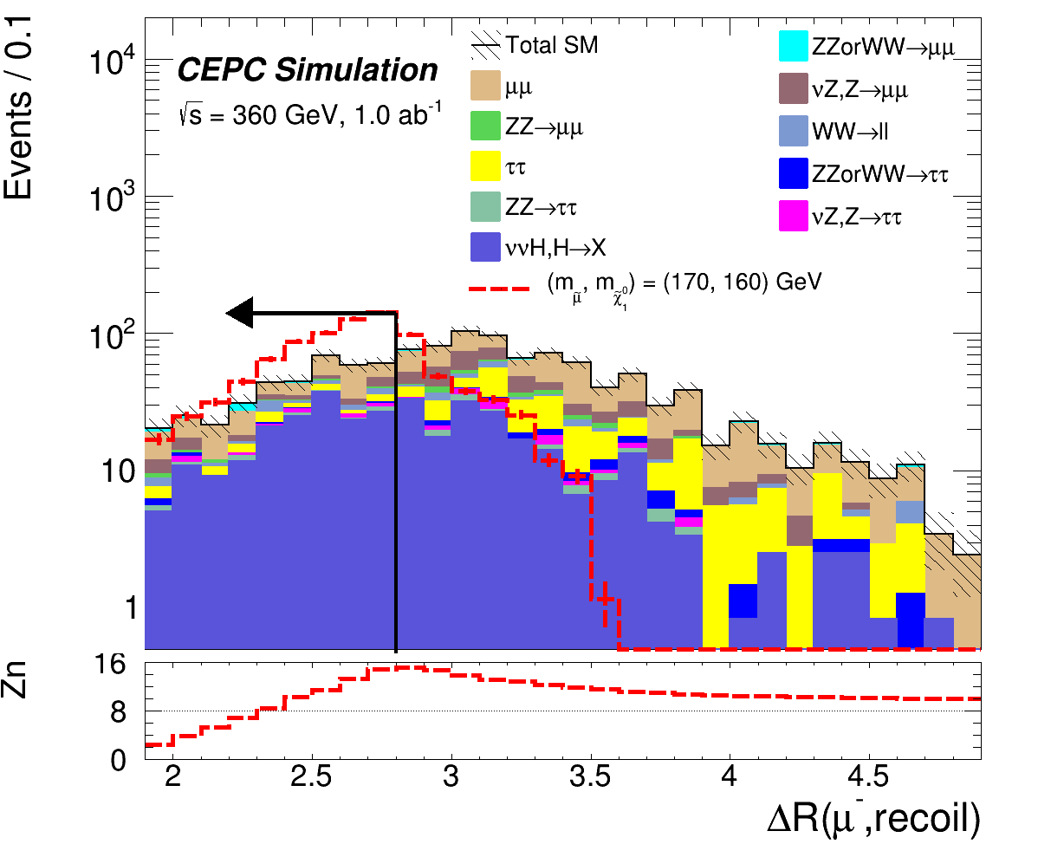
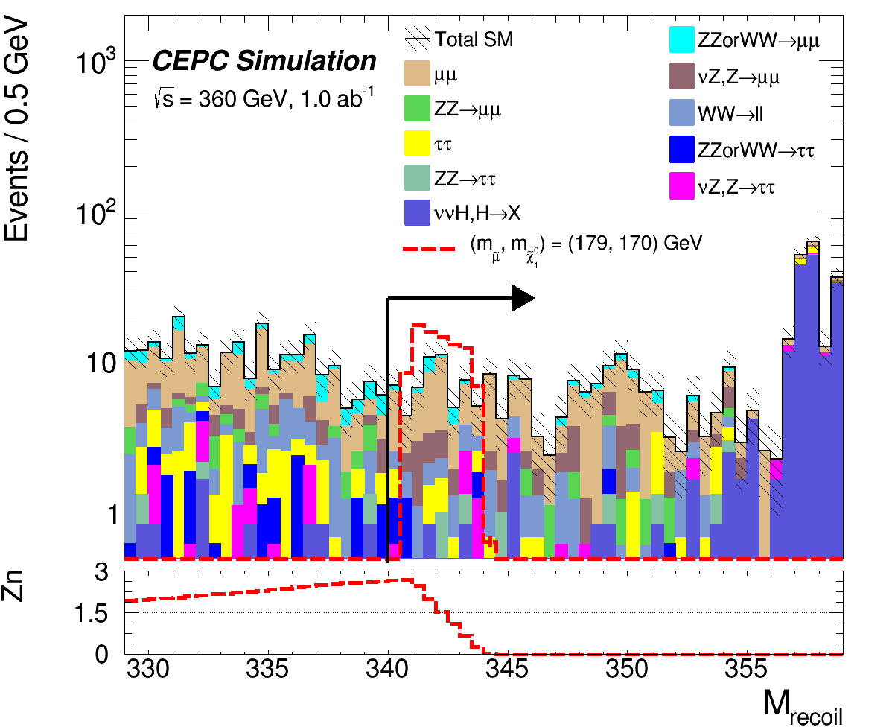
N-1 Plots: SR-LowDeltaM（ΔM≤10GeV）
OSmuon==1 &&
1.9< ΔR(μ,recoil) < 2.8 &&
M_{recoil} > 340GeV
Good optimized !

Slide 12
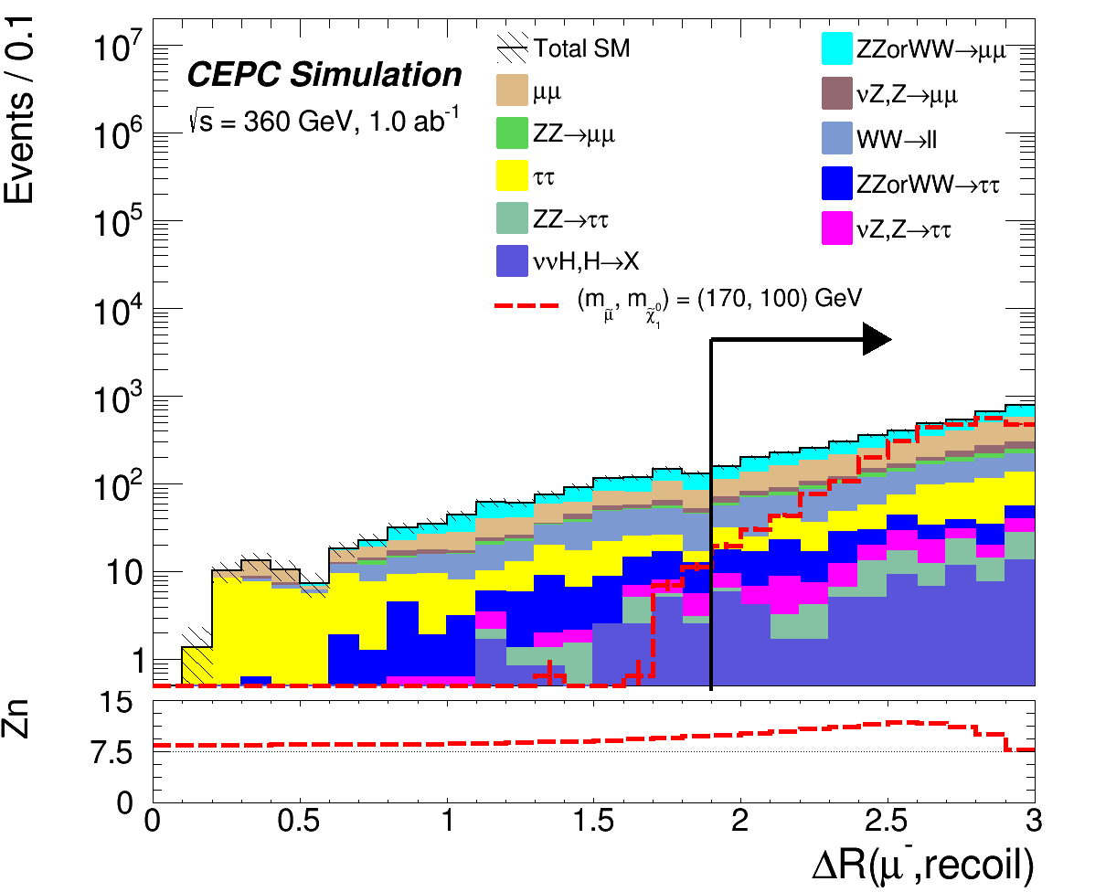
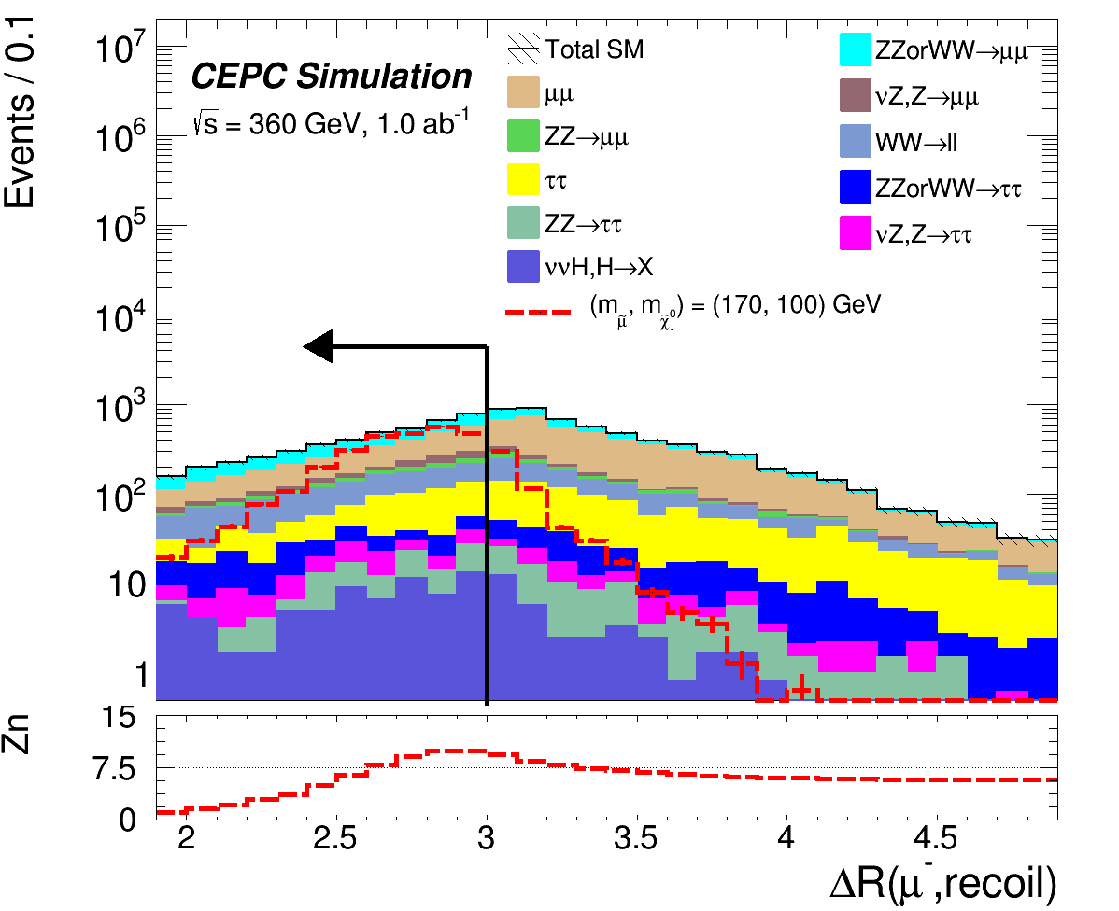
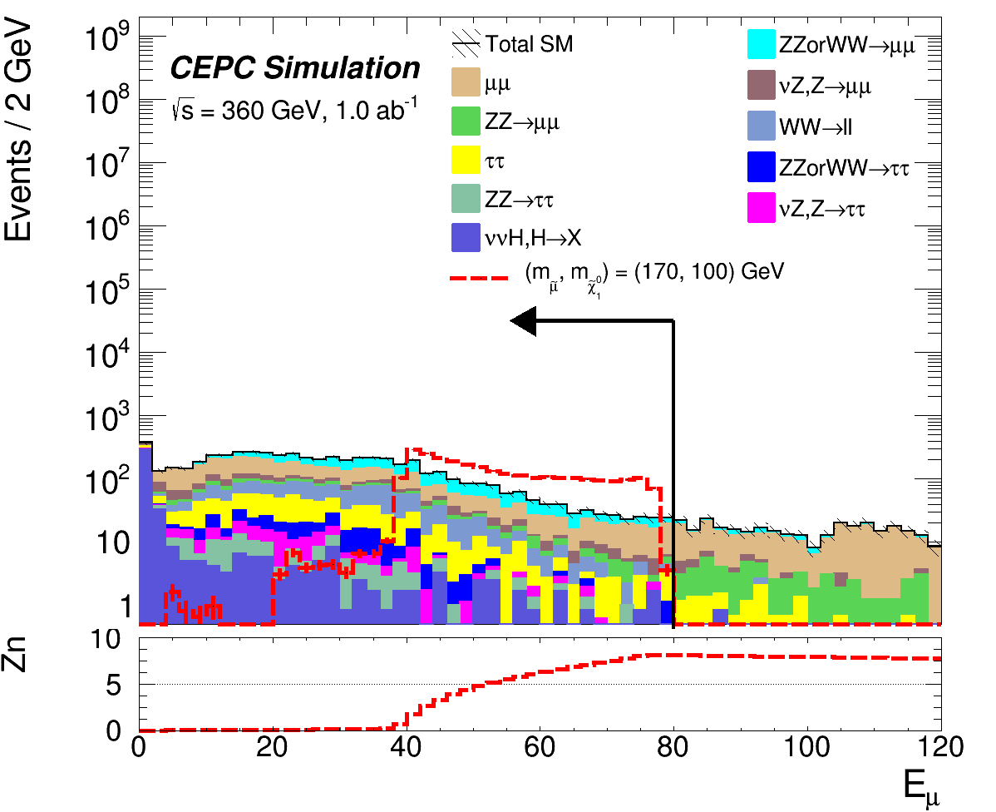
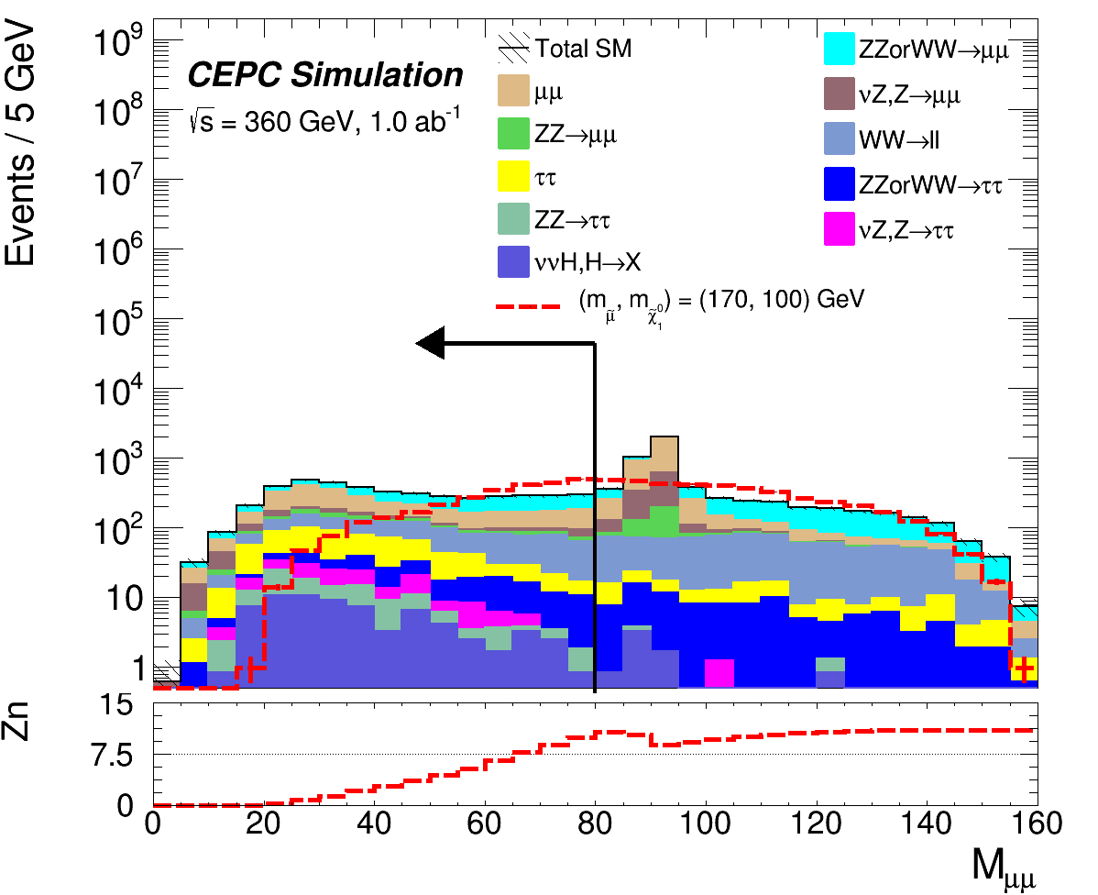
N-1 Plots: SR-MiddleDeltaM（10GeV<ΔM≤100GeV）
OSmuon==1 &&
1.9< dR(μ,recoil) <3.0 &&
E_{μ} < 80GeV &&
M_{μμ} < 80GeV
Good optimized !

Slide 13
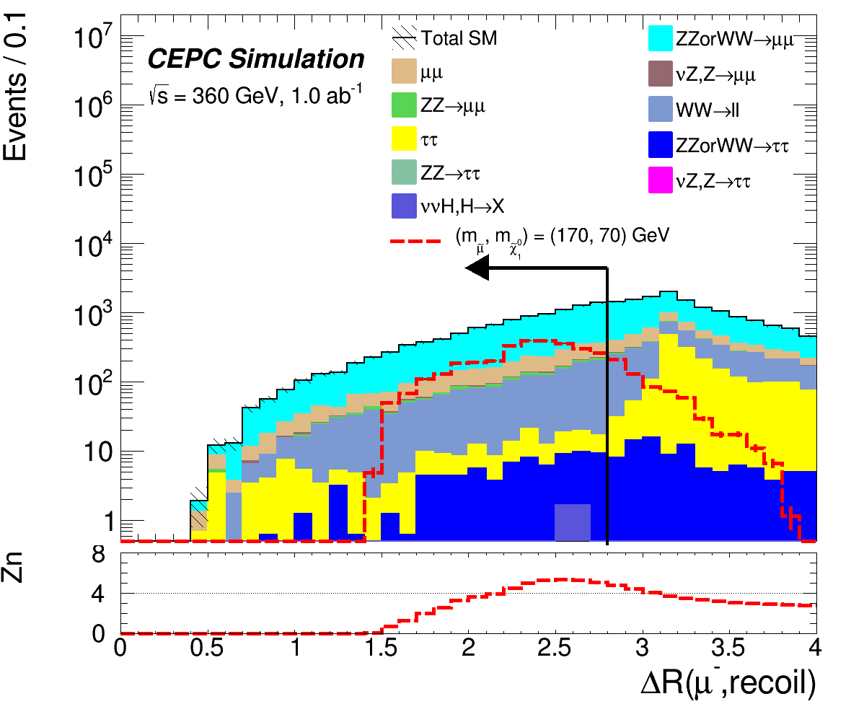
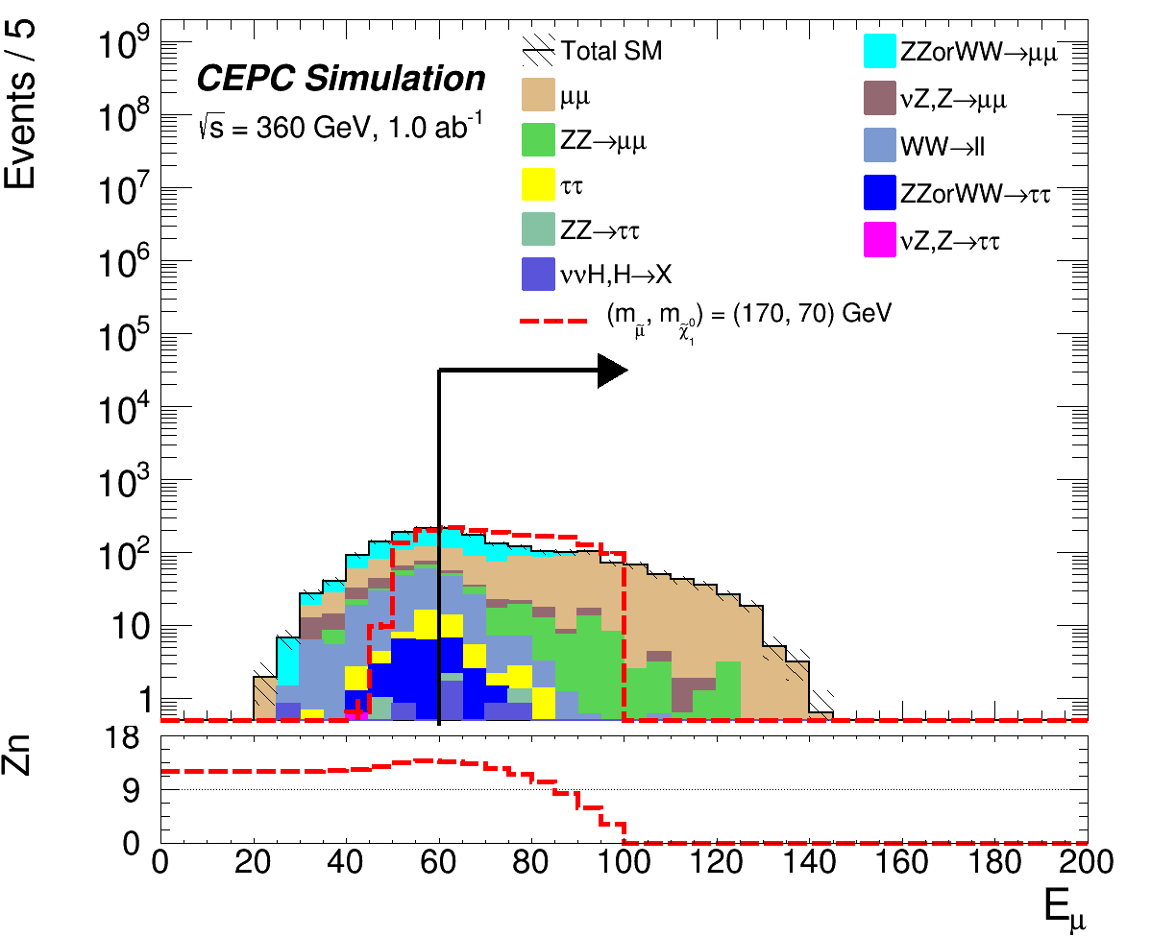
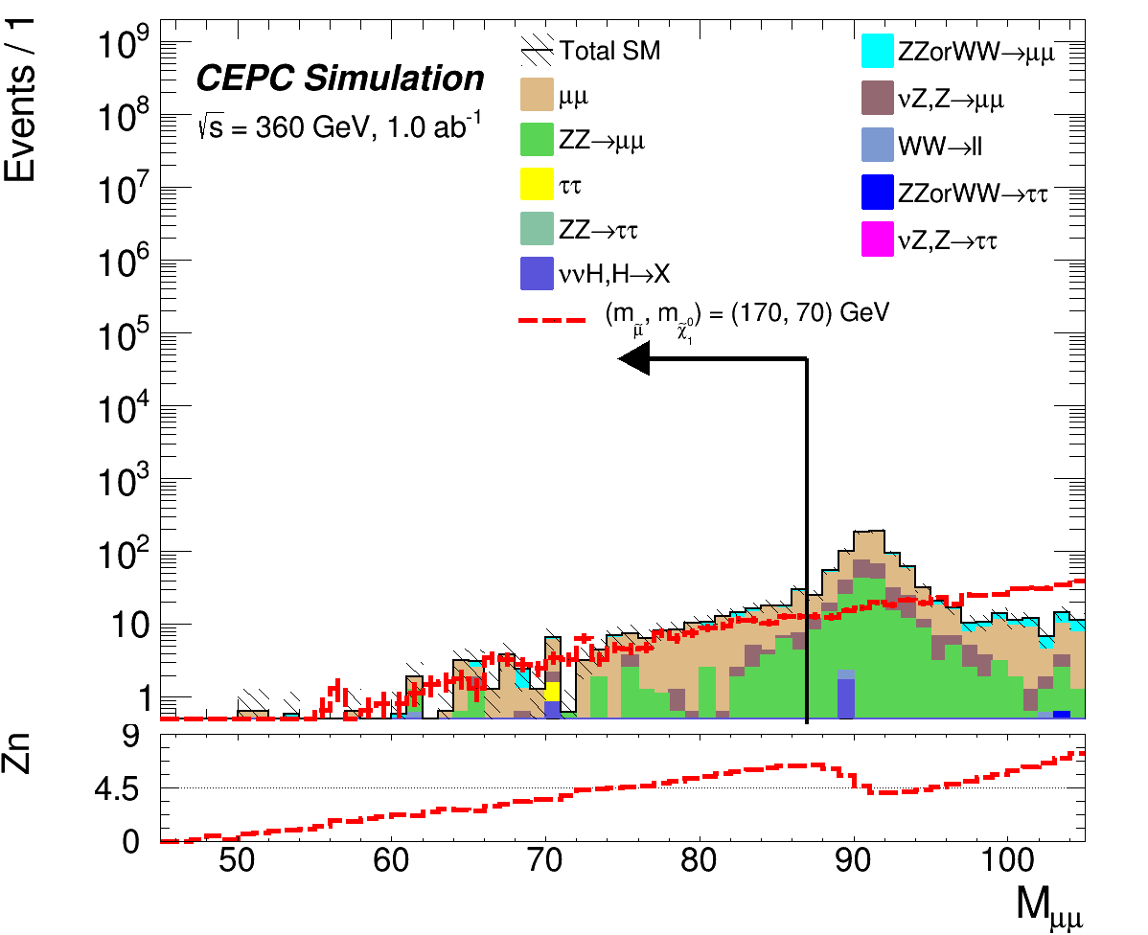
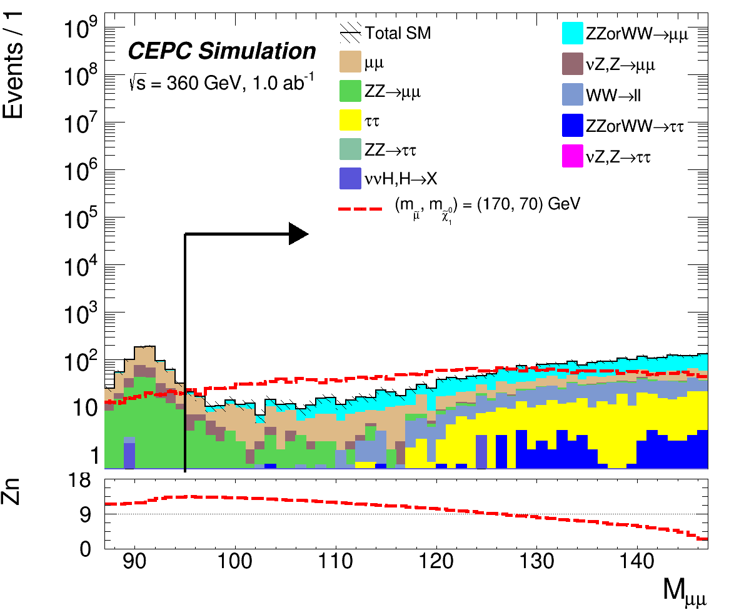
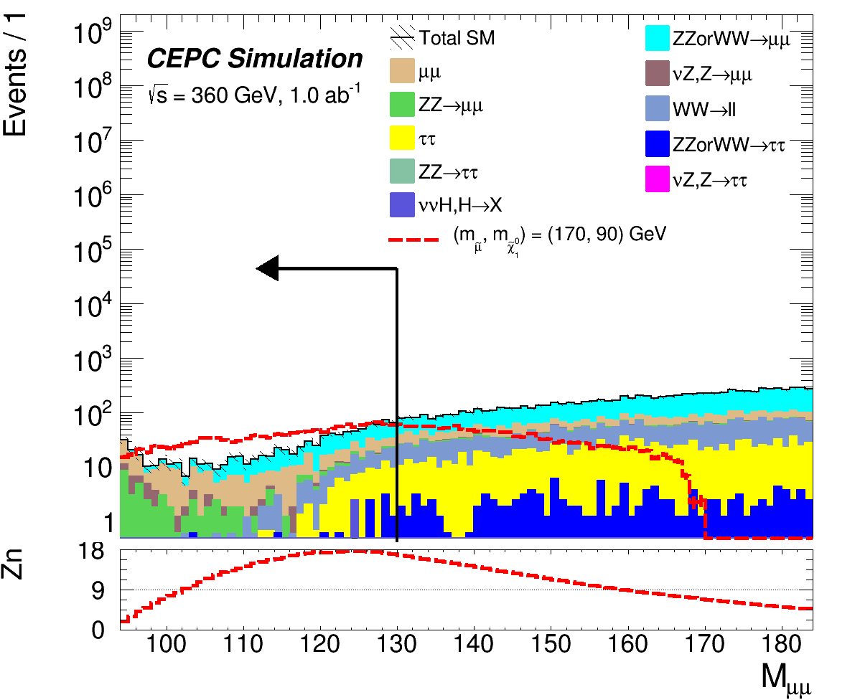
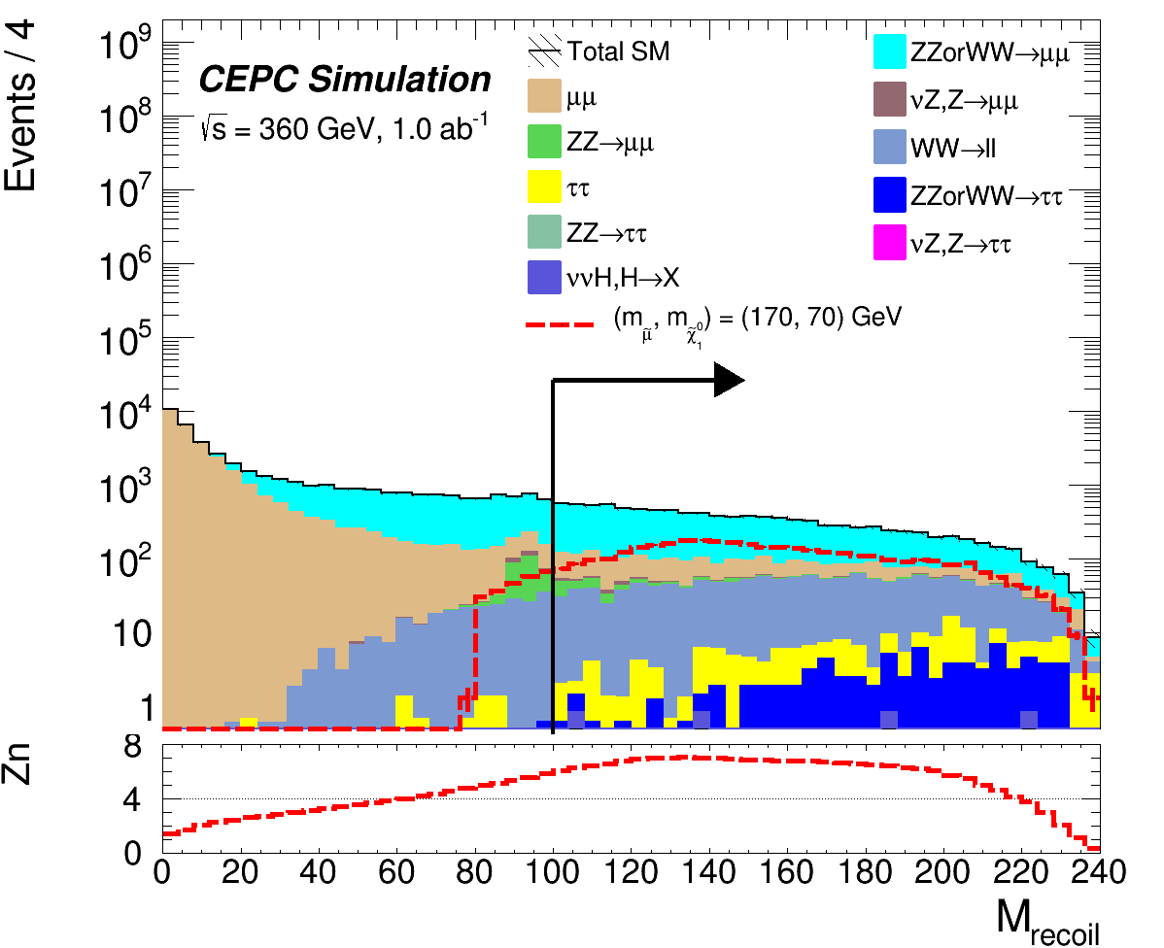
N-1 Plots: SR-HighDeltaM（dM>100GeV）
OSmuon==1 && ΔR(μ,recoil) <2.8 && E_{μ}>60 && ( M_{μμ}<87.0 || 95<M_{μμ}<130 ) && M_{recoil}>100
Good optimized!

Slide 14
SM BKG & Signal yields
Process | Preselection | SR-highDeltaM | SR-midDeltaM | SR-lowDeltaM
μμ | 1.59 E6 ± 1015 | 218.6 ± 11.9 | 1743 ± 33.6 | 107.1 ± 8.3
ZZ or WW → μμνν | 116669 ± 262 | 332.5 ± 14.0 | 1335 ± 28.0 | 14.10 ± 2.88
νZ, Z → μμ | 22705 ± 119 | 21.3 ± 3.6 | 383.7 ± 15.5 | 25.66 ± 4.01
ZZ → μμνν | 27213 ± 130 | 45.0 ± 5.3 | 191.9 ± 11.0 | 5.63 ± 1.88
WW → ll | 39268 ± 155 | 67.4 ± 6.4 | 678.1 ± 20.4 | 18.38 ± 3.35
ZZ or WW → ττνν | 3751 ± 49 | 7.57 ± 2.18 | 148.9 ± 9.7 | 3.79 ± 1.55
ττ | 48579 ± 183 | 13.1 ± 3.0 | 540.5 ± 19.3 | 21.4 ± 3.8
νZ, Z → ττ | 1001 ± 25 | 0.0 ± 0.0 | 98.2 ± 7.8 | 8.76 ± 2.34
ZZ → ττνν | 1068 ± 23 | 1.00 ± 0.71 | 83.1 ± 6.5 | 6.01 ± 1.73
ννH, H → anything | 2776 ± 48 | 3.34 ± 1.67 | 419.1 ± 18.7 | 170.3 ± 11.9
SM Total BKG | 1.86 E6 ± 1092 | 710 ± 21 | 5622 ± 60 | 381.0 ± 16.6
Signal 175_10 | 5145.6 ± 17.5 | 354.5 ± 4.6 | -------- | --------
Signal 175_65 | 6157.1 ± 17.6 | 972.2 ± 7.6 | -------- | --------
Signal 170_120 | 13426 ± 47 | --------- | 4290 ± 27 | --------
Signal 175_155 | 4382 ± 16 | --------- | 383.7 ± 15.5 | --------
Signal 173_163 | 5137.2 ± 22 | --------- | --------- | 600.6 ± 7.7
Signal 173_170 | 6307.4 ± 24 | --------- | --------- | 2048.3 ± 14.2

Slide 15
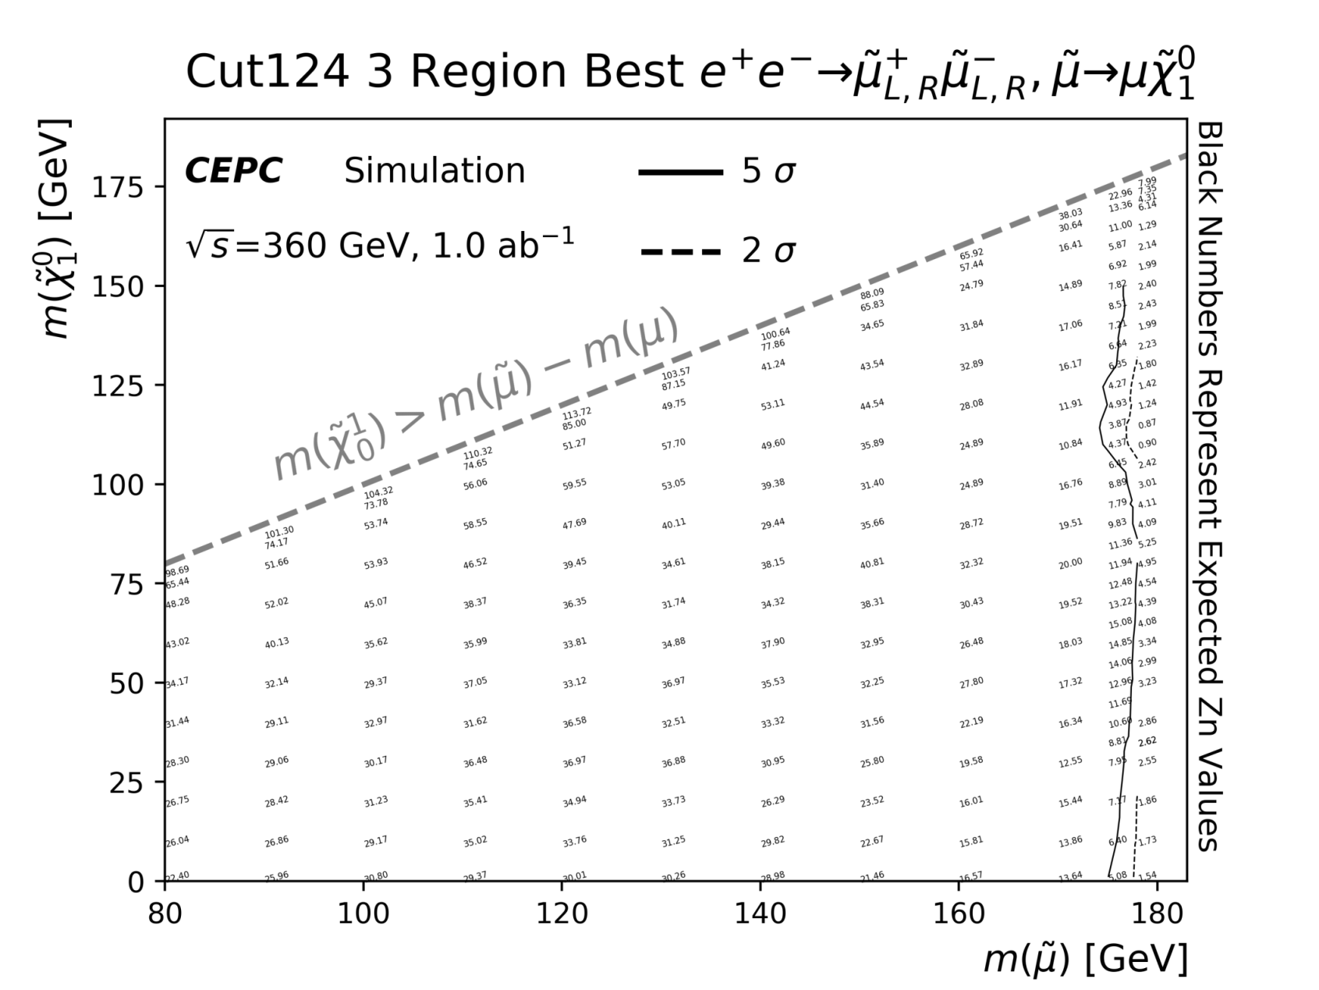
Final Zn plot
170
175
178

Slide 16
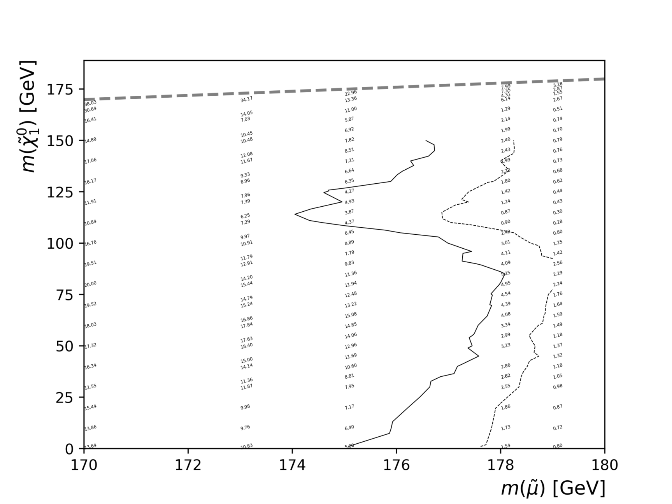
Enlarged Zn plot with all points ( + 173, 179GeV )
173
175
179

Slide 17
Summary
smuon search at 360GeV CEPC with 1ab⁻¹ is investigated
With 5% flat systematic, the discovery sensitivity with 360GeV 1ab⁻¹ can reach up to 173GeV and most of LSP values of 175GeV in smuon mass, our analysis greatly enlarges smuon discovery range, become one of important motivation to raise CEPC CME to 360GeV
Will continue to investigate Zn performance of smuon
174GeV LSP points, and further optimize this search

Slide 18
Thanks a lot !

Slide 19
Backup

Slide 20
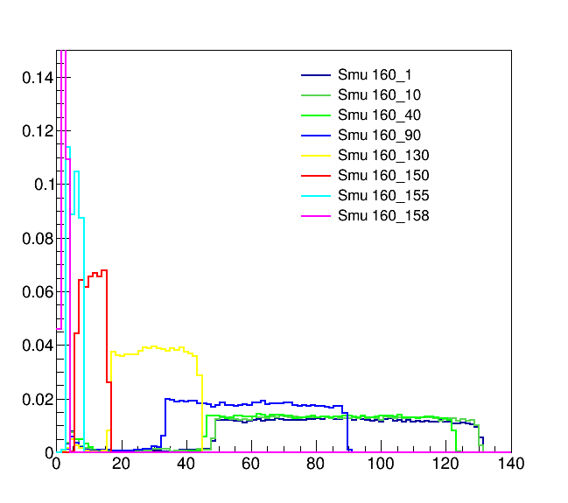
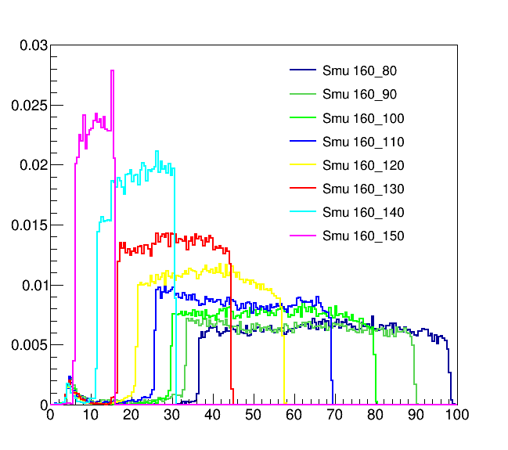
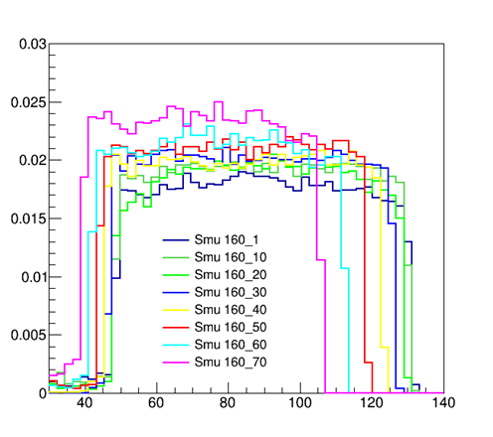

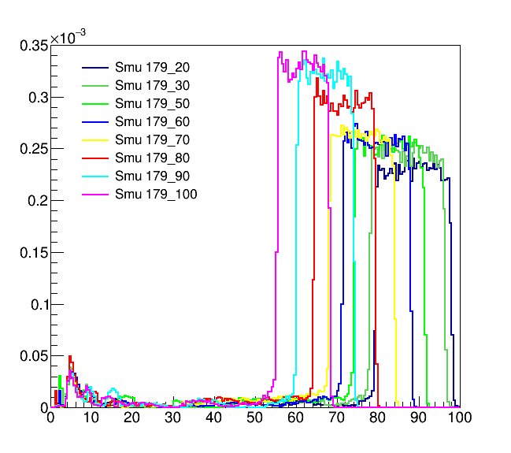
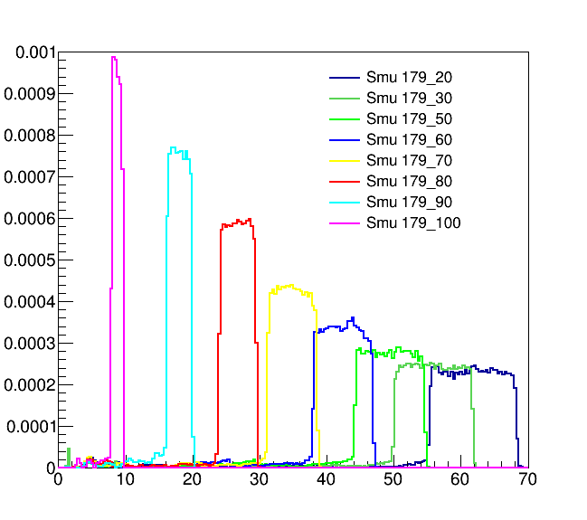
smu pair Signal Eμ dstribution
( 0.5 <ΔR(μ,recoil)< 4.2 && OSmuon==1 )

Slide 21
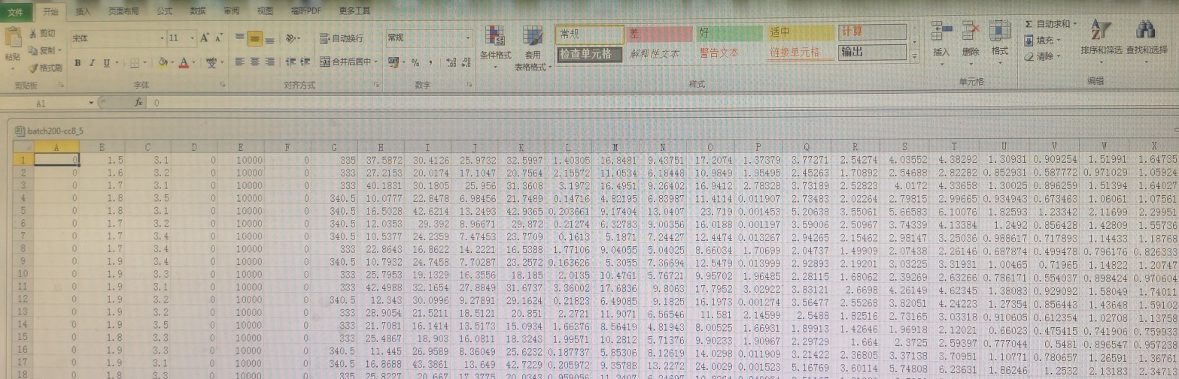
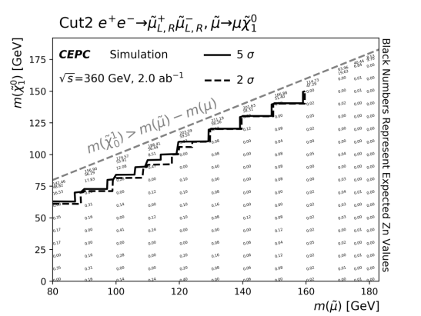
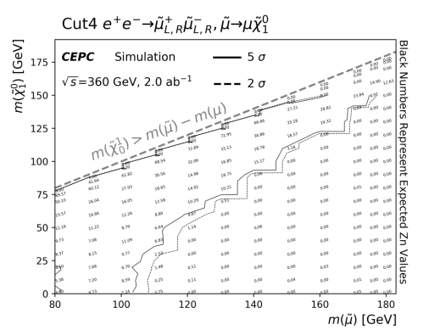
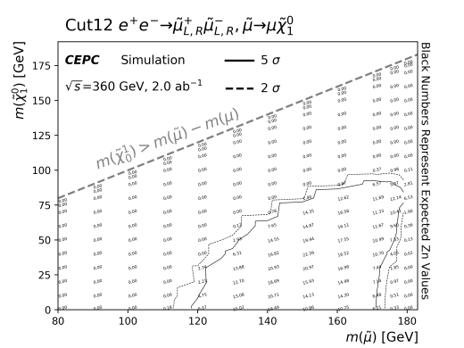
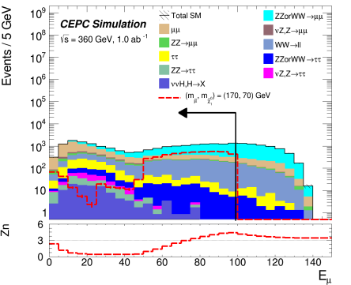
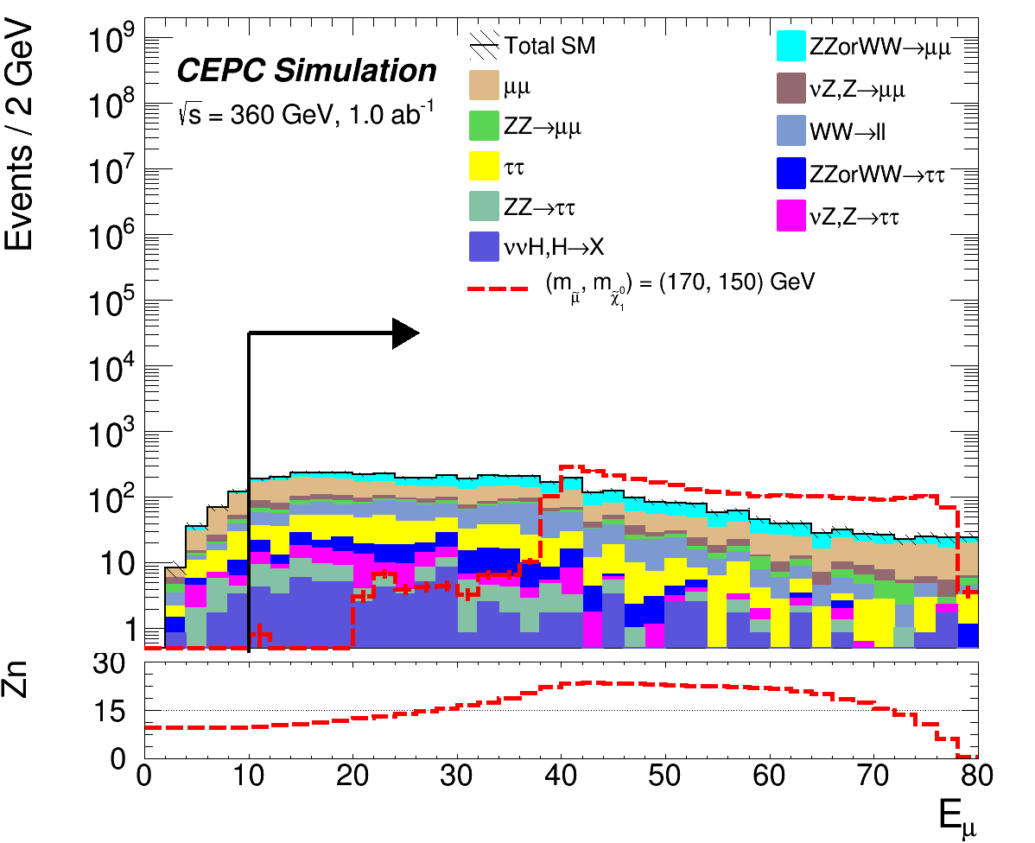
360GeV 1ab Analysis: Three key tools
Sensitivity values Execl created by several ten thousands of combinations of ΔR(μ,recoil), E_{μ}, M^{μμ} and M_{recoil}
Sorting & finding Better
E x a m p l e s
Zn plot
~200 Global comparing
& finding larger contour
N-1 plot
~100 Final check
& best selection

