Slide 1
Progress of the Yoke iron and Beampipe
Mechanical design
2022年5月23日

Slide 2
Content：
1. Overview
2. Yoke iron design
3. Beampipe Mechanical design
4. summry

Slide 3
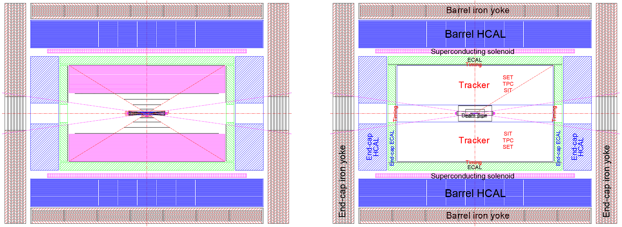
1、Overview
Layout 3… (March,2021)
Layout 3… (Jan 20,2021)
Different: Detectors
Common： Yoke and Beampipe

Slide 4
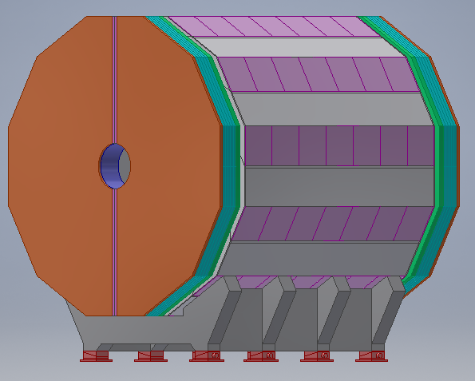
2、Iron Yoke design
The iron yoke consists of 12 iron yoke units with a total weight of 589 tons. In the design of 2021 version, iron yoke has a total weight of 760 tons with five detector layers.
Yoke design in may 2022

Slide 5
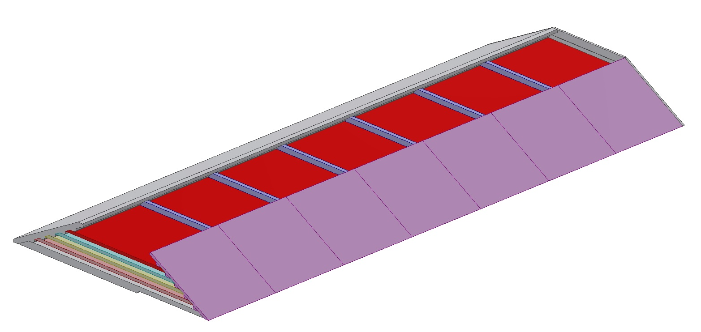
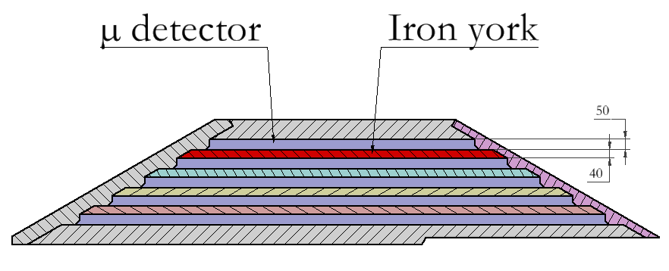
2、Iron Yoke design
The 2021 version：
Iron Yoke thinkness：50mm
μ derctor thinkness：40mm
The 2022 version：
Iron Yoke thinkness：40mm
μ derctor thinkness：50mm
The yoke becomes thinner, resulting in a lower yoke weight， While the thickness of the μ detector increases, the total volume of the yoke remains the same

Slide 6
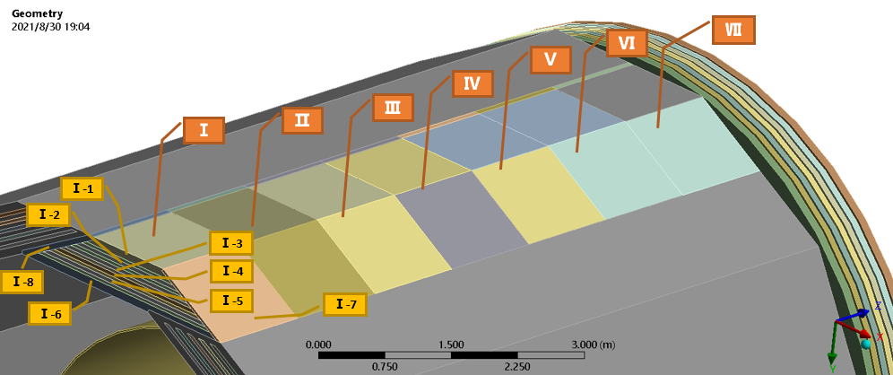
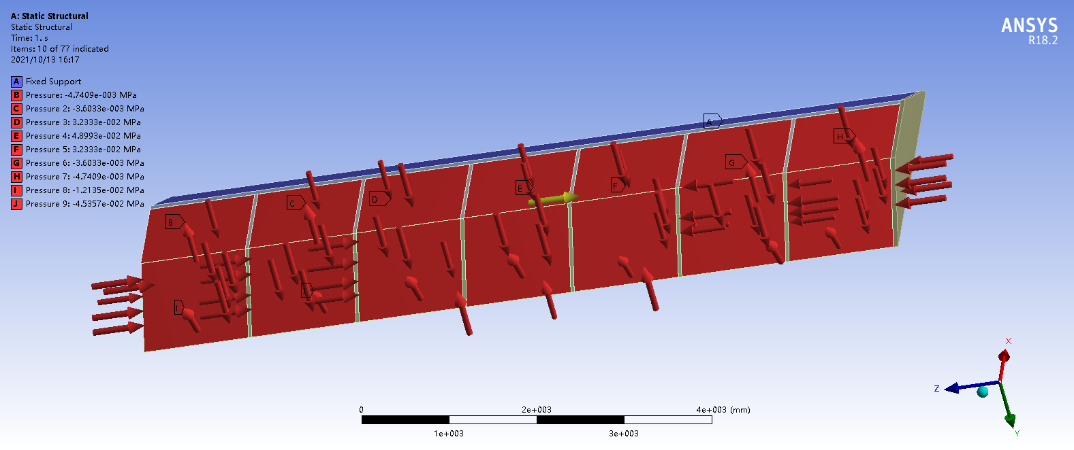
2.2 Structural analysis of iron yoke under magnetic force
The two versions were analyzed by ANSYS, according to the same analysis method.
Loading of magnetic force
A unit of the yoke is combined to analyze the magnetic force structure；The magnetic field intensity is 3T；
Each piece has a total of 8 force surfaces, and the magnetic field forces are loaded separately. The magnetic field forces include radial and axial.

Slide 7
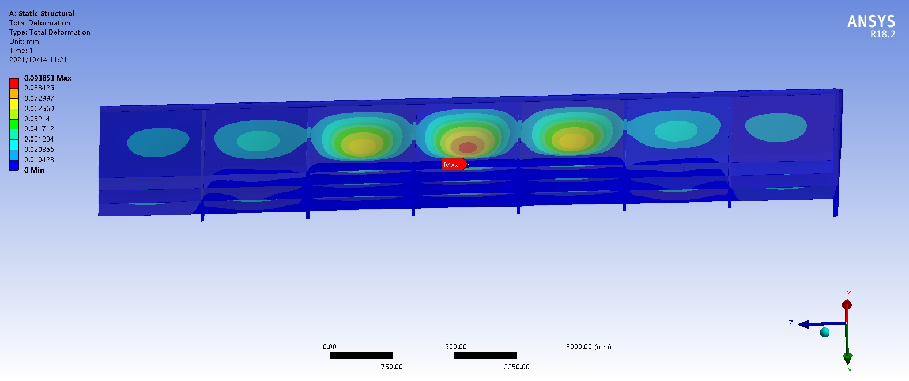
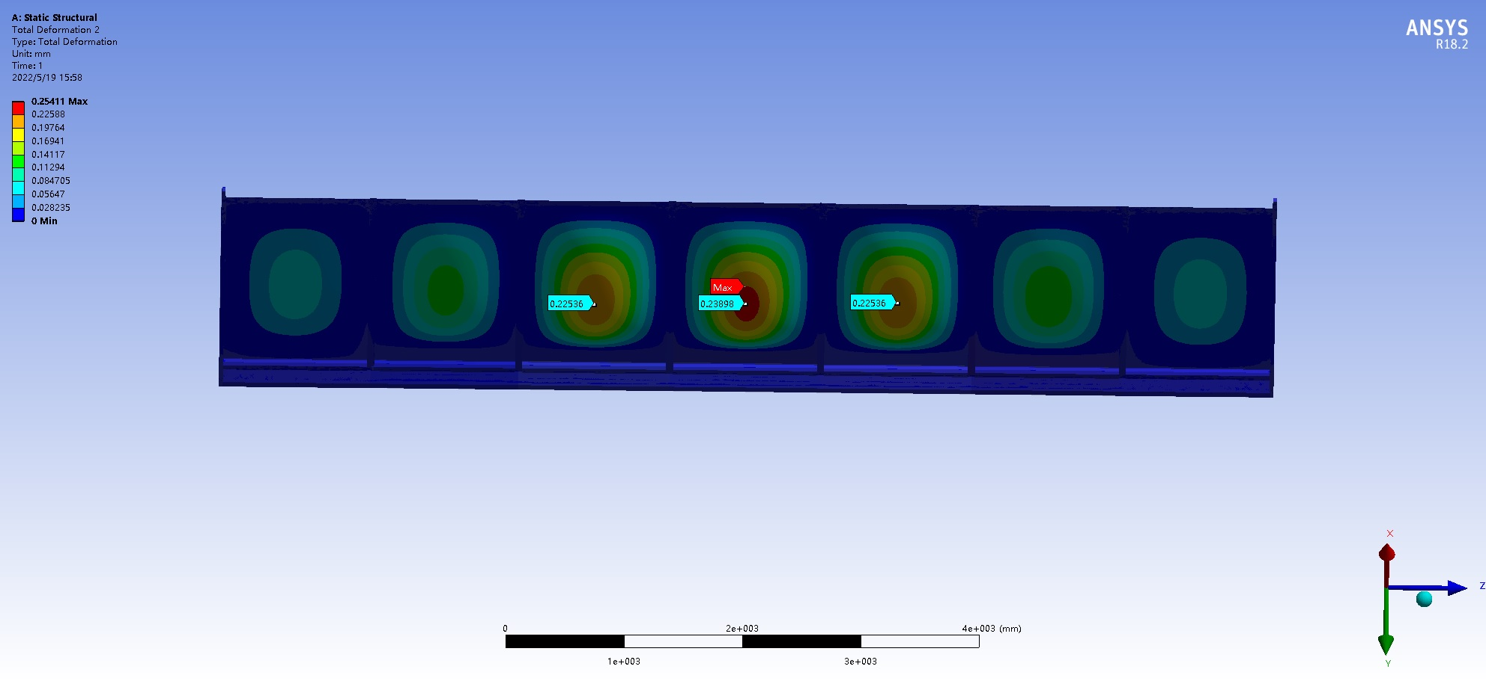
2.2 Structural analysis of iron yoke under magnetic force
versions | Max deformation mm | Max stress Mpa | Iron thinkness mm
2021 | 0.094 | 11 | 50
2022 | 0.25 | 18.9 | 40
When the yoke thickness is reduced, the magnetic force is reduced, the structural strength is weakened, and eventually the deformation and stress are increased.

Slide 8
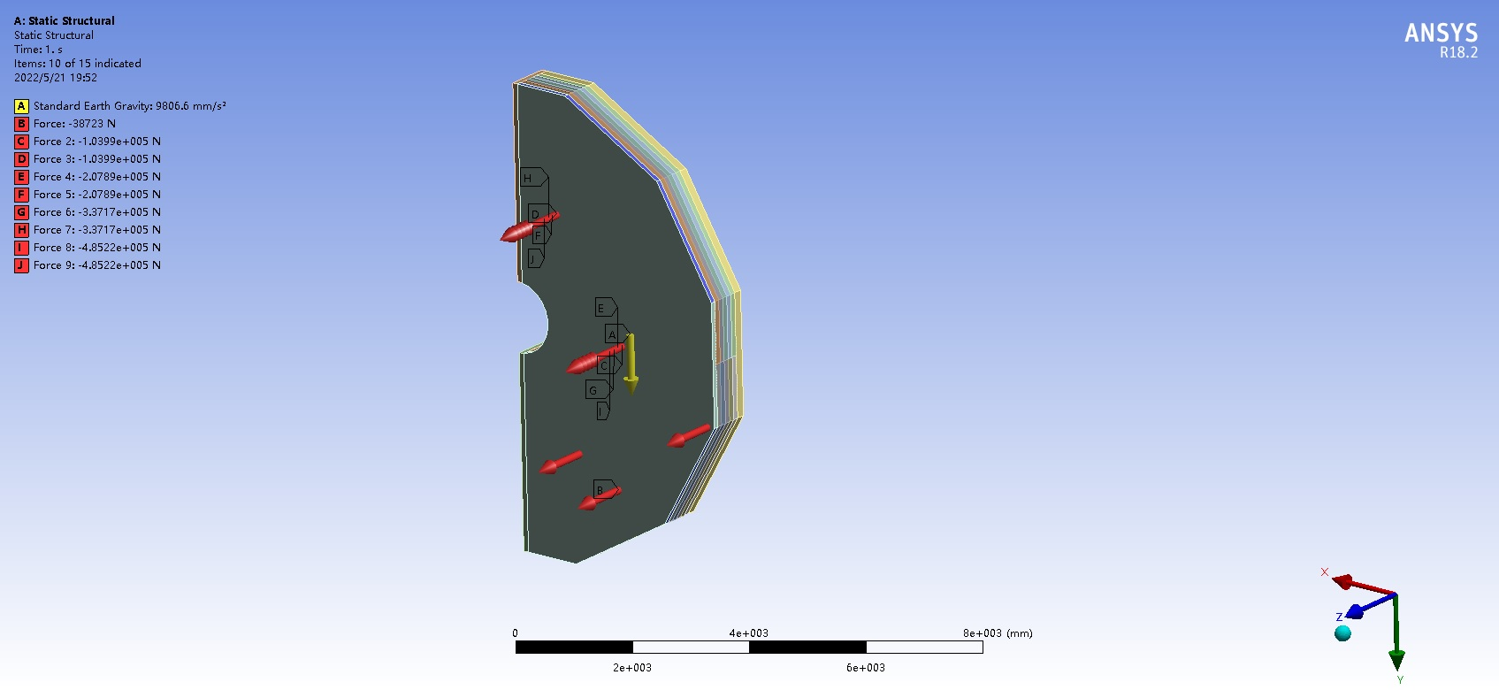
2.2 Structural analysis of iron yoke under
The force analysis of the end yoke under the action of magnetic force and gravity is calculated. The end yoke is divided lengthwise into two halves and is bound at the edges of the end yoke.

Slide 9
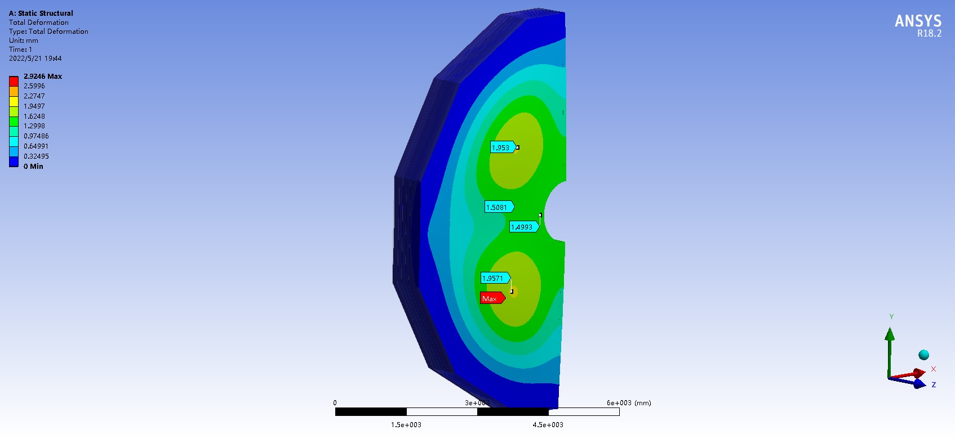
2.2 Structural analysis of iron yoke under
Under the action of magnetic force, the center of the end yoke will collapse inward, and the maximum deformation is 2.9mm. The maximum deformation of the center part of the iron yoke is about 1.5mm.

Slide 10
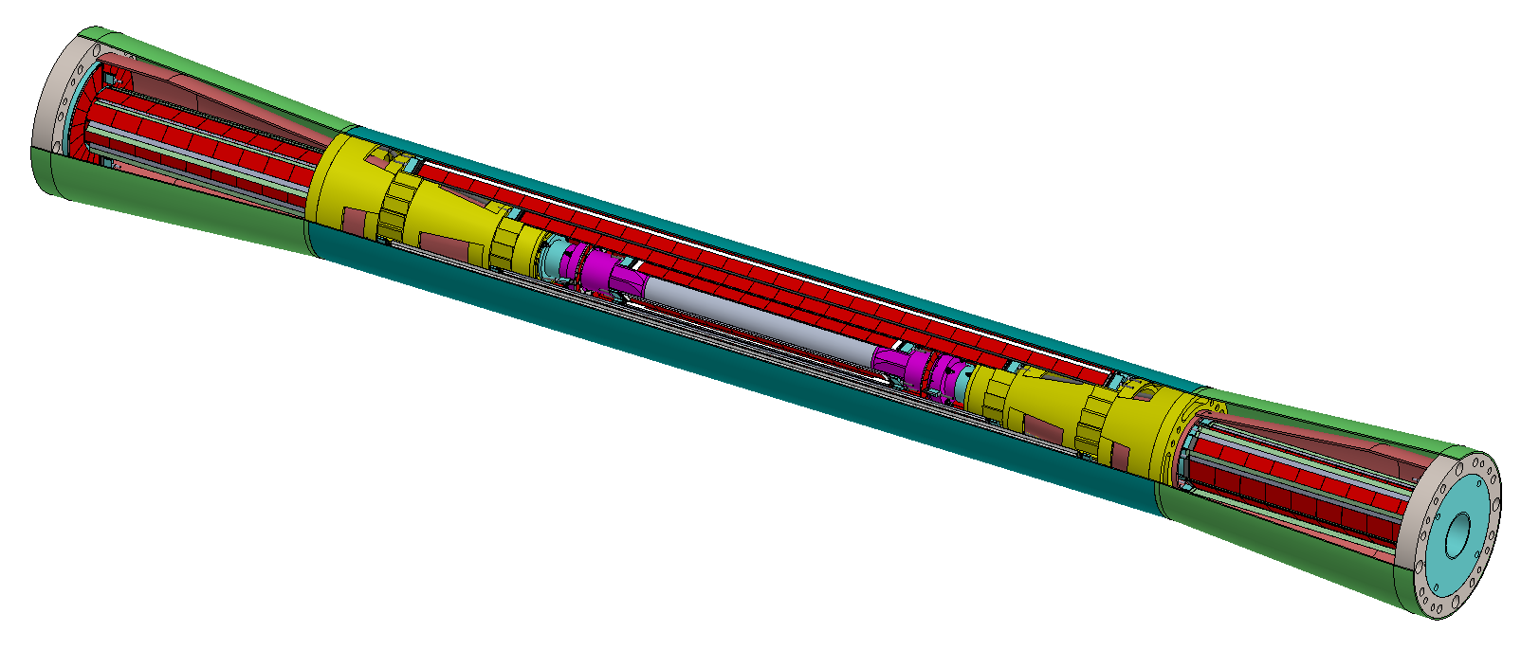
3 Beampipe Mechanical design
Beam pipe：The particles pass out of the window to maintain a high vacuum environment in the electron-positron collision zone
e+
Beryllium tube
e-
work environment
temperature：<30℃
vacuum ： 10⁻⁸Pa
coolling medium ：water / oil

Slide 11
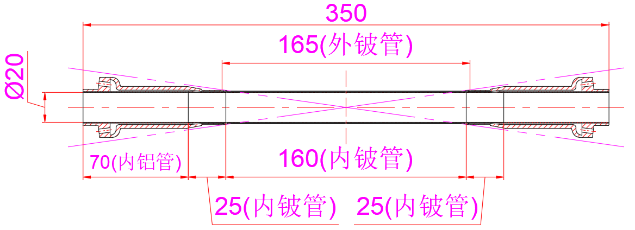
3 Beampipe Mechanical design
Beryllium tube size:
Beryllium tube inside ----diameter20mm，thinkness0.2mm，length160mm
Beryllium tube outside----diameter21.4mm，thinkness0.15mm，length165mm
Beryllium tube outside：0.15mm
gap：0.35mm
Beryllium tube outside：0.2 mm
The length of the radiation：>0.15% (CDR)
The radiation length of the beryllium tube is greater than that of the 0.5mm single-layer beryllium tube

Slide 12
3.1 The key of theBeampipe design
Beryllium tube Corrosion problem
Paraffin cooling for Be pipe:
Flow rate: 3.4L/min
Inlet velocity: 2m/s
Velocity in ring pipe: 1.2m/s
Max.t of Be: 70.6℃
Water cooling for Be pipe:
Flow rate: 1.7L/min
Inlet velocity: 1m/s
Velocity in ring pipe: 0.6m/s
Max.t of Be: 41.5℃
Through simulation calculation, it can be seen that in beryllium tube structure, local temperature and pressure will be higher when oil is used as cooling medium. Water cooling is more efficient than oil cooling, but water is highly corrosive to beryllium tubes

Slide 13
3.1 The key of theBeampipe design
Research status
Corrosion data for beryllium
Beryllium is scarce, toxic and difficult to process，
1987，ASM Metal Handbook report corrosion rate of beryllium is less than 25 μm/year in the water.
Lack of quantifiable beryllium corrosion data/study of corrosion of beryllium tubes .

Slide 14
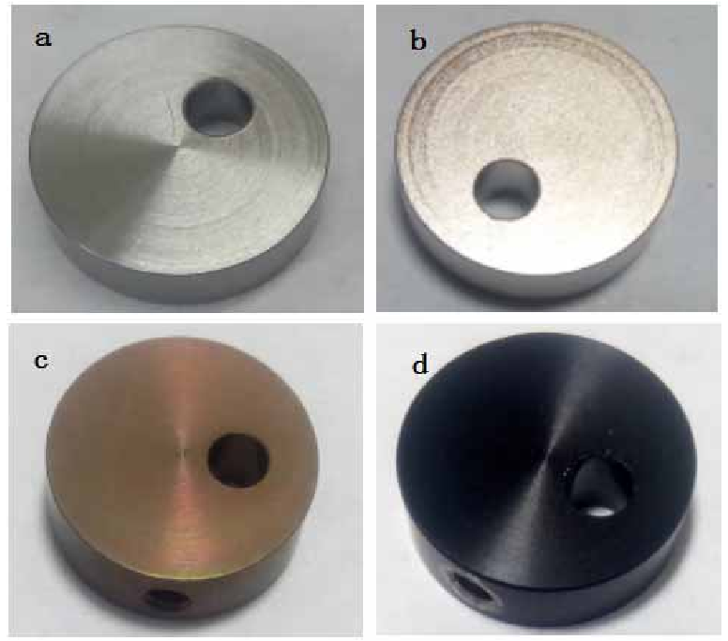
3.1 The key of theBeampipe design
Research status of surface modification of beryllium
Common methods: electroplating, chemical conversion (chromization, fluorination), coating (enamel, organic film), anodic oxidation, etc
无膜层
化学镀镍
Lack of compactness, poor membrane - base bonding, short protection life
阳极氧化
化学钝化
Under complex and harsh conditions, whether the new generation of beryllium pipe can meet the requirements of stability, reliability and long life will directly affect the safety construction of CEPC. Therefore, it is very necessary to study the corrosion behavior of beryllium under irradiation and the corrosion protection technology of beryllium tube.
surface modification of beryllium
a.no modification b.chemical nickel-plating c. chemical passivation d.oxidization

Slide 15
Summary
The iron yoke design was optimized to reduce the thickness of the iron yoke single layer and reduce the overall weight. After finite element analysis and calculation, the structural strength is weakened compared with the 2021 version, but can meet the use;
The development of beryllium beam tubes needs to begin. The research focuses on the processing technology of beryllium beam tube, welding technology and corrosion rate of beryllium in coolant environment.

Slide 16
Thanks!

