Slide 1
Ladder design discussion
JunHu
2022/4/7

Slide 2
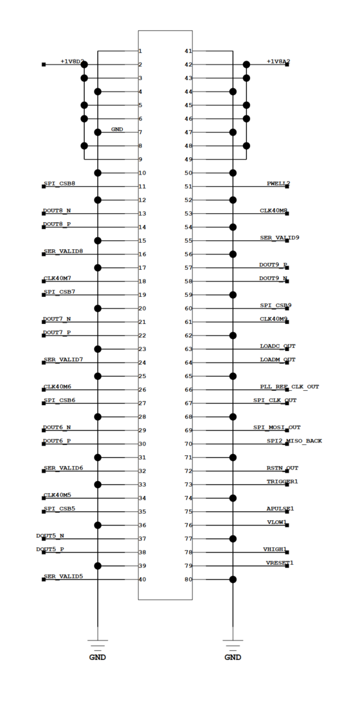
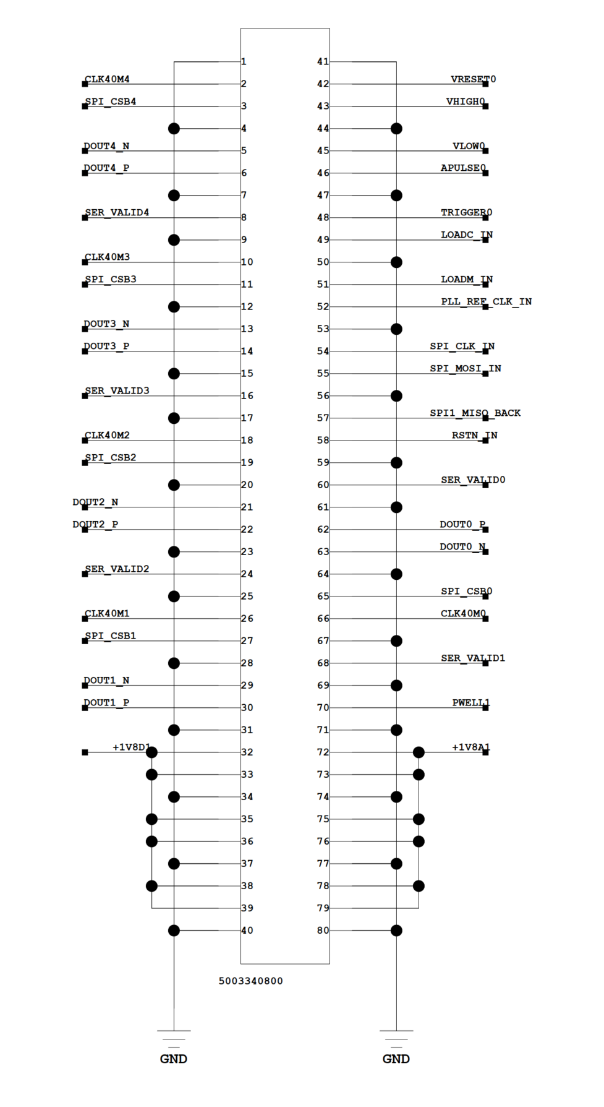
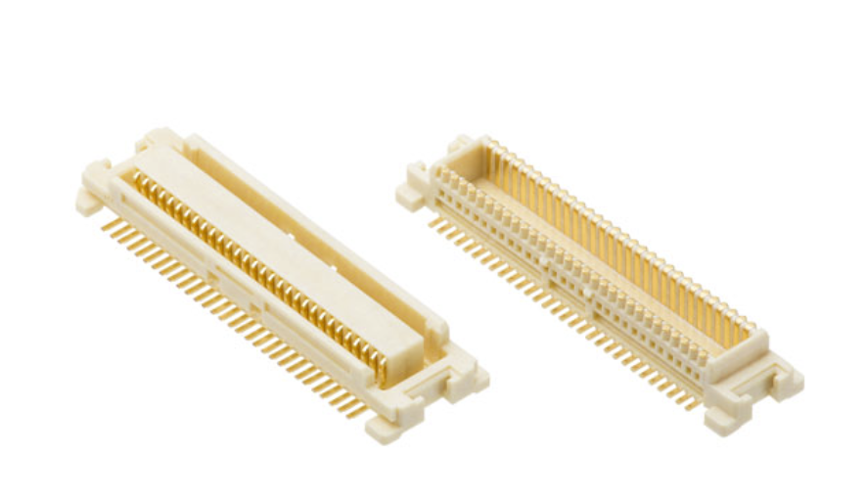
Flex
External flex
(147.7 X 17.23)
Sensor area(257.6 X 17.23)
External flex
(147.7 X 17.23)
socket
socket
553mm length in total
Socket signal definition
Left
Right

Slide 3
Interposer
10cm max
LINEAR REGULATOR
FMC
Top view
100X17.23
7cm
Flex
DAC
REF
Voltage Regulator
FMC
Sockets
1.6cm
Side view

Slide 4
Assembled
interposer
Flex
FPGA
Sockets
interposer
Flex
FPGA

